Slide 1
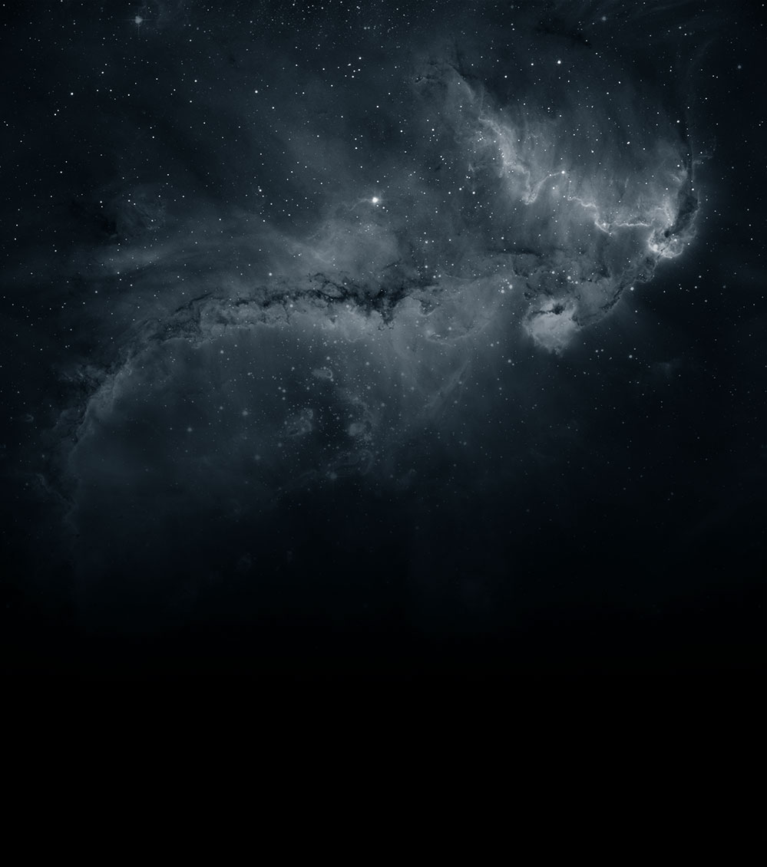





Massive Gravity from the top down and bottom up
Claudia de Rham
PASCOS 2018
5th June 2018

Slide 2




Tate Deskins
(@ CWRU)
Shuang-Yong Zhou
(@ USTC)
Andrew Tolley
(@ Imperial)
Scott Melville
(@ Imperial)
CdR, Deskins, Tolley & Zhou, 1606.08462, RMP
CdR, Melville, Tolley & Zhou, 1702.06134 & 1702.08577
CdR, Melville, Tolley & Zhou, 1706.02712 & 1804.10624
CdR, Melville & Tolley, 1710.09611

Slide 3
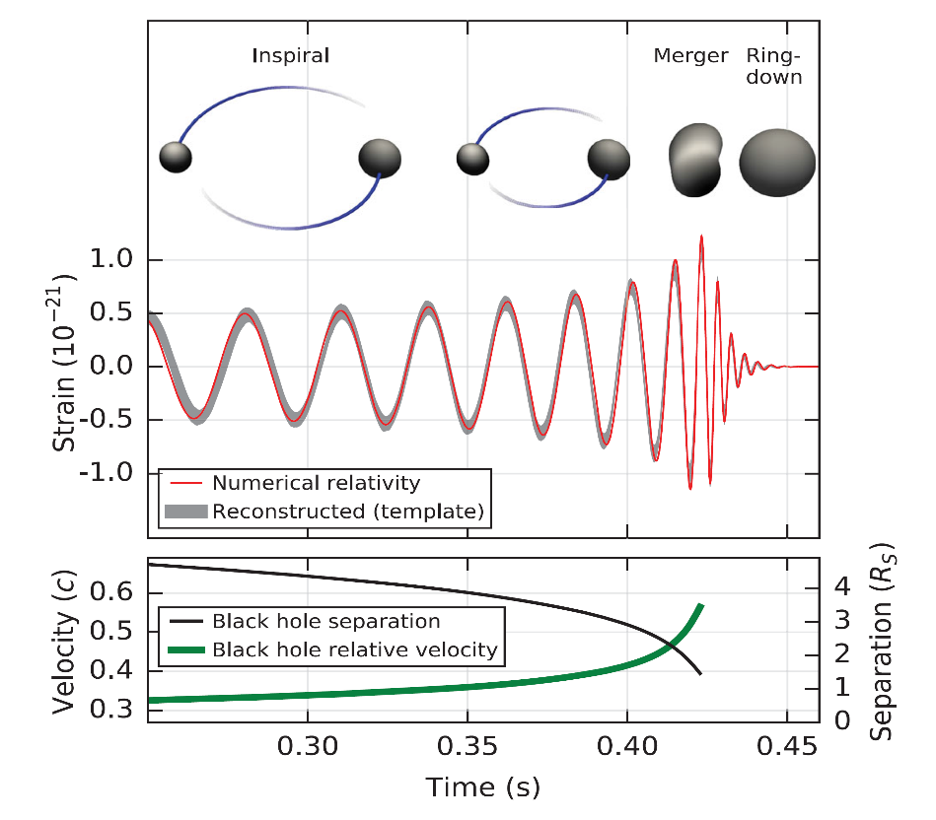
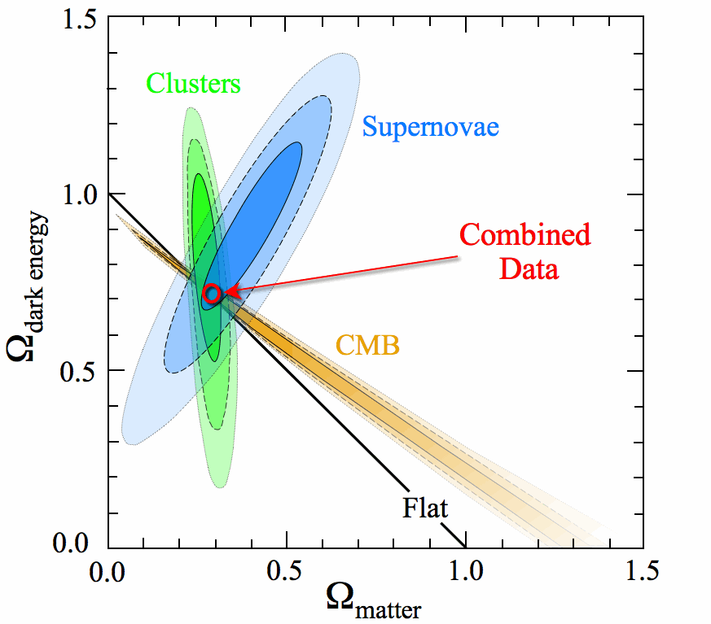
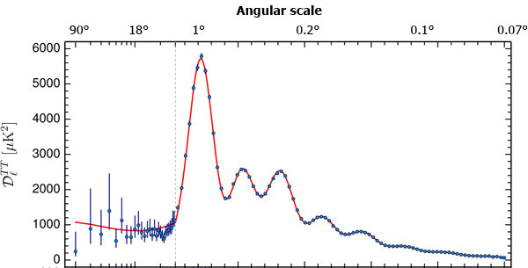
A century of success

Slide 4
A century of success
With open questions…
Nature of Inflaton
Pre Big Bang ? Alternatives to Inflation?
Cosmological
Constant
Problem
Nature of Dark Energy
Nature of Dark Matter

Slide 5
There has recently been an explosion of models that can play important roles for cosmology
(eg. DBI, K-inflation, G-inflation, gauge inflation, ghost inflation, Axion Monodromy, Chromo-Natural Inflation, f(R), Chameleon, Symmetron, ghost condensate, Galileon, generalized galileon, Horndeski, beyond Horndeski, beyond beyond Horndeski, Fab4, beyond Fab4, EST, DHOST, K-essence, DGP, cascading gravity, massive gravity, minimal massive gravity, bi-gravity, multi-gravity, mass-varying massive gravity, f(R) massive gravity, mass-varying massive gravity, quasi-dilaton, extended quasi-dilaton, superfuid dark matter, Proca dark energy, generalized Proca, beyond generalized Proca, gauge field dark energy, Galileon genesis, extended Galileon genesis, SLED, mimetic gravity, unimodular gravity, dipolar dark matter, …, … )
+ Lorentz breaking models

Slide 6
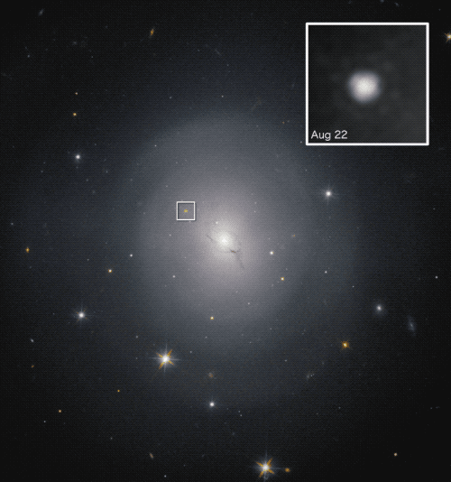
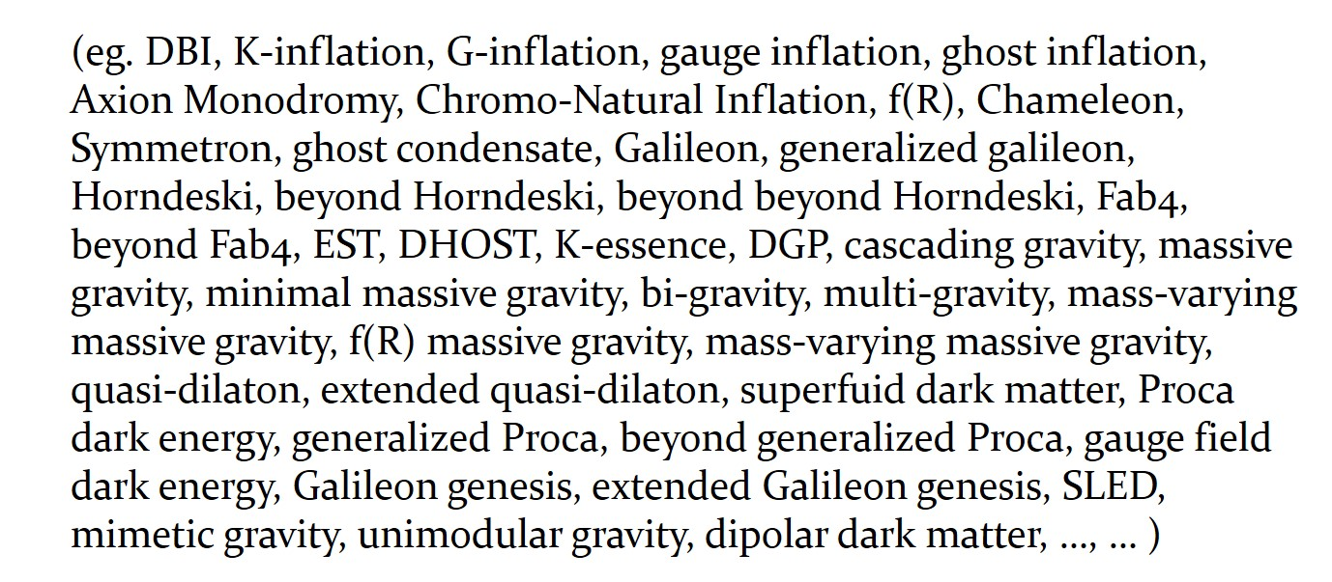
Setting different EFTs apart
We could simply wait for observations to tell
them apart
GW&GBR 170817

Slide 7
Setting different EFTs apart
We could simply wait for observations to tell
them apart Already doing well ! (but models evolve with observations…)
In parallel, we can question their theoretical consistency
Do these theories:
1. preserve perturbative unitarity ?
2. have any chance of ever admitting
a standard Wilsonian UV completion ?
3. … 4. … causal, well-posedness, caustics, …

Slide 8
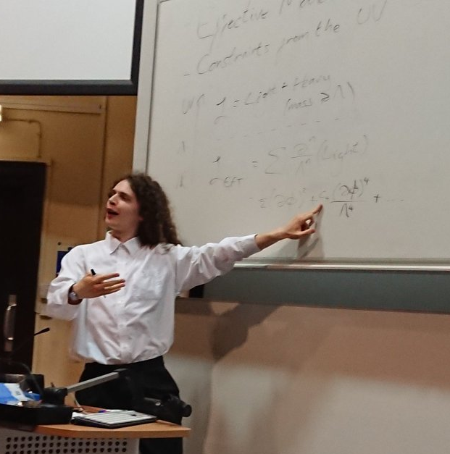

See 1703.00025
with Scott Melville
Do these theories:
1. preserve perturbative unitarity ?
2. have any chance of ever admitting
a standard Wilsonian UV completion ?
3. … 4. … causal, well-posedness, caustics, …
work to appear with Jonathan Crabbé

Slide 9
“Standard” UV completion – should we care ???
By “standard” UV completion, mean
Unitary,
Lorentz-invariant,
Local (to some extend),
Analytic
Analyticity is implied by causality
The absence of such a UV completion would have profound consequences for our understanding of UV physics (quantum gravity)

Slide 10
“Standard” UV completion ???
The existence of a “standard” UV completion, ie
Unitary,
Lorentz-invariant,
Local (to some extend),
Analytic (implied by causality)
Implies a set of constraints on any low-energy EFT
that manifest as positivity bounds
see talks by Andrew Tolley, Austin Joyce, James Bonifacio, Scott Melville

Slide 11
Setting different EFTs apart
There has recently been an explosion of models that can play important roles for cosmology
(eg. DBI, K-inflation, G-inflation, gauge inflation, ghost inflation, Axion Monodromy, Chromo-Natural Inflation, f(R), Chameleon, Symmetron, ghost condensate, Galileon, generalized galileon, Horndeski, beyond Horndeski, beyond beyond Horndeski, Fab4, beyond Fab4, EST, DHOST, K-essence, DGP, cascading gravity, massive gravity, minimal massive gravity, bi-gravity, multi-gravity, mass-varying massive gravity, f(R) massive gravity, mass-varying massive gravity, quasi-dilaton, extended quasi-dilaton, superfuid dark matter, Proca dark energy, generalized Proca, beyond generalized Proca, gauge field dark energy, Galileon genesis, extended Galileon genesis, SLED, mimetic gravity, unimodular gravity, dipolar dark matter, …, … )

Slide 12
Setting different EFTs apart
There has recently been an explosion of models that can play important roles for cosmology
(eg. DBI, K-inflation, G-inflation, gauge inflation, ghost inflation, Axion Monodromy, Chromo-Natural Inflation, f(R), Chameleon, Symmetron, ghost condensate, Galileon, generalized galileon, Horndeski, beyond Horndeski, beyond beyond Horndeski, Fab4, beyond Fab4, EST, DHOST, K-essence, DGP, cascading gravity, massive gravity, minimal massive gravity, bi-gravity, multi-gravity, mass-varying massive gravity, f(R) massive gravity, mass-varying massive gravity, quasi-dilaton, extended quasi-dilaton, superfuid dark matter, Proca dark energy, generalized Proca, beyond generalized Proca, gauge field dark energy, Galileon genesis, extended Galileon genesis, SLED, mimetic gravity, unimodular gravity, dipolar dark matter, …, … )

Slide 13
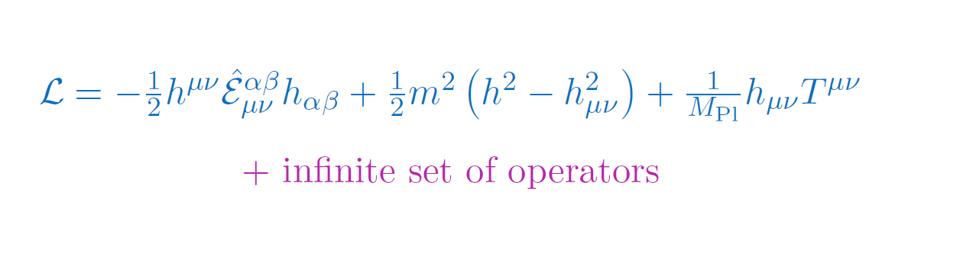
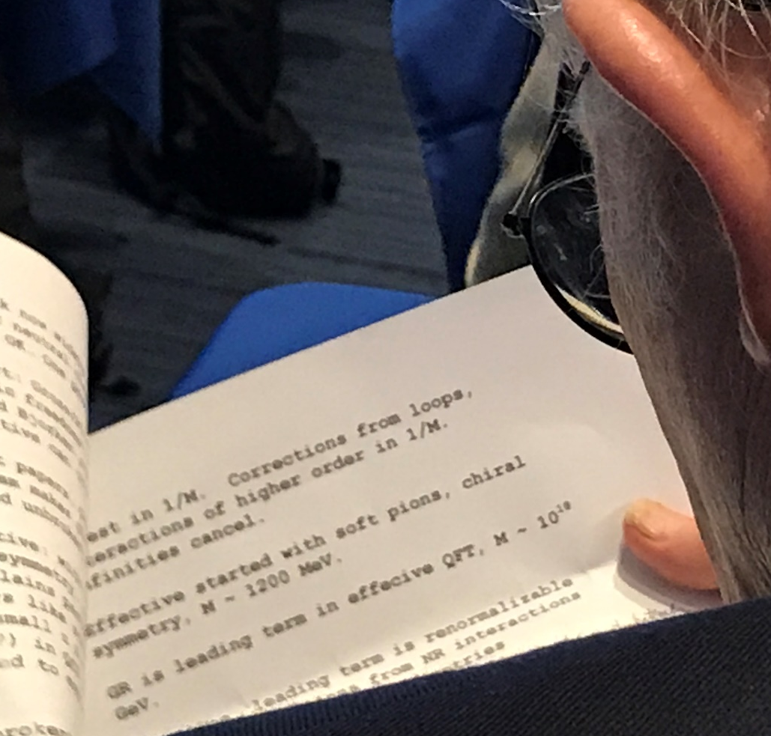
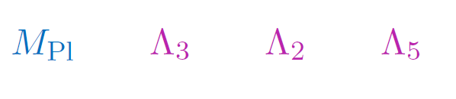
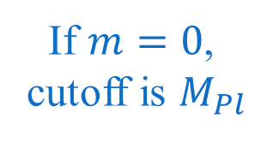

(Massive) spin-2 EFT
If $m≠0$,
cutoff is typically
If $m=0$,
cutoff is $M_{Pl}$

Slide 14
Massive spin-2 EFT
If $m≠0$,
cutoff is typically
If $m=0$,
cutoff is $M_{Pl}$

Slide 15
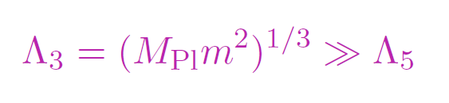
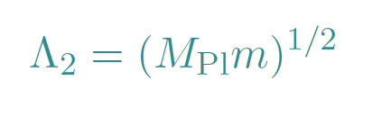
Massive spin-2 EFT
If $m≠0$,
cutoff is typically
If $m=0$,
cutoff is $M_{Pl}$
There is a very special class of non-linear theory for which the cutoff
(or possibly strong coupling scale) is raised to
Gabadadze, Tolley & CdR, 2010
Or even on AdS (see Gregory’s talk) or on some backgrounds
Tolley, Zhou & CdR 2015

Slide 16
Massive spin-2 EFT

Slide 17
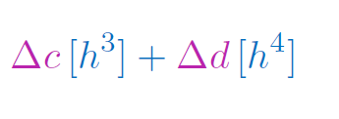
Positivity bounds on Massive spin-2 EFT
Operators that contribute
(as far as 2-2 tree level is concerned)

Slide 18
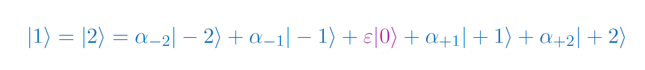
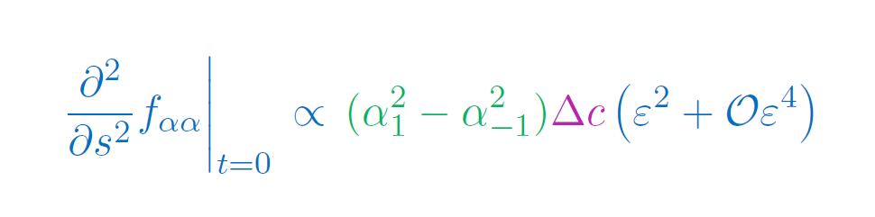






Positivity bounds on Massive spin-2 EFT
Operators that contribute
(as far as 2-2 tree level is concerned)
Eg. of forward scattering
$$1$$
$$1$$
$$2$$
$$2$$
Should be positive for any choice of $α_{±1}$
Melville, Tolley, Zhou, CdR 1804.10624
$$Δc=0$$

Slide 19

Positivity bounds on Massive spin-2 EFT
Operators that contribute
(as far as 2-2 tree level is concerned)
Beyond forward
$$1$$
$$1$$
$$2$$
$$2$$
$$Δd=0$$
Melville, Tolley, Zhou, CdR 1804.10624

Slide 20
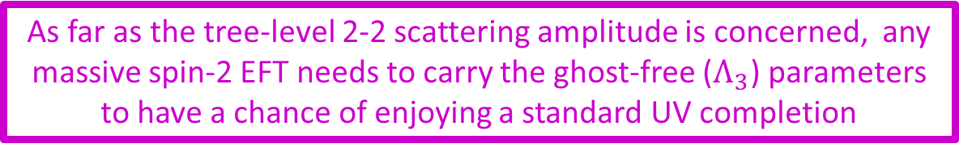
Positivity bounds on Massive spin-2 EFT
Operators that contribute
(as far as 2-2 tree level is concerned)
Beyond forward
$$1$$
$$1$$
As far as the tree-level 2-2 scattering amplitude is concerned, any massive spin-2 EFT needs to carry the ghost-free ($Λ_{3}$) parameters to have a chance of enjoying a standard UV completion
$$2$$
$$2$$
Melville, Tolley, Zhou, CdR 1804.10624

Slide 21
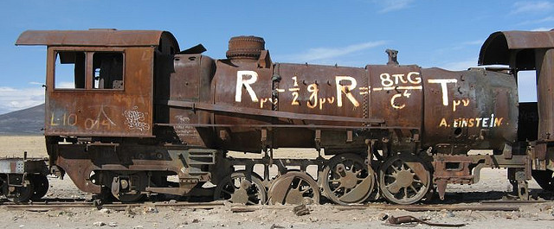

Massive Gravity
There is a special class of interactions for which the strong coupling scale is raised to (and carries no ghosts)
$$+m^{2}M_{μν}$$
CdR & Gabadadze, 2010
CdR, Gabadadze & Tolley, 2011

Slide 22

Massive Gravity
There is a special class of interactions for which the strong coupling scale is raised to (and carries no ghosts)
$$+m^{2}M_{μν}$$
Kinetic term has to be identical as in GR
With Andrew Matas & Tolley, 2013, 2015, 2015, 2015

Slide 23
Massive Gravity
There is a special class of interactions for which the strong coupling scale is raised to (and carries no ghosts)
$$+m^{2}M_{μν}$$
Matter coupling has to be identical as in GR

Slide 24
Massive Gravity
There is a special class of interactions for which the strong coupling scale is raised to (and carries no ghosts)
Can we test such a theory ???
$$+m^{2}M_{μν}$$
Only 2-parameters + mass scale

Slide 25
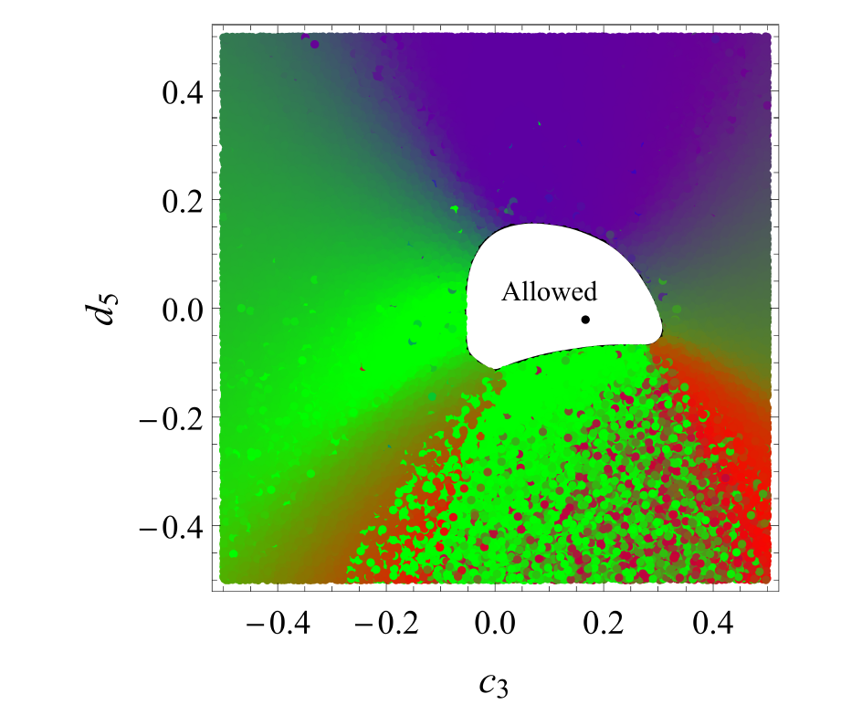
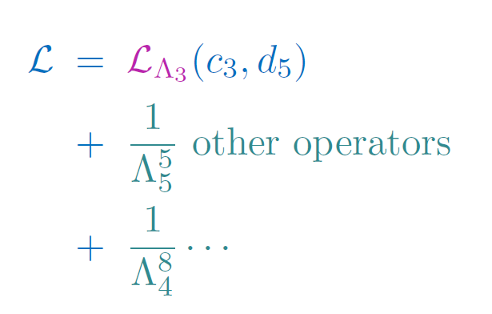

Positivity bounds on $Λ_{3}$massive gravity
Cheung & Remmen, JHEP 1604 (2016)

Slide 26
Observational Tests
Solar System
Binary Pulsars
Black Holes
Massive Gravity
Primordial Gravity Waves
Supernovae
Weak Lensing
Cluster of galaxies
CMB, …
Structure
Formation
Universe
Evolution
(Supernovae, BAO, CMB,…)

Slide 27
Observational Tests
Size in cm
Universe
Galaxy
10²⁰
Sun
Earth
10⁰
Human
Atom
Virus
Electron
Inaccessible by Gravity
(form Black Hole)
10⁻²⁰
Quantum Regime
Mass/Energy
in grams
10⁻⁵⁰
10⁰
10⁵⁰

Slide 28
Observational Tests
Effect of mass becomes relevant
Size in cm
Universe
Galaxy
10²⁰
Sun
Earth
10⁰
Human
Atom
Virus
Electron
10⁻²⁰
Inaccessible by Gravity
(form Black Hole)
Quantum Regime
Mass/Energy
in grams
10⁻⁵⁰
10⁰
10⁵⁰

Slide 29
Observational Tests
Vainshtein mechanism less efficient larger departures from GR
Size in cm
Universe
Galaxy
10²⁰
Sun
Earth
10⁰
Human
Atom
Virus
Electron
10⁻²⁰
Inaccessible by Gravity
(form Black Hole)
Quantum Regime
Mass/Energy
in grams
10⁻⁵⁰
10⁰
10⁵⁰

Slide 30
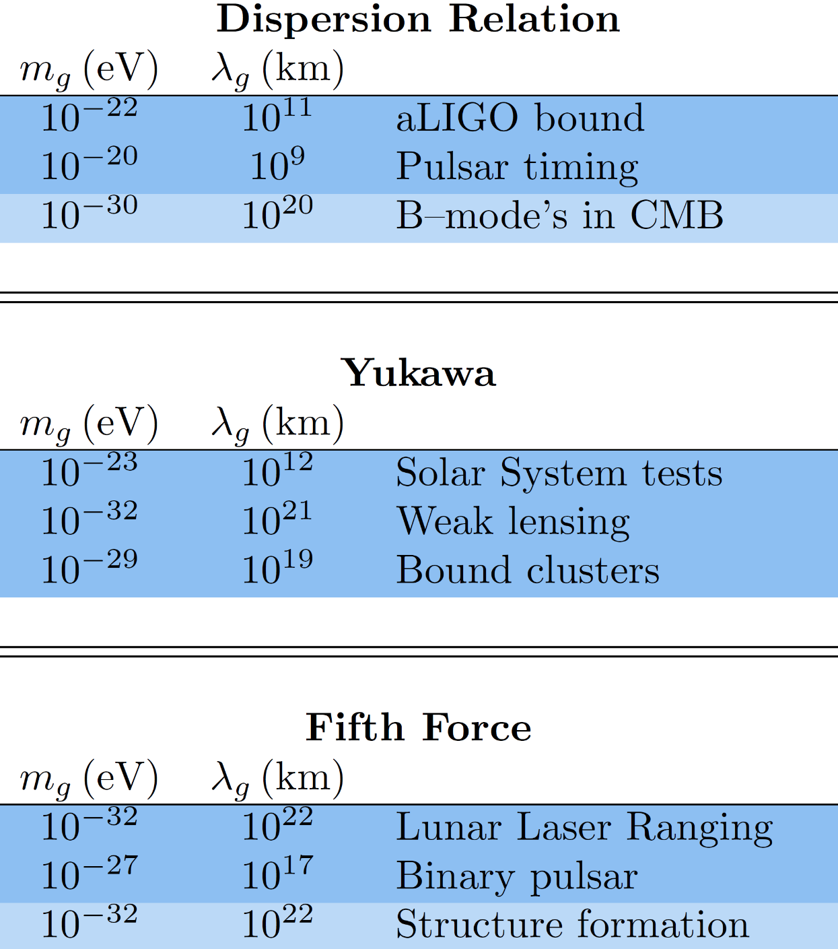
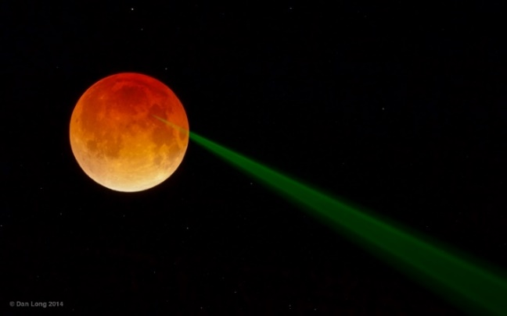
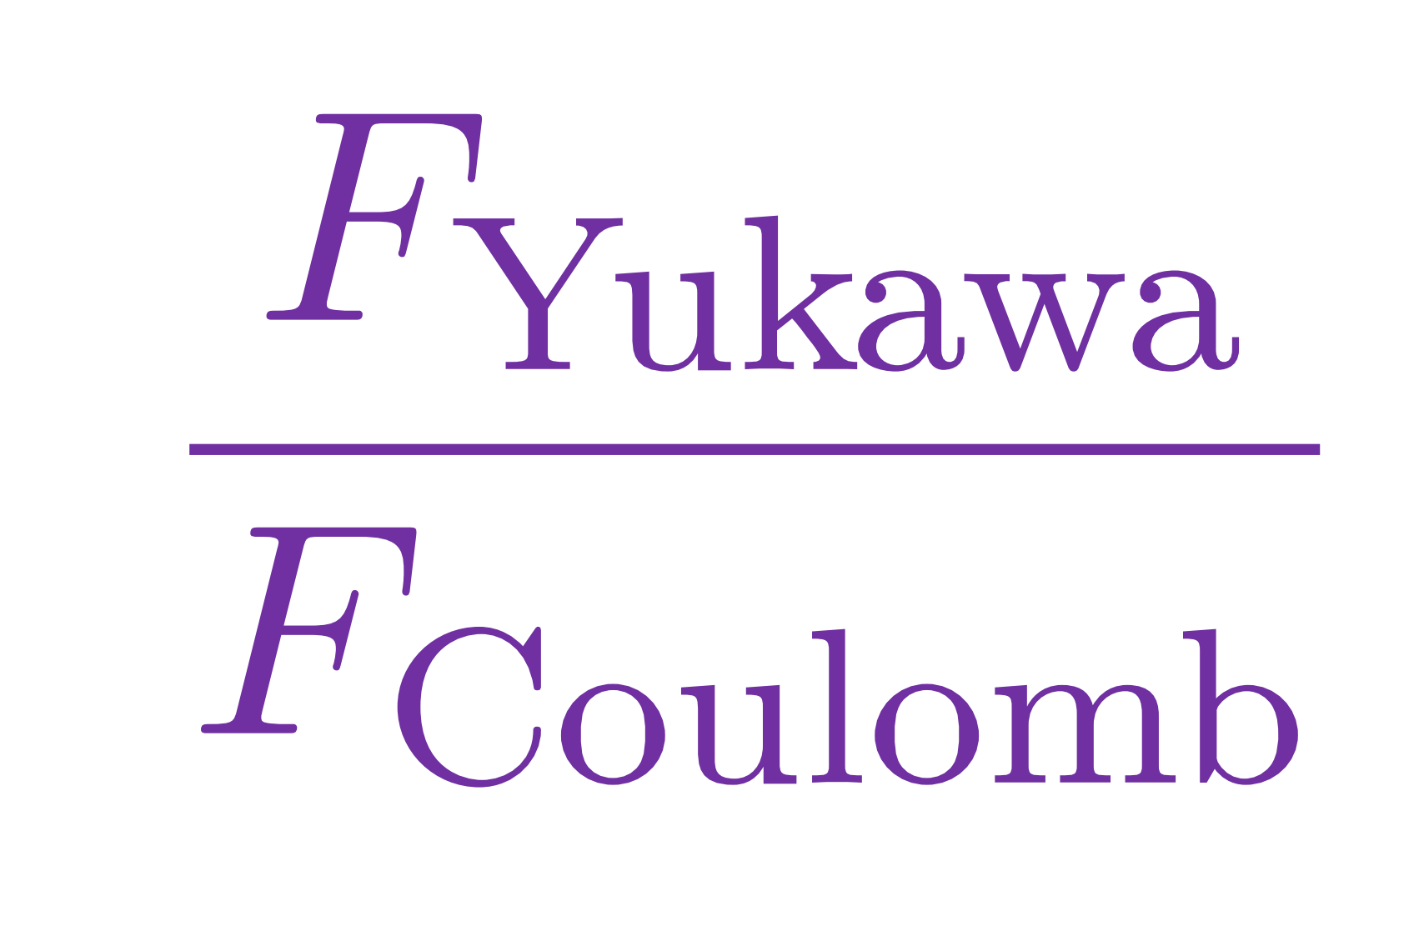
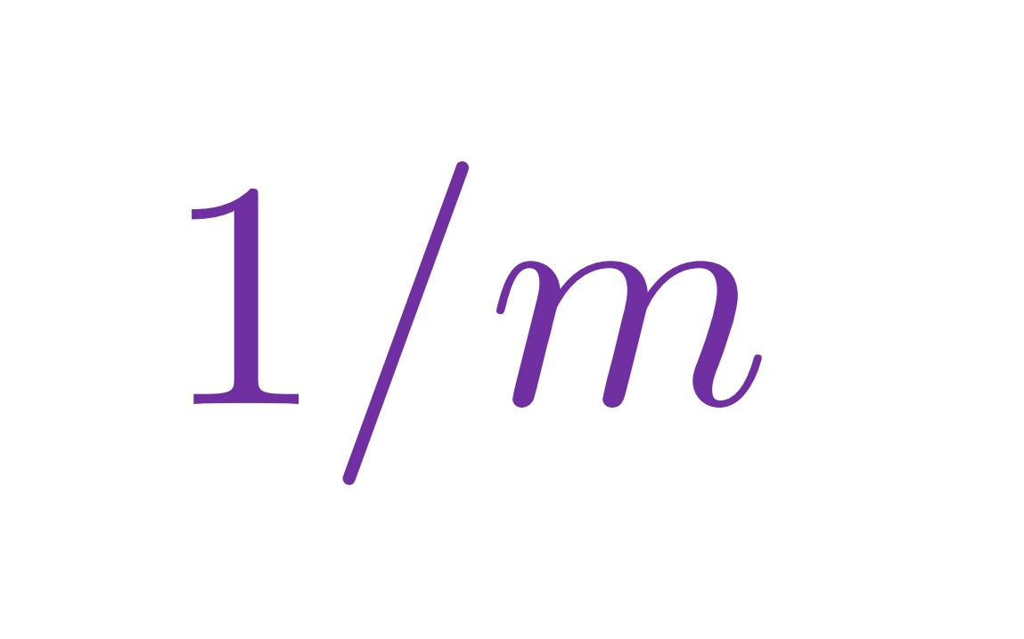

How light is gravity ???
Deskins, Tolley, Zhou, CdR1606.08462, RMP

Slide 31
How light is gravity ???
Cleanest
(least model dependent)
Only for models
that carry a helicity-0 mode
(ie. For Local and Lorentz-
invariant models)
Deskins, Tolley, Zhou, CdR 1606.08462, RMP

Slide 32
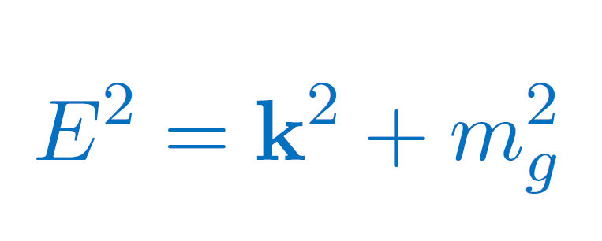
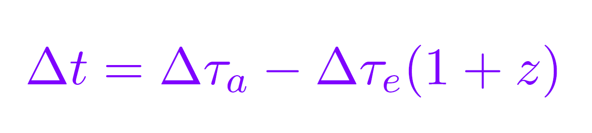
Direct detection of GWs
Constraints modifications of the dispersion relation
Generic for the helicity-2 modes of any Lorentz invariant model of massive gravity (including DGP at the level of spectral representation)
GW signal would be more squeezed than in GR
matched filtering technique allows to determine the signal duration when emitted $Δτ_{e}$ very accurately which can be compared with the signal duration when observed $Δτ_{a}$.
Will 1998

Slide 33
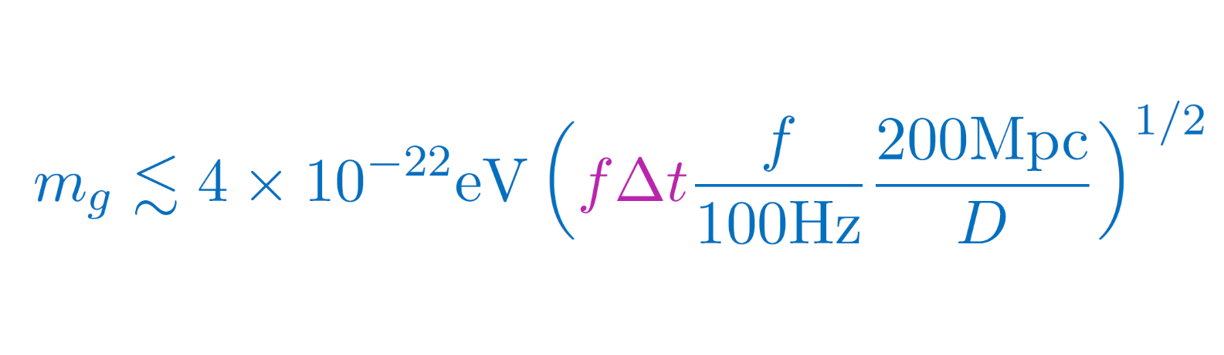
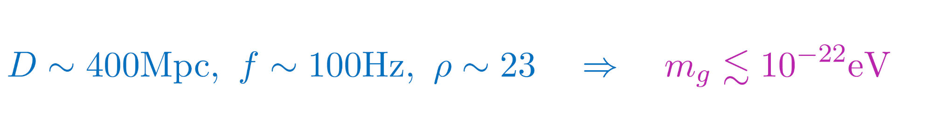
Direct detection of GWs
modifications of the dispersion relation put a bound on the graviton mass
Phase distortion $fΔt$ can be measured up to $1/ρ$ ($ρ:$the signal to noise ratio)
For GW150914,
For GW151226, $ρ$ is smaller and the BHs are lighter so $f$ is larger not as competitive
Will 1998
Abbott et al., 2016

Slide 34
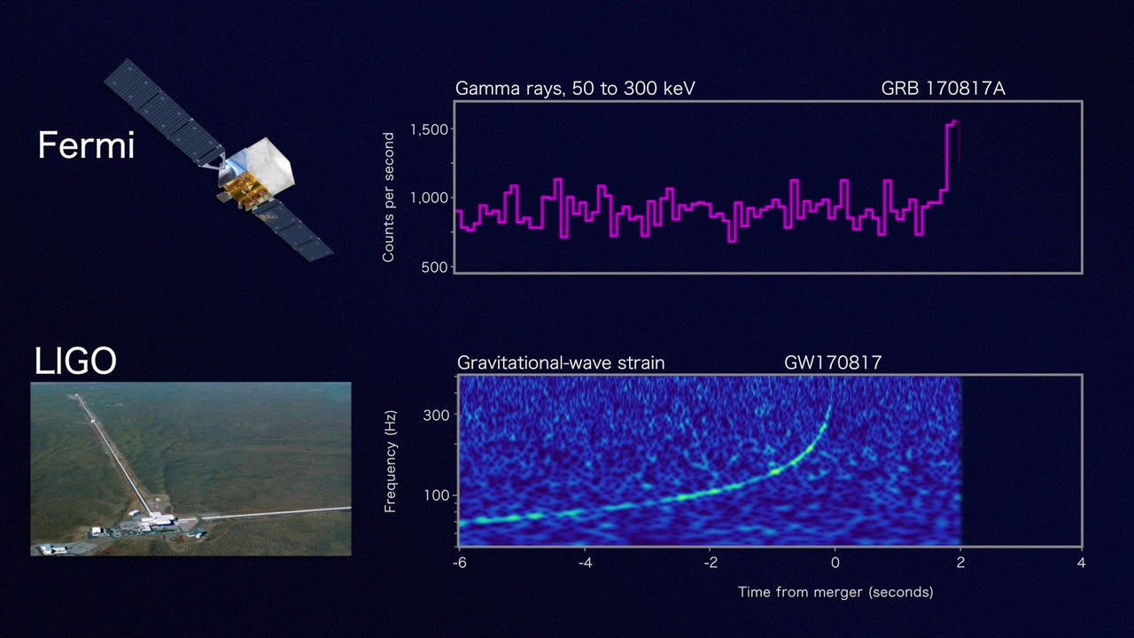
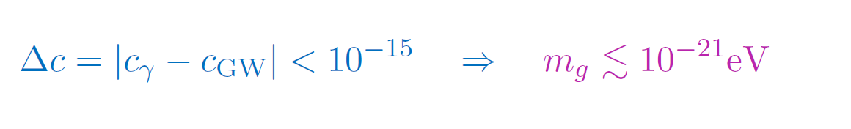

$≳{10}^{19}$Hz
Direct detection of GWs
For GW150914,
For GW170817 & GRB170817A

Slide 35
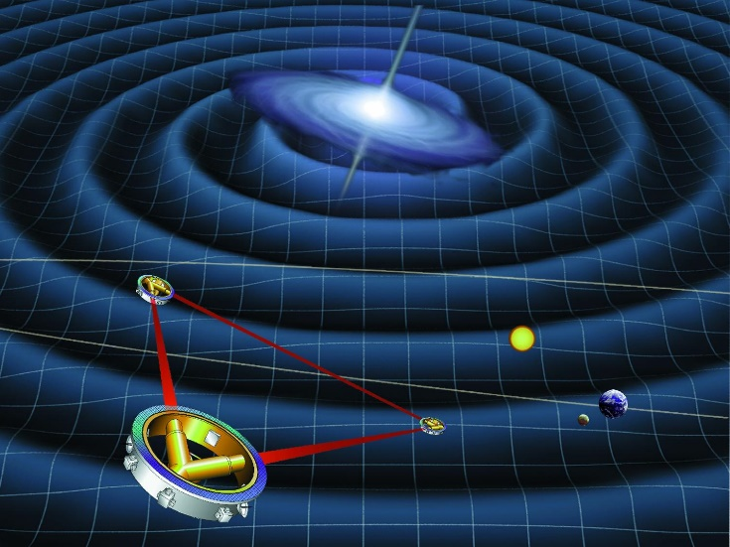
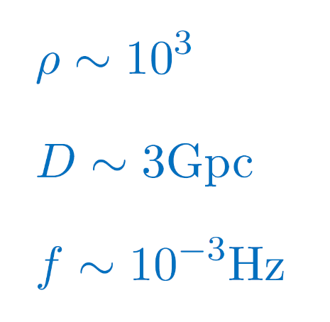
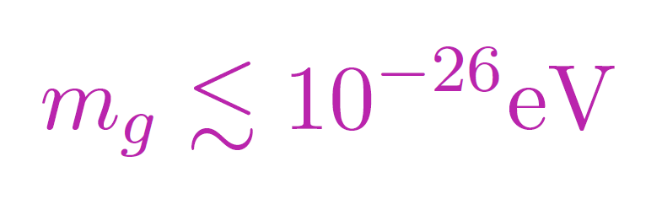
Direct detection of GWs
modifications of the dispersion relation put a bound on the graviton mass
For LISA, could have

Slide 36
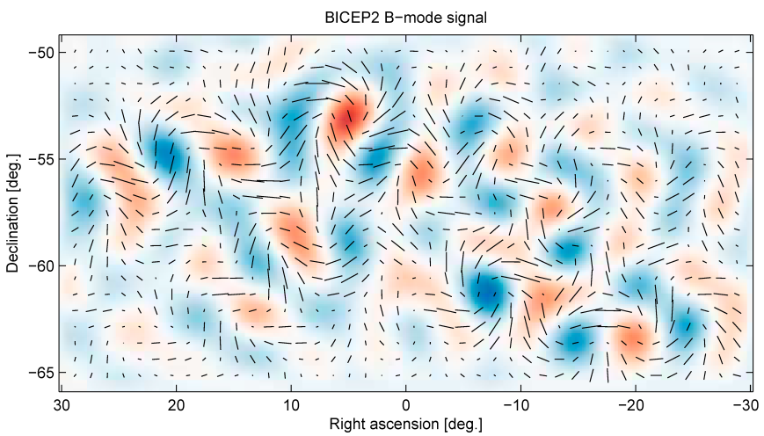
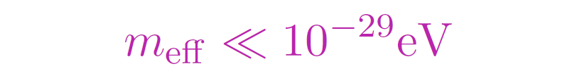
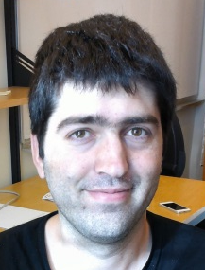

Bounds from Primordial Gravitational Waves
if ever detected…
would imply the graviton is effectively massless at the time of recombination
Dubovsky, Flauger, Starobinsky & Tkachev, 2010
Fasiello & Ribeiro, 2015, (for bi-gravity)
Lin&Ishak, 2016 (Testing gravity using tensor perturbations)
Notes:
The detection of primordial GWs would have a huge consequences for our understanding of physics. First it would indicate that the graviton is quantized during inflation just like the inflaton scalar field. Second it would also mean that the graviton should effectively be massless at the time of recombination which puts some constraints on the graviton mass.
Now compared with the bounds from the solar system and from late-time cosmology this does seem a strong bound, but its really a bound not on the bare mass parameter but rather on the effective mass which itself can evolve in time and the effective mass could be larger in the past so the detection of primordial GWs could really constraints these models of modified gravity.

Slide 37
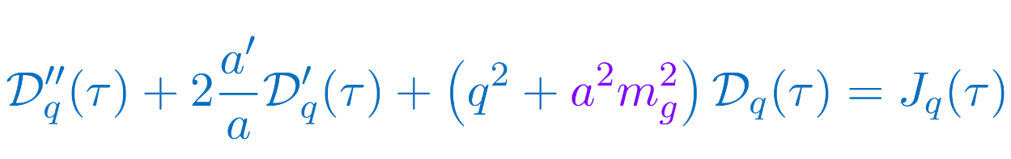
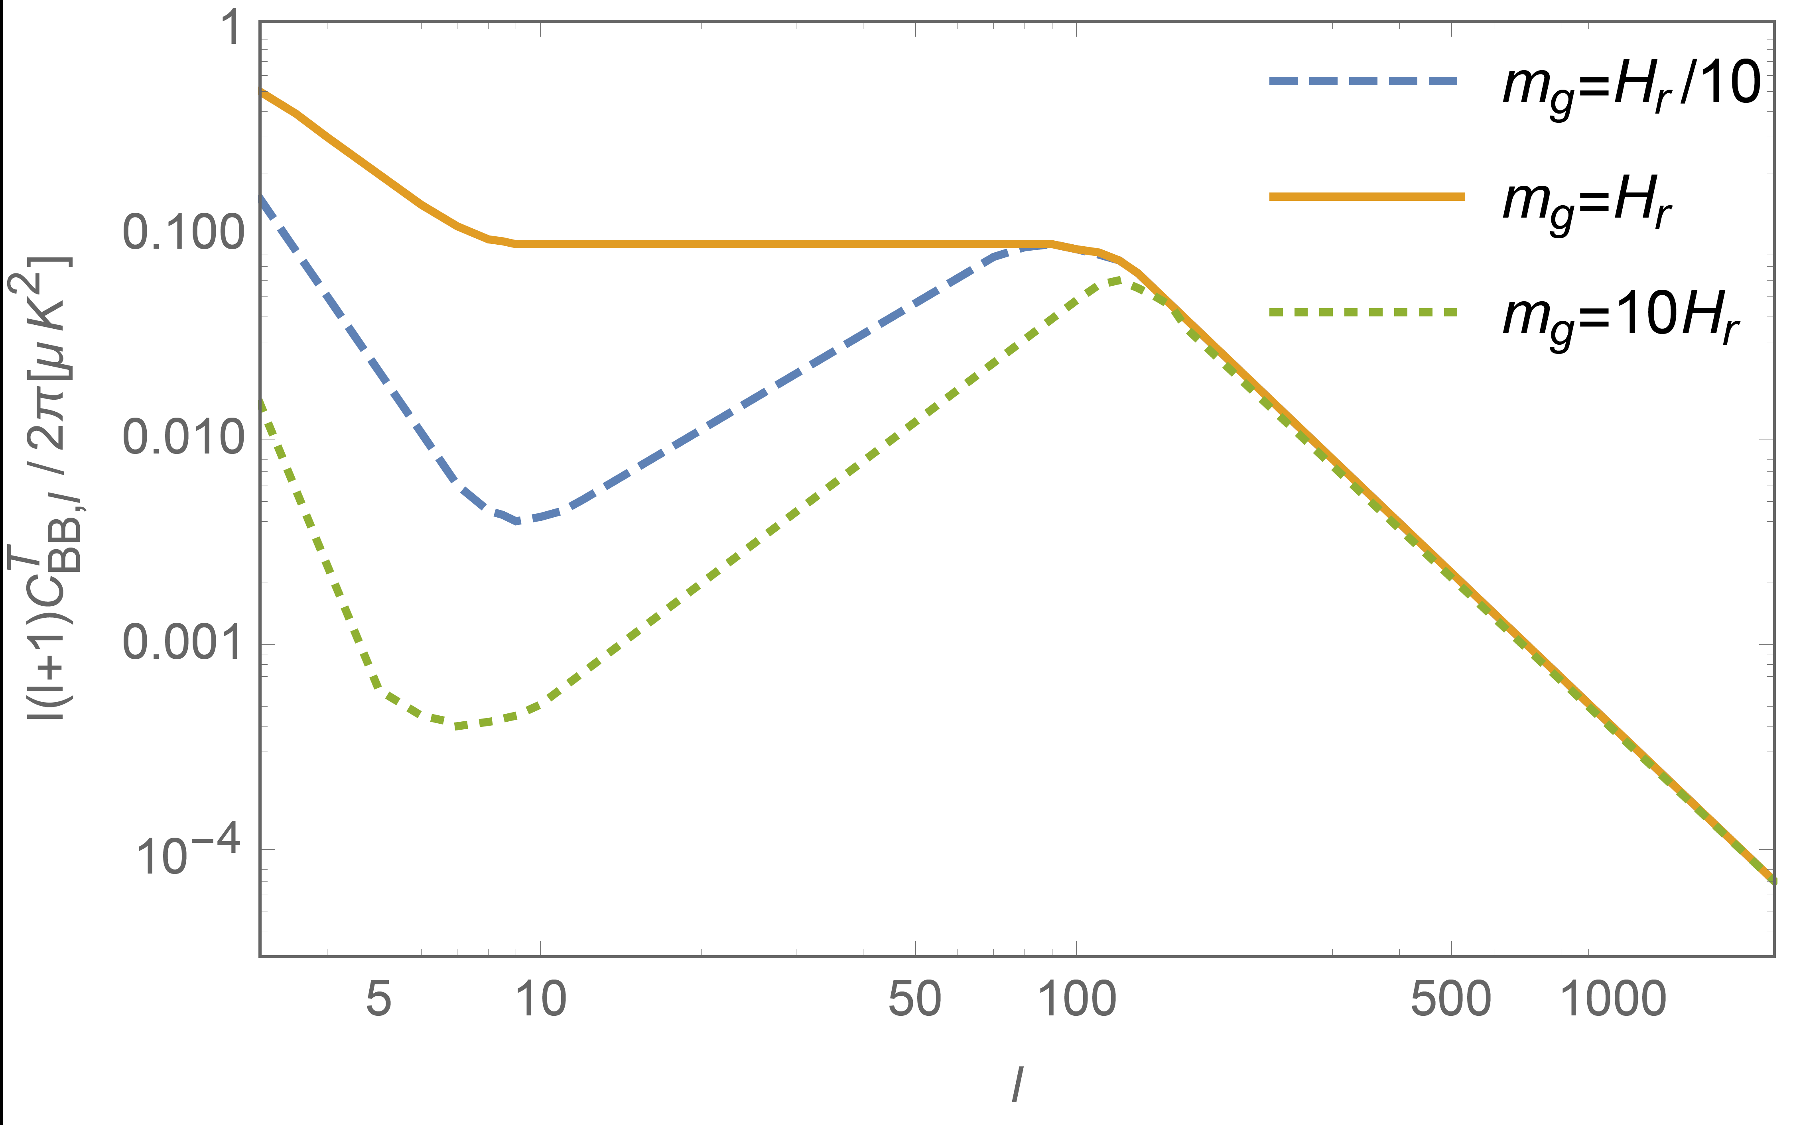
Bounds from Primordial Gravitational Waves
Modification to the
tensor mode evolution
Dubovsky, Flauger, Starobinsky & Tkachev, 2010
Fasiello & Ribeiro, 2015, (for bi-gravity) Lin&Ishak, 2016
Notes:
The detection of primordial GWs would have a huge consequences for our understanding of physics. First it would indicate that the graviton is quantized during inflation just like the inflaton scalar field. Second it would also mean that the graviton should effectively be massless at the time of recombination which puts some constraints on the graviton mass.
Now compared with the bounds from the solar system and from late-time cosmology this does seem a strong bound, but its really a bound not on the bare mass parameter but rather on the effective mass which itself can evolve in time and the effective mass could be larger in the past so the detection of primordial GWs could really constraints these models of modified gravity.

Slide 38
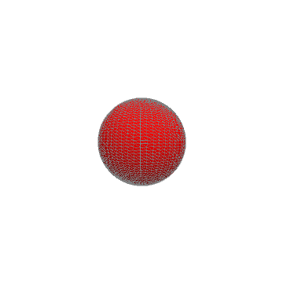
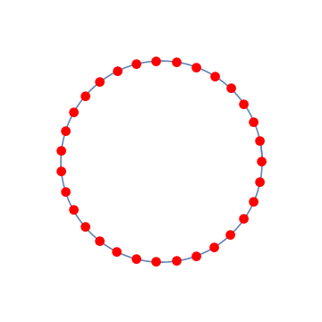
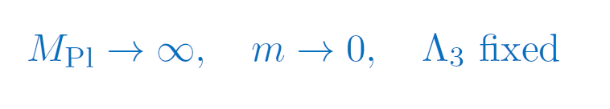
Scalar and Vector modes of the graviton
In a Lorentz invariant theory, a massive graviton also carries:
2 helicity-1 modes and one helicity-0 mode
Helicity-0 mode propagates an additional gravitational force that can be very well tested (particularly in the Solar System)
Screened via a Vainshtein mechanism.
In the limit where the helicity-0 mode behaves as a Galileon
Notes:
The detection of primordial GWs would have a huge consequences for our understanding of physics. First it would indicate that the graviton is quantized during inflation just like the inflaton scalar field. Second it would also mean that the graviton should effectively be massless at the time of recombination which puts some constraints on the graviton mass.
Now compared with the bounds from the solar system and from late-time cosmology this does seem a strong bound, but its really a bound not on the bare mass parameter but rather on the effective mass which itself can evolve in time and the effective mass could be larger in the past so the detection of primordial GWs could really constraints these models of modified gravity.

Slide 39
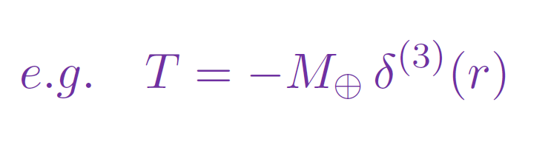
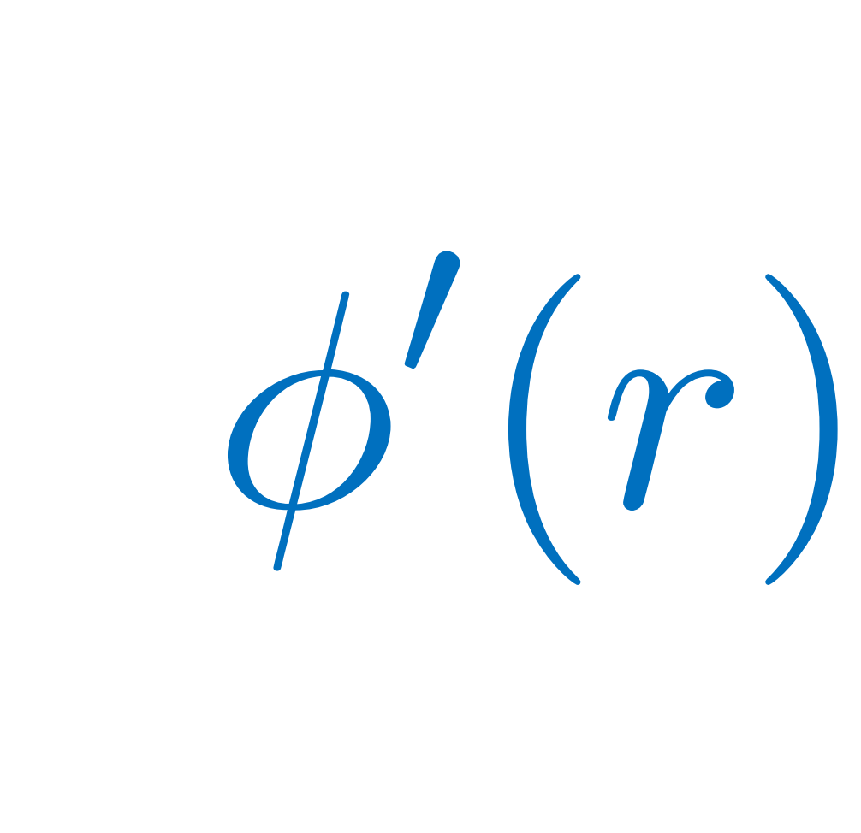
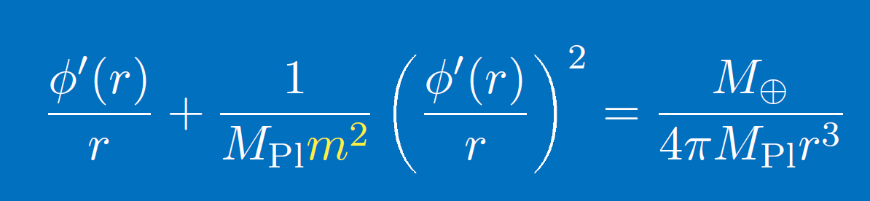

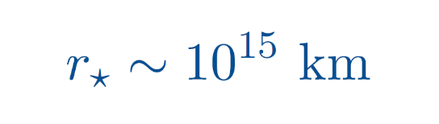
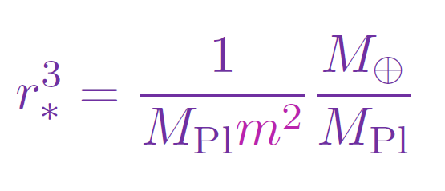
Vainshtein mechanism
Well understood for Static & Spherically Symmetric configurations
Force mediated by the helicity-0 mode
Vainshtein radius:

Slide 40
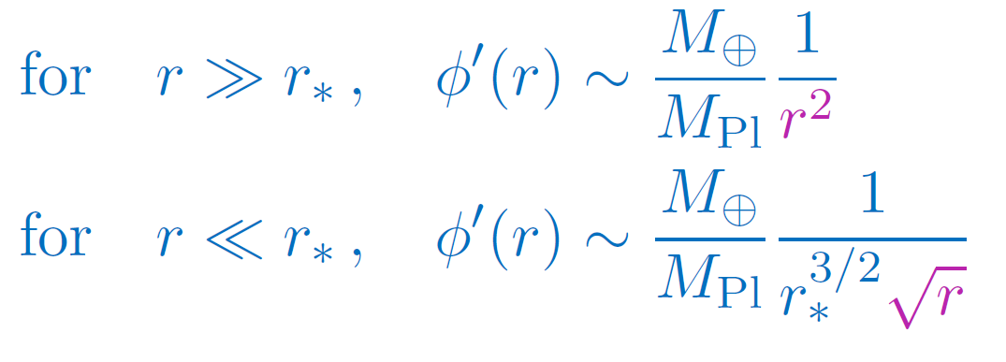
Vainshtein mechanism
Well understood for Static & Spherically Symmetric configurations
Force mediated by the helicity-0 mode
Vainshtein radius:

Slide 41
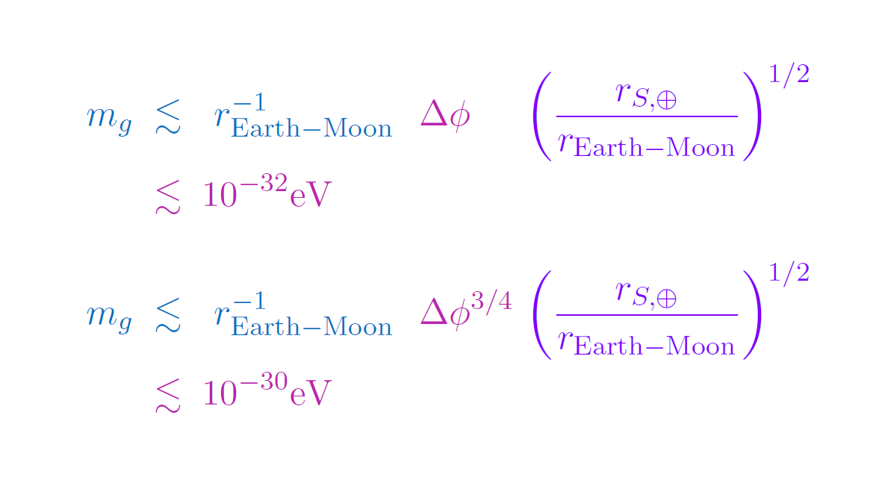

Lunar Laser Ranging bounds
For DGP, (soft massive gravity, cubic Galileon)
For hard mass graviton, (~ quartic Galileon)

Slide 42


Radiation into the scalar mode of the graviton
The existence of a scalar mode means new channels of radiation
For Binary systems:
Monopole & dipole exist but are suppressed by conservation of energy & momentum.
Quadrupole emitted by helicity-0 mode is suppressed by Vainshtein mechanism
(best understood in a Galileon approximation)
Notes:
The detection of primordial GWs would have a huge consequences for our understanding of physics. First it would indicate that the graviton is quantized during inflation just like the inflaton scalar field. Second it would also mean that the graviton should effectively be massless at the time of recombination which puts some constraints on the graviton mass.
Now compared with the bounds from the solar system and from late-time cosmology this does seem a strong bound, but its really a bound not on the bare mass parameter but rather on the effective mass which itself can evolve in time and the effective mass could be larger in the past so the detection of primordial GWs could really constraints these models of modified gravity.

Slide 43





Work with Furqan Dar, Tate Deskins,
John Tom Giblin & Andrew Tolley
For the cubic Galileon:
Power still in the quadrupole as in GR
Corrections to GR are very suppressed
Contours of
$${\dot{φ}}^{2}$$

Slide 44


Galileon Quadrupole emission
For the Hulse-Taylor Pulsar
For the Cubic Galileon, higher multipoles are suppressed by additional powers of velocity

Slide 45
Galileon Quadrupole emission
For the Hulse-Taylor Pulsar
For the Cubic Galileon, higher multipoles are suppressed by additional powers of velocity
Massive gravity and stable self-accelerating models always include at least a quartic Galileon
In the Quartic Galileon, the angular direction is not screened as much as the others many multipoles contribute to the power with the same magnitude…
Multipole expansion breaks down

Slide 46
How light is gravity ???
Cleanest
(least model dependent)
Only for models
that carry a helicity-0 mode
(ie. For Local and Lorentz-
invariant models)
Deskins, Tolley, Zhou, CdR 1606.08462, RMP

Slide 47
Summary
Cosmology has motivated the (re)development of entire new classes of scalar EFTs
Observations already put strong constraints on some of these models, and particularly on the (effective) graviton mass
(perturbative) unitarity & analyticity can allow for a better segregation
Framework not only serves modified gravity but the whole set of EFTs used in cosmology for the description of
- inflation, (including gauge field inflation, etc…)
- pre big-bang/bouncing cosmology/other alternatives to inflation
- dark energy
- potential framework to tackle the CC problem
- CFT’s
- …

Slide 48
How light is gravity ???

Slide 50


Improved positivity bounds
Effectively measures the scale of the cutoff
CdR, Melville, Tolley, 1710.09611

Slide 51

Improved positivity bounds
Bellazzini, Riva, Serra, Sgarlata 1710.0253
Assuming a large enough g, the improved positivity
bounds can rule out the allowed parameter space
CdR, Melville, Tolley, 1710.09611: the improved positivity bounds should be seen as a constrain on the value of the cutoff !

Slide 52

Cherenkov Radiation
Particles traveling faster than GWs could decay into GWs
graviton
Forbidden process in
Lorentz invariant models
(if the photon is massless)
photon
Would be allowed for particles faster than photon (Lorentz violating models)
graviton
eg. Blas, Ivanov, Sawicki, Sibiryakov1602.04188
Can be used to put bounds on the difference of speeds
but those translate into very weak bounds on the graviton mass

Slide 53



Graviton Decay
If the graviton has a mass:
aLIGO direct detection:
Very weak bound…
Constraints from cosmology:

Slide 54





Graviton Decay
If the graviton is a resonance (eg. in DGP, Cascading Gravity,…)
The graviton already has a finite lifetime
even without taking into account its possible decay into photons

Slide 55



Graviton Decay
For a hard mass graviton
At tree-level,
loop-effect on graviton self-energy
N: total number of light particles that may exist
(photon + axion, hidden sector not subject to SM constraints,…)

Slide 56













Causality vs Analyticity
$$1$$
$$3$$
$$2$$
$$4$$
is analytic in $k^{0}$ in upper ½ of plane $k^{0}$
For fixed
is analytic in $s$ in upper ½ of $ℂ$ plane

Slide 57












Analyticity and Causality
$$1$$
$$3$$
Consider the lightest massive particle,
a single such particle is stable against decay
$$4$$
$$2$$
Response to a source (current) :

Slide 58









Bogoliubov-Shirkov Causality
$$y$$
$$≠0$$
$$=0$$
$$x$$
Amplitude $A$

Slide 59





Breit coordinate system
$$1$$
$$3$$
$$2$$
$$4$$
at high energy
is analytic in $k^{0}$ in upper ½ of plane $k^{0}$

Slide 60


Breit coordinate system
$$1$$
$$3$$
$$2$$
$$4$$
For fixed
is analytic in $s$ in upper ½ of $ℂ$ plane
is analytic in $k^{0}$ in upper ½ of plane $k^{0}$

Slide 61



Weak Coupling
Positivity bound imposes $c_{1}>0$
At one loop, renormalization contributes at order $Λ^{−8}$
would need to specify how to separate tree and loops before
we can impose $c_{2}>0$
Issue if there is only one scale in the problem (theory strongly coupled at $Λ$)
Weak Coupling (UV theory is weakly coupled)

Slide 62



Alternatives to Weak Coupling
Massive Galileons (or $P(X)$)
while
Tree-level bounds apply at least up to order $Λ^{−10}$(without invoking weak coupling)
Including the Loops to a given order

