Slide 1

BLACK HOLES FROM COSMIC INFLATION
Alex Vilenkin (Tufts University)
CWRU, June 2018

Slide 2
Black hole puzzles
1. Supermassive black holes
, already present at z ~ 7.
How were they formed?
.
2. LIGO observations
Gravitational waves from in-spiraling and colliding black holes.
More massive than expected:
.
Primordial black holes formed in the early universe?
Most scenarios predict unacceptably large spectral distortions
of the CMB (for ).
.
Notes:
This motivated the recent upsurge of interest in PBH.

Slide 3
This talk: a new mechanism of black hole formation.
Vacuum bubbles spontaneously nucleate during inflation.
They expand to very large sizes and collapse to black holes
after inflation ends.
BH distribution with a very wide spectrum of masses.
Work with Jaume Garriga, Jun Zhang, Heling Deng and Masaki Yamada

Slide 4
Inflation
– a period of accelerated expansion driven by
the potential energy of a scalar field.
“Slow roll”
Our
vacuum
scalar field
(inflaton)
Explains some puzzling features of the big bang.
Predictions are confirmed by the data.

Slide 5
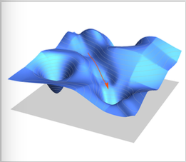
Bubble nucleation
Particle physics models generally include a number of scalar fields.
Then the “ball” rolls in a multi-dimensional landscape.
Each local minimum represents a vacuum state.
As the field rolls towards our vacuum, it can tunnel to another vacuum.
Our
vacuum

Slide 6
Bubble nucleation
Coleman & De Luccia (1980)
Energy
Density
Bubbles of a lower-energy vacuum nucleate and expand during the slow roll: .
Our
Vacuum
Scalar Field 1
Scalar
Field 2
Notes:
The vacuum b has energy density lower than I but higher than our vacuum.
The bubble eats up the high-energy false vacuum, and the released energy goes into the kinetic energy of the bubble wall.

Slide 7
Bubble nucleation
Coleman & De Luccia (1980)
Bubble radius:
Bubble size distribution:
Nucleation
rate

Slide 8
What happens to the bubbles when inflation ends?
Matter
The bubble wall initially expands relativistically relative to matter.
It is quickly slowed down by particle scattering.
An expanding relativistic shell of matter is formed
(a shock wave).
The bubble eventually collapses to a black hole.
But there is more to the story…

Slide 9
What happens inside the bubble?
Matter
Bubbles of radius
collapse to a singularity.

Slide 10
What happens inside the bubble?
Matter
Bubbles of radius
collapse to a singularity.
If the bubble expands to a radius ,
its interior begins to inflate:
But the universe outside the bubble is expanding much slower.

Slide 11
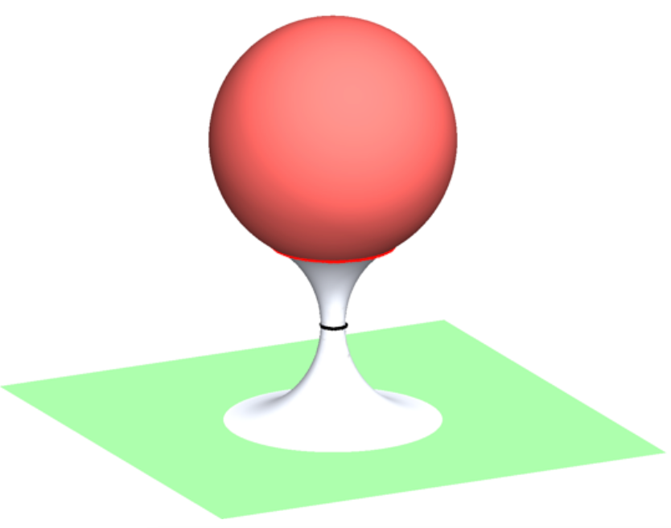
Inflating
baby
universe
The “wormhole” is seen
as a black hole by exterior observers.
Exterior
FRW region
Black holes bigger than a certain critical size
have inflating baby universes inside.
Notes:
Given the bubble size, we want to know the mass of the resulting BH. This requires a numerical simulation.
But we can impose an upper bound on how large this mass can be.

Slide 12
Upper bound on BH mass
The shocked region expands as .
The universe outside of it is unperturbed.
The size of this region when it comes within the
horizon is .
The largest BH that can fit into this region has mass
Need numerical simulations to determine M_{bh}.
Notes:
The bubbles are initially much bigger than the horizon.

Slide 13
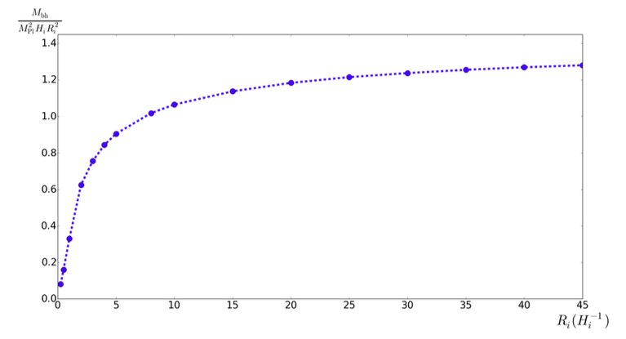
Numerical simulations
Heling Deng & A.V. (2017)
M ~ M_{max}
Depending on microphysics, M* may take a wide range of values.

Slide 14
Mass distribution of black holes
Fraction of dark matter density
in black holes of mass ~ M :
Use and .

Slide 15
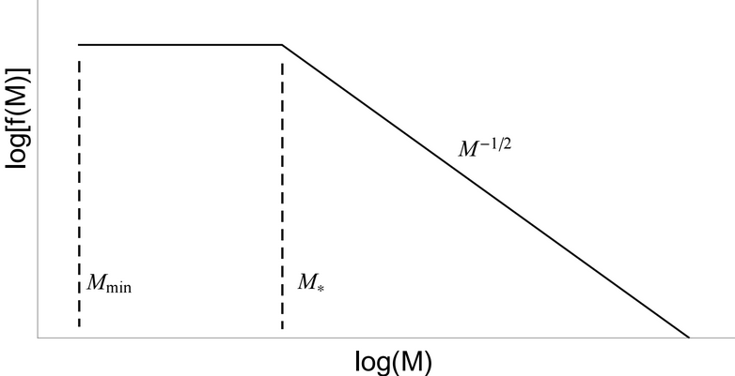
Mass distribution of black holes
Fraction of dark matter density
in black holes of mass ~ M :
The overall magnitude is determined
by the bubble nucleation rate .
The mass distribution depends on 2 parameters:
It generally has upper and lower cutoffs.

Slide 16
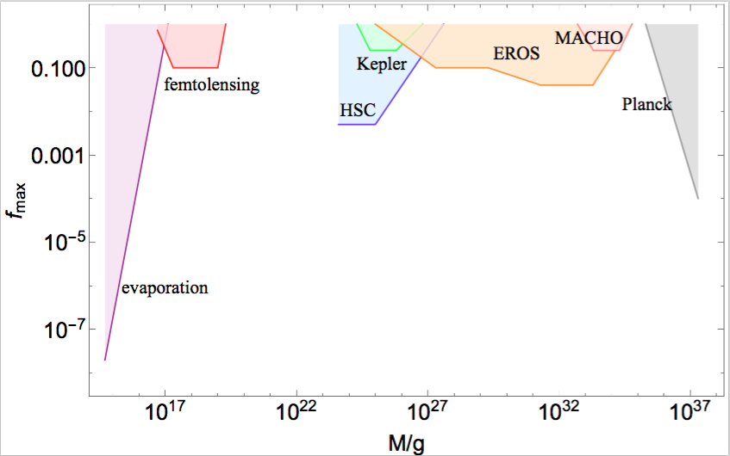
Observational bounds
Notes:
BH with M between 10^18 and 10^25 g can be dark matter.

Slide 17
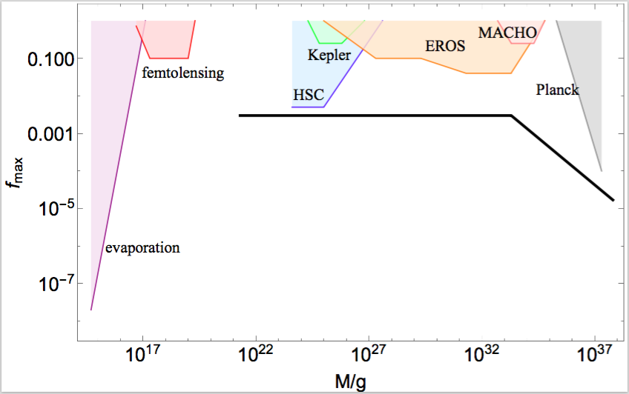
Accounting for LIGO observations
.
BH merger rate observed by LIGO requires for .
.
Sasaki et al (2016)
Note: BH produced by bubbles are non-rotating.

Slide 18
Supermassive black holes
.
The largest BH we can expect to find in a galaxy has mass .
.

Slide 19
CMB spectral distortion
Deng, A.V. & Yamada (2018)
Photon diffusion from the shock distorts the Planck spectrum.
Photons develop a chemical potential
( - distortion).
– unobservably small.
But potentially detectable spectral distortion on angular scale ~ 10’ around the most massive BHs.

Slide 20
Global structure of spacetime
The baby universes will inflate eternally.
Bubbles of all possible vacua, including ours, will be formed.
Notes:
In some of the bubbles this scenario will repeat, and BHs will be formed with inflating universes inside.
We may be living in a baby universe inside a BH.

Slide 21
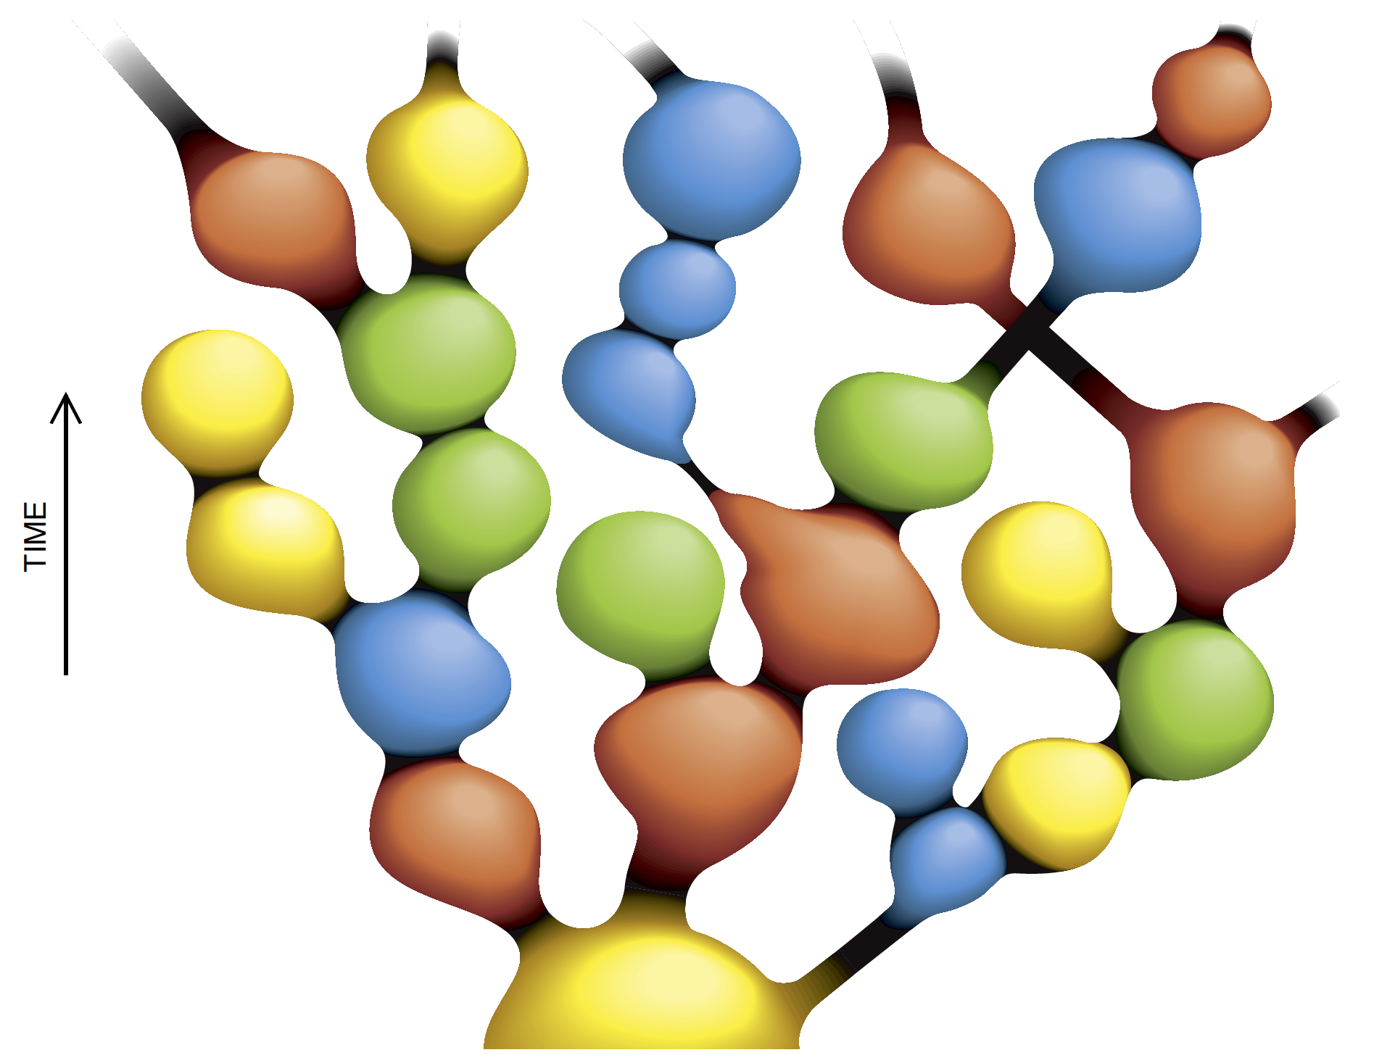
The big picture
Linde (1988)

Slide 22
Conclusions
Vacuum bubbles may nucleate during inflation, leading to the formation of black holes with a wide spectrum of masses.
These black holes have inflating universes inside.
A discovery of black holes with the predicted distribution of masses
would provide evidence for inflation – and for nontrivial spacetime structure of the universe.
These BH might act as seeds for supermassive BH and might have formed the binaries observed by LIGO.
Early formation of quasars; spiky spectral distortion.

Slide 24
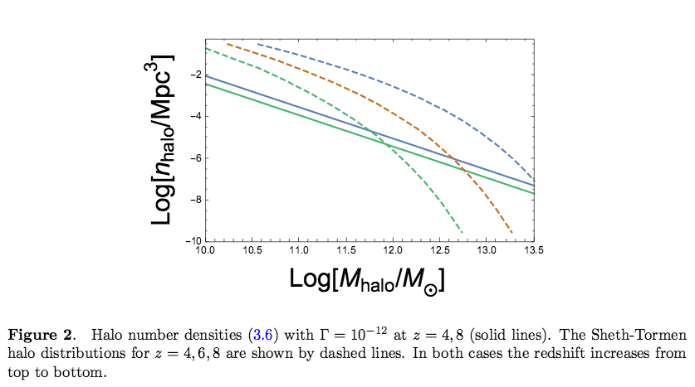
Early formation of galaxies and quasars
Deng, A.V. & Yamada (2018)

Slide 25
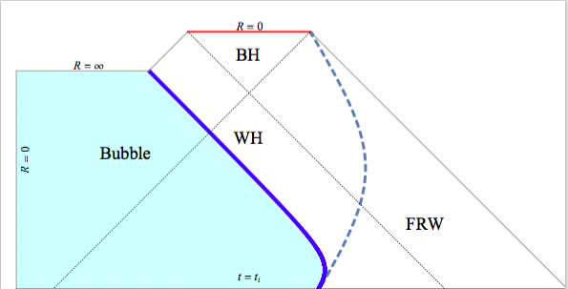
Penrose diagram
Shock
Light propagates
at 45º.
Future
infinity

Slide 26
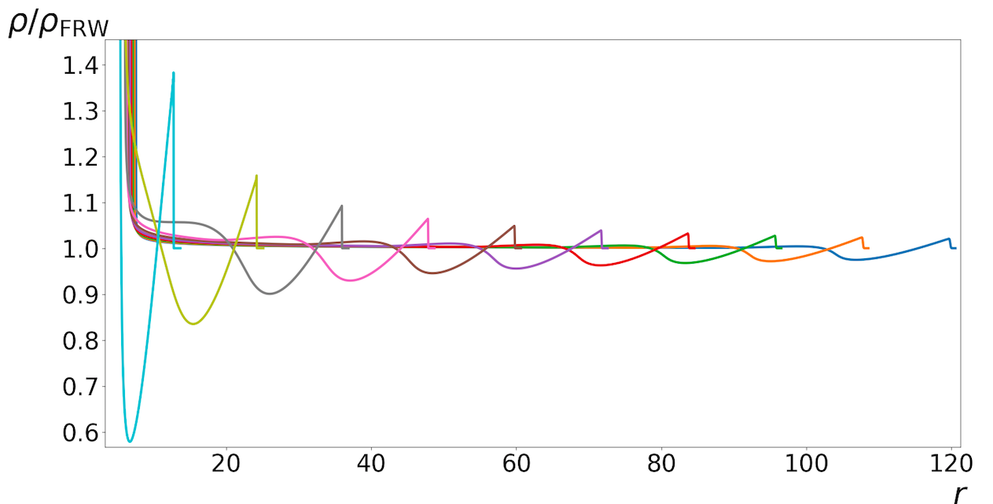
Shock propagation
At later times the BH is surrounded by a thin overdense shell, followed by a thicker underdense shell, propagating in a nearly uniform radiation.
The overall mass deficit in the shells is .
Notes:
The layer next to the bubble is evacuated by the impact. E+ ~ -E- ~ M.

