Slide 1
Physics Beyond Colliders
CERN 14/06/2018
  Future QCD Facility at SPS (CERN)
  LoI status and news
Oleg Denisov for Future QCD Facility LoI group

Slide 2
Outline
LoI status
Input provided to PBC QCD conveners
New entries:
  Neutral pion life time
  Vector meson production in nuclear matter
Proton radius – first results of 2018 beam test
Mini Workshop
Timelines

Slide 3
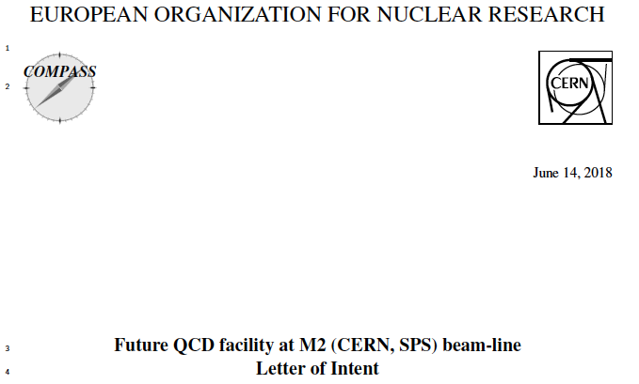
New CERN SPS based QCD facility
Letter of Intent
First step: Internal circulation to the COMPASS Collaboration
of March 20th 2018

Slide 4
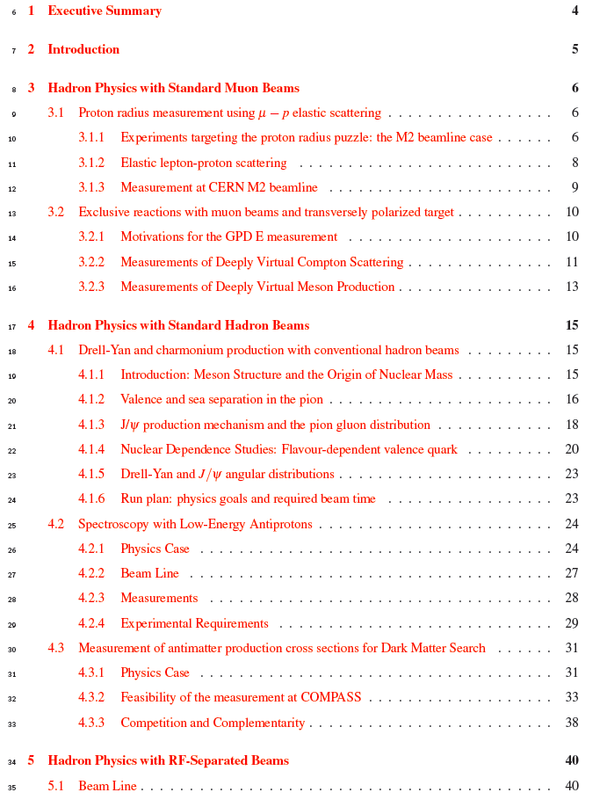
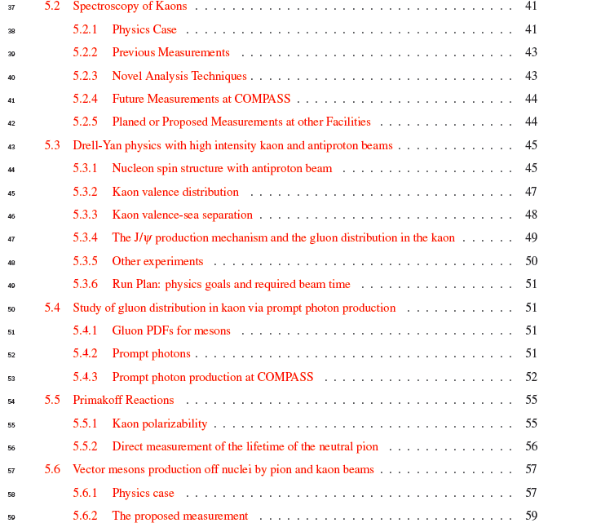
LoI content: Physics
The content of the LoI has been reported at
several PBC meetings in 2016 and 2017.
10 projects for the moment, at first stage we are going to use available hadron/muon beam, at the second – RF separated kaon and antiproton beam.
All beams we are going to use are unique
worldwide

Slide 5
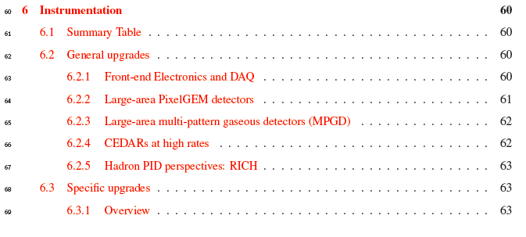
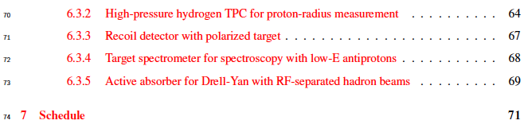
LoI content: Instrumentation
It is difficult to give exact cost estimate right now: it stays in the range 10-20 MCHF

Slide 6
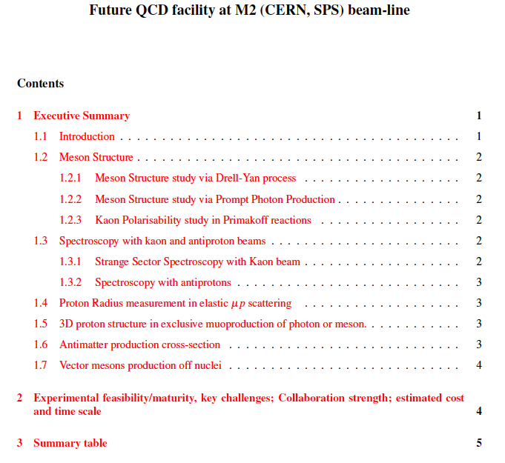
Summary for PBC QCD conveners

Slide 7
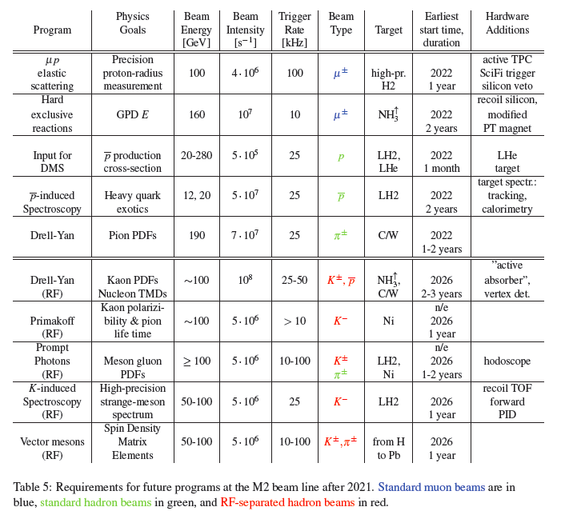
Summary table – beam requirements

Slide 8
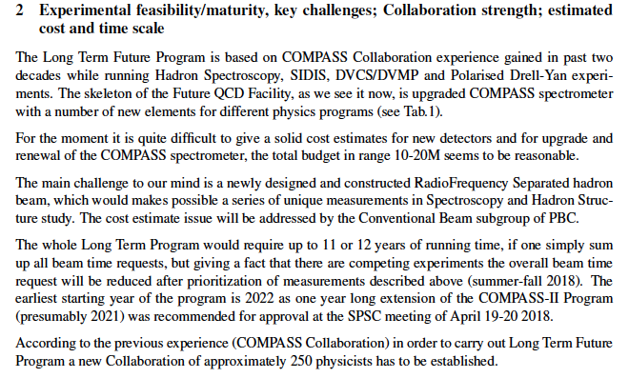
Summary for PBC QCD conveners

Slide 9
LoI – new entries
The content of the LoI has been reported at PBC meetings in 2016 and 2017.
LoI is open for new ideas and collaborators so it is changing every time..
Two new entries over the past ~2 month:
Neutral pion life time measurement
Vector meson production in nuclear matter

Slide 10
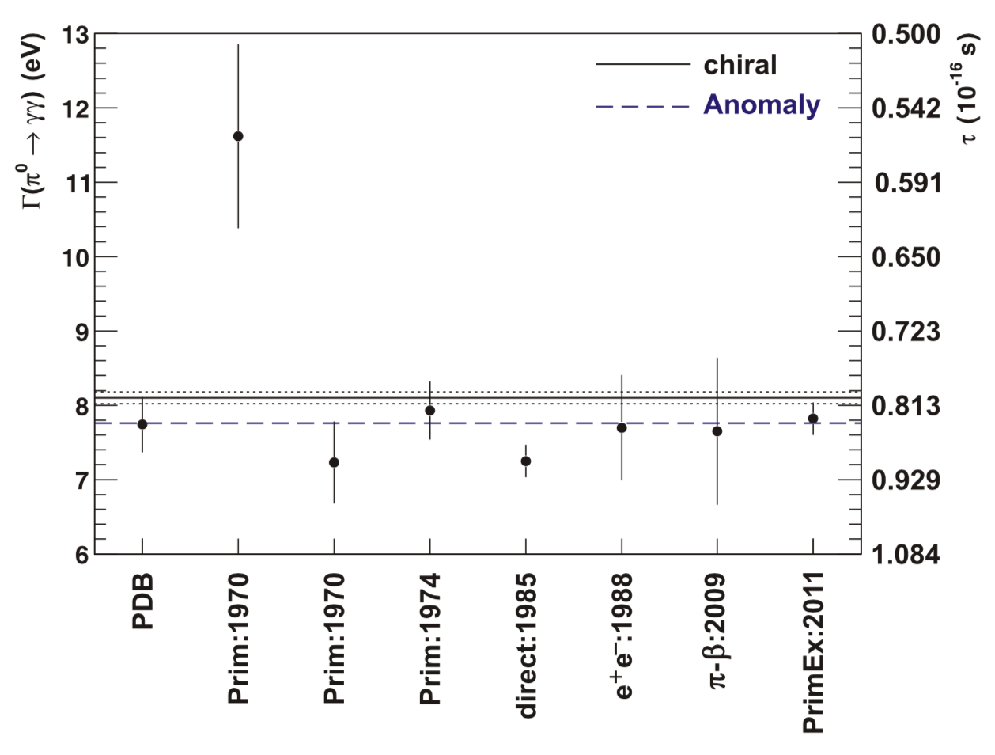
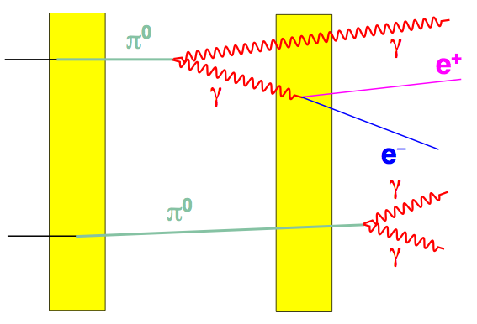
LoI – neutral pion life time
D
We measure the conversion rate as a function of separation D
1 year of data taking with ≥100 GeV/c pion or kaon beam in parasitic mode
with other programs (prompt photons, kaon spectroscopy, kaon polarizability…)
→ statistical accuracy <1%
Special requirement: the target consisting of two ~30 μm foils with variable
separation (0-200 μm, accuracy < 1 μm)
Special requirement: the target consisting of two ~30 μm foils with variable separation (0-200 μm, accuracy < 1 μm)
Special requirement: the target consisting of two ~30 μm foils with variable separation (0-200 μm, accuracy < 1 μm)
Special requirement: the target consisting of two ~30 μm foils with variable separation (0-200 μm, accuracy < 1 μm)

Slide 11
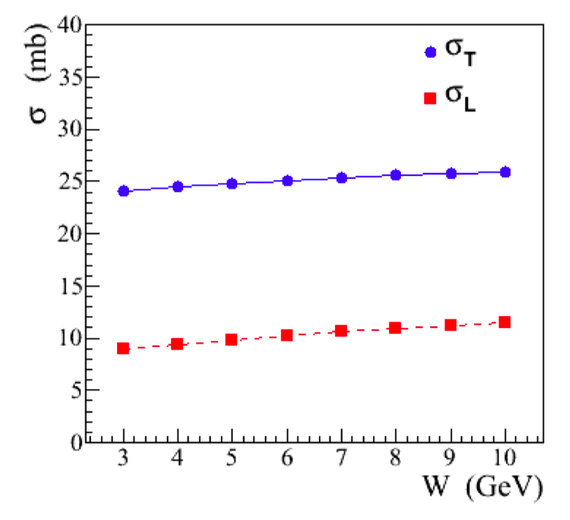
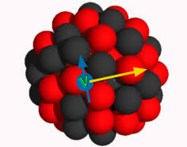
LoI – vector meson production in nuclear matter
Models predict different V-N interaction cross sections for longitudinally and
transversely polarized vector mesons.
rho-meson
Exclusive charge exchange reactions
(Longitudinal polarization dominates!):
K⁻ A → K*⁰(892) A’
π⁻ A → ρ⁰(770) A’
π⁻ A → f2⁰(1270) A’
…
Pion and kaon beam, different nuclear targets, parasitic mode
We propose to measure the cross section of longitudinally
polarised vector mesons interaction with nucleons, σL, and
spin density matrix elements for the produced vector
mesons.
We propose to measure the cross section of longitudinally polarised vector mesons interaction with nucleons, σL, and spin density matrix elements for the produced vector mesons.
We propose to measure the cross section of longitudinally polarised vector mesons interaction with nucleons, σL, and spin density matrix elements for the produced vector mesons.

Slide 12
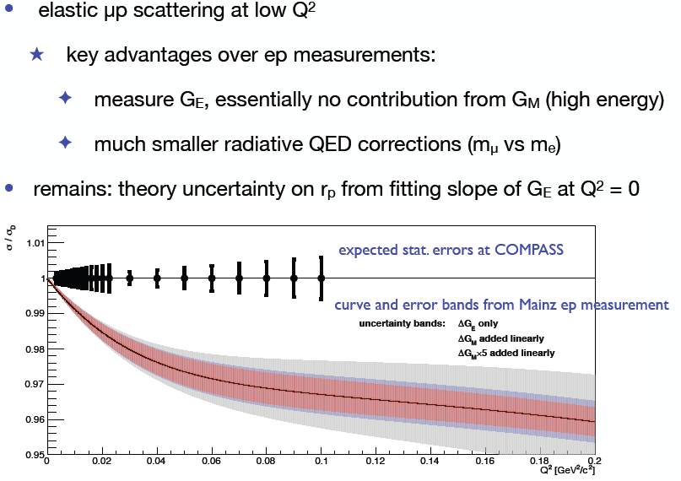
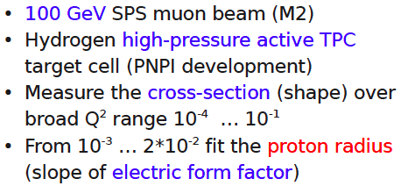
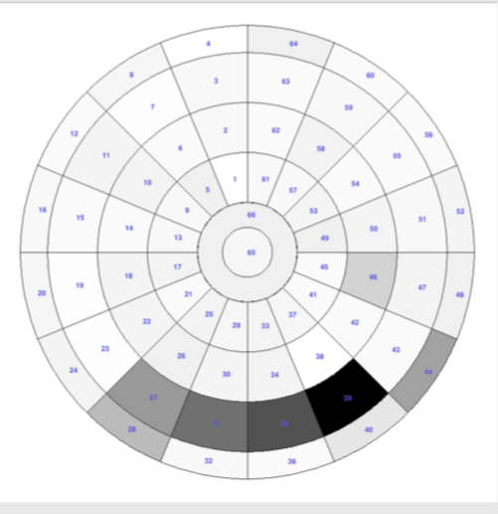
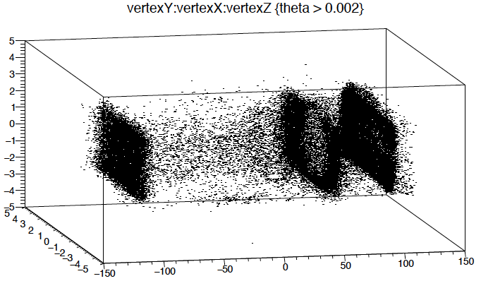
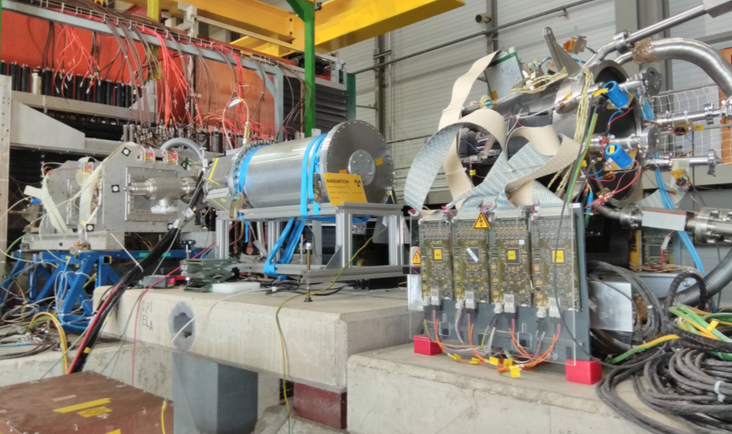
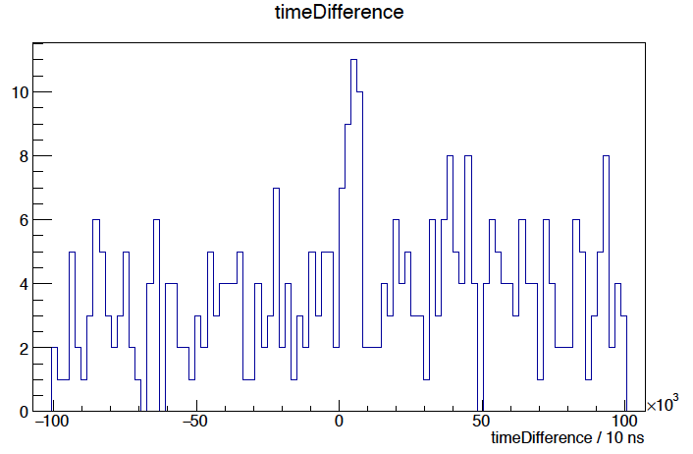
Beam test for Proton Radius measurement

Slide 13
Loi & Proposal timelines
End of June: LoI available world wide, start of the promotion campaign. The
goal it two fold:
  to wind new collaborators
  to establish the priority list of all possible experiments
September 2018: LoI submission to SPSC
In parallel start of the Proposal preparation
End of 2019: Proposal submission to the SPSC in the end of 2019
IMPORTANT:
LoI presentation at Mini Workshop (Wednesday June 20th)

Slide 14
Mini Workshop
CERN-Prevessin, Bat 774/R013, 2pm-7pm https://indico.cern.ch/event/737176/
=== SESSION 1 = start at 14:00 ===
15’ Proton Radius Speaker:
15’ GPDs Speaker:
15’ Antimatter production Speaker:
15’ Spectroscopy with antiprotons Speaker:
15’ Drell-Yan Speaker:
45’ Round Table Convention beam
COFFEE 30’ (16:00)
=== SESSION 2 = start at 16:30 ===
15’ RF-separated beams Speaker:
15’ Drell-Yan + PP kaons /antiprotons Speaker:
15’ Primakoff + pion life time Speaker:
15’ Spectroscopy with kaons Speaker:
15’ Instrumentation Speaker:
45' Round table RF-separated beam

Slide 15

SUMMARY
Existing SPS extracted hadron/lepton beams are unique world-wide
LoI preparation proceeding well, next step is to make it available to outside world
Prioretized list of project (measurements) will be ready in September 2018
Mini-Workshop next week is a first step to establish new collaboration

Slide 16
Thank you!

