Slide 1


Conventional Beams
PBC General Meeting, CERN
L.Gatignon on behalf of the CBWG
13 June 2018

Slide 2
List of experiments to be covered
What? | Activities, Status
NA62++ (beam dump) | Benchmarking ‘ok’, optimizing layout for dedicated runs
KLEVER | Targeting studies completed, optimizing neutral beam
T10 flux increase | Ongoing discussions with RP, EN-STI, EN-CV
NA60++ | First ideas worked out
DIRAC++ | First ideas worked out
MuonE | Several tests in H8 and M2 under way. Working on options for final locations.
NA64-mu | Improved understanding of requirements. Tests underway. Two options for full experiment
COMPASS | SPSC recommendation for 2021.
RF separated beam | Studies just launched. First discussion with RF.
NA61 | High intensity tests, machine protection issues progressing. First design of VLE beam.
REDTOP | First evaluation of possibilities made. Now on hold

Slide 3
Outline
Introduction
EHN1 projects
EHN2 projects
ECN3 projects
Others (e.g. REDTOP)
Outlook

Slide 4
EHN1: NA61, NA64-e
Both are continuations of ongoing experiments. NA61 uses primary Pb and secondary light ions as well as hadron beams. NA64 uses electrons and in the future also secondary hadron beams.
Both aim at highest possible intensities and optimum beam quality
For NA64-e, the present limit seems to be pile-up as well as time
needed for setting up the experiment each time.
For NA61 shielding measurements and studies are under way,
ideas exist for improvement.
Discussions on interlocks against beam movements are under study.
NA61 asks for the study of a low-energy hadron beam (≦ 9 GeV/c).
A first conceptual design exists, profiting from ~50 m available in the shielded zone upstream of the NA61 target. Easy transition between ‘normal’ and VLE beam modes (just a vacuum pipe).

Slide 5
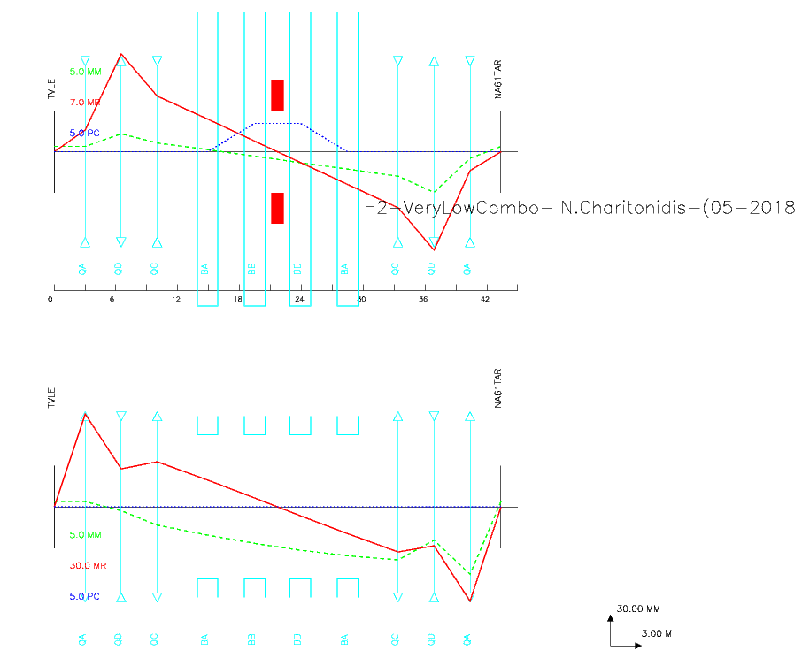
Large Acceptance Low-Energy beam in H2/NA61
(Preliminary)
175 mm*mrad % in the horizontal
750 mm*mrad % in the vertical
Only 4 power supplies needed for the whole line
QPLs available – MBPLs missing
120 mrad / MBPL angle
40 m total length
Space available in PPE132/142
Zone very shielded anyway
High intensities possible
N.Charitonidis

Slide 6
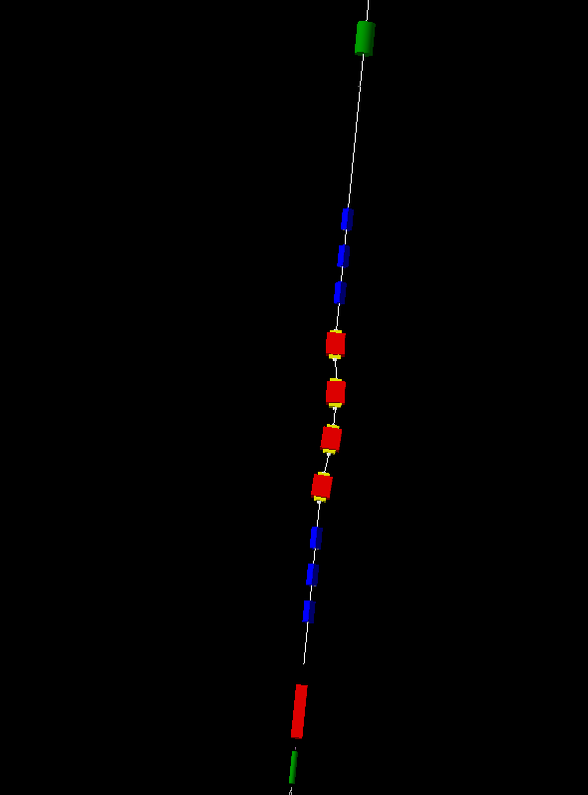
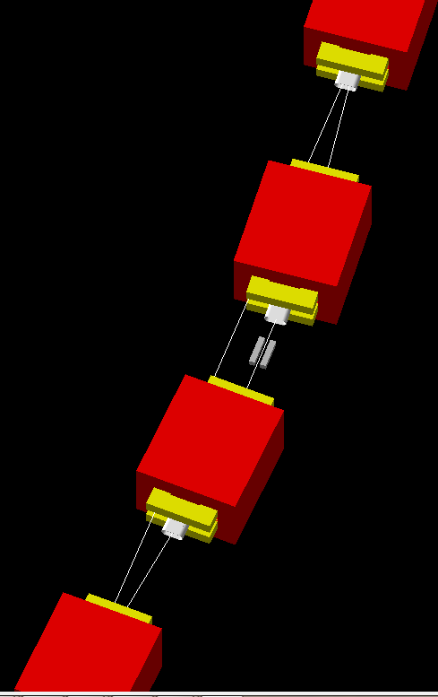
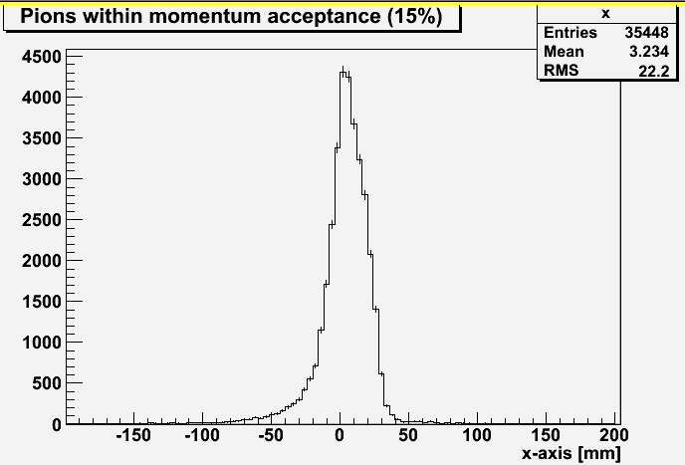
H2-VLE for NA61 preliminary simulations
QNL022444
Pions @ the end of the VLE beam line @ 9 GeV/c
-10⁷ p.o.t
New branch
MBNH022309
Spot-size, target, background etc ….need to be optimized but results look very promising !

Slide 7
EHN2: COMPASS, NA64-μ, MuonE
Test locations have been defined and implemented for pre-LS2 tests, with first results available from and for the experiments.
Studies are ongoing for final implementations of the three experiments.
The feasibility for standalone running of each of them should not be problematic, but compatibility with the presence of the COMPASS detector requires detailed studies, which are under way.
Simultaneous operation of two or more of the experiments would be ideal, but more difficult. Studies continuing.
For NA64 and MuonE two options are being evaluated:
  Upstream: NA64µ Phase 1 / MuonE 30-35 m set-up
  Downstream: Compact NA64µ Phase 2 inside the SM2 magnet (synergy with COMPASS) and MuonE 15 m behind Compass or 35 m with EHN2 extension (given that the beam is not focussed upstream)
Studies for a RF separated anti-proton or K± beam have started

Slide 8
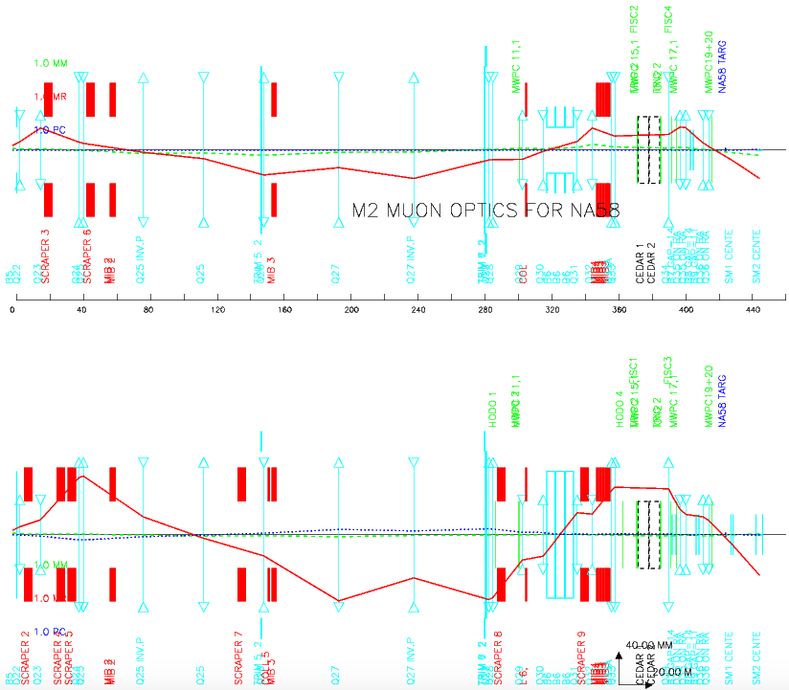
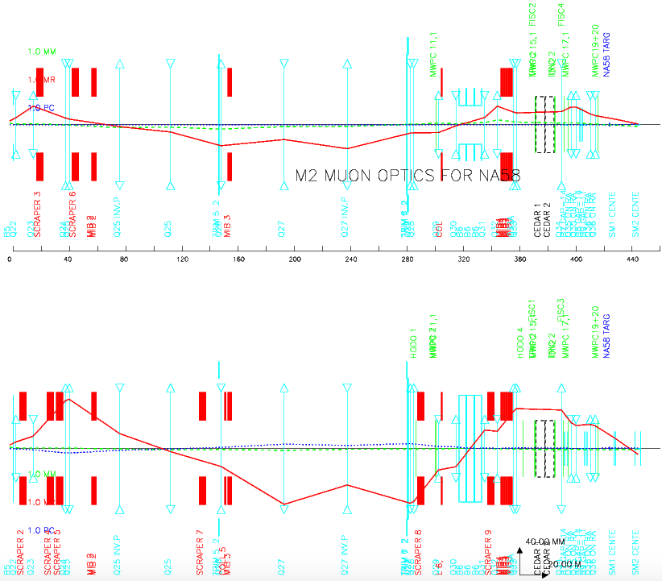
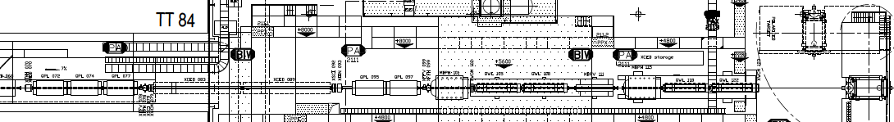
EHN2: Upstream options
Studies for MuonE / NA64µ Phase 1 in combination with COMPASS proton radius or MuonE with NA64µ Phase 2 running inside SM2.
Removed beam line elements mainly necessary for M2 hadron beams, now 30-35 m space available for parallel muon beam and focussed beams downstream.
Caveat: Material of experimental set-ups increases slightly beam spot and momentum spread downstream.
µp optics
NA64µ optics
30 m
Q34 Q35 Q36

Slide 9
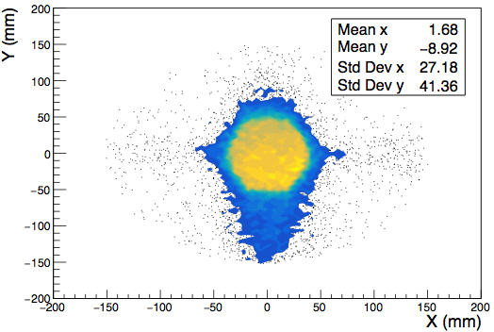
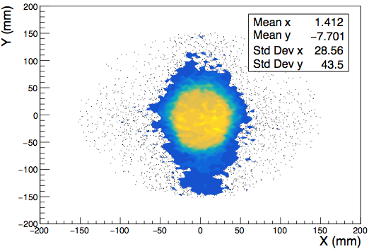
EHN2: Upstream options
σ_{x} = 20 mm
σ_{y} = 26 mm
σ_{x'} = 0.22 mrad
σ_{y'} = 0.18 mrad
σ_{p} = 5 GeV/c
σ_{x} = 22 mm
σ_{y} = 30 mm
30 m
Q34 Q35 Q36

Slide 10
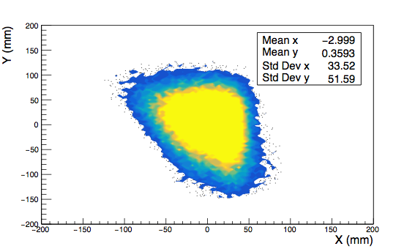
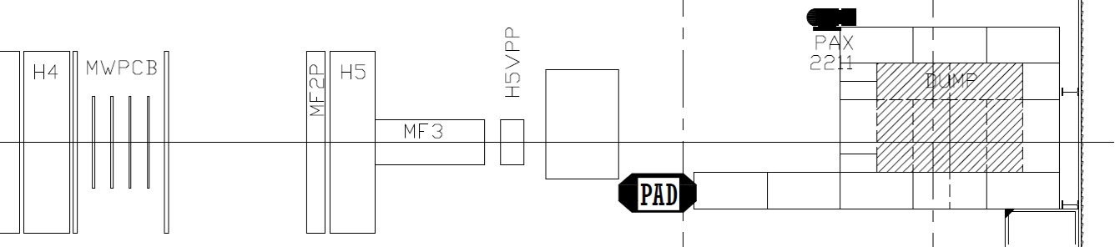
EHN2: Downstream options
NA64µ Phase 2 set-up would require spectrometer at COMPASS target location, re-use of existing “chicane” possible with additional dipole, otherwise no show-stoppers identified.
Studies for full-scale downstream MuonE location might impose expensive building extension or partial removal of COMPASS detectors
Removal of beam dump necessary, will most probably restrict to µ beams only in EHN2 due to safety reasons (no e⁻ / hadron option)
Caveat: Dispersion for one experiment and only possible if no focus upstream due to beam divergence requirements
2021: 7.5 m
2022+: 14.9 m + X

Slide 11
ECN3: NA62, KLEVER, DIRAC, NA60
The impact and mitigation measures for higher fluxes to the T10 location are under study with the help of RP and equipment groups
NA62 is expected to continue its K⁺ → π⁺νν program for several years,
in alternation with occasional short (~8-24 hours) dedicated runs in dump mode for HNL and axion searches. A one-year run for dedicated and optimised beam dump running is under discussion. Optimisation of both configurations is under detailed study.
For KLEVER a potentially dangerous background from Λ → π^{ο}n has been identified and a solution for its mitigation proposed. Now the neutral beam line itself is being simulated and optimised in terms of collimation and gamma rejection.
A possible implementation for DIRAC⁺⁺ and NA60⁺⁺ in place of (or after) NA62 (or KLEVER) is proposed.

Slide 12
Main issues for ECN3
The presence of a second beam in ECN3 is incompatible with NA62 or KLEVER, as both experiments are wide and cover the full length of TCC8 plus ECN3.
In case neither NA62 nor KLEVER is installed, a cohabitation of H10 (old beam for NA60) and K12 becomes possible again, e.g. NA60⁺⁺ in place of the old NA60 experiment with the old beam and DIRAC⁺⁺ in a new charged beam similar to the old H10 beam (but new design).
The proposal would be to put the K12 experiment somewhat upstream of the one in H10 (to gain lateral space) and to bend the new K12 beam away from the Salève wall to exploit the available space more symmetrically.
Especially the DIRAC⁺⁺ intensity limit has not been studied yet, As the DIRAC target is very thin, it is possible to make a proper re-entrant dump
as was done in the East Area (still used for CHARM).

Slide 13
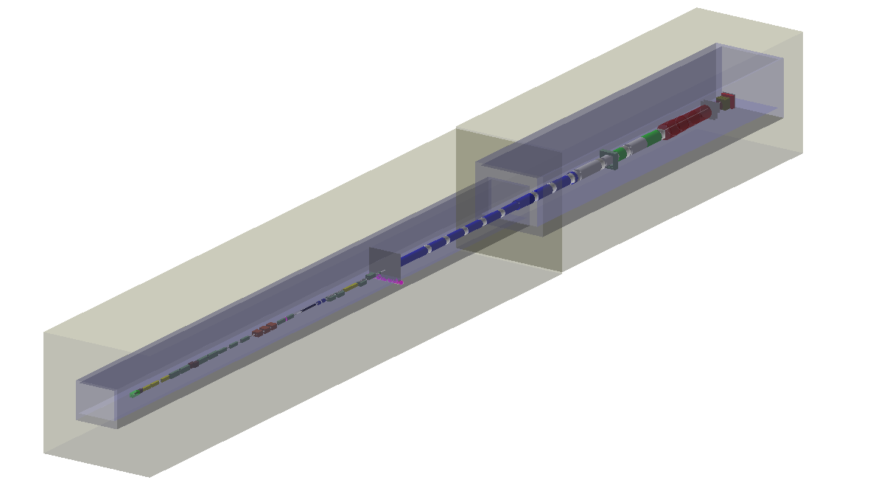
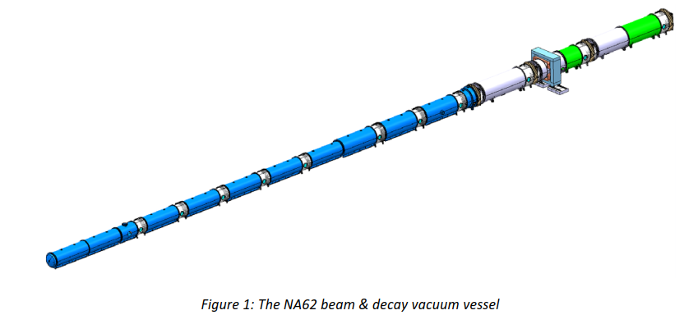
NA62 beam dump studies
G4Beamline model drastically extended to also include basic geometries of the NA62 experiment

Slide 14
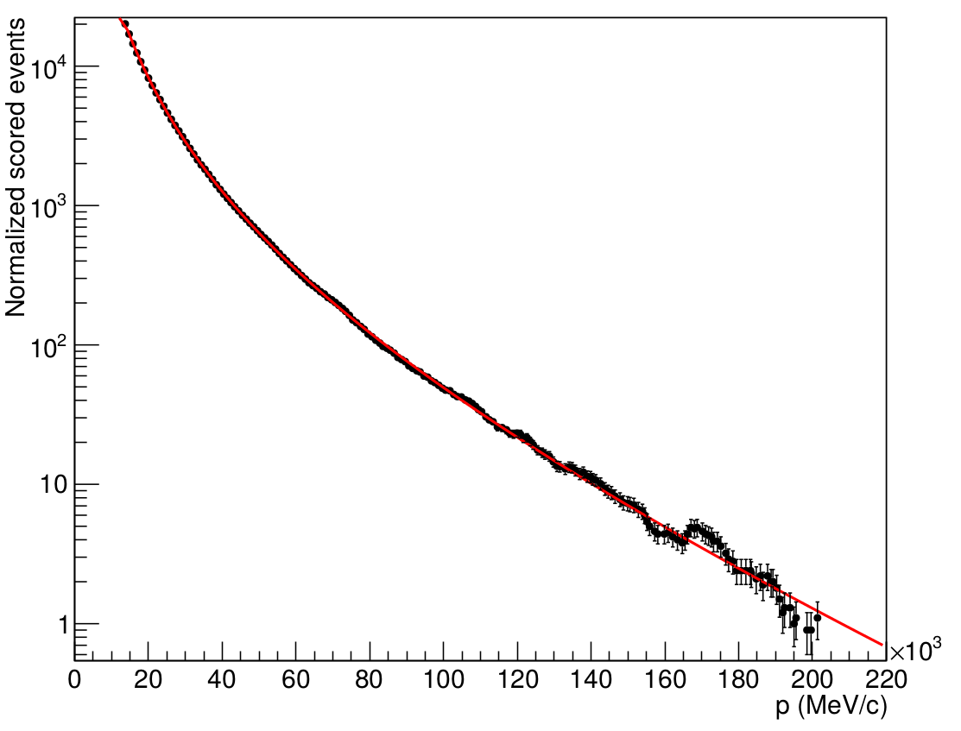
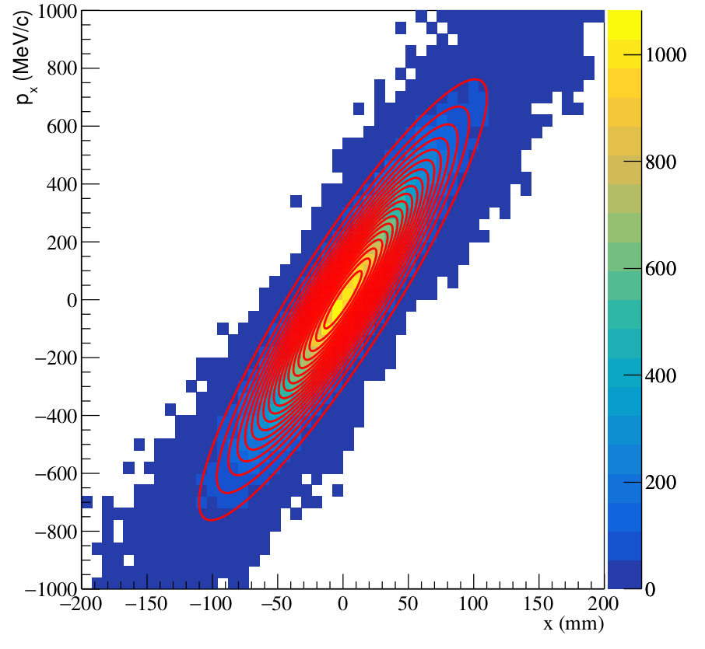
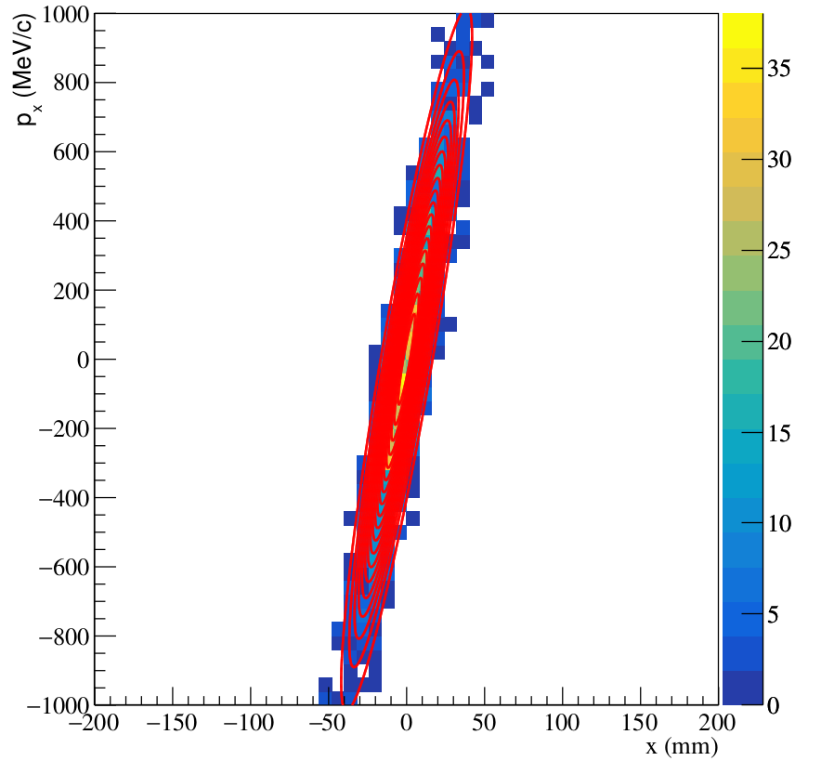


NA62 beam dump studies
M.Rosenthal
Production of muons with high momenta is suppressed
  Computationally very expensive to generate statistics
An analytical description for the scored muon distributions after the TAX has been developed and is used for extrapolation to high momenta
$p_{μ}$ ~20 GeV/c
$p_{μ}$ ~75 GeV/c

Slide 15
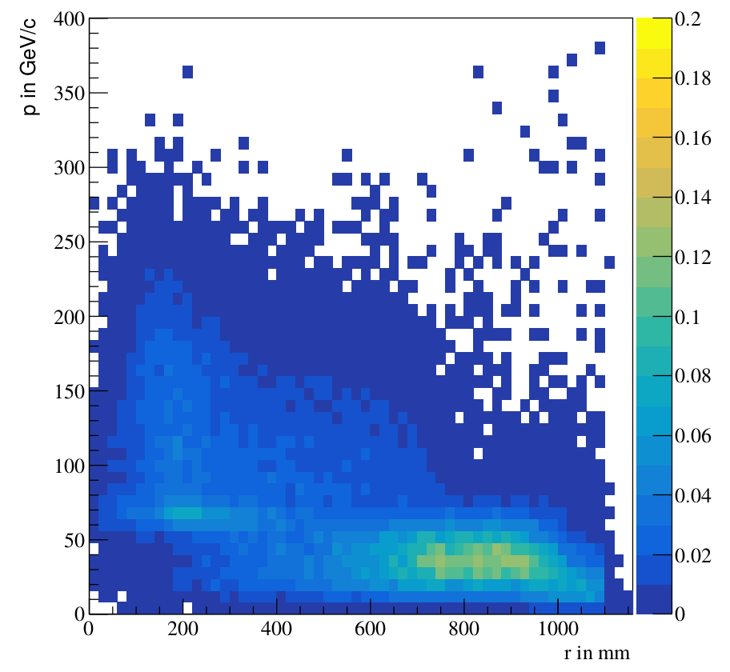
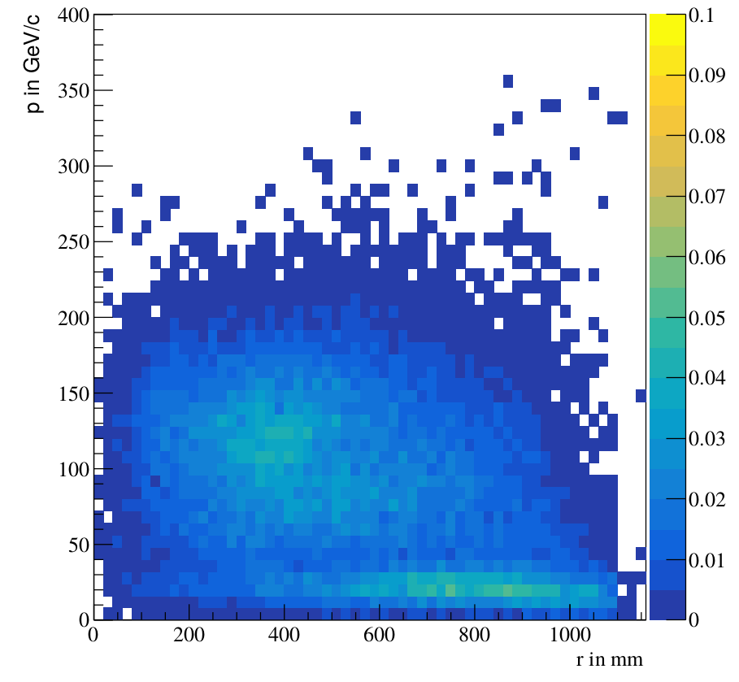
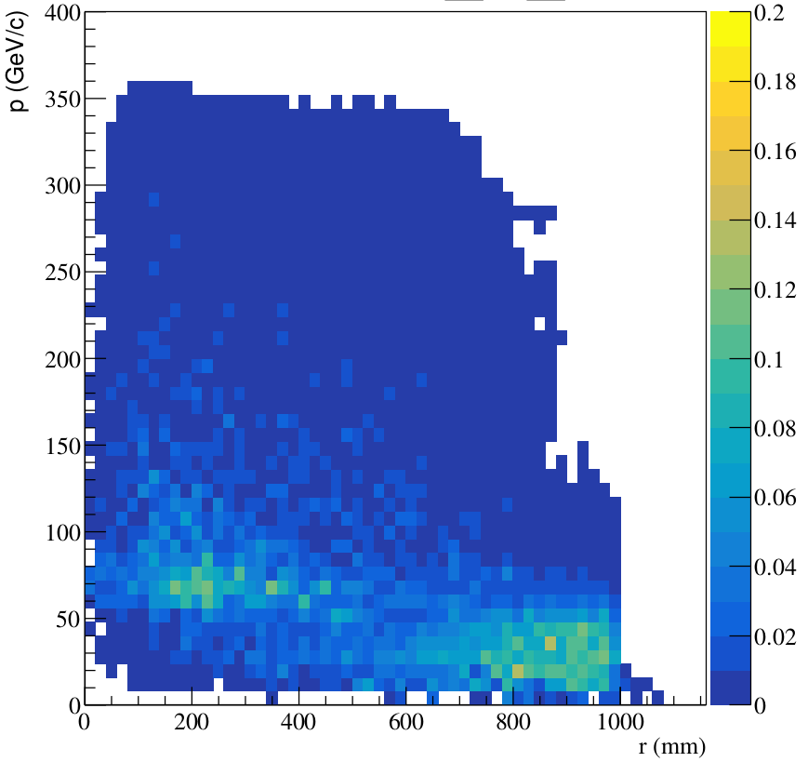
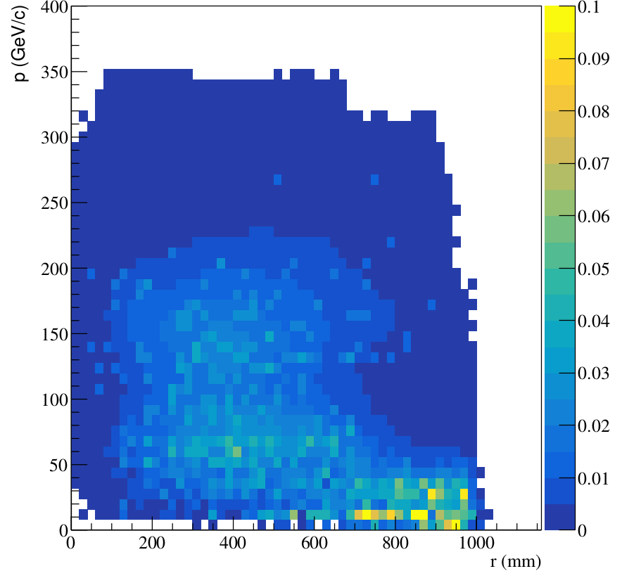


Benchmarking continued
Positive Tracks
Negative Tracks
Characteristic
muon distribution
reproduced
Rates at higher
momenta estimated
from extrapolation
Absolute scaling of
data and MC differs
by factor ~5
$→$ under investigation
(comp. expensive)
Data by NA62
a.u.
Model
Count / bin / ${10}^{9}$ POT

Slide 16
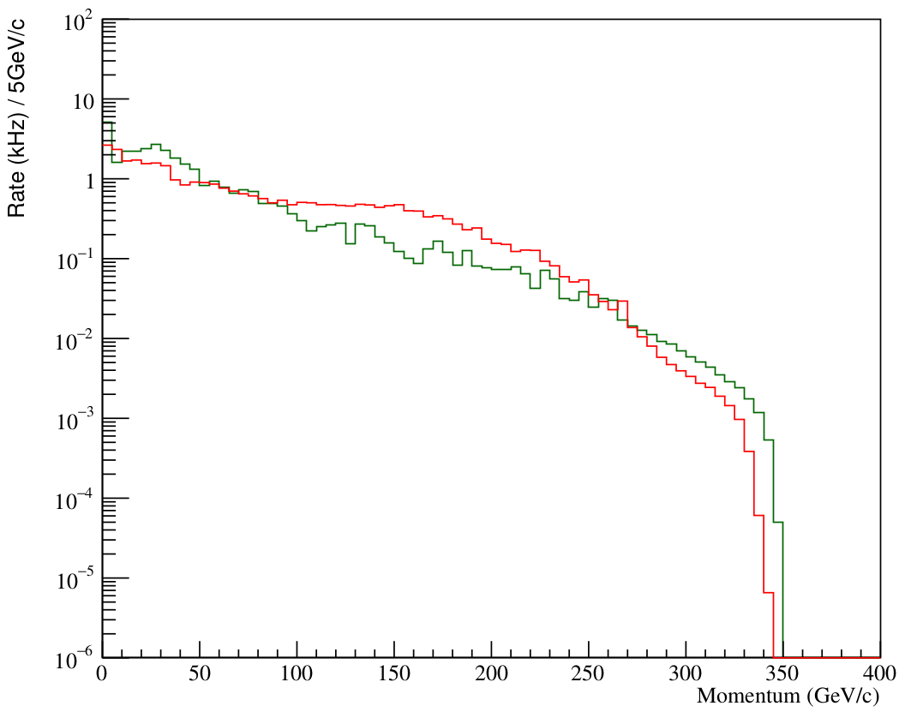
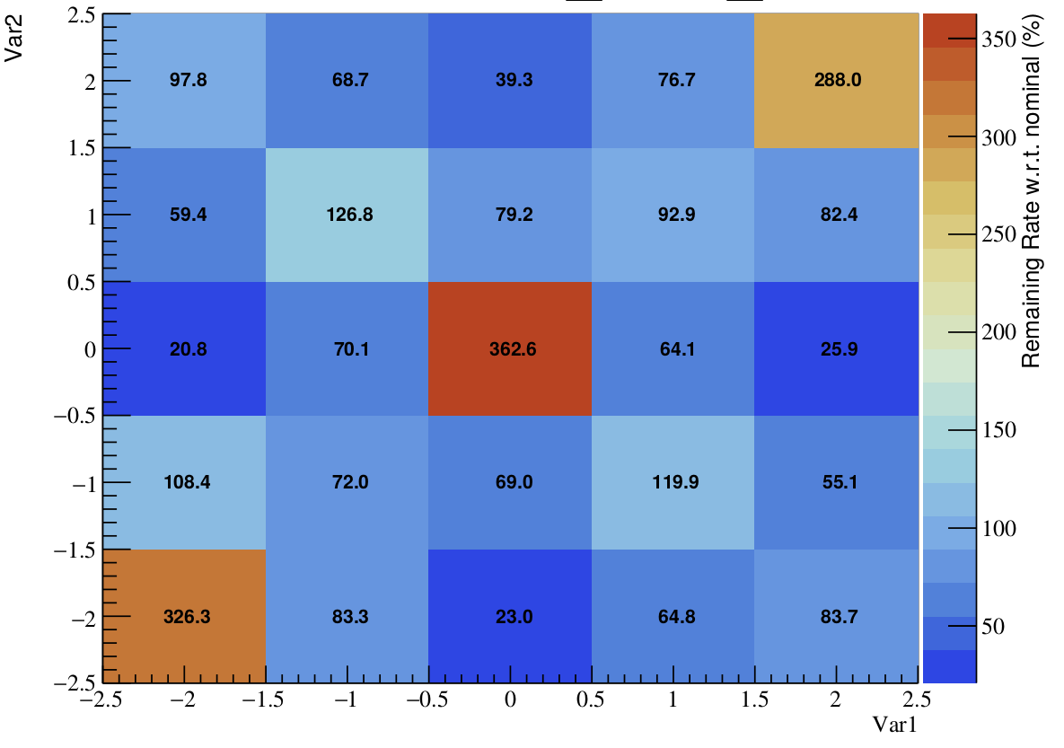
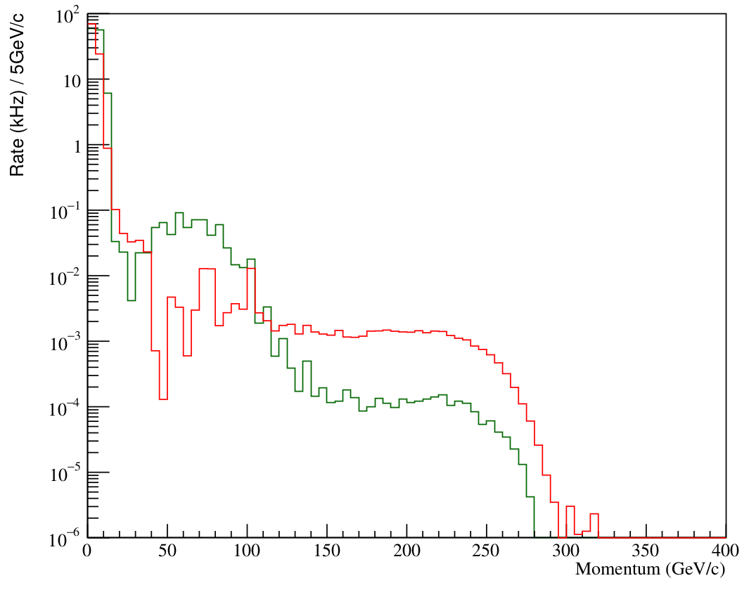


Optimization studies
Rate vs. $μ$-momentum
B1B = -2 T
B1C = 2 T
Two first bending magnets after TAX scanned:
  MUV3 rate reduced to 20% ( $p_{μ}$ < 350 GeV/c)
~ 100%
B1C (T)
Positive Muons
Negative Muons
~ 20%
B1B = -2 T
B1C = -2 T
Limited by
return fields
~ 320%
Nominal settings
B1B (T)

Slide 17
Fluka simulations on-going
M.Van Dijk
Targeting studies
Neutral beam studies
8 mrad production angle
Lower K_{L} flux and Λ/K_{L} ratio
Compensate with larger acceptance
Lower K_{L} and Λ momenta
More K_{L} decay in FV, more Λ before
Study K_{L}, Λ, n, γ fluxes
Optimise collimation
Reduce γ rate by converter
Optimise converter thickness
Later: Crystal converter
High-Z target material

Slide 18
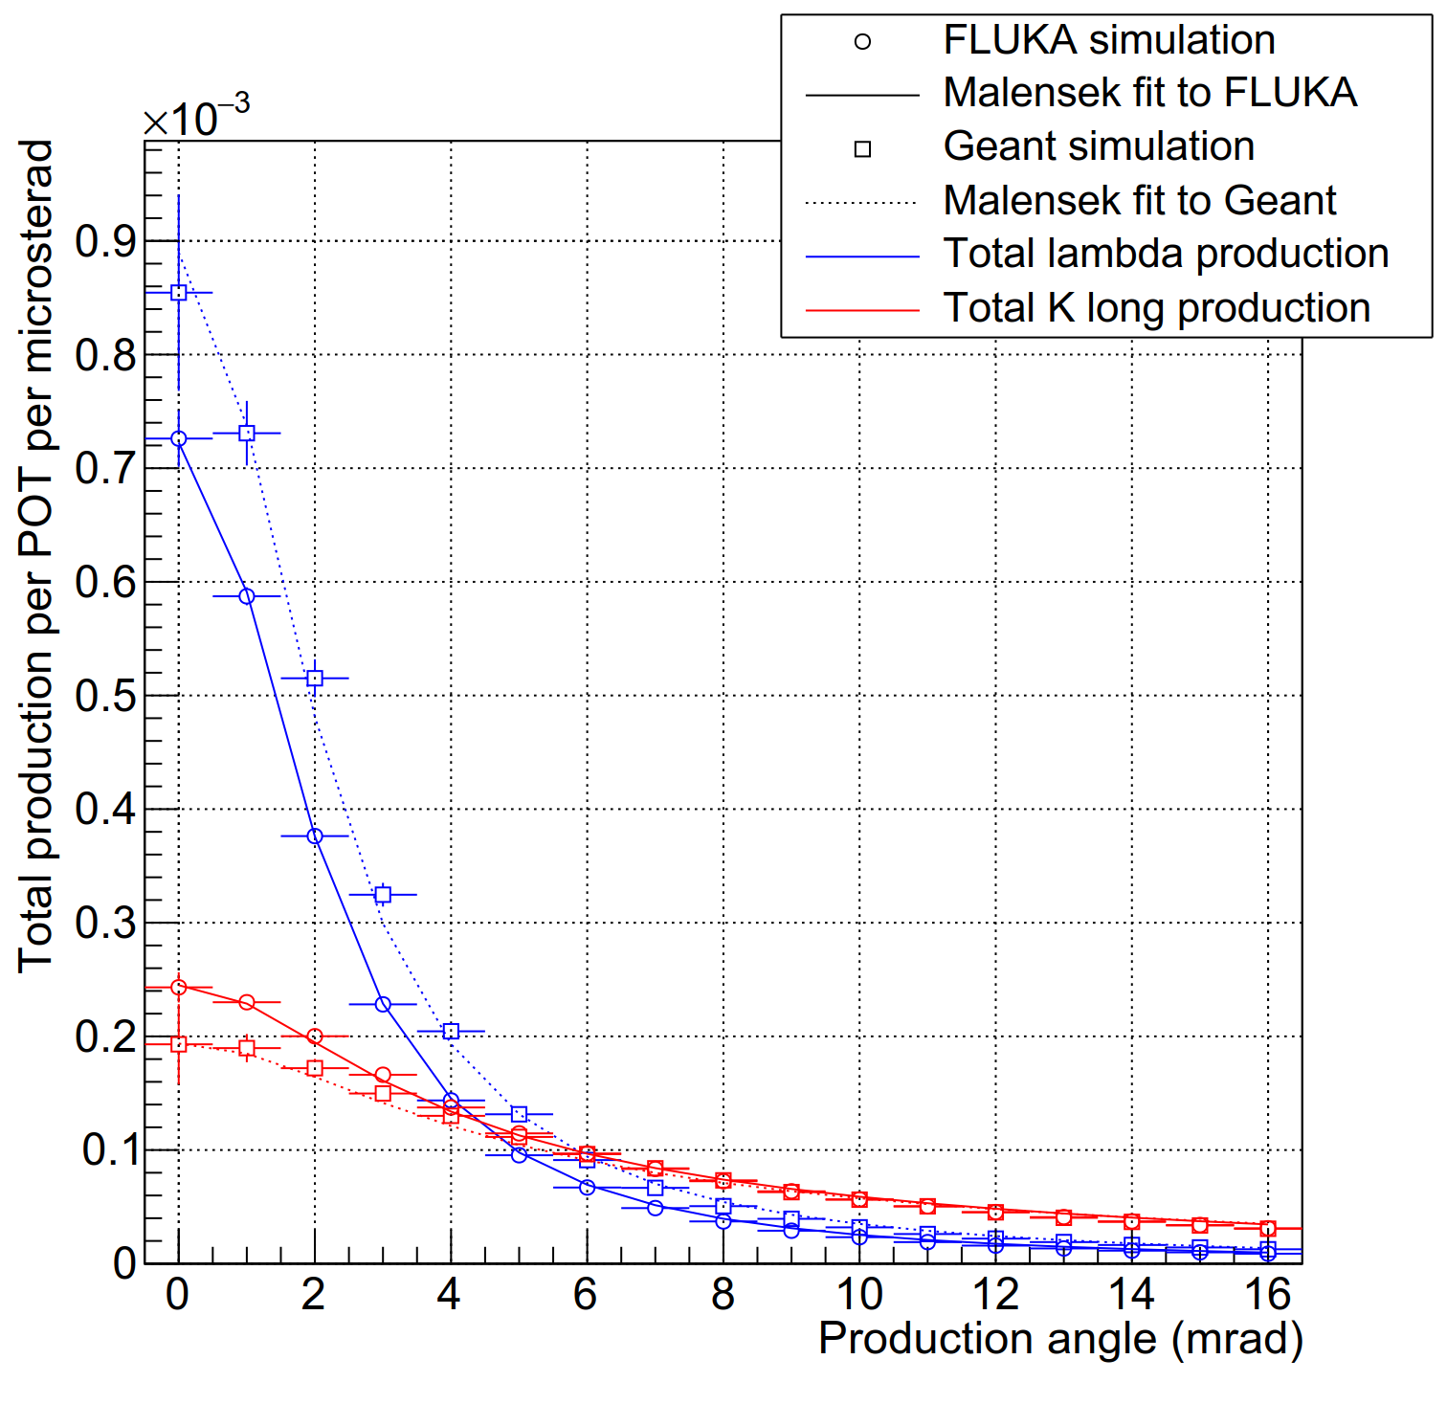
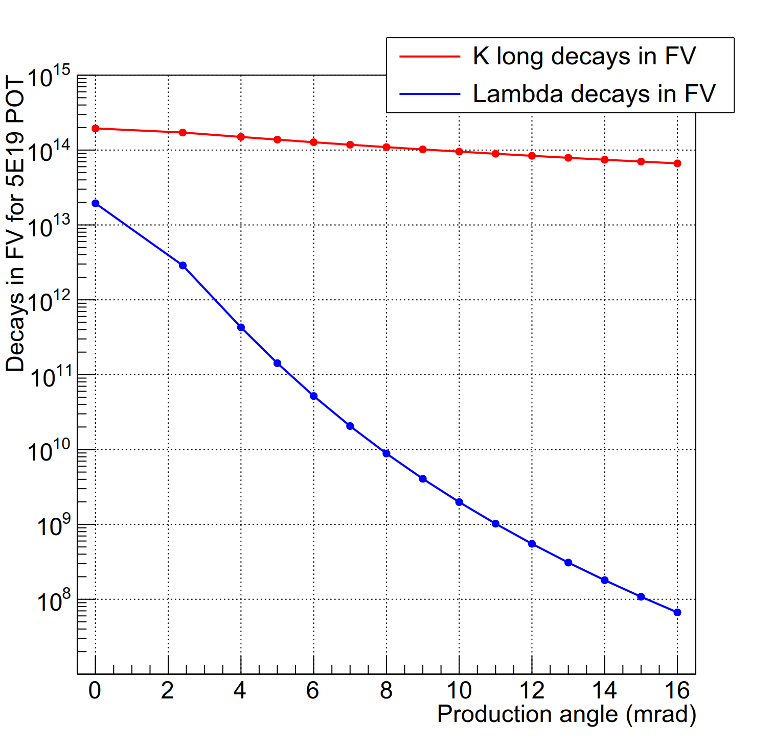
KLEVER – ongoing studies
Target studies complete
  ATS note draft has been completed and is currently under review
  The envisioned production angle has been changed from 2.4 to 8 mrad
Impact on signal to background
  The expected background from Λ⁰ decays is now highly suppressed
  Impact on K_{L} production compensated by opening acceptance from 0.3 to 0.4 mrad
  Number of K_{L} decays impacted but compensated by lifetime

Slide 19
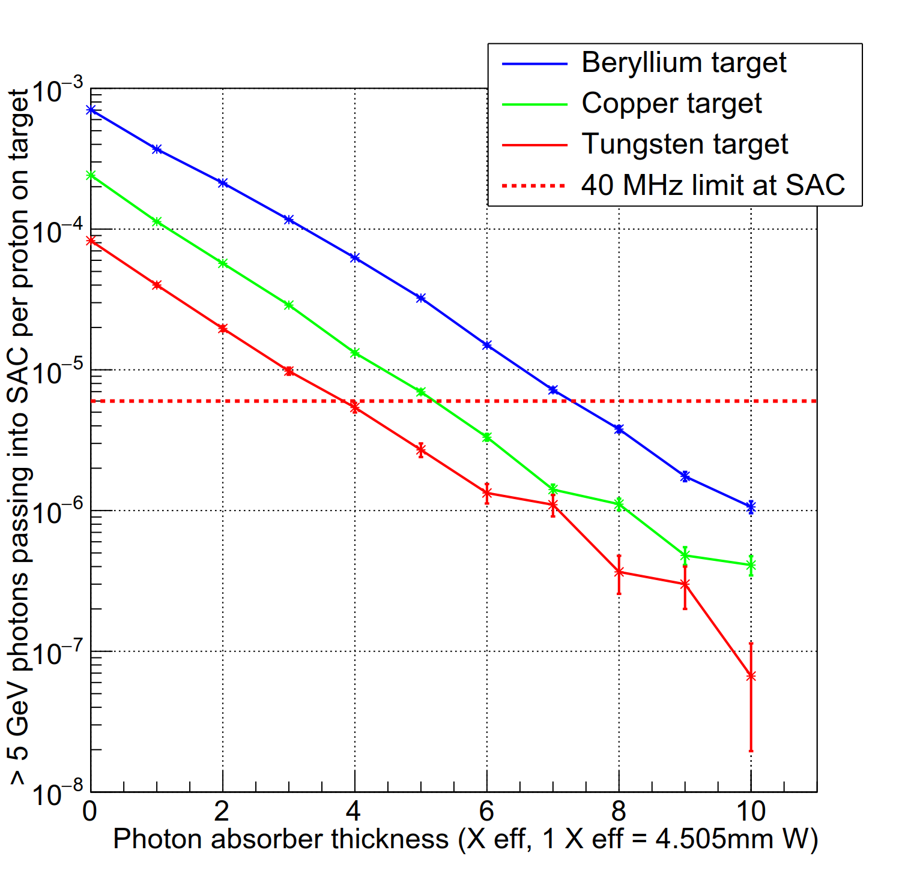
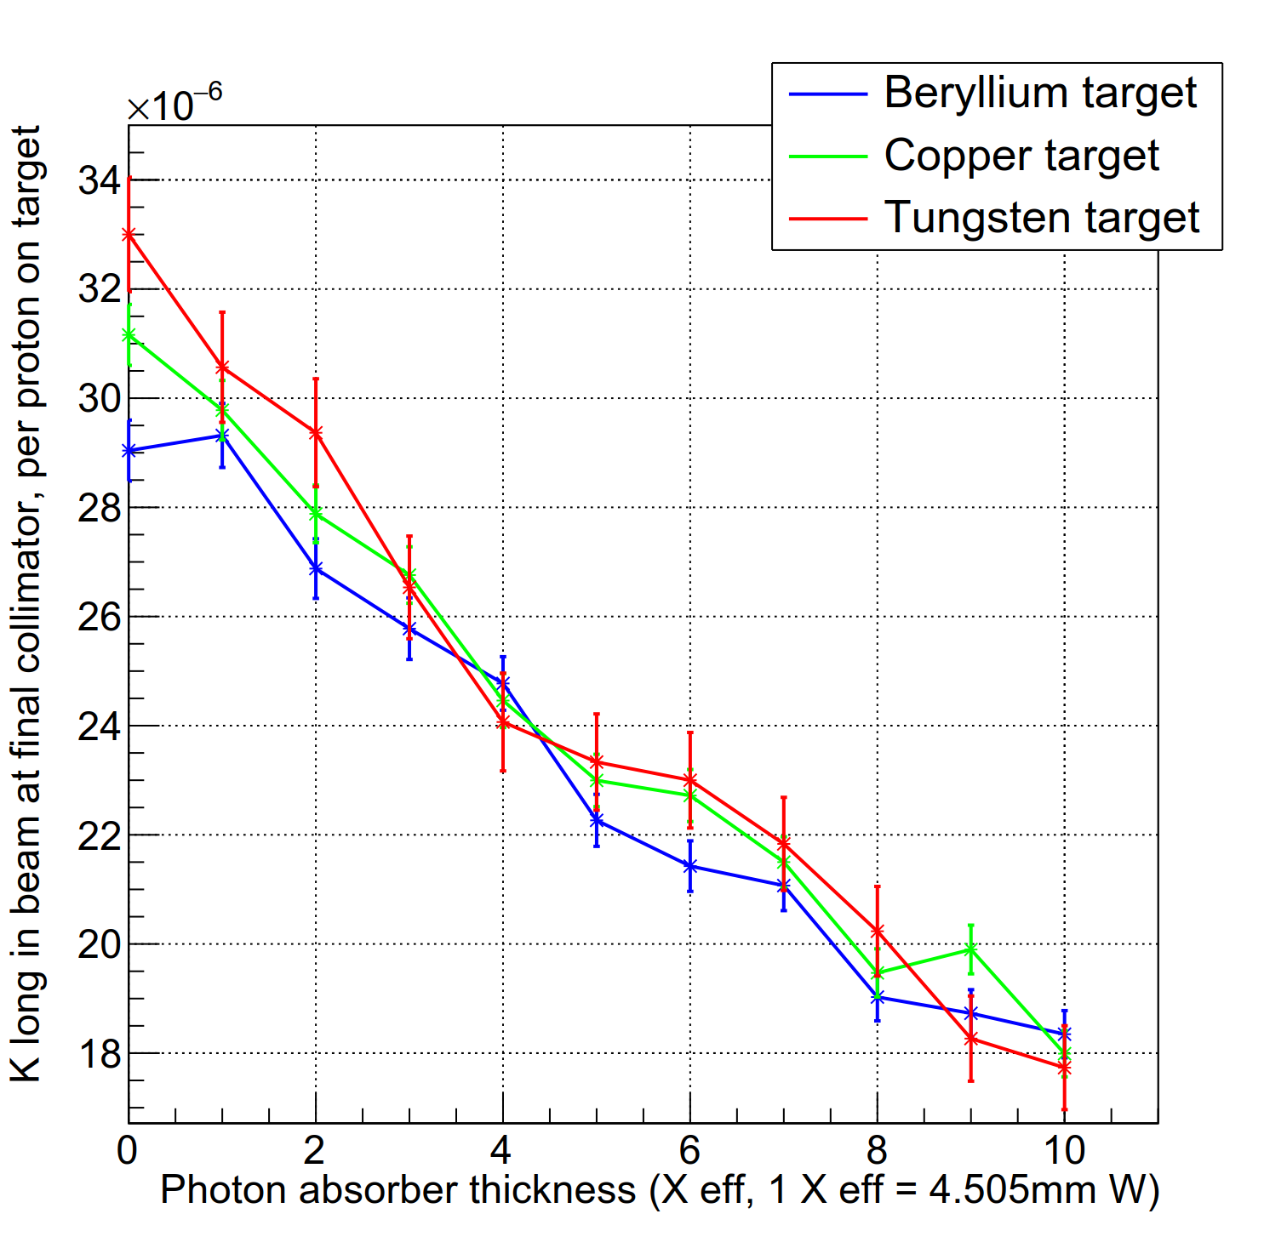
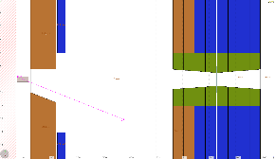
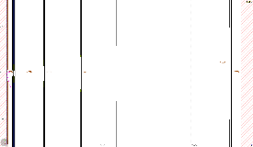
KLEVER – ongoing studies
The change in production angle is currently under study in the context of the full beamline
  Design by N. Doble featuring four collimators and photon absorber in TAX
  The photon absorber thickness has been assessed, aiming to get <40MHz of photons
  >5 GeV in the small angle calorimeter
  Different target materials allow for thinner photon absorber and transmit higher K_{L} flux
Target region in FLUKA
Beamline in FLUKA

Slide 20
NA60⁺⁺ and DIRAC⁺⁺ in ECN3
We only see possibilities in place of NA62 (resp. KLEVER)
For NA60⁺⁺ the old H10 beam for NA60 could be revived,
for DIRAC⁺⁺ a H10-like beam has been designed in place of the
K12 beam line.
NA60⁺⁺
DIRAC
TT85
TCC8
ECN3

Slide 21
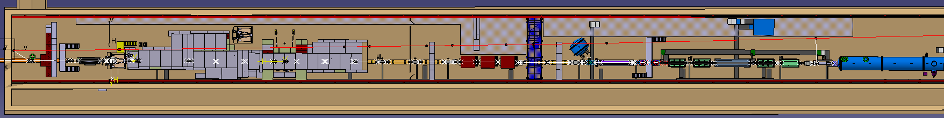
Incompatibilities with NA62
Presence of necessary front-end shielding
Lateral space for the experiment (< 6 m)
Space required for interventions on LAVs, RICH, etc
Higher intensities into ECN3 turn ECN3 into a controlled area with long
cooldowns and probable needs for ventilation upgrade (RP driven)
Proton sharing (mainly in case of DIRAC running)
etcetera
H10
K12

Slide 22
Intensity at T10
Estimates for air activation and leakage into the environment were based on very conservative assumptions. The main reason for discrepancy is smaller air flow and mixing than assumed. Recent air flow measurements indicate essentially zero flow. This is now being reassessed by RP and CV. Therefore ventilation and associated costs may be much less of an issue than expected so far (tbc).
However, the prompt dose above ECN3 is already close to the limit, hence putting constraints on the maximum flux at T10 in the present configuration. Not much space is available for improving the front-end shielding and the usefulness would need to be evaluated.
Equipment protections studies are being kicked off.
For KLEVER the 8 mrad production angle will probably help significantly against prompt dose. This is one of the topics yet to be studied and hopefully confirmed.
Proton delivery may be possible (tbc), but only for a not too long flat top.

Slide 23
of air flow

Slide 24
REDTOP
REDTOP is an experiment for very rare eta decays, originally proposed for FERMILAB. Discussions with several machine experts have taken place concerning implementation at CERN. They request 10¹⁸ pot per year and hence a duty cycle of 80% or more..
In LEIR the beam energy is too low and many machine aspects would need serious studies and investment. In particular LEIR is not a shielded machine
The upgraded PSB energy after LS2 would match perfectly, but here the implementation would also be difficult and penalising for the other users.
At the PS slow extraction into a heavily shielded facility (like the IRRAD+CHARM bunker in the East Hall) has been looked at. No showstopper has been identified. Again many studies would be required and the impact on the rest of the PS physics program would be very significant. Reduced flux requirements could ease the situation.
For the moment this study is put on hold and any further study should be in a more machine oriented working group.

Slide 25
Outlook
A lot of effort has gone into the development of the tools needed for these studies and their benchmarking. These tools will remain vital for future studies for the future fixed target program.
Conceptual designs exist in most cases and some are more worked out in detail than others,
Work is now continuing in view of the final report for PBC, due later this year.
It is also clear that the required amount of work cannot all be completed by the deadline and that some of the studies require several years of continued effort.
A detailed structure of the proposed document has been prepared and the writing of the chapters has started.
In addition several notes have been published as ATS notes or will be published soon. E.g. the targeting studies for KLEVER.

Slide 26
The Conventional Beams Working Group members are:
Dipanwita Banerjee, Johannes Bernhard, Markus Brugger,
Nikos Charitonidis, Maarten van Dijk, Lau Gatignon,
Alexander Gerbershagen, Eva Montbarbon, Bastien Rae,
Marcel Rosenthal,
Thanks to Reyes Alemany, Brennan Goddard, Bettina Mikulec, Denis Cotte and Klaus Hanke for their valuable input concerning REDTOP.

Slide 28
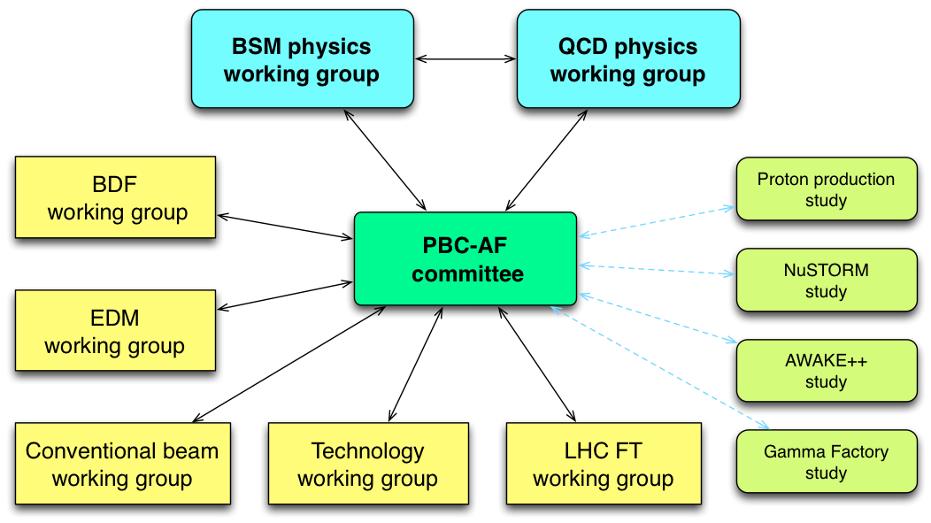
Introduction
During the kickoff workshop a large number of fixed target proposals were presented. It is thought important to perform pre-proposal studies in order to allow the working groups to make progress with their evaluation.
Given the relatively long list of studies, we will focus first on those leading to a possible short and medium time-scale implementation and with limited resources, as well as on those
which seem to be the most
advanced and competitive
(based on the available input
after the initial kickoff event
and on a first feasibility
analysis regarding the
FT implementation).

Slide 30
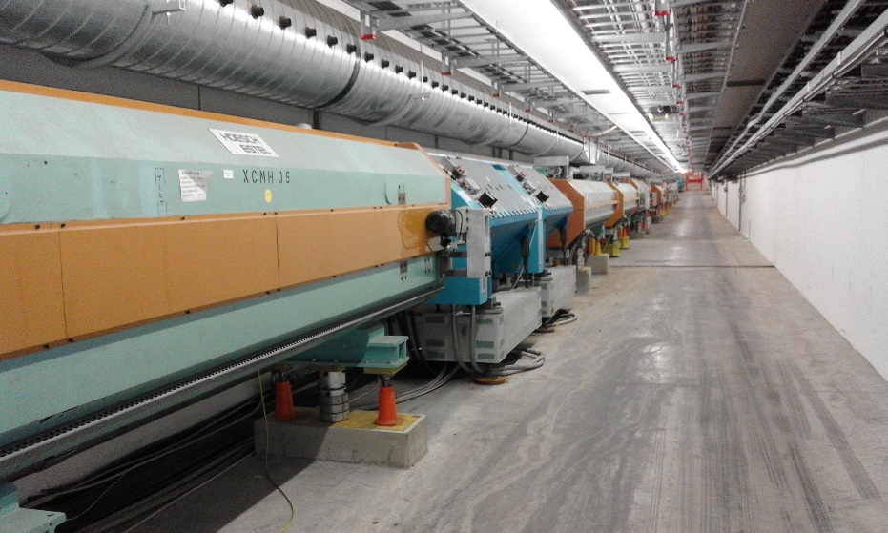
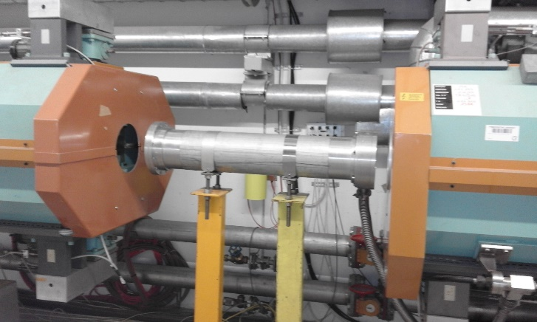
EHN2: Low-energy antiproton beams
Study for 12 – 20 GeV/c antiproton beams shows no problems from particle production point of view, however the missing vacuum pipes in about 80 m of M2 would have to be installed
Main equipment without vacuum: 9 scrapers (5m long magnetic collimators required for muon beams), 1 collimator (replaceable), beam instrumentation, absorbers in B4 (removable)
Cost estimate: 90-110 kCHF for special vacuum chambers in scrapers
Scraper
Notes:
SafDeat

Slide 31
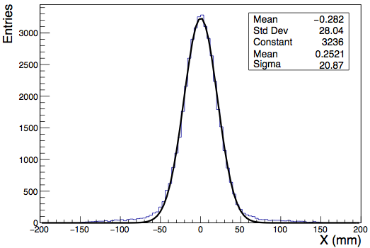
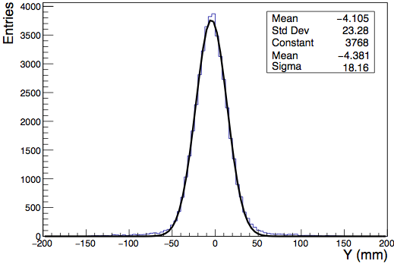
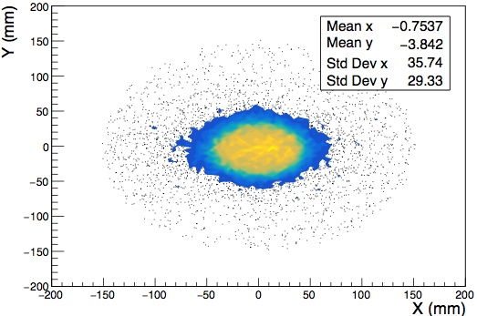
EHN2: Beam for NA64µ Phase 2
σ_{x} ~ 21 mm
σ_{y} ~ 18 mm
Notes:
SafDeat

Slide 32
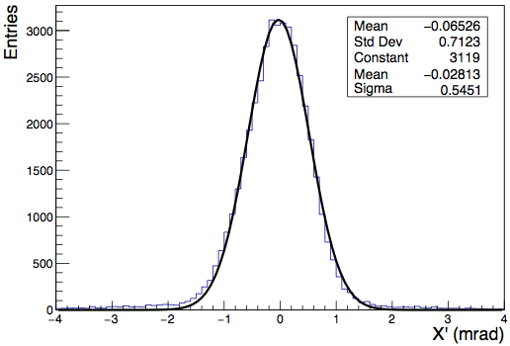
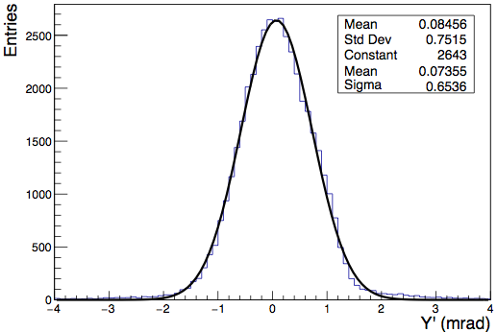
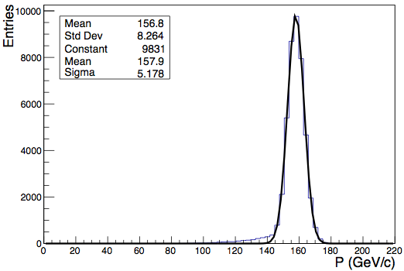
EHN2: Beam for NA64µ Phase 2
σ_{x’} ~ 0.5 mrad
σ_{y’} ~ 0.6 mrad
p ~ 158 GeV/c
dp ~ 5 GeV/c
Notes:
SafDeat

Slide 33
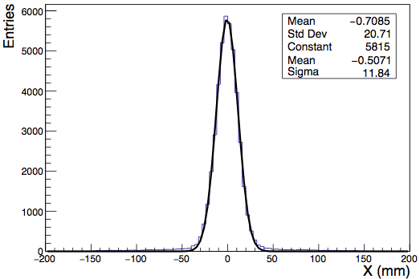
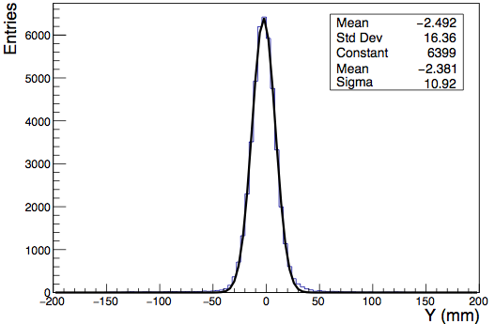
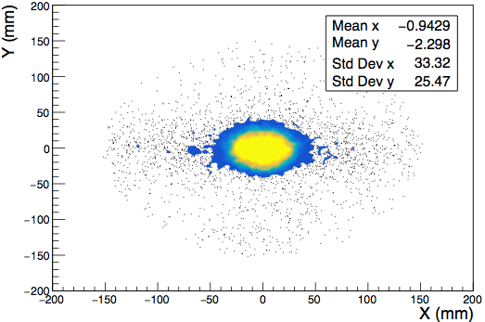
EHN2: Beam for COMPASS R_{proton}
σ_{x} ~ 11 mm
σ_{y} ~ 11 mm
Notes:
SafDeat

Slide 34
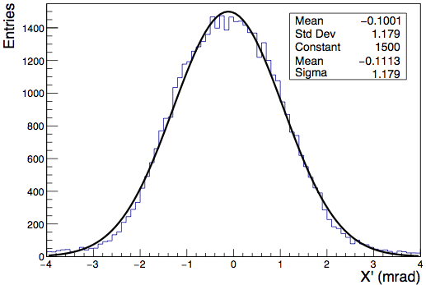
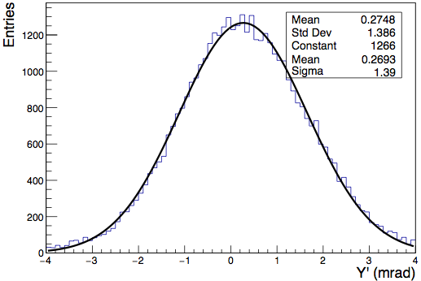
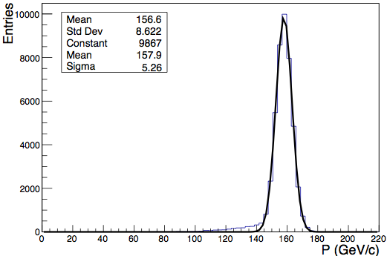
EHN2: Beam for COMPASS R_{proton}
σ_{x’} ~ 1 mrad
σ_{y’} ~ 1 mrad
p ~ 158 GeV/c
dp ~ 5 GeV/c
Notes:
SafDeat

Slide 35
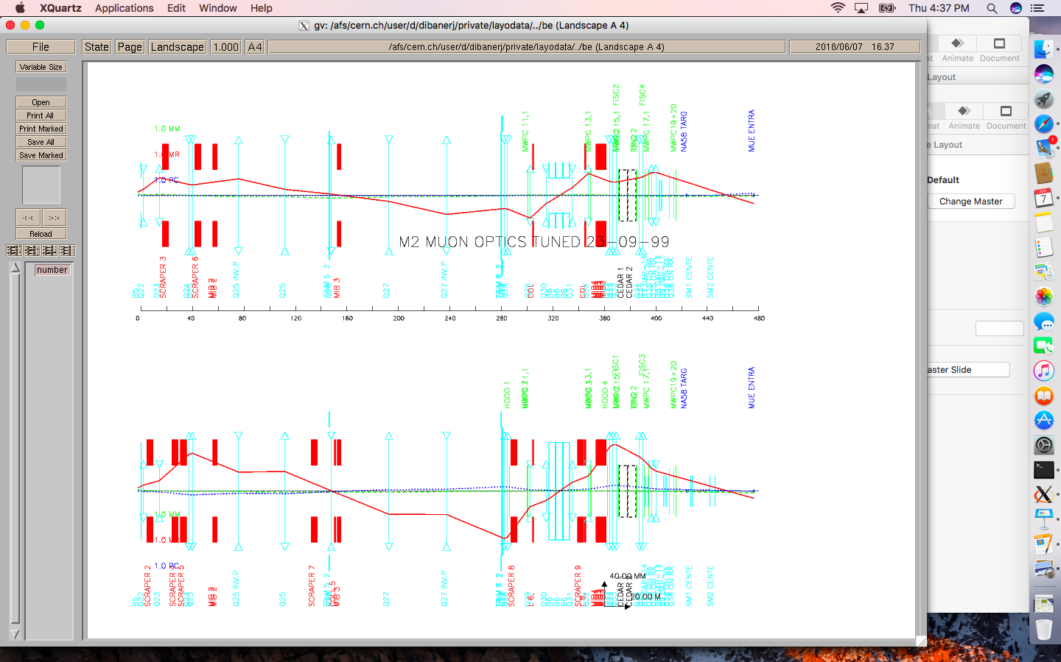
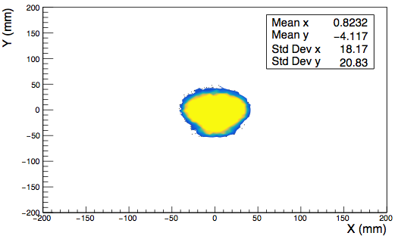
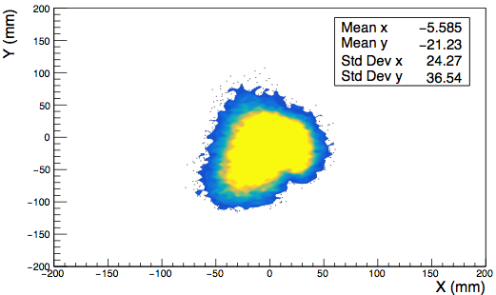


EHN2: Option for intermediate focus
In case of another test / pilot run in the downstream area of EHN2, an option for an intermediate focus downstream of the polarised target of COMPASS was studied, however still having dispersion downstream.
σ_{x} ~ 13 mm
σ_{y} ~ 11 mm
σ_{x’} ~ 0.5 mrad
σ_{y ‘}~ 0.4 mrad
Notes:
SafDeat

Slide 36
Air flow measurement locations
EN/CV measured air flow in (at least) 3 locations in TDC85 and TCC8,
as indicated schematically in the layout below. Normally no air flow is
expected, but a measurement / upper limit is always very useful.
In the gallery next to the T10 cooling station logging would be useful,
to detect stability of air flow vs atmospheric pressure variations
With logging

Slide 37

The H10 optics (cut out from full P41 line)

Slide 38

The K12 proton beam optics

Slide 39


Spot size at DIRAC⁺⁺ target (Turtle)
Entries
X (mm)
Y (mm)

Slide 40



Slide 41
Global structure of final document
Executive summary
Introduction (including list of proposals)
Organisation in subgroups (according to experimental halls)
EHN1 related projects
EHN2 related projects
ECN3 related projects
Interfaces to other PBC working groups
Future studies and outlook
Summary and conclusions
REDTOP to be decided
Notes:
EHN1 projects(

Slide 42
Possible future studies and R&D
Obviously depending on how far we get. E.g. future needs or plans for:
Section
RF separated beam design
KLEVER implementation
Intensity increase in ECN3
Detailed design of ‘H10 beam’ (if not excluded already)
Safety aspects in more detail
More detailed costing in general
Notes:
SafDeat

