Slide 1
MBH – 11T model test results
Gerard Willering
Credits go to all involved in magnet design and production
Thanks for the support in testing to Franco Mangiarotti, Jerome Feuvrier, Vincent Desbiolles, Michal Duda, Havard Arnestad, Hugo Bajas, Daniel Turi, Javier Villena, Christian Löffler, Susana Izquierdo Bermudez, Emelie Nilsson, Marta Bajko, Bernardo Bordini, Philippe Grosclaude, et al.
MDP-FCC-EuroCirCol – 07/03/2018

Slide 2
Test overview
Training
MBHSP106
  RR study, training, degradation, High-MIIts studies
Midplane limit MBHDP102 and Block 3 limit MBHSP106
Coil limit overview
Successes
Conclusions

Slide 3
Training
Training of all models at CERN:
All single aperture magnets show their first quench between 8 and 9 kA.
DP101 went immediately to 12.2 kA.
DP102 went straight to a conductor induced limit.
Quench curves give only half the information:
Quenches typically come in two fashions:
Induced by mechanical movement (slip-stick, epoxy cracking, etc.)
Induced by conductor limits (degradation, current distribution effects, flux jumps, etc. )
Special high-MIIts training, see later slide

Slide 4
Details of MBHSP106 powering tests

Slide 5
Quench events of the last SP106
Full quench history including ramp rate studies (before high-MIIts studies).
In light-blue are the quenches limited by the conductor.
In the following slide the data is split up:
Training curve with clear mechanical movements causing the quench.
Quench at conductor limit, placed in the ramp rate dependency curve

Slide 6
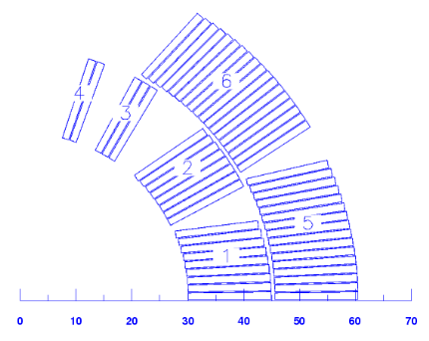
Ramp rate dependency of model SP106
Coil 116 has a clear limit in I7-I8 and I8-I9 at 1.9 and 4.5 K.
At 4.5 K another limit was found in coil 116 I13-I14.
Both are close to the middle of the straight part of the coil.
Pole turn I13-I14.
I7-I8 and I8-I9
Three turns of block 3 quench simultaneously.

Slide 7
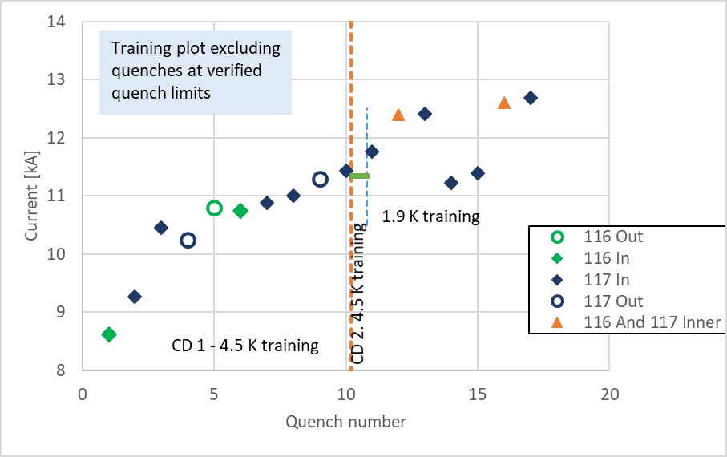
Training of model SP106
First training was at 4.5 K, looking rather similar to training of other coils at 1.9 K.
Second training at 4.5 K showed good memory up to 11.3 kA without quench
Training continued at 1.9 K and showed two important detraining quenches at 11.2 and 11.3 kA, but stable performance after the end of training.

Slide 8
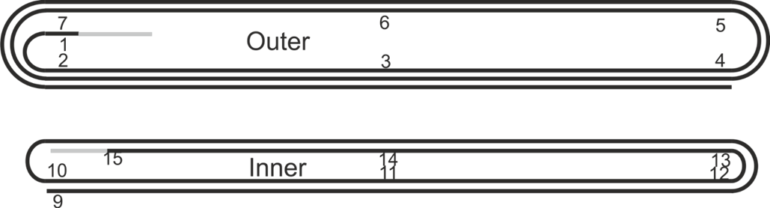
(de)Training in head coil 117 inner layer connection side
1
5
9
4
3
12
7, 8, 10, 11, 13, 14, 15, 17
Very prominent training and detraining location is the connection side head of coil 117 where the following quenches originate
7, 8, 10, 11, 13, 14, 15, 17
Quench 12 and 16 started in coil 116 and 117 simultaneously.
16
2
6
Coil 117
Coil 116

Slide 9
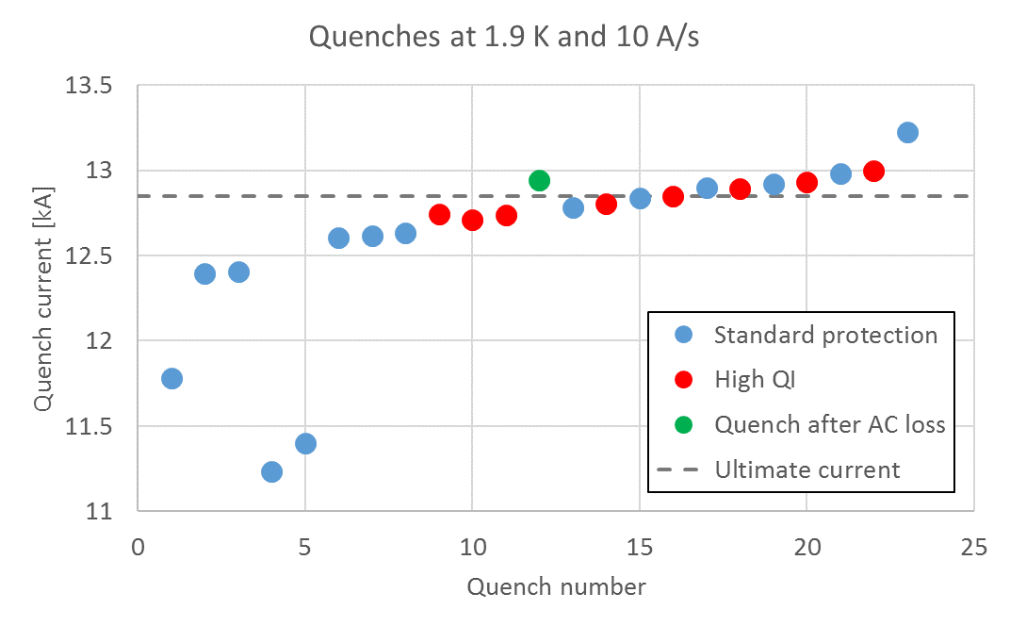
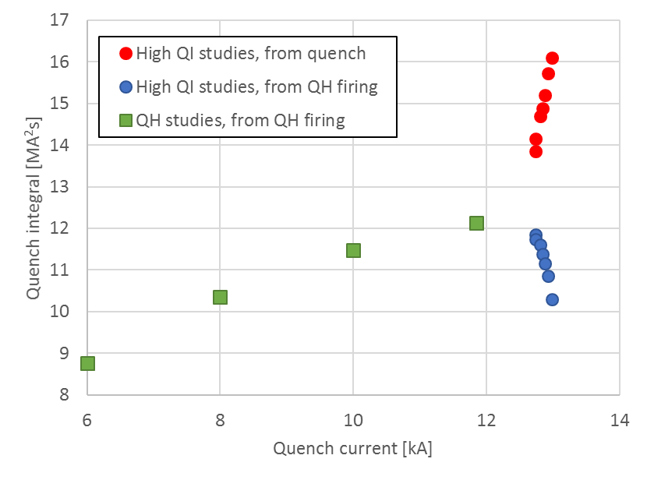
High QI studies
~430 K
~370 K
Quenches in 116 I7-I8 & I8-I9
After all the high QI quenches (except the first one), the quench current increases
We have reached a maximum quench current of 13.23 kA
All the high QI & verification quenches were in the same location

Slide 10
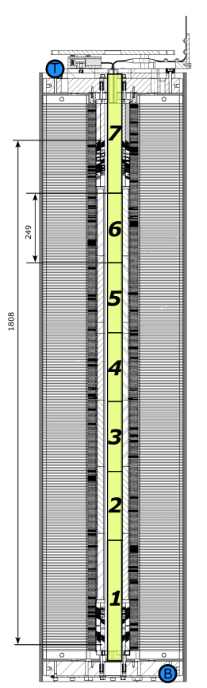
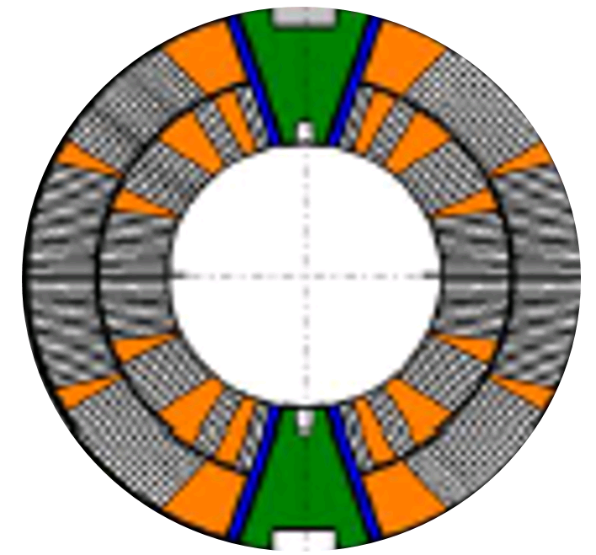
High QI studies – location
All those quenches were in the same location, block 3 of coil 116.
Quenches in 116 I7-I8 & I8-I9
116
117
Important conclusion: After all these quenches we don’t:
Have any mechanically induced quench (training)
Have any detraining, even in the “loose head” of coil 117

Slide 11
How do high-QI studies improve the quench current?
How do high-QI studies improve the quench current?
Difficult question to answer.
The only firm conclusion we can draw from the measurements is:
We don’t see degradation up to 13.2 kA with hotspot temperatures up to ~430 K.
Can we expect the same phenomena in other coils too?
No statistics: we did not test it in previous models.

Slide 12
Degradation in mid-planes in MBHDP102 and in block 3 of MBHSP106

Slide 13
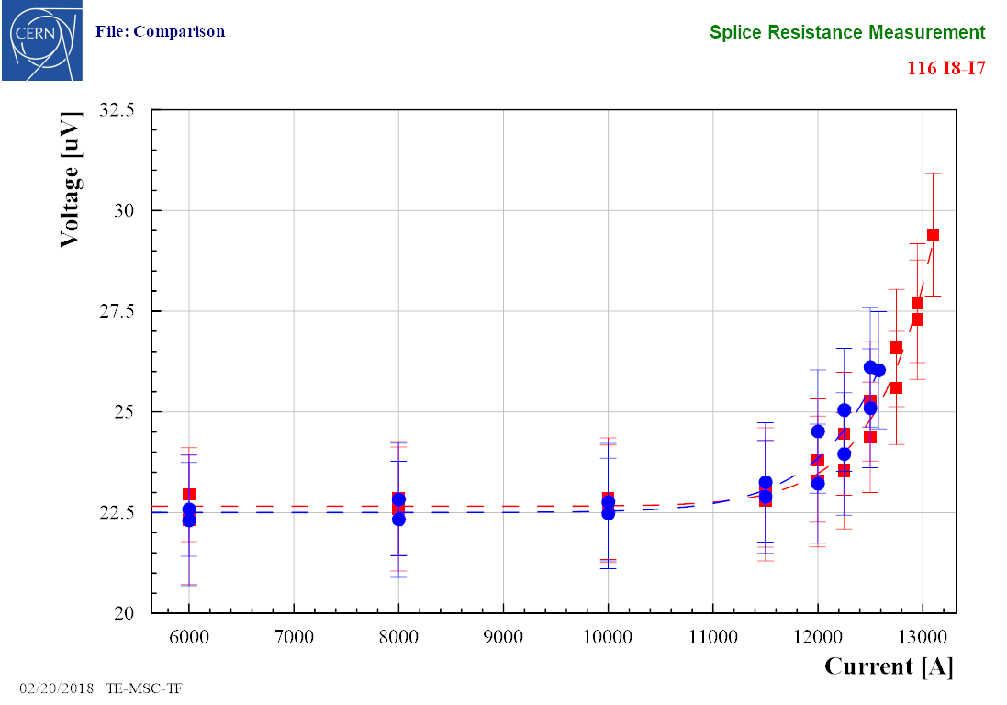
VI curve – block 3 coil 116
The segments that quenched:
  Segment 116 I7-I8 shows a transition, very similar to the measured before the high QI studies
    “n” value ~ 20-25
  Segment 116 I8-I9 does not show a superconducting transition
Midplane segments
  116 II-I1, I2-I3 and 117 II-I1, I2-I3 do not show a superconducting transition

Slide 14
VI curves – midplanes DP102
112
Aperture 1 with coil 109 and 112
20 µV at 11400 A
109

Slide 15
114
20 µV at 14100 A
Aperture 2 with coil 114 and 115
115

Slide 16

V-I curves and n-value in magnets
Typically n-value is used with constant magnetic field for (I/I_{c})^{n} and cannot be compared to (I/I_{ss})^{n}. However, we can fit the curve with the following formula, using for I_{c}(B) and n(B) the values from extracted strand data.
Find the best fit for
$$E(I,B)=E_{c}{\left(\frac{I}{f_{I_{c}}I_{c}(B)}\right)}^{\left(f_{n}n(B)\right)}$$
(with E_{c} = 10 uV/m)
 | Block 3 coil 116 | Midplane coil 109
I_{c} reduction factor (f_{Ic}) | 0.62 | 0.26
n-value reduction factor (f_{n}) | 0.20 | 0.12
Note1: Very rough estimate.
Note2: the approach is very simple, it assumes homogeneous conductor degradation, which in very unlikely.
Note3: The magnetic field gradient over the cable width is taken into account by calculating the average E at the thin edge, the mid point and the thick edge of the cable, all using n(B) and Ic(B). This can be further improved, but it gives a good first order approach.
Both the midplane turn in coil 109 as the block 3 in coil 116 show a SC to normal transition with
very little hysteresis
a low n-value
no decay at constant current.
Interpretation: All this info points to a distributed degradation of the conductor over at least a twistpitch, but likely more.

Slide 17
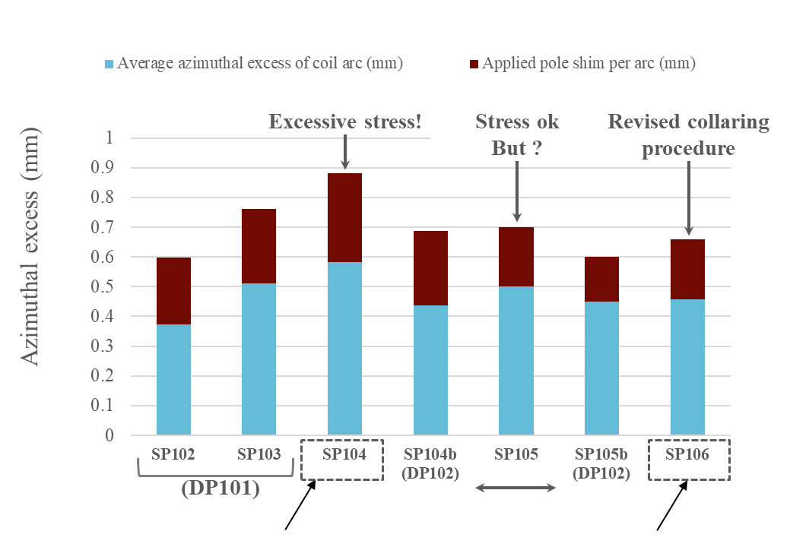
Midplane limit
The V-I measurements were only done for DP102 and SP106 on the 1.4 m straight midplane segments.
DP102:
4 out 8 mid-plane segments showed a SC-NC transition below 11.5 kA
SP106:
0 out of 4 mid-plane segments showed a SC-NC transition up to 13.2 kA.
Soft conclusion: the revised collaring procedure seems to give the expected improvement. Would be good to see more statistics.
Courtesy C. Löffler, E. Nilsson

Slide 18
Coil limit overview

Slide 19
Coil limits overview
All coils, except the mirror coils, were limited well below the short sample limit, at 4.5 K and at 1.9 K.
The limit location varies.
Many investigations are ongoing to address these limits due to the conductor.

Slide 20
Successes

Slide 21
Successes
Splices
All 24 Nb₃Sn to NbTi splices were excellent with a resistance below 0.5 nOhm.
Holding current tests
Except for coil 113 (layer jump issue) all magnets could hold the current for 1 to 12 hours very close to maximum quench current.
Memory
Every retraining of a coil after thermal cycle, including after re-collaring and re-assembly from single to double aperture, showed a very good memory.
Protectability
The high-MIIts studies for SP106 did not show any degradation up to 13.2 kA up to ~430 K using only nominal protection by the outer layer quench heaters. This gives confidence for the prototypes and series magnets protection. Flux jumps at low current seem to be easily ignored by variable threshold detection cards.
Understanding
With all effort put in to the measurements throughout the lifecycle of the magnet, issues seem well identified and can be solved.
In MBHSP106 there is no sign anymore of the midplane limit.

Slide 22
Coil performance assessment
Assessment
Combining the data makes an overview more clear.
Single aperture model SP106 and double aperture DP101 are assessed to be good in all important aspects.

Slide 23
Conclusions
Last magnet was a good magnet, as was the first double aperture.
We have a large amount of measurements: understanding so much data is not always easy.
It is clear from the measurements that the conductor is strongly degraded in the midplane for DP102 and for block 3 in SP106. This is the main issue that is being addressed by all teams at CERN.

Slide 24
Thank you.

Slide 25
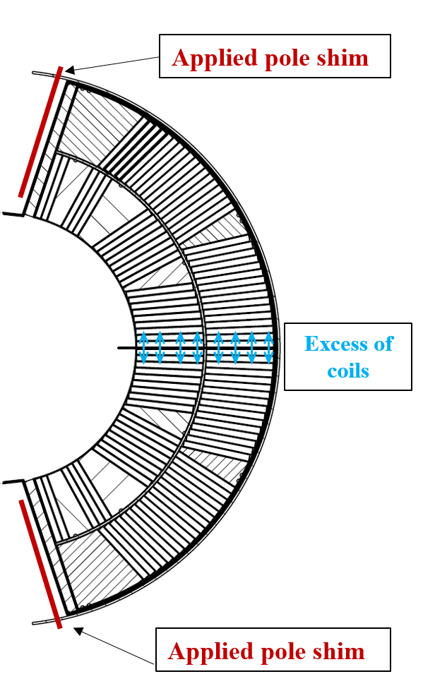
Shimming of magnet models
The pre-stress depends on the sum of the azimuthal oversize of the coils with the thickness of the pole shims (… and also on the mechanical properties of the coil)
Excessive stress!
Stress ok
But ?
Revised collaring procedure
11 T coil branch
(DP101)
Average inner layer azimuthal stresses @ 12 T
Midplane turn | -147 MPa
Pole turn | -29 MPa
Midplane turn | -127 MPa
Pole turn | -7 MPa
Courtesy C. Löffler, E. Nilsson
Notes:
Comment on corresponding average pre stress
Add SP101 and SP106

Slide 26
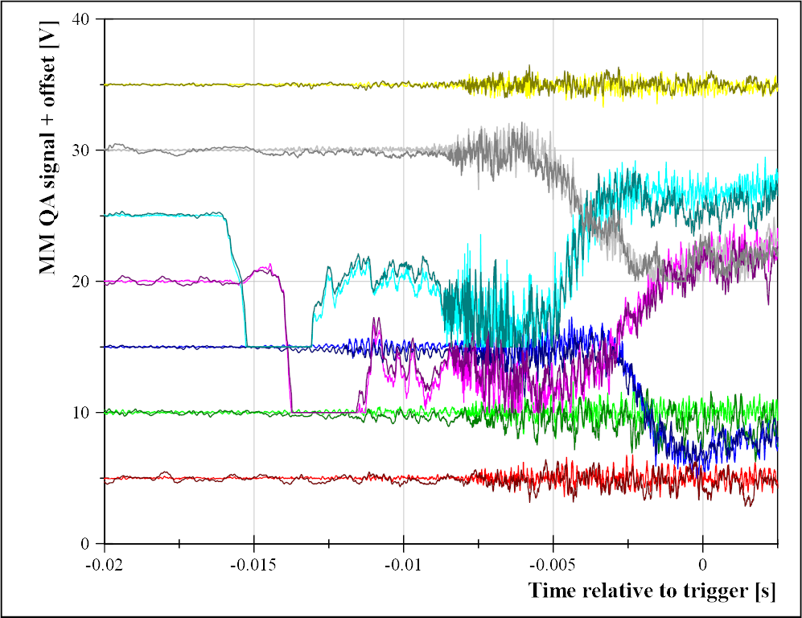
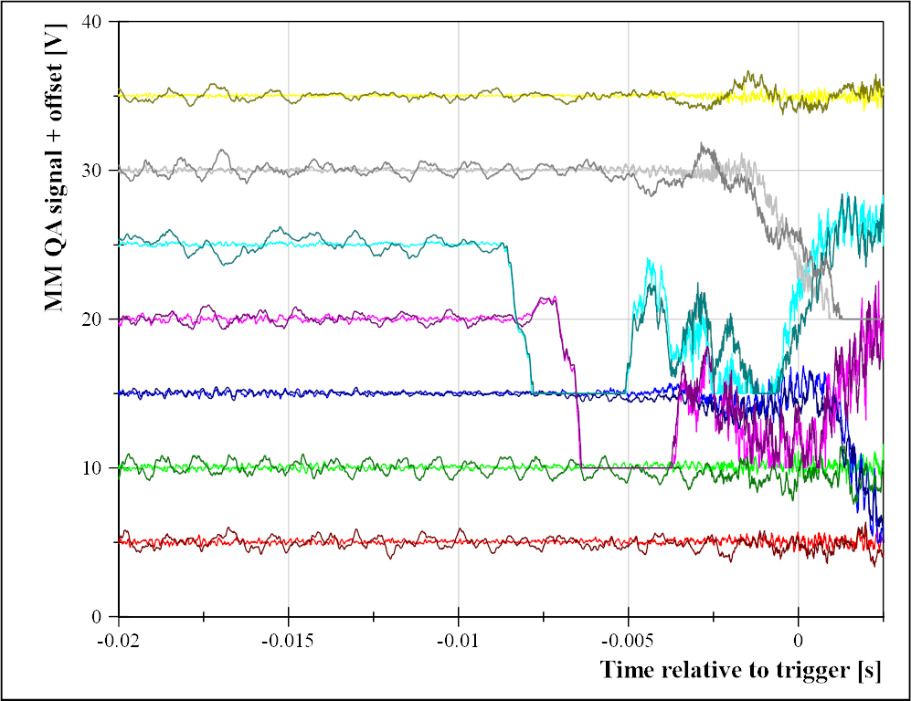
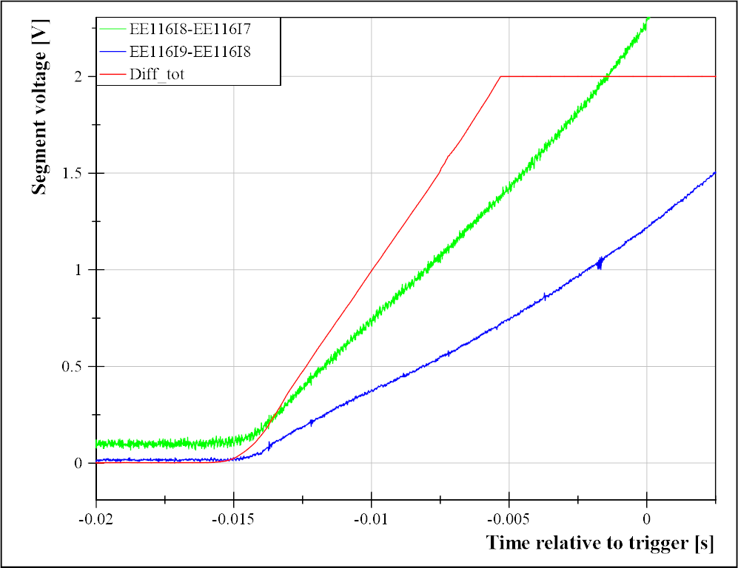
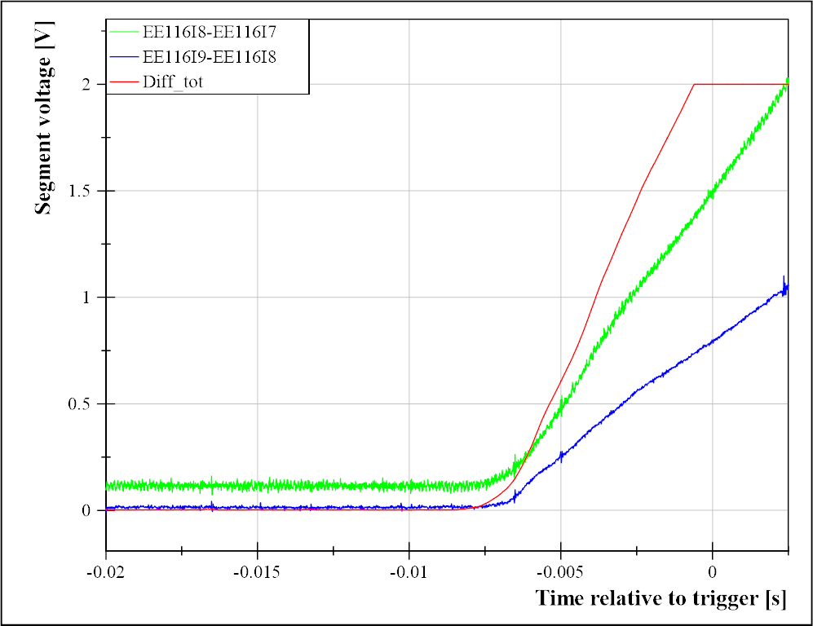
High QI studies – before and after
Magnet top
Right
Left
Magnet bottom

Slide 27
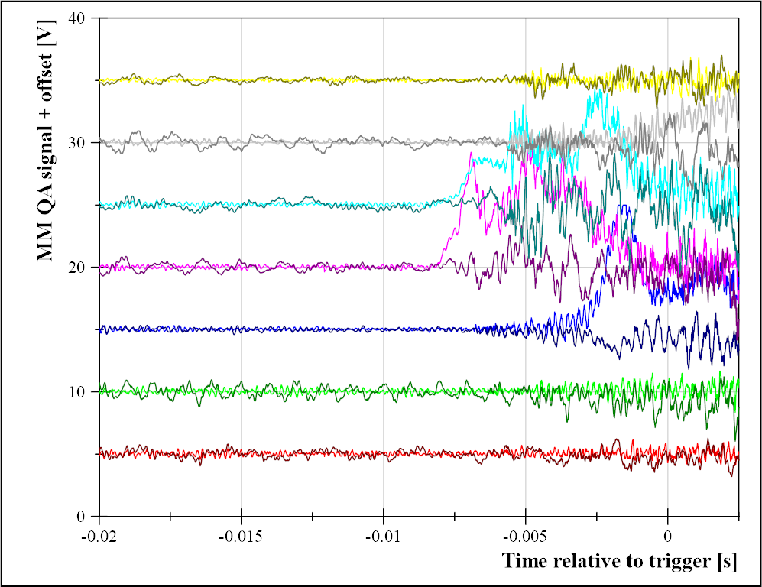
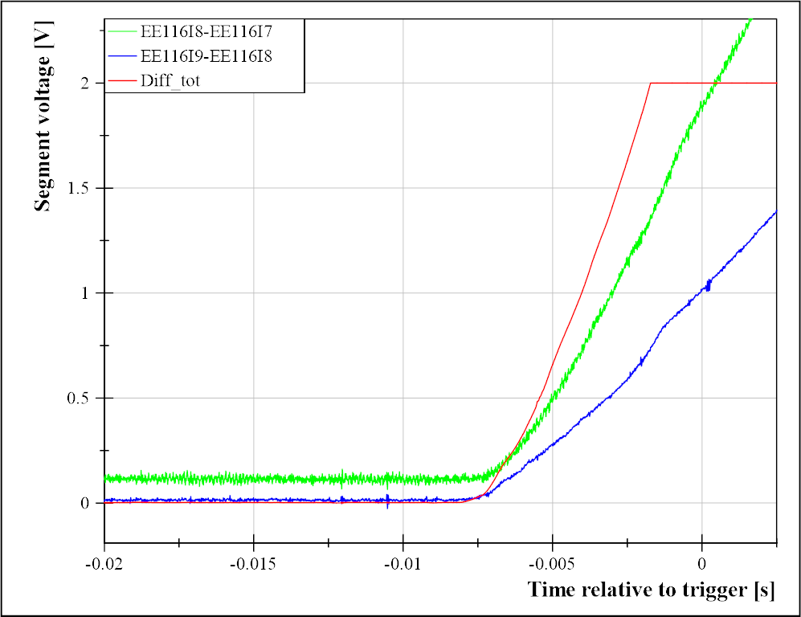
High QI studies – before and after
Magnet top
Right
Left
Magnet bottom

