Slide 1





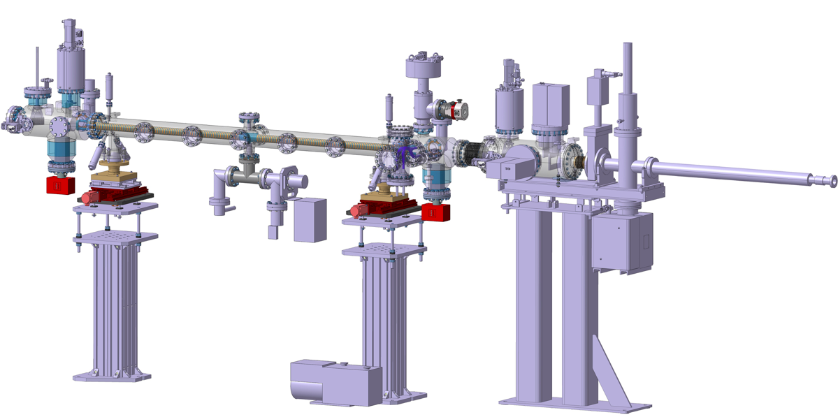
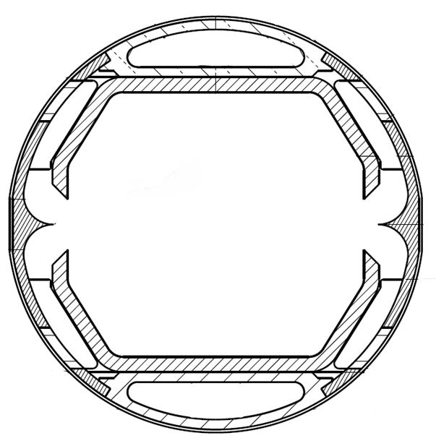


Test of FCC-hh Beam Screen at the KARA Beamline.
Luis Gonzalez^{1, 2}
1
2
3
4
5
Task4.6: Measurements on cryogenic
beam vacuum system prototype
Test of FCC-hh Beam Screen at the ANKA Beamline.
Luis Gonzalez
LNF-INFN/CERN TE-VSC
CERN February 20th 2018

Slide 2
Outline
Motivation of the Experiment
Description of the Experiment
Samples
Geometry
Experimental Configurations
Results and Comparison with Simulations
Test of FCC-hh Beam Screen at the ANKA Beamline.
1
Luis Gonzalez
LNF-INFN/CERN TE-VSC
CERN February 20th 2018

Slide 3
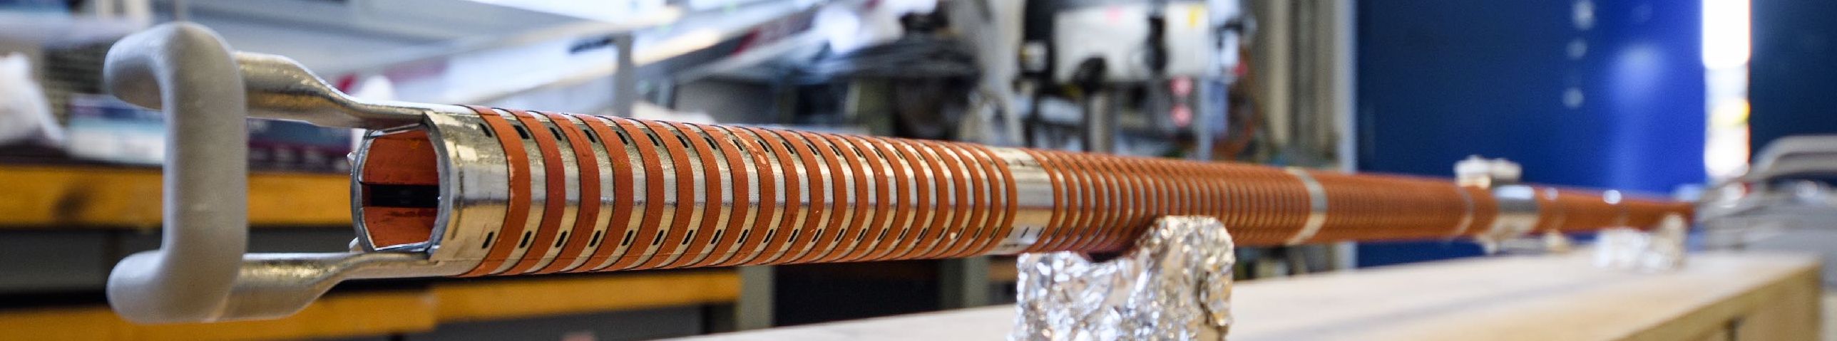
Motivation of Experiment
Validation of Simulation Techniques
used for the real machine
PSD
Reflectivity
Heat Load
Photoelectron Generation
 | LHC - 0.58A 7TeV | FCC-hh - 0.5A 50TeV
SR power [W/m] | 0,2 | 35,2
Flux* ph/m/s | 4,2·10¹⁶ | 1,5·10¹⁷
Critical Energy | 44,2eV | 4,3 KeV
*Photon energy above 4eV
R.Kersevan; Beam Dynamics meets Vacuum, Collimations, and Surfaces Workshop. KIT, Karlsruhe. March 2017
Test of FCC-hh Beam Screen at the ANKA Beamline.
2
Luis Gonzalez
LNF-INFN/CERN TE-VSC
CERN February 20th 2018

Slide 4
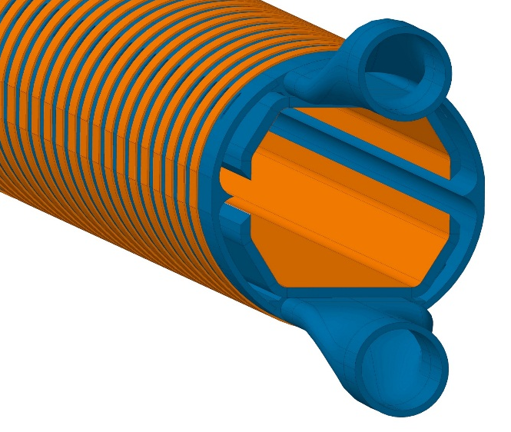
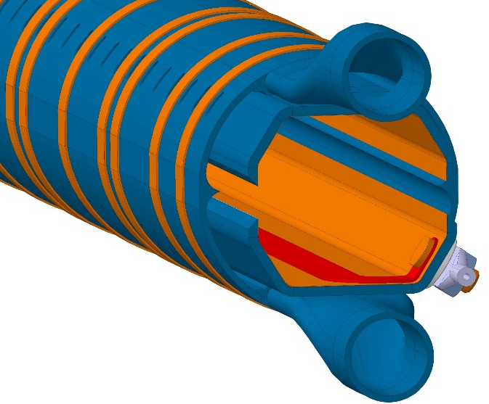
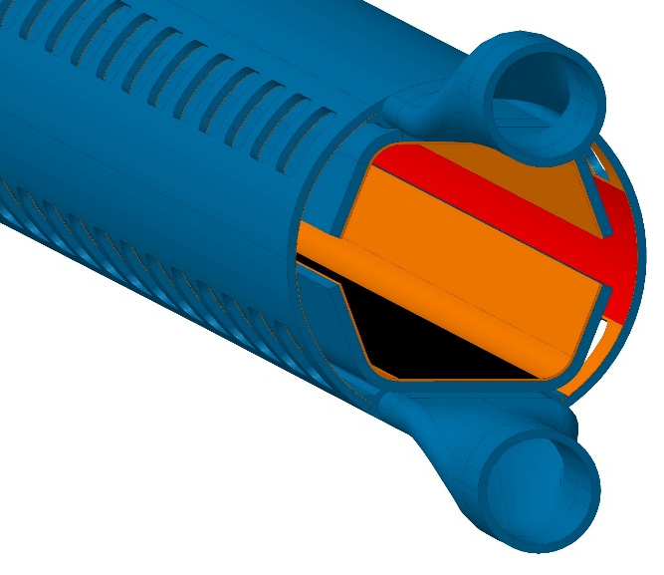
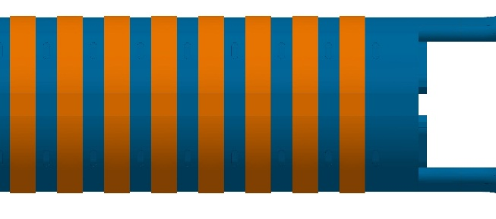
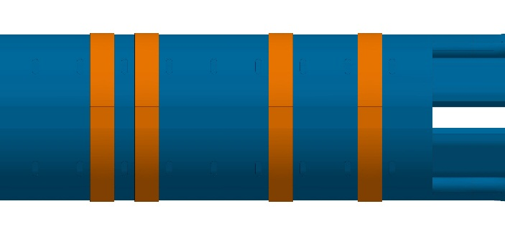
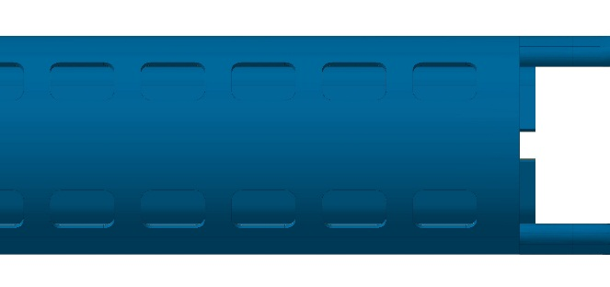
Samples: FCC-hh Beam Screen Prototypes
Prototype #1 July- Oct ‘17
Prototype #2 Jan- May ‘18
Prototype #3 June-Aug‘18
#1: Validation of temperature profile and validity of photon reflector
#2: #1 + Electrode for photoelectron current measurements
#3: Surface treatments as for baseline. Updated internal screen and pumping slots. Substitution Reflector for Sawtooth
Test of FCC-hh Beam Screen at the ANKA Beamline.
3
Luis Gonzalez
LNF-INFN/CERN TE-VSC
CERN February 20th 2018

Slide 5
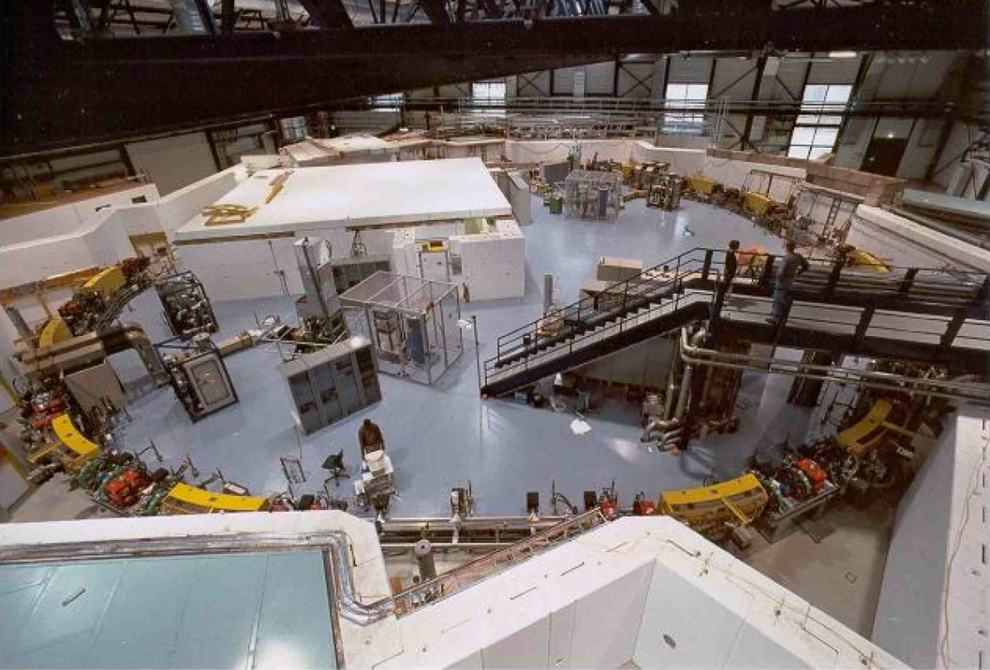
Experiment at KARA
KARA
(KArlsruhe Research Accelerator)
Ec FCC-hh = 4.2 KeV
Ec KARA = 6.2KeV
KARA reasonably resembles FCC-hh’s spectrum and linear power, and even at nominal beam energy (2.5 GeV) ANKA’s spectrum is a close match of that of FCC-hh.
Simulations performed with Synrad; M. Ady, R. Kersevan, M.Grabski, IPAC15. http://test-molflow.web.cern.ch/node/107
Test of FCC-hh Beam Screen at the ANKA Beamline.
4
Luis Gonzalez
LNF-INFN/CERN TE-VSC
CERN February 20th 2018

Slide 6
Experiment at KARA
KARA e-Beam
Test of FCC-hh Beam Screen at the ANKA Beamline.
5
Luis Gonzalez
LNF-INFN/CERN TE-VSC
CERN February 20th 2018

Slide 7
Experiment at KARA
KARA e-Beam
2m FCC-hh Protoype
Test of FCC-hh Beam Screen at the ANKA Beamline.
5
Luis Gonzalez
LNF-INFN/CERN TE-VSC
CERN February 20th 2018

Slide 8
Experiment at KARA
KARA e-Beam
2m FCC-hh Protoype
2m FCC-hh Protoype
D-horizontal
Test of FCC-hh Beam Screen at the ANKA Beamline.
5
Luis Gonzalez
LNF-INFN/CERN TE-VSC
CERN February 20th 2018

Slide 9
Experiment at KARA
Irradiated length 1.8m
KARA e-Beam
2m FCC-hh Protoype
D-horizontal
θ
Test of FCC-hh Beam Screen at the ANKA Beamline.
5
Luis Gonzalez
LNF-INFN/CERN TE-VSC
CERN February 20th 2018

Slide 10
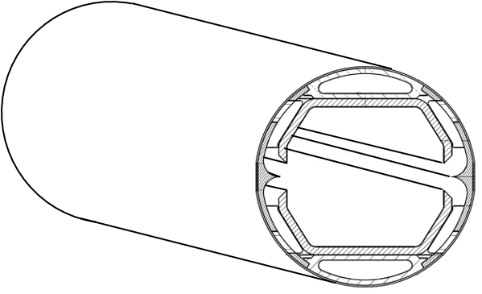
Experiment at KARA
Irradiated length 1.8m
KARA e-Beam
2m FCC-hh Protoype
D-horizontal
θ
2m
Test of FCC-hh Beam Screen at the ANKA Beamline.
5
Luis Gonzalez
LNF-INFN/CERN TE-VSC
CERN February 20th 2018

Slide 11
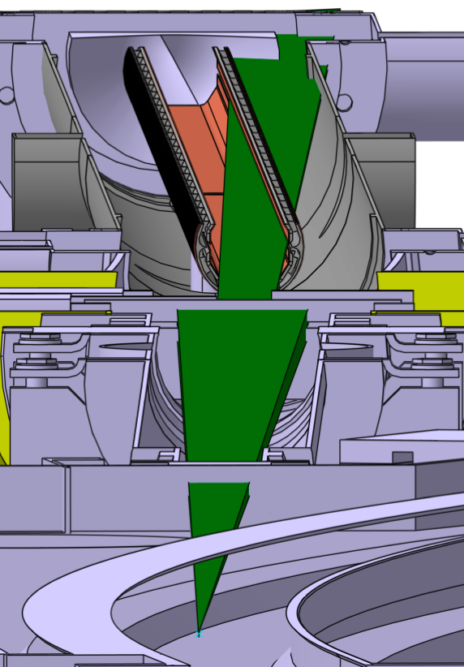
Experiment at KARA
Irradiated length 1.8m
KARA e-Beam
2m FCC-hh Protoype
D-horizontal
θ
D-vertical
2m
Test of FCC-hh Beam Screen at the ANKA Beamline.
5
Luis Gonzalez
LNF-INFN/CERN TE-VSC
CERN February 20th 2018

Slide 12
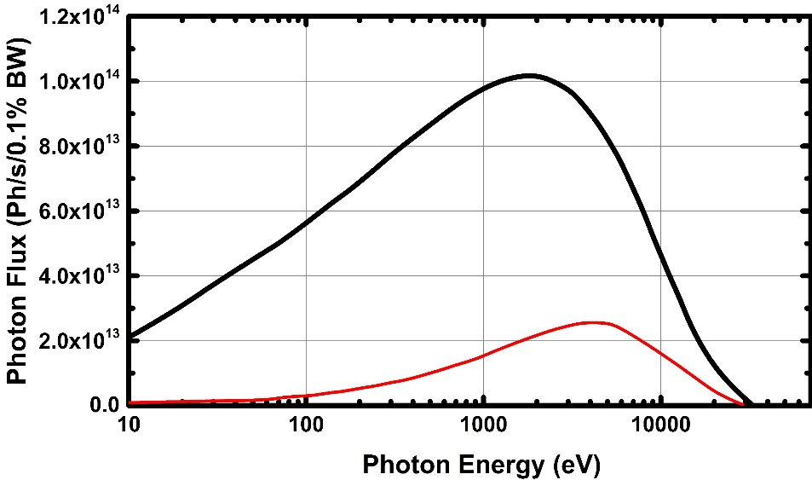
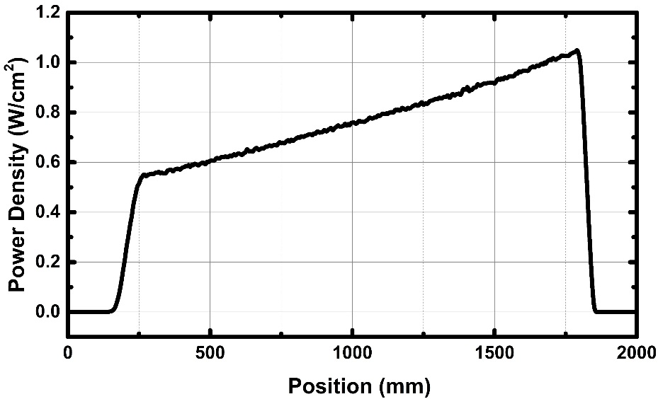
Experiment at KARA
Beam Direction
1.8m
 | KARA | FCC-hh
SR Flux | 8.7E+16ph/s | 1.5E+17ph/s
SR Power | 32W/m | 32W/m
Angle of Incidence | 18mrad | <2 mrad
Ec | 6.2KeV | 4.2KeV
After collimation :
83% of Photon Flux Cropped
69% of Photon Power Cropped
Test of FCC-hh Beam Screen at the ANKA Beamline.
6
Luis Gonzalez
LNF-INFN/CERN TE-VSC
CERN February 20th 2018

Slide 13
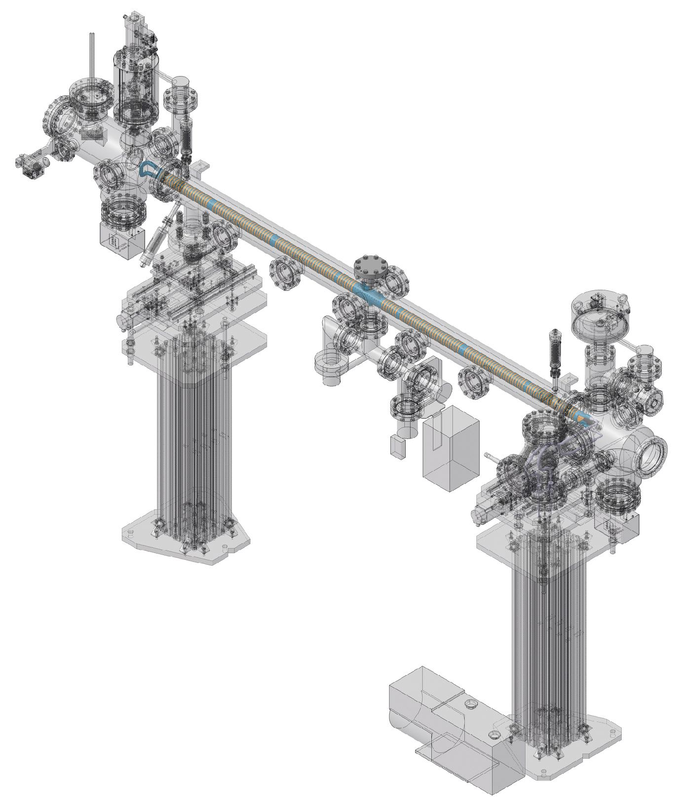
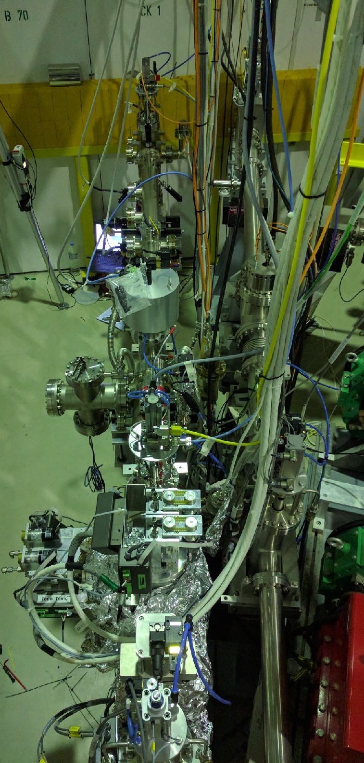
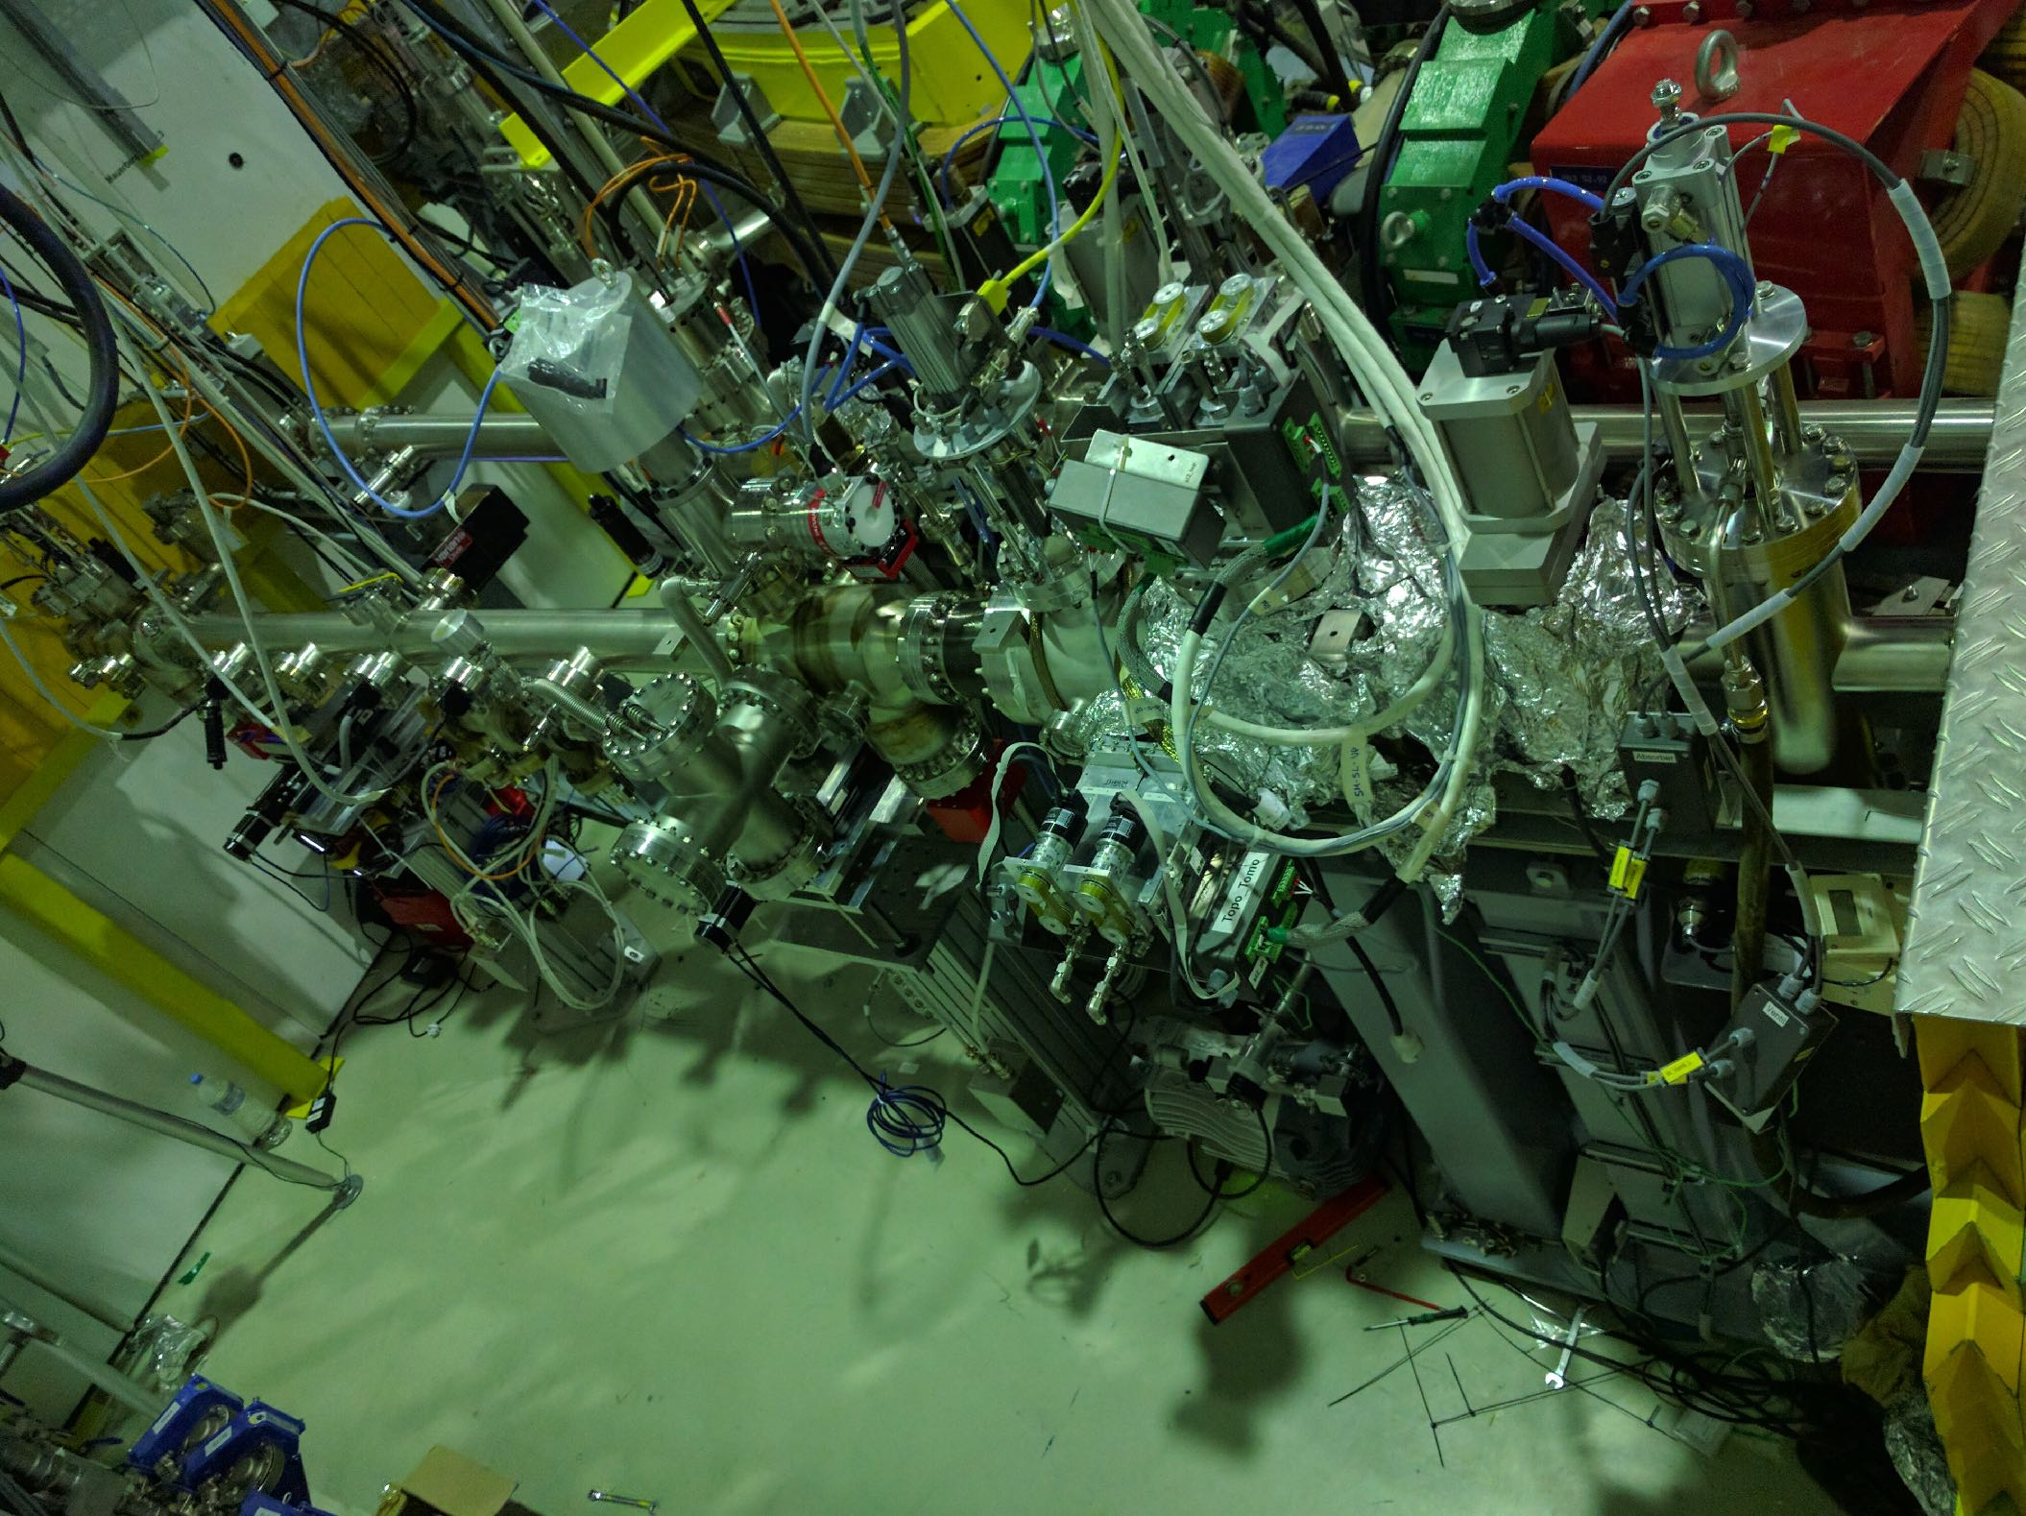
Experiment at KARA
The Setup
BEam Screen Testbench Experiment
BESTEX
Beam
See Miguel’s presentation
Test of FCC-hh Beam Screen at the ANKA Beamline.
8
Luis Gonzalez
LNF-INFN/CERN TE-VSC
CERN February 20th 2018

Slide 14
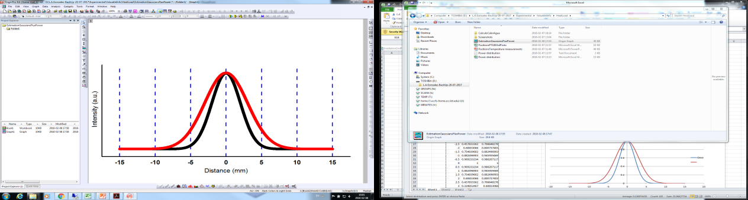
Experiment at KARA
Experimental Configurations
Ph Flux = 8.73E+16 Ph/s
Normal operation of FCC-hh
Missalignment @ FCC-hh
Ph Flux = 8.73E+16 Ph/s
Power
Flux
Geometry #1
Geometry #4
Power
Flux
Power
Flux
Geometry #2
Power
Flux
Geometry #3
Ph Flux = 1.44E+17 Ph/s
Injection @ FCC-hh
Injection @ FCC-hh
Ph Flux = 1.44E+17 Ph/s
Test of FCC-hh Beam Screen at the ANKA Beamline.
7
Luis Gonzalez
LNF-INFN/CERN TE-VSC
CERN February 20th 2018

Slide 15
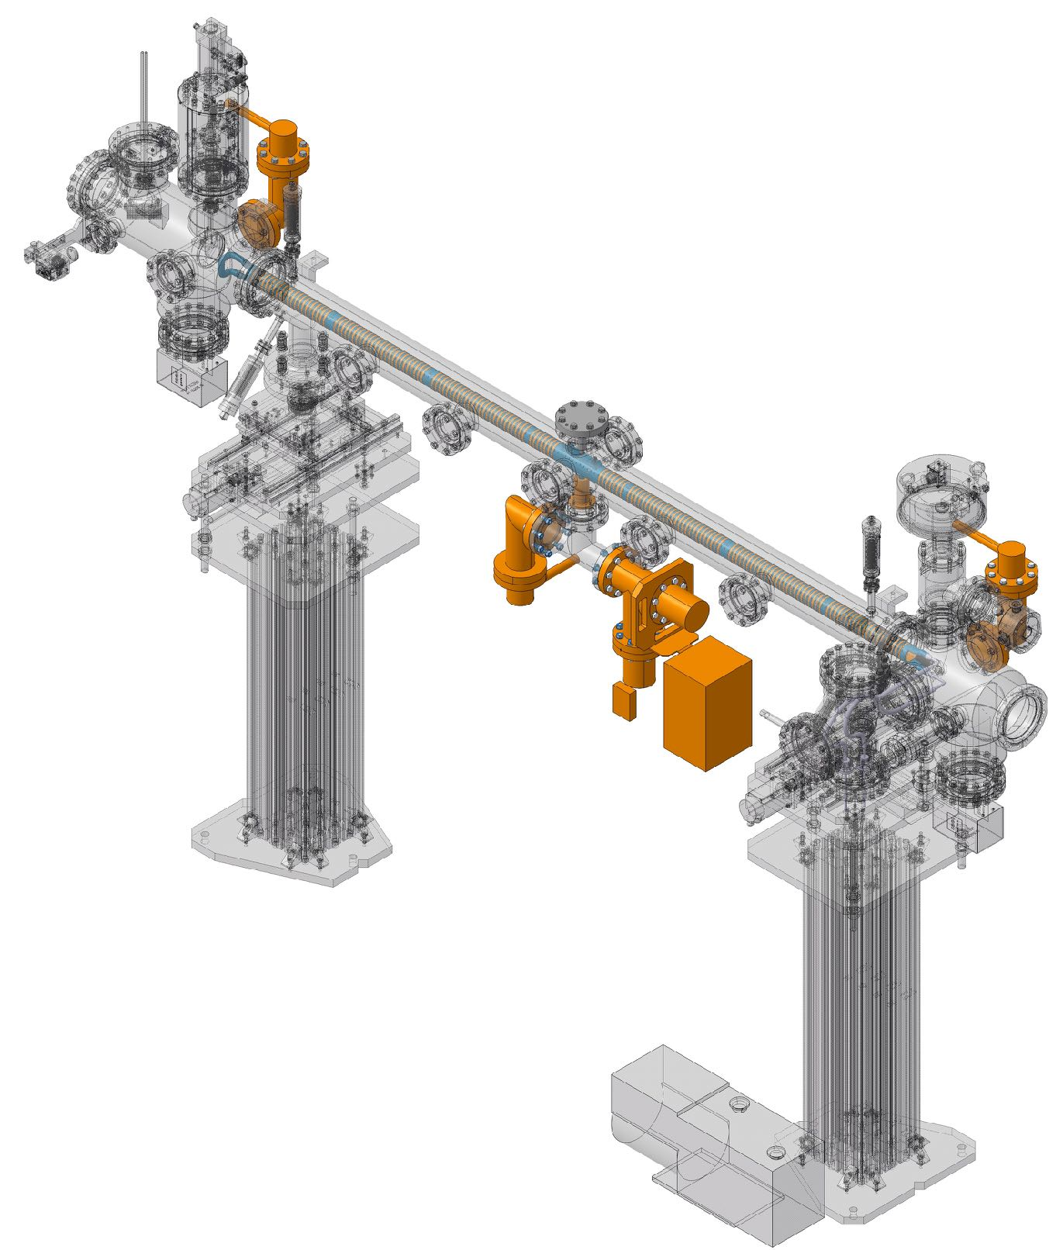
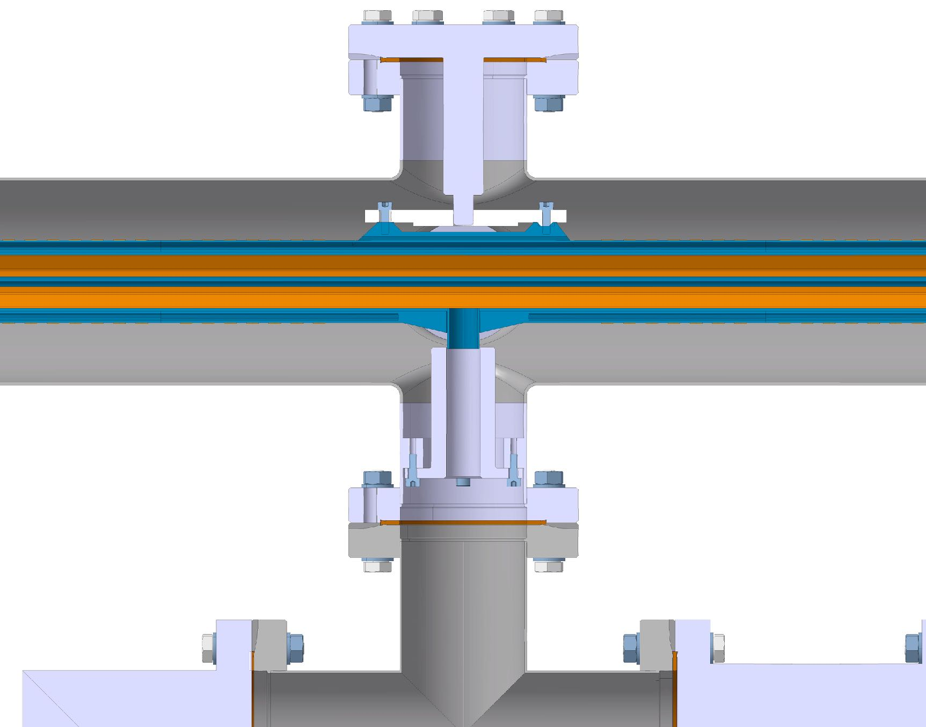
Experiment at KARA
PSD Studies
Back End BAG
Front End BAG
Beam
Middle
BAG + RGA
Chimney Connection
Test of FCC-hh Beam Screen at the ANKA Beamline.
9
Luis Gonzalez
LNF-INFN/CERN TE-VSC
CERN February 20th 2018

Slide 16
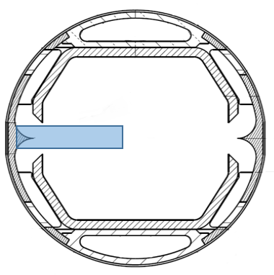
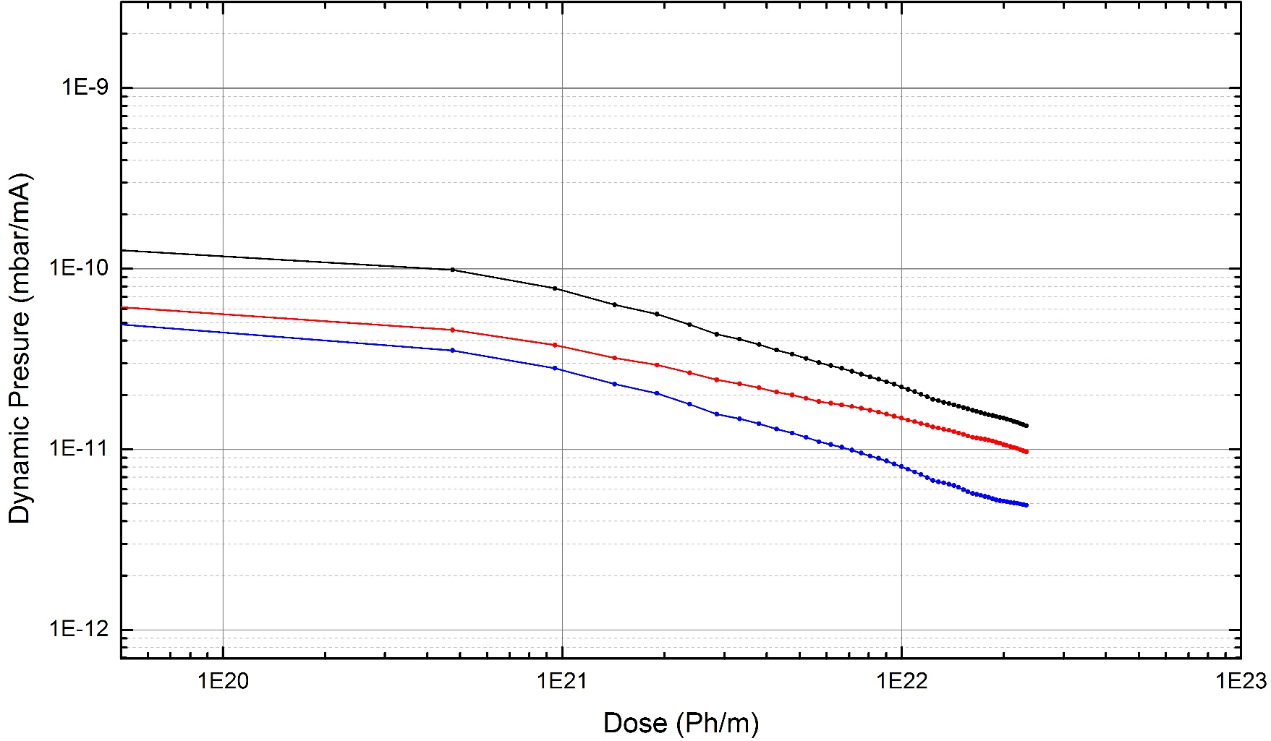
Experiment at KARA
PSD Studies
Experimental Results Prototype #1
Energy
Flux
Middle
Front
Back
Conditioning of the Sample takes place as photon dose increase
Test of FCC-hh Beam Screen at the ANKA Beamline.
10
Luis Gonzalez
LNF-INFN/CERN TE-VSC
CERN February 20th 2018

Slide 17
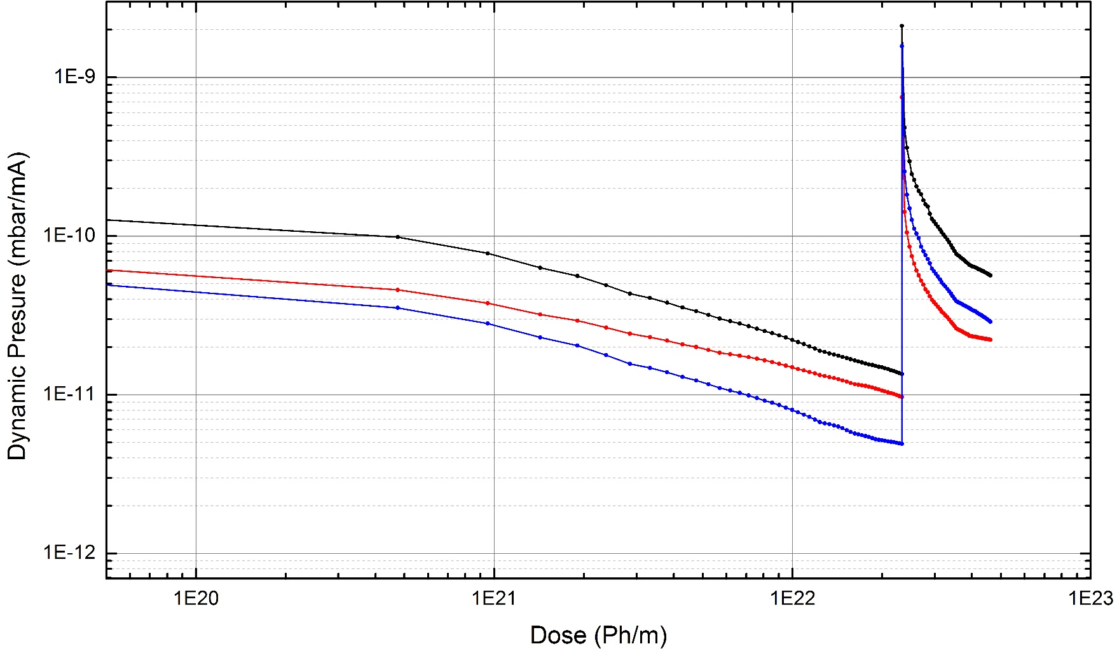
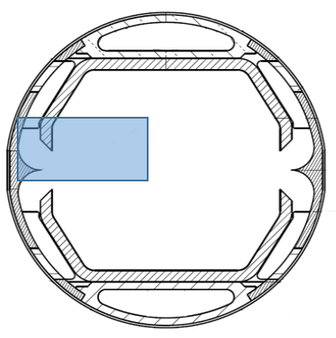
Experiment at KARA
PSD Studies
Experimental Results Prototype #1
Middle
Front
Back
Power
Flux
At Geometry #2 a pressure increase takes place.
Test of FCC-hh Beam Screen at the ANKA Beamline.
10
Luis Gonzalez
LNF-INFN/CERN TE-VSC
CERN February 20th 2018

Slide 18
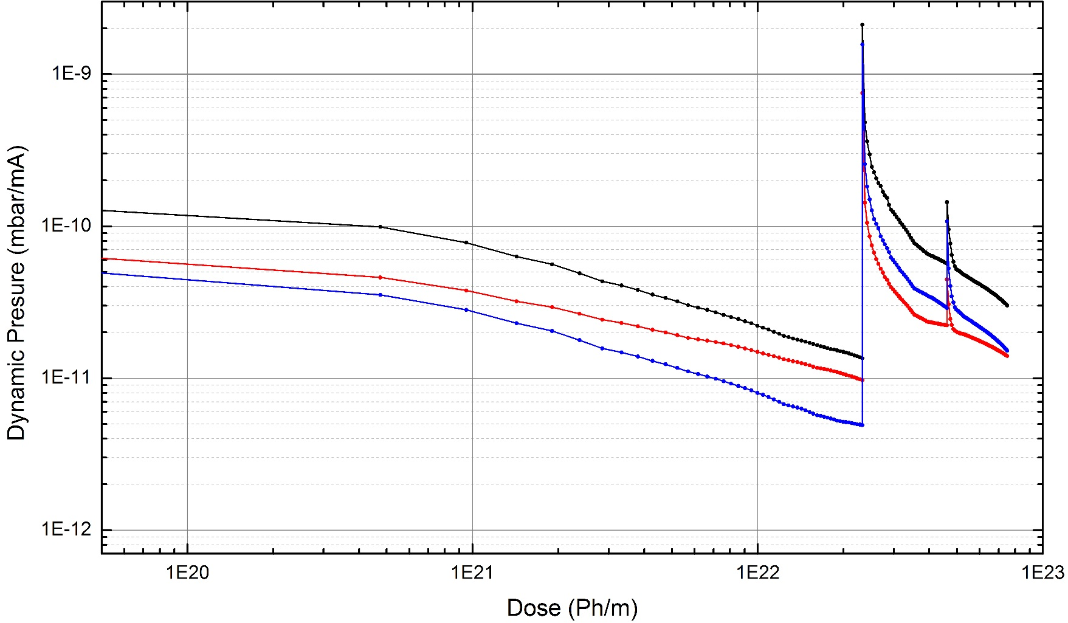
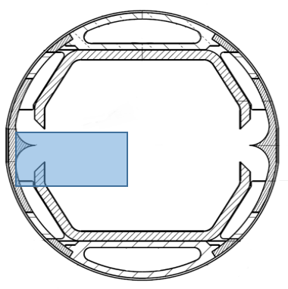
Experiment at KARA
PSD Studies
Experimental Results Prototype #1
Middle
Front
Back
Power
Flux
At Geometry #2 a pressure increase takes place.
At Geometry #3 The pressure follows the trend of Geometry #2
Large amount of internally reflected photons
Test of FCC-hh Beam Screen at the ANKA Beamline.
10
Luis Gonzalez
LNF-INFN/CERN TE-VSC
CERN February 20th 2018

Slide 19
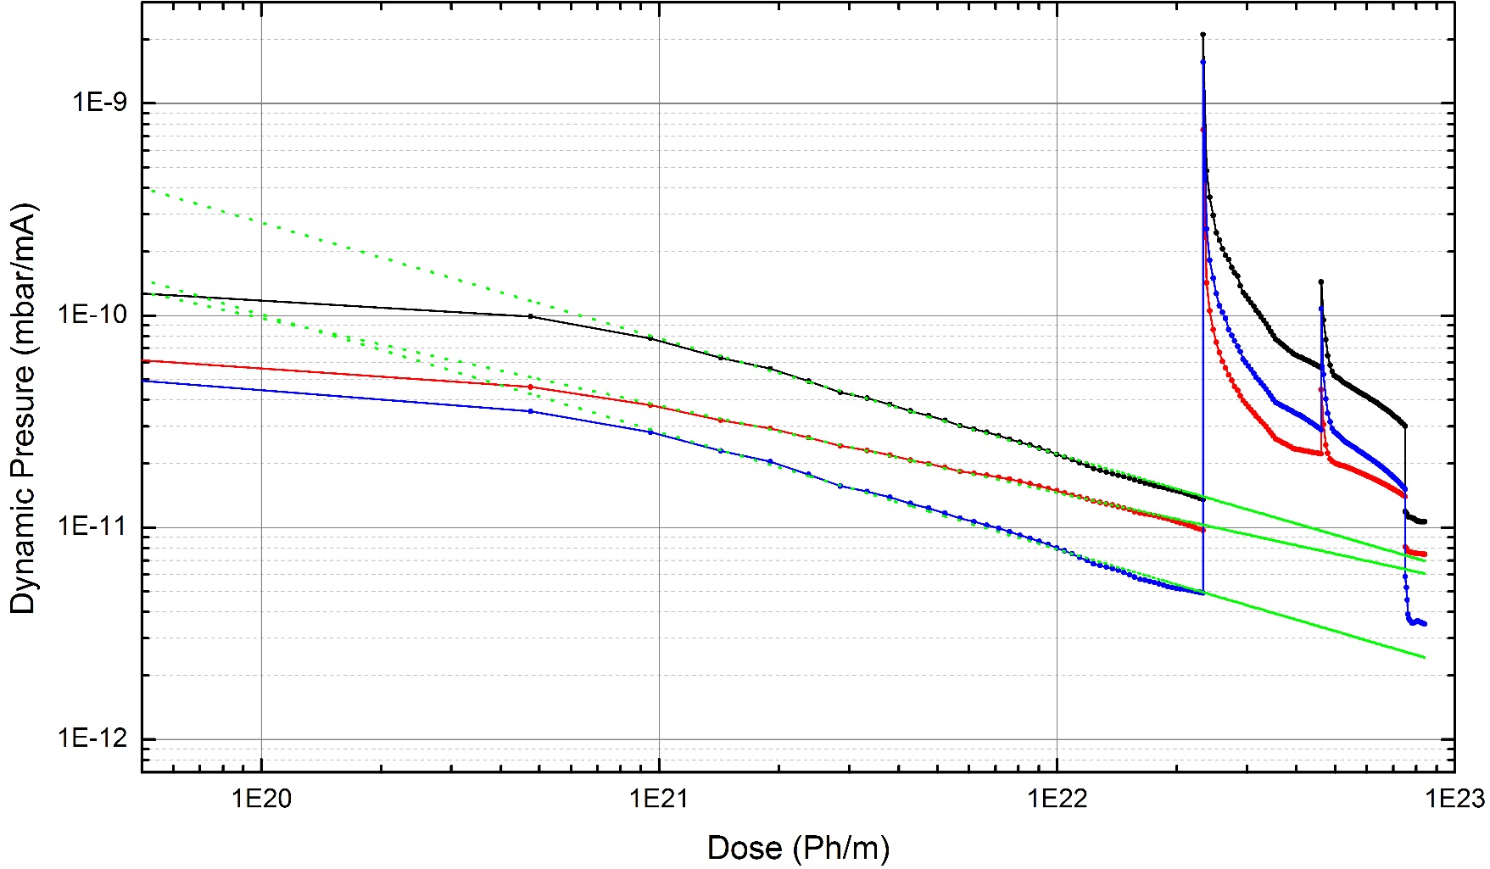

Experiment at KARA
PSD Studies
Experimental Results Prototype #1
Power
Flux
Middle
Front
Back
Levenberg-Marquardt Algorithm
X=-0.54 ± 0.01
X=-0.41 ± 0.01
X=-0.55 ± 0.01
$$η∝Γ^{x}$$
Back at Geometry #1 conditioning is rate recovered.
Pressure ~x2 larger than the foreseen after extrapolation.
Test of FCC-hh Beam Screen at the ANKA Beamline.
10
Luis Gonzalez
LNF-INFN/CERN TE-VSC
CERN February 20th 2018

Slide 20
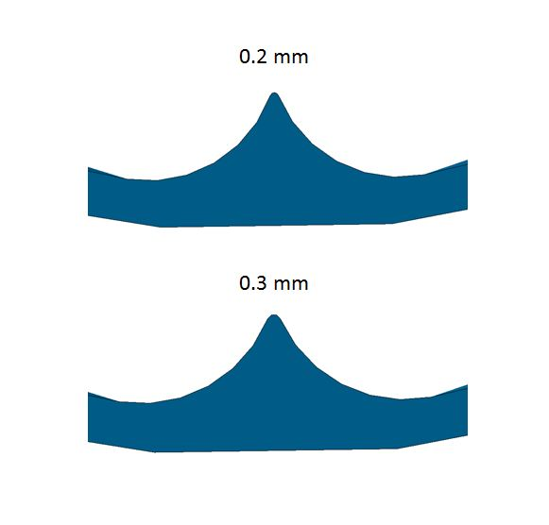
Experiment at KARA
PSD Studies
Experimental Results – Comparison with Calculations
 | 2.5GeV/130mA
 | 3Ah |  |  |  |  | 9.5Ah
 | Experiment | Calculations |  | Rel Discrepancy % |  | Experiment | Calculations |  | Rel Discrepancy %
 |  | 1st | 2nd | 1st | 2nd |  | 1st | 2nd | 1st | 2nd
Middle (mbar) | 5.7E-09 ± 15% | 2.3E-08 | 6.3E-9 | 74% | 9% | 3.0E-09 ± 15% | 1.2E-08 | 3.3E-9 | 76% | 13.2%
Front (mbar) | 2.9E-09 ± 15% | 4.7E-09 | 2.9E-9 | 33% | 1% | 2.0E-09 ± 15% | 2.8E-09 | 1.6E-9 | 31% | 15%
Back (mbar) | 2.0E-09 ± 15% | 3.8E-09 | 2.8E-9 | 46% | 29% | 1.0E-09 ± 15% | 2.0E-09 | 1.4E-9 | 45% | 25%
1st Calculations
Leak tight Chimney
Perfectly pointy reflector
2nd Calculations (more realistic)
Not leak tight Chimney
Rounded reflector
Test of FCC-hh Beam Screen at the ANKA Beamline.
11
Luis Gonzalez
LNF-INFN/CERN TE-VSC
CERN February 20th 2018

Slide 21
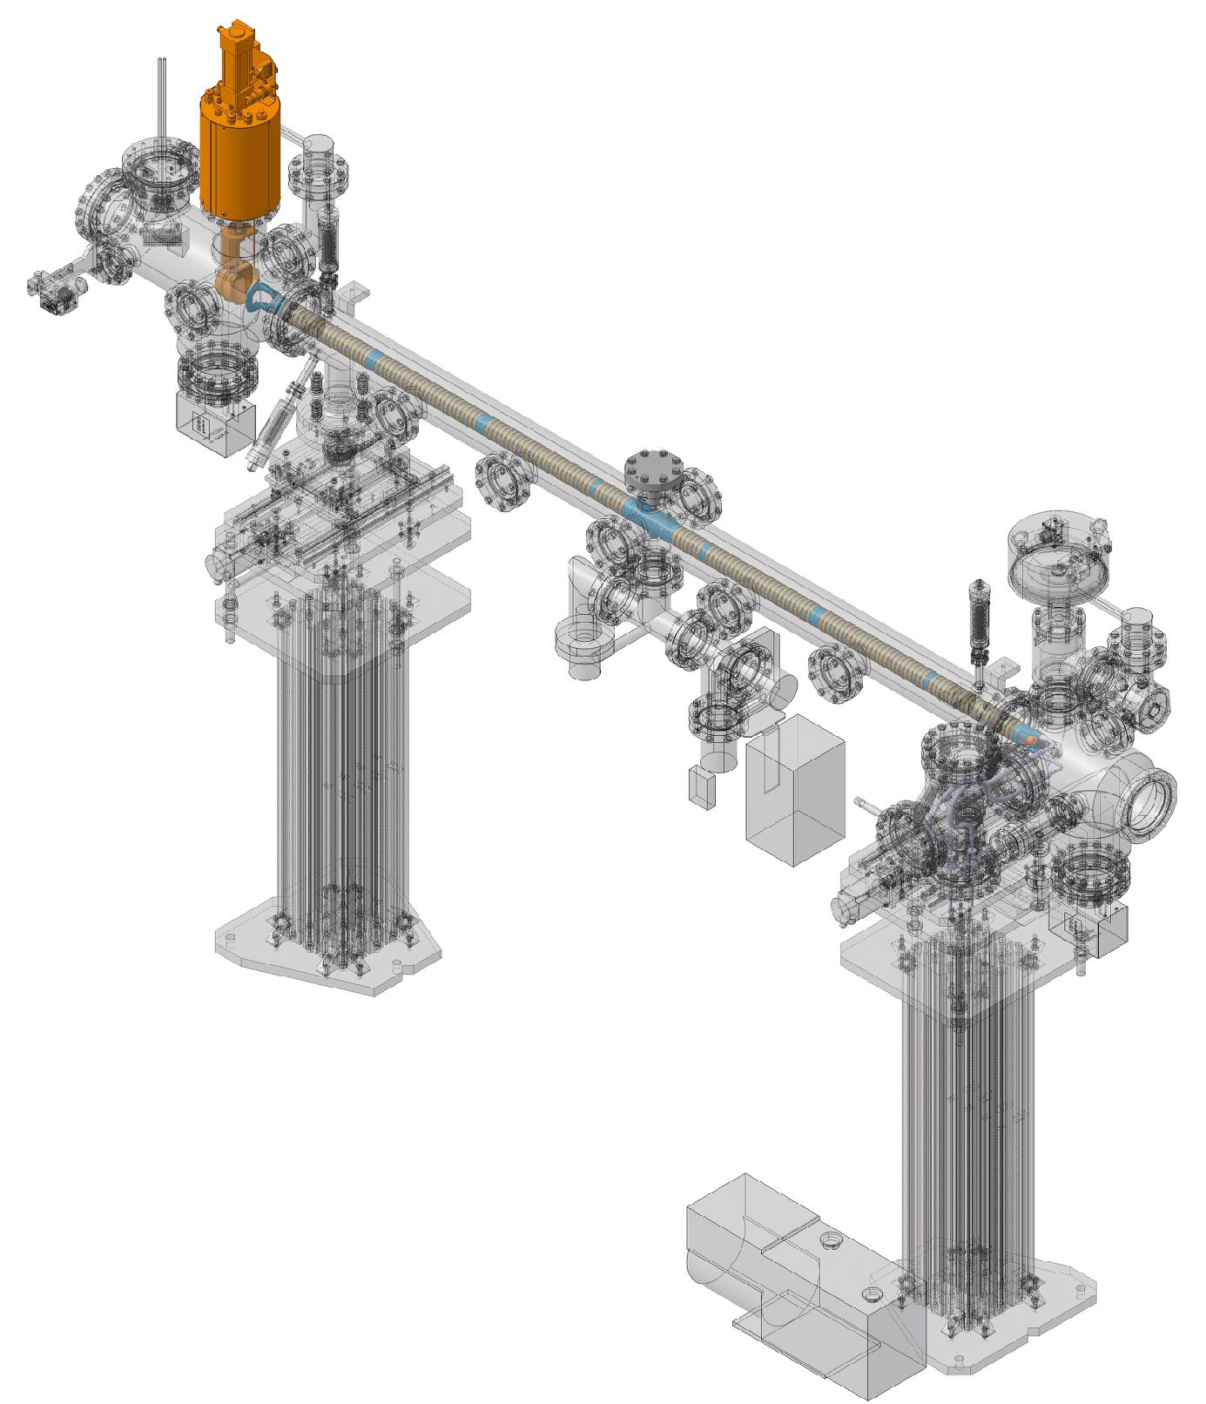
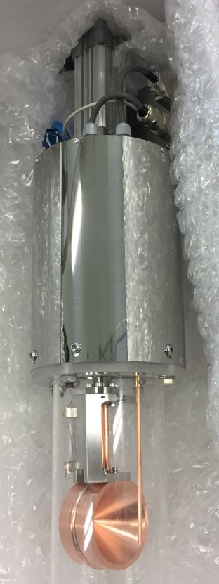
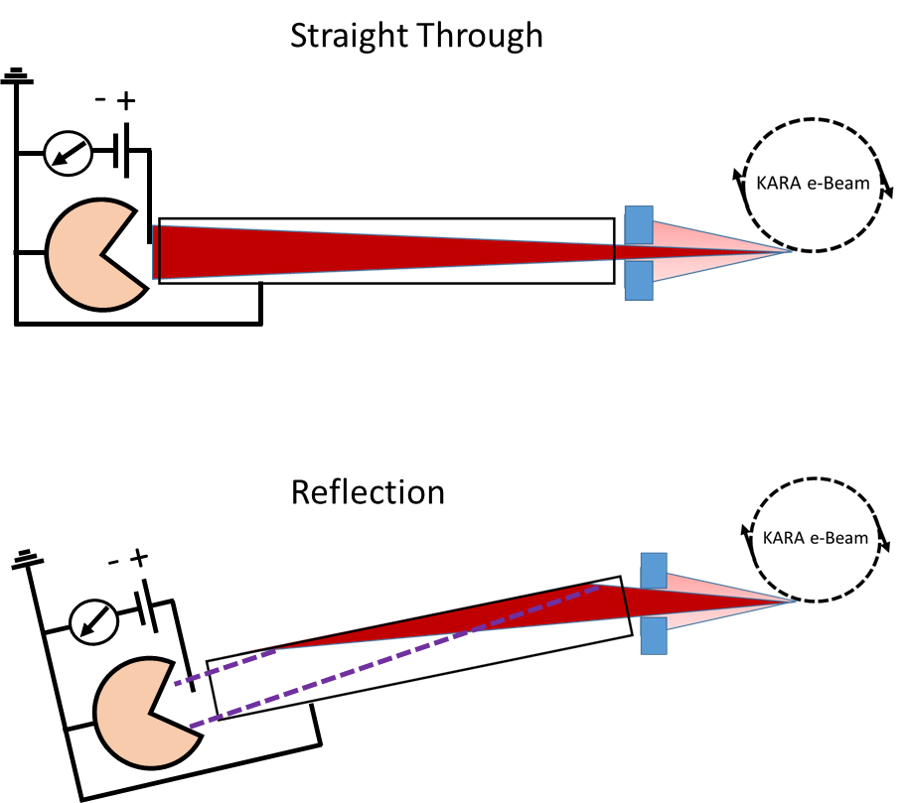

Experiment at KARA
Reflectivity Studies
Experimental Equipment
R=$\frac{I_{Reflection}}{I_{Straight Through}}x100$
Beam
Test of FCC-hh Beam Screen at the ANKA Beamline.
12
Luis Gonzalez
LNF-INFN/CERN TE-VSC
CERN February 20th 2018

Slide 22
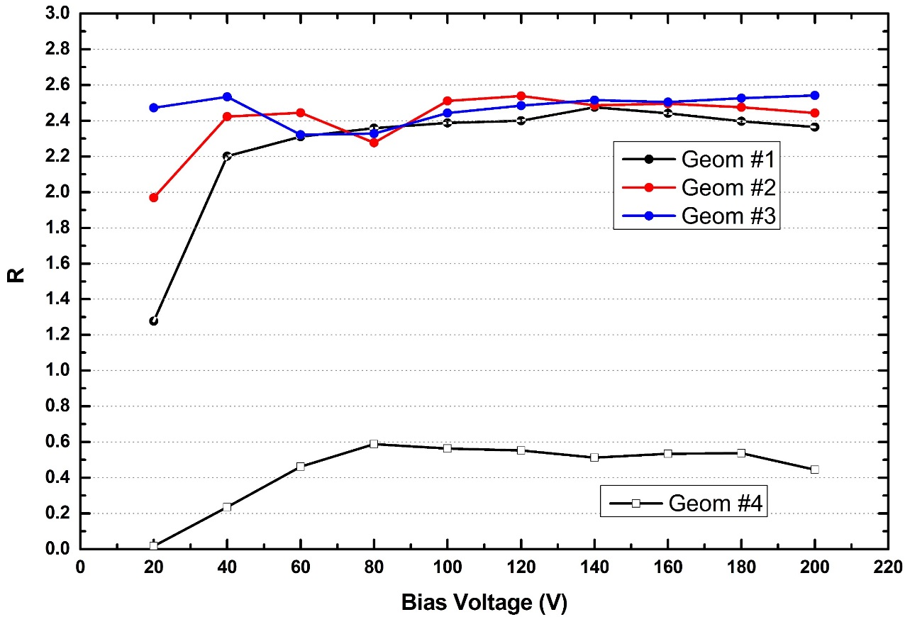
Experiment at KARA
Reflectivity Studies
Experimental Results Protoype #1
R=$\frac{I_{Reflection}}{I_{Straight Through}}x100$
2.4%
0.5%
#1
#2
#3
#4
Photoelectron current measurements at the photon cup show a very low amount of reflected photons for Geometry 4.
Test of FCC-hh Beam Screen at the ANKA Beamline.
13
Luis Gonzalez
LNF-INFN/CERN TE-VSC
CERN February 20th 2018

Slide 23
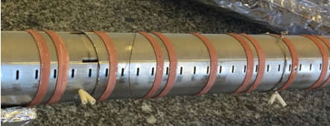
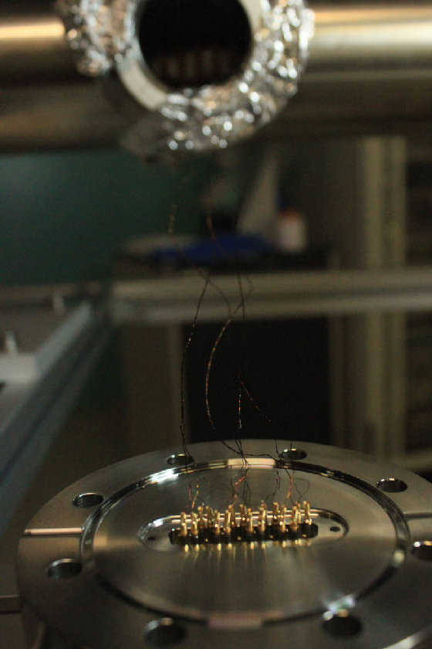
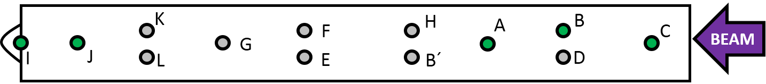
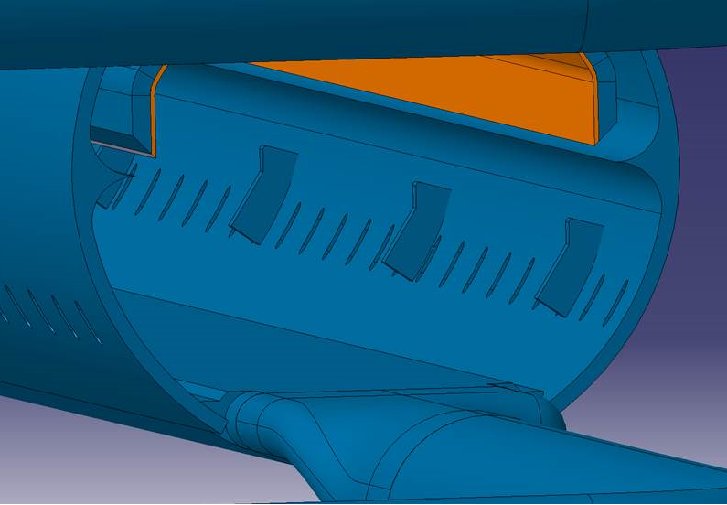
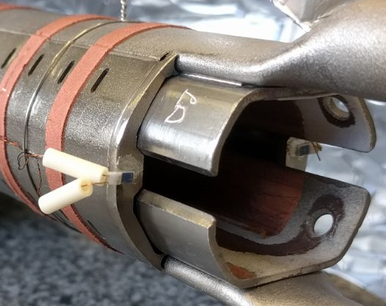
Experiment at KARA
Heat Load Studies
Experimental Equipment
PT100
PT100
Beam
Test of FCC-hh Beam Screen at the ANKA Beamline.
15
Luis Gonzalez
LNF-INFN/CERN TE-VSC
CERN February 20th 2018

Slide 24
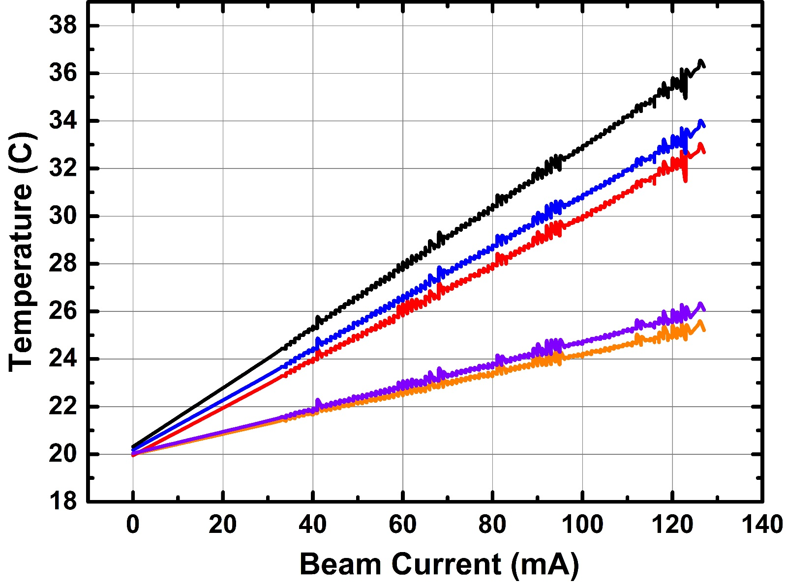
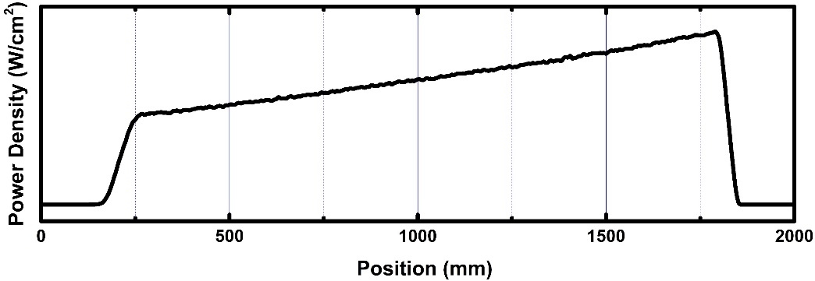
Experiment at KARA
Heat Load Studies
Experimental Results Prototype #2
C
A
J
Extrapolation
B
I
Extrapolation @ 0 mA converge in 20ºC
Reliable experimental data
Test of FCC-hh Beam Screen at the ANKA Beamline.
16
Luis Gonzalez
LNF-INFN/CERN TE-VSC
CERN February 20th 2018

Slide 25
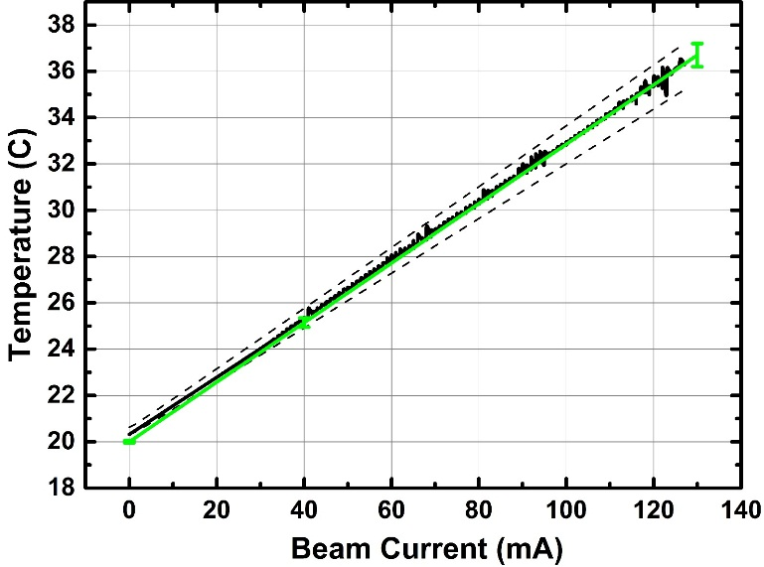
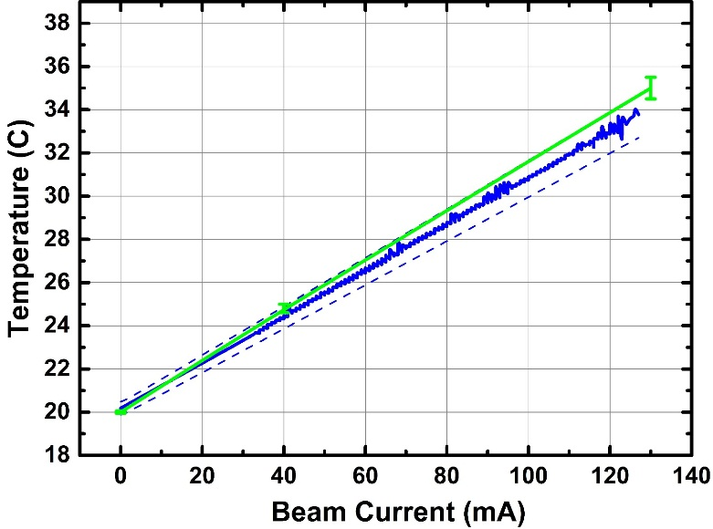
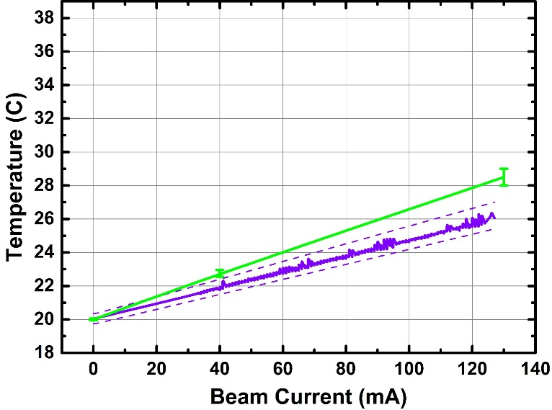
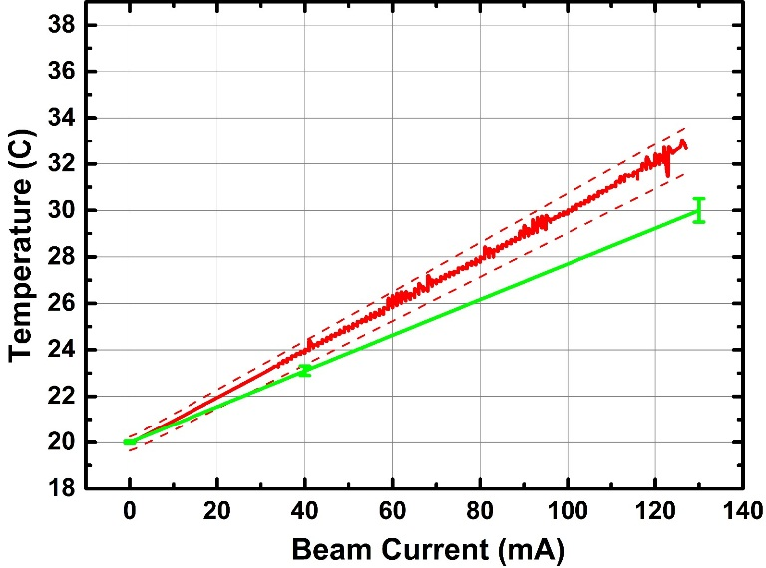
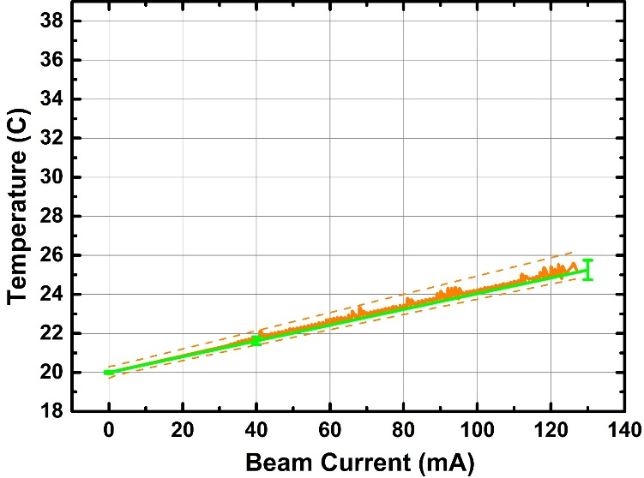

Experiment at KARA
Heat Load Studies
Experimental Results Prototype #2
Calculation
C
A
J
B
Test of FCC-hh Beam Screen at the ANKA Beamline.
17
Luis Gonzalez
LNF-INFN/CERN TE-VSC
CERN February 20th 2018

Slide 26
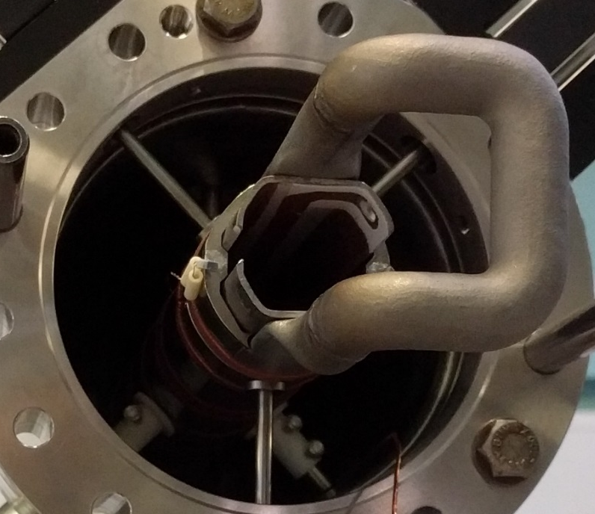
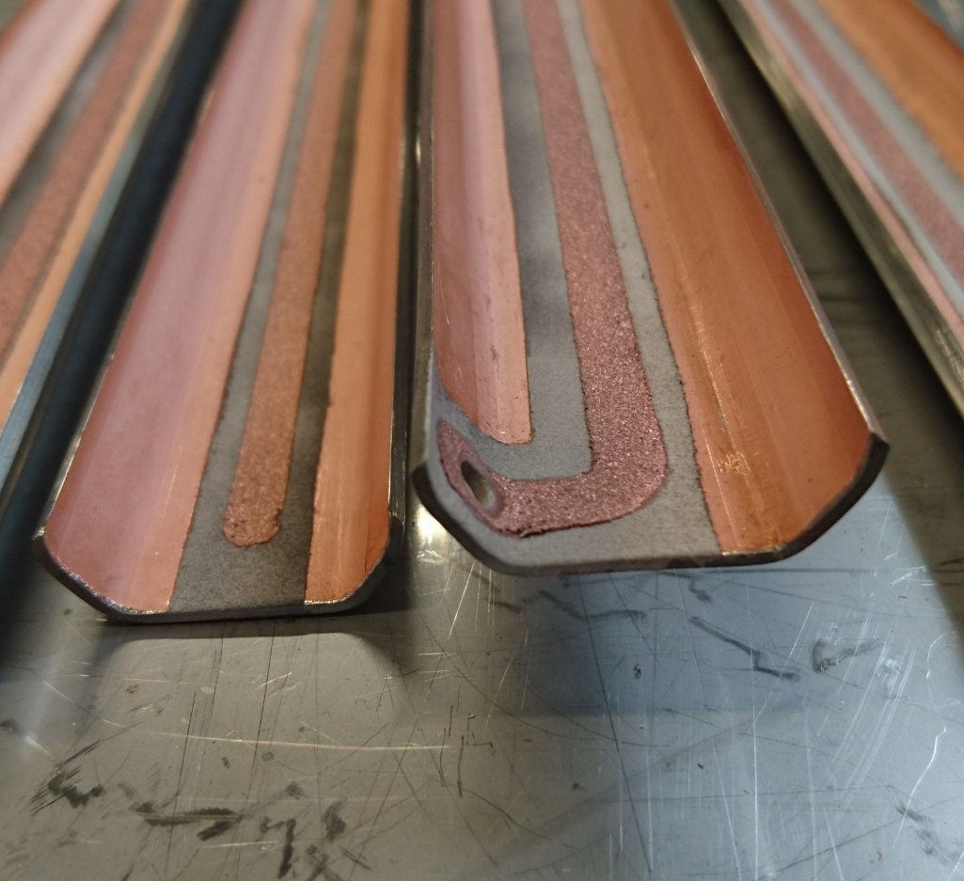
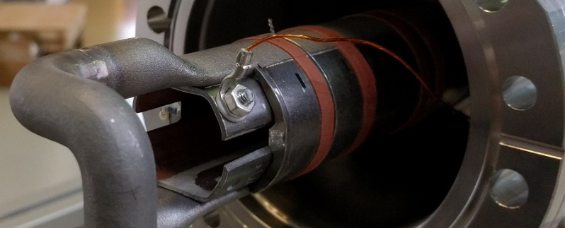
Experiment at KARA
Photoelectron Generation Studies
Experimental Equipment
Cold Sprayed Isolated Electrode
SR
e⁻
-
+
A
Test of FCC-hh Beam Screen at the ANKA Beamline.
18
Luis Gonzalez
LNF-INFN/CERN TE-VSC
CERN February 20th 2018

Slide 27
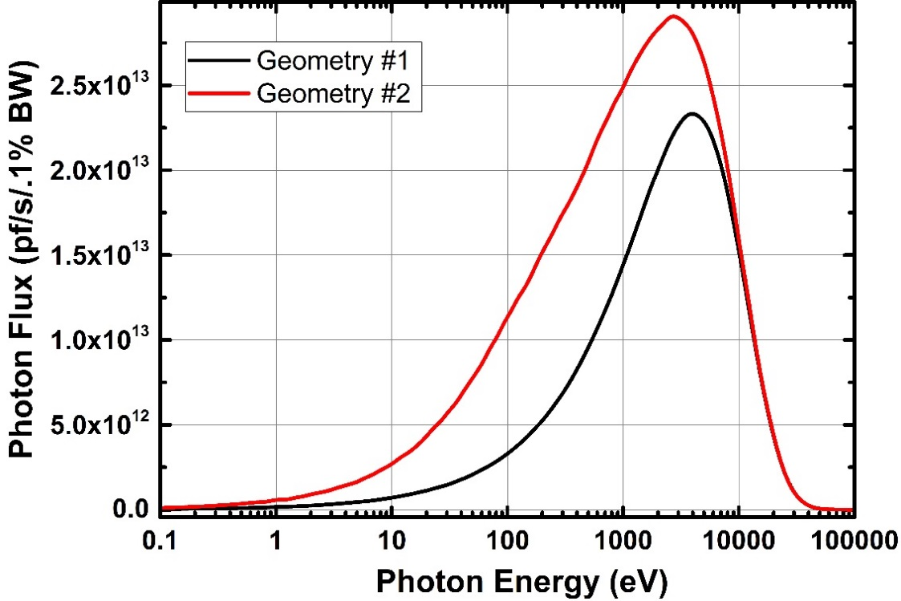
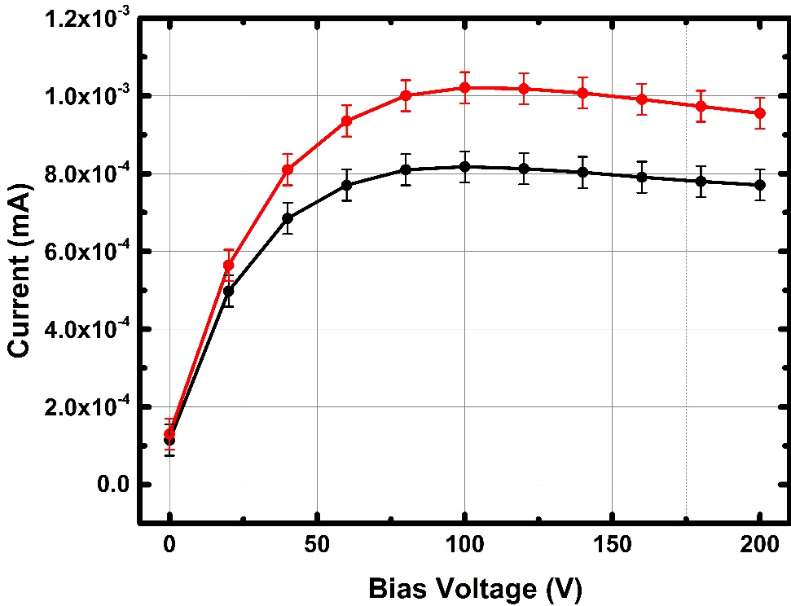
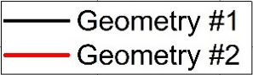
Experiment at KARA
Photoelectron Generation Studies
Experimental Results – Prototype #2
SR
e⁻
-
+
A
#2
Photon Flux
75.4% Increase
Photoelectrons
23.7% Increase
#1
Test of FCC-hh Beam Screen at the ANKA Beamline.
19
Luis Gonzalez
LNF-INFN/CERN TE-VSC
CERN February 20th 2018

Slide 28
Summary and Conclusions
After installation of BESTEX at KARA first experimental data have been obtained.
Experiments have been carried out in different irradiation configurations, in order to mimic the different scenarios at FCC-hh
Experimental PSD results in prototype #1 indicate a large amount of reflected photons inside the BS when irradiating outside the reflector region.
PSD calculations were carried out, compared to experimental results and tuned by using more realistic models.
Experimental PSD results and calculations show a discrepancy which remains below 30% in al cases.
Experimental reflectivity measurements show an unforeseen decrease of the amount of reflected photons for the misalignment case. Comparison with simulations is ongoing. Further analysis is needed.
Calculations on the temperature distribution are in good agreement with calculations.
Measurements on Photoelctron generation inside the BS have been peformed for two different configurations so far.
Further data acquisition and data interpretation is needed.
Test of FCC-hh Beam Screen at the ANKA Beamline.
20
Luis Gonzalez
LNF-INFN/CERN TE-VSC
CERN February 20th 2018

Slide 29
Acknowlegments
Miguel Gil Costa – Management, Setup development, Installation, mechanical design…
Ignasi Bellafont – Synrad + Molflow Calculations
Javier Fernandez Topham – Comsol Calculations
Antoine Benoit
Abel Gutierrez
Jesus Fernandez
Marton Ady
Alexis Vidal
Bernard Henrist
Berthold Jenninger
Ivo Wevers
Sophie Meunier
Christian Duclos
Herve Rambeau
David Saez
Erhard Huttel
Andreas Graü
CERN
Paolo Chiggiato -CERN
Roberto Cimino -INFN
Vincent Baglin -CERN
Francis Perez -ALBA
Cedric Garion -CERN
Sara Casalbuoni -KIT-IBPT
Roberto Kersevan -CERN
KIT-IBPT
Test of FCC-hh Beam Screen at the ANKA Beamline.
21
Luis Gonzalez
LNF-INFN/CERN TE-VSC
CERN February 20th 2018

Slide 30
Acknowlegments
Thank You
Test of FCC-hh Beam Screen at the ANKA Beamline.
Luis Gonzalez
LNF-INFN/CERN TE-VSC
CERN February 20th 2018

Slide 31

Test of FCC-hh Beam Screen at the ANKA Beamline.
Luis Gonzalez
LNF-INFN/CERN TE-VSC
CERN February 20th 2018

Slide 32




Test of FCC-hh Beam Screen at the ANKA Beamline.
Luis Gonzalez
LNF-INFN/CERN TE-VSC
CERN February 20th 2018

Slide 33
ANKA Parameters
Energy | 2.5 | GeV
Emittance | 50 | nm
Circumference | 110.4 | m
Current | 200 | mA
Optics | 4x2 | DBA
DP-Field | 1.5 | T
DP SR Power | 18 | W/mrad
DP SR Photon Flux | 6 10¹⁹ | Ph/(s mrad)
E_{critic} | 6.2 | KeV
FCC Parameters
DP SR Power | 32 | W/m*
DP SR Photon Flux | 1x10¹⁷ | Ph/(s m*)
BESTEX Parameters (at ANKA after collimation)
DP SR Power | 32 | W/m*
DP SR Photon Flux | 5 10¹⁶ | Ph/(s m*)
Incident angle | 18 | mrad
*m: irradiated length
Test of FCC-hh Beam Screen at the ANKA Beamline.
Luis Gonzalez
LNF-INFN/CERN TE-VSC
CERN February 20th 2018

Slide 34




Test of FCC-hh Beam Screen at the ANKA Beamline.
Luis Gonzalez
LNF-INFN/CERN TE-VSC
CERN February 20th 2018

Slide 35




Test of FCC-hh Beam Screen at the ANKA Beamline.
Luis Gonzalez
LNF-INFN/CERN TE-VSC
CERN February 20th 2018

Slide 36


Test of FCC-hh Beam Screen at the ANKA Beamline.
Luis Gonzalez
LNF-INFN/CERN TE-VSC
CERN February 20th 2018

Slide 37

Test of FCC-hh Beam Screen at the ANKA Beamline.
Luis Gonzalez
LNF-INFN/CERN TE-VSC
CERN February 20th 2018

Slide 38


Experiment at KARA
PSD Studies
Experimental Results
Middle
Front
Back
Levenberg-Marquardt Algorithm
X=-0.16 ± 0.01
X=-0.02 ± 0.01
X=-0.23 ± 0.01
Power
Flux
Test of FCC-hh Beam Screen at the ANKA Beamline.
Luis Gonzalez
LNF-INFN/CERN TE-VSC
CERN February 20th 2018

Slide 39

Experiment at KARA
PSD Studies
Experimental Results
Middle
Front
Back
Levenberg-Marquardt Algorithm
X=-0.16 ± 0.01
X=-0.02 ± 0.01
X=-0.23 ± 0.01
Lower starting point lower conditioning rate.
Indicates pre-conditioning of the Geometry #4 region due to scattered photons
Test of FCC-hh Beam Screen at the ANKA Beamline.
Luis Gonzalez
LNF-INFN/CERN TE-VSC
CERN February 20th 2018

Slide 40




Experiment at KARA
Photoelectron Currents Ratio
Reflectivity Studies
Experimental Results
.
Geometry #1
$$\frac{I_{Reflection}}{I_{Straight Through}}x100$$
$$\frac{Γ_{Reflection}}{Γ_{Straight Through}}x100$$
.
Straight Irradiation
Irradiation after Reflection
Geometry
#1
2.4%
1.3%
Geometry #2
Straight Irradiation
Irradiation after Reflection
Geometry #3
2.4%
1.2%
Geometry
#2 & #3
Geometry #4
Straight Irradiation
Irradiation after Reflection
0.5%
0.3%
Geometry
#4
Test of FCC-hh Beam Screen at the ANKA Beamline.
Luis Gonzalez
LNF-INFN/CERN TE-VSC
CERN February 20th 2018

Slide 41

Acknowlegments

Slide 42


