Slide 1
How can physicists explore the particle world?(I)
Junji Haba (KEK)
The 4th Asia Europe Pacific School of HEP
At Quy Nhon, Vietnam

Slide 2
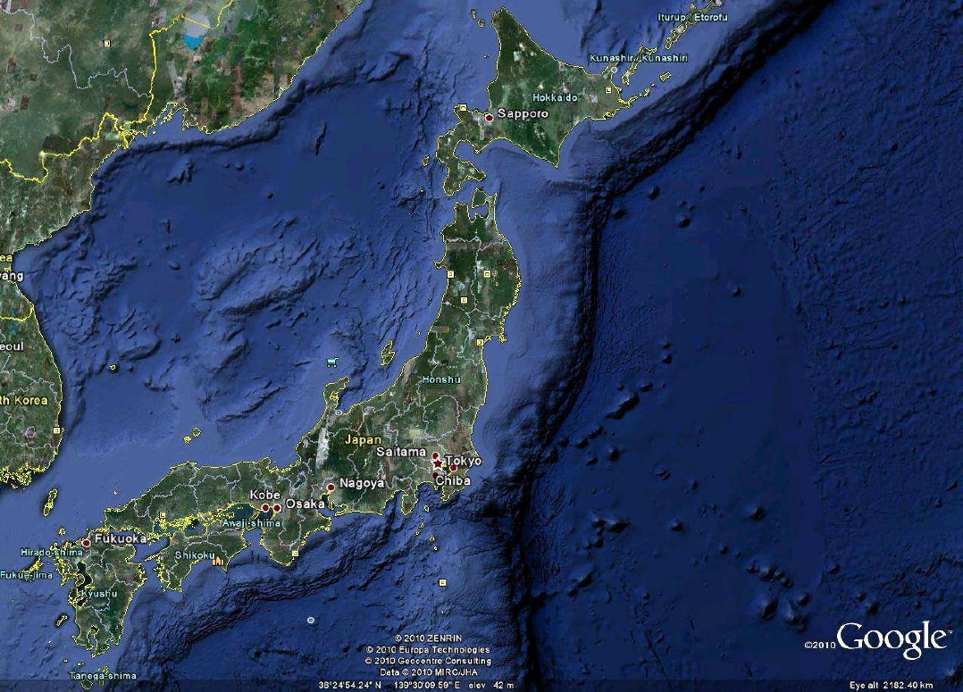
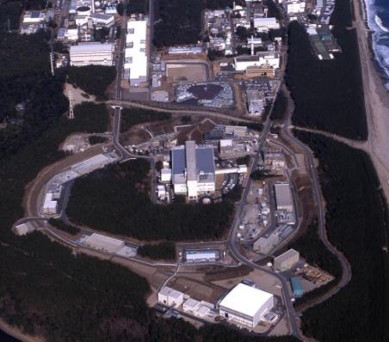
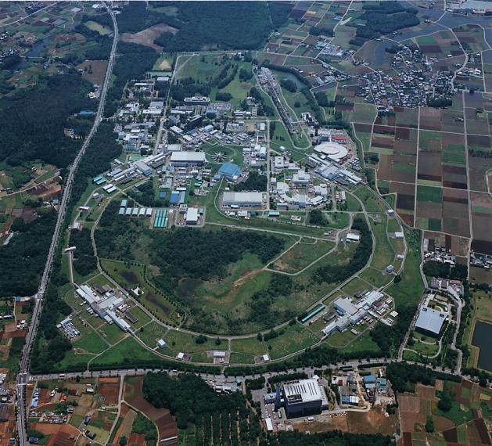
Electron accelerators in Tsukuba
and proton accelerators in Tokai
J-PARC: high intensity proton accelerator complex jointly operated by KEK and JAEA
KEK Tsukuba: SuperKEKB, PF, ATF
Tokai
Tsukuba

Slide 3
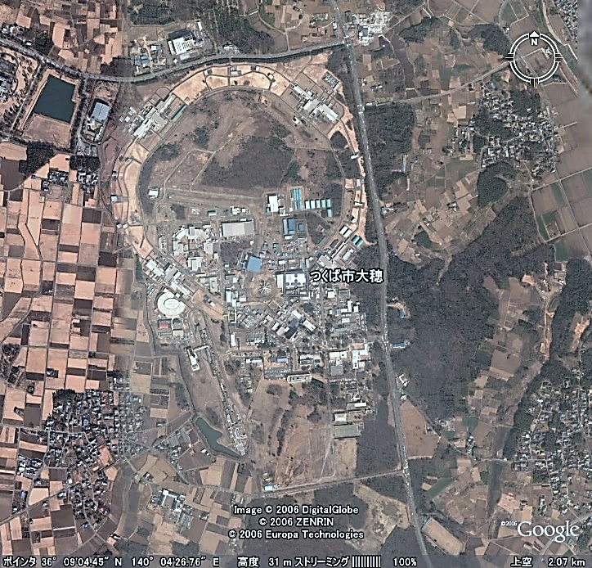
KEK Accelerators
Tsukuaba Electron/Positron
1km diameter
large accelerator ring
10m underground
SuperKEKB/
Belle II
PF PF-AR
(SRF)

Slide 4
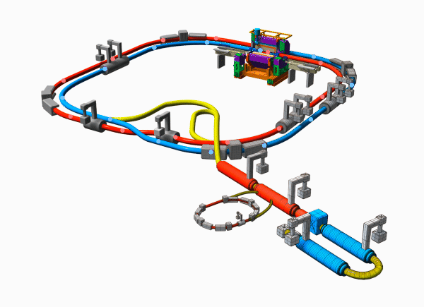


Slide 5
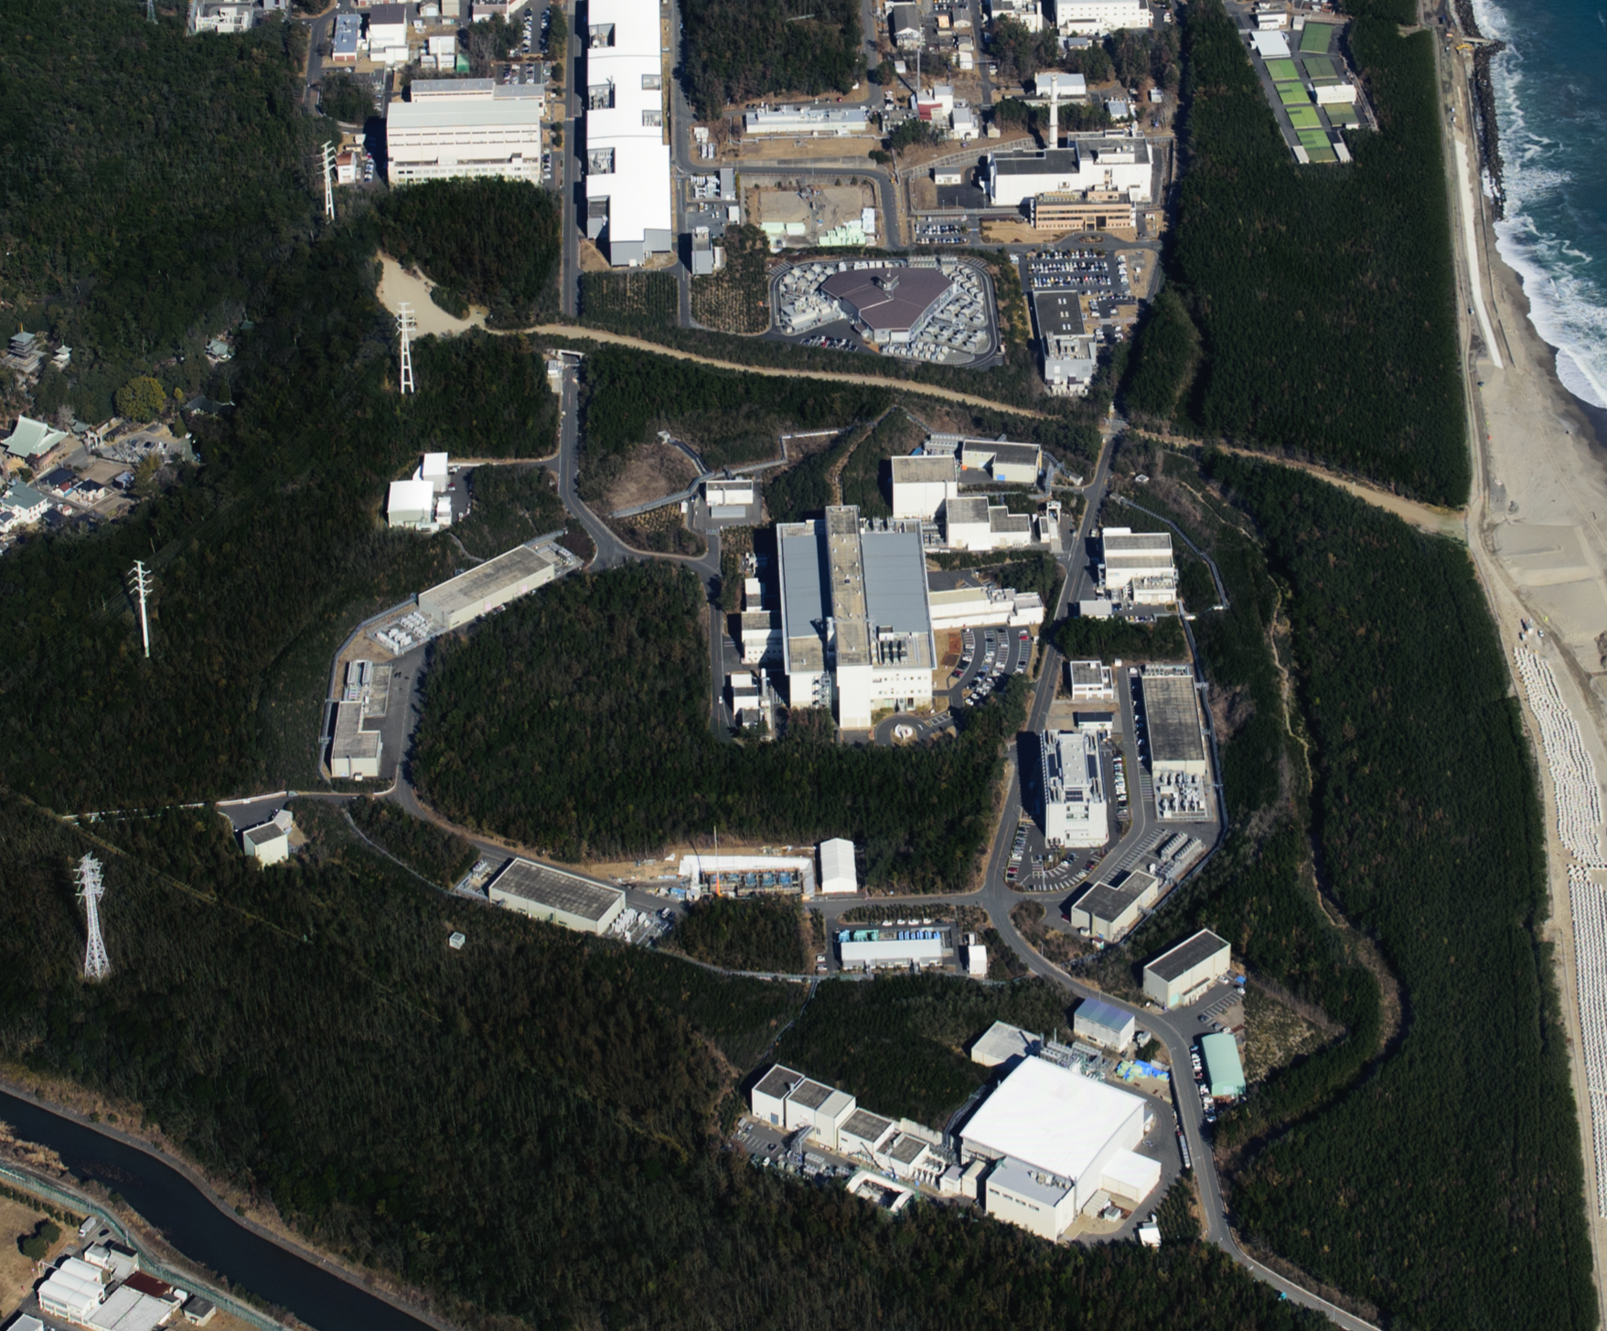

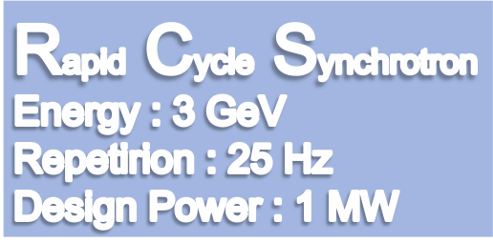




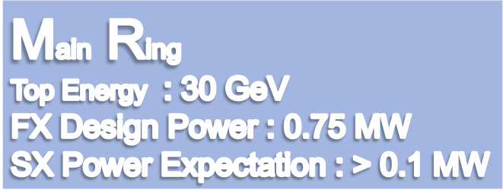
KEK Accelerator
Tokai proton
LINAC
400 MeV
Neutrino Beam to Kamioka
Currently 0.525MW
Material and Life Science Facility
Currently 0.485 MW(FX) and 0.051 MW (SX)
Hadron Hall
Notes:
まず、こちらが、J-PARCの加速器複合施設です。陽子ビームを１８１MeVまで加速する（来年度以降４００ MeVになる）線形加速器ライナックがあり、その後、ビームは、40 msという短い時間の間に3 GeVまで加速されます。そのビームのほとんどは、この物質生命科学実験施設で中性子やミュオンを使った実験の為に使われています。

Slide 6
Disclaimer
This lecture was originally prepared for the students of PPSEA school (Partilce Physics School in South East Asea)
The lecture is intended to give the most fundamental idea about the particle detector to students in early year master course students (and also theorists who have some interests on the topics).
Elder sutudents may enjoy good break for their brain among high level lectures in this high-quality School.

Slide 7
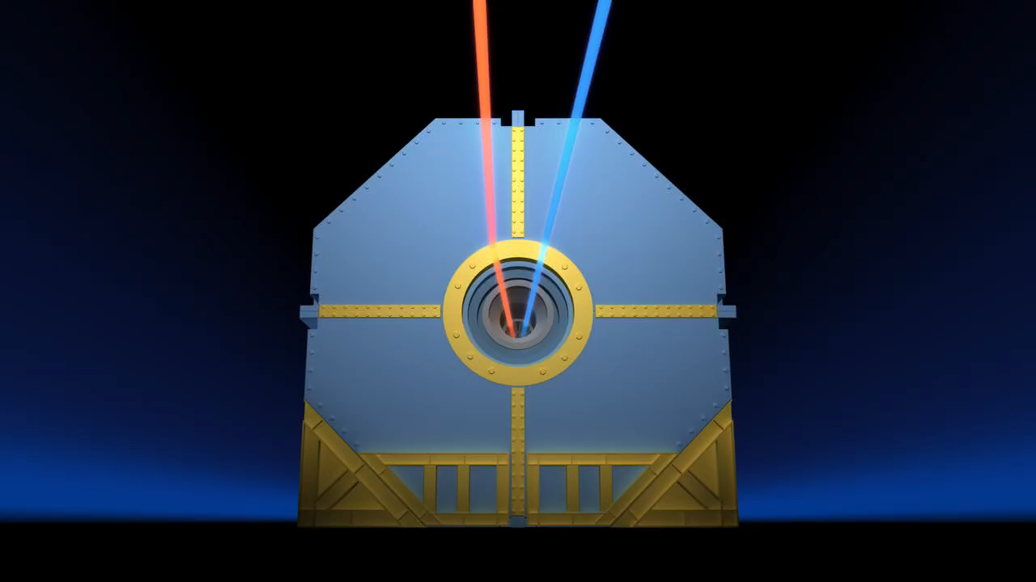
Colliding beams

Slide 8
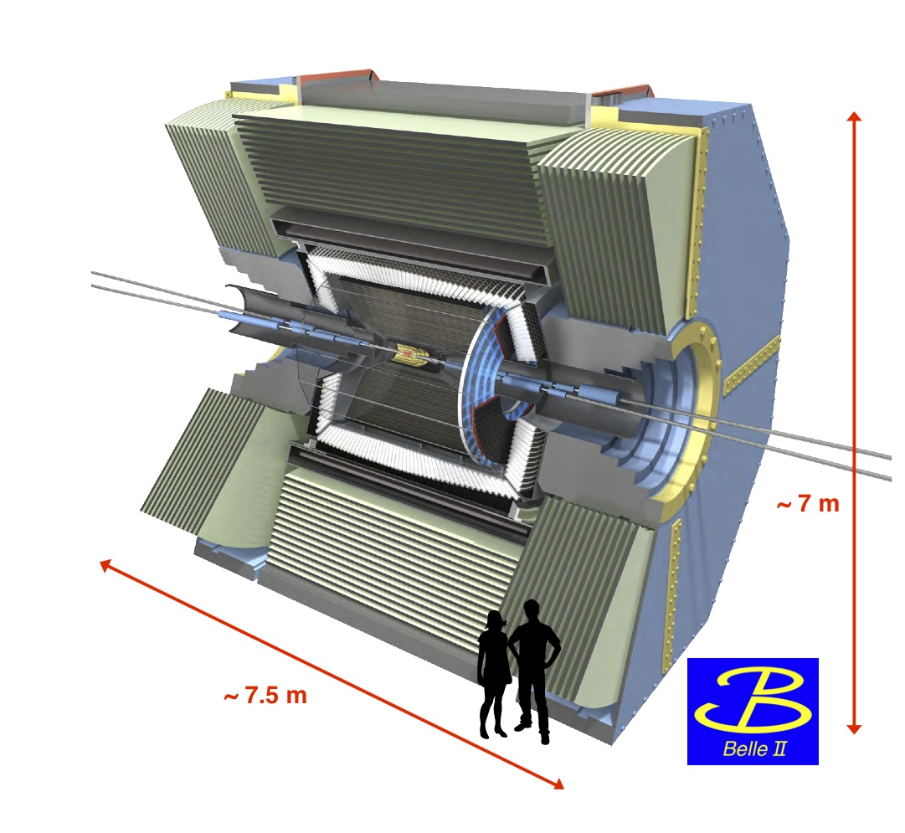
Why do we need this huge equipment?

Slide 9
To study the particles and their interactions…
Detect the emerging particles
Measure their kinematical quantities
  Momentum, velocity, energy or mass….
  →Four momentum (E,p_{x},p_{y},p_{z}) using Lorentz relations
  Charge
Determine mass/Identify particle species
Reconstruct the particle interactions/decays

Slide 10
Key concept
Four vectors can be determined for final particles
Four vector is conseverd through any interaction/decay
You can reconstruct
the initial (original interesting)
Particle such as Higgs as

Slide 11
Review of Relativistic kinematics
Formula from Einstein’s Relativity
  Equivalence among energy and mass
  Mass would increase according to its velocity

Slide 12
Important relations
momentum
Four vector and Lorentz invariance

Slide 13
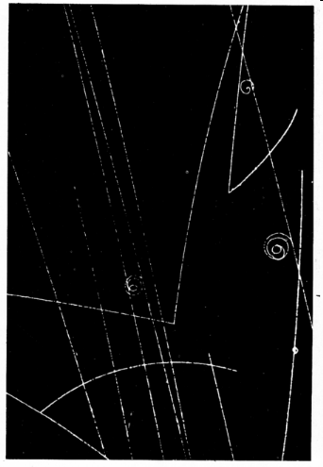
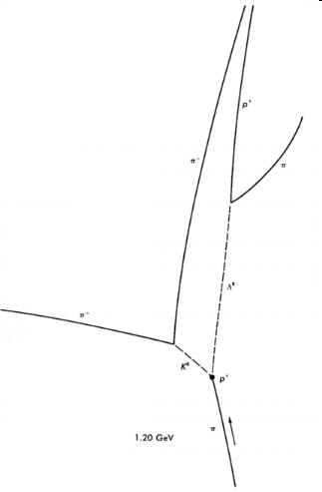
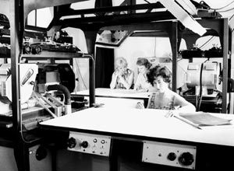
What can we actually do with the detector?
Legacy experiments with Bubble Chamber
Measure Energy/momentum and velocity
Detemine the mass/identify particles
Four vector determined.
Mother particles identified
Interatction reconsructed
p
+
+
−
π
π
0
Event
Reconstuction
−
Λ
π
0
K
−
π

Slide 14
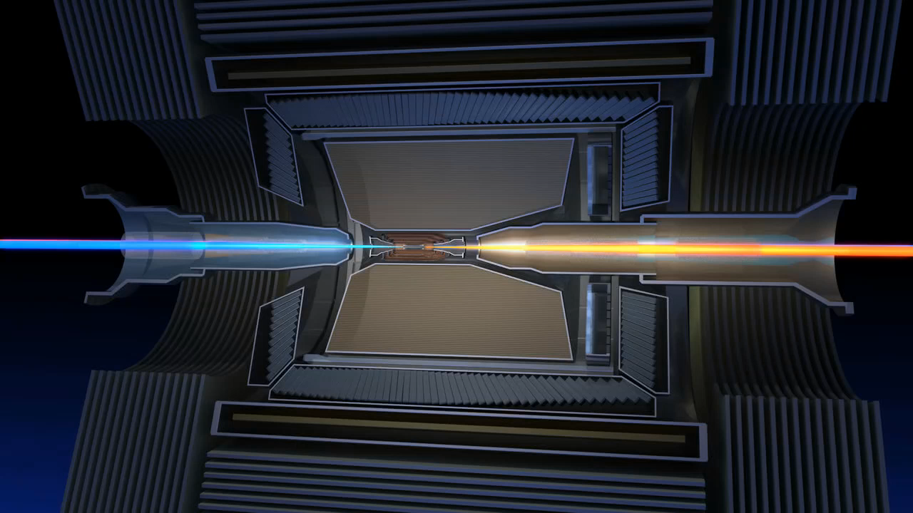
Collider experiment and detector

Slide 15
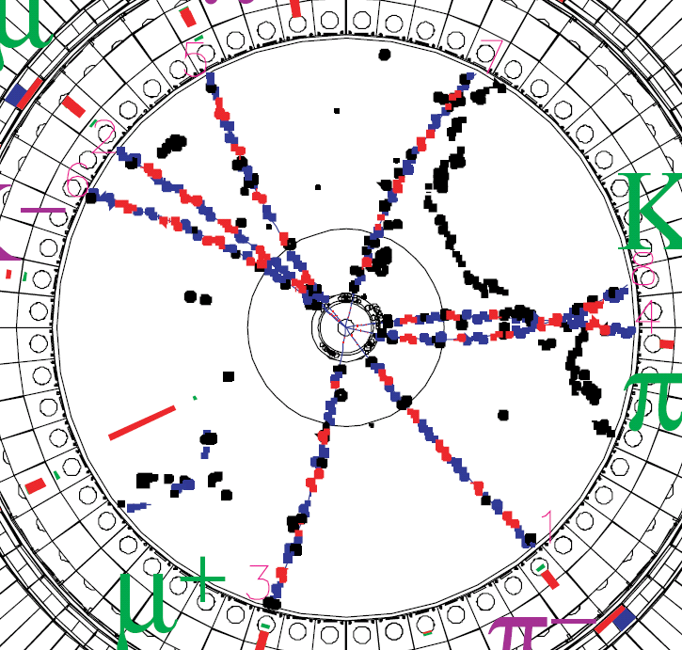
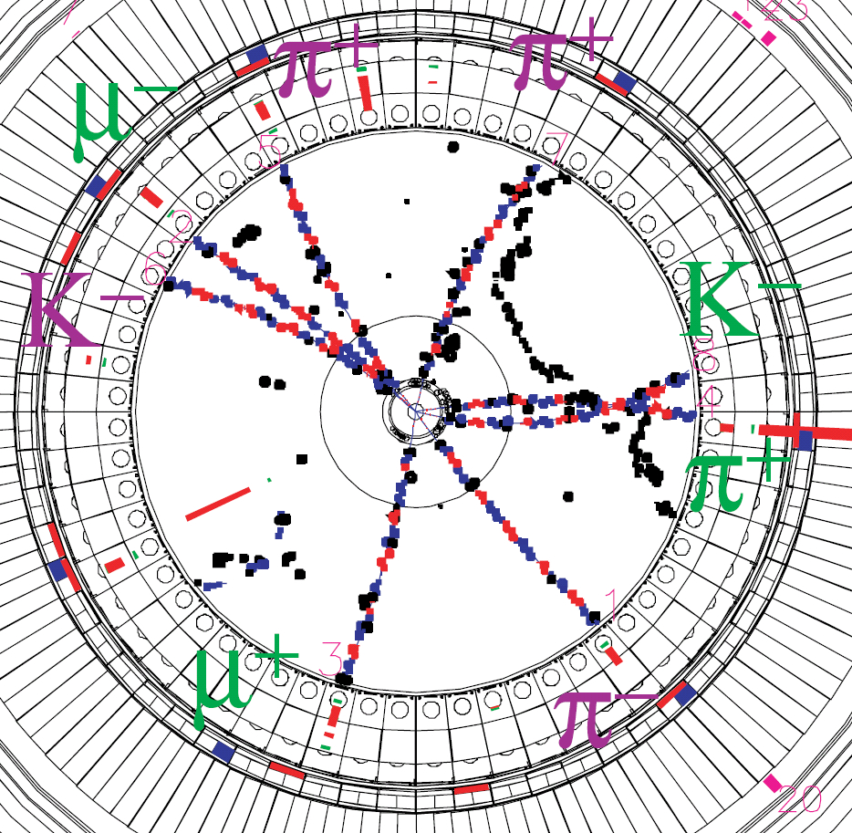
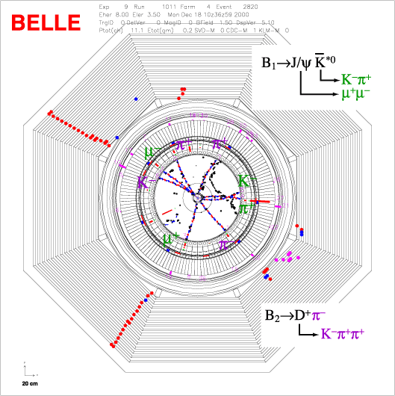
Today,
“Digital bubble chamber”

Slide 16
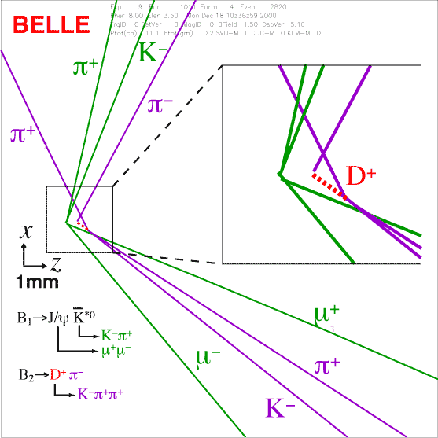
Event reconstruction using signals from millions of detector sensors with computers
We can reproduce elementary particle reactions created inside the accelerator vacuum tube..
electron
B₁
B₂
positron

Slide 17
How to detect the particles ?
  Unable to see
  Unable to touch
→Try to find the faint trace of the particles
(Ionization, excitation of molecule)
    Classical: Cloud chamber, bubble chamber, spark chamber, scintillator …..
    Modern：Drift chamber, TPC, silicon detector, scintillator….
→Try to catch the faint light emitted from the particles
    Cherenkov radiation detector, transition radiation detector

Slide 18
Energy loss due to ionization
Similar velocity as atomic orbital electron
Relativistic
rise
No theory

Slide 19
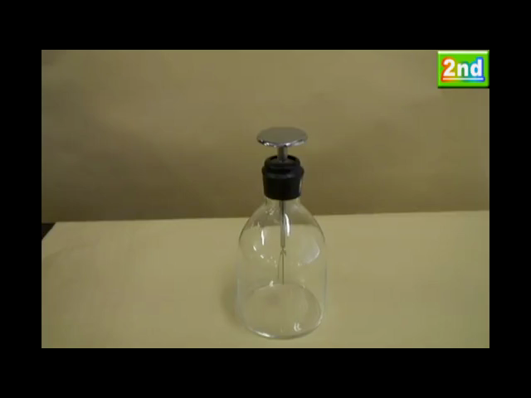
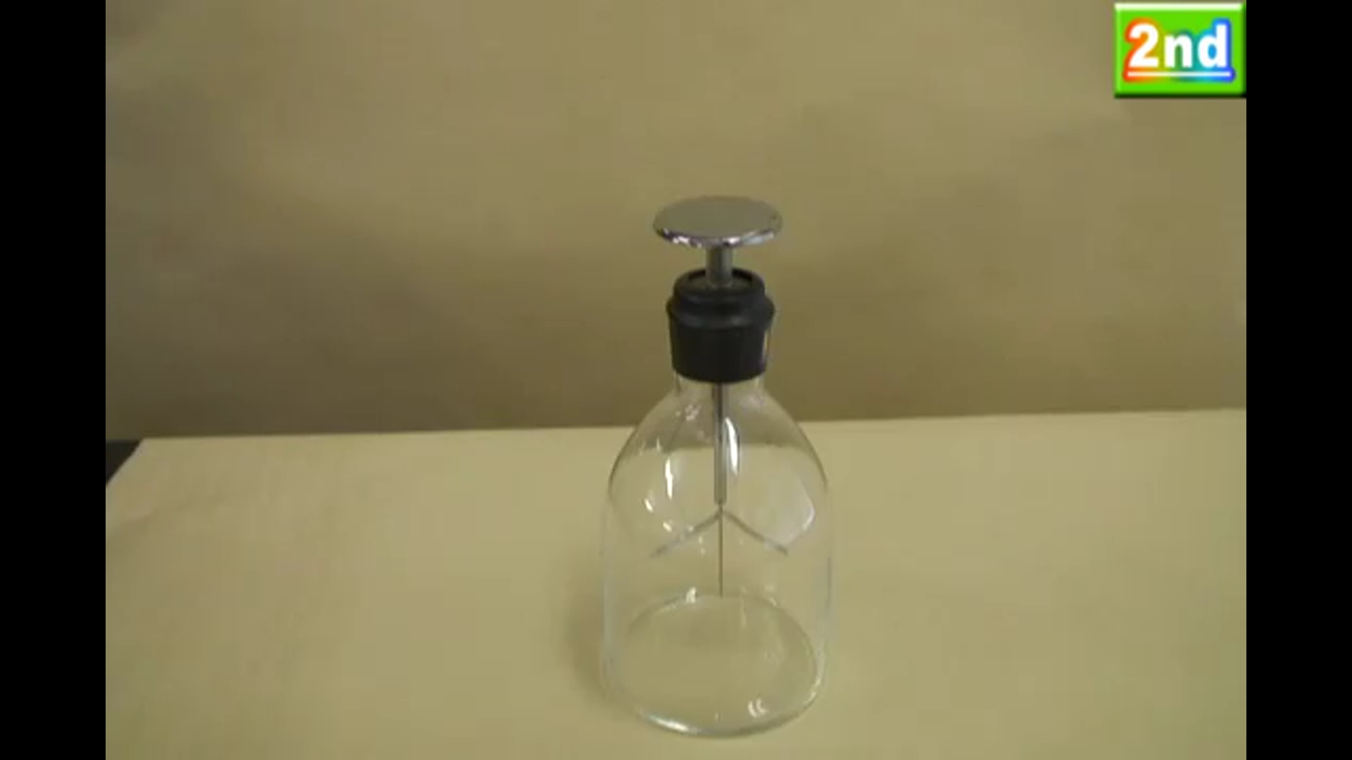
First particle detector using ionization:
Leaf electroscope
Discarged through ionization
of particles passing nearby

Slide 20
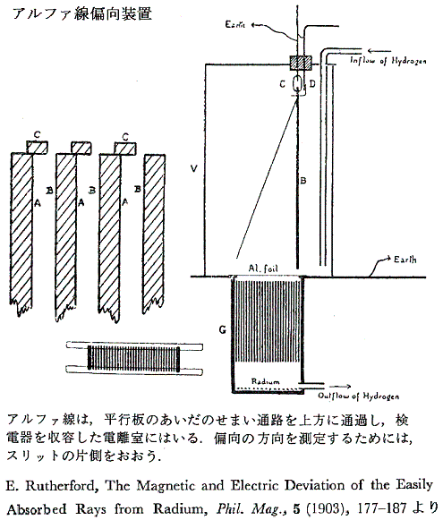
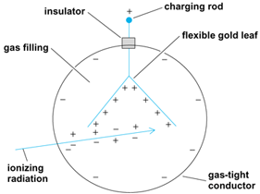
How can we see ionization?
Very early attempt

Slide 21
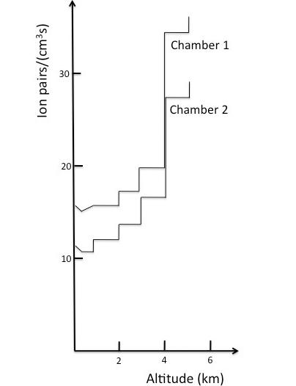
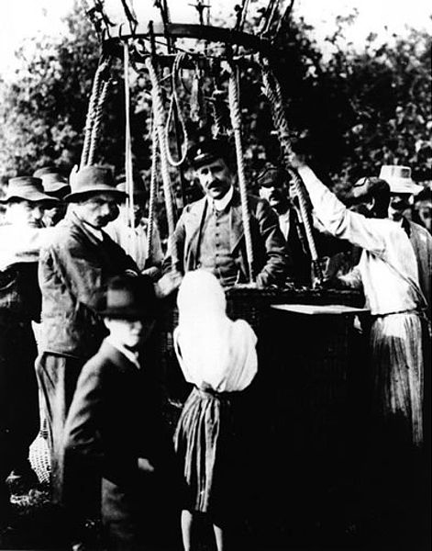
Leaf electroscope carried by balloon to confirm the existence of Cosmic Ray for the first time.
Discharge seems quicker in higher altitude.
Dr. Hess was coming back from the ballon fight in 1912 August
in which he discovered Cosmic ray for the ftirst ime
Source: American Physical Society.

Slide 22
To discover new elementary particle, radiation flux measurement is not sufficient.
Need to observe radiation particle by particle, photon by photon , quanta by quanta ,
It is impossible to see this tiny signal
→Small stimulation (Ionization, emission) may trigger visible large enough effect which make an observation possible.

Slide 23
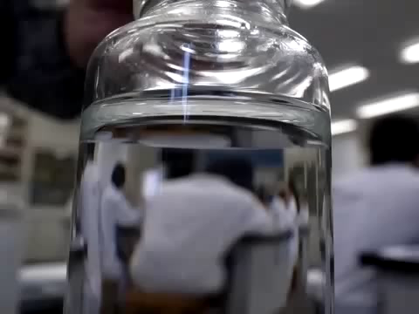
We want to observe any direct sign of particle passing by Eyes.
Tiny effect stimulated by particle (Ionization) may sometime trigger a visible signature in matter
Supersaturated
Water solution of
sodium acetate
http://www.youtube.com/user/ikemonmon

Slide 24
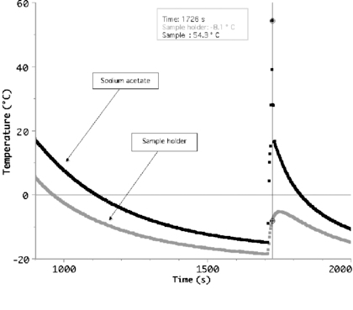
Supercooled solution and sudden crystallization caused by a tiny stimulation
Figure 7 from Using Peltier cells to study solid–liquid–vapour transitions and supercooling
Giacomo Torzo et al 2007 Eur. J. Phys. 28 S13 doi:10.1088/0143-0807/28/3/S02

Slide 25
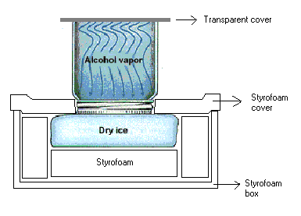

Cloud chamber
Contrail
Generated in super saturated vapor
Particle detector
you can build
at home

Slide 26
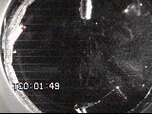
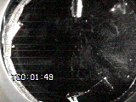
Cloud chamber animation

Slide 27
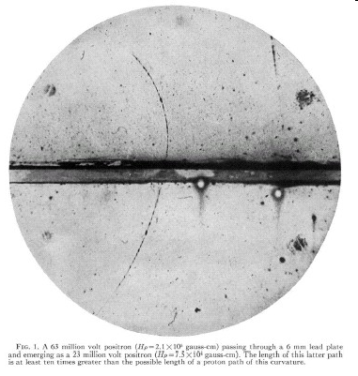
Cloud chamber, energy loss and discovery of positron(1932)
Anderson's cloud chamber picture of cosmic radiation from 1932 showing for the first time the existence of the anti-electron that we now call the positron. In the picture a charged particle is seen entering from the bottom at high energy. It then looses some of the energy in passing through the 6 mm thick lead plate in the middle. The cloud chamber is placed in a magnetic field and from the curvature of the track one can deduce that it is a positively charged particle. From the energy loss in the lead and the length of the tracks after passing though the lead, an upper limit of the mass of the particle can be made. In this case Anderson deduces that the mass is less than two times the mass of the electron. Caption credit: CERN
Q=+1
p and ΔE

Slide 28
What can you tell from the Anderson’s picture?
Momentum of particle?
Mass of particle?
Charge of particle?
Discovery or routine observation?

Slide 29
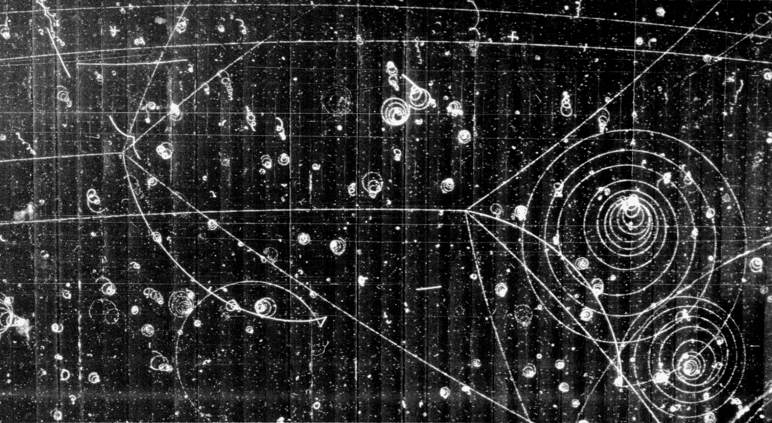
“Cloud” was replaced with “Bubble” shortly

Slide 30
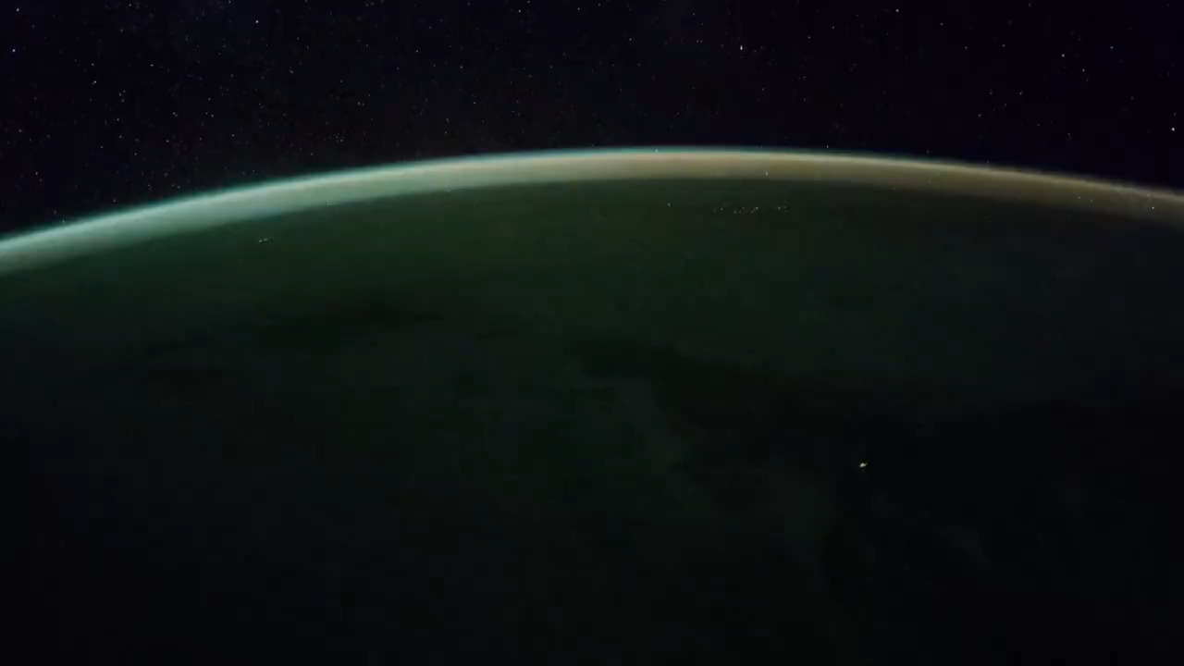
Excitation and scintillation
Aurora is a cosmic ray detector in the skay

Slide 31
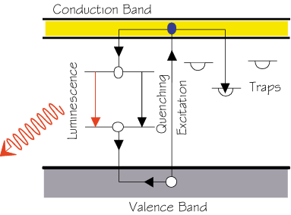
Scitillation
Demonstration
UV LED light and scintillators

Slide 32



Cherenkov Radiation (1)
Moving charge in matter
at rest
slow
fast

Slide 33
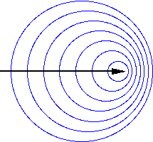
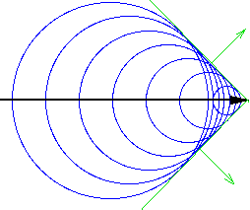
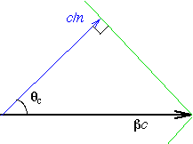
Cherenkov Radiation (2)
Wave front comes out at certain angle
The particle with β<1/n could never emit the radiation

Slide 34
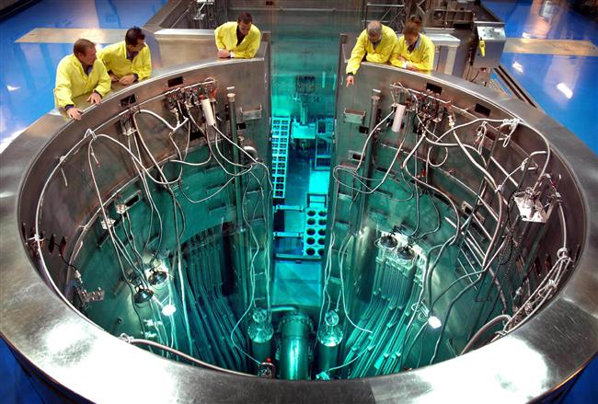
Cherenkov light in reactors
OPAL –
the Open Pool Australian Lightwater reactor

Slide 35
Intreraction of neutral particles
Unable to see their ionizations
Unable to detect their radiation
  Photon, γ, X Electromagnetic interaction
  Neutron strong interaction with nucleus or nucleon
  Neutrino weak interaction with nucleon

Slide 36
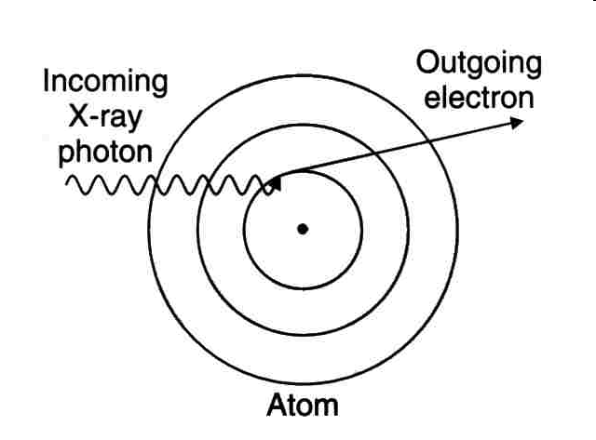
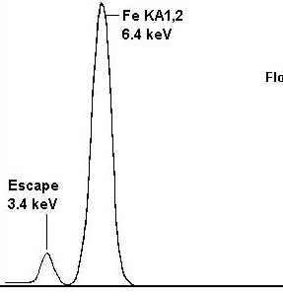
Photoelectric effect
X ray
Absorbed

Slide 37
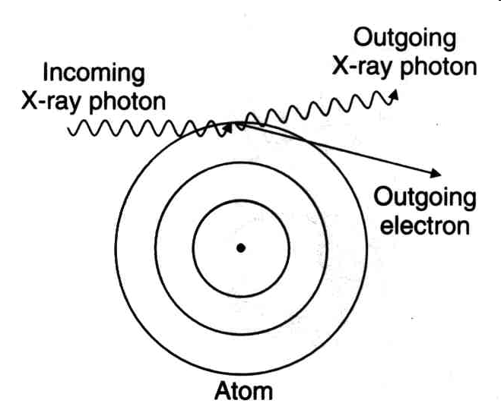
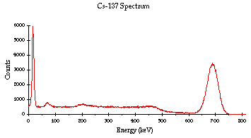
Compton scattering
escaping
absorbed
Maximum energy
transfer

Slide 38
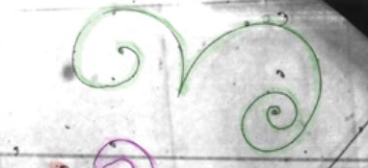
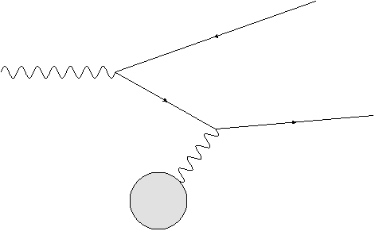
Pair Creation
Postiron
γ
Electron
Nucleus Ｚｅ

Slide 39
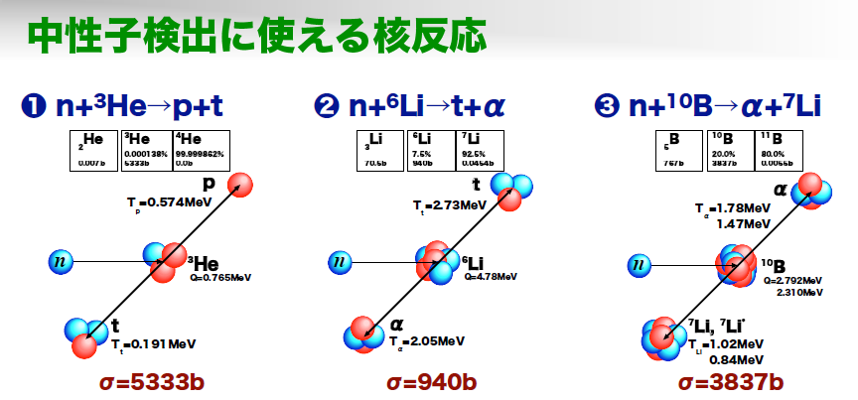
Detection of Neutron
Low energy
Nuclear reaction useful to detect neutrons
Shimizu

Slide 40
Neutron interaction at higher energy

Slide 41
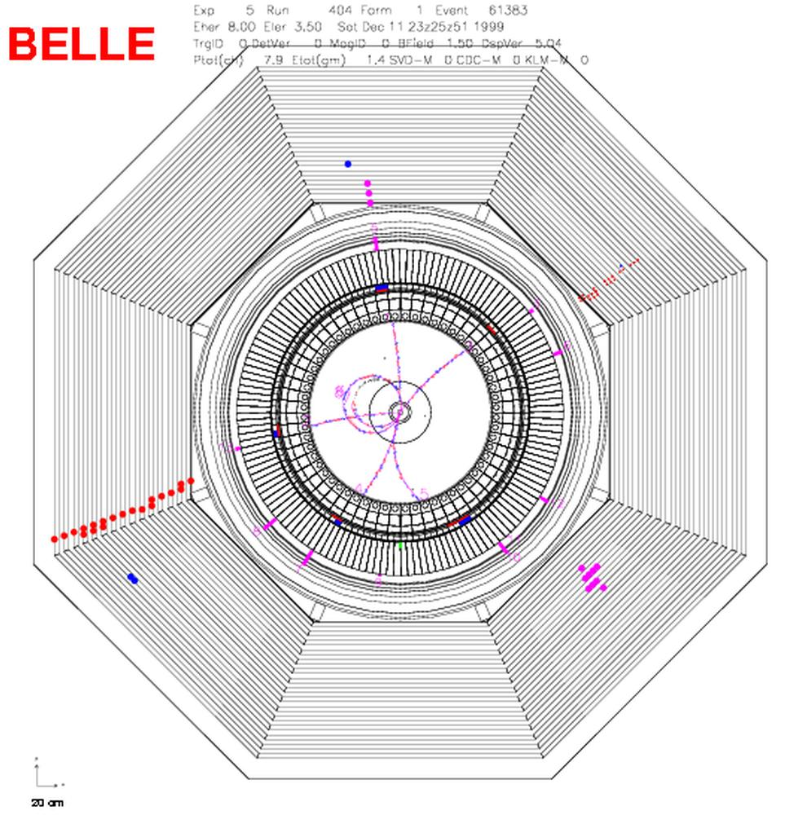
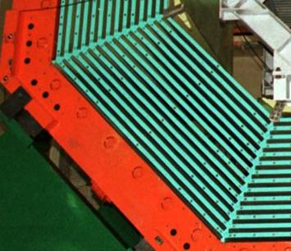
Neutral hadron/K_{L} detection
K_{L}
K_{L} hits

Slide 42
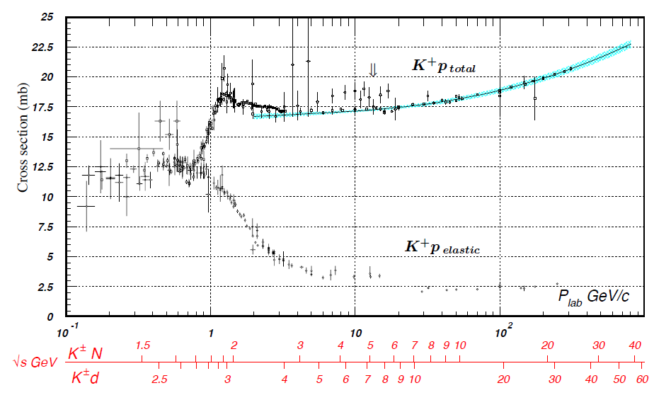
Hadron reaction cross section

Slide 43
Finally neutrino detection..
Exercise What is the detection efficiency of 1m thick iron

Slide 44
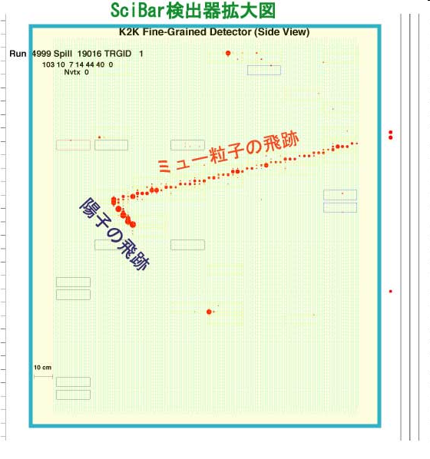
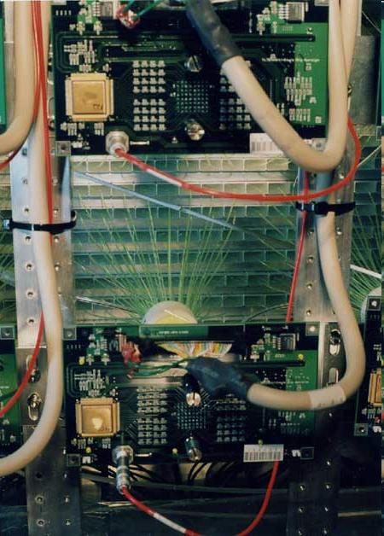
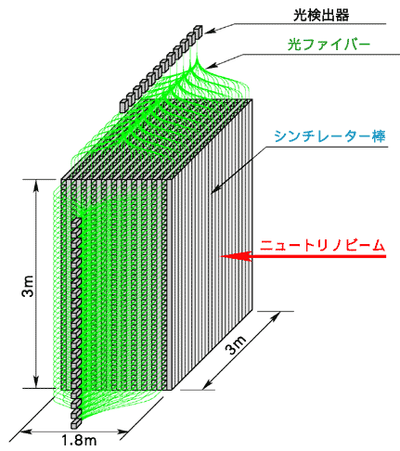
SciBar detector (K2K)
ν＋ｎ → μ^{ー} ＋ ｐ

Slide 45

Neutrino detection in Kamiokande

Slide 46


Water Cherenkov Detector

Slide 47


Dark Matter?

Slide 48

A calibration event from PICO-2L shows boiling from multiple recoiling atomic nuclei. PICO-2L is designed to see a recoiling nucleus a from dark matter interaction
Xe 131, Ge 72.6 I 127, Bi 209, Ar 40, Br 80, Hg 200.6

Slide 49
Summary at this point
Detection of charged particles
  Ionization
  Excitation
  Cherenkov radiation
  Bremsstrahlung (Electron)
Detection of Neutral particles
    Nuclear reaction (Neutron, hadron)
    Weak interaction (Neutrino)
    Photoelectric/Compton scattering (Photon)
    What about dark matter (??) We have to try any type of detection shceme. We don’t know what it is.

