Slide 1
How can physicists explore the particle world? (II)
Junji Haba (KEK)
The 4th Asia Europe Pacific School of HEP @Quy Nhon, Vietnam

Slide 2
The 2nd step
Measuring four momentum of particles combining the information from detectors….

Slide 3
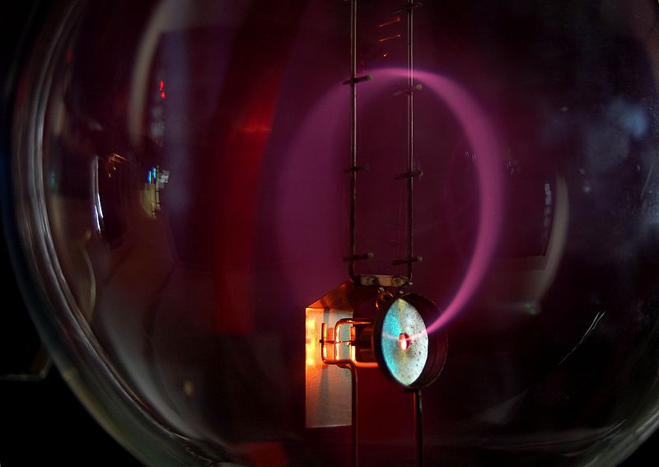
Momentum
Momentum can be measured as a radius of circular motion in a magnetic field
B

Slide 4
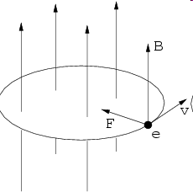
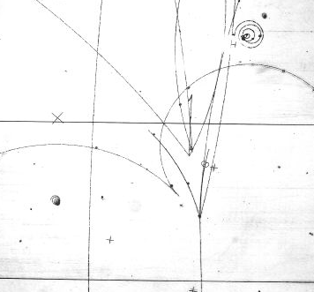
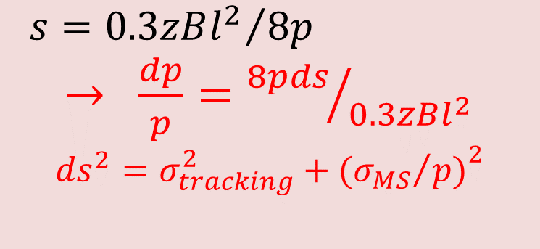
Lorentz force and momentum measurement
sagitta
r
s
p
q or ze
${s=0.3zBl^{2}}/{8p}$
$→ \frac{dp}{p}={8pds}/{0.3zBl^{2}}$
$${ds}^{2}=σ_{tracking}^{2}+{({σ_{MS}}/{p)}}^{2}$$

Slide 5
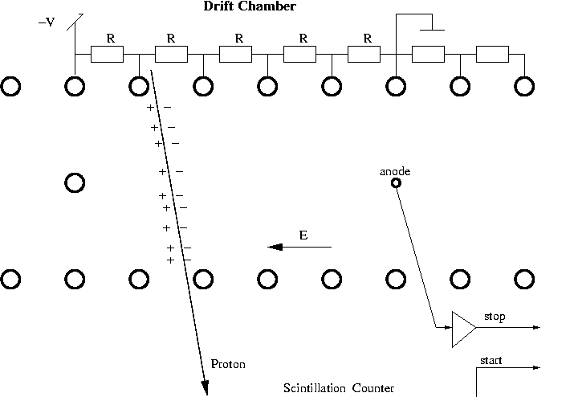
Wire chambers invented by Charpak
Ionization

Slide 6
Drift velocity

Slide 7
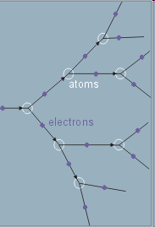
Electron avalanche multiplication

Slide 8
Electric field around a thin wire is extremly high
b
V
a

Slide 9
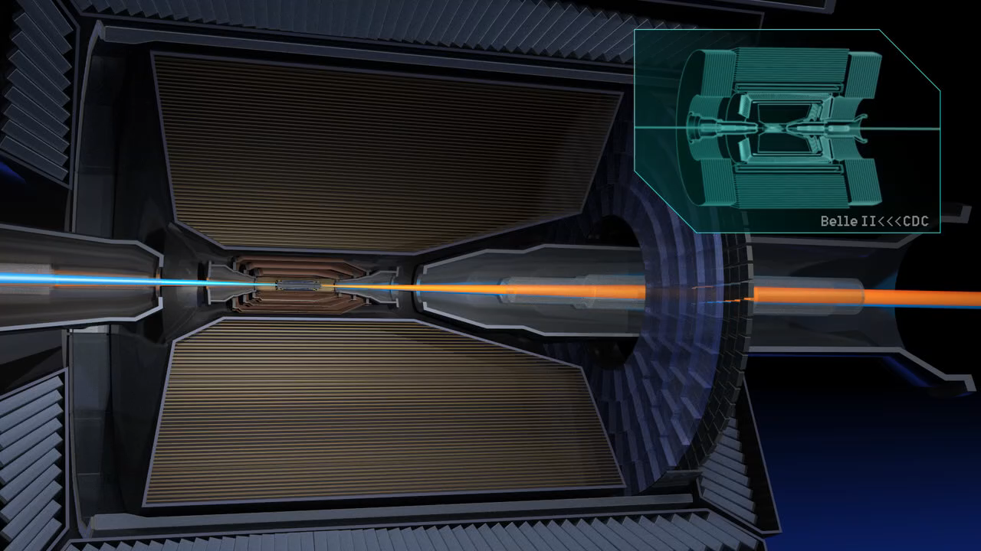
Central Tracker

Slide 10
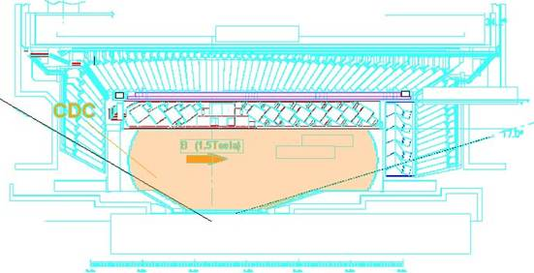
Drift Chamber
(momentum,PID)
Belle CDC consists of three parts(Main, Inner and Cathode).
Curved Aluminum enplates for the main part.
  Thickness : 10mm^{t}
Conical endplates for the inner part to give a space for accelerator components.

Slide 11
X-T relation
(drift time vs position)
He(50%)-C₂H₆(50%)
B=1.5Tesla
HV : 2.3KV
Cell Size:18mm
Maximum Drift Time : ~400nsec
+
+
+
+
+
+
cell

Slide 12
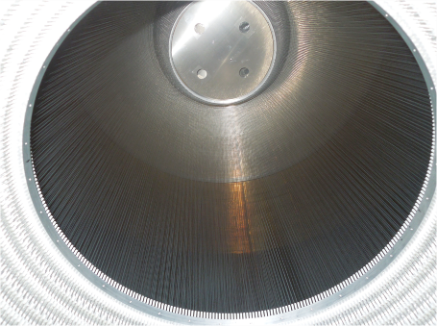
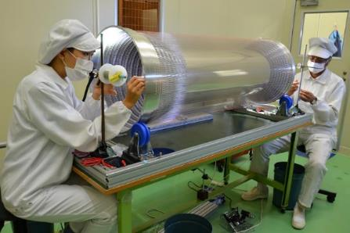
Wire stringing for
BelleII central drift chamber
Inner part
5120 wires
Outer part
43,776 wires
It took more than 5 years to complete

Slide 13
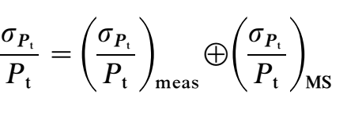
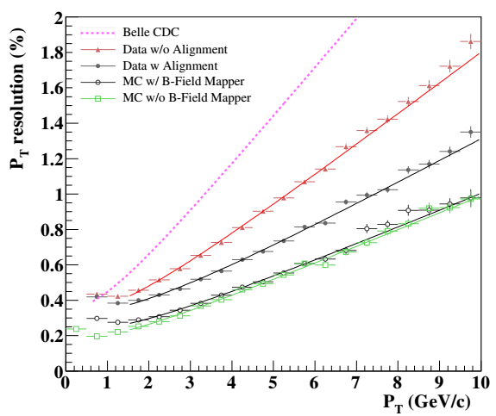
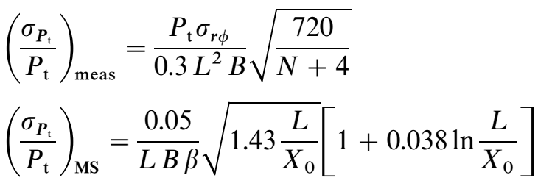

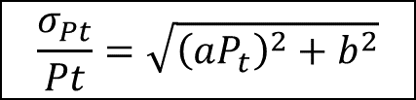
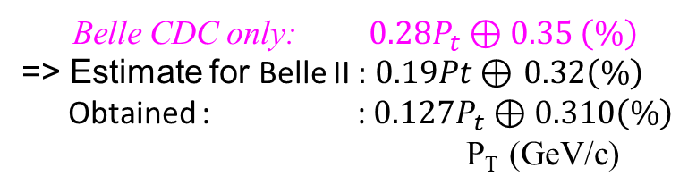
P_{t} resolution of BelleII CDC
(Big contribution of Vietnamise students in KEK)
Belle CDC
Before Align
σ_{rϕ}: position resolution
B: magnetic field (1.5 T).
Χ_{o}: radiation length.
L: lever arm.
N: number of measurement point
(0.05p+0.7)%
~ CMS
MC
After Align
No B-filed mapper
$after align: 0.127P_{T} \text{⊕ }0.310 (\%)$
$$\frac{σ_{Pt}}{Pt}=\sqrt{{\left(aP_{t}\right)}^{2}+b^{2}}$$
P_{T} resolution is much improved compare with Belle CDC.
Much better than the expectation (extrapolation from Belle CDC)
Observed constant term is not improved as expected because of the multiple scattering on the B-field mapper
Belle → Belle II
L: 77.5 → 94.84 cm
N: 50 → 56
Belle CDC only: $0.28P_{t} \text{⊕} 0.35 \left(\%\right)$
=> Estimate for Belle II :$0.19Pt \text{⊕ }0.32\left(\%\right)$
Obtained : :$0.127P_{t} \text{⊕ }0.310\left(\%\right)$
P_{T} (GeV/c)

Slide 14
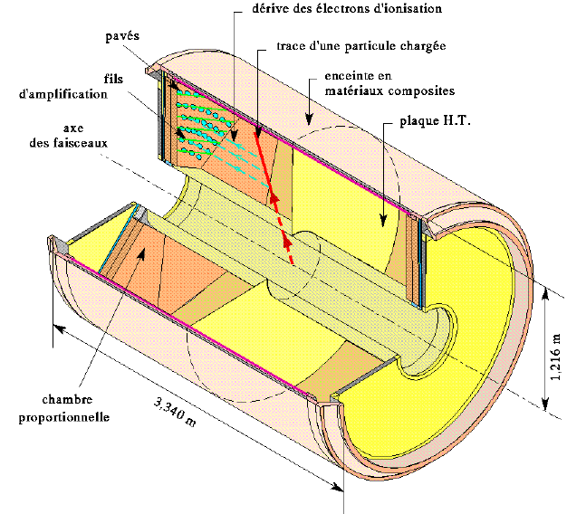
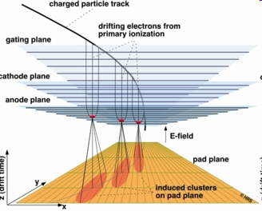
TPC(Time Projection Chamber)
Z座標をドリフト時間で
３次元の空間測定
CERN/ALICEウェブページ
より抜粋

Slide 15
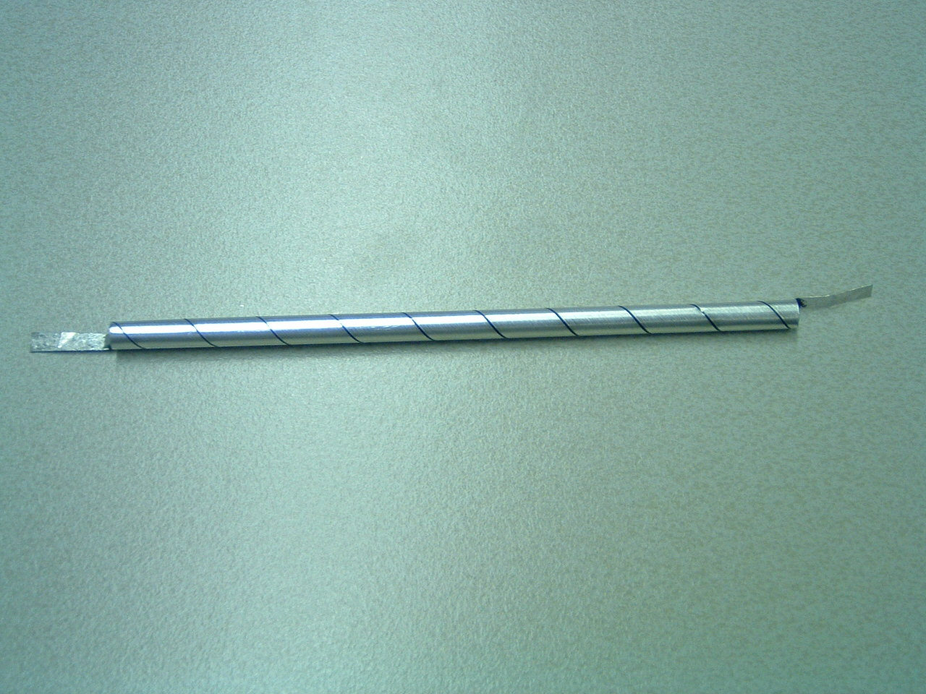
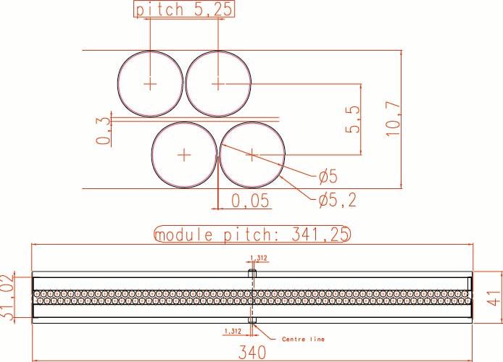
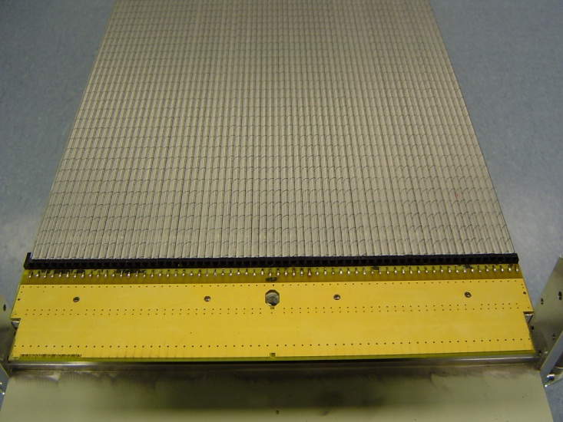
Straw Tubes Modules
Straw Tubes packed in double-layered modules
modules 64-cells wide
modules only ~0.37% of 1 X₀
  “light” panels
  (Rohacell core with carbon fiber skins)
  “light” straws
z
x

Slide 16
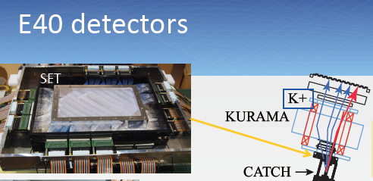
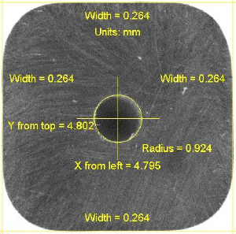
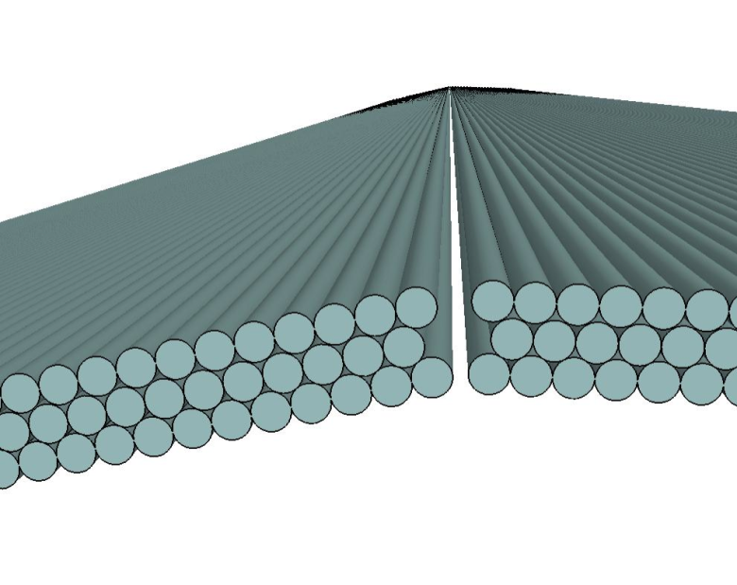
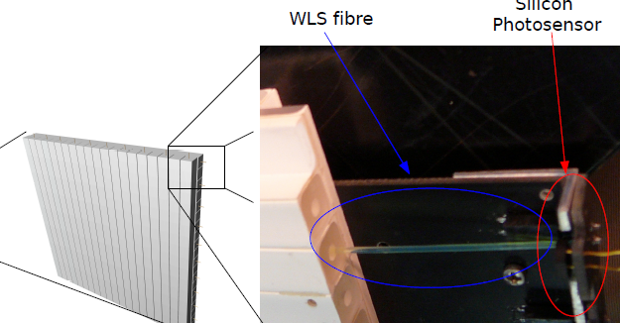
Scintillation strip/fiber tacker
0.5 – 1 mmφ
Mu3e
T2K FGD
0.25 mmφ

Slide 17
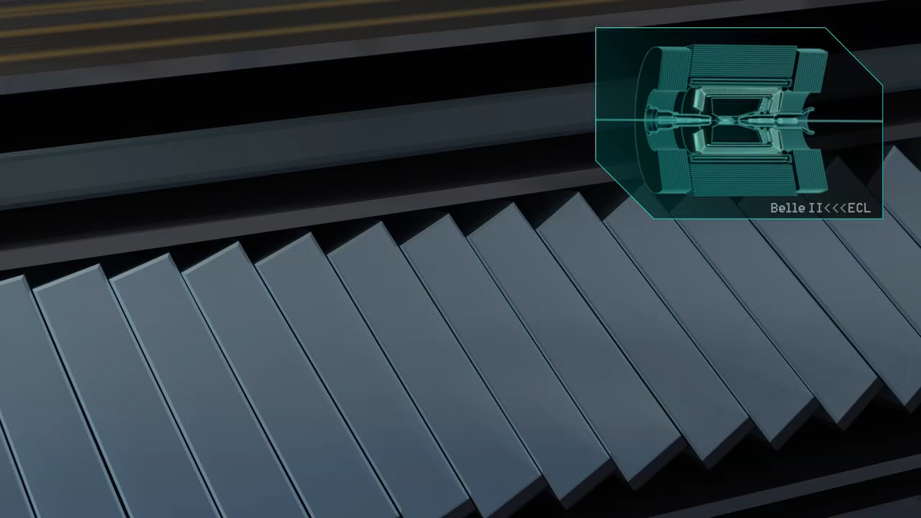
Energy measurement
Energy can be measured
by a total absorption calorimeter,
in which all the energy are released
through cascading shower.

Slide 18
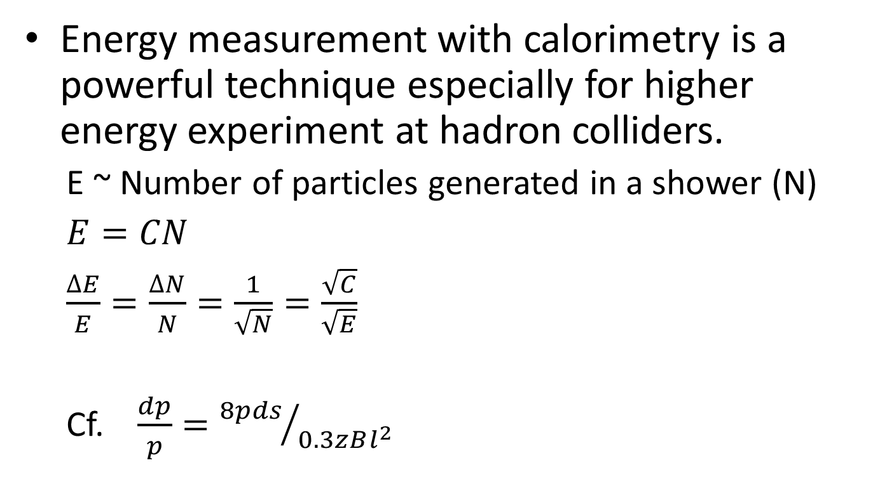
Energy measurement
Energy measurement with calorimetry is a powerful technique especially for higher energy experiment at hadron colliders.
  E ~ Number of particles generated in a shower (N)
  $E=CN$
  $\frac{∆E}{E}=\frac{∆N}{N}=\frac{1}{\sqrt{N}}=\frac{\sqrt{C}}{\sqrt{E}}$
  Cf. $\frac{dp}{p}={8pds}/{0.3zBl^{2}}$
Traditional sampling calorimeter
Klaus Pretzl 2005 J. Phys. G: Nucl. Part. Phys. 31 R133

Slide 19
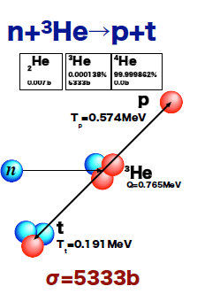
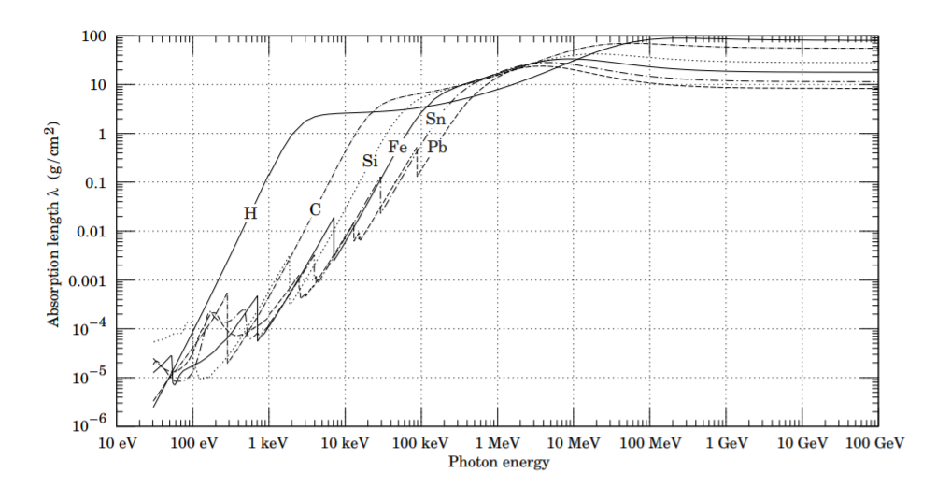
Photon vs neutron
For low energy area
Question given yesterday: How to distinguish photon from neutron?
  Material with high Z for photon, high absorption cross section (like 3He) for neutron

Slide 20
  Pulse shape discrimination in scintillation device, very important technique in low energy neutrino experiment or DM search
Lintereur, Azaree T.; Ely, James H.; Stave, Jean A.; McDonald, Benjamin S.
PNNL-21609

Slide 21
For high energy area
Radiation length, interaction length (~ mean free paths of photon or neutron, respectively)
 | Radiation length | Nuclear interaction length | Density
W | 6.76 (g/cm^2) | 191.9 (g/cm^2) | 19.3 g/cm^3
 | 0.35 cm | 9.94 cm
Fe | 13.84(g/cm^2) | 132.1(g/cm^2) | 7.87 g/cm^3
 | 1.76 cm | 16.8cm
10cm thick W EM calorimeter
~28.6 r.l. ~1.0 int. l.
photon
neutron
~56.8 r.l. ~ 6 int. l.
100cm thick Fe Hadron calorimeter

Slide 22
Organic scintillator and ＷＬＳ
Scintillator | Emission spectrum（nm） | Decay time（ns） | Light yield wrt NaI
Naphthalene | 348 | 96 | 0.12
Anthracene | 440 | 30 | 0.5
p-Terphenyl | 440 | 5 | 0.25
PBD | 360 | 1.2
POPOP | 420 | 1.6
bis-MSB | 420 | 1.2

Slide 23
Particle identification
Particle identification (mass) can be made from its veolocity（β=v/c）, which can be measured through time of flight, Cherenkov radiation or energy loss rate.
Life time (flight distance) of particle is another very important characteristics.
 | μ ± | e ± | γ | π ± | K⁰ | K ± | p | n
Mass (MeV/c²) | 106 | 0.511 | 0 | 140 | 498 | 494 | 938 | 940
Detection | Charge | Charge Shower | Shower | Charge Strong | Strong | Charge Strong | Charge Strong | Strong
Life time （cτ m） | 659 | -- | -- | 7.8 | 0.027 (15.3) | 3.7 | -- | 2.7 x10¹¹

Slide 24
Some theorists know better….

Slide 25
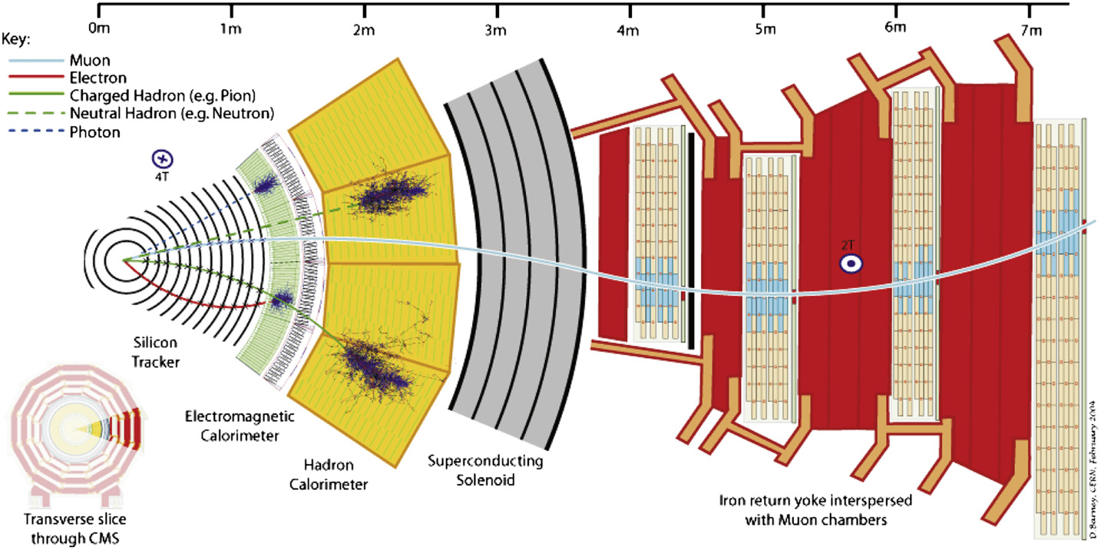
How modern detector measrue them?
Higher energy collider

Slide 26
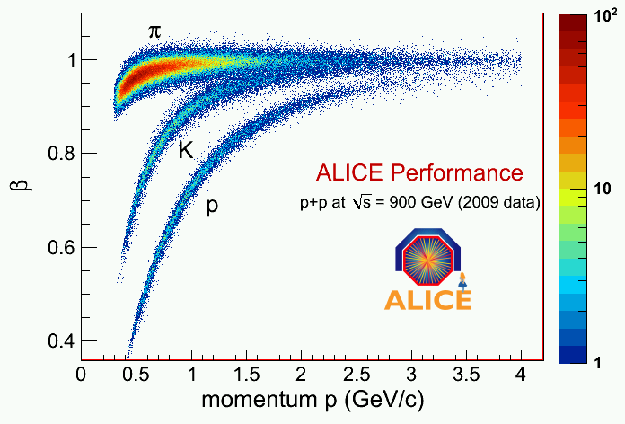
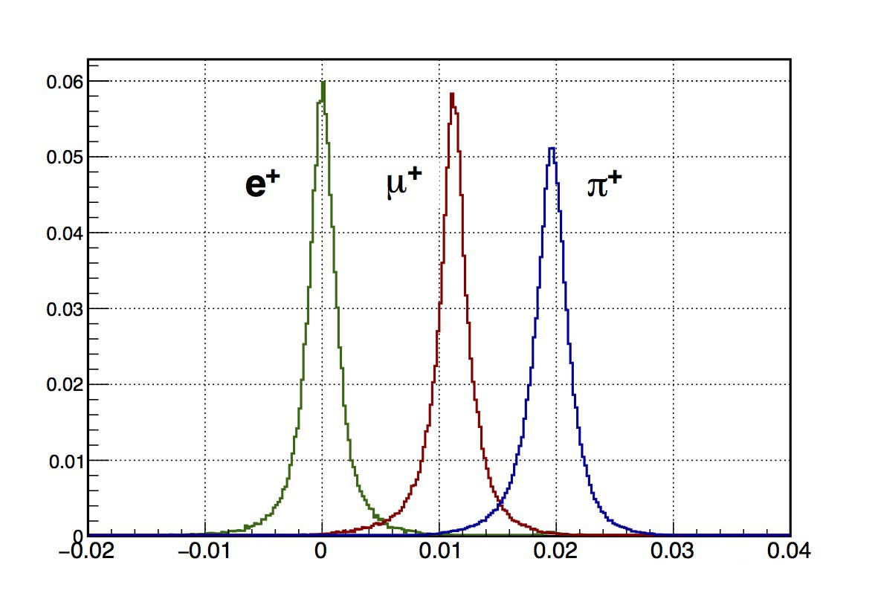

Direct β measurement: ToF
(Time of Flight)
$cβ=\frac{flight distance}{flight time}$

Slide 27
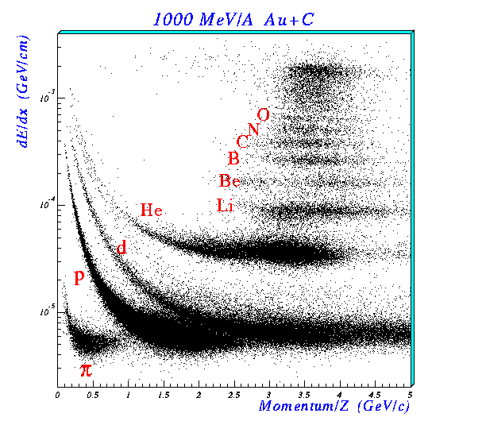
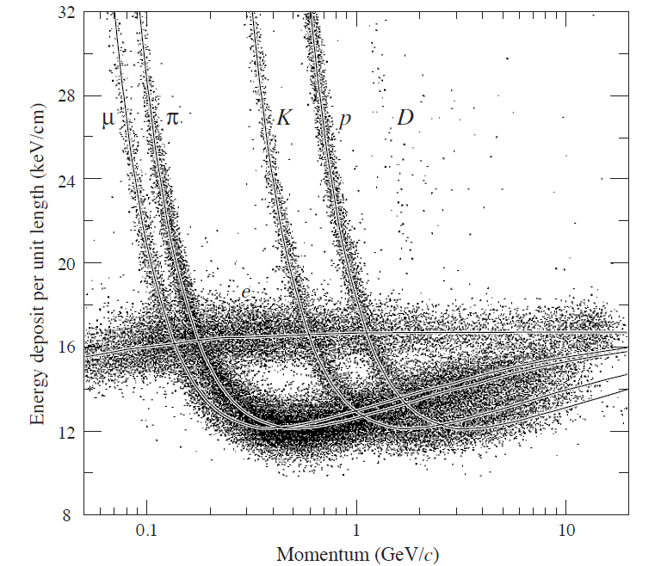
β measurement through energy loss information
Remember Bethe-Bloch formulation
Effective aet low enrgy

Slide 28
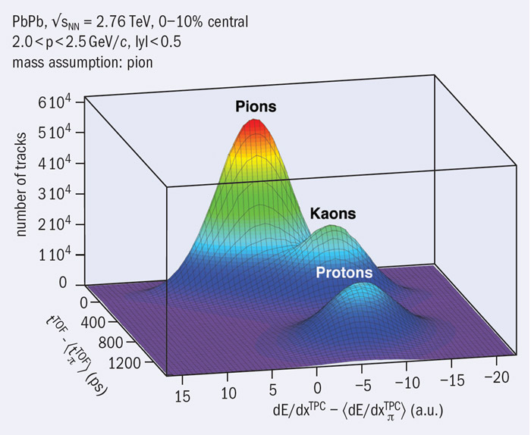

Slide 29
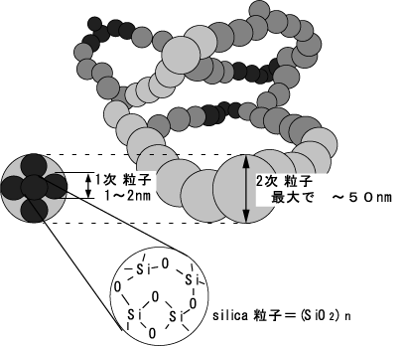
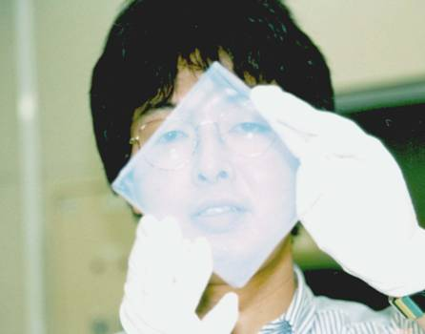
Particle identification with
Silica Aerogel Cherenkov radiator
Colloidal form of SiO₂. Very special refractive index of n=1.006 ~ 1.06
with ρ=0.1g/cc. Hydrophobic
Fractal structure

Slide 30
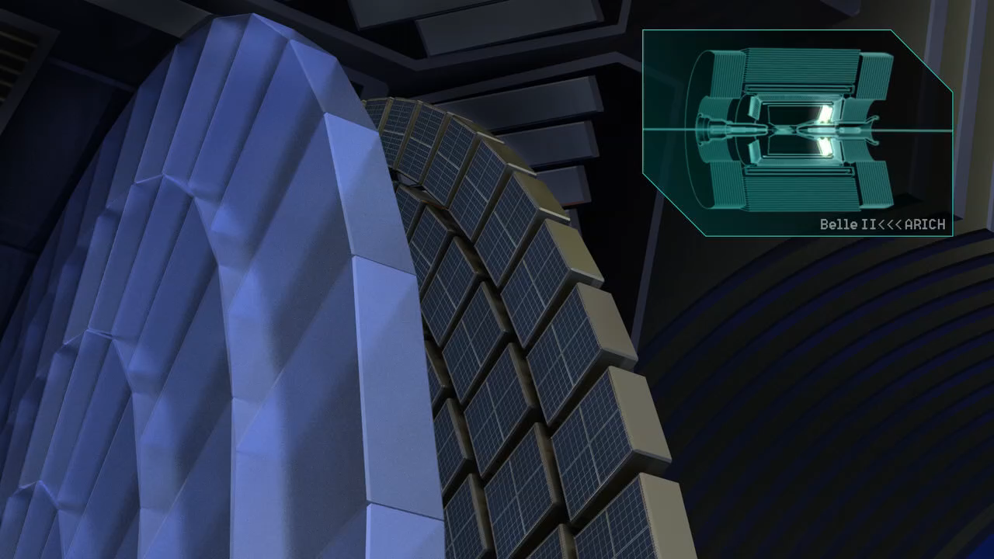

Slide 31
Belle II A-RICH

Slide 33
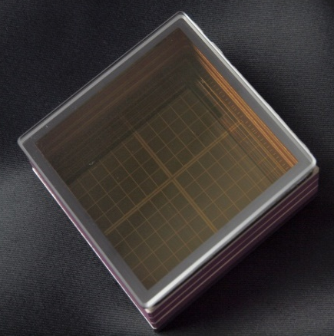
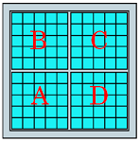
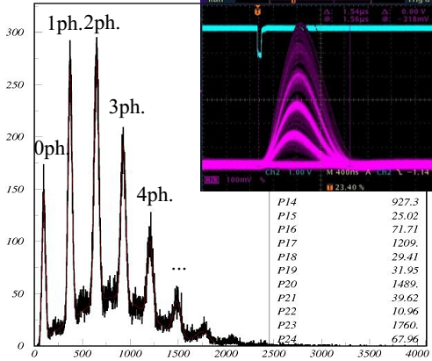
HAPD Belle II
Photo-detector
~5mm pixel size. Large coverage.
Immune to 1.5T magnetic field.
Radiation tolerance (neutron, gamma).
HAPD (Hybrid Avalanche Photo-Detector)
Developed with Hamamatsu Photonics.
144 channels (36-ch APD chip×4).
Gain ≥45000.
Peak QE ~28%
Size 73mm×73mm.
Effective area 63mm×63mm (65%).
Total 420 HAPDs

Slide 34
Possible Solution
HPD with Multi-pixel Avalanche Diode (AD-HPD)
Photocathode
Avalanche gain (x40)
EB gain (x1200)
Multi-pixel AD
Electron
Output
Photon
Acceleration
Total gain:
5x10⁴
Proximity focus
(8kV)
AD voltage
(-200 to -400 V)

Slide 35
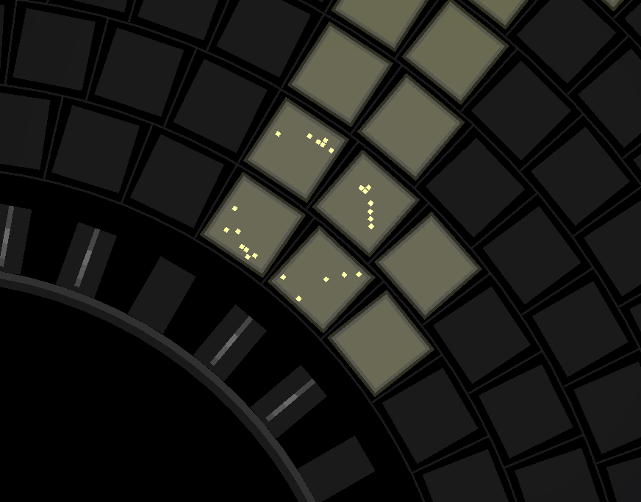

Slide 36
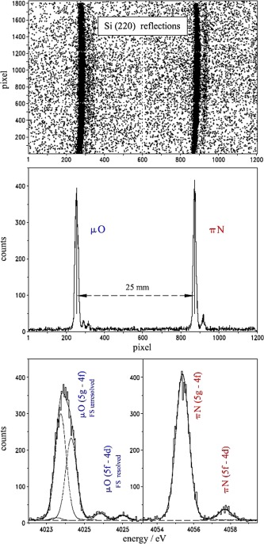
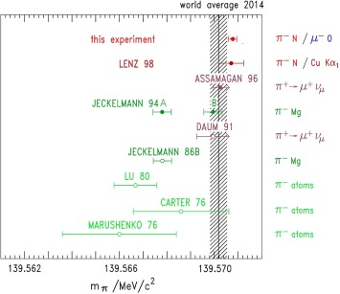
cf Serious mass measurement beyond particle identification..
Example of
π mass
measurement
Example of
π mass
X-ray spectrum from
pionic atom
μ spectrum from π decay at rest

Slide 37
Life time measurement using decay vertex
Life time is measured through “decay length “ L,
L= c β γ τ
\\\
L

Slide 38
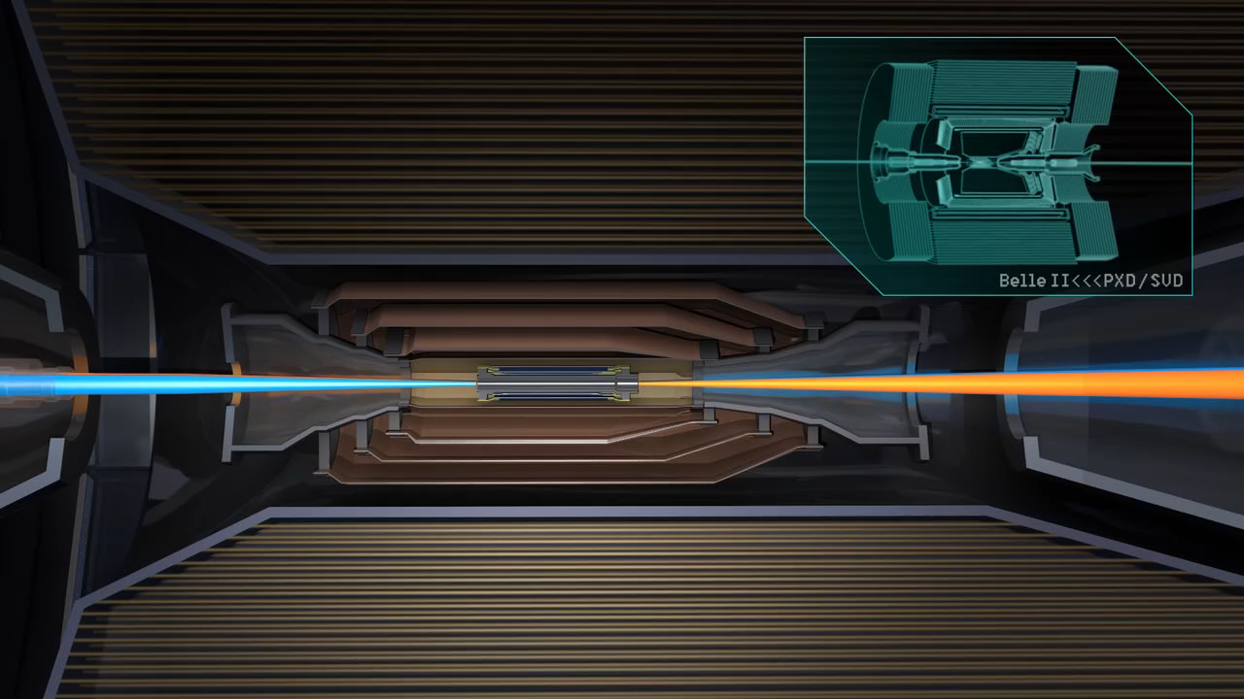
Vertex detector

Slide 39
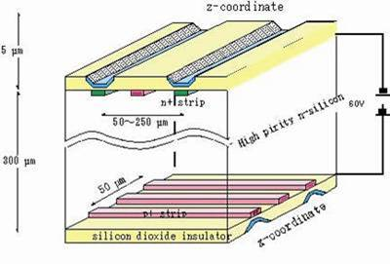
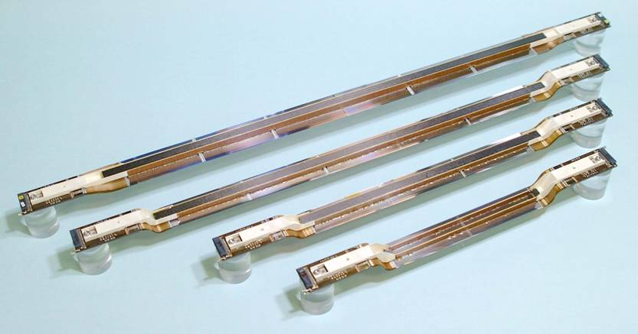
Silicon vertex detector

Slide 40
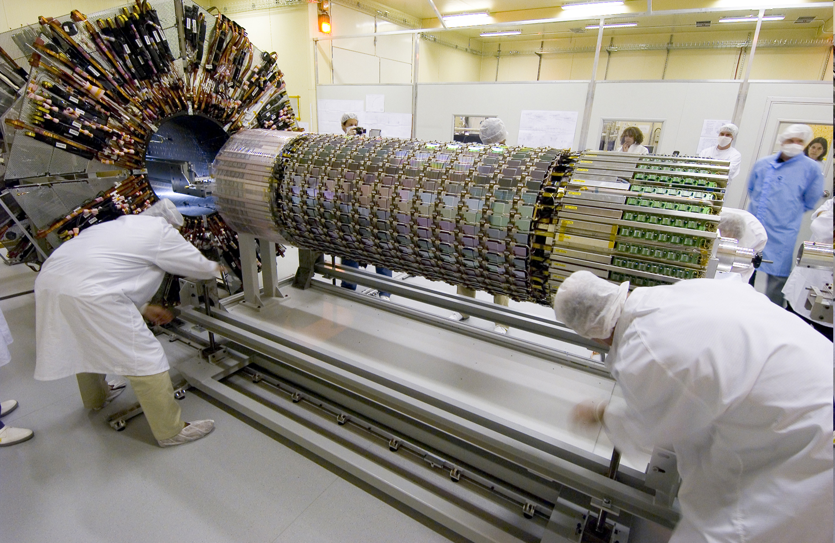
ATLAS SCT
ATLAS
Web page

Slide 41
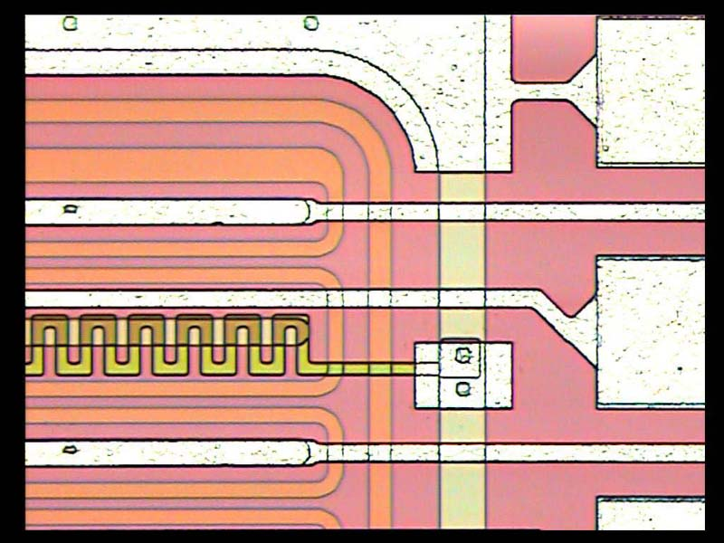
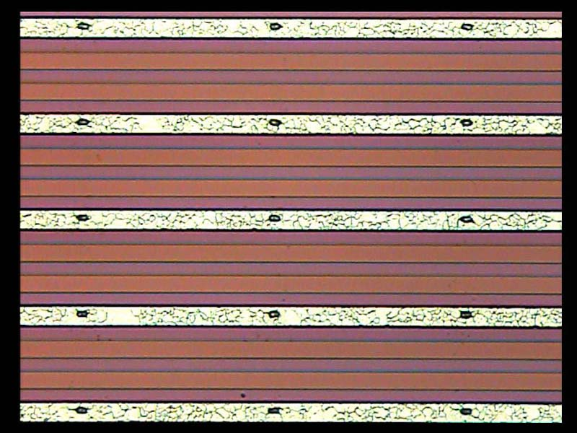
150μm

Slide 42
Principle of semiconductor detector
Depletion layer
－
－
－
－
＋
＋
＋
＋
－
－
－
－
＋
＋
＋
＋
－
－
－
－
＋
＋
＋
＋
P type semiconductor
N type semiconductor
－
acceptor
+
donor
hole
electron
Reverse bias

Slide 43

No big difference from old leaf electroscope
shown yesterday!

