Slide 1
How can physicists explore the particle world?(II+)
Junji Haba (KEK)
The 4th Asia Europe Pacific School of HEP @Quy Nhon, Vietnam

Slide 2
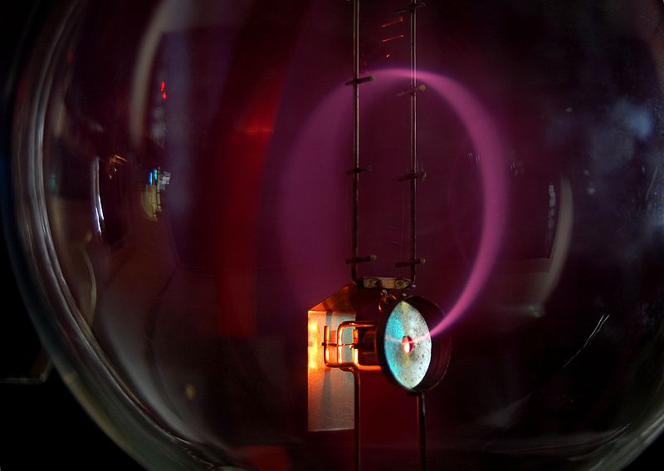
Very important components to measure momentum, magnetic field
Image of momentum measurement

Slide 3
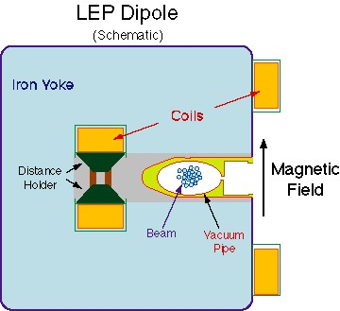
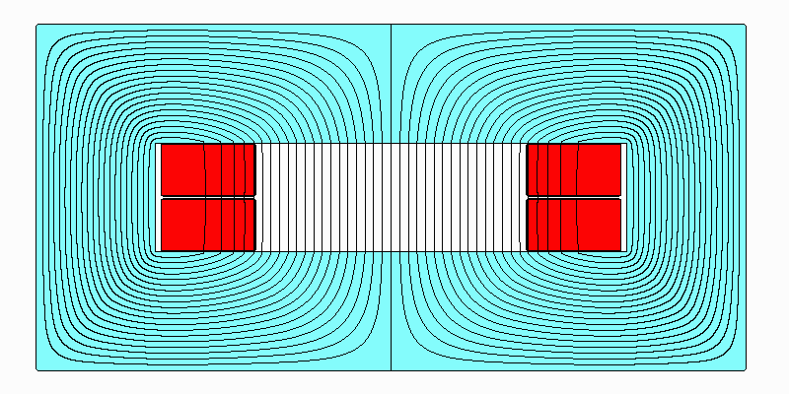
Magnetic field gereration
Dipole configuration

Slide 4
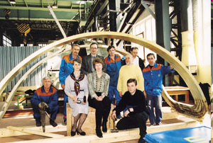
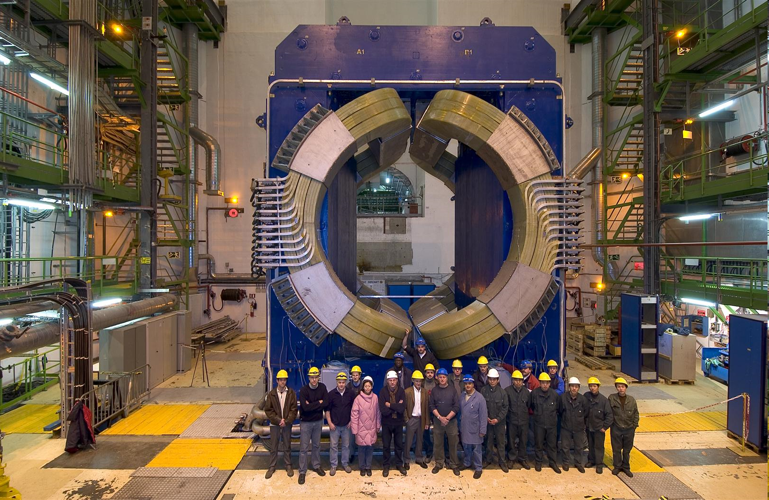
ALICE muon dipole
One of the biggest warm dipoles in the world
(free gap between poles ≈ 3 m, height of the yoke ~ 9 m
Designed for 0.7T w/6000A @600V ).

Slide 5
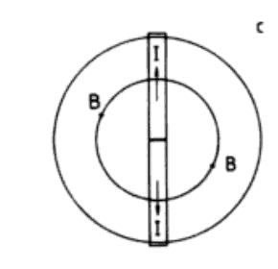
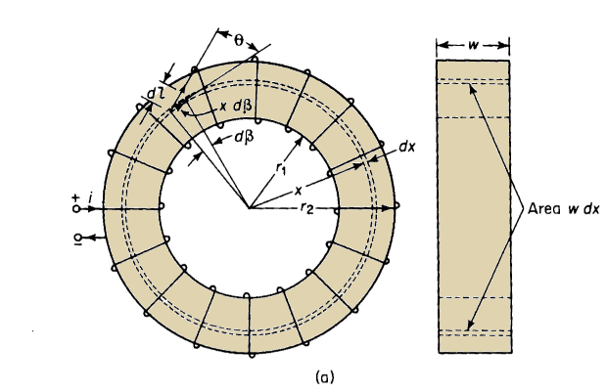
Toroidal magnets

Slide 6

ATLAS Toroidal magnet

Slide 7
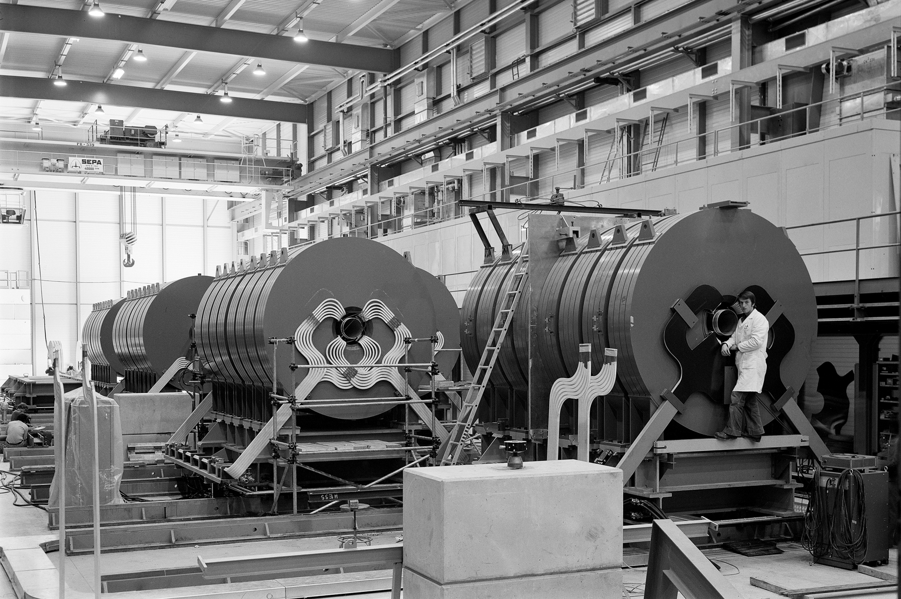
Toroidal magnet for neutrino experiment

Slide 8
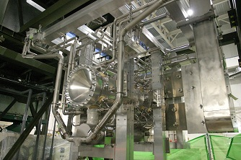
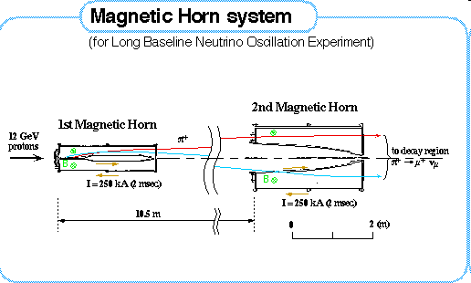
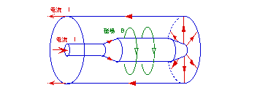
Toroidal (horn) magnet for neutrino production

Slide 9
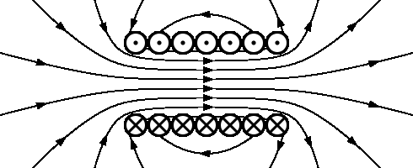
Solenoid magnet most standard magnet for collider detectors

Slide 10
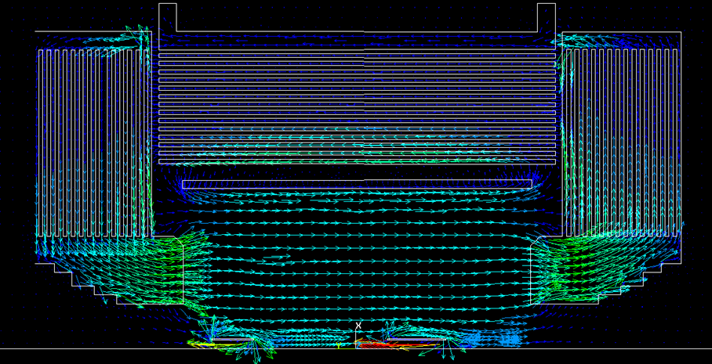
Solenoid magnet: Belle
Iron flux return
Non-uniformity below 5% inside tracking volume.
Field mapping with 0.3% precision.

Slide 11
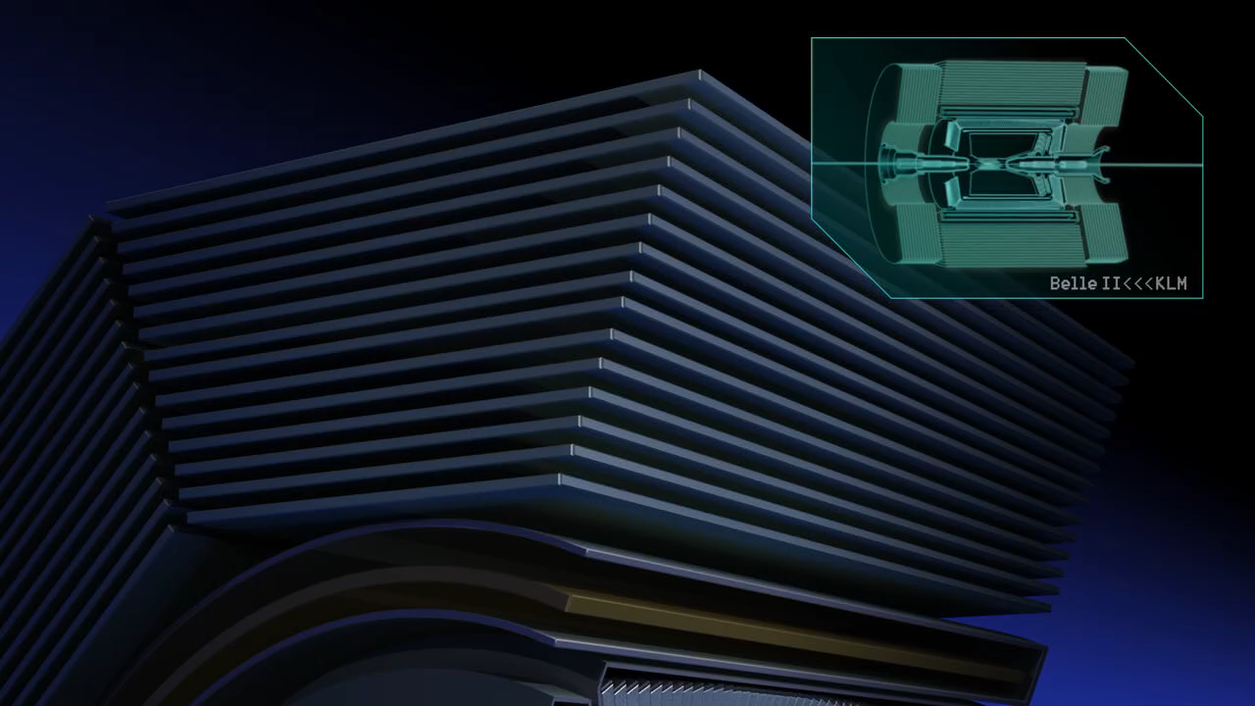
Muon Identification using
Instrumented flux return

Slide 12
Comments from the last lecture
Drift velocity is not always monotonically increasing with external electrical field. Why?

Slide 13
How can physicists explore the particle world?(III)
real
Junji Haba (KEK)
The 4th Asia Europe Pacific School of HEP @Quy Nhon, Vietnam

Slide 14
Applications of HEP detector technology to society
At Hospitals…
  X-ray, g-ray, ＰＥＴ diagnosis, Cancer therapy
At Aiports or Boarder gates….
  X-ray inspection
At factories, infrastructures as bridges, power plants….
  X-ray or Neutron Non–destructive defect/damage inspection
At the Fukushima site
  Mapping and Identification of radioactive substances

Slide 15
X-ray

Slide 16
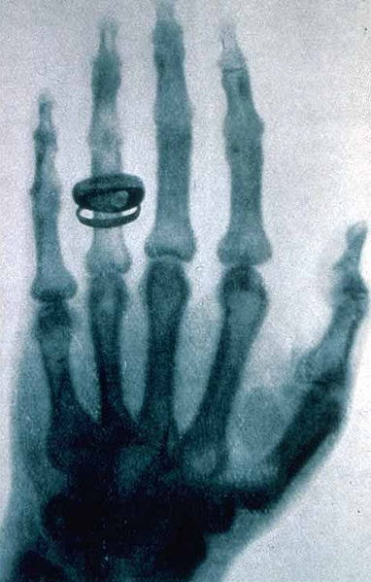
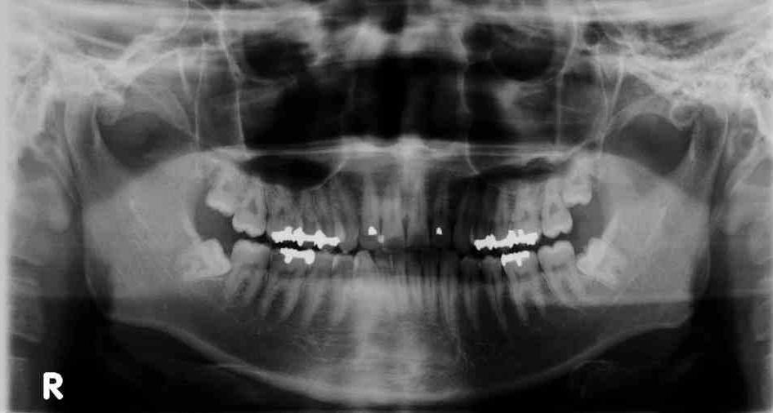
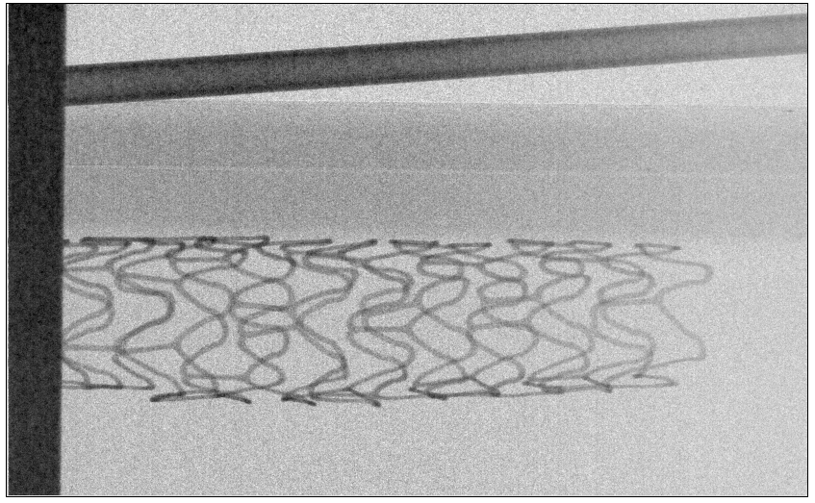
X-ray imaging device with the most advanced technology developped in Particle detectors

Slide 17
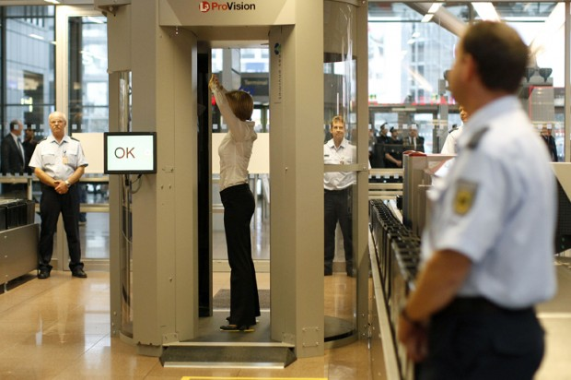

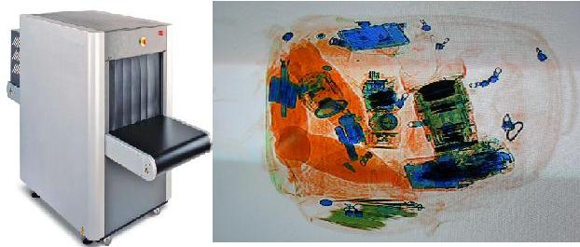
For safety Flights:

Slide 18
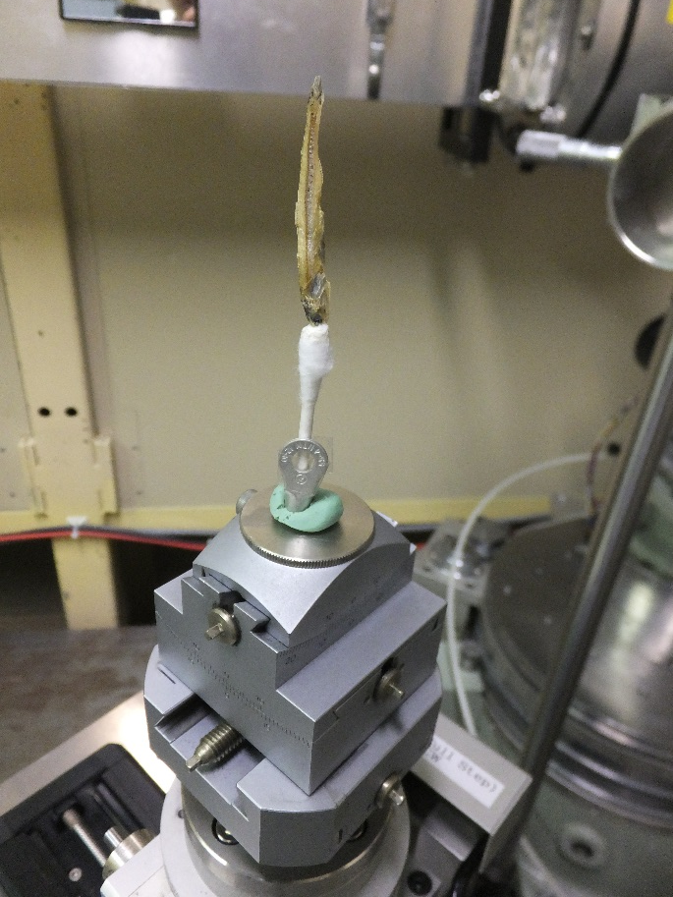
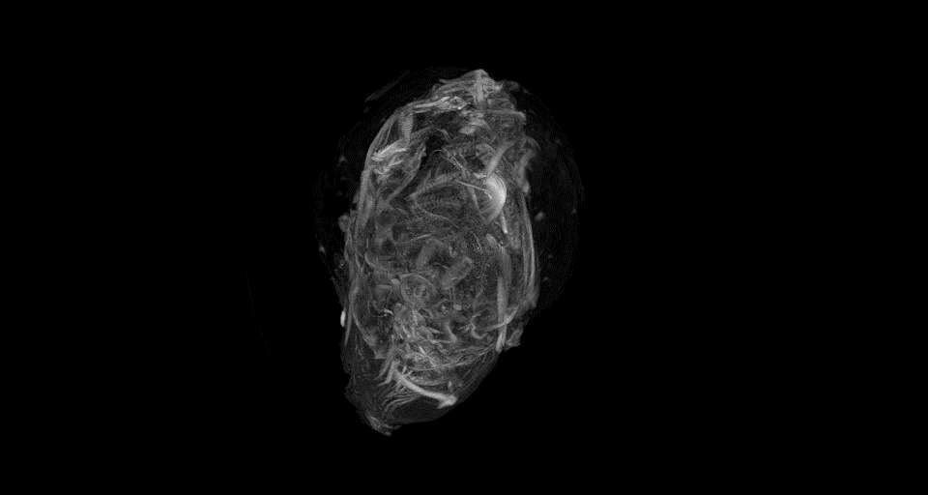
3D X-ray CT
Sensor chip INTPIX4 NFZ (5JA-FZ-1407) Back illumination
HV：200V、integration/frame：1ms、ScanTime：320ns/pix
Calibration：500frame、Event：1000frame
X-ray energy：9.5keV
(by R. Nishimura, K. Hirano)

Slide 19
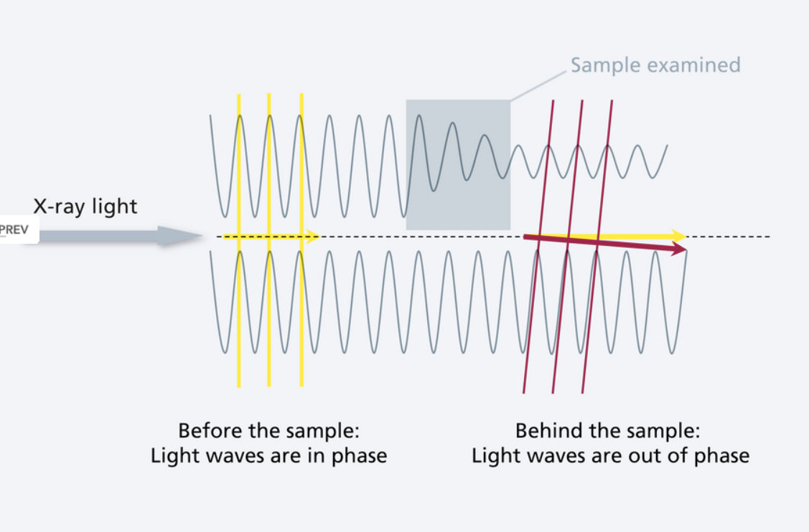
New technique of X-ray imaging:
Phase contrast image

Slide 20
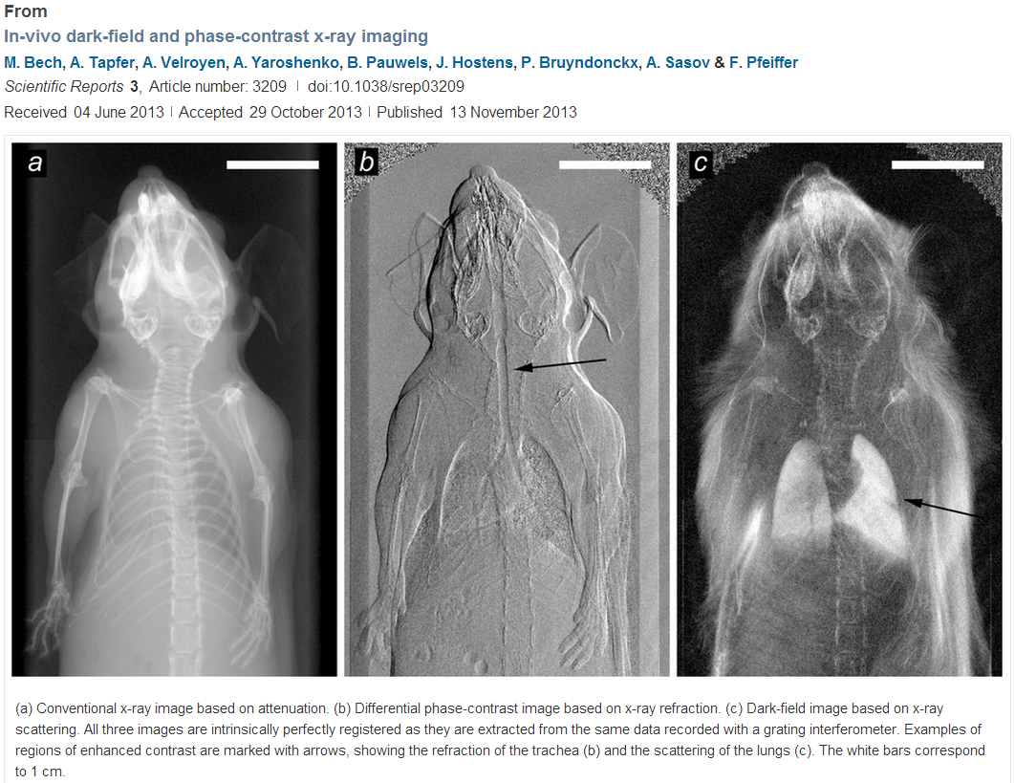

Slide 21
Gamma Ray

Slide 22
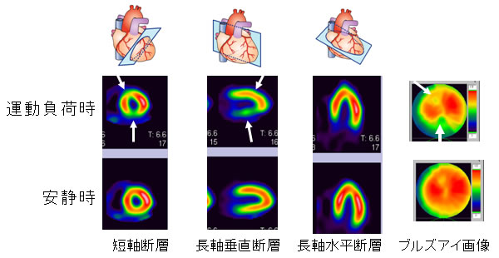

Scintigraphy
Blood flow can be observed externally by radio isotope (RI) labelling.
Imaging of radiation from RI by particle detectors.
After exercise
At rest
撮像３０分とのこと

Slide 23
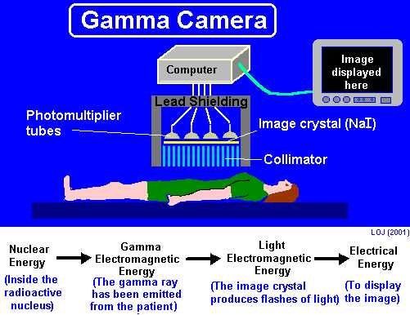

Standard Gamma “camera”
Not very efficient. Most of gamma rays are absorbed in collimators.

Slide 24
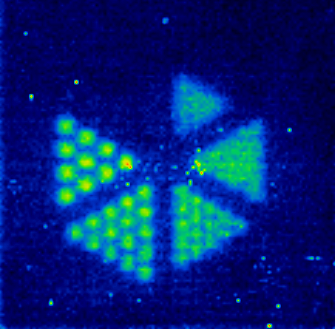
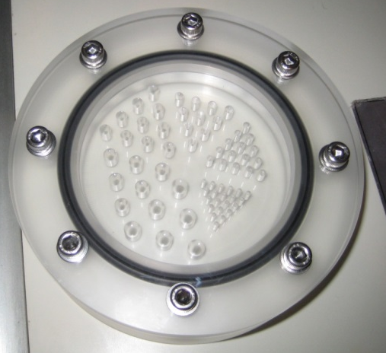
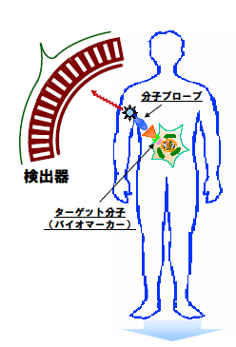
Gamma Pin hole camera
γ ray imager
γ ray
Enlarge
RI source
Pinhole
10mm
2mm
60°

Slide 25
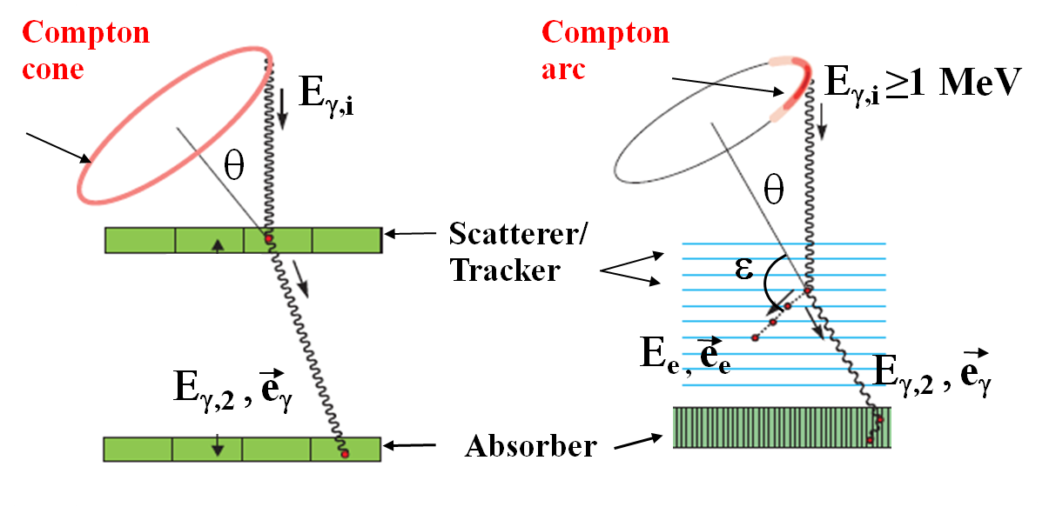
Further attempt: Compton camera

Slide 26
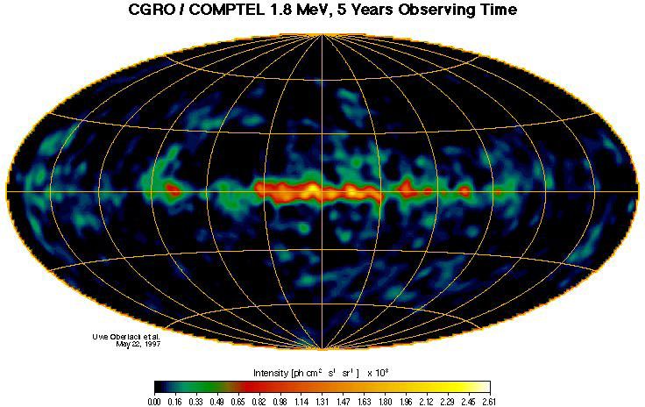

Application of Gamma camera developed for Gamma ray astronomy
to Fukushima NP restoration
平成24年11月15日
宇宙航空研究開発機構
三菱重工業株式会社
国立大学法人 名古屋大学
独立行政法人 科学技術振興機構

Slide 27
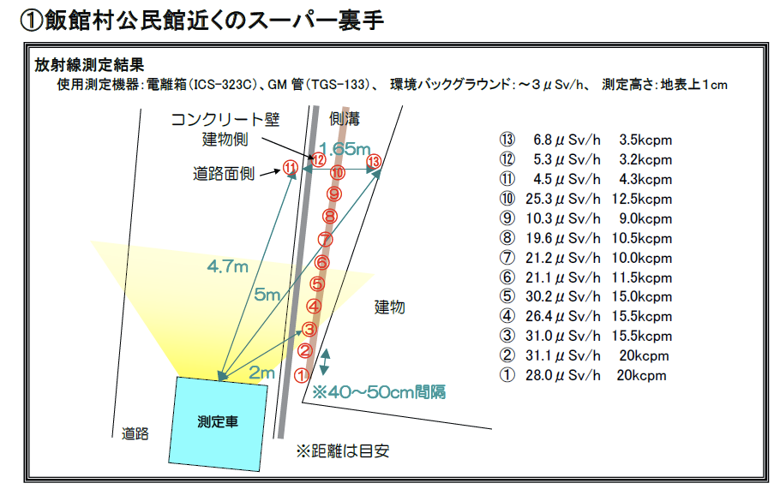
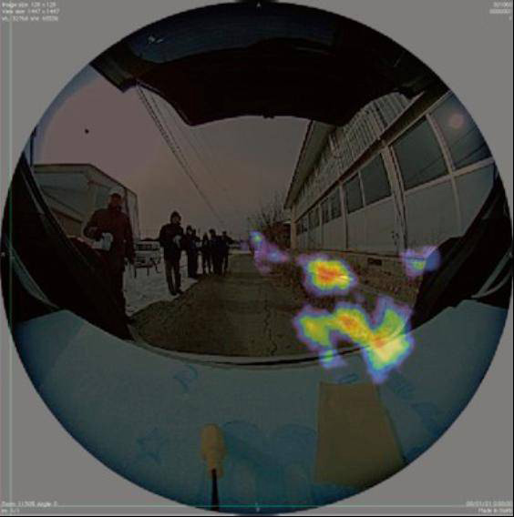
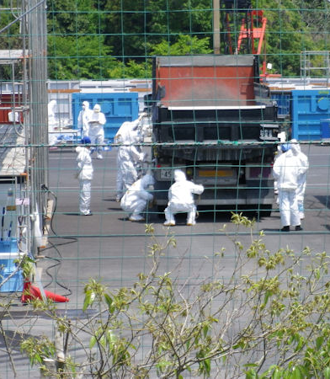

Slide 28
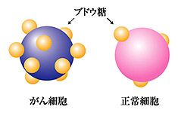
Very useful for medical application
ＰＥＴ（Positron Emission Tomography ）
glucose
Cancer
tissue
Normal
tissue

Slide 29
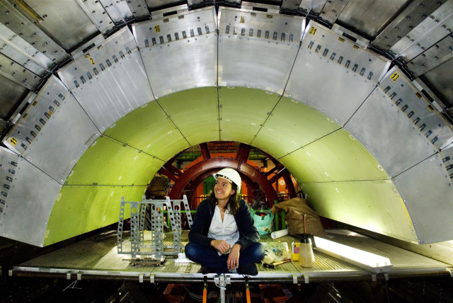
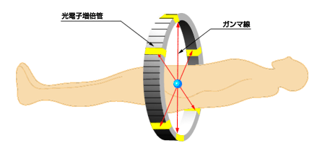
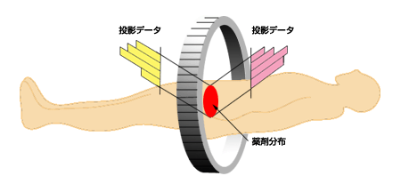
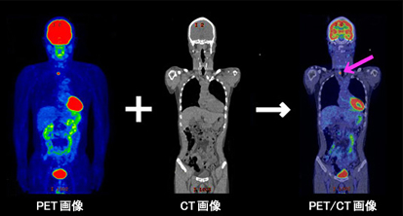
Just like a barrel calorimeter of collider detectors
From the photo gallery cmsinfo.cern.ch
Higher resolution/efficiency can make
exposure dose less.

Slide 30
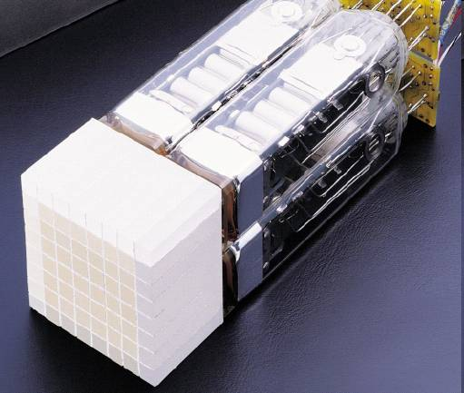
PET γ detector module
© Siemens AG

Slide 31
Neutron

Slide 32
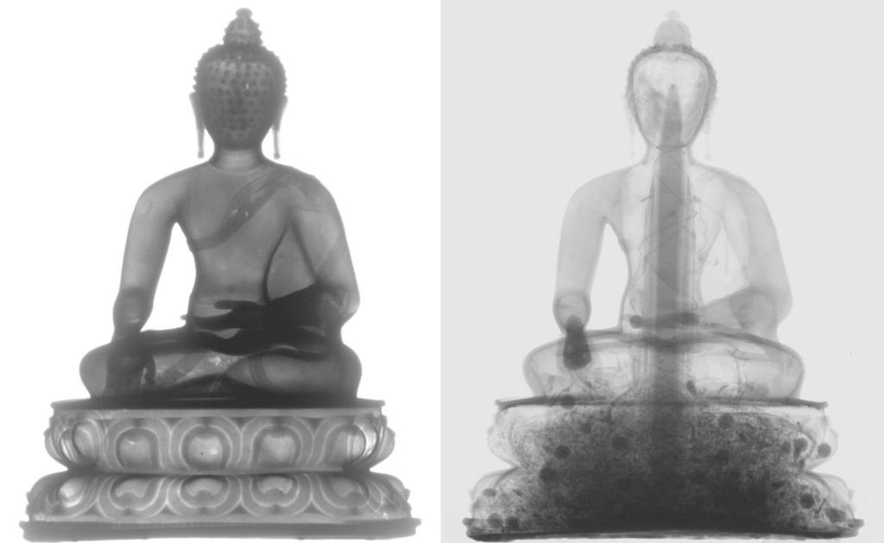

Imaging with neutron beam
Left: X-ray image
Right: Neutron imaging. Organic material buried inside , invisible with X-ray, can be visualized by neutron.
(photo: example of Sakyamuni, Bhumisparsa Mudra, West-tibet, 14.- 15. century).
Non-invasive studies of objects from cultural heritage

Slide 33
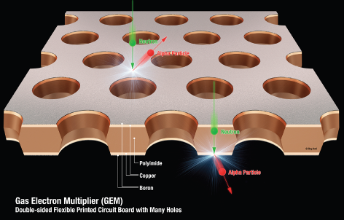

Application to Neutron Detector
Ar-CO₂
Cathode plate
With B10
Expensive ³He Gas is not necessary.
  No pressure vessel
Free readout pattern
High resolution
  Position and Time
Insensitive against g-ray
Capability against high counting rate
B10 coated
GEMs
Normal GEM
Readout board

Slide 34
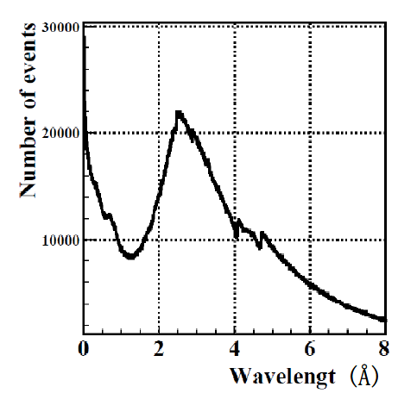
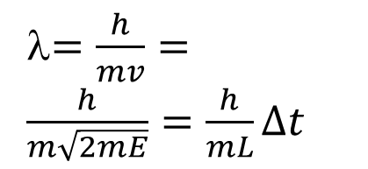
Pulse neutron and
Energy Selective Neutron Radiography
Resonance absorption region (E>1eV)
Bragg Edge
region
(Thermal and cold)
λ$=\frac{h}{mv}=\frac{h}{m\sqrt{2mE}}=\frac{h}{mL}∆t$

Slide 35
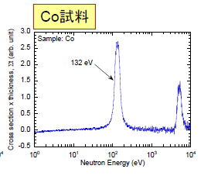
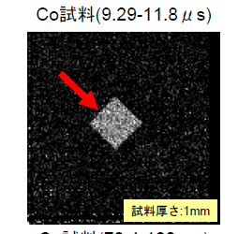
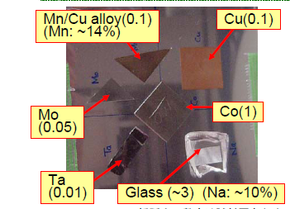
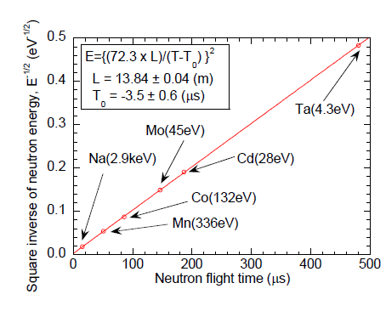
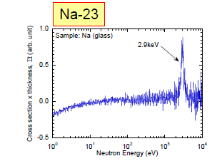
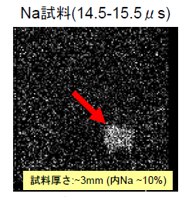
Resonance absorption imaging
By T. Kai (JAEA) et al.
at BL10 in J-PARC

Slide 36
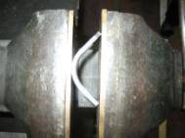


Imaging for bended iron plates at LINAC in Hokkaido University
Sample
90°Bending
and Re-flattening
90°Bend
60°Bend
+Reference
（without bending）
30°Bend
Moderator
Flight tube
Sample
70cm
504cm
100cm
GEM
Detector
674cm

Slide 37

Results
90° Bending
60° Bending
30° Bending
Reference
Re-flattening
Position Y (mm)
Photo of iron plates
Position X (mm)
Two dimensional imaging of crystallite size in the bended iron plates
can be done clearly.
Visualization of microstructure for heavy material can be performed with the gaseous neutron detector.

Slide 38
Others

Slide 39


See through mega structure using cosmic ray muons
K.Morishima (Nagoya U.)
東大地震研HPより

Slide 40

Low energy negative muon can probe inside material
3D imaging of
material
composition

Slide 41
Summary
Huge detector system for HEP is very important tool to investigate Law of Nature together with a large accelerators.
The system is a complex of advanced radiation measurement devices.
Those “advanced” system enables very quick diagnose with higher precision using much less radiation dose. They are also very useful to visualize the hidden structure /defect /dangerous substance inside material clearly.
The advanced detector technology originally developed for particle physics are now being applied to innovate the instrumentations in society like medical or industrial equipment. Higher resolution, higher sensitivity and lower dose exposure for human is expected.

Slide 42
What is the next generation tracking system?
One of the question raised in the discussion sessions.
My answer is that it should be
  Better precison in position resolution
  Thinner
  Higher functionality (good timing and/or dE/dx information, local tracking, trigger, …)
  Better timing resolution
  dE/dX information hopefully
  Tolerance for higher particle flux

Slide 43
One of promising candidates:
Monolithic pixel sensor using SOI
My very personal view
Monolithic pixel sensor
  Silicon sensor with read out CMOS electronics on chip
SOI: Silicon-On-Insulator

Slide 44


SOI Performance : Smaller Junction Capacitance
Cj is 1/10 of Bulk technology.
Gate Capacitance is 30-40%
Lower.
High Speed / Low Power
44

Slide 45
Thinner than Hybrid pixel applied in the LHC experiment
No bump bonding at all
Hybrid Detector
Silicon-On-Insulator (SOI)
Full Deplete
(Hi-R)
Full Deplete
(Hi-R)

Slide 46
Pix size 8um
No bump bonding
Springer Proc.Phys. 213 (2018) 331-338

Slide 48
High functionality On-Chip

Slide 49

Not very high radiation tolerant so far
It will survive in e+e- collider like SUperKEKB, ILC

Slide 50
Thank you for your attention (and patience).
It has really been a nice experience for me to meet and discuss you all at Quy Nhon.
Please do not hesitate to contact with me junji.haba@keke.jp if you have any question later.

