Slide 1
Maximum tolerable a4 and b5 errors on the triplets based on the available corrector strengths
Y. Nosochkov, M. Giovannozzi
Acknowledgements:
R. De Maria, A. Mereghetti, S. Fartoukh, E. Todesco, and Boinc volunteers
WP2 meeting 13 March 2018

Slide 2
Outline
Expanded DA study of large IT a4, b5 errors including different ratios of a4 to b5 for a complete 2D scan
More accurate estimate of the maximum strength of the IT a4, b5 correctors with increased number of random seeds from 60 to 600
Estimate of the effect of a4, b5 in D1 on the IT corrector’s strengths
Evaluation of maximum allowed a4 and b5 uncertainty/random errors for the present corrector specifications
Comparison with the measured a4, b5 data
Conclusions

Slide 3

DA simulations set-up
Lattice configuration
  HLLHCV1.0 lattice at collision (7 TeV)
  Tune: 62.31, 60.32
  Chromaticity: +3
  Normalized emittance: 2.5 μm
  Arc errors and standard corrections
  IT non-linear correctors in IR1, IR5
  60 error seeds for calculation of DA
  600 seeds for calculation of the IT corrector strengths
FQ tables of IT, D1, D2, Q4, Q5 magnets
  “ITbody_errortable_5”, “ITcs_errortable_v5”, “ITnc_errortable_v5” (with end effects)
  “D1_errortable_v1_spec”, “D2_errortable_v5_spec”
  “Q4_errortable_v2_spec”, “Q5_errortable_v0_spec”
  a2 and b2 terms are set to zero to simulate linear correction
Beam-beam effects are not included
Field errors are randomly generated according to , where random ξ_{u} < 1.5 and ξ_{r} < 3 (with σ_{ξ} = 1); and similarly for the a-terms

Slide 4
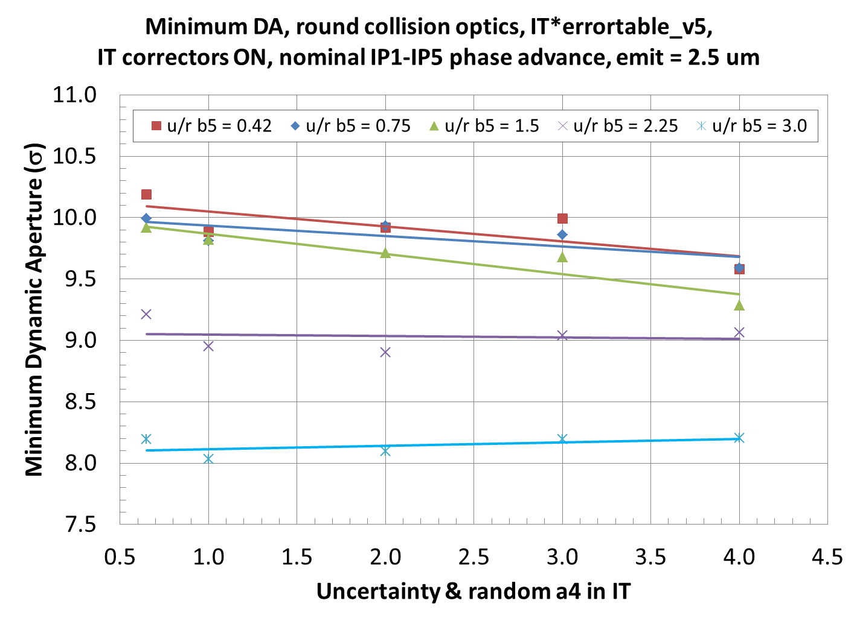
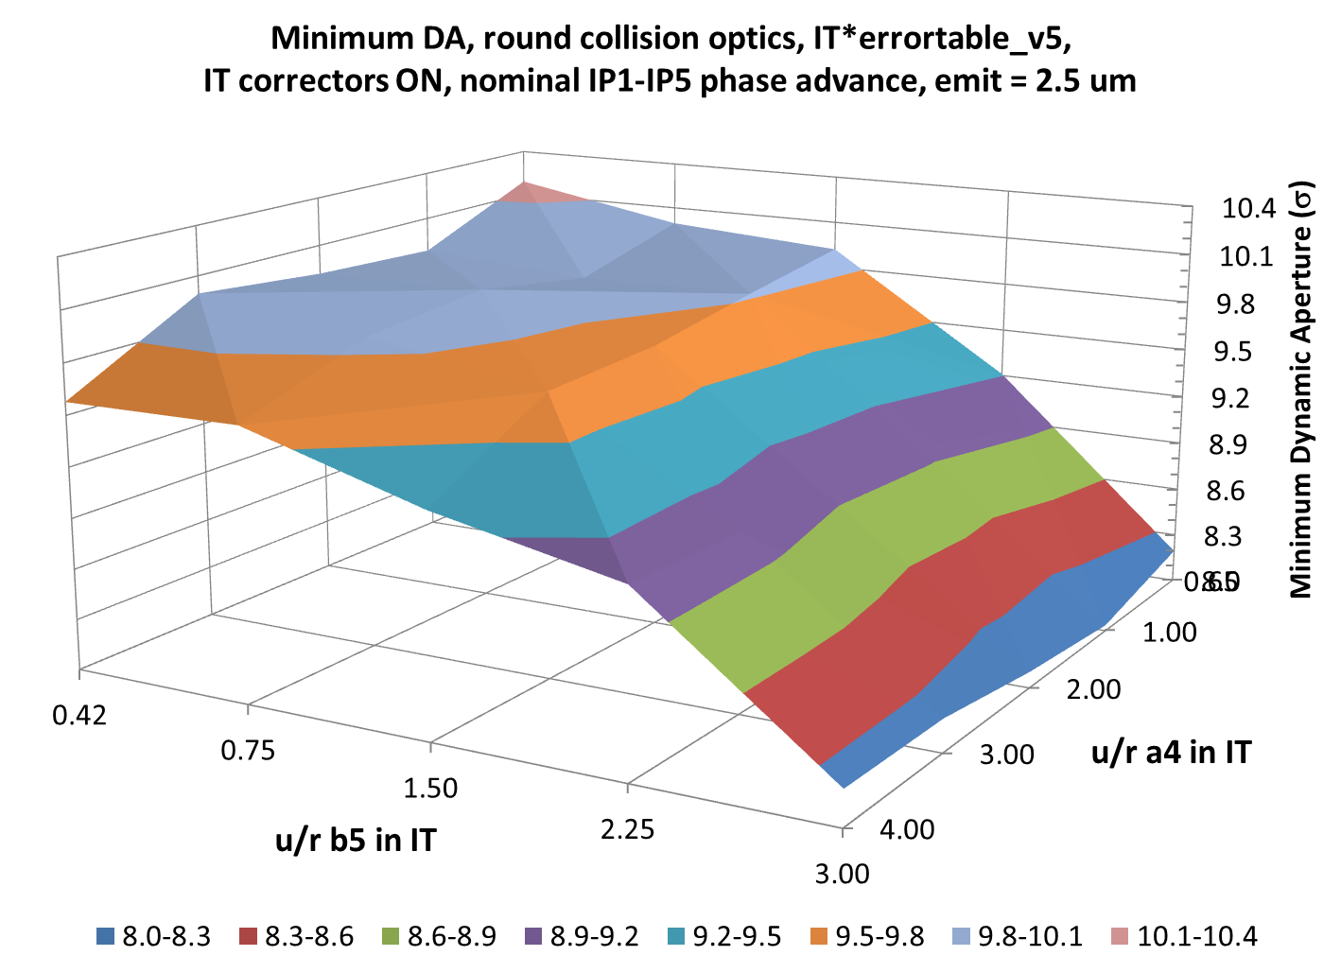
Minimum DA vs a4 & b5
Relatively mild impact at u/r a4 < 3 and b5 < 1.5
Strong impact at u/r b5 > 1.5 (1.7σ reduction of minimum DA at b5 = 3)
Optimization of IP1-5 phase advance may improve the DA; the result may depend on the a4, b5 values
Present IT FQ expected at 7 TeV: u/r a4 = 0.65, b5 = 0.42

Slide 5
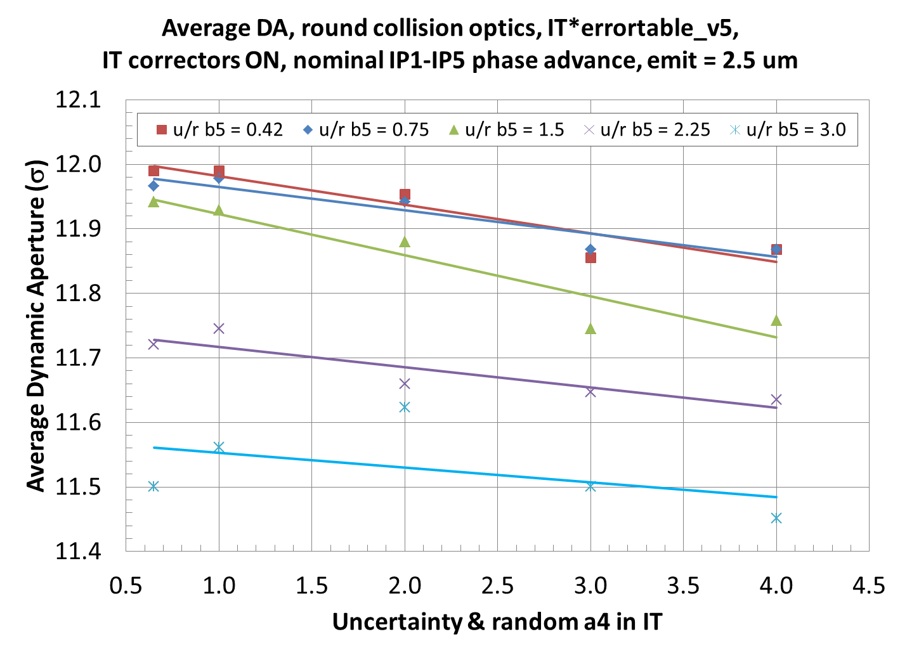
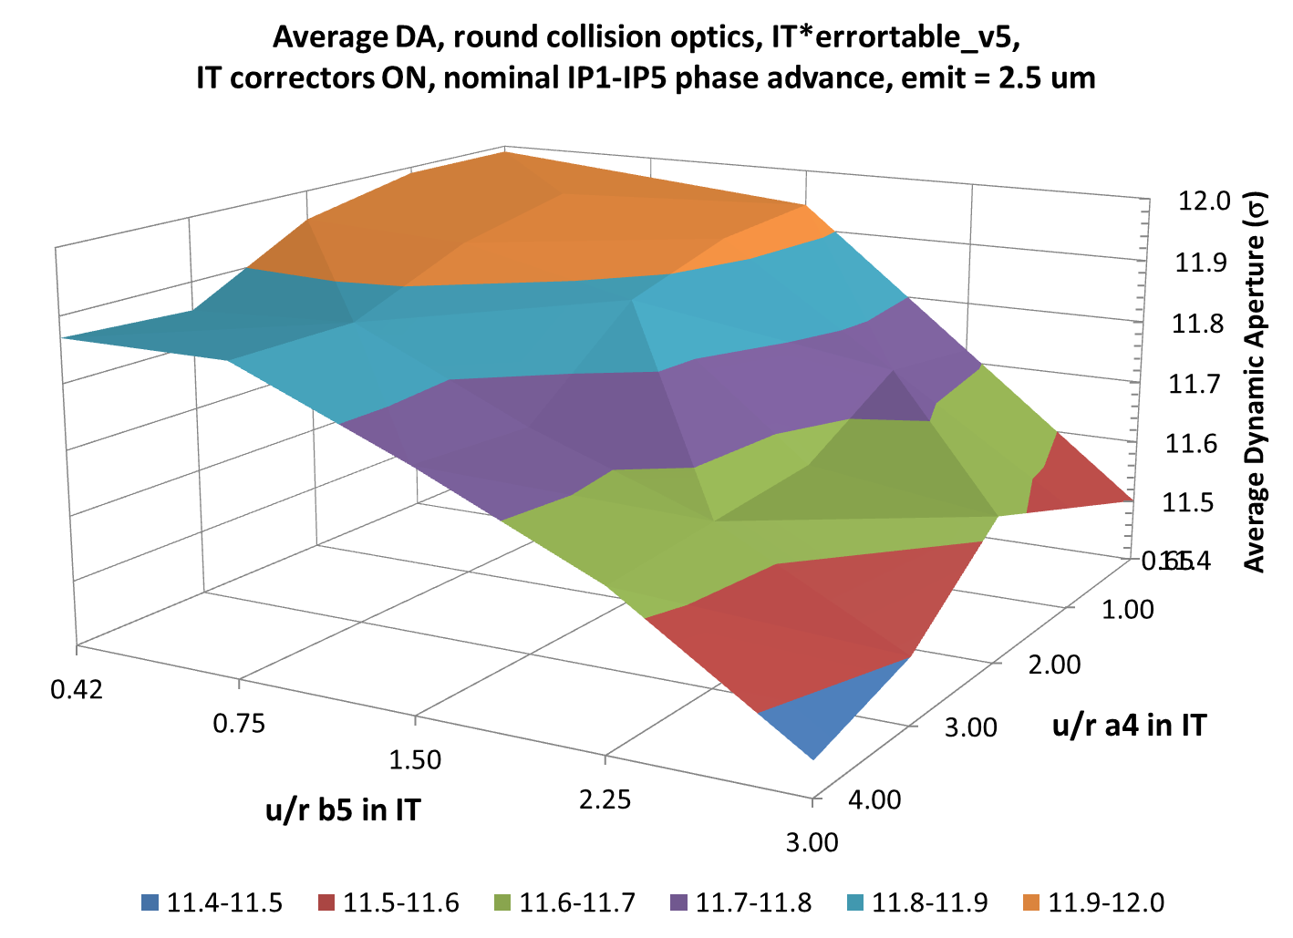
Average DA vs a4 and b5
Impact on the average DA is much less than on the minimum DA (0.5σ vs 2σ reduction at b5 = 3)
    This indicates that the effect is mostly due to a large spread of the DA among different seeds at large uncertainty/random a4, b5
A “desirable” a4, b5 range for a small impact on DA appears to be within a4u, a4r < 2 and b5u, b5r < 1
Present IT FQ expected at 7 TeV: u/r a4 = 0.65, b5 = 0.42

Slide 6
Evaluation of maximum a4, b5 corrector strengths vs a4, b5
Field errors are randomly generated according to , where random ξ_{u} < 1.5 and ξ_{r} < 3 (with σ_{ξ} = 1); and similarly for the a-terms
According to the above formula, the theoretically maximum generated error value is b_{max} = b_{u} + 3*b_{r} (for b_{s} = 0) → high statistics is needed to approach this value
We use large number of seeds (600) to determine maximum a4 & b5 corrector strengths as a function of theoretically maximum error values a4max & b5max
This method avoids ambiguity related to the dependence of four a4 (or b5) corrector strengths on the 24 random values of a4 (b5) errors in the 24 IT quadrupoles in IR1 & IR5
From this dependence we can determine the maximum allowed a4max & b5max values satisfying the a4 & b5 corrector specifications, namely
  a4 -> BL_{max} = 0.046 Tm @ 50 mm
  b5 -> BL_{max} = 0.025 Tm @ 50 mm
Finally, we can determine the corresponding maximum allowed uncertainty & random a4 & b5 for the present corrector spec
  a4u = a4r = a4max / 4
  b5u = b5r = b5max / 4

Slide 7
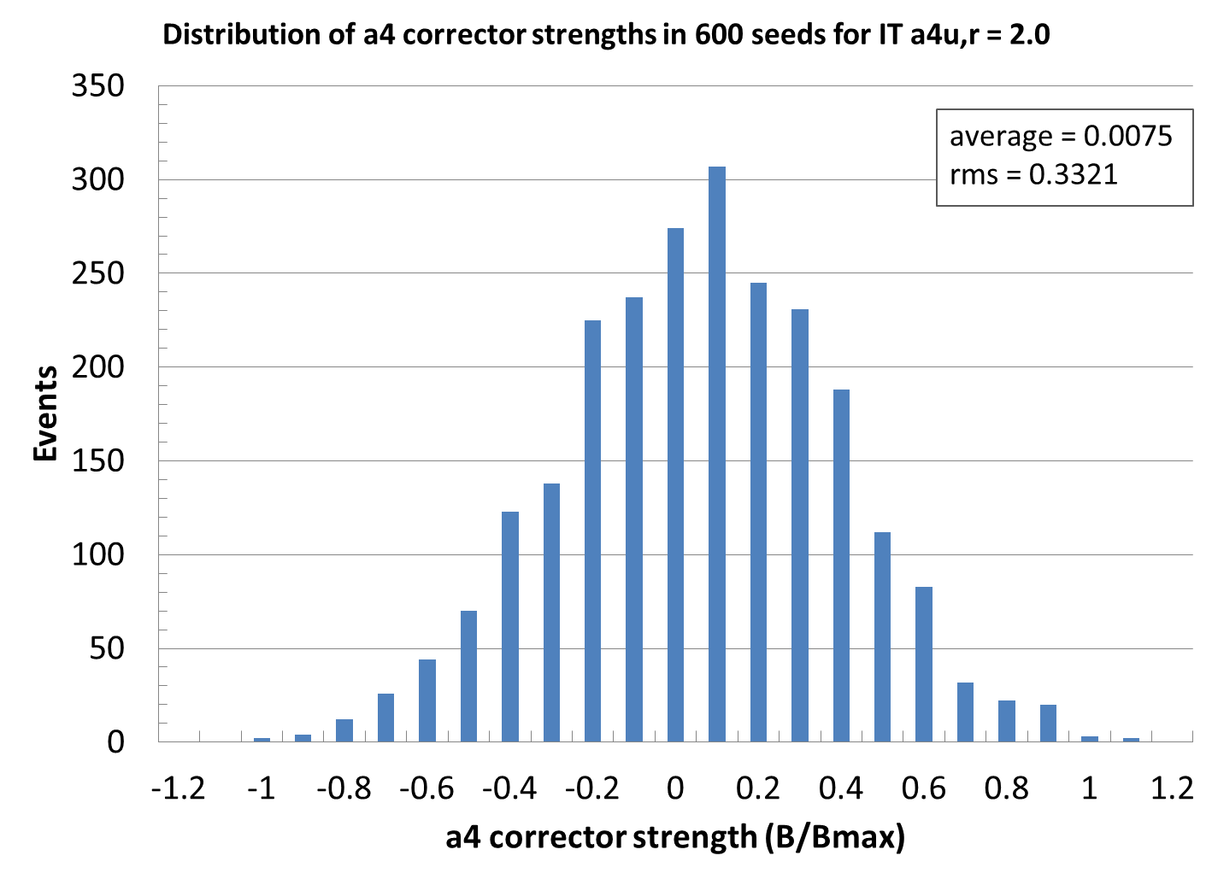
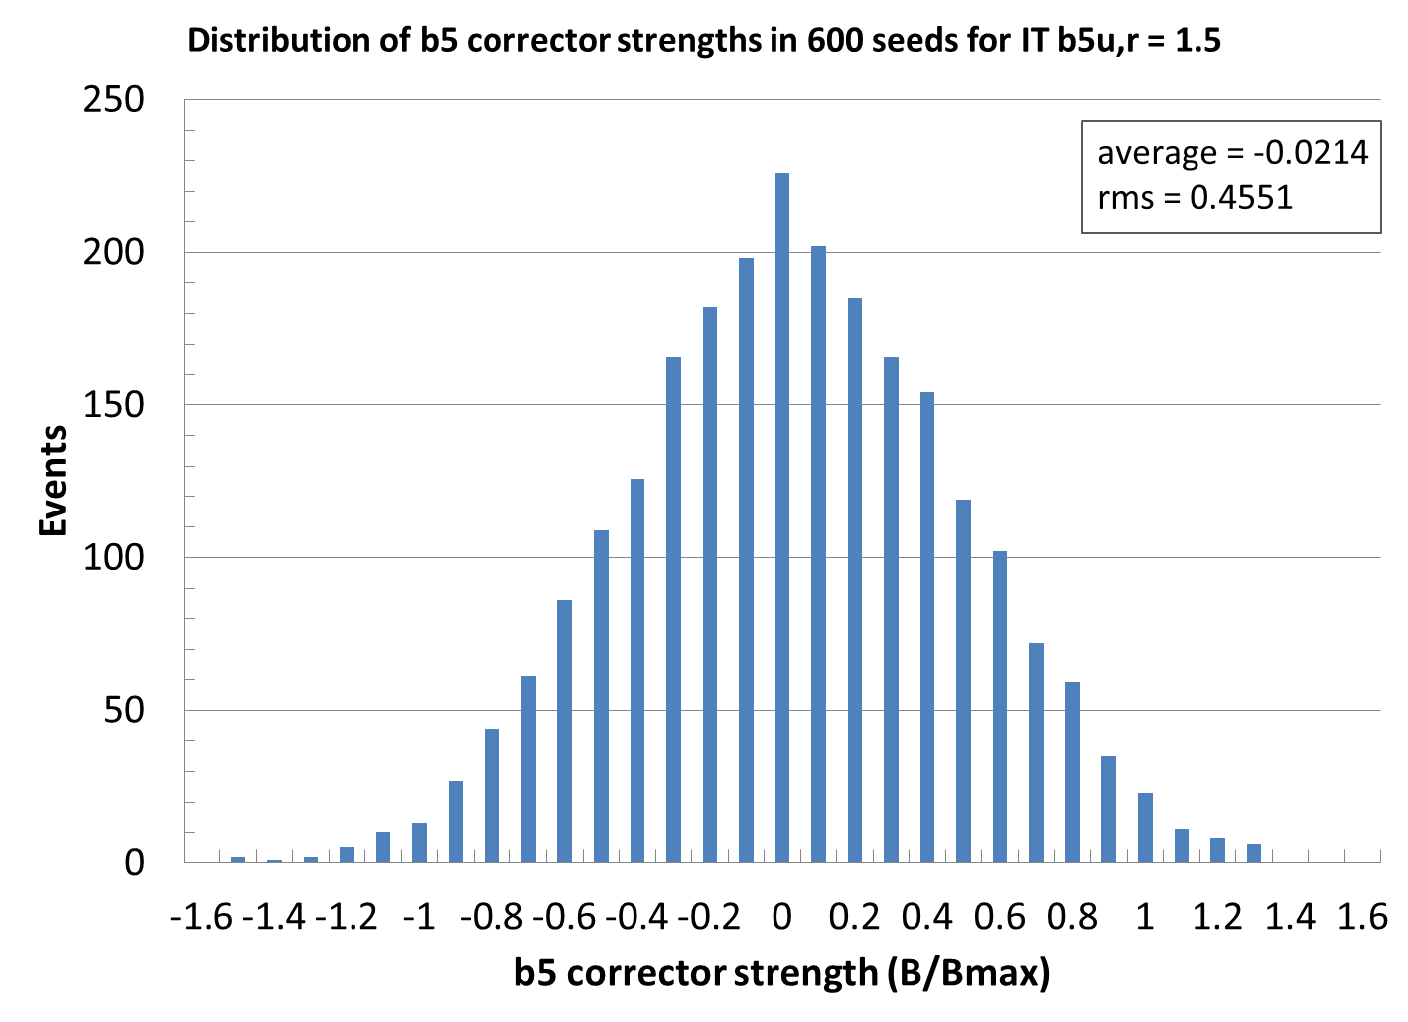
Example of distribution of a4 and b5 corrector strengths
Distribution of a4 and b5 corrector strengths in 600 seeds for a4u = a4r = 2 and b5u = b5r = 1.5
a4
b5

Slide 8
Maximum a4 corrector strength vs theoretically maximum a4 error
Corrector strength is normalized to the corrector spec (BL_{max} = 0.046 Tm @ 50 mm)
The effect of D1 a4 error on the maximum a4 corrector strength is small (about 8%)
According to the linear fit, the corrector spec strength is reached at the theoretically maximum error of a4max = 7.508
This corresponds to the maximum uncertainty & random values: a4u = a4r = a4max / 4 = 1.877
This maximum value is within the estimated “desirable” range of u/r a4 < 2
To provide margin on the a4 FQ spec, the latter should be improved compared to this estimate, or the a4 corrector strength increased

Slide 9
Maximum b5 corrector strength vs theoretically maximum b5 error
Corrector strength is normalized to the corrector spec (BL_{max} = 0.025 Tm @ 50 mm)
The effect of D1 b5 error on the maximum b5 corrector strength is small (10%). To note that the D1 b5 currently features 0 systematic component.
According to the linear fit, the corrector spec strength is reached at the theoretically maximum error of b5max = 3.778
This corresponds to the maximum uncertainty & random values: b5u = b5r = b5max / 4 = 0.944
This maximum value is within the estimated “desirable” range of u/r b5 < 1
To provide margin on the b5 FQ spec, the latter should be improved compared to this estimate, or the b5 corrector strength increased

Slide 10
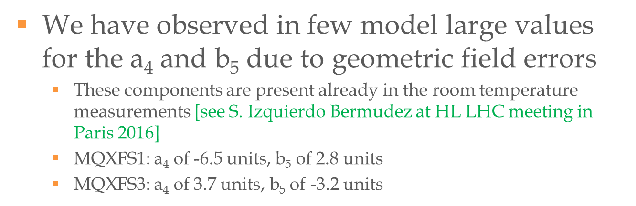
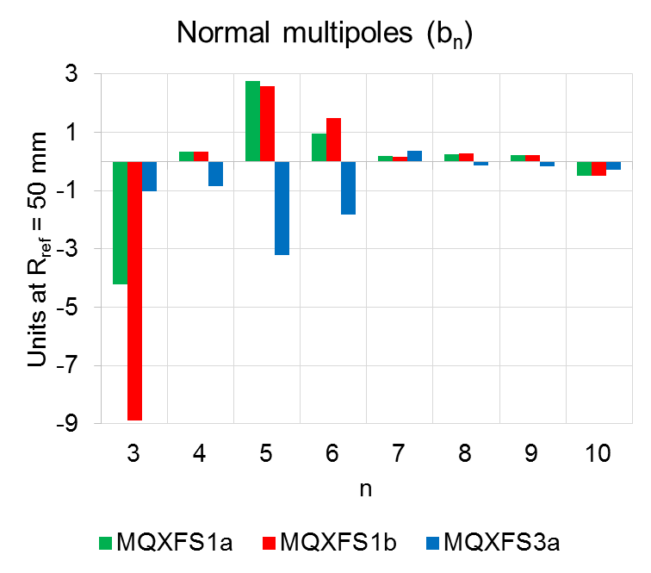
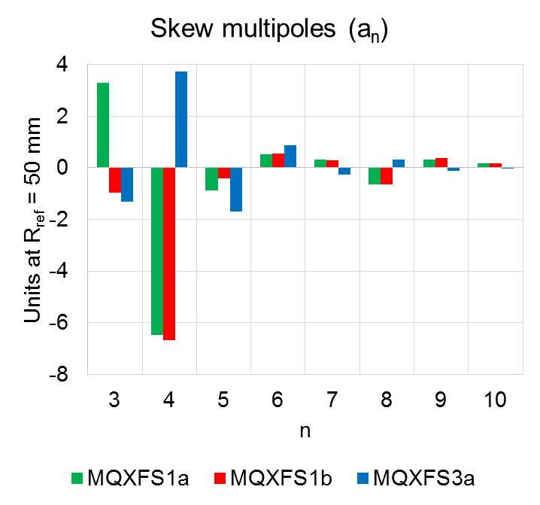
Comparison with measured a4, b5 errors
(E. Todesco et al, 28-Feb-2017 WP2 meeting)
(S.I. Bermudez et al, 6th HL-LHC collaboration meeting, Nov 2016)
So far, the measured a4 & b5 are within the maximum values allowed by the corrector spec
    measured a4 < 6.5 → less than a4max = 7.508 → a margin of 13%
    measured b5 < 3.2 → less than b5max = 3.778 → a margin of 15%
The measurements have limited statistics to determine the distribution
The margin on the corrector strength can be increased by
  making the correctors longer and/or
  increasing the maximum corrector current

Slide 11
Conclusions
Impact of large a4, b5 IT errors on the collision DA is evaluated in the range of a4u, a4r < 4 and b5u, b5r < 3
A “desirable” a4, b5 range, where the impact on the DA is relatively small, is estimated to be within a4u, a4r < 2 and b5u, b5r < 1
A large number of seeds (600) is used to determine the maximum strengths of IT a4, b5 correctors vs the a4, b5 IT errors
The present corrector spec is compatible with the errors up to
  a4max = 7.508, corresponding to the maximum a4u = a4r = 1.877
  b5max = 3.778, corresponding to the maximum b5u = b5r = 0.944
These “acceptable” error values are within the estimated “desirable” range
The impact of D1 a4, b5 spec errors on the maximum corrector strength is small
So far, the measured a4, b5 errors are below the estimated maximum “acceptable” errors, with a margin of 13% (a4) and 15% (b5)
  The margin can be increased by making the correctors longer and/or increasing the maximum corrector current

