Slide 1
Effect of collimator coating thickness on
HL-LHC octupole thresholds
S. Antipov, N. Biancacci, E. MEtral
13.03.18

Slide 2
Motivation and previous work
Operation at the HL-LHC intensity (2.3x10¹¹ ppb) is not compatible with the present LHC transverse impedance
In order to reduce the impedance, an upgrade of the collimator system is planned
  Lower the total impedance and the octupole threshold by ~ 50%
Secondary collimators in IR-7 are coated with 5 μm Mo
  The coating thickness should provide sufficient margins for stable operation
References:
N. Biancacci, ‘Update on the HL-LHC impedance budget’, 4th HL-LHC Meeting, KEK, Japan, 2014
E. Metral, et al., ‘Beam intensity limitations’, 4th HL-LHC Meeting, KEK, Japan, 2014
N. Biancacci, ‘HL-LHC impedance and beam stability’, 5th HL-LHC Meeting, CERN, 2015
S. Antipov, et al., ‘Machine impedance and HOM power update’, 7th HL-LHC Meeting, Madrid, 2017
A. Mereghetti, et al., ‘Impedance measurement of TCSPM collimator’, LHC MD2193 Note, CERN, in preparation

Slide 3
Goal: Update the estimate on how the thickness of the coating affects the octupole threshold
Most challenging, Ultimate, OP scenario
Three coating scenarios:
  Mo+MoGr
  Cu+MoGr
  Cu+CFC
Various coating thickness:
  1, 3, 5 μm
Energy, β* | E = 7 TeV, β* = 41 cm
Beam intensity | M = 2760, N_{b} = 2.3x10¹¹ p
Beam emittance Bunch length | ε_{n} = 2.1 μm (injection) σ_{z} = 9.0 cm, rms, Gaussian
Damper | d = 100 turns⁻¹
Octupole SD | Negative polarity, no ATS Tails cut at 3 rms beam size
Collimator settings | Nominal (2.5 μm ref. ε): TCP – 6.7σ TCSG – 9.1σ

Slide 4
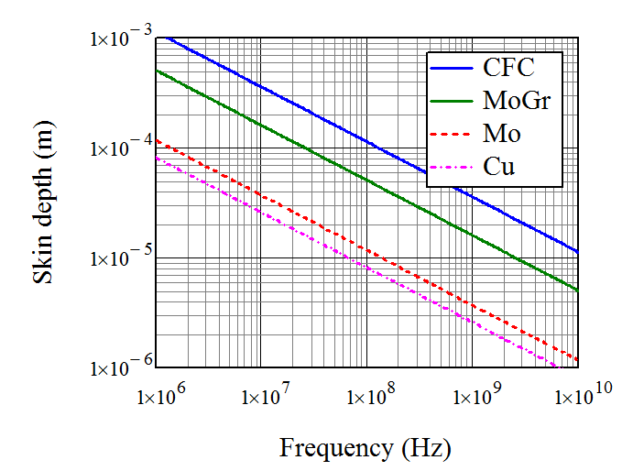
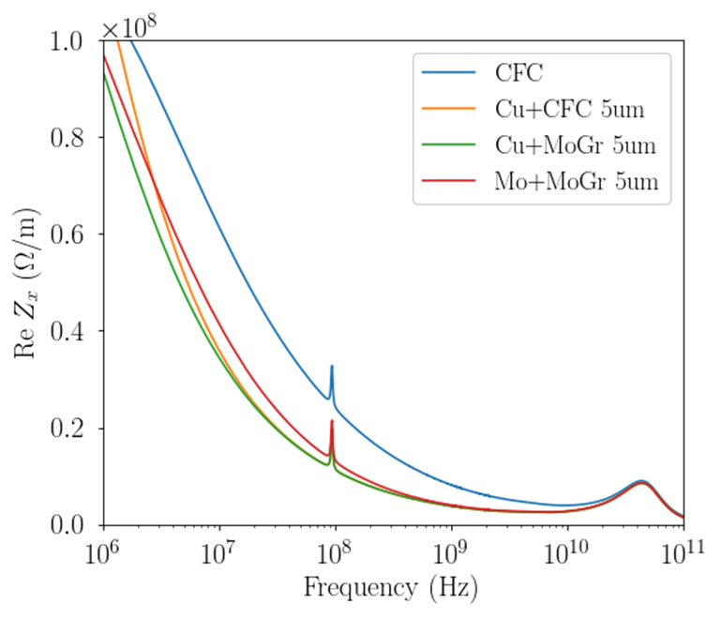
The bulk has little effect on impedance for a sufficiently thick coating
1000
100
Skin depth (μm)
10
f_{rf}
1
Material | Bulk resistivity (nΩ-m)
CFC | 5000
MoGr | 1000
Cu | 26
Mo | 53.5

Slide 5
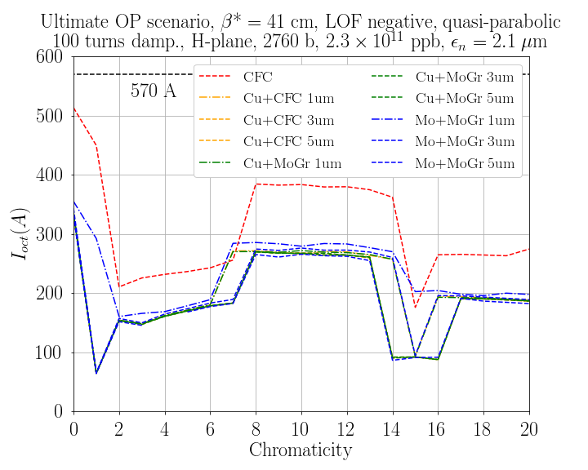
Octupole threshold increases for thinner coatings
Mo: +20 A for Q’ ~ 8-12
Cu: no significant difference
for Cu around Q’ ~ 10
The effect may be large at
some chromaticities

Slide 6
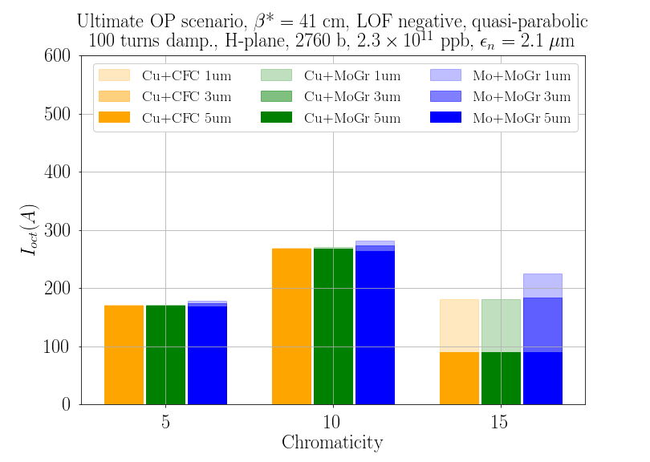
Increase in octupole threshold assuming ΔQ’ = ±1 uncertainty in Q’
CFC

Slide 7
Conclusion
The choice of bulk collimator material has little effect on the machine impedance and hence beam stability if the coating is sufficiently thick
5 μm coating provides a significant safety margin in terms of the octupole threshold
The increase of octupole current for thinner coatings is relatively small for most positive Q’, even when its thickness is reduced to 1 μm
  Up to 20 A (~10% of the total) for Mo coating on MoGr and Q’ ~ 10
  Nearly no effect for better coatings with lower resistivity, such as Cu
  The octupole threshold may double for certain values of Q’
    Still, it shall not exceed 300 A at any chromaticity in the range Q‘ = 5-20

Slide 8
Back-up slides

Slide 9
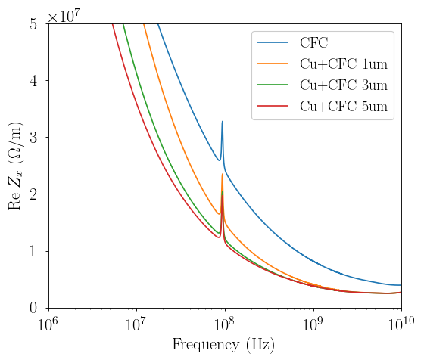
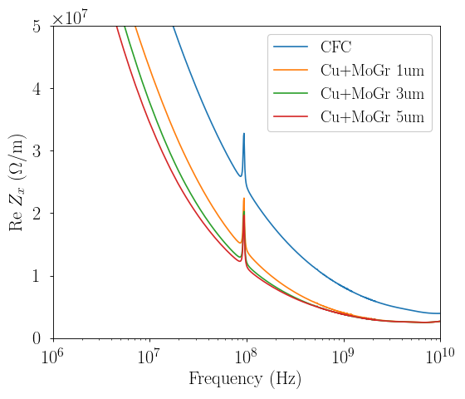
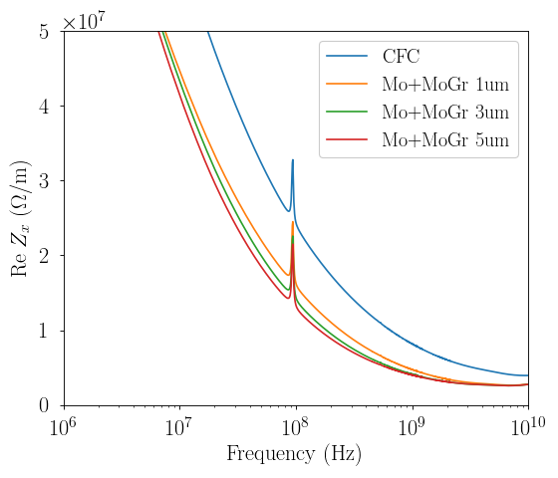
Impedance of different coating thickness options
f_{rf}
f_{rf}
f_{rf}

Slide 10
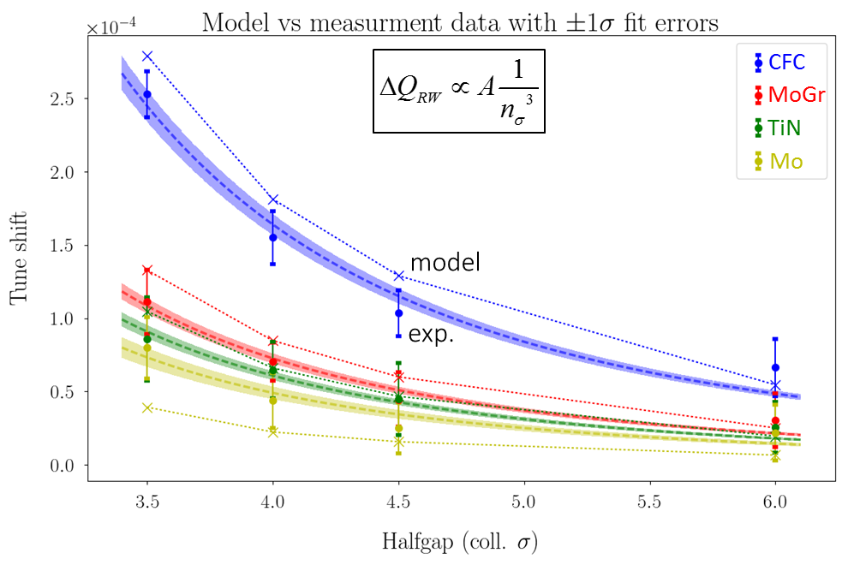
Mo resistivity might be not as good as expected
Material resistivities (in nΩ-m): measured vs expected
Material | Beam Meas. | Lab Meas. (AC) | IW2D Model
CFC | 4030 ± 380 | – | 5000
MoGr | 760 ± 60 | 800 – 1200 | 1000
TiN | 340 ± 40 | Not measurable | 400
Mo | 250 ± 50 | 20 – 100 | 50

