Slide 1
Transverse kick factor of HL-LHC crab cavities
S. Antipov, N. Biancacci, X. Buffat, B. Salvant, E. Metral
Many thanks to R. Calaga, J. Mitchell, R. De Maria
13.03.18

Slide 2
Could the random nature of crab cavity HOMs lead to emittance growth?
Randomness of the modes comes from the construction, once the cavity is built, there are no random component in the resulting wake fields/impedance
There is no reason to treat the impedance of the CC differently from other impedances
Might be an issue
  Alex Lumpkin, “Observations of Higher-Order-Mode Effects in Tesla-Type SCRF Cavities on Electron Beam Quality”, IPAC’18, to be followed up
Is the HOM impedance strong enough to amplify an external source of noise?
How does it compare to the other sources of impedance?

Slide 3
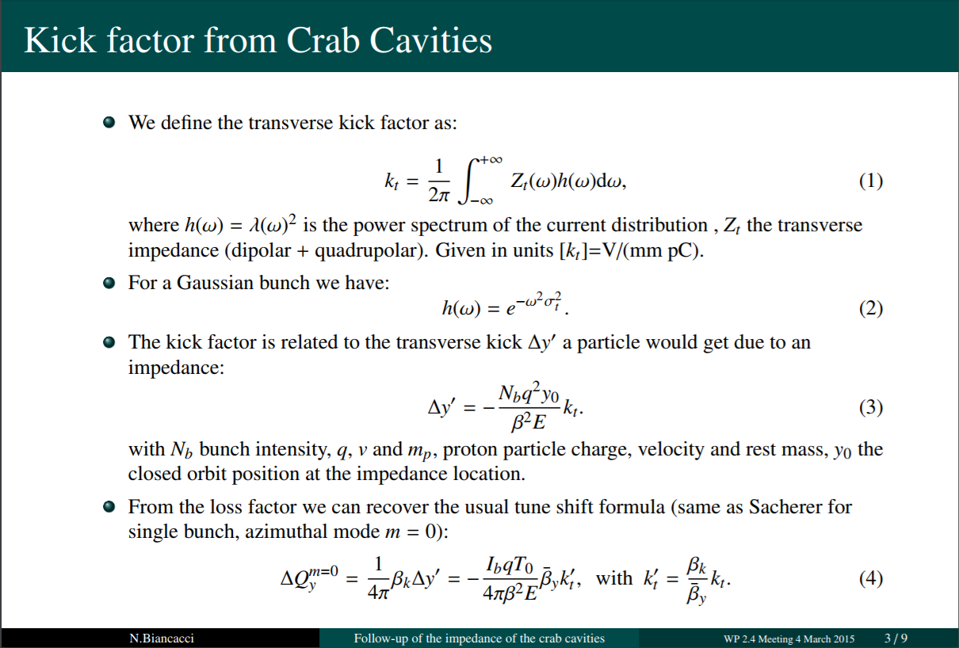
N. Biancacci, et al., “Follow-up of the impedance of the crab cavities”, WP2.4 Meeting, 04.03.15

Slide 4
Previous studies have estimated the effect to be small
All crab cavities combined:
  k’_{t} = 1.4 V/mm-pC
One primary collimator at a half-gap of 1 mm:
  k’_{t} = 3.1 V/mm-pC
Whole collimation system:
  k’_{t} = 45.3 V/mm-pC
8 CC / beam / IP
E = 7 TeV, β* = 15 cm, σ_{z} = 7.6 cm
N_{b} = 2.2x10¹¹ ppb
N. Biancacci, et al., “Follow-up of the impedance of the crab cavities”, WP2.4 Meeting, 04.03.15

Slide 5
Previous studies have estimated the effect to be small
All crab cavities combined:
  k’_{t} = 1.4 V/mm-pC
One primary collimator at a half-gap of 1 mm:
  k’_{t} = 3.1 V/mm-pC
Whole collimation system:
  k’_{t} = 45.3 V/mm-pC
Impedance and damper can be treated similarly
  Y. I. Alexakhin, Particle Accelerators, Vol. 59, pp. 43-74 (1997)
Amplification factor, analogue to damper gain:
  How big is it compared to damper gain?
  Damper gain ~10⁻²
(2x10⁻⁴)
(5x10⁻⁴)
8 CC / beam / IP
E = 7 TeV, β* = 15 cm, σ_{z} = 7.6 cm
N_{b} = 2.2x10¹¹ ppb
N. Biancacci, et al., “Follow-up of the impedance of the crab cavities”, WP2.4 Meeting, 04.03.15

Slide 6
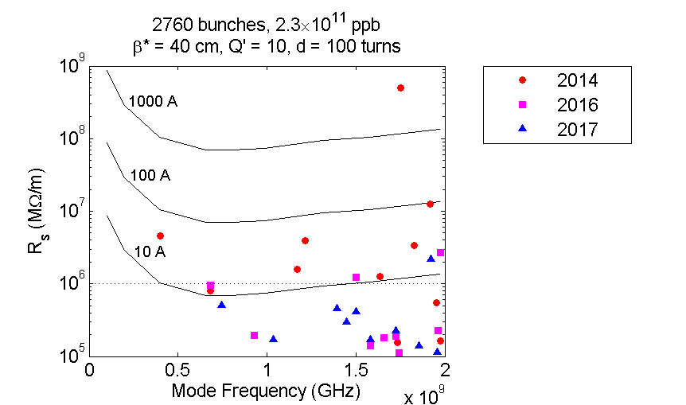
CC HOM kicks have reduced dramatically
Shunt impedance has decreased
8 CC per IP -> 4 CC per IP
Bunch length has increased, lowering
the impact of high frequency modes
σ_{z}: 7.6 cm -> 9.0 cm
Progress of DQW HOM shunt impedance

Slide 7
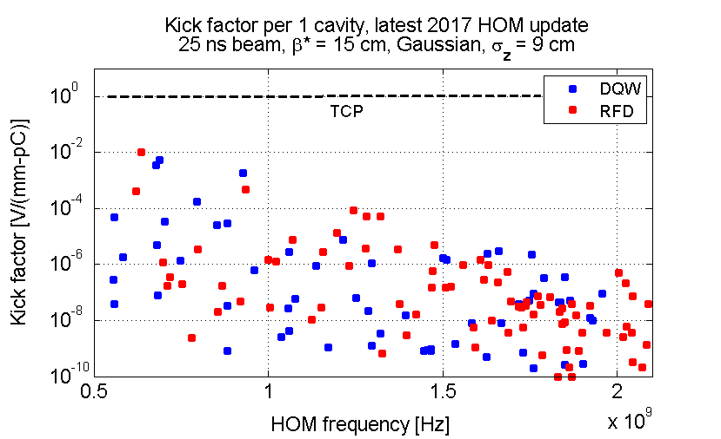
The total impact of the HOMs is insignificant
Assuming the max β-function at the
cavities
  During collision, β* = 15 cm
One crab cavity:
  k’_{t} = 1x10⁻² V/mm-pC
All 4 crab cavities:
  k’_{t} ~ 0.04 V/mm-pC (DQW)
  2 orders of magnitude lower than
  the collimator system

Slide 8
The largest kick factors are those of low-Q modes
No impact of the details of the
coupled-bunch spectrum
DQW | RDF
f = 689 MHz, Q = 40, R_{s} = 13 kΩ/m | f = 636 MHz, Q = 800, R_{s} = 406 kΩ/m
f = 678 MHz, Q = 230, R_{s} = 45 kΩ/m | f = 612 MHz, Q = 55, R_{s} = 1 kΩ/m
f = 929 MHz, Q = 30, R_{s} = 9.6 kΩ/m | f = 936 MHz, Q = 300, R_{s} = 27 kΩ/m

Slide 9
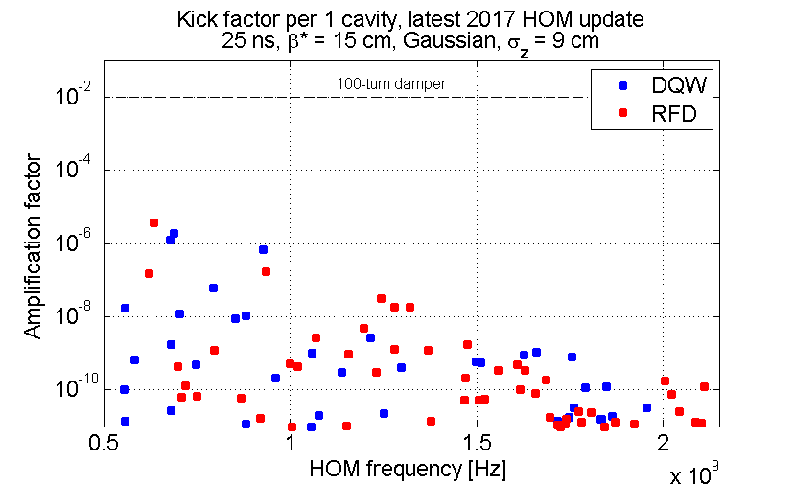
HOM amplification factor is small compared to damper gain
Assuming the max β-function at the
cavities
  During collision, β* = 15 cm
One crab cavity:
  4x10⁻⁶
All 4 crab cavities:
  ~ 1.6x10⁻⁵ (DQW)
  3 orders of magnitude lower than
  the amplification factor of the damper

Slide 10
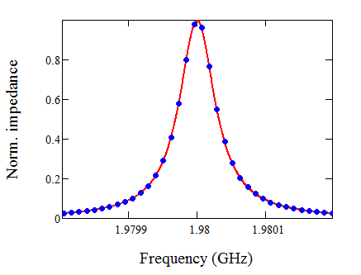


No significant effect even if an HOM hits a coupled-bunch line
For the purpose of transverse coupled-bunch stability the HOMs have limited shunt impedances – not more than 1 MΩ/m
Assume Q’ = 0
  Beam spectrum decays with the frequency as
  All HOMs are higher than 500 MHz
Kick factor:
Amplification:
Significantly lower than the damper gain
$$e^{−{\left(2πf_{HOM}τ_{rms}\right)}^{2}}$$
$\frac{N_{b}q_{e}^{2}}{E}β_{av}k_{t}^{′}<$ 10⁻⁷

Slide 11

No significant effect even if an HOM hits a coupled-bunch line
For the purpose of transverse coupled-bunch stability the HOMs have limited shunt impedances – not more than 1 MΩ/m
Assume a large Q’
  The maximum of beam spectrum is exactly on a CB line
Kick factor:
Amplification:
Significantly lower than the damper gain
$\frac{N_{b}q_{e}^{2}}{E}β_{av}k_{t}^{′}<$ 2.5x10⁻⁷

Slide 12
Conclusion
Crab cavity HOMs can lead to an emittance growth, but should be treated as and in comparison to any other source of impedance
  RF source does not create noise at the high HOM frequencies
The impact of the HOMs on the beam emittance is negligible for both DQW and RFD designs

Slide 13
Back-up slides

Slide 14
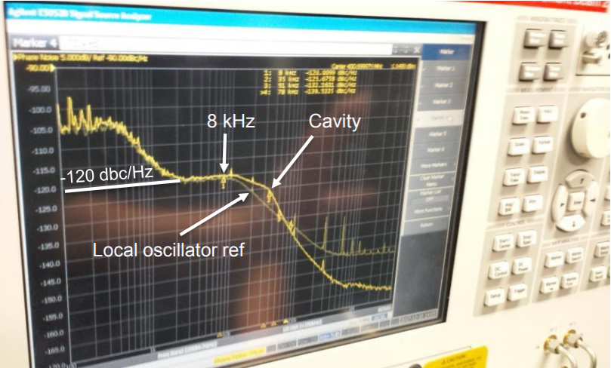
In RF measurements no noise signal is seen at the HOM frequencies
No dedicated test of RF noise in HOMs has been done, but can be performed if needed
The RF source bandwidth is not enough to excite them
The HOMs have to be excited by the beam
Most of the measured phase noise is
at the low frequency end of the spectrum
R. Calaga, SPS Crab Cavity Tests, Chamonix 2018

Slide 15
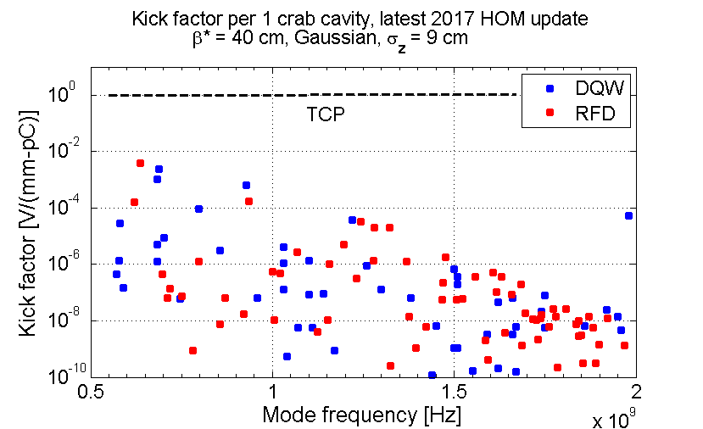
Before the beams are brought into collision
Maximum impact at β* = 41 cm
for the Ultimate OP scenario
One crab cavity:
  k’_{t} = 4.3x10⁻³ V/mm-pC
All 4 crab cavities:
  k’_{t} ~ 0.02 V/mm-pC
  2 orders of magnitude lower than
  the collimator system

