Slide 1
Beam Instrumentation and Diagnostics for High Luminosity LHC
Rhodri Jones

Slide 2
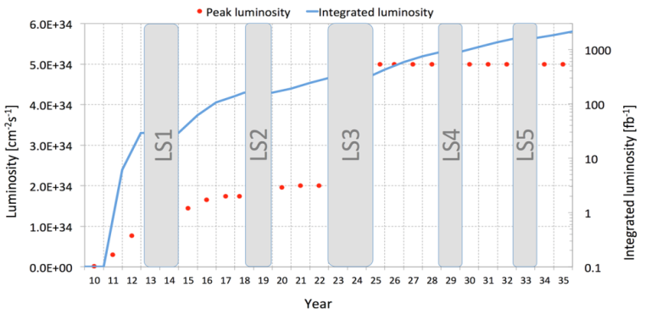
Goal of High Luminosity LHC
Prepare LHC for operation beyond 2025
Achieve a total integrated luminosity of 3000 fb⁻¹ by 2035
    Integrated luminosity of 250 fb⁻¹ per year
    Levelled luminosity of 5×10³⁴ cm⁻² s⁻¹
Ten times luminosity reach of first 10 years of LHC operation

Slide 3
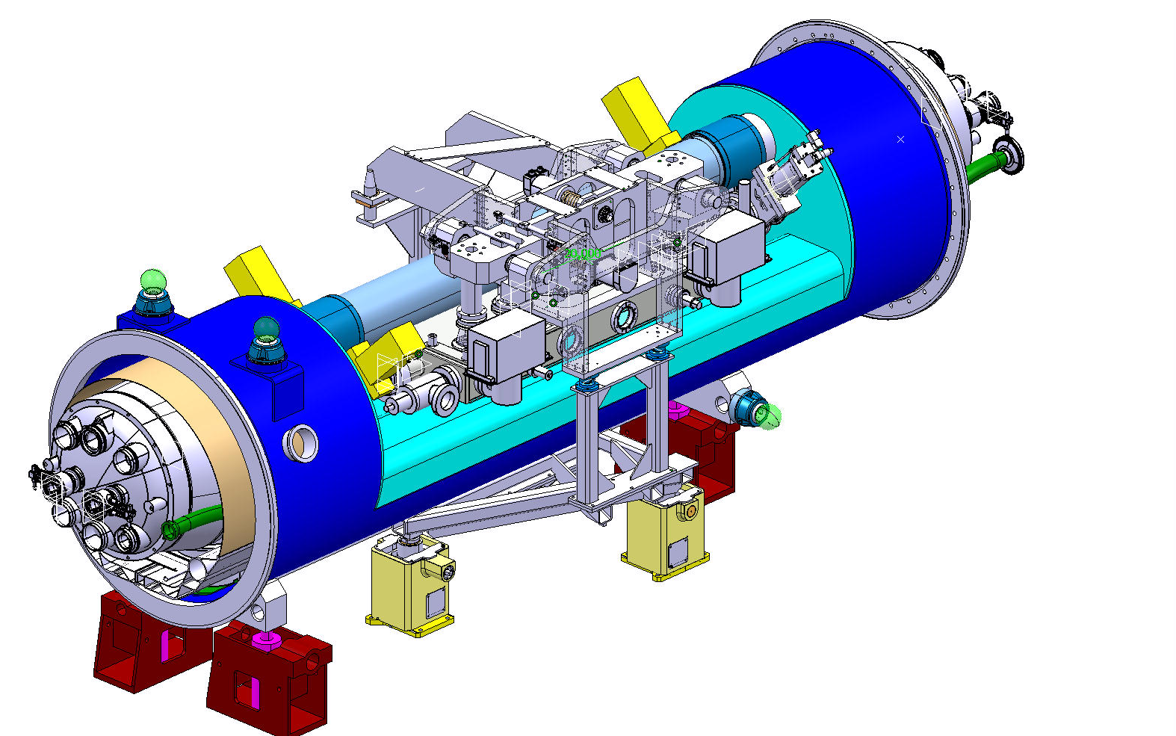
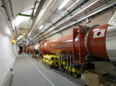




Critical zones around ATLAS & CMS
ATLAS
CMS
  Installation of over 1.2km worth of new equipment
    New triplets using Nb₃Sn technology
    Addition of Crab Cavities & new D1, D2, Q4 & correctors
    11 T Nb₃Sn dipole to allow extra collimator in dispersion suppressor
Elimination of technical bottlenecks
    Cryogenic system upgrades
    Relocation of power converters – high temperature superconducting links
Need for new beam instrumentation to further optimise the machine

Slide 4
Scope of WP13 – Beam Instrumentation and Long-Range Beam-Beam Compensation
Upgraded Beam Instrumentation for HL-LHC
Long-Range Beam-Beam Compensation
  Studies leading to proof of concept
  Design study for possible final implementation
Task | Description
13.1 | Radiation Hard BLM Electronics
13.2 | Gas Jet Curtain Development
13.3 | New BPMs Q1 to Q5 with dedicated electronics
13.4 | Luminosity Monitors
13.5 | High Bandwidth Transverse Pick-ups
13.6 | Upgrade to Synchrotron Light Monitor
13.7 | Beam Gas Vertex Detector
13.8 | Long Range Beam-Beam Compensator Studies

Slide 5
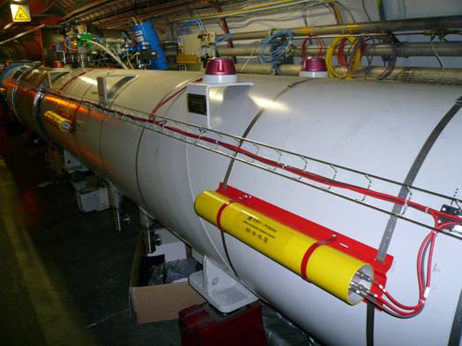
Beam Loss Monitoring for HL-LHC
Essential for safe & reliable operation of LHC
Existing system
    Meets needs of the HL-LHC in arc regions
        ~3000 ionisation chambers
    In LSS : Quench level approaches noise level for long cables at high energy
New requirements for high luminosity LHC
    Mount electronics on (or very close to) detector to eliminate long cables
    Requires development of radiation hard front-end electronics
    Collaboration with EP underway to design & produce ASIC
    Prevents damage to accelerator components
    Avoids quenches & associated time-consuming cryo recovery

Slide 6
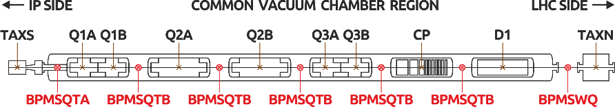
Beam Position Monitoring for HL-LHC
Beam Position System
  Over 500 BPMs per beam capable of bunch by bunch acquisition
    No performance increase required for arc BPMs
    Renovation of the electronics foreseen for Long Shutdown 3 (2023-2025)
New BPMs required for HL-LHC insertion regions
    Directional stripline BPMs
    Distinguish between both beams (in same vacuum chamber)
    Limited by signal isolation of one beam on the other
        Location optimised for time separation
        Directivity optimised by design

Slide 7
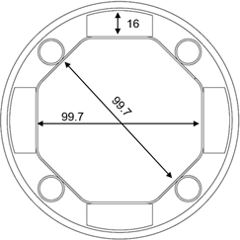
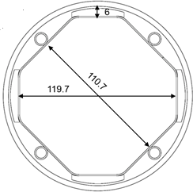
Challenges
Both beams in a single vacuum chamber
Octagonal vacuum chamber
Cryogenic BPMs installed in vacuum
Tungsten blocks at H and V planes to absorb collision debris
Heat load due to electron cloud
Complicated integration and alignment
A
B

Slide 8
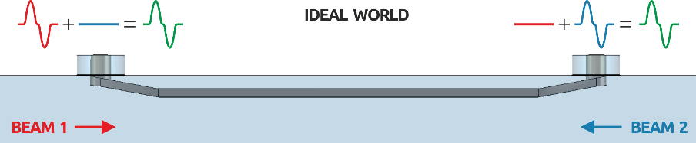
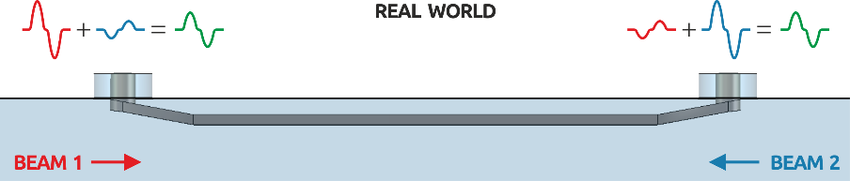
BPM directivity

Slide 9
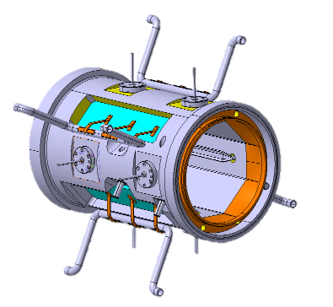
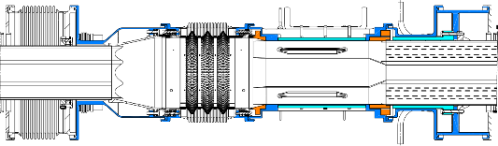
Mechanics, integration and alignment
Courtesy: N. Chritin
Mechanical design well advanced
Integration with the interconnects and
alignment ongoing with other WPs

Slide 10
String test
6 cold BPMs required – 1 x BPMSQTA and
5 x BPMSQTB – verification whether full BPMs are really needed
Possibility of including warm BPMSWQ under study
The BPMs need to be ready in 2020

Slide 11
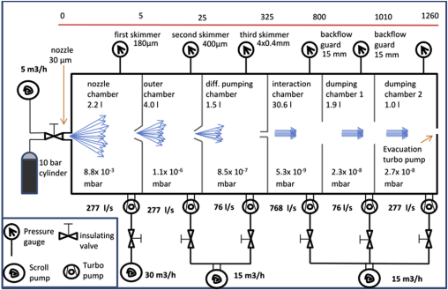
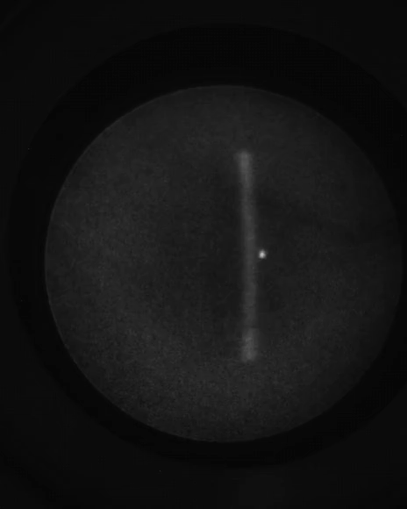
Gas Jet Monitor
Aims to provide a non-invasive method of aligning electron beam devices with the proton beam
  Hollow electron lens or long-range beam-beam compensator
Gas sheet in combination with luminescence
Collaboration partners
  University of Liverpool for development of the gas sheet
  GSI for the luminescence detection
Electron
Beam

Slide 12
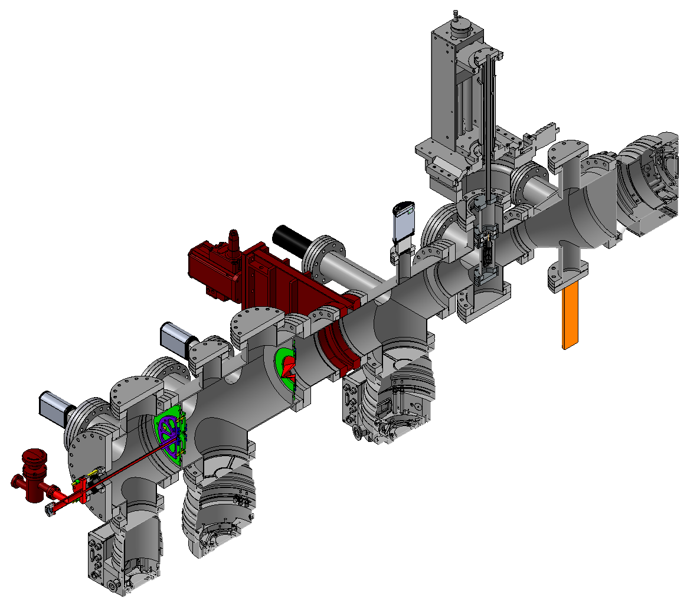
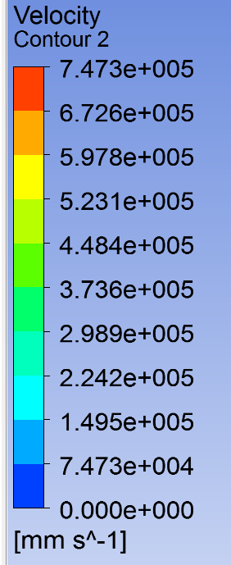
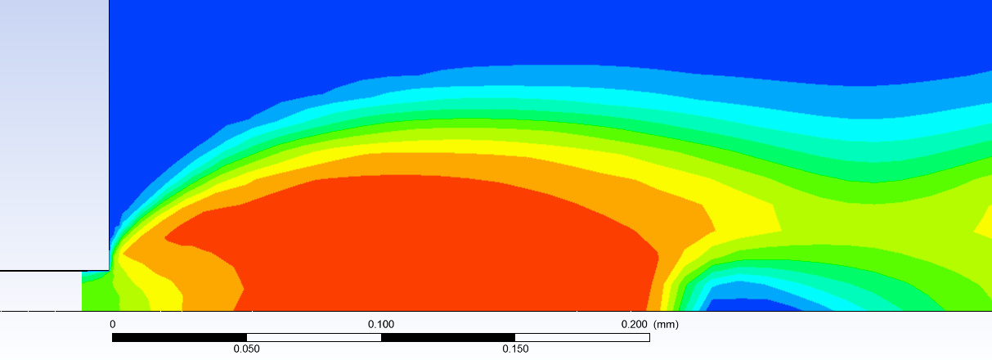
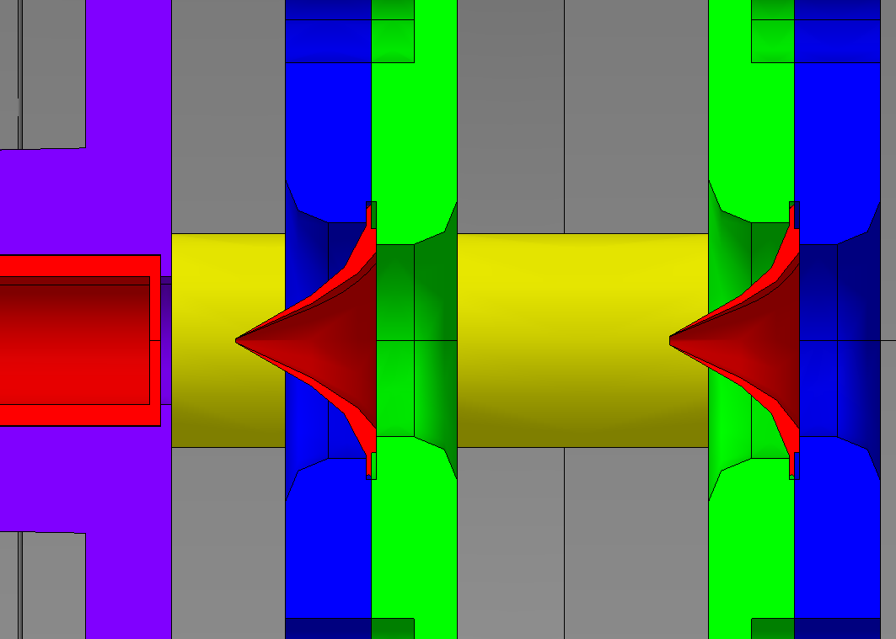
Gas Jet Monitor
Studies to optimise supersonic gas sheet generation ongoing
Optical system under development
  Choice of gas fluorescence line
  Influence of strong magnetic solenoid field
First prototype construction nearing completion
Nozzle
1st Skimmer

Slide 13
Luminosity Monitors
IP2 & IP8
Luminosity monitors upgraded in LS1 based on Cherenkov in quartz
Radiation damage study underway with a prototype installed in IP1
  Early indications show detector is radiation hard enough for HL-LHC
IP1 & IP5
Current monitors housed in TAN & based on gas ionisation detectors
  These are degrading and will need to be replaced for HL-LHC
Proposal to replace with combined Cherenkov detectors in the TAXN
  Low luminosity (first / probe collisions): Cherenkov light in quartz
  High luminosity (physics fills): Cherenkov light in gas
Status
Proof of concept prototype installed in IP1 for since 2016 run
  Based on these results such design seems feasible for HL-LHC
Next Steps
  Qualify for radiation environment
  Find optimal location to be crossing angle independent
  Start the design of the HL-LHC detector
  Remote handling, vacuum bakeout, motorisation ….

Slide 14
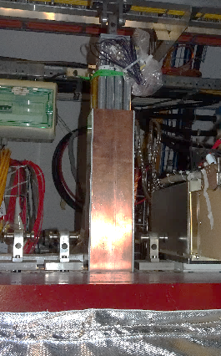
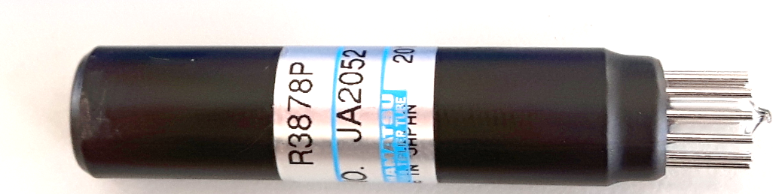
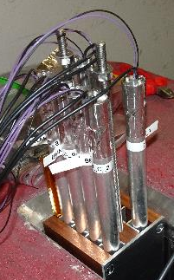
BRAN prototype for HL-LHC
Principle
Configuration (2016)
6 quartz rods (Spectrosil, Suprasil)
1 Empty tube (air) with reflective Al-foil on inside
1 Blacked PMT (reference)
Installation into TAN
Stainless
steel tube
Photomultiplier
(PMT)
Air gap
BRAN prototype
Quartz rod
Cherenkov
light
Right (x4)
ATLAS
Charged particle
TAN
Left (x4)

Slide 15
Intra-Bunch Diagnostics
Already important for understanding instabilities
    Electron cloud, impedance, beam-beam, ….
Will also be essential for crab cavity diagnostics
    Understanding their effect on the beam
Two methods being investigated
    Streak cameras looking at synchrotron radiation
        Will require new light extraction line to be built
        Light transport to radiation free area
    High resolution electromagnetic pick-ups

Slide 16
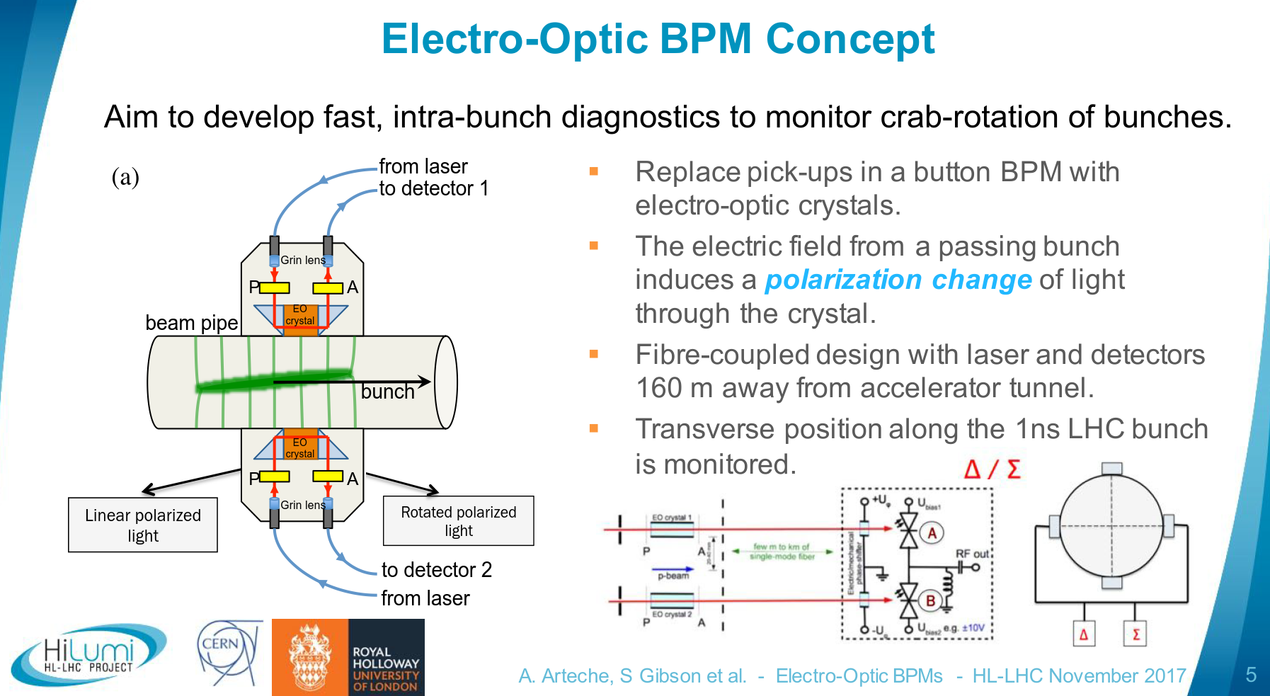

Slide 17
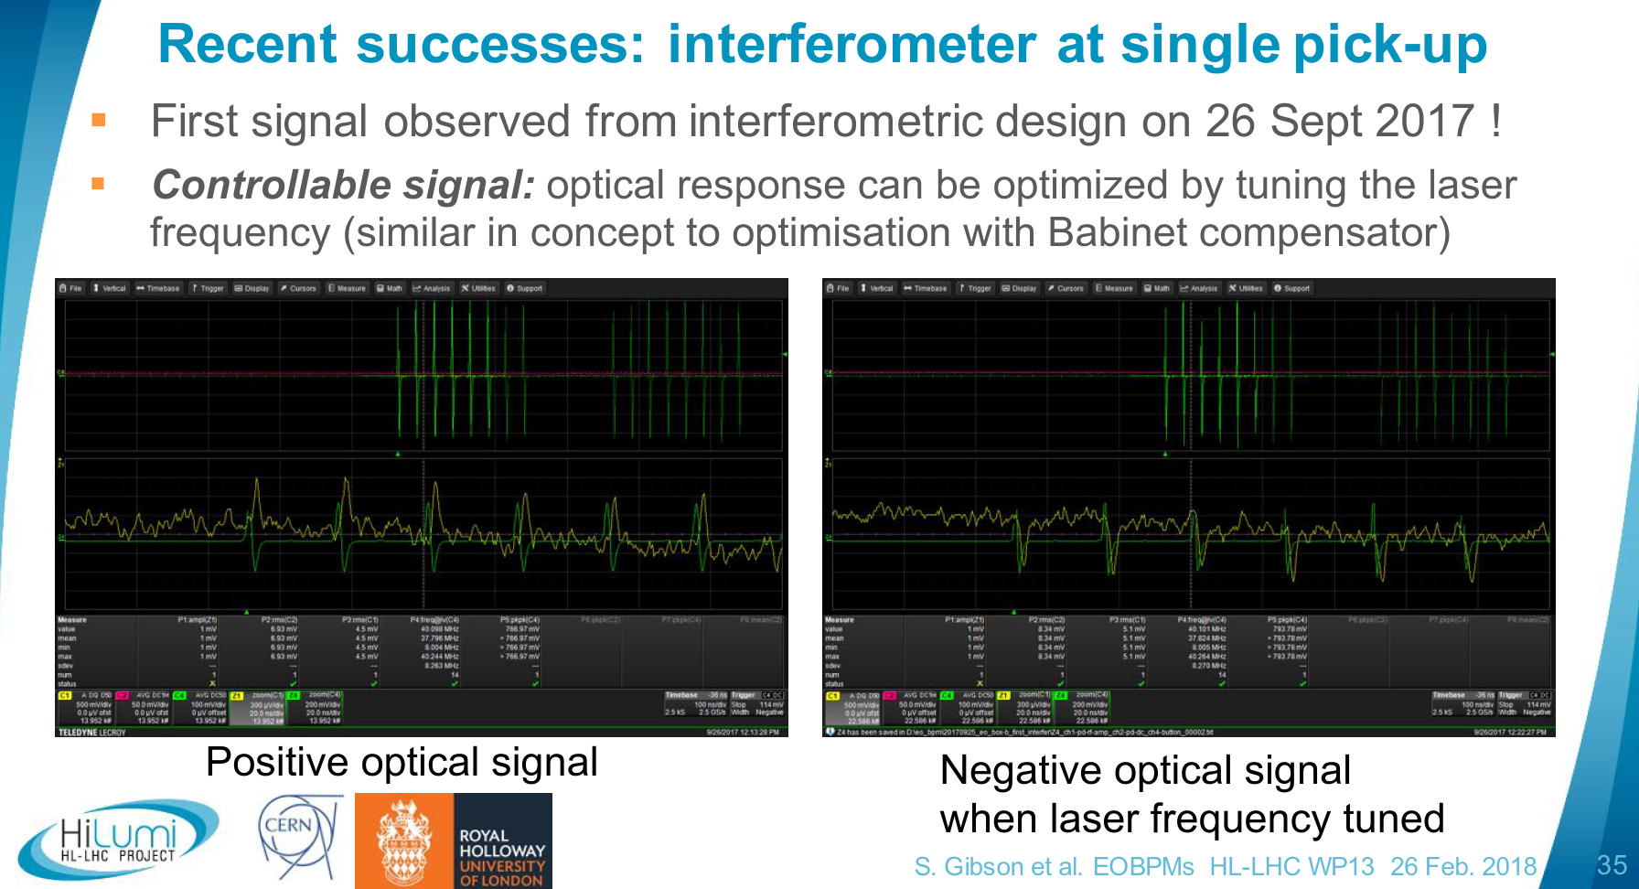

Slide 18
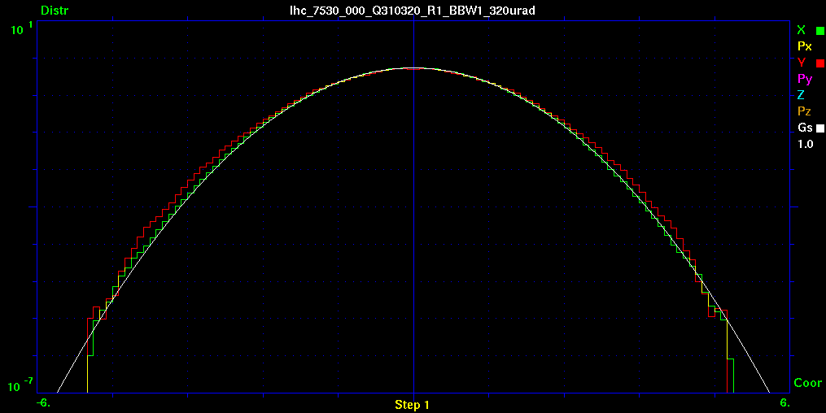
Halo Diagnostics for HL-LHC
No instrumentation currently installed in LHC to measure the beam halo
Important for HL-LHC
    Mitigate crab cavity failure by measuring the halo
        Excessive halo population can be quickly lost on crab failure
    Essential diagnostic for several options currently considered
        Hollow electron beam collimation
        Long range beam-beam compensators
Non-Invasive techniques being considered
    Use of gas jets
    Optical techniques using synchrotron radiation
10⁻⁵ level
Courtesy of
Alexander Valishev

Slide 19
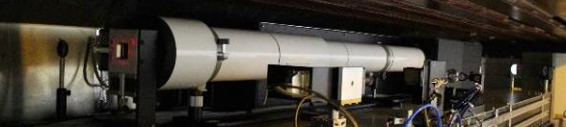
Upgrade of Synchrotron Light Diagnostics
Baseline
New Light Extraction Path to Optical Dark Room in UA43/UA47
  Required for additional measurement stations such as for Halo Diagnostics or Streak Cameras for intra-bunch measurement
Status
Prototype coronagraph for halo diagnostics installed in LHC
  KEK collaboration providing expert manpower & optical components
  First measurements taken during machine development periods
  Parasitic light at 6.5TeV observed and needs to be understood
  Contrast of 2x10⁻³ already demonstrated with early tests at 450GeV
Additional light extraction possibility for HL-LHC identified
  D4 magnet for incoming beam either side of Point 4
    Without additional undulator only provides diagnostics from 2TeV onwards
  Study to be started for design of light extraction path

Slide 20
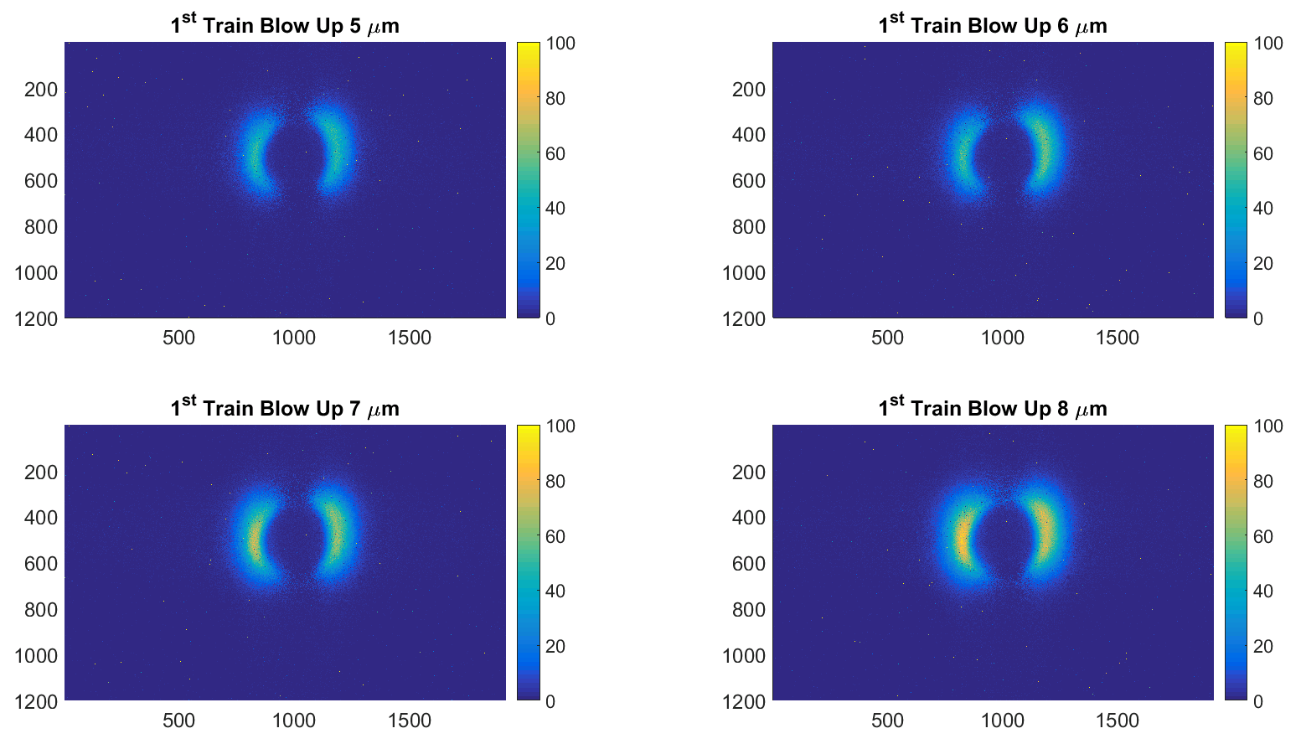


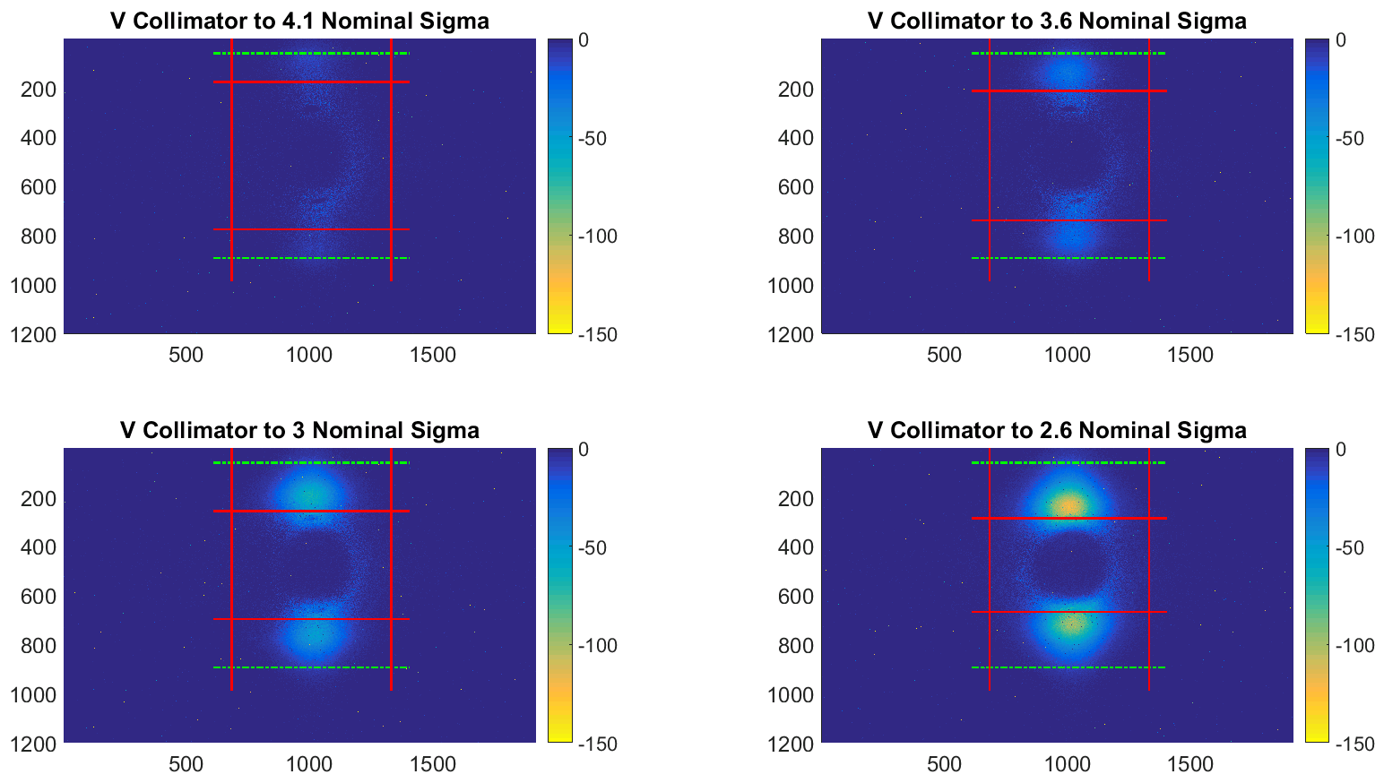
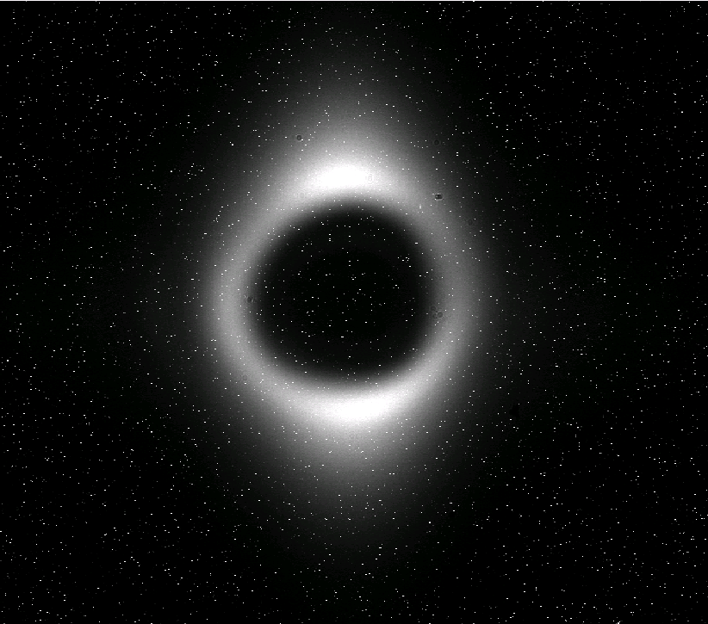

Prototyping the Coronagraph in LHC
Coronagraph images during controlled blow-up
Coronagraph images during controlled scraping

Slide 21
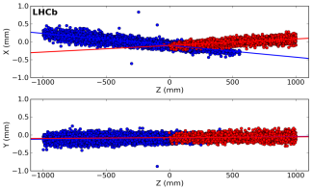
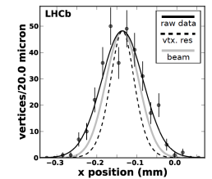
Non-invasive beam size measurement
The Beam Gas Vertex Detector
    To overcome limitations of wire scanner & synchrotron light
Beam Trajectories
Beam Profile
Concept used by LHCb vertex detector (VELO)
Collaboration between CERN, EPFL (CH), RWTH (DE)

Slide 22
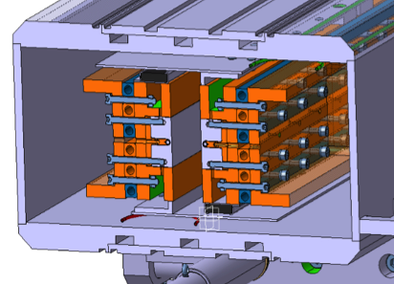
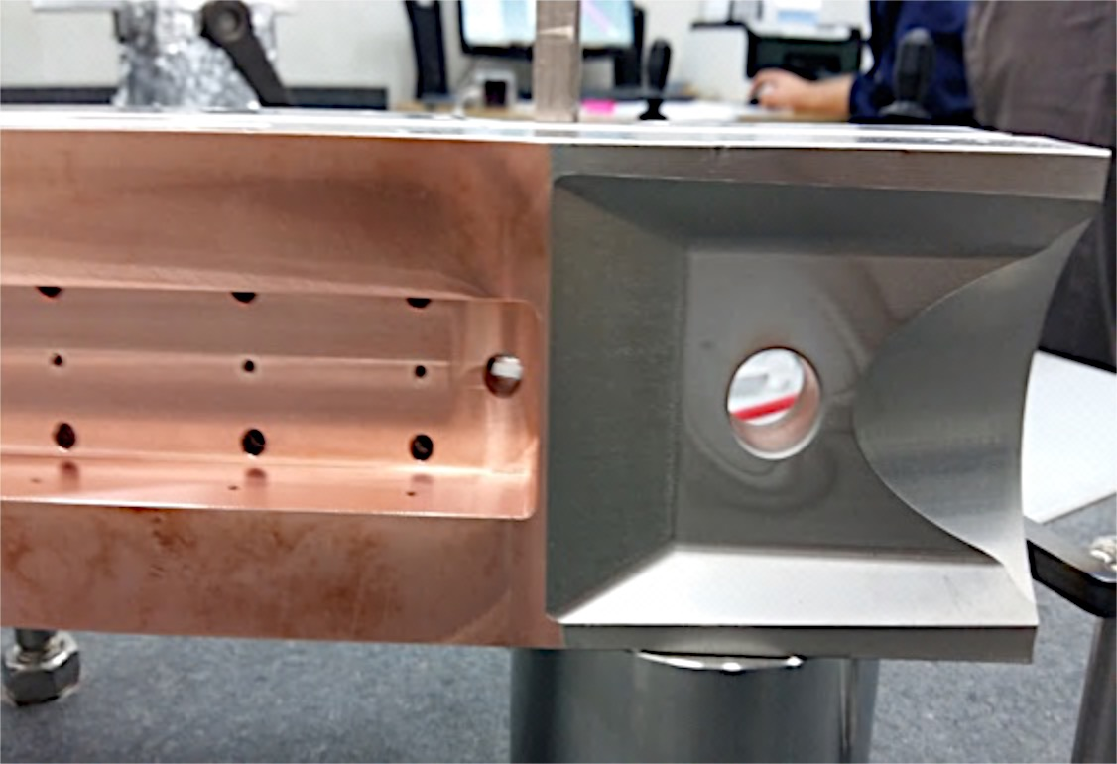
Long-Range Beam-Beam Compensation
Studies leading to proof of concept
  4 wire-in-jaw collimators replace IR1 & IR5 tertiary collimators
    Up to 350A in a wire < 3mm from collimation surface
  First beam tests in 2017 to be continued in 2018
Design study for possible final implementation
  Feasibility of high current electron beam to replace wire under study
    Collaboration with FNAL, BINP, EU ARIES
    Looking at production and confinement of 20A electron beams
  Test stand to be constructed (WP3 synergy – hollow e-beam studies)
    Test of high current (& hollow) e-guns & non-invasive diagnostics

Slide 23

Summary
LHC constructed with comprehensive suite of beam diagnostic devices
    These play an important role in its safe & reliable operation
HL-LHC will push the performance of LHC even further
    Requires a deep understanding of beam related phenomena
Can only be delivered through its beam instrumentation
    Upgrade to many of the existing systems
    Development of new diagnostics to address specific needs

