Slide 1
IR4 Optics for HL-LHC
R. De Maria
Thanks to S. Fartoukh, A. Rossi, A. Mereghetti.
Meeting 6/3/2018

Slide 2
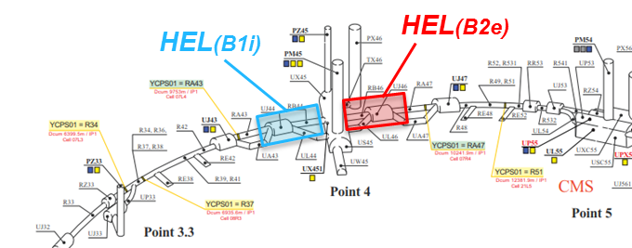
IR4 Optics development for HL
SLHCV3.0 – HLLHC1.2:
Twiss parameter at IP and phase advance adjusted for ATS
LHC:
new IR4 optics developed by S. Fartoukh in 2015 to enhance beta for instrumentation.
HLLHCV1.3:
Proposal for enhancement β functions (also during the ramp, 67th WP2 meeting 26/4/2016) but no action pending e-lens specification finalization.
IR4 modified for phase optimization for MKD-TCT phase advance.
HLLHCV1.x: E-lens final specifications:
Spec | Value
β [m] | 220±40
|D| [m] | < 0.5
|Orbit| [mm] | ±2
Solenoid [T] | 5
Bends [Tm] | ~ 2·2.5·sin(15°)·0.15 =0.2
Bends kick [µrad] | 130 @ 450 GeV
S. Redaelli, A. Rossi, D. Perini

Slide 3
BI Requirements
Device/ instrument | Position (from IP4) and constraints | Phase advance | Beta/beam size | Injection/flattop optics
BGI | ~ -63m (B1) | N/A | as large as possible | *
BGI for HL | one on each side – opposite beam from BSRT. (BGI B1 on L, BGI B2 on R) | N/A | as large as possible | *
BGV now | ~ -220m (B2) | N/A | as large as possible | *
BGV for HL | 1 on B2. Baseline location for HL between Q6 and Q7. Could also consider Q5 to Q6 but more crowded. | N/A | as large as possible circular beam | constant beam size throughout the cycle would be an advantage
BSRT – BSRI | ~ ±59m | 90° from crabs and -180°from IP in IP1/5 | as large as possible | *
E/O BPM | Where phase advance (Q5-Q6 easier to integrate) | 90° from crabs and -180°from IP in IP1/5 |  | -
HEL | ~ -40m (B1), +40m (B2) | N/A | as large as possible circular beam | constant beam size throughout the cycle would be an advantage
Schottky BPM BQSV & BQSH | ~ 115.3, 174.1m (B1) ~ 114, 176m (B2) | N/A | as large as possible | Orbit must be in the centre throughout the cycle*
Tune BPM BQL | ~ 138, 149, 172.7m (B1) ~ -175, -116.8m (B2) | N/A | as large as possible | *
WS | ~ ±85m | N/A | as large as possible | *
* change in beta between injection and flattop (if not too large) should be ok, to be evaluated depending on proposed optics. Beta must then be measured throughout the full cycle.
A. Rossi, 31/1/2018

Slide 4
IR4 Beams sizes
*squeezed optics not optimized in IR4
β_{xB1}/β_{yB1} β_{xB2}/β_{yB2}[m] | Pos. | LHC Run I | LHC 2015-16 | LHC 2017 | HLLHC <=V1.3 (inj*)
e-lens | D3 | 271/ 94/224/228 | 280/250/283/206 | 287/220/278/272 | 232/212/281/263
BSRT/I | D3 | 178/191/128/332 | 204/317/201/327 | 205/287/190/356 | 136/270/191/365
BGI | D3-4 | 314/ 96/273/213 | 316/242/321/188 | 324/214/318/259 | 279/208/321/245
WS | D3-4 | 165/288/124/405 | 195/368/189/411 | 193/340/178/414 | 130/320/178/435
BQSH | Q5-7 | 469/129/406/198 | 483/126/419/171 | 459/129/421/247 | 426/ 92/425/226
BQSV | Q5-7 | 169/388/138/459 | 198/418/151/372 | 194/393/130/543 | 142/371/130/491
BPLH1 | Q5-7 | 434/175/416/229 | 455/173/415/195 | 443/169/416/283 | 400/135/420/256
BPLH2 | Q5-7 | 448/126/399/166 | 460/123/460/182 | 431/128/433/152 | 403/ 89/431/165
BPLV | Q5-7 | 216/386/139/474 | 245/384/191/493 | 239/365/180/470 | 193/337/180/500
BQLV2 | Q5-7 | -/-/138/440 | -/-/151/358 | -/-/130/519 | -/-/129/470
BPLX | Q5-7 | 304/279/297/323 | 331/278/302/268 | 323/266/294/394 | 277/234/296/356
Type | Elem Beam 1 | Elem Beam 2 | Type | Elem Beam 1 | Elem Beam 2
BSRT | MU.A5R4.B1 | MU.A5L4.B2 | BPLH1 | BPLH.A6R4.B1 | BPLH.6R4.B2
BGI | BGIH.5L4.B1 | BGIH.5R4.B2 | BPLH2 | BPLH.7R4.B1 | BPLH.A7L4.B2
WS | BWS.5R4.B1 | BWS.5L4.B2 | BPLV1 | BPLV.B6R4.B1 | BPLV.B5L4.B2
BQSH | BQSH.7R4.B1 | BQSH.5R4.B2 | BPLV2 | None | BPLV.7R4.B2
BQSV | BQSV.5R4.B1 | BQSV.7R4.B2 | BPLX | BPLX.H6R4.B1 | BPLX.D6R4.B2

Slide 5
Options for HLLHCV1.x
Improvements with no optics changes during the ramp (constrained by aperture at injection).
With optics transition during the ramp (constrained by phase advance and ATS squeeze):
  Round beam as large as possible at e-lens only (Beam 1 left, Beam 2 right)
  Round beam left – right as large as possible (proposed by S. Fartoukh, 27/11/2018)
Performing optics transition during the ramp opens:
  Needs optics measurement along the ramp and calibrations
  Similar overhead for optics correction of starting ATS squeeze during the ramp.

Slide 6
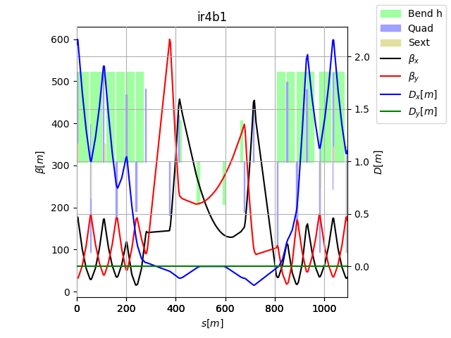
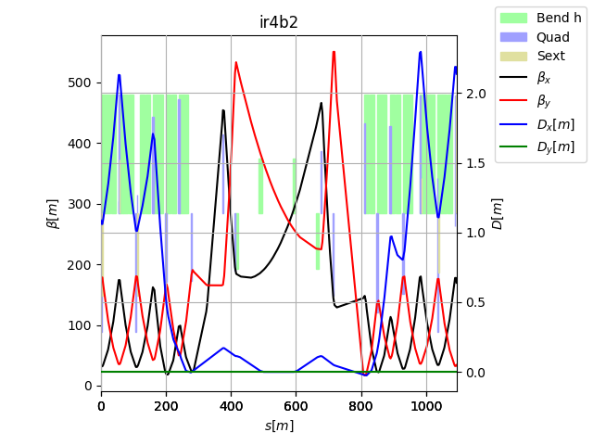
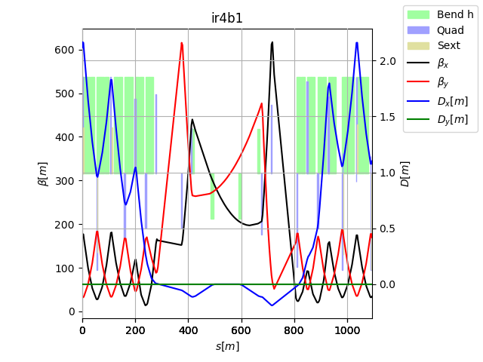
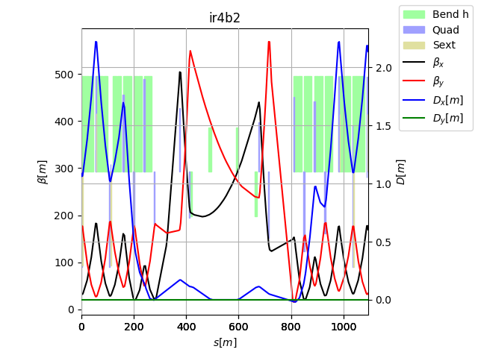
New IR4: No Optics changes during ramp
HL1.3
HL1.x
Increased beta and rounded in B1, more round in B2

Slide 7
New IR4: No Optics changes
β_{xB1}/β_{yB1} β_{xB2}/β_{yB2}[m] | Pos. | HLLHC <=V1.3 (inj.) | HLLHC 1.x Inj | LHC 1.X Round 15cm
e-lens | D3 | 232/212/281/263 | 280/280/280/280 | 280/280/280/280
BSRT/I | D3 | 136/270/191/365 | 206/351/206/384 | 206/351/206/384
BGI | D3-4 | 279/208/321/245 | 314/270/314/262 | 314/270/314/262
WS | D3-4 | 130/320/178/435 | 197/402/197/453 | 197/402/197/453
BQSH | Q5-7 | 426/ 92/425/226 | 577/ 58/405/240 | 515/109/405/240
BQSV | Q5-7 | 142/371/130/491 | 201/451/124/506 | 201/451/ 76/559
BPLH1 | Q5-7 | 400/135/420/256 | 543/117/396/270 | 481/165/387/276
BPLH2 | Q5-7 | 403/ 89/431/165 | 543/ 51/479/168 | 492/104/432/230
BPLV | Q5-7 | 193/337/180/500 | 260/389/201/517 | 251/405/201/517
BQLV2 | Q5-7 | -/-/129/470 | -/-/124/483 | -/-/ 73/530
BPLX | Q5-7 | 277/234/296/356 | 375/246/280/371 | 346/283/251/397
Flat 30/7.5 cm and 18/7.5 cm optics are also possible.
No MS10-14F families should be possible although they are a bit harder.

Slide 8
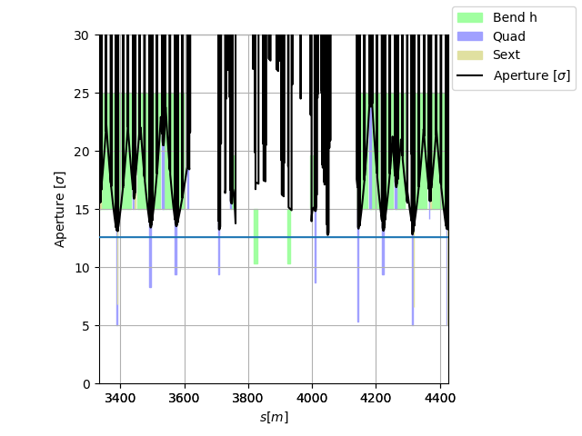
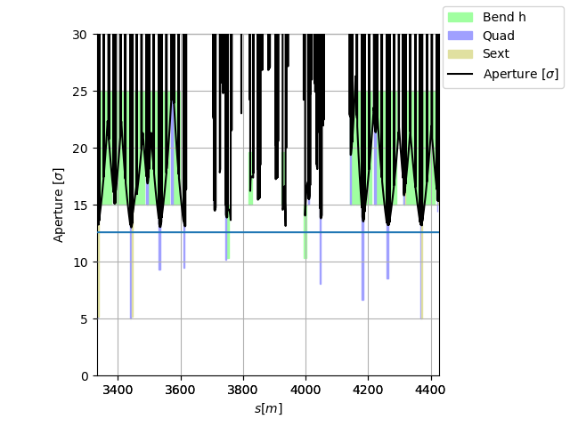
New IR4: No Optics changes
Aperture at injection above the target of 12.6 σ using HL-LHC aperture tolerances..

Slide 9
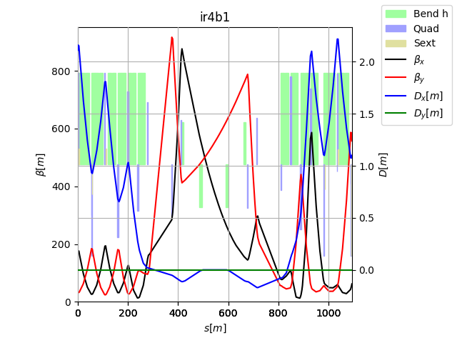
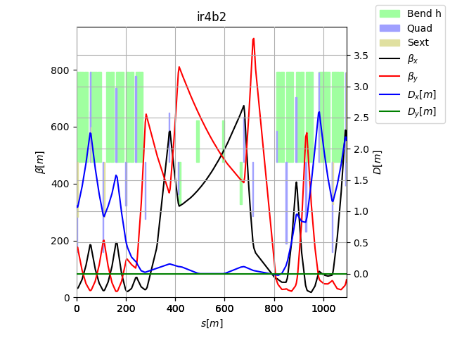
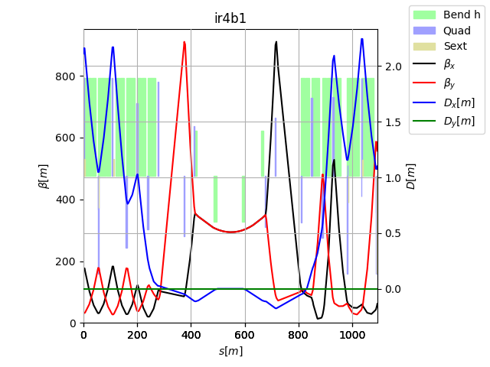
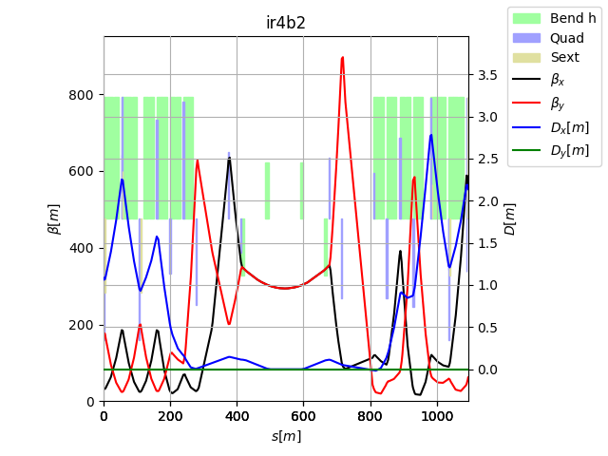
New IR4: Optics changed during the ramp
Round 15 cm Flat top
Option:
Largest and round beta at e-lens only
Option:
Large and round beta everywhere

Slide 10
New IR4: Optics changed during the ramp
β_{xB1}/β_{yB1} β_{xB2}/β_{yB2}[m] | Pos. | HLLHC No ramp | HLLHC Ramp elens max | LHC Ramp all round
e-lens | D3 | 280/280/280/280 | 500/500/500/500 | 300/300/300/300
BSRT/I | D3 | 206/351/206/384 | 265/624/386/634 | 300/300/300/300
BGI | D3-4 | 314/270/314/262 | 587/472/541/470 | 309/309/309/309
WS | D3-4 | 197/402/197/453 | 195/695/350/710 | 317/317/317/317
BQSH | Q5-7 | 577/ 58/405/240 | 284/211/638/417 | 864/ 76/341/341
BQSV | Q5-7 | 201/451/124/506 | 157/757/161/831 | 337/337/ 86/811
BPLH1 | Q5-7 | 543/117/396/270 | 270/303/602/453 | 809/116/316/409
BPLH2 | Q5-7 | 543/ 51/479/168 | 272/201/554/374 | 826/ 72/601/209
BPLV | Q5-7 | 260/389/201/517 | 164/678/328/777 | 425/295/338/338
BQLV2 | Q5-7 | -/-/124/483 | -/-/156/801 | -/-/ 84/780
BPLX | Q5-7 | 375/246/280/371 | 208/489/418/609 | 584/203/217/572
With optics transition during the ramp one can aim at substantially increase beta at the instrumentation.
Values for 15 cm round, flats and MS10-14F may have smaller values since they are harder to optimize.

Slide 11
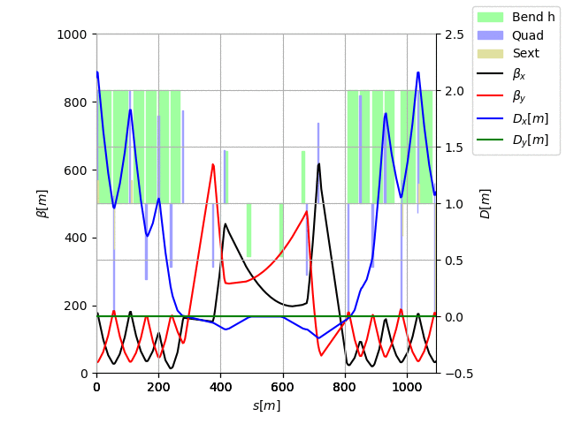
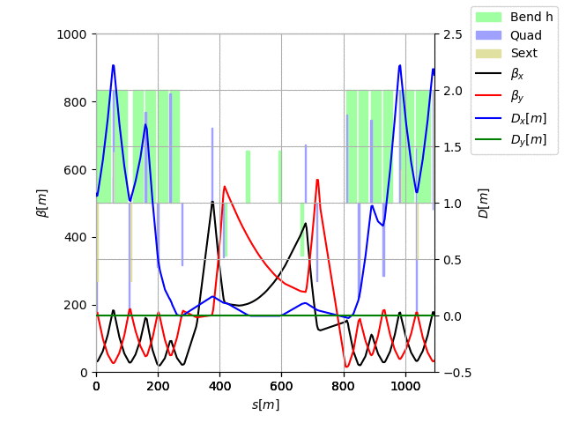
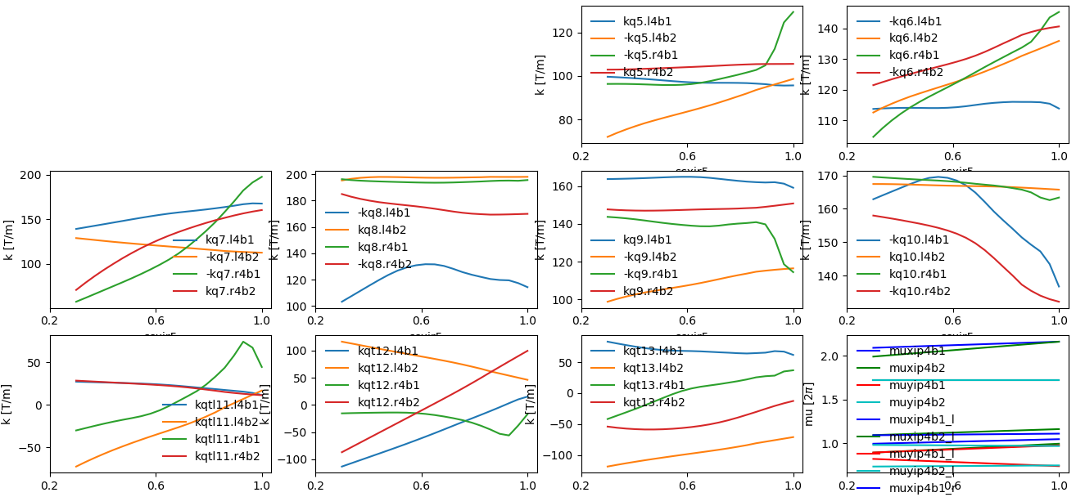
New IR4: Optics changed during the ramp
ATS scale

Slide 12


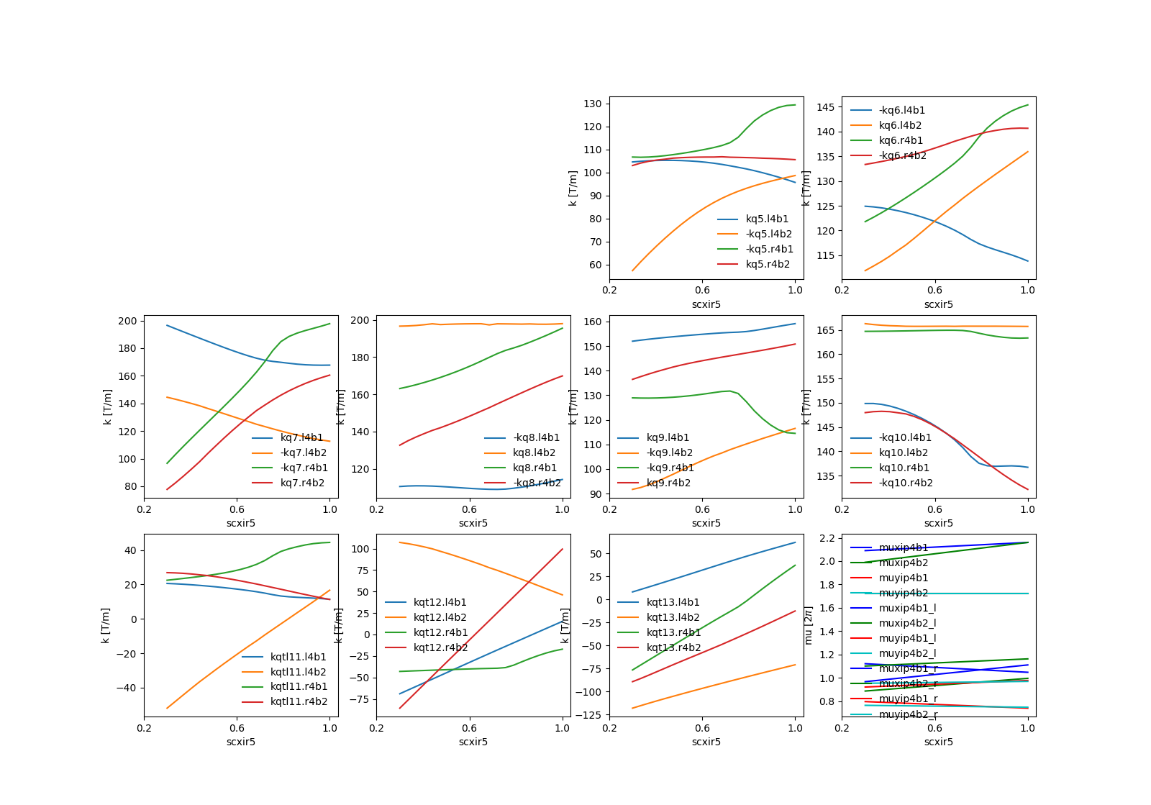
New IR4: Optics changed during the ramp
ATS scale
smooth but not acceptable

Slide 13
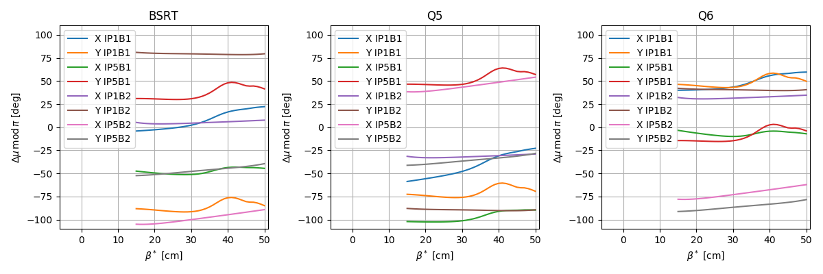
Phase Advance constraints
Phase advance constraints from IP1/5 to IP4 cannot be resolved today because:
MS 10 Option has impact on µ_{y} ARC45
Lifetime studies depending on Δµ_{x/y} IP1-IP5 can further constraint the phase.
MKD-TCT constraints µ_{x} in almost all the ring
During ATS Δµ_{x} IP4 to IP1/5 changes during ATS squeeze
Best bet: 2 location space by π/2 (as the ADT) to be at least sensitive in one instrument
HLLHCV1.3 round squeeze

Slide 14
Phase Advance constraints
Phase advance constraints from IP1/5 to IP4 cannot be resolved today because:
MS 10 Option has impact on µ_{y} ARC45
Lifetime studies depending on Δµ_{x/y} IP1-IP5 can further constraint the phase.
MKD-TCT constraints µ_{x} in almost all the ring
During ATS Δµ_{x} IP4 to IP1/5 changes during ATS squeeze
Best bet: 2 location space by π/2 (as the ADT) to be at least sensitive in one instrument
Example round optics HL1.3

Slide 15
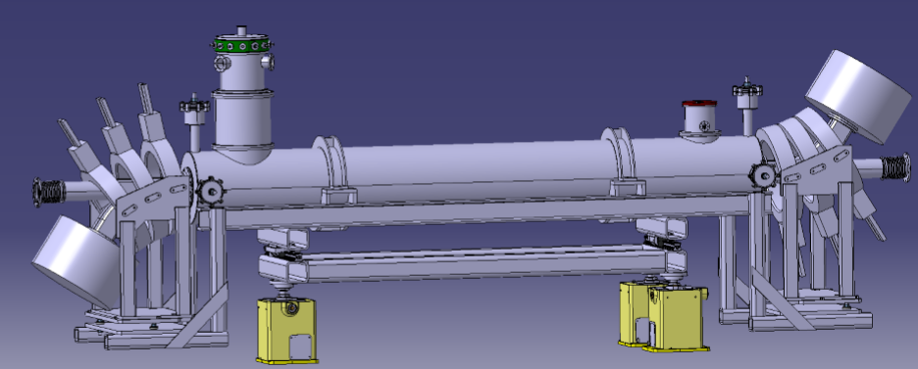
Orbit in IR4 with e-lens
B_{y}
B_{y}
B
B
Bent solenoids introduce a non negligible dipolar horizontal kick in particular at injection:
2·2.5 T·15 cm·sin(15°) ~ 0.2 Tm ~ 130 µrad@450GeV [specs from D. Perini, real field integral to be evaluated]
Since no close orbit corrector (closer is 80 – 100 m away)
Absorb orbit change with a local orbit corrector
If not possible at least one can us D3-D4 (as last resort…)

Slide 16
Small aperture structure
W. Hofle asked for an aperture restriction to fit a small aperture structure (High-BW pickup).
Best location for round structure as close as possible to the e-lens:
β_{x} and β_{y} ~280 m at injection
Beam size (12.6 σ + tol. ) ~20 mm (radius) instead of 26 mm (e.g. in ADT)
e-lens

Slide 17
Conclusion
HL-LHCV1.3 IR4 good starting point for e-lens and instrumentation optimizations
Can be improved by taking advantage of the injected aperture.
Can be further improved by performing optics transitions at cost of additional complexity that needs to be evaluated.
Phase advance constraints are difficult to meet and can conflict with aperture and lifetime optimizations.
Orbit effects of e-lens needs to be addressed.
Close to e-lens one can reduce the aperture.

Slide 18
Back-up

Slide 19
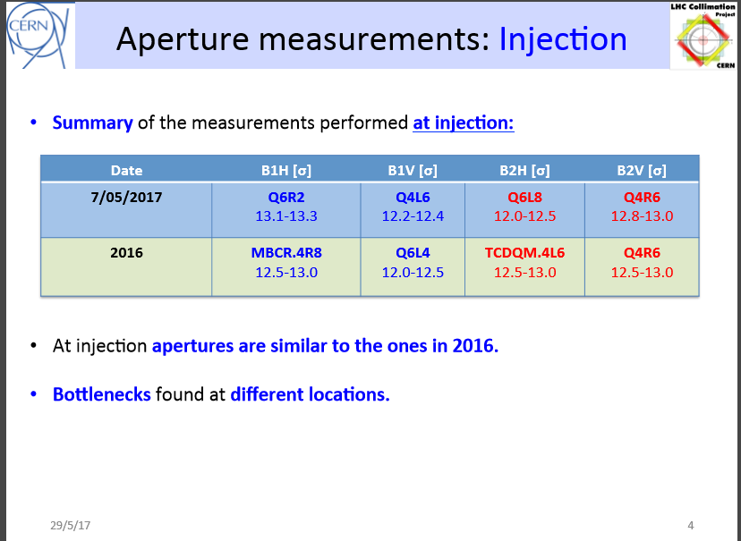
Aperture at injection - 2017
N. Catalan, 29/5/2017, collimation meeting
https://indico.cern.ch/event/642139/

