Slide 1

Optics in HL-LHC IR4 for BE-BI
BE-BI

Slide 2
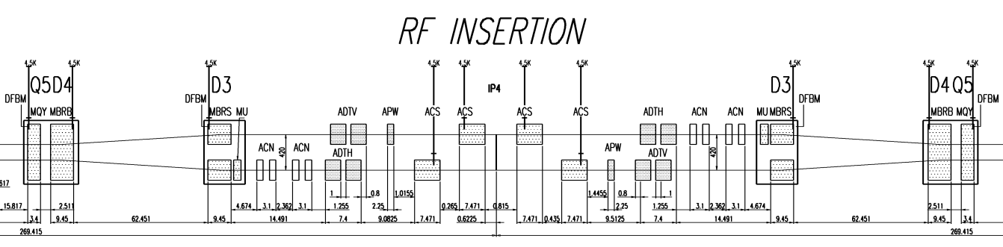
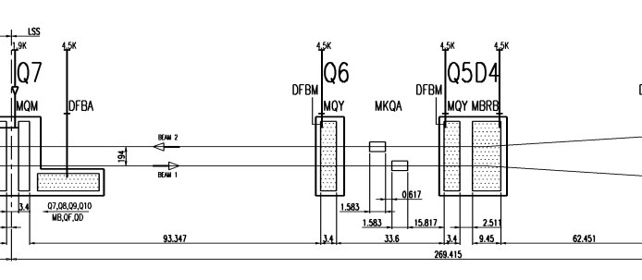
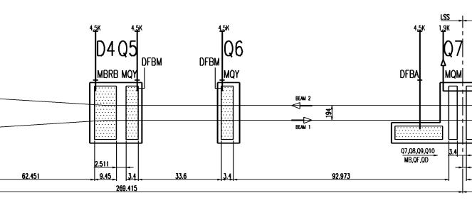
IR4 layout (not to scale)
existing
HL fixed position
HL position tbd
WS.B2
BGI.B2
HEL.B2
BSRT/I
BSRT/I
HEL.B1
BGI.B1
WS.B1
BGV.B2
B2
B1
BGV.B2
EO/BPM
BQSV/H
BQSV/H
BPL
BQSV/H
BPL
BQSV/H
EO/BPM
BGV.B2

Slide 3
Requirements on optics
Device/ instrument | Position (from IP4) and constraints | Phase advance | Beta/beam size | Injection/flattop optics
BGI | ~ -63m (B1) | N/A | as large as possible | *
BGI for HL | one on each side – opposite beam from BSRT. (BGI B1 on L, BGI B2 on R) | N/A | as large as possible | *
BGV now | ~ -220m (B2) | N/A | as large as possible | *
BGV for HL | 1 on B2. Baseline location for HL between Q6 and Q7. Could also consider Q5 to Q6 but more crowded. | N/A | as large as possible circular beam | constant beam size throughout the cycle would be an advantage
BSRT – BSRI | ~ ±59m | 90° from crabs and -180°from IP in IP1/5 | as large as possible | *
E/O BPM | Where phase advance (Q5-Q6 easier to integrate) | 90° from crabs and -180°from IP in IP1/5 |  | -
HEL | ~ +40m (B1), -40m (B2) | N/A | as large as possible circular beam | constant beam size throughout the cycle would be an advantage
Schottky BPM BQSV & BQSH | ~ 115.3, 174.1m (B1) ~ 114, 176m (B2) | N/A | as large as possible | Orbit must be in the centre throughout the cycle*
Tune BPM BPL | ~ 138, 149, 172.7m (B1) ~ -175, -116.8m (B2) | N/A | as large as possible | *
WS | ~ ±85m | N/A | as large as possible | *
* change in beta between injection and flattop (if not too large) should be ok, to be evaluated depending on proposed optics. Beta must then be measured throughout the full cycle.

Slide 4
Conclusions
An increase in the beta functions in IR4 has a positive effect on all the profile monitors :
  Reducing the measurements errors: WS, BGV, Orbit and Tune
  Allowing “meaningful” (not dominated by corrections) measurements at 7 TeV: BSRT, BGI.
It makes electron beam more stable: HEL
It is no longer necessary to keep same beta, as long as measured throughout cycle.
Beta functions should not be excessively high (>400 m) at the D3; it compromises interferometry measurements at injection energy.

