Slide 1
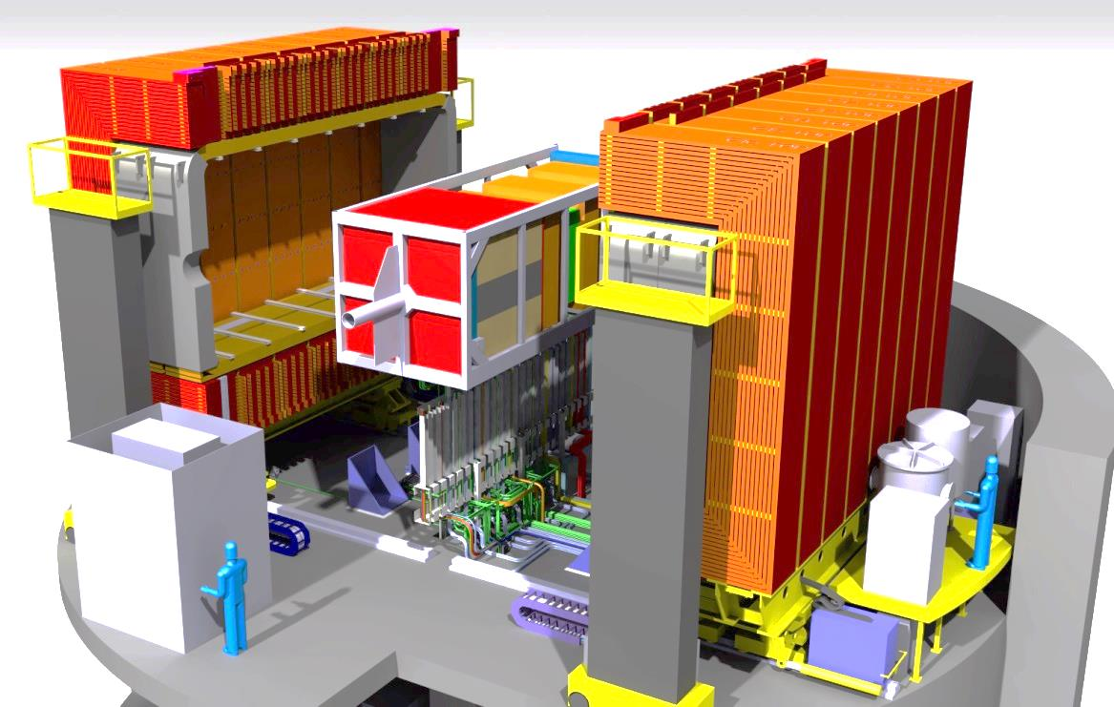
New Detectors into the basket
Integration issues

Slide 2
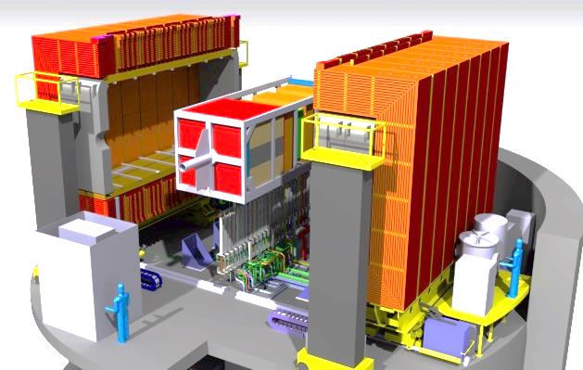
Outlines
ND280 Current design
ND280 Evolution (Upgrade)
Guidelines for I/F & Integration management

Slide 3
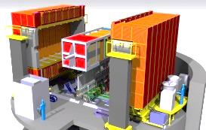
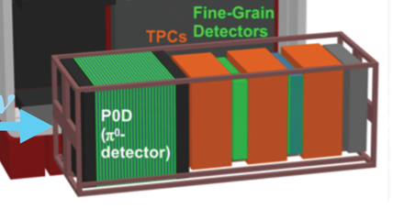
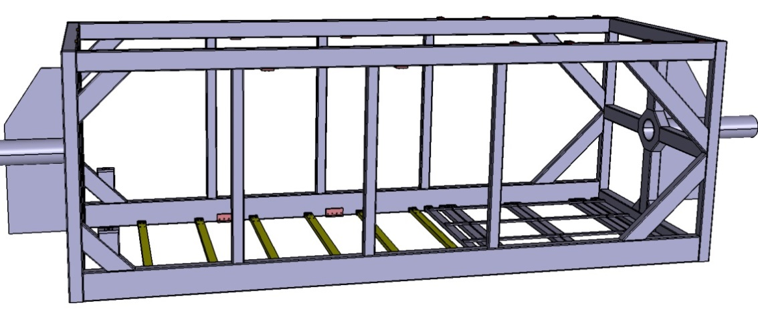
Overview of the current situation
FGD
FGD
Downstream ECAL
Vert. TPC
This part to be replaced
The basket is the main interface to hold every detectors (modifications to be investigated).
Material: Stainless Steel

Slide 4
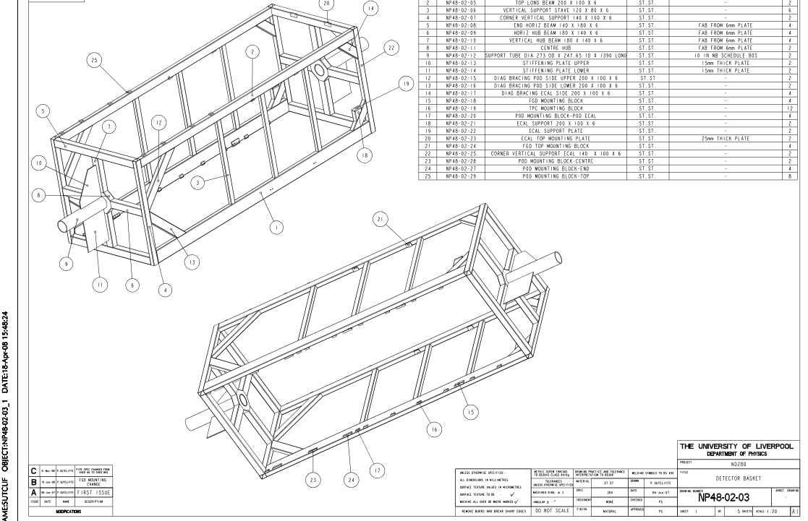
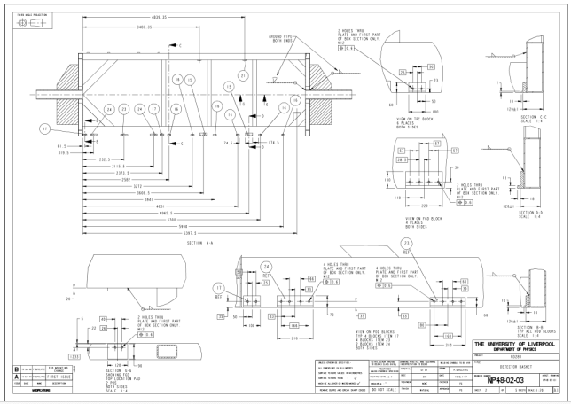
Overview of the current situation
Thanks to Peter Sutcliffe (Liverpool), basket fabrication dwgs are all available (needed for modifs)
+…

Slide 5
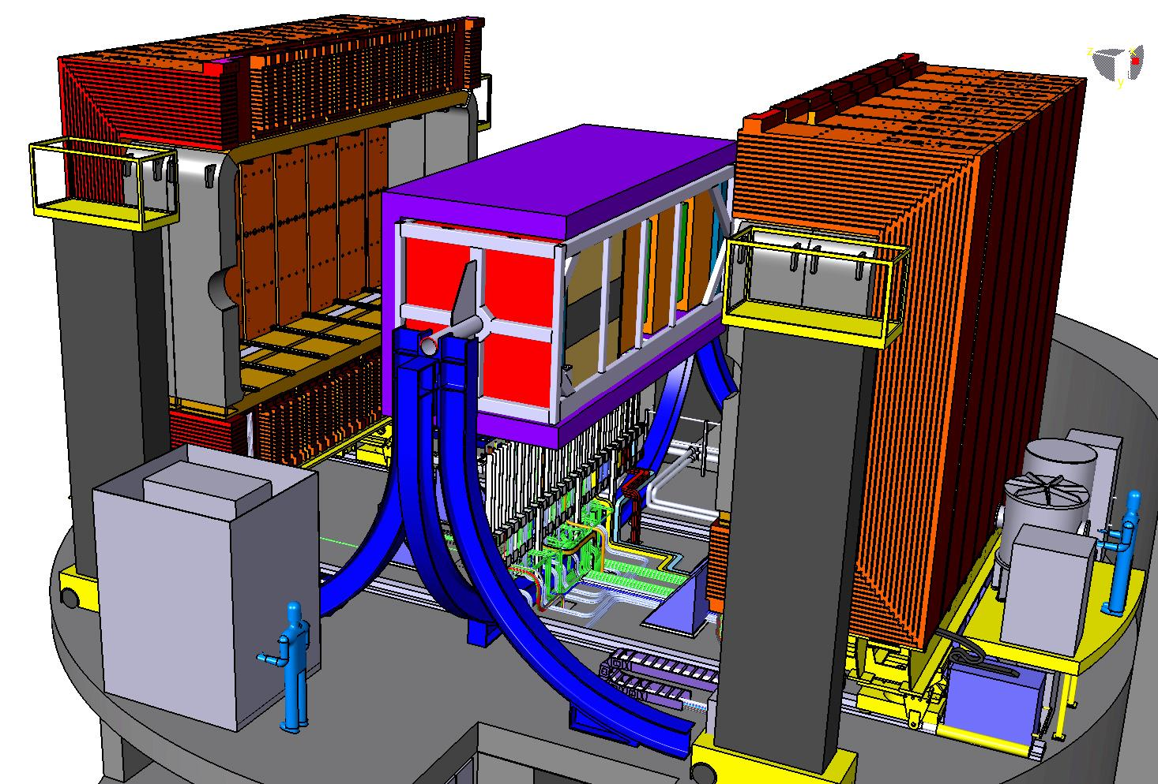
Overview of the current situation
Basket in the middle
(3.7m high)
Magnets in 2 halves
Most of services
running down to the floor

Slide 6
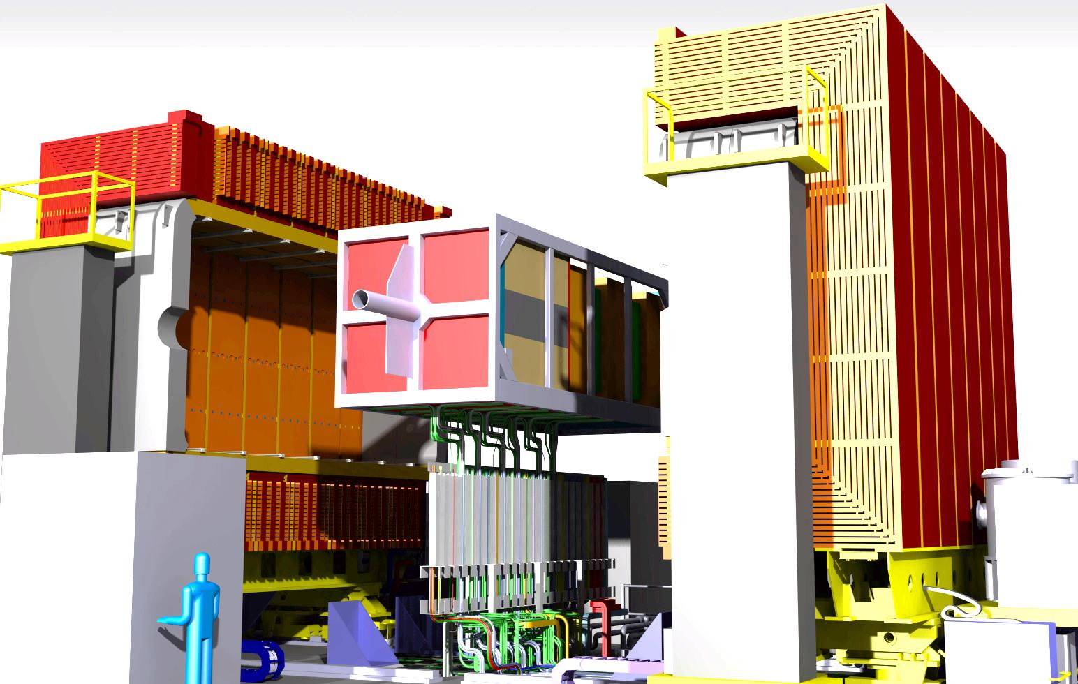
Overview of the current situation
Services are organized downward (basket support removed for clarity)

Slide 7
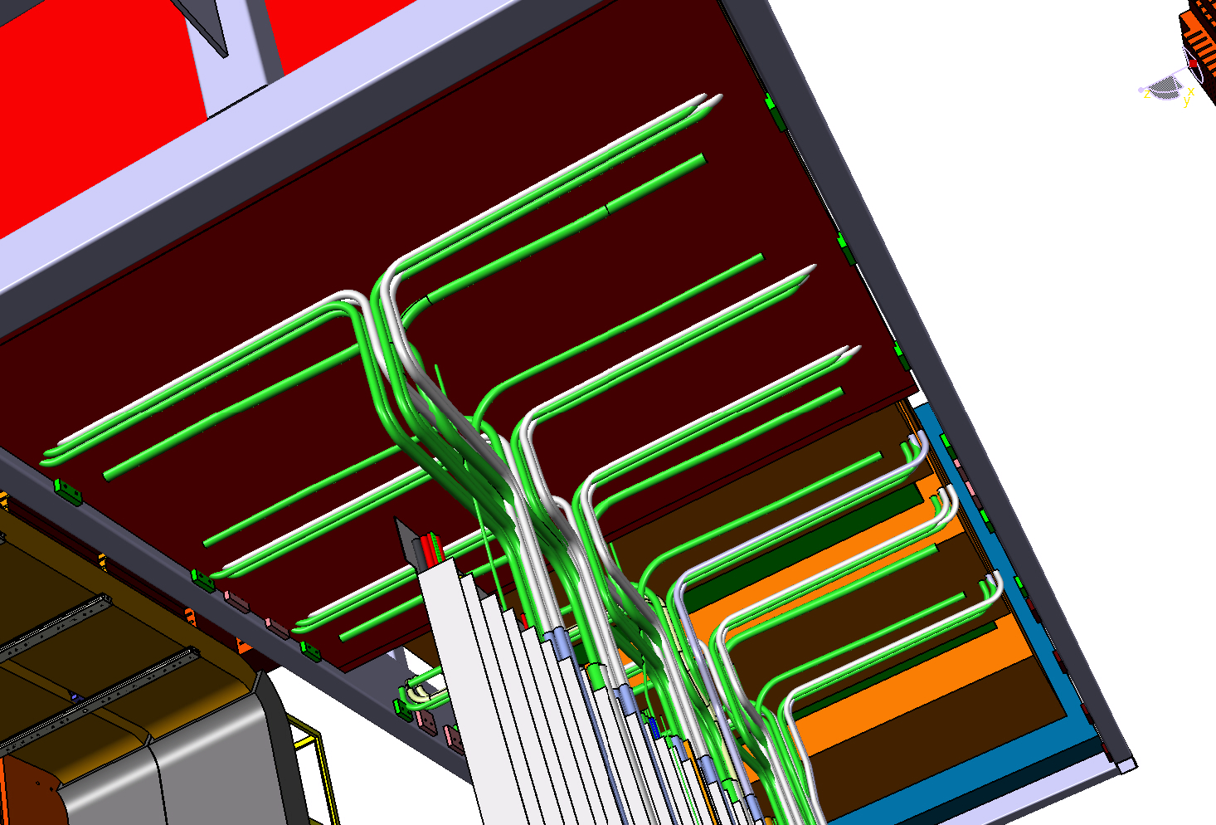
Overview of the current situation
Services are organized downward (close up underneath the basket…)
Some of services won’t be reused (from P0D)

Slide 8
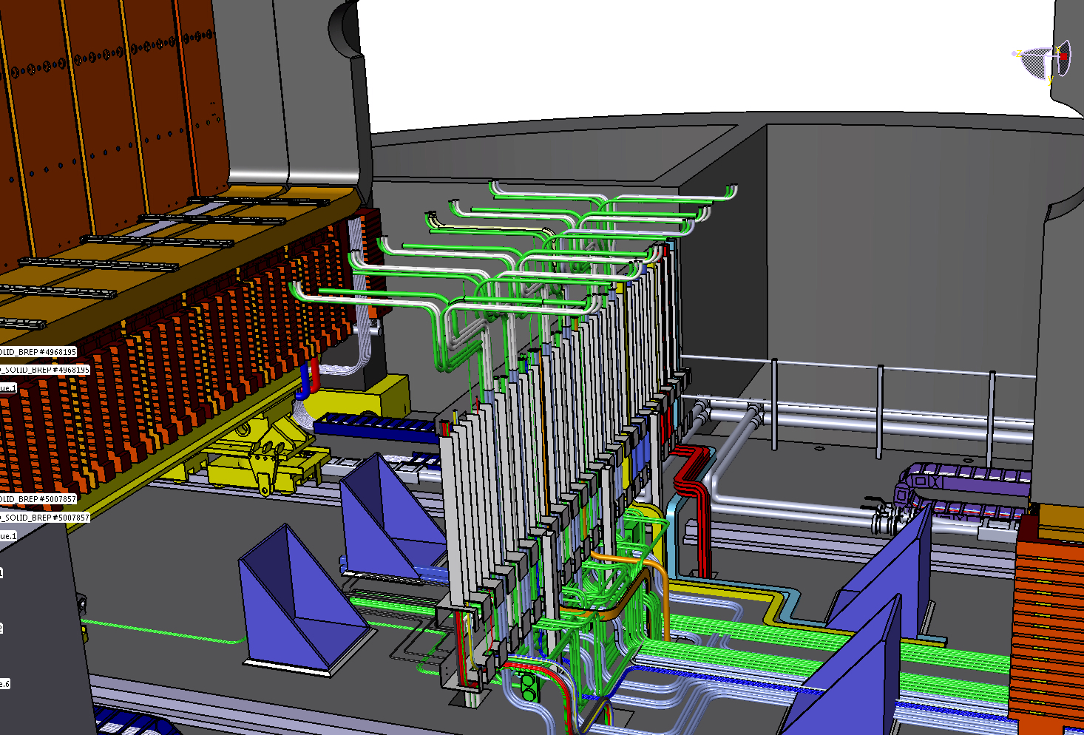
Overview of the current situation
Services is the key part of the upgrade (envelopes, routing..)
Some sort of similar routing design is expected !

Slide 9
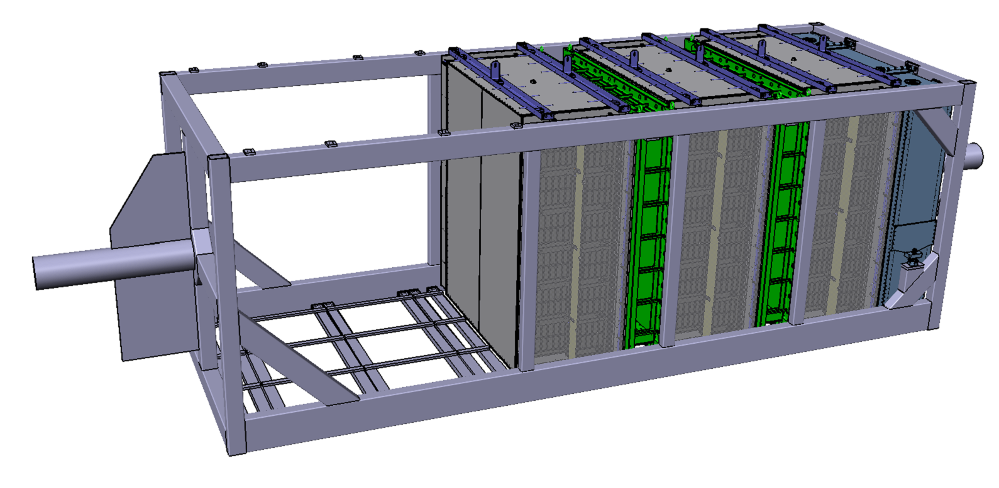
New Detectors into the basket
3 vertical TPC’s
2 Fine Grain Detectors (FGD)
1 Downstream ECAL
Frozen part of the upgrade
Empty part for Upgrade
beam

Slide 10
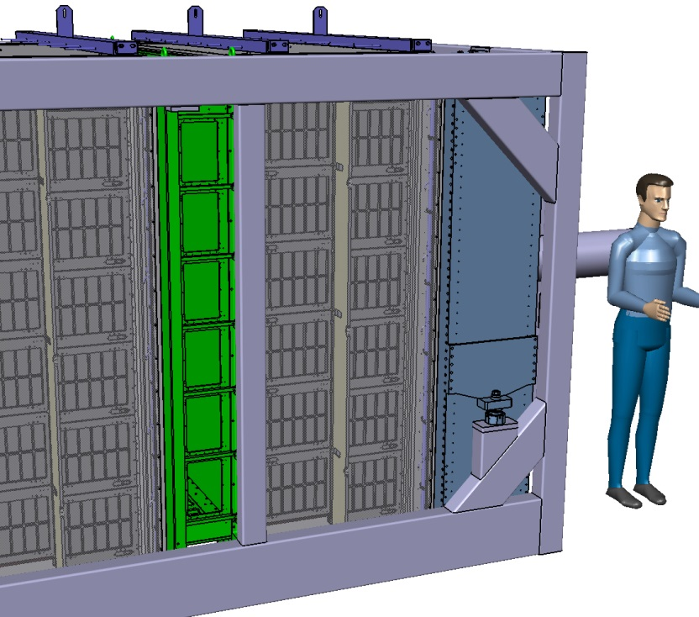
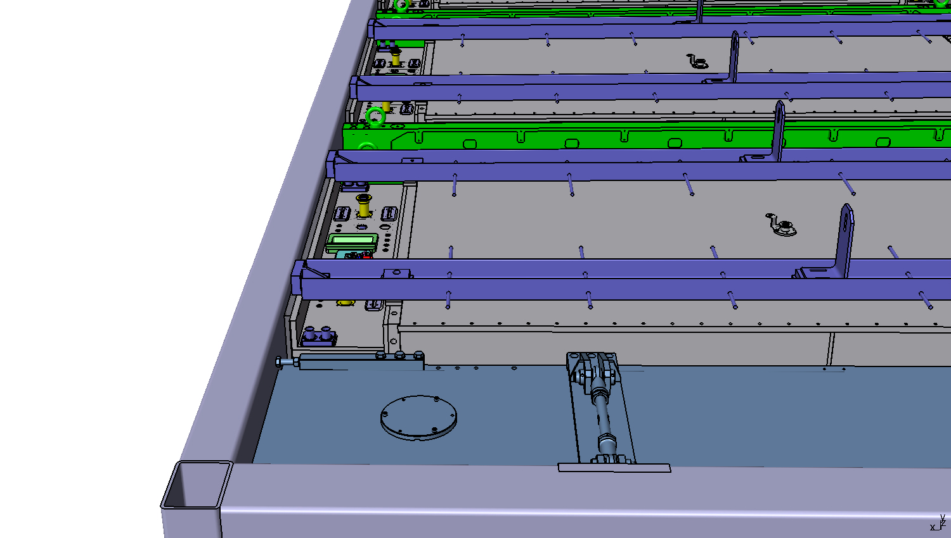
New Detectors into the basket
Detector services
(view of TPC patch panels from the top)

Slide 11
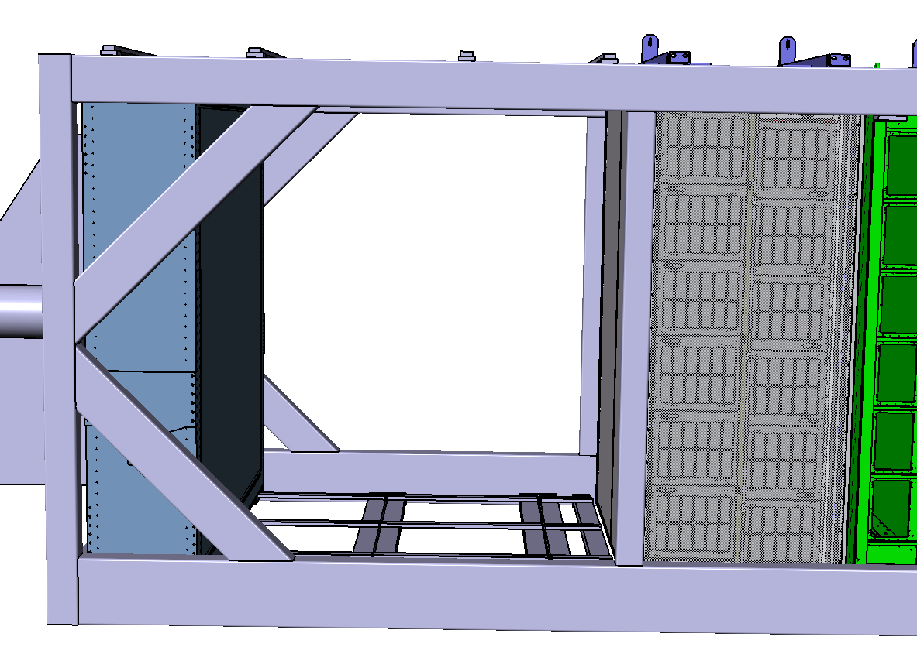
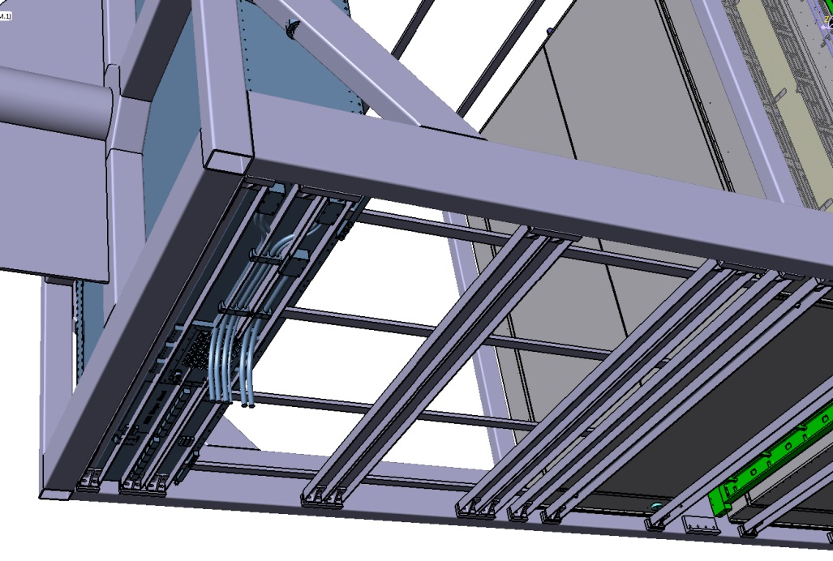
New Detectors into the basket
New ECAL (Upstream ECAL)
Upstream ECAL (Copy-Past of the Downstream ECAL for outer volume)

Slide 12
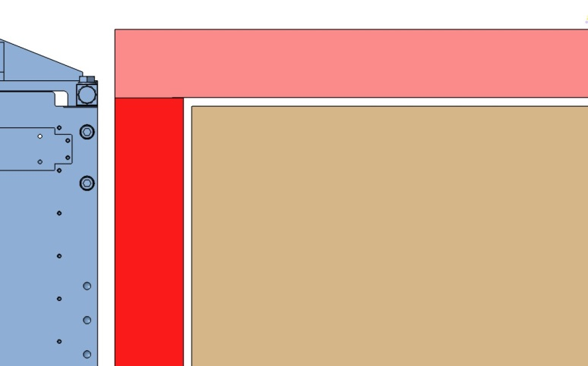
New Detectors into the basket
Before showing the CAD designs…
…Rules to define the Detector envelopes (TB Discussed):
Each detector volume includes: sensitive parts, frames, some services & readout system… like the current ones.
10mm gap is assumed between detectors “blocs” to account for deformations, insertion, handling…and more margin of safety!
Brackets, fixation points are not considered yet
ToF overall thickness (80mm) is given as a starting point…
The idea is to iterate to get the
right envelope sharing!

Slide 13
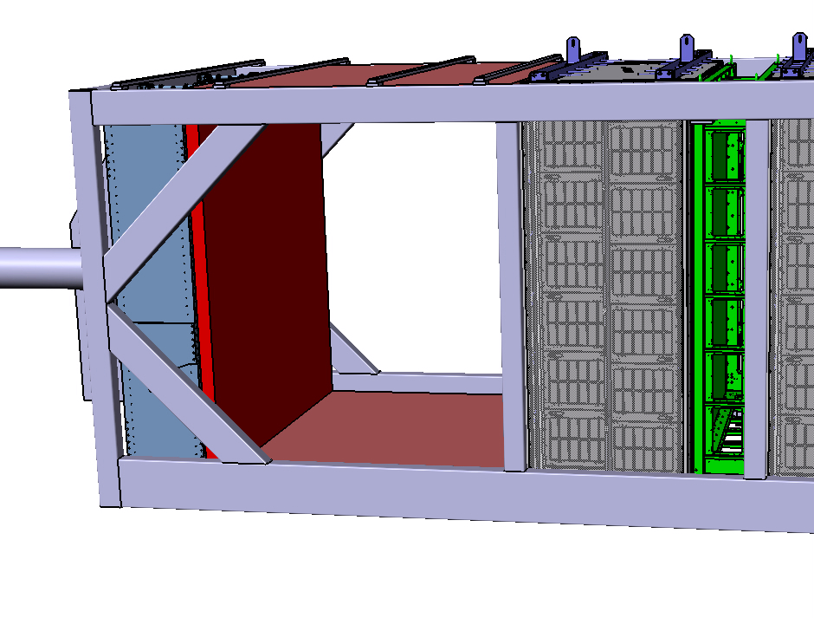
New Detectors into the basket
New Time of Flight (ND280 Tof)
Tof
Assumptions:
80mm thick
Design with fixation INSIDE Basket frame
2 sides not shown (in total 6 sides: 2230x2320x80mm / 2320x1910x80 / 2390x1910x80)
OPTION: Tof could be mounted OUTSIDE the Basket (careful with unprotected parts!)

Slide 14
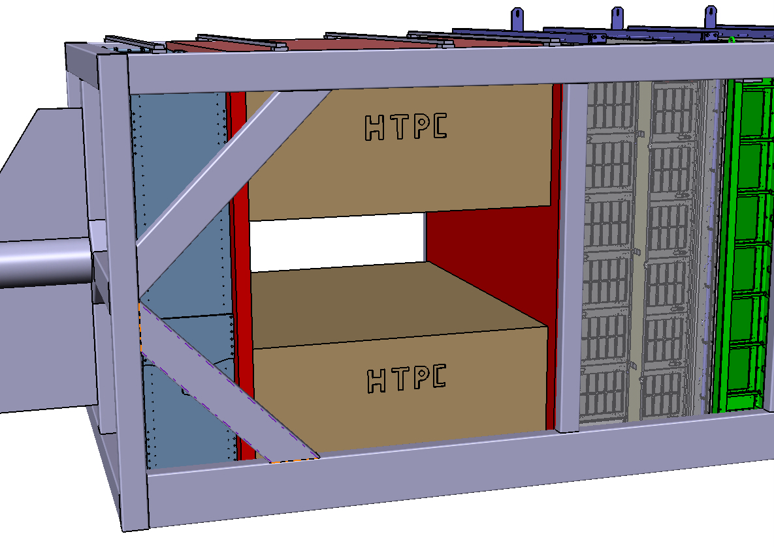
New Detectors into the basket
New horizontal TPC’s (ND280 HTPC)
Beams prevent
µmegas
from access
+ new Upstream ECAL
Size:
1730x2140x800mm
10mm clearance / neighbor

Slide 15
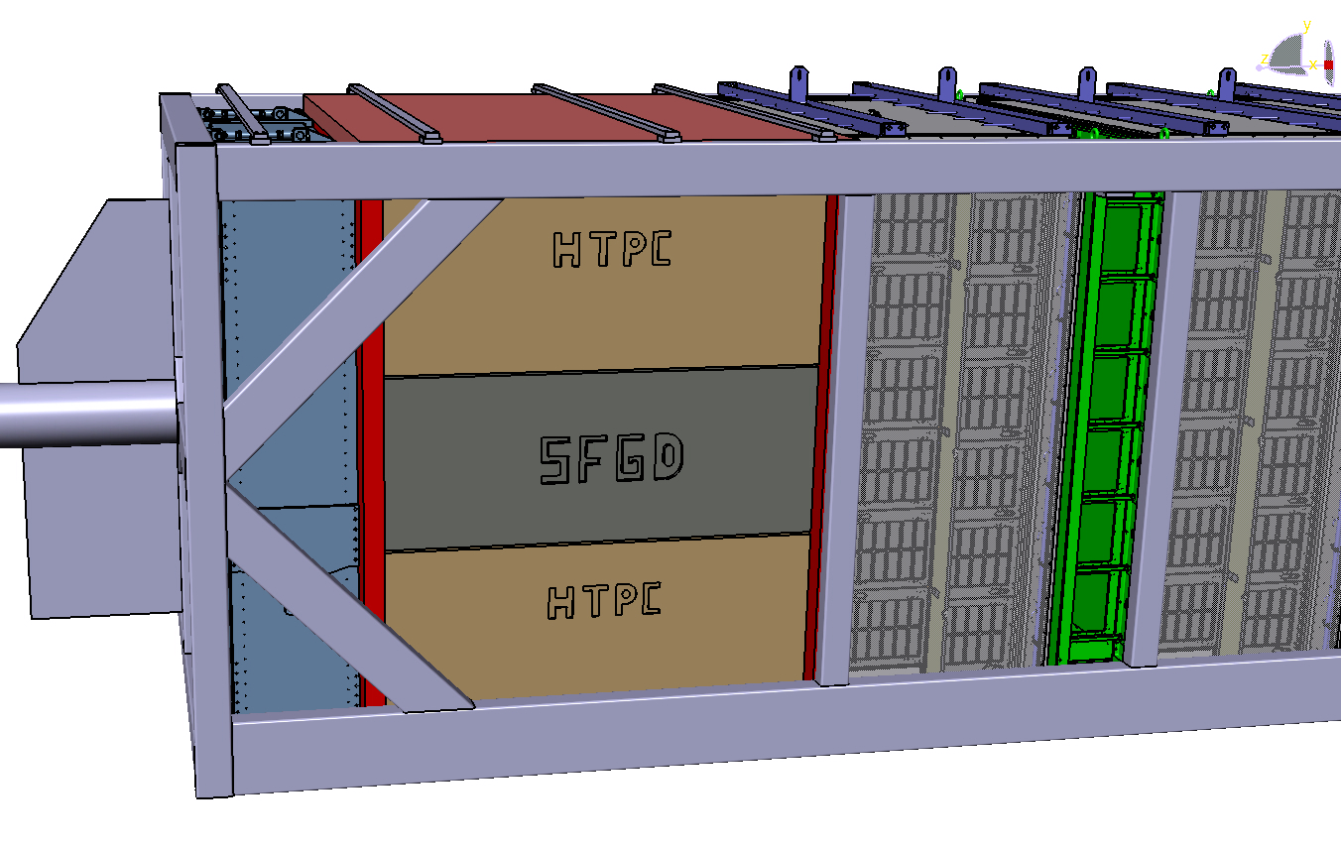
New Detectors into the basket
Super FGD (sFGD)
Size:
1730x2140x600mm
10mm clearance / neighbor
Super FGD is about 2 Tons !
Insertion & fixation is a key part

Slide 16
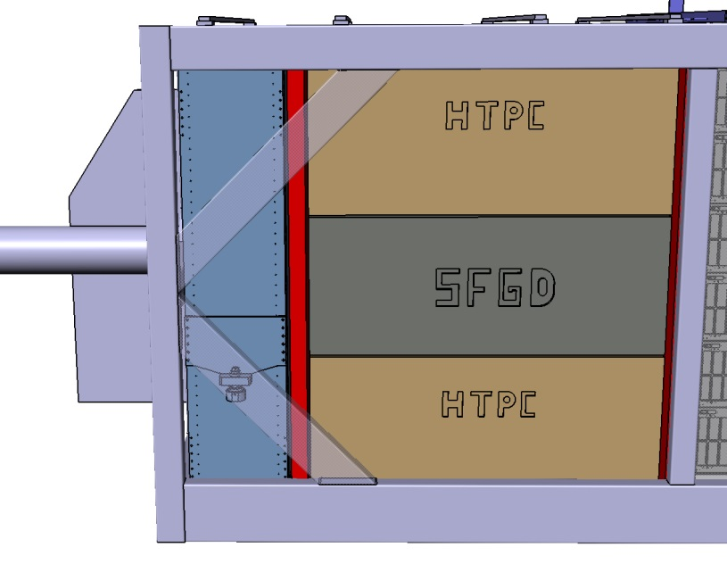
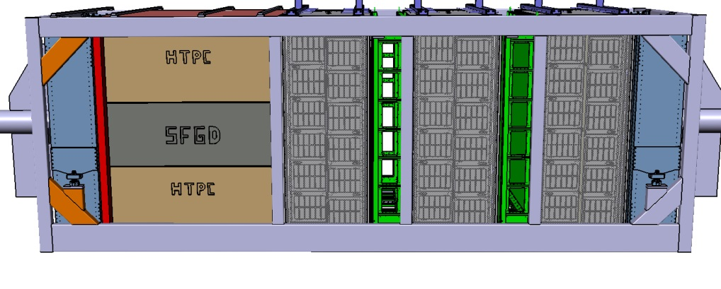
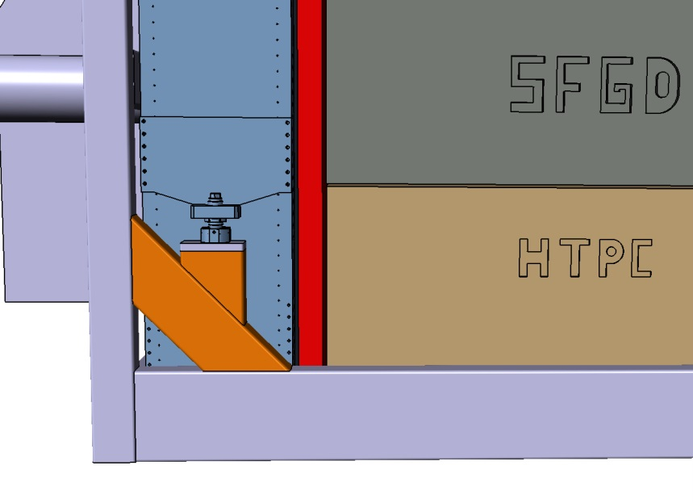
New Detectors into the basket
Clear the access for HTPC µmegas
(oblique beams)
Reuse the current beam
sys for Downsteam ECAL (below)
See next slide…

Slide 17
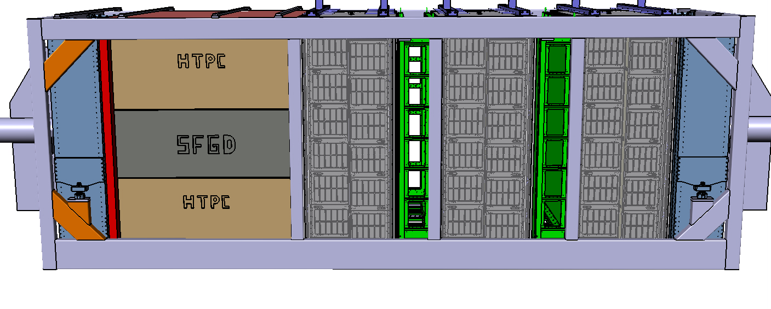
New Detectors into the basket
Possible modifications (detector holding) ?
Add vertical bars and horizontal Xbeams (see below)
FEA is needed for validation (sFGD is weighing nearly 2 Tons!)
Since weight distribution is modified, check / several boundary conditions & Loads…

Slide 18
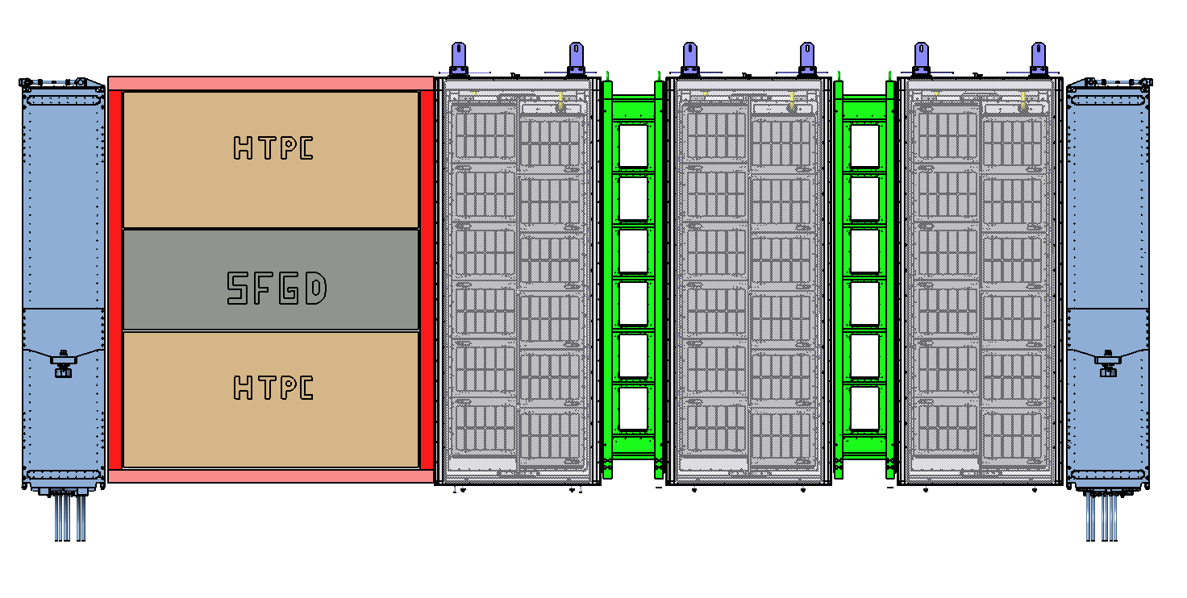
New Detectors into the basket
Side view without the Basket (DETECTORS ONLY)

Slide 19
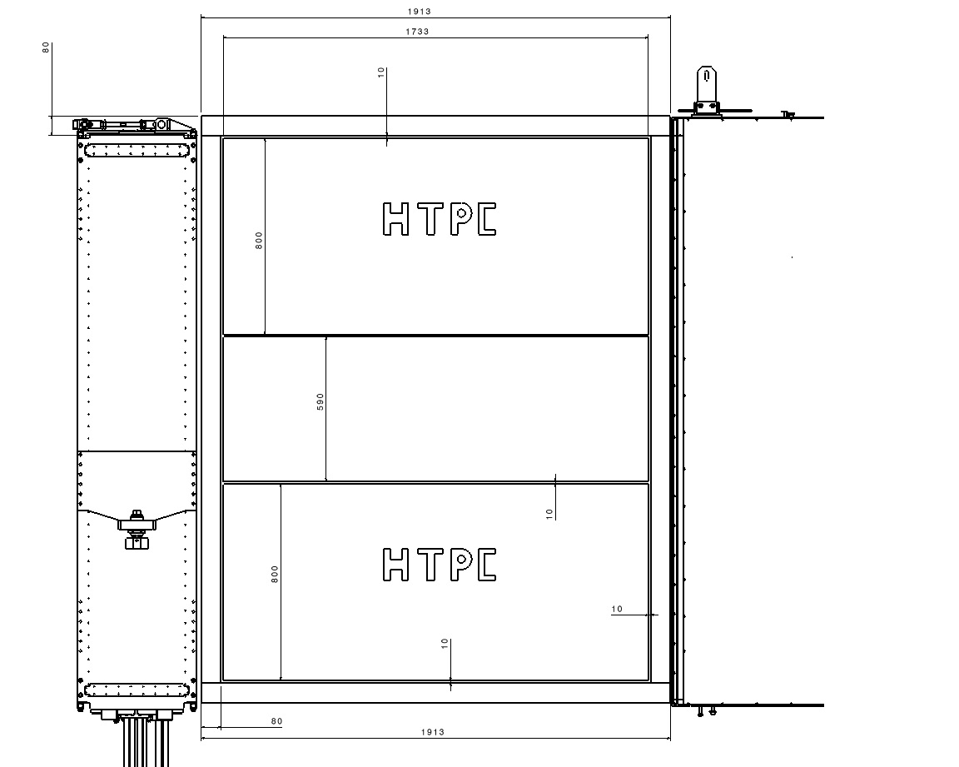
New Detectors into the basket
From 3D model to the 2D drawings … a way to keep track of modifs!

Slide 20
Guidelines for I/F & Integration
Clearly identify the technical coordinator for each part:
HTPC, TOF, sFGD, Upstream ECAL, global services…
Provide CAD models, and in case FEA’s to the resp. for Integration
Organize a sort of inner Data Base for the Upgrade in which the latest CAD versions are saved (to ease exchanges)… STEP model is OK for exchanges (even using the same software!!)
Perform the updated FEA on the Basket with new config. (see wrt proposed modifs and new weights)
Services are a key issue (as always!)…to be tackled soon! It may drive some design choices.
To do so.. an Engineer is requested to take the lead on integration…

