Slide 1
Status of LHCb and its upgrade
Collaboration matters
LHCb YETS and preparation for 2018
Physics output and selected physics results
The LHCb upgrade
Conclusions and outlook
G. Passaleva
INFN – Florence and CERN
On behalf of the LHCb collaboration
RRB – 25/04/2018

Slide 2
Collaboration matters 1/2
Marie-Hélène Schune (LAL – Orsay – FR) was elected as new Physics Coordinator in June 2017 but
unfortunately has had to resign due to personal reasons
  Election procedure for the new Physics Coordinator ongoing, election foreseen in May
  Former Physics Coordinator, Vincenzo Vagnoni (INFN – Bologna) and Marie-Hélène’s deputy, Marc-Olivier Bettler (Cambridge) are meanwhile coordinating the physics activities.
LHCb collaboration still growing
  Four new groups applied for membership since October 2017
  One group applied to move from associated to full membership
  Scrutiny ongoing, approvals in June 2018
A 1st joint workshop between LHCb and BESIII was held on February 8-9, 2018 at IHEP, Beijing.
  discussed synergies between the two experiments in the field of charm physics,
  The managements of the two collaborations agreed to pursue regular contact between the collaborations on topics of common interest.

Slide 3
Collaboration matters 2/2
Double LHCb/Belle II membership protocol
  forbids new LHCb members engaged in physics analysis to be part of both the LHCb and Belle II collaborations. Ensure scientific independence of the results from LHCb and Belle II.
  developed in coordination with Belle II, that endorsed a similar protocol
Introduced the status of Technical Associate
  allows new groups to contribute to R&D activities on future LHCb upgrades.
  Technical Associate Members will not have authorship nor access to LHCb data and internal physics results.
Adopted Guidelines for reviewing high-impact analyses
  Defines guidelines for high-impact analysis reviews
  Also encouraged by CERN management

Slide 4
2017 YETS and 2018 LHCb run
LHCb operations and performance

Slide 5
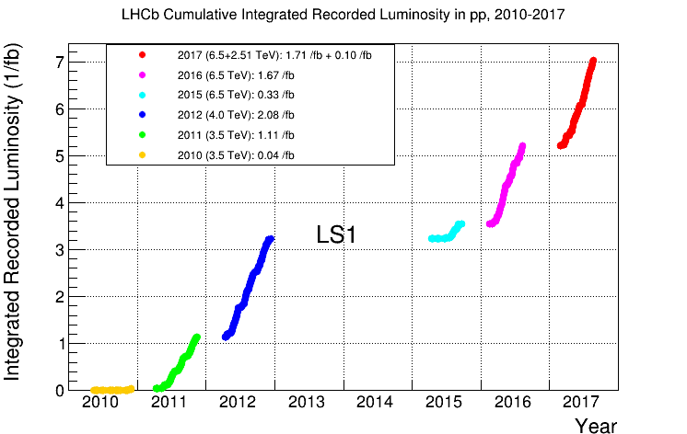
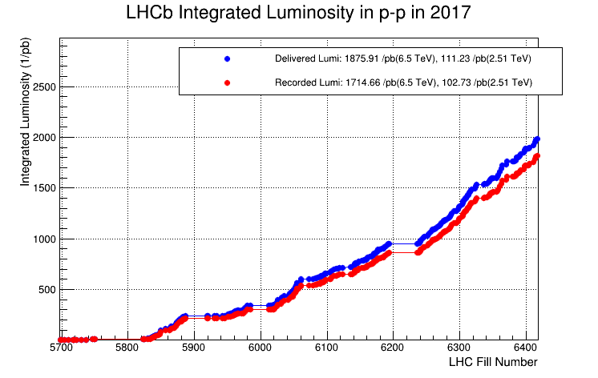
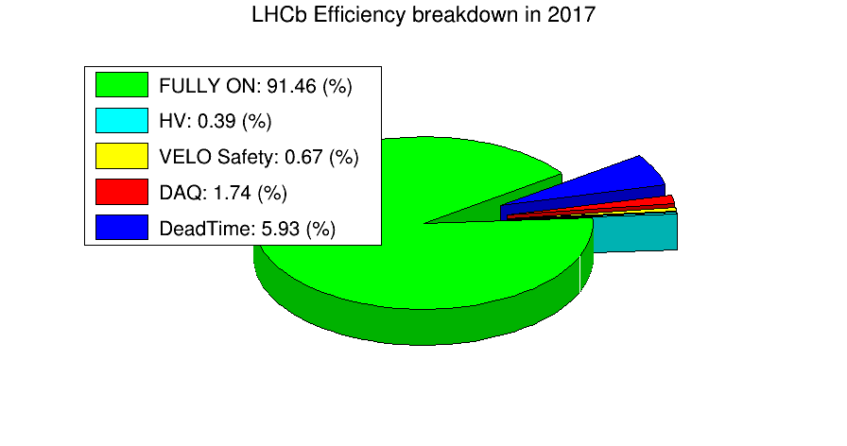
Detector operations in 2017
Reached 7 fb⁻¹ Run 1 + Run 2
1.7 fb⁻¹ recorded in 2017, despite the problems in LHC
many thanks to the LHC experts for the usual outstanding work!
The LHCb performance was excellent with a DAQ efficiency close to the maximum

Slide 6
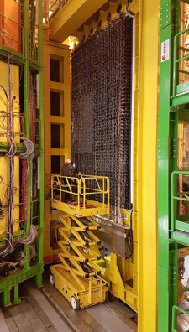
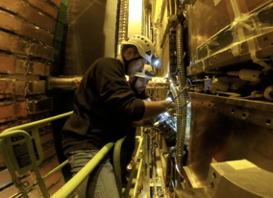
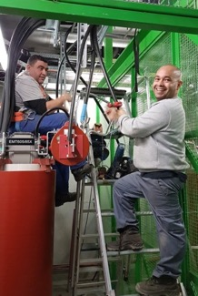
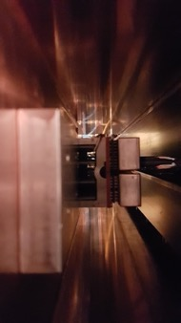
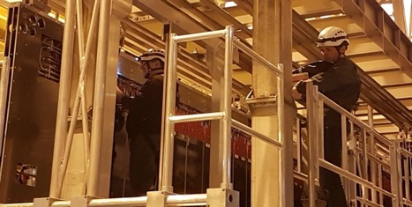
Summary of Year End Technical Stop (YETS)
YETS activities went through without problems
Maintenance activity of detectors went as planned
Many activities on the infrastructure
Preparation for the upgrade
Work on calorimeters
Fixing Muon GEMs
RICH upgrade EC installed in RICH 2
Replacement of 18kV transformers
Replacing RICH HPDs
Preparing for beam pipe “plugs” dismantling
Activity on Outer Tracker

Slide 7
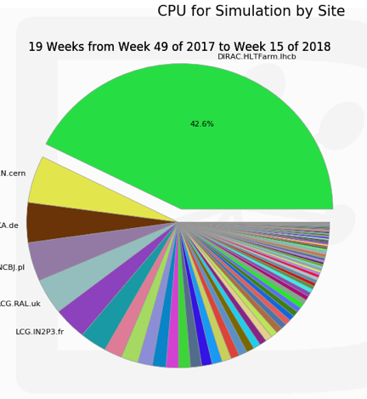
Computing resource usage
Continued high usage of the online farm resources for simulation workflows
  Possibility to run simulation in parallel with trigger
Online Farm
Online Farm contributing 40% of CPU time to monte carlo simulation productions

Slide 8
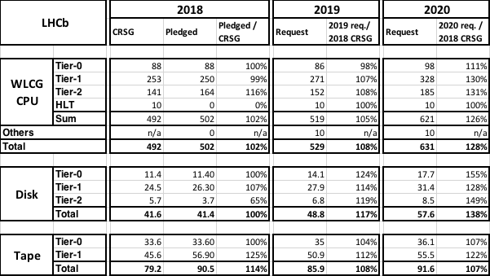
LHCb forecast of computing requests
Resource increase in 2019 and 2020 generally within «constant funding»
Part of 2020 resources will be used for the preparation of the upgrade (simulation and system tests)
Resources for analysis preservation (30kHS06, 0.5PB) and open data access (0.5PB disk) not included
kHS06
kHS06
PB
PB

Slide 9
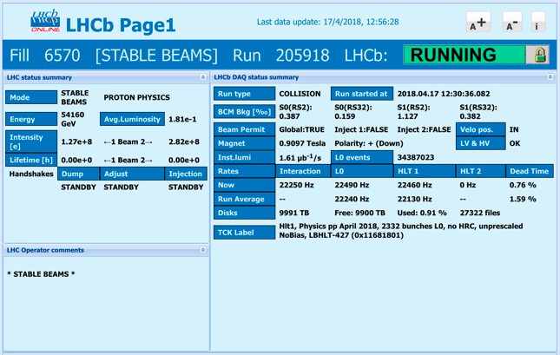
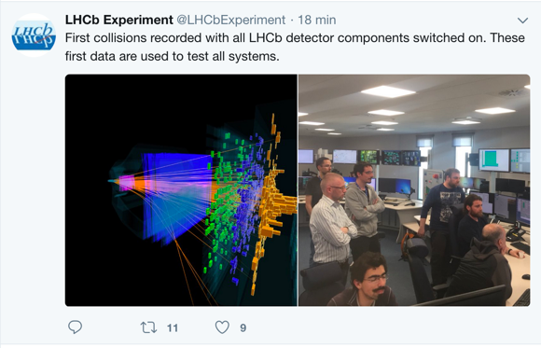
Run 2018: plan for operations
Last year of running for the current LHCb!
Stable operation conditions as last year:
Same reconstruction
Same alignment and calibration strategy.
  Some further tuning of the selection
  Work ongoing to fully automate ECAL 𝛑⁰ calibration
Same trigger strategy, aiming at stable running conditions
Run 2018 is restarting smoothly, we hope to collect as much luminosity as possible!

Slide 10
Physics output and selected physics results
Paper production

Slide 11
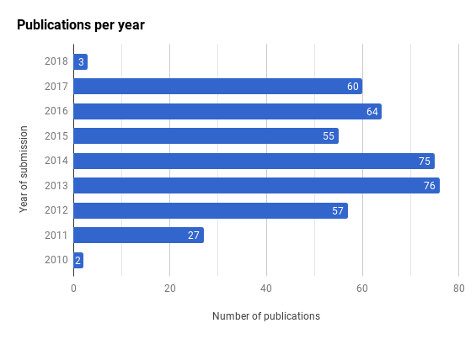
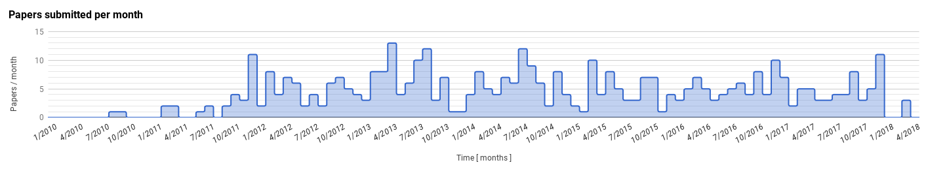
Physics: paper production
6
422 papers submitted (22 since Oct ‘17 RRB)
  60 in 2017
  14 other papers being processed within the Editorial Board
40 further analyses under review
2010
2011
2012
2013
2014
2015
2016
2017
2018

Slide 12
Meson oscillations at work
Measurement of CP asymmetry in B⁰_{s}→ D∓_{s}K± decays
D⁰ - D⁰ mixing

Slide 13
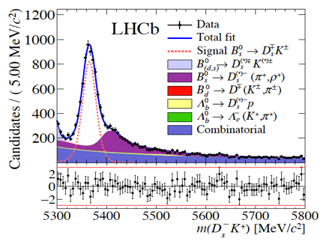





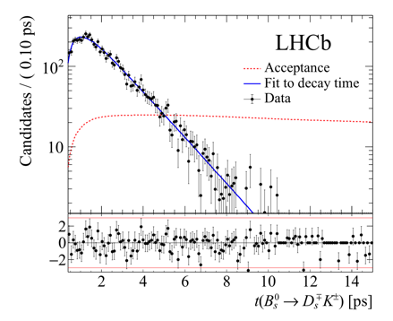
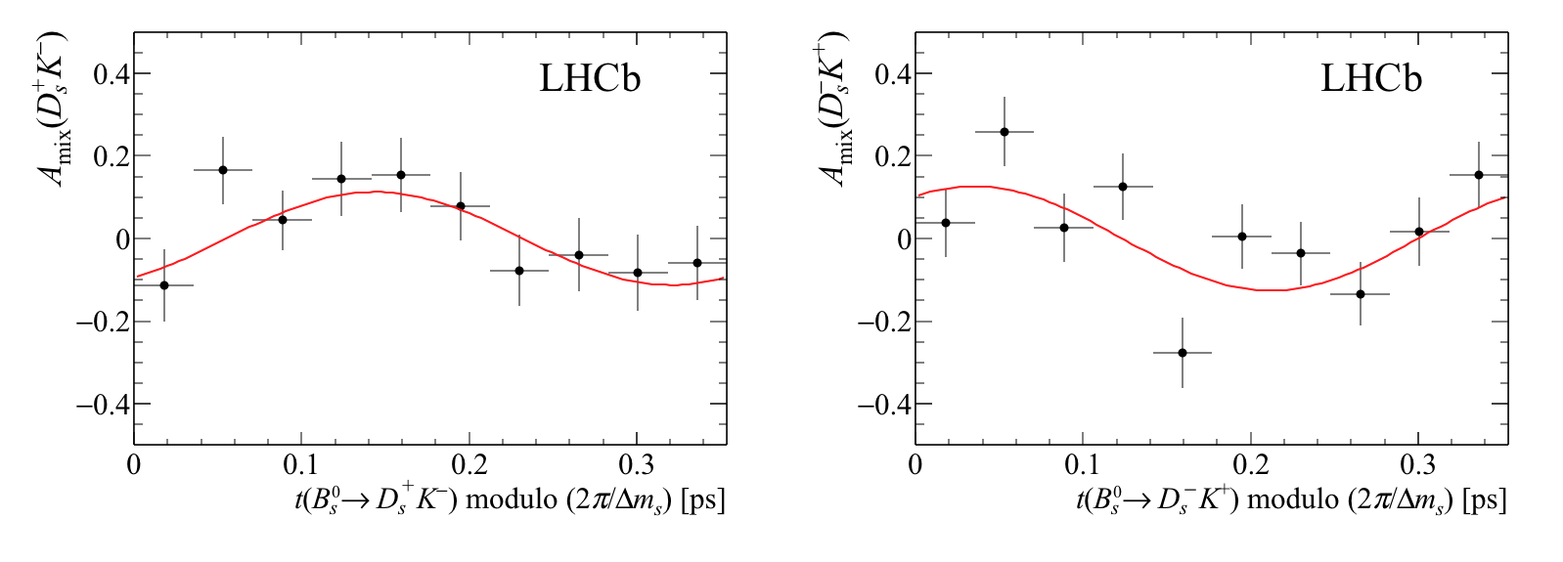
Measurement of CP asymmetry in B⁰_{s}→ D∓_{s}K± decays
JHEP 03 (2018) 059 RUN1 3fb⁻¹
CP violation arises in the interference between mixing and decay
  ☞ sensitive to (γ -2β_{s})
r_{DsK} ~ 0.4
σ_{t}∼O(10 fs)
Oscillations clearly seen!

Slide 14
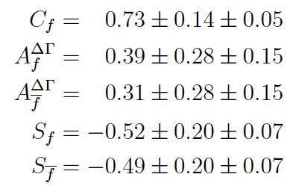
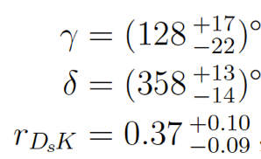
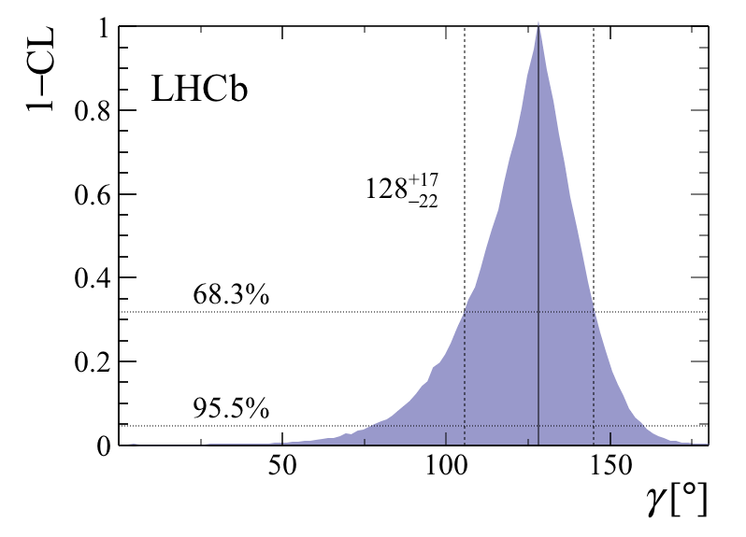
Measurement of CP asymmetry in B⁰_{s}→ D∓_{s}K± decays
JHEP 03 (2018) 059 RUN1 3fb⁻¹
Results
Evidence for CP violation is found at about 3.8σ
γ measurement not yet competitive, but…
  ~11º at the end of Run II
  ~2º at the end of upgrade

Slide 15
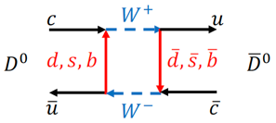
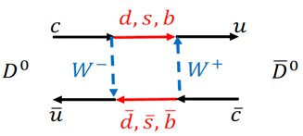



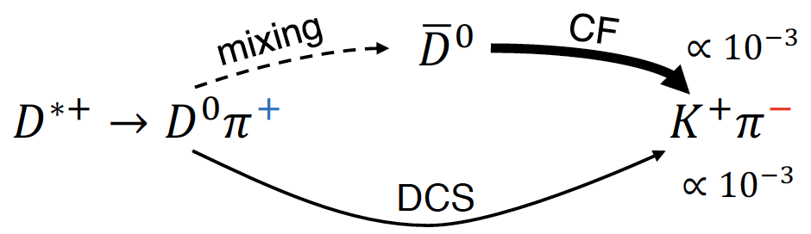
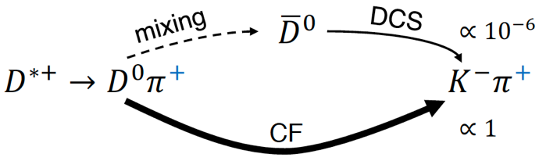
D⁰ - D⁰ mixing and CP violation with D⁰ → K⁺π⁻
Phys. Rev. D 97 (2018) 031101. RUN1+2 5fb⁻¹
Charm is the only up-type quark where we can look for flavor/CP violation
Mixing can be studied through the interference between different decay amplitudes to the same final states
The ratio between “wrong” and “right” sign decays depends on decay time t if mixing is present
R(t) can also be sensitive to CP violation (in that case R(t) is different
for D⁰ and D⁰
wrong sign
right sign

Slide 16
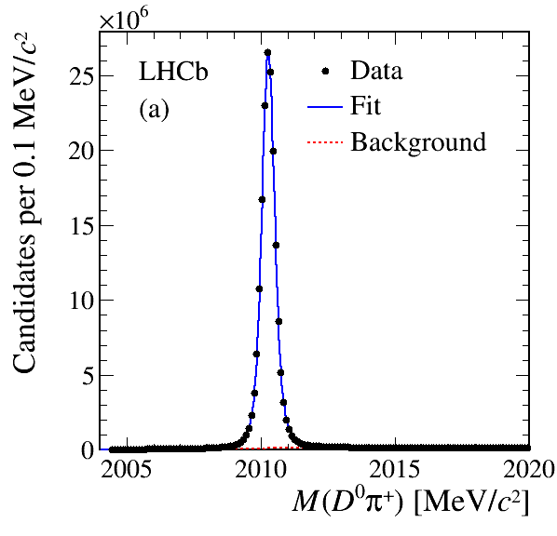
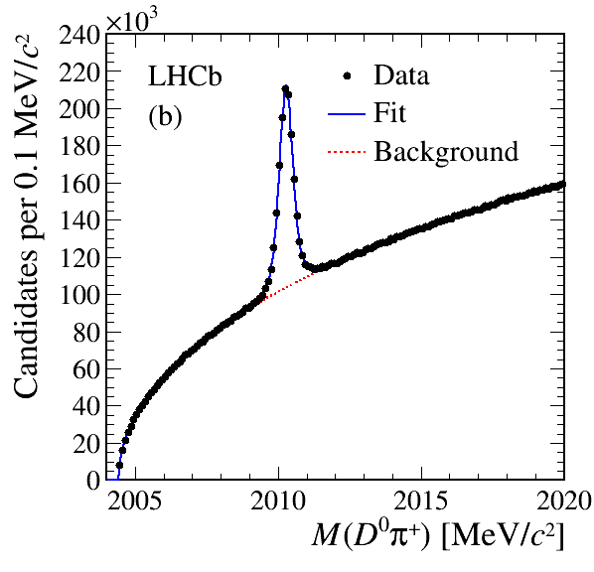
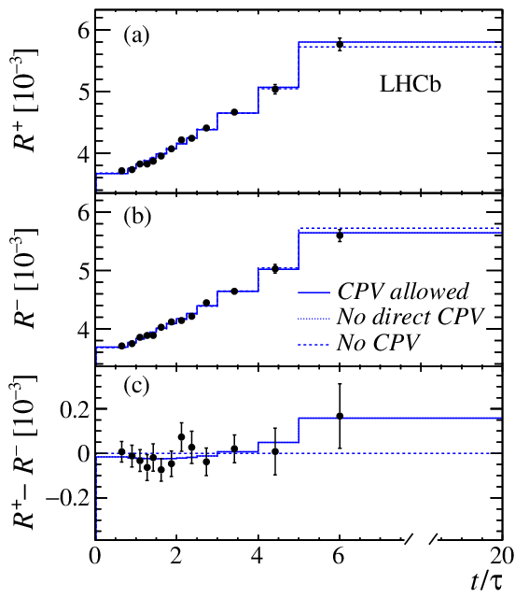
D⁰ - D⁰ mixing and CP violation with D⁰ → K⁺π⁻
Results
Assumunig CP conservation:
R_{D} = (3.454 ± 0.031) 10⁻³
x₀^{’2} = (3.9 ± 2.7)10⁻⁵
y₀' = (5.28 ± 0.52) 10⁻³
LHCb dominates the scene
(other measurements precision ~x10 worst)
Phys. Rev. D 97 (2018) 031101. RUN1+2 5fb⁻¹
1.8x10⁸
RS events
No evidence of CPV
7.2x10⁵
WS events
Run 2 signal yields ~ 2 times larger than Run 1

Slide 17
Υ production at √s = 13 TeV
Measuring standard candles

Slide 18
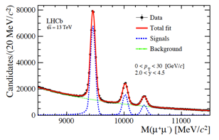
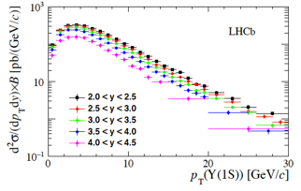
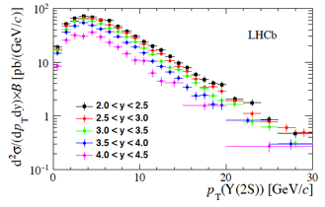
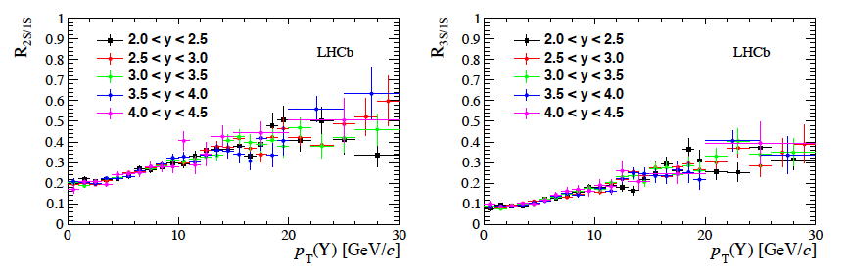
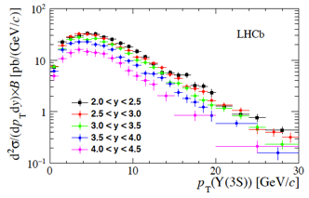
Υ production at √s = 13 TeV
Measure the double differential production cross-sections in p_{T} and y over the range 0 < p_{T} < 30 GeV/c and 2.0 < y < 4.5
Dimuon final states
Use 277 pb⁻¹, collected in 2015
About half a million ϒ candidates
A lot of high precision data.
PAPER-2018-002 RUN2 0.3 fb⁻¹
Ratios R_{2S/1S} and R_{3S/1S} of Υ(2S) and Υ(3S) to Υ(1S) x-sections

Slide 19
top pair production at √s = 13 TeV
High p_{T} physics in the forward region

Slide 20
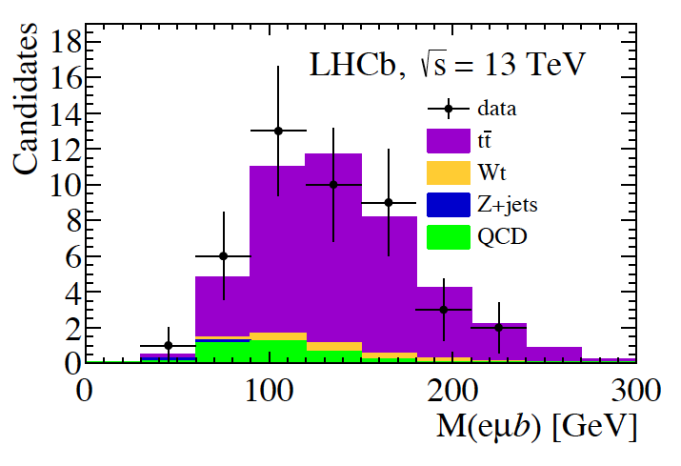
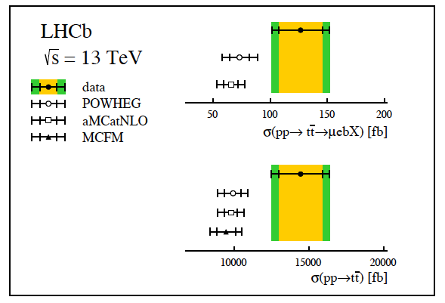
top pair production at √s = 13 TeV
arXiv:1803.05188 RUN2 2 fb⁻¹
tt production in LHCb acceptance: sizeable rates
of q anti-q and qg scattering, higher than in the central region, in addition to gg fusion
☞ Potential interest to study FB production asymmetries
1st measurement of top production with Run 2 data
  use high-momentum electrons, muons and b-jets
  About 87% of selected events correspond to the signal process, highest purity measurement of top physics at LHCb to date
Still statistically limited, but will not remain so for long

Slide 21
Study of {b,c}→{d,u}l⁺l⁻
The partners of b→sl⁺l⁻ transitions

Slide 22
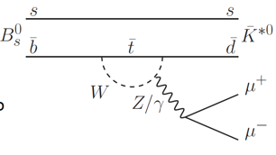
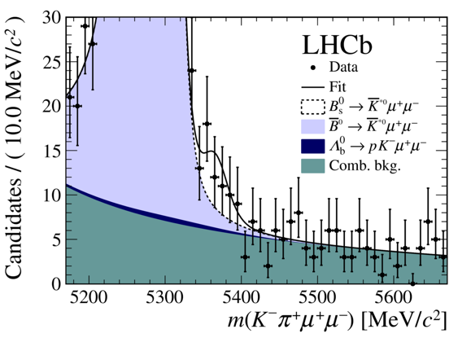
Evidence for the decay B⁰_{s} →K*(892)⁰μ⁺μ⁻
arXiv:1804.07167 RUN1+2 4.6fb⁻¹
Look to measure the branching fraction of the rare decay
  Heavily suppressed b → dll transition - SM expectation for BR O(10⁻⁸)
  potential to observe effects of new particles that are comparable to the Standard Model
Could be used with B⁰ → K^{*0}μ⁺μ⁻ to get a measurement of V_{td}/V_{ts}
Counterpart of the b → sll transitions
  ☞setting the ground work for angular analysis and study of LFUV with upgraded LHCb
Results:
38±12 signal events 3.4σ significance

Slide 23
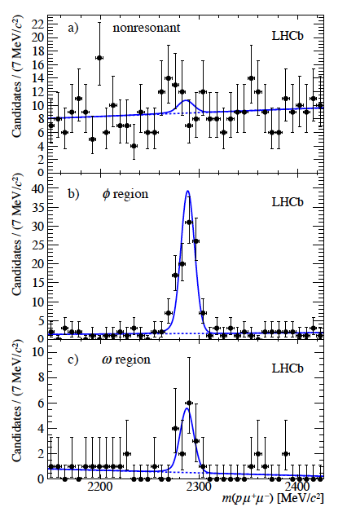
Search for the rare decay Λ_{c}→pμμ
PAPER-2017-039 RUN1+2 5fb⁻¹
FCNC c →ul⁺l⁻ decay, heavily suppressed in the SM
  analogue of b →sl⁺l⁻ in the charm sector
  non resonant decay very suppressed in SM, sensitive to new physics
  decay may occur also through an intermediate resonance decaying into a dimuon pair
Analysis performed in three regions of dimuon mass: ω, φ and non-resonant
No evidence for the non-resonant component
  Set an upper limit
  Improvement of two orders of magnitude with respect to BaBar [PRD 84 (2011) 072006]
For the first time the signal is seen in the ω region with a statistical significance of 5σ

Slide 24
The LHCb upgrade

Slide 25
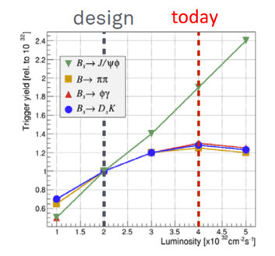
The LHCb upgrade
An LHCb Upgrade is scheduled, with installation in 2019-2020 (LHC LS2) and first data-taking in Run 3 (2021-2023). The motivation is to take increased advantage of the huge rate of heavy-flavour production at the LHC.
Full software trigger
Raise operational luminosity by factor five
to 2 x 10³³cm⁻²s⁻¹
Necessitates redesign of several sub-detectors and overhaul of readout
Huge increase in precision, in many cases to the theoretical limit, and the ability to perform studies beyond the reach of the current detector.
Flexible trigger and unique acceptance also opens up opportunities in other topics apart from flavour (‘a general purpose detector in the forward region’)
Allows effective operation at higher luminosity
Improved efficiency in hadronic modes

Slide 26
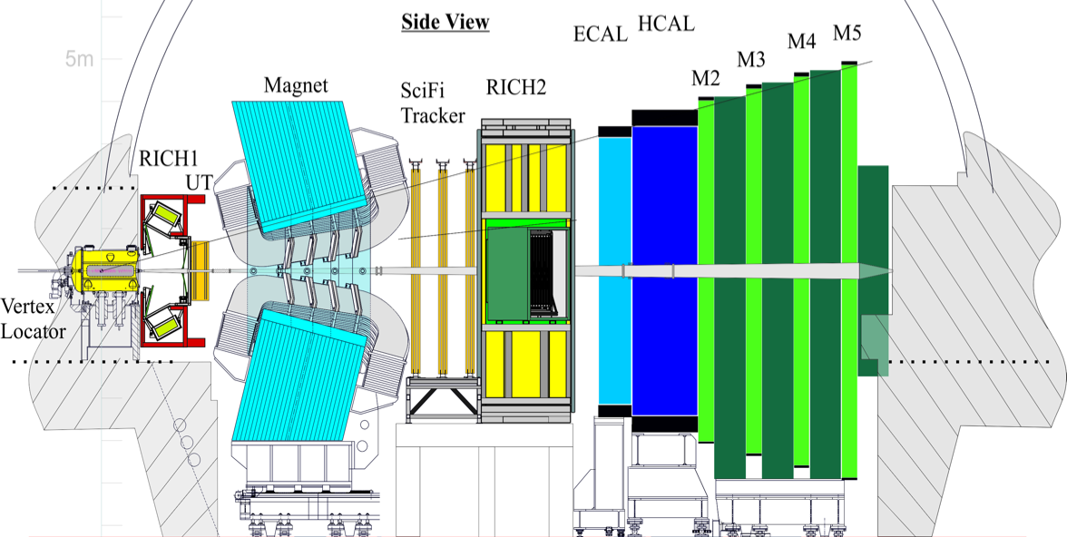
The LHCb upgrade in a snapshot
All sub-detectors read out at 40 MHz for a fully software trigger
Upgraded detector
New scintillating fibre tracker
New silicon upstream tracker
New PIXEL vertex detector
New RICH optics and photodetectors
New electronics for muon an calorimeter systems

Slide 27
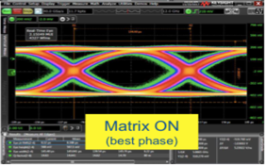
LHCb upgrade: VELO
VELO project progressing very well
VeloPix:
  First wafers received
  SEL and SEU problems fixed in the last version
  High rate output signals now OK
  Wafer tests started: yield ~68%
Sensors:
  Sensors must be tested in vacuum: challenging !
  Test method and setup finalized: start Q&A for production
Cooling substrate production started, high yield, excellent quality
VELO sensor tiles testing device
tiny voids seen in preproduction are not present in the production lot
VeloPix wafers
First production lot
preproduction lot
VeloPix eye diagram
Scanning Acoustic Microscope (SAM) images

Slide 28
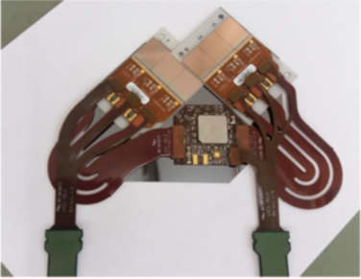
LHCb upgrade: VELO
Modules and mechanics
Readout chain:
  Full “electrical module” ready
  Tests of the full readout chain ongoing
  Design of signal cables finalised
Module mechanics:
  Finalising the infrastructure preparation of the production: huge work!
  Gluing is a challenge: large thermal excursions, thermal properties, radiation hardness,… tests ongoing to define the optimal glue and optimal gluing patterns
Detector mechanics:
  Very complex structure, many different parts
  In production
  Cooling plant and installation infrastructure
  progressing
Prototype of VELO “electrical module” and readout chain under test
Construction of the “module base”
Prototypes of VELO “mechanical module”
Prototypes of VELO “mechanical module”

Slide 29
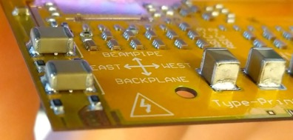
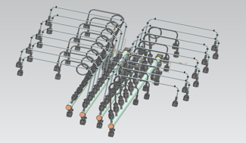
LHCb upgrade: UT
First 25 “Type A” sensors delivered end of February. QA well advanced, no problems seen – Green light for mass production!
Tenders for FLEX cables and hybrids ready
“PEPI” electronics progressing well
Integration and installation details being worked out – Coordination by a Project Engineer
Integration infrastructure at CERN being prepared
Preseries Type-A sensor under QA test
PEPI electronics engineering
4-chips hybrid preseries
Design of the cooling manifold
Integration of the stave supporting area

Slide 30
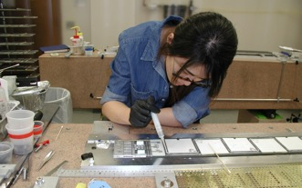
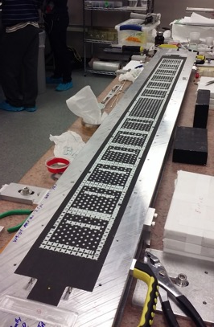
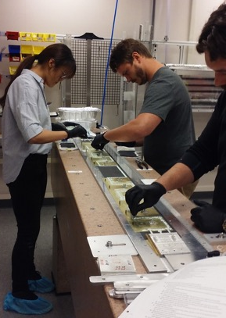
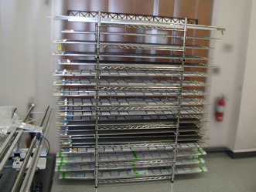
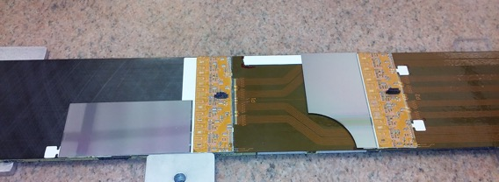
LHCb upgrade: UT
Bare stave construction is in full swing
Module construction is being exercised
SALT front-end chip is still delayed and represents a major concern
  Identified problems in the analog front-end in the latest version
  A new version reworked by the manufacturer, being tested now
Bare stave construction activities
Test of UT module assembly

Slide 31
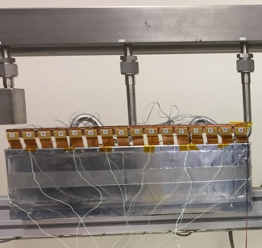
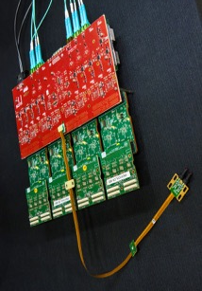



LHCb upgrade: SciFi
12000 km of fibers delivered !
Fibre mat production almost completed (1024 needed)
Module production progressing according to schedule
First batch of 1000 flex cables with SiPMs delivered
First wafers of FE-ASIC (PACIFIC 5) being received and sent for packaging
Orders for readout electronics being placed
Production of cold boxes started
1194 wound mats
942 finished mats
Cold box prototype
Flex cable with SiPM array
PACIFIC 5
Readout boards
Module construction

Slide 32

LHCb upgrade: SciFi
Assembly, transportation and installation tool
Design of C-Frames and preparation for assembly progressing
  First prototype in construction
Assembly structure built at CERN
Preparation of buildings for installation in the pit ongoing
Modules keep arriving at CERN and stored in an assembly hall
C-Frame prototype top beam
Cutting SX8 walls to allow SciFi access
SciFi module boxes at P8

Slide 33


LHCb upgrade: RICH, Muon, Calorimeters
RICH
  Over 80% of MaPMT production already received and QA certified.
  20k of the 35k CLAROs have been tested (32k needed)
  Decision on Digital Board FPGA taken (was waiting for radiation tests)
  All mechanics milestones achieved! Go full steam to finalise construction and to installation
  A module with MaPMTs installed in LHCb: first light seen!
Muon
  Tender for nSync/nODE about to be launched
  PRR for nSB/nPDM mid May, tender starts straight after
  Full electronics production completed by end 2018.
Calorimeters
  Analog chip: production completed by Nov 2017, tests ongoing
  “All-electronics PRR” held in February 2018. Production ready to be launched
Robotised QA of ICECAL chips
RICH MaPMT module installed in LHCb. First hits seen !
Tests of calorimeter electronics
Tests of muon electronics

Slide 34


LHCb upgrade: Online and computing
PCIe40
  Tender for PCIe40 boards completed and order placed
  PCIe40 production of 1st batch of 24 progressing as expected.
Scaling of event builder network still under test
  Simulation is nicely reproducing data
  Will be very helpful to understand problems and bottlenecks
PCIe40 boards – preseries production
Event builder detwork simulation
Target: 80Gb/s on 500 nodes
(40 Tb/s total traffic)
Test of EB network scaling

Slide 35


LHCb upgrade: software & computing TDR
Upgrade HLT will process data at 30 MHz – challenging !
  Need software modernization
  Need proper software engineering
  Exploit modern CPU features (multi-threading, vectorization)
  Huge effort ongoing, substantial progress in many areas
Current trigger performance does not follow modern CPU computing power
Vectorization can give up to an ideal x8 speed-up factor
Throughput dependence on tracking requirements
Significant gain by tightening impact parameter and p_{T} cuts
However this affects the physics program
A factor 2 in throughput is gained with respect to previous studies
Multi-threading gain
HLT1 throughput [events/s/node]
Clear performance improvement of multi-threaded execution vs
single-threaded (~20%)
Displacement from PV [mm]
Tracking algorithm optimization

Slide 36

LHCb upgrade: software & computing TDR
TDR on upgrade software and computing about to be released to LHCC
  Summarizes core software solutions to enable HLT implementation
  All aspects of data processing (Simulation, offline, distributed computing,…) are discussed
  Will be complemented with a Computing Model document where offline computing resources will be discussed (in preparation, submission: summer 2018)

Slide 37


Upgrade II (LS4)
LHCb issued Expression of Interest in an LS4 Upgrade II, a HL-LHC era flavour physics experiment, in February 2017:
  Modest consolidation in LS3 (~2025)
  LS4 Upgrade II installation (~2030)
  Collect ~ 50 fb⁻¹ / yr, > 300 fb⁻¹ total
Presented to LHCC and encouraged to continue to a physics case document and proceed with discussions with LHC
  Physics document in preparation, present preliminary version for end May 2018
  Encouraging discussions with the HL-LHC experts
Workshop in Annecy to review physics and detector options
At this point no action from RRB requested,
for info. only
  TDR timescale 2020

Slide 38
Conclusions and outlook

Slide 39

Conclusions and outlook
LHCb run in 2017 was very smooth with detector working very well
YETS activities completed successfully
2018 run starting very well
LHCb continues to provide a wealth of excellent physics results
  Also preparing the ground for high statistics
  measurements in the upgrade phase
The march towards the LS2 upgrade is continuing
  All subsystems progressing - crucial steps forward in critical projects
  Schedule is tight and some delays represent major concerns
Looking into the far future:
  Expression of Interest for future upgrades submitted
  Preparing a physics case document

Slide 40

Thank you !

Slide 41
Run 2018: Run2 strategy
Buffer all events to disk before running HLT2
Real-time alignment and calibration procedure before HLT2
Full offline-like reconstruction in HLT2
Turbo stream for physics analysis directly on the trigger output
LHC bunch crossing (30 MHz)
L0 hardware trigger (1MHz)
HLT1 software trigger (150 kHz)
Buffer
~10 PB
Real time alignment and calibration
HLT2 software trigger (12.5 kHz)
Full
Offline reconstruction and associated processing
Turbo
User Analysis
Calibration
Offline reconstruction and associated processing

