Slide 1
Computing Resources Scrutiny Group Report
Donatella Lucchesi
University and INFN of Padova
For the Computing Scrutiny Group

Slide 2
C-RSG membership
C Allton (UK) | J Kleist (Nordic countries)
V Breton (France) | D Lucchesi (Italy, Chairman)
G Cancio Melia (CERN) | H Meinhard (CERN, scient. secr.)
A Connolly (USA) | P Sinervo(Canada)
M Delfino (Spain) | J Templon (Netherlands)
F Gaede (Germany)
P Sinervo, is the new Canada representative. We welcome Sinervo, who actively participated to this scrutiny round.
The group thanks Jeff Templon for his valuable contribution during the years and ask the Netherland to nominate a new representative.
Thanks to the experiment representatives for their collaboration and to CERN management for the support.
I want to thank the C-RSG members for their commitment, it is a great team!

Slide 3
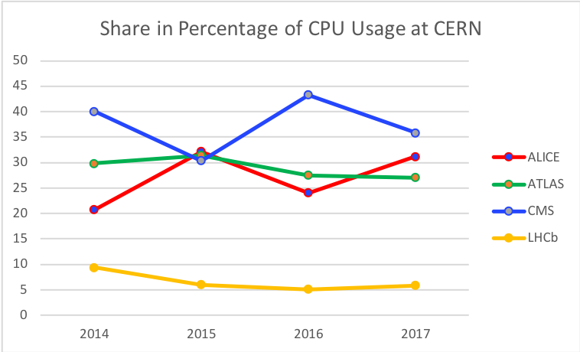
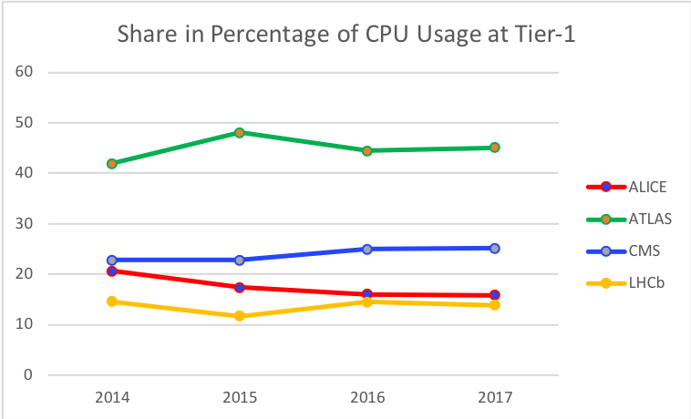
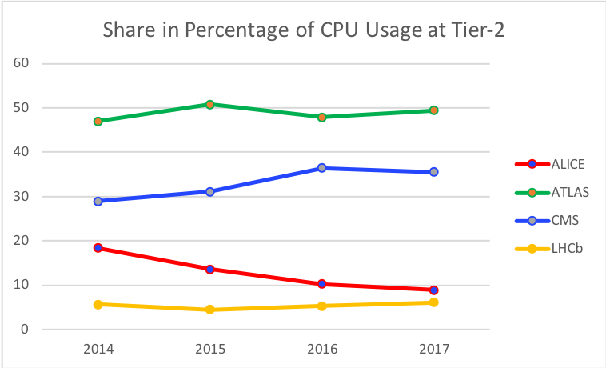
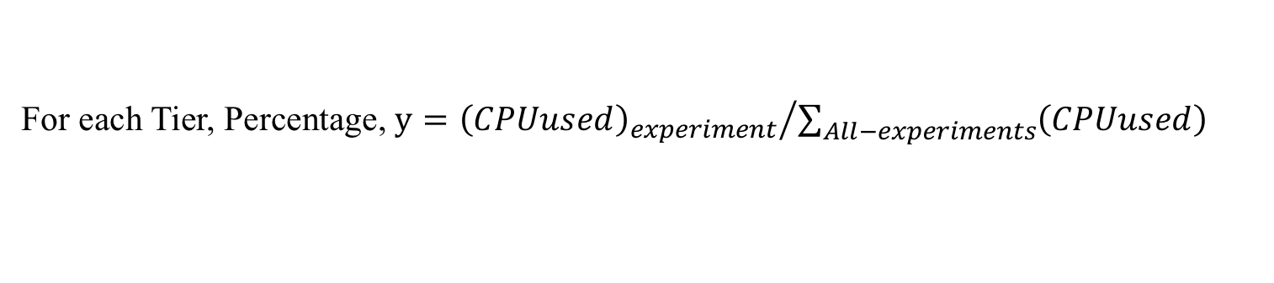
General Usage - CPU
For each Tier, Percentage, $y={{\left(CPUused\right)}_{experiment}}/{\sum_{All−experiments}{\left(CPUused\right)}}$

Slide 4
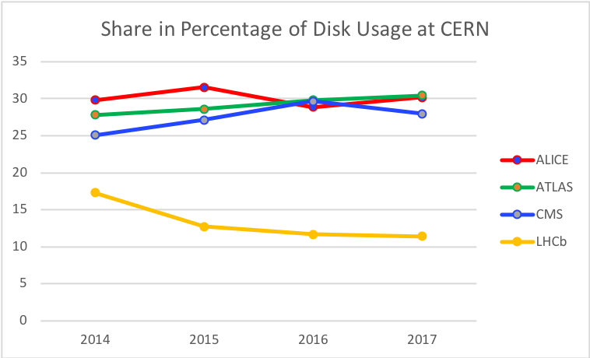
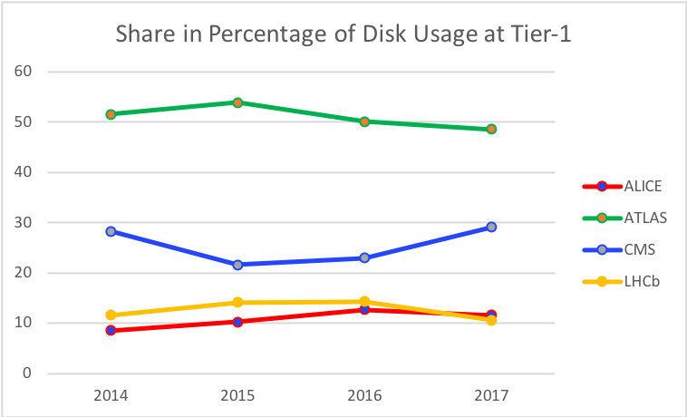
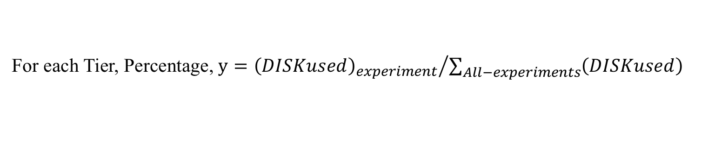
General Usage – Disk Space
For each Tier, Percentage, $y={{\left(DISKused\right)}_{experiment}}/{\sum_{All−experiments}{\left(DISKused\right)}}$

Slide 5
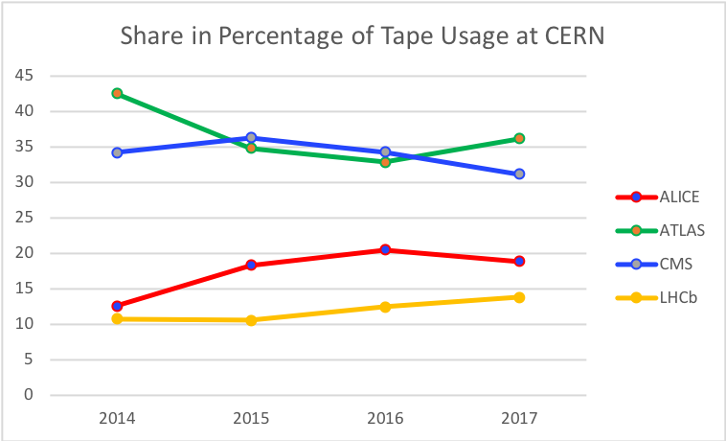
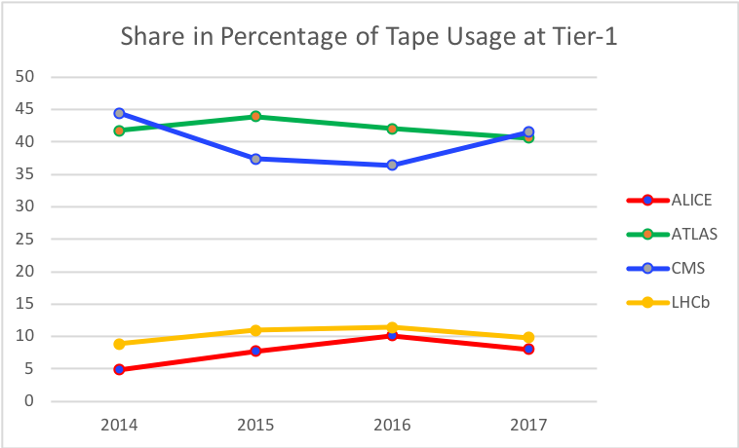
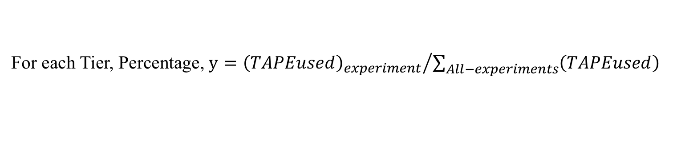
General Usage – Tape Space
For each Tier, Percentage, $y={{\left(TAPEused\right)}_{experiment}}/{\sum_{All−experiments}{\left(TAPEused\right)}}$

Slide 6
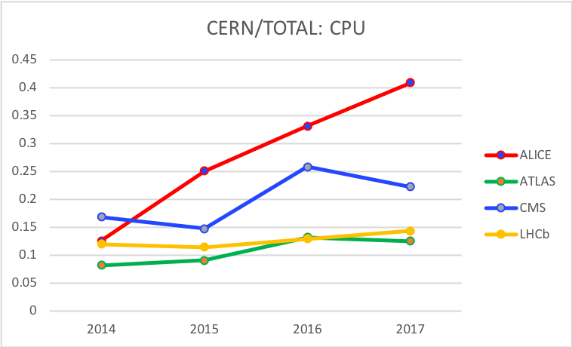
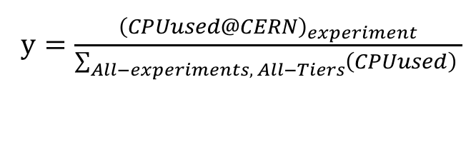
General Usage
$y=\frac{{\left(CPUused@CERN\right)}_{experiment}}{\sum_{All−experiments, All−Tiers}{\left(CPUused\right) }}$

Slide 7
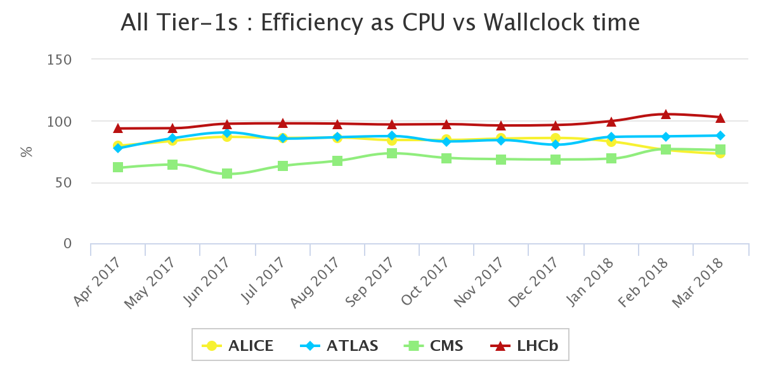
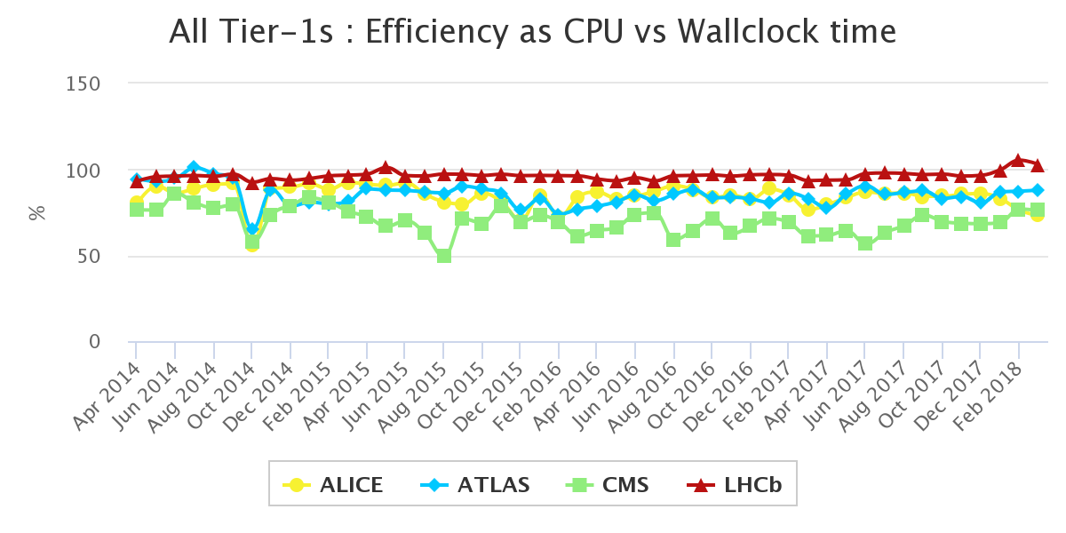
CPU Efficiency

Slide 8
Usage experiment by experiment

Slide 9
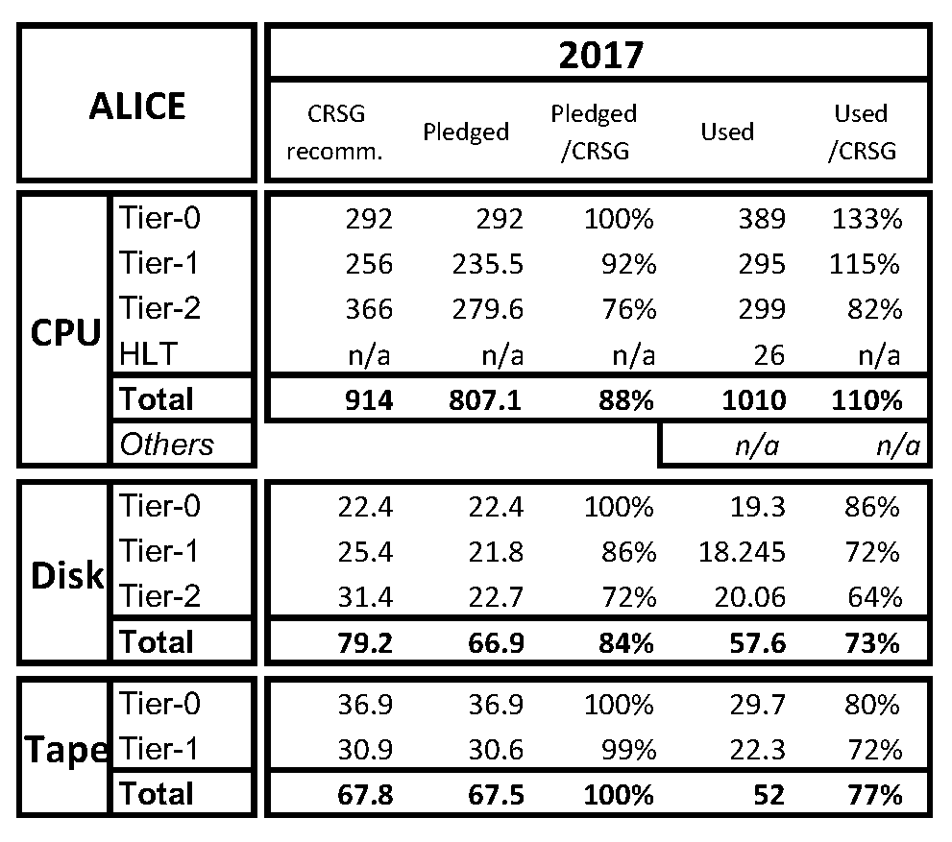
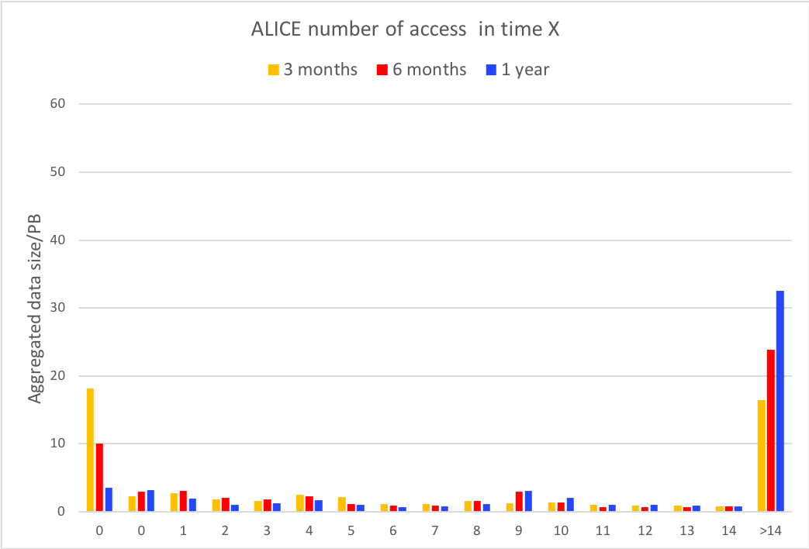
ALICE Usage
Good use of opportunistic CPU resources.
More cycles could be exploited on HPC systems, they are not of easy access by ALICE.
Disk space still under-pledged but much less than last year, ALICE thinks this does not impact performances.
Raw event size reduced thanks to improved HLT compression ⇒ less tape space needed
2017 unused tape will be accounted for in 2018 and 2019 requests.

Slide 10
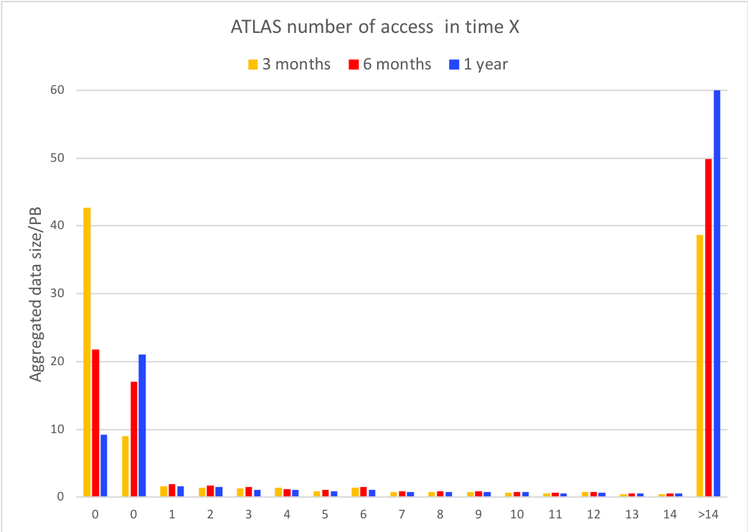
ATLAS Usage
Very high use of opportunistic CPU resources.
Sizeable amount of CPU cycles from HPC farms,
contributions also from volunteer computing.
Disk space ~100% full.
Increase of not accessed data in last 6 months due to large dataset not fully
ready for analysis.
Tape usage less than expected due to: smaller cosmic and calibration dataset, deleted Run 1 non-raw events and better than expected lifetime model at Tier-1.

Slide 11
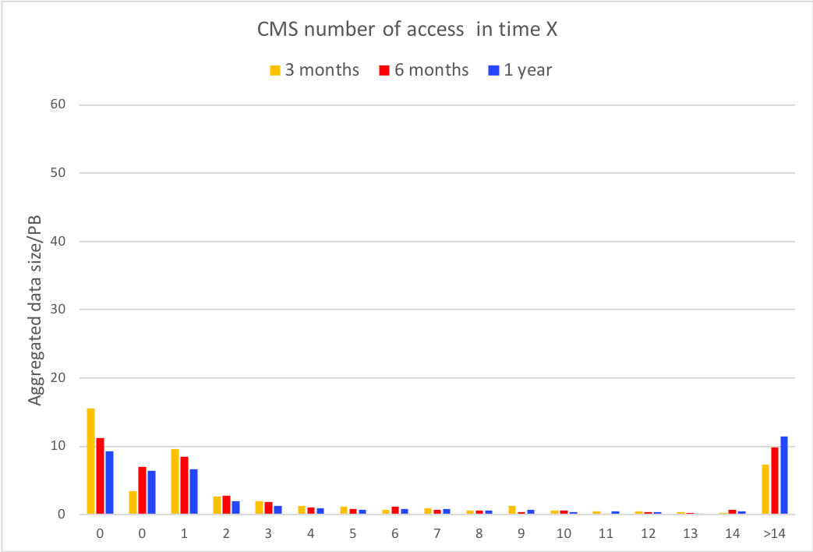
CMS Usage
Challenging 2017 due to incident at CNAF, issues and less pledged resources than recommended.
Mitigations came from opportunistic CPU resource and tape deletion campaign @Tier-1
Very good use of disk space: dynamic storage management and reduced data formats
Mitigations were possible thanks to additional operational efforts

Slide 12
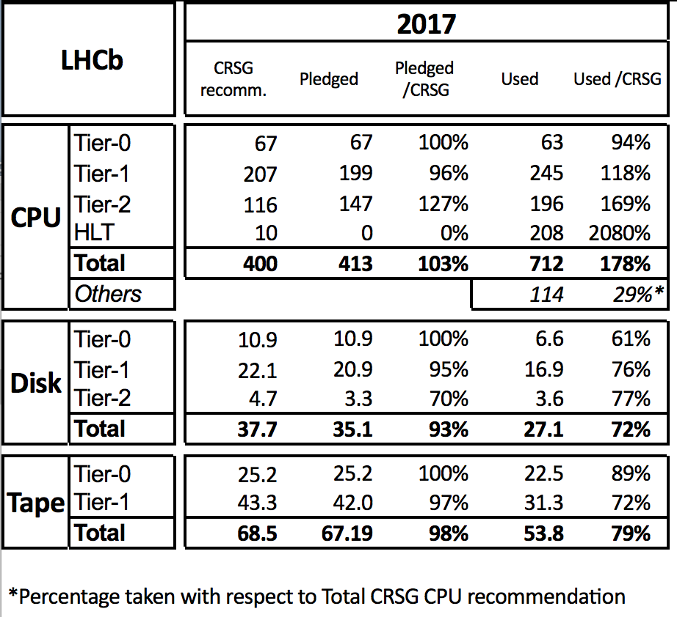
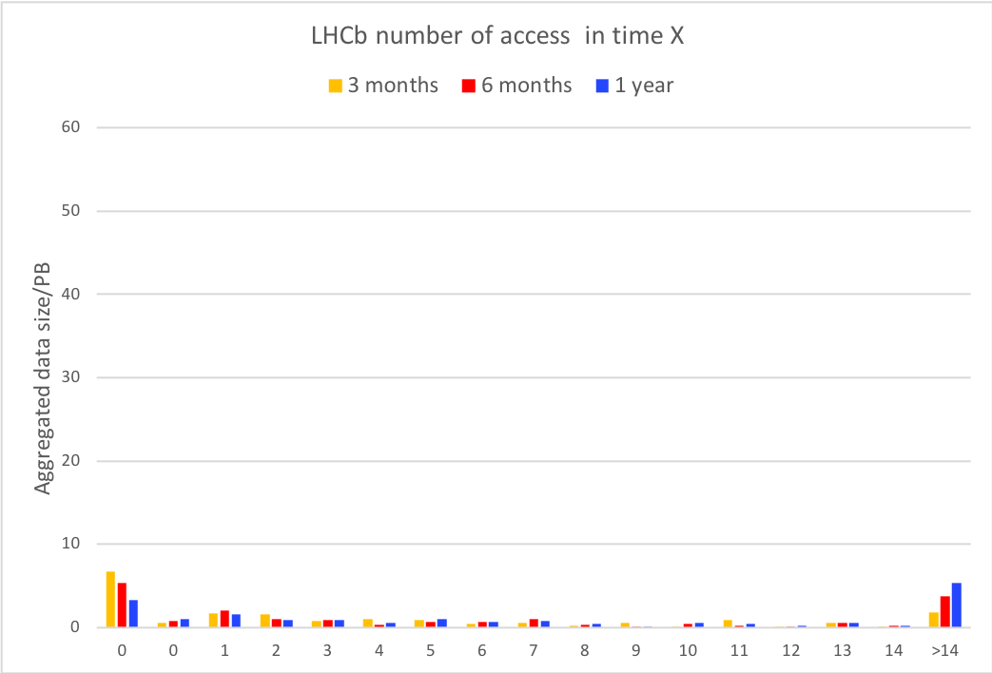
LHCb Usage
Very good use of not pledged CPU resources, and HLT
Substantial contribution from non WLCG CPU resources used for non critical tasks as additional Mont Carlo production
Refinement of the TURBO data format helps optimize storage use, which results not fully utilized here but peak utilization happened during the year
CNAF incident had a substantial impact on LHCb, ~18% of data inaccessible for many weeks.

Slide 13
Resource Requirements for 2019
2019 – shutdown year.
Tier-0 management expects CERN resources pledged in 2019 identical to 2018 with the intention to re-profile a maximum of funding to the beginning of Run 3.
Tier-0: ATLAS and CMS no resource increase, LHCb modest and ALICE substantial increase.

Slide 14
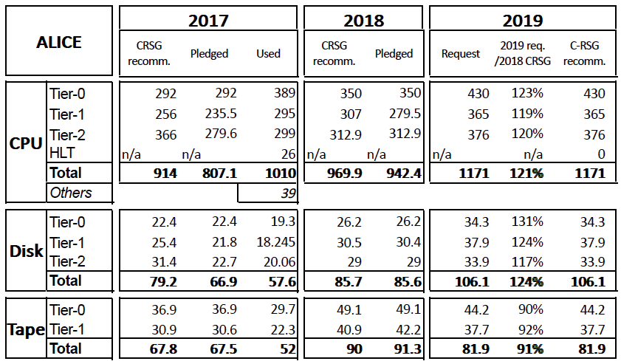
Alice Requests for 2019
No C-RSG recommendations for 2018 Tier-2 CPU and disk. The pledged values are assumed as recommended.
Requests changed substantially since October 2017: -25% for CPU, and -12% for disk space.
Tier-0 CPU and disk space requests are due to Pb - Pb data taking with event data size increased due to new trigger mix.

Slide 15
ALICE Recommendations
C-RSG strongly encourages ALICE to keep working to reduce the size of Pb – Pb data and associated Monte Carlo
C-RSG welcomes ALICE’s work on Geant4 multithreading and strongly encourage further developments that will better match the opportunistic resources, in particular HPC

Slide 16
ATLAS Requests for 2019
Sizeable contribution from beyond- pledge CPU resources is expected
Disk space request at Tier-1 and Tier-2 are slightly high, but given ATLAS computing model this appears a critical request
Even if tape occupancy is below pledged, ATLAS expects tape usage to catch up with pledges over 2018, 2019. Additional space is for contingency

Slide 17
ATLAS Recommendations
C-RSG is concerned about the growth in the ATLAS disk usage and reliance on uncommitted CPU resources.
C-RSG notes that ATLAS has significantly more disk resources than CMS on the Tier-1 and Tier-2 sites.
The difference continues to grow in the 2019 requests: +29% at Tier-1 and + 38% at Tier-2.
ATLAS explains this by differences in the computing model such as the data format and event sizes.
C-RSG encourages ATLAS to consider investigating smaller data formats, higher compression rates and/or virtual data for fast simulation streams, similar to what CMS has achieved.

Slide 18
CMS Requests for 2019
CMS requests are minimal.
Since October RRB C-RSG notes a reduction in tape space request at Tier-1.

Slide 19
CMS Recommendations
C-RSG notes that the 2018 pledge is now less than 5% below for disk and 8% for tape compared to C-RSG recommendations, which lowers previous C-RSG concerns about the lack for pledged resources to CMS.
C-RSG applauds CMS’s work on using reduced size data-formats such as miniAOD and their investigations into even more compact nanoAOD.
C-RSG recommends CMS to continue to seek improvements to the relatively low CPU efficiency, and appreciates the work done to understand the background to this.

Slide 20
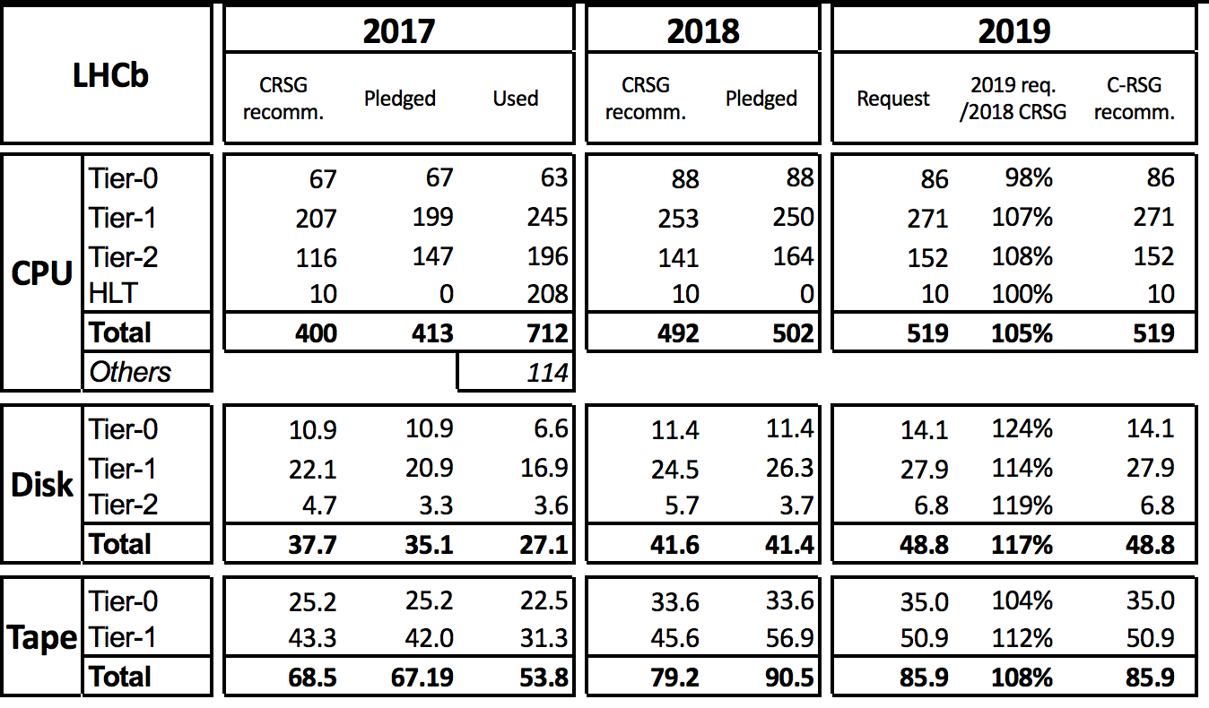
LHCb Requests for 2019
LHCb requests are minimal
Increase is driven mainly by re-stripping
Additional CERN requests for data and analysis preservation Open Data project:
  +30 kHS06-years CPU
  +0.5 PB +0.5 PB of disk for the two projects

Slide 21
LHCb Recommendations
C-RSG congratulates LHCb on the very successful management of their computing model and the links to their data processing operations, including usage monitoring and future resource prediction.
C-RSG considers that LHCb has an appropriate contingency plan in case more data is accumulated in 2018 than planned.
C-RSG takes note of the needs reported by LHCb for analysis and data preservation as well as for participation in CERN’s Open Data project.

Slide 22
Contingency Plan
C-RSG asked the experiments, as part of future resources assessments, to provide a mitigation strategy to address changes in the assumed running conditions at the level of a 20% increase.
Answers:
ALICE:
will keep data on tape. Data reconstruction, MC, and analysis delayed until sufficient amount of CPU and disk resources are available. The required resources are expected to scale linearly with the amount of data.
ATLAS:
CPU Tier-0, off-load to Tier-1’s via spill-over operations with very low increase of resources.
Increase of +0.5 FTE to guarantee the operations.
Storage Tier-0: +8PB of disk and more tapes depending on how much disk will be available.

Slide 23
Contingency Plan – cont’d
C-RSG asked the experiments, as part of future resources assessments, to provide a mitigation strategy to address changes in the assumed running conditions at the level of a 20% increase.
Answers:
CMS:
  CPU Tier-0 use Tier-1s or CERN_T2.
  CPU Tier-1 and Tier-2 delays in analysis and reprocessing.
  Disk space Tier-0 move operation to Tier-1.
  Disk space Tier-1,Tier-2 further reduction of AOD(SIM) copies that will go below 1.
  All of the above will requiring additional operations.
LHCb:
use the powerful online selection capabilities to park on tape specific datasets and postpone analysis. This has a multiplying effect ⇒ simulation will also be postponed.

Slide 24
2020 Outlook
ALICE: no CPU and tape increase. Needs for disk space: around 20% at T0 and T1 and 15% at T2. Activities: third pass for pp data and the final two passes for the Pb-Pb data and the associated MC production.
ATLAS: ATLAS has not been able to quantify their needs for 2020 as their computing needs for LS2 still need to be understood.
CMS: full model not in place yet, as it depends on the 2021 LHC machine parameters. At the moment, no increase is foreseen for 2020 while it is expected a substantial increase in 2021.
LHCb: well advanced in estimating resource needs. There will be a need for 15-20% growth in CPU and disk resources, whilst tape growth is expected to be negligible. The resources will be needed to overlap the consolidation of all processed data from Run2 to prepare for Run3

Slide 25
Comments and Recommendations
Only partial disk space accounting is available, C-RSG would require to monitor also the Tier-2 disk space usage starting from the next scrutiny.
In the shutdown years the purchasing profile can be different with respect to data taking periods. C-RSG would request that the experiments for the next scrutiny provide requests assuming:
  the purchasing will be delayed until the begin of Run 3;
  the resources are provided year by year during the shutdown.
The C-RSG requests that CERN’s expectations for the resource as function of time for Run 3 be documented and communicated to the experiments prior to the start of Run 3.
The C-RSG commends the experiments for having started the activity on long term data preservation and their involvement on making data available for education through Open Data Portal. C-RSG recommends that these projects are discussed within WLCG and the experiments in order to have a structured projects with the appropriate funding.

Slide 26
Comments and Recommendations cont’d
The C-RSG appreciates the continued work on increasing the computational efficiency and on reducing the CPU and disk resources requirements. The C-RSG hopes that all the experiments reach the same level of involvement in improving the computational efficiency and reducing the data size format.
The C-RSG would request that as part of future resources assessments the experiments provide a proposed mitigation strategy to address changes in the assumed running conditions for the experiment at the level of a 20% increase.
Experiments are encouraged to gather accounting information on the use of non-WLCG resources in order to be able to report them in future to the C-RSG. Furthermore we welcome the fact that every experiment has made use of their HLT farms to augment their CPU resources.

