Slide 1

Introduction to CERN and KT
Giovanni.Anelli@cern.ch
Knowledge Transfer Group - IPT Department
06.08.2018

Slide 2


Welcome to CERN
Accelerating Science and Innovation
Notes:
2

Slide 3
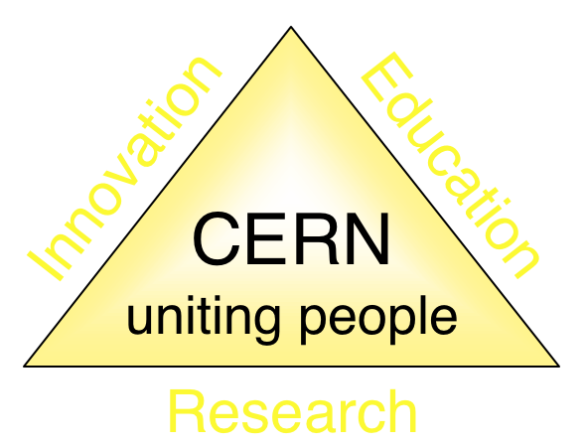
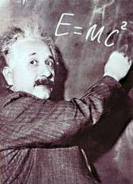
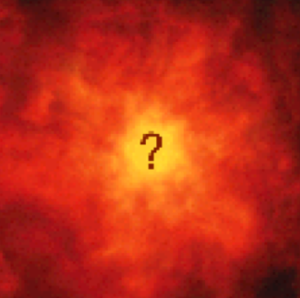
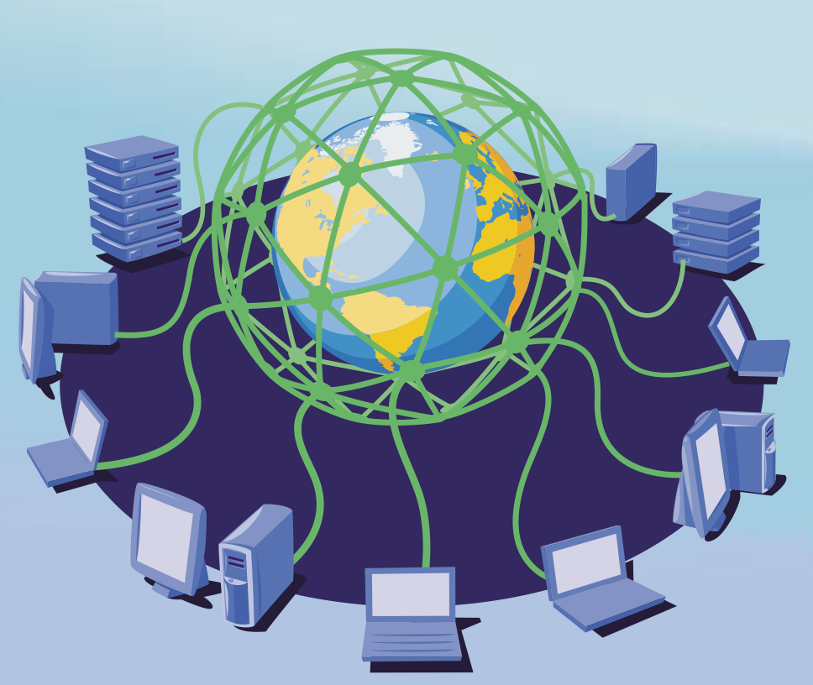

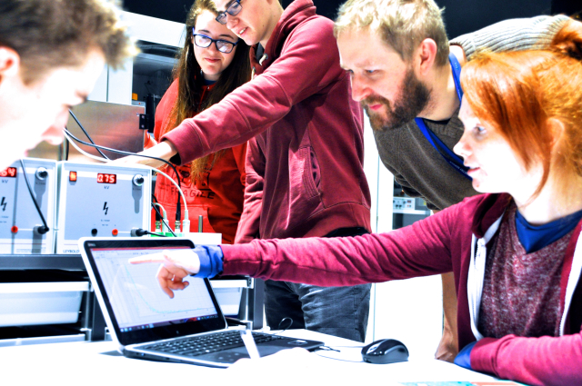
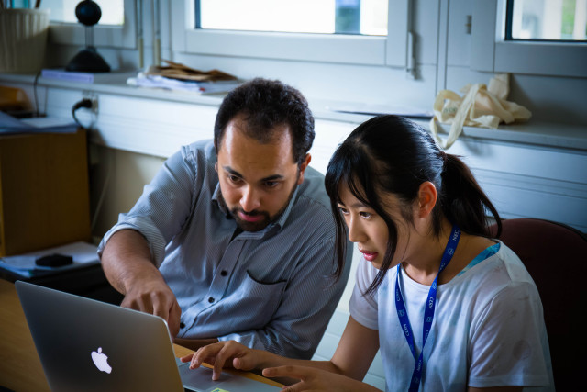
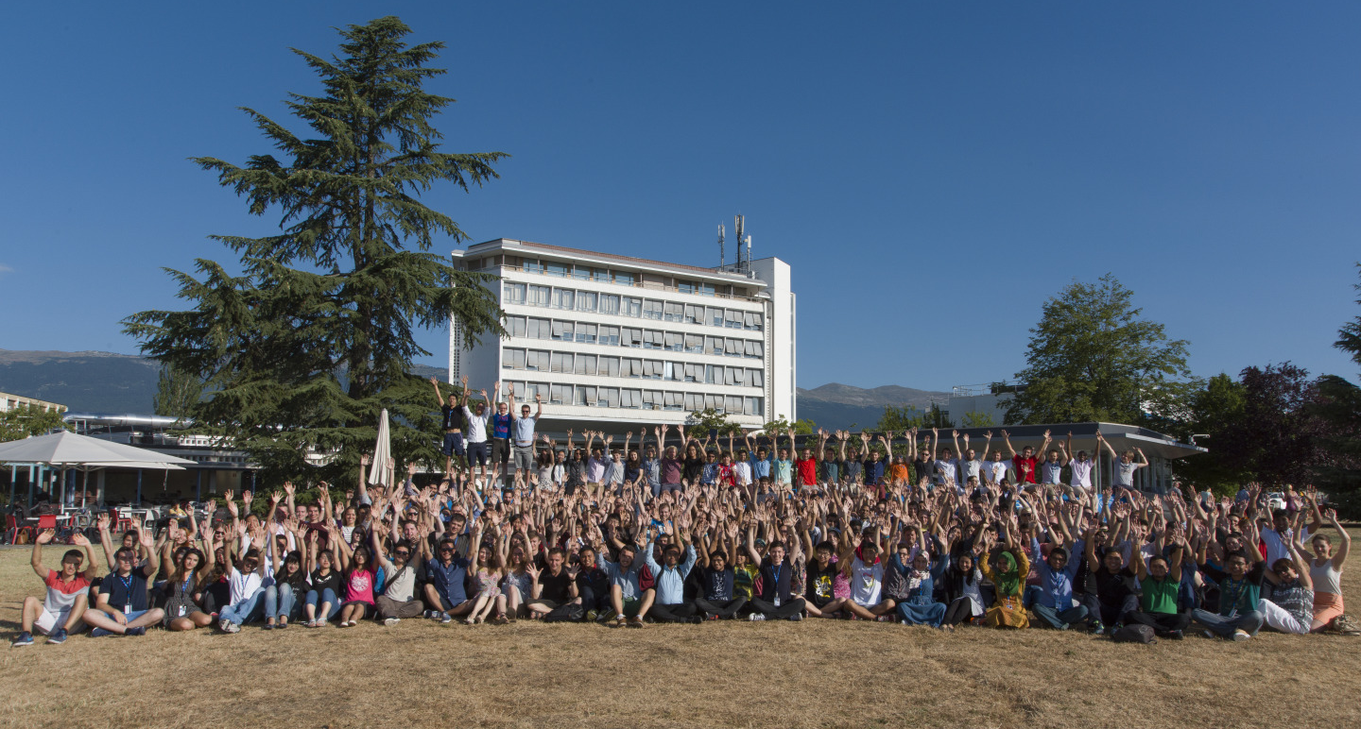
The Mission of CERN
Push back the frontiers of knowledge
E.g. the secrets of the Big Bang …what was the matter like within the first moments of the Universe’s existence?
Develop new technologies for accelerators and detectors
Information technology - the Web and the GRID
Medicine - diagnosis and therapy
Train scientists and engineers of tomorrow
Unite people from different countries
and cultures
Notes:
3

Slide 4
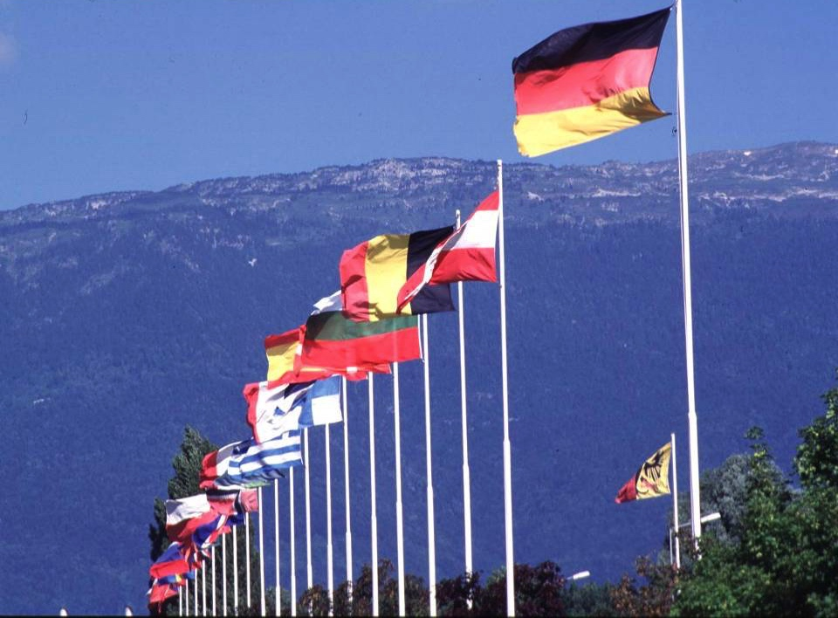

CERN: founded in 1954: 12 European States
“Science for Peace”
Today: 22 Member States
~ 2500 staff
~ 1800 other paid personnel
~ 13000 scientific users
Budget (2017) ~ 1100 MCHF
Member States: Austria, Belgium, Bulgaria, Czech Republic, Denmark, Finland, France, Germany, Greece, Hungary, Israel, Italy, Netherlands, Norway, Poland, Portugal, Romania, Slovak Republic, Spain, Sweden, Switzerland and
United Kingdom
Associate Members in the Pre-Stage to Membership: Cyprus, Serbia, Slovenia
Associate Member States: India, Lithuania, Pakistan, Turkey, Ukraine
Applications for Membership or Associate Membership:
Brazil, Croatia
Observers to Council: Japan, Russia, United States of America;
European Union, JINR and UNESCO
4
Notes:
4
----- Meeting Notes (09/01/2013 14:16) -----
nnn

Slide 5
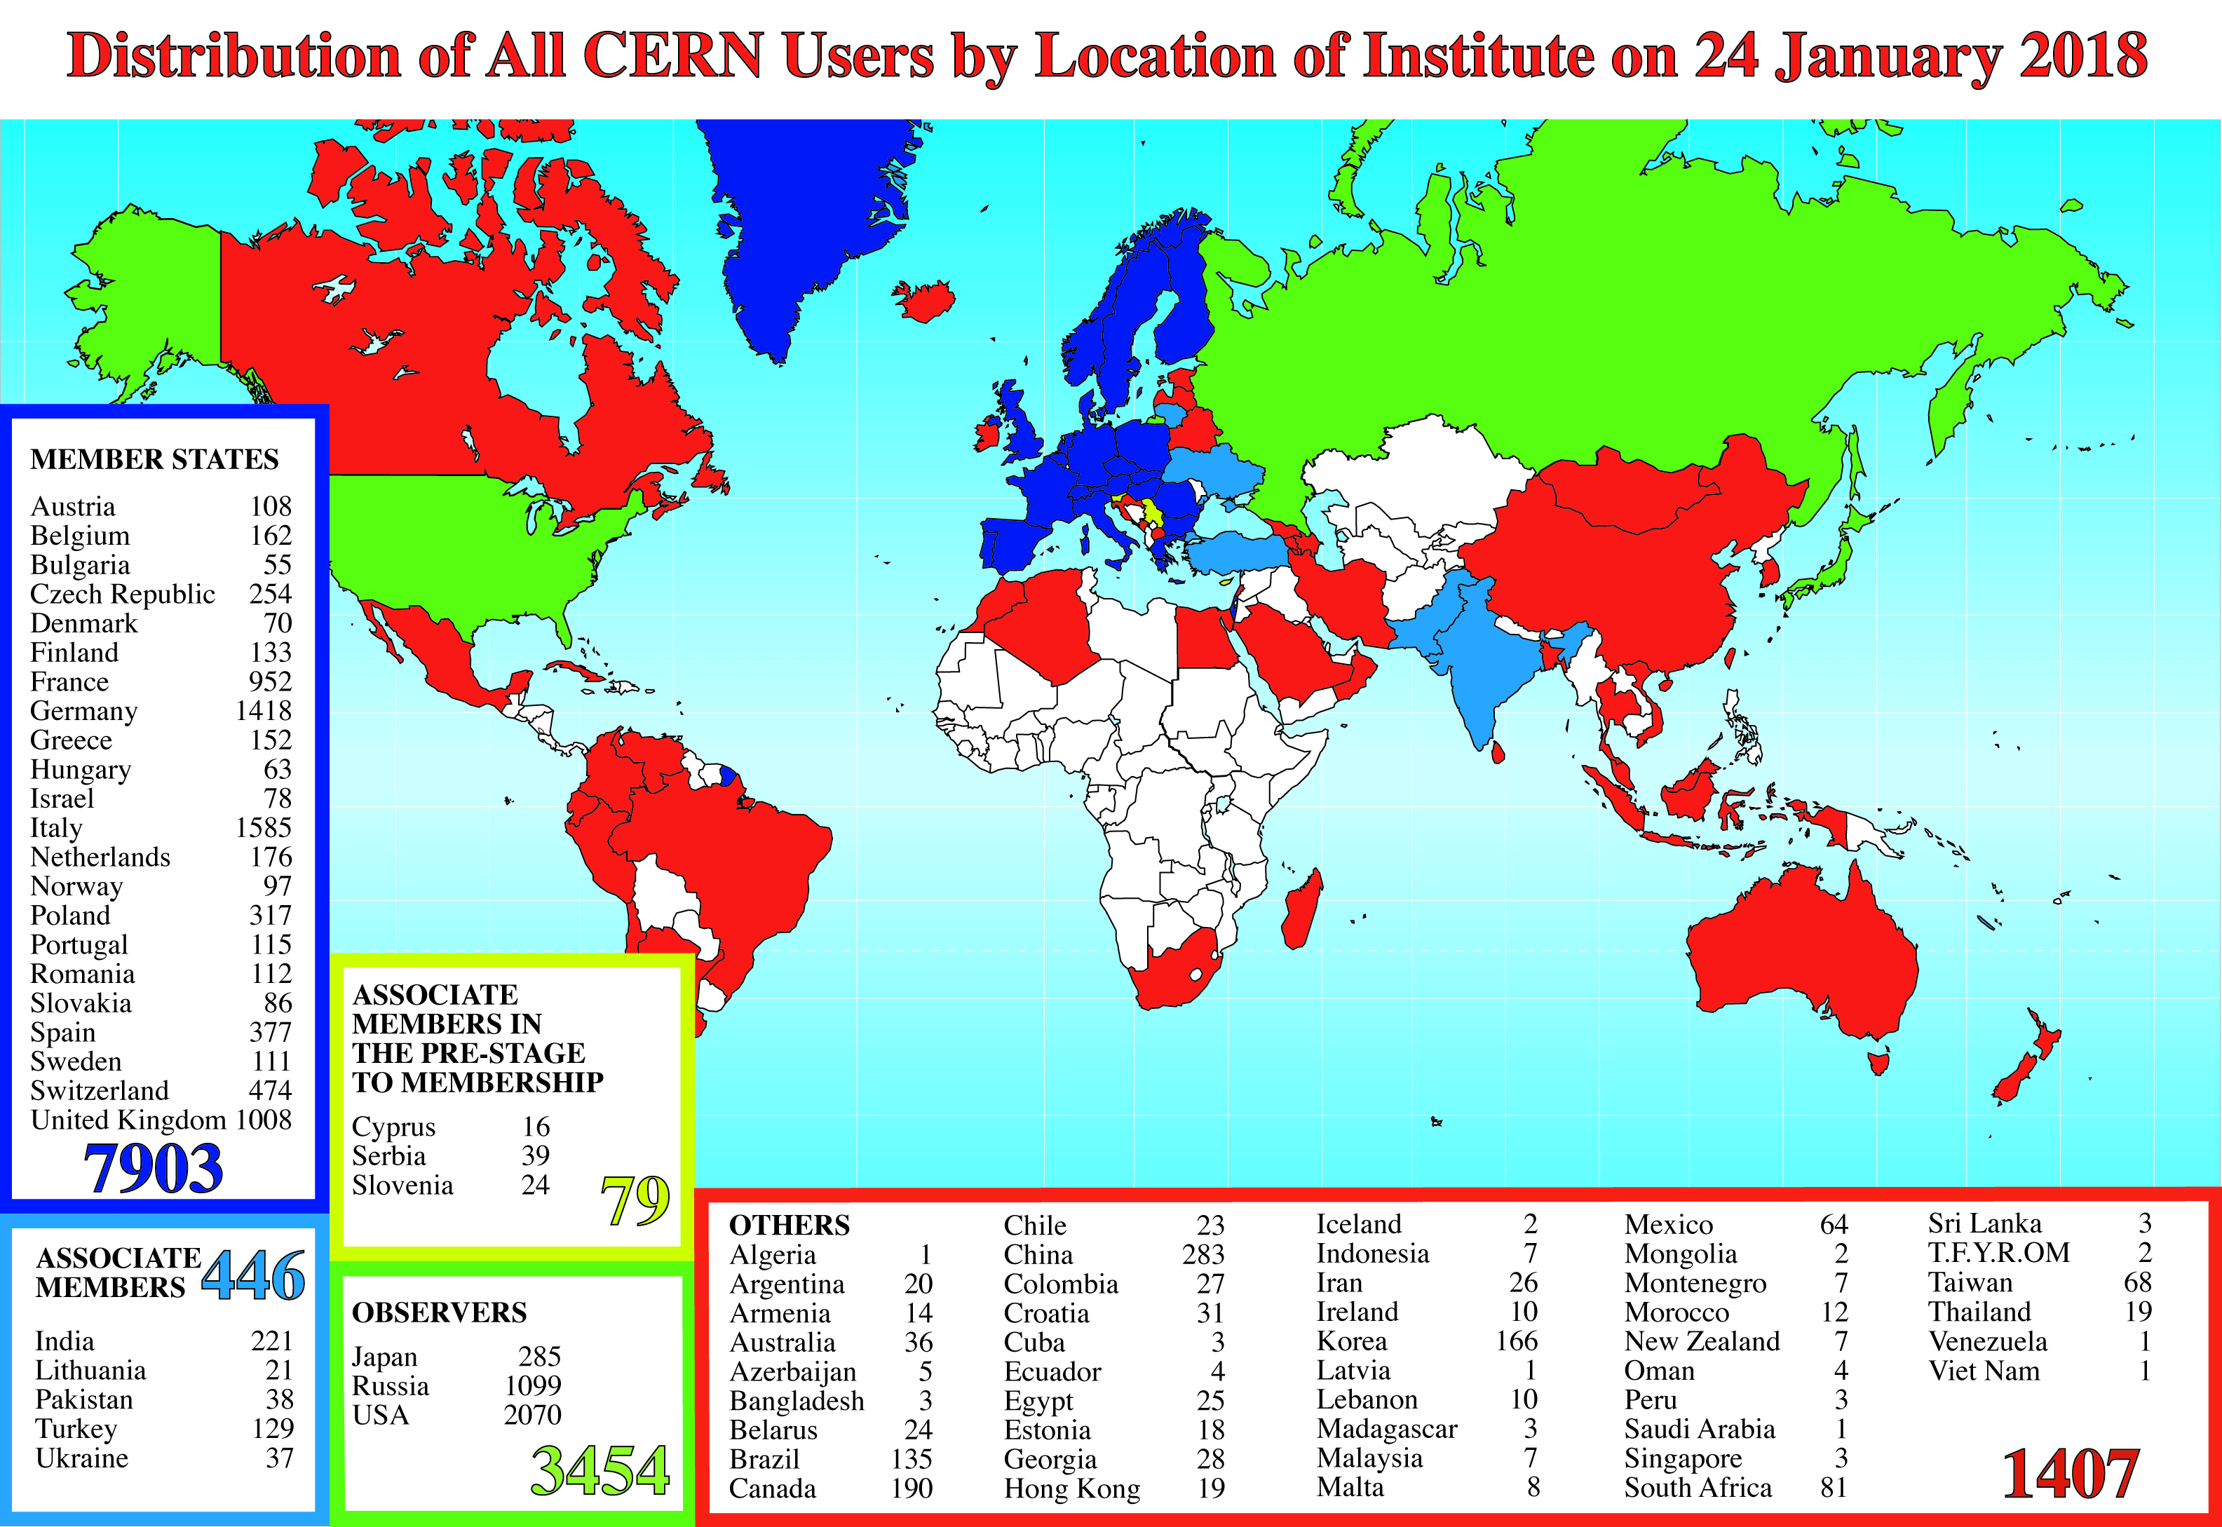
Science is getting more and more global
Notes:
5
5

Slide 6
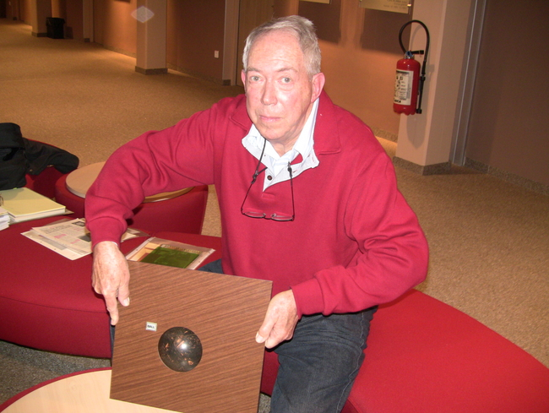
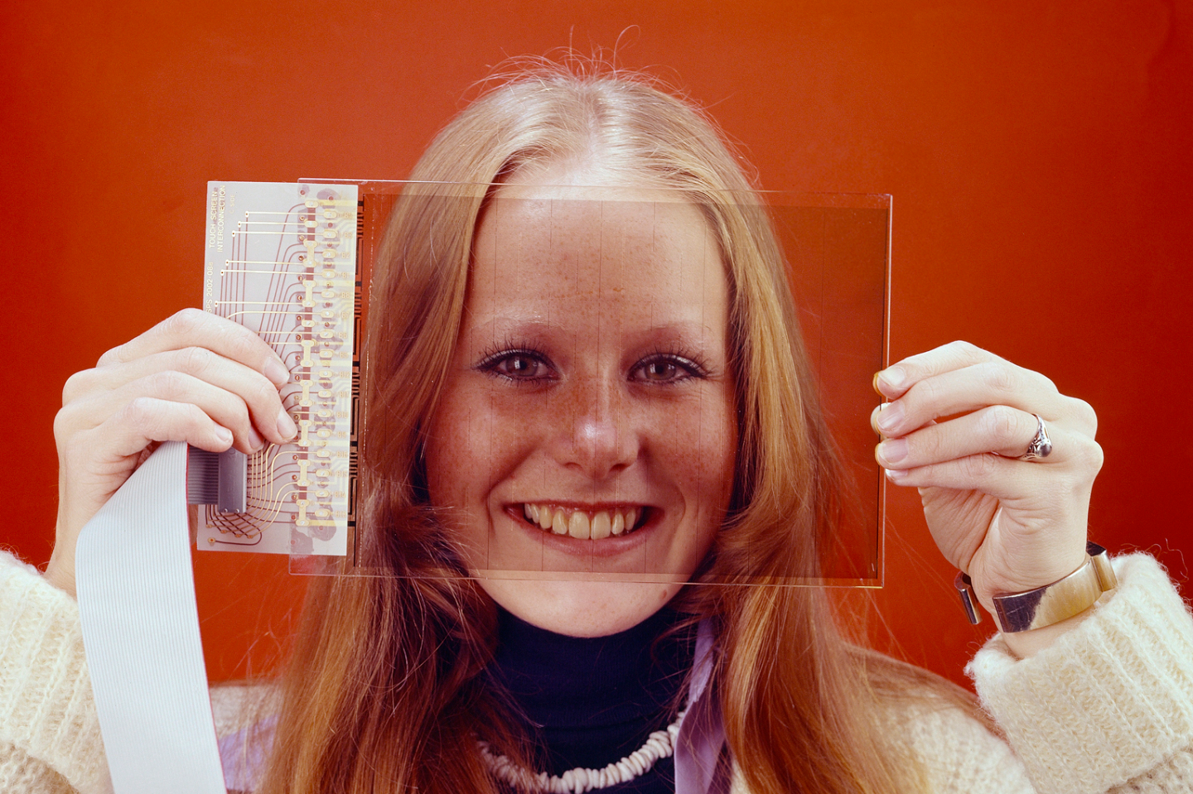
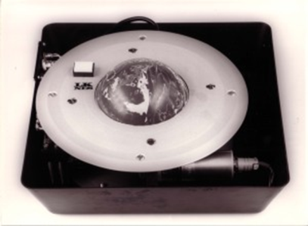
Did you know?

Slide 7
KT Mission
Maximize the technological and knowledge return to society, in particular through Member States industry
Promote CERN’s image as a center of excellence for technology and innovation
Demonstrate the importance and impact of fundamental research investments
Key words are dissemination and impact

Slide 8
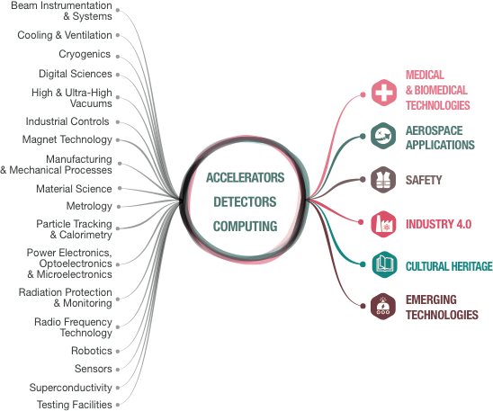
From CERN Technologies …
… to Society
Notes:
CERN’s mission extends beyond science: it also aims to advance the frontiers of technology, to train the next generation of scientists and to bring nations together. The transfer of CERN technologies and know-how to society – grouped under the concept of Knowledge Transfer – is an integral part of each of these activities.

Slide 9
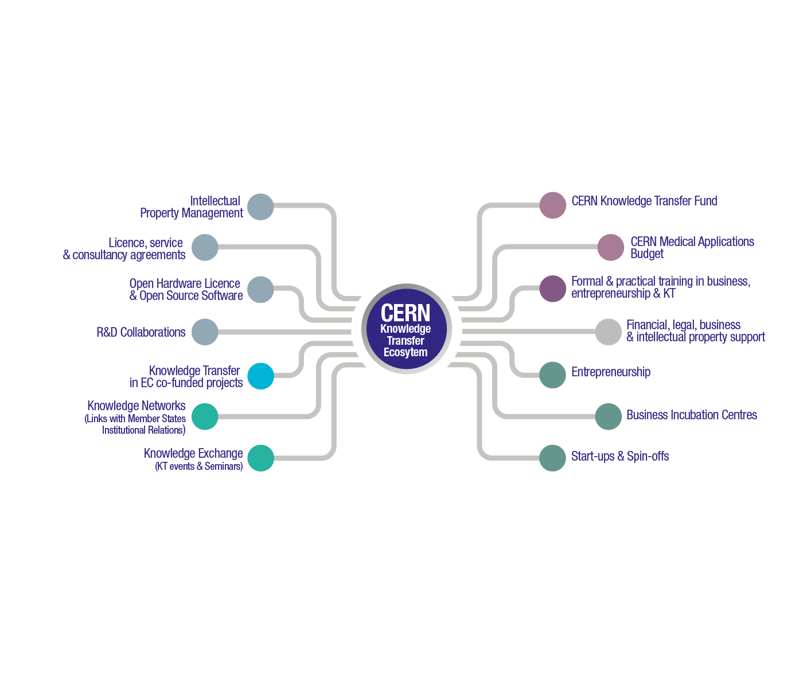
Notes:
This slide needs to be updated

Slide 10
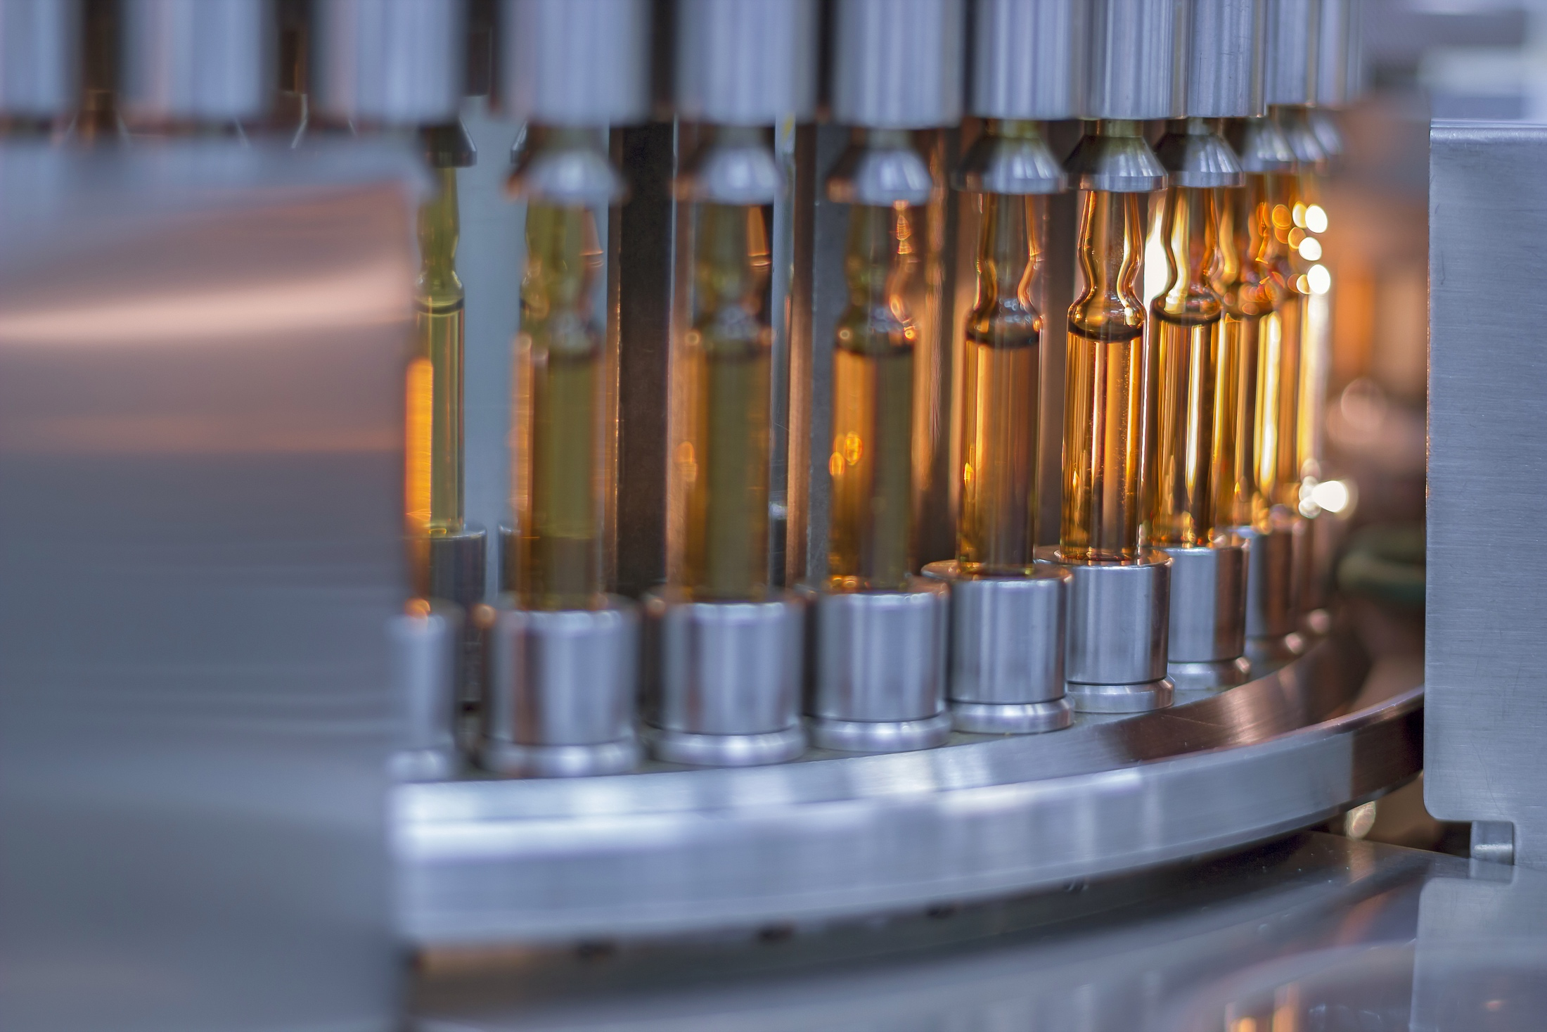
“How can machine learning improve vaccine production?”
CERN - Sanofi
Notes:
Example 1 - Medtech
CERN experts train Sanofi in machine learning - potential application in their vaccine production
Training was in 2017

Slide 11
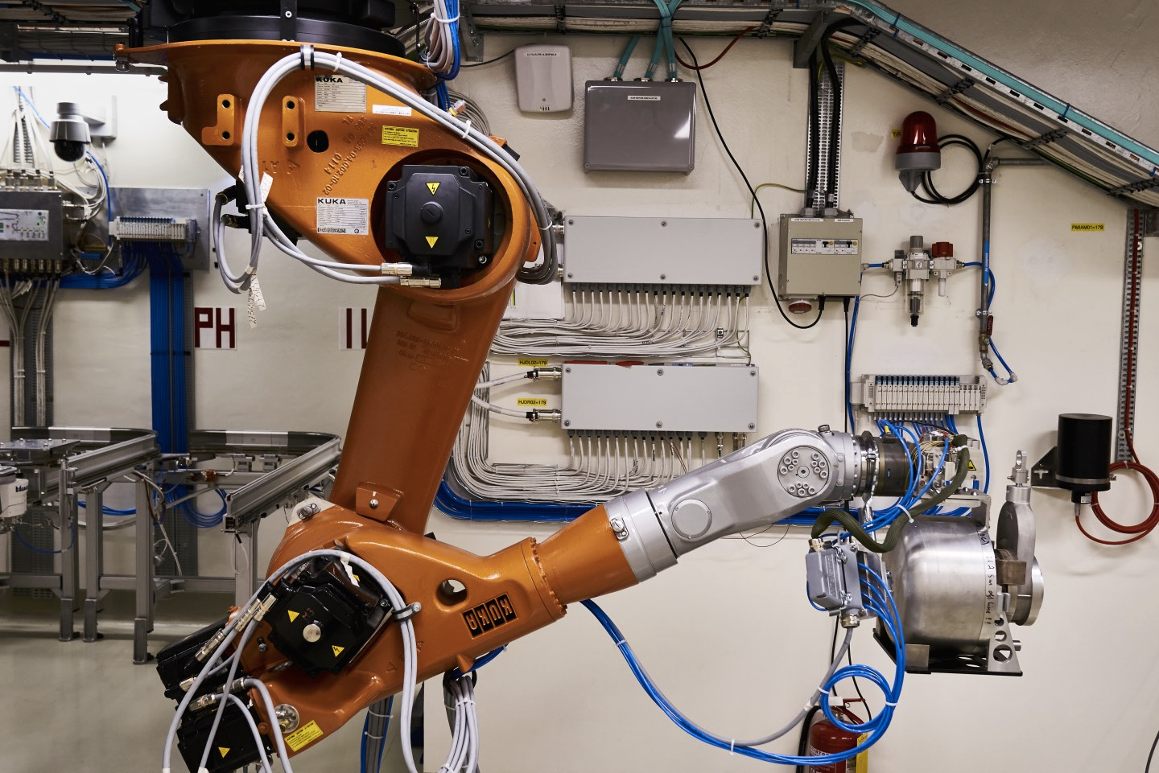
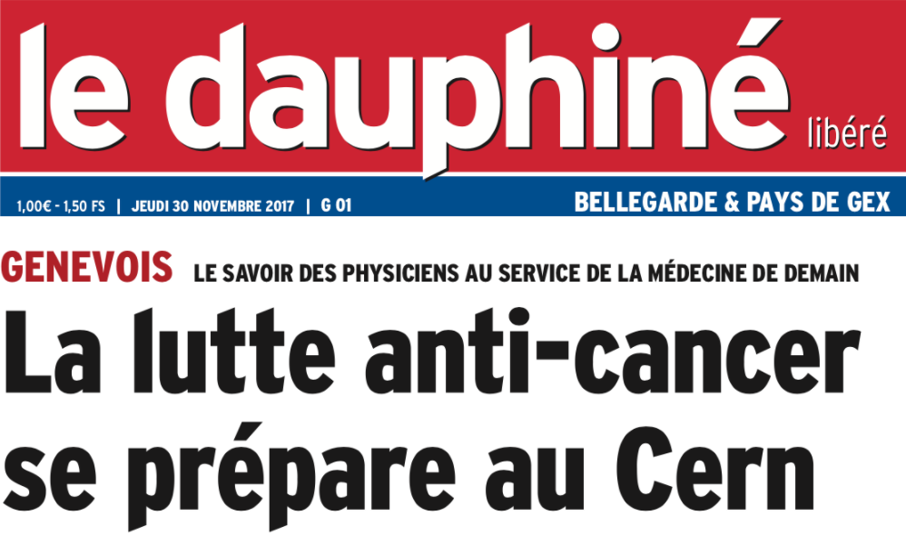
CERN-MEDICIS
First medical isotopes produced

Slide 12
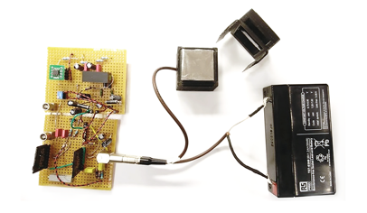
Neasens -
A start-up to tackle radon gas risk

Slide 13
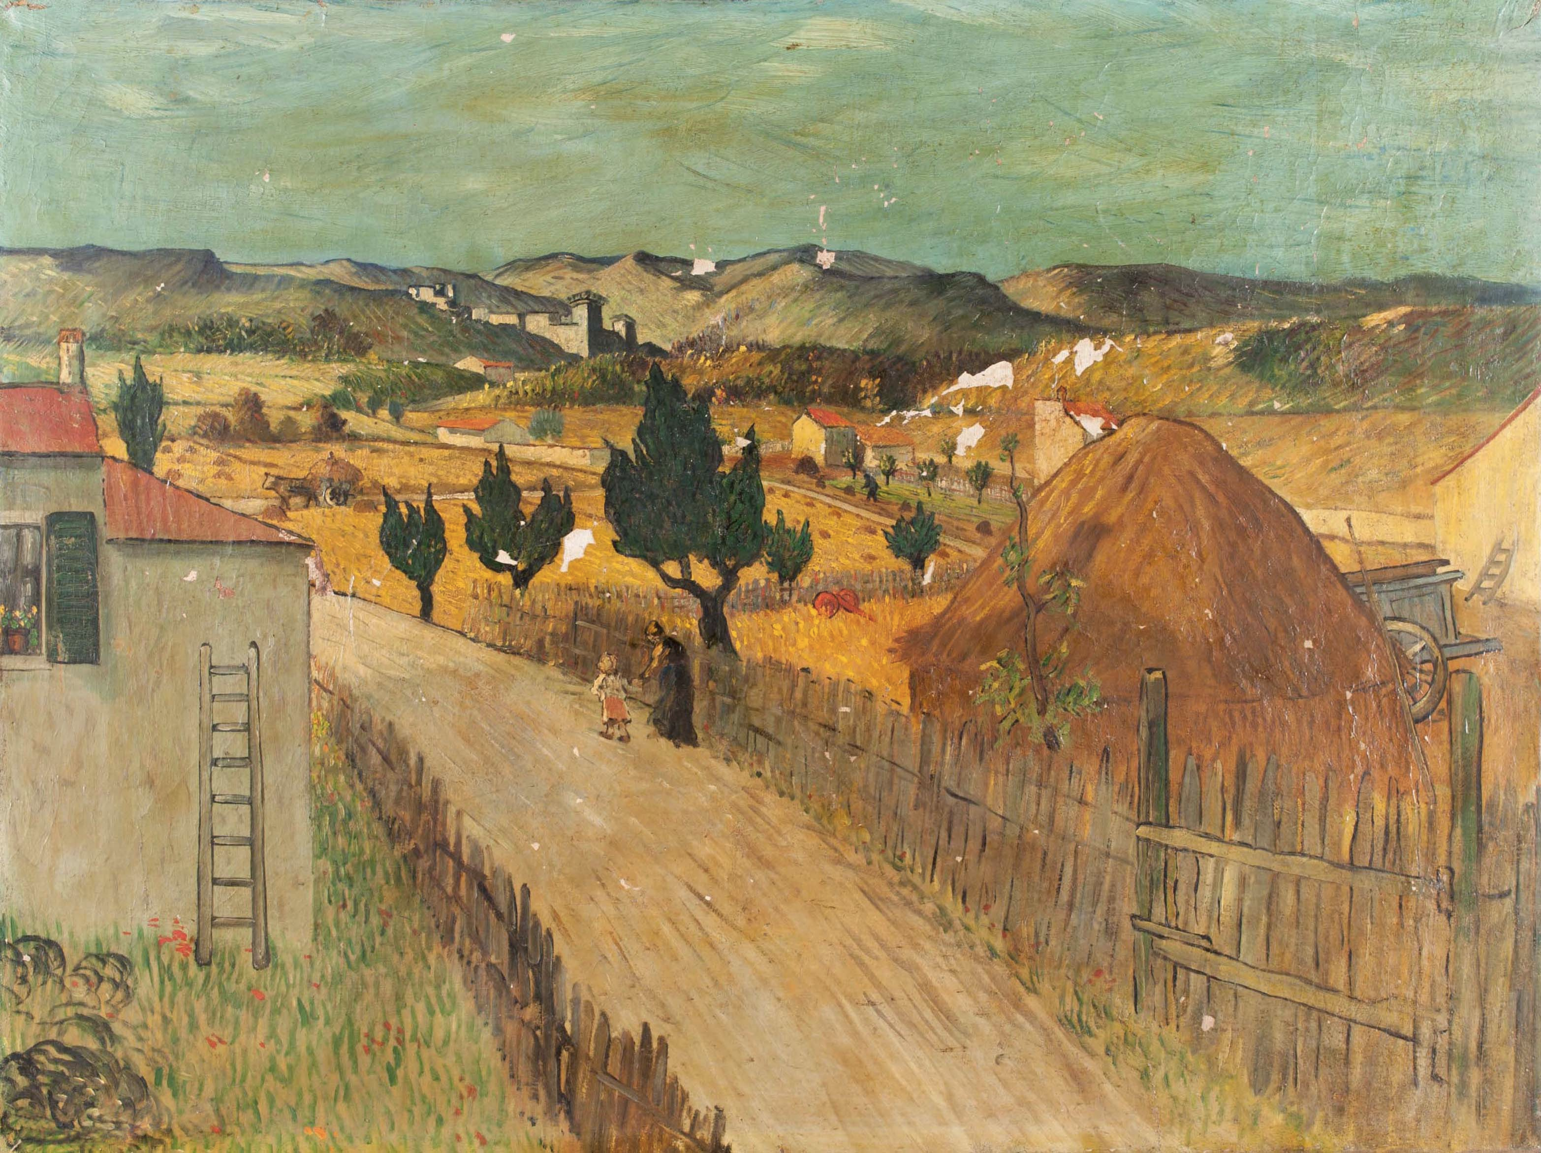
#EuropeForCulture
X-ray eyes for cultural heritage - Medipix chip
Notes:
#EuropeForCulture = because 2018 is the European Year for Cultural Heritage.
Note: Cultural Heritage is defined as: “Cultural heritage takes many forms: from the tangible legacy of monuments, artwork and books, to digital resources, either newly created or used to ensure cultural preservation. The concept also includes intangible (such as language and oral traditions) and natural elements (such as flora and fauna). This heritage may seem remotely connected to CERN's technological advances, yet the opposite is true: in 2018, several projects related to art restoration and digital preservation are using CERN technology.”

Slide 14
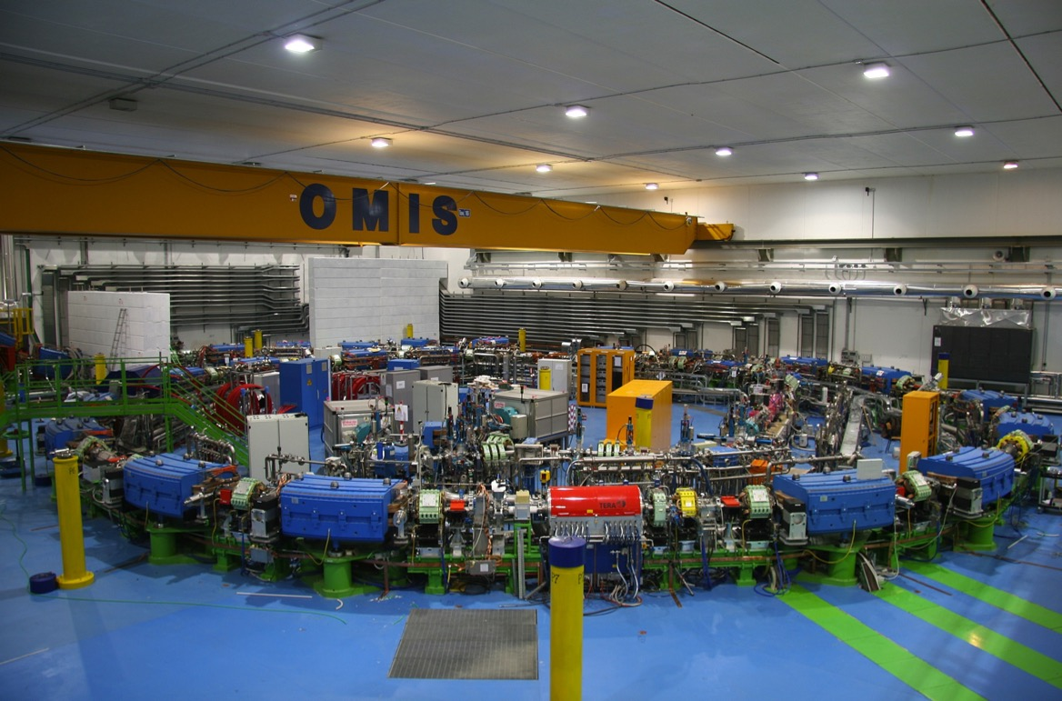
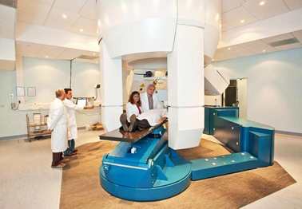

Slide 15
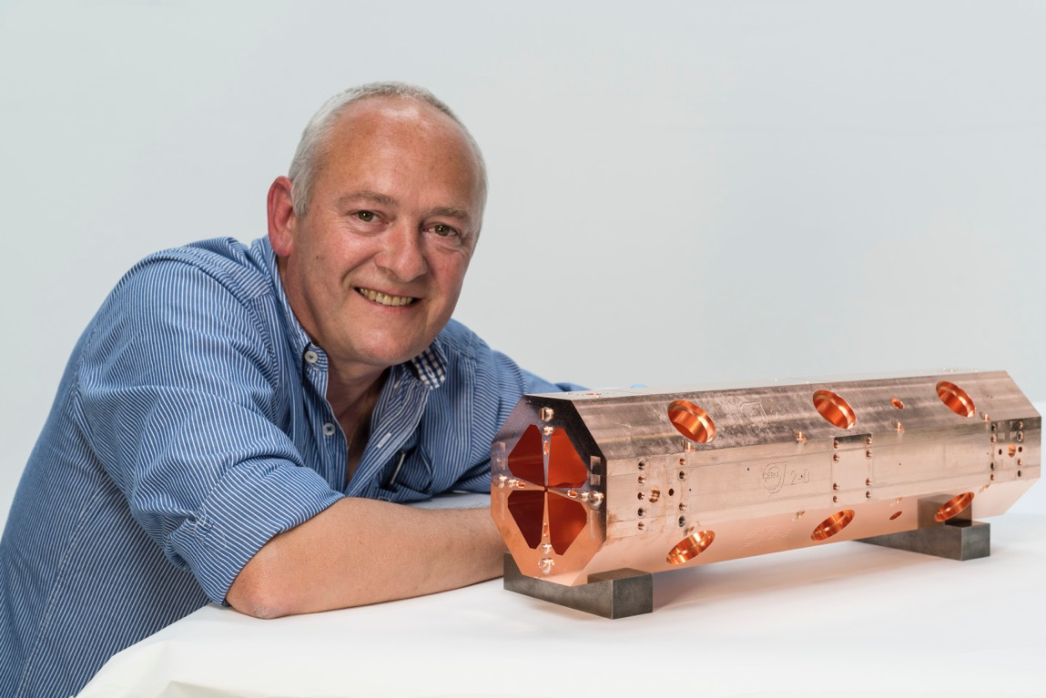

Slide 16
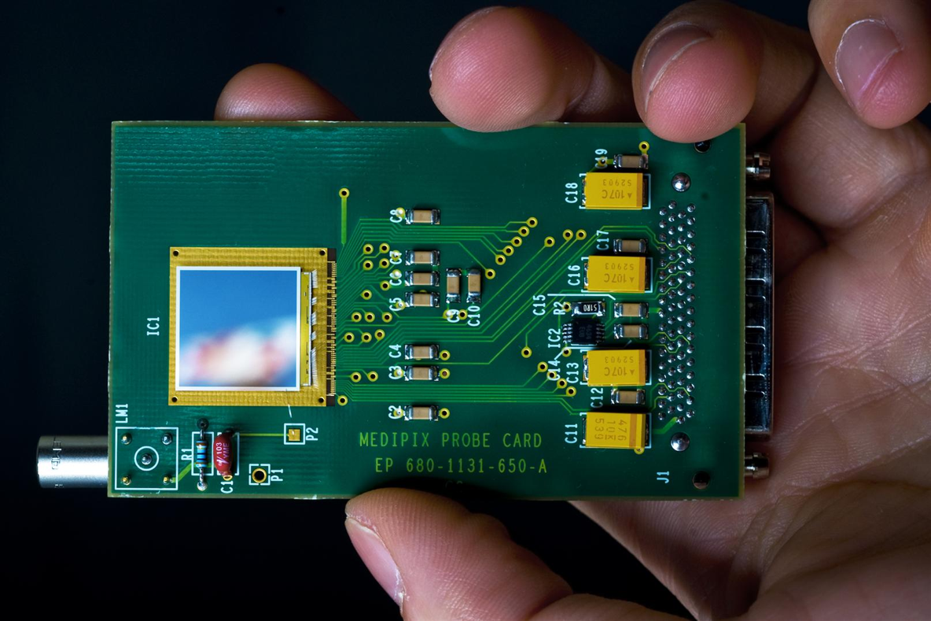

Slide 17
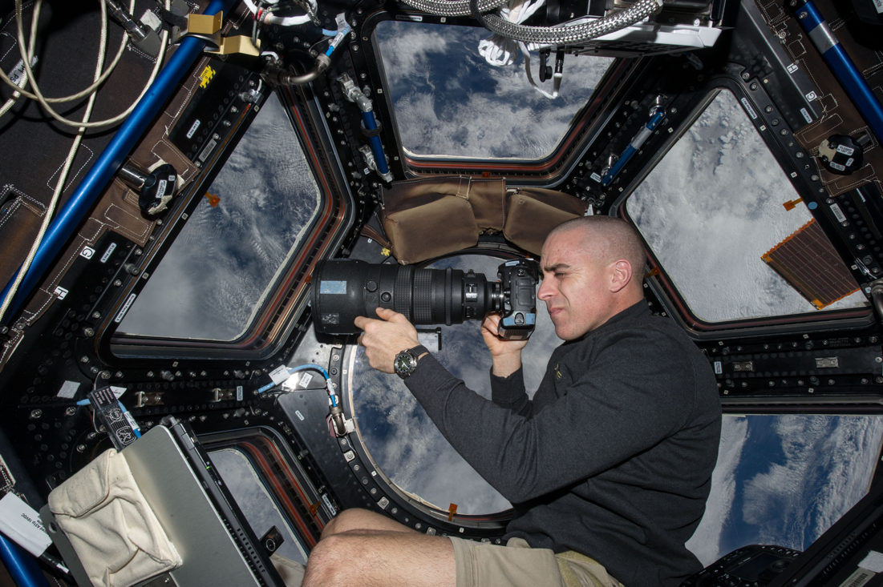

Slide 18
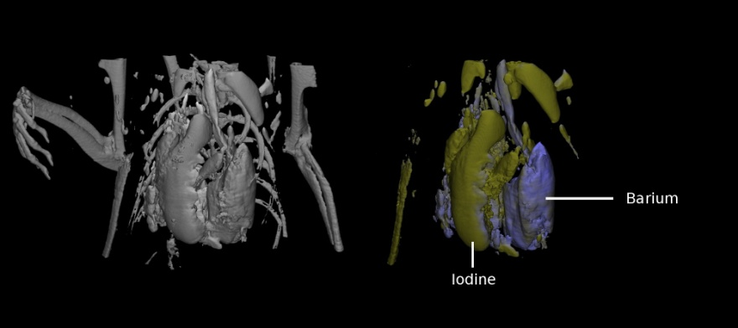
(courtesy of MARS Bioimaging Ltd)

Slide 19
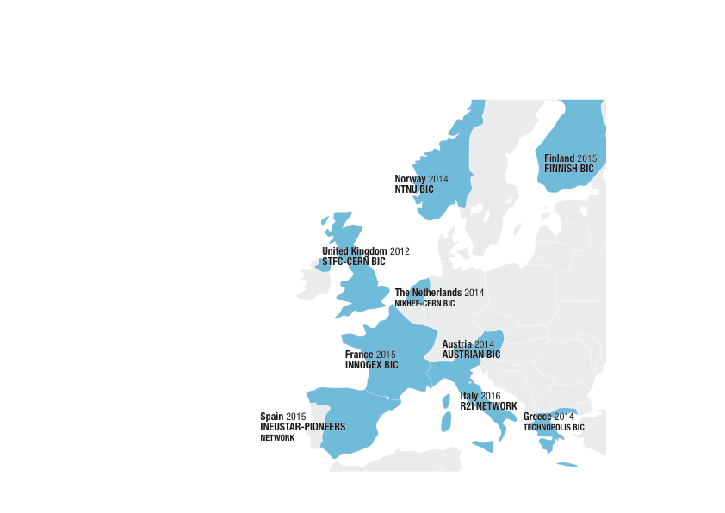
CERN BICs
CERN Network of 9 Member State Business Incubation Centres

Slide 20
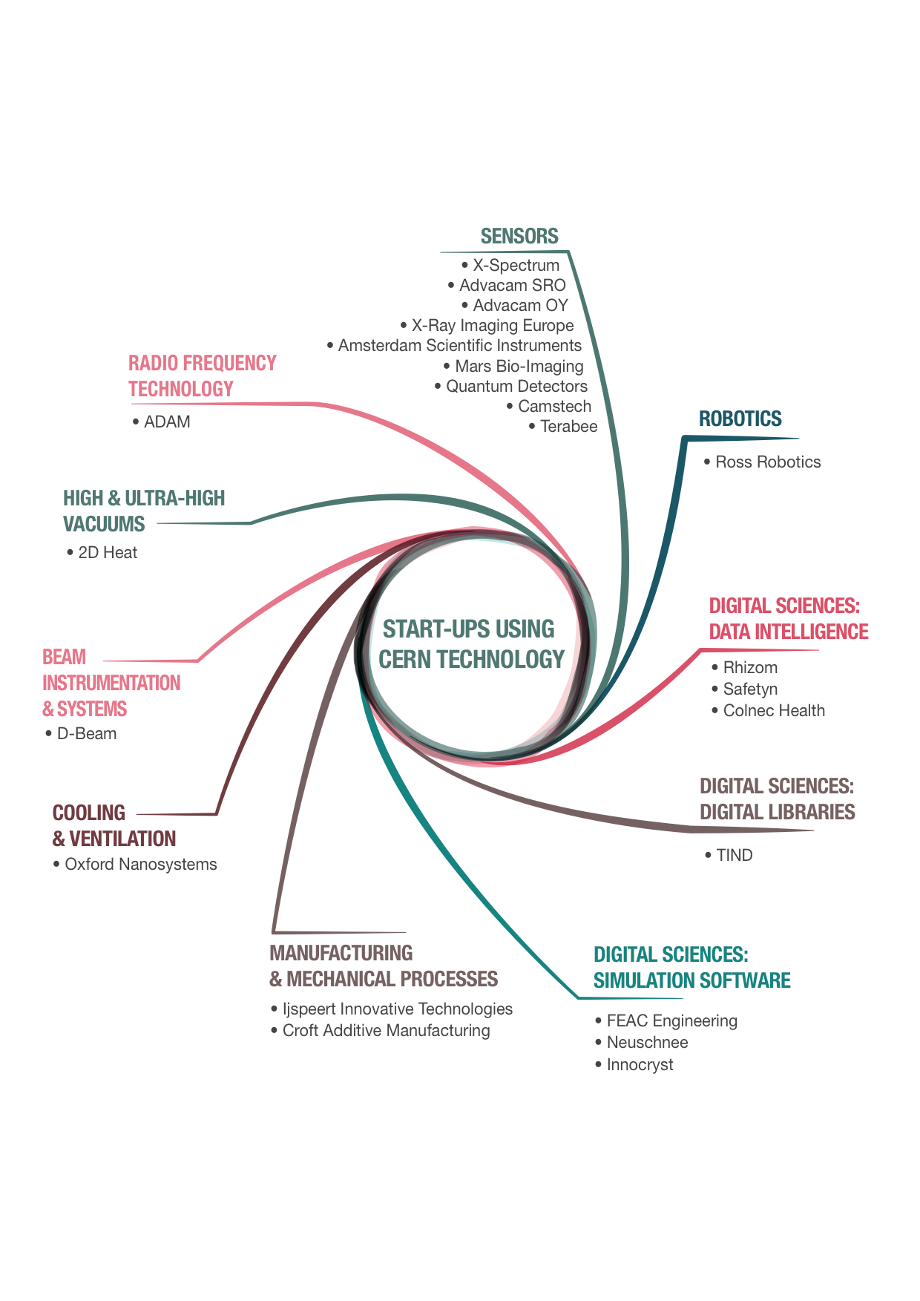
Notes:
Stats = currently 23 start-ups using CERN technology.
Fields from medtech to aersopace, and from industry 4.0 to cultural heritage.

Slide 21
Many thanks for your attention

