Slide 1


Insights from building DIXIT
Piergiorgio Cerello

Slide 2

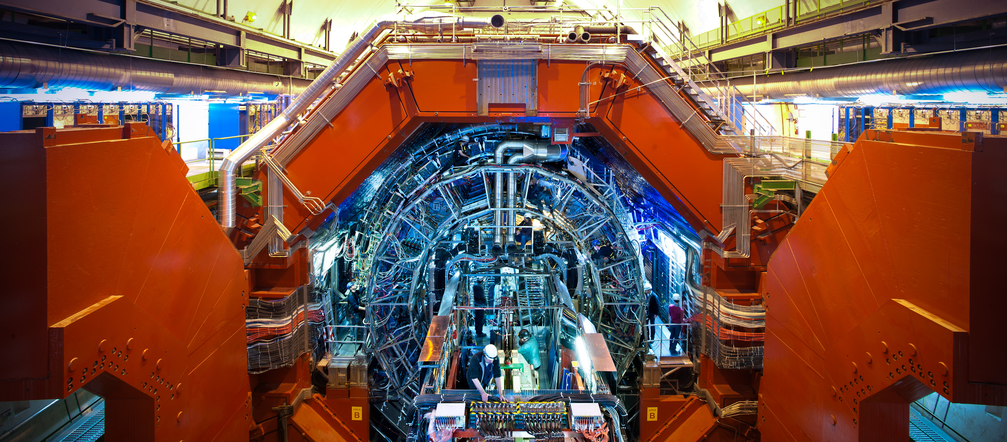
Why am I here?

Slide 3

Interactive Distributed Analysis for Medical Images
IEEE 2006
Why am I here?
San Diego, Nov 1st, 2006
P. Cerello (INFN – Torino)
on behalf of the MAGIC-5 Collaboration
cerello@to.infn.it

Slide 4
Screening
IEEE 2006
San Diego, Nov 1st, 2006
Data Collection Centre
Diagnostic Centre
GRID
Service
Provider
Data & MetaData Catalogue
1 - Data
Collection
4 - Transfer
Selected Data
3 - Run CAD
remotely
5 - Interactive
Diagnosis
GRID
Service
Provider
2 - Data Registration
CAD selection to minimize data transfers

Slide 5

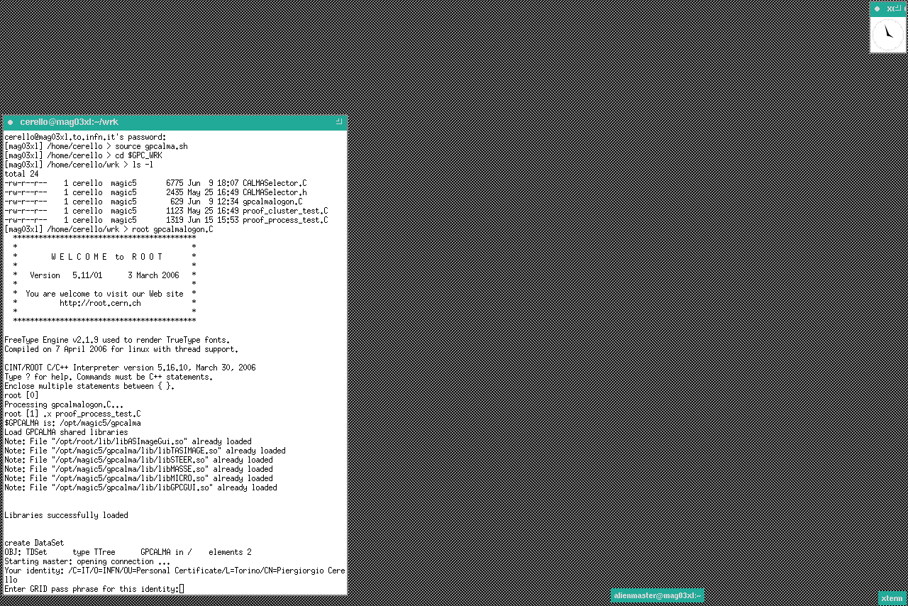
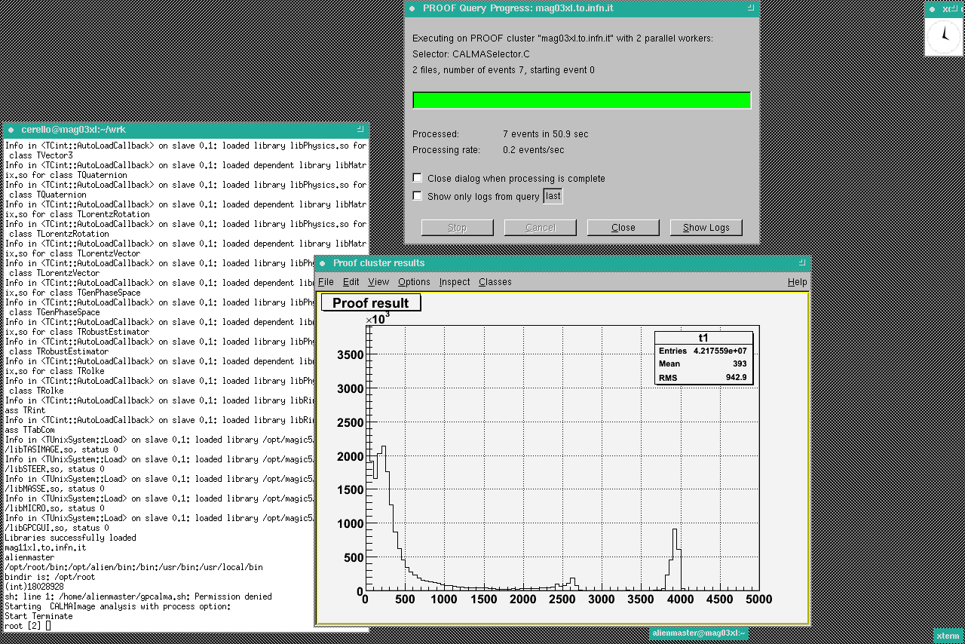
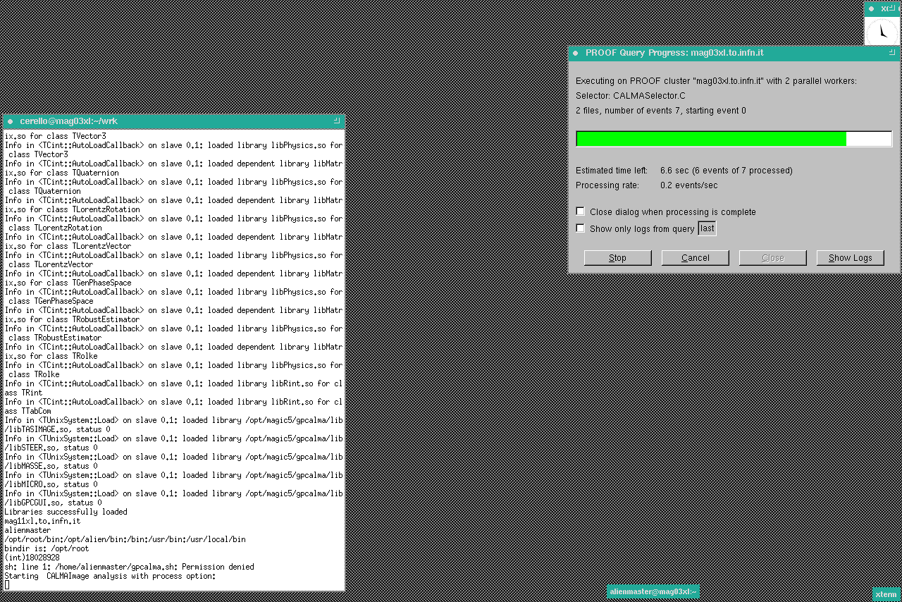
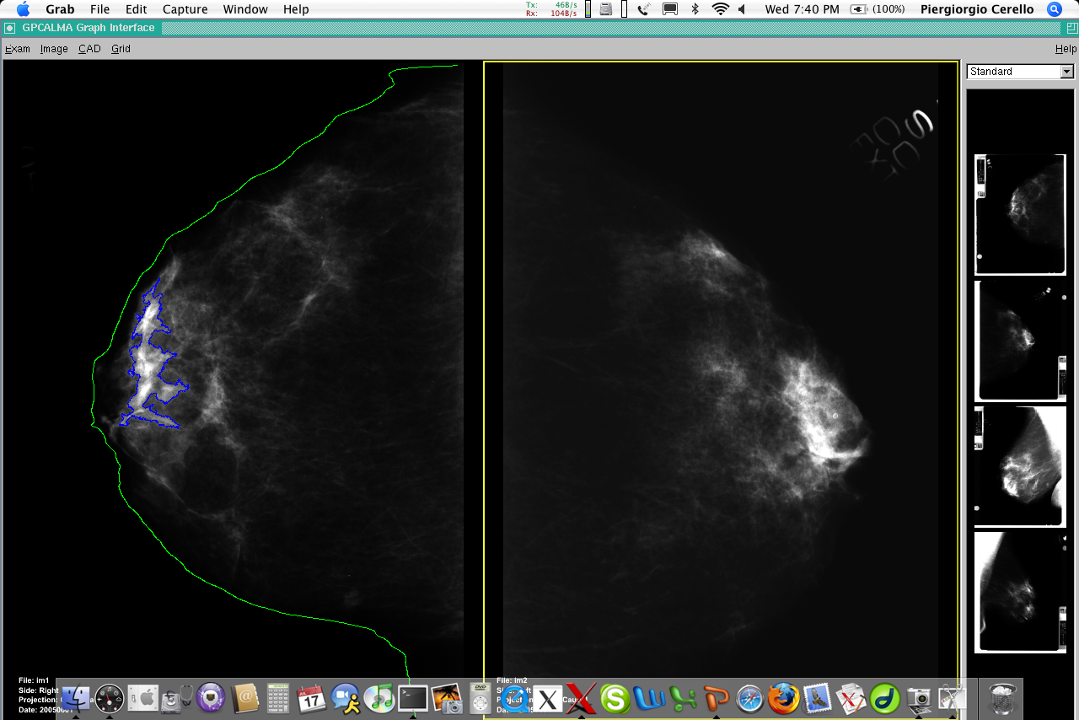
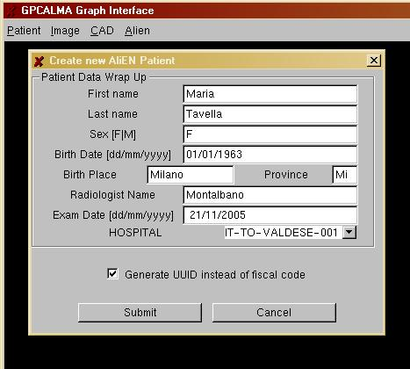
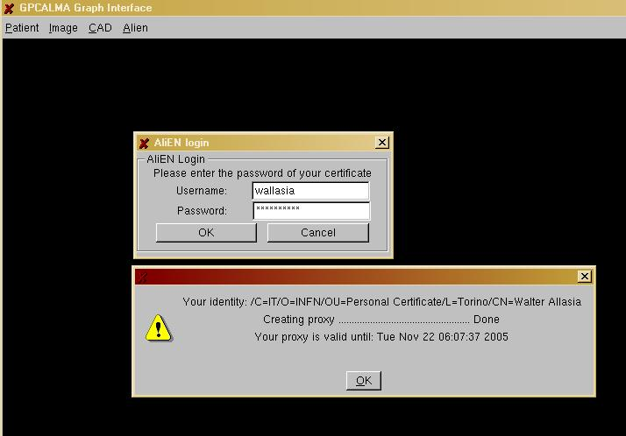
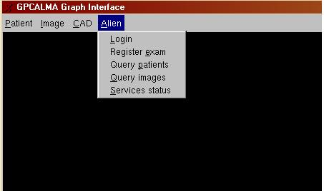
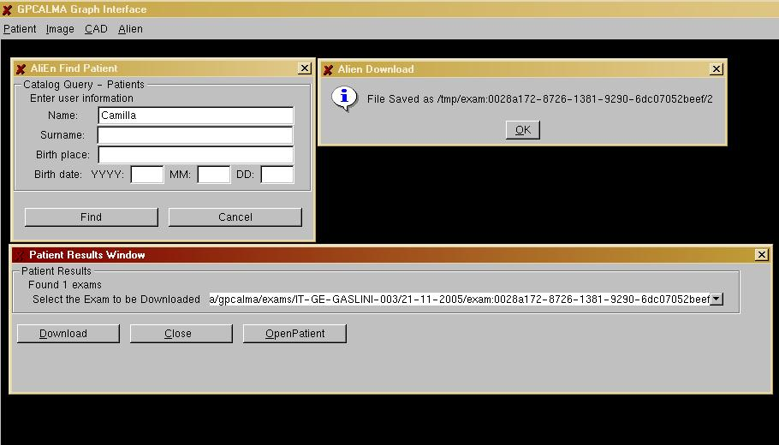
Start PROOF Cluster
GSI Authentication Required
The MAGIC-5
GUI to Grid Services
Query on Patient Data
Find (& Retrieve) Exams
PROOF Cluster - End of Task
Display (or Save) Results
Register a new Exam
in the Data Catalogue
Working PROOF Cluster
Ongoing Analysis
Analysis Station
Login: User Authentication
Send CALMASelector.C code
for distributed interactive execution
using the CINT Interpreter
The MAGIC-5 Mammogram Analysis Station

Slide 6
Medical Imaging in a trial?
PETcentre of the GITIL Institution
PET-2 + PET-0
Imaging-adapted therapy
Central panel for PET reviewing (CP)
Reviewer 1
Reviewer 2
Reviewer 3
Reviewer 4
Reviewer 5
Reviewer 6
Reviewer 7
Reviewers accept review
the HD0607 protocol
Pos./ neg.
Pos./ neg.
Pos./ neg.
Within 3 working days
Central Data Center (CDC)
PET-2 positive or negative
Clinical Centre (CC) GITIL

Slide 7
What is a clinical trial?
Clinical trials are research studies that test how well new medical approaches work in people. Each study answers scientific questions and tries to find better ways to prevent, screen for, diagnose, or treat a disease.
Clinical trials may also compare a new treatment to a treatment that is already available.
  https://medlineplus.gov/clinicaltrials.html

Slide 8
Medical Imaging in a trial?
PETcentre of the GITIL Institution
PET-2 + PET-0
Imaging-adapted therapy
Central panel for PET reviewing (CP)
Reviewer 1
Reviewer 2
Reviewer 3
Reviewer 4
Reviewer 5
Reviewer 6
Reviewer 7
Reviewers accept review
the HD0607 protocol
Pos./ neg.
Pos./ neg.
Pos./ neg.
Within 3 working days
Central Data Center (CDC)
PET-2 positive or negative
Clinical Centre (CC) GITIL

Slide 9
The early days (2007-2011)
How to implement the HD0607 protocol?
Design choice: WEB service
  Put together a development team
  Develop a β-version of the service
  Gather feedback on the design and the functionality
  Run 4 trials

Slide 10
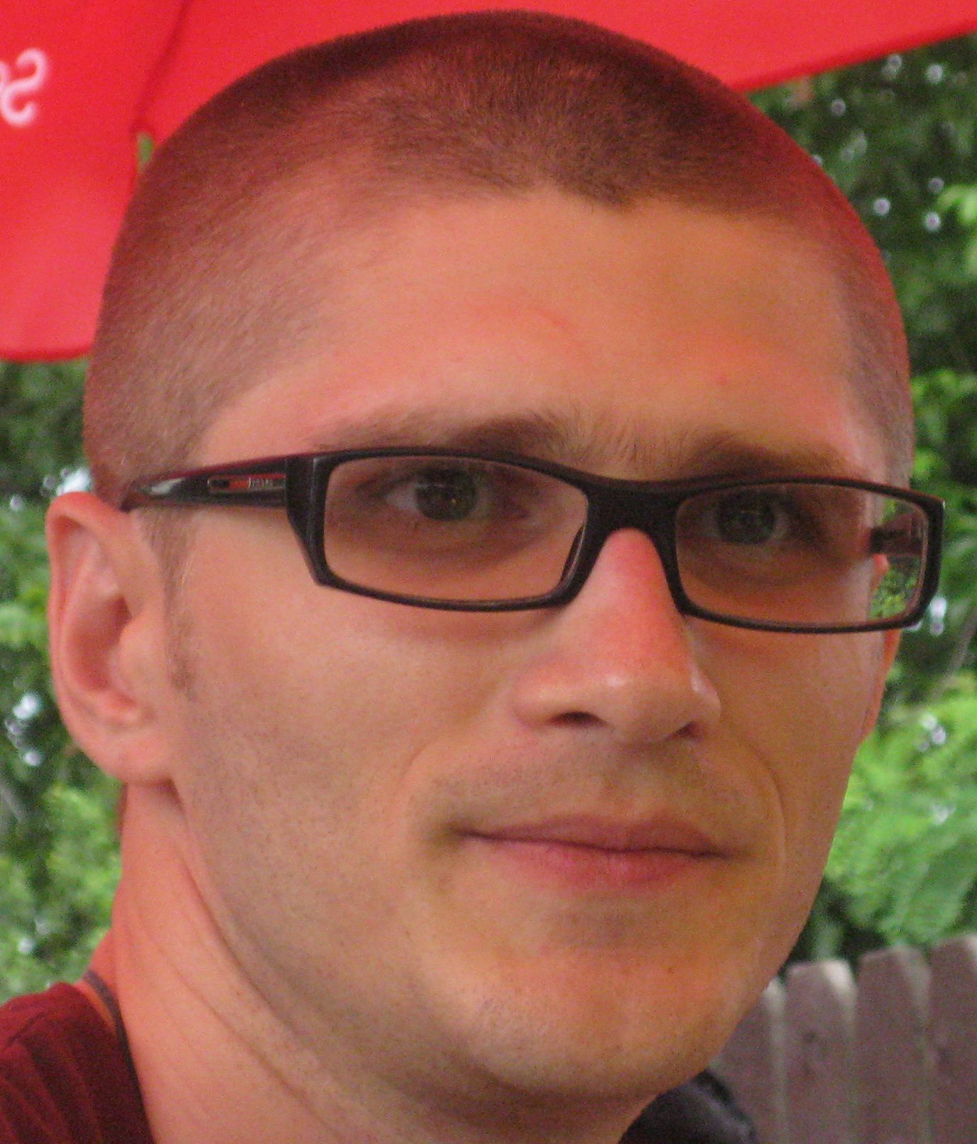
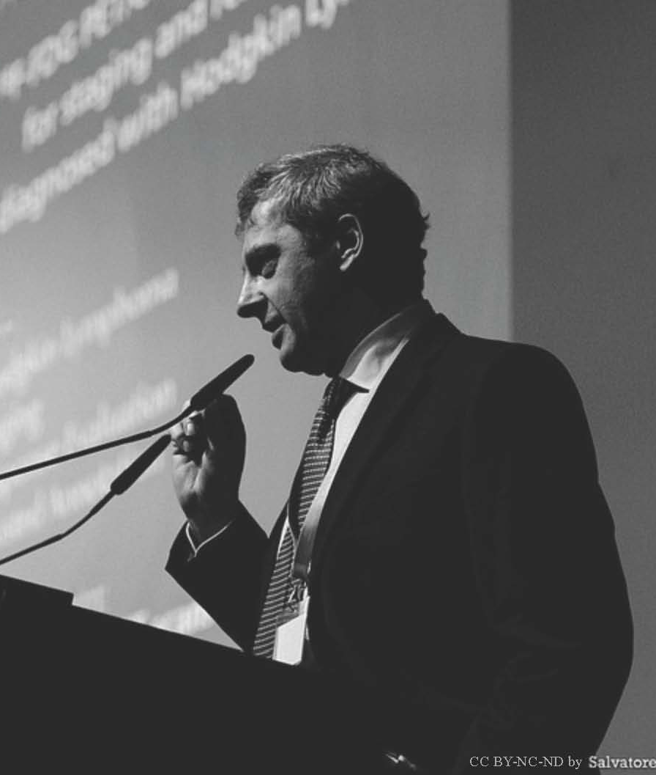
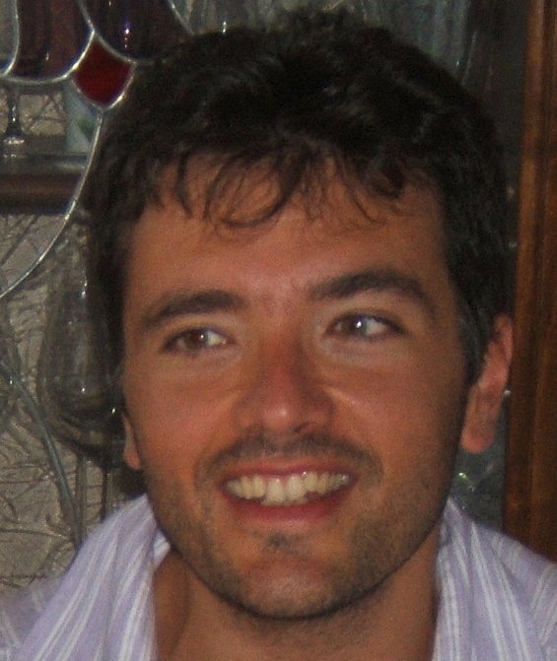
The team
Advisers
Alexandru Stancu, CEO
10+ years of SW development
1 start up
Piergiorgio Cerello, co-founder
Senior Researcher at INFN, Torino, IT
20+ years of SW development
15+ years in Medical Physics
Stephane Chauvie, co-founder
Head of Medical Physics Unit,
S. Croce e Carle Hospital, Cuneo, IT

Slide 11
www.widen.it

Slide 12
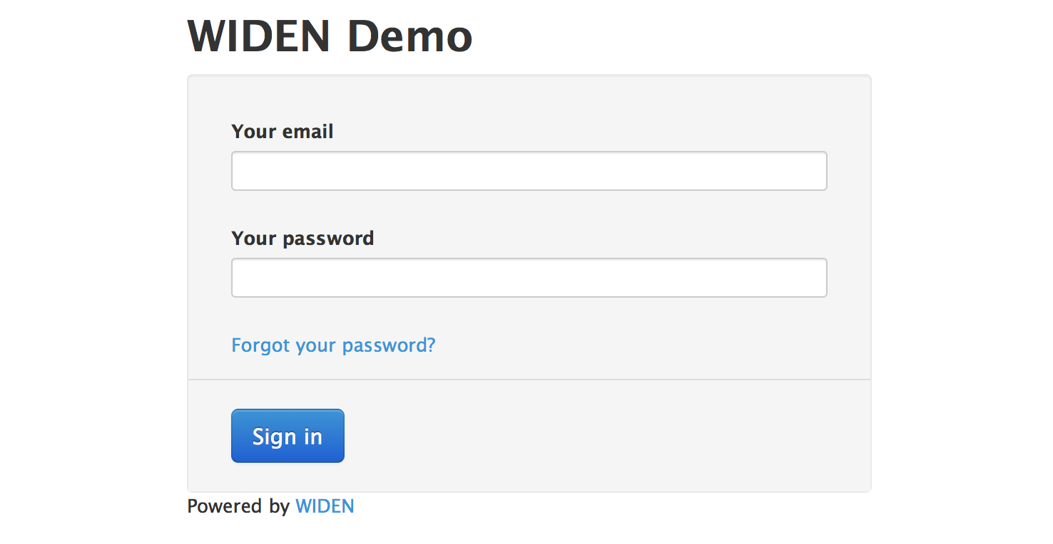

Slide 13
DIXIT s.r.l. March 2011
Contact the University of Torino Business Incubator…
… and discover another world
“Write a business plan… and prepare a pitch”
  https://www.youtube.com/watch?v=FTttlgdvouY
How do you interact with a potential Investor?
  ISP2013

Slide 14
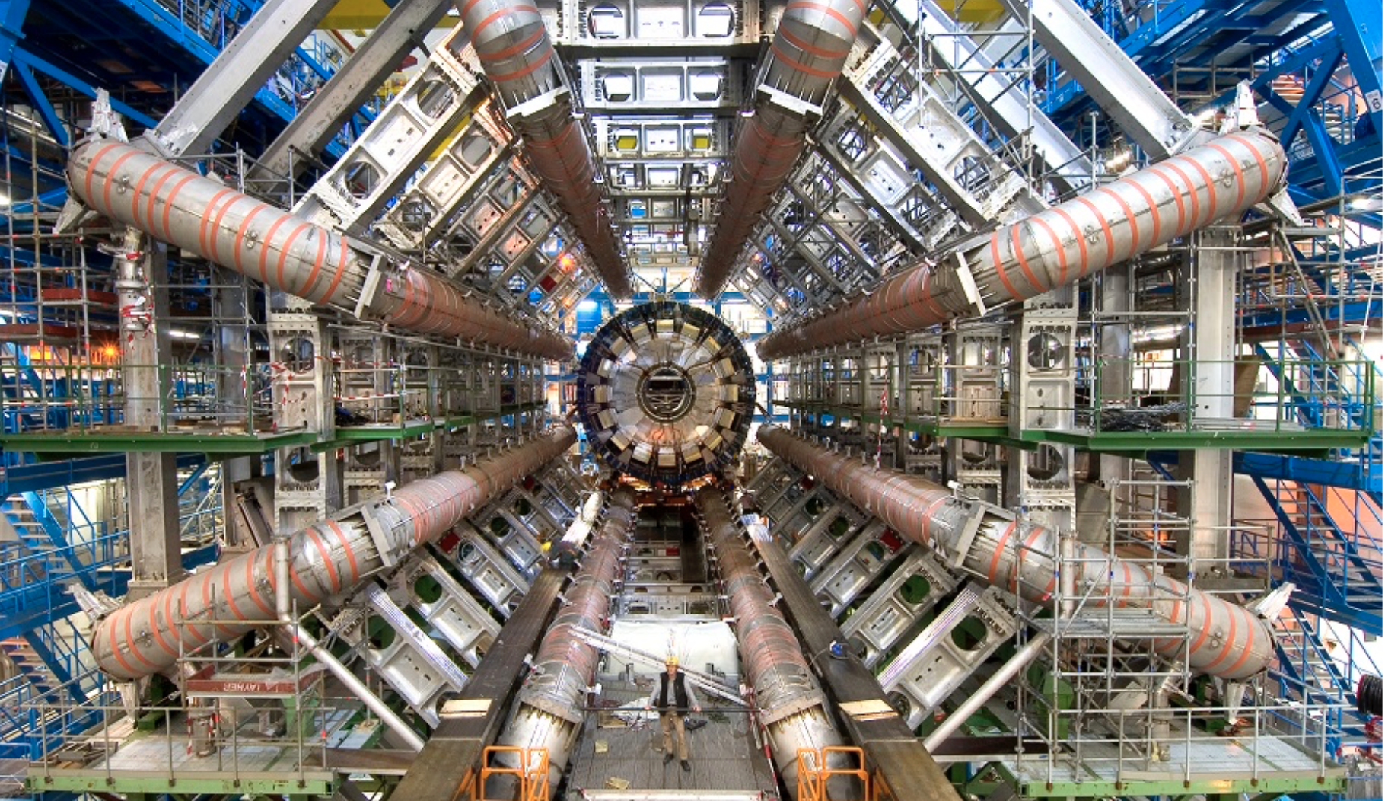
Lessons learnt: who we are

Slide 15
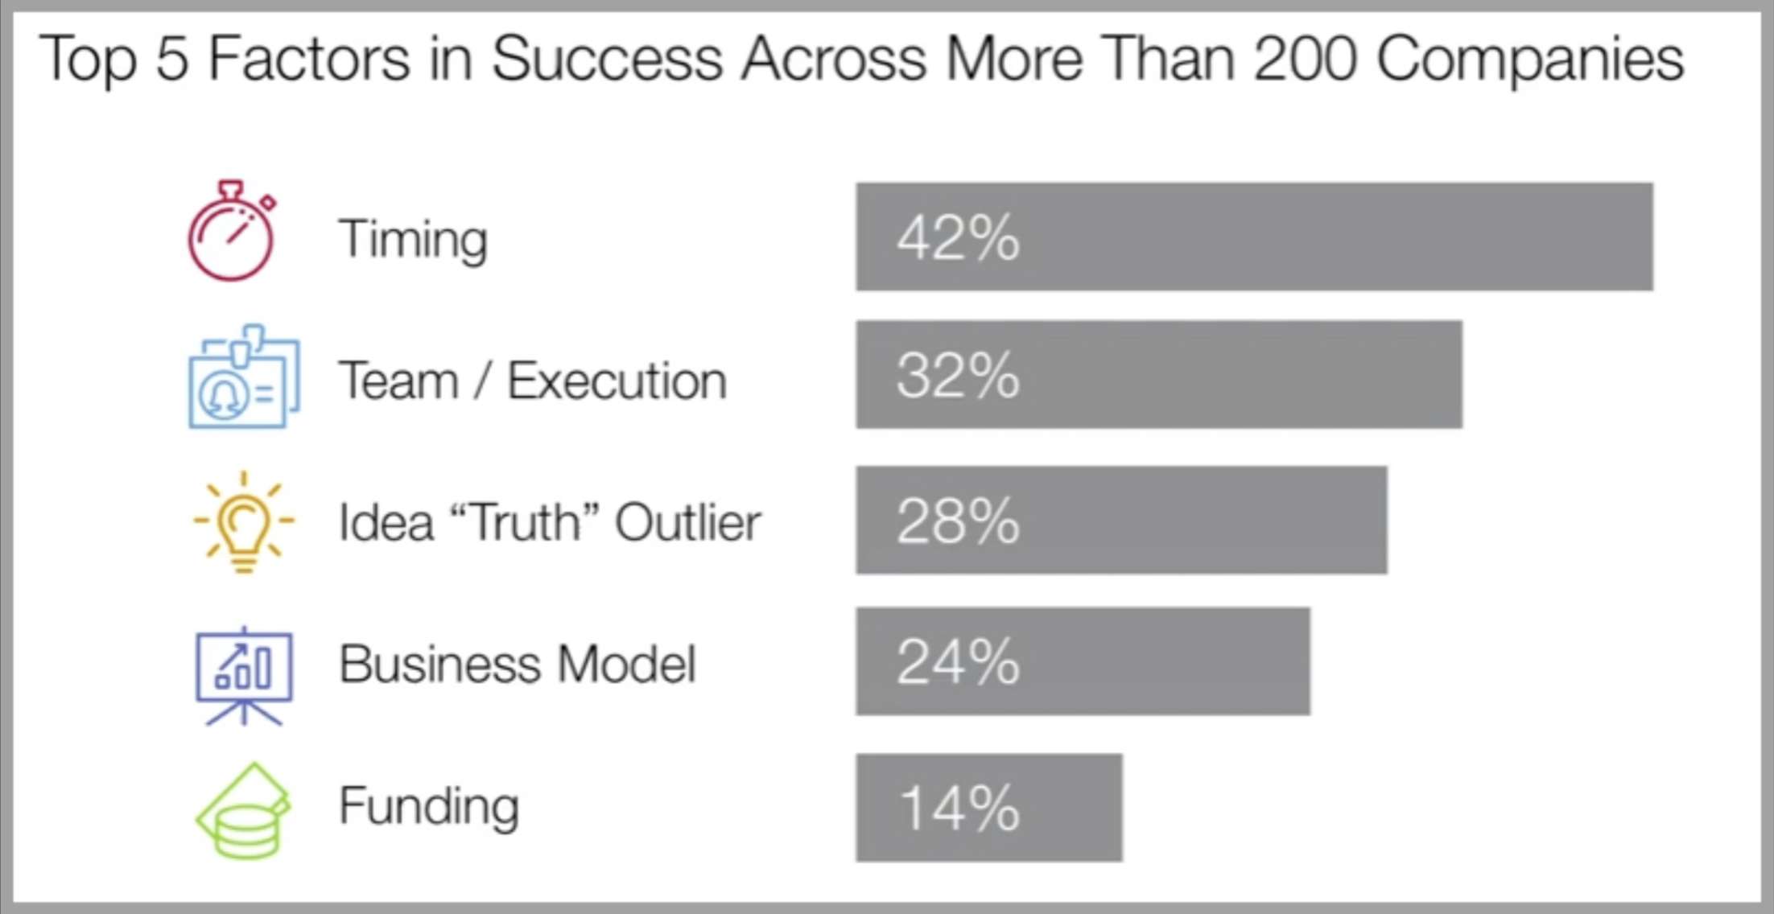
Lessons learnt: funding

Slide 16

Lessons learnt: the team

Slide 17

Lessons learnt: marketing

Slide 18
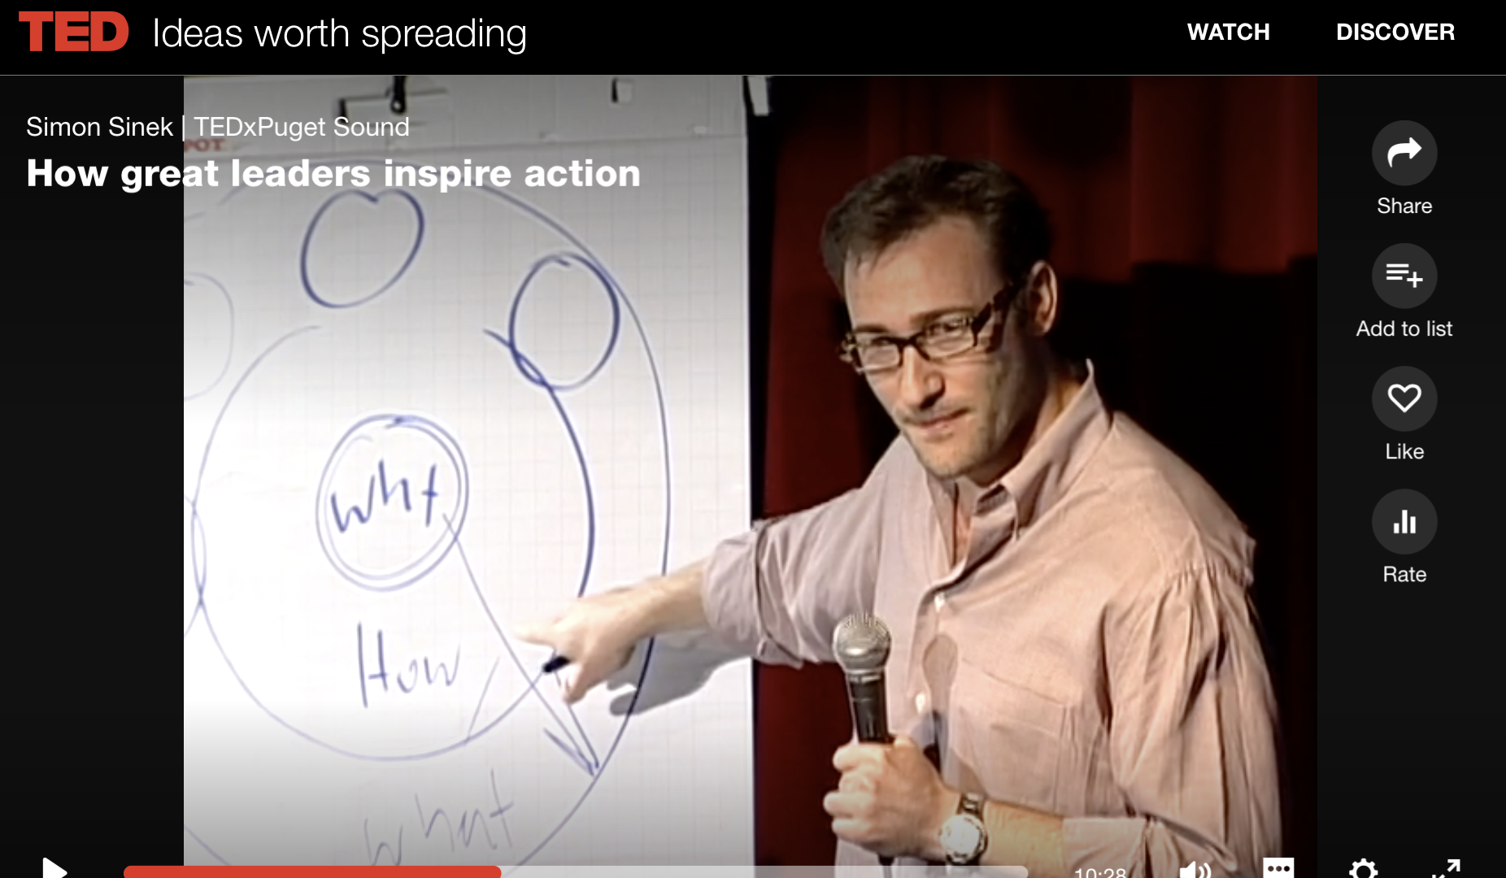
Lessons learnt: marketing

Slide 19

Lessons learnt: the exit strategy
Scale up the company ? Sell the prototype

Slide 20
Lessons learnt: how much resilience?

Slide 21

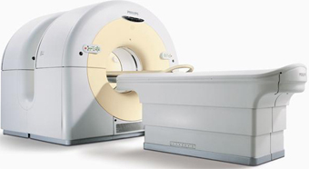
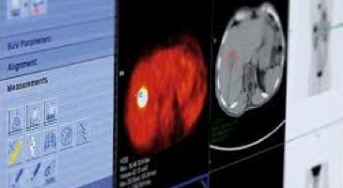
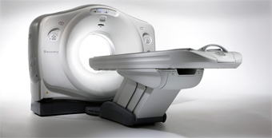
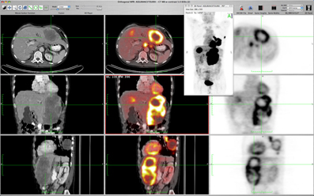
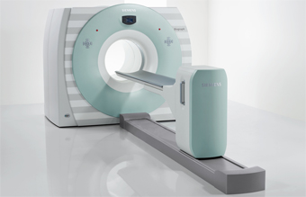
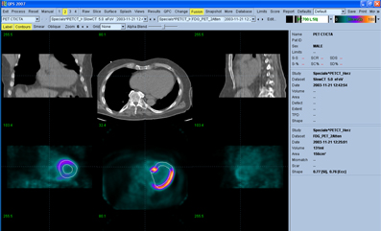
Trial Workflow
Real-time
SCANNERS OR
WORKSTATIONS
PANEL
OF REVIEWERS
Custom Configuration
Workflow
Quality Control

Slide 22
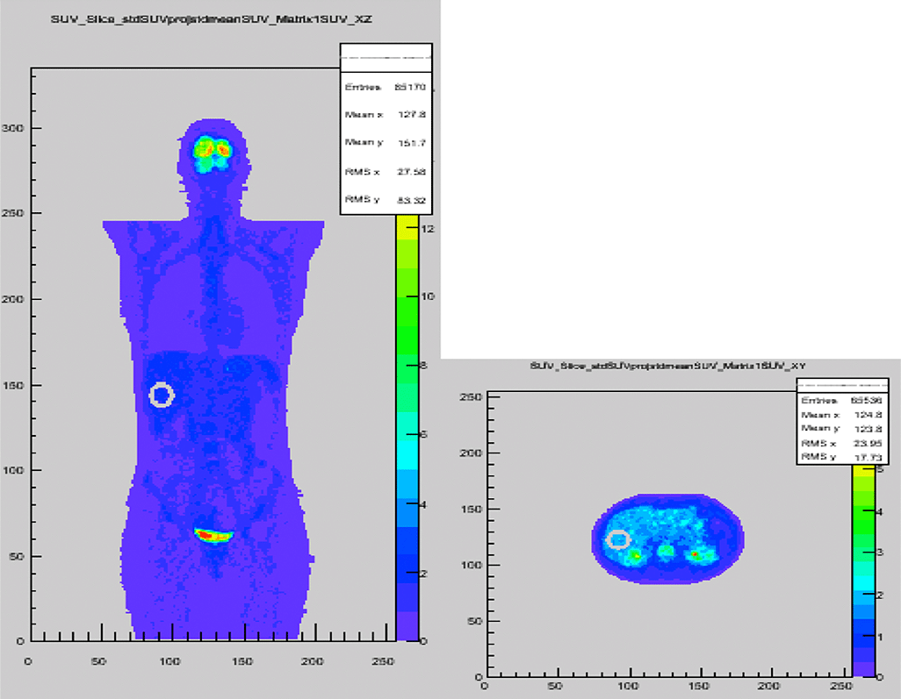
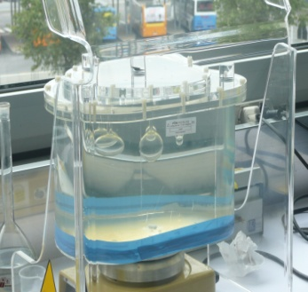
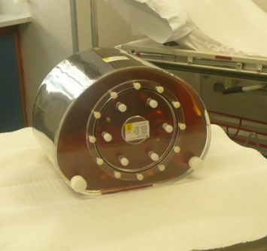
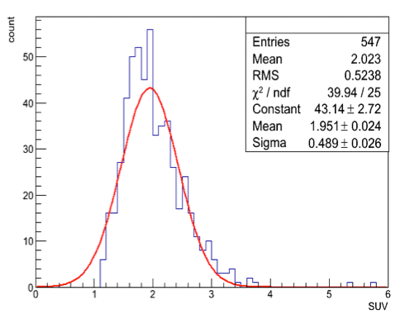
Quantitative PET
Quality Control
Liver-based SUV validation
Plug & Play PET Phantom
PCT Patent Pending
PCT Patent Pending
¹⁸F
⁶⁸Ge
 | ¹⁸F | ⁶⁸Ge
PET scanners | 63 | 17
Scanner variability | 23.6% | 9.4%

Slide 23
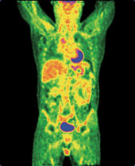
Training
PET in Hodgkin Lymphoma
¹⁸F-FDG PET/CT interpretation criteria for staging and restaging patients diagnosed with Hodgkin Lymphoma
Agreement with ECM provider STAFF
Lectures
  Hodgkin Lymphoma
  Staging
  Response Evaluation
  Assisted Annotation
Interactive Training
  On clinical PET/CT scans
Final test
  On clinical PET/CT scans

Slide 24
Worldwide Presence (2018)
200 CENTERS | 22 COUNTRIES | 5 CONTINENTS

Slide 25
So many mistakes…
Incomplete team
    (marketing & management underestimated)
Business model not well defined
How to set the price?
Undefined exit strategy
but customers stay with us (until now)

Slide 26

High Quality
Quantitative Molecular Imaging
Worldwide
contact@dixitsolutions.com
www.widen.it

