Slide 1
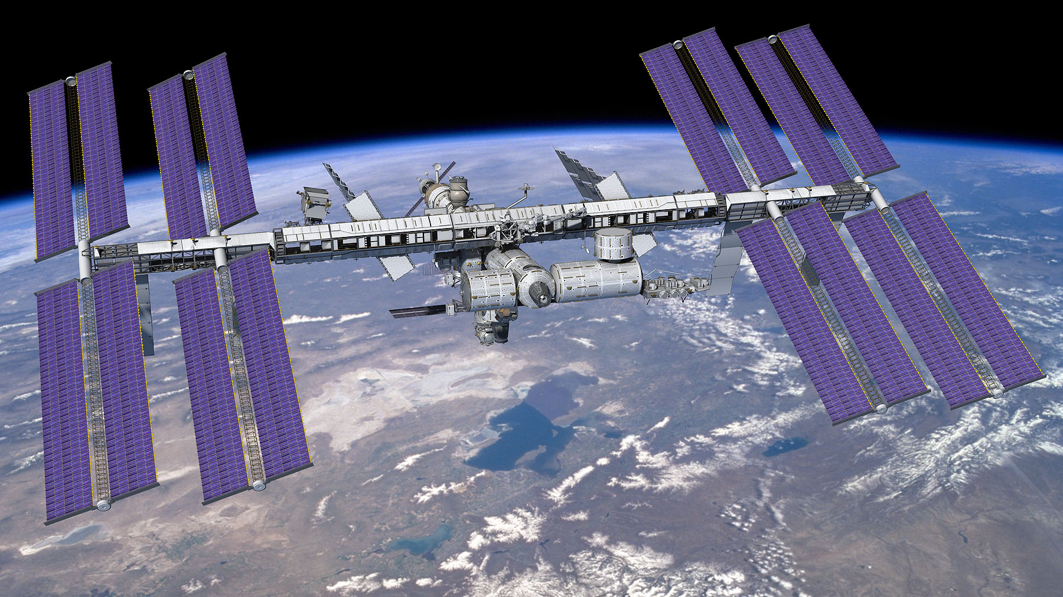
The Alpha Magnetic Spectrometer
on the
International Space Station
AMS
S. Ting

Slide 2
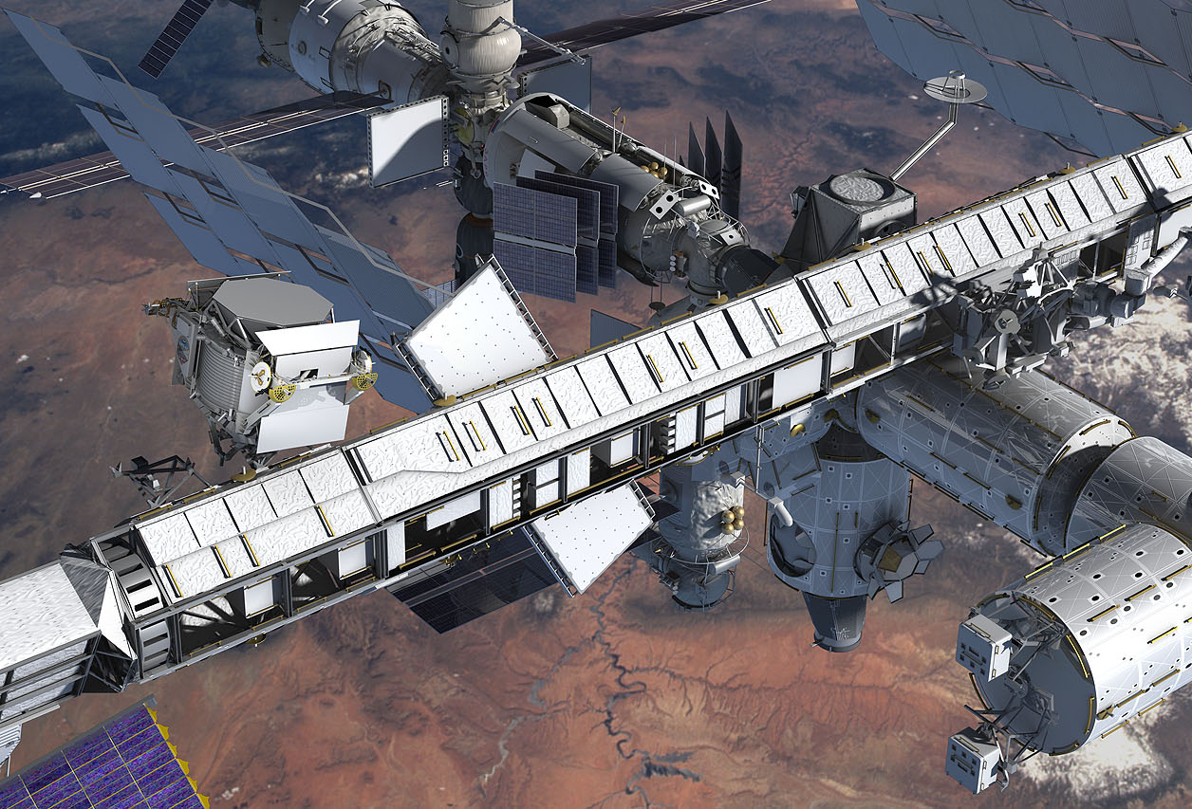
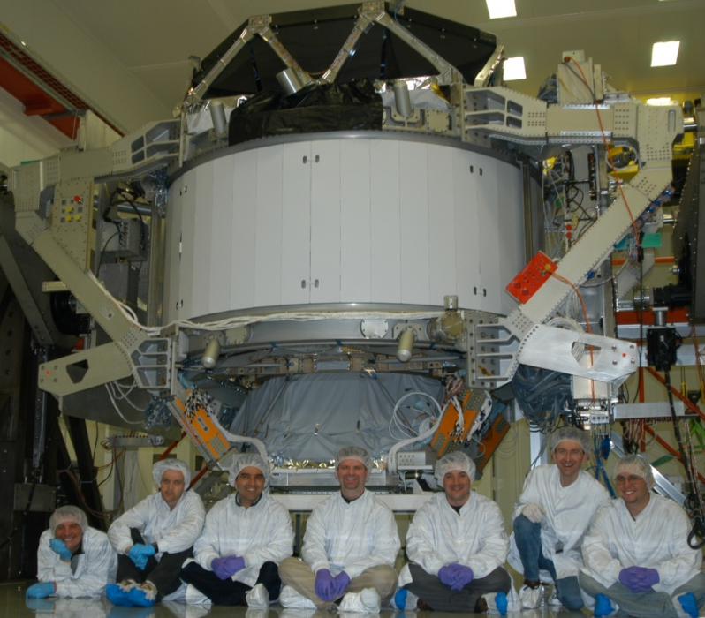
Fundamental Science on the International Space Station (ISS)
There are two kinds of cosmic rays traveling through space
1- Chargedless cosmic rays (light rays and neutrinos):
Light rays have been measured (e.g., Hubble) for over 50 years.
Fundamental discoveries have been made.
2- Charged cosmic rays: An unexplored region in science. Using a magnetic spectrometer (AMS) on ISS is the only way to measure high energy charged cosmic rays.
The major physical science experiment
on the ISS
AMS
AMS

Slide 3
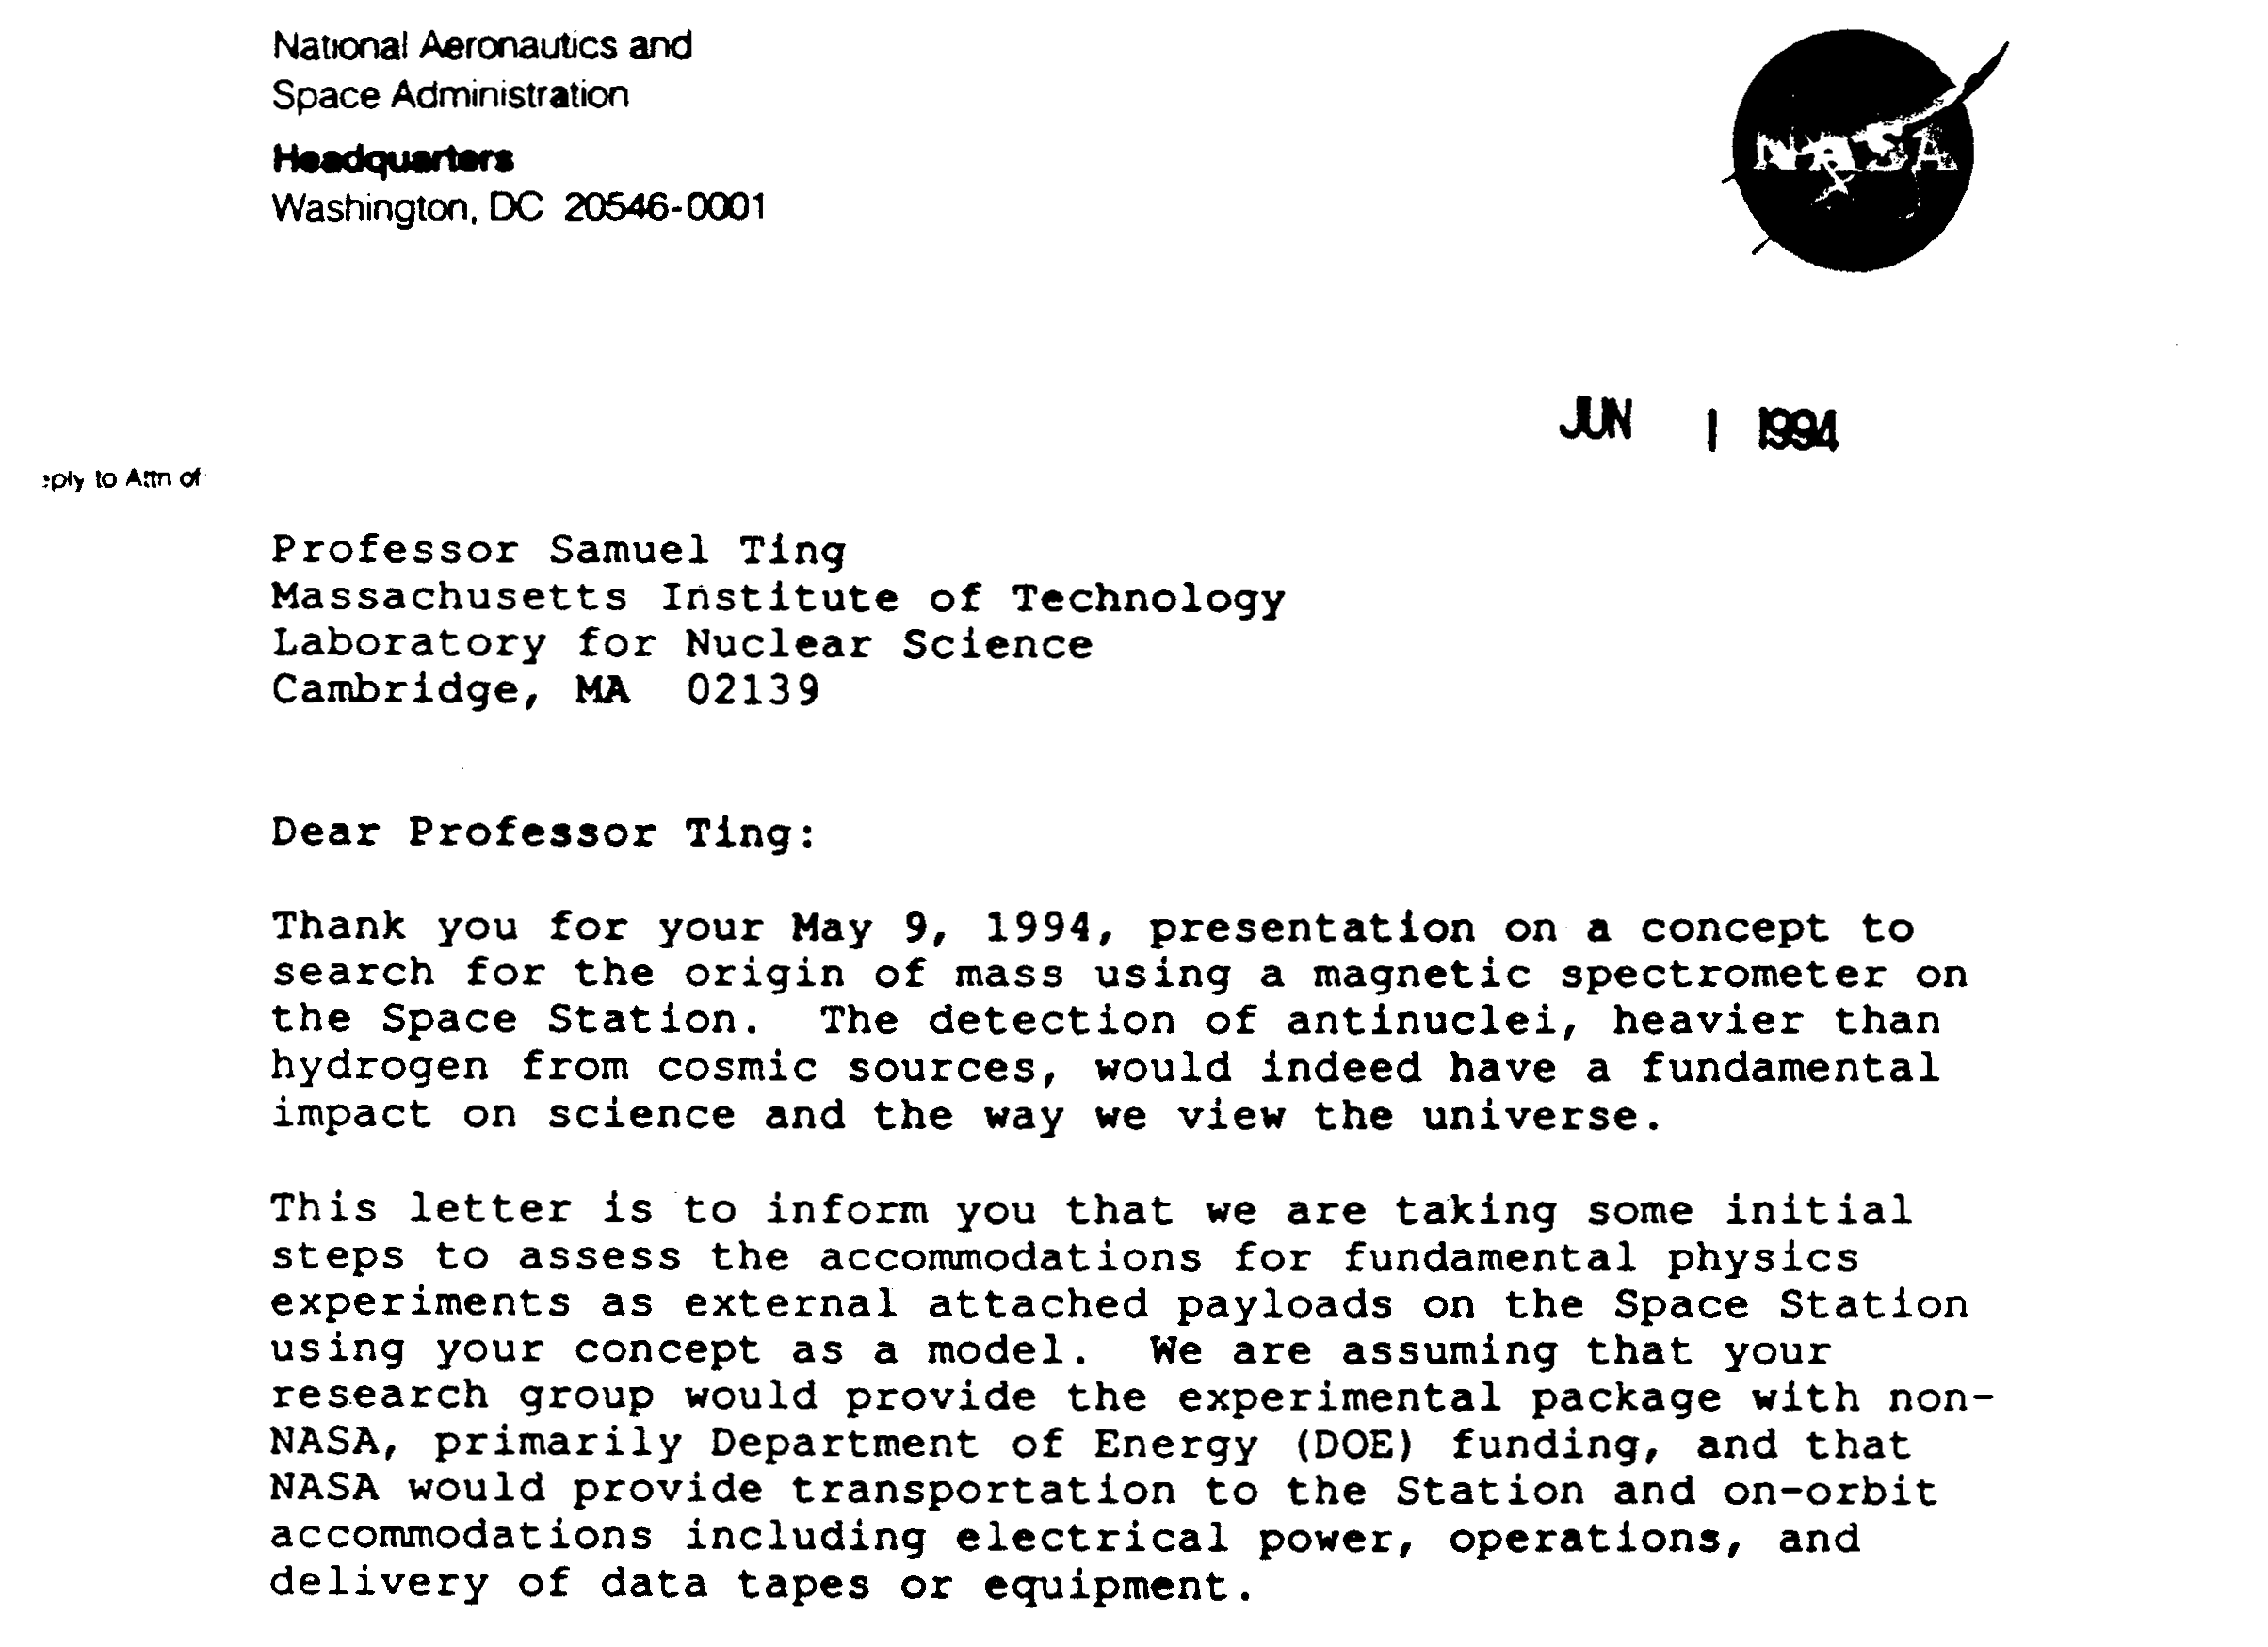
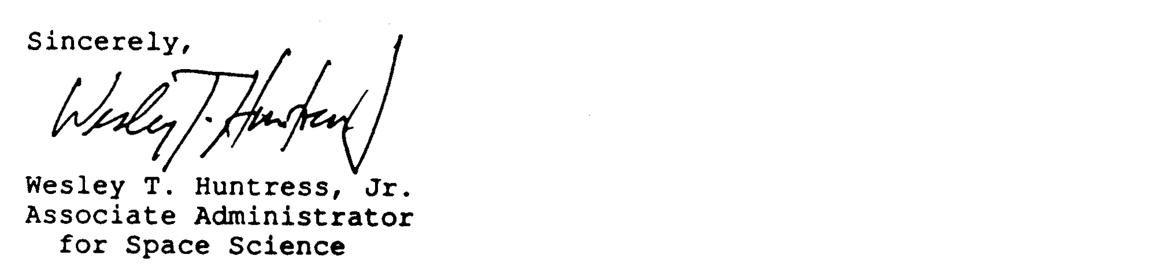

Slide 4
FINAL of 3 SCIENTIFIC REVIEWS of AMS by the U.S. DOE (Sept 25, 06)
by the DOE AMS committee:
Barry C. Barish, Chair, Caltech
Elliott D. Bloom, Stanford University
James Cronin, University of Chicago
Steve Olsen, University of Hawaii
George Smoot, L.B.N.L.
Paul J. Steinhardt, Princeton University,
Trevor Weekes, Harvard University
Notes:
4
4
4

Slide 5
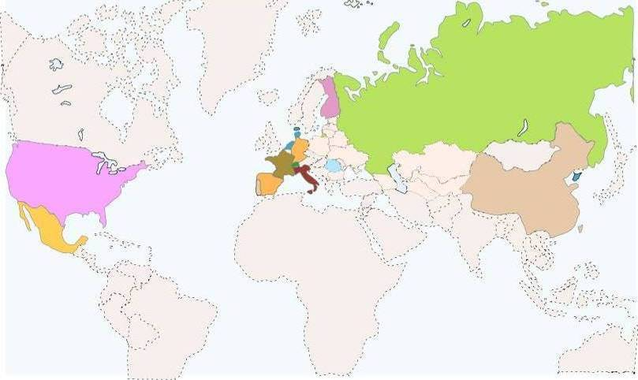
AMS is an international collaboration of 16 countries, 60 institutes (10 U.S.) and 600 physicists.
FINLAND
HELSINKI UNIV.
UNIV. OF TURKU
RUSSIA
I.K.I.
ITEP
KURCHATOV INST.
MOSCOW STATE UNIV.
DENMARK
NETHERLANDS
UNIV. OF AARHUS
GERMANY
ESA-ESTEC
NIKHEF
NLR
RWTH-I
RWTH-III
MAX-PLANK INST.
UNIV. OF KARLSRUHE
USA
KOREA
FLORIDA A&M UNIV.
FLORIDA STATE UNIV.
MIT - CAMBRIDGE
NASA GODDARD SPACE FLIGHT CENTER
NASA JOHNSON SPACE CENTER
NASA KENNEDY SPACE CENTER
TEXAS A&M UNIVERSITY
UNIV. OF FLORIDA
UNIV. OF MARYLAND
YALE UNIV. - NEW HAVEN
EWHA
KYUNGPOOK NAT.UNIV.
FRANCE
ROMANIA
CHINA
BISEE (Beijing)
IEE (Beijing)
IHEP (Beijing)
SJTU (Shanghai)
SEU (Nanjing)
SYSU (Guangzhou)
SDU (Jinan)
GAM MONTPELLIER
LAPP ANNECY
LPSC GRENOBLE
ISS
UNIV. OF BUCHAREST
SWITZERLAND
ETH-ZURICH
UNIV. OF GENEVA
SPAIN
TAIWAN
CIEMAT - MADRID
I.A.C. CANARIAS.
ITALY
ACAD. SINICA (Taiwan)
AIDC (Taiwan)
CSIST (Taiwan)
NCU (Chung Li)
NCKU (Tainan)
NCTU (Hsinchu)
NSPO (Hsinchu)
ASI
CARSO TRIESTE
IROE FLORENCE
INFN & UNIV. OF BOLOGNA
INFN & UNIV. OF MILANO
INFN & UNIV. OF PERUGIA
INFN & UNIV. OF PISA
INFN & UNIV. OF ROMA
INFN & UNIV. OF SIENA
MEXICO
UNAM
PORTUGAL
LAB. OF INSTRUM. LISBON

Slide 6
Acknowledgement
The CERN cryogenics, magnet, vacuum and accelerator groups have provided outstanding technical support which has kept AMS on schedule.
Many theoretical physicists at CERN, John Ellis, Alvaro De Rujula and others, have kept a continuous interest in AMS. They have contributed greatly in the formation of our data analysis framework.

Slide 7
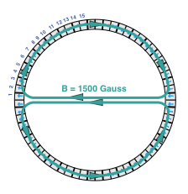
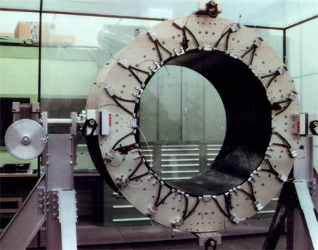
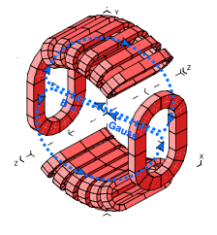
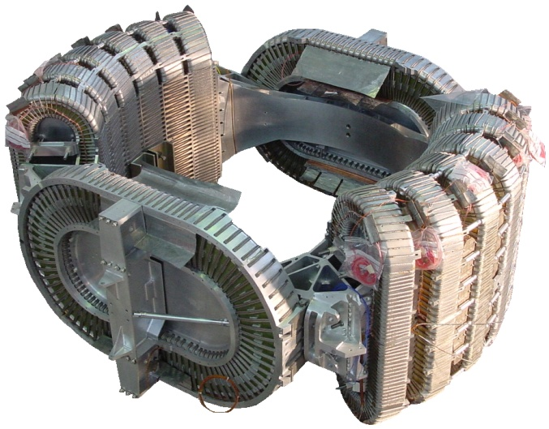
There has never been a superconducting magnet in space
due to the extremely difficult technical challenges
AMS-01
STEP ONE:
A Permanent Magnet to fly on the Shuttle
1- Minimum torque from Earth’s
magnetic field
2- Minimum field leakage
3- Minimum weight: no iron
B = 0.5 Gauss
AMS-02
STEP TWO:
A Superconducting Magnet
with the same field arrangement
8.600
Notes:
7

Slide 8
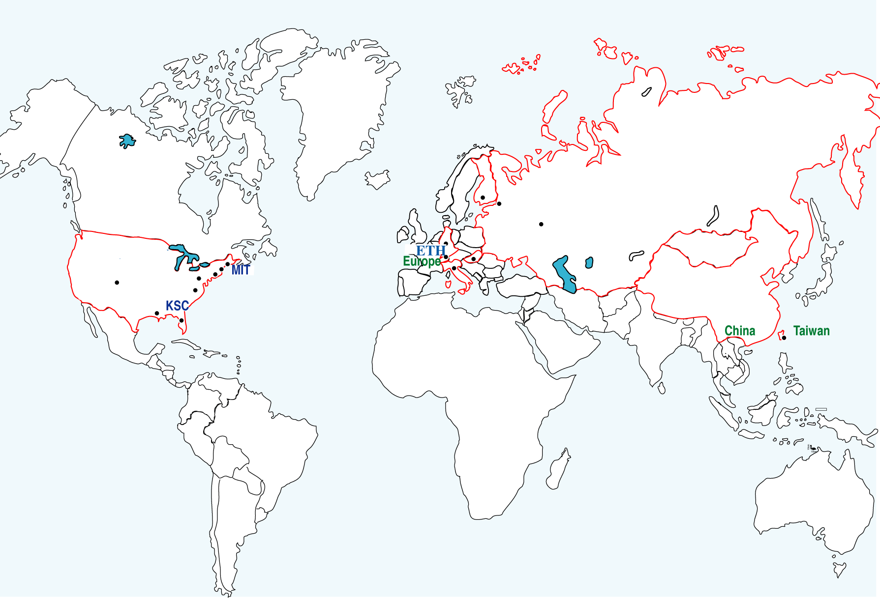
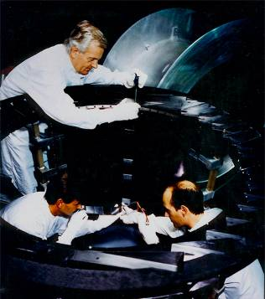
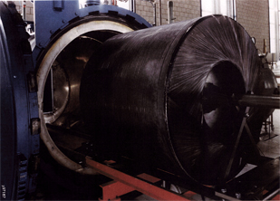
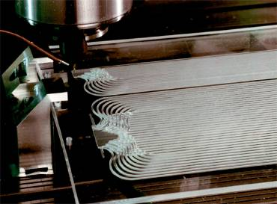
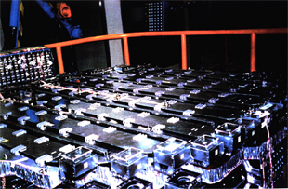
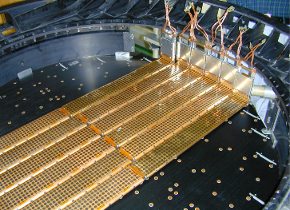
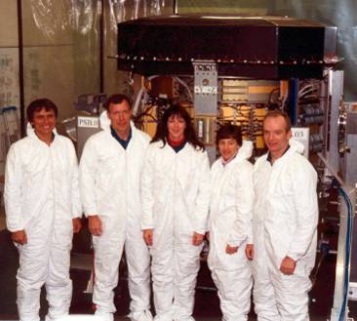
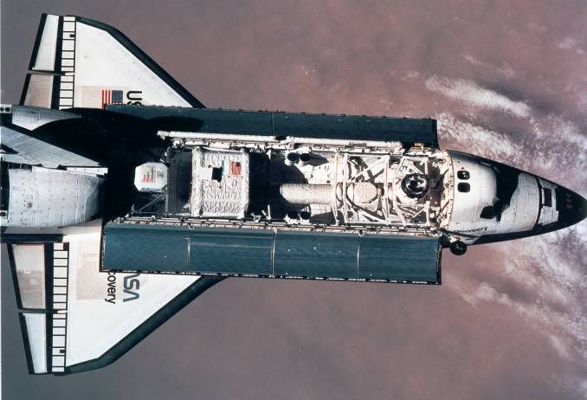
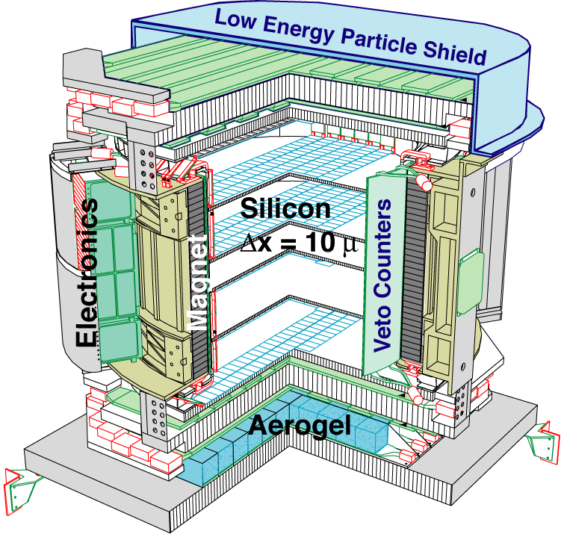
First flight AMS-01
Approval: April 1995, Assembly: December 1997, Flight: June 1998
AMS
y96207_05b

Slide 9
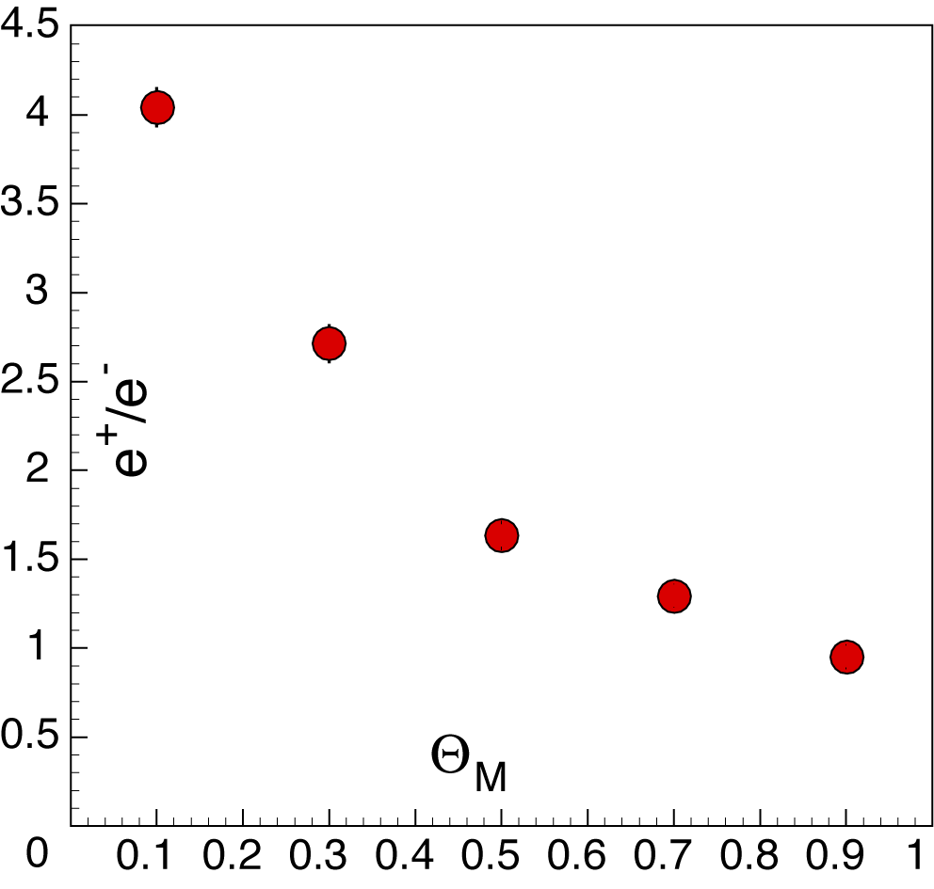
Unexpected results from first flight:
There are many more positrons (e⁺) than electrons (e⁻)
Geomagnetic
latitude
(radians)
Phys. Lett. B484 (27 Jun 2000) 10-22
Notes:
9

Slide 10
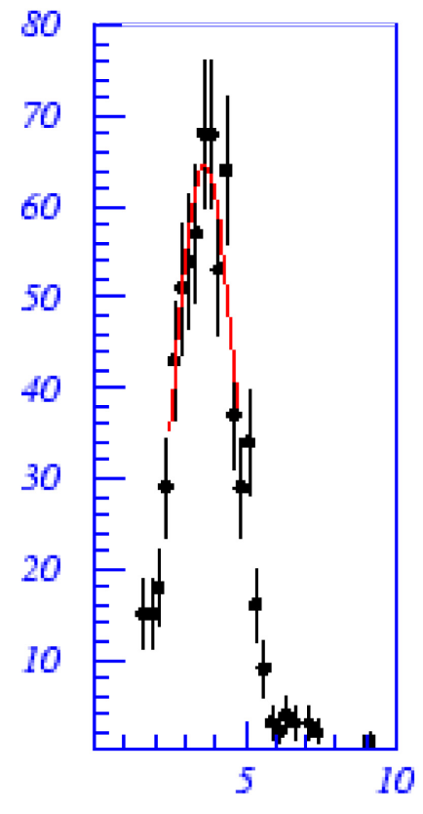
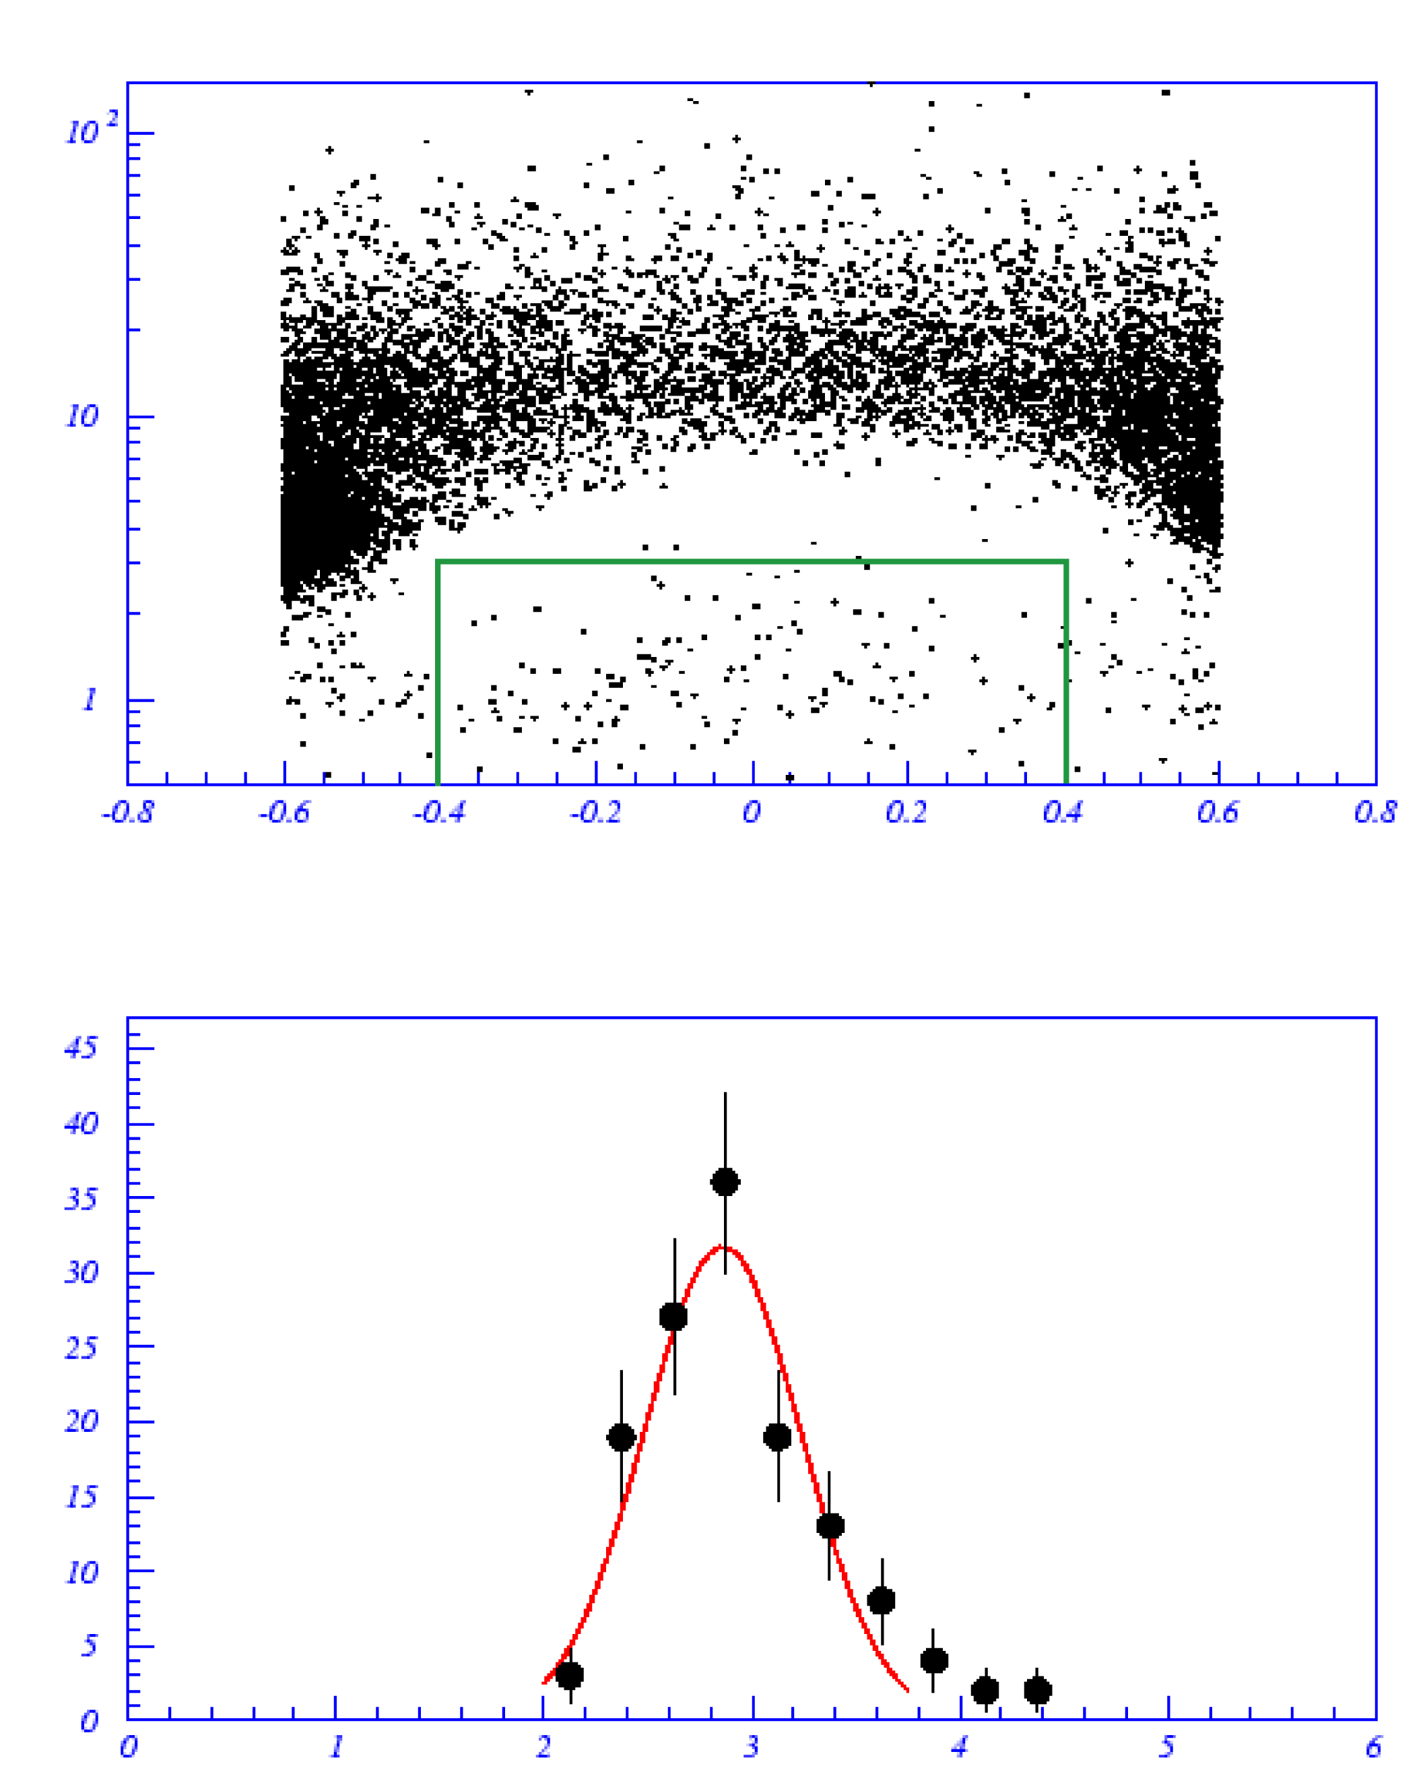
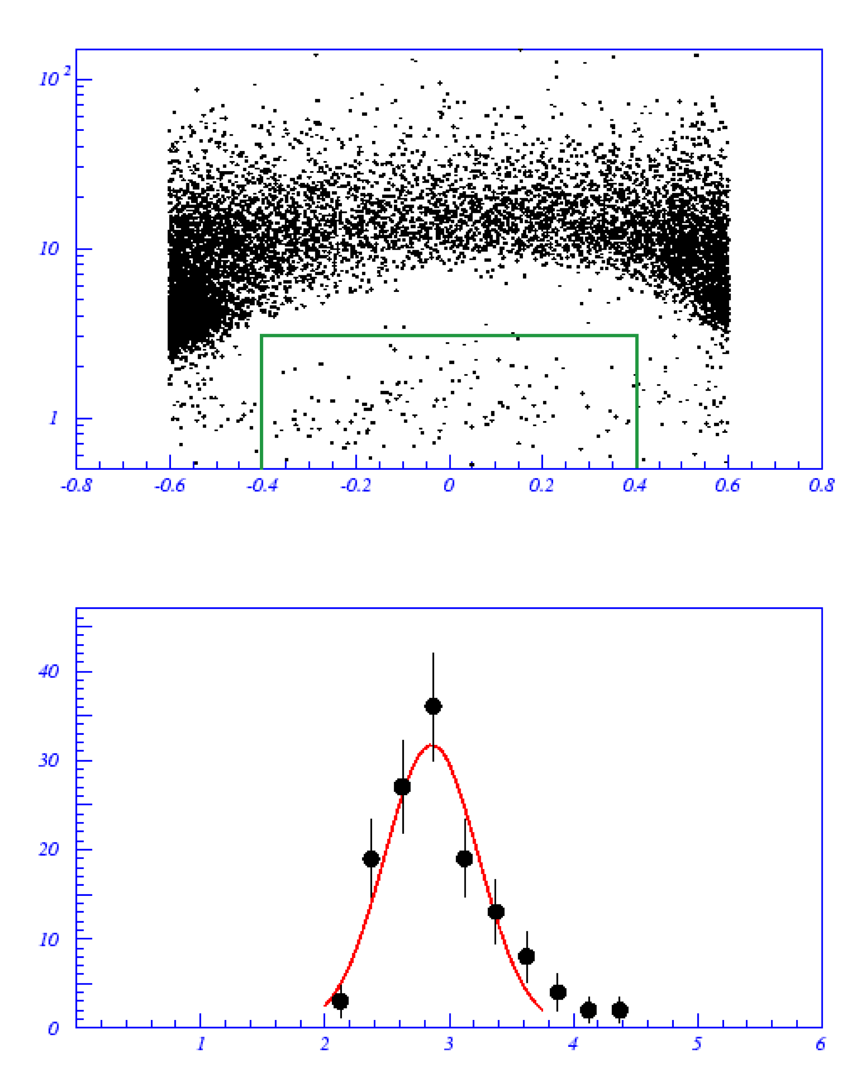
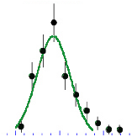
“Helium in Near Earth Orbit”
80
(Mass of He⁴ = 3.7 GeV; He³ = 2.8 GeV)
3.65±0.09
10²
He⁴
70
He⁴
60
10
Rigidity (GV)
50
He³
Events
1
40
-0.8
-0.4
0
0.4
0.8
Magnetic Latitude (rad)
30
40
2.86±0.04
He³
20
30
Events
10
20
0
10
5
10 (GeV)
0
1
2
3
4
5
6
Mass (GeV)
Physics Letters B vol.494 (3-4), p193.
AMS-01 results were not predicted by any cosmic ray model

Slide 11
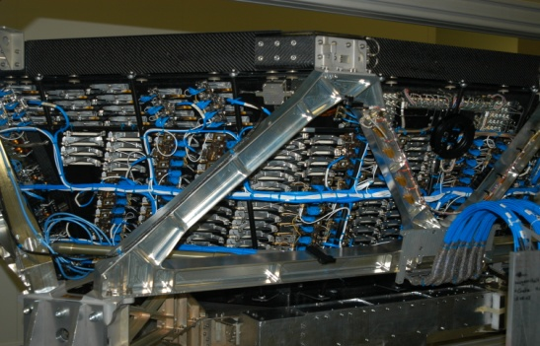
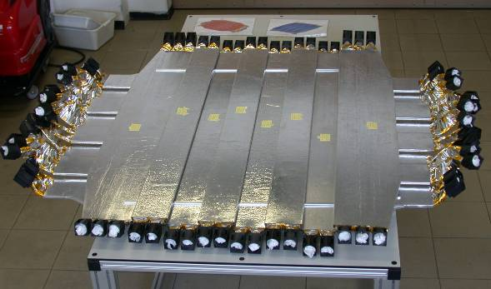
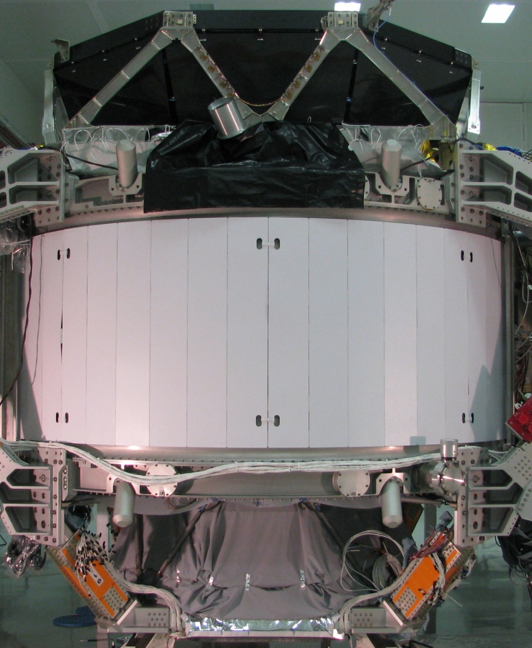

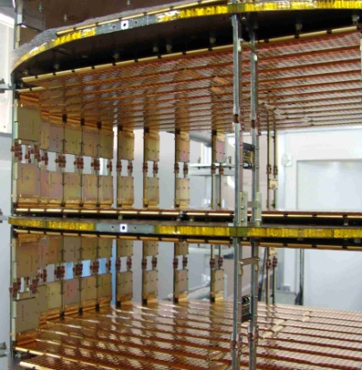
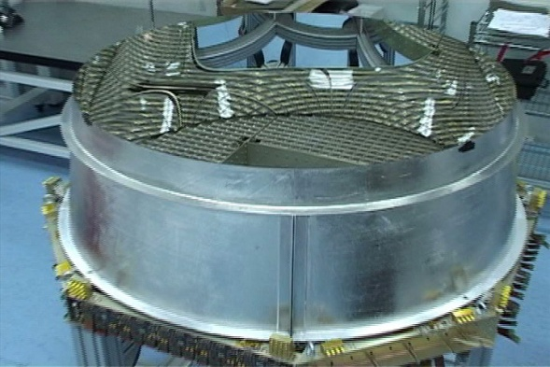
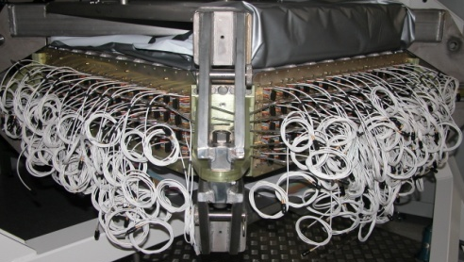
AMS on ISS
Particles are identified by their mass, charge and energy.
TRD
Electrons
TOF
Mass, Charge, Energy
Magnet
Mass, ± Charge, Energy
Silicon Tracker
Mass, Charge, Energy
RICH
Mass, Charge, Energy
ECAL
Electrons, Gamma-rays
11
Notes:
11
11
11

Slide 12
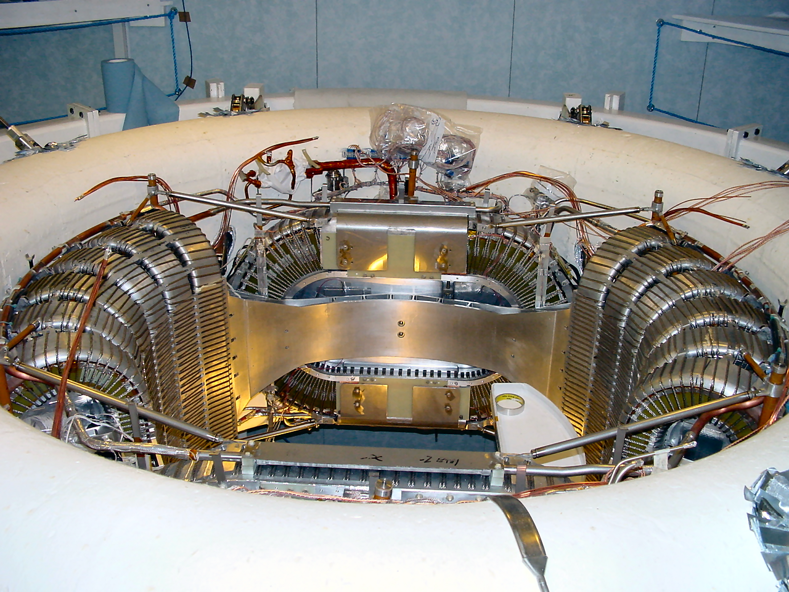




The Superconducting magnet
2,500 liters of Superfluid Helium (1.8K)
Duration: 3-5 years

Slide 13
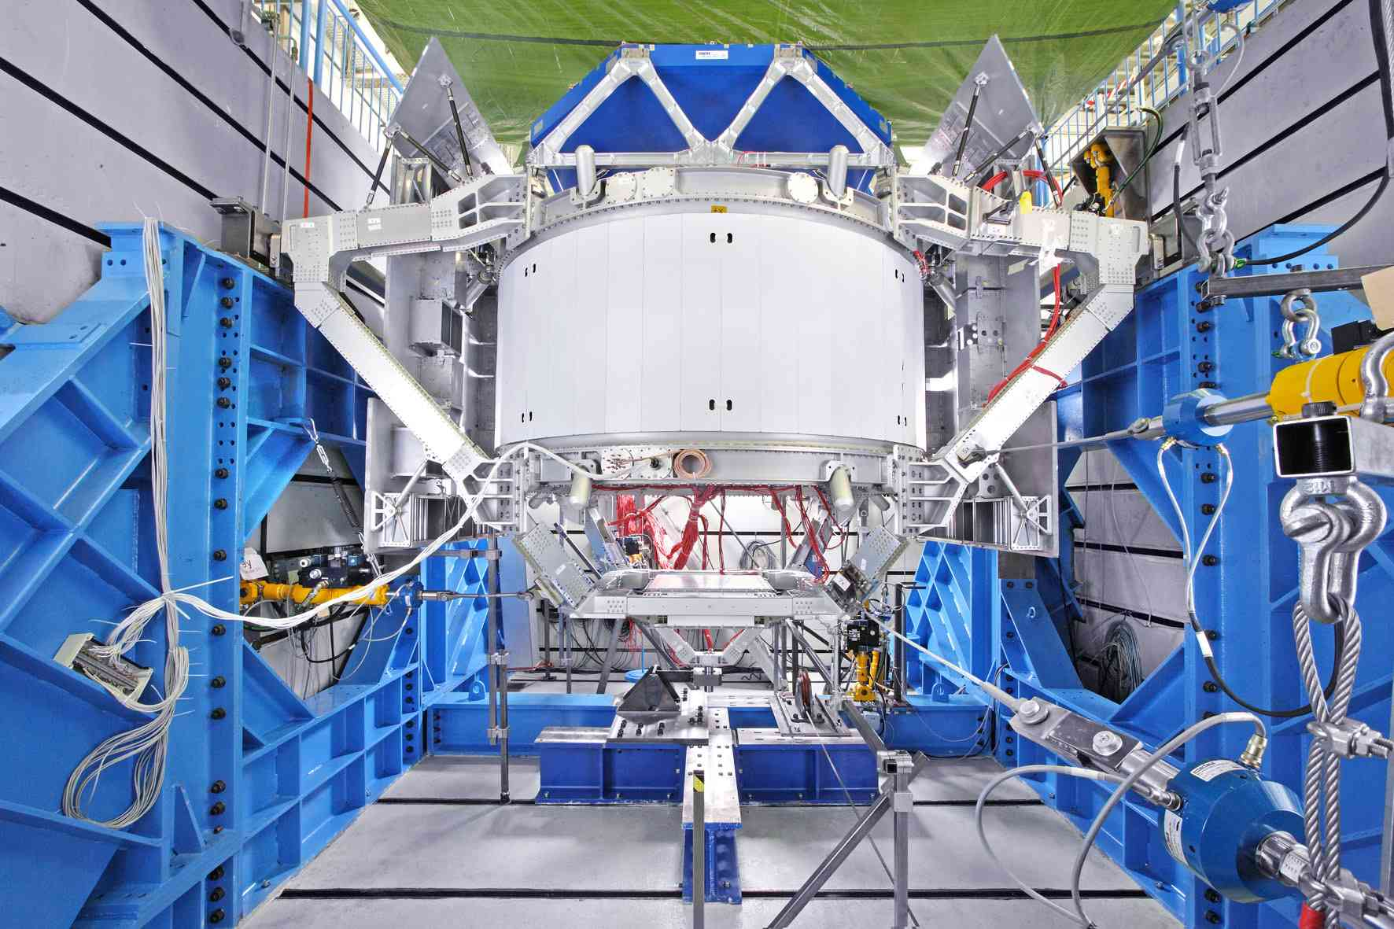
For AMS-02, two Magnets were built:
One for Space Qualification Tests in Germany and Italy

Slide 14
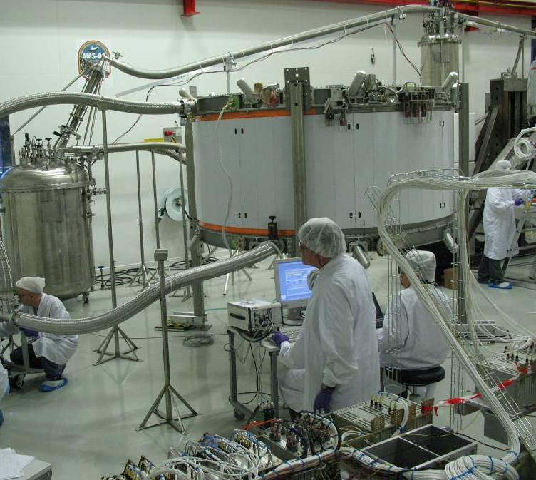
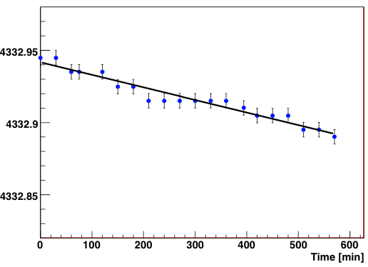
Testing of the flight magnet
Field (Gauss)
L = 49.2 H
R = 17 nΩ
T₀ = 94.6 years
(Field decay 1.1% per year)
Once charged, the magnetic field will decay ~5% in 5 years.
It will require no additional charge.

Slide 15

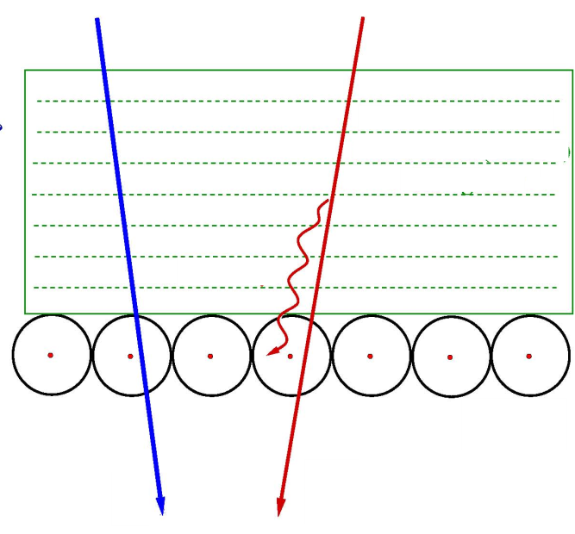
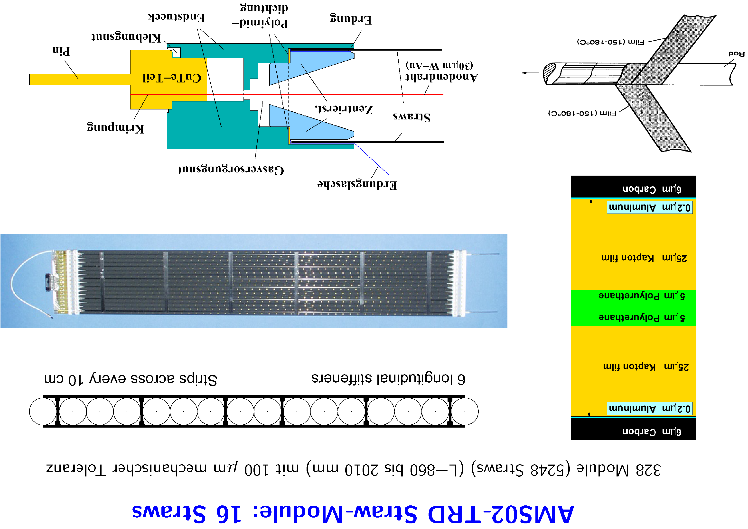
Transition Radiation Detector (TRD) Identifies electrons
radiator
One of 20 layers
Xe/CO₂
Signal wire
Straw
Tube
heavy
particle
electron
5248 tubes filled with Xe/CO₂, 2m length centered to 100 μm
Life time ~ 21 years

Slide 16
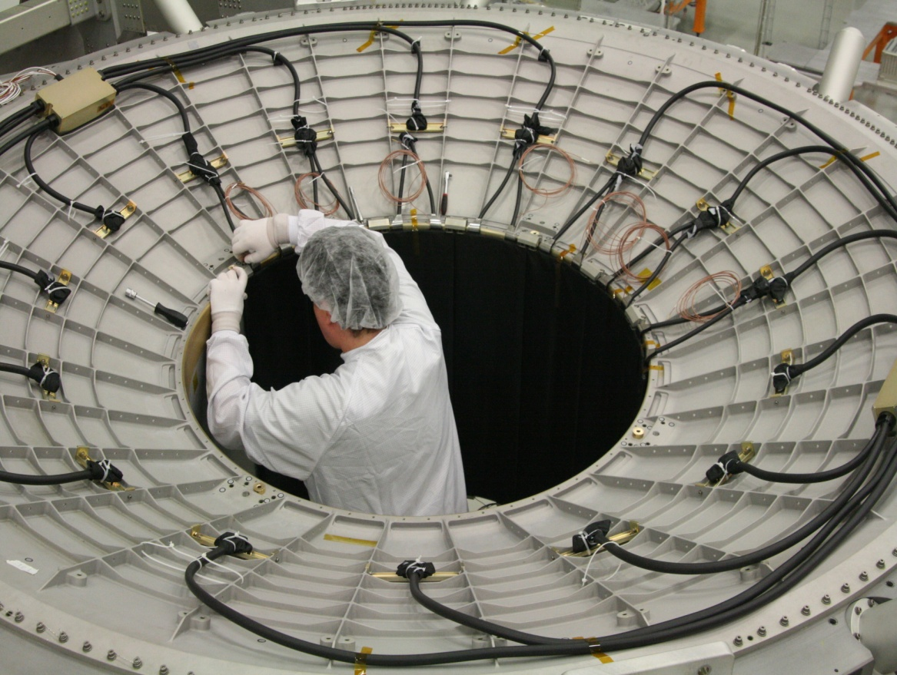
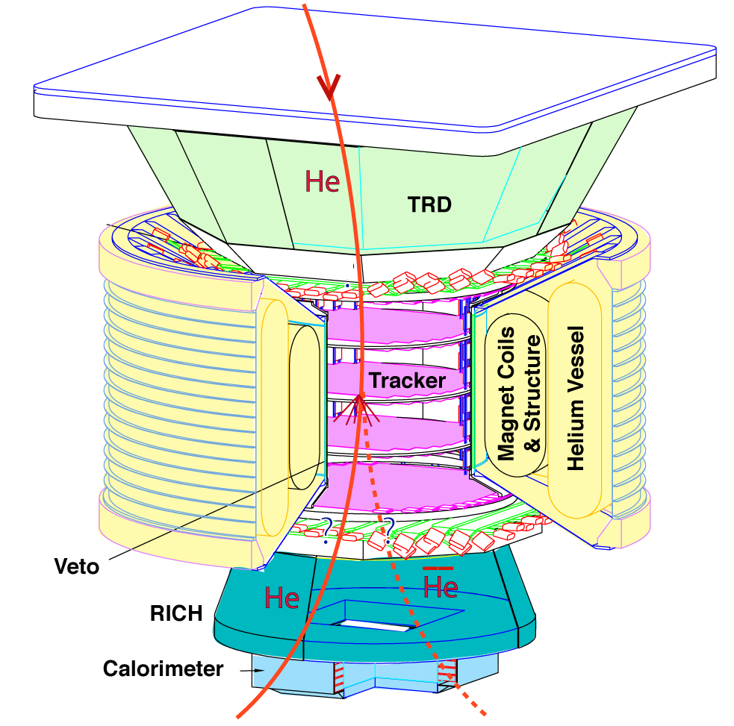
Veto System rejects random cosmic rays
AMS-02 Magnet with Veto Counters
Measured veto efficiency
better than 0.9999
Notes:
16

Slide 17




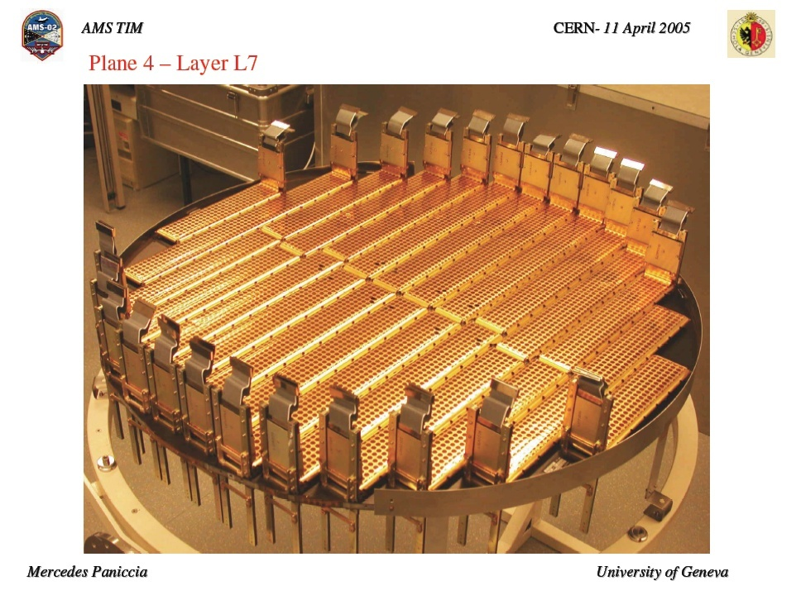
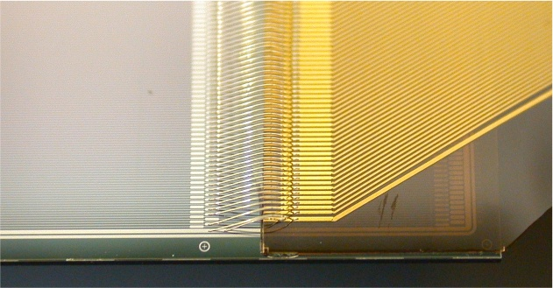
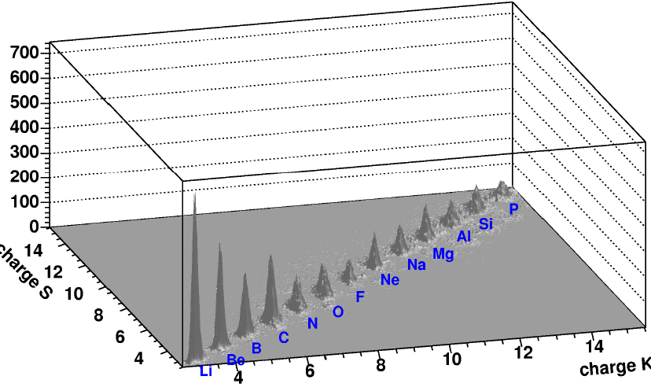
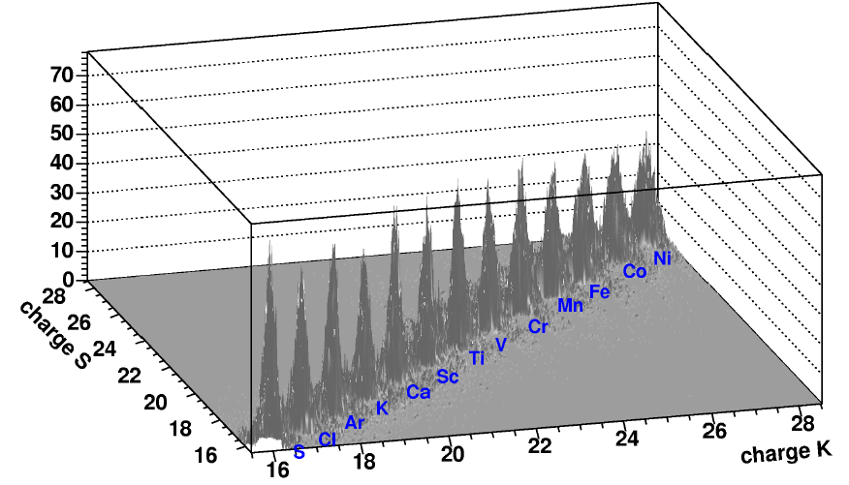
Silicon
Tracker
8 planes, 200,000 channels
Resolution: 10 μm
Test results: measure all nuclei simultaneously

Slide 18
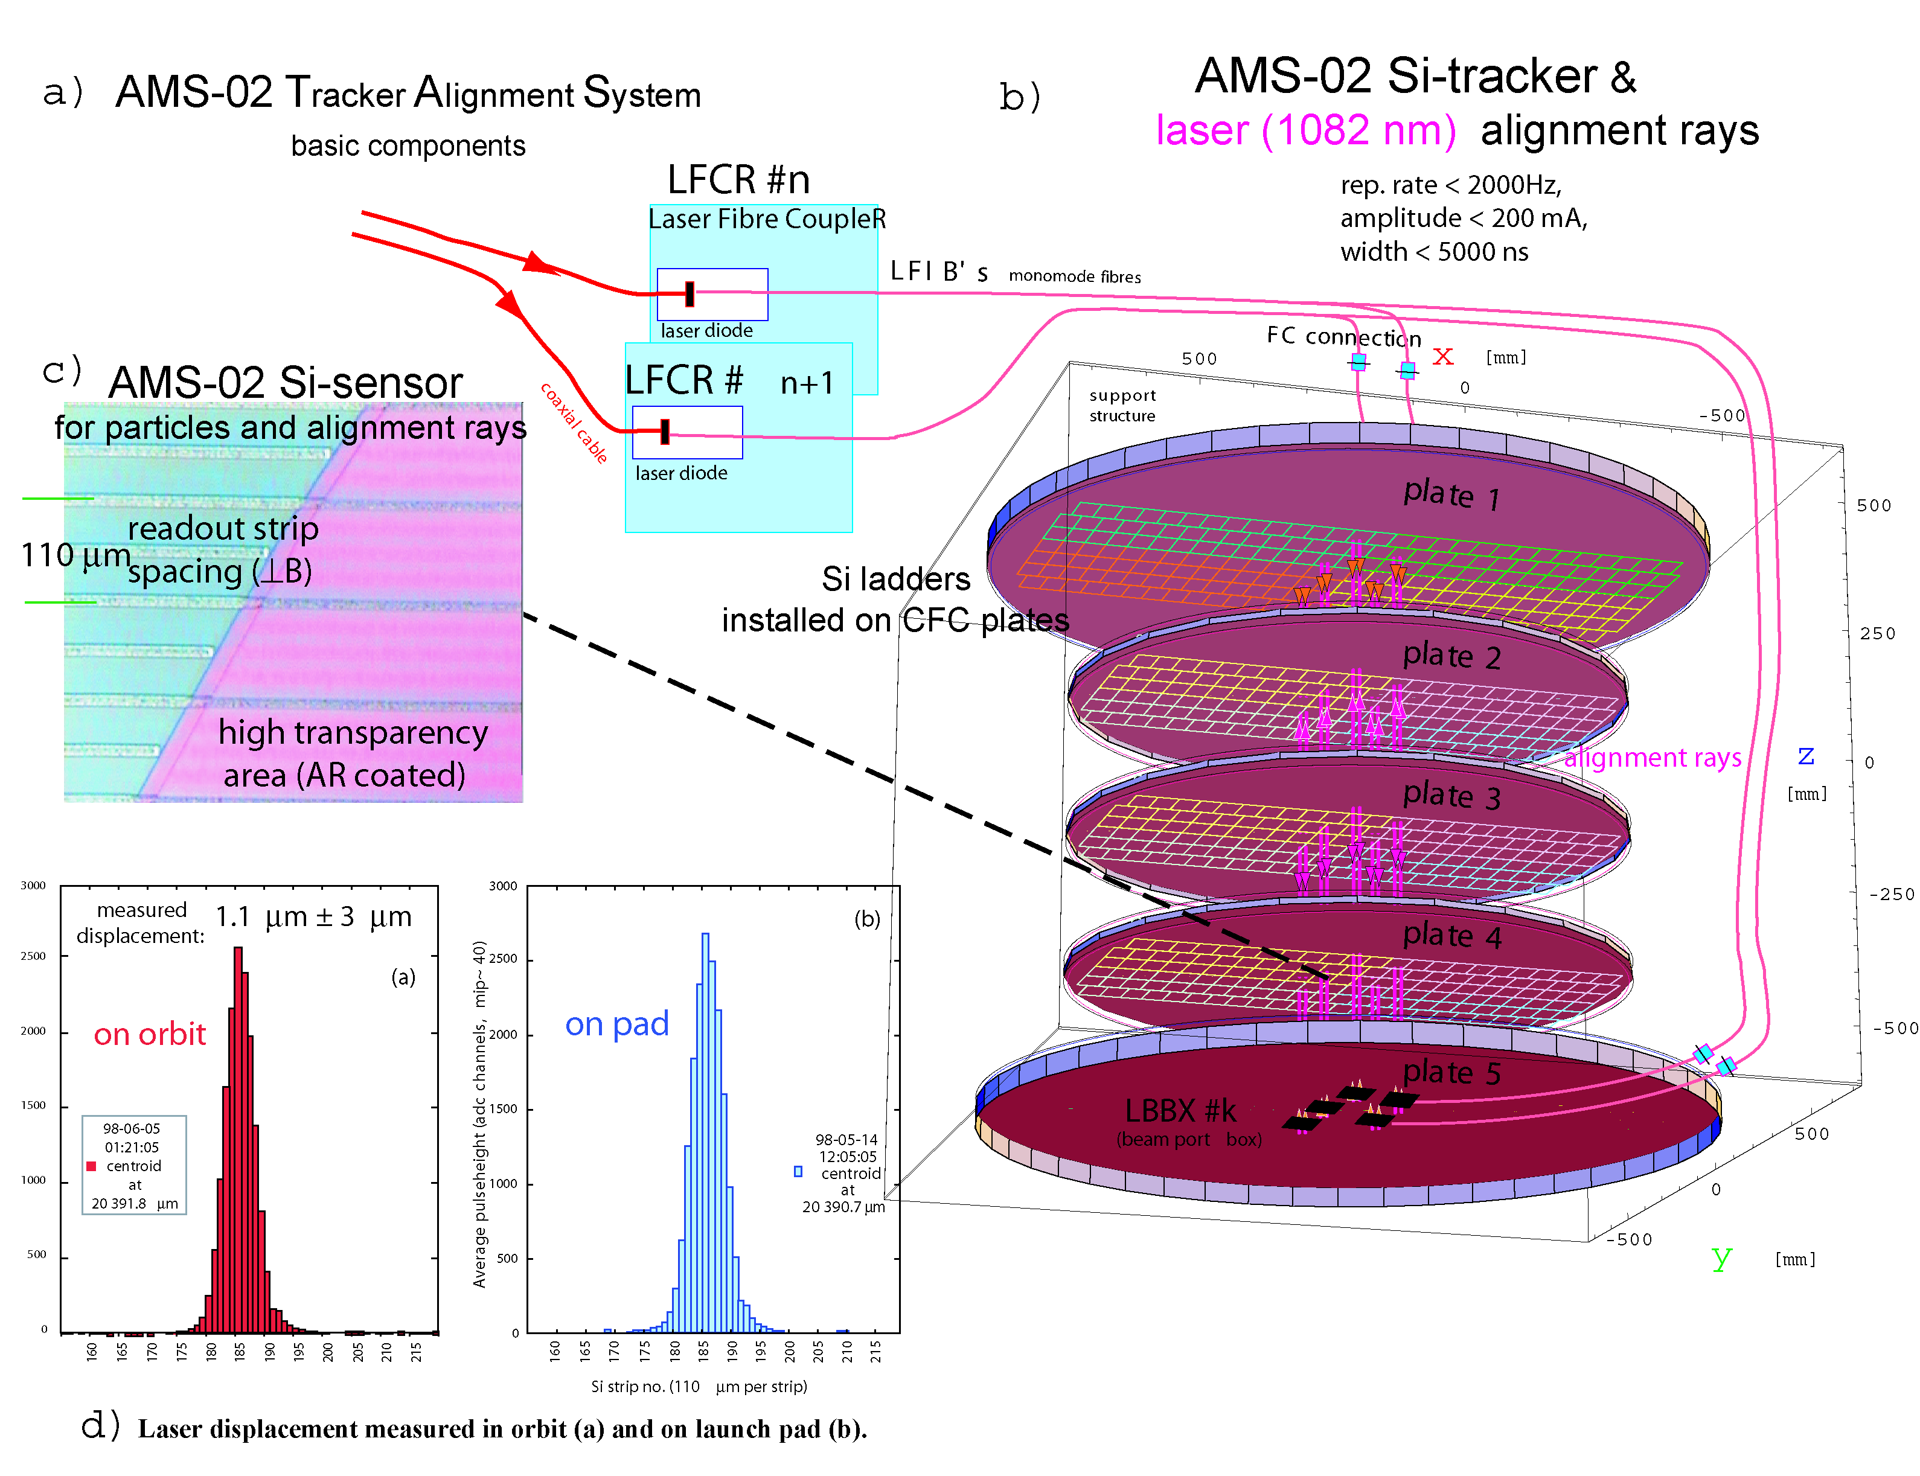
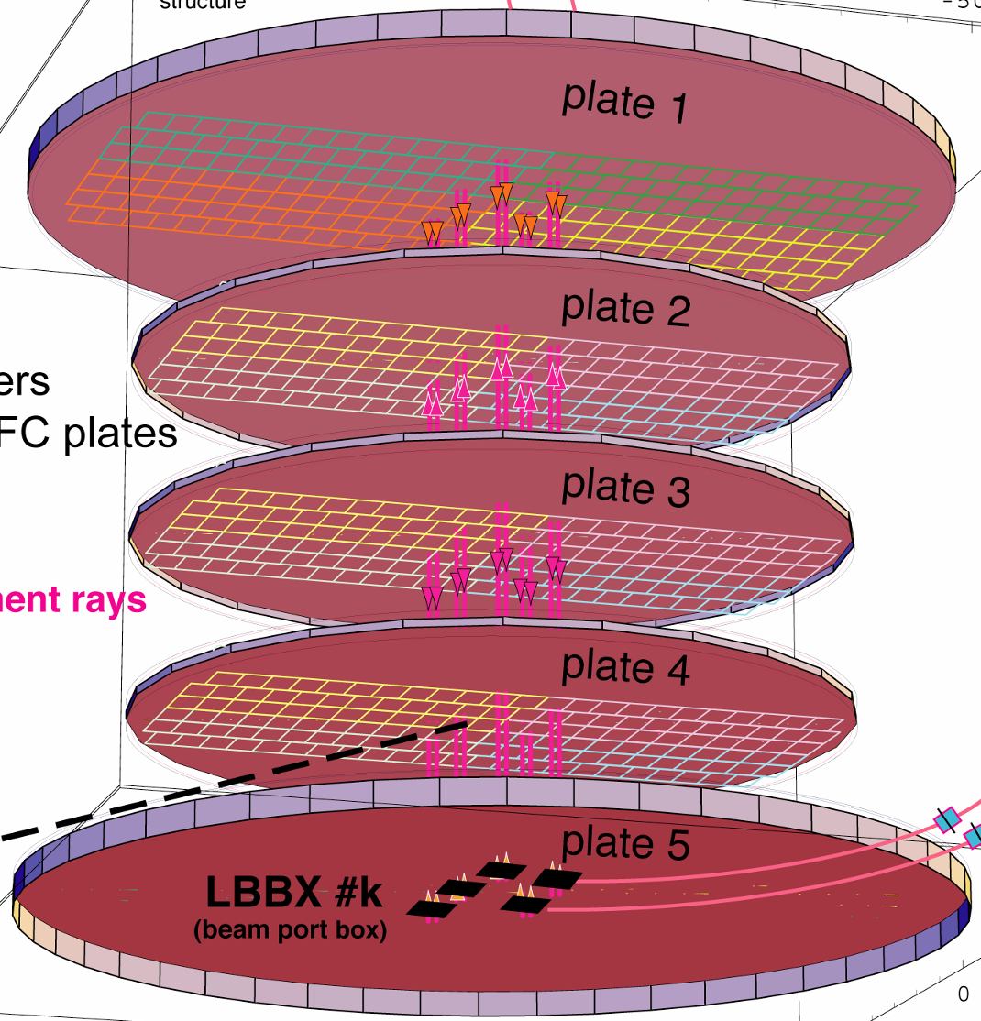
In space, the tracker alignment of 3 μm will be continuously monitored by 40 Laser beams.
Tracker alignment
AMS-01
On launch pad
On orbit
Notes:
18

Slide 19


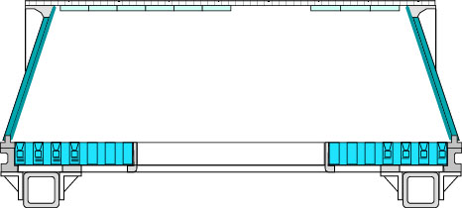
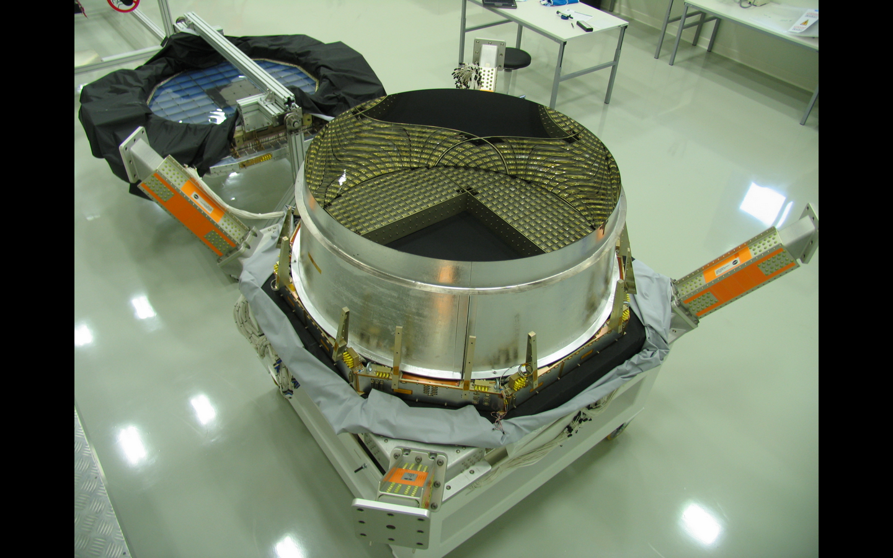
Ring Imaging Cerenkov Counter (RICH)
Particle: Velocity(θ), Charge(Intensity)
Radiator
Reflector
γ
θ
10,880 Photodetectors

Slide 20
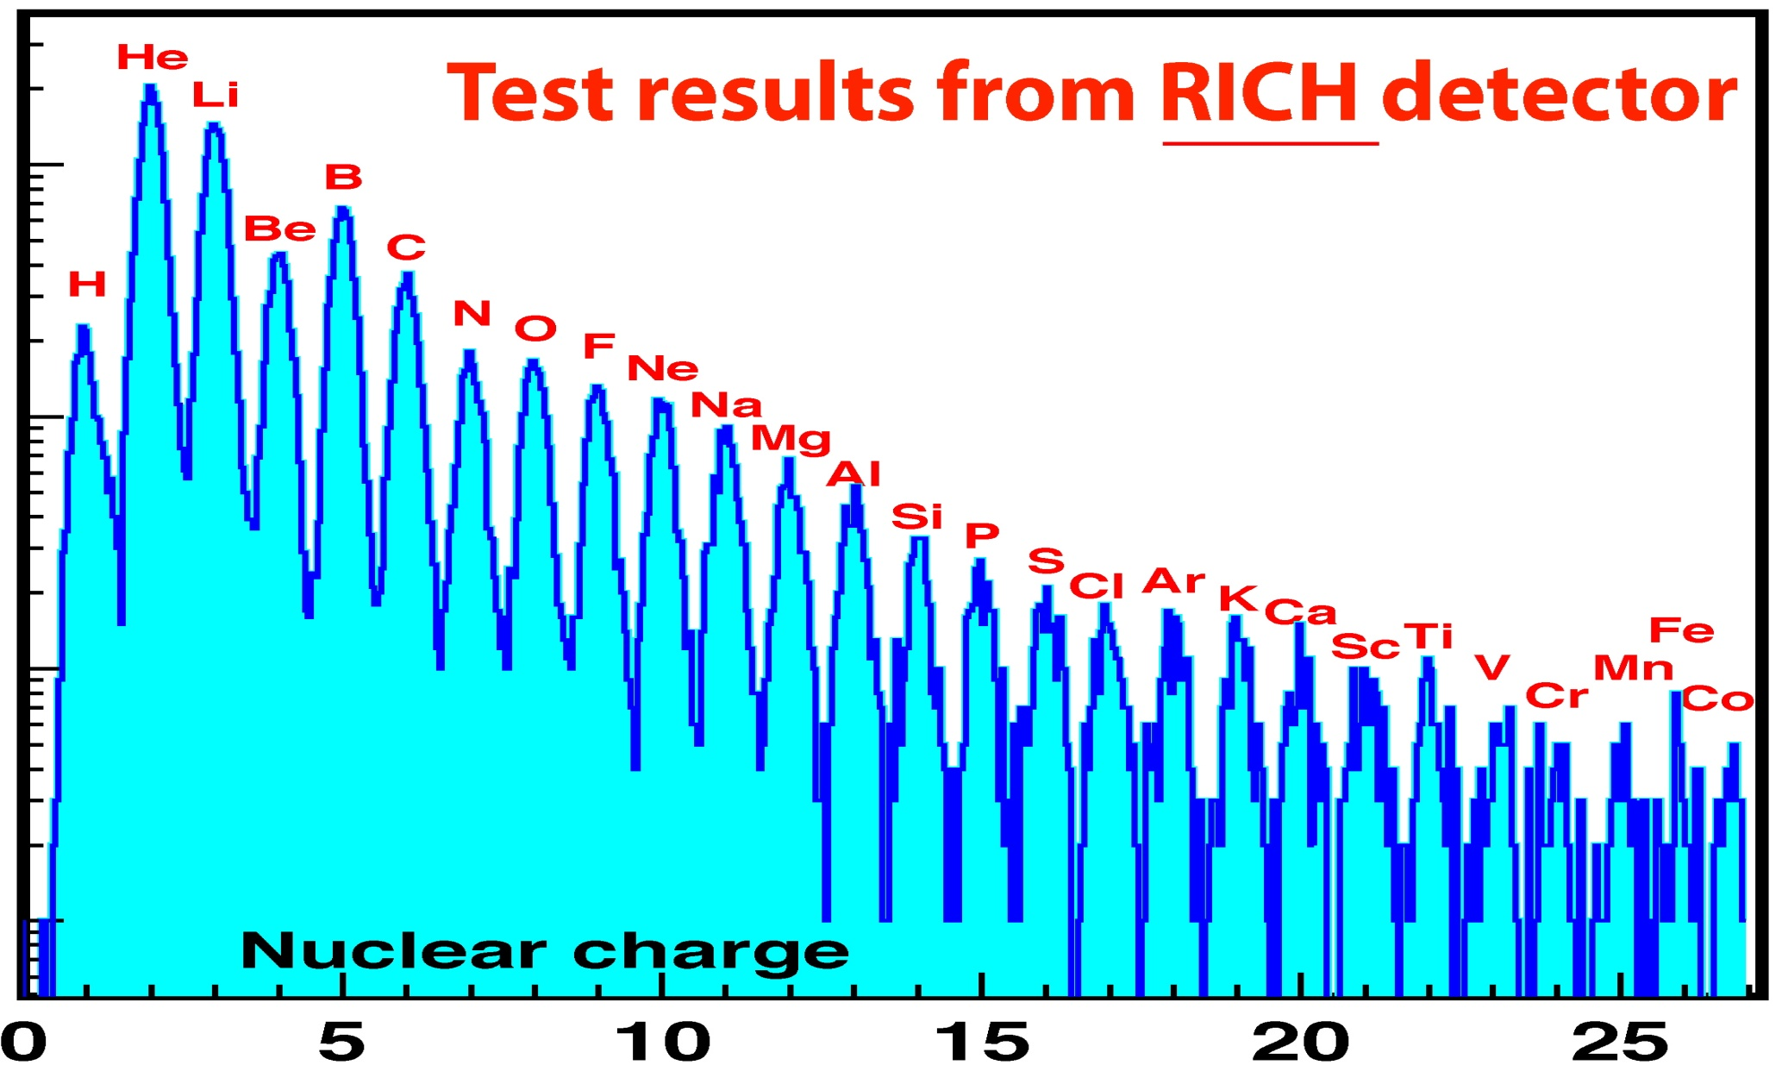
Tests with Accelerator at E=158 GeV/n
10³
10²
Events
10
1
RICH has no consumables: AMS on ISS can study
high energy cosmic ray spectra indefinitely

Slide 21



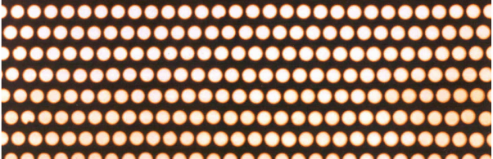
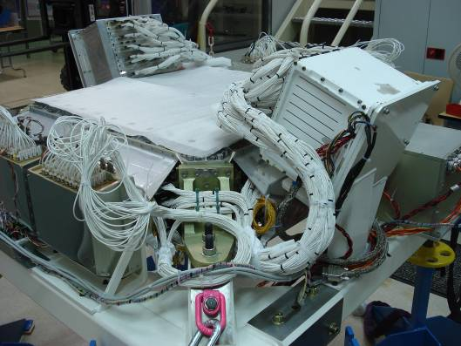
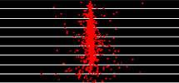

Calorimeter (ECAL)
A precision 3-dimensional measurement of the directions and energies of light rays and electrons
10 000 fibers, φ = 1 mm
distributed uniformly
Inside 1,200 lb of lead
e±, γ
proton

Slide 22

We gained extensive experience,
adjusted all the cables and
the integration sequence by
integrating AMS in 2008

Slide 23




He
Simultaneous measurement
of all nuclei
Li
C
Test results from accelerator
B
N
O
F
Ne
Na
Mg
Be
Al
Si
Number of Events
P
S
Cl
Ar
K
Ca
Sc
Ti
V
Cr
Mn
Fe
Co
Atomic Number
10³
Δv/v = 0.001
Δx = 10 µm
Δ t = 160 ps
2500
10²
Events
1500
Events
Events/20 ps
10
500
-2
-1
0
1
2
1
(1−β)/1000
Time of Flight (ns)
y04K513_05

Slide 24


Slide 25

AMS Astronauts with AMS detectors 13-16 Oct 2009

Slide 26







Fill Port
Mark E. Kelly
Gregory H. Johnson
E. M. “Mike” Fincke
Gregory Errol
Chamitoff
Andrew J.
Feustel
Roberto Vittori
The astronauts strongly urged us to study the on-orbit refill capability
so that AMS will continue to produce unique science

Slide 27

Flight Integration of AMS: installation of the Veto system
27

Slide 28

Flight Integration of AMS: cabling
of the inner tracker

Slide 29

Flight Integration of AMS: mounting of the TRD and TOF

Slide 30

Flight Integration of AMS: installation of the
TOF, RICH & ECAL
All of the detectors have been re-integrated and functionally tested

Slide 31



The AMS Science Operation and Data Analysis Center at CERN
AMS
AMS
FINLAND
RUSSIA
HELSINKI UNIV.
I.K.I.
UNIV. OF TURKU
ITEP
USA
DENMARK
KURCHATOV INST.
FLORIDA A&M UNIV.
NETHERLANDS
UNIV. OF AARHUS
GERMANY
MOSCOW STATE UNIV.
JOHNS HOPKINS UNIV.
ESA
-
ESTEC
RWTH
MIT
-
I
-
CAMBRIDGE
NIKHEF
RWTH
NASA GODDARD SPACE FLIGHT CENTER
NLR
MAX
-
-
III
KOREA
NASA JOHNSON SPACE CENTER
PLANK INST.
EWHA
NASA KENNEDY SPACE CENTER
UNIV. OF KARLSRUHE
KYUNGPOOK NAT.UNIV.
FLORIDA STATE UNIVERSITY
FRANCE
ROMANIA
CHINA
BISEE (Beijing)
(NAT. HIGH MAG. FIELD LAB)
GAM MONTPELLIER
CERN
ISS, UNIV. OF BUCHAREST
IEE (Beijing)
TEXAS A&M UNIVERSITY
LAPP ANNECY
SWITZERLAND
IHEP (Beijing)
UNIV. OF FLORIDA
LPSC GRENOBLE
ETH
-
ZURICH
SJTU (Shanghai)
UNIV. OF MARYLAND
SPAIN
ITALY
UNIV. OF GENEVA
SEU (Nanjing)
UNIV. OF TEXAS
CIEMAT
SYSU (Guangzhou)
YALE UNIV.
-
MADRID
ASI
-
NEW HAVEN
I.A.C. CANARIAS.
CARSO TRIESTE
SDU (Jinan)
TAIWAN
MEXICO
IROE FLORENCE
ACAD. SINICA (Taiwan)
UNAM
INFN & UNIV. OF BOLOGNA
AIDC (Taiwan)
PORTUGAL
INFN & UNIV. OF MILANO
CSIST (Taiwan)
INFN & UNIV. OF PERUGIA
NCU (Chung Li)
LAB. OF INSTRUM. LISBON
INFN & UNIV. OF PISA
NCKU (Tainan)
NCTU (
Hsinchu
INFN & UNIV. OF ROMA
NSPO (
)
Hsinchu
INFN & UNIV. OF SIENA
)

Slide 32









Search for Cold Dark Matter: χ⁰
Physics example
Collisions of χ⁰ will produce excesses in the spectra of
e⁺,e⁻,p different from known cosmic ray collisions
AMS-02 (m_{χ}=200 GeV)
From Dark matter
collisions
From normal cosmic ray collisions
The spectra of all types of cosmic rays
will be measured by AMS simultaneously

Slide 33

DM, mass = 1 TeV
Normal CR collisions
R. Battiston, S. Haino 2009
10
100
1000

Slide 34

AMS is sensitive to very high SUSY masses
AMS spectra
with Mχ = 840 GeV
(not accessible to LHC)
From Dark matter
collisions
p/p
From normal
cosmic ray collisions
y06K318a

Slide 35



Physics examples
Search for the existence of Antimatter in the Universe
The Big Bang origin of the Universe requires matter and antimatter
to be equally abundant at the very hot beginning
Accelerators
AMS in Space
AMS
LHC
Notes:
35
35

Slide 36

AMS-02 Antihelium Limits
Current antimatter
searches are limited
He/He (CL 95%)
y06K301
Notes:
36

Slide 37



AMS Physics example
Study of high energy (0.1 GeV – 1 TeV) diffuse gammas
γ
T.Prodanovi´c et al., astro-ph/0603618 v1 22 Mar 2006
Space Experiments
Ground Experiments
EGRET
e⁻
e⁺
upper limits
AMS-02
The diffuse gamma-ray spectrum of the Galactic plane
40º < 1 < 100º, |b| < 5º
Pointing precision of 2 arcsec
UTC time (from GPS, μsec accuracy) allows to relate
AMS measurements with other missions
Notes:
37
37

Slide 38

Pulsars in the Milky Way:
Pulsar:
Neutron star sending radiation in a periodic way, currently measured with millisec accuracy.
Emission in radio, visible, X- and gamma rays currently measured up to ~1 Gev.
AMS: pulsar periods measured with μsec time precision and
energy spectrum for pulsars measured to 1 TeV
(a factor of 1,000 improvement in time and energy).
Similar studies can be made for Blazers and Gamma Ray Bursters
Notes:
38
38

Slide 39
Physics Example
Search for New Matter in the Universe
Jack Sandweiss, Yale University
There are six types of Quarks found in accelerators (u, d, s, c, b, t).
All matter on Earth is made out of only two types (u, d) of quarks. “Strangelets” are new types of matter composed of three types of quarks (u, d, s) which should exist in the cosmos.
Carbon Nucleus
Z/A ~ 0.5
Strangelet
Z/A ~ 0.1
A stable, single “super nucleon” with three types of quarks
ii. “Neutron” stars may be one big strangelet
n
s
d
u
p
u
d
d
s
d
u
d
u
s
d
d
u
d
u
s
u
u
u
s
u
s
u
u
u
d
d
u
d
d
s
d
u
u
d
d
u
d
d
u
d
d
s
u
u
d
d
u
u
d
d
d
d
d
d
s
d
u
u
u
u
s
u
u
u
u
u
d
d
d
AMS will provide a definitive search for this new type of matter.
39
Notes:
39

Slide 40


Strangelet candidate from AMS-01
Observed 5 June 1998 11:13:16 UTC
Lat/Long= -44.38°/+23.70°, Local Cutoff 1.95±0.1 GV, Angle= 77.5° from local zenith
Front view
Side view
AMS-01
β₁
Amplitude => Z, β₂
Candidate
Z/A
Rigidity = 4.31 ± 0.38 GV
Charge Z = 2
β₁ = β₂ = 0.462 ± 0.005
Mass = 16.45±0.15 GeV/c²
Z/A = 0.114 ± 0.01
Flux (1.5 < E_{K} < 10 GeV) = 5x10⁻⁵ (m² sr sec)⁻¹
Background probability < 10⁻³
Notes:
40

Slide 41
Discoveries in Physics
Original purpose,
Expert Opinion
Discovery with
Precision Instrument
Facility
P.S. CERN
(1960’s)
π N interactions
Neutral Currents -> Z, W
ν_{e}, ν_{μ}
CP violation,
J
Brookhaven
(1960’s)
π N interactions
FNAL
(1970’s)
Neutrino physics
b, t quarks
SLAC Spear
(1970’s)
ep, QED
Scaling, Ψ, τ
PETRA
(1980’s)
t quark
Gluon
Super Kamiokande
(2000)
Proton decay
Neutrino oscillations
Hubble Space
Telescope
(1990’s)
Galactic
survey
Curvature of the universe,
dark energy
Dark Matter, Antimatter
Strangelets,…
?
AMS on ISS
Exploring a new territory with a precision instrument is the key to discovery.
y96402nac.ppt

Slide 42
The Cosmos is the Ultimate Laboratory.
Cosmic rays can be observed at energies higher than any accelerator.
The issues of antimatter in the universe and the origin of Dark Matter
probe the foundations of modern physics.
AMS
The most exciting objective of AMS is to probe the unknown;
to search for phenomena which exist in nature that we have not yet imagined nor had the tools to discover.
Notes:
42
42

