Slide 1

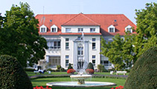
Klinik und Poliklinik für
Nuklearmedizin
Leiter: Univ.-Prof. Dr. Mathias Schreckenberger
¹⁴⁹Tb radio-immunotherapy –
advances of short-range
alpha radiation and 4.1 h half-life
demonstrated in vitro and in vivo
M. Miederer, J.Comor, S. Vanjes-Duric and GJ Beyer

Slide 2
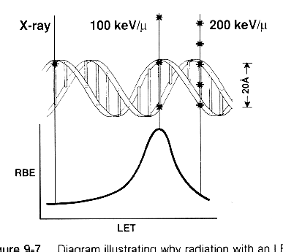
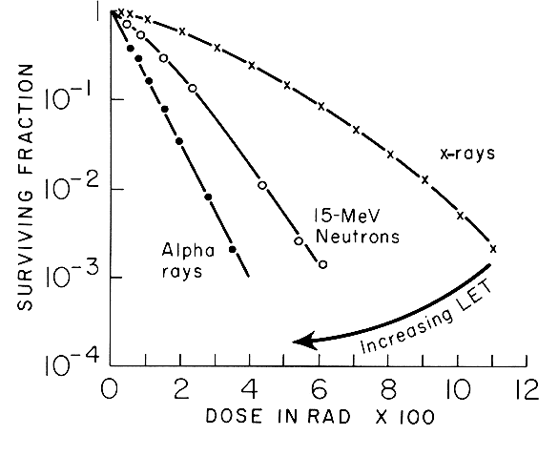
Radiobiology of high LET Radition
The extremely dense ionisations result in more lethal double strand breaks, which are not accessable to repair mechanisms (Locally multiply damaged site (LMDS)).
no dose-effect shoulder
no correlation with Oxygen saturation
dose rate less relevant

Slide 3
Alpha track in relation to cancer cells
Tumor cell

Slide 4
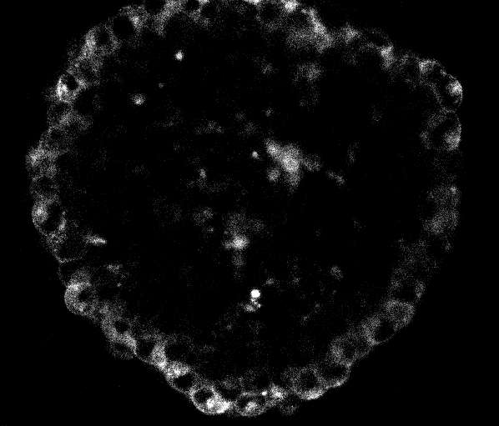
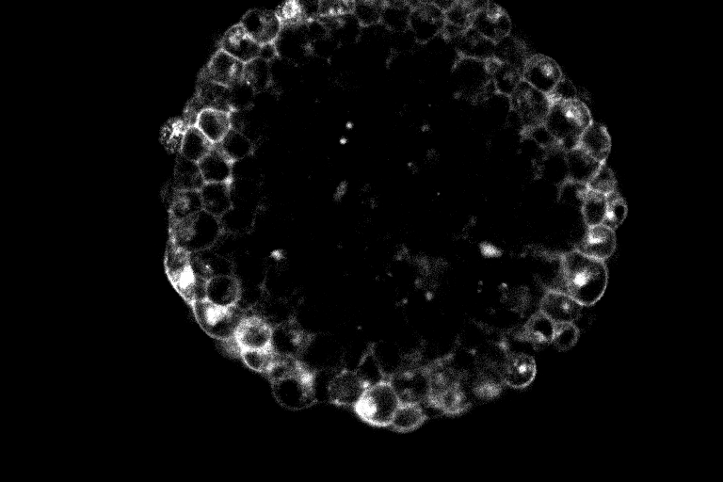
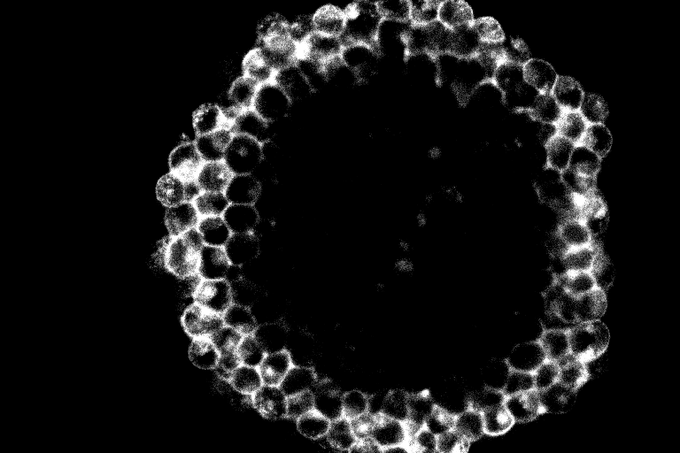
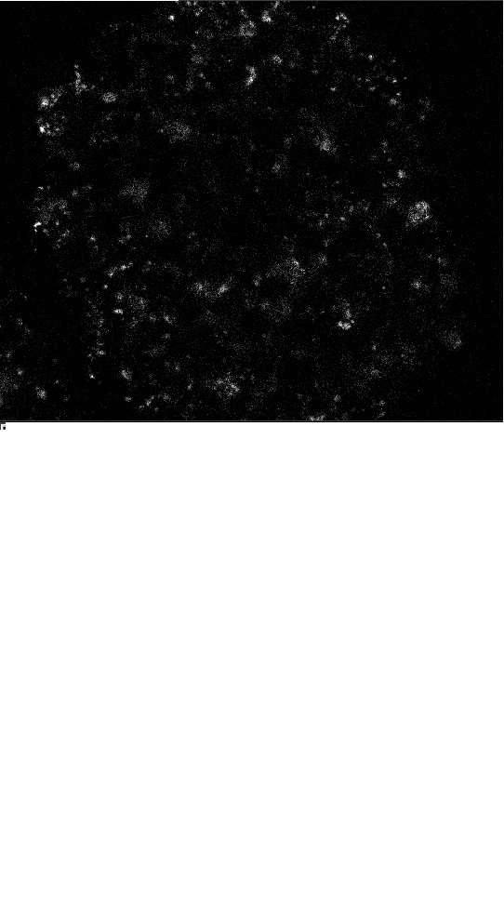
Antibody Penetration over time
Confocal microscopy slices through the equator of LNCaP spheroids
following incubation with 10 μg/ml FITC-J591 and wash (3x).
Incubation duration (min):
15
60
120
120
Ab penetration (cell diameters):
Control:
(10 μg/ml FITC-HuM195)
1
2
3
Sgouros, et al

Slide 5
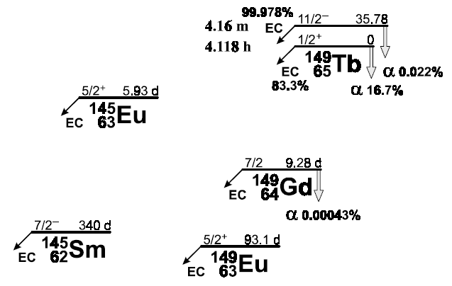
Terbium-149 – a new Isotope for targeted cancer therapy ?

Slide 6
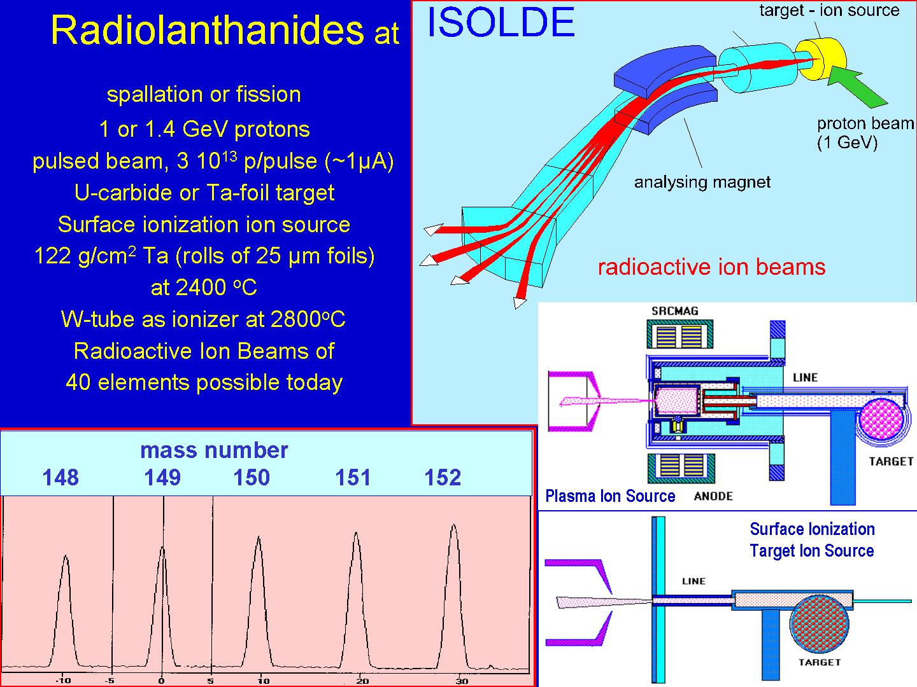
Beyer et al 2001

Slide 7
Comparision: ²¹³Bi ¹⁴⁹Tb
T _{1/2} | 46 min | 4.1 h
α branch | 100 % | 17 %
E _{Α} [MeV] | 8.4 (²¹³Po) | 3.97
Range | 80 µm | 28 µm
LET [keV/µm] | 105 | 140
gamma | 440 keV | divers
ß⁺ (PET?) | no | 7 %
Daughter nuclides | ²⁰⁹Pb (3.25h) | ¹⁴⁹Gd (9d), ¹⁴⁹Eu(93d), ¹⁴⁵Eu(6d), ¹⁴⁵Sm(340d), ¹⁴⁵Pm(18y)
Availability | generator | CERN

Slide 8
In vitro system for investigation of single cell-kill potential of Terbium-149
Tb-149 – d9Mab binding to gastric cancer cells
Monte Carlo simulation
¹⁴⁹Tb
¹⁴⁹Tb RIT
²¹³Bi
²¹³Bi RIT
experiment
Miederer et al 2003

Slide 9
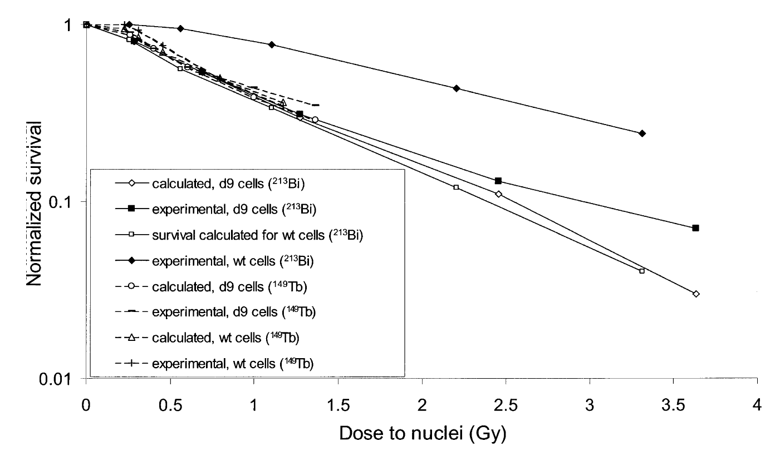
Comparision of theoretical and experimental single cell kill with Bi-213 and Tb-149
Conclusion: For Bi-213 and Tb-149 RIT theory and experiment are close, however
targeting needs to be improved for single cell kill
Miederer et al 2003

Slide 10
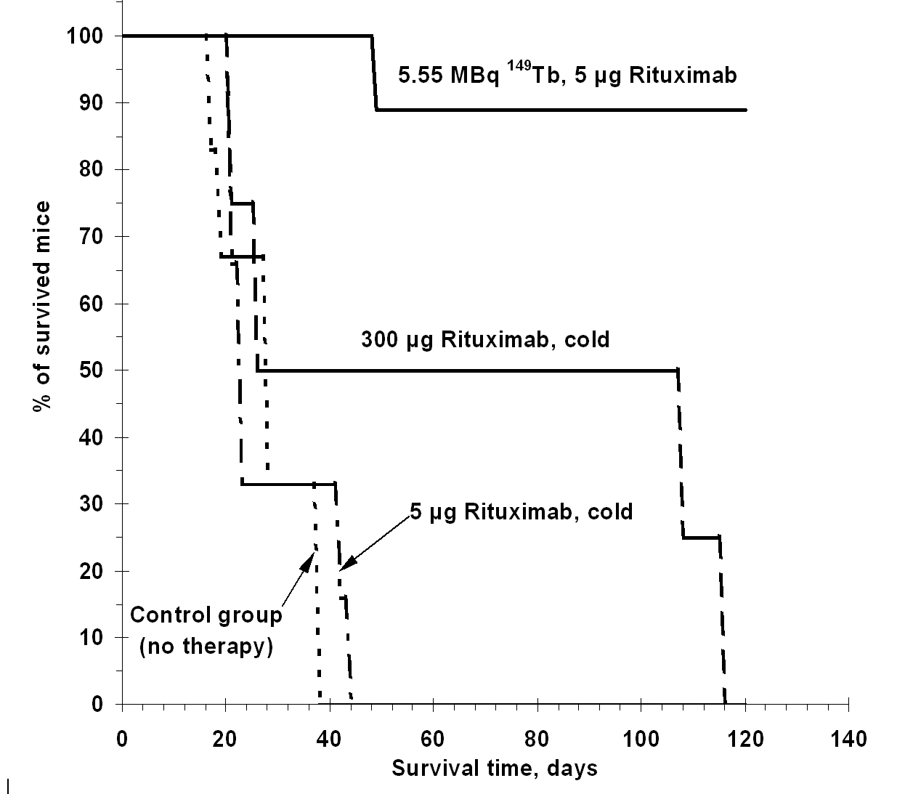
In vivo system for investigation of single cell-kill potential of Terbium-149
In vivo system with Lymphoma xenograft 2 days after i.v. injection
1. High specific activity
2. High affinity and internalizing monoclonal Antibody (Rituximab)
Beyer et al 2004

Slide 11
Radioactivity distribution in alpha-RIT with ¹⁴⁹Tb-Rituximab
Blood | n.d. | 60 + 4 | < 0.01
Liver | 18 + 3 | 24 + 4 | 1.8 + 0.3 | 1.6 + 0.2
Bone | 13 + 1 | 9.1 + 0.7 | 26 + 4 | 13 + 2
Spleen | 1.9 + 0.2 | 42 + 4 | 0.40 + 0.06 | 12 + 2
Heart | 4.5 + 0.7 | 41 + 6 | < 0.01
Lung | 2.4 + 0.5 | 18 + 4 | < 0.01
Kidney | 6 + 1 | 24 + 4 | 0.2 + 0.03 | 0.5 + 0.08
Muscles | 0.14 + 0.03 | 0.8 + 0.2 | < 0.02
Bladder | 0.12 + 0.03 | 3.7 + 0.9 | < 0.01
Body total | 100 |  | 28.4 + 4
Beyer et al 2004

Slide 12
The retention of the long-lived daughter nuclides (¹⁴⁹Eu, ¹⁴⁵Sm) is identical and not influenced by the radioactive decay mode (alpha or EC)
All the daughter nuclides stabilizes themselve initially in the the unbound free Me³⁺ form, their excretion can be supported by suitable chelating ligands (EDTA for example)
3. MIRDOSE model gives 400 mSv dose to a patient, for a 5 GBq ¹⁴⁹Tb-rituximab (weight factor 10 for α)
Gamma spectra of the organs of the animals used in the study 120 days after injection for quantitative data analysis
Notes:
Blood dose of Bi-213-HuM195: 2.6 ± 1.2 mSv/MBq (range, 1-5.1 mSv/MBq), liver dose: 5.8 ± 1.6 mSv/MBq (jurcic blood 2002)

Slide 13
Dose-Limiting Toxicities after Cytarabine and ²¹³Bi-HuM195 (Anti CD 33 in Leukemia)
Dose Level (MBq/kg) | No. of Patients | Dose-Limiting Toxicities
18 | 3 | None
27 | 3 | None
37 | 5 | Prolonged myelosuppression (n=1)
46 | 2 | Prolonged myelosuppression (n=1) Death from pneumonia (n=1)
2 GBq ²¹³Bi-HuM195 appears save even in combination with chemotherapy
Jurcic et al unpublished

Slide 14
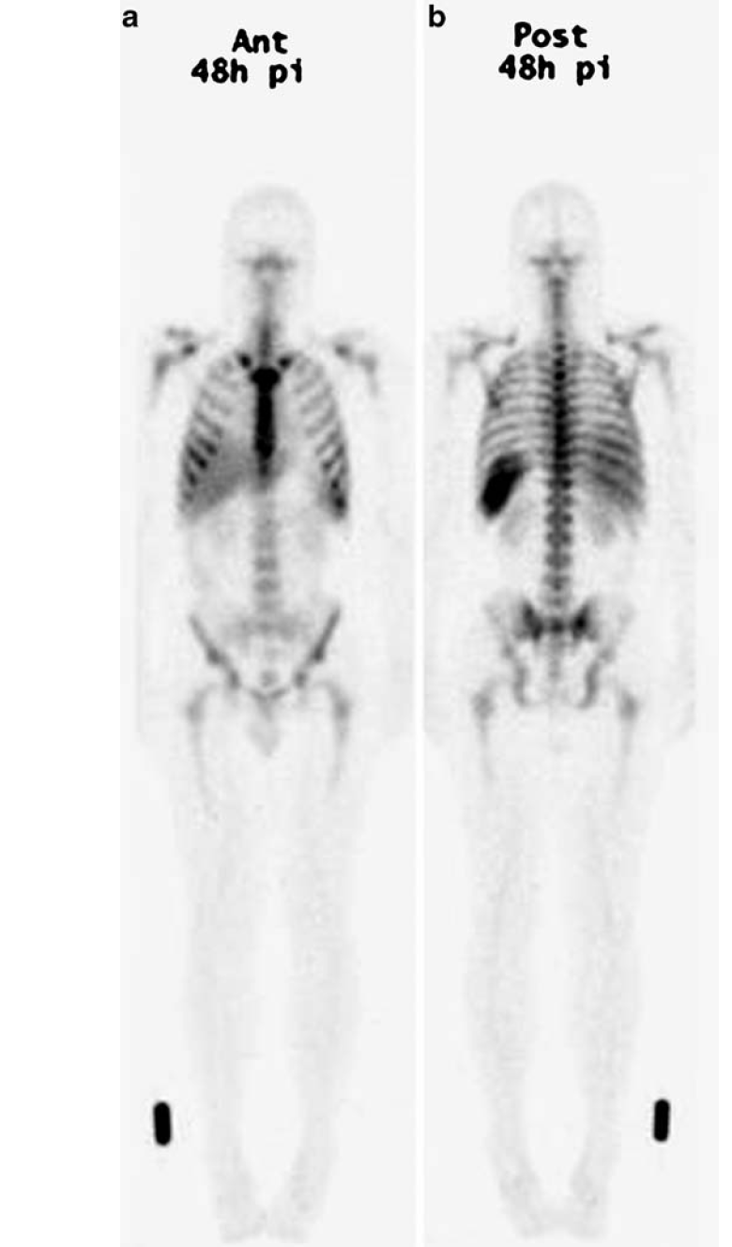
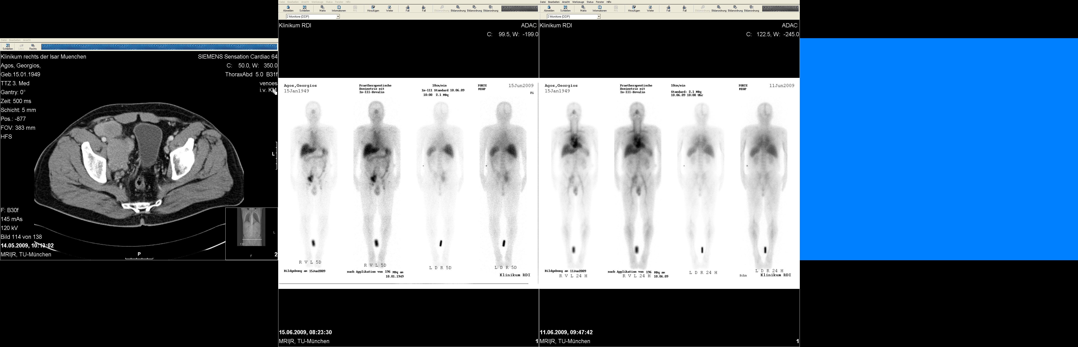
Current clinical application of Radioimmunotherapy with Y-90
In-111-CD66 dosimetry
In-111-Zevalin dosimetry

Slide 15
Acknowledgments
Memorial Sloan-Kettering Cancer Center
David A. Scheinberg, Joseph G. Jurcic, Michael McDevitt,
Institute for Transuranium Elements
Tuomo Nikula, Christos Apostolidis
CERN, Geneva
Gerd J. Beyer, Josef J Comor, Sanja Vranjes-Duric, ISOLDE Collaboration
Nuclear Medicine/Radiochemistry
National Cancer Institute
Martin Brechbiel,
Technical University Munich
Reingard Senekowitsch-Schmidtke, Christof Seidl
David E Charlton
University Medical Center Geneva
G. Künzi, O. Hartley, D. Soloviev,
Franz Buchegger

Slide 16
Cancer statistics
 | Leukemia | Gastric cancer | Hon Hodgkin Lymphoma | Prostate cancer | Breast cancer
Incidence rate per 100,000 | 4 | 8 | 20 | 160 | 124
5 Year survival | 23% | 26% | 67% | 99% | 89%
5 year survival localized stage |  | 63% | 81% | 100% | 98%
5 year survival advanced stage |  | 3% | 57% | 31% | 23%
 | renal cancer | Colon Cancer | Lung cancer
Incidence rate per 100,000 | 14 | 49 | 63
5 Year survival | 68% | 65% | 16%
5 year survival localized stage | 90% | 91% | 53%
5 year survival advanced stage | 10% | 11% | 4%
SEER Database 2002-2006

Slide 17
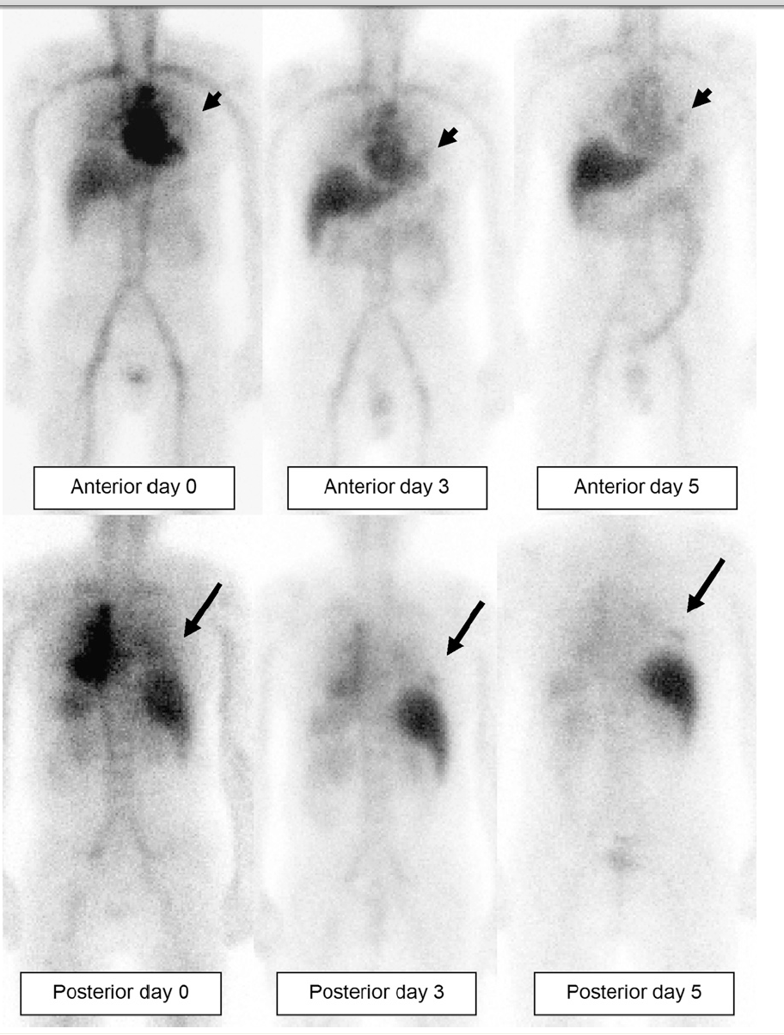
Experimental clinical application of radioimmunotherapy in solid tumors – Prostate Cancer
In-111-J591 for prostate cancer, Pandit-Taskar, JNM 2008

Slide 18
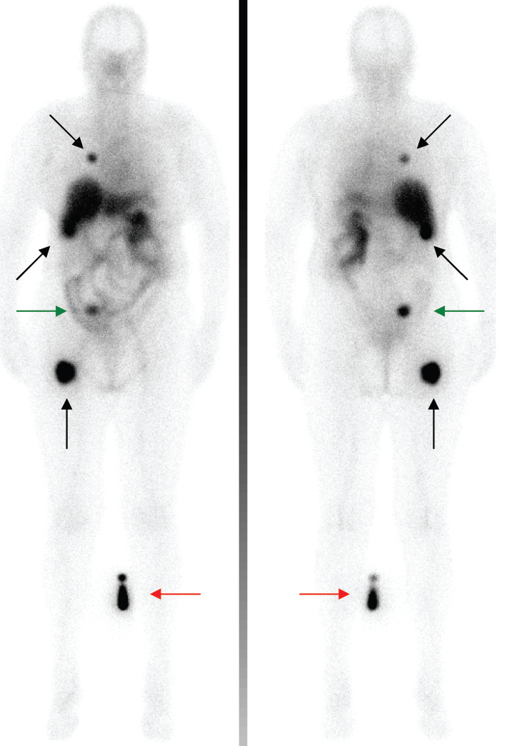
Experimental clinical application of radioimmunotherapy in solid tumors – renal cancer
In-111-g250 for renal cancer, Stillebroer, Cancer Imaging 2007

Slide 19
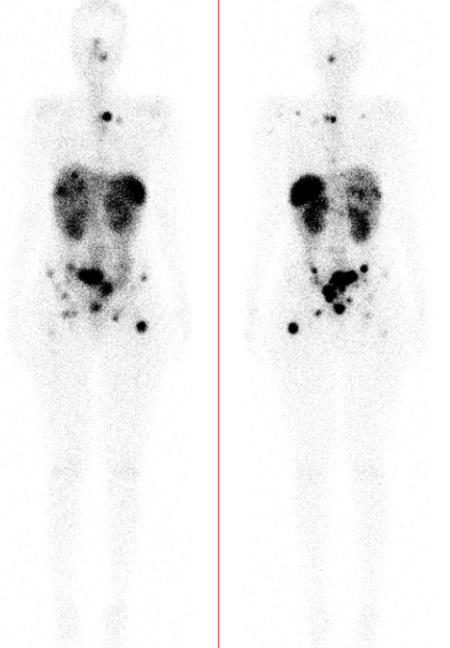
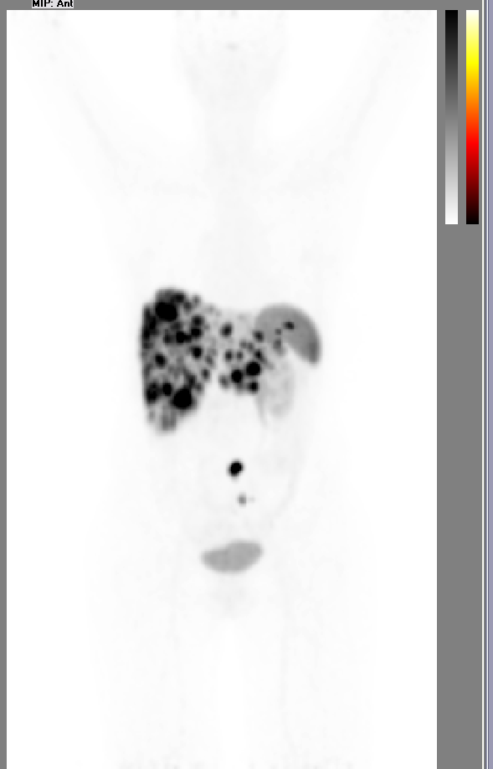
clinical application of radiopeptides
Therapy with Lutetium-177-DOTATATE
PET imaging with Gallium-68-DOTATOC

