Slide 1
Baltic School of Particle Physics
Christoph Schäfer
CERN-Baltic Group Meeting 29.5.2018

Slide 2
What exists on the market
CERN organises three main schools:
  CERN Schools of High-Energy Physics
    European School (annually), Latin-America School and Asia-Europe-Pacific School (bi-annually)
  CERN Accelerator Schools (various topics, 4 times/year)
  CERN School of Computing (main, inverted and thematic)

Slide 3
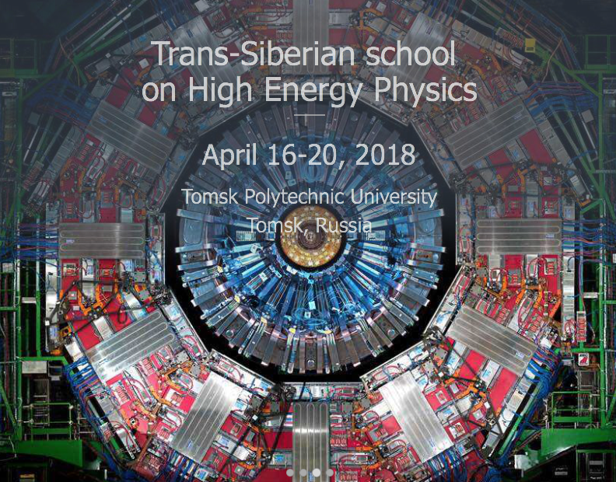
Other schools

Slide 4
Motivation
There are plenty of particle physics schools around - Why another one?
We need a school adapted to the needs and competences in the Baltic region
It could be integral part of a joint particle physics study program - targeted to master students
Participants could/should gain ECTS points

Slide 5
Motivation
Meet key players in the field
Lecturers should come from all labs: CERN, DESY, CEA, INFN etc.
Topics could cover all aspects of particle physics:
  Theory, data analysis, detectors, accelerators, computing, technology transfer (medical applications)
Preference to overview rather than depth
Specialised schools exist already for further study

Slide 6
Constraints
Location limited to the Baltic region in order to reduce travel costs
Dates must be compatible to University calendar
ECTS points and exams must be agreed on by all participating universities

