Slide 1

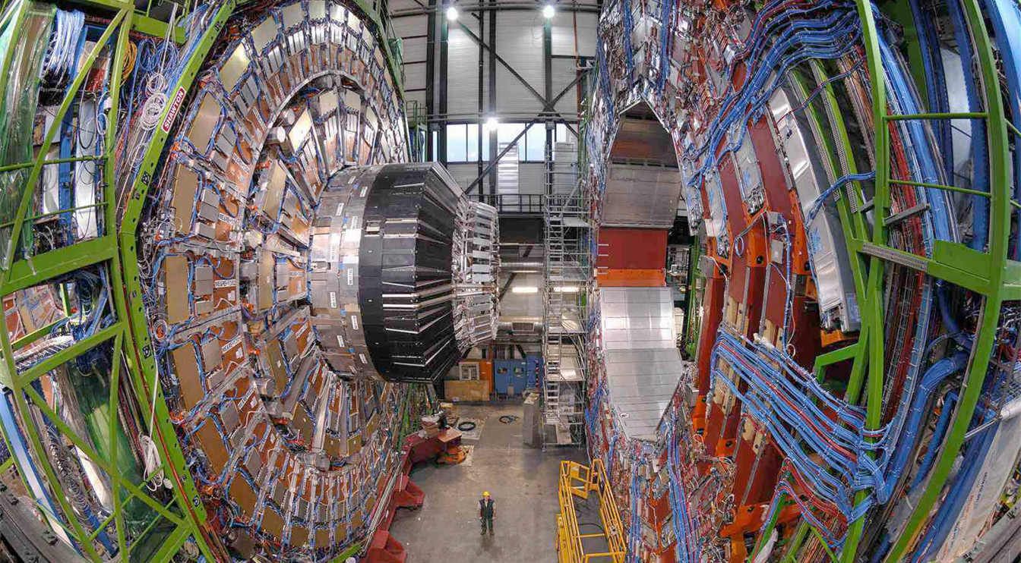
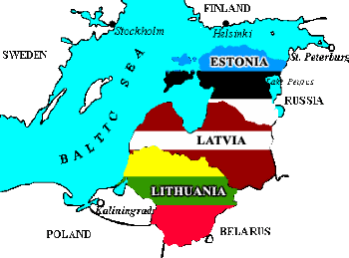
Finance Issues
A. Charkiewicz, Baltic Meeting, 29 May 2018
Notes:
1

Slide 2
CMS is a global Collaboration
CMS is composed of over 40 countries with each represented by one or more Funding Agency (FA) in the Resource Review Board (RRB)
The RRB meets twice a year (April and October) and decides on all major financial issues related to CMS (approval of budget and expenditures)
CMS has three types of membership status
  Full member
  Cooperating member
  Associate member
For new Funding Agencies a Linkperson who is the interface between that FA and CMS and a member of the Finance Board (FB) will be nominated. The FB meets on average ten times a year
The Finance Board is chaired by the CMS Resources Manager and its role is to manage all financial issues and prepare the budget request and other documents for RRB approval
The CMS budget is reviewed by external review groups: LHC Committee (LHCC), Upgrade Cost Group (UCG) and Scrutiny Group (SG)

Slide 3
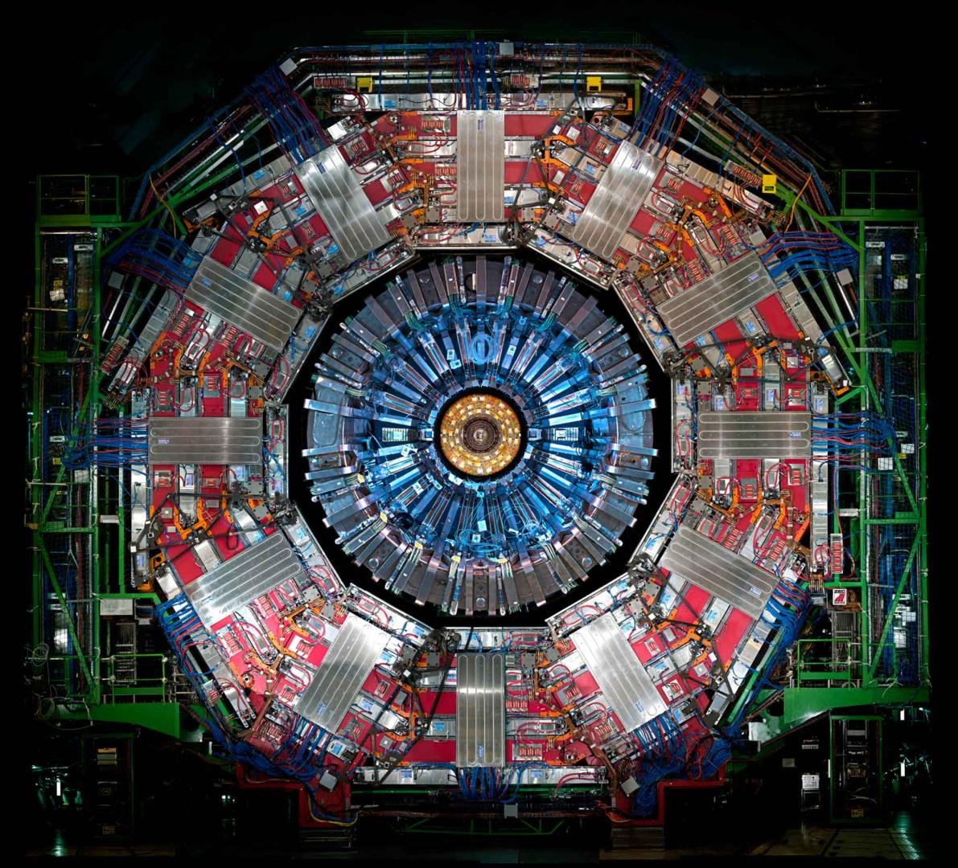
CMS Budgets
Maintenance and Operation Category A (M&O-A)
  Expenditures common to the whole detector
  Sharing based on the number of physicists signing CMS papers (PhD List)
Maintenance and Operation Category B (M&O-B)
    Subsystem-specific expenditures
    Sharing based on institute responsibility with PhD list as guideline
Upgrades
  Phase I Upgrade (65 MCHF)
    Including Common Fund of 6.5 MCHF
  Phase II Upgrade (280 MCHF)
    Including Common Fund of 25 MCHF

Slide 4
2019 M&O-A Preliminary Budget request
The M&O-A cost estimates for 2019 were presented to the RRB at the meeting in April 2018
The total estimated budget for M&O-A is 15’297 kCHF
The RRB is presented with a budget projection for the following 4 years
Experience shows higher expenditures in the years of Long Shutdowns
Final approval of the budget for 2019 is made by the RRB at its meeting in October 2018

Slide 5
2019 M&O-A Preliminary Budget Request

Slide 6
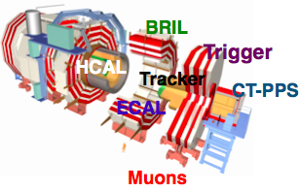
M&O-B Budget
Each CMS Subdetector or Subsystem is an independent entity with its own management structure including a System Manager, System Resources Manager and an Institution Board which approves all major financial decisions and the annual budget
Each CMS Funding Agency is expected to contribute to at least one Subsystem (where it is implicated on the technological and research level)
The sharing mechanism among Funding Agencies and the consequent contributions are decided by the Institution Board
In most Subsystems the relative percentage as defined by the PhD count is used. Only few use other schemes.

Slide 7
2019 M&O-B Preliminary Budget Request
In the same way as the M&O-A budget the Subsystems’ M&O-B budgets are submitted to the RRB for approval (preliminary request in April and final in October)
The forecast of the M&O-B budget for 2019 amounts to 5’382 kCHF
The M&O-B expenditures undergo formal scrutiny by the RRB Scrutiny Group (following an internal CMS Scrutiny process)
The forecast for the next four years shows that the M&O-B budget remains at a flat level
This is however likely to change in the future due to the addition of new Subsystems with the Phase II Upgrade (Endcap Calorimeter, MIP Timing Detector)

Slide 8
2019 M&O-B Preliminary Budget Request

Slide 9
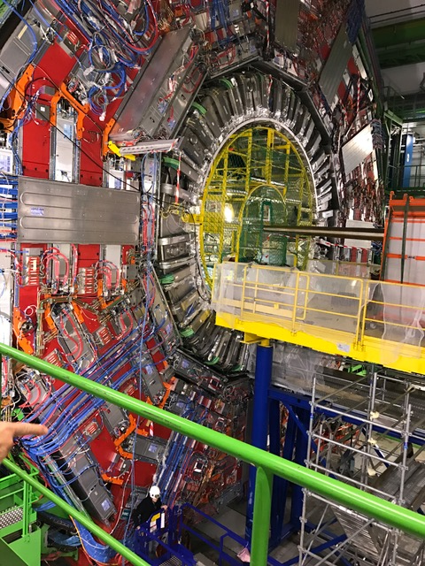
Upgrade Status
Notes:
1

Slide 10
Status of Phase I Upgrade
The CMS Phase I Upgrade has already been largely accomplished with few expenditures remaining for HCAL, Tracker and DAQ
There is no change to the overall budget of the Phase I Upgrade
There are no specific problems related to funding
Phase I Money Matrix
Phase I Spending Profile
FROZEN
since three years

Slide 11
Phase II Upgrade
CMS is currently shifting full focus to intense preparations for the Phase II Upgrade with each Subsystem project having prepared a Technical Design Report (TDR) with accompanying cost, schedule and resource information
All reviews by the LHCC and UCG (the Upgrade Cost Group) are complete for all projects except for the Trigger and DAQ systems, for which the final TDRs are planned in 2020-2021
CMS Management continues iterations with Funding Agencies via the Linkpersons to the CMS Finance Board with the main objective of addressing cost and funding imbalances across different Subsystem projects
One MoU Addendum defining GEM GE 1/1 Upgrade Project has been finalized the process of being signed by Funding Agencies participating in this project
More MoU Addenda specific to every TDR project will follow after October 2018 RRB meeting in order to formalize the funding of the Phase II Upgrade
New countries and institutes joining CMS are expected to contribute to the Phase II Upgrade (preferably in projects which remain underfunded)

Slide 12
Phase II Upgrade Common Fund
A Phase II Common Fund has been established to cover infrastructure upgrades which benefit all Subsystems
It will be financed by contributions expected from all CMS Funding Agencies as agreed at the October 2017 RRB with a total cost established at the level of 25 MCHF
At the end of last year, CMS finalized the elaboration of an Addendum No. 10 to the Memorandum of Understanding for the Construction of the CMS Detector outlining the principles of this Common Fund
Up to date, a significant number of Funding Agencies have already signed the document and some have made contributions, which is highly welcome since the Phase II Infrastructure work is already ongoing
Sharing of costs is defined by the proportion of PhD physicist authors supported by each Funding Agency (list established for the 2015 M&O-A sharing)
Newly joining countries will contribute in accordance with their foreseen number of PhDs (as defined in MoU Addendum No 10)

Slide 13
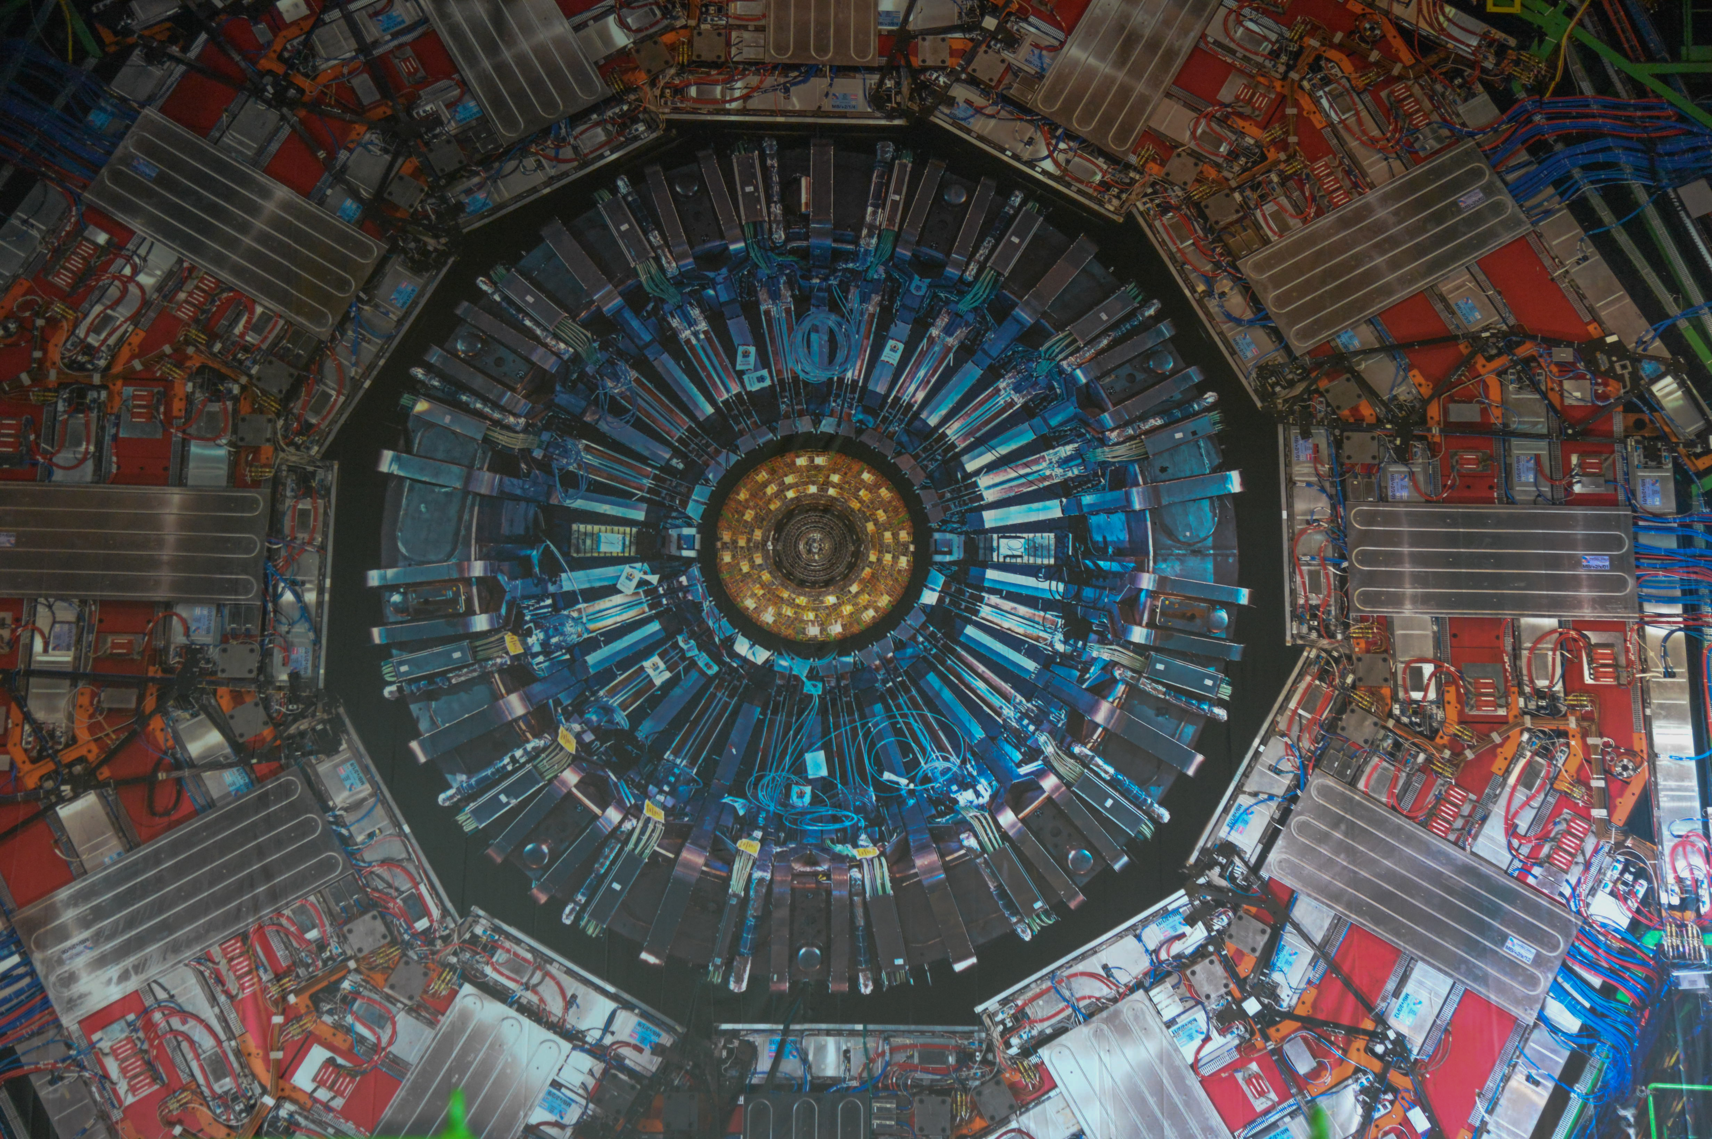
Questions
Thank you for your attention

