Slide 1
The CERN Accelerator School
Established at the beginning of 1983
  To preserve and transmit knowledge accumulated, at CERN and elsewhere, on particle accelerators and colliders of all kinds
This provided a framework for a series of courses
  General accelerator physics
    Introduction to Accelerator Physics
    Advanced Accelerator Physics
  Specialized topic in the field
  50 to 70 hours teaching in 1-2 week intensive residential courses
About 70 courses held so far
Occasional courses in the framework of the US-CERN-Japan-Russia Joint Accelerator School (JAS)
  14 schools held so far (since 1985)

Slide 2
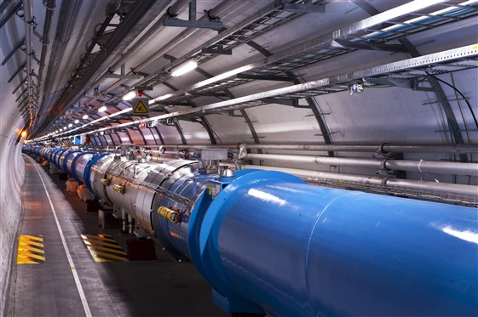
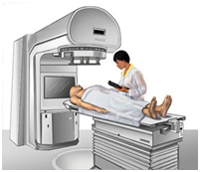
Scope
Accelerator Physics
Relativity / Electro-Magnetic Theory / Transverse Beam Dynamics / Longitudinal Beam Dynamics / Linear Imperfections and Resonances / Synchrotron Radiation / Electron Beam Dynamics / Multi-Particle Effects / Non-Linear Dynamics Beam Instabilities / Landau Damping / Beam-Beam Effects
Accelerator Systems
Particle Sources / RFQ / LEBT
RF Systems / Beam Measurement / Feedback Systems / Beam Injection and Extraction / Beam Transfer Power Convertors / Warm Magnets / Superconducting Magnets / Vacuum Systems Machine Protection Systems Radiation and Radioprotection
Accelerators
Linear Accelerators
Synchrotron Light Machines
FELs
FFAGs
Cyclotrons
Synchrotrons
Colliders
Applications
High Energy Physics
Nuclear Physics
Industrial Applications
Medical Applications
Cancer Therapy

Slide 3
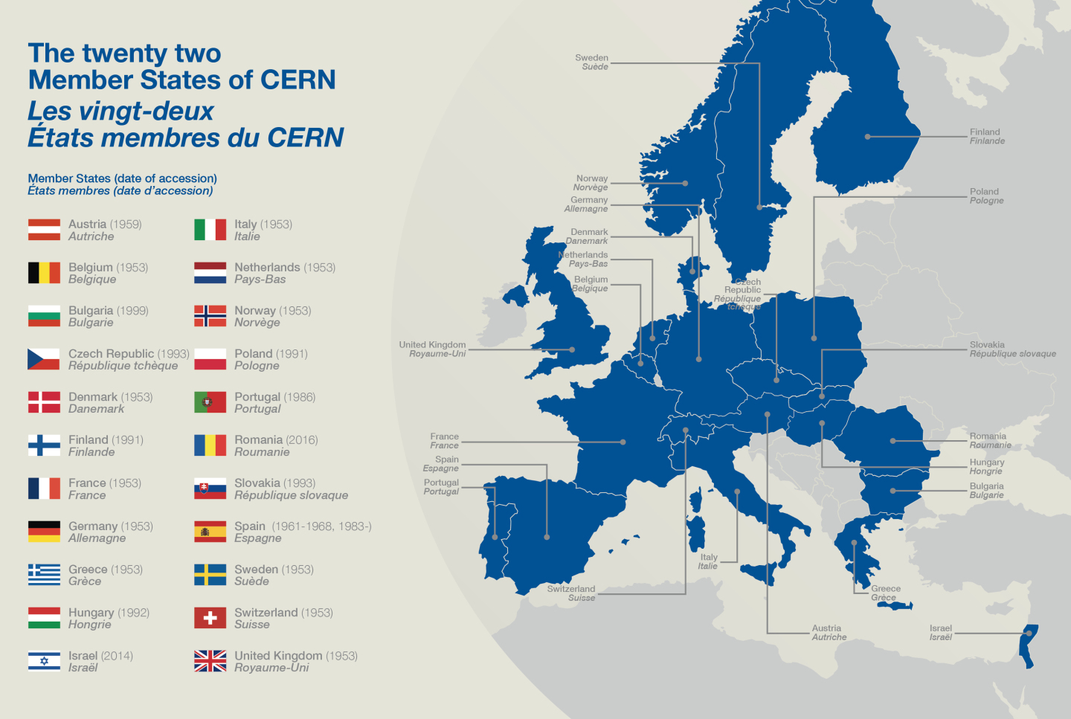
The CERN Accelerator School holds courses in all of the Member States of CERN
Have been to all except Israel (joined 2014) and Romania (joined 2016)

Slide 4
CAS courses - details
“General Courses”; length 12 or 13 nights
Accelerator beam dynamics and technologies
- on an introductory level (every year)
- on an advanced level (every second year)
“Topical Courses”; length 12 or 13 nights
Specialized course on a topic selected by the CAS advisory board; repetition rate of most relevant topics: 4…8 years
“Local School”
CERN centric; 5 days, non residential, but now also open for external application
called CAS@ESI (close to CERN)

Slide 5
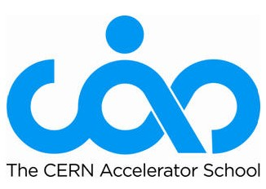
Course Program 2018 - 2021
 |  | Period I |  | Period II |  | Period IIb |  | Period III |  | Period IV |  | JAS 2017: RF
 |  | Feb-April |  | May-June |  | End June |  | Sept-Oct |  | Nov-Dec |  | Japan (Hayama)
2018 |  | Future Colliders |  | Beam Instrumentation |  | Short Introduction |  | General Introduction |  | Comp. Methods
 |  | Switzerland |  | Finland |  | France (local) |  | Romenia |  | Greece
2019 |  | Advanced Acc. Concepts |  | General Advanced |  | Short Introduction |  | General Introduction |  | JAS: Ion Colliders
 |  | Portugal (Lisbon) |  | Danmark |  | France (local) |  | Slovakia |  | Russia
2020 |  | RF |  | Mechanical Engineering |  | Short Introduction |  | General Introduction |  | Warm magnets
 |  | associate member state |  | Holland |  | France (local) |  | Ukraine earmarked |  | Austria
2021 |  | Digital Signal Processing |  | General Advanced |  | Short Introduction |  | General Introduction |  | JAS: Very Advanced Beam Dynamics
 |  | tbd |  | tbd |  | France (local) |  | tbd |  | "In the Americas"
 |  |  |  |  |  | * CAS@ESI
 |  |  |  |  |  | (Archamps)

Slide 6
What’s new at CAS?
More courses/year
- Introductory General Course every year (September)
- Advanced General Course remains every second year
(June)
- Basic (non-residential) course in the vicinity of CERN every year (also open for people from outside CERN)
Joint Accelerator School course every second year
Major topical courses every 4-5 years
(beam instrumentation, RF, vacuum, magnets…)
New topical courses (mechanical engineering…)
10 students grants for every course
New splendid website http://cas.web.cern.ch/

Slide 7
What does it need to host a CAS?
A local host in collaboration with the CAS team
- choice of venue
- planning of social programs
- contribution to scientific program
- (technical support for afternoon hands-on courses”)
- office support during the school
If possible, a financial contribution of up to 20 kCHF in order to co-finance 10 student grants at the school.
(Apart from the grants the school is meant to act cost neutral; difficult in some countries)

