Slide 1
CMS Software and Offline preparation for future runs
Tommaso Boccali
INFN Pisa / CERN

Slide 2
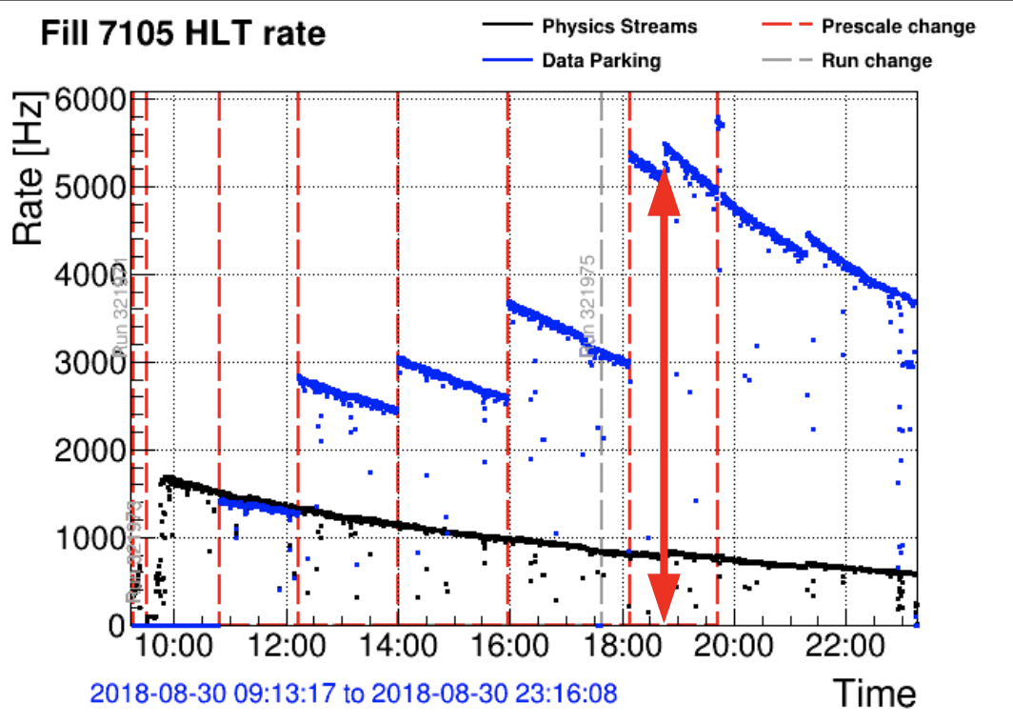
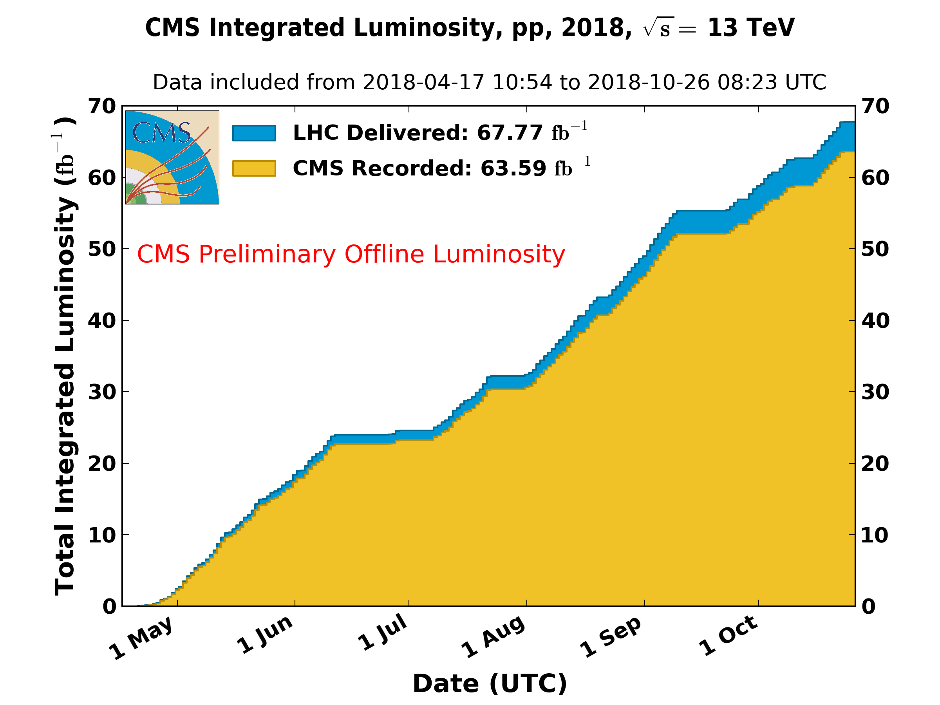
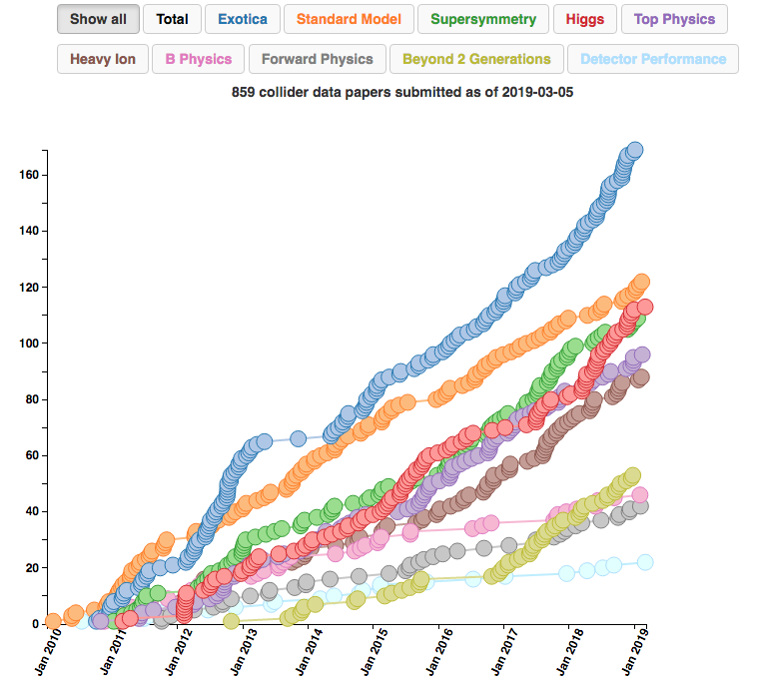
CMS Computing circa 2019 the status
LHC concluded in December 2018 its second Run (“RunII”)
CMS very successful in the data taking and analysis operations, with computing supporting unexpected requirements
  ParkingB: additional 12 B events collected in 2018 to support CMS B Physics; a sample 5x larger than Babar’s and Belle’s!
    Up to 6 kHz additional rate to tape
  HF flavour physics in Heavy Ions: 4.5 B additional Minbias events collected in Nov 2018
    Rate to offline > 7 GB/s
On top of that, standard pp operations (64/fb collected), analysis operations in full swing
  859 collider papers submitted
  Derivative increasing!

Slide 3
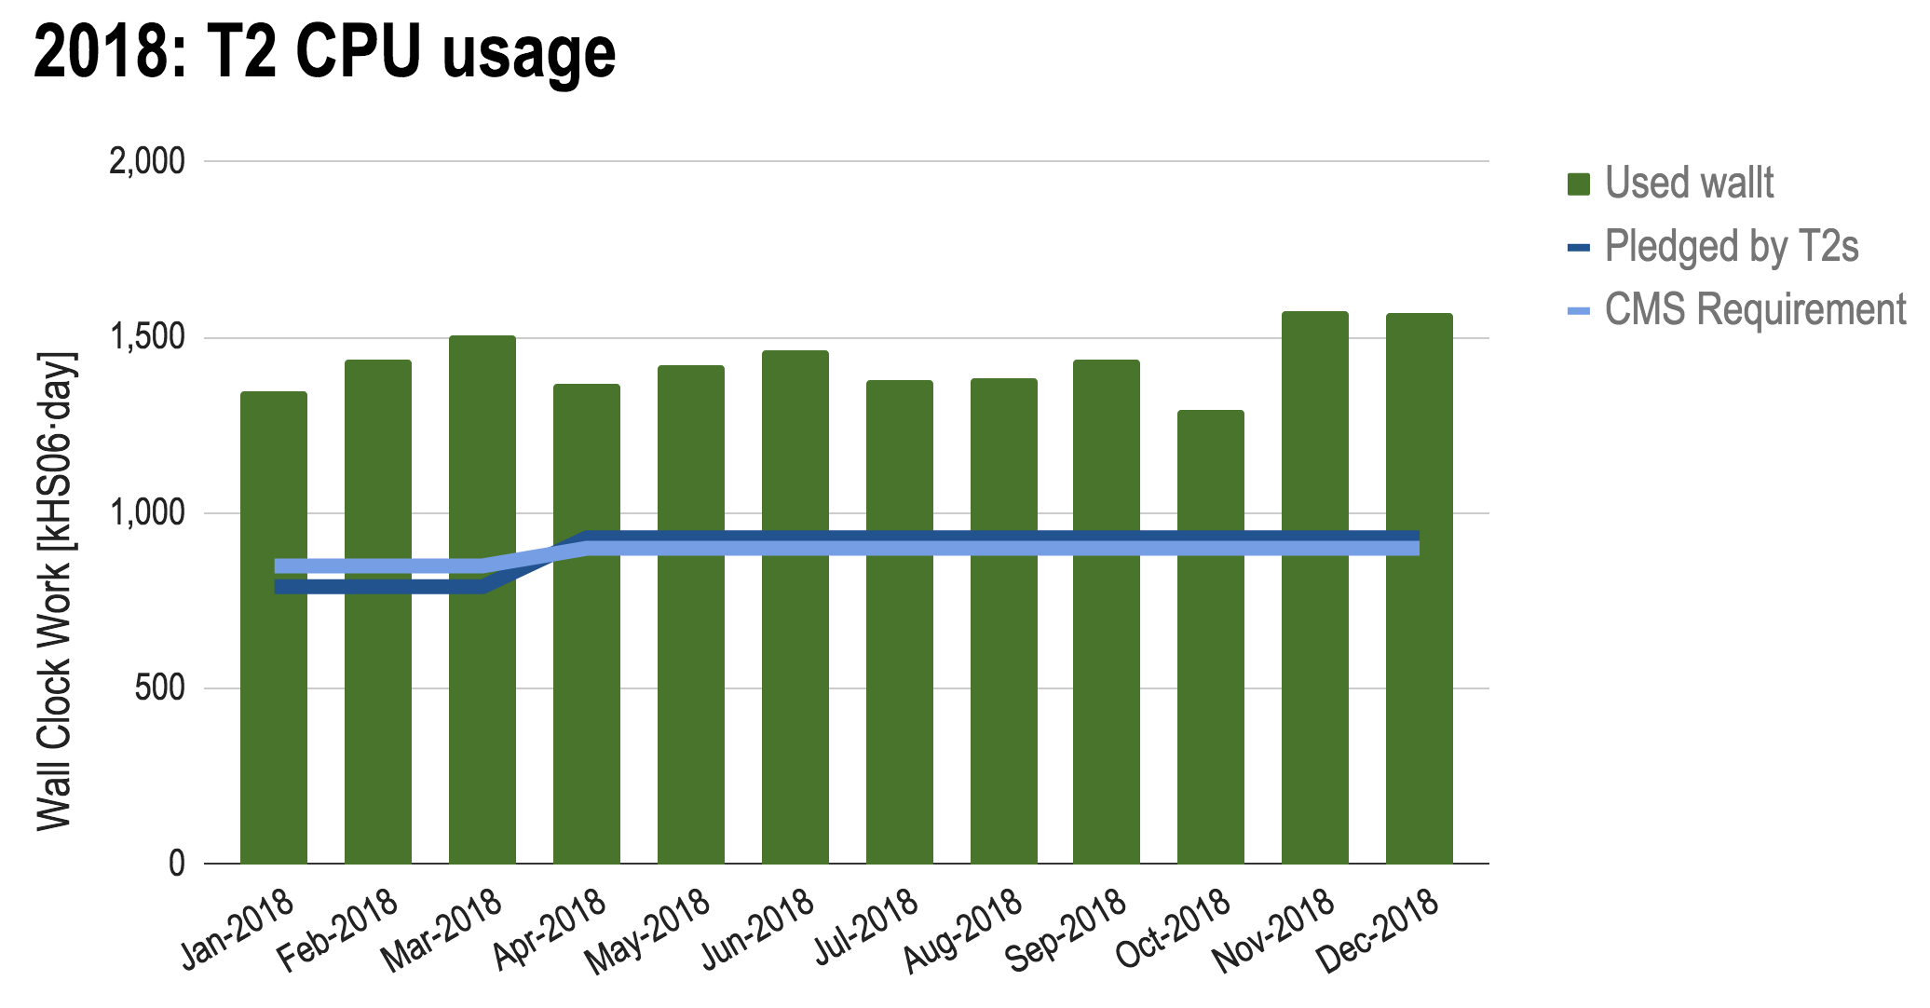
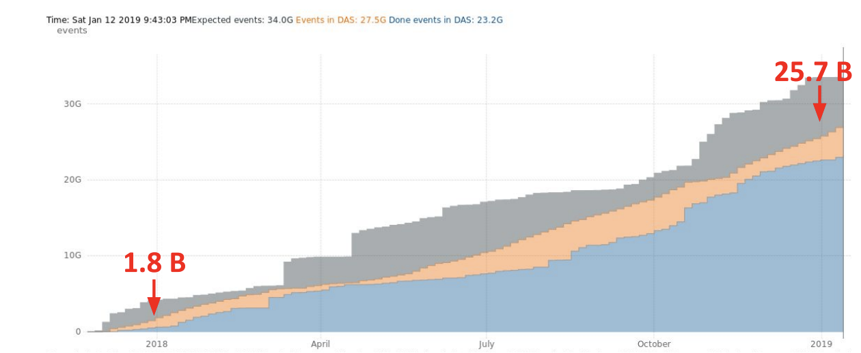
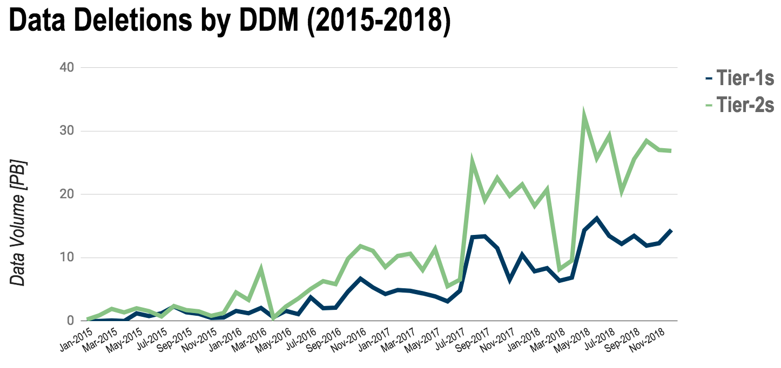
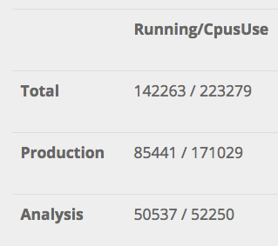
Overall...
Utilization
Pledge
Complete utilization of resources, with sizeable over-pledges in CPU
In 2018, more than 24 B full Simulation events generated to support the physics program
Storage areas (disks, tape systems) well under control
  Thanks to Dynamo/DDM, operational since the start of the Run
CMS SW in full-real multithreading mode since 2015 (8 threads is the default): no memory problems, even with PhaseII simulations
24B Full Sim events
generated in 2018
DDM deletes
~40 PB/month
Production varies from 1-15 threads
Analysis still mostly single thread

Slide 4
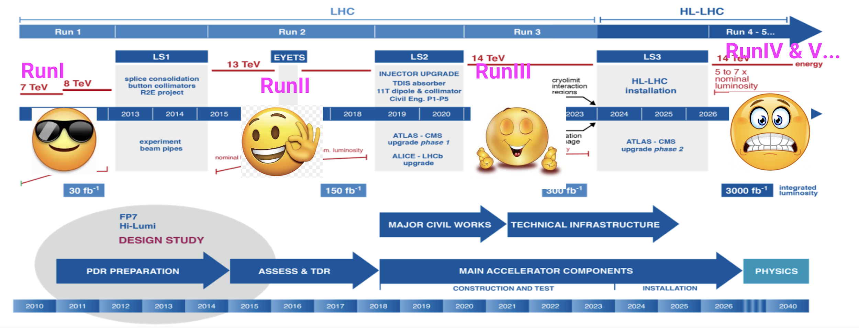
So where is the problem?
2009-2012 (RunI): resources somehow overprovisioned, luxury mode
2013-2014 (LS1): Funding Agencies imposed a “flat funding”, which means ~20% increase/y thanks to Moore’s law (and friends)
2015-2018 (RunII): resources more and more constrained, Moore’s law starting to be excessively optimistic
2019-2020 (LS2): virtually no increase in resources granted
2021-2023 (RunIII): in principle not incredibly different from RunII, but LHC is willing to surprise us
2024-2025 (LS3): no increases?
2026+ : the LHC Phase II, the problem!

Slide 5
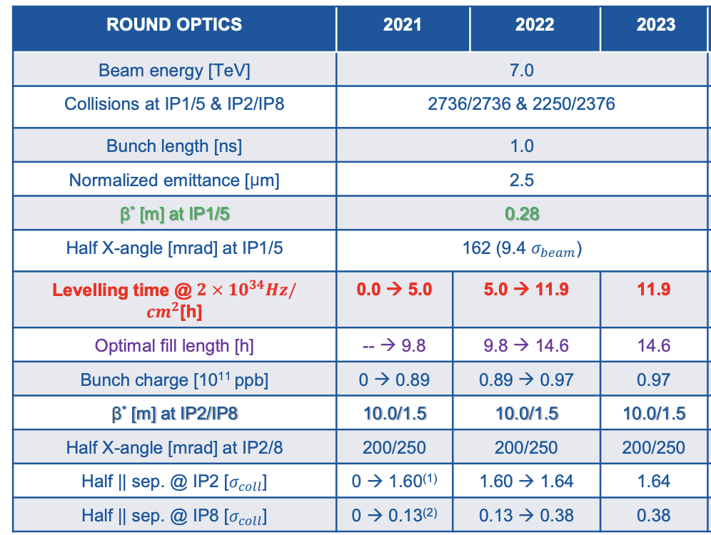
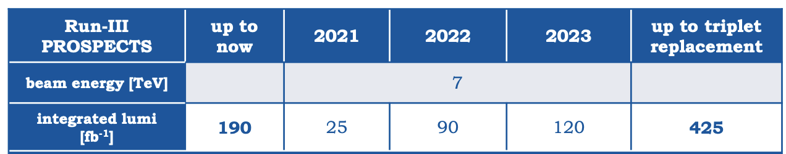


RunII → RunIII
Limit in instantaneous luminosity @ 2e34 cm⁻²s⁻¹, close to RunII …
… but levelled for most of the fill time (12 h?) → much larger average inst lumi → <PileUp> 35 → 55 (?)
Inst Lumi
Not possible,
triplet cooling
2e34
Not-so-easy any more, when considering an almost halved Moore’s law around +10%/y
Fill length (h)
Fill length (h)

Slide 6
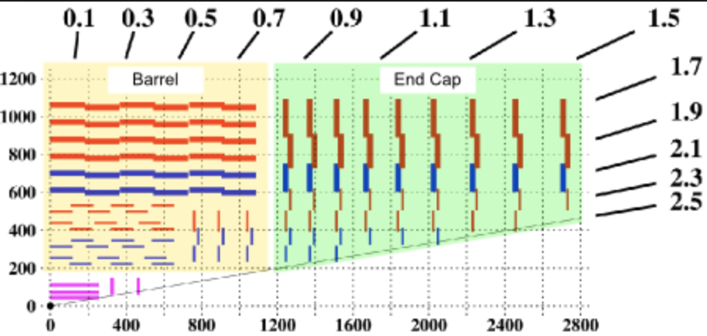
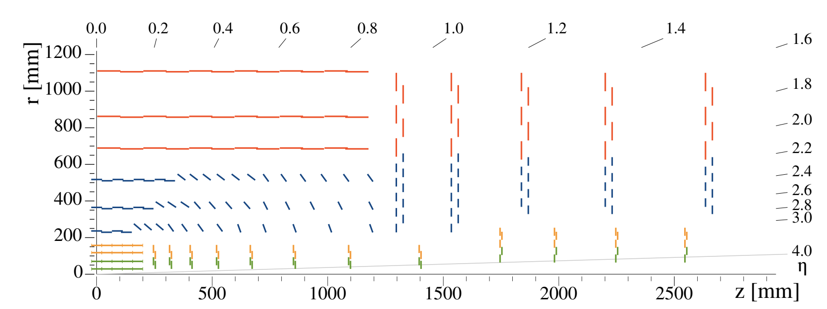

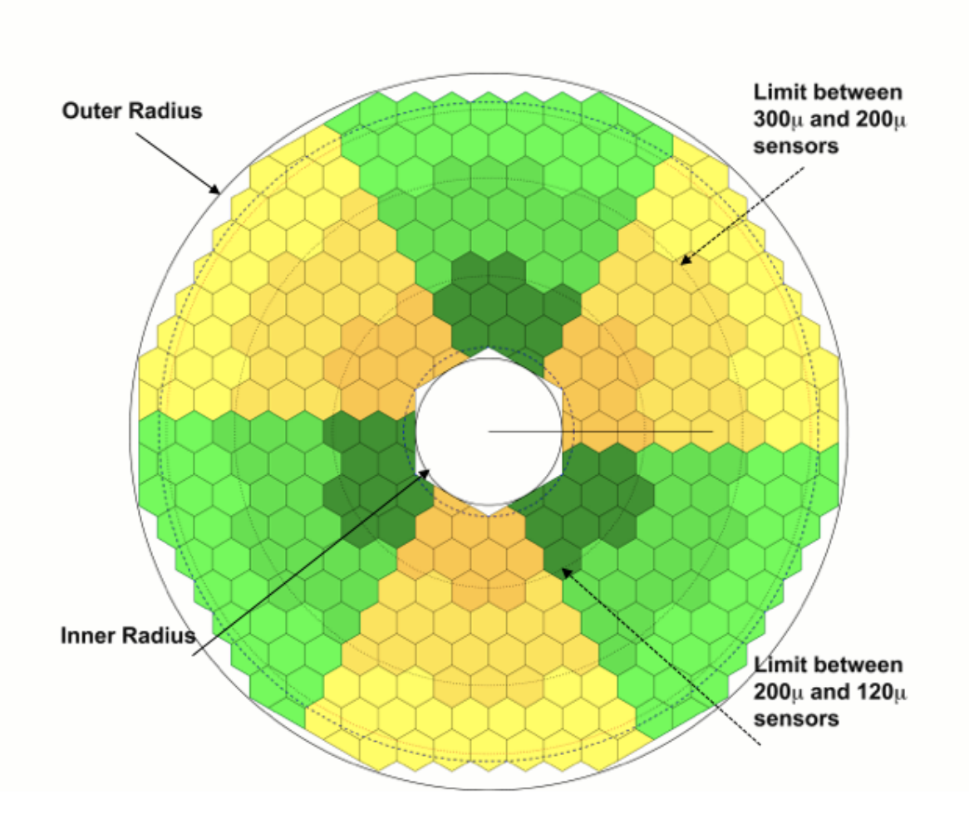
RunIII → RunIV
Current modelling expects up to 7.5e34 cm⁻²s⁻¹ flat luminosity during fills
PU = <PU> = 200
CMS with an upgraded detector:
  Many more silicon tracker measurements
  Completely revamped forward calorimetry
  → many more channels, much larger expected algorithmic complexity
Physics requirements currently suggesting 5-10x increased trigger rate
→ on paper, easy to get factors 50-100x more resources needed with respect to RunII!
(see An analytics driven computing model for HL-LHC here at ACAT)

Slide 7
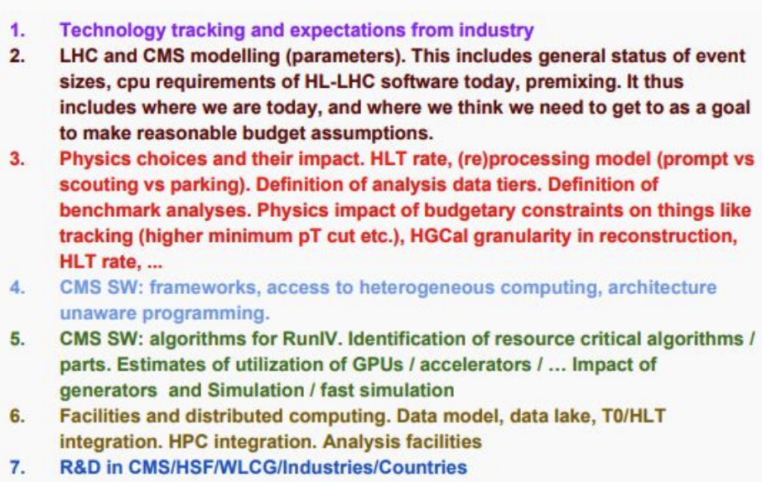
What to do?
Even considering an optimistic technology factor ~4x from technology, factors > 10x are missing
Miracles apart (quantum computing anyone?), we need an intense and focused R&D program in order to allow for a(n economically) viable exploitation of HL-LHC
In CMS, the activity is carried out in multiple groups, with an attempt of light steering from the Evolution of Computing Model 202X → ECoM2X
It is not a Computing only effort, but an overall CMS effort, including:
  Physics, Trigger, PPD and Run Coordination
  Expert analysts
  Representative of major funding agencies
Activity split in 7 Working Groups
Some highlights in the next slides...

Slide 8
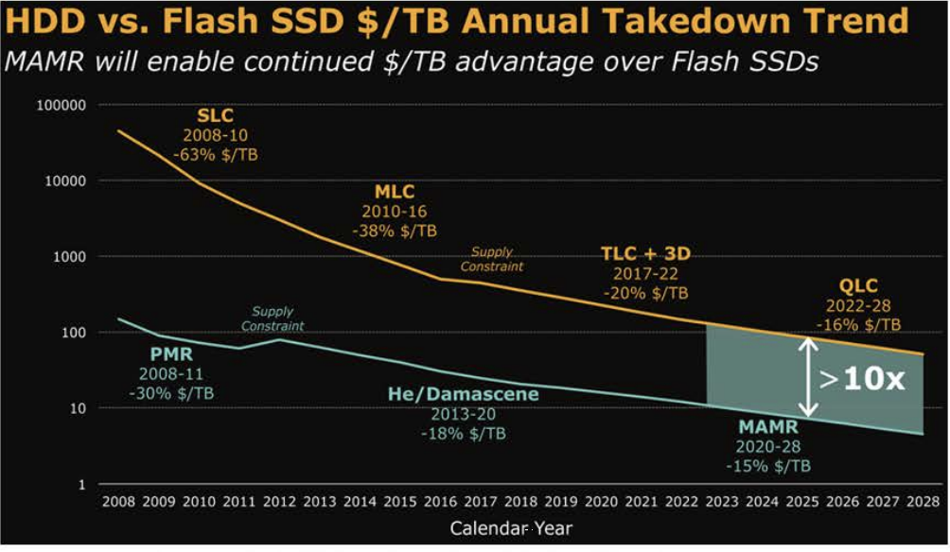
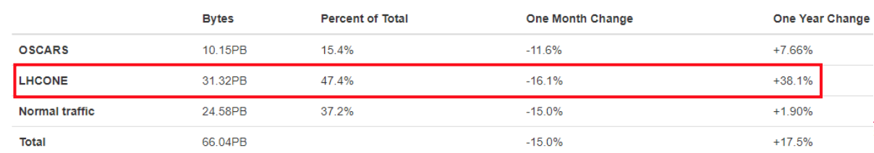
Technology tracking
Difficult to fully predict the 2026+ technology scenario, but our analyses show that we should focus on:
  Directly supporting GPUs and FPGAs in our software stacks
  TPUs are also promising, but are there use cases apart from speeding up ML training?
At the moment there is no convergence of HDD and SDD, with a “distance” in $$/TB roughly constant in time
Tape technologies are advancing at higher pace than disk; still there is a problem with decreasing user base
Up to now no real effort to streamline network utilization (considered infinite)
This will probably change by RunIV, at least for transatlantic links
  Abandon uniform full mesh?
  Segregate continents?
  US (ESnet) LHCone traffic +40%/y

Slide 9
Physics choices, data rates and analysis model
Investigations just started, and complex due to many stakeholders
Naive extrapolation from L=1.9e34 → L=7.5e34 explains the expected need of HLT output at ~ 7.5 kHz, mostly coming from single object triggers
  Unless we want to reduce / descope a part of the physics program
  Unless we can use less inclusive trigger approaches - to be studied!
More to be gained by smart data handling approaches:
  Park a large fraction of triggers, and recover in the winter shutdown or LSs
  Scouting datasets, with small “reco like” output to offline
  Prompt reconstruction just in order to ensure data quality; deferred reconstruction for the rest
  …
The amount of MC to produce has a large effect on resource needs
  Need for a common-HEP GAN based Fast Simulation?
  Event generators’ increase in resources due to N(NNN)LO to be kept under control - today it is not

Slide 10
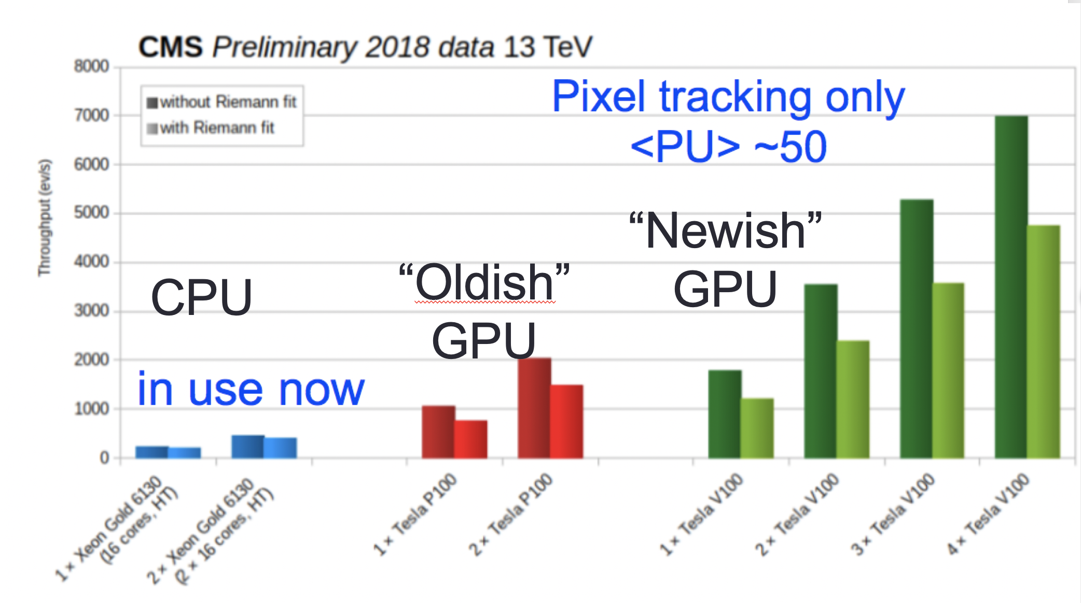
Heterogeneous architectures
There is general consensus that the best performance/$$ will not be obtained with standard CPUs
Testbeds active on GPUs, FPGAs, … initially as standalone exercises
In the last year, CMS has performed a general attempt to systematically include these in the standard CMSSW Software Framework:
  Allow multiple versions of “equivalent” modules, and defer the decision on which to use even very late (event by event, module by module)
  Allow the best communication between modules exposing different interfaces (for example, aut. chain GPU modules without moving data back to the host)
  Have CUDA as an external tool in CMSSW, for native utilization
  Next step (in collaboration with other experiments?) is to try and have automatic code translation in place (is it even possible?)
Examples exist; see for example Towards a heterogeneous High Level Trigger farm for CMS at ACAT
Status of the framework allows to run benchmarks / compare architectures / plan for infrastructure

Slide 11
Reduced data formats
Data Tier | Size (kB)
RAW | 1000
GEN | < 50
SIM | 1000
DIGI | 3000
RECO(SIM) | 3000
AOD(SIM) | 400 (8x reduction)
MINIAOD(SIM) | 50 (8x reduction)
NANOAOD(SIM) | 1 (50x reduction)
The most important result of the previous ECoM17 task force has been the definition of a (even more) reduced data format
CMS already in 2014 pioneered the definition of “small” general purpose data format, MiniAOD @ ~ 1/10 of the standard AOD
Its adoption has been overwhelming in RunII: its adoption was expected to be for ~70% of analysis, it now reached 95%
NanoAOD go even further: we were aiming at ~ 5 kB/ev, eventually we are at 1 kB/ev!
Expected analysis coverage ~50%; we hope to be positively surprised as for Mini!
See The NanoAOD event data format in CMS at ACAT
Full RunII:
25 (DT) + 35 (MC) B events
Expected to fit in 60TB
Analysis data formats
Exec Summary: “Prevalent analysis format in CMS reduced by a factor 3000x in event size since the start of RunI”

Slide 12



Changing SW tools
The CMS SW stack and Computing Infrastructure were adequate for CMS needs in RunII, and then some.
We have no real hint that RunIII would pose irresolvable problems either; but, since RunIV is a different story, CMS plans to try and test any disruptive technology already in RunIII
Among the software tools, the biggest worries in the RunIV time scale are about software support and sustainability. Common solutions with other experiments are a way to mitigate the support cost
CMS identified 3 initial areas where we can profit from existing OSS:
  Geometry description: testing DD4HEP from AIDA2020; if testing is positive, transition in ~1 y
  CRIC from CERN as a replacement for the Information System - already in place for the first use cases
  Rucio (initially from ATLAS) as the Data Management solution - transition and then large scale test in ~ 1 y

Slide 13
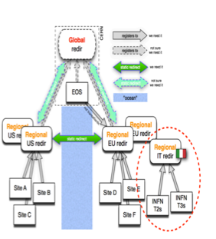
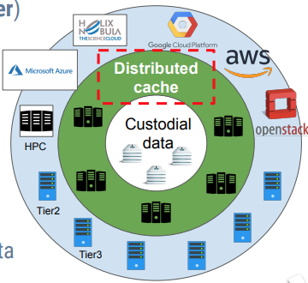
Changes to the infrastructure
Reducing the needs for data replication is of paramount importance for a cost reduction
This can come from aggressive policies paired with remote reads
  CMS already executes prod WFs without data locality, and explicit overflows to “close sites” via the Xrootd federation
The data lake seems the most promising solution to-date for a safe storage of our data, with limited replication
It also allows to think that most of the CPU resources can be served without managed disks. This opens to:
  HPC systems
  Commercial Clouds
  Ephemeral sites
and drives the needs for proper caching tools, easy to deploy. See Using DODAS as deployment manager for smart caching of CMS data management system at ACAT
The AAA Xrootd Federation

Slide 14
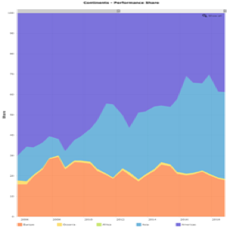

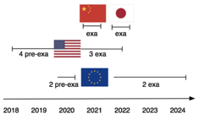
HPC systems
An HPC races is going on, at least between major players
Next big thing is ExaScale (10¹⁸ Flops - operations per second)
  Should be well available by HL-LHC
Somehow difficult to compare, technologies / benchmarks, but
  LHC needs today the equivalent of ~30 PFlops
  A single Exascale system is ok to process 30 “today” LHC
  Scaling: a single Exascale system could process the whole offline HL-LHC with no R&D or model change
Some FAs/countries are explicitly requesting HEP to use the HPC infrastructure as ~ only funding; it is generally ok IF we are allowed to be part in the planning (to make sure they are usable for us)
Americas
Asia
EU
2006
2018
US: apparently no current way to have a say at least on big DOE systems
EU: ETP4HPC has at least “asked for HEP position”
China: no current way to have a say

Slide 15
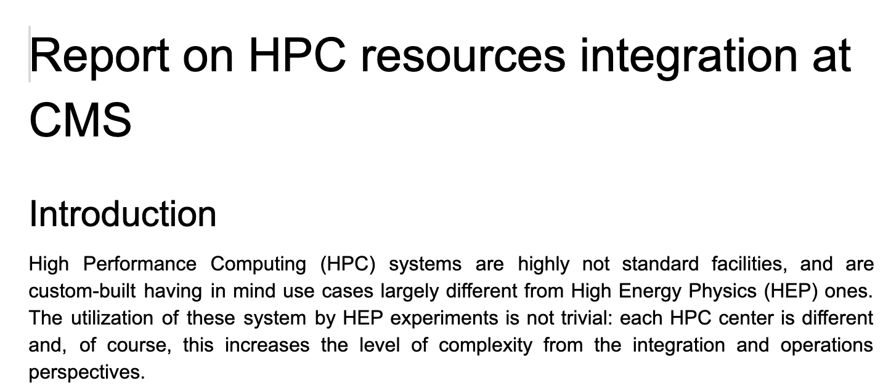
HPC systems #2
Our Funding Agencies are asking CMS to be prepared to use national HPC infrastructures for a sizeable part of our needs, by RunIV
There are many not trivial problems to solve:
  Data access (access, bandwidth, ...)
  Accelerator Technology (KNL, GPU, FPGA, TPU, ???, …)
  Primary architecture (Intel, Power9, ARM, proprietary …)
  Submission of tasks (MPI vs Batch systems vs proprietary systems)
  Node configuration (low RAM/Disk, …)
  Not-too-open environment (OS, Access policies,…)
Since many problems are more political than technical, CMS has prepared a document to perform handshaking with HPC sites, and in order to
  Explain our needs
  Propose solutions (standard, ad-hoc)
  Discuss out-of-the-box solutions for
  Future systems
  (shared with the other exps to find a
  Common ground)
CMS plans a (virtual) trip to visit all
the HPC sites, and establish
direct links

Slide 16
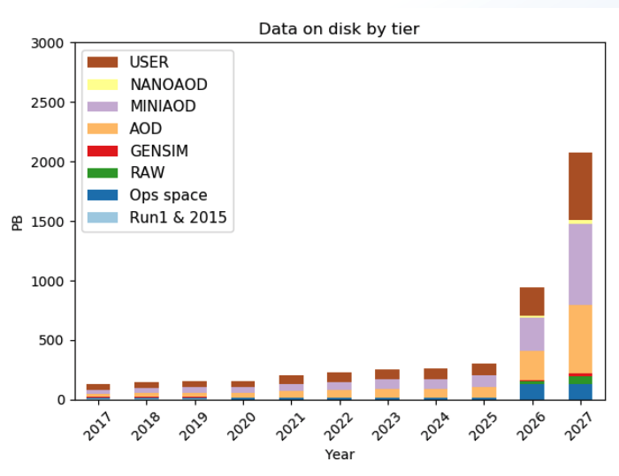
Current understanding of resource needs for PhaseII
All, in all, starting from the factors 50-100x as previously mentioned, the efforts already put in place are starting to pay off
Last public version of our 2027 estimates cite projected needs for
  CPU: 44 MHS06
  Disk: 2.2 EB
  Tape: 3 EB
  (with respect to 2019 pledges, these are 22x, 13x and 15x)
.. with a storage decrease by 2x due the modellization of NanoAOD as a tool for 50% of the analyses, and thus reducing the needs to process and store on disk larger data formats
See An analytics driven computing model for HL-LHC at ACAT for more information

Slide 17
Conclusions
HL-LHC is a fascinating research environment, with incredible capabilities for physics discoveries
Unfortunately, the large amount of expected data does not fit any reasonable amount of funding, if handled via standard operation models
CMS has started a deep and intense R&D program, involving all the stakeholders from Physics groups to Trigger experts, in order to pave a way towards an affordable HL-LHC computing
Ideas are being collected, analyzed and formalized, with the plan to have them under test in RunIII before the final deployment in production starting from 2026

