Slide 1
New ROOT graphics language
Iliana Betsou | National Technical University of Athens
Serguei Linev | GSI Darmstadt
Bertrand Bellenot | CERN
Olivier Couet | CERN

Slide 2
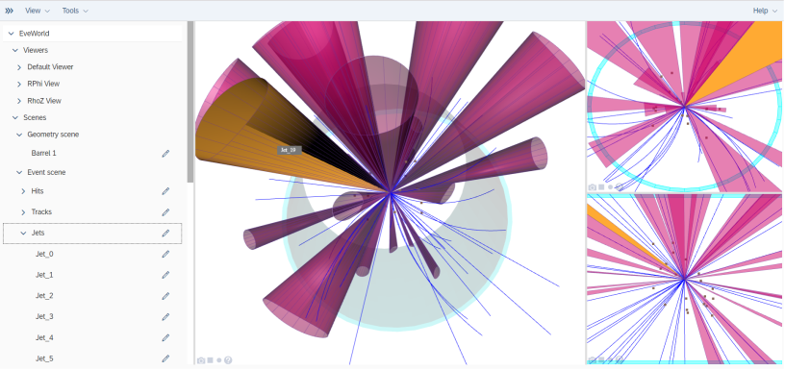
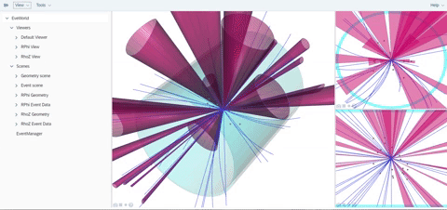
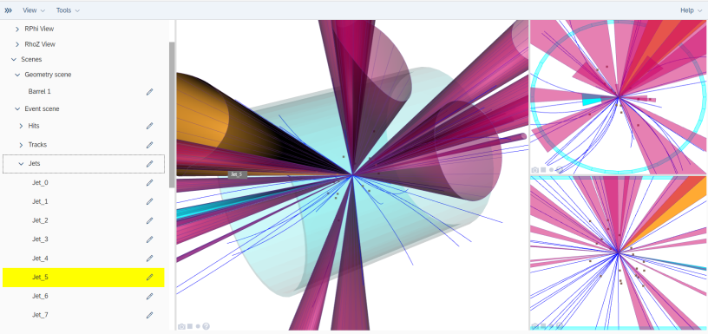
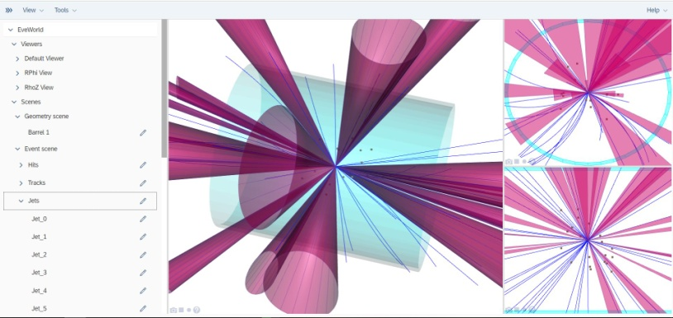
WebEve
https://linev.github.io/eve7/

Slide 3
Why new graphics?
ROOT6 GUI is very “OS-specific”
OpenGL + remote X11
X11 will not be supported on MacOS
Single threaded
Long-term maintenance problems
Lack of new technologies

Slide 4
Objectives of the new version
Graphics can be reinvented based on 20 years of experience
Based on widely used technologies (SVG/WebGL) supported by a very large community
What we want from the new version:
  Portable
  Remote displays
  Multiple views
  Multi threaded
  Remote/web GUI
  Support any future new platform (as soon as a web browser is available)

Slide 5
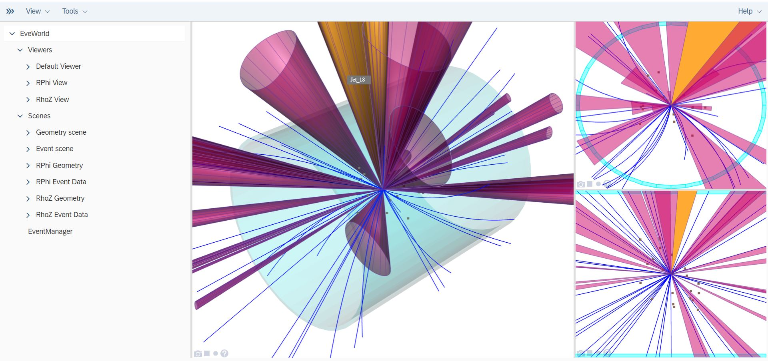
What is ROOT7
ROOT7 is a local application which uses web technologies
ROOT7 is able to run in the Web Browser

Slide 6
How it’s working (1/2)
Client/Server Architecture
  Components:
  JavaScript ROOT → code base for clients
  THttpServer → communication
  TBufferJSON → I/O
  OpenUI5 → JavaScript Library
  Runs directly in a browser
  ◦ Client side → JavaScript
  ROOT
  ◦ Server side → C++

Slide 7
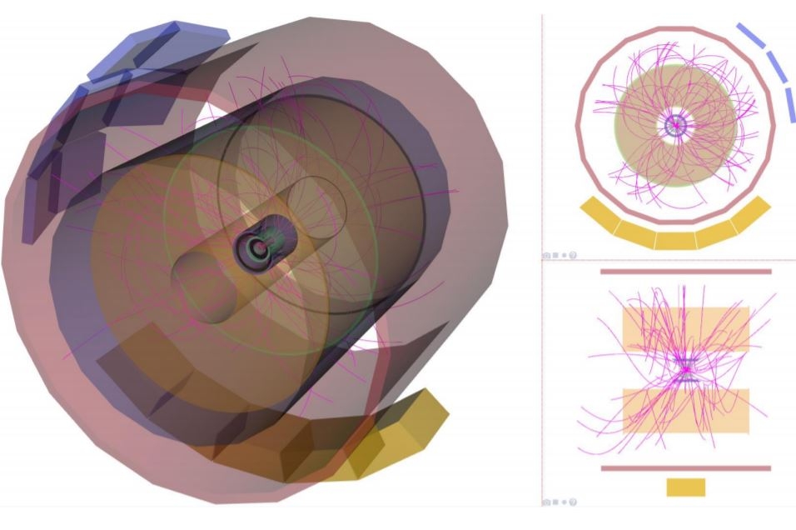
JavaScript ROOT
ROOT objects displayed in web browsers
Binary data reading, including TTree
Uses ROOT JSON format
It is used by the ROOT jupyter interface
User interface for the THttpServer
Developed since 2012
  https://root.cern/js/
  https://github.com/root-project/jsroot

Slide 8
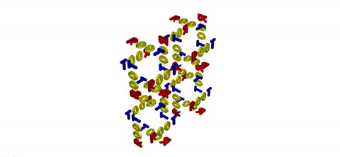
THttpServer
Gives HTTP access to running ROOT application
Execution of commands and methods
Objects visualization with JSROOT
Websockets support
bidirectional
binary data

Slide 9
TBufferJSON
Converts any streamable object to JSON
ROOT I/O remains fully on the server side
Support of custom streamers
Optional arrays compression
Reading objects from JSON
Simplifies data exchange between C++ server side and JavaScript-based clients

Slide 10
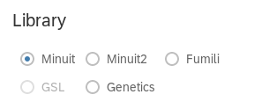
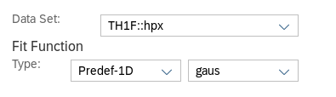
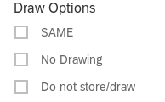
OpenUI5
OpenUI5 is the new technology we have used to design the layout of the new ROOT widgets. It is a JavaScript UI library consisting of a really large number of UI controls.
Combo Boxes
Radio Buttons
Check Boxes

Slide 11
RWebWindow Class (1/2)
Server-side entity in new ROOT window management
Main functionality:
  Display window in web browser(s)
  Manage multiple connections with the clients
  Data transfer to/from clients
  Support of batch (headless) mode

Slide 12
RWebWindow Class (2/2)
using namespace ROOT::Experimental;
// create window instance
auto window = RWebWindowsManager::Instance()->CreateWindow();
// configure html page loaded when window shown
window->SetDefaultPage("file:Main.html");
// this is call-back, invoked when message received from client
window->SetDataCallBack( [](unsigned connid, const std::string &arg) { printf(“Get msg %s from %u\n”, arg.c_str(), connid); } );
// configure predefined geometry
window->SetGeometry(300, 300);
// display window
window->Show();

Slide 13
Graphics Model
Advantages:
  Independent from any local graphics backend
  Allows remote display on all kind of devices
  For local display, the JavaScript rendering might be performed in a local canvas
Implementation of such system already exists for ROOT6 → JSROOT
  The initial goal of JSROOT was to read/browse objects in ROOT files and display them in a web browser using JavaScript
  Then the displayed objects could be manipulated in the web browser (zoomed, scaled, etc…)

Slide 14
Concepts of ROOT7 (1/2)
Pad:
  Base entities containing the list of graphics objects to be drawn
  Implemented in the RPad C++ class
Canvas:
  A window’s topmost pad.
  Implemented in the RCanvas C++ class.
Drawable:
  Something which can be drawn on a pad.
  Implemented in the RDrawable C++ class
  Each drawable entity has a GetDrawable method

Slide 15
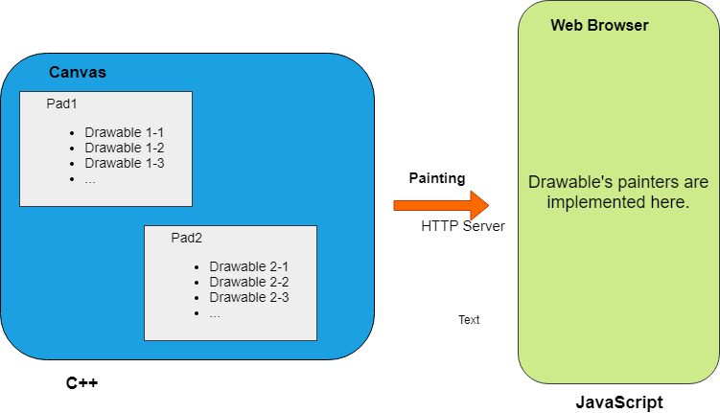
Concepts of ROOT7 (2/2)

Slide 16
Batch Output
Two main kinds of batch output images:
  Vector graphics output (PDF, SVG, Latex) →implemented by native ROOT classes (ROOT6)
  Bitmap output (PNG, JPEG, etc) → implemented natively on top of libAfterImage (ROOT6)
  GOAL in ROOT7: Not rely on any native ROOT library
  Headless mode (Chrome/Firefox): the complete HTML/JavaScript/SVG code works without screen display
  Use this mode to generate SVG/PNG/JPEG/PDF images
  MathJax.js → for Latex (we are also working for a simpler solution)

Slide 17
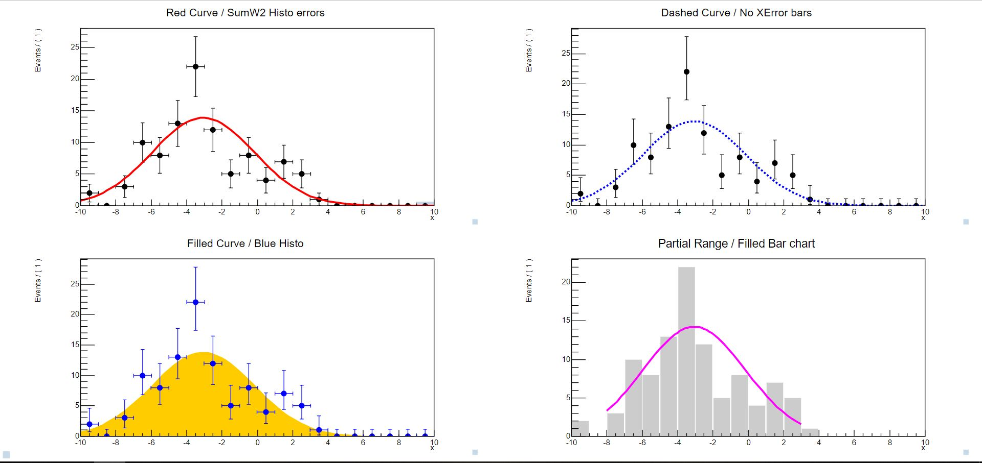
JSROOT examples (1/2)

Slide 18
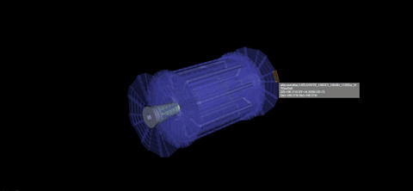
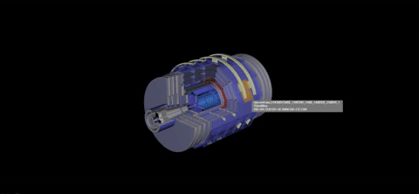
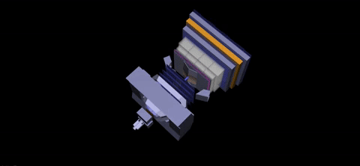
JSROOT examples (2/2)
ATLAS
CMS
LHCb

Slide 19
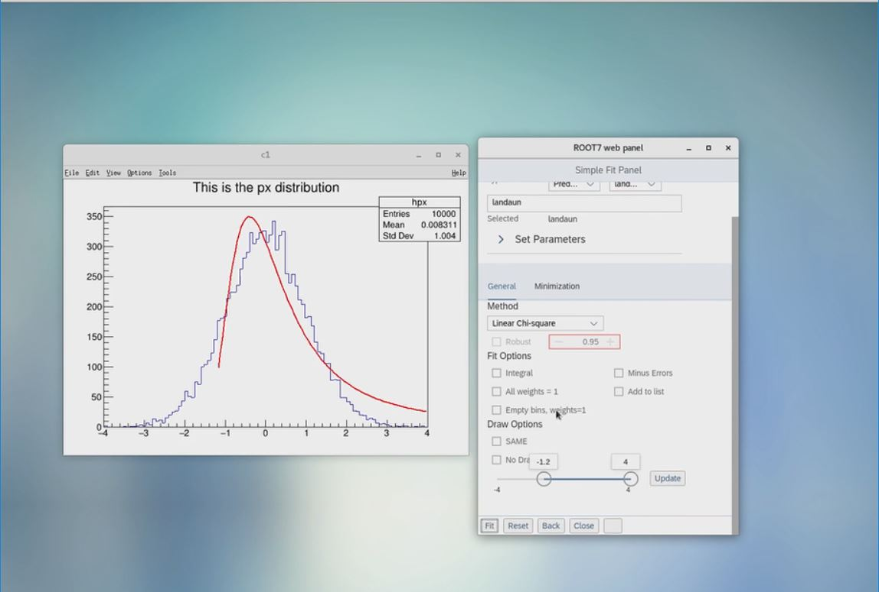
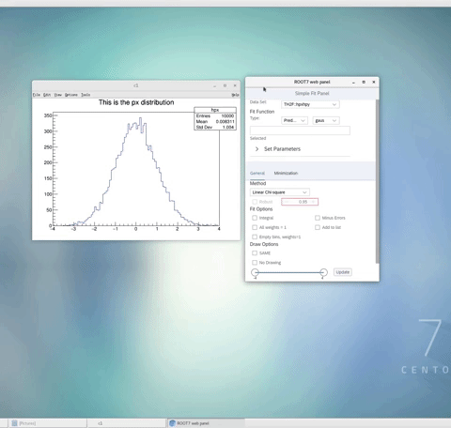
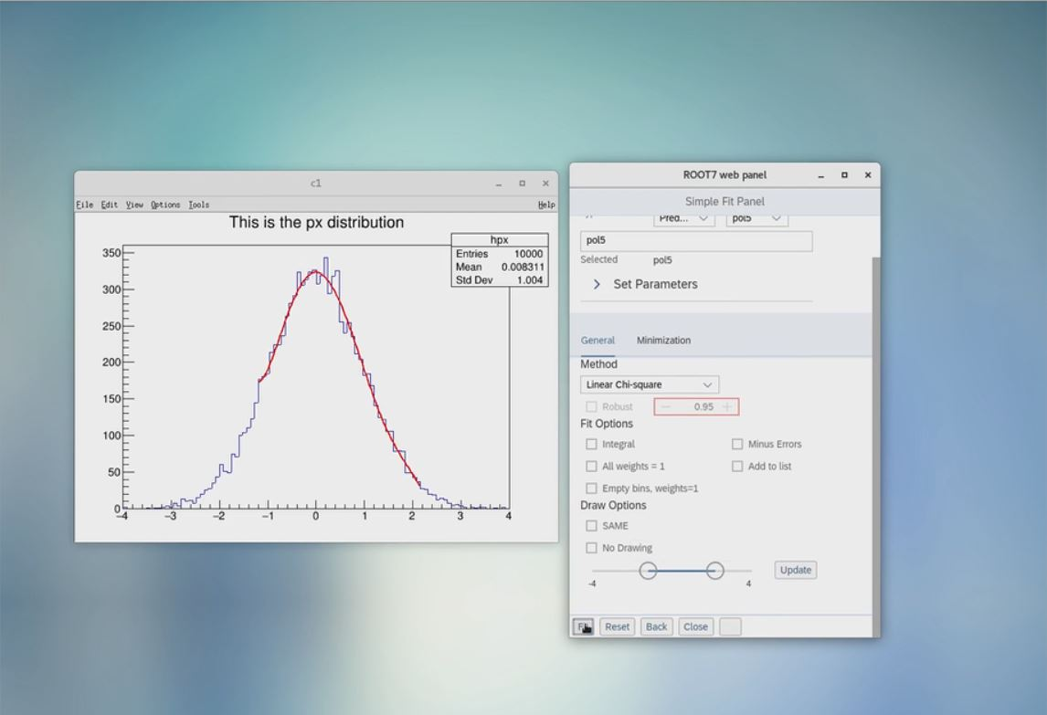
FitPanel Example

Slide 20
Conclusion
Graphics based on new technologies (SVG/HTML/WebGL)
Client/Server model with C++ on the server side and JavaScript on the client side
Batch output do not rely on any native ROOT Libraries with the use of headless mode
Basic graphics classes have been implemented

Slide 21
Future Plans
Authentication and authorization
  Support OAuth technology in the future
Implementation of main ROOT widgets
  RFitPanel, RBrowser, RWebEve
Painters on the JavaScript side for all high level objects
Generation of batch graphics images
  Investigate a solution for TeX
Testing

Slide 22
Thank you for your attention!!

Slide 23
More Stuff!!
HTML RWebWindow Class

Slide 24
ROOT7 GUI
ROOT7 need more than just graphics
  RBrowser, RFitPanel
Library for buttons, checkboxes, list, menu,…
  SAP OpenUI5: https://openui5.org
OpenUI5 fully supported in RWebWindow
  Any other library can be used

Slide 25
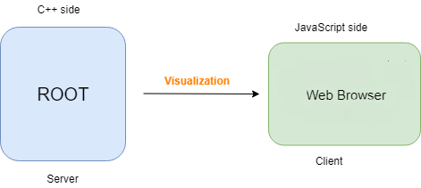
How it’s working (2/2)
  ROOT is running as usual and generates the graphics display list by drawing objects → C++ side
  The graphics display list is sent to a client (Web Browser/libChromium) → JavaScript side

Slide 26
Multithreading
Default:
  All RWebWindow runs in main thread
Optional:
  Special thread for THttpServer
  Dedicated thread for every RWebWindow
  Dedicated thread(s) for clients communication
Need to care about I/O thread safety

Slide 27
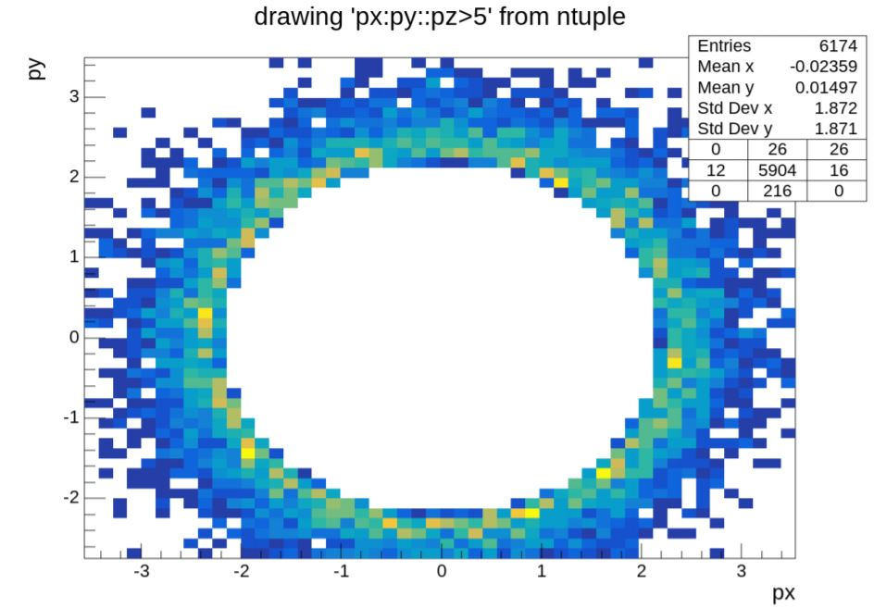
JSROOT examples (3/3)

Slide 28
RWebWindow Class(3/3)
<!DOCTYPE HTML>
<html>
<head>
<meta charset="utf-8">
<title>RWebWindow example</title>
<script src=“/jsrootsys/scripts/JSRootCore.js” type="text/javascript"></script>
<script type=“text/javascript”>
function InitUI(handle) {
// full access to OpenUI functionality }
JSROOT.ConnectWebWindow({
prereq: "openui5",
receiver: {
OnWebsocketOpened: function(conn) {},
OnWebsocketClosed: function(conn) {},
OnWebsocketMsg: function(conn, data, len) {}
},
callback: InitUI });
</script>
</head>
<body class="sapUiBody" id="content" role="application">
</body>
</html>

Slide 29
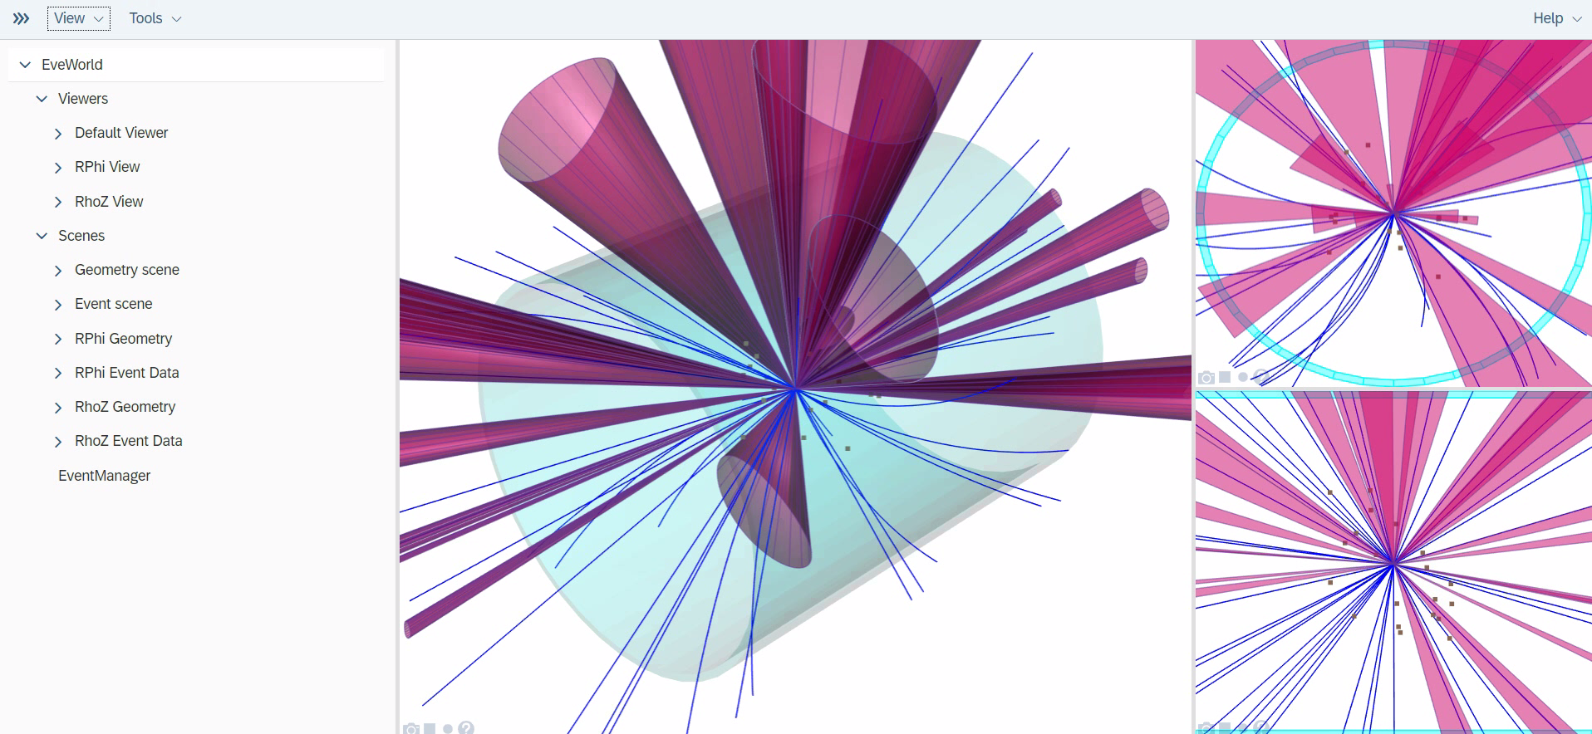
WebEve

Slide 30
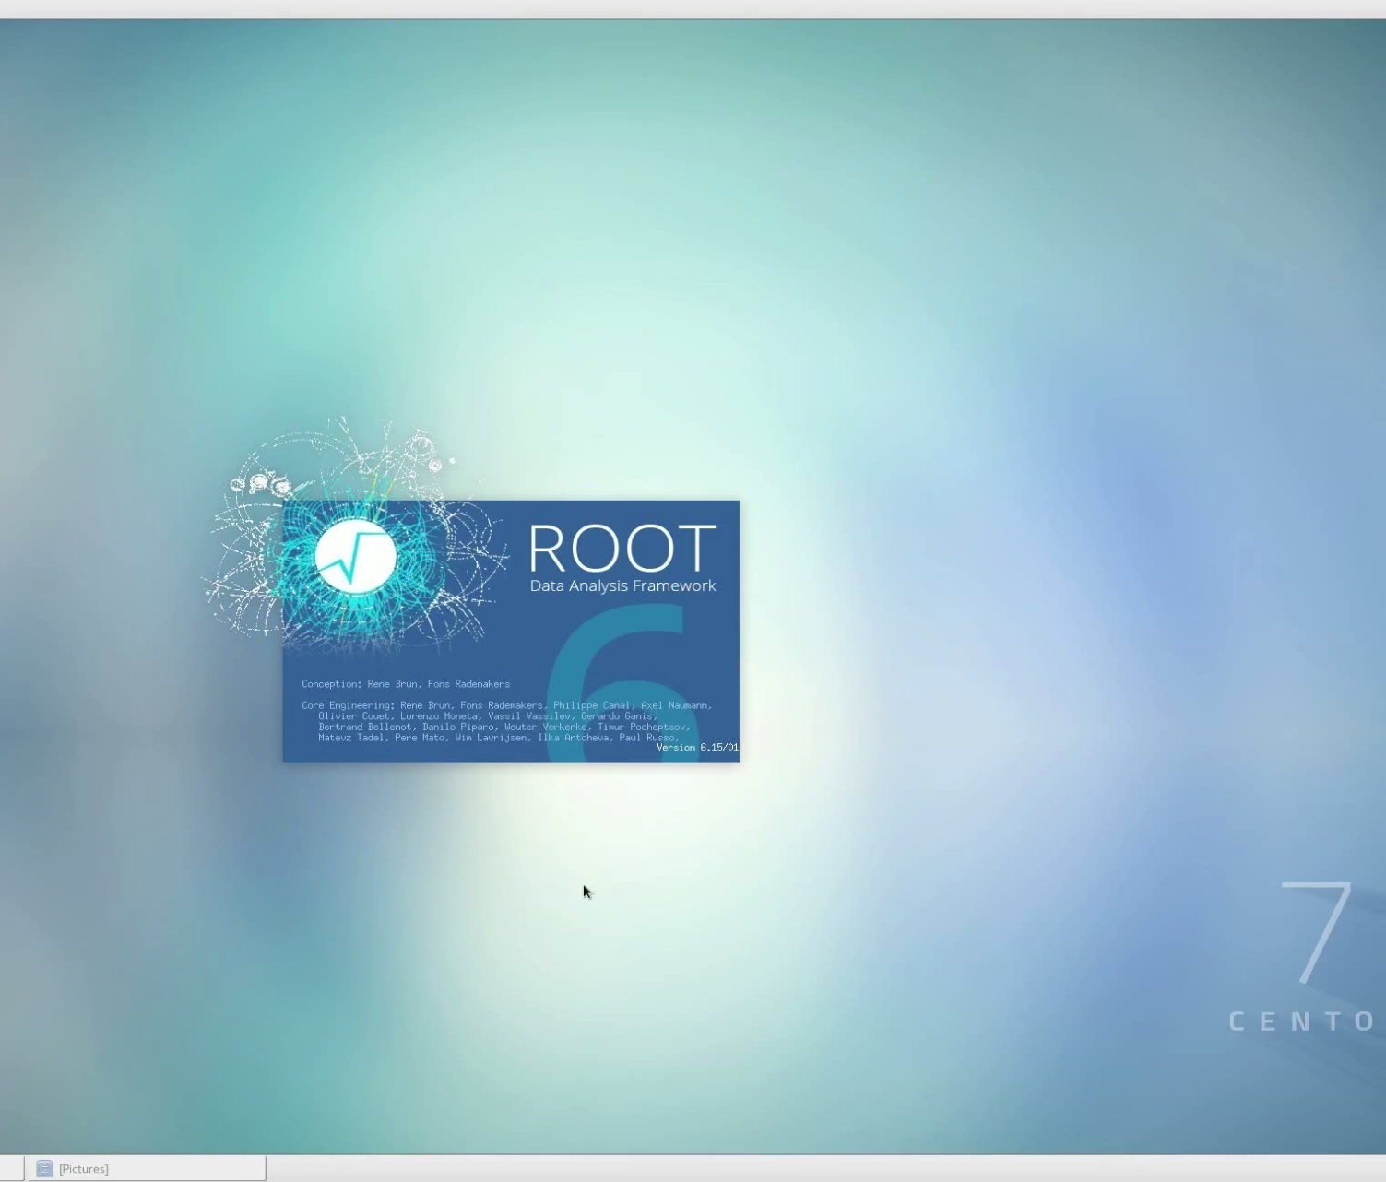
FitPanel Example

