Slide 1
Machine Learning for an X-ray Laser
Mar. 11, 2019
D. Ratner, E. Cropp, J. Duris, A. Edelen, C. Emma, K. Kabra, D. Kennedy, T. J. Lane, S. Li, T. Maxwell,
P. Musumeci, X. Ren, G. Stupakov, J. Wu, X. Zhang
SLAC National Accelerator Laboratory
ACAT 2019

Slide 2
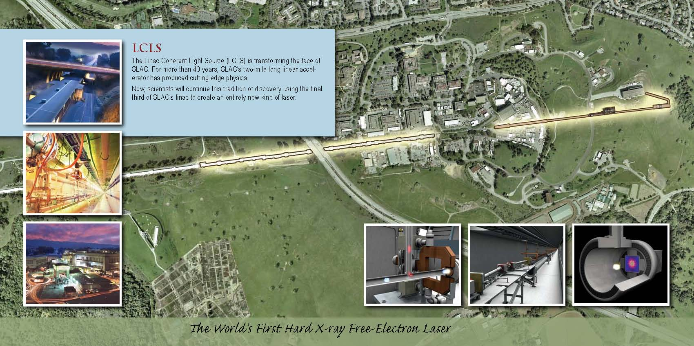
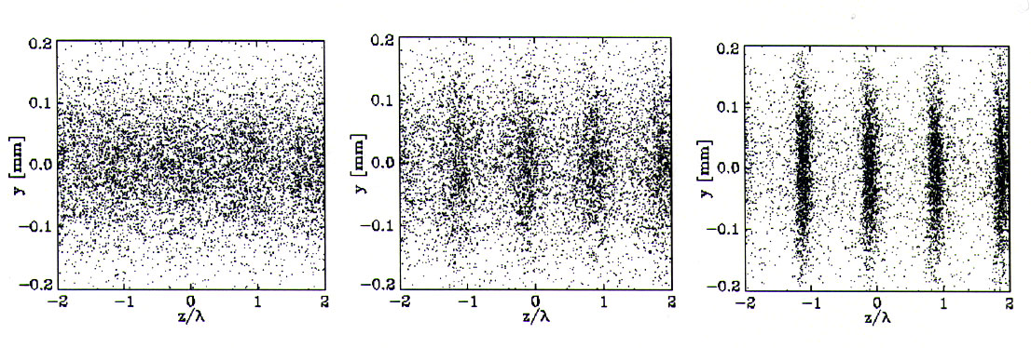

Slide 3
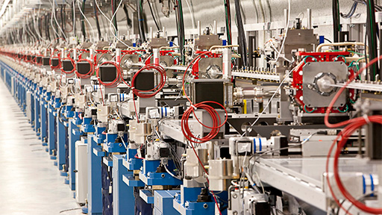
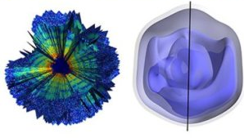
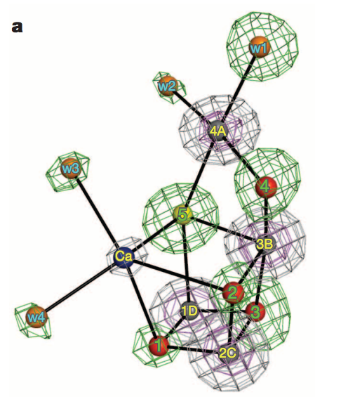
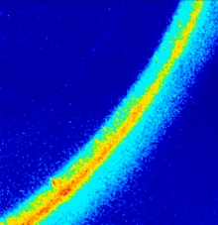
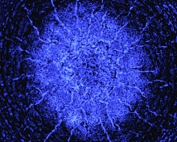

Motivation
Why build an FEL?
Single particle imaging (Mimivirus)
Photosystem II
Ekeberg et al.,
Structural biology
Suga et al.
Shock waves in extreme conditions
Cu powder
diffraction
Si
Milathianaki et al.

Slide 4
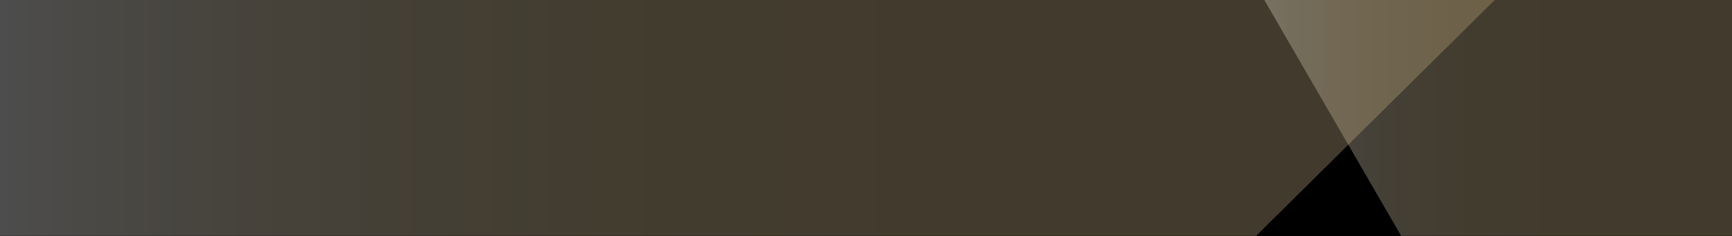

Molecular Movies: Pump-probe scans
Slide courtesy M. Minitti

Slide 5
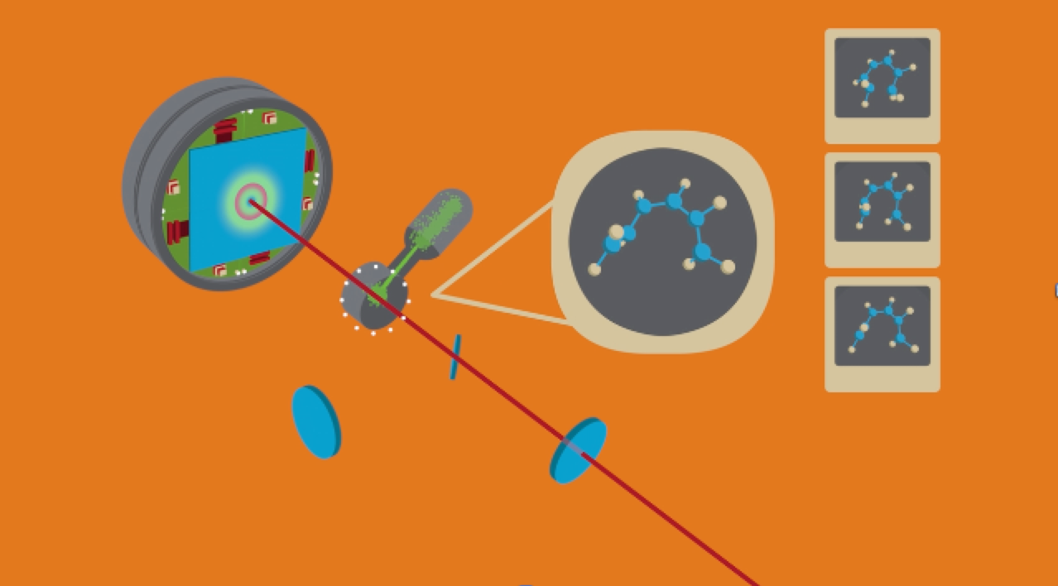
Molecular Movies: Pump-probe scans
UV
X-rays
Slide courtesy M. Minitti

Slide 6
Overview
ML for an X-ray Laser
SLAC is working (to various degrees) on:
Machine Tuning: Online optimization of the accelerator
Data Analysis: Computer vision for screens, inverse problems
Novel methods: Ghost imaging, fluctuation analysis
Surrogate modeling: machine design, tuning, user support
Prognostics: Anomaly/breakout detection to avoid/recover from beam faults.
In-the-loop data acquisition: adaptively change experimental parameters during acquisition with Reinforcement learning
User-side: edge-ML for detectors, domain science applications

Slide 7
Overview
ML for an X-ray Laser
SLAC is working (to various degrees) on:
Machine Tuning: Online optimization of the accelerator
Data Analysis: Computer vision for screens, inverse problems
Novel methods: Ghost imaging, fluctuation analysis
Surrogate modeling: machine design, tuning, user support
Prognostics: Anomaly/breakout detection to avoid/recover from beam faults.
In-the-loop data acquisition: adaptively change experimental parameters during acquisition with Reinforcement learning
User-side: edge-ML for detectors, domain science applications

Slide 8
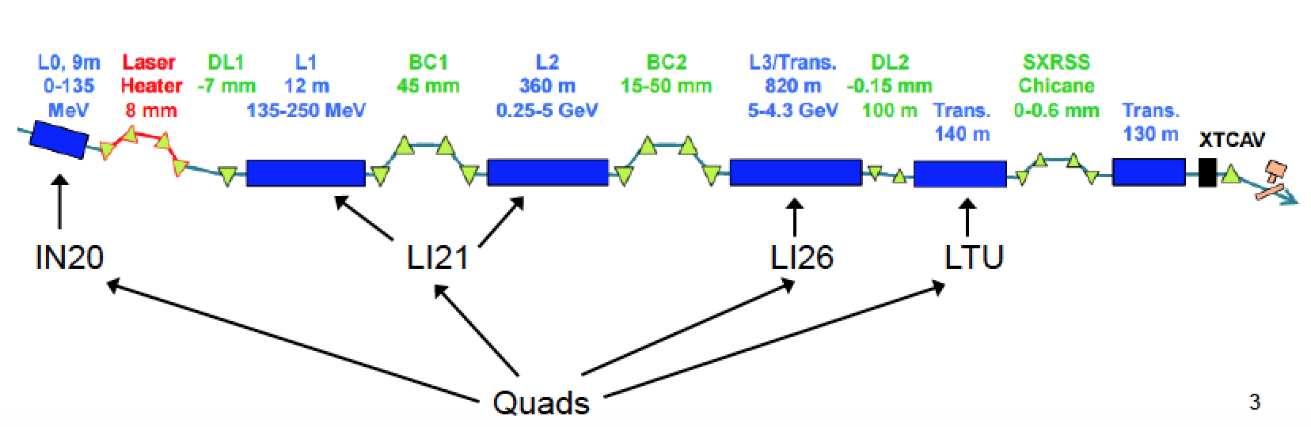
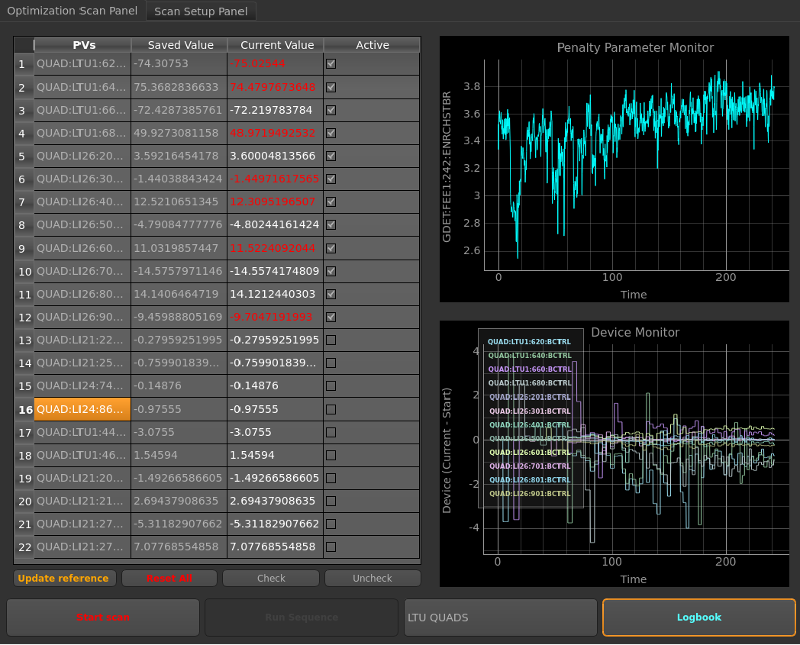
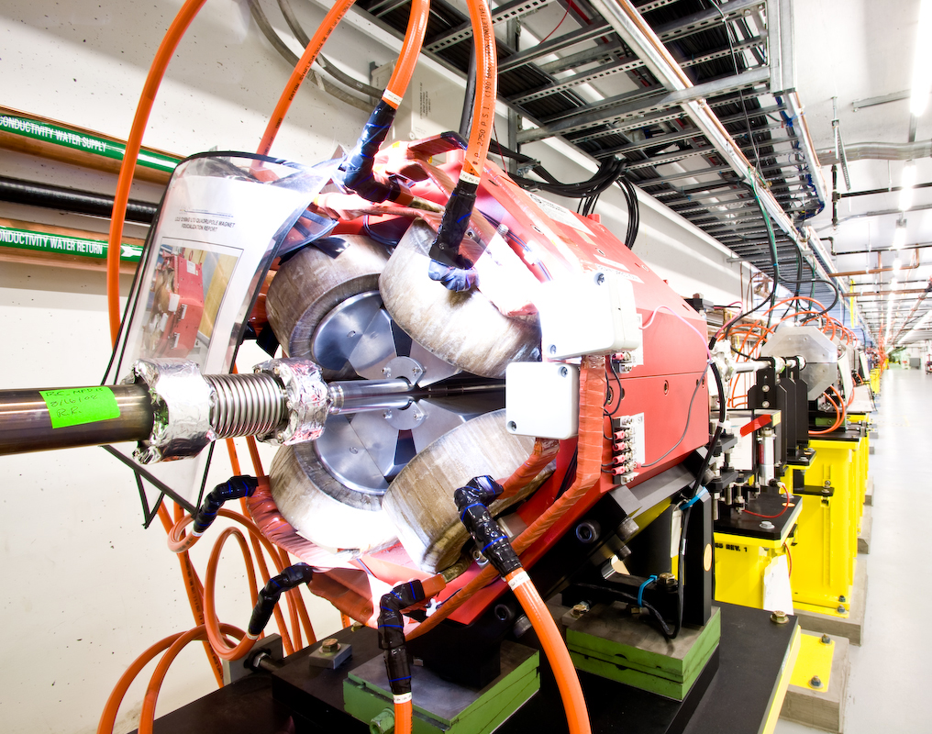
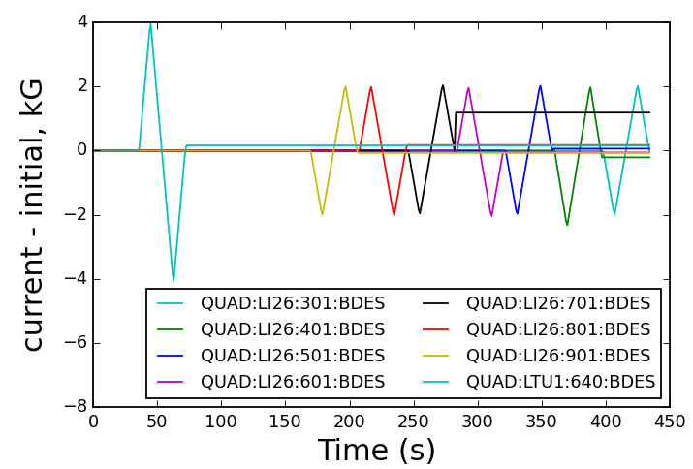
Optimization
Online tuning:
XFELs are instabilities ➔ very sensitive to initial conditions
In total 500 hours/year, single task of quad tuning half of that
Automate (e.g. simplex)
Ocelot

Slide 9
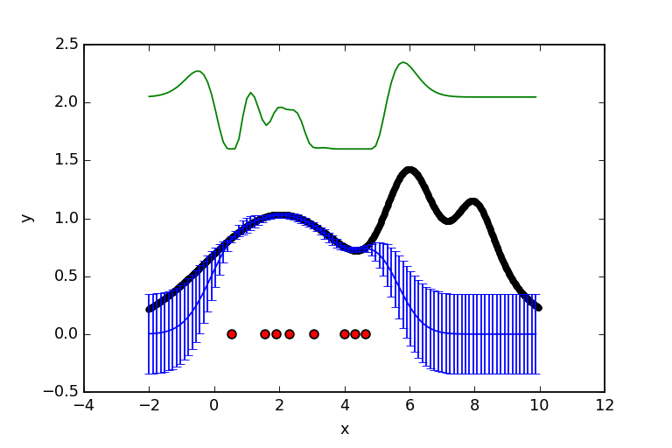
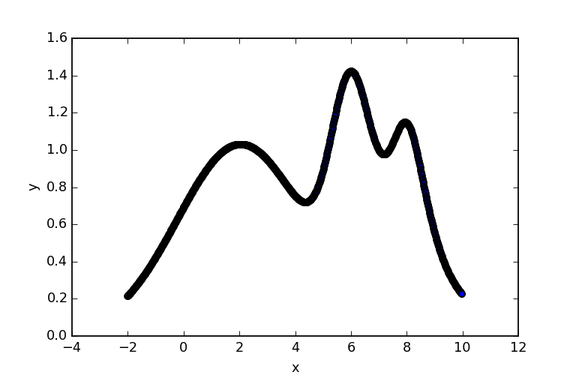
Optimization: Bayesian optimization
Model-based optimization
Advantage 1: Balance “exploitation vs. exploration”
➔ Find global maximum
Bayesian optimizer
Acquisition point
Gradient optimizer
Acquisition
function
Ground truth
Posterior
Joe Duris

Slide 10
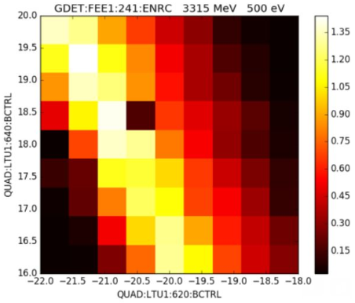
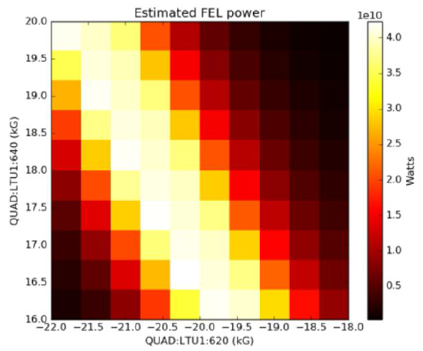
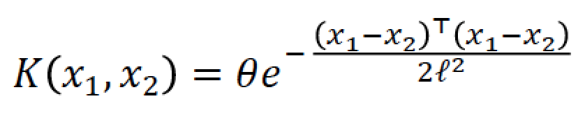
Optimization: Bayesian optimization
Model-based optimization
Advantage 2: Existence of model enables use of physics, archived data
Gaussian process: instance based learning method
Kernel function:
x₂
FEL vs quads (i.e. strong focusing)
Measured
Modeled
x₁
x*
Quad 2
x₃
Quad 1
Quad 1
Joe Duris

Slide 11
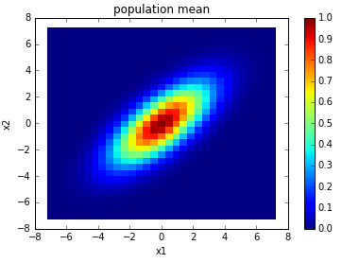
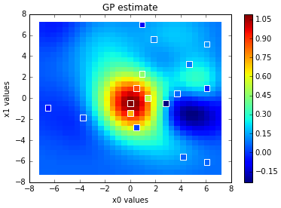
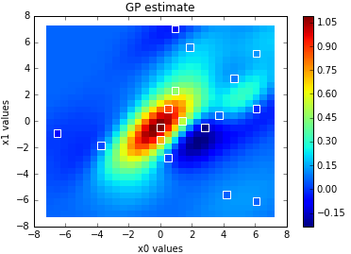
Optimization: Bayesian optimization
Model-based optimization
Advantage 2: Existence of model enables use of physics, archived data
Gaussian process: instance based learning method
Kernel function:
GP model,
no correlation
GP model,
w/ correlation
Groundtruth
ρ = 0
ρ = 0.7
Joe Duris

Slide 12
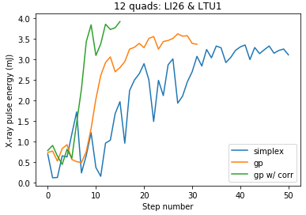
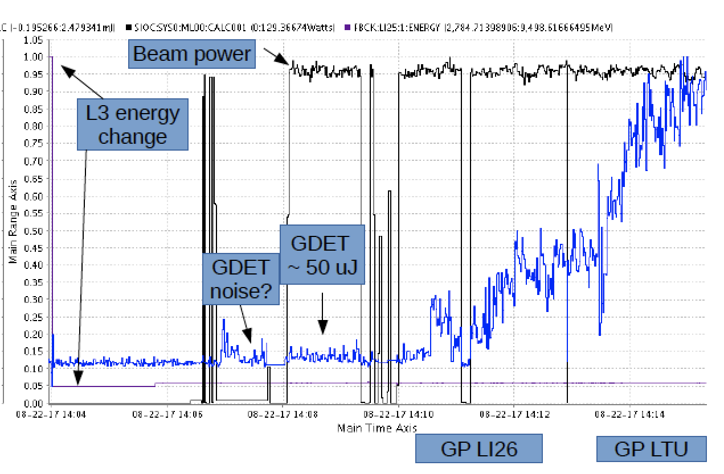
Optimization: Bayesian optimization
Model-based optimization
Upshot: ➔ Faster tuning (factor of 4 vs. simplex)
➔ More robust tuning (e.g. tune from noise)
Example 1: Fast tuneup in high dimensions
Example 2: tuning quadrupoles from pure noise
Joe Duris

Slide 13
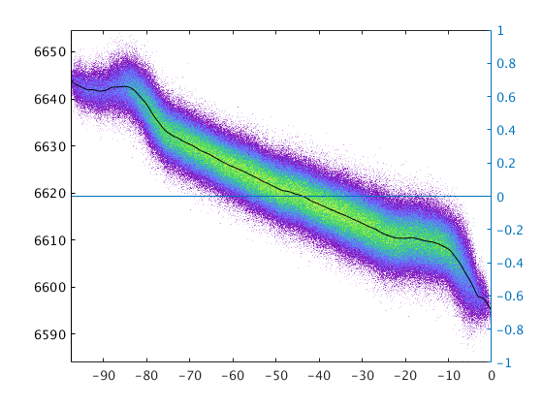
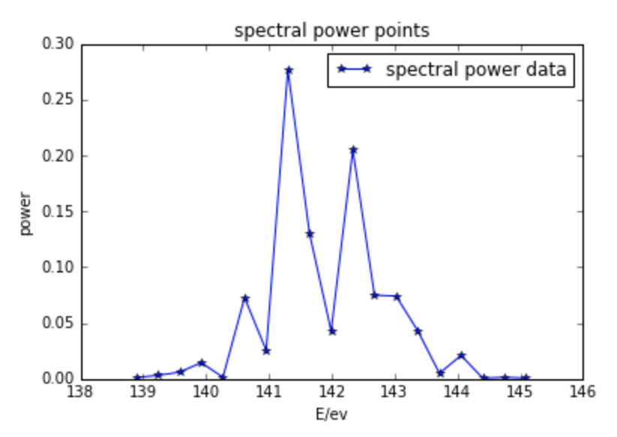
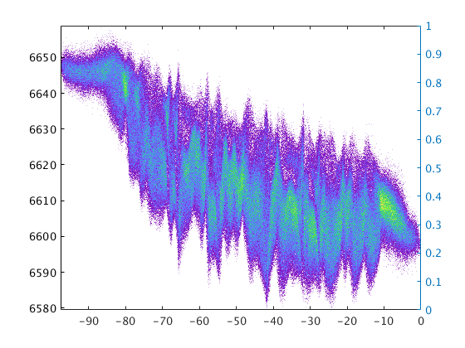
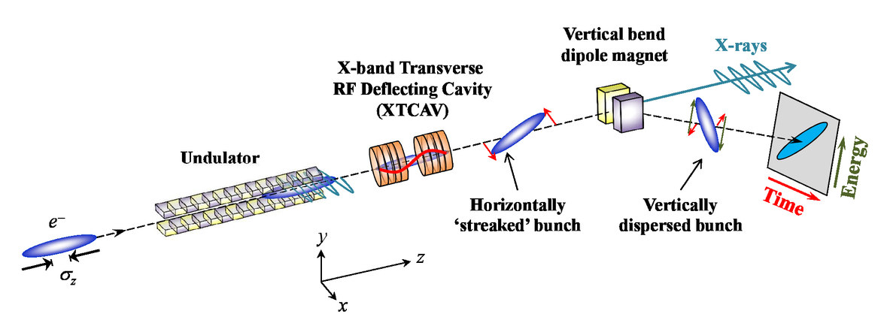
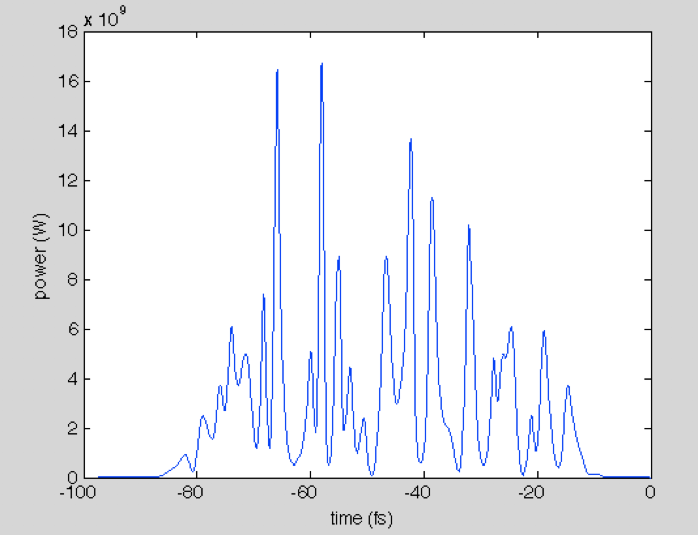
Data Analysis: Pulse reconstruction
How can we measure femtosecond X-rays?
Users want:
High resolution X-ray power profile shot-by-shot
Full (phase and amplitude) reconstruction of X-ray pulses
Before lasing
e- energy (γ)
Spectrum
Electron phase space
After lasing
e- energy (γ)
Maxwell, Timothy J., et al. International Society for Optics and Photonics, 2014.
Power (W)
Time (fs)

Slide 14
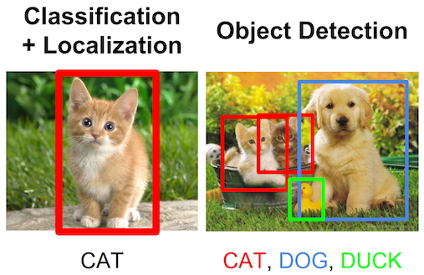
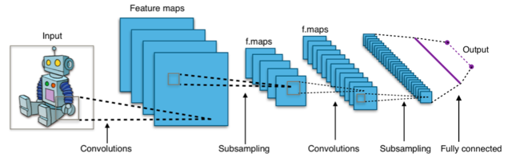
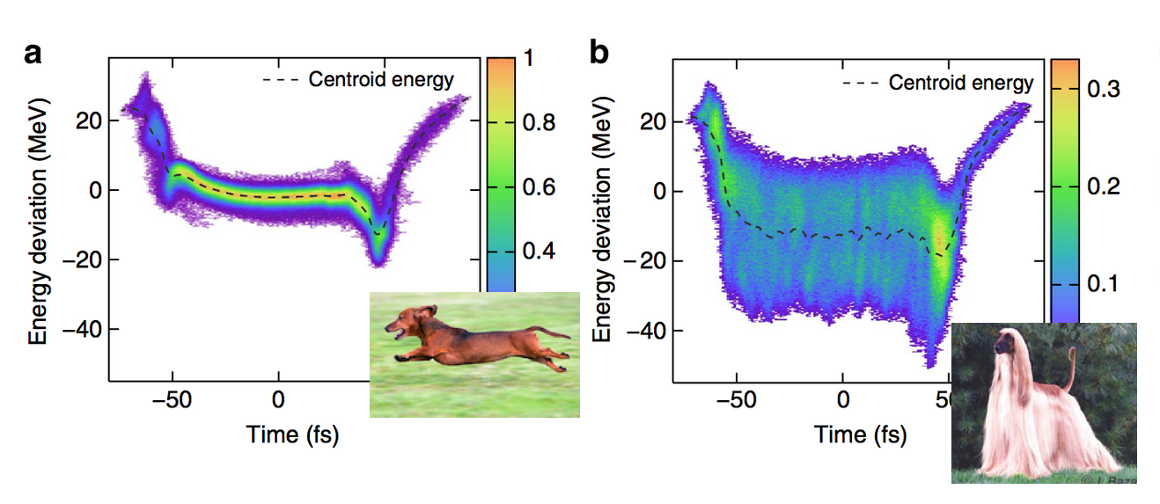
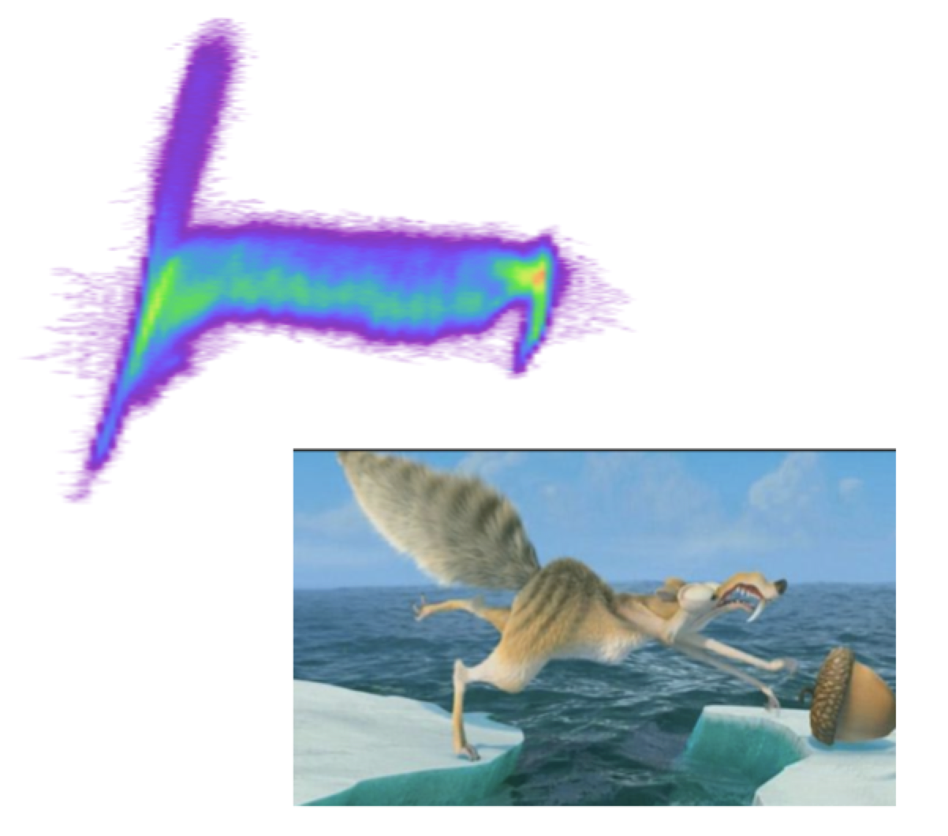
Data Analysis: Pulse reconstruction
Computer vision
Aphex34 https://commons.wikimedia.org/w/index.php?curid=45679374
Stanford CS231n
D. Mendez

Slide 15
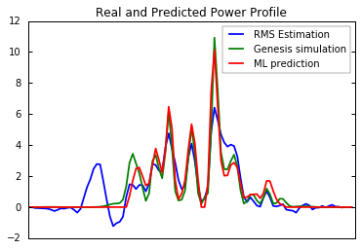
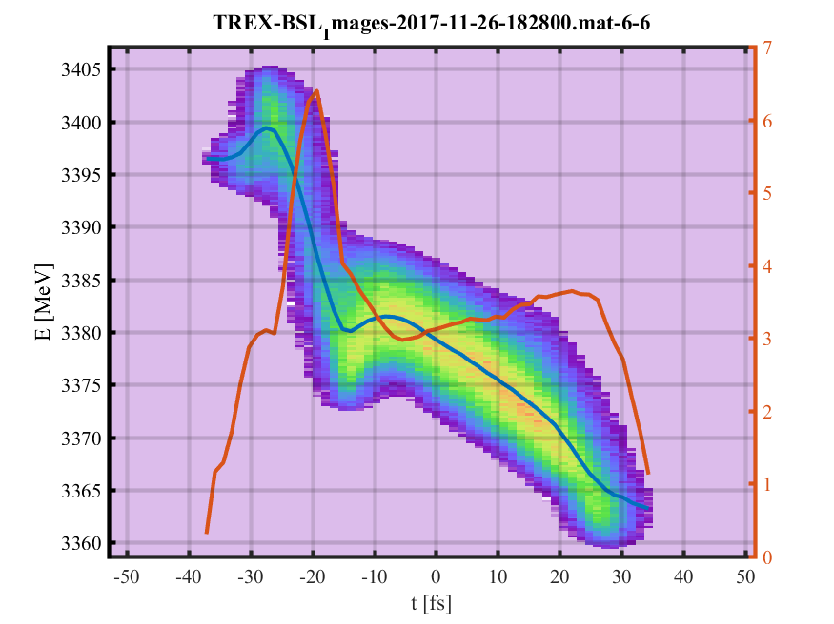
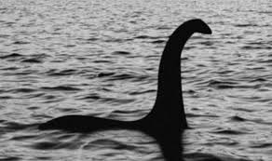
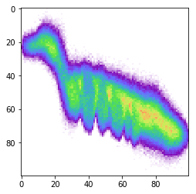
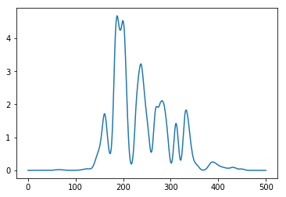
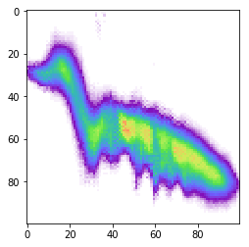
Data Analysis: Pulse reconstruction
Power Prediction from with Vision-based Neural Network
XTCAV provides best record of X-ray power profile
Problem: Can only measure one image at a time
Alternative: Use computer vision on only lasing-ON image!
Unlabeled data
Labeled Training Set
Convolutional neural network (CNN) recovers X-ray power with smaller errors than current state-of-art
Genesis Simulation
Training Set
Experiment
Feed Training Data
CNN
The generative adversarial network (GAN) generates labeled images
➔ Augment training for CNN or other data-hungry algorithms
Data Augmentation
GAN
X. Ren

Slide 16
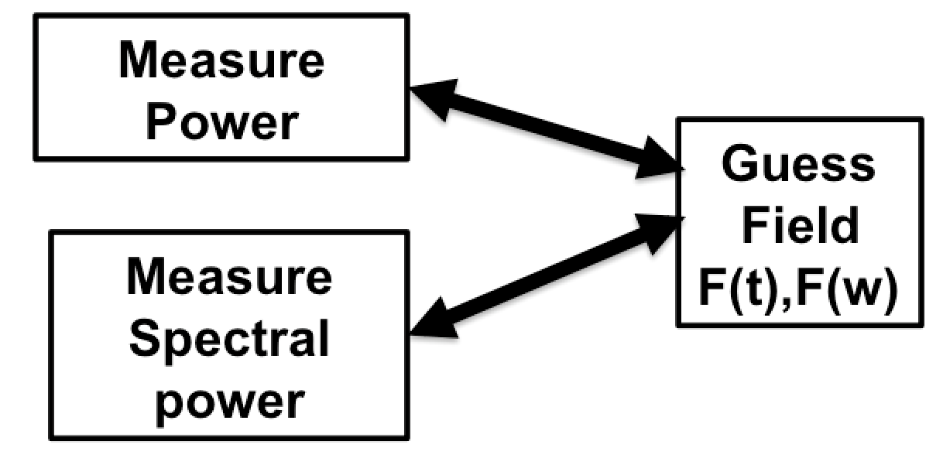
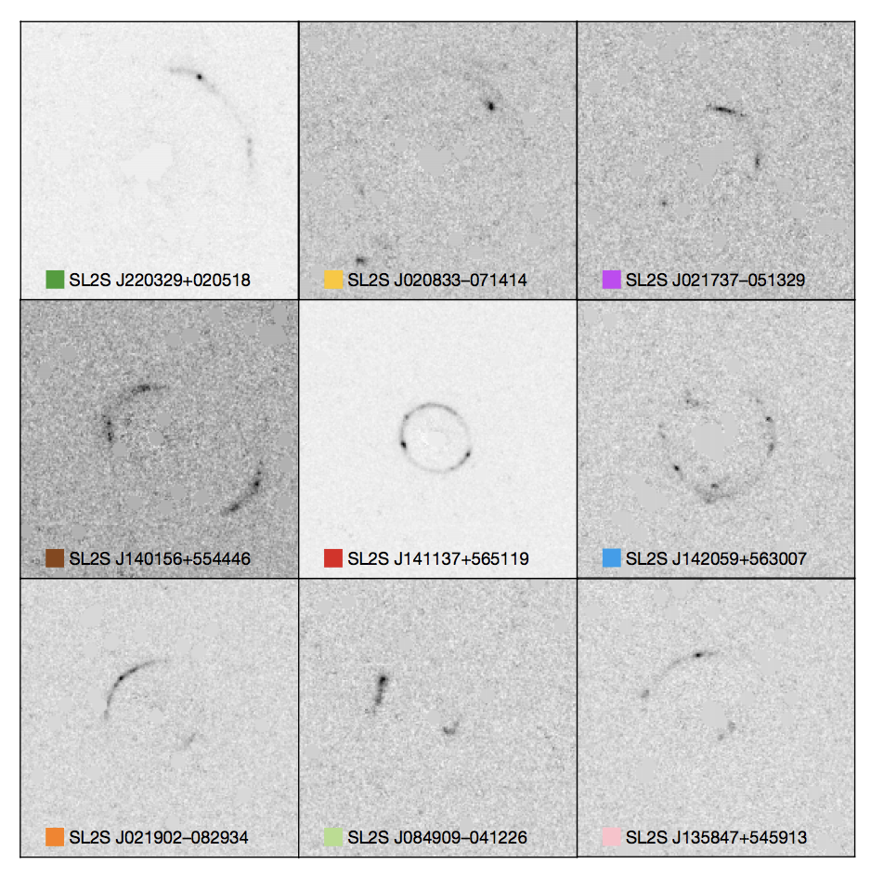
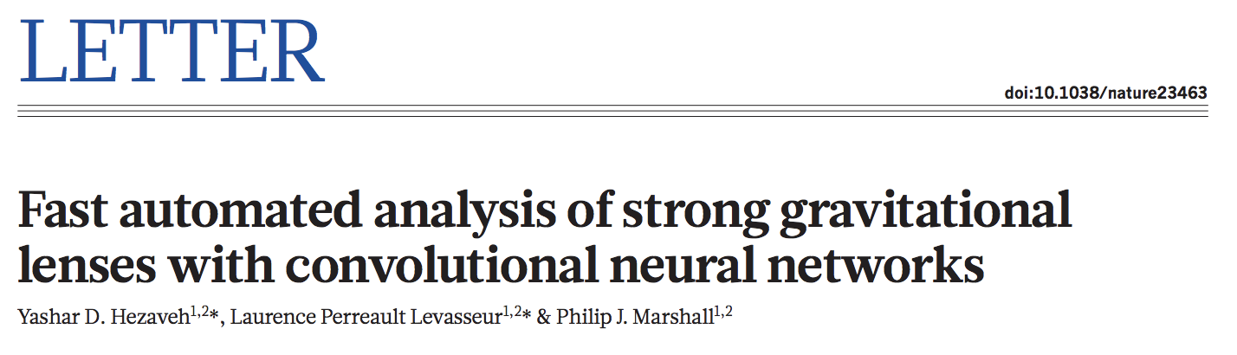
Data Analysis: Pulse reconstruction
Full beam reconstruction
Measure amplitude of power/spectrum: can I recover phase?
Measure Power
Pulse #1
Guess
Field
F(t),F(w)
…
10⁶-10⁹ times
Measure Spectral power
Pulse #n
Solve inverse problem w/ NN ➔ 10¹⁰ speedup!
X. Zhang

Slide 17
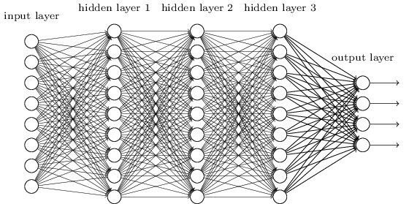
Data Analysis: Pulse reconstruction
Full beam reconstruction
Measure amplitude of power/spectrum: can I recover phase?
Measure Power
Pulse #1
Guess
Field
F(t),F(w)
…
10⁶-10⁹ times
Measure Spectral power
Pulse #n
Input
Hidden layers
Measure Power
Output
Guess
Field
F(t),F(w)
Measure Spectral power
X. Zhang
Only solve once!

Slide 18
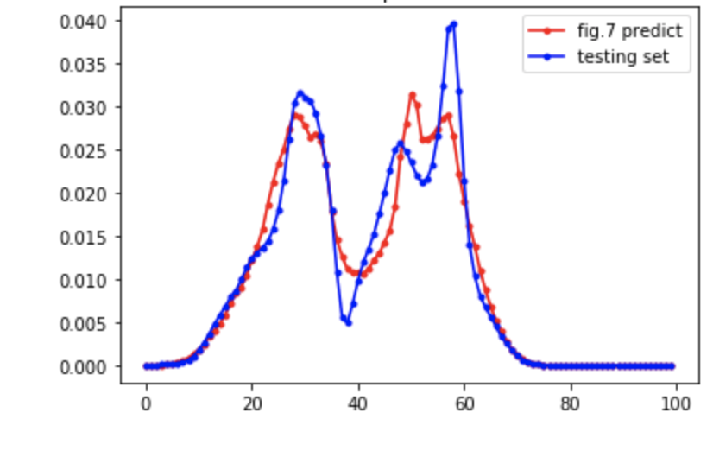
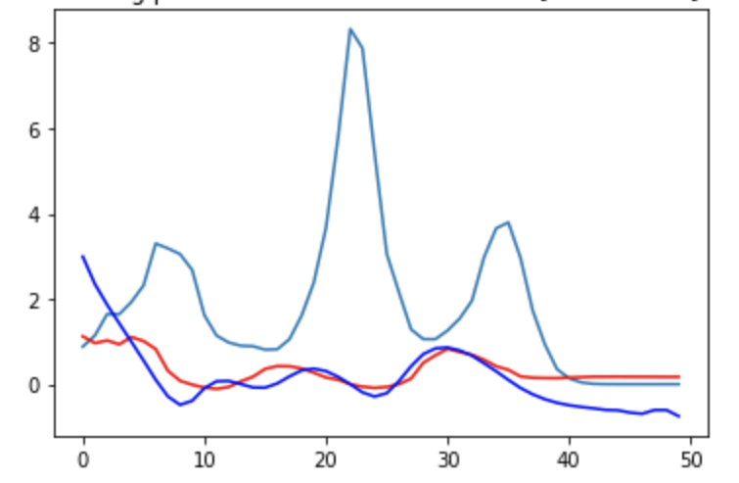
Data Analysis: Pulse reconstruction
Full beam reconstruction
Measure amplitude of power/spectrum: can I recover phase?
Amplitude
Phase
groundtruth
prediction
amplitude
prediction
groundtruth
Time (fs)
Time (fs)
Input
Hidden layers
Measure Power
Output
Guess
Field
F(t),F(w)
Measure Spectral power
X. Zhang
Only solve once!

Slide 19
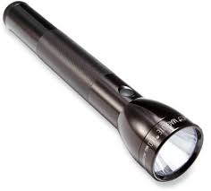
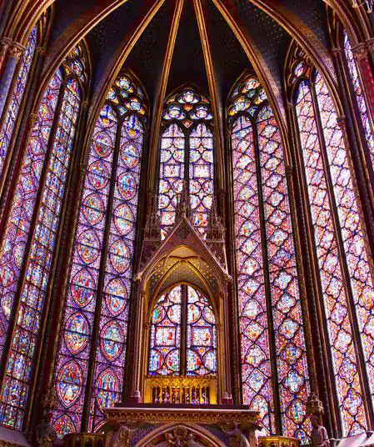
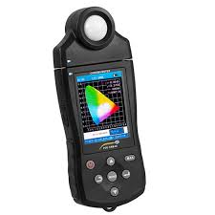
Data Analysis: Ghost imaging
Ghost Imaging / Single Pixel Camera
Riddle: How can I take a picture with a spectrometer?
Answer: Have a friend with a flashlight

Slide 20

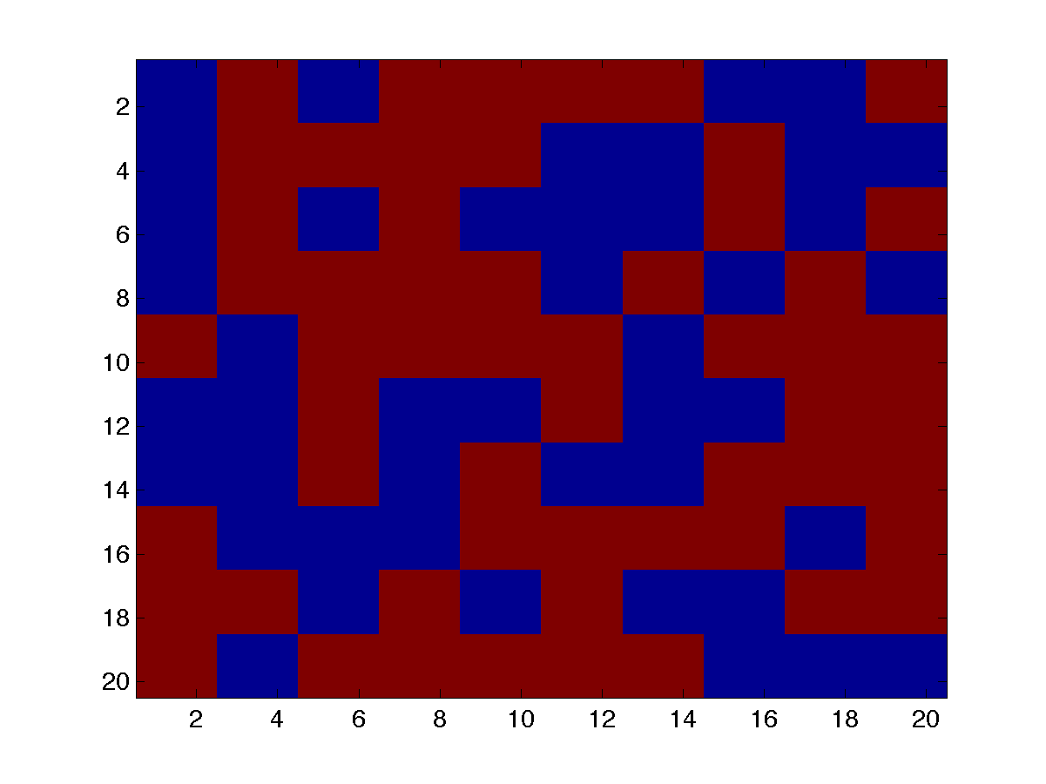
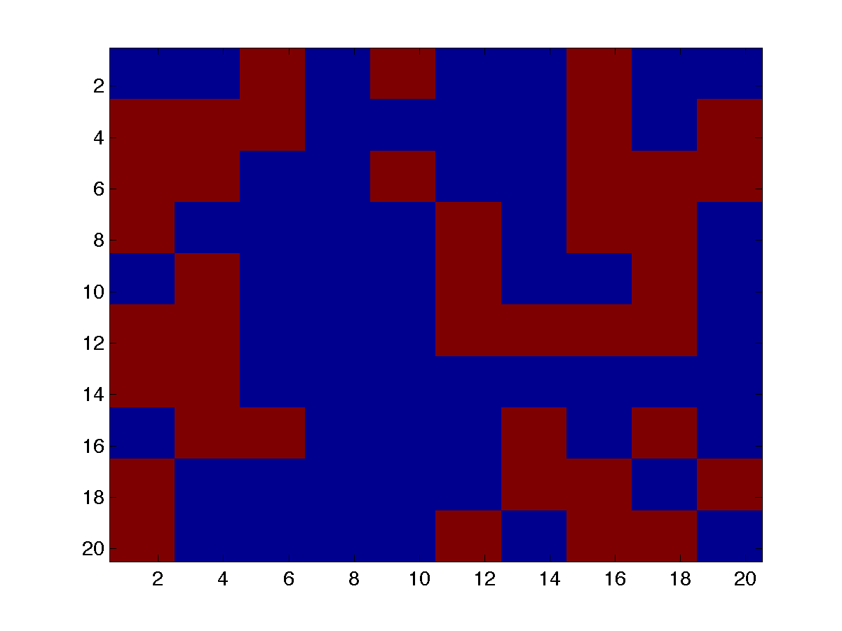
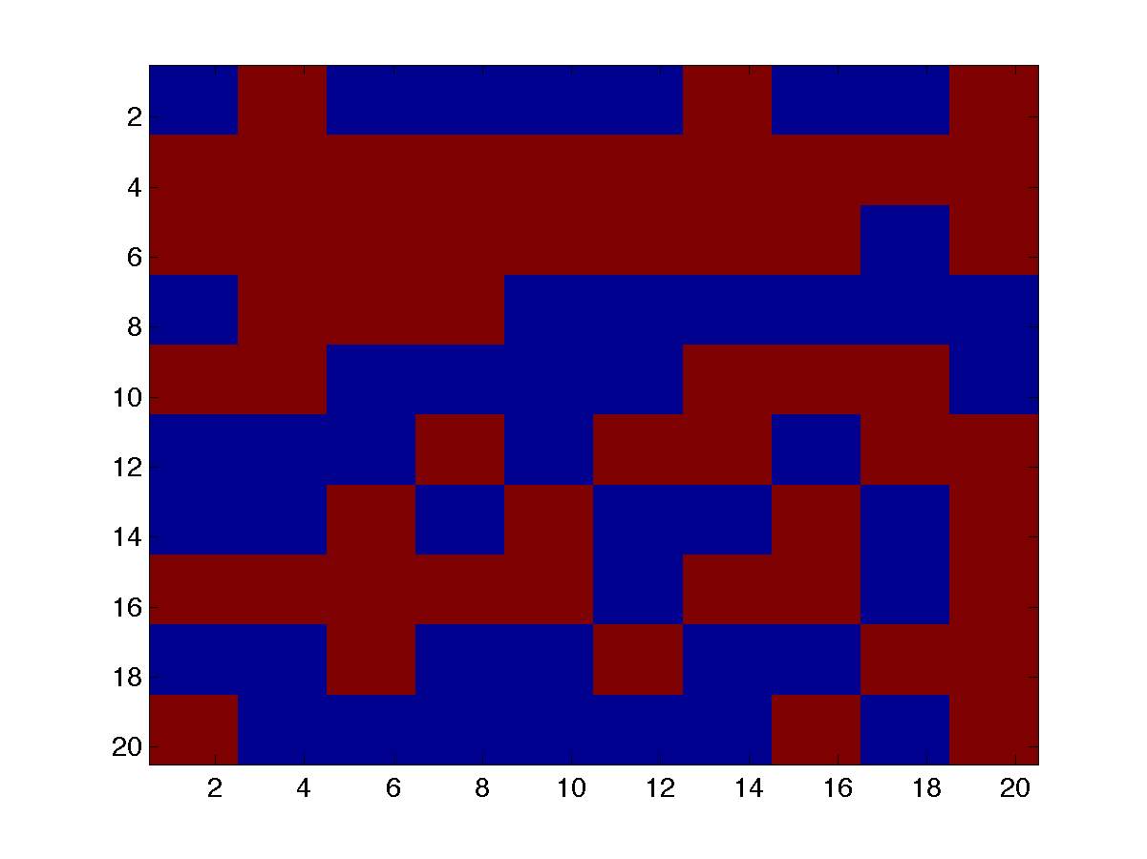
Data Analysis: Ghost imaging
Ghost Imaging / Single Pixel Camera
Philosophy: don’t average out fluctuations… use fluctuations to probe your sample!
➔ “Compressive ghost imaging” leverages the ML toolbox.
B
=
A
x
Radiation, A
target reconstruction
B = [ 5037,
4783,
4891, … ]
Bucket measures total transmission
Random patterns
target
Siqi Li

Slide 21




Data Analysis: Ghost Imaging
Ghost imaging in the time domain
target
Pump X-ray
Array of buckets (B)
Target (x)
Sample, CO
e-
Probe X-ray
Electron energy (eV)
A. Picon
Delay (fsec)
Time
System (CO) evolves after absorbing X-ray, changing electron energies
Incident radiation (A)
τ
“Pump-probe” scan of delay, τ

Slide 22
Conclusion
Additional applications not discussed:
Surrogate modeling: machine design, tuning, user support
Prognostics: Anomaly/breakout detection to avoid/recover from beam faults.
In-the-loop data acquisition: adaptively change experimental parameters during acquisition
User-side: edge-ML for detectors, domain science applications…
Thanks for Listening!
And thanks to collaborators:
E. Cropp, J. Duris, A. Edelen, C. Emma, K. Kabra,
D. Kennedy, T. J. Lane, S. Li, T. Maxwell,
P. Musumeci, X. Ren, G. Stupakov, J. Wu, X. Zhang

Slide 23
Conclusion

Slide 24
Data Analysis: Ghost Imaging
Ghost imaging with electrons
Passive measurement of photocathode’s quantum efficiency
target
Total Charge
Cathode
Cathode laser

Slide 25






Data Analysis: Ghost Imaging
Ghost imaging with electrons
Passive measurement of photocathode’s quantum efficiency
target
Total Charge
Cathode
Cathode laser
Reconstructed QE

Slide 26





Surrogate Models: FEL simulations
Generative adversarial networks (GANs)
e- energy
GAN
“Physics”
Simulation ~1000 cpu-sec
GAN: ~0.001 gpu-sec
X. Ren
Notes:
Genesis simulations provide users very accurate prediction of X-ray pulses for preparing for shifts and testing analysis methods. However, each simulation takes ~1000s of CPU-seconds. For users who require large numbers of examples, e.g.crystallography or statistical methods like ghost imaging, Genesis is too slow.
Generative adversarial networks (GANs) use two networks: the “discriminator” tries to identify if an example is real (i.e. Genesis), or fake (i.e. the “generator”). The generator tries to fool the discriminator. As the two networks fight, the generator makes more and more realistic examples. Images at right show a generated fake XTCAV image (upper right) and the associated X-ray profile (lower right, green). The blue curve is what the old XTCAV algorithm would have estimated from the fake example, showing that the generated example is reasonable.

Slide 27



Surrogate Models: Accelerator models
High fidelity physics simulations are remarkable:
J. Qiang
LCLS microbunching instability
measurement
simulation
…but also slow. (e.g. hours on NERSC)
How can we best support design of a new machine?
LCLS-II simulations, Y. Ding

Slide 28

Surrogate Models: Accelerator models
Predict XTCAV image from other diagnostic output or upstream machine settings to create a non-destructive virtual diagnostic
Simulation + neural network results match well for FACET-II (see left)
Small study with LCLS machine data and XTCAV images (scan of L1S phase and BC2 peak current at 13.4 GeV)
Emma, Edelen, et al. in preparation

Slide 29



Gaussian Process Optimizer
Gaussian process: instance based learning method
Covariance function:
prior mean
observations
new point to predict
new point
taken from M. Ebner, GP for Regression

Slide 30


Gaussian Process Optimizer
Gaussian process: instance based learning method
Covariance function:
prior mean
observations
new point to predict
new point
Prediction of new point:
Variance of new point:
taken from M. Ebner, GP for Regression

Slide 31
Gaussian Process Optimizer
Gaussian process: instance based learning method
Covariance function:
prior mean
observations
new point to predict
new point
Acquisition function:

