Slide 1

Welcome to ACAT 2019
ACAT 2019
Federico Carminati
March 10th, 2019

Slide 2
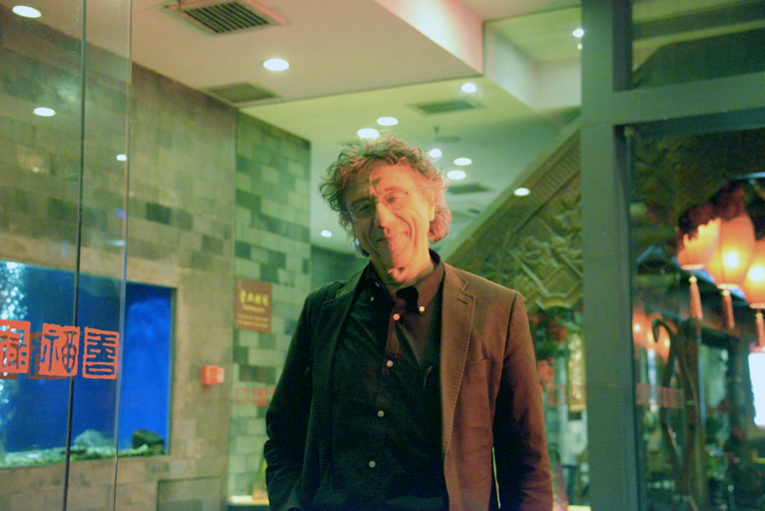
First ACAT without Denis

Slide 3
Before I forget
Big thanks to CERN openlab & Alberto Di Meglio
Maria Girone, Fons Rademakers, Sofia Vallecorsa
And above and beyond
Kristina Gunne
All this would not have happened without the generosity of our patron
Eddy Offermann

Slide 4
Logistic
The conference venue is Steinmatte conference center
The agenda of the conference can be found here https://indico.cern.ch/event/708041/timetable/#all.detailed .
For full details on the conference and Saas Fee, please visit the conference website: https://indico.cern.ch/event/708041/overview
The registration desk is open up again on Monday morning at 8.00 at the Steinmatte conference center, and remain open each morning until Wednesday lunch time. After this, badges can be found at the conference center reception;
All coffee breaks will take place in the Steinmatte conference center;
The conference buffet lunch will be served in the Hotel Dom and the Glacier Hotel, both are situated about 1 km from the conference center. You MUST wear your conference badge in order to be able to eat!
The Conference dinner will take place on Wednesday evening, at the Dom Hotel. The registration for the dinner online is now closed, but a few tickets will be available on Monday at the registration desk. The cost for the dinner is 100 CHF.

Slide 5
Posters
As we have accepted many posters, we have two groups of poster sessions
Posters will be hanged in room B
Poster Session 1 will take place on Monday and Tuesday
Poster Session 2 will take place on Wednesday and Thursday
Poster sessions will take place during coffee breaks in room B.
Instructions as well as the schedule can be found here: https://indico.cern.ch/event/708041/page/16528-poster-sessions
A vote will be arranged for the best poster per session, more information will be sent out to conference delegates later on.

Slide 6
Diversity round table
Wednesday panel after diversity-themed plenary
Short form to gather questions for panel members to be discussed at the RT:
http://cern.ch/go/9q6h
  What makes a good computer? 9 qubits, 6 hard drives!
Please contact acat-dwg@cern.ch should you have comments

Slide 7
Speakers
All speakers are kindly requested to upload their talks through the Indico system. If you have any problems, please contact your Track conveners.
Track 1: acat-tc1-2019@cern.ch
Track 2: acat-tc2-2019@cern.ch
Track 3: acat-tc3-2019@cern.ch

Slide 8
WiFi
Name: HotelAllalin
Password: AhsF1415
Name: ACAT1_2.4GHz, ACAT1_5GHz
Password: ACAT2019
Name: ACAT2_2.4GHz, ACAT2_5GHz
Password: ACAT2019
For people with Swiss GSMs please use the 4G network

Slide 9
Bus Transfer
Conference Delegates who have booked a bus transfer MUST make sure they arrive in time to the designated meeting area.
The bus leaving from Saas Fee on Friday will leave at 14h sharp on Friday from the bus terminal in Saas Fee.

Slide 10
Recordings
Please be aware that the Plenary talks will be recorded and possibly uploaded to the indico page after the event.
You can follow the conference on your mobile devices via the HEPcon app. HEPcon can be downloaded from the Apple and Google app stores. For more on HEPcon see:
https://vgvassilev.github.io/hepcon/
The HEPcon developers were so kind to collaborate with us to make this happen.

Slide 11
Ski Passes
If you mention you are with the ACAT conference you will receive a 20% reduction on the ski passes

Slide 12
Thanks for your attention!
federico.carminati@cern.ch

