Slide 1
Neuroscience and the Future of Computing
Prof. Felix Schürmann
Blue Brain Project – Co-Director, Head of the Computing Division
Adjunct Professor, Laboratory for Neurosimulation Technology
Ecole polytechnique fédérale de Lausanne, CH

Slide 2
Simulation Science
“Summit”: ~10¹⁷ FLOPS
FIRST CLIMATE MODELS
MECHANICAL ENGINEERING
ASTROPHYSICS
AEROSPACE INDUSTRIES
NUCLEAR STOCKPILE STEWARDSHIP
COMPUTATIONAL BIOLOGY
COMPUTATIONAL CHEMISTRY
CIVIL ENGINEERING
SIMULATION NEUROSCIENCE
1950s
1960s
1970s
1980s
1990s
2000s
2010s
NUMERIAL WEATHER PREDICTION
ELECTRICAL ENGINEERING
DRUG DESIGN & SURGICAL PLANNING
COMPUTATIONAL MEDICINE
(AERO)SPACE & COMPUTATIONAL FLUID DYNAMICS
MATERIAL SCIENCE
ADVANCED CLIMATE MODELING
EARTH SYSTEM MODELING
PHARMACOLOGY
“ENIAC”: ~10³ FLOPS
Notes:
Computing has seen an unparalleled exponential development
In the last decades supercomputer performance grew 1000x every ~10 years
Almost all scientific disciplines have long embraced this capability

Slide 3
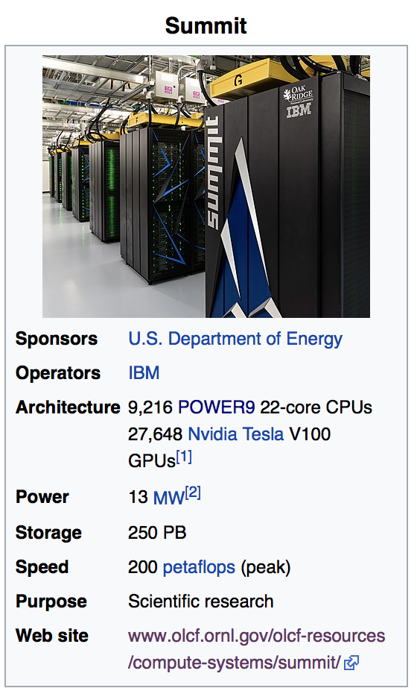
Let’s Remind Ourselves – what is a supercomputer?
OLCF – “Summit”
2,397,824 cores!!

Slide 4
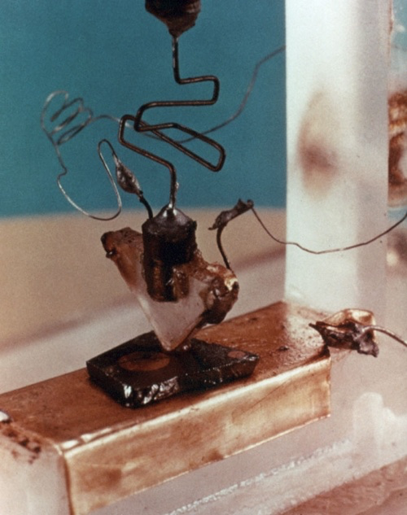
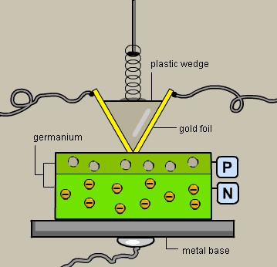
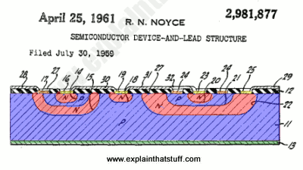
Key Enablers
Transistor - 1948
Integrated Circuit - 1958
Notes:
Bardeen, Brattain, Shockley
– Invented 1948 at Bell Labs
– 1956 Nobel Price for the transistor effect
Jack Kilby, 1958, Texas Instruments, Nobel Price 2000 Robert Noyce, 1958, Fairchild Semiconductors

Slide 5
Moore’s Law

Slide 6
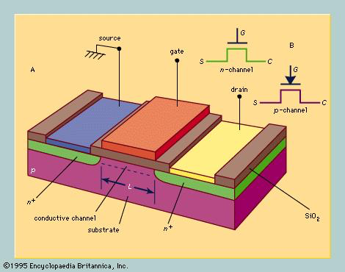
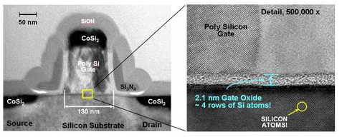
How does it work? – CMOS Scaling
SCALING:
Voltage: V/a
Oxide: t_{ox} /a
Wire width: W/a
Gate width: L/a
Diffusion: x_{d} /a
Substrate: a * N_{A}
RESULTS:
Higher Density: ~a²
Higher Speed: ~a
Power/ckt: ~1/a²
Power Density: ~Constant
→ Device density scales quadratically
→ Circuit speed increases linearly
→ Power reduces quadratically

Slide 7
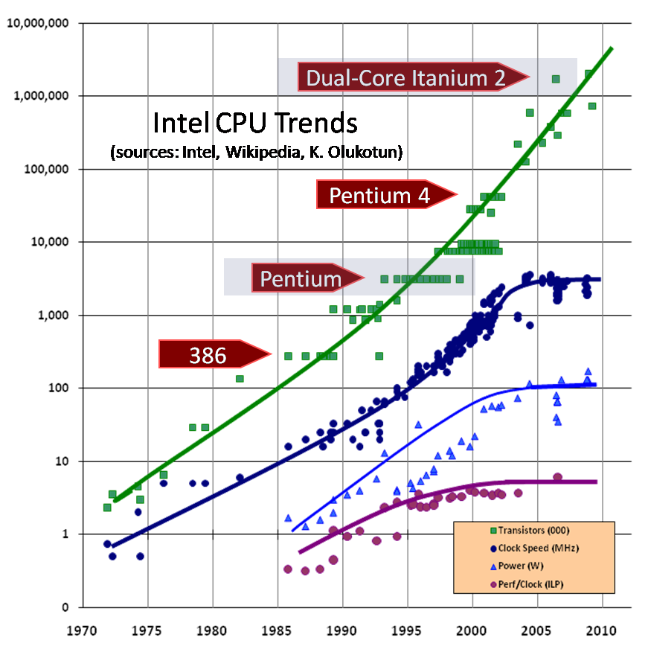
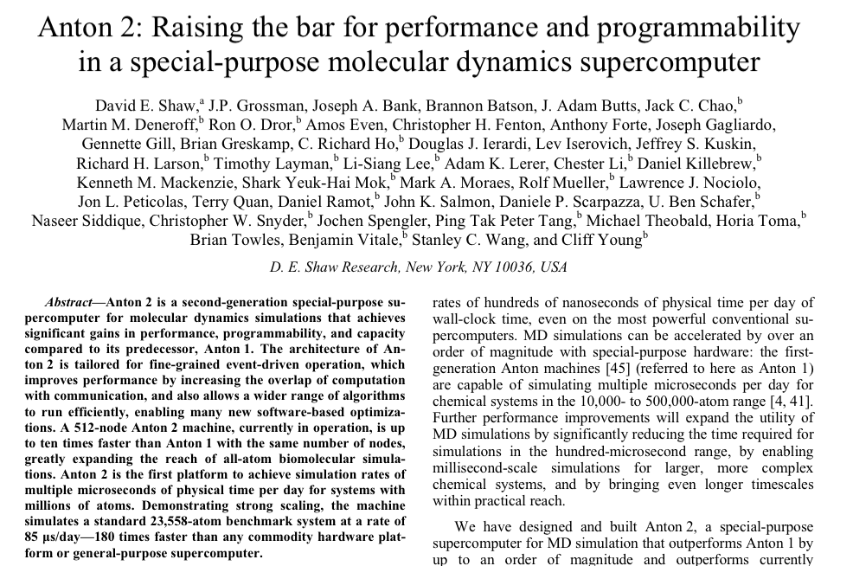
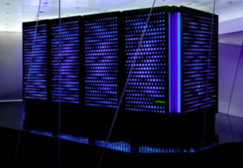
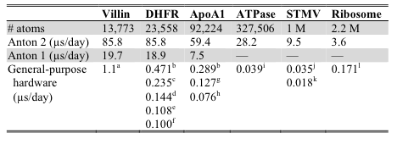
Earlier Signs of Concern – Break Down of Strong Scaling
Shaw et al., SC2014 - Molecular Dynamics – Anton2
Source: Dr. Dobb’s Journal, 30(3), 2005; update 2009 online
→ O(100x) faster than general-purpose computers

Slide 8

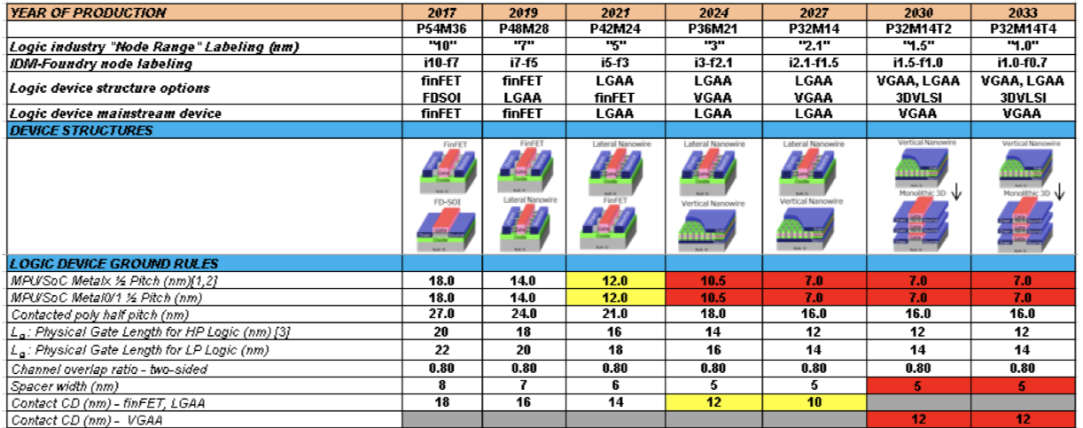
The End of Moore as we Know it for Weak Scaling?!
More Moore
  “Ground rule scaling is expected to slow down and saturate around 2027”
  “Transition to 3D integration and use of beyond CMOS devices for complementary System-on-Chip (SoC) functions are projected after 2027”
  "technological solutions will assure continuation of Moore’s Law for an additional 10−15 years”
  BUT also: “Die cost reduction has been enabled so far by concurrent scaling of poly pitch, metal pitch, and cell height scaling. This [will likely] continue until 2024”
Beyond CMOS
  Emerging Architectures
  Emerging Devices/Processes
  Emerging Materials

Slide 9
What shall we do?
There is still substantial room for improvement in software and algorithms
  We will have to work more on software and be ready for architectural changes
Specialized Chips
  GPUs, TPUs, NPUs, Spatial Accelerators etc.
New computing paradigms: Neuromorphic, Quantum

Slide 10
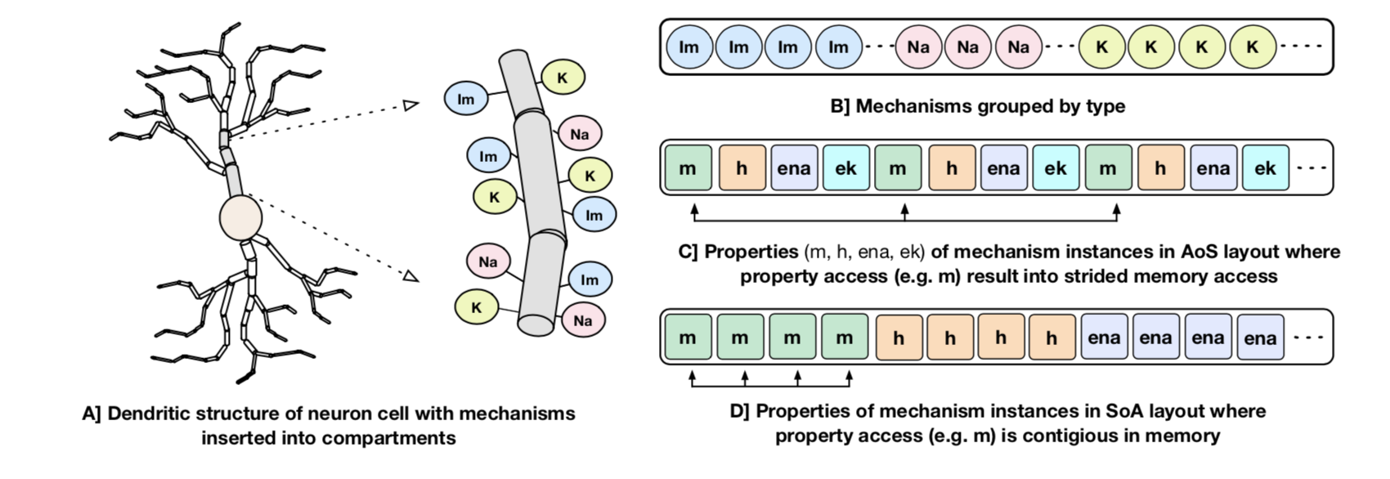
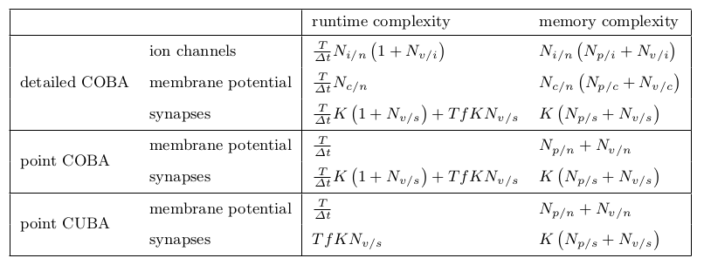
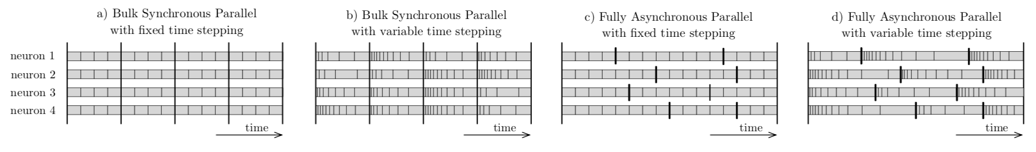
Examples of Software Improvements in BBP
1) Classical Optimization and Scaling
3) Source to Source Translation
2) Analytical Performance Modeling
4) Asynchronous Execution
5) Rethinking the problem: e.g. using machine learning
Pramod Kumbhar, Francesco Cremonesi, Bruno Magalhaes http://arxiv.org/abs/1901.10975, http://arxiv.org/abs/1901.05344
Notes:
Kumbhar et al., arXiv, http://arxiv.org/abs/1901.10975
Cremonesi et al., arXiv, http://arxiv.org/abs/1901.05344

Slide 11
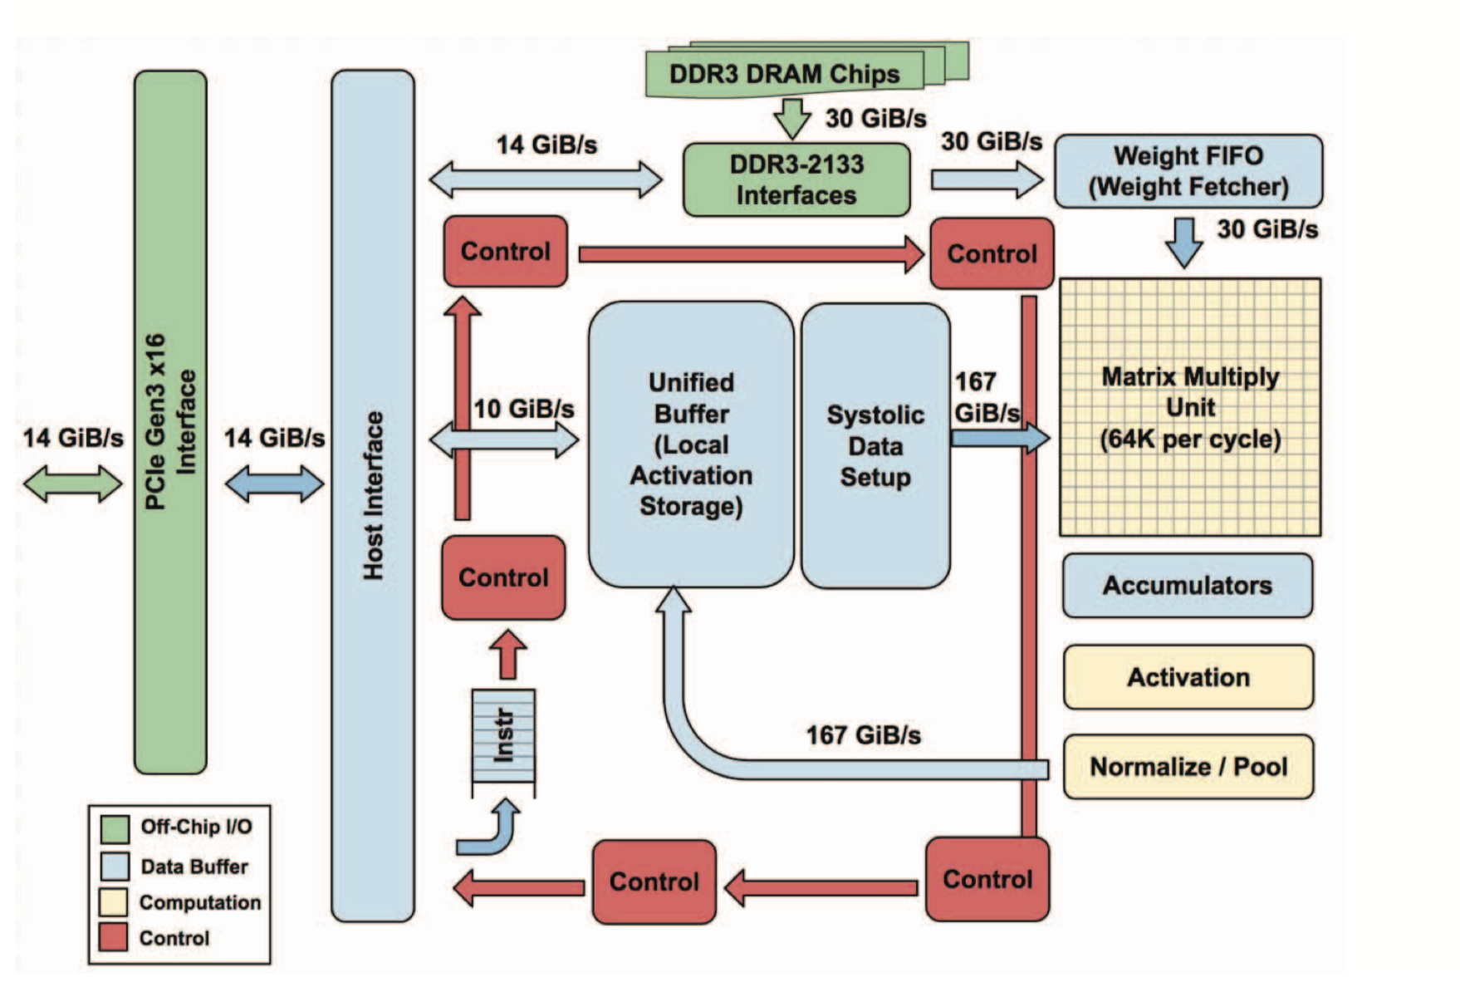
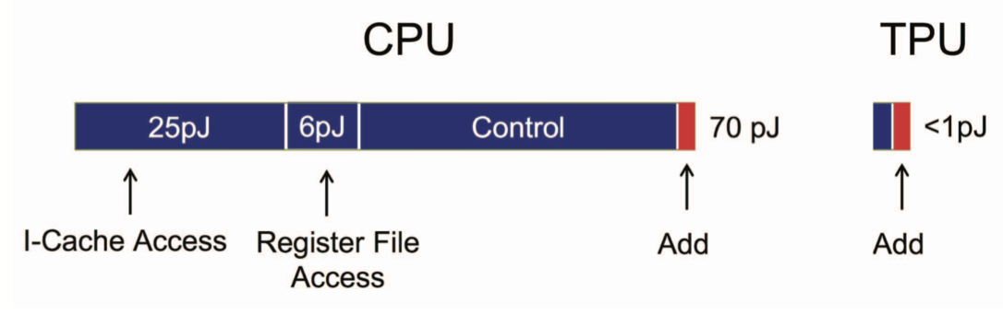
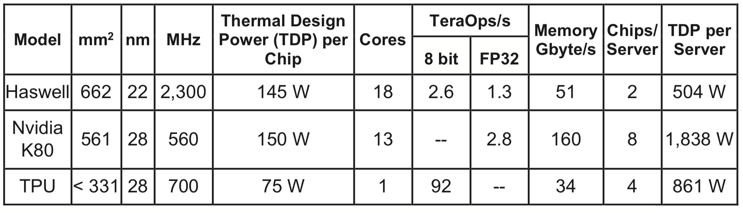
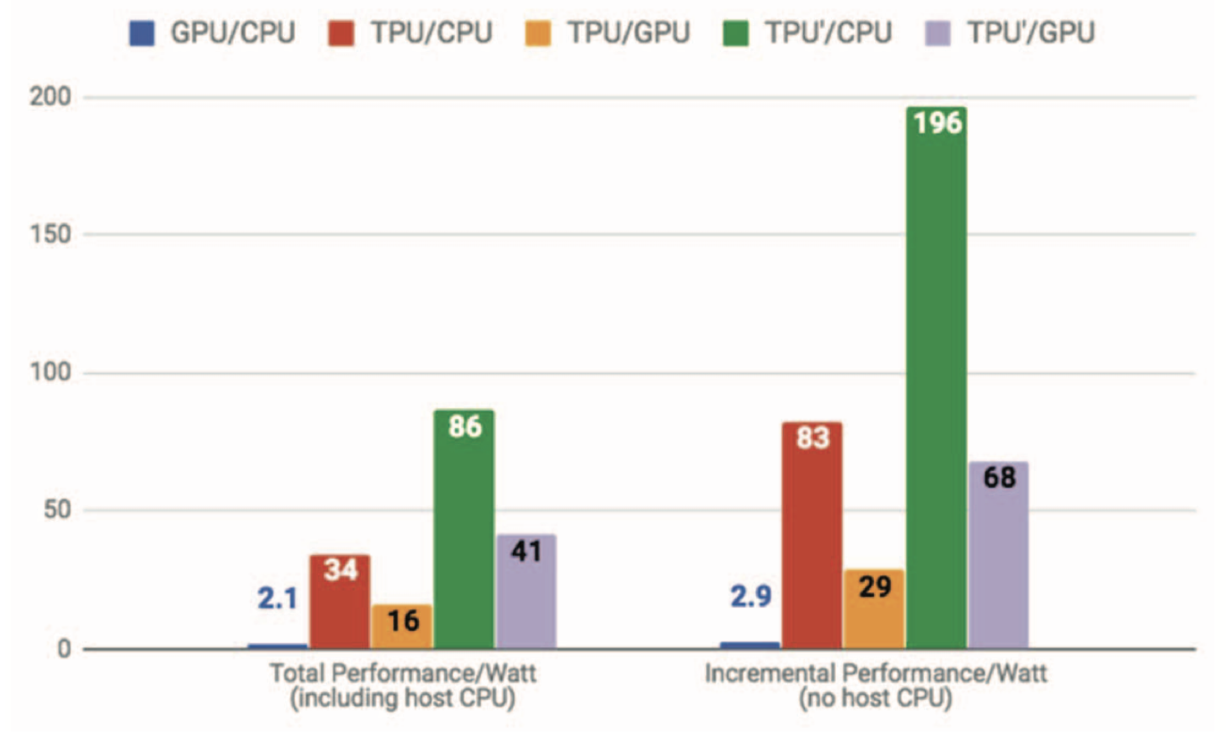
Specialized Chips
E.g. Google’s TPU v1 – an ASIC specialized to calculate matrix-vector multiplications for deep neural network inference
Jouppi et al., 2018
Notes:
10x faster by comparable latency
Three ideas:
systolic array → reduce area and power
Decoupled access/execute
CISC instructions

Slide 12
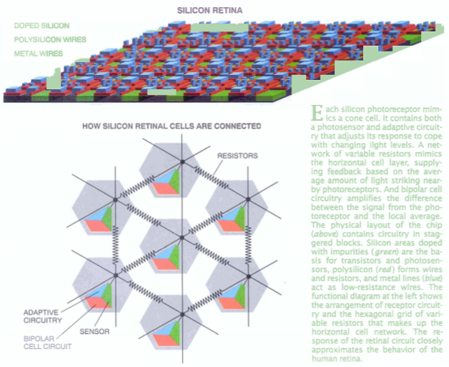
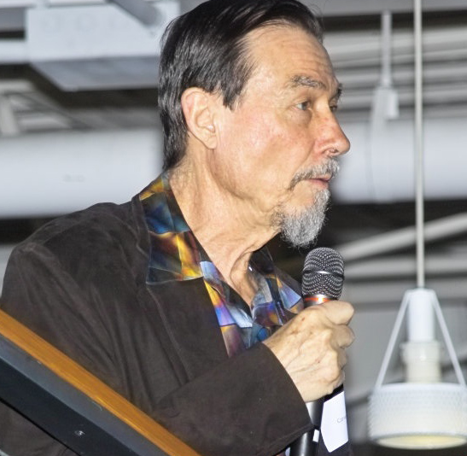
Neuromorphic Computing
“The fact that we can build devices that implement the same basic operations as those the nervous system uses leads to the inevitable conclusion that we should be able to build entire systems based on the organizing principles used by the nervous system. I will refer to these systems generically as neuromorphic systems”
Carver Mead (Caltech), 1990
1988; picture from Scientific America Article (1991)

Slide 13
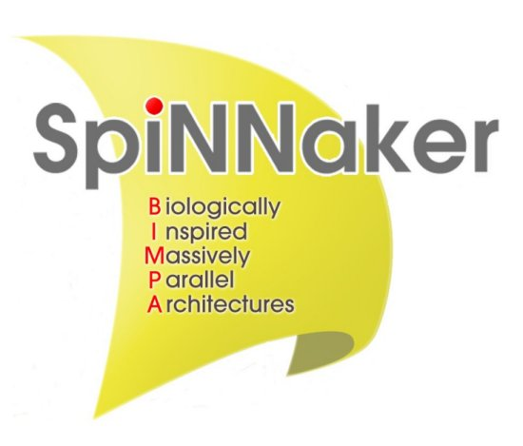


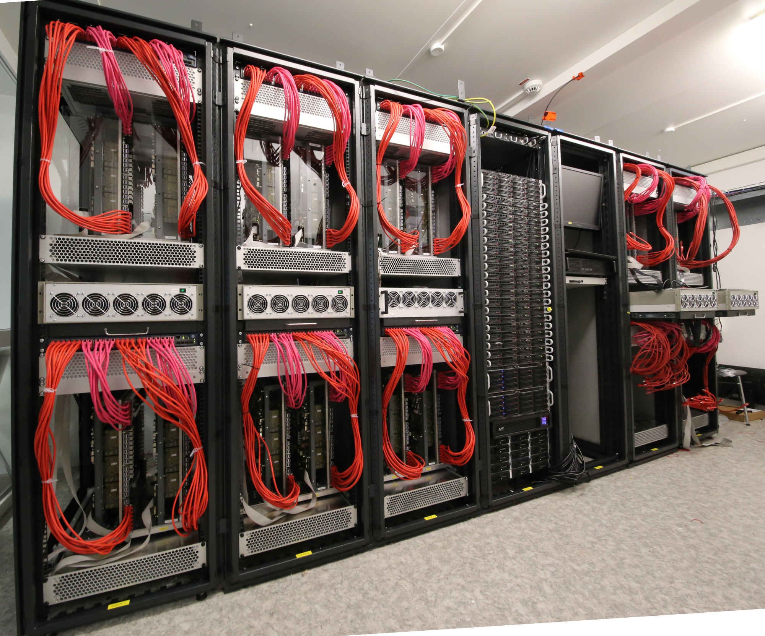
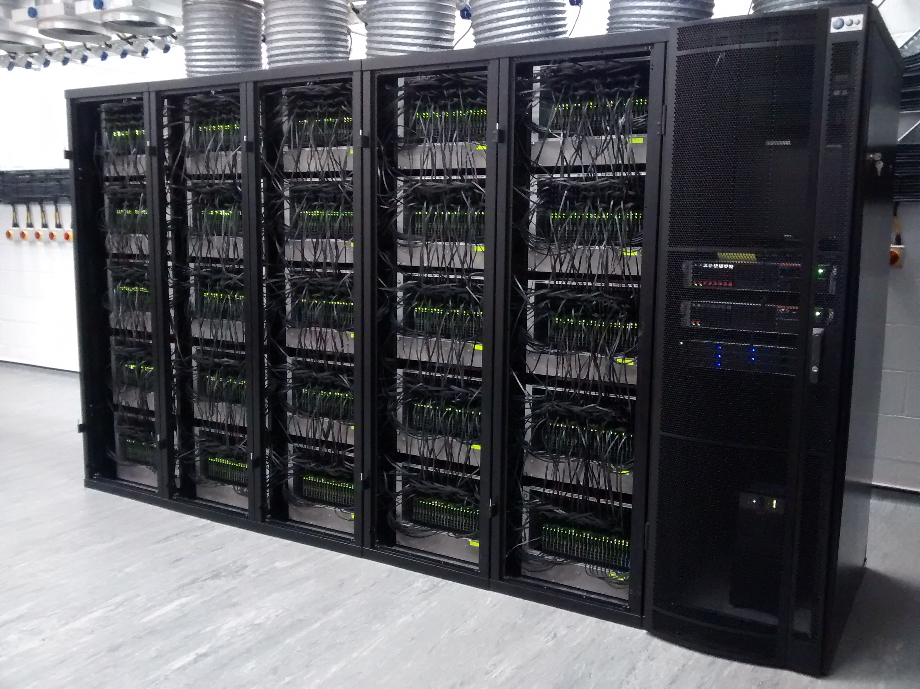
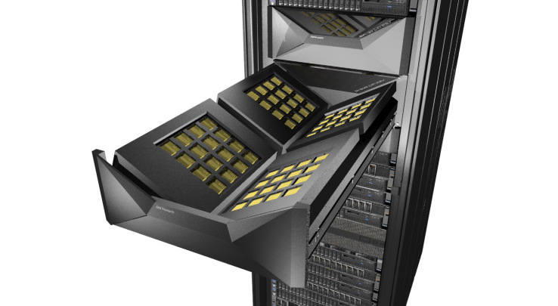
Selected Contemporary Neuromorphic Systems
TrueNorth
Loihi
Biological realism
Many-core (ARM) architecture
Optimized spike
communication network
Programmable local learning
x0.01 real-time to real-time
Full-custom-digital neural circuits
No local learning (TrueNorth)
Programmable local learning (Loihi)
Exploit economy of scale
x0.01 real-time to x100 real-time
Analog neural cores
Digital spike communication
Biological local learning
Programmable local learning
x1.000 real-time
Also: Stanford – NeuroGrid/BrainDrop architectures
Zurich – DeltaRNN architecture

Slide 14
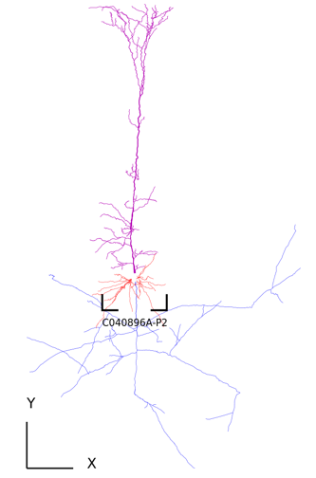



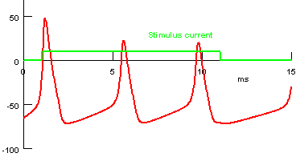
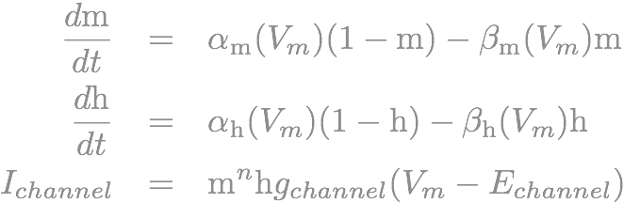
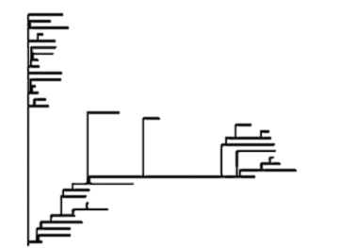

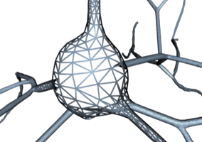
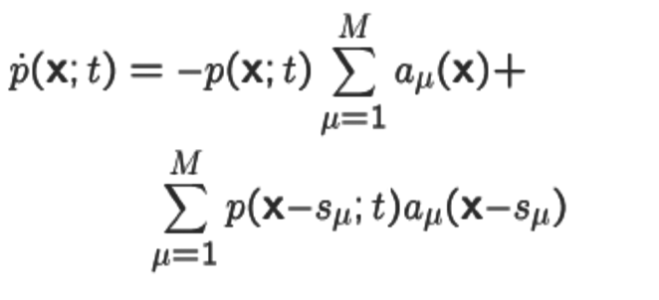
Building Blocks of Neuromorphic Hardware: Neurons
TrueNorth
Loihi
Abstract model: Point neuron, e.g. Leaky Integrate and Fire
YES
numeric
YES
numeric
YES
numeric
YES
physical
Simplified model: Single compartment and ion channel formalisms
Vm
Cm
Rm
I inj
g_{Na}
g_{k}
Em
E_{Na}
E_{k}
NO
NO
NO
NO
Cellular model: Cable and ion channel formalisms
NO
NO
COMP
numeric
COMP
physical
Subcellular model: Reaction-Diffusion formalism
NO
NO
NO
NO

Slide 15
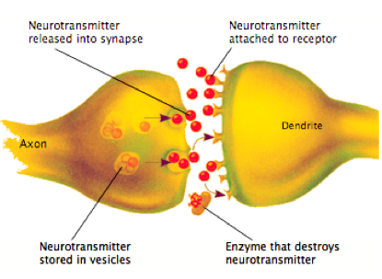
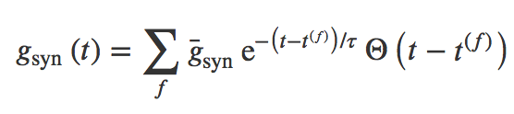
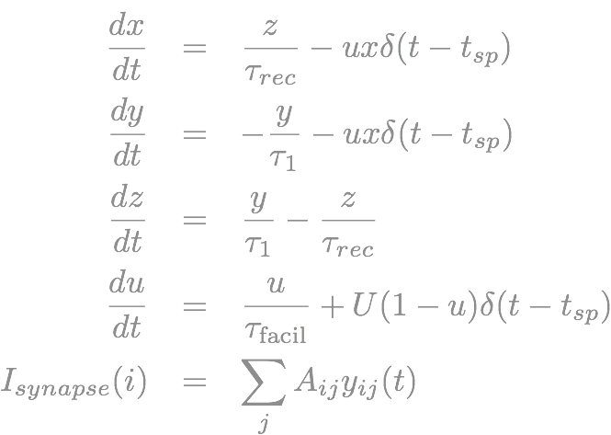
Building Blocks of Neuromorphic Hardware: Synapses
TrueNorth
Loihi
Abstract model: fixed weight
w
YES
numeric
1-bit
numeric
9-bit
numeric
6-bit
physical
Simplified model: exponential
YES
numeric
NO
NO
6-bit
physical
Phenomenological: Short term plasticity
NO
NO
NO
NO
Subcellular model: Reaction-Diffusion formalism
NO
NO
NO
NO

Slide 16

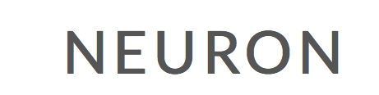

Different Design Points
R = 1/g_{leak}
V(t)
E_{leak}
C_{m}
Numerical Simulation
Numerical Neuromorphic
Physical Neuromorphic
TrueNorth
Loihi

Slide 17
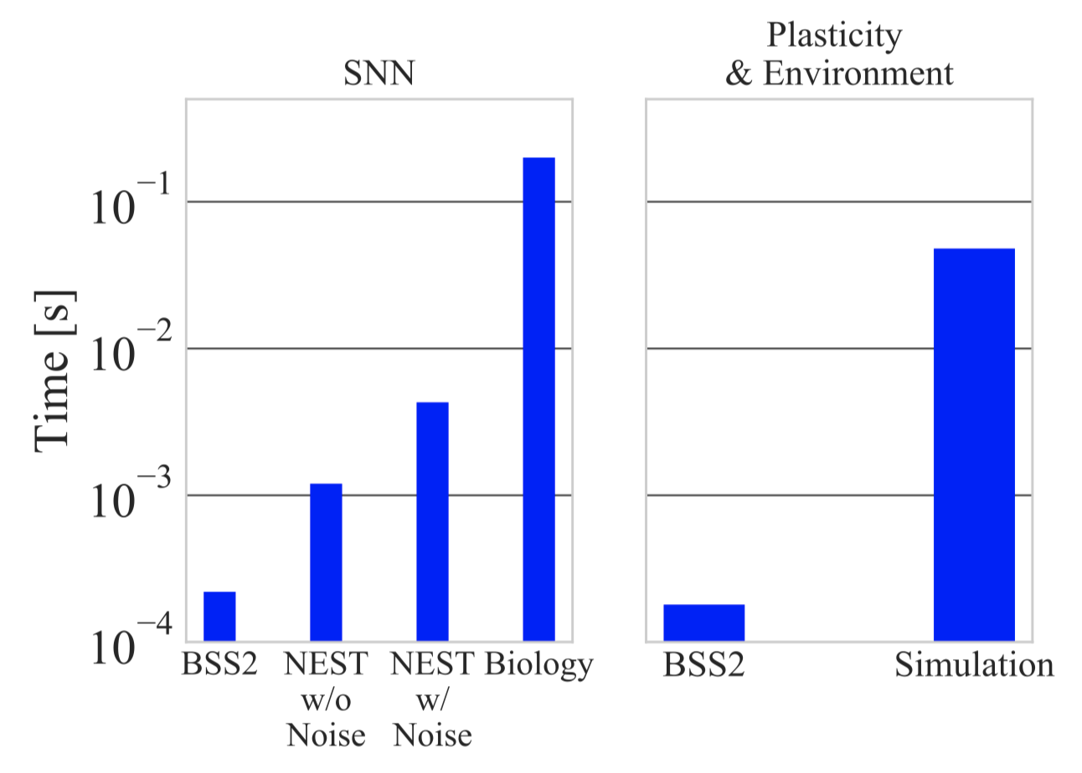
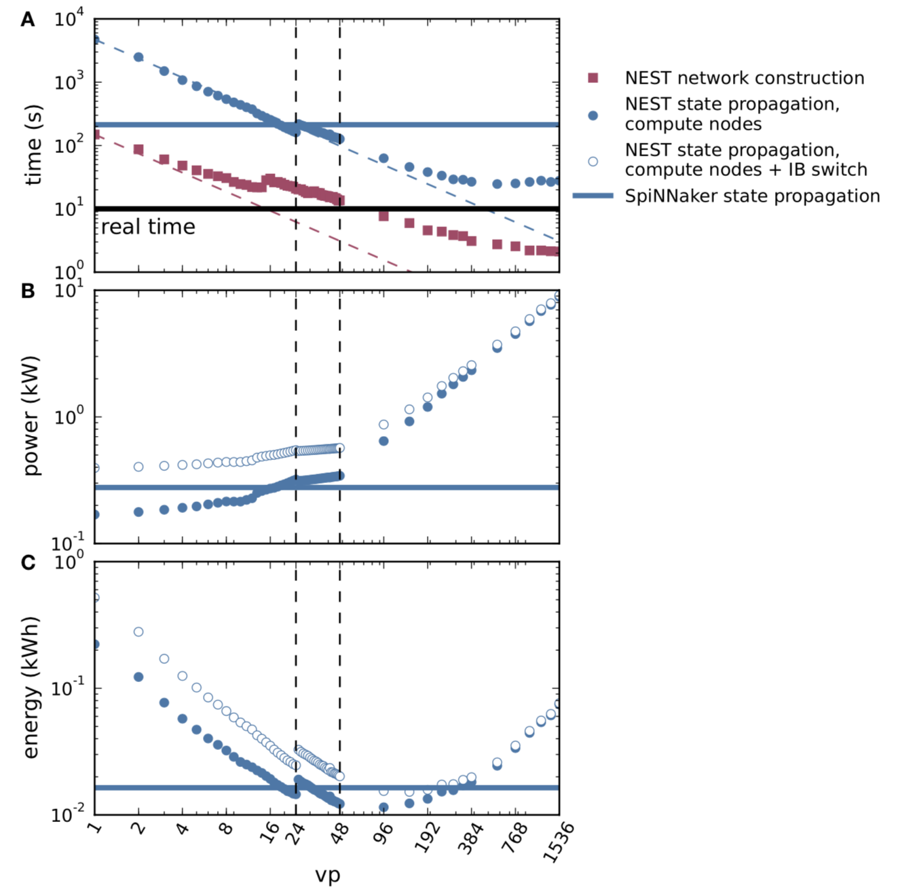
Successes and Challenges of Neuromorphic Systems
At similar time to solution numerical neuromorphic and simulation have similar power consumption; simulation can go 10x faster at cost of higher energy
Physical neuromorphic up to 100x faster and 1000x more power efficient than simulation
All neuromorphic systems have same challenge in common: the circuits/architecture have to come from somewhere else and in the meantime learning is supposed to fix this.
Wunderlich et al., 2019
van Albada et al., 2018

Slide 18
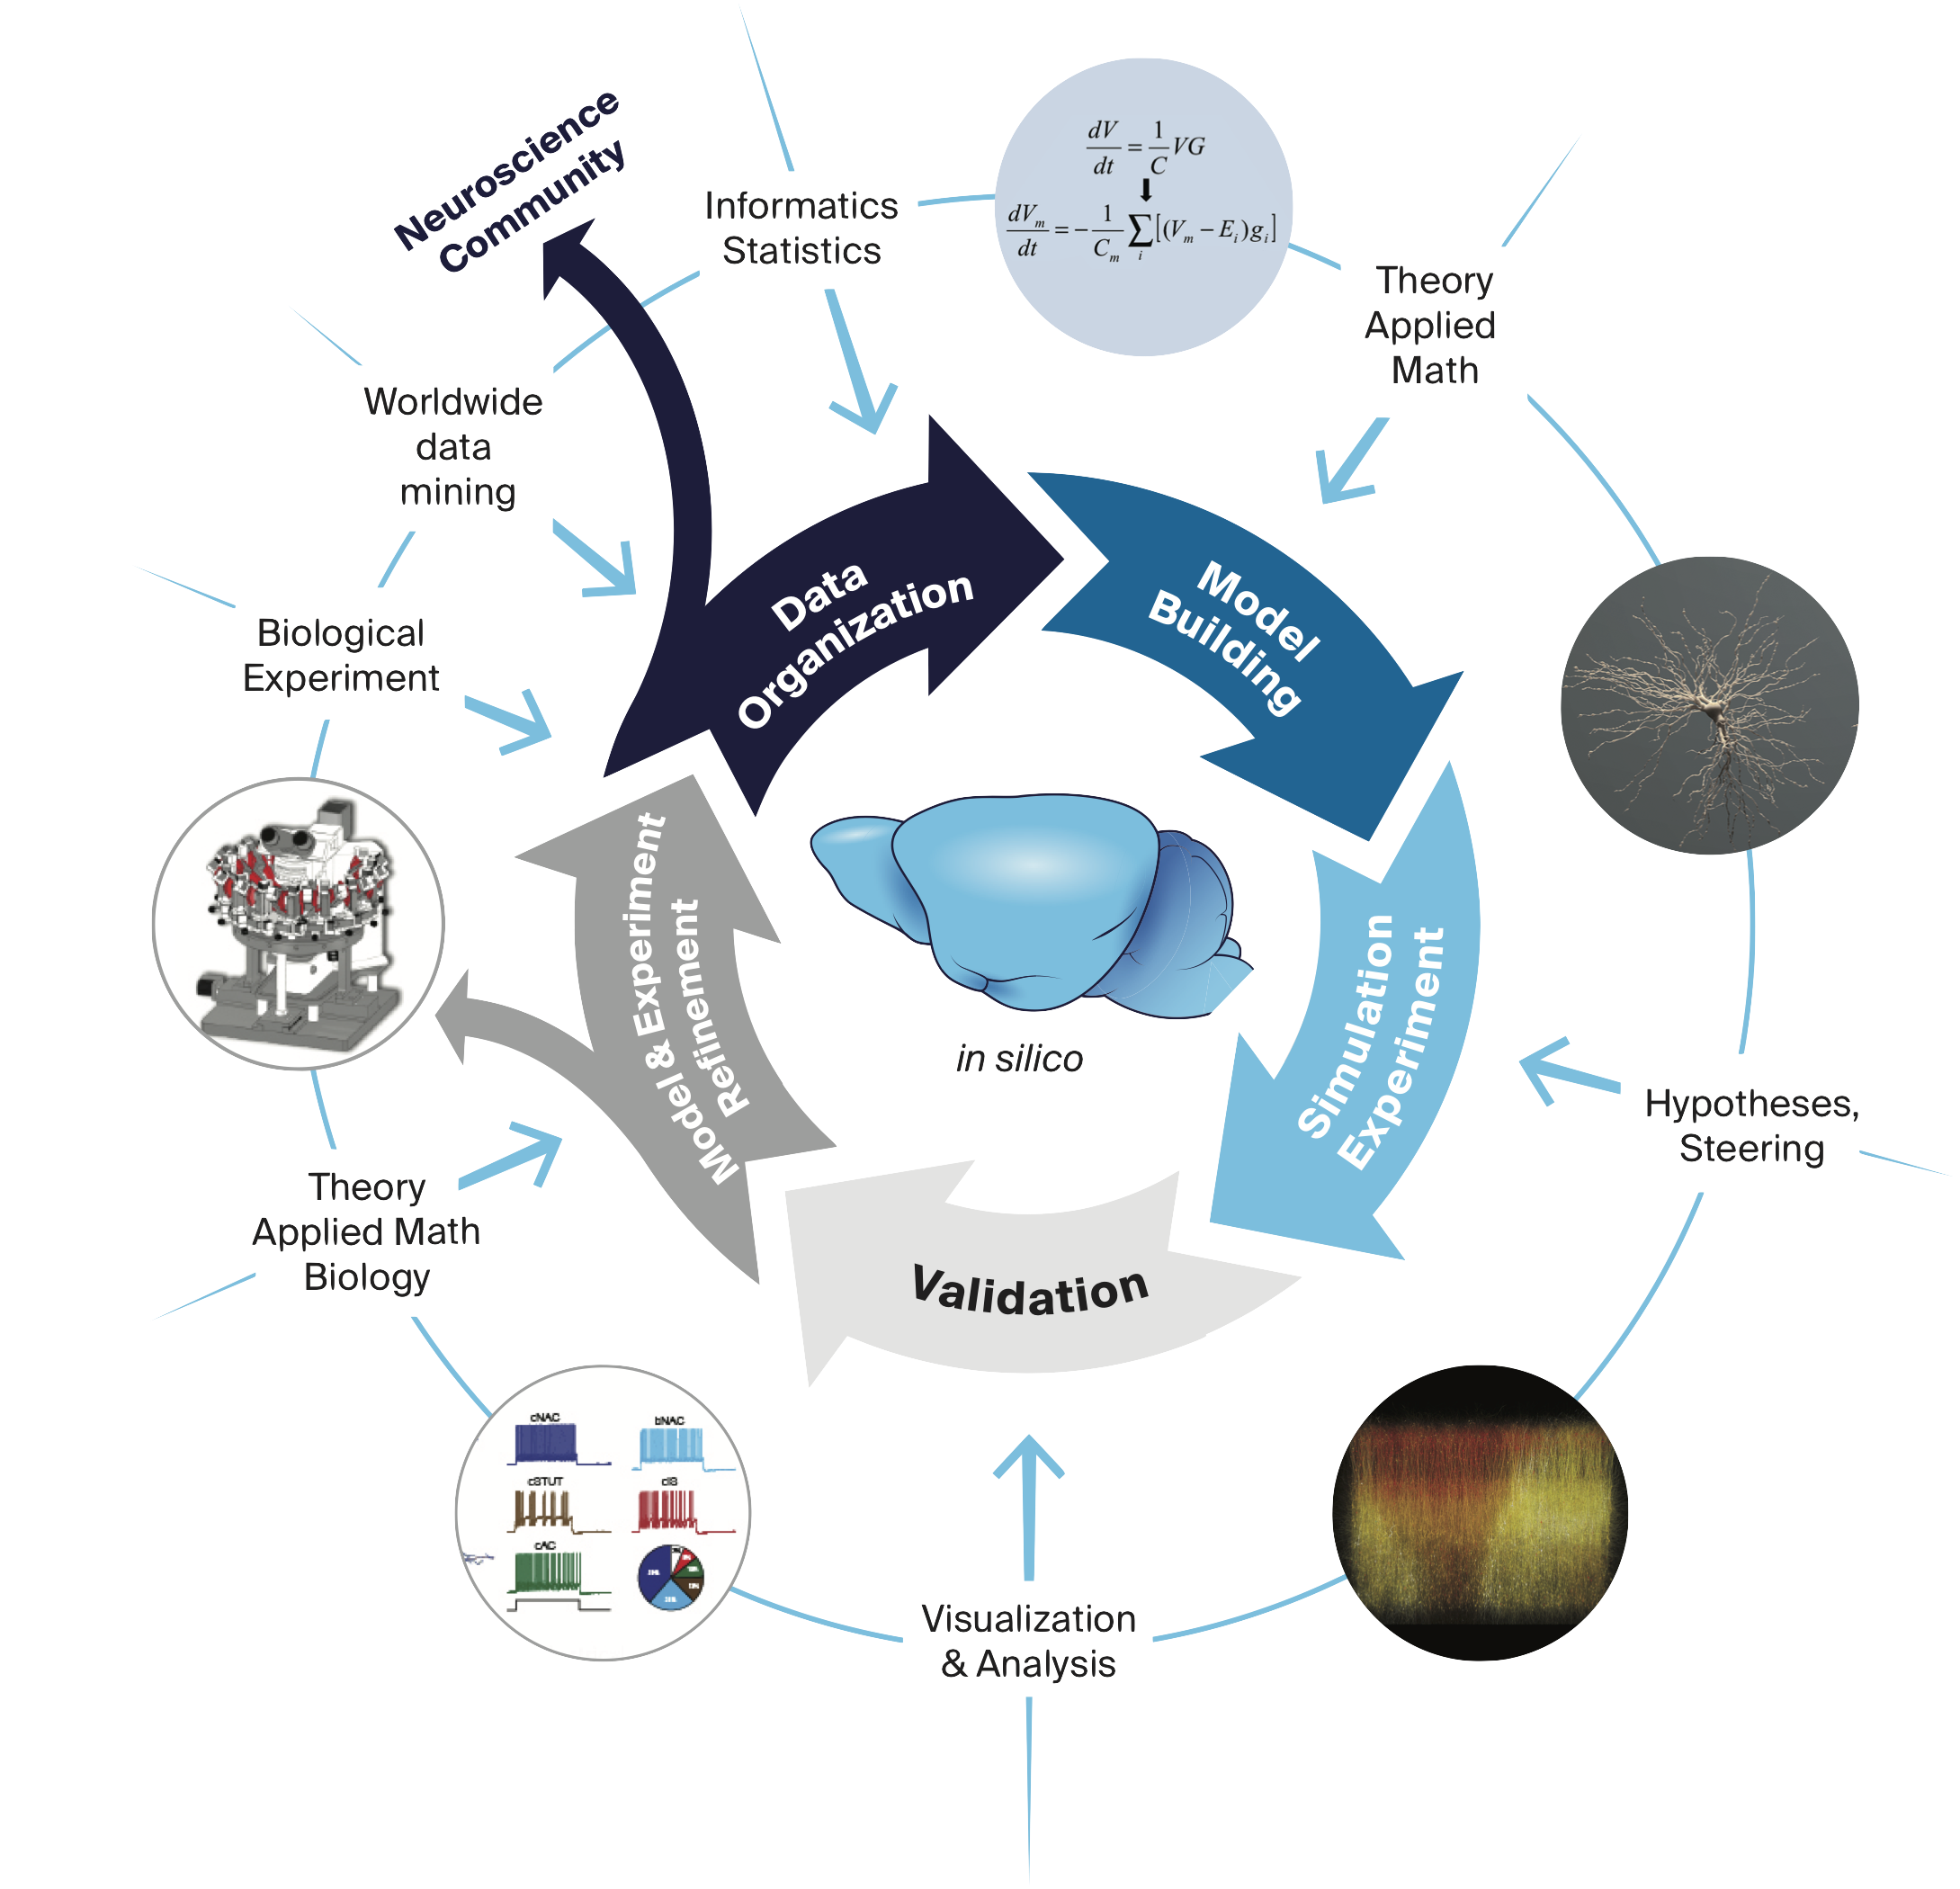
Blue Brain Project – Simulation Neuroscience
A Swiss national infrastructure project to build digital reconstructions and simulations of the rodent, and ultimately the human brain
Funded by the ETH Board and implemented as a center at EPFL
Mission-driven team-science project with 130 scientists and engineers
Website: https://bluebrain.epfl.ch
Public Resources: https://portal.bluebrain.epfl.ch

Slide 19
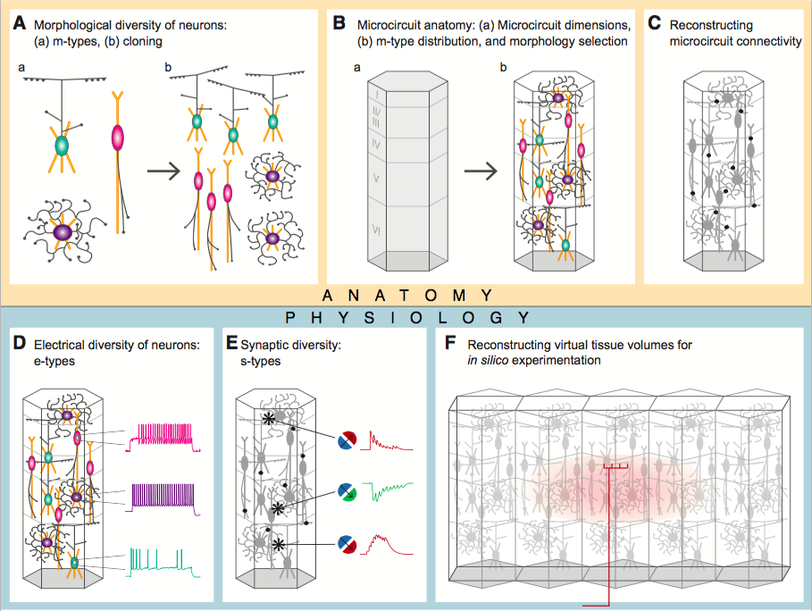
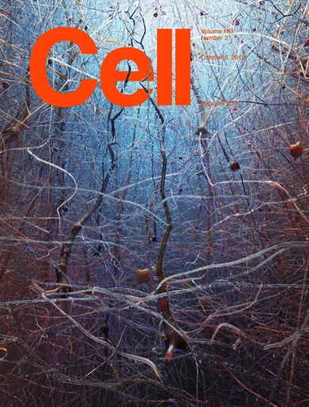
BBP Reconstruction and Simulation of Neocortical Microcircuitry
H. Markram, E. Muller, S. Ramaswamy, Michael W. Reimann, M. Abdellah, Carlos A. Sanchez, A. Ailamaki, …, Stefano M. Zaninetta, J. DeFelipe*, Sean L. Hill* I. Segev*, and F. Schürmann* ,
Reconstruction and Simulation of Neocortical Microcircuitry, Cell, 2105
https://bbp.epfl.ch/nmc-portal/
Major example of highly collaborative neuroscience: 82 authors
Shows that detailed models can be built from sparse data
Emergent behavior reproduces wide range of in vitro and in vivo experiments
Can ask new questions about cellular and synaptic mechanisms

Slide 20
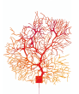
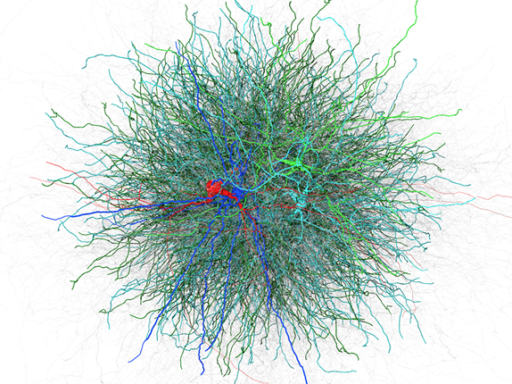

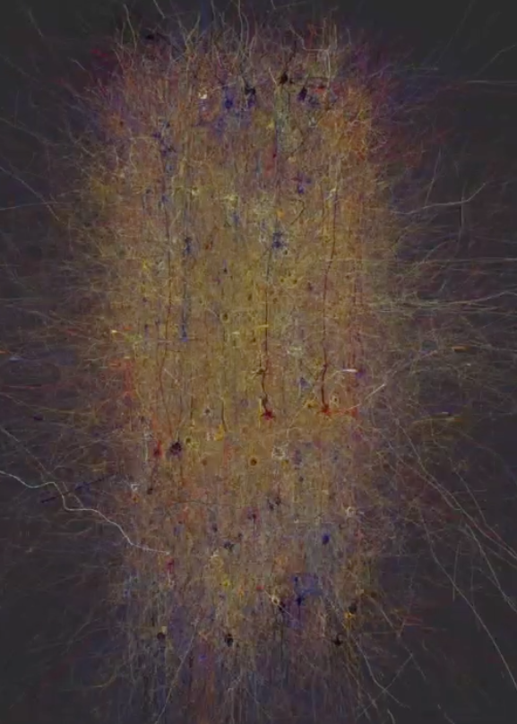
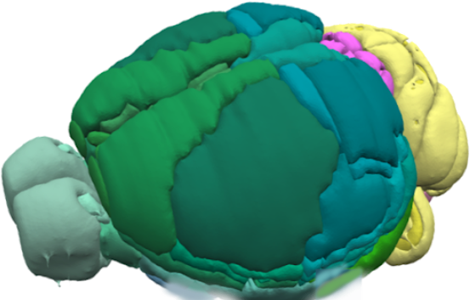
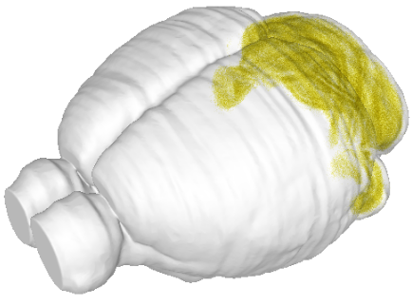
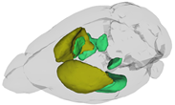
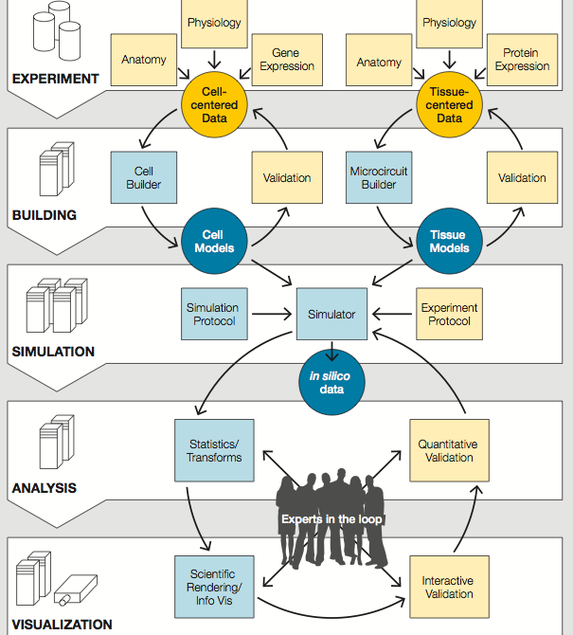
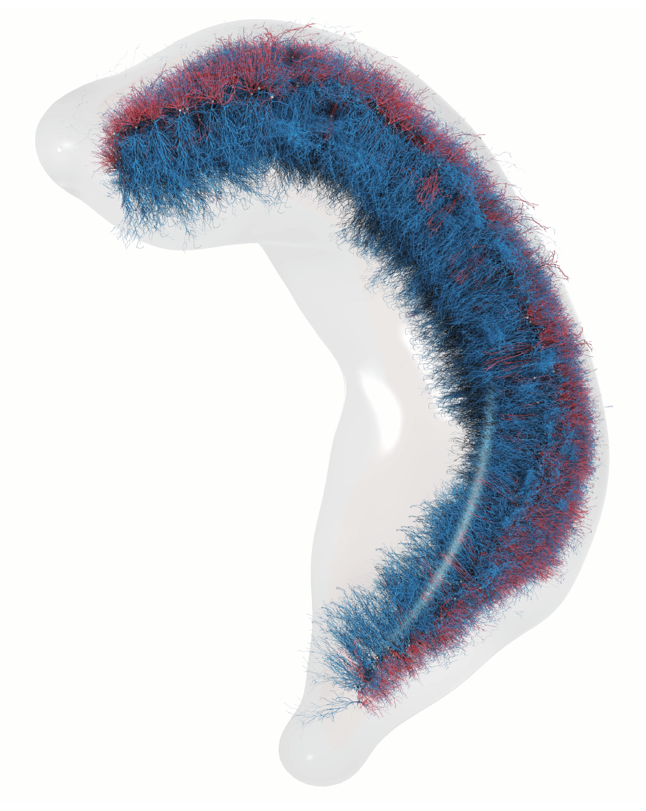
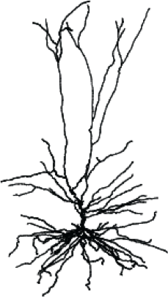
Accelerating Research towards Whole Brain
Microcircuit
Neocortex
Rodent Cerebellum
Rodent Basal Ganglia
Rodent Hippocampus CA1
Blue Brain Reconstruction & Simulation Workflows
Human Neurons

Slide 21
Neuroscience and the Future of Computing
General + Specialized Architectures
General Purpose
More Moore
Beyond CMOS
maintain
boost
Specialized Architectures
Machine Learning
complement
complement
More Moore
Beyond CMOS
boost
boost
Machine Learning/Bio-inspired Intelligence
Neuromorphic Architectures
More Moore
Beyond CMOS
Better architectures
Optimization?
Quantum Annealing Architectures
Search/Specialized Functions?
Quantum Gate Computers

Slide 22
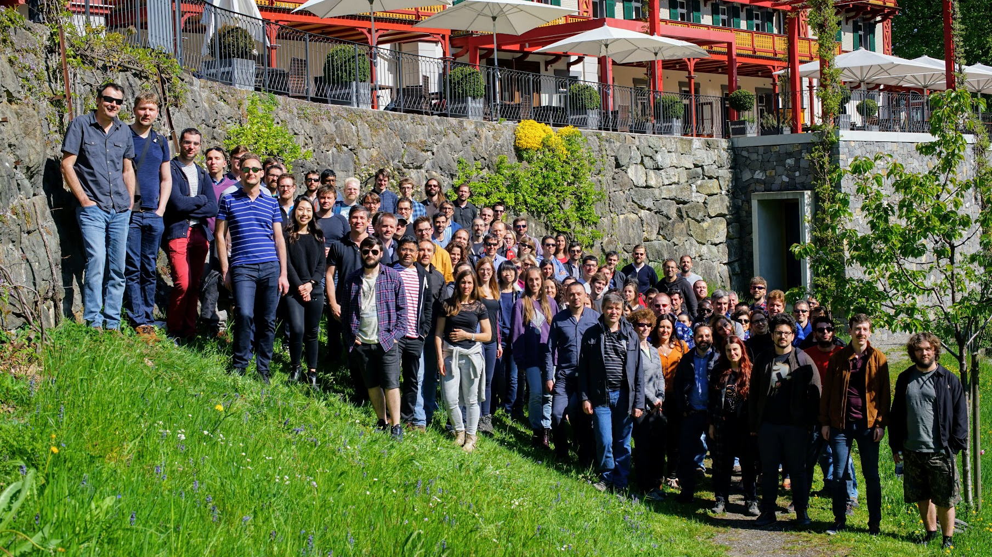
Acknowledgments
The Blue Brain Team
Laboratory of Neurosimulation Technology
Francesco Cremonesi – Performance Modeling
Pramod Kumbhar – CoreNeuron, Source-2-source
Bruno Magalhaes – Asynchronous Execution
Judit Planas – Data Intensive Computing
Collaborations
Dr. Michael Hines (Yale University) – NEURON simulator
Prof. Thomas Sterling (Indiana University) – ParalleX Execution Model/HPX
Prof. Gerhard Wellein/Dr. Georg Hager – ECM Performance Modeling
Fabien Delalondre - CoreNeuron
Timothey Ewart – Exponential, SIMD
Funders
ETH Board
EC Human Brain Project
Computing Resources
Blue Brain Project @ CSCS
Julich Supercomputing Center
Argonne National Laboratory

