Slide 1
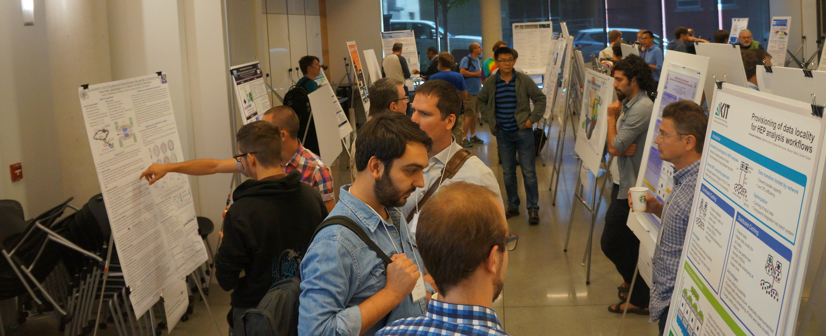
Welcome to Day 3 of ACAT 2017!!
Thanks for the Tuesday Poster Votes!
We will do the same thing for Thursday Posters – so please make sure to check out the posters Thursday!
Please take down all posters by the end of morning Coffee Break!
Thursday posters can go up after the end of the plenaries today, or first thing tomorrow morning!
Lunch is in Lander Hall today!

Slide 2
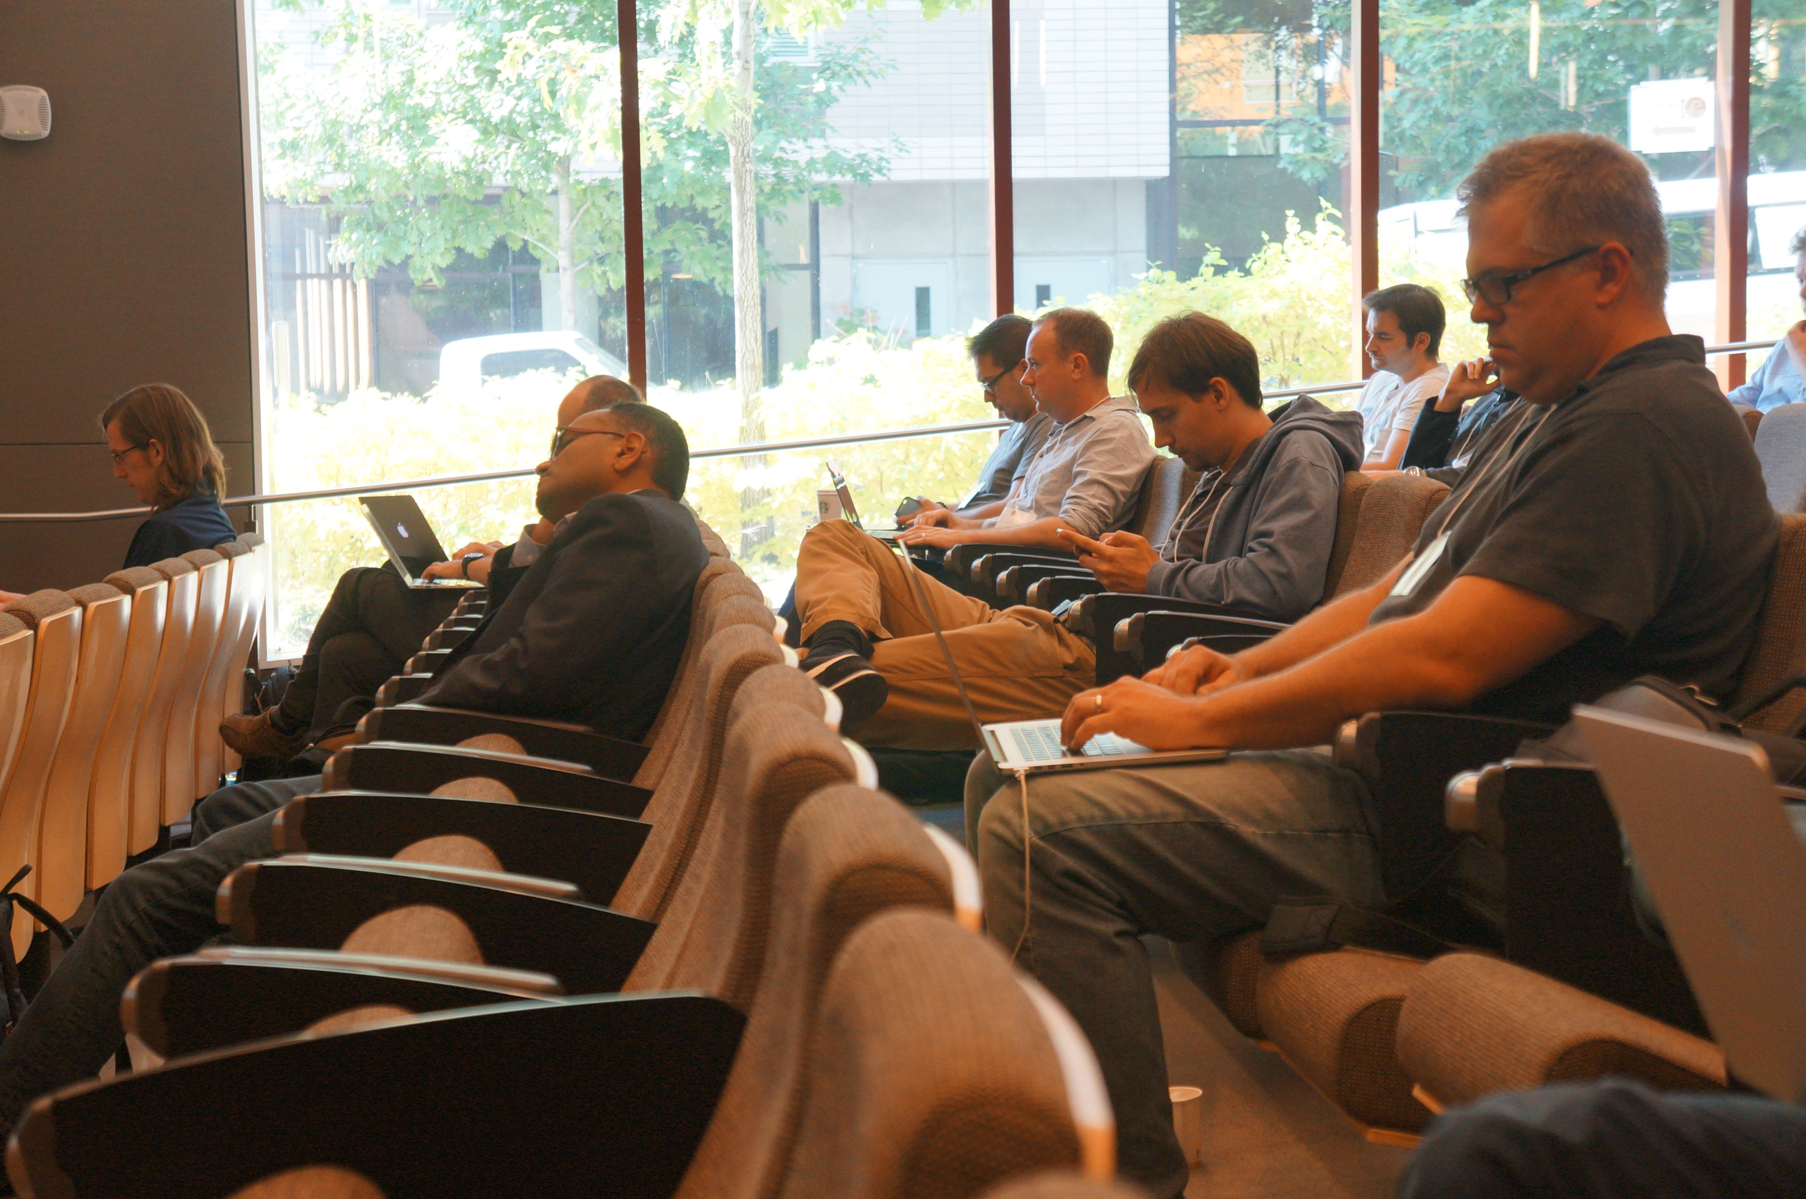
Sight See
Relax
Have a great Seattle meal
Recharge and be ready for more intense discussions on Thursday!
Today is a half day!

Slide 3
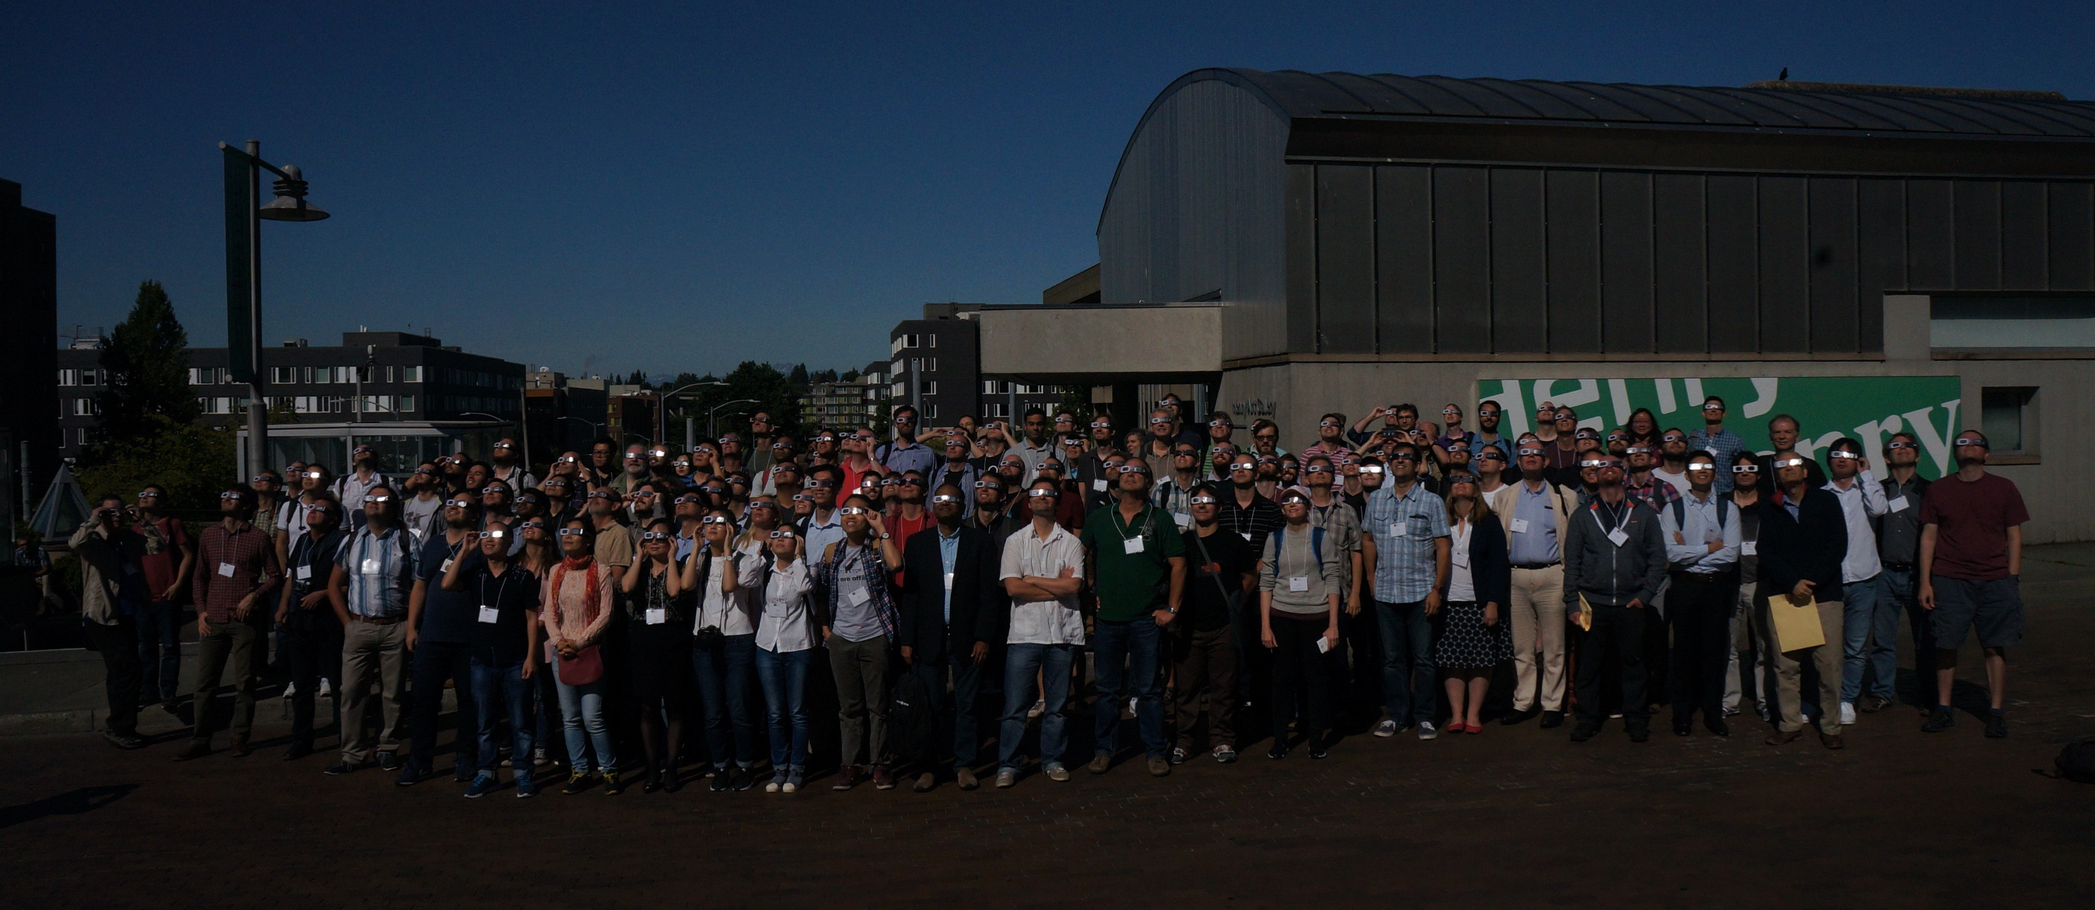

Slide 4
Please send in questions for the Diversity Round Table!
You can find the link on the Friday Morning Round Table Indico Entry!
They will collate the questions starting at 2 pm!

Slide 5
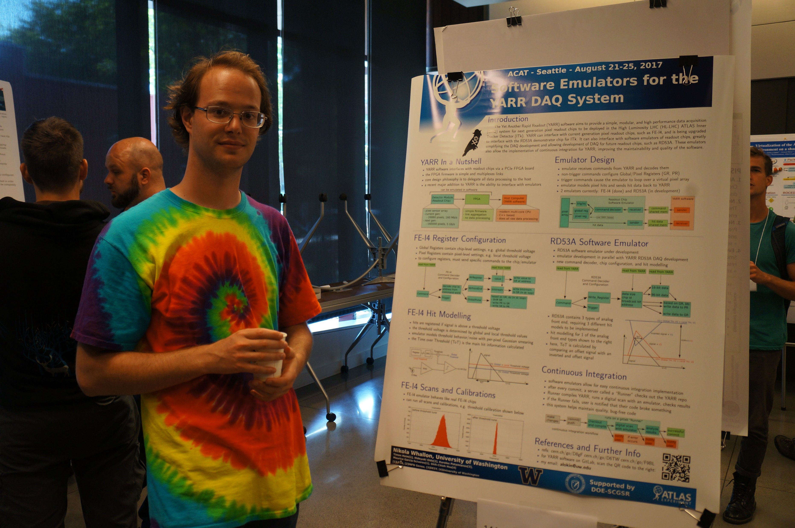
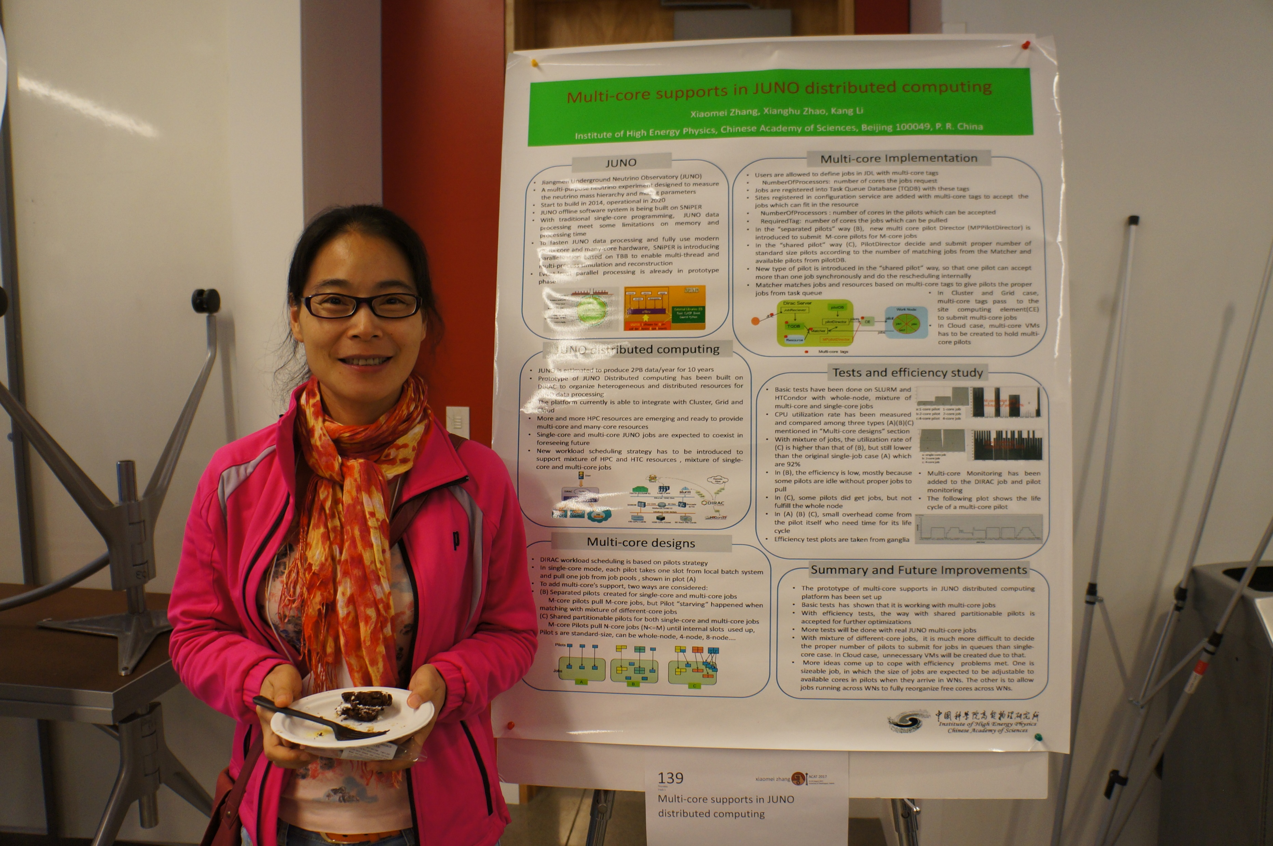

Slide 6
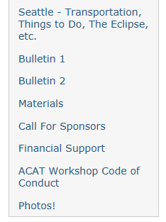
Want to see more Photos?

Slide 7
