Slide 1
LHC CYCLE for the 2018 ION RUN
S. Fartoukh BE/ABP
Acknowledgements: J. Jowett, M. Solfaroli, J. Wenninger
Main optics parameters
Optics and crossing scheme transition in IR2 & IR8, including IP2 shift
Aperture
Hypercycle (IR optics assembly strategy)
Chromatic aberrations & spurious dispersion
Matched points selection
Conclusions

Slide 2
Main optics parameters in collision (6.37 ZTeV)
(→ the injection optics is kept unchanged)
 | IR1 | IR2 | IR5 | IR8
β* [m] | 0.5 | 0.5 | 0.5 | 1.5
External Half X-angle [μrad] ^{(*)} | ±160 (V) | ±137^{(**)} (V) | ±160 (H) | ±170 (H)
External X-angle [σ] (for γε=3.75 μm) | 9.6 | 8.3 | 9.6 | 17.7
Half parallel separation [mm]^{(*)} | ±0.55 | ±1 | ±0.55 | ±1
Vertical IP shift [mm] | 0 | -2 | -1.8 | 0
^{(*)}: Reached end of ramp (after possible Xing gymnastic in IR2, see below), and kept cst till end of squeeze
^{(**)}: ± 60 μrad internal (see later the bb separation)
Only the “good polarity” for LHCb is planned (→ internal half-crossing angle of ± 320 μrad)
A polarity switch of the Alice spectrometer is planned, which might impact on the min. allowed end of ramp β* for IR2 (TBD) and might impose a special BP for crossing angle gymnastic in the end of the ramp (see later)

Slide 3
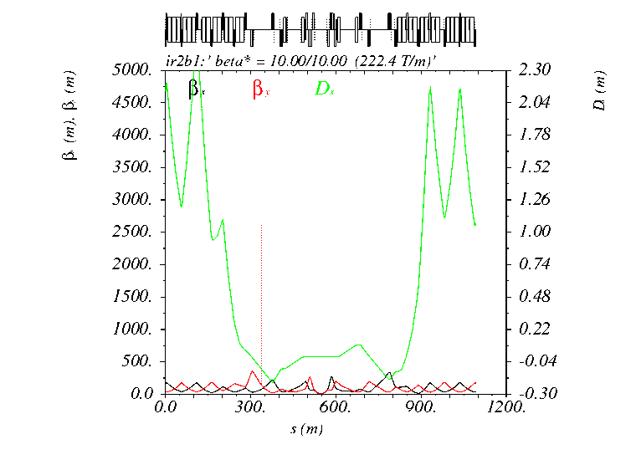
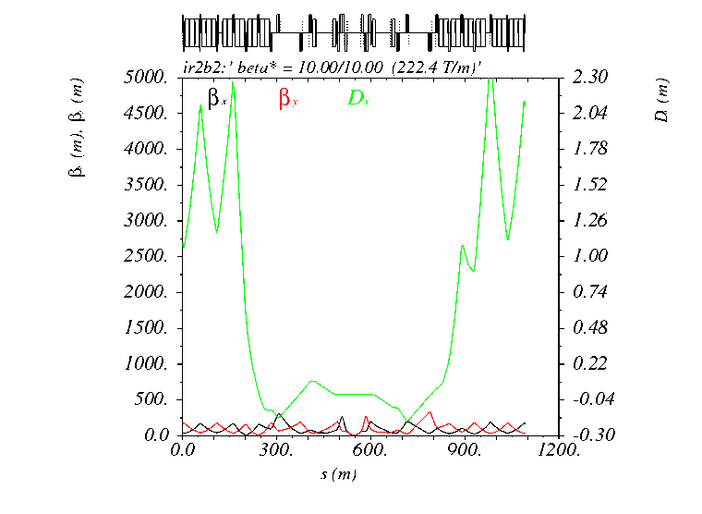
IR2 transition (10 m → 50 cm)
Optics
Beam 1
Beam 2

Slide 4
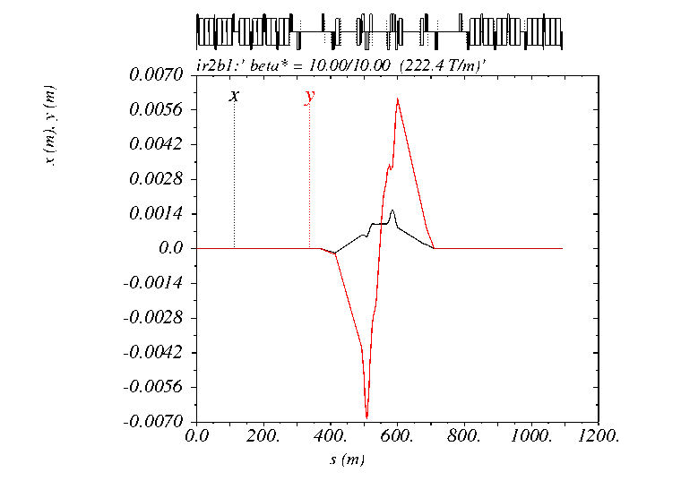
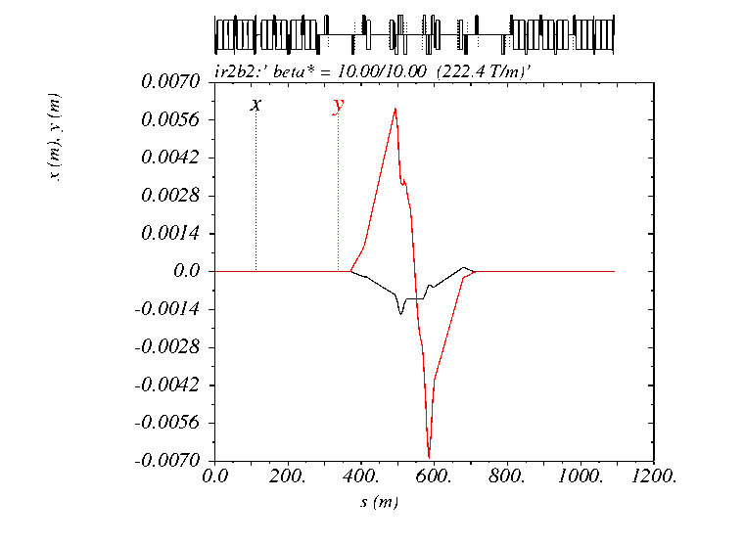
Crossing bumps (animation with Xangle kept fixed at 137 μrad)
Beam 1
Beam 2

Slide 5
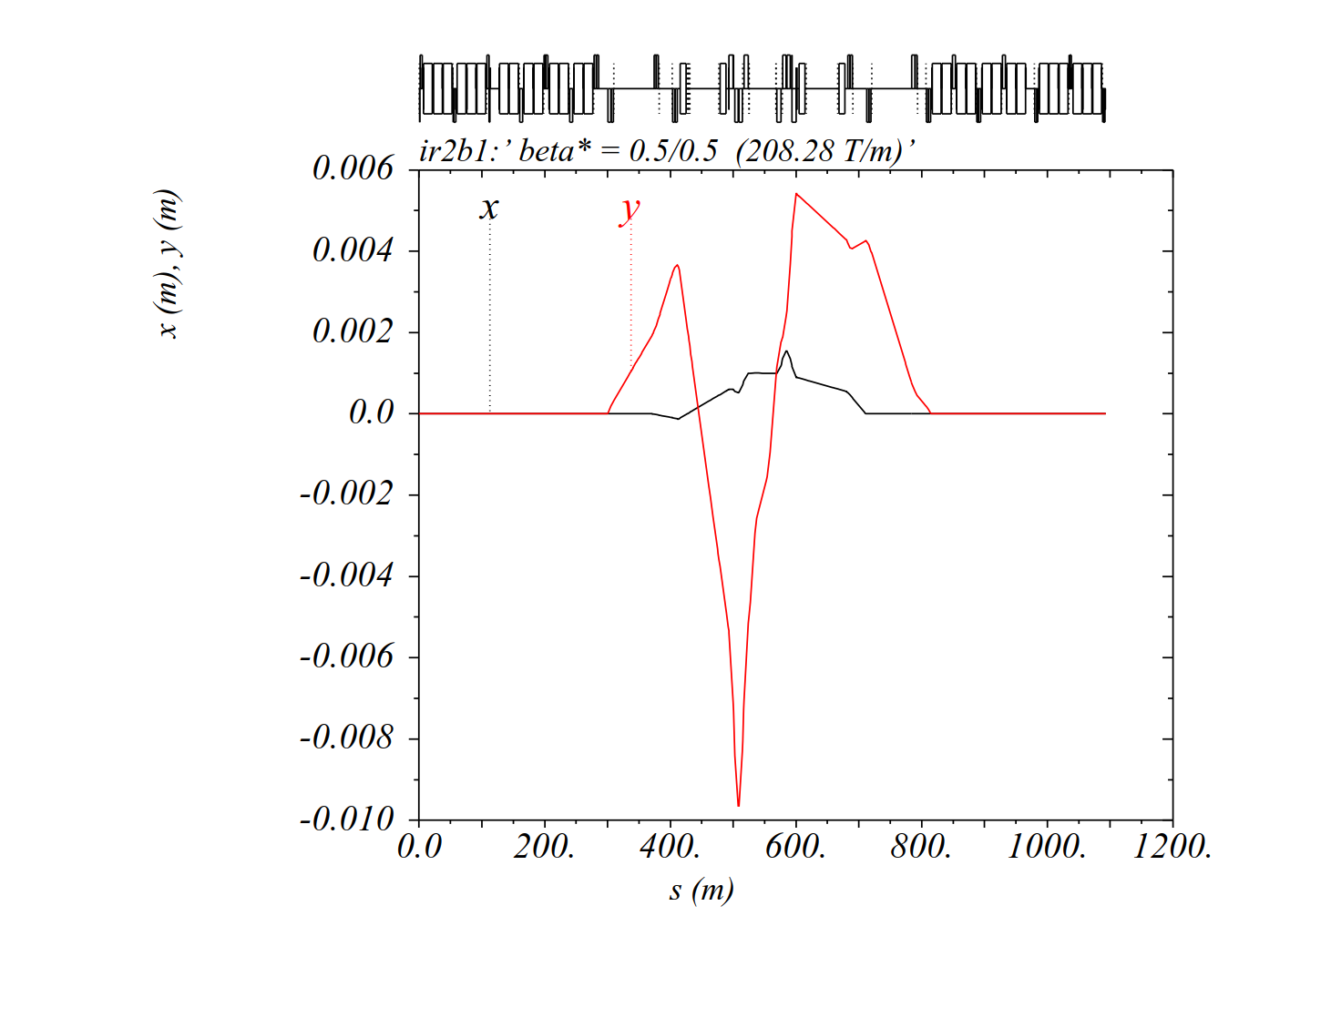
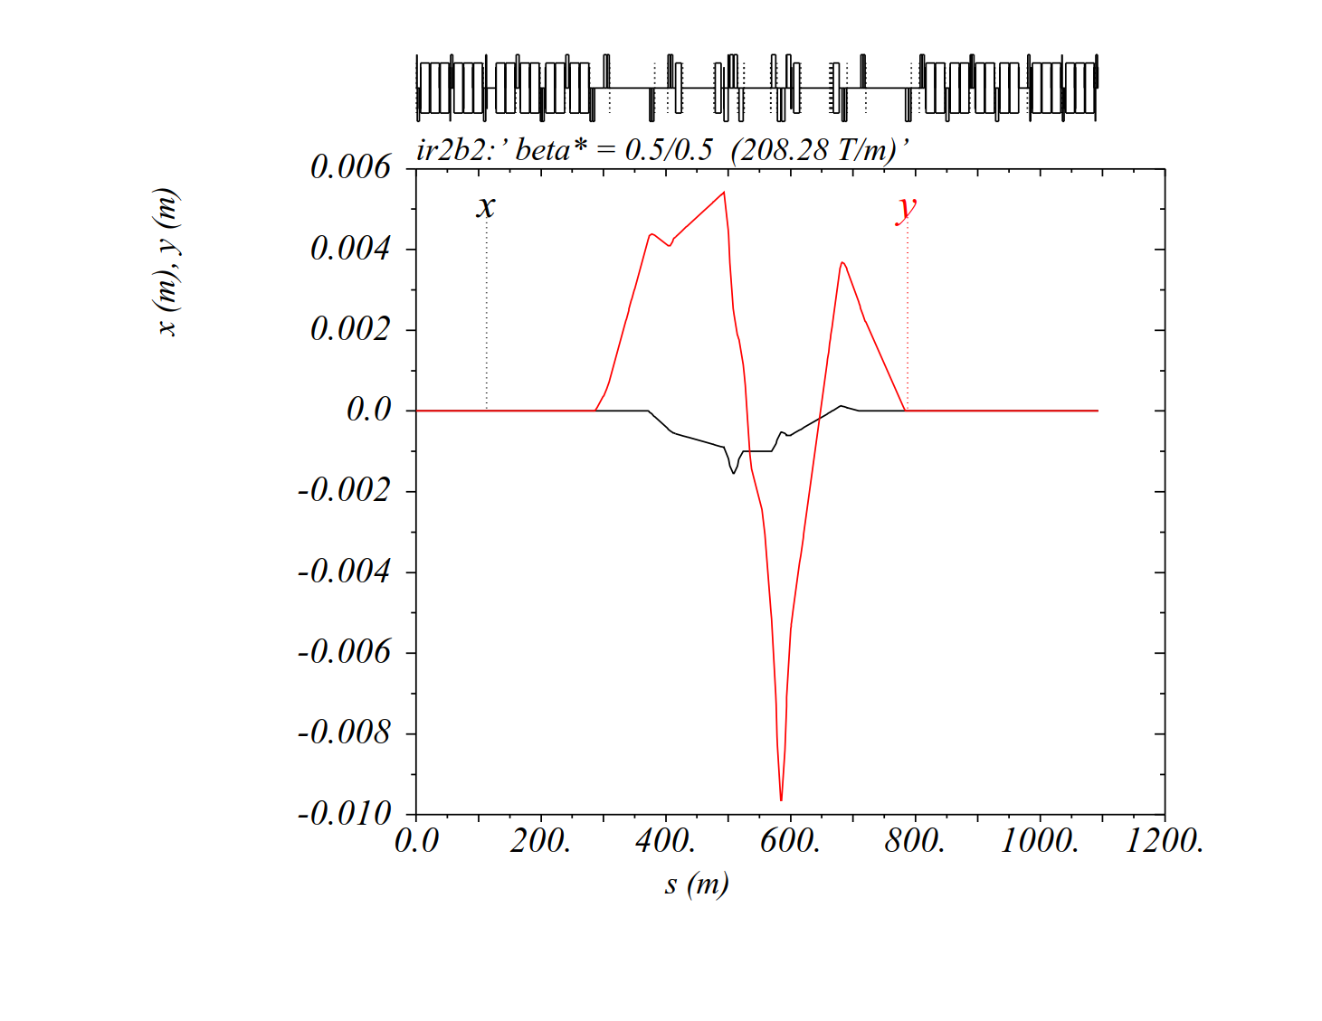
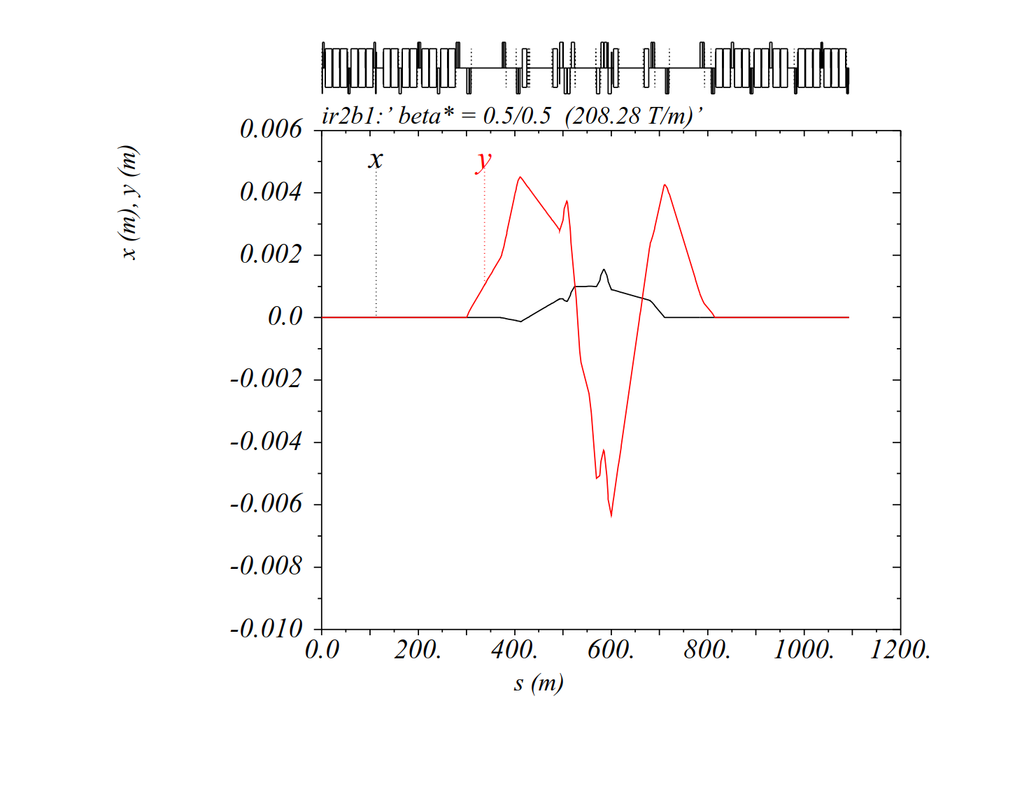

Crossing bumps with IP shift ON (-2 mm)
Beam 1
Beam 2
Positive external X-angle (+137 μrad)
with negative spectrometer polarity
MCBY(C)S pushed up to 80% (7 TeV eq.)
Standard MCBY(C) at Q4/5/6/7 not
exceeding 40% (7 TeV eq.): to be checked
if OK vs. 2017 for closed orbit correction
Negative external X-angle (-137 μrad)
with positive spectrometer polarity
MCBY(C)S pushed up to 90% (7 TeV eq.)
Standard MCBY(C) at Q4/5/6/7 not
exceeding 40% (7 TeV eq.): to be checked
if OK vs. 2017 for closed orbit correction

Slide 6
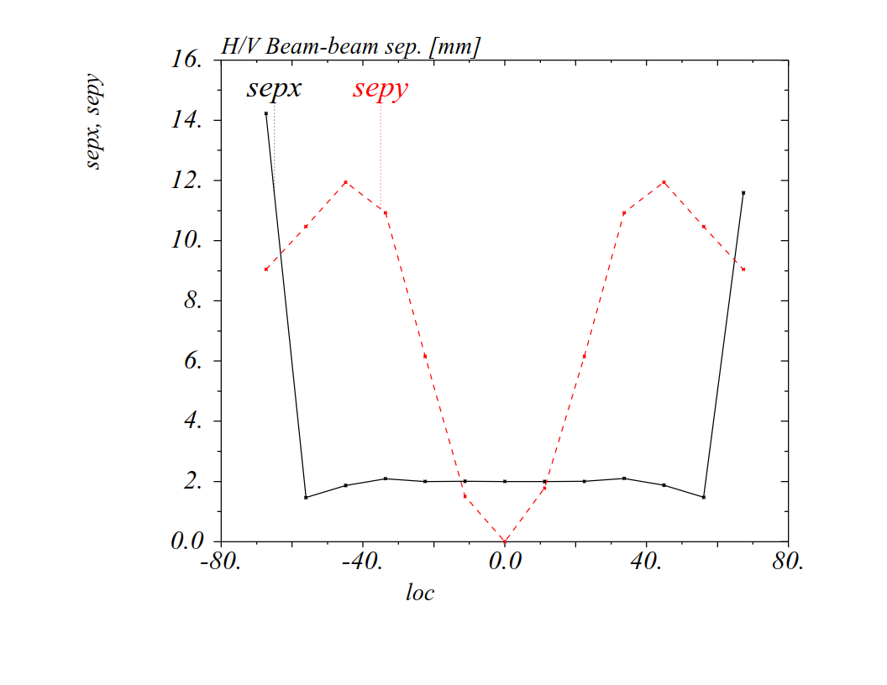
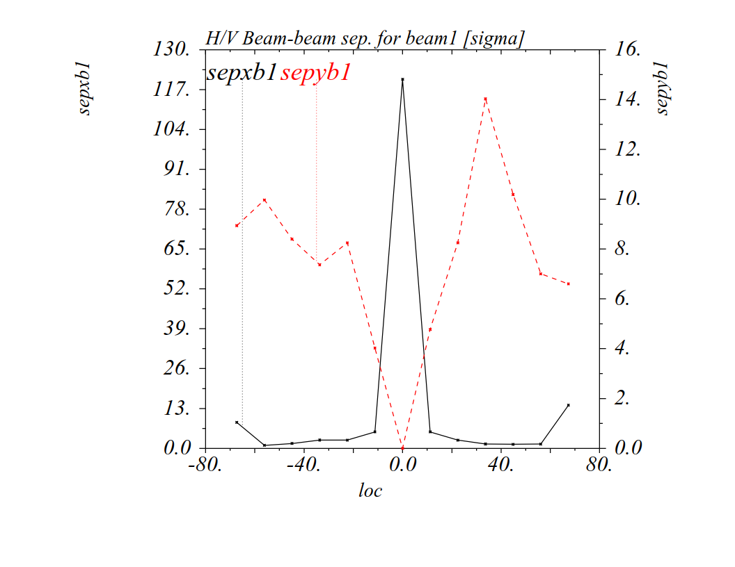
Beam-beam separation in IR2 (75 ns)
H
V
Last 75 ns BBLR encounter before D1
In millimeter
Normalized (2 BBLR’s @ 4-5σ)

Slide 7
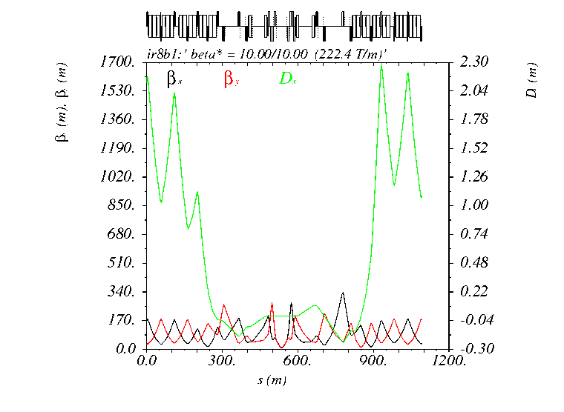
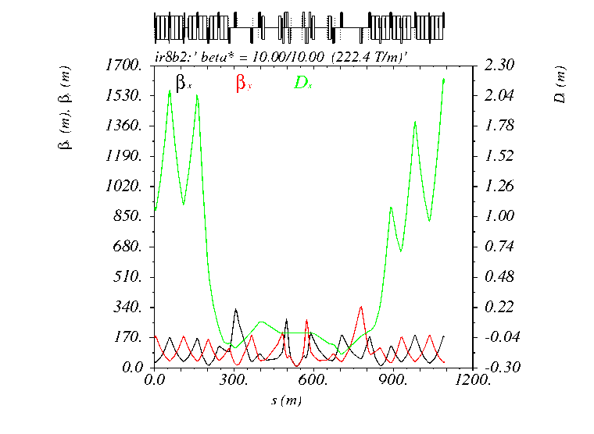
IR8 transition (10 m → 1.5 m)
Optics
Beam 1
Beam 2

Slide 8
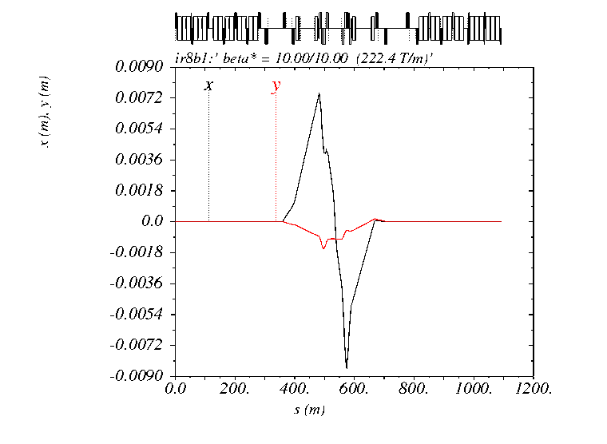
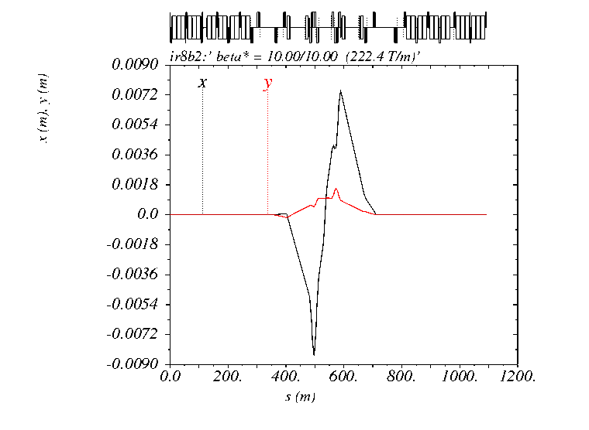
Crossing bumps (Xangle kept fixed at 170 μrad)
Beam 1
Beam 2

Slide 9
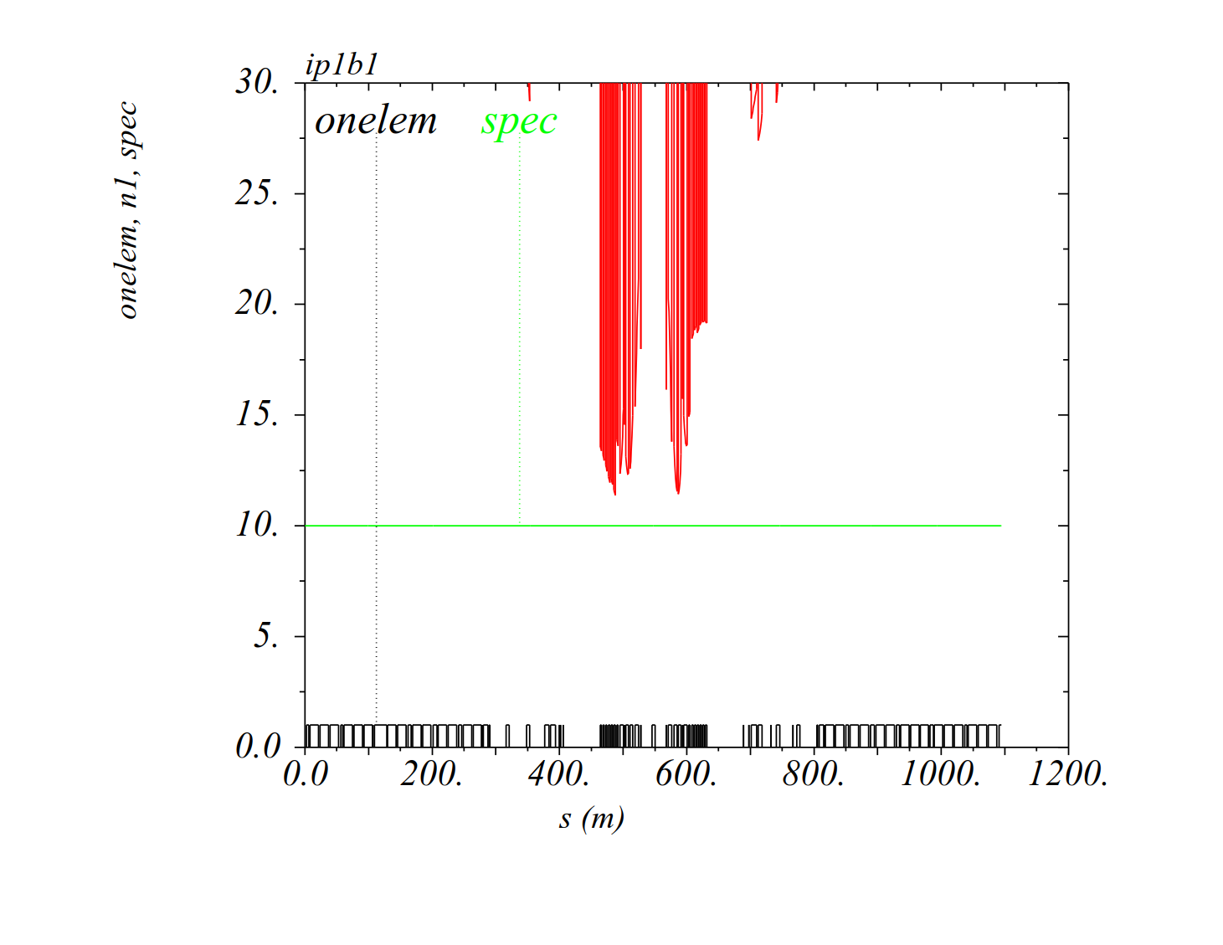
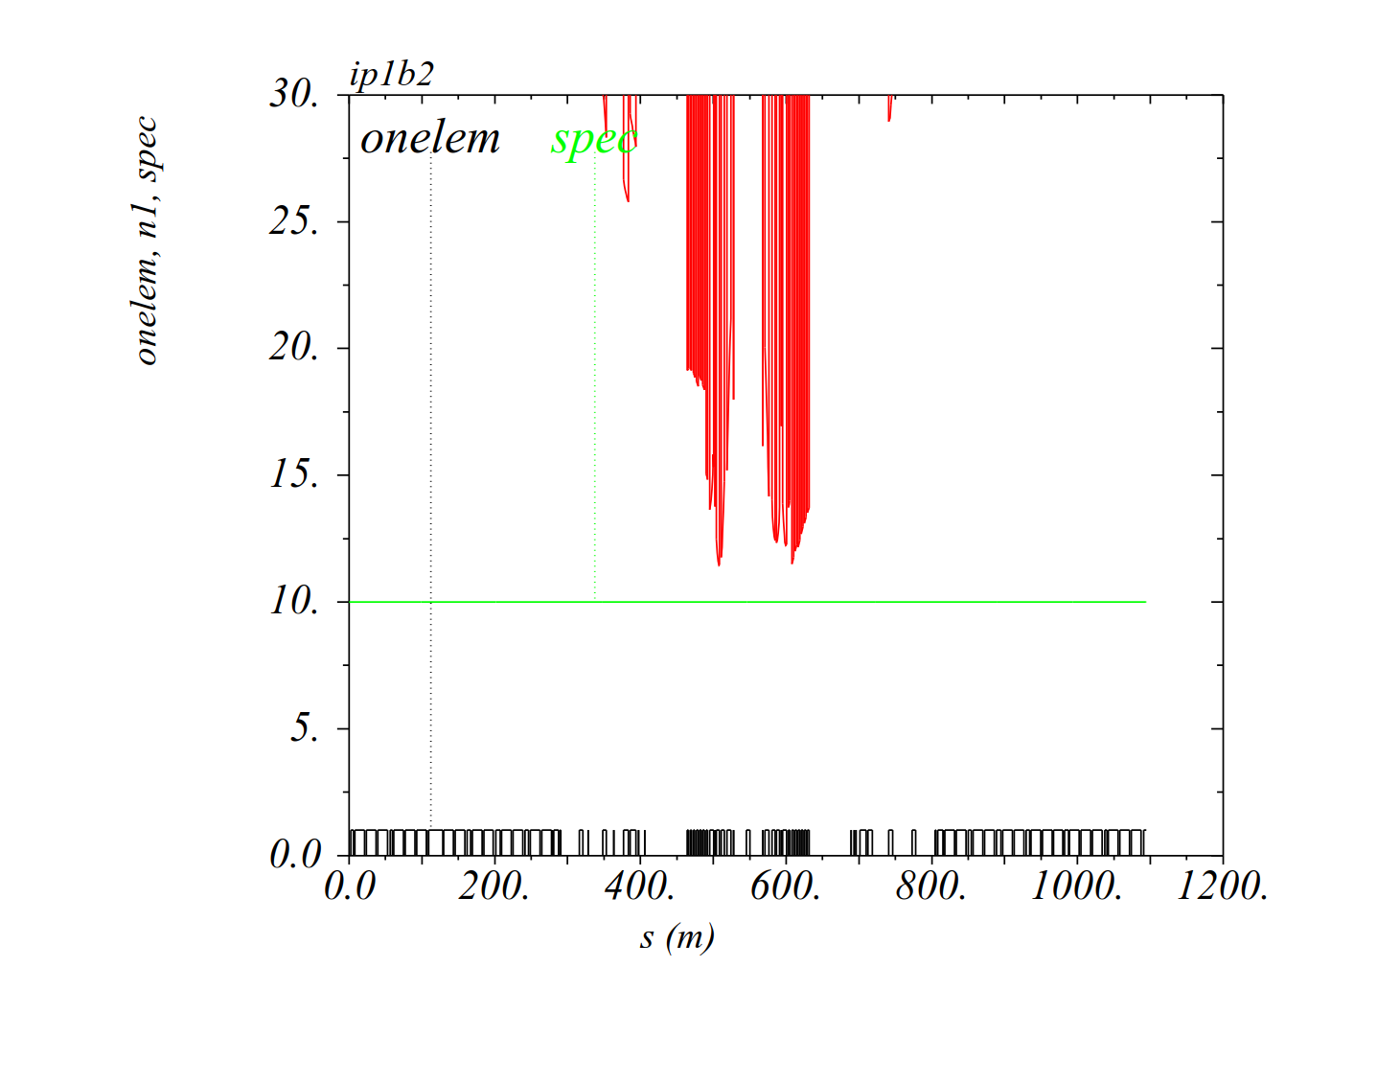
Aperture calculation (with LHC as-built tolerances)
IR1-b1 (no IP shift)
(β* =50 cm, +160 μrad V)
IR1-b2 (no IP shift)
(β* =50 cm, -160 μrad V)
10 σ (to guide the eyes)
IT (D1) aperture: ~ 11 σ ln IR1 (with MKD-TCT phases of 175º/176º for b1/b2)

Slide 10
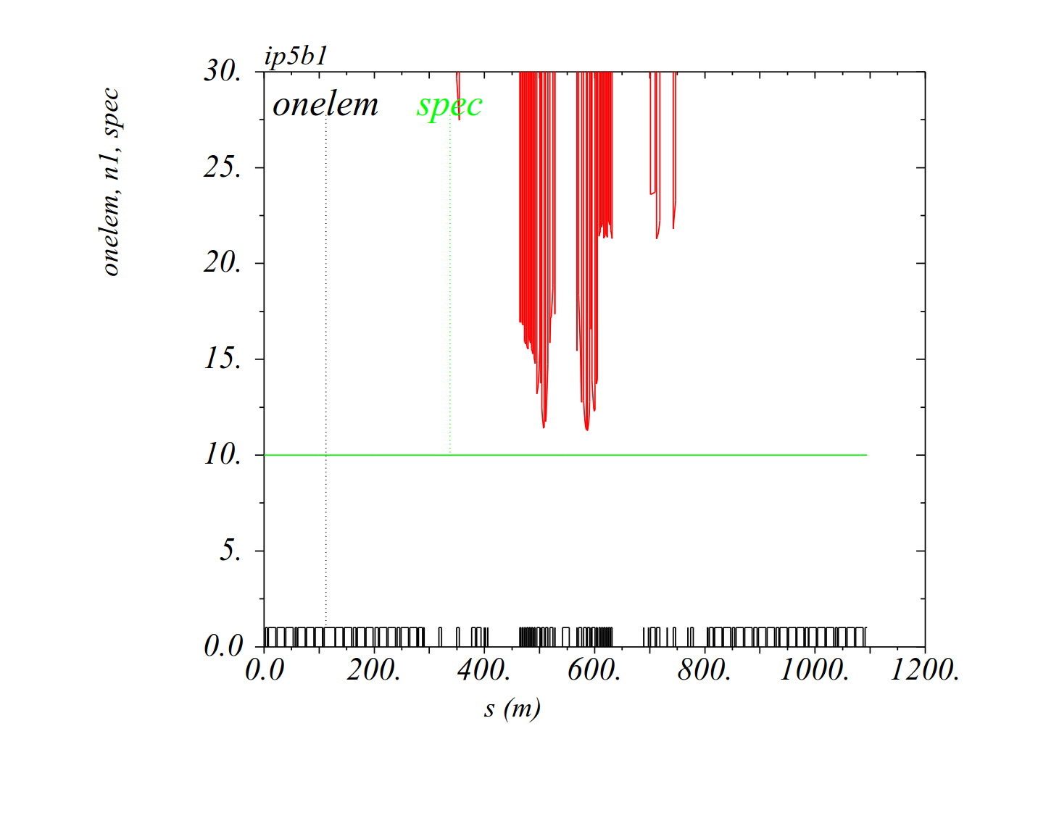
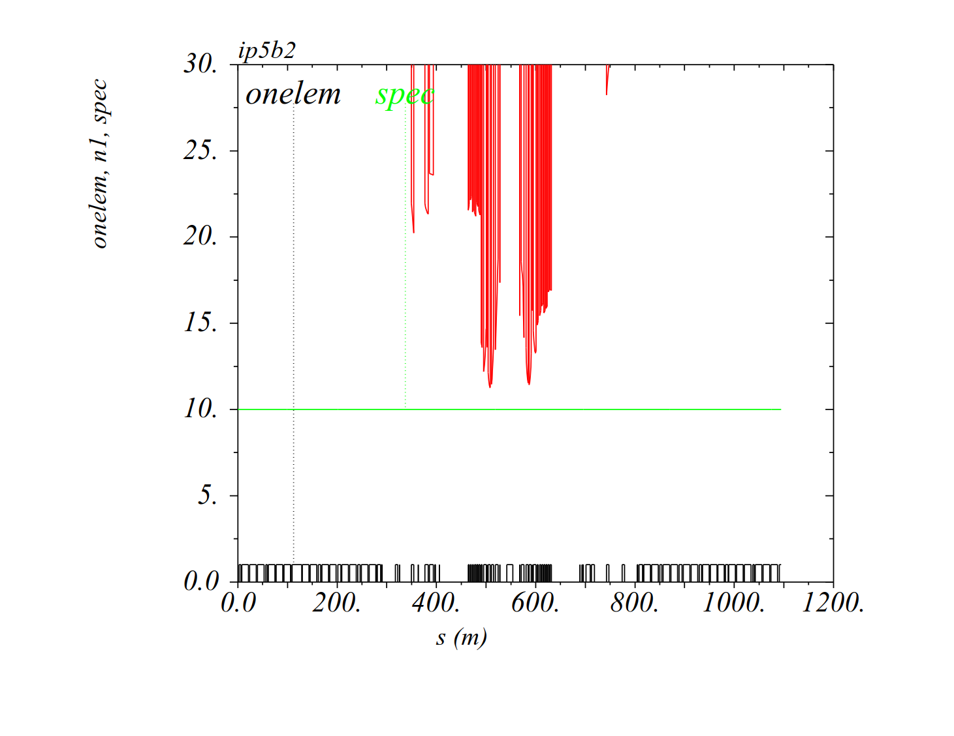
Aperture calculation (with LHC as-built tolerances)
IR5-b1 (with -1.8 mm IP shift)
(β* =50 cm, +160 μrad H)
IR5-b2 (with -1.8 mm IP shift)
(β* =50 cm, -160 μrad H)
o
IT aperture: ~ 11 σ in IR5 (with MKD-TCT phases of 167º/153º for b1/b2)

Slide 11
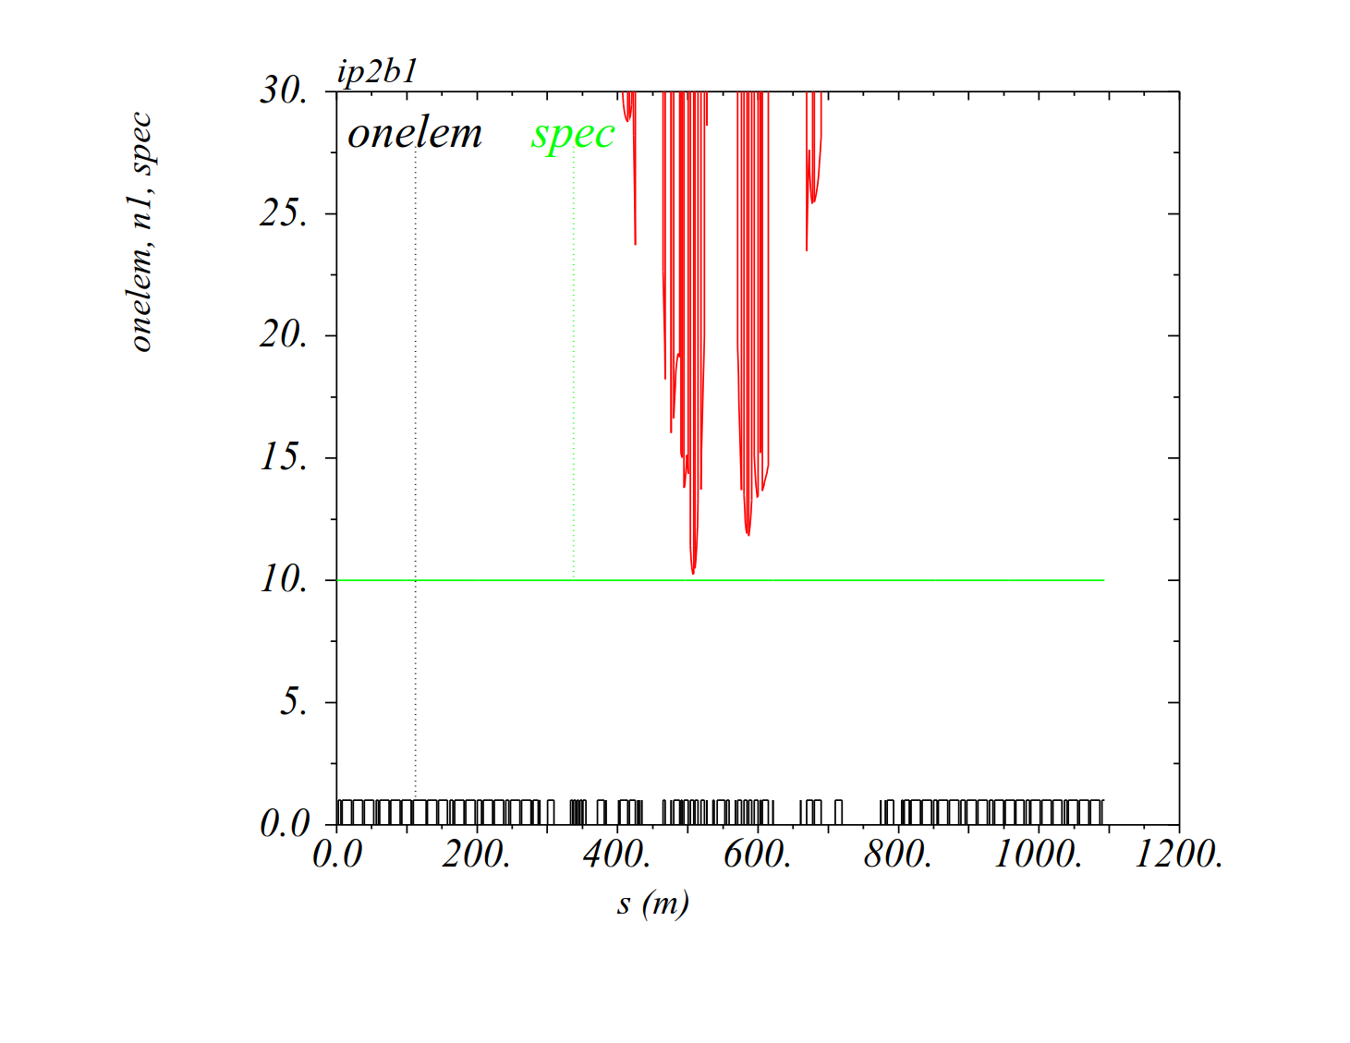
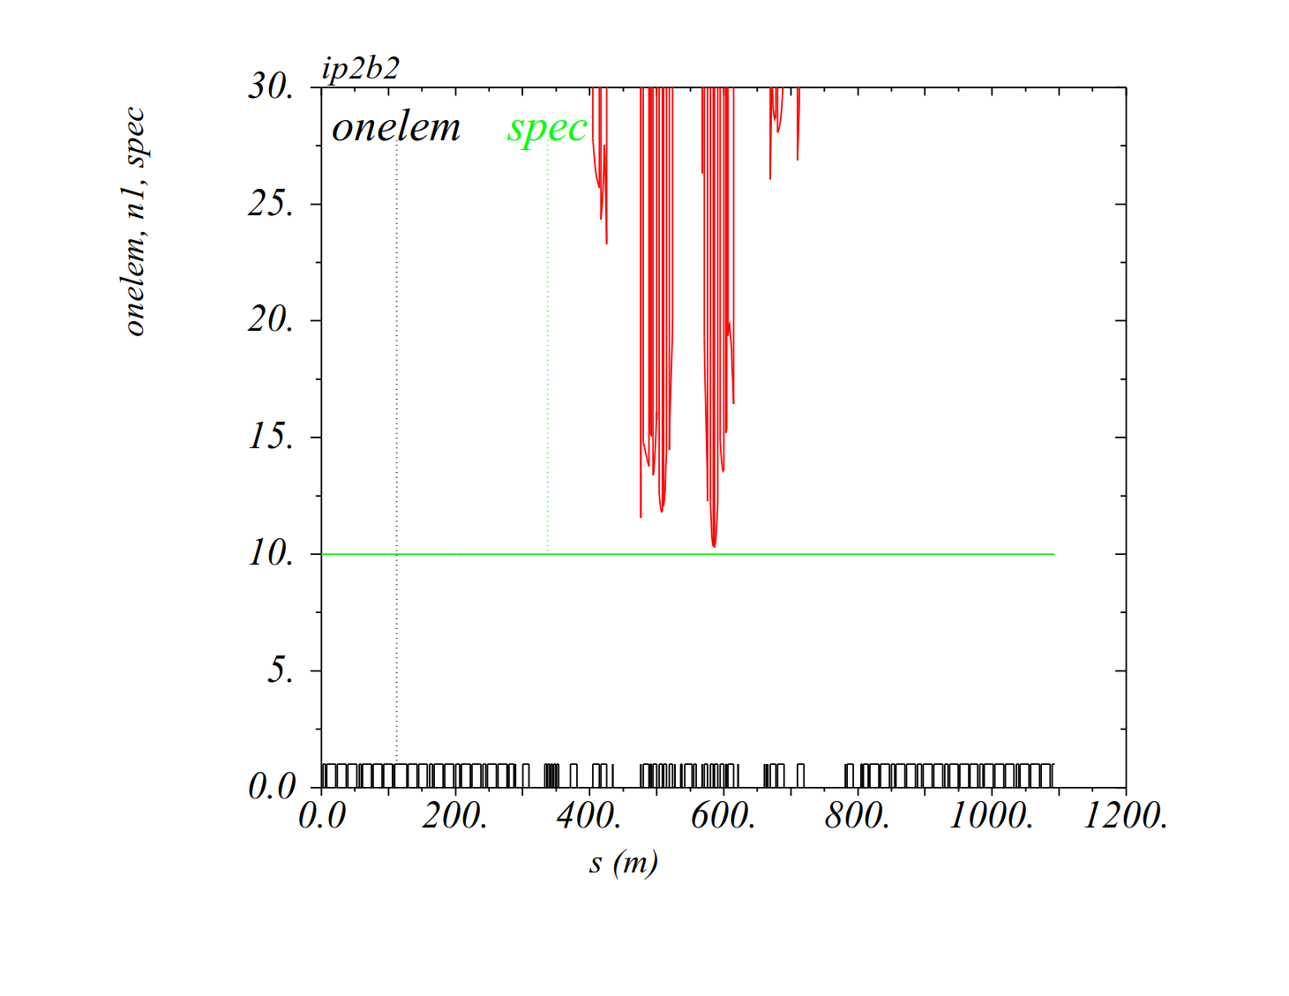
Aperture calculation (with LHC as-built tolerances)
IR2-b1, X-angle > 0 (-2.0 mm IP shift)
(β* =50 cm, +137 μrad V)
IR2-b2, X-angle > 0 (-2.0 mm IP shift)
(β* =50 cm, -137 μrad V)
TCDD @ 11.3 σ ??
IT aperture: ~ 10 σ in IR2 (with MKD-TCT phases of 228º/211º for b1/b2)

Slide 12
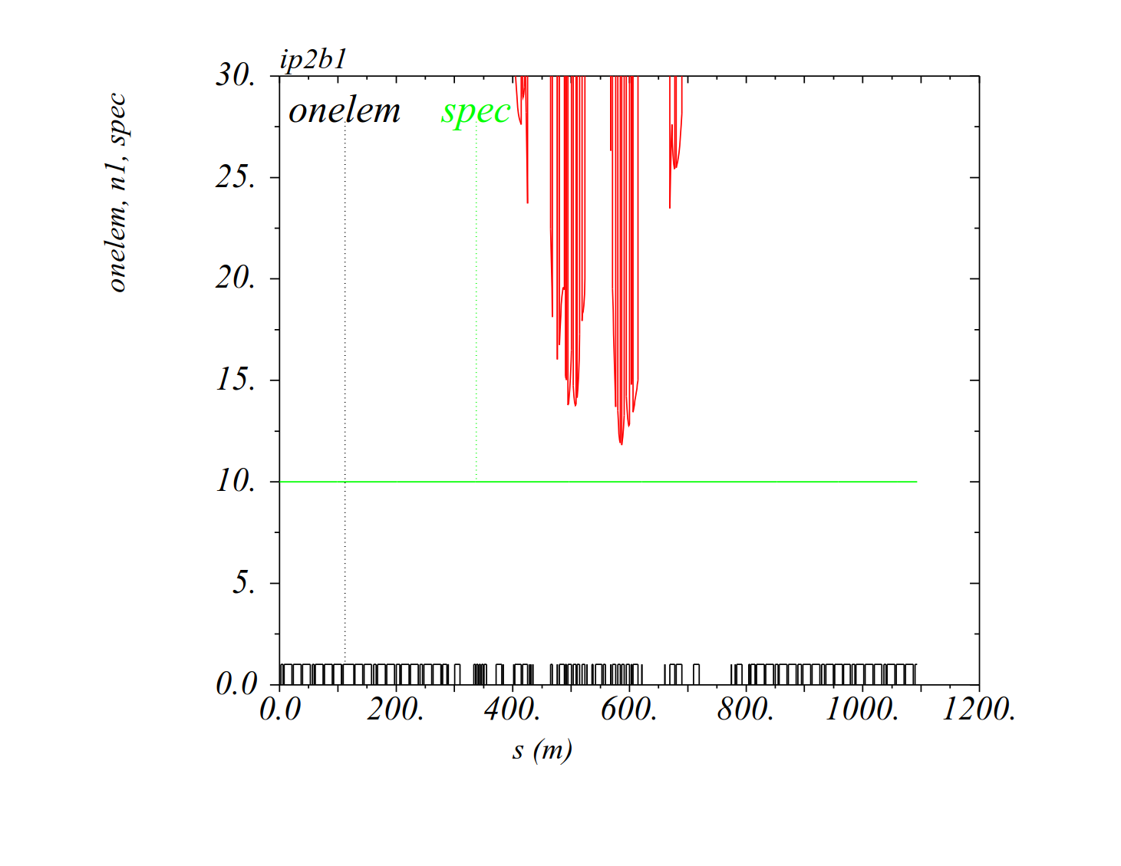
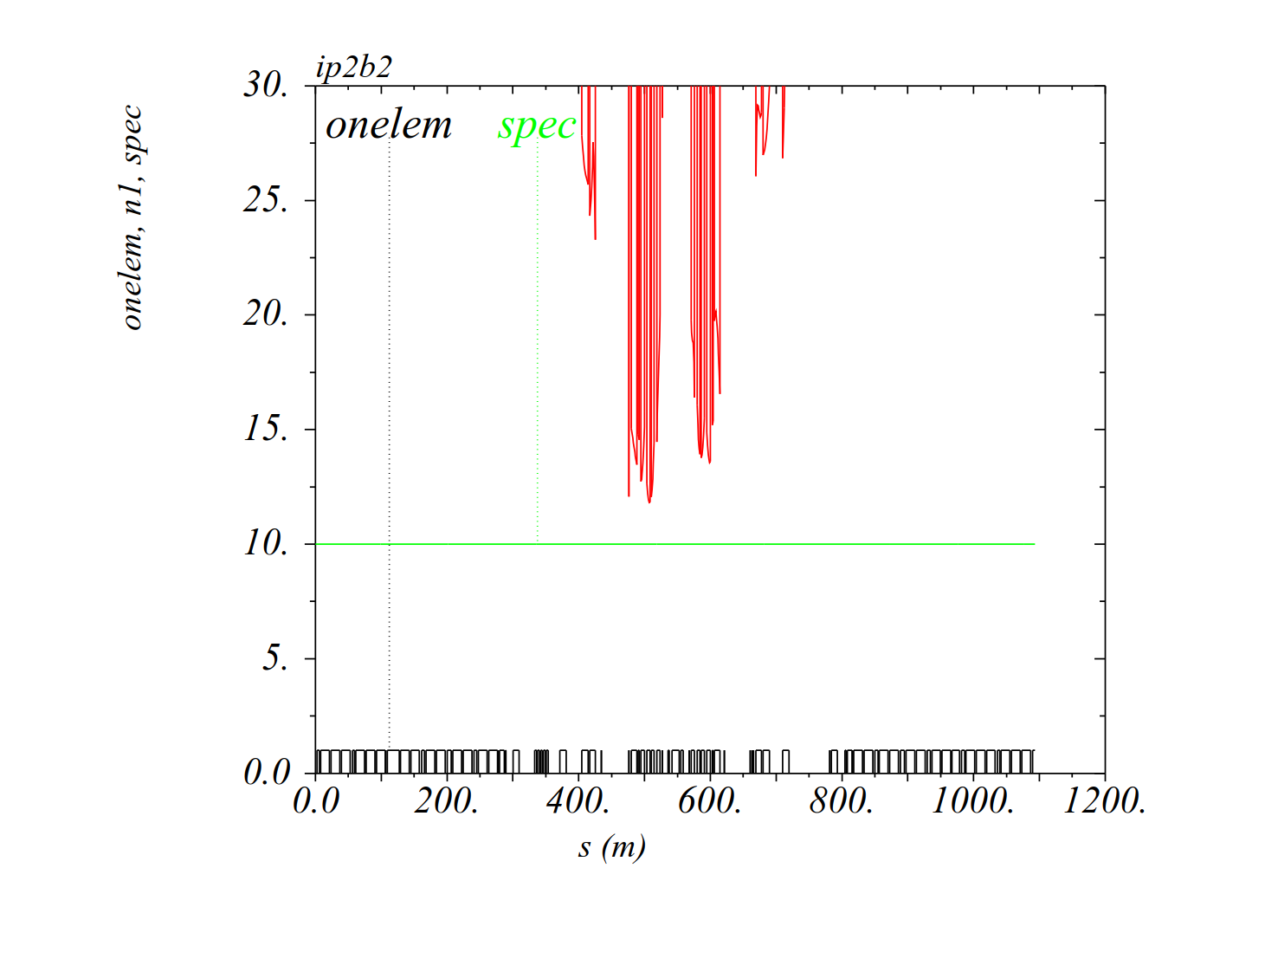
Aperture calculation (with LHC as-built tolerances)
IR2-b1, X-angle < 0 (-2.0 mm IP shift)
(β* =50 cm, -137 μrad V)
IR2-b2 X-angle < 0 (-2.0 mm IP shift)
(β* =50 cm, +137 μrad V)
TCDD @ 12 σ ??
IT aperture: ~ 11.5 σ in IR2 (with MKD-TCT phases of 228º/211º for b1/b2)

Slide 13
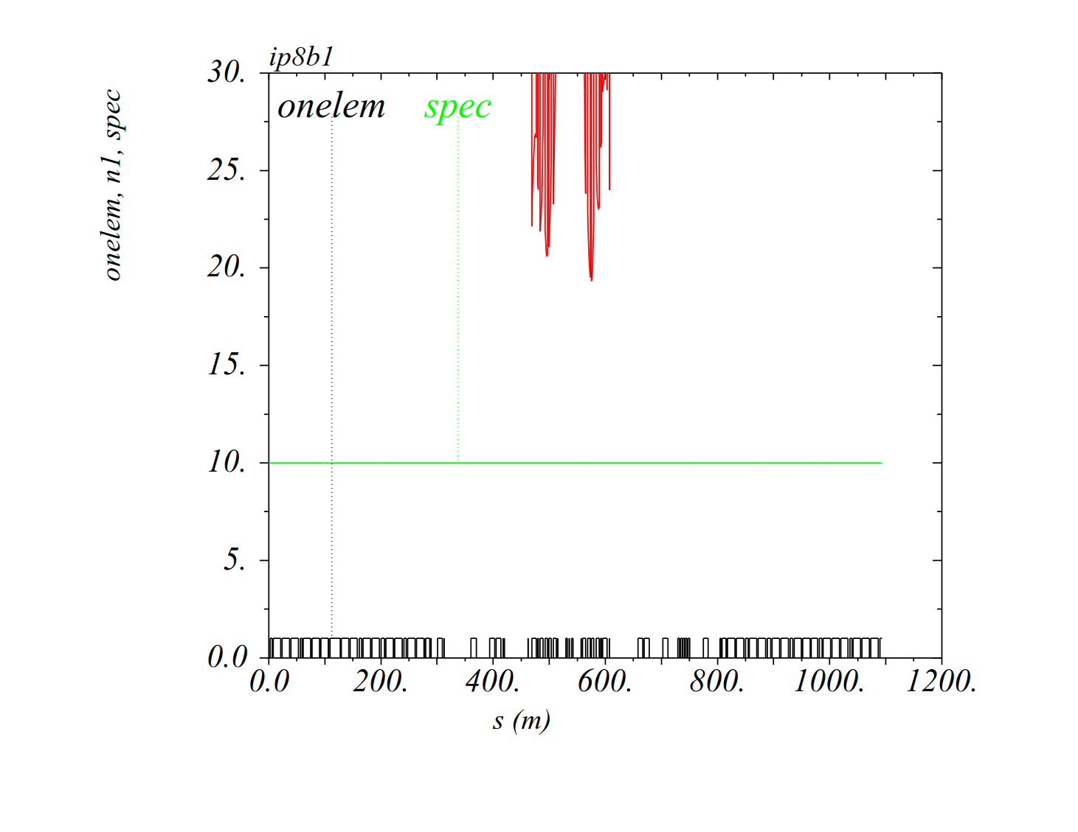
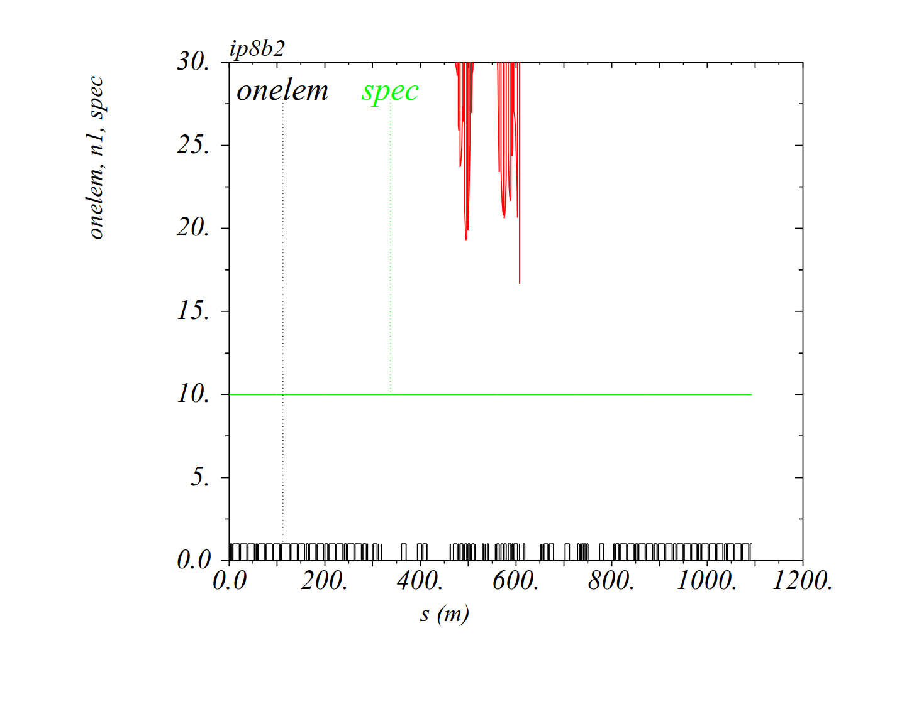
Aperture calculation (with LHC as-built tolerances)
IR8-b1 (no IP shift)
(β* =1.5 m, -170 μrad H)
IR8-b2 (no IP shift)
(β* =1.5 m, +170 μrad H)
TCDDM
IT aperture: ~ 19 σ in IR8 (TCDDM @ 16.6 σ for beam2)

Slide 14
  Hypercycle (IR optics assembly strategy)
Injection optics
  Nominal 2017 injection optics (β* =11/10/11/10 m at IP1/2/5/8)
Combined ramp and squeeze down to β* =1.0/1.0/1.0/1.5 m at IP1/2/5/8
  → First, IR1/5 squeezed from 11 m to 10 m at cst IR2/8 optics (β* = 10 m)
  → Second, IR1/2/5/8 squeezed from 10 m to 1.5 m
  Third, IR1/2/5 squeezed from 1.5 m to 1 m at cst IR8 optics (β* = 1.5 m)
Squeeze down to β* =0.5/0.5/0.5/1.5 m at IP1/2/5/8 (40 cm optional @ IP1/5)
  Baseline: IR1/2/5 squeezed from 1.0 m to 50 cm at cst IR8 optics (β* = 1.5 m)
  Extension: IR1/5 cont’d from 50 to 40 cm at cst IR2/8 optics (β* = 0.5/1.5 m)

Slide 15
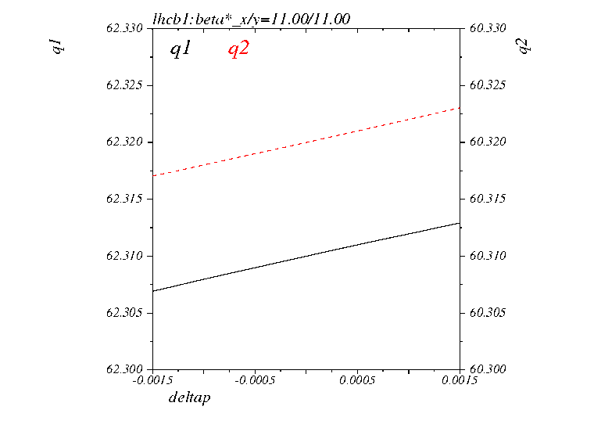
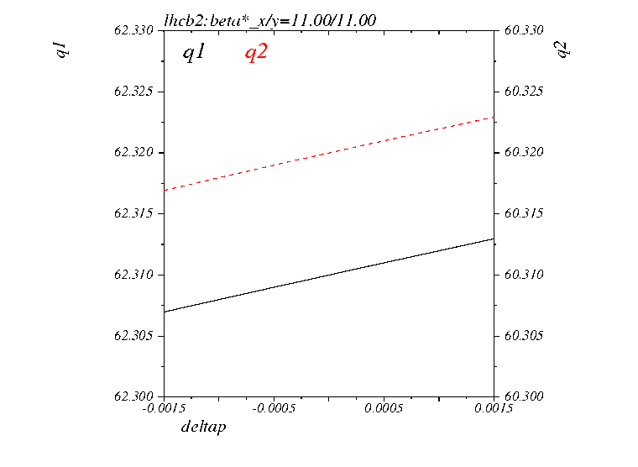
Chromatic aberrations (sextupole functions)
Tunes vs. δ_{p} vs. β* at IP1/5 (Q’ = 2 in this example) → OK
Beam 1
Beam 2
Bucket
Bucket

Slide 16
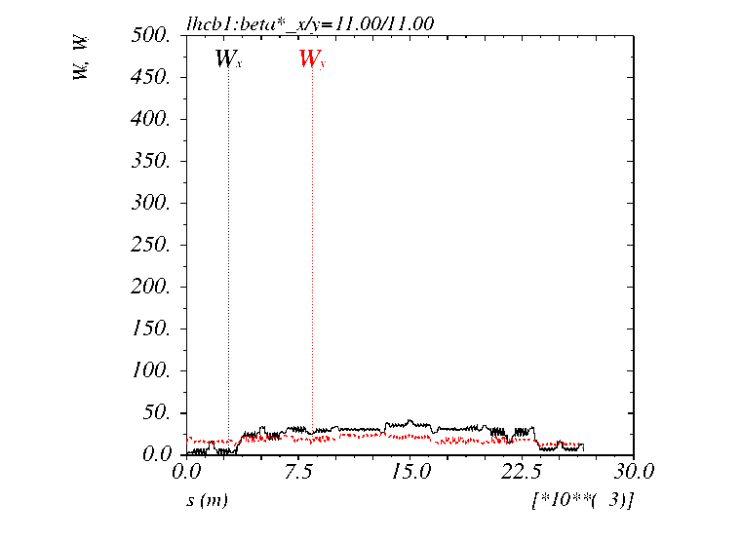
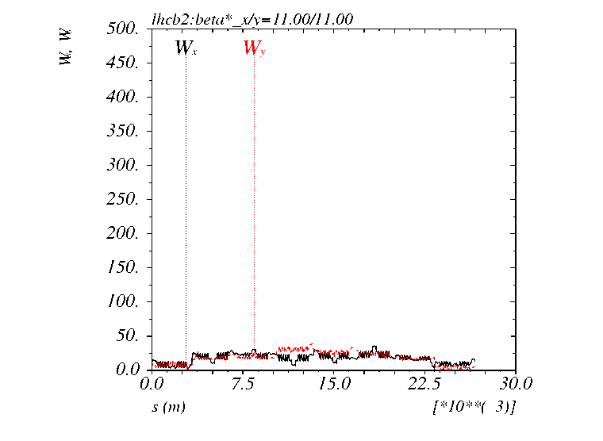
Chromatic aberrations (sextupole functions)
Off-momentum β-beating vs. β* at IP1/5 → OK
Beam 1
Beam 2
vs. b* at IP1/5
IR3
IR7
±10% β-beat over the bucket

Slide 17
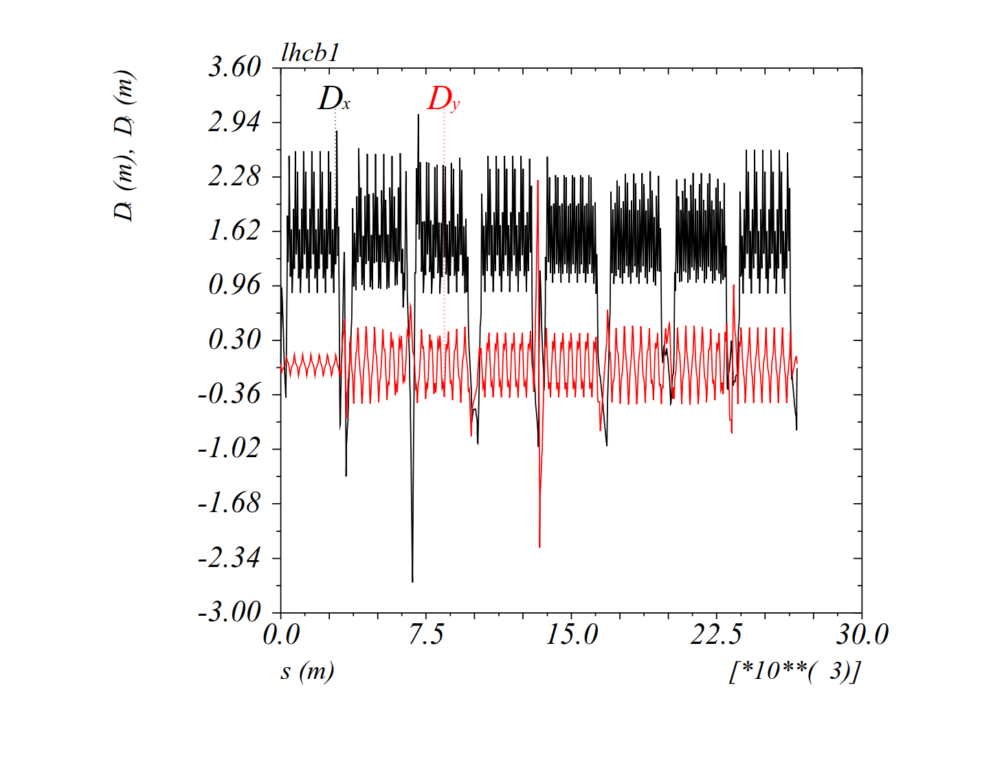
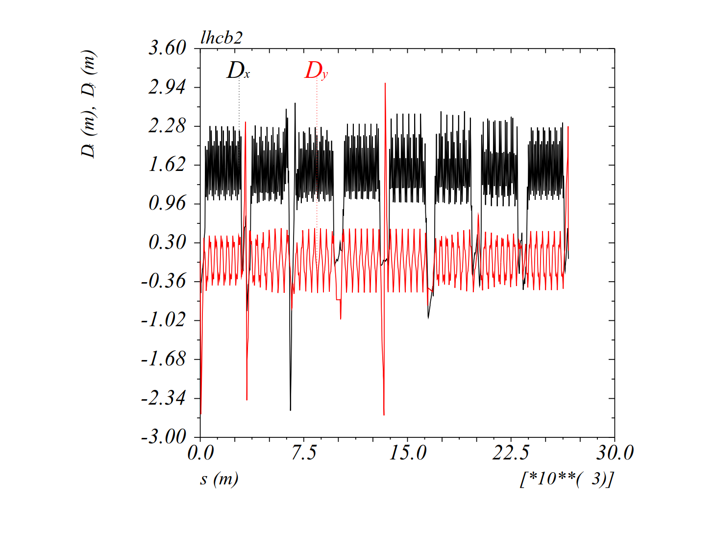
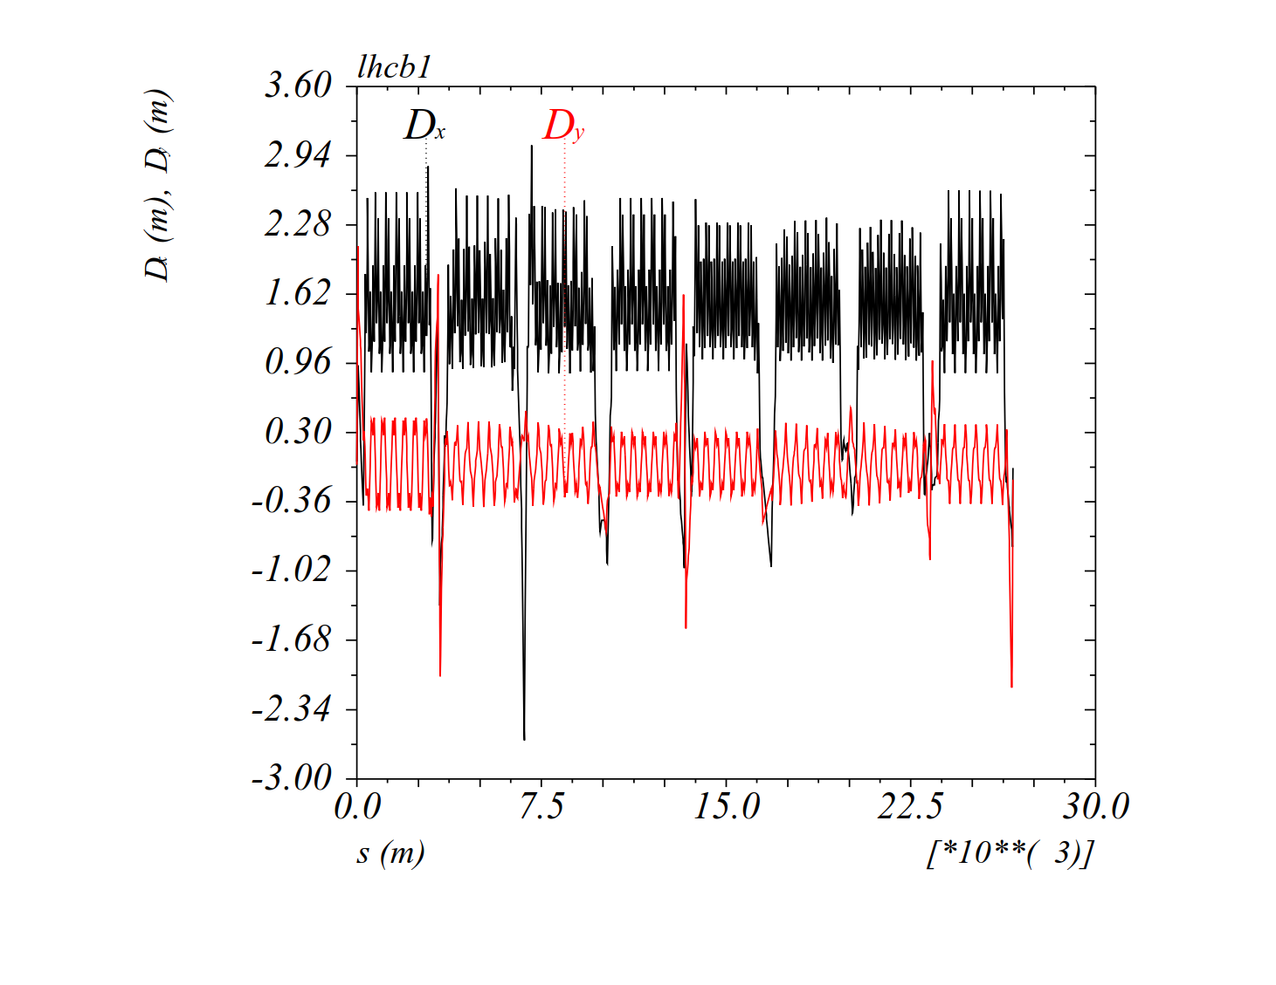
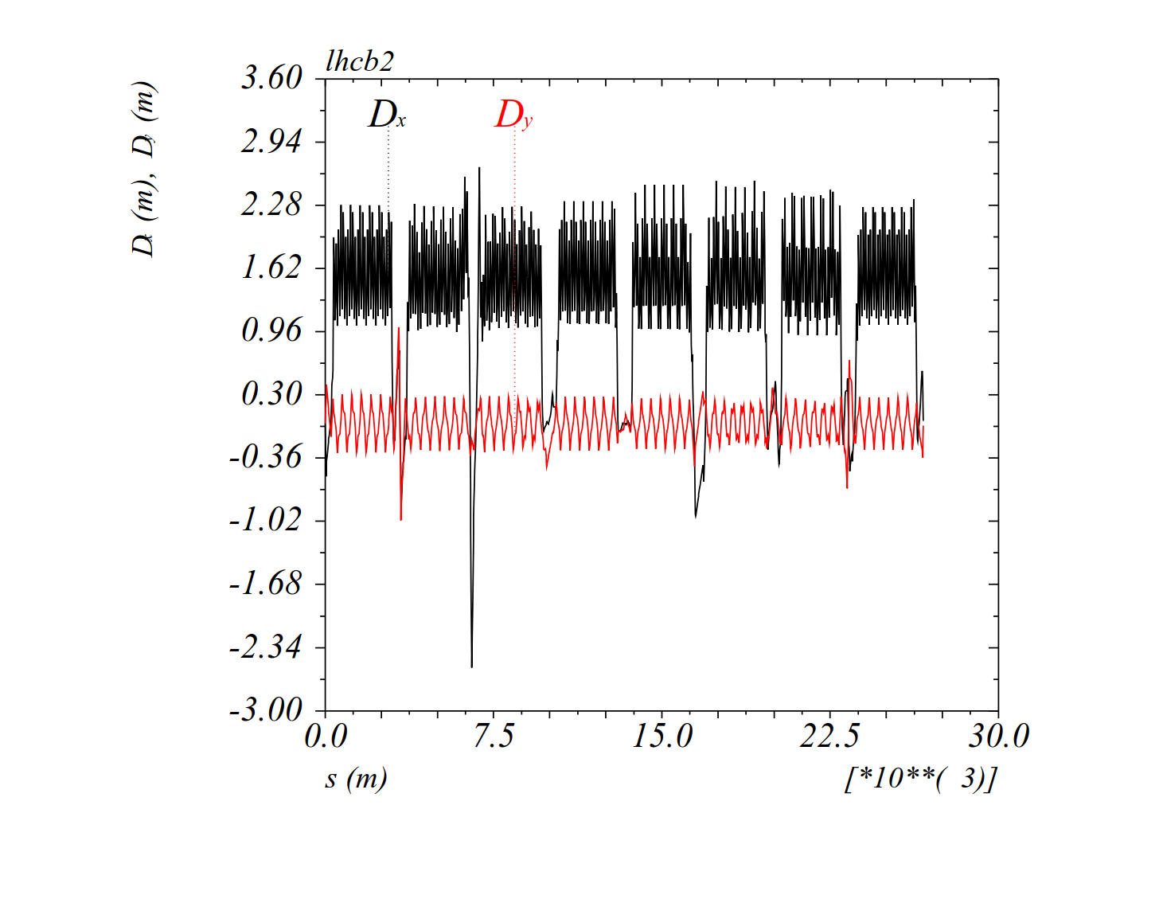
Dispersion from X-angle before adjust (parallel sep., no IP shift)
Beam1
(β*=04/0.5/0.4/1.5 at IP1/2/5/8)
Beam2
(β*=0.4/0.5/0.4/1.5 at IP1/2/5/8)
Positive ext. X-angle
Up to ~ 2.0 m for beam1
(Dy in IT5)
Up to ~2.5-3 m for beam2
(Dy in IT1, IT2 and IT5)
Negative ext. X-angle
Up to ~ 2 m for beam1
(Dy in IT1 and IT2)
Up to ~ 1 m for beam2
(Dy in IT2)

Slide 18


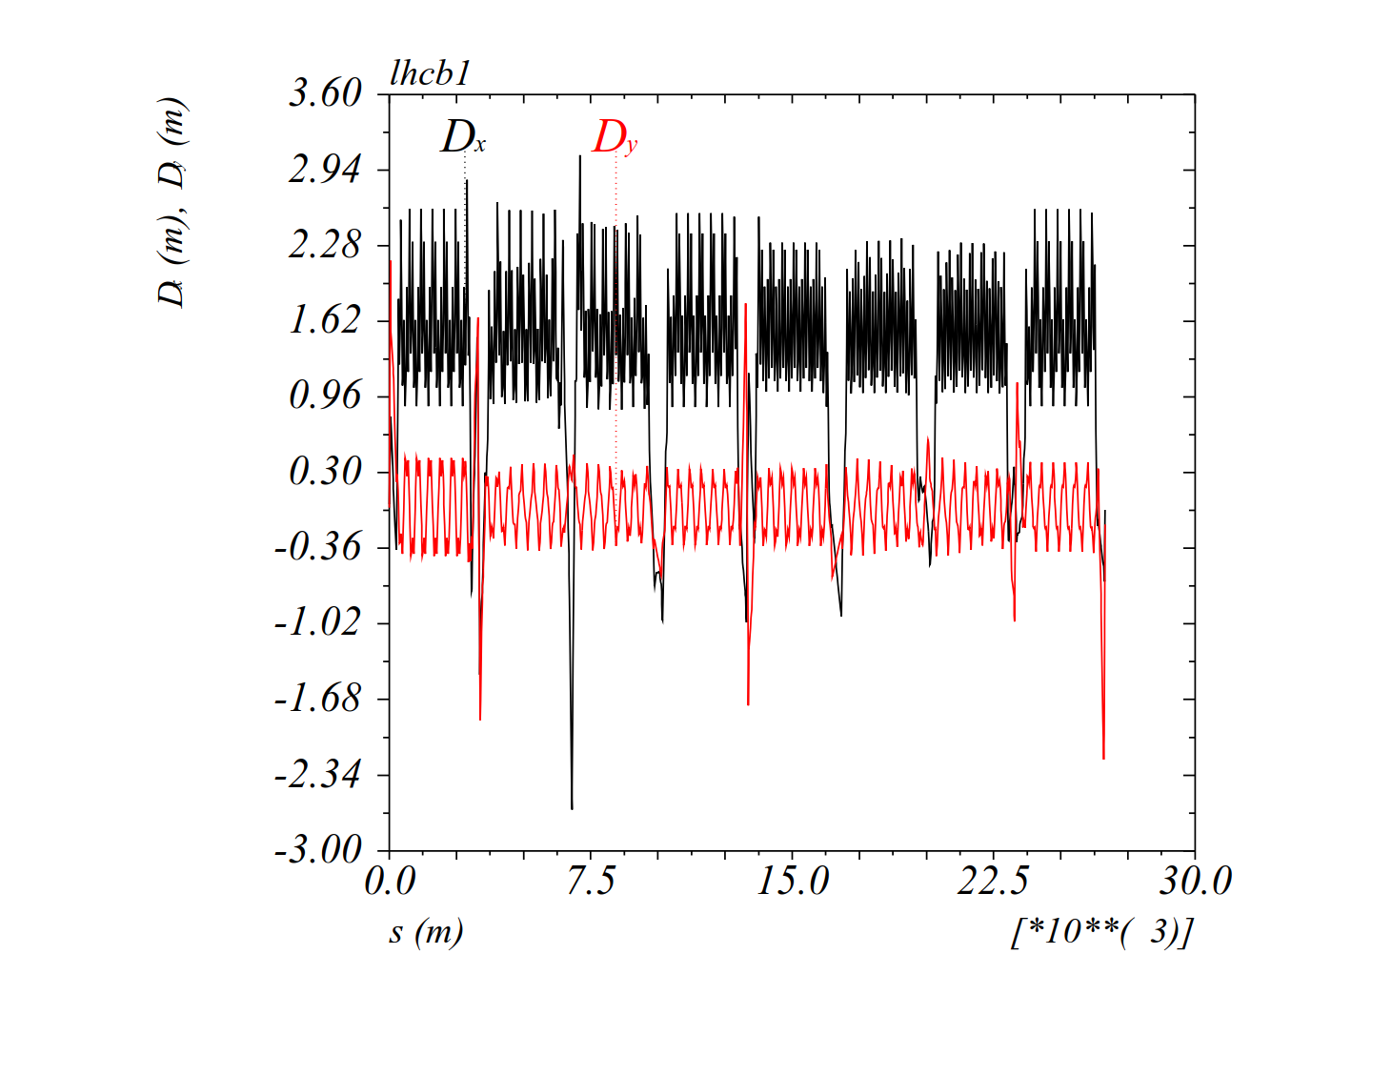
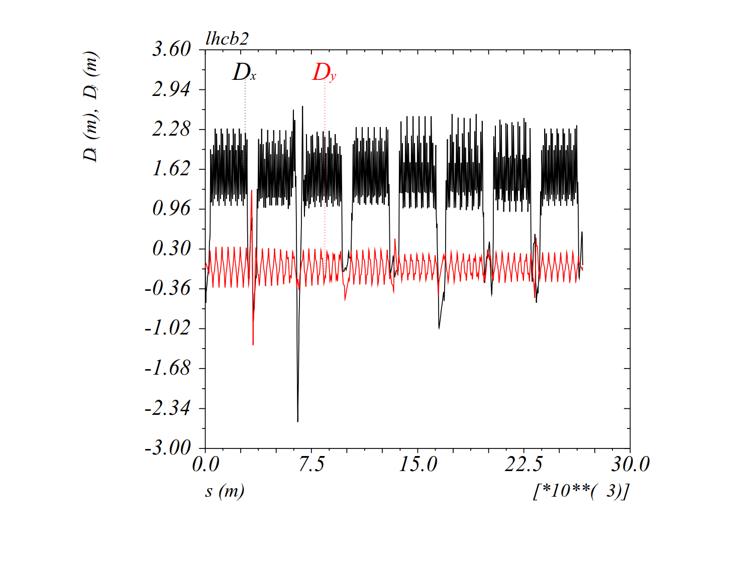
Dispersion from X-angle in collision (no sep., with IP shift)
Beam1
(β*=04/0.5/0.4/1.5 at IP1/2/5/8)
Beam2
(β*=04/0.5/0.4/1.5 at IP1/2/5/8)
Positive ext. X-angle
Up to ~ 2.5 m for beam1
(Dy in IT5)
Up to ~3.0-3.5 m for beam2
(Dy in IT1, IT2 and IT5)
Negative ext. X-angle
Up to ~ 2 m for beam1
(Dy in IT1 and IT2)
Up to ~ 1 m for beam2
(Dy in IT2)

Slide 19
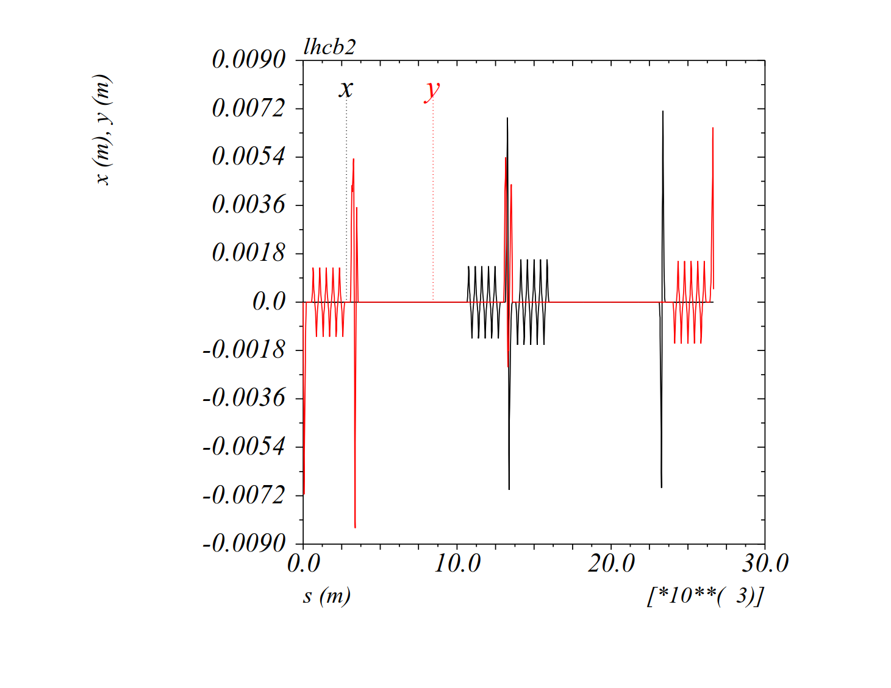
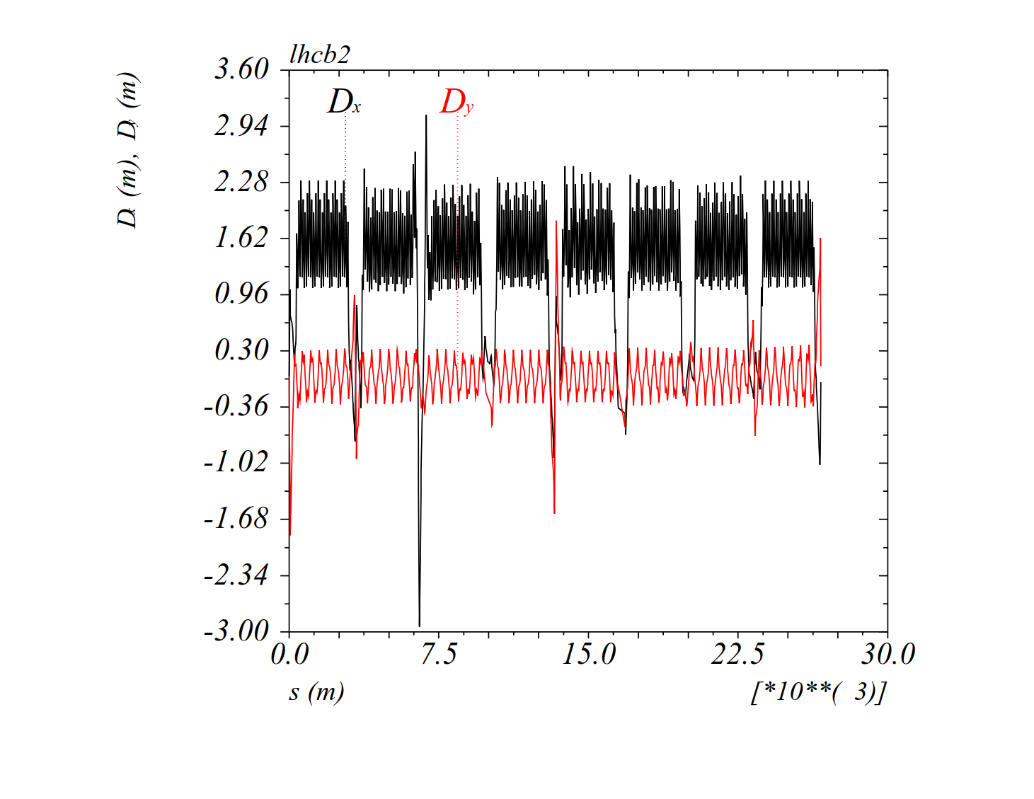
Dispersion from X-angle in collision
Possible mitigation with ATS dispersion bumps (compensating IR1 & 5 only)
For the worst case of b2 with IP shift and positive ext. X-angle, D_{x/y} is more than halved

Slide 20
Matched point selection (1/2)
Arbitrary β* granularity is available, but only a few optics are selected (ΔQ ∼ a few 10⁻³, ΔQ’ < 0.5 units,
Δβ/β ∼ 1-2 % between matched points) → Optics files uploaded: /afs/cern.ch/eng/lhc/optics/runII/2018/ION
Combine Ramp & Squeeze → 17 Matched Points (MP)
Optics file | β* [m] in IR1/2/5/8 | Peak Δβ/β [%] between MP | Comment
Opticsfile.1 | 11.00/10.00/11.00/10.00 | - | Nominal 2017 injection optics
Opticsfile.2 | 9.70/9.70/9.70/9.70 | 1.9 (b1-V) | With passage to the ATS compatible IR4 optics (as for protons)
Opticsfile.3 | 9.20/9.20/9.20/9.20 | 1.6 (b1-V)
Opticsfile.4 | 8.50/8.50/8.50/8.50 | 1.7 (b1-V)
Opticsfile.5 | 7.60/7.60/7.60/7.60 | 1.7 (b1-H)
Opticsfile.6 | 6.70/6.70/6.70/6.70 | 1.7 (b1-H)
Opticsfile.7 | 5.90/5.90/5.90/5.90 | 1.8 (b1-V)
Opticsfile.8 | 5.20/5.20/5.20/5.20 | 1.6 (b1-V)
Opticsfile.9 | 4.50/4.50/4.50/4.50 | 1.8 (b1-V)
Opticsfile.10 | 4.00/4.00/4.00/4.00 | 1.5 (b1-V)
Opticsfile.11 | 3.60/3.60/3.60/3.60 | 1.4 (b1-V)
Opticsfile.12 | 3.20/3.20/3.20/3.20 | 2.0 (b1-V)
Opticsfile.13 | 2.90/2.90/2.90/2.90 | 1.5 (b2-H)
Opticsfile.14 | 2.30/2.30/2.30/2.30 | 1.9 (b1-V)
Opticsfile.15 | 1.85/1.85/1.85/1.85 | 1.7 (b2-H)
Opticsfile.16 | 1.35/1.35/1.35/1.50 | 1.8 (b1-V & b2-H)
Opticsfile.17 | 1.00/1.00/1.00/1.50 | 1.9 (b1-V & b2-V) | End of Ramp

Slide 21
Matched point selection (2/2)
Squeeze at flat top → 5 (+2) matched points
Optics file | β* [m] in IR1/2/5/8 | Peak Δβ/β [%] between MP | Comment
Opticsfile.17 | 1.00/1.00/1.00/1.50 | -- | Beginning of squeeze
Opticsfile.18 | 0.82/0.82/0.82/1.50 | 1.0 (b1-V & b2-V)
Opticsfile.19 | 0.68/0.68/0.68/1.50 | 1.0 (b1-V & b2-V)
Opticsfile.20 | 0.57/0.57/0.57/1.50 | 0.9 (b1-V & b2-V)
Opticsfile.21 | 0.50/0.50/0.50/1.50 | 0.6 b2-V) | End of squeeze (50 cm @ IP1/2/5, 1.5 m @ IP8)
Opticsfile.22 | 0.44/0.50/0.44/1.50 | 0.7 (b1-V & b2-V) | Optional extension for IR1 & IR5 (44 cm @ IP1/5)
Opticsfile.23 | 0.40/0.50/0.40/1.50 | 0.4 (b1-V & b2-V) | Optional extension for IR1 & IR5 (40 cm @ IP1/5)

Slide 22
Summary and outlook
β* = 50 cm @ IP2 is challenging due to the IP2 shift of -2 mm in the X-plane:
with positive external crossing angle (negative Alice polarity): tight aperture, worst case for spurious dispersion (which can be mitigated with the ATS dispersion bumps)
  → Green light from collimation and MP is needed (~45/30º MKD-TCT phase for b1/2)
for both polarities: truncating 36 % (@6.37 TeV) of the COD budget at Q4/5/6/7
  Inspection of the 2017 COD settings needed for knob confirmation.
The strategy for the Alice spectro-meter polarity reversal needs to be work out.
3 (+1) options are possible and under discussion (decision postponed to Sept-October):
  Brute force: Commissioning of 2 injection BPs, 2 ramps, 2 squeezes with opposite ext. crossing angle in IR2
  .. Not ideal
  (ii) Risky: External crossing angle polarity switch in the end of the squeeze
  Unknown territory for 75 ns bunch spacing (was done with 200 ns, at β*= 80 cm)
  (iii) Possible compromise: Rotating the X-plane by 180º at EoR for one polarity, and commission 2 squeezes
  → COD functions to be defined and the aperture checked @ β*= 1 m
  The future: Flat optics (e.g. 1 m/25 cm) with H external crossing (enabling as well a further reduction of the internal crossing angle below 60 μrad)
  → For Run III

