Slide 1
Notes:
On behalf of the Safety Unit,
W e l c o m e a t C E R N !
This presentation is about :
* CERN is a safe place.
* What CERN does to keep you safe
* What are your responsibilities

Slide 2







Slide 3
Safety at CERN
La sécurité au CERN
Notes:
What does S a f e t y a t C E R N cover?

Slide 4
➊ Occupational Health & Safety
Santé et sécurité au travail
H
S
Read CERN Safety Policy
E
➋ Environmental Protection
Protection de l'environnement
➌ Safe Equipment and Operation
Sécurité des équipements et de l'exploitation
Notes:
At CERN, Safety covers 3 major aspects:
1. Occupational Health
Ensure the best possible protection in health and safety matters of all persons
independently of their status
participating in the Organization’s activities or present on its site
population living in the vicinity of its installations
You return home healthy at the end of your working day
Going intact at the end of the day
2. Limit the impact of the Organization's activities on the environment
3. Safe Equipment and Operation

Slide 5
Director General
Director General
Sectors
Accelerators &
Technology
Finance &
Human Resources
International
Relations
Research &
Computing
Dep.
BE
EN
TE
FAP
IPT
HR
SMB
…
ECO
EP
TH
IT
Groups
Accelerator
Beam Transfer
Cryogenics
Electrical Power
Converter
Machine Protection
Electrical Integrity
Magnets, Super-
conductors, Cryostats
Vacuum, Surfaces
and Coatings
Sections
Beam Transfer
Physics
Electronics
& Controls
Fast Pulsed
Systems
Septa
Notes:
…the hierarchical line
Your 3 main partners in matters of Safety are:
HSE Unit
The HSE Unit supports the Organization in the implementation of
* the CERN Safety Policy,
* the CERN Safety Rules,
* the CERN Safety Objectives and
* best practices at all levels.
It is in particular responsible
* for Radiation Protection and
* the establishment of the CERN Safety Rules.
It grants Safety clearance for
* Installations, including special equipment,
* activities,
* projects and
* CERN Experiments with major Safety implications
Therefore the HSE is composed of

Slide 6
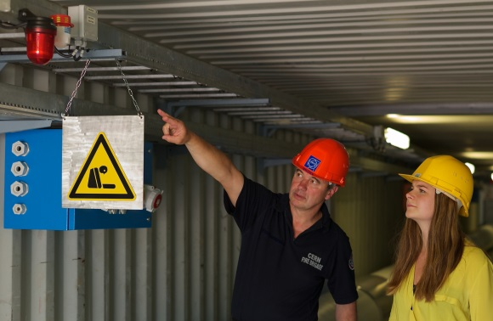
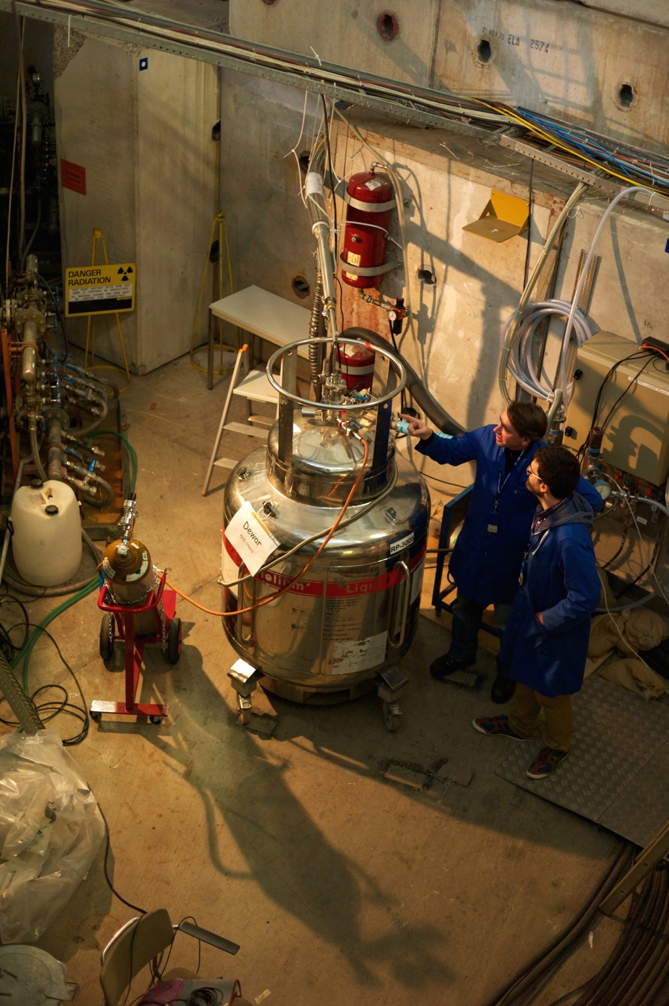
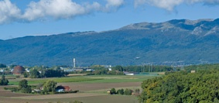

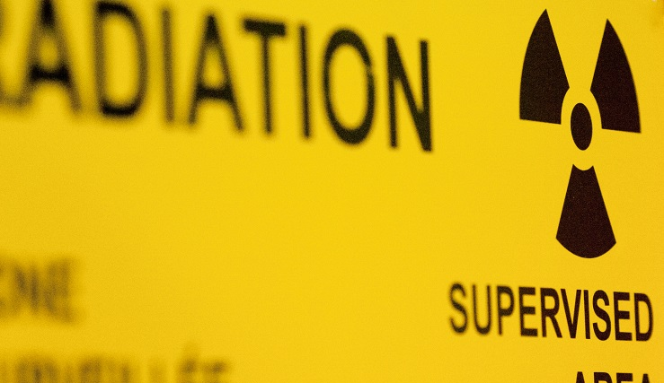

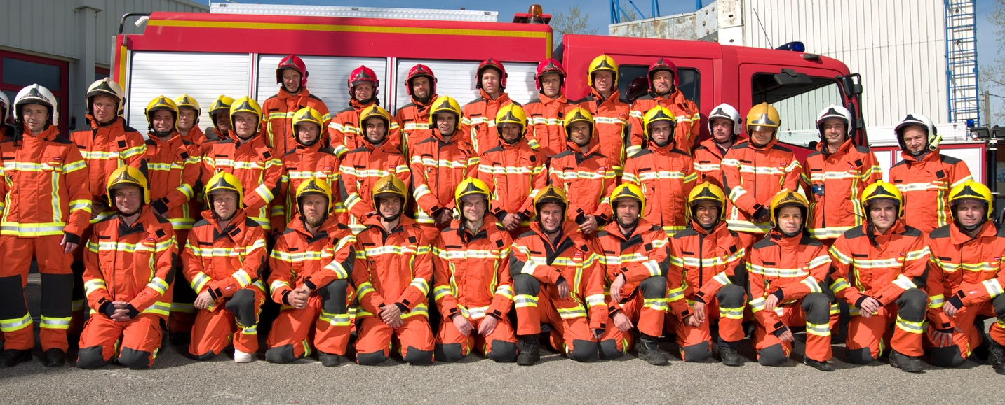

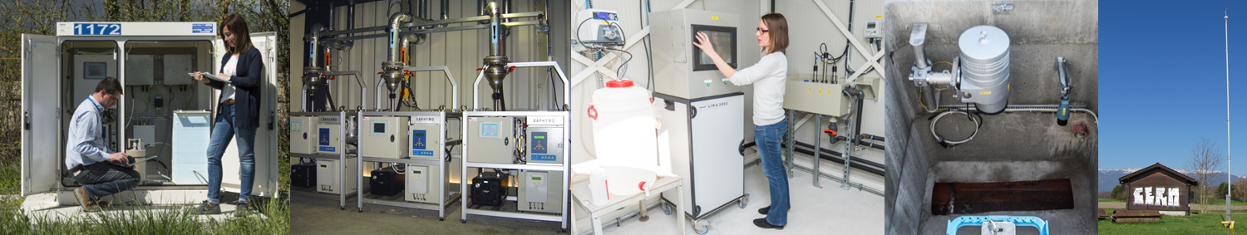

Safety Engineering
Safety Support
Safety Inspections
Medical Service
Occupational
Health & Safety
Santé au travail & Sécurité
Read CERN Safety Policy
Record emergency number
Research & Design Studies
Operational Radiation Protection
Personal Dosimetry
Radioactive Waste
Radiation Monitoring
Radiation
Protection
Radioprotection
Ambulance
Prevention
Intervention
Drill
74444
+41 22 767 4444
Fire & Rescue
Service
Service Secours & Feu
Air, Water, Soil
Waste, Energy
Management
Monitoring & Reporting
Awareness
Environmental
Protection
Protection environnementale
Notes:
4 groups
a. Occupational Health & Safety
cover all aspects re Occupational Health & Safety and Environmental Protection.
Medical service
b. Radiation Protection Group
* ensures that all personnel on the CERN sites and the public are protected from potentially harmful effects of ionizing radiation linked to CERN activities.
c. Fire & Rescue Service
* CERN has its own Fire Brigade.
* 58 professionnals firefighters do
* ensure the safety of all CERN personnel, contractors, visitors and users due to fire and other threats.
* provide emergency ambulance care due to accident or illness.
* act in case of environment incidence
* hold Safety training courses
* in case of emergency (like a fire, work accident, any medical emergencies, pollution) call the Fire Brigade at 7 44 44
hold the line if a machine is answering!
remain calm and wait for instructions from the Fire Brigade.
FB is open 24/24 and able to receive any call in French and English.
d. Environment Protection
F. Gianotti 29.02.2016 : “ … I believe CERN should become a role model for an environmentally-aware scientific research laboratory …”
Energy – You don’t use it? Switch it off!
Waste – Sort it for easier recycling!
Water – Stop wasting it. Sewer systems are not waste bins
Hazardous substances – Pay attention, follow regulations when using and disposing of the substances.
Natural environment – Some green areas are protected (bee, orchids, …) Respect them!
Prevention of environmental accidents – In case of pollution dial 0041 22 76 (74444)!
The HSE Unit – support, monitor and grant Safety clearance

Slide 7
Safety Engineering
Safety Support
Safety Inspections
Medical Service
Occupational
Health & Safety
Santé au travail & Sécurité
Occupational
Health & Safety
Research & Design Studies
Operational Radiation Protection
Personal Dosimetry
Radioactive Waste
Radiation Monitoring
Radiation
Protection
Radioprotection
Radiation
Protection
Ambulance
Prevention
Intervention
Drill
74444
+41 22 767 4444
Fire & Rescue
Service
Service Secours & Feu
Fire & Rescue
Service
Air, Water, Soil
Waste, Energy
Management
Monitoring & Reporting
Awareness
Environmental
Protection
Protection environnementale
Environmental
Protection

Slide 8
Director General
Occupational
Health & Safety
Director General
Radiation
Protection
Fire &
Rescue
Environmental
Protection
Accelerators &
Technology
Finance &
Human Resources
International
Relations
Research &
Computing
BE
EN
TE
FAP
IPT
HR
SMB
…
ECO
EP
TH
IT
Accelerator
Beam Transfer
Cryogenics
Electrical Power
Converter
Machine Protection
Electrical Integrity
Magnets, Super-
conductors, Cryostats
Vacuum, Surfaces
and Coatings
Beam Transfer
Physics
Electronics
& Controls
Fast Pulsed
Systems
Septa
Notes:
2. First Aiders
HSE gets support in case of emergency by voluntary First Aiders.

Slide 9
Director General
Occupational
Health & Safety
Director General
Radiation
Protection
Fire &
Rescue
Environmental
Protection
Accelerators &
Technology
Finance &
Human Resources
International
Relations
Research &
Computing
BE
EN
TE
FAP
IPT
HR
SMB
…
ECO
EP
TH
IT
Accelerator
Beam Transfer
Cryogenics
Electrical Power
Converter
Machine Protection
Electrical Integrity
Magnets, Super-
conductors, Cryostats
Vacuum, Surfaces
and Coatings
Beam Transfer
Physics
Electronics
& Controls
Fast Pulsed
Systems
Septa
Notes:
2. First Aiders
HSE gets support in case of emergency by voluntary First Aiders.

Slide 10
Read CERN Safety Policy
Record emergency number
Meet First Aider
FIRST AIDER
SECOURISTE
First Aider
Secouriste
NAME : Jean-Pierre DUCHEMIN
VALIDITY : 12 November 2019
Notes:
2. First Aiders
At CERN we have many first aiders. Background:
* People at work can suffer injury
* Immediate help and attention can save lives and avoid major complications in case of injuries
* Therefore every building has at least one First Aider
* Just have a look at the sticker on the door

Slide 11
Director General
Occupational
Health & Safety
Director General
HSE
HSE
Radiation
Protection
Occupational Health & Safety
and Environment Protection Unit
Fire &
Rescue
Environmental
Protection
Accelerators &
Technology
Finance &
Human Resources
International
Relations
Research &
Computing
BE
EN
TE
FAP
IPT
HR
SMB
…
ECO
EP
TH
IT
Accelerator
Beam Transfer
Cryogenics
Electrical Power
Converter
Machine Protection
Electrical Integrity
Magnets, Super-
conductors, Cryostats
Vacuum, Surfaces
and Coatings
Beam Transfer
Physics
Electronics
& Controls
Fast Pulsed
Systems
Septa
+
+
+
Notes:
3. Safety Officers

Slide 12
Director General
Occupational
Health & Safety
Director General
HSE
HSE
Radiation
Protection
Occupational Health & Safety
and Environment Protection Unit
Fire &
Rescue
Environmental
Protection
Accelerators &
Technology
Finance &
Human Resources
International
Relations
Research &
Computing
BE
EN
TE
FAP
IPT
HR
SMB
…
ECO
EP
TH
IT
Accelerator
Beam Transfer
Cryogenics
Electrical Power
Converter
Machine Protection
Electrical Integrity
Magnets, Super-
conductors, Cryostats
Vacuum, Surfaces
and Coatings
Beam Transfer
Physics
Electronics
& Controls
Fast Pulsed
Systems
Septa
+
+
+
Notes:
3. Safety Officers

Slide 13
Read CERN Safety Policy
Record emergency number
Meet First Aider
BUILDING Nº: _ _ _
Territorial Safety Officer
_ _ _ _ _ _ _ Dep.: _ _ _ _
Tel / GSM: _ _ _ _ _ _ _ _
192
+ TSO
T. Jones
TE
74711
Territorial
Safety Officer
Délégué à la Sécurité
Territoriale
T
S
O
Notes:
3. Safety Officers
* Safety officers are specialized in certain safety matters
* There are several types of safety officers at CERN:
DSO Departmental CSO Cryogenic
TSO Territorial FGSO Flammable Gas
EXSO Experiment RSO Radiation
PSO Project ESO Electrical
LSO Laser
* To take one example: Territorial Safety Officer (TSO)
* Every building has a TSO.
* The TSO is responsible for the building in matter of Safety.
* Name and phone number of the TSO can be found on labels attached to the doors of the building

Slide 14
Director General
Occupational
Health & Safety
Director General
HSE
HSE
Radiation
Protection
Occupational Health & Safety
and Environment Protection Unit
Fire &
Rescue
Environmental
Protection
Accelerators &
Technology
Finance &
Human Resources
International
Relations
Research &
Computing
BE
EN
TE
FAP
IPT
HR
SMB
…
ECO
EP
TH
IT
DSO
DSO
DSO
DSO
DSO
DSO
DSO
DSO
DSO
DSO
DSO
DSO
Accelerator
Beam Transfer
Cryogenics
Electrical Power
Converter
Machine Protection
Electrical Integrity
Magnets, Super-
conductors, Cryostats
Vacuum, Surfaces
and Coatings
Beam Transfer
Physics
Electronics
& Controls
Fast Pulsed
Systems
Septa
TSO
TSO
TSO
PSO
FGSO
RSO
EXSO
CSO
+
+
+
Notes:
In summary, at CERN there is
* Service: HSE
* Person: First Aiders
* Person: Safety Officers
You and your supervisor
Most important persons in matter of Safety are
* YOU and
* Your supervisor

Slide 15
Director General
Occupational
Health & Safety
Director General
HSE
HSE
Radiation
Protection
Occupational Health & Safety
and Environment Protection Unit
Fire &
Rescue
Environmental
Protection
Accelerators &
Technology
Finance &
Human Resources
International
Relations
Research &
Computing
BE
EN
TE
FAP
IPT
HR
SMB
…
ECO
EP
TH
IT
DSO
DSO
DSO
DSO
DSO
DSO
DSO
DSO
DSO
DSO
DSO
DSO
Accelerator
Beam Transfer
Cryogenics
Electrical Power
Converter
Machine Protection
Electrical Integrity
Magnets, Super-
conductors, Cryostats
Vacuum, Surfaces
and Coatings
Beam Transfer
Physics
Electronics
& Controls
Fast Pulsed
Systems
Septa
sup
you
TSO
TSO
TSO
PSO
FGSO
RSO
EXSO
CSO
+
+
+
Notes:
In summary, at CERN there is
* Service: HSE
* Person: First Aiders
* Person: Safety Officers
You and your supervisor
Most important persons in matter of Safety are
* YOU and
* Your supervisor

Slide 16
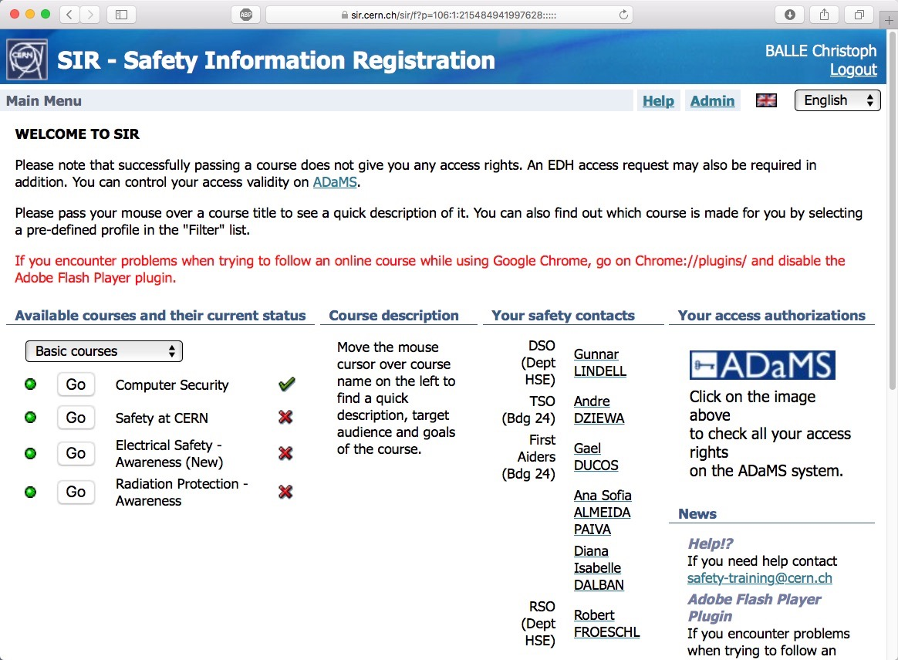

Read CERN Safety Policy
Record emergency number
Meet First Aider + TSO
Do basic safety courses > SIR
you
Notes:
*

Slide 17
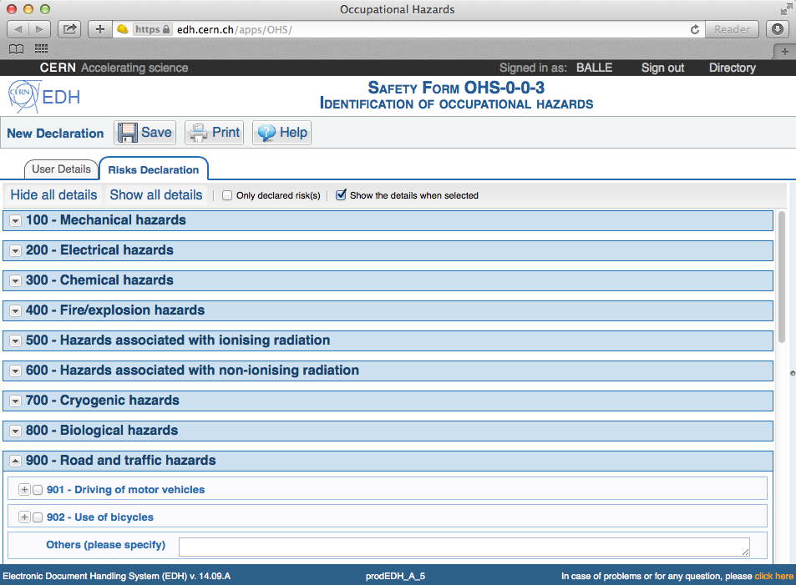
Read CERN Safety Policy
Record emergency number
Meet First Aider + TSO
Do basic safety courses > SIR
Make Risk Declaration > EDH
sup
you
Notes:
You and your supervisor
* Your supervisor is your first contact in matter of Safety!
Do not hesitate to ask him questions.
Your supervisor will tell you about:
* workplace related risks,
* the preventive measures,
* …

Slide 18

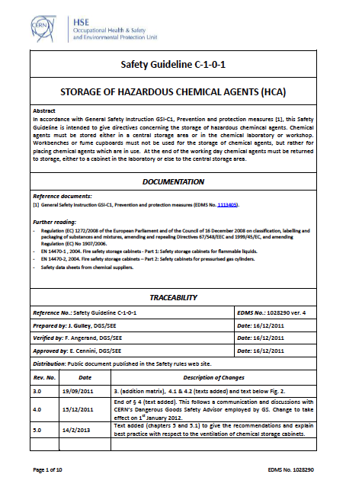
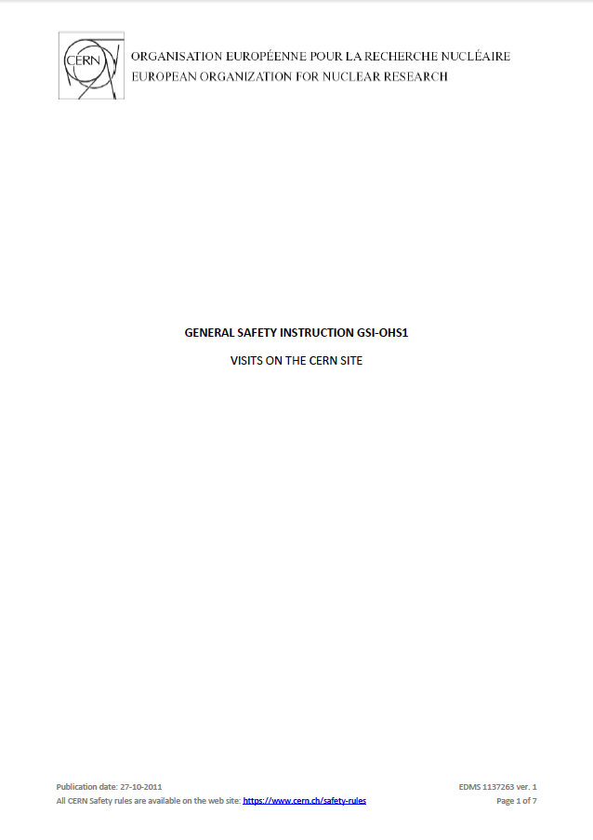
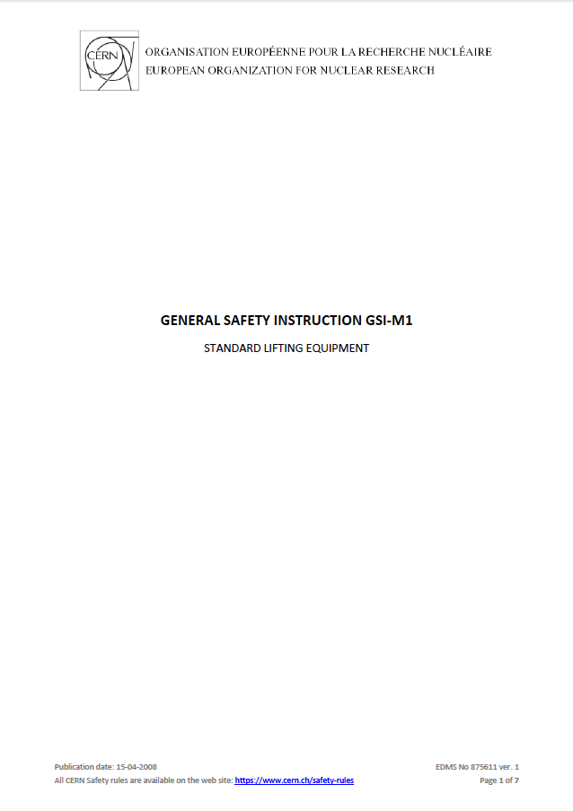
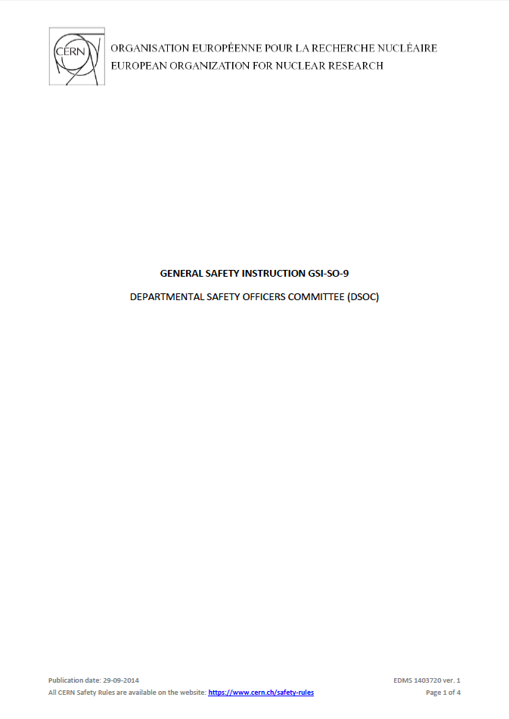
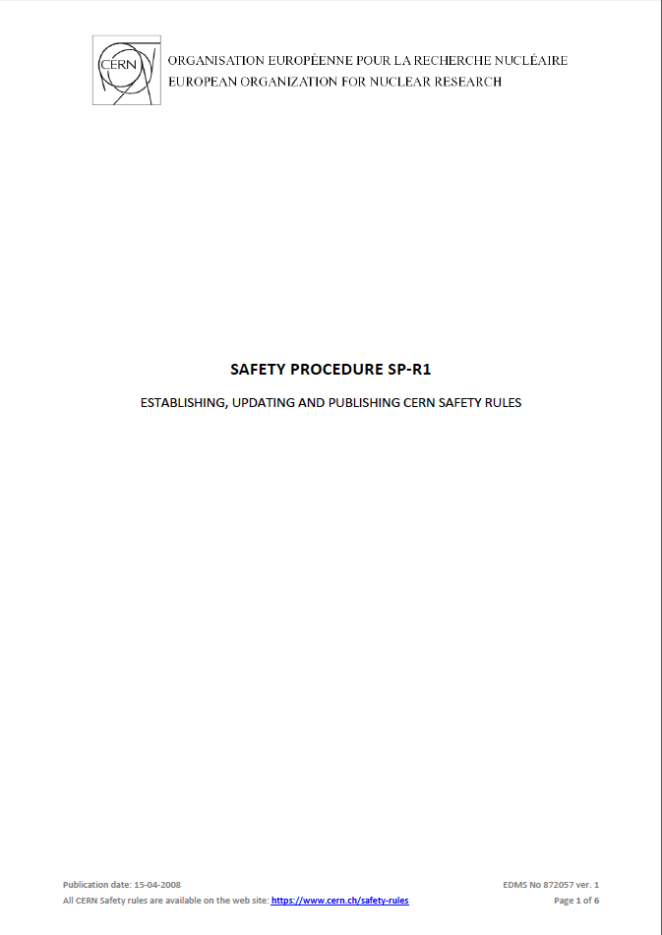
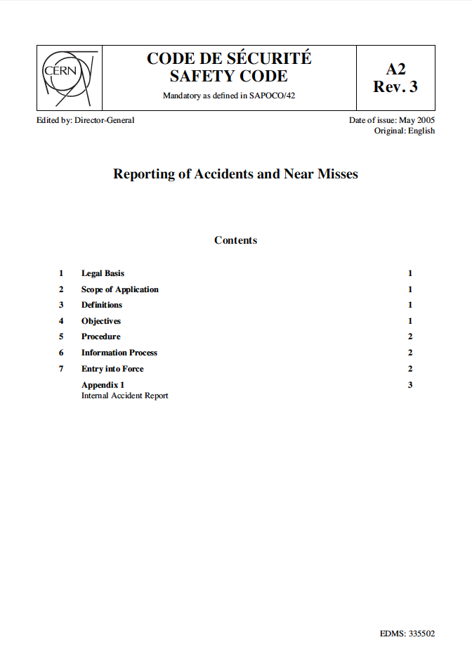
you
Notes:
You
* There are some CERN regulations you should be aware of.
* Ask your supervisor in case of questions

Slide 19
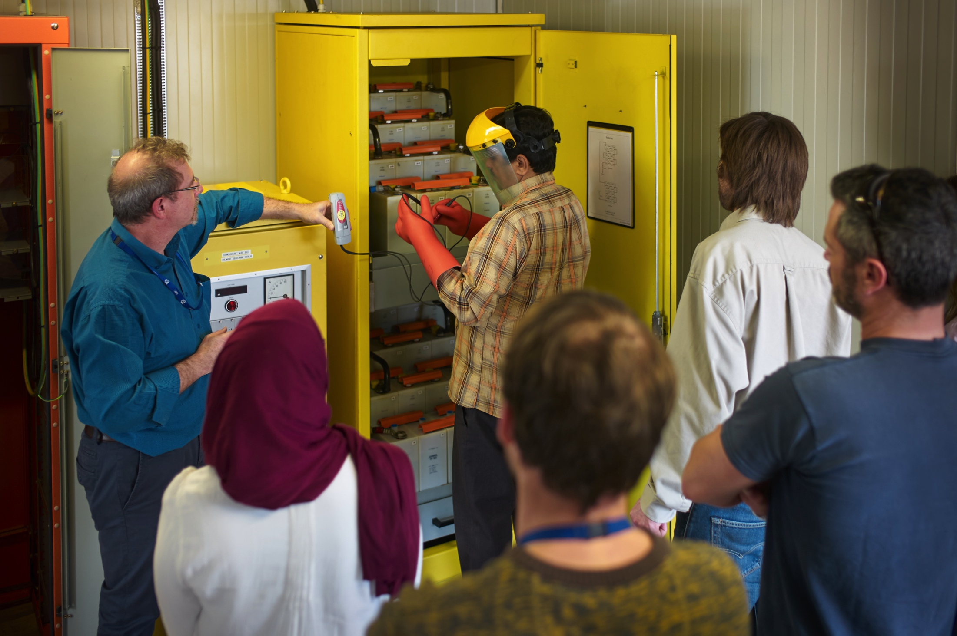
you
Notes:
* Safety Training needs
-> classroom (theory + practice) courses, see CERN’s training catalog on the web

Slide 20
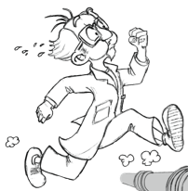








you
Personal Protective Equipment
Equipement de Protection Individuelle
Notes:
* Personal Protective Equipment required (PPE)

Slide 21

Safety
you
Notes:
You
To summarize:
* Safety is an integral part of CERN and your daily life

Slide 22
Read CERN Safety Policy
Record emergency number
Meet First Aider + TSO
Do basic safety courses > SIR
Make Risk Declaration > EDH
✔
✔
✔
✔
✔

Slide 23

www.cern.ch

