Slide 1
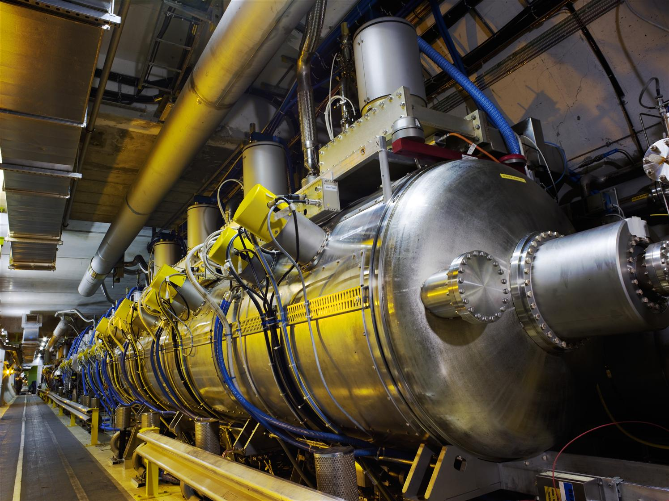
LHC Spare RF Cryomodule Project
M. Karppinen on behalf of Project Team

Slide 2
Acknowledgements
BE-RF:
S. Bizzaglia, J. Biessy, O. Brunner, Y. Cuvet, M. Gourragne, A. Macpherson,
P. Maesen, A. Miyazaki, G. Pechaud, E. Sancho Cabrera, K. Schirm,
N. Schwerg, D. Smekens, M. Therasse, K. Turaj, N. Valverde,
W. Venturini, A. Xydou
EN-MME:
C. Abajo Clemente, S. Atieh, E. Cantergiani, O. Capatina, A. Cherif,
R. Claret, L. Dassa, G. Favre, JM. Geisser, L. Mettler, F. Motschmann,
P. Naisson, F. Pillon, T. Tardy, P. Trubacova
TE-VSC:
S. Calatroni, L. Ferreira, S. Forel, P. Maurin, G. Rosaz, M. Taborelli,
M. Thiebert, L. Viezzi
HSE:
C. Arregui

Slide 3
LHC Spare-related Topics
Brief project status update Mikko
Cavity fabrication Fritz
Vertical test results Akira
¼-Cryomodule David
Tuner FEA Anastasia
SRF WS 2016 LHC Spares:
https://indico.cern.ch/event/550515/contributions/2234387/

Slide 4
Motivation
A full vacuum aperture (100 mm) opening near the LHC cavities will result in He-vessel rupture and cavity collapse. Opening of one beam pipe aperture will be survivable with the existing rupture discs (2.1 bars). 3-4 incident was a near miss.
Failure of the MPC ceramic window in LHC could result in the contamination of two cryomodules, i.e. eight cavities.
Today it would take more than a year to recondition/replace a faulty cavity in a cryomodule.
Today one (almost) valid spare cavity in stock.
Lead-time for 4 new spare cavities currently about 2 years.
LEP experience:
  None of cavities in the machine was ever scrapped due to damage.
  One vacuum sector was vented in Pt 8 and one cavity was polluted. It was rinsed, with a total down total time of 3 months.
Some references:
  E. Ciapala: RF PREPARATION FOR BEAM IN 2009, Proceedings of Chamonix 2009 workshop on LHC Performance
  E. Ciapala: Justification for derogation to fit 1.8 bar pressure release valves, Aug-2007 (EDMS 880723)

Slide 5
LHC Spare Cryomodule Project Goals
Re-establishment of :
  Cryomodule testing capability in M9
  Cavity production line including He-tank
  Cryomodule assembly line
Training of personnel on design, construction, operation, and maintenance of LHC (and other) SRF cavities and cryomodules
Production 4-8 dressed cavities
Assembly of 2nd spare CM

Slide 6
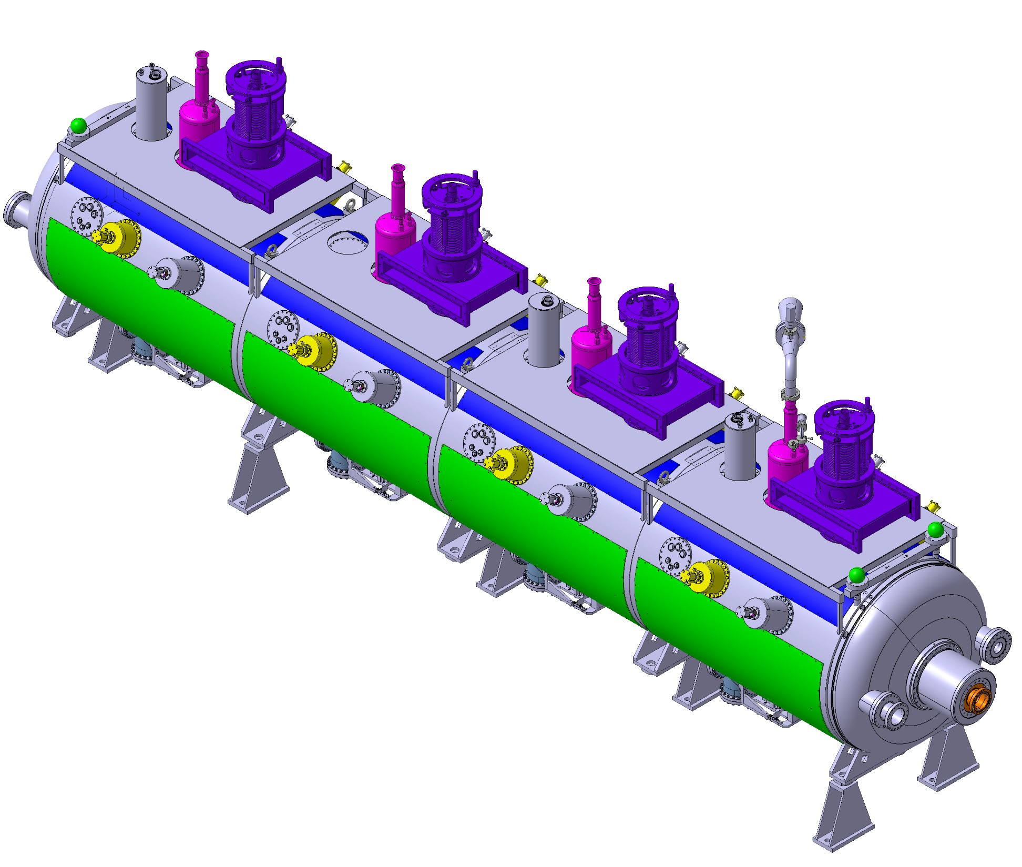
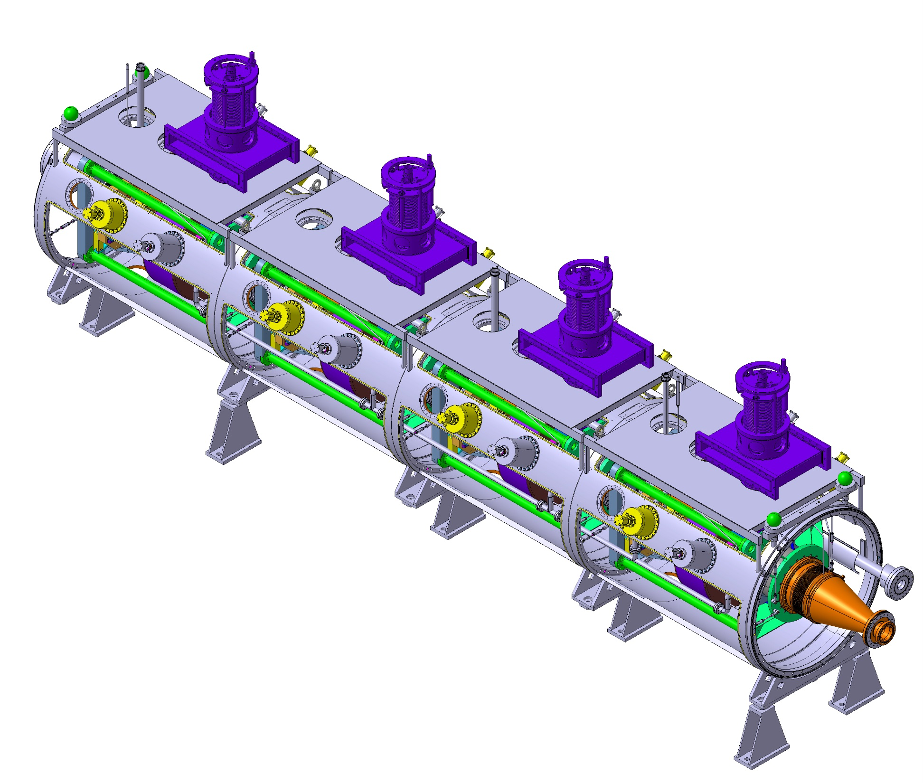
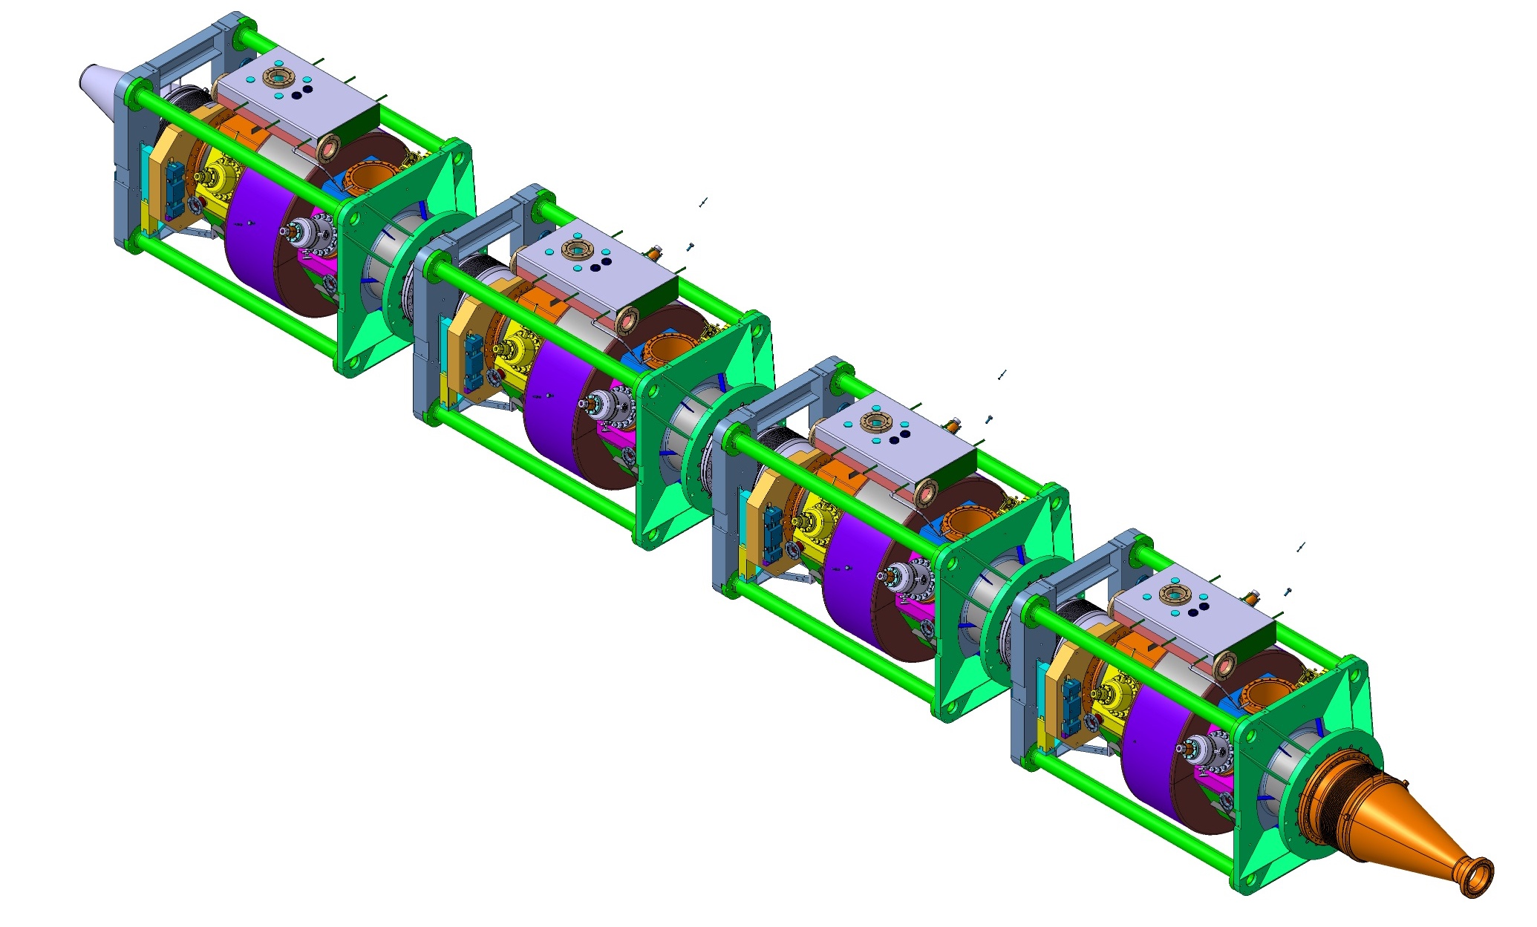
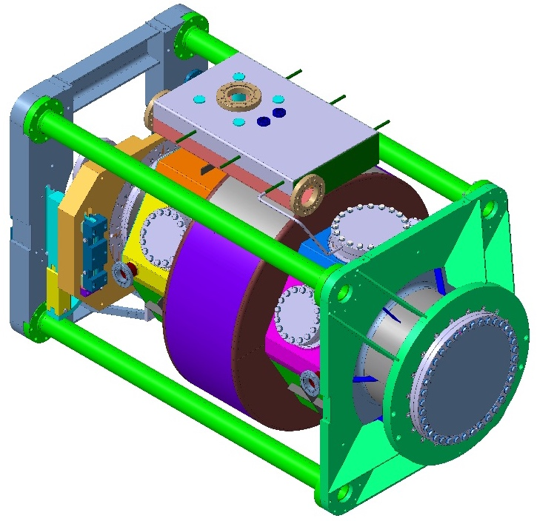
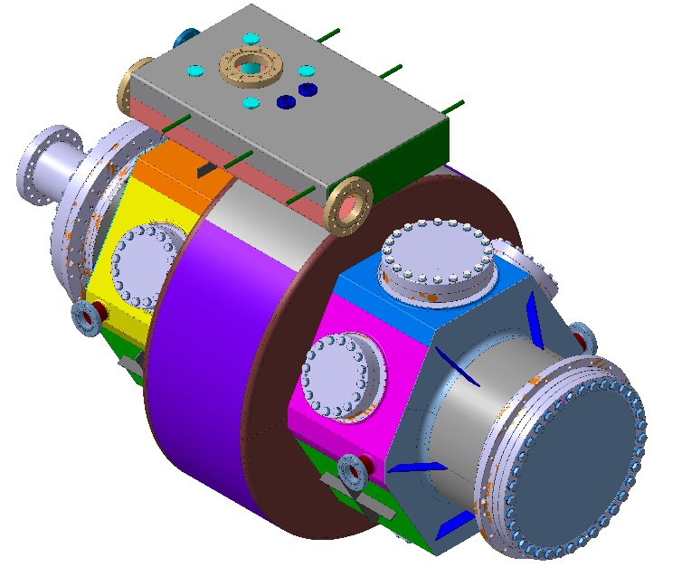
Deliverables
Complete fully tested
Cryomodule
Semi-complete
Cryomodule
1-2 x Cavity train
4-8 x Dressed cavity
Today
>1 yr ^{(*}
27 w
23 w
16 w
4 w
Time to cryomodule at 4.5 K in LHC
^{*)} Reconditioning of 4 cavities installed in LHC

Slide 7
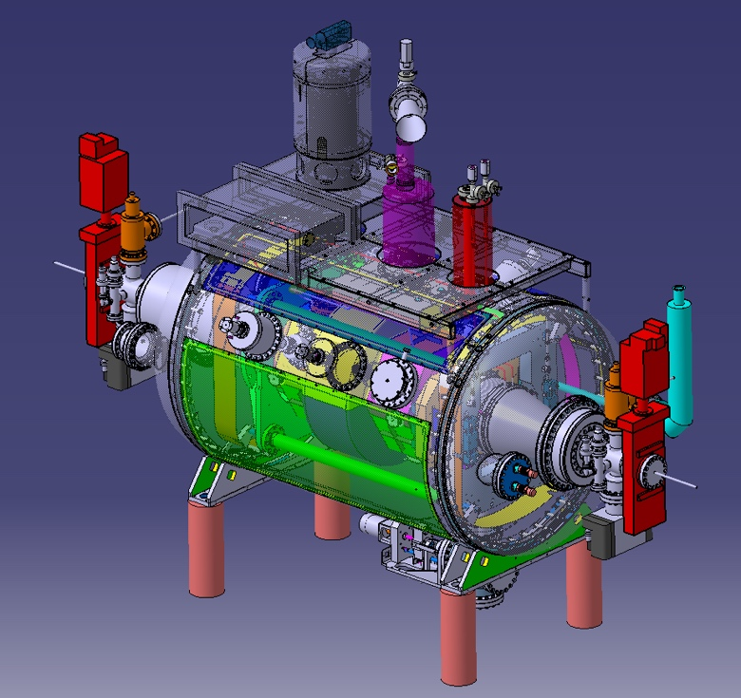
New Scope (since Sep-17)
Dressed Model cavity
Cavity design
Cavity assembly
Processing
Nb-coating
He-tank
1/4 Cryomodule
CM integration
RF performance
Training of team
Tooling
Draft procedures for full CM
4 x Dressed Cavity
End-2018
End-2018
Mid-2020

Slide 8
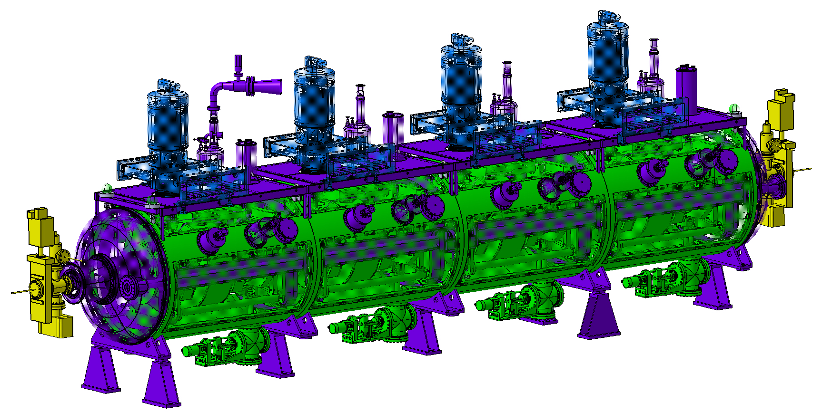
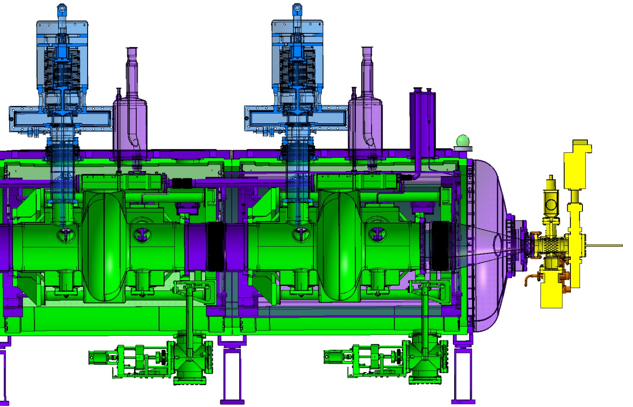
Cryomodule Design Status
F. Pillon EN-MME
Released Catia/ Smarteam
Coupler team BE-RF-PM
Only 3d model
In progress
New design for for LS2 (TBC)

Slide 9
Some Results since last SRF WS
Cavity #19 re-processing and test
Practice cavities:
  PC02 re-coating, test, and He-tank assembly
  PC05 test
  PC03 test

Slide 10
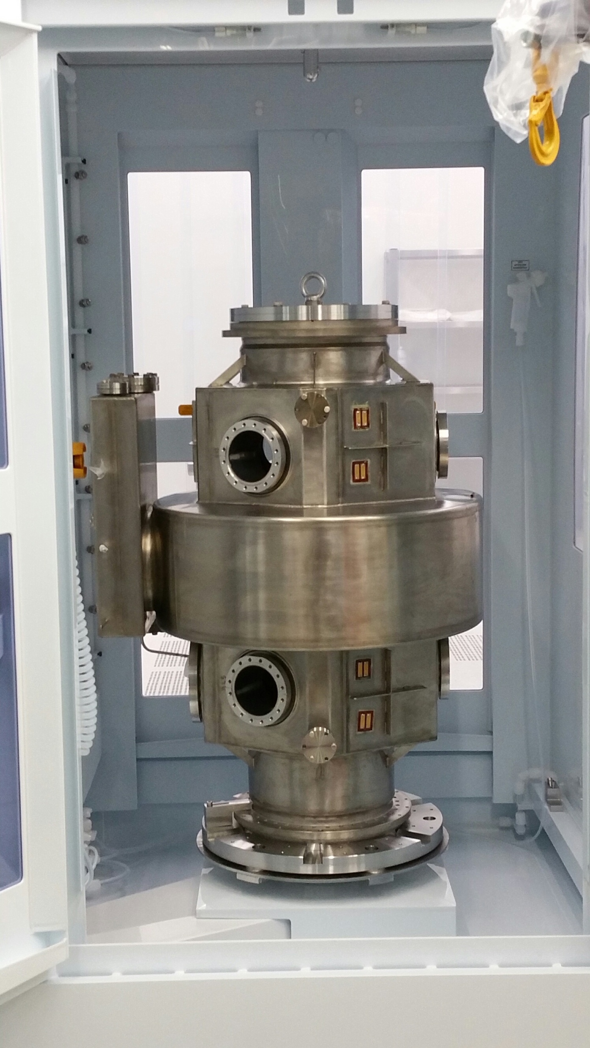
Cavity #19
(The only) Spare unit from the original LHC production
HPWR and LPWR to remove contaminants
Vertical test Dec-17 slightly below the spec (1.7E+09 @ 2 MV)
Strip and recoat planned once we have new spares
A. Miyazaki

Slide 11
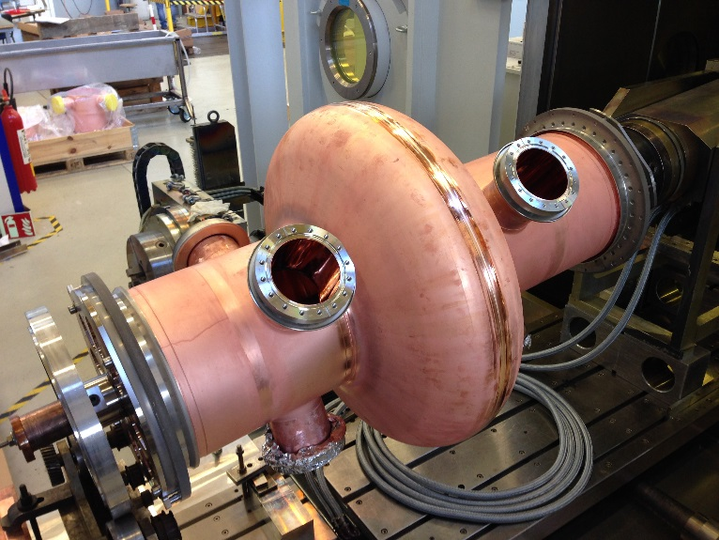
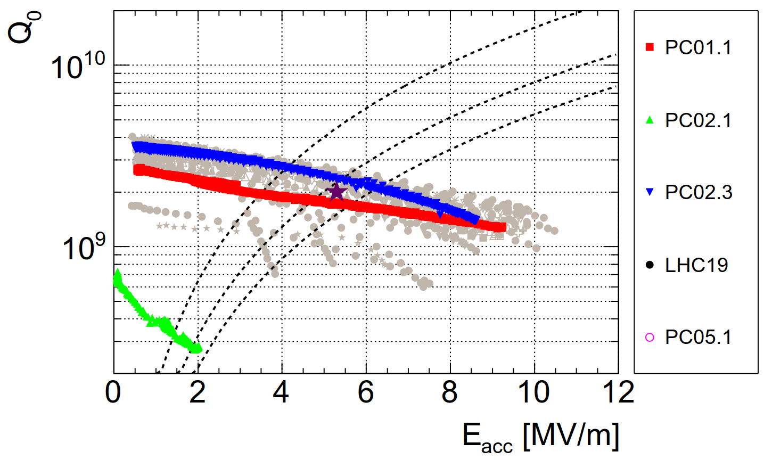
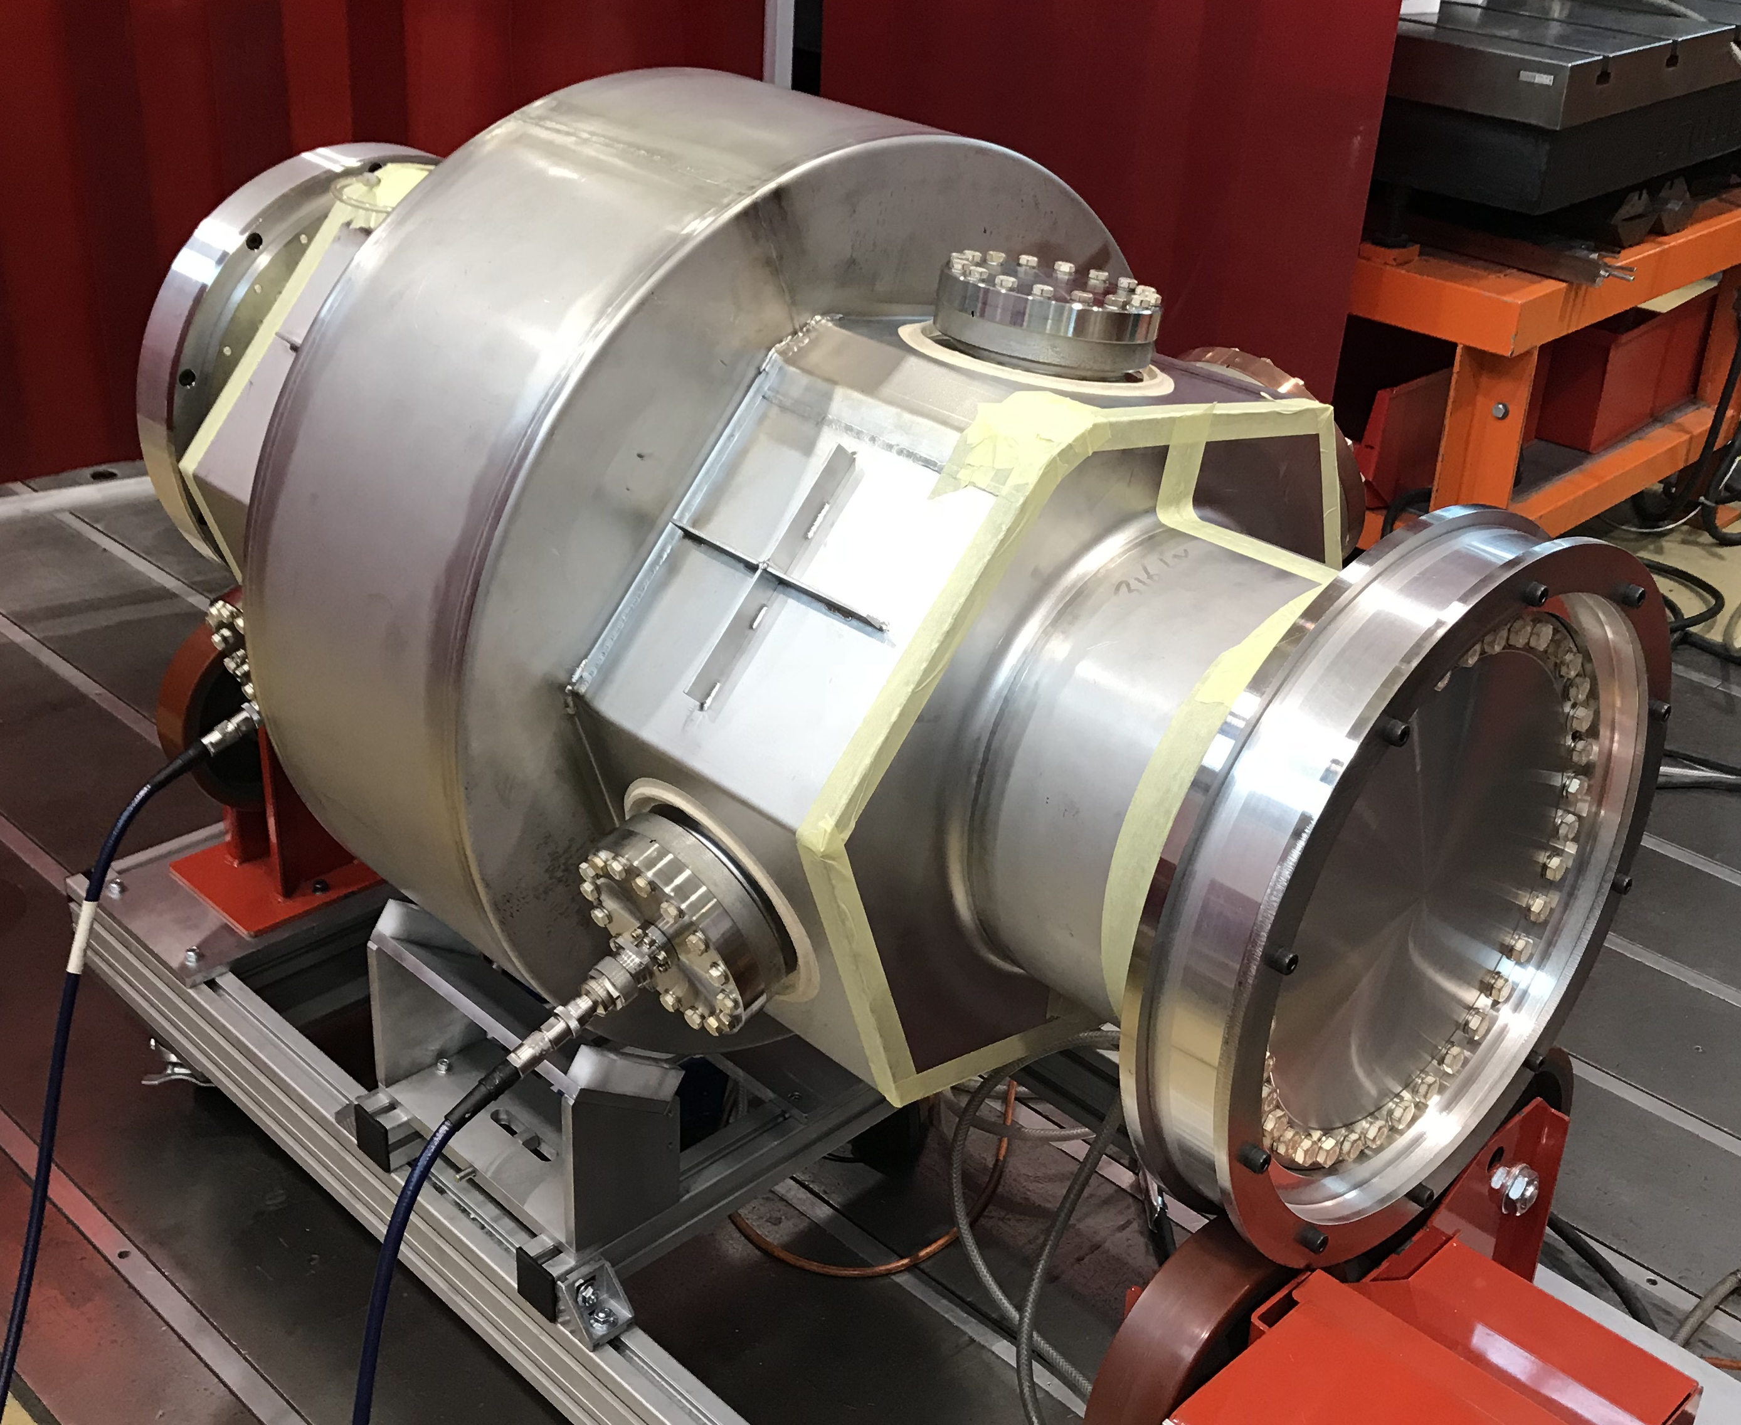
Practice Cavity PC01& 02
Goals:
  Cut-off and cavity assembly process, rinsing, chemistry
  Nb-coating
  He-tank assembly
Spun halfcells (Bonitempo 2nd gen)
Old design (f = +0.7 MHz)
Full cut-off
PC01 tested once. Re-coat planned.
PC02 failed in first test and exceeded the specs after 2nd re-coat.
Dressed PC02 completed with updated He-tank design. Will be used for ¼-CM
A. Miyazaki

Slide 12
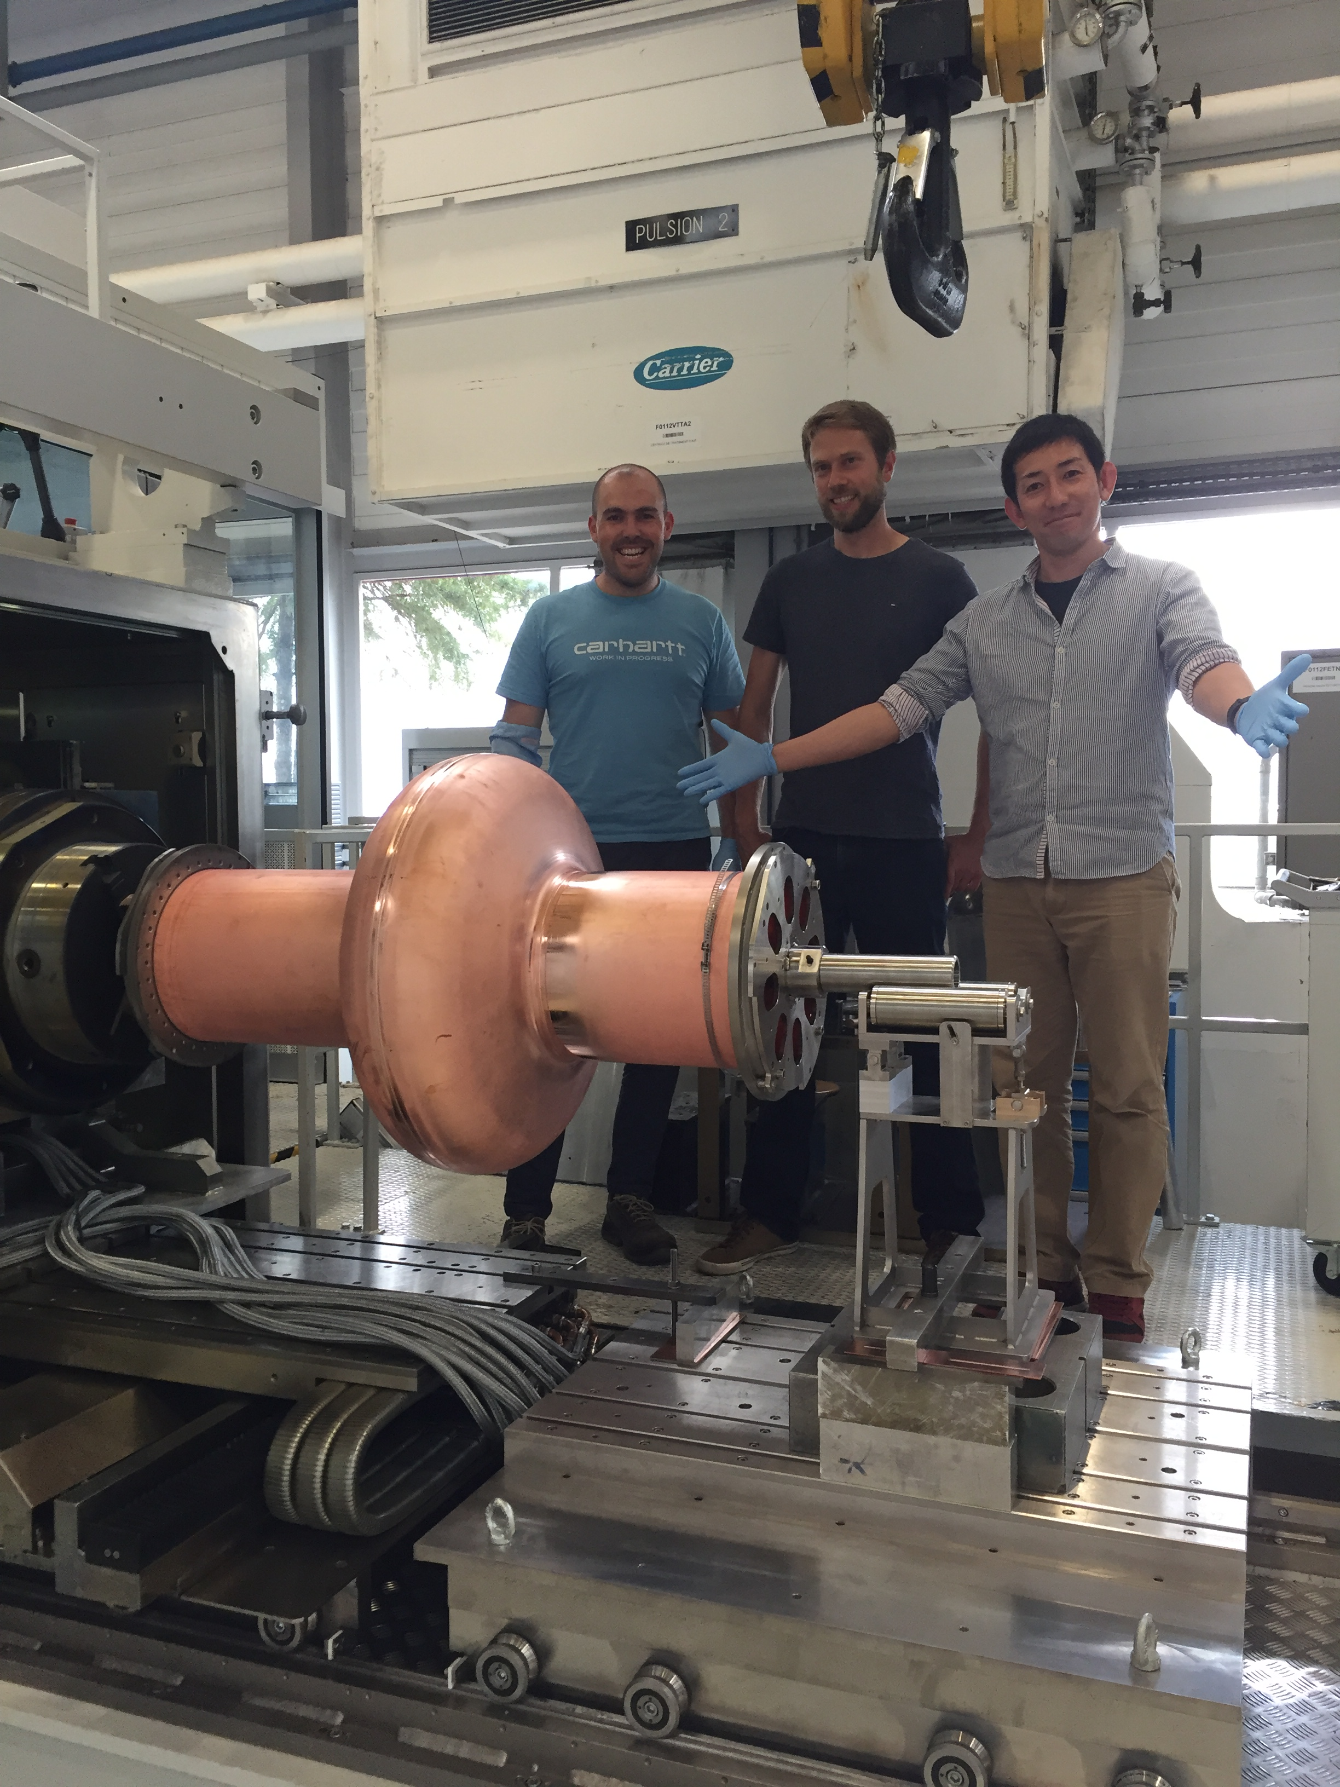
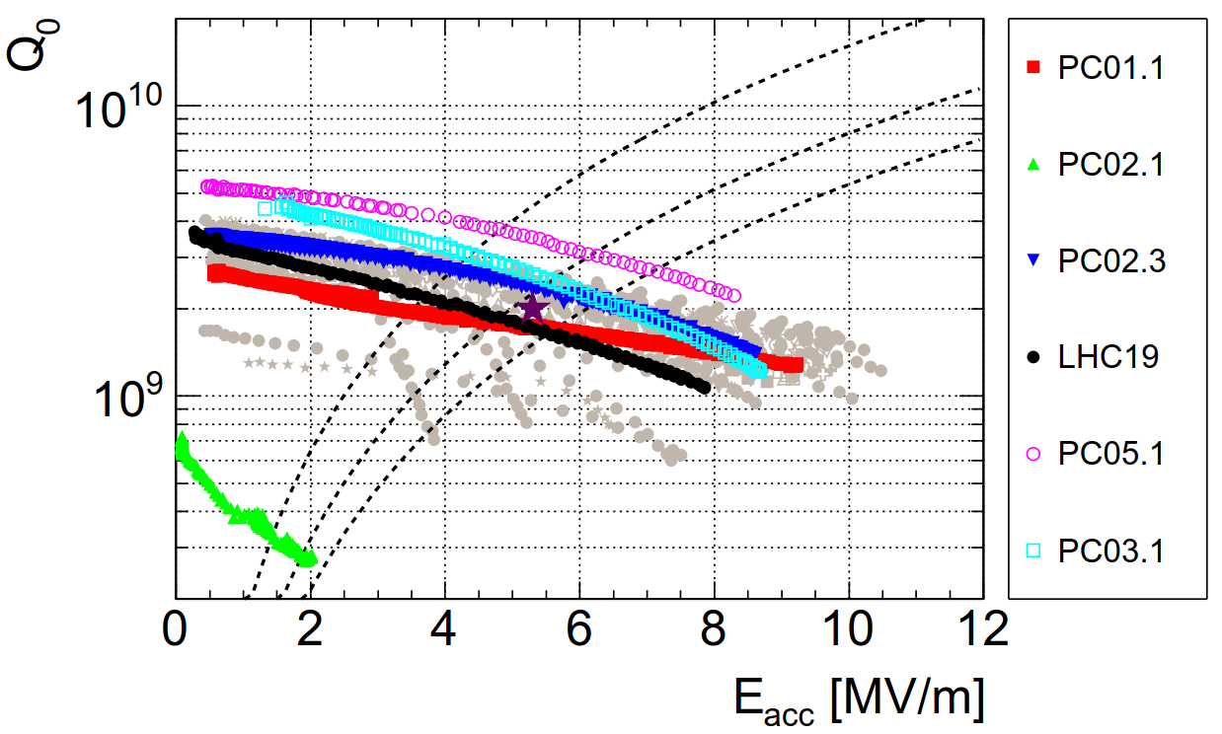
Practice Cavity PC03-05
Goals:
  Cavity forming technology
  Demonstration of EM-performance
  Validation of assembly process, quality control, coating, processing,..
Simplified cut-off
Updated cavity design
PC05 spun and machined halfcells from Heggli (CH). Now the base-line for “series”
PC03 EHF halfcells from BMAX (F), however, not representative due to grinding of entire RF-surface (PC04 planned as the demonstrator)
Both successfully tested exceeding the LHC specs
A. Miyazaki

Slide 13
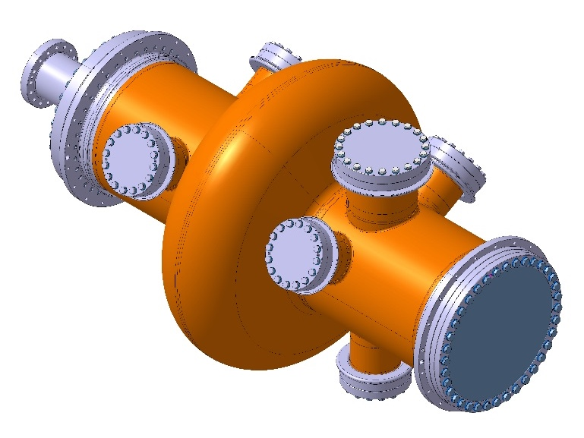
Model Cavity MC01
Prototype and possibly the 1st spare for LHC
Full cut-offs ready
Spun & machined halfcells just in from Heggli (CH)
Test in V6 expected in Oct-18
Dressed MC01 test early 2019

Slide 14
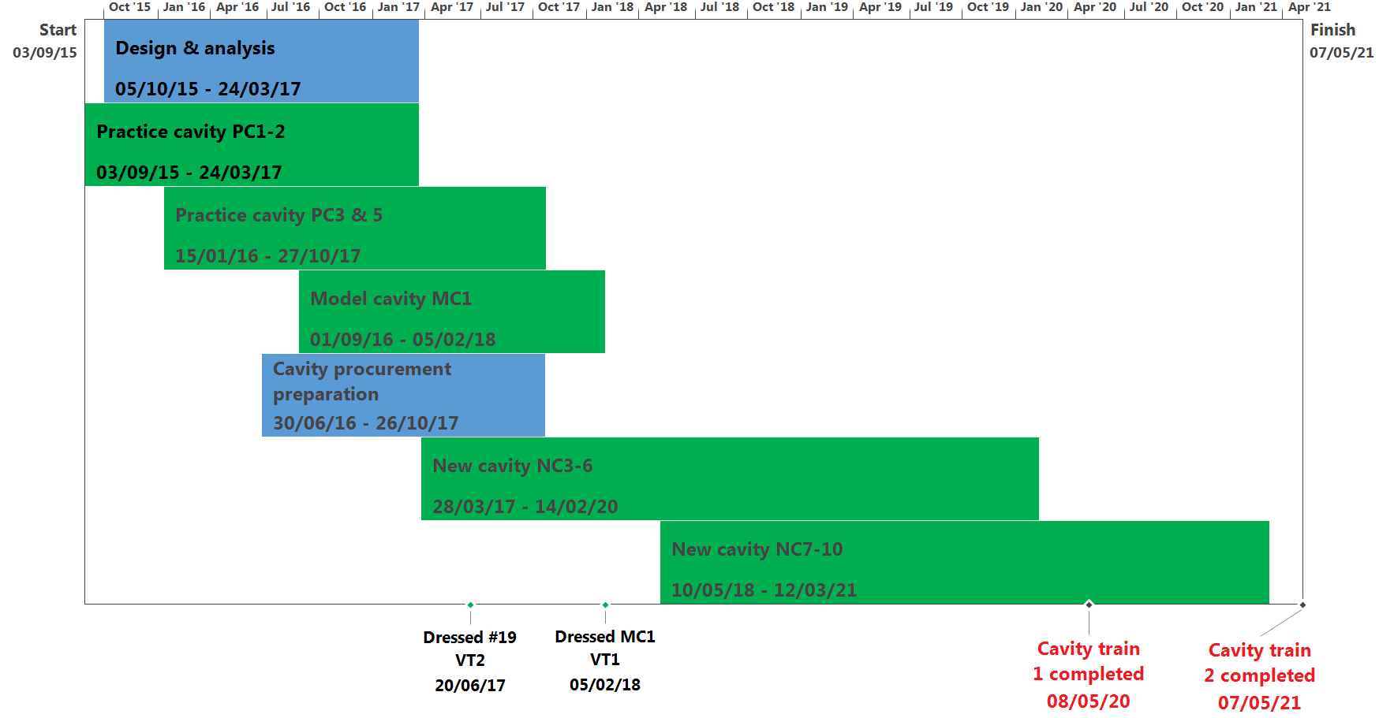
Project Timeline (Dec-16)
2016
2017
2018
2019
2020
Design & analysis
6-12 months delay due to B252 works
Practice cavity
PC1 & PC2
LS2
Practice cavity
PC3 & PC5
Model Cavity MC1
SM18 Stop
Cut-offs: MS, IT, Technology transf.
Spare cavities #1-#4
Spare cavities #5-#8

Slide 15
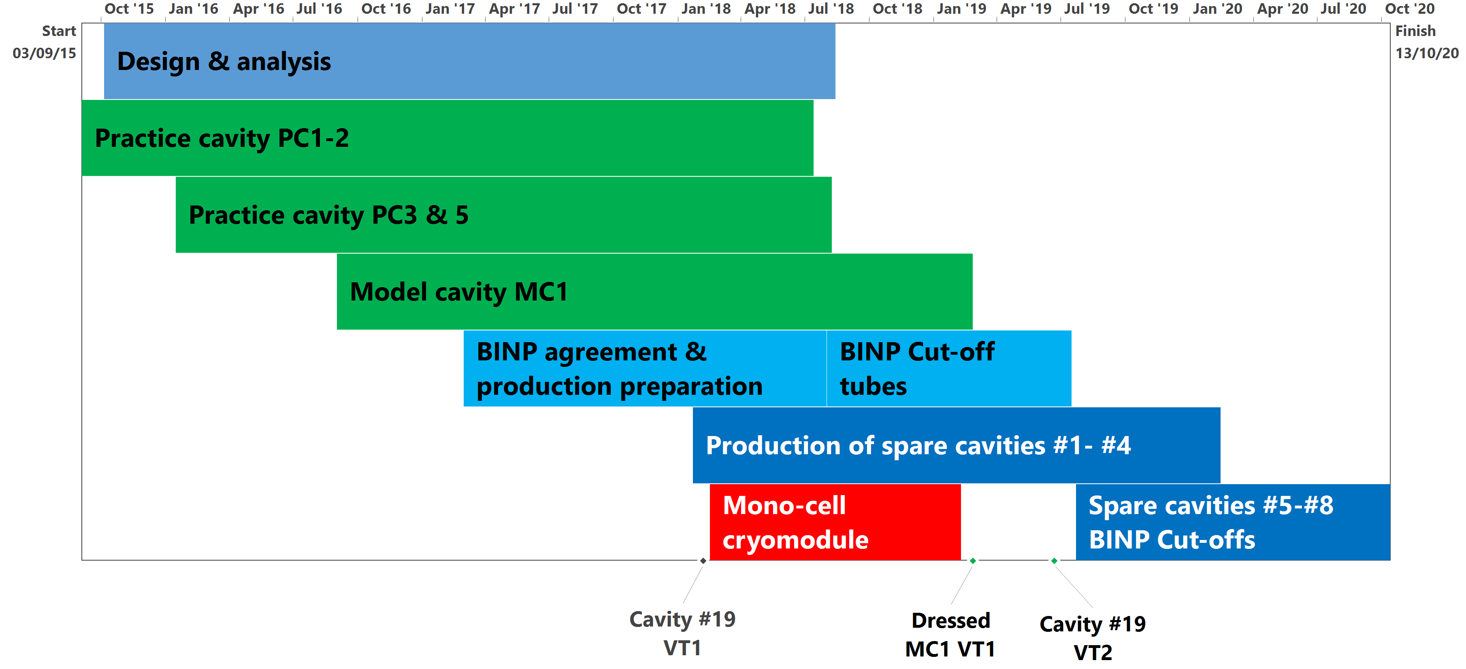
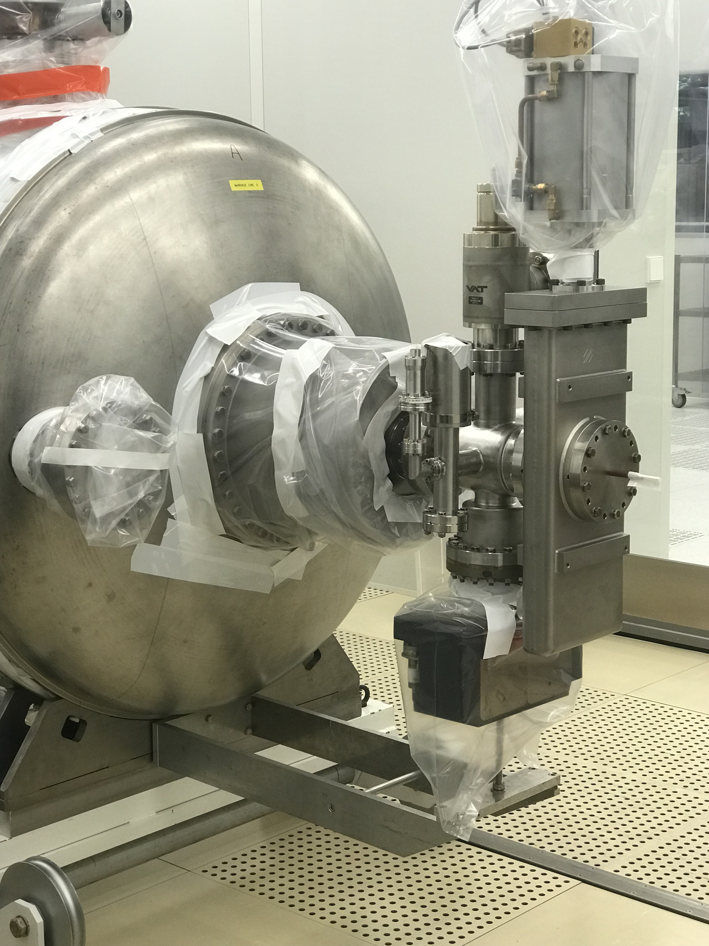
Project Timeline (May-18)
2016
2017
2018
2019
2020
LS2
SM18 Stop
Pumping-X
X-change
Spare CM Test

Slide 16
Summary
Expected down-time of LHC currently > 1 year if 2 CM need to be restored. One CM can be theoretically replaced in 4 weeks (+3 weeks WU & cooling).
Almost 1 year slip in project schedule last year due to resources being allocated to CRAB and HIE-ISOLDE
Cryomodule design file almost complete. Surprises during CM assembly cannot be fully excluded.
Cryomodule assembly-line, procedures, and associated part inventory & logistics in progress..
Cryomodule intervention team to form and train on ¼-CM
Cavity #19 has been re-validated as a spare for LHC
4 practice cavities tested to large extent validating cavity design, fabrication, Nb-coating and processing
Project re-scoped to deliver 2-4 dressed cavities by 2020 bringing the potential downtime of LHC to 27 weeks in the event of 2 CM failing.

