Slide 1
Cold Test Summary 2017
Alejandro Castilla, on behalf of:
The BE-RF-SRF and SM18 Testing Team

Slide 2
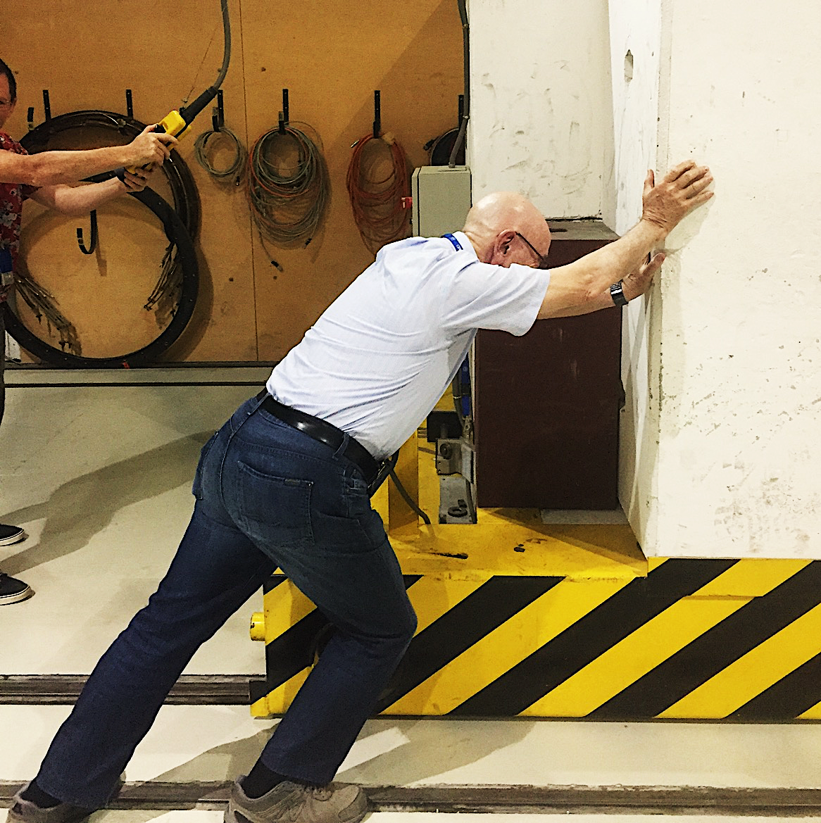
How does it work?

Slide 3
There are many ways to group the roles, I’ve chosen the following one:
Technical Support
Engineering Support
Cryo Operations
Vertical Cryostats
Horizontal Bunkers
Cryomodule Eng.
Bulk Nb
Nb/Cu
Cryolab

Slide 4
Max Gourragne (Staff)
Mikko Karppinen (Staff)
Alick Macpherson (Staff)
Ester Sancho Cabrera (Staff)
David Smekens (Staff)
Mathieu Therasse (Staff)
Katarzyna Turaj (Staff)
Walter Venturini (Staff)
+ Paul Kohler (Staff)
+ Nuria Valverde (Staff)
- Nikolai Schwerg (Staff)
- Sauro Bizzaglia (Staff)
+ Niall Stapley (RF-CS Staff)
+ Marcel Coly (BE-OP Staff)
Marco Arzeo (Fell)
Alejandro Castilla (Fell)
Hernan Furci (Fell)
Anastasia Xydou (Fell)
+ Anton Ivanov (Fell)
- Sarah Aull (Fell)
- Silvia Teixeira Lopez (Fell)
Nicholas Shipman (COAS/Fell)
- Karim Hernandez (DOC)
James Mitchel (RF-BR DOC)
Akira Miyazaki (PJAS)
Marcin Wartak (PJAS)
Agnieszka Zwozniak (PJAS)
- Arthur Krawczyk (PJAS)
- Boguslaw Prochal (PJAS)
+ Ece Ozelci (TECH)
+ Clement Pillou (Stagiarie)
Jeremy Biessy (TEMC)
Christophe Duval (40/30 FSU)
Jean-Pierre Essombe (FSU)
+ Jeremy Bastard (40/30 FSU)
+ Arnaud Cogex (40/30 FSU)
+ Remi Dumont (40/30 FSU)
- Simon Barriere (TEMPC)
- Benoit Frere-Bouniol (FSU)

Slide 5
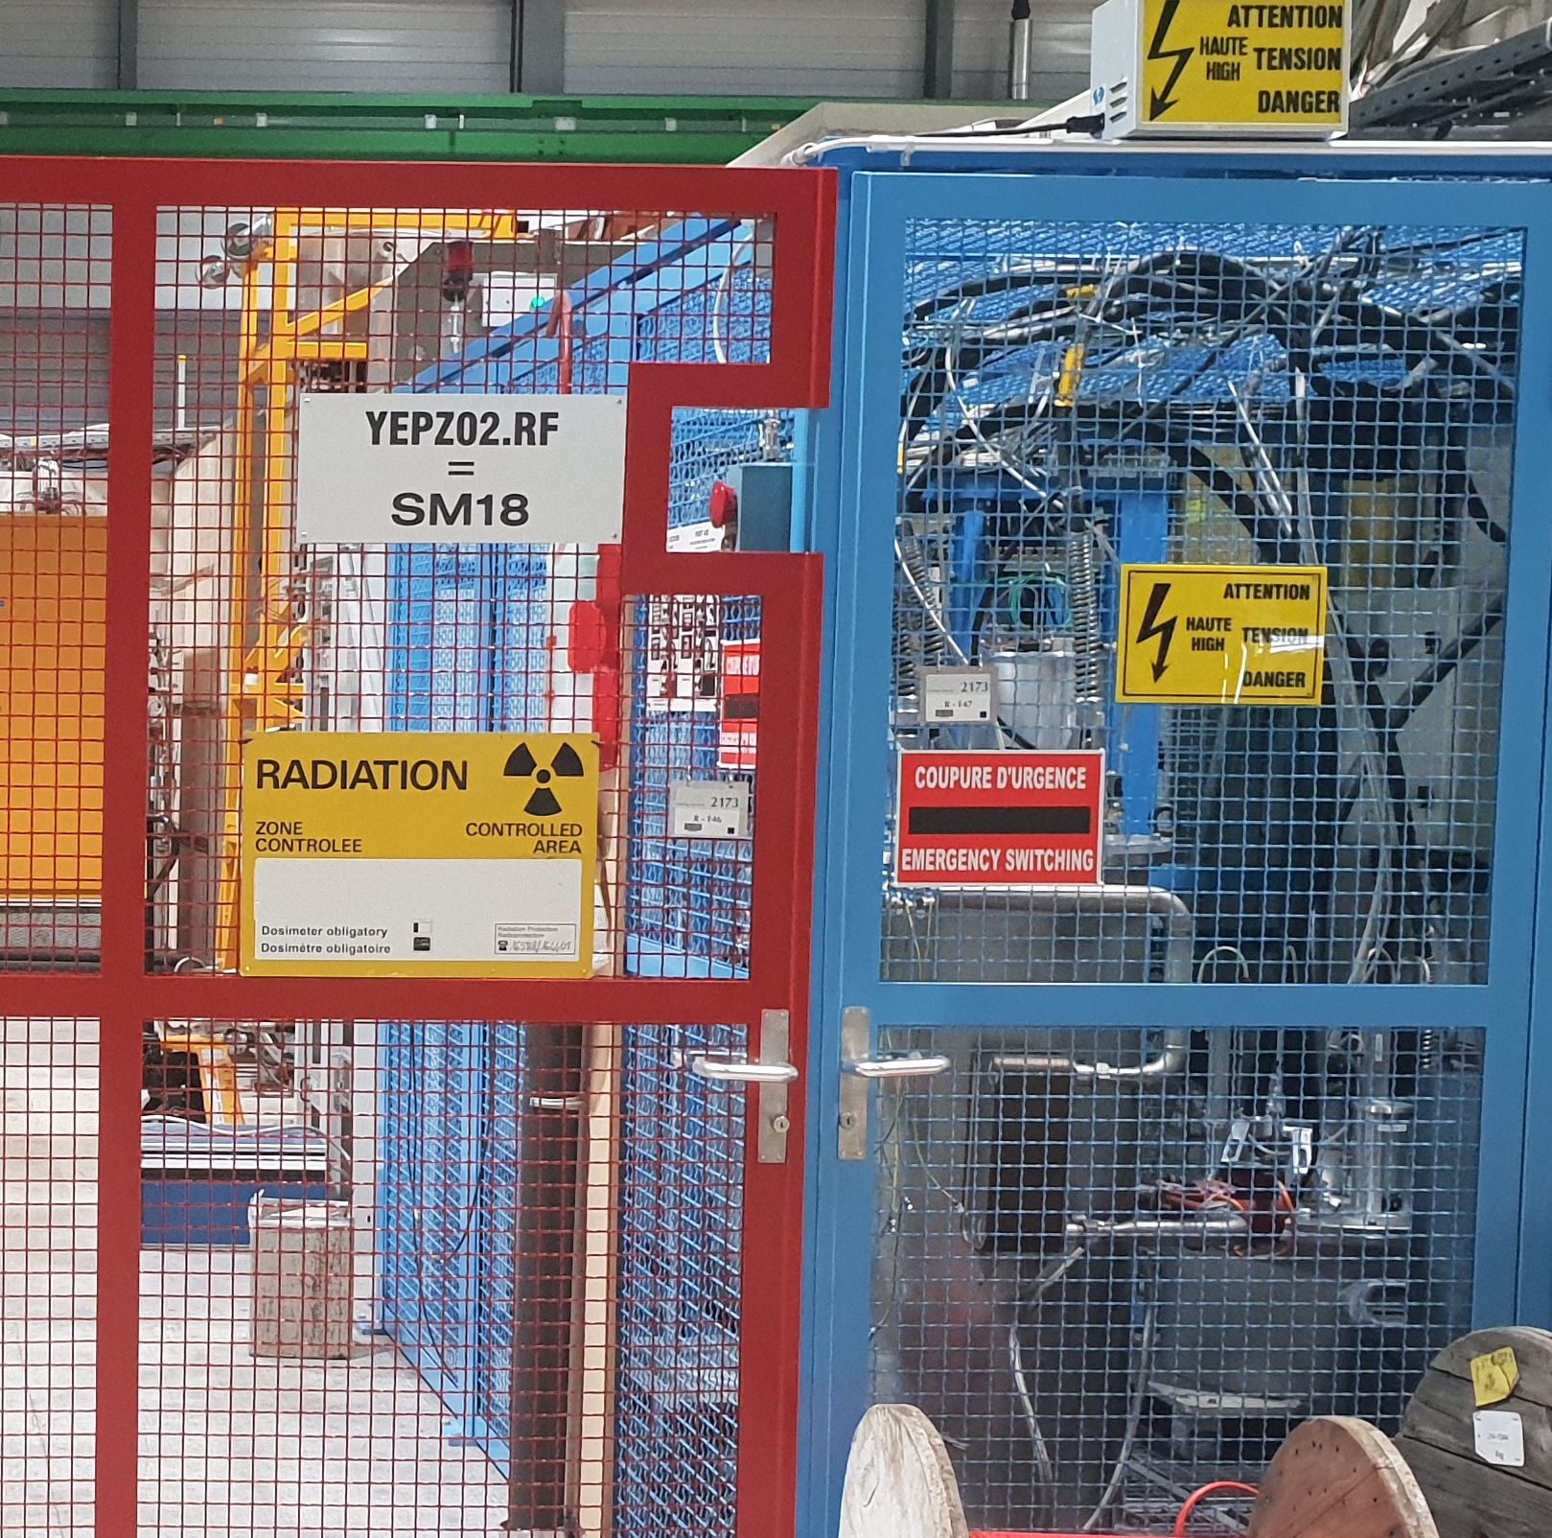
Safety First!

Slide 6
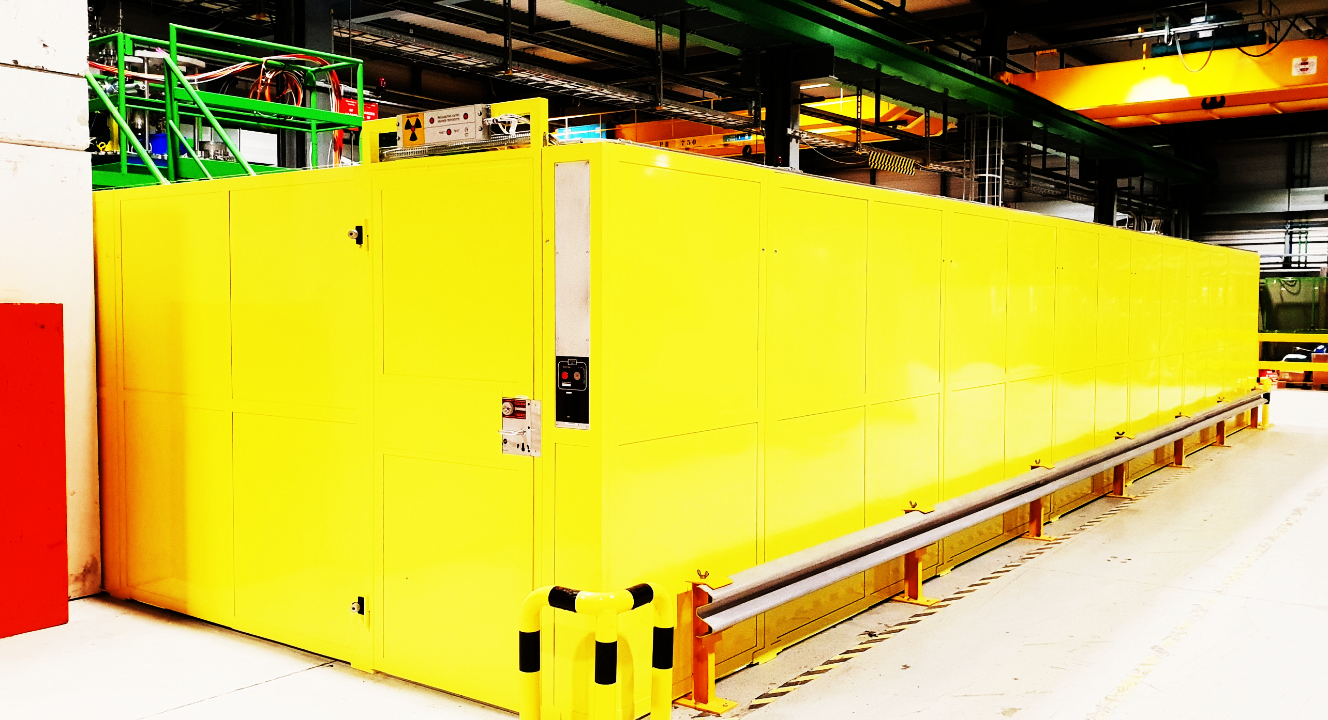
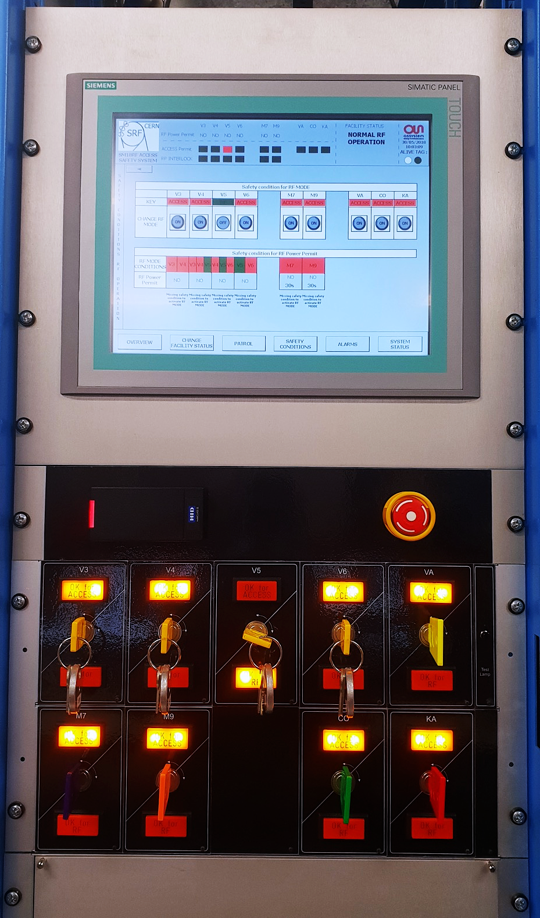
New Access System
Up and running…

Slide 7
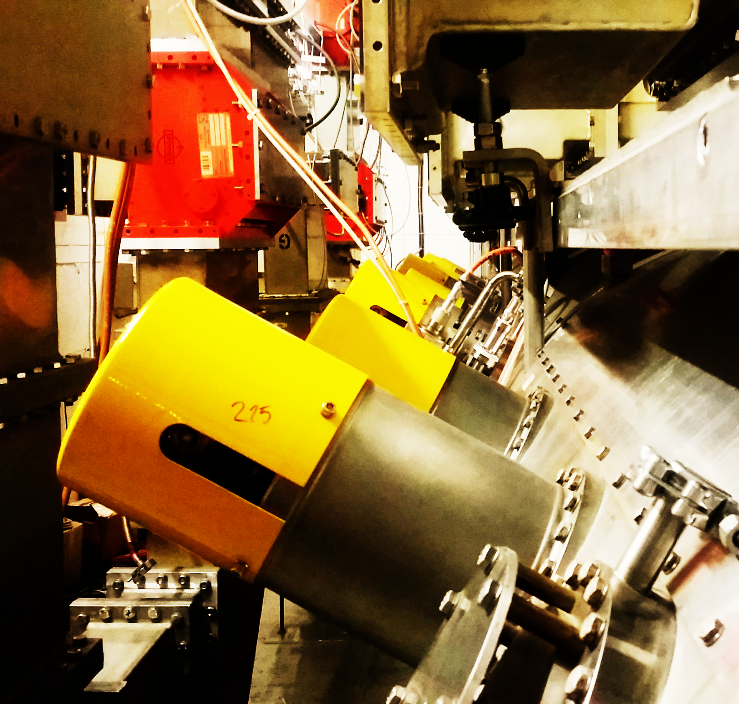
Horizontal Bunkers

Slide 8
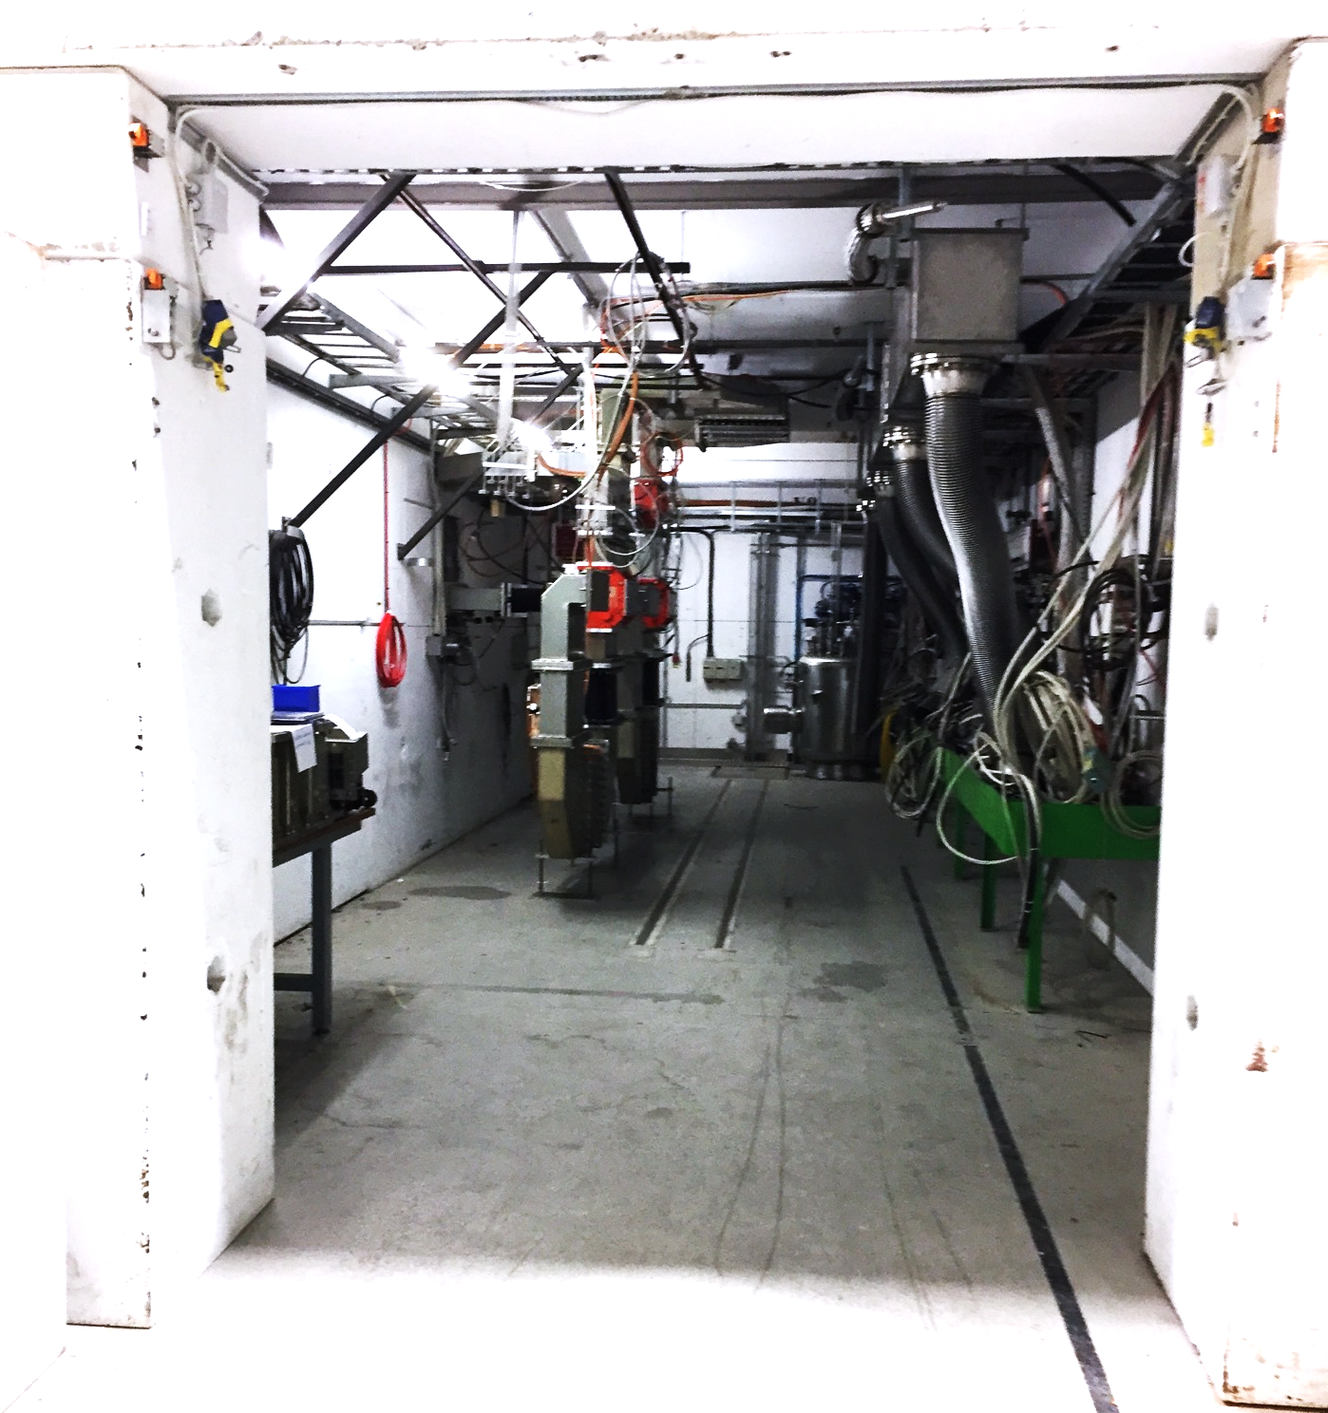
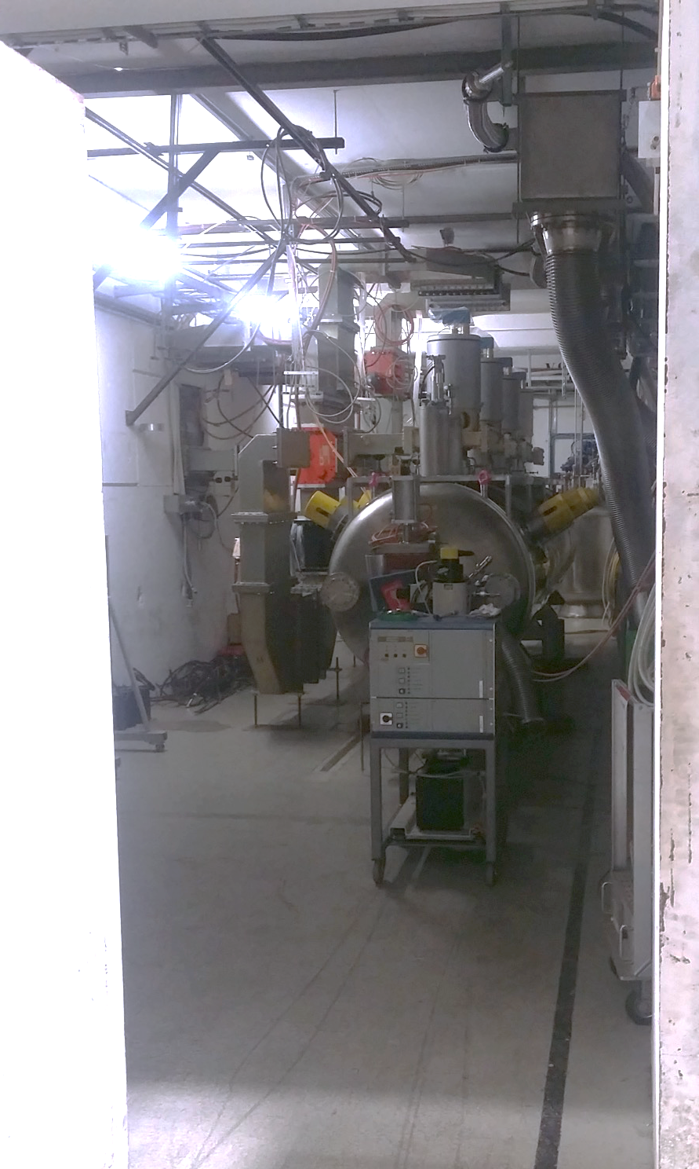
M9 – Under Refurbishment
Before
Work in Progress

Slide 9
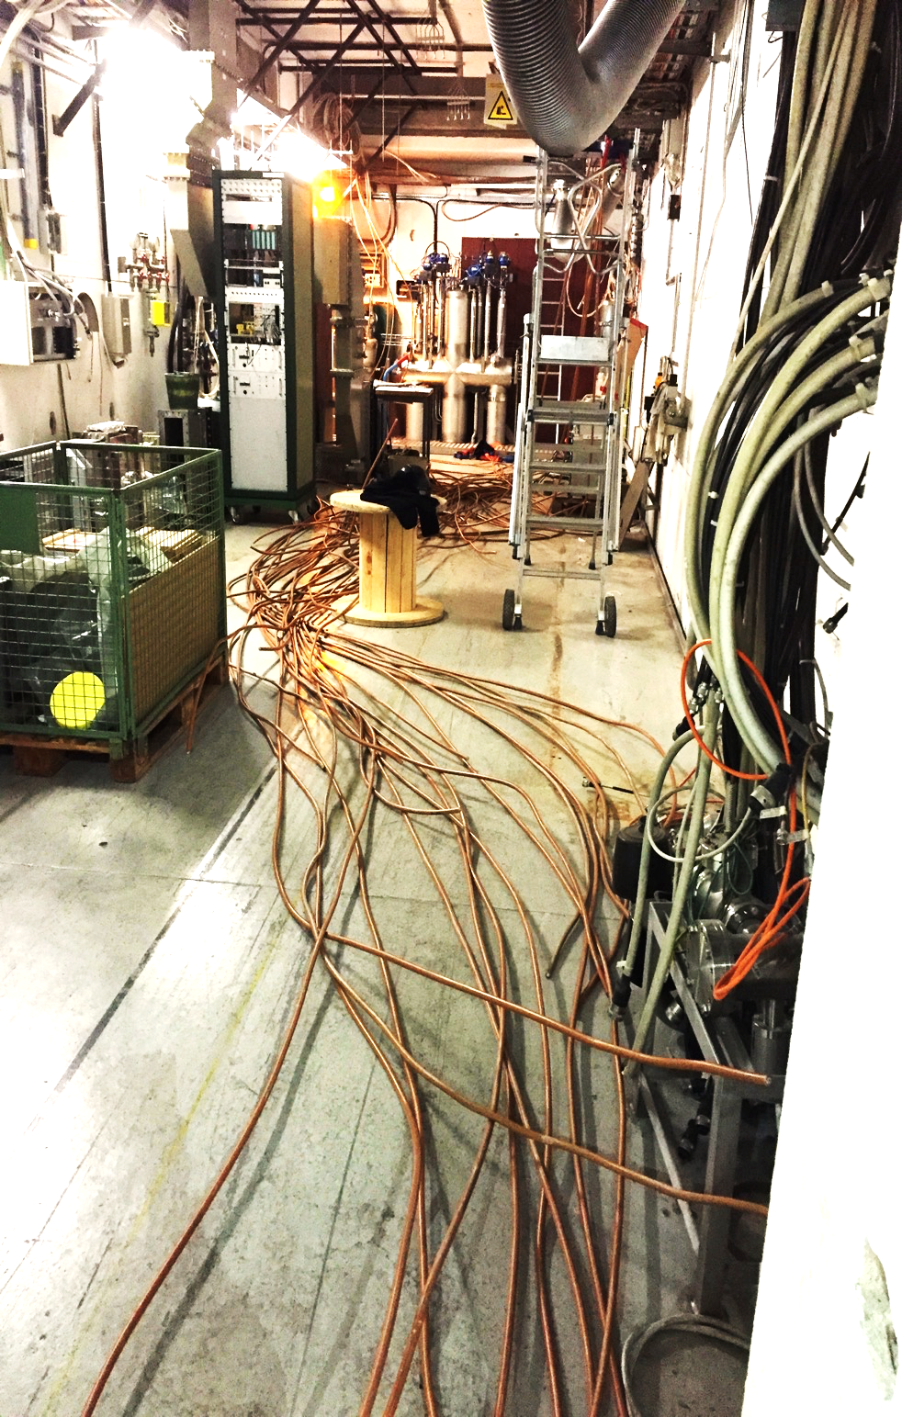
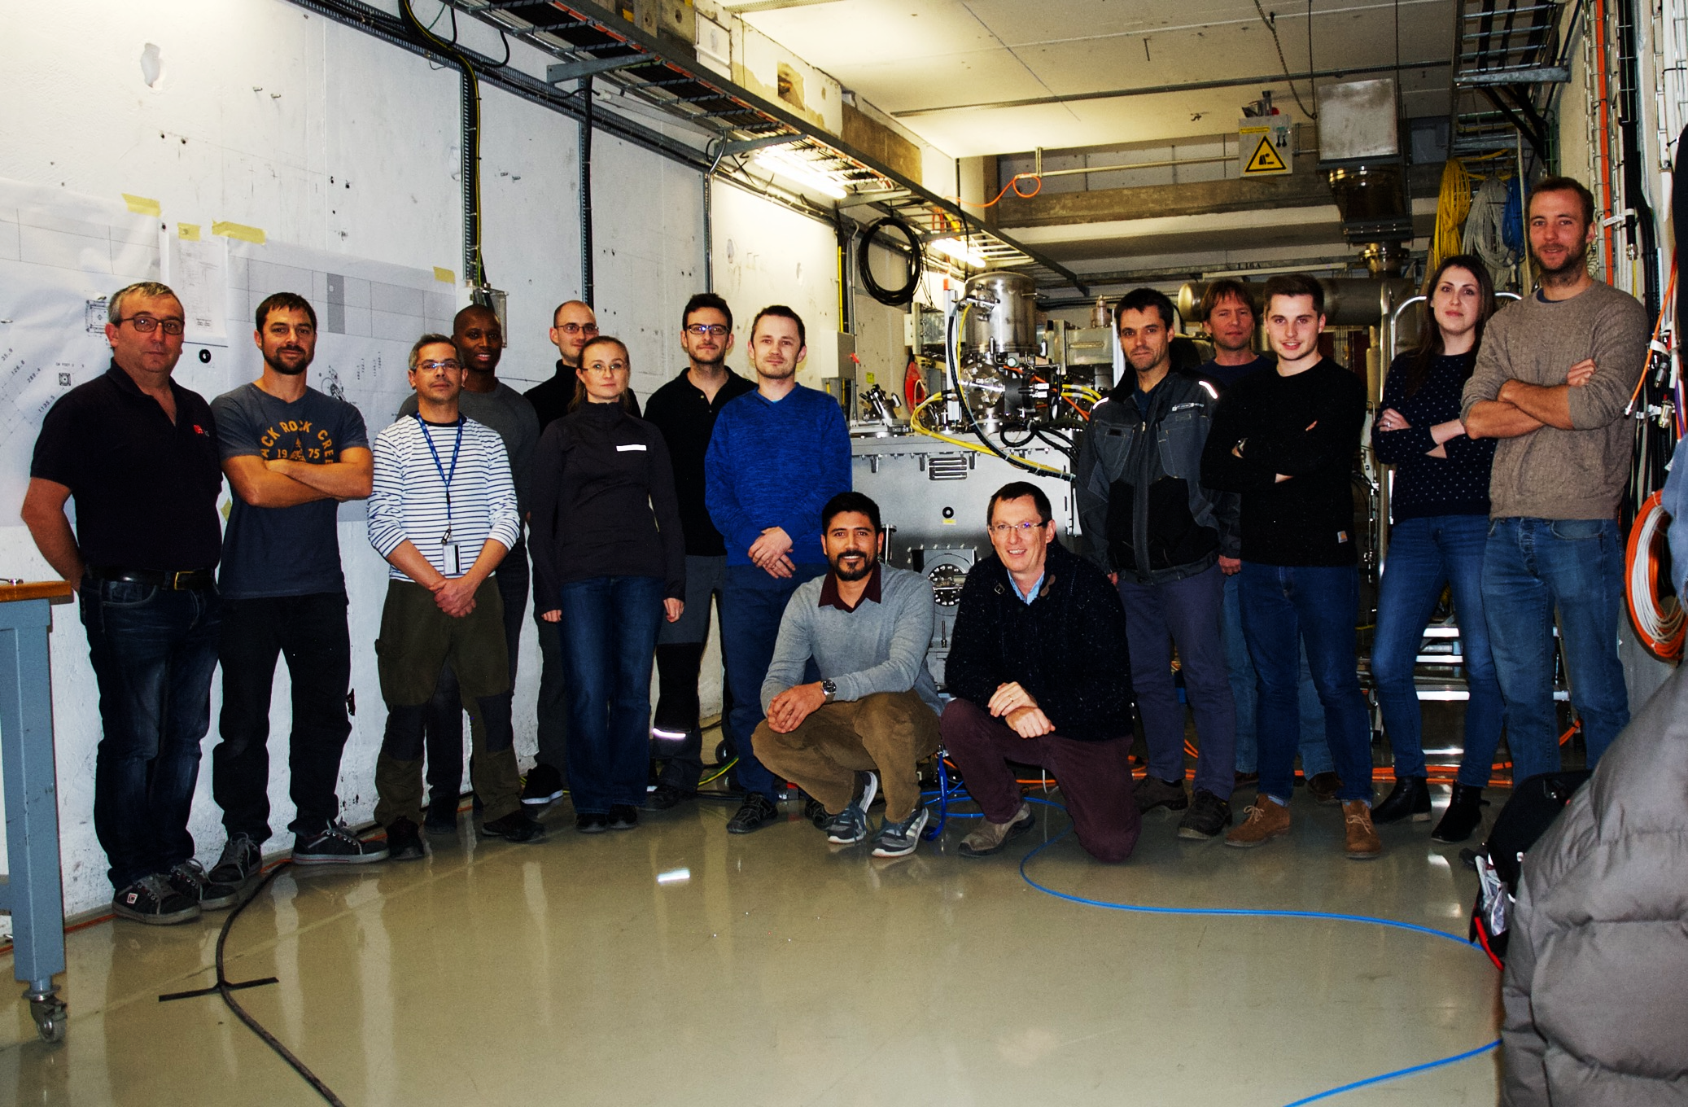
M7 – Makeover
Before
After

Slide 10
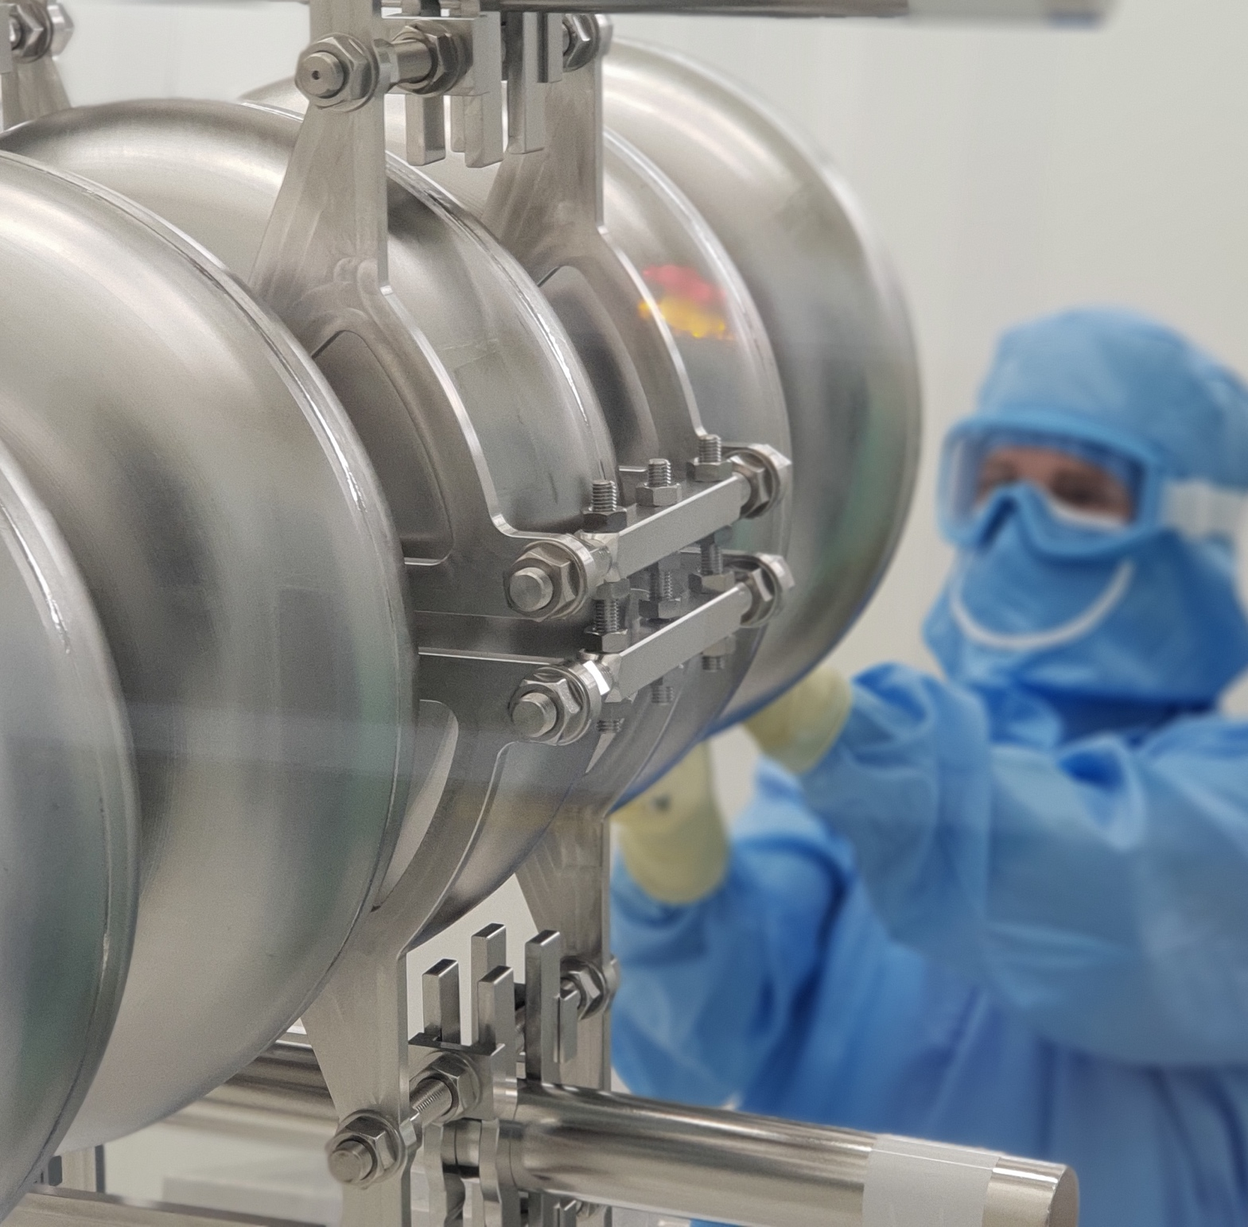
Cavity Testing

Slide 11
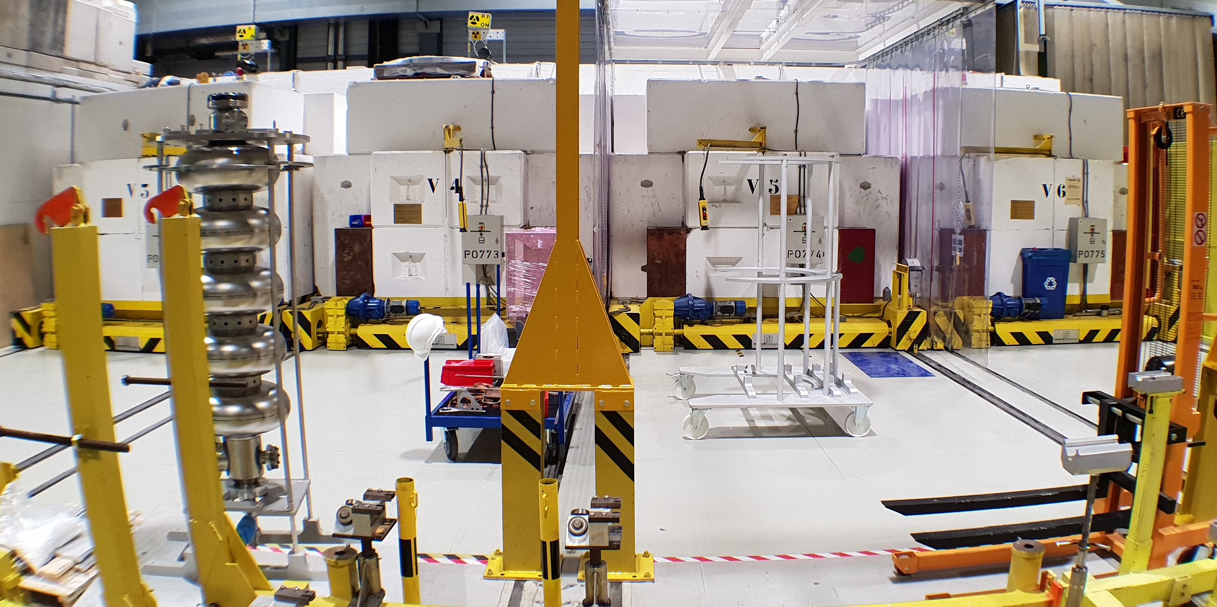
Vertical Cryostats

Slide 12
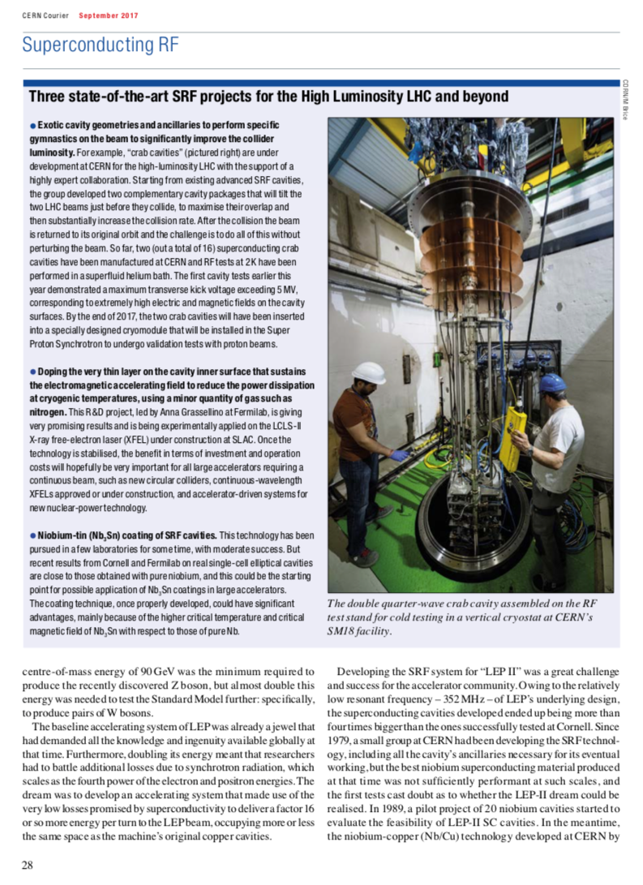
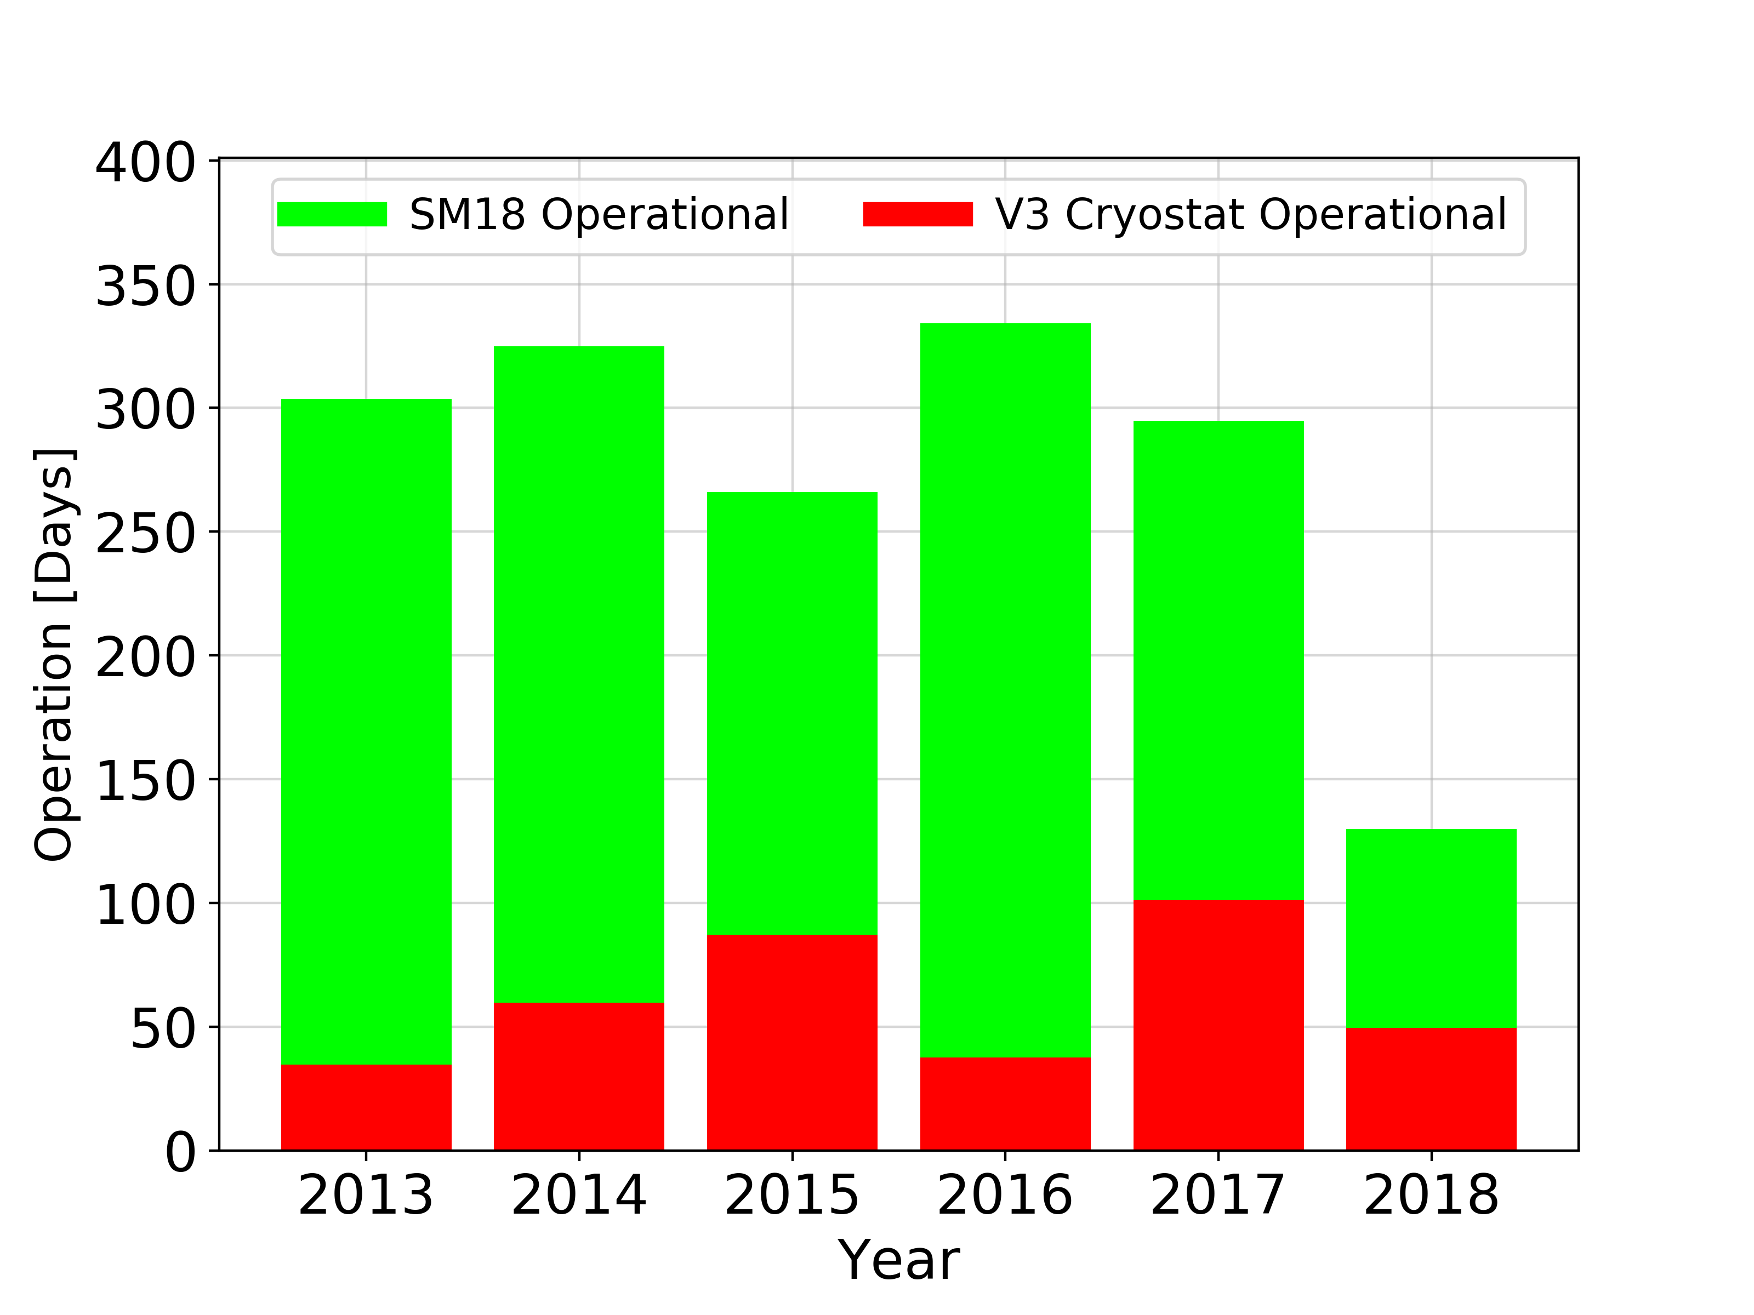
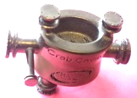
V3

Slide 13
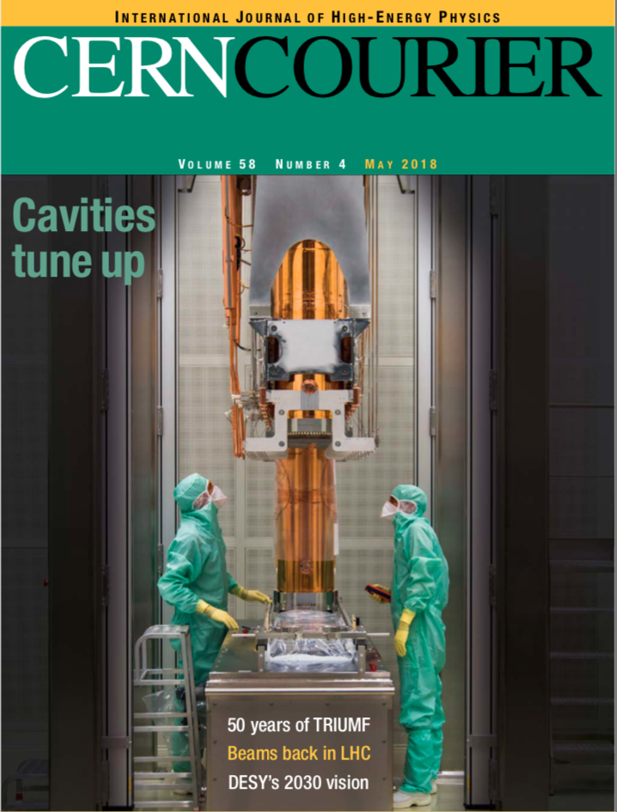
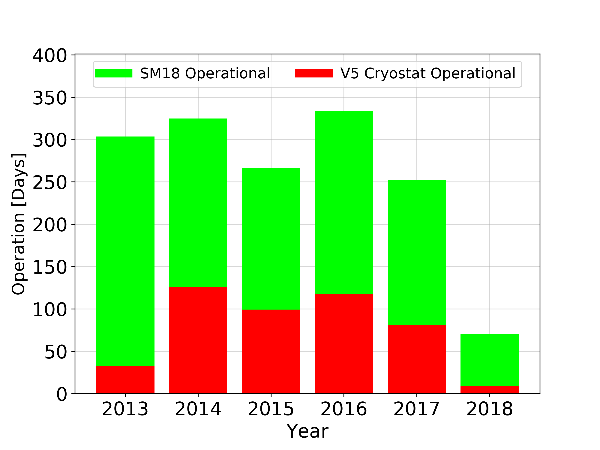
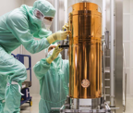
V5

Slide 14
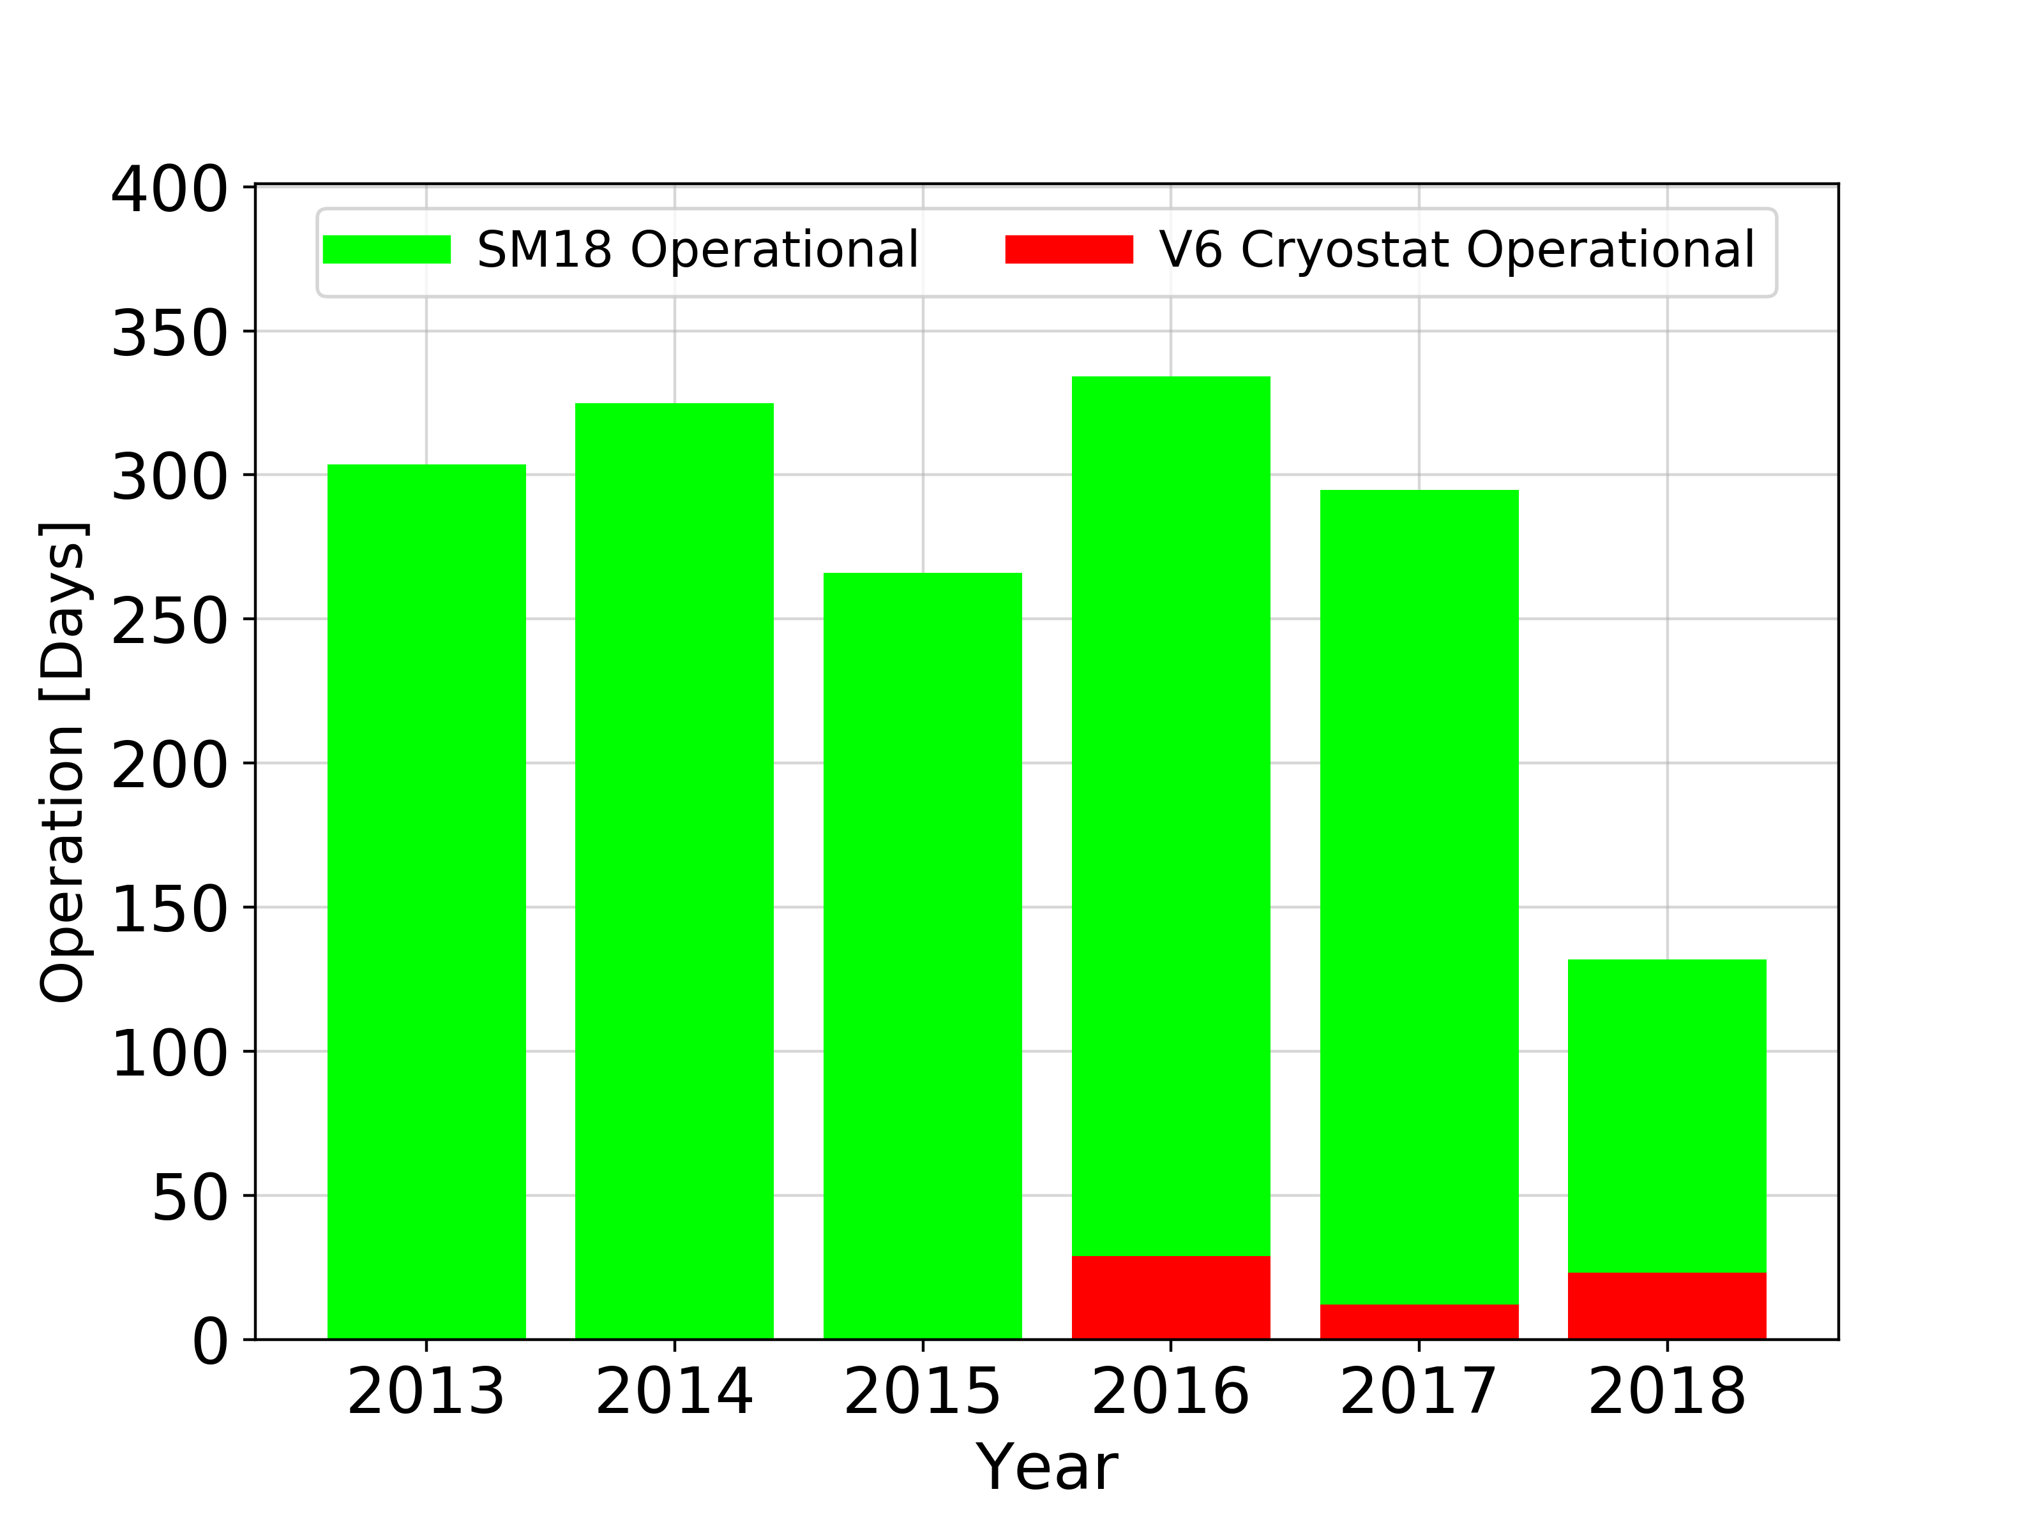
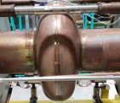
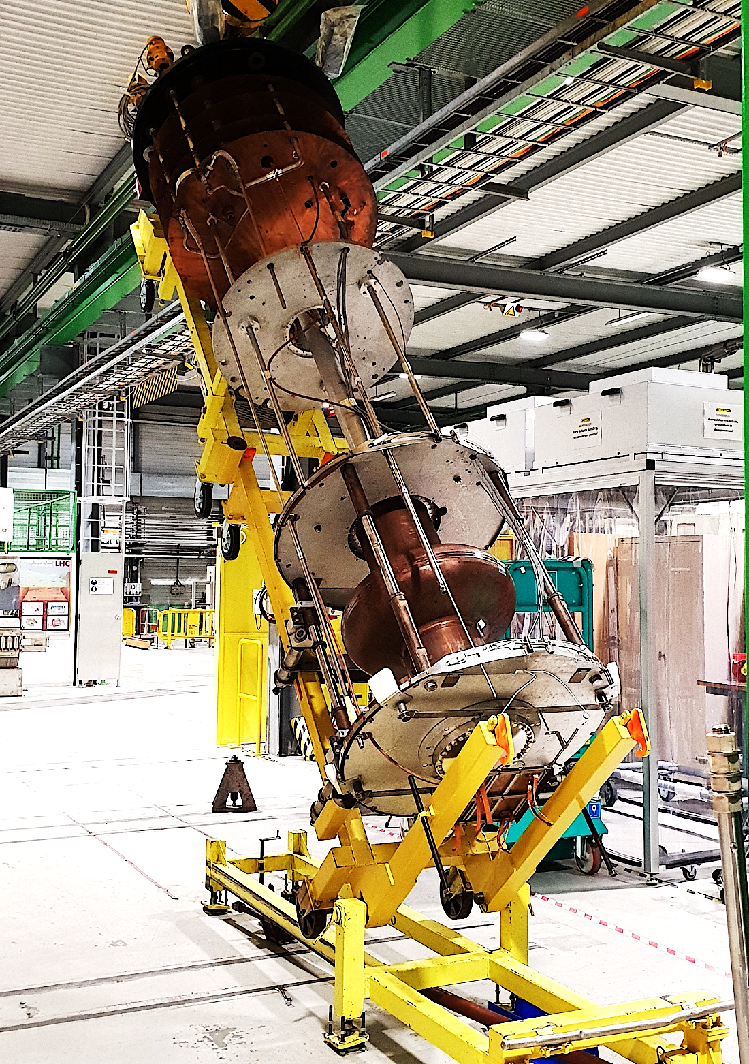
V6

Slide 15
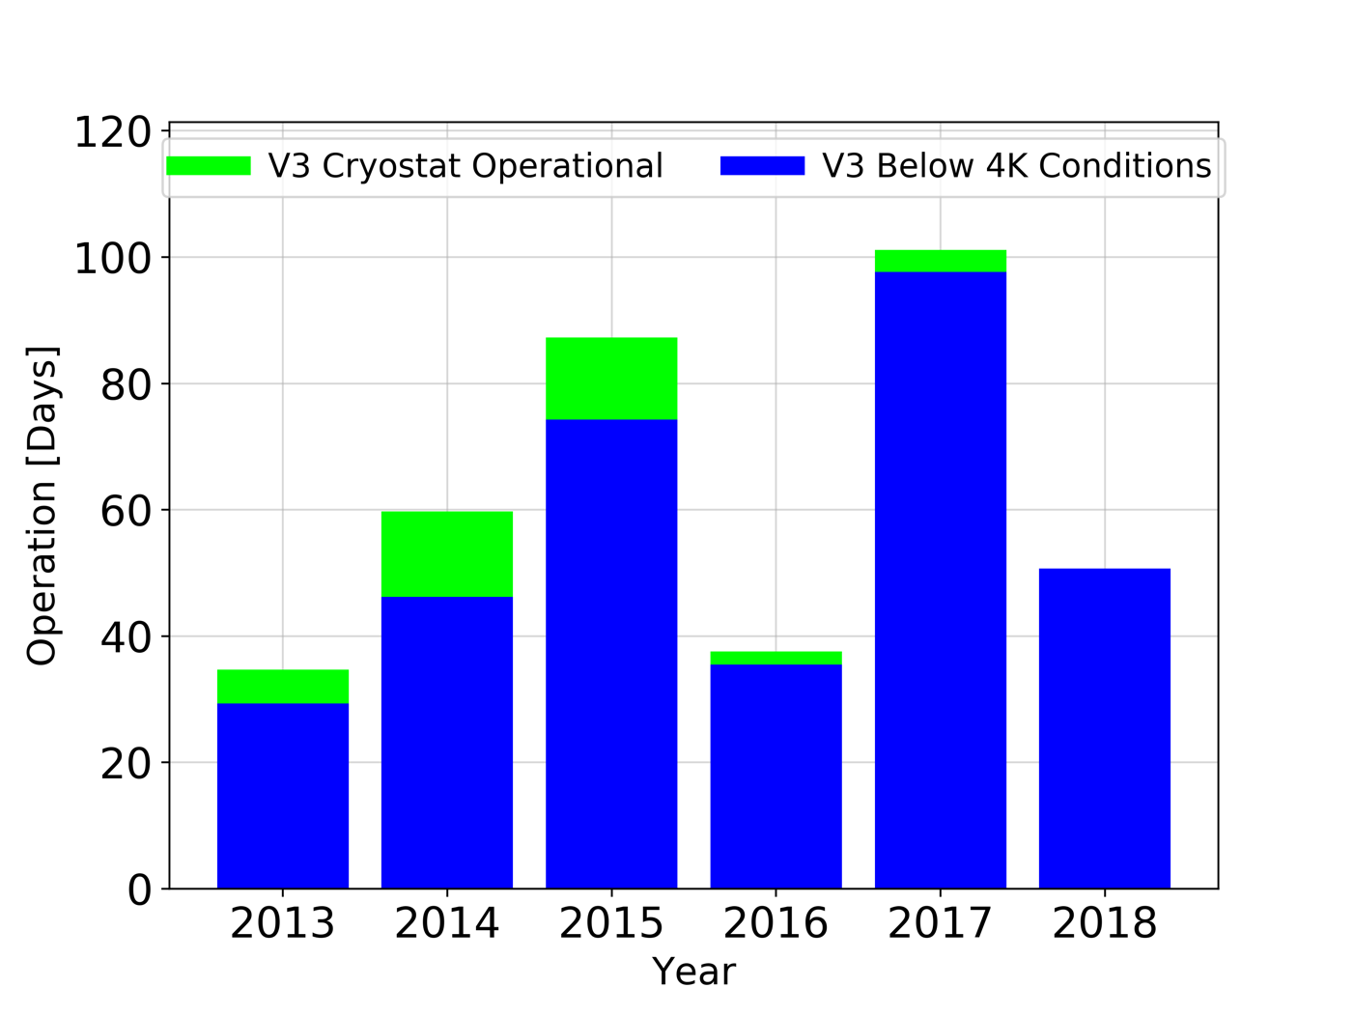
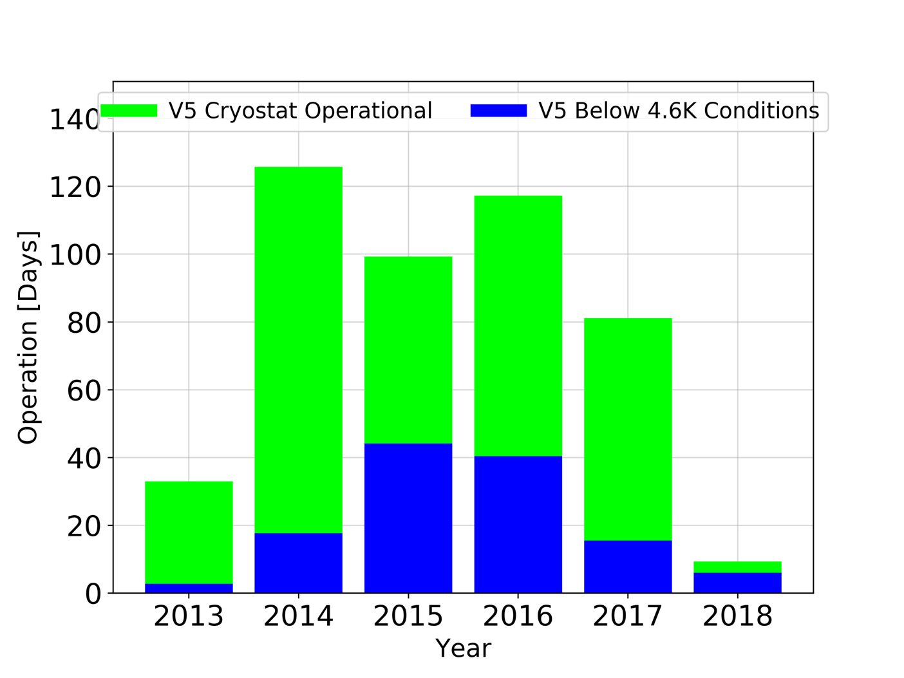
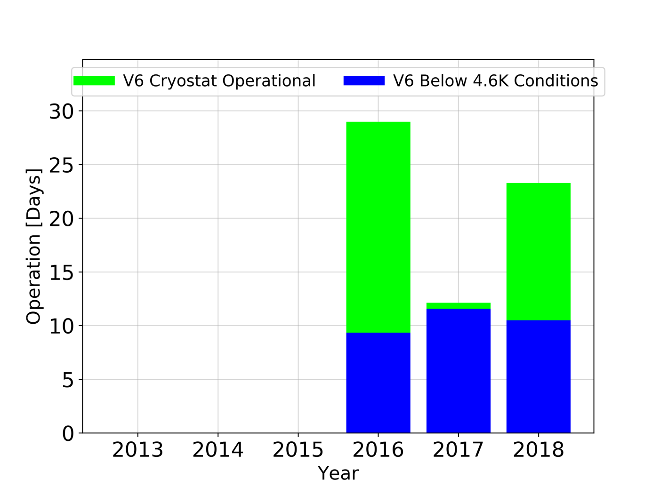
Different Operation Schemes
V3 4K Conditions
V5 4.5K Conditions
V6 4.5K Conditions

Slide 16
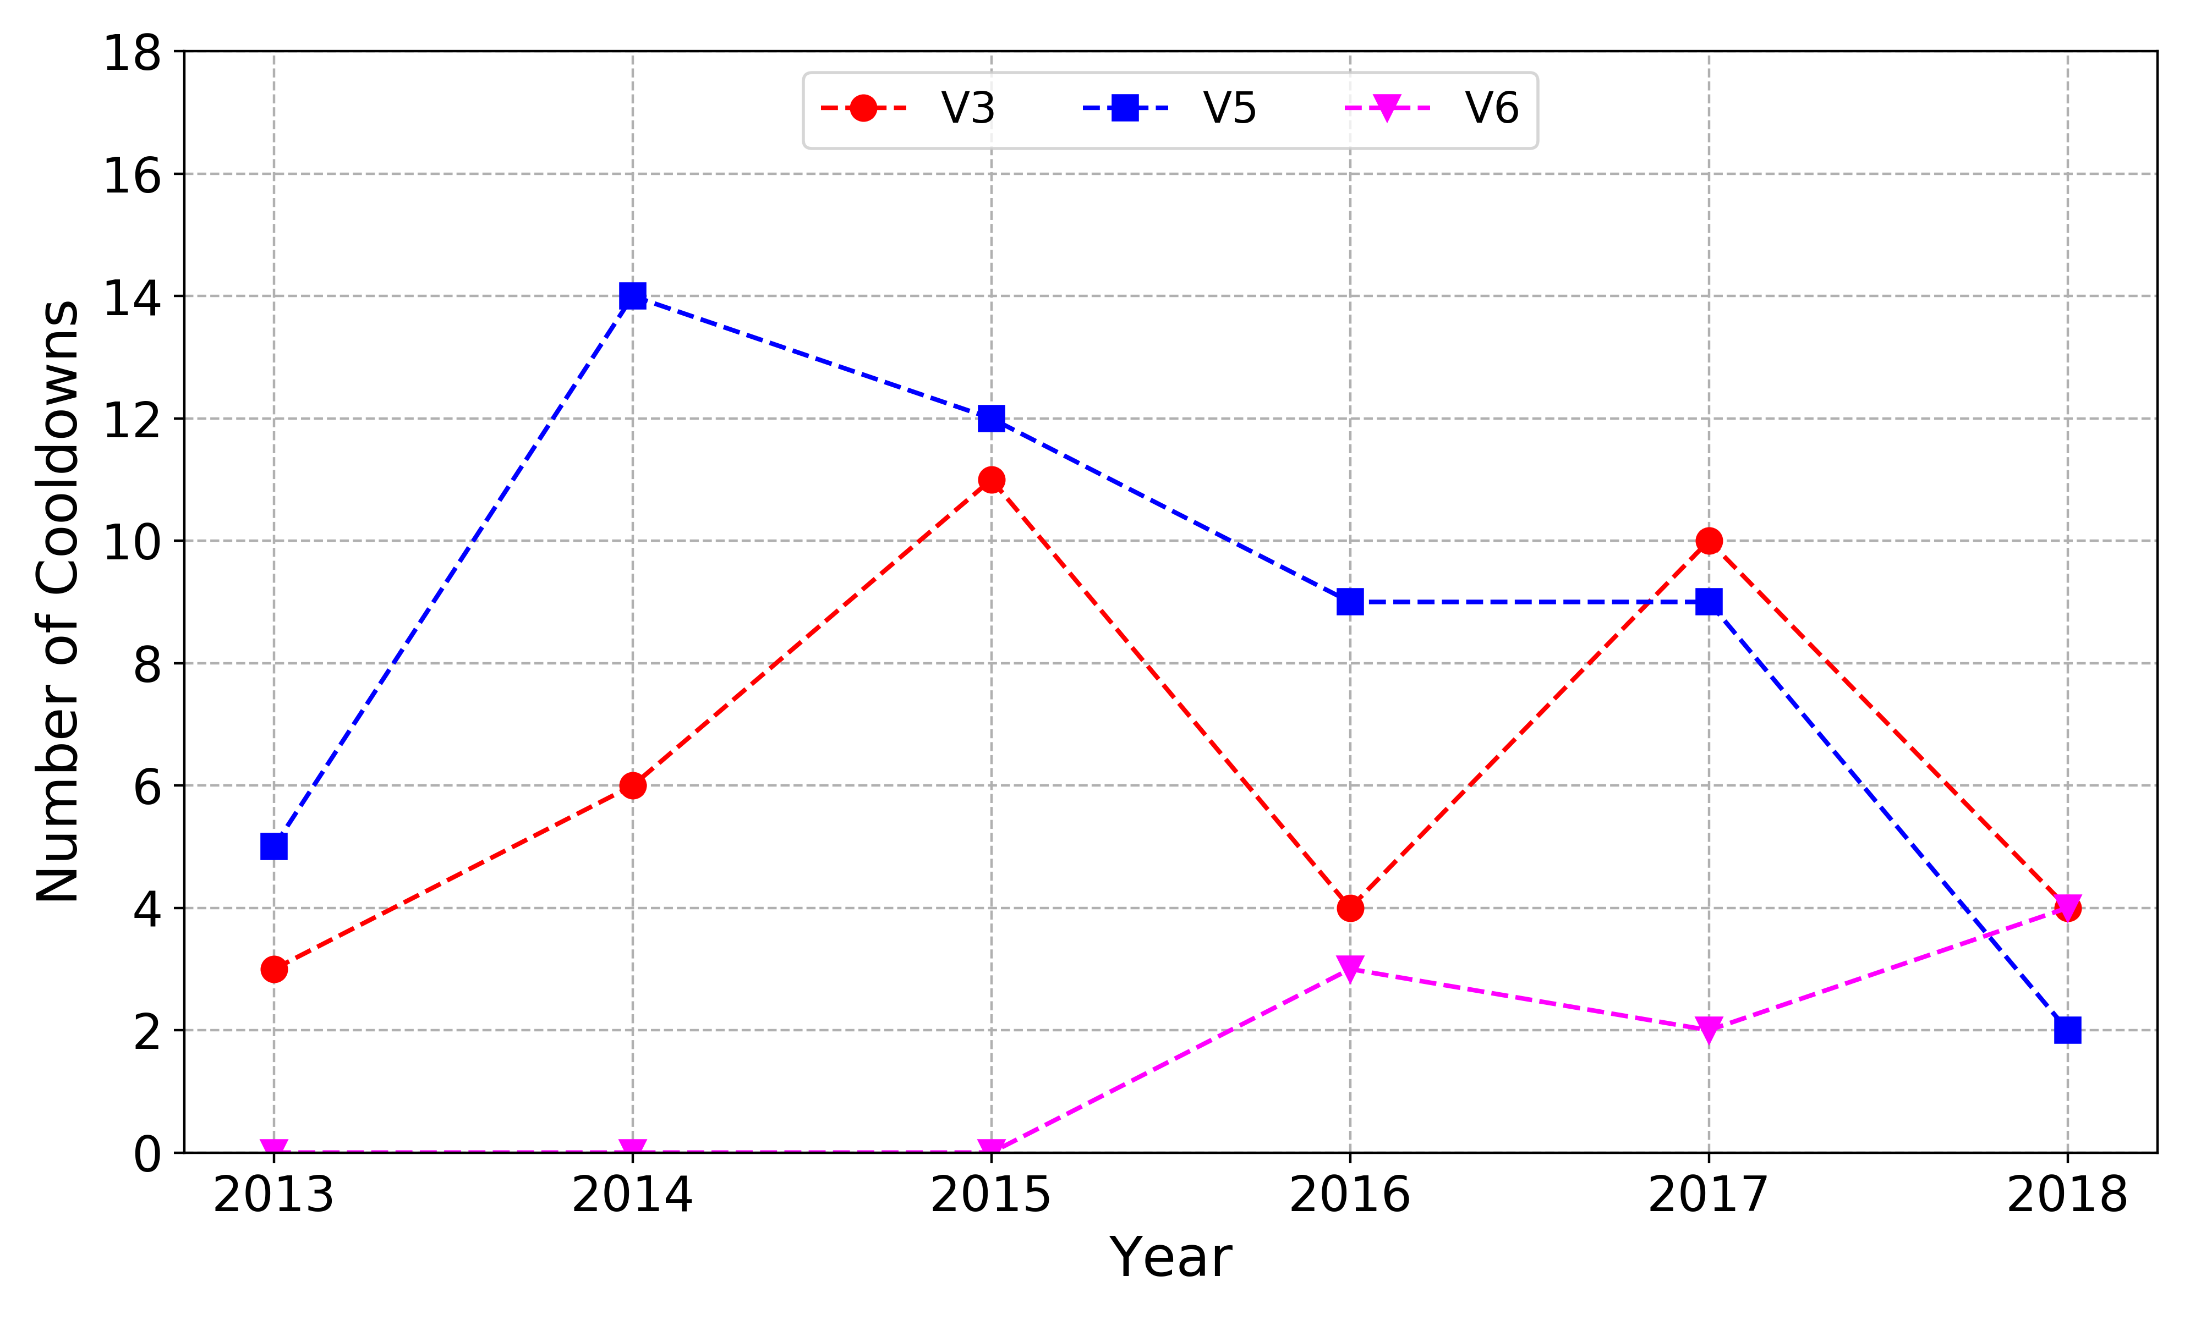
Number of Cooldowns

Slide 17
Number of Cooldowns
Cryolab

Slide 18
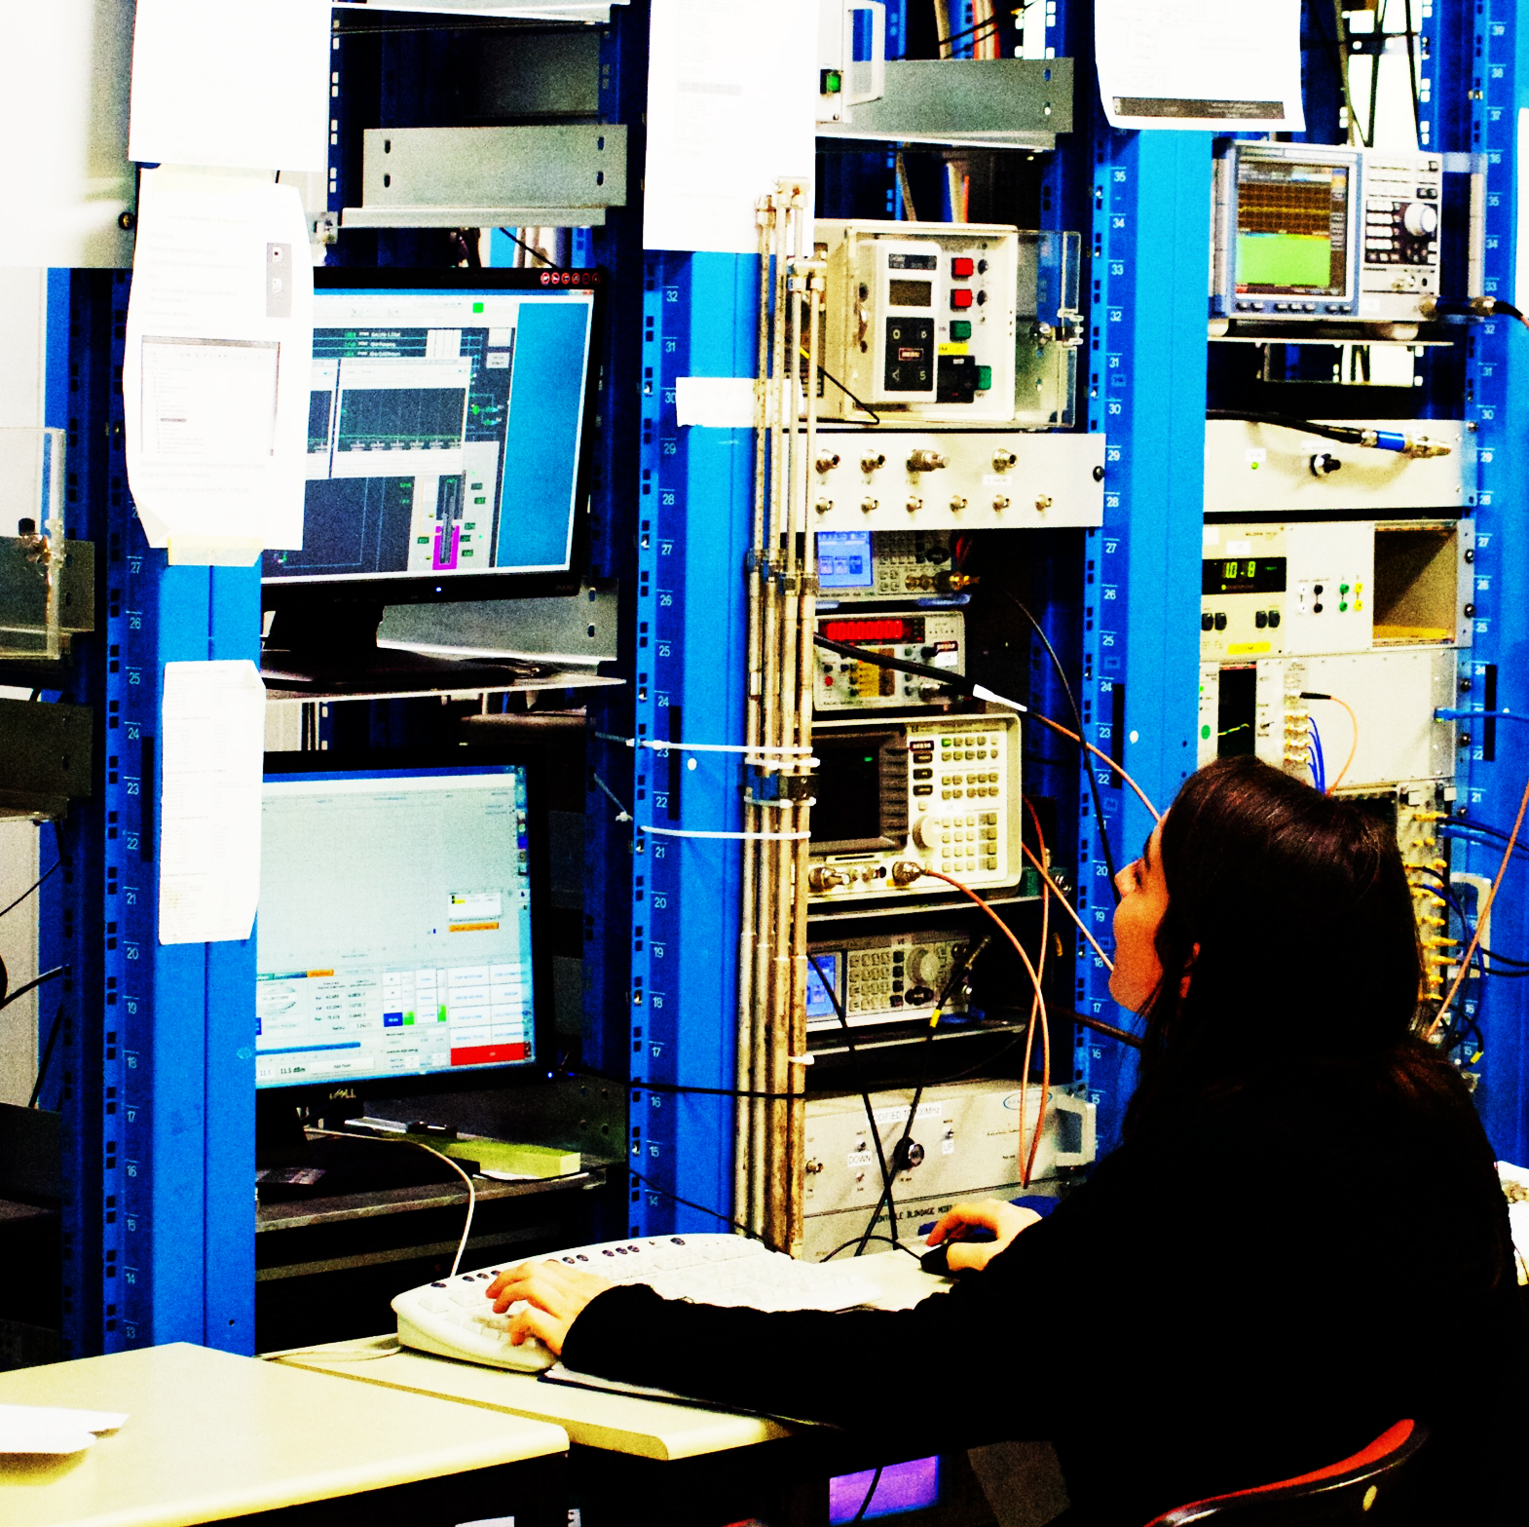
Measurements

Slide 19
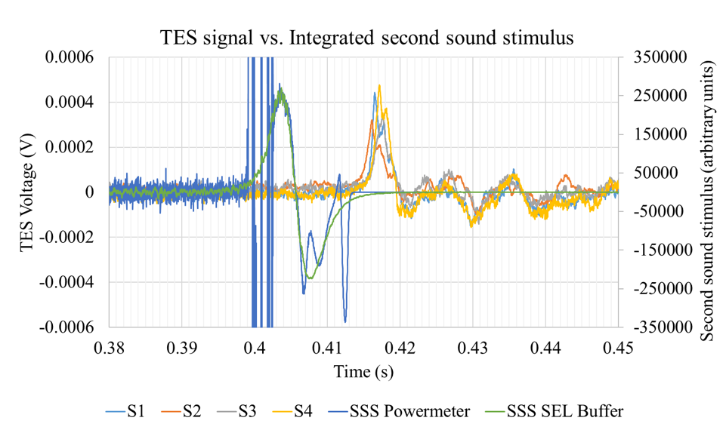
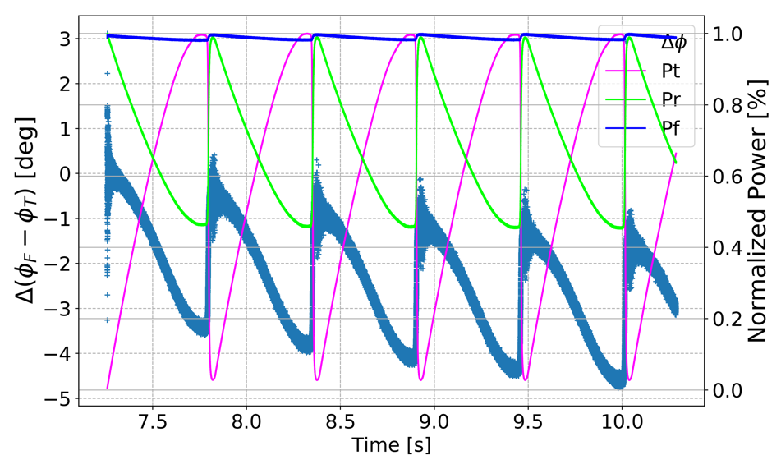
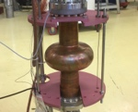
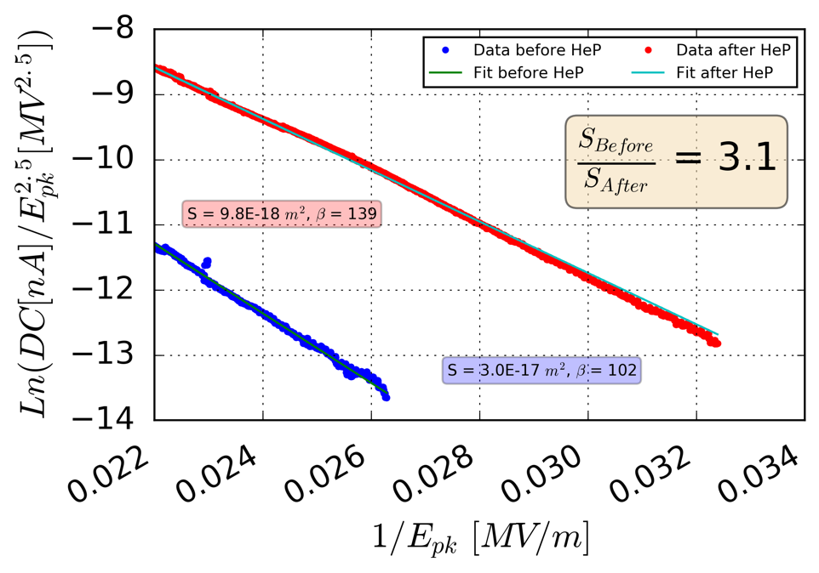
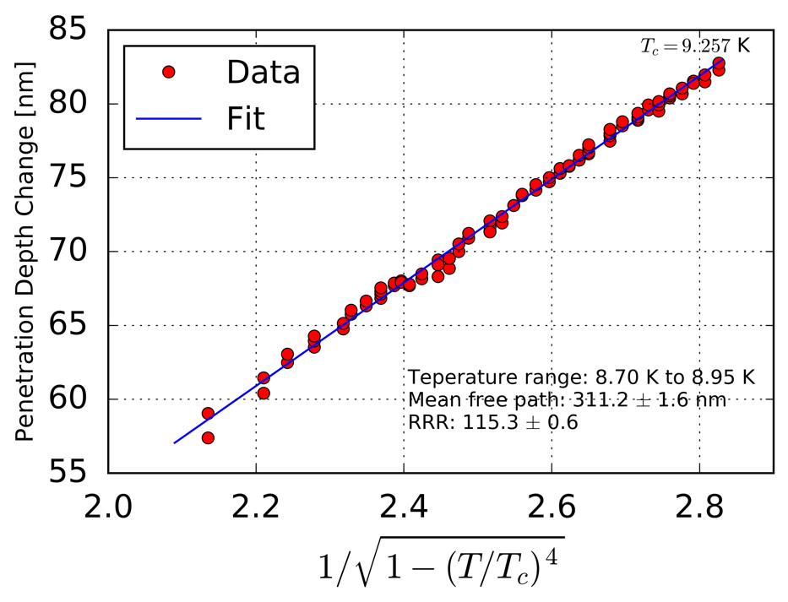
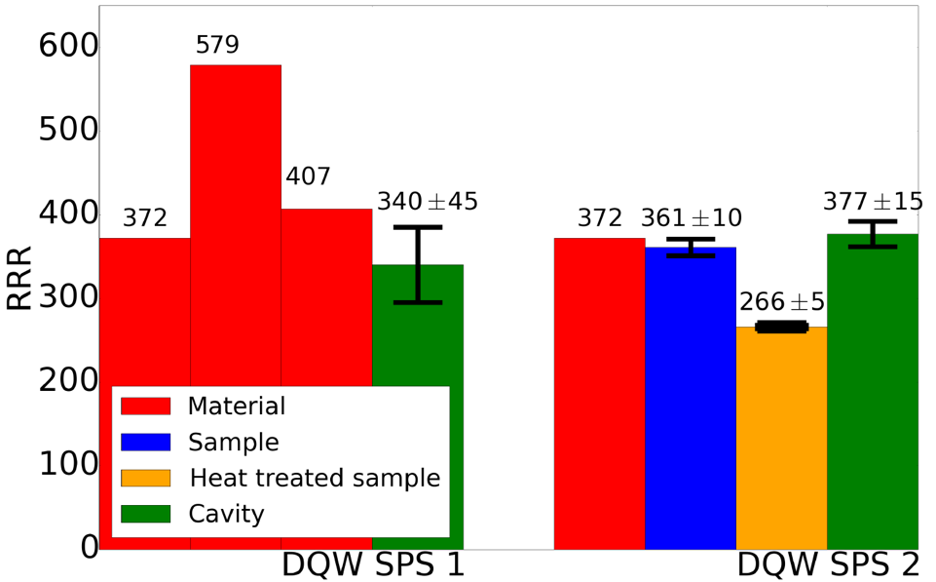
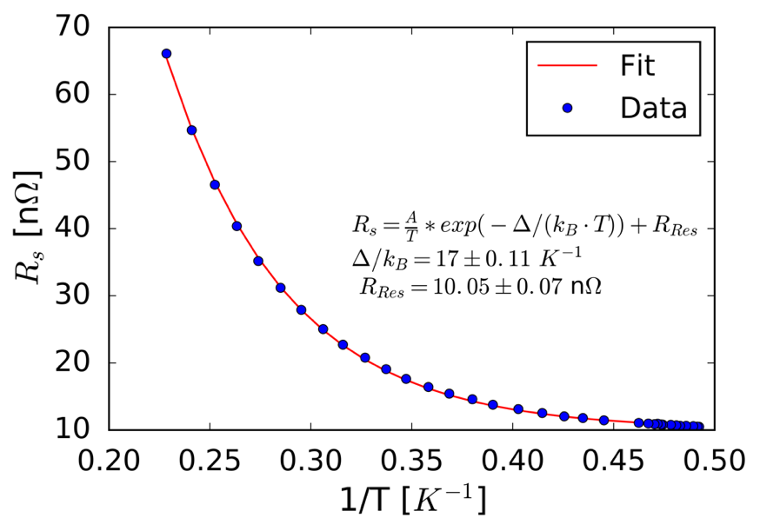
SM18
Many measurements beyond Q0 Vs E:
In-situ cavity surface and bulk RRR
Penetration depth
Surface resistance
Lorentz force detuning
Helium pressure sensitivity
RF transients during failures
Flux expulsion
He-Processing and FE…

Slide 20
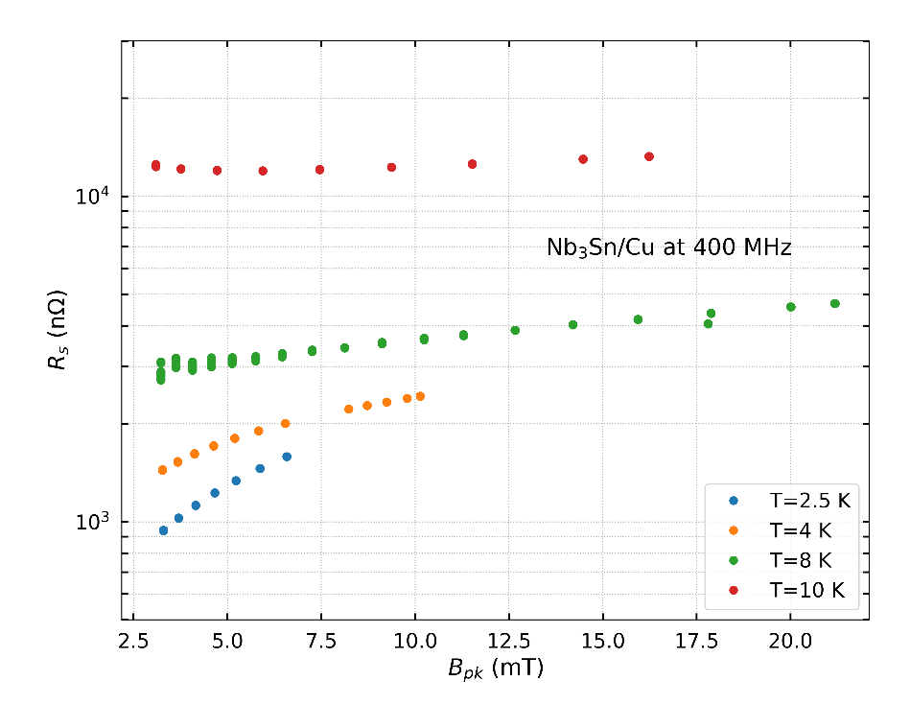
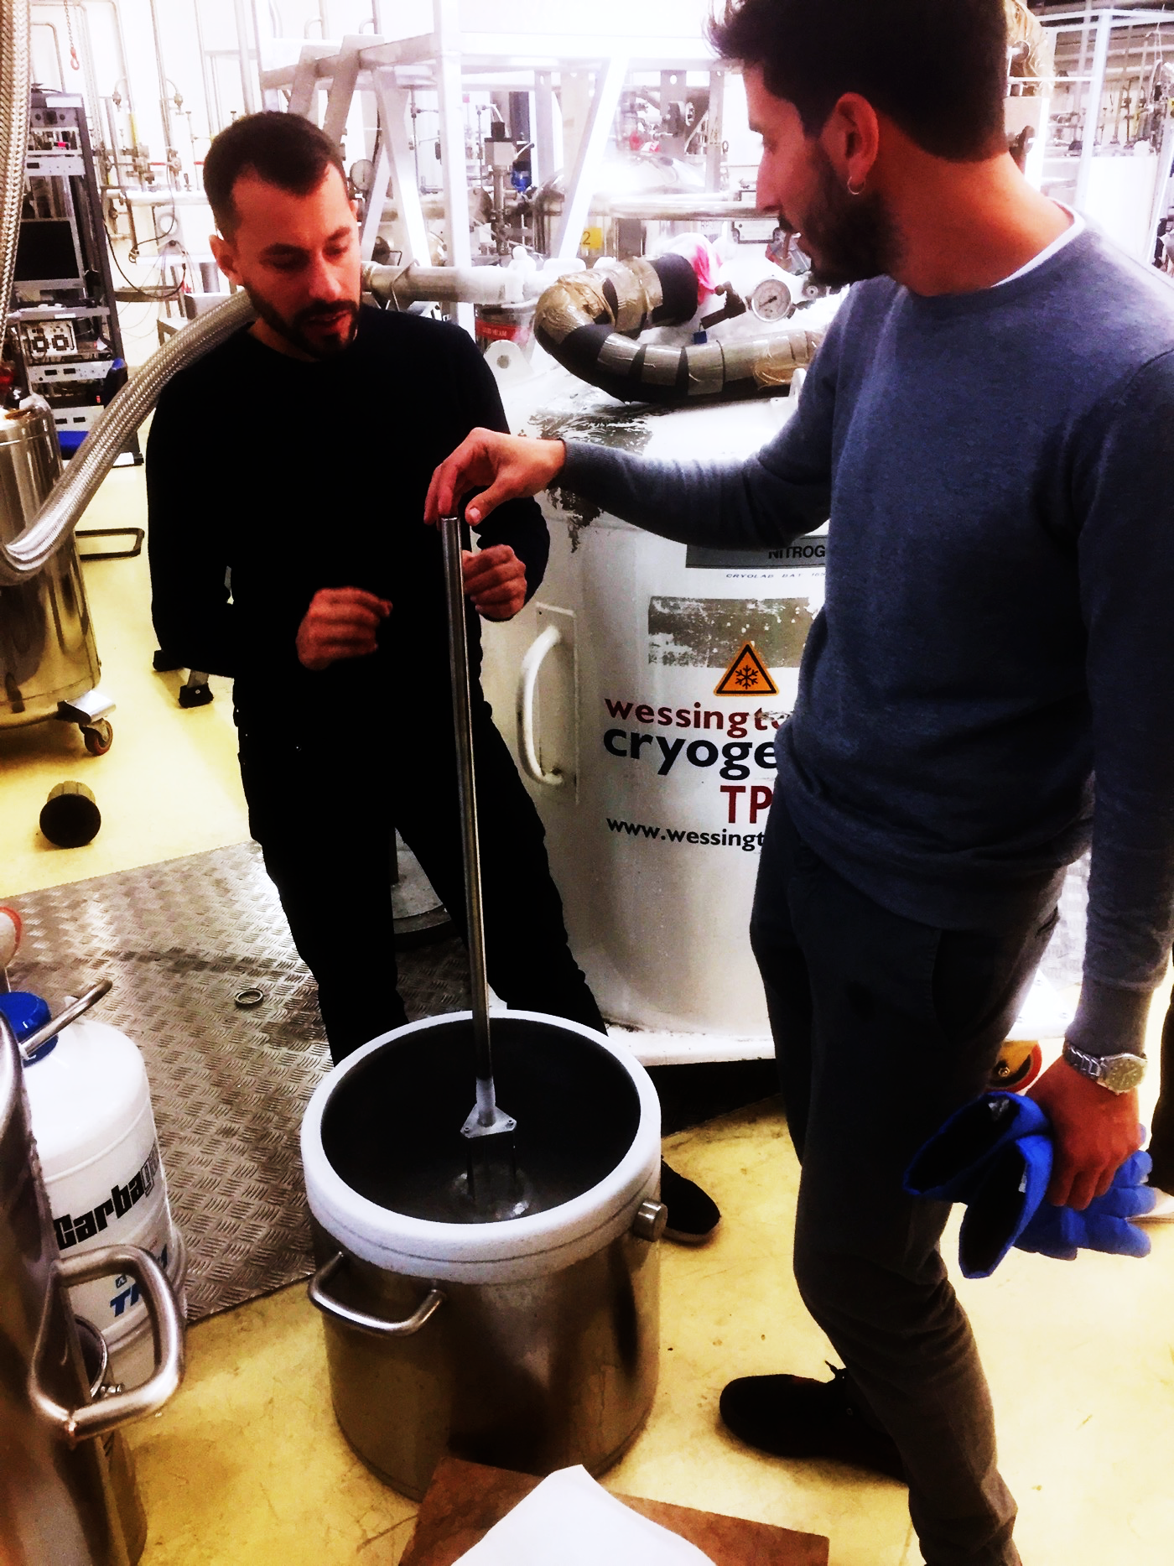
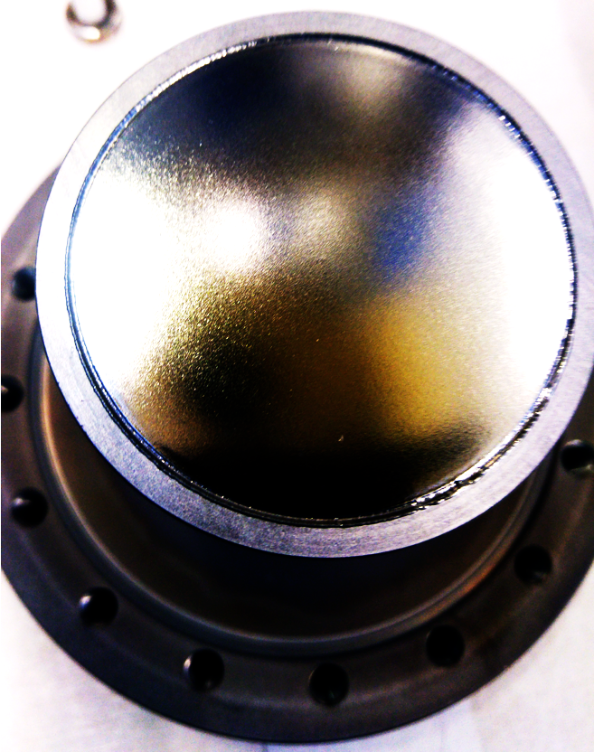
Cryolab
1st RF Characterization of Nb3Sn on Copper films
Strongly mitigated Q-slope of Nb/Cu using ECR
More in talks by Walter, Guillaume, and Alban this afternoon
Credit: Marco Arzeo (BE-RF-SRF)

Slide 21
Closing Remarks
Beyond manpower, building up and maintaining expertise is the key
Keep in mind the co-activities, service work is important, necessary, and will affect the higher priority goals
‘Feedback loops for humans’: using what we have learnt to improve our performance will pay off:
Learn your lessons
Communicate clearly
Make plans and allow them to evolve
2017 was an impressive year, filled with many achievements for us
2018 seems to be following closely with a strong start

