Slide 1


A15 Sputtered thin films for SRF applications
KATSIARYNA ILYINA-BRUNNER
G. Rosaz, S. Calatroni, W. Vollenberg, J. B. Descarrega, A. Lunt, A. Gerardin, F. Leaux, A. Sublet,
M. Taborelli, W. Venturini-Delsolaro

Slide 2
Outline
Motivation
Sample preparation & analysis
Critical temperature
Substrate choice
Achievements and future actions

Slide 3
Accelerating Superconducting RF cavities
Thin film approach used un CERN : Nb on copper
Copper
Niobium
“-” | “+”
Q-slope not fully understood/explained | “Cheap” bulk material (Cu) High thermal conductivity Well known technique used since LEP generation at CERN

Slide 4
Accelerating Superconducting RF cavities
Thin film approach used un CERN : Nb on copper
Copper
Niobium
Nb
Nb3Sn
“-” | “+”
Q-slope not fully understood/explained | “Cheap” bulk material (Cu) High thermal conductivity Well known technique used since LEP generation at CERN

Slide 5
Accelerating Superconducting RF cavities
Thin film approach used un CERN : Nb on copper
Copper
Tc | Nb₃Sn ~ 18.3 K
 | Nb ~ 9.3 K
Niobium
Nb
Nb3Sn
“-” | “+”
Q-slope not fully understood/explained | “Cheap” bulk material (Cu) High thermal conductivity Well known technique used since LEP generation at CERN
R_{BCS} @ 4.2K and 500MHz | Nb₃Sn ~ 0.4 nΩ
 | Nb ~ 45 nΩ

Slide 6
Sample preparation by magnetron sputtering

Slide 7
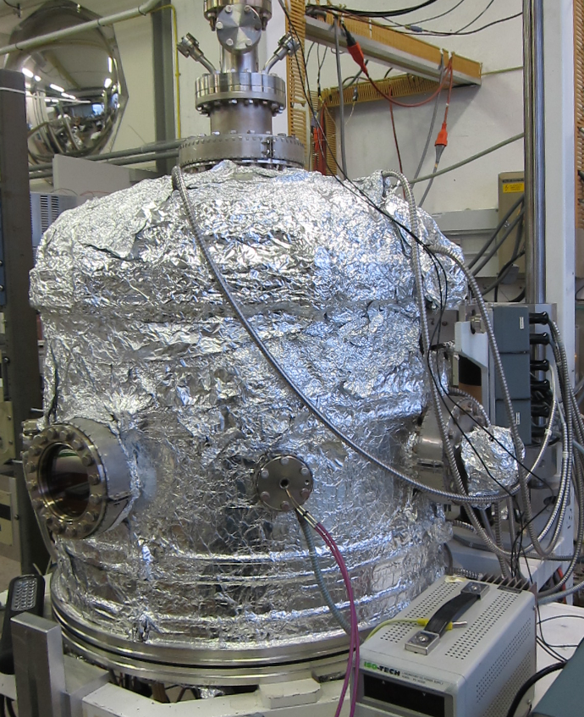
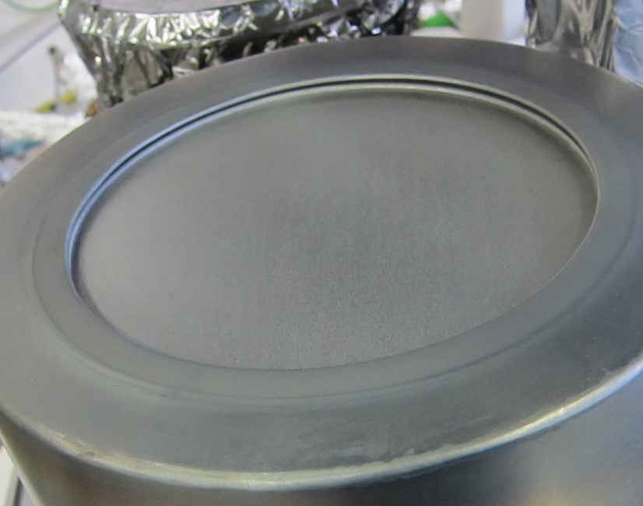
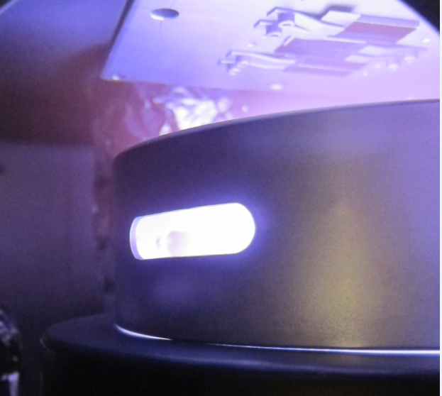
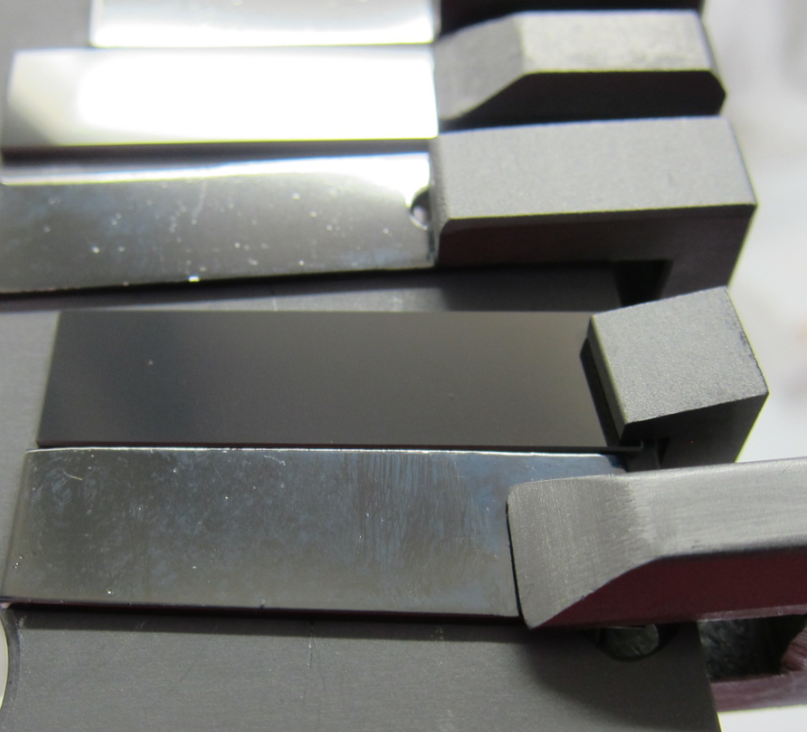
Sample preparation by magnetron sputtering
Reacted After Coating
Post-coating Annealing
Annealing temperatures | 600 - 800ºC
Annealing time | 24 h… 72 h

Slide 8
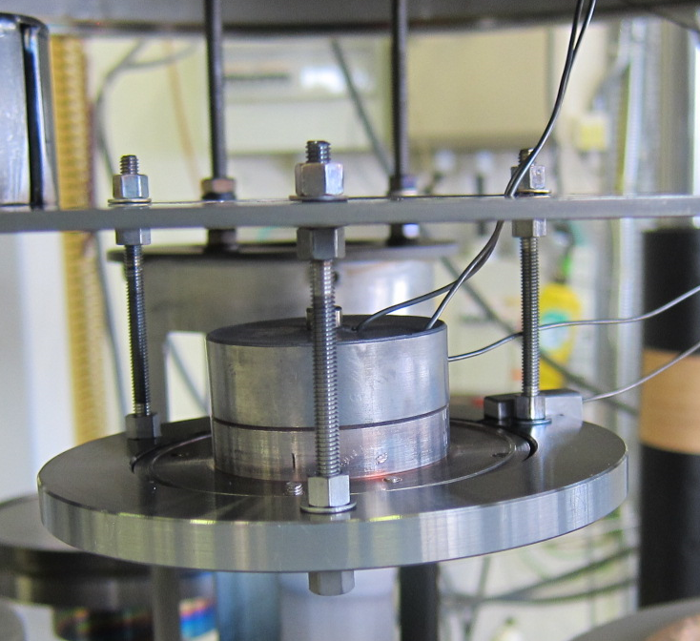
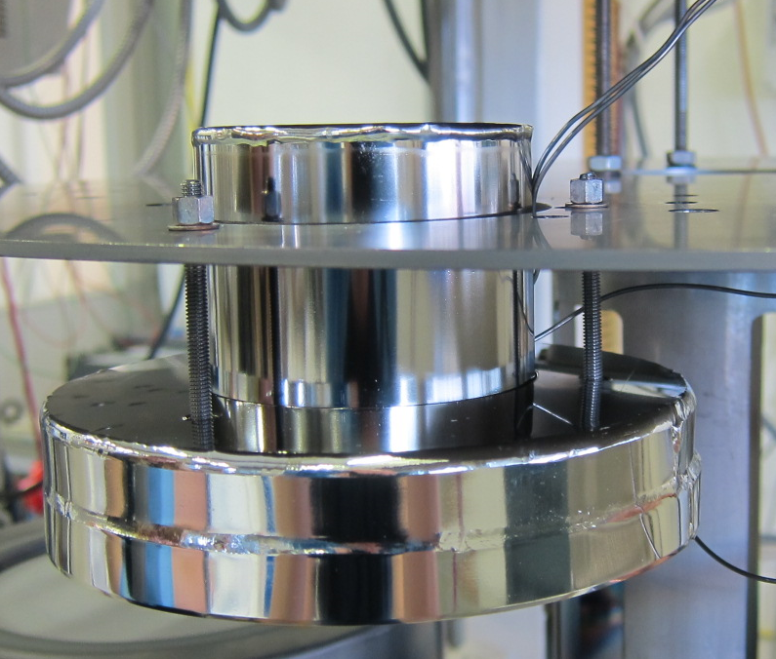
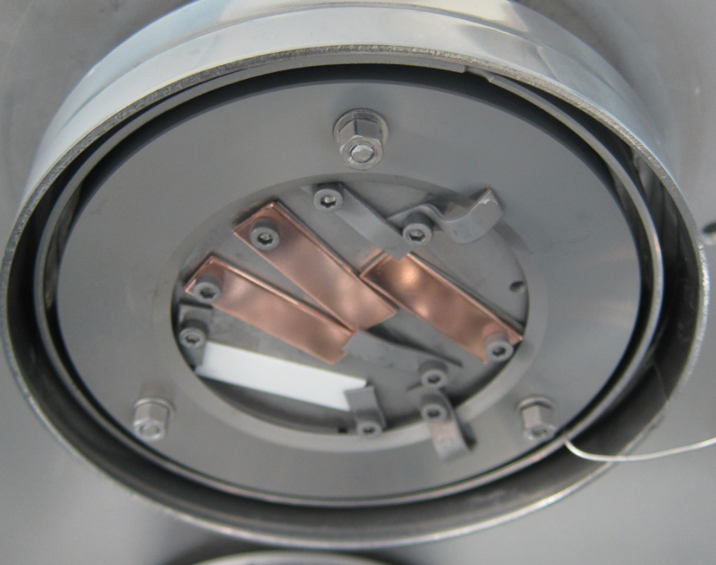
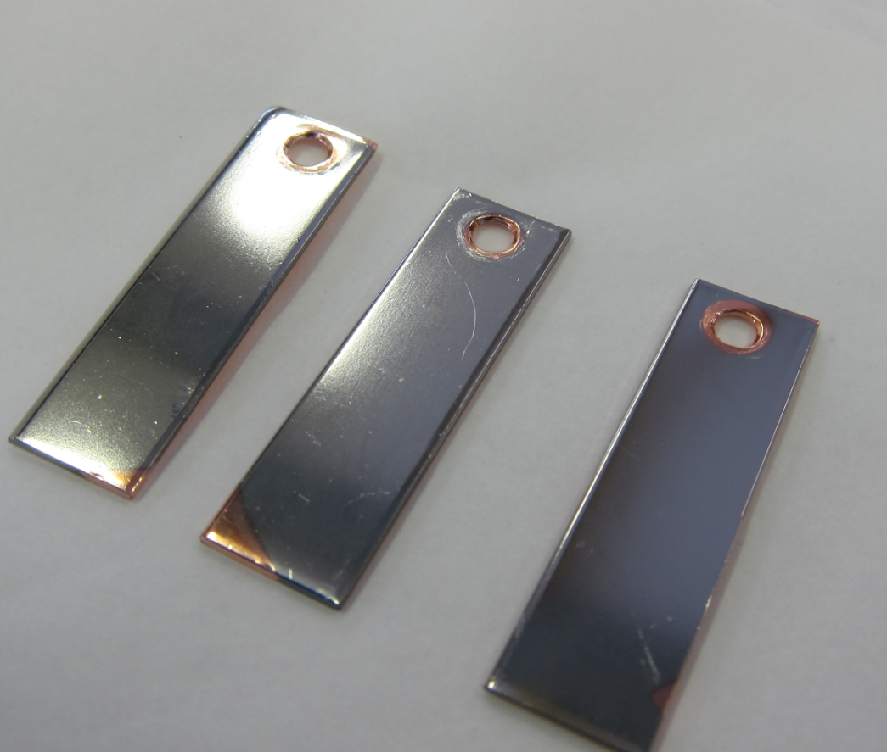
Sample preparation by magnetron sputtering
Reacted After Coating
Reacted During Coating
Post-coating Annealing
Alternative Annealing
Annealing temperatures | 600 - 800ºC
Annealing time | 24 h… 72 h
Coating temperatures | 600 - 735ºC
Alternative Additional Annealing | 24 h… 72 h

Slide 9
Sample preparation by magnetron sputtering
Reacted After Coating
Reacted During Coating
Coating parameters:
Coating gas: Ar or Kr
Coating pressures:
7·10⁻⁴ mbar … 5·10⁻² mbar
Composition:
Sn 18 At% to 27 At%,
Post-coating Annealing
Alternative Annealing
Annealing temperatures | 600 - 800ºC
Annealing time | 24 h… 72 h
Coating temperatures | 600 - 735ºC
Alternative Additional Annealing | 24 h… 72 h

Slide 10
ACHIEVED RESULTS

Slide 11
Films Reacted After coating
A15 phase formation. XRD analysis & Morphology

Slide 12
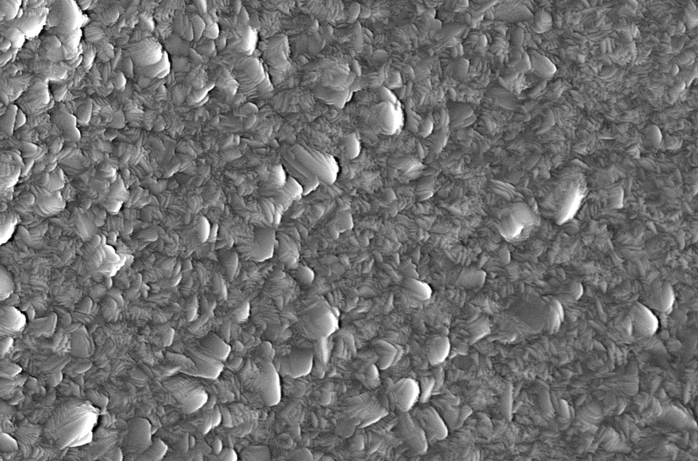
Films Reacted After coating
A15 phase formation. XRD analysis & Morphology
As-deposited
100 nm

Slide 13
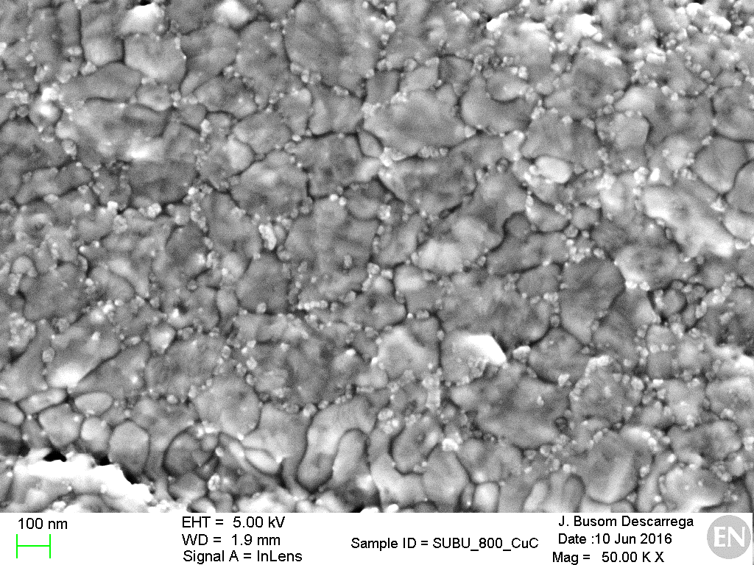
Films Reacted After coating
A15 phase formation. XRD analysis & Morphology
A15 phase confirmed by the presence of Nb₃Sn characteristic peaks of (200), (210), (211) … (332)
Absence of non-desired phases NbSn₂, Nb₆Sn₅
As-deposited
Annealed in vacuum furnace - 24h - 800ºC
100 nm
100 nm

Slide 14
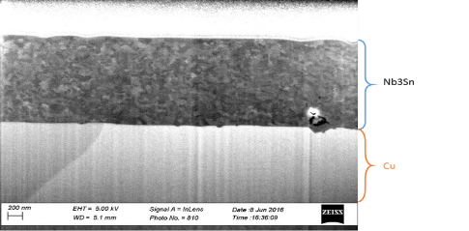
Films reacted during coatings
Characteristics peaks after the coating of (200), (210), (211) … (332) – Confirmation of the superconducting A15 phase
Absence of non-desired phases NbSn₂, Nb₆Sn₅
Dense morphology
FIB
Pt
SEM
Nb₃Sn
200 nm
Cu
100 nm

Slide 15
Critical temperature
Composition
Substrate choice
Additional Annealing
How to increase T_{c}?
[1] A. Godeke. Supercond. Sci. Technol., 19 (2006) R68-R80

Slide 16
impact of the substrate choice on T_{c} transition
Increase of the Tc on 2-4K for the films grown on ceramic substrates
Sharper transition for Nb₃Sn synthesised on ceramics
Best Tc
on copper ~ 16 K
on ceramic (Al₂O₃)~ 17 K

Slide 17
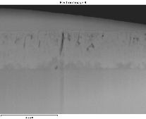
Copper substrate challenge
Nb and Sn distribution are homogenous
High temperature treatment causes copper interdiffusion
Reacted After Coating (24h - High Temperature Treatment)
Cu
Nb
Sn
Pt
Nb₃Sn
Cu
1 µm
1 µm
1 µm
1 µm

Slide 18
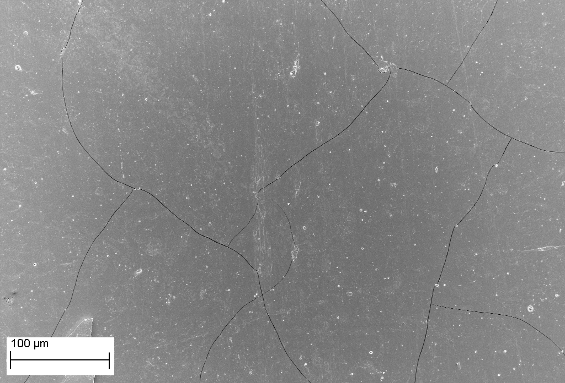
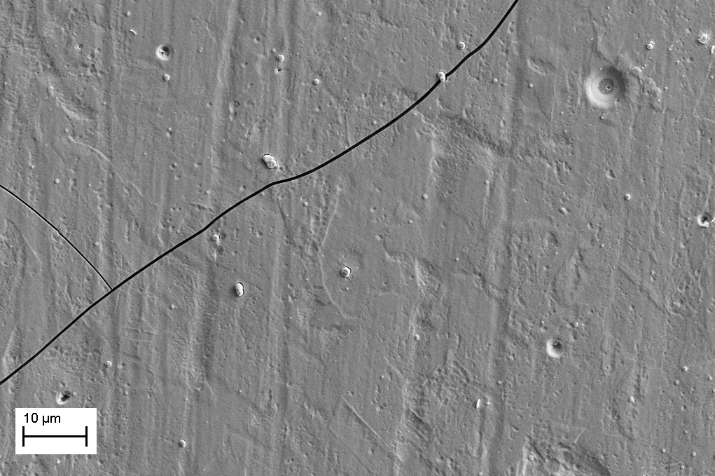
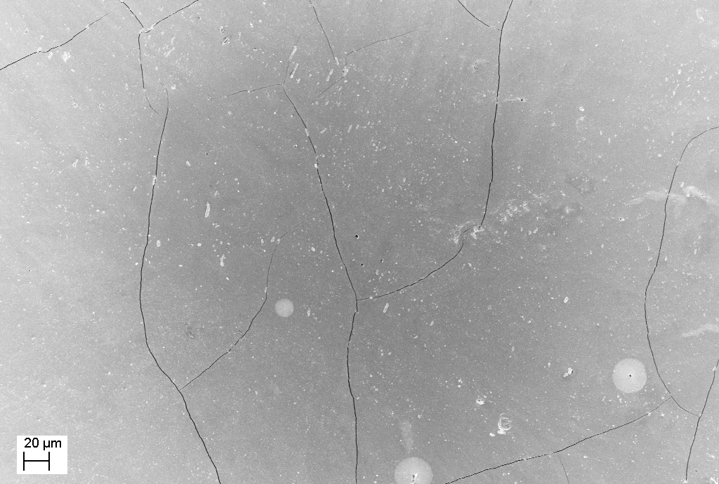
Cracking of the films after annealing
T _{annealing} = 700ºC | T _{annealing} = 750ºC | T _{annealing} = 700ºC
100 µm
10 µm
20 µm
Without solving “cracking” problem not RF compatible

Slide 19
Proposal: Intermediate layer
Works as “buffer” layer to reduce residual stresses in the films (to solve cracking problem for the films reacted AFTER the coating)
Decrease lattice mismatch, i.e. improving crystalline lattice order (to avoid T_{c} depression) [2]
Diffusion barrier layer (to prevent copper interdiffusion into Nb₃Sn layer)
Possible candidates – Nb, Ta, Al₂O₃…
[2] Hein. The A15 story. The Science and Technology of Superconductivity pp 333-372

Slide 20
Intermediate layer: preliminary results
How to increase T_{c}?
[1] A. Godeke. Supercond. Sci. Technol., 19 (2006) R68-R80

Slide 21
Summary
We are able to produce high quality films (good composition, crack-free surface, on copper ~ 16 K, ceramic – 17K, on copper with intermediate layer 17.4 K)
Impact of the copper substrate, i.e. increasing in disorder degree and copper interdiffusion after annealing, can be minimised by using intermediate layer. First results showing effectivity of the approach.
First QPR sample in order to test RF properties of the film has been coated and measured. Modest RF performances due to coating technical issue. Next QPR coating expected before July 2018.

Slide 22
Thank you for your attention!

