Slide 2
An SRF Test stand in proton beams Design, installation, lessons learned
G.Vandoni

Slide 3
A TEST BENCH for SRF (Projects)
With HIE-Isolde linac, only 2 complete SRF projects, from cavity to beam:
SPS test bench :Modest, but rich in experience and lessons
Point of view of the SPS Integration Task within WP4/HL-LHC:
Integration = Management of interfaces

Slide 4
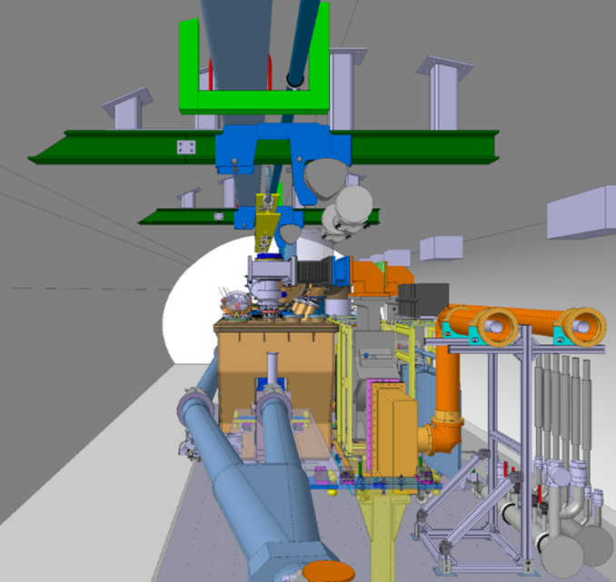
DESIGN

Slide 5
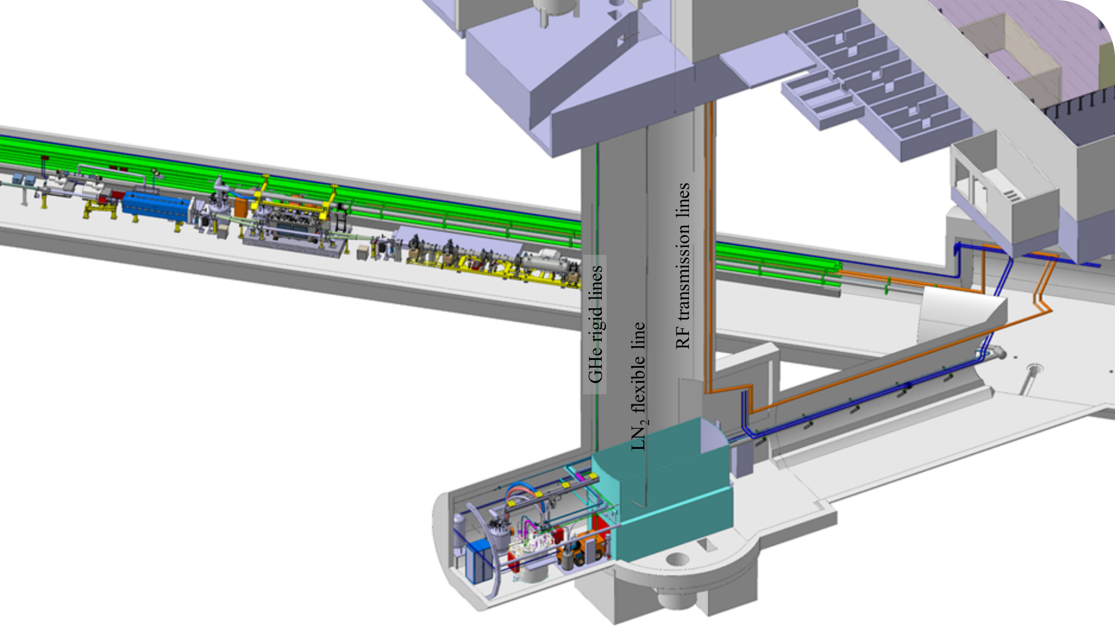
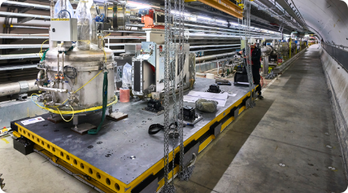
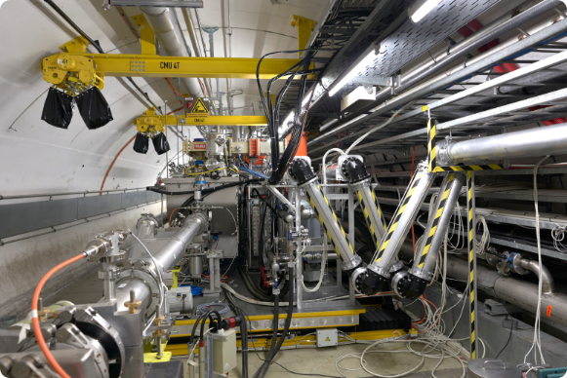
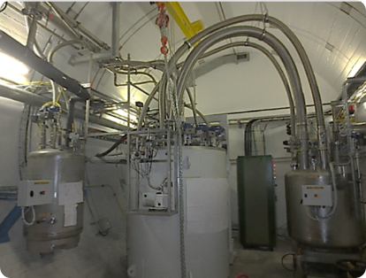
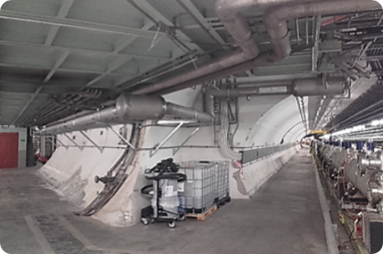
LAYOUT
Motorized transfer table 510mm 4μm, remote control
2x RF amplifiers IOT 60kW each
Faraday cage for LLRF
Cryogenic compressor & oil removal
El. Transformer/ Switchboard/ Control racks
2 x He pumping units, 48W
Articulated Y-chambers C-coated
LN₂ phase separator
80m long cryo distribution line
Valve-box
RF transmission lines, rotating coupling
Cold-box

Slide 6
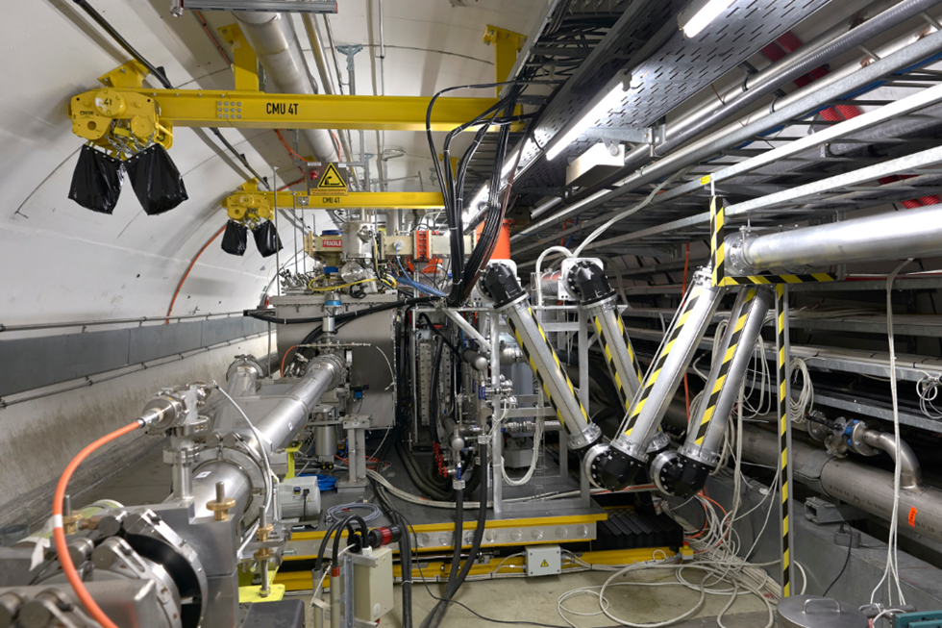
DESIGN
Fully remote handling and controls
Ancillary equipment at the surface – refrigeration underground (LN₂)
Minimize number of cables
Local safety features
Simple interlocking, following operation scheme
  Personnel protection
  Machine protection
  Equipment protection
Operation ≤10 years

Slide 7
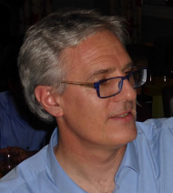
DESIGN Lessons learned
Minimize cable pulling caused trade-offs
  No camera
  No mech. Instrumentation readout
  High power RF not standalone
Interlock with access for RF too restrictive for operation in LHC
Not all is designed for longstanding robustness (cable protection missing)
Water pressure overhead in tunnel overseen (cryo & RF)
High power RF system should remain fully standalone.
More cables, but less complication. We will apply this strategy in HL-LHC.

Slide 8
DESIGN for SAFETY
Main Hazard | Origin | Treatment
Radiological risk | RF (X-rays, dark currents) | Interlock access
Oxygen deficiency | Cryo spillout | ODH detectors + alarms
Pressure | Pipework, valveboxes, CM | Tests, certification
Mechanical | Table | Alarms, procedures, local key-box
Noise | Compressor, fans | FC sonic insulated
Risk analysis 1.Cryogenic, 2.Cryomodule, 3.Test stand, 4.Table
Safety review Actions / Follow-up meetings
Safety SPS SIR Training Updated
Safety file In Work
TOOLS

Slide 9
SAFETY FILE Completion
List by C.Gascon / C.Gaignant
Safety inspections & documents | Carry out and complete
EIS | Issue intervention PROCEDURE/ update layout database
Cryogenics safety | Implement LN₂ feed stop versus ODH signal
 | Update Cryogenic Risk analysis 1730771
 | Provide final PID plan on CDD (SPSQAIL)
 | Issue PROCEDURE for cryoworks on cold CM
Mechanical safety | Issue PROCEDURE for heavy transport at cold CM
 | Issue PROCEDURE for use of table local mode
Ergonomics | Evaluate noise in local BA6 CRG control room
Safety file | Draft and submit to the SPS CSAP
Inspections need to be completed and documented
Procedures must be written and approved
Safety file must be written

Slide 10
DESIGNING for SAFETY
Lessons learned
Needs time
Appropriate tools and culture not generalized, not taken into account in resources
Role and responsibility of HSE, DSO, Project engineers
HSE is consultant WHILE Responsibility is in hierarchy
(DSO support)
RESULT:
Safety design overshooted?
“If we could have so many ODH/meter in LHC as you have here…”

Slide 11
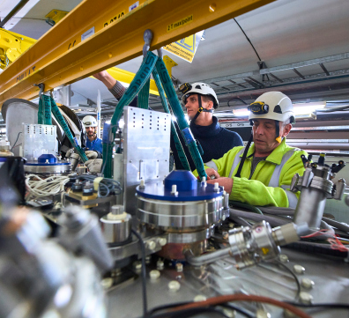
INSTALLATION

Slide 12
INSTALLATION
MASTER
PLAN
EYETS = 12 weeks
YETS = 8 weeks
Largest and most complex equipment to install in shortest time

Slide 13
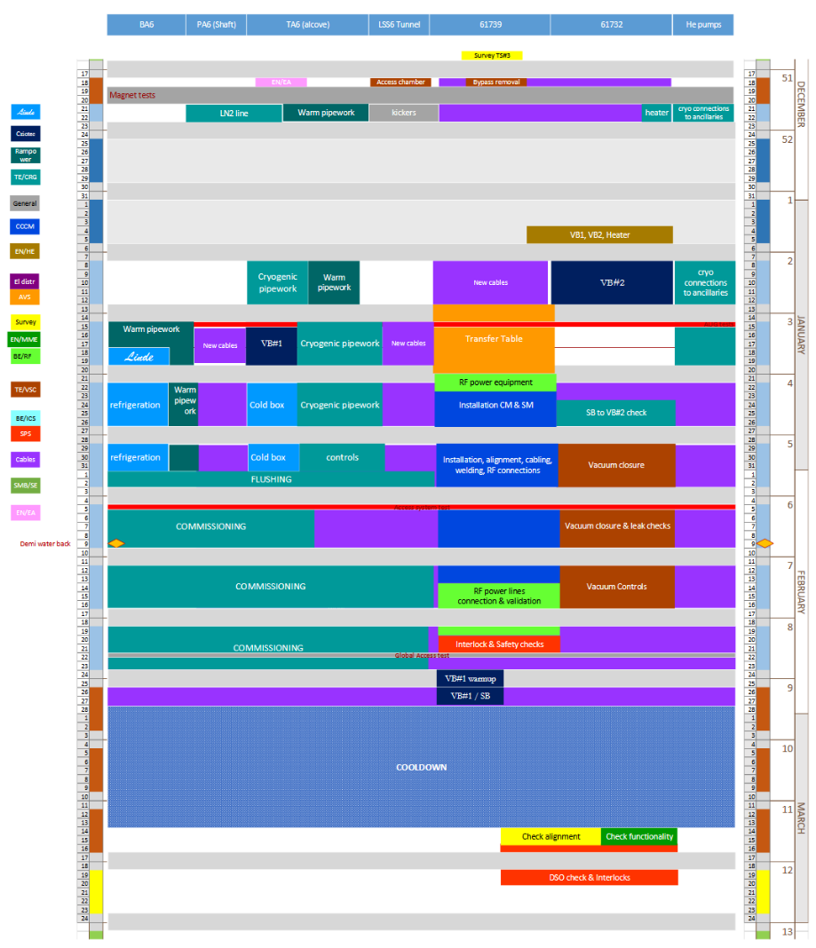
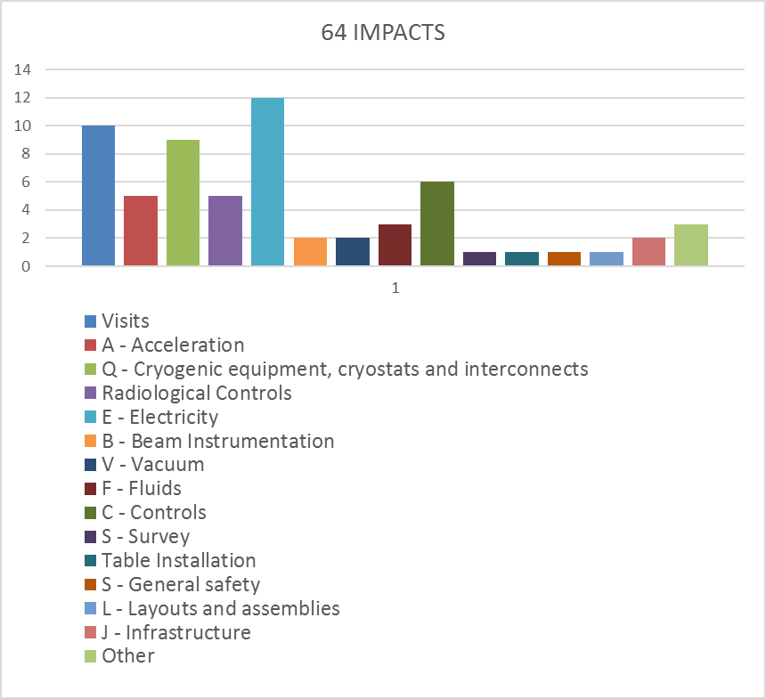
YETS 17/18 Statistics
64 IMPACTS
200 Estimated participants
~20 Teams involved

Slide 14
INSTALLATION TIMELINE
Cryomodule/RF
Cryogenics
Cabling

Slide 15
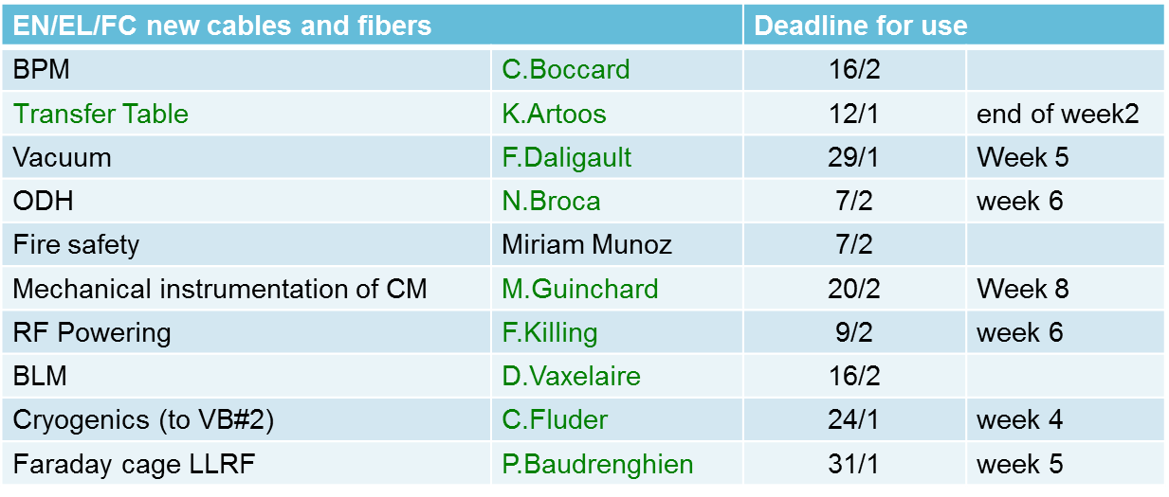
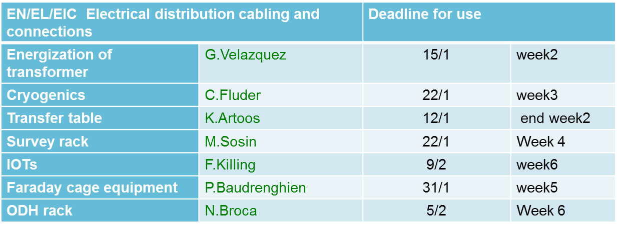
EN/EL Staging of deadlines
CABLING
CABLING
TA6/ shaft
Tunnel
BA6
CRYOGENICS
TA6/ shaft
MAIN ACTIVITIES
Tunnel
BA6
POWERING
TEST STAND
Tunnel
Transfer Table
RF equipment
CRYOMODULE
Vacuum
Notes:
Cabling activities and cryogenics related activities shared all locations, needed the whole timespan. The test stand, in 10m of tunnel length, was the scene of an important co-activity all along the YETS.

Slide 16
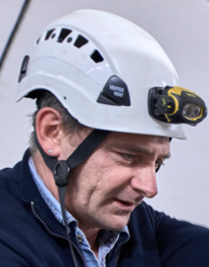

INSTALLATION – Lessons learned
Working hand in hand with services: understanding and integrating specific difficulties, in a creative and collaborative approach.
Field coordination paramount (thanks Simon!): presence/ anticipation/ swift change of sequences to cope with field difficulties (and a lot of patience by the field actors)
We can install a cryomodule in a YETS (cryomodule alone: 14 days)
«We structured the work by user and not by location. With an initial visit with each user and final handover, this shortened times and improved quality»
«Associate transport to design, since the beginning»

Slide 17

WORKSITE Safety & Coordination
Large number of involved teams
Small space
No margin schedule
High level of coactivity: stress, hazards
Field treatment of contingency and issues
GSI-WS-1 “Safety Coordination for Works and Services” applied first time after approval 2016.
Not outspoken situation:
According to GSI-WS-1 WP4 deliverable responsible was both
TECHNICAL COORDINATOR (planning) and SAFETY COORDINATOR (safety).
Work supervisors not named on all activities, not formed.
Complex contractual situation, communication issues
INTERESTS CONFLICT

Slide 18
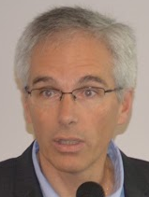
WORKSITE Safety & Coordination
Large number of involved teams
Small space
No margin schedule
High level of coactivity: stress, hazards
Field treatment of contingency and issues
GSI-WS-1 “Safety Coordination for Works and Services” applied first time after approval 2016.
IN SUCH a TENSE SITUATION:
Not outspoken situation:
According to GSI-WS-1 WP4 deliverable responsible was both
TECHNICAL COORDINATOR (planning) and SAFETY COORDINATOR (safety).
Work supervisors not formed, not defined correctly on all activities (cryo!).
Complex contractual situation, communication issues
«We should prioritize safety issues and not track the most inconsequential trifle»

Slide 19
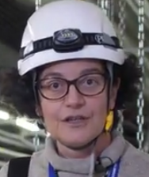

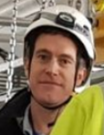

QUALITY & DOCUMENTATION
To “learn the lesson” and use it as reference, we must solve non-conformities, document interfaces, complete the safety file and write missing procedures.
Unequal quality culture across SRF teams.
Hand-over should be improved: procedures, implemented design changes, should all be recorded and well documented in the same way.
…you got it
With external institutes joining for HL-LHC, we need to be strong and well defined in terms of quality request and communication schemes

Slide 20
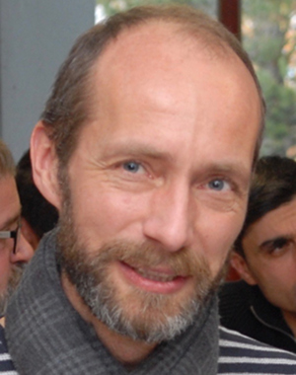

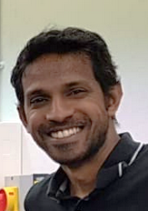
…and for HL-LHC?
At CERN anything is possible if people are willing to work together, even a project with a "negative time margin” in the planning
Indeed, it was a success story based on people’s commitment, enthusiasm, motivation – not on simple duty!
But we should NOT be relying on good will for the LHC.
In the LHC, we will have 8 x more to do… with the same manpower.
If appropriate resources (in number and competence) are not allocated, then we will face serious inefficiencies.

Slide 21
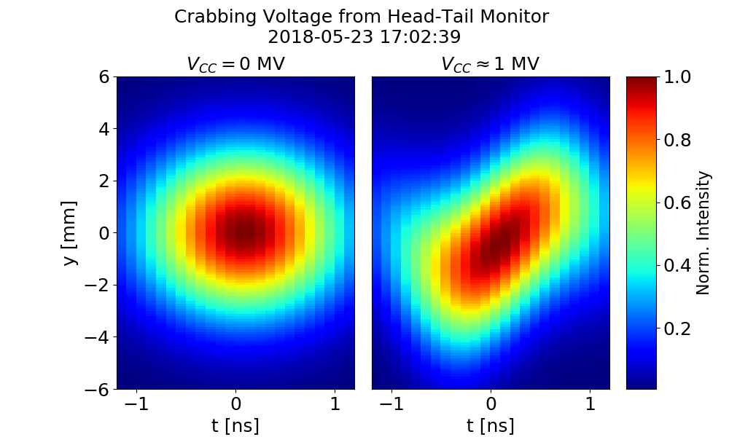
«Keep the whole community in the information loop»

Slide 22
CONCLUSIONS
SRF projects are an old yet young story at CERN: standard practice needs to be developped
The crab cavity test stand in SPS was the occasion to elaborate practice and work out interfaces.
Not a sterile intellectual game, but a robust brick to bring in the HL-LHC construction – and in all future SRF projects.
Thank you for your attention

Slide 24
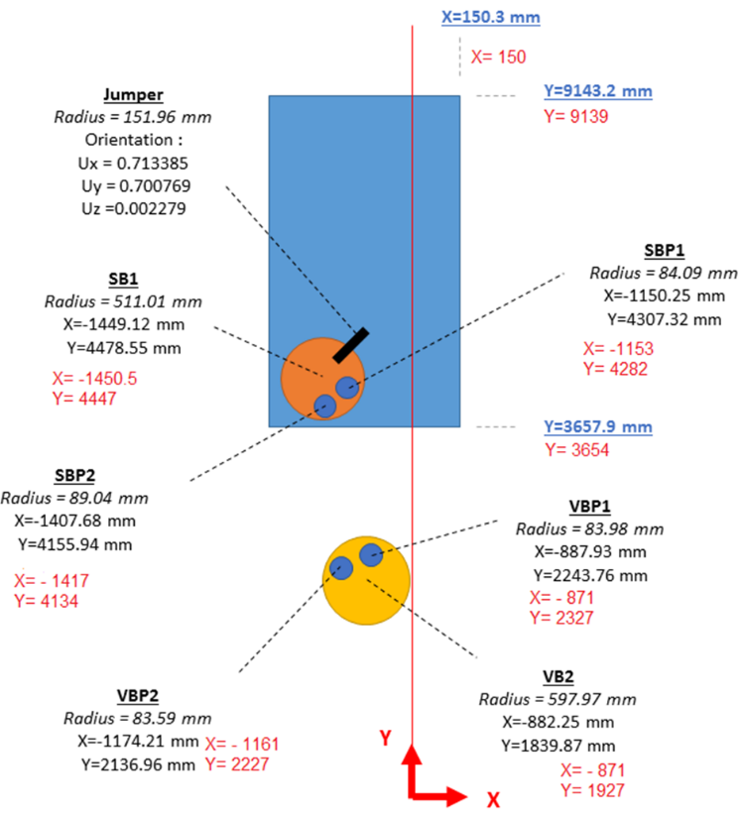
Main non-conformities
Cryo danger zone not marked
Cryo-lines versus insulation vacuum status, procedure not indicated on items
Water pressure on circulator & load too high
Cable’s hard protection missing
Mechanical instrumentation cables missing
Brakes on motors
Vacuum interlocks to cryo are not hard cabled
VVS interlock to table position is not hard cabled
VB2 and SB mutual distance not according to integration
Helium leak on line between CB and VB1
ODH signals impacted by occasional noise, reach pre-alarm

Slide 25
DESIGN - INTERLOCKS
Type | Why | What
Personnel safety | Radiation (X-rays) ODH and cryo hazard mechanical hazard | Access versus RF Power to cavities Table movement/ LHe level
Machine protection | Aperture Protection SPS and cavities | Beam & extraction versus table position, table movement, vacuum sector valves SIS: set of parameters, to define
Equipment protection | Protection of cavities and their ancillaries | RF Power versus Vacuum (beam/ insulation) Cryogenics (cryo OK given manually+ interlocks) Beam versus HOM power
Cryogenic distribution line

Slide 26
INTERLOCK Lessons learned
INTERLOCKS are an INTERFACE between SYSTEMS, by DESIGN:
They should be treated by Integration
Engineering Specification treated only Safety and Machine Protection interlocks
Equipment Protection interlocks in SRF are NOT YET a standard practice:
Some cables not pulled because each partner thought the other would ask
Some interlocks requested even if redundant
Commissioning tests had to be repeated several times because all was not tested in one go
Full documentation of tests needs to be written and recorded in EDMS.

Slide 27
INTERLOCKS Non-conformities
Non conformity | Solution
Table out of beam: VVS not interlocked | Cable to be pulled for hardware interlock
Table position to Vacuum valves opening is now via software | Cable to be pulled for hardware interlock
Vacuum to cryogenics is now via software | Cable to be pulled for hardware interlock
Interlocks Engineering Specification records only Safety and Machine Protection interlocks, not the Equipment mutual protection | Modify the Interlocks Engineering Specification to include all equipment protection interlocks

