Slide 1

Advanced Simulations of Manufacturing Methods for SRF Cavities
Alexandre Amorim Carvalho
On behalf of the EN/MME Design Office and Workshop

Slide 2
Summary
Fabrication Processes
  Metal Forming
  Crab Cavities Challenge
Niobium Sheets under Forming Processes
  Simulating What?
  Material Behavior and Material Models
Simulations Capabilities
  Present and Future

Slide 3
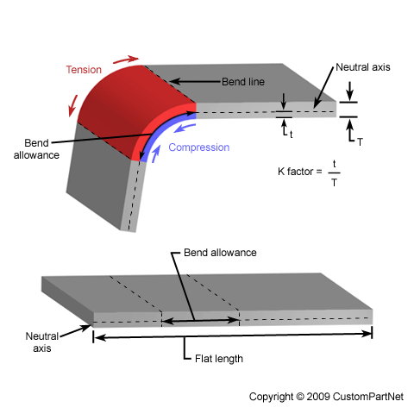
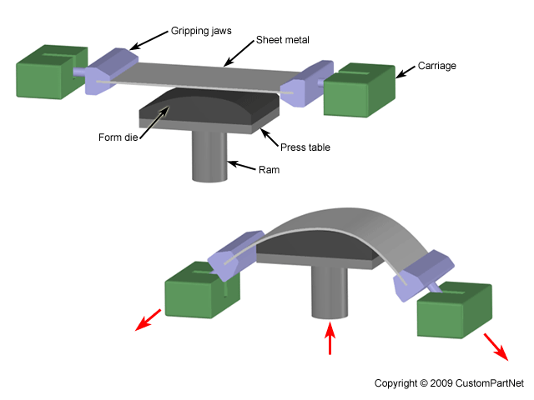
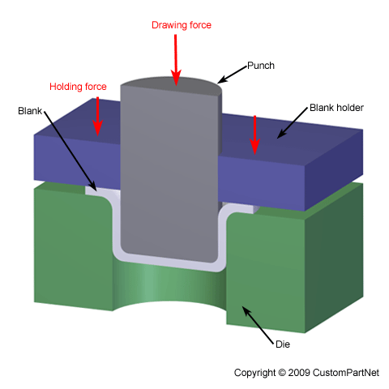
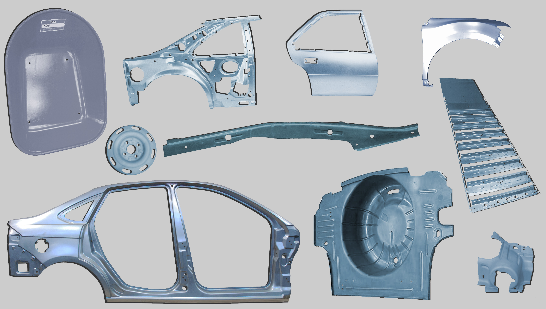


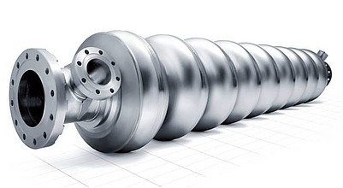
Sheet Metal Forming
Bending, stretching, compressing, twisting, extruding of metal sheets

Slide 4
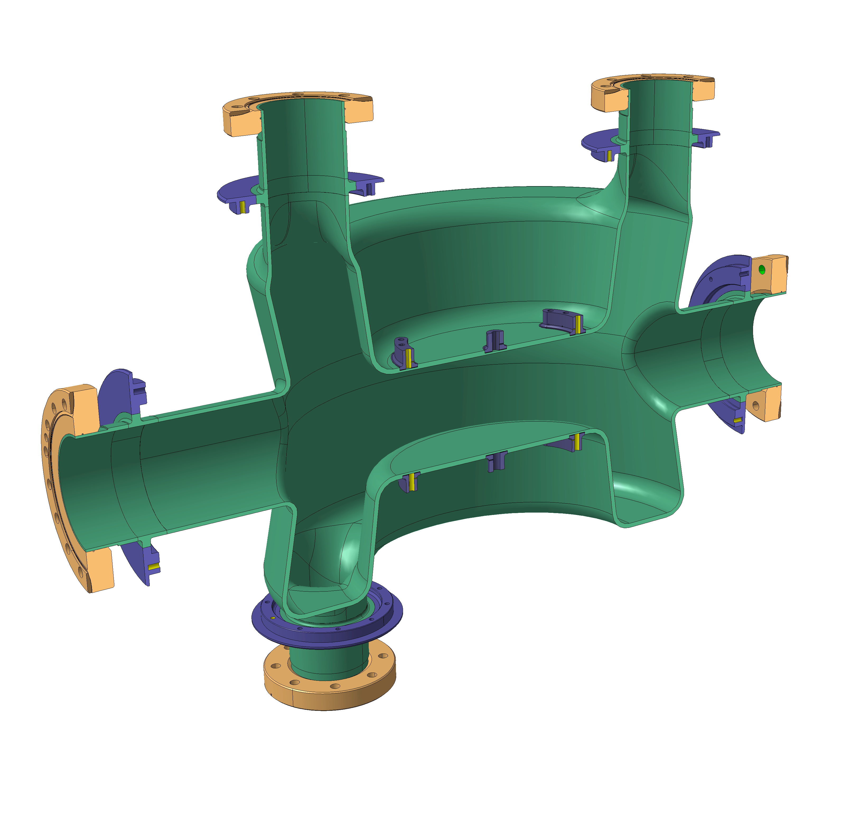
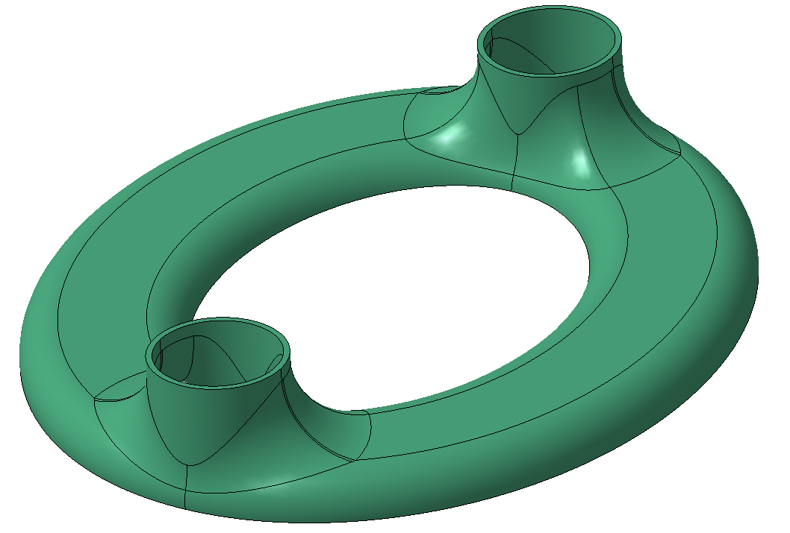
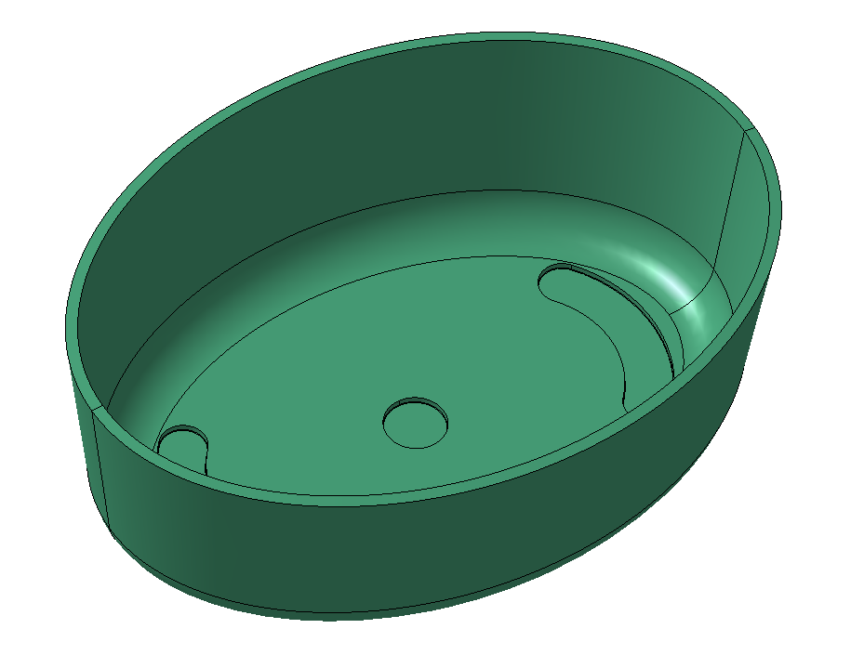
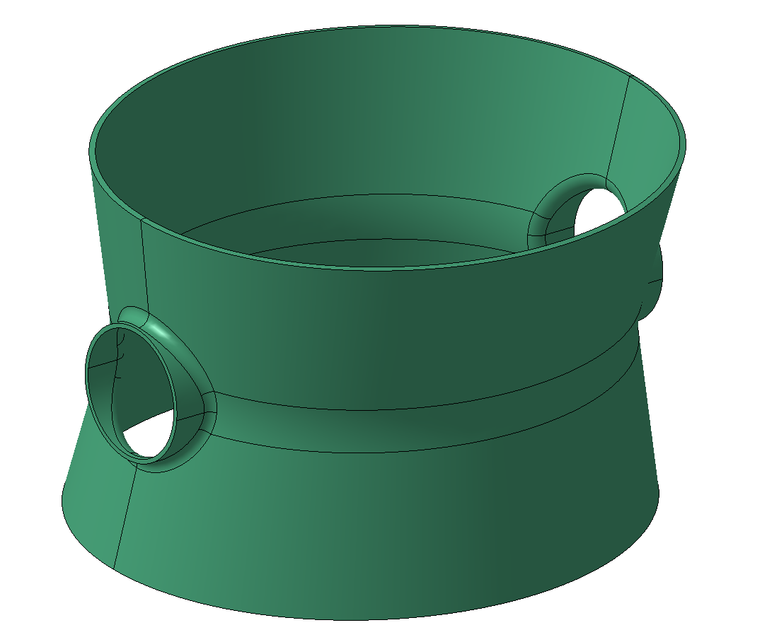
The Crab Cavities Challenge
Shaping + Electron Beam welding of 3x main subcomponents
0.5m
Manufacturing Challenges!
Material: pure Niobium 4mm thick sheets
Shaping:
  large deformation processes (deep drawing, extrusion..)
  multiple shaping steps on same subcomponent
  highly precise tolerances (±0.3mm)
0.65m
Elliptical Cap
0.4m
Bowl
Main
Body
FE analyses to
Steer manufacturing choices
Speed up tool design and reduce tooling costs
DQW

Slide 5

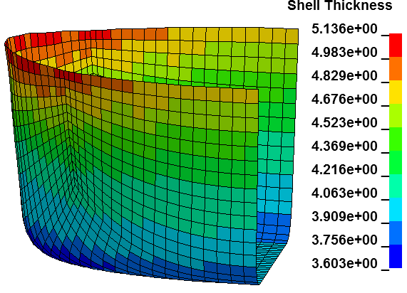
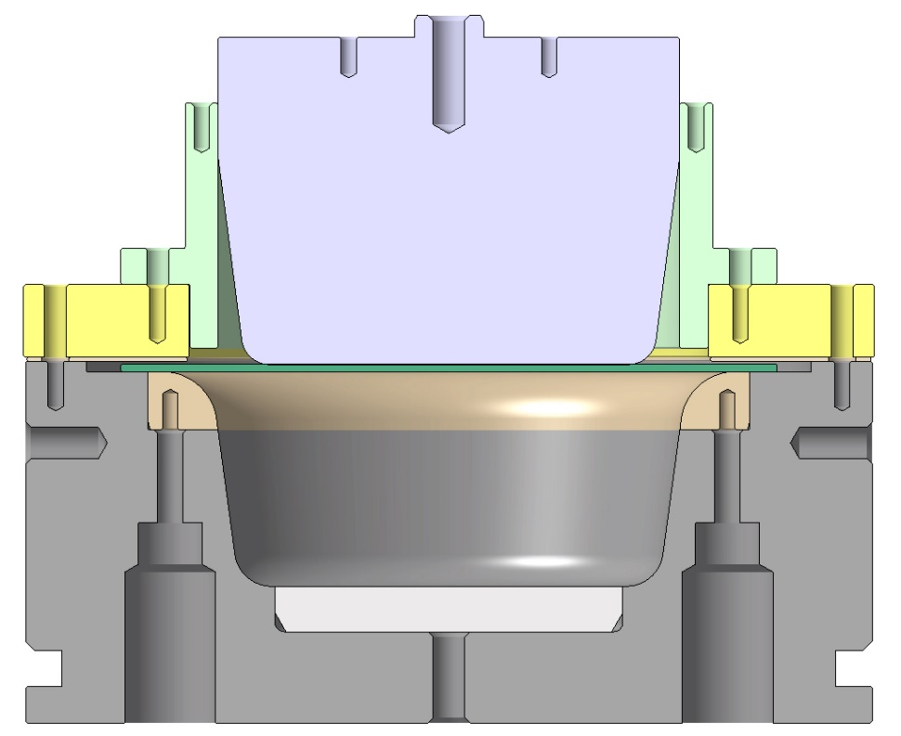
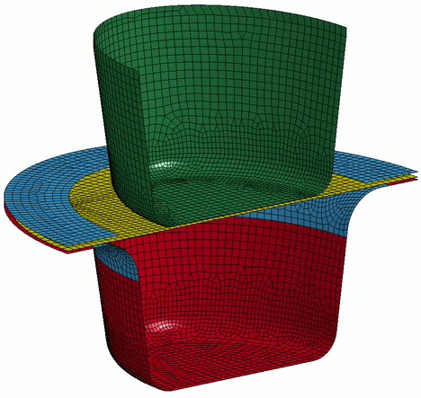
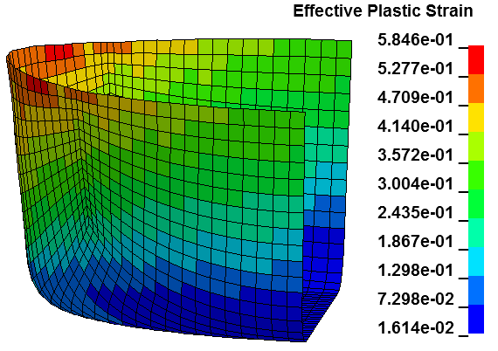
Sheet Metal Forming Simulations: Why?
Take the initial trials out of the workshop into simulations.
Compare different manufacturing strategies;
Identify forming defects e.g. wrinkles;
Identify highly stressed regions;
Awareness on the final thickness distribution;
Optimize the initial sheet for forming;
Explicit Integration
Identify tooling's design improvements
Steel 1.2343
Bronze

Slide 6
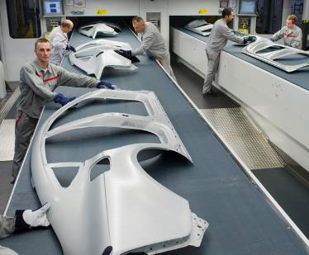
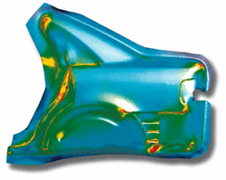
Sheet Metal Forming Simulations: Why?
Take the initial trials out of the workshop into simulations.
Compare different manufacturing strategies;
Identify forming defects e.g. wrinkles;
Identify highly stressed regions;
Optimize the initial sheet for forming;
Awareness on the final thickness distribution;
Explicit Integration
Identify tooling's design improvements
Exercise extensively done in the automotive industry and all industries of mass production

Slide 7
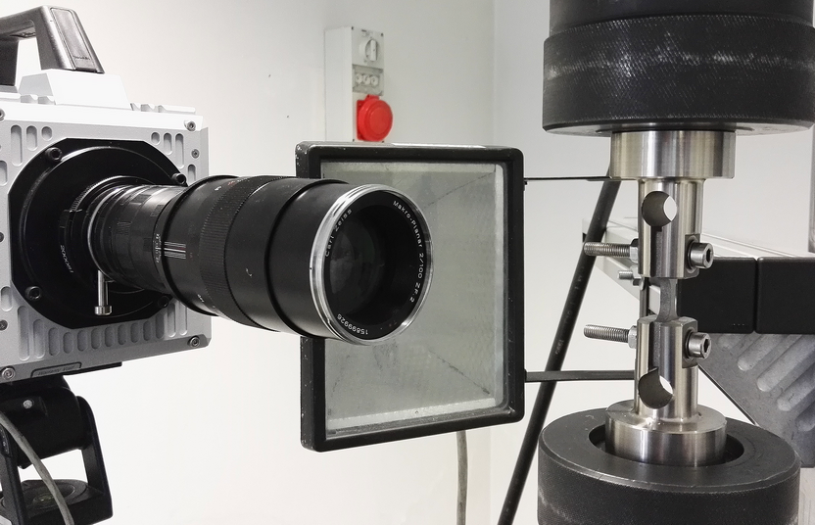
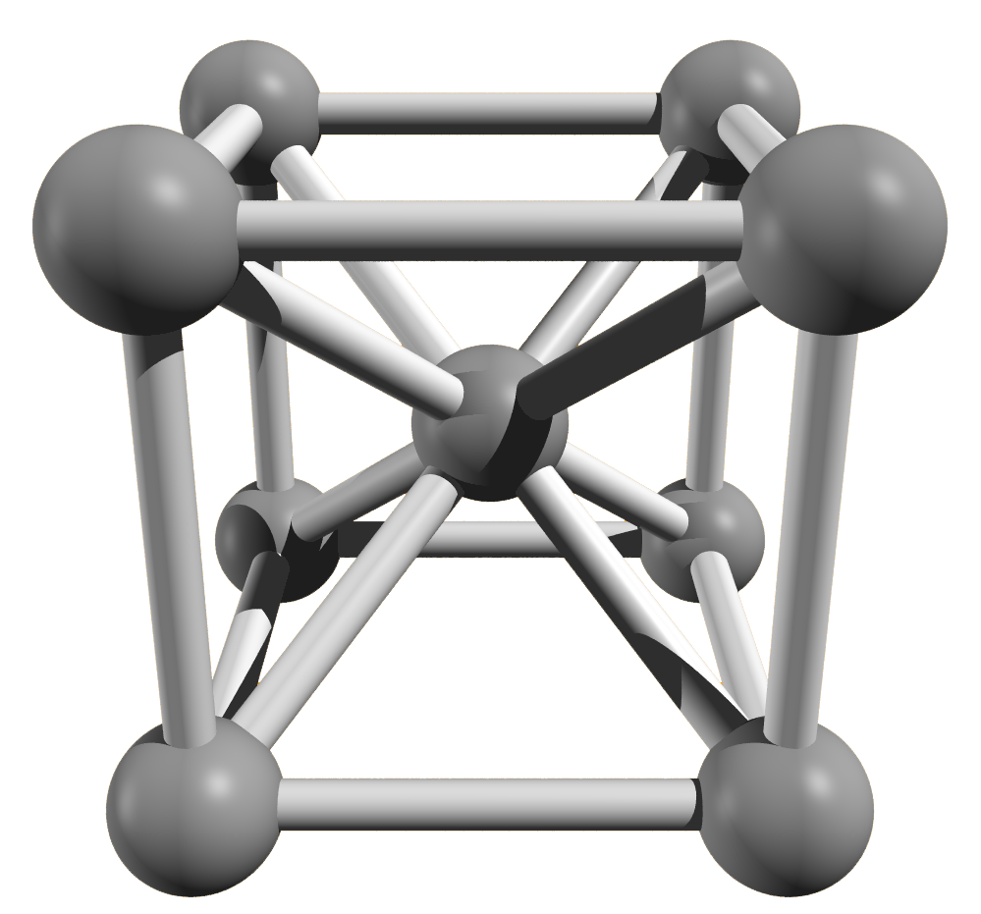
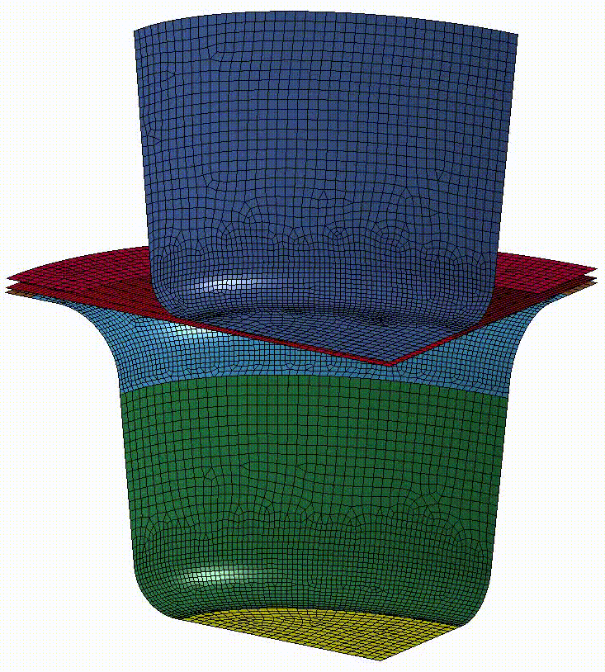
Niobium Sheets under Forming Processes
Tensile Tests
Preferred orientation typically affects sheet metal forming processes.
Anisotropy
Strain Rate
Cyclic Plasticity
Anisotropy
Strain Rate
Niobium has Body Centred Cubic (BCC) structure:
Strain Rate Sensitivity (SRS) in the Yield stress.
Cyclic plasticity
Testing campaign @ Politecnico di Torino
See EDMS. 1907223
Compression + Tension

Slide 8
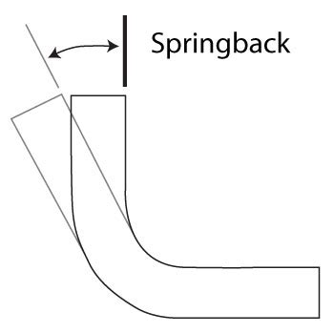
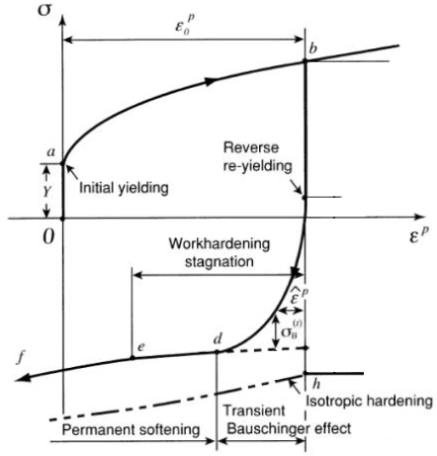
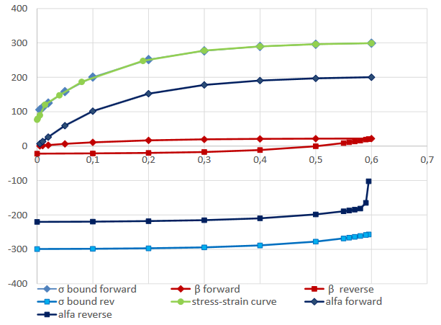
Niobium Sheets under Forming Processes
Cyclic Plasticity: non-linear Springback is not relevant
Strain rate: workshop processes are barely affected, impact can be estimated
Anisotropy: First indications show it’s not present, further testing is required
springback
Cyclic Plasticity specific material model

Slide 9
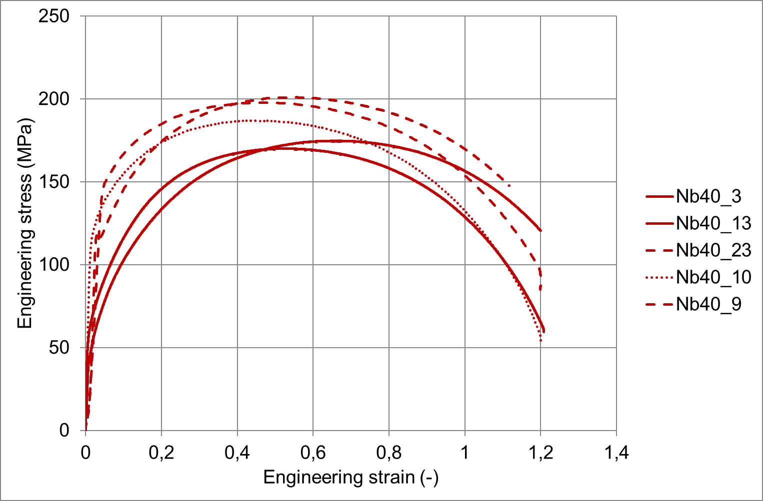
Niobium Sheets under Forming Processes
Cyclic Plasticity: non-linear Springback is not relevant
Strain rate: workshop processes are barely affected, impact can be estimated
Anisotropy: First indications show it’s not present, further testing is required
In niobium sheets
Typically in BCC …
0.1 1/s
0.01 1/s
0.001 1/s
Strain rate specific material model

Slide 10
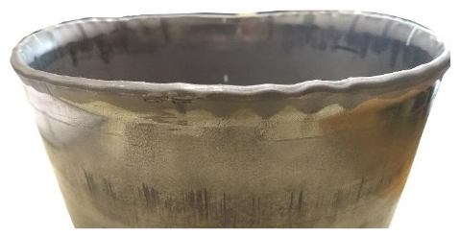
Niobium Sheets under Forming Processes
Cyclic Plasticity: non-linear Springback is not relevant
Strain rate: workshop processes are barely affected, impact can be estimated
Anisotropy: First indications show it’s not present, further testing is required
Deep drawing processes done in the workshop tend to confirm that niobium sheets are isotropic.
Testing campaign not successful
New tests being prepared

Slide 11
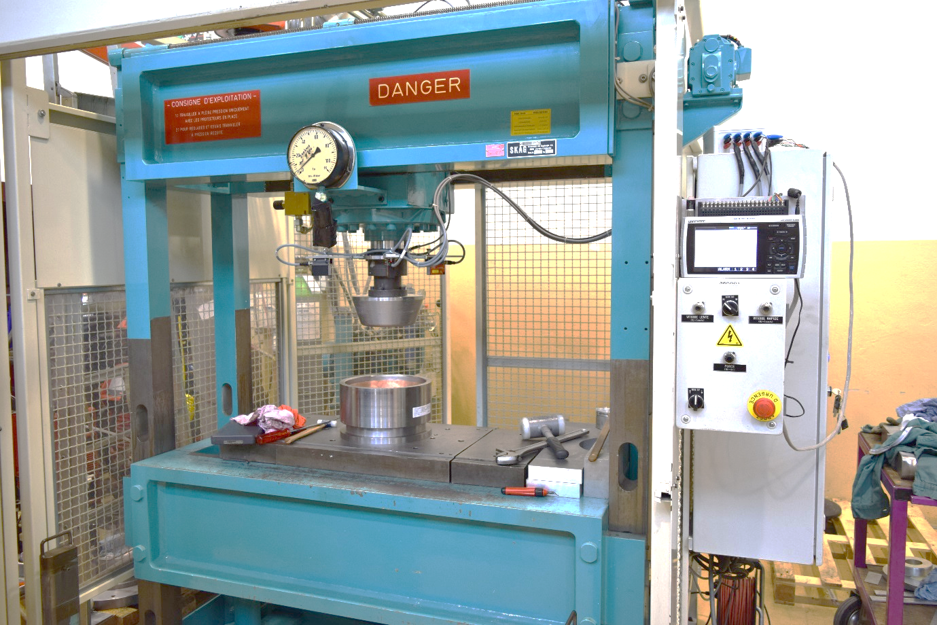
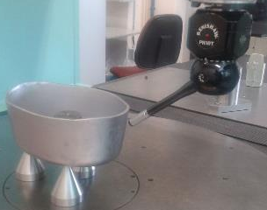
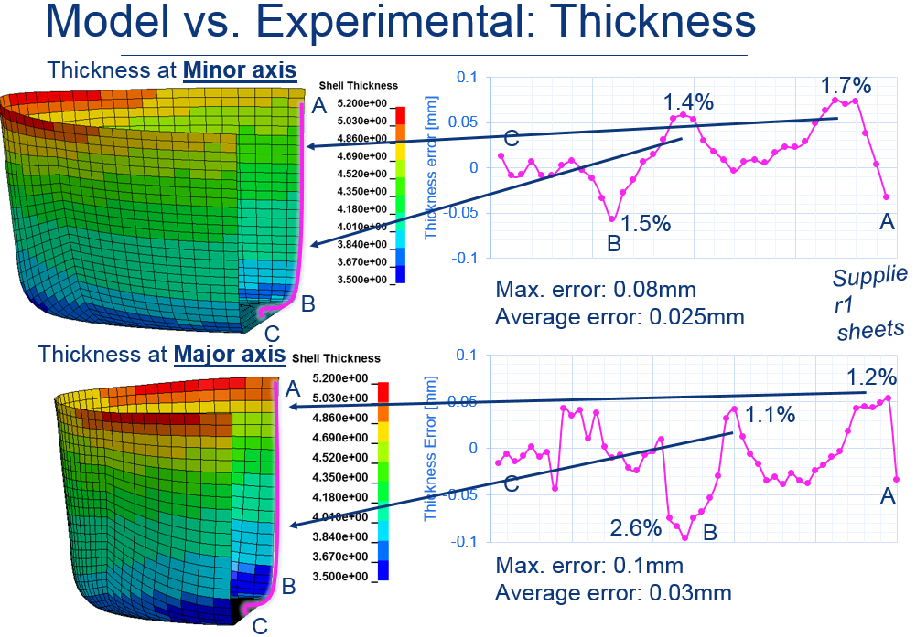
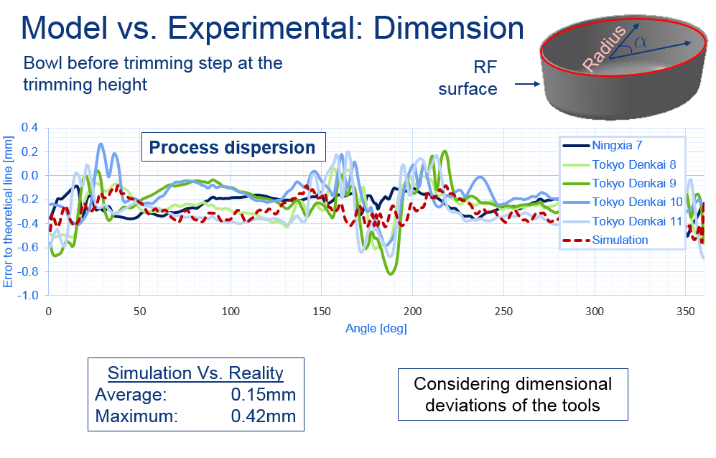
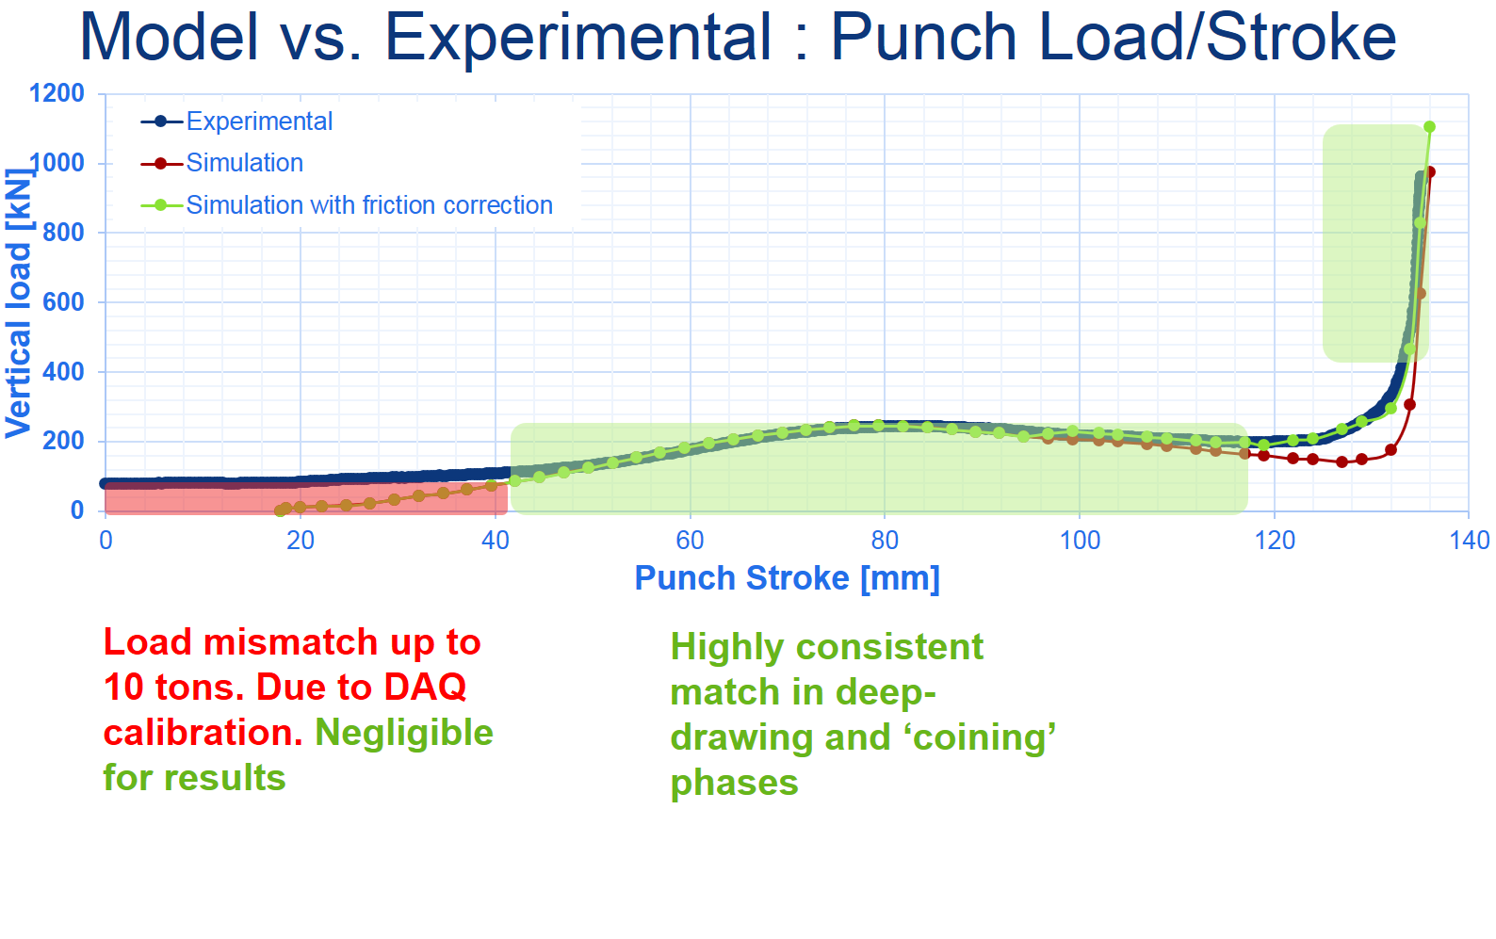
Benchmarking of the FE model
Metrology &
Evaluation of thicknesses via Matlab® code
DAQ
Displacement & pressure sensors
Achievements
Thickness accuracy – max. error of 0.1mm;
Dimensional accuracy – max. error of 0.42mm;
Punch Load vs. Punch Stoke – consistent
See EDMS. 1740011

Slide 12
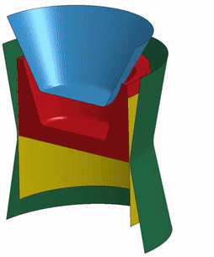
Simulation capabilities
Tailored material models available
Predict formed shapes (≈ 0.4mm error)
Predict thickness distributions (≈ 0.1mm error)
Estimate springback and sequential processes
Optimize tools and material usage
Introduce the real thickness distribution of the sheet before forming
Export deformed geometry

Slide 13

Ongoing activities
Exploitation of thickness knowledge for advanced tooling design
Thickening
Thinning

Slide 14
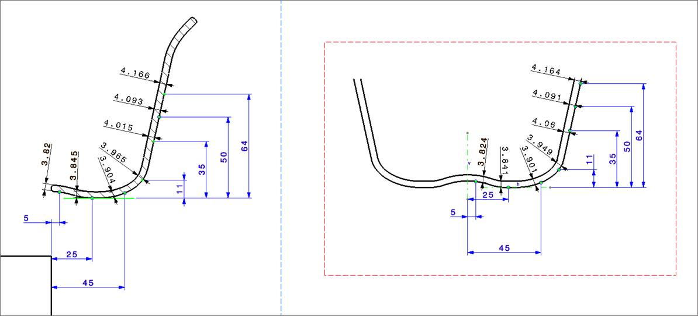
Ongoing activities
Exploitation of thickness knowledge for advanced tooling design
After forming
Distance mould to punch

Slide 15
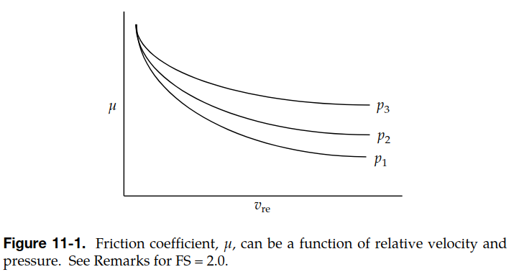

Ongoing activities
Friction coefficient mapping according to tool speeds and surface pressure

Slide 16
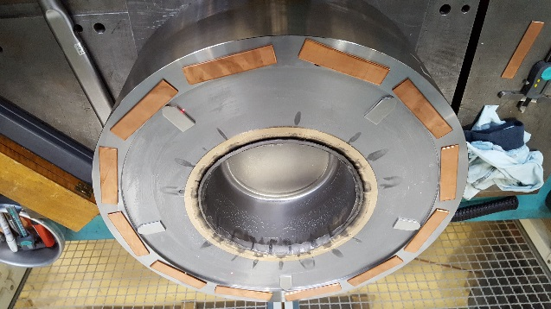
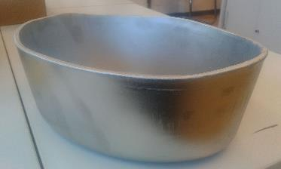
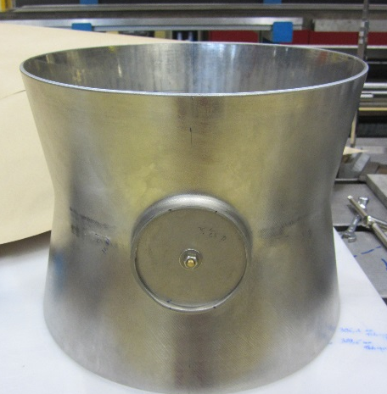
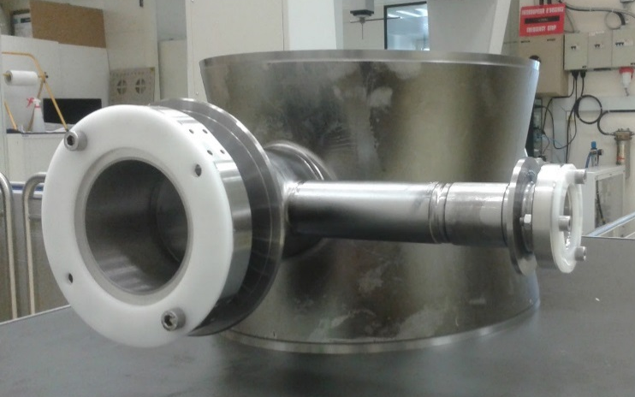
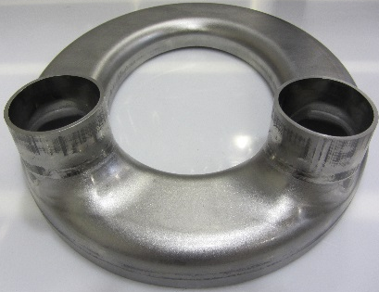
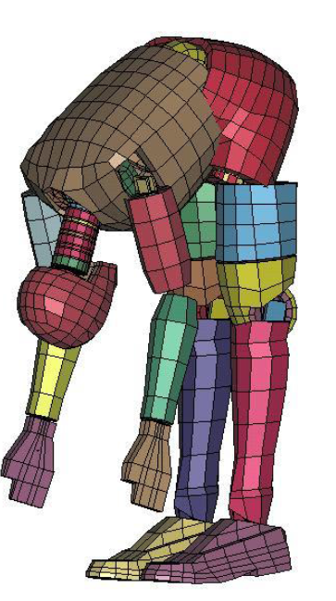
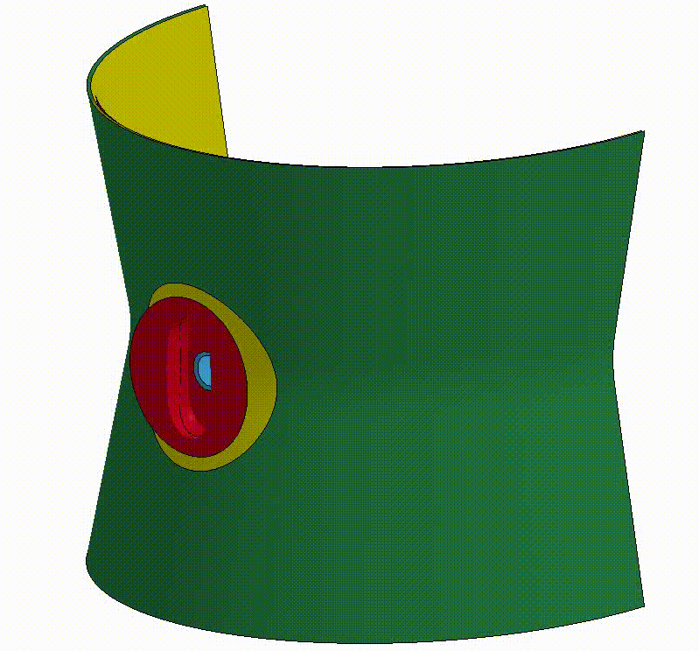
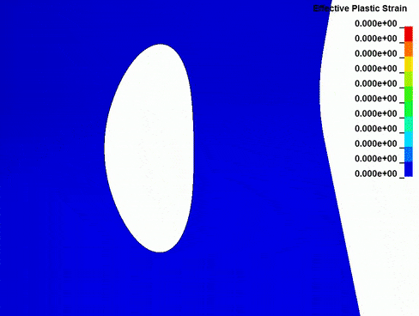
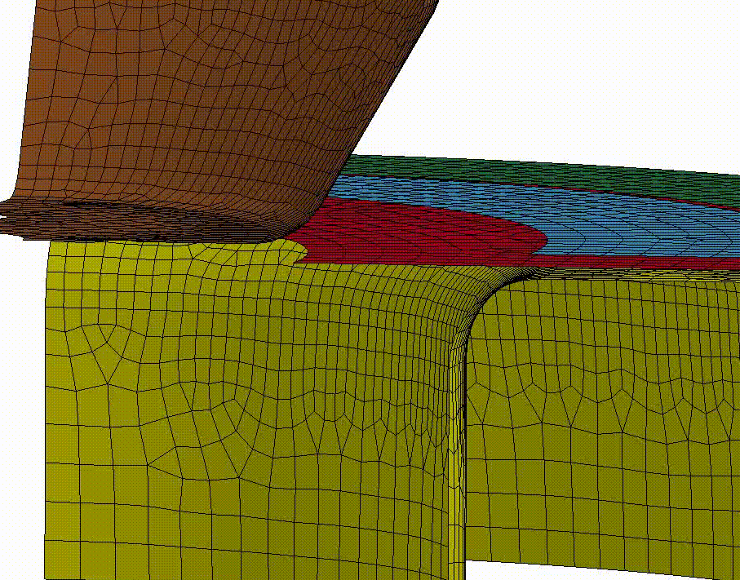
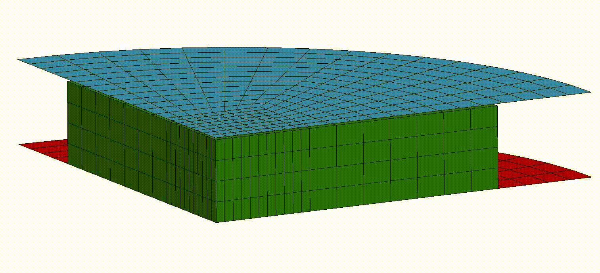

Slide 17
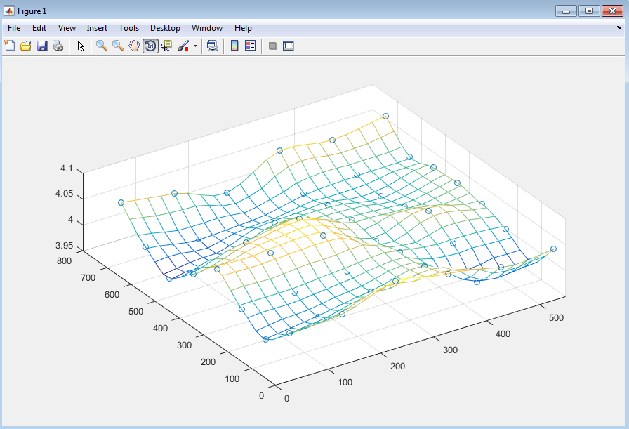
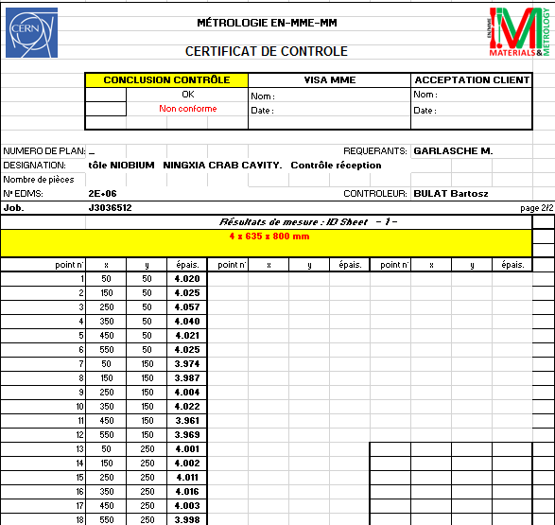
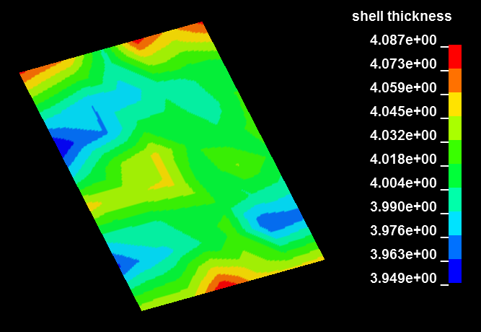
Initial sheet thickness
2.
1.
3.

Slide 18
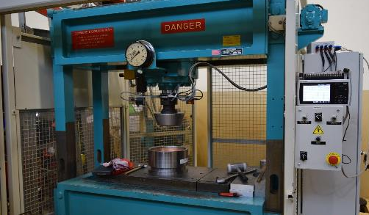
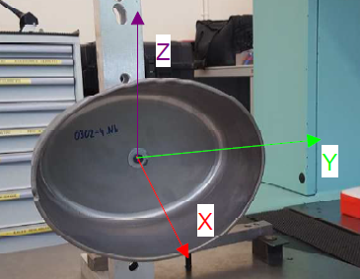
Benchmarking – How?
EDMS: 1572428
Supply
Pressure sensor
Displacement sensors
Post forming metrology
Process data acquisition
Graphtec
EDMS: 1709479
Hydraulic Pressure Machine
SKAG – Type JP-SVF
Max. Load 100tons
Data acquisition:
3 optical displacement sensors;
Pressure sensor in the hydraulic system;
+
Calibration of pressure sensor with load cell
Matlab program maps the points and calculates thickness on a given cross section
Δz vs. Fz
Uncertainty for small loads due to variation in hydraulic pressure

Slide 19
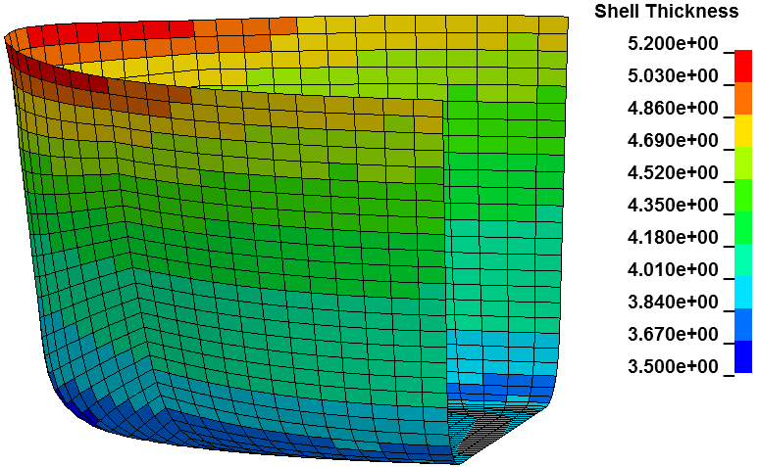
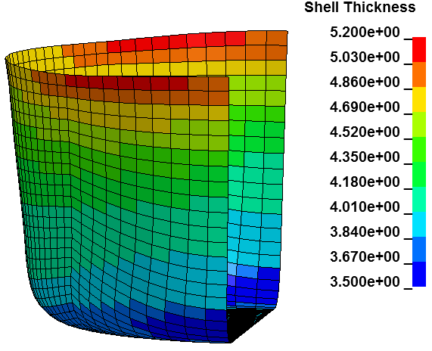
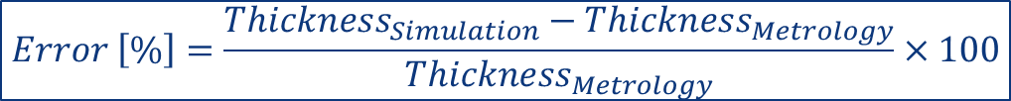
Model vs. Experimental: Thickness
Context
Bowl
Diabolo
Beyond
$$Error \left[\%\right]=\frac{{Thickness}_{Simulation}−{Thickness}_{Metrology}}{{Thickness}_{Metrology}}×100$$
Thickness at Minor axis
1.7%
A
1.4%
C
1.5%
A
Supplier1 sheets
Max. error: 0.08mm
Average error: 0.025mm
B
C
Thickness at Major axis
A
1.2%
1.1%
C
A
2.6%
B
Max. error: 0.1mm
Average error: 0.03mm
B
C

Slide 20
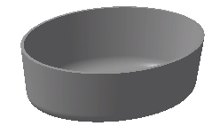
Model vs. Experimental: Dimension
Context
Bowl
Diabolo
Beyond
a
Radius
Bowl before trimming step at the trimming height
RF surface
Process dispersion
Simulation Vs. Reality
Average: 0.15mm
Maximum: 0.42mm
Considering dimensional deviations of the tools

Slide 21

Ongoing activities
Exploitation of thickness knowledge for advanced tooling design
Thickening
Thinning

