Slide 1
Lessons learned by design activities on the High-Gradient Cryomodule
Luca Dassa

Slide 2
Outline
Design
  Cavity supporting strategy
  Magnetic shields / Material properties
  RF power coupler
  HOMs cooling
  Cryogenic operation / Safety
Cost evaluation
Cavities
Towards PERLE

Slide 3
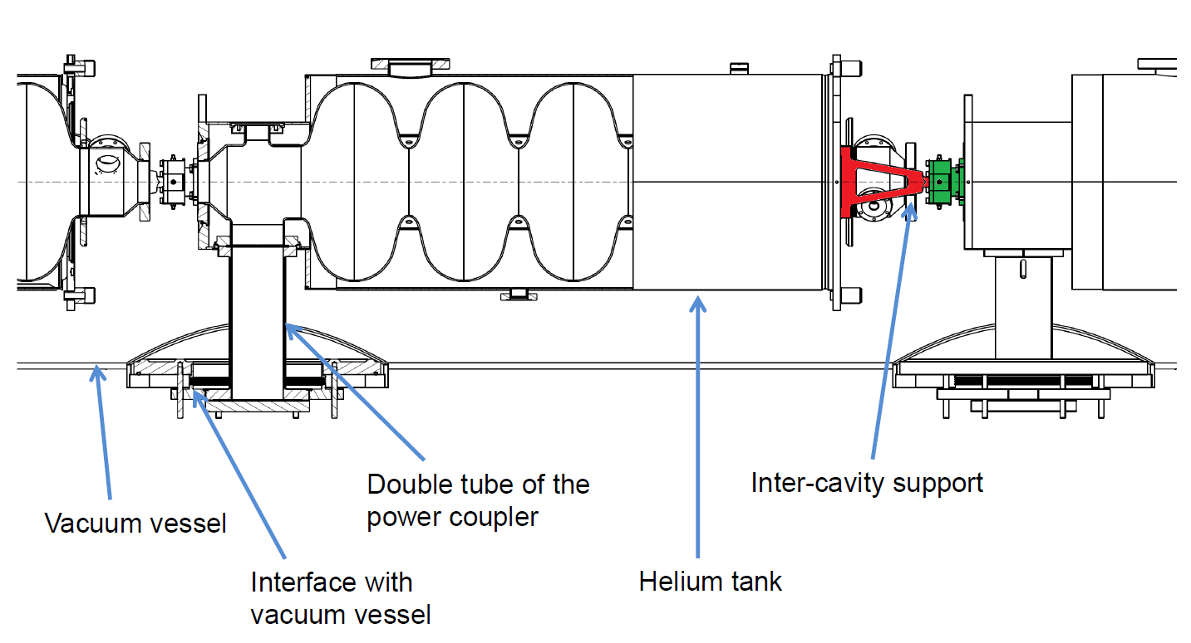
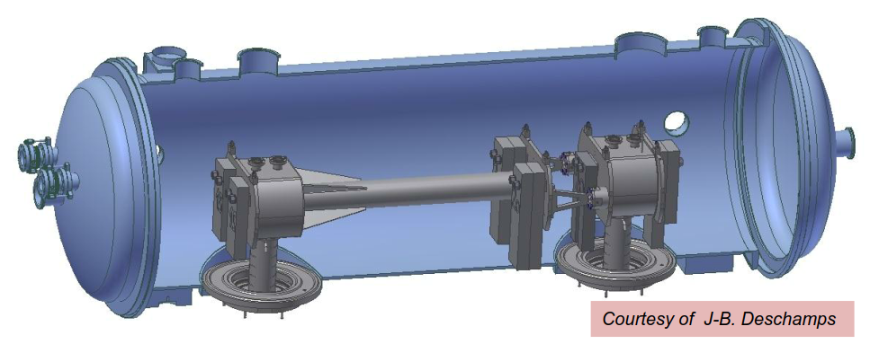
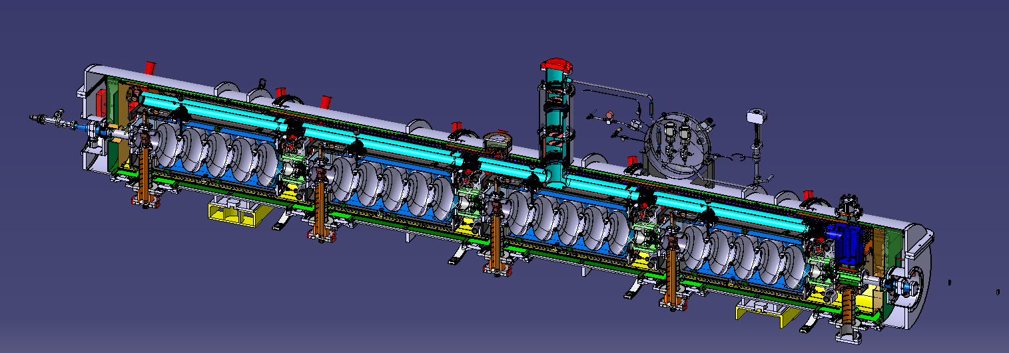
design for innovative supporting of cavities via power coupler
Cavity supporting strategy
Lessons learned:
Concept is feasible, after results obtained on the mock-up
Accessibility to the internal alignment system is limited (intercavity support)
Difficult alignment of the cavities once the train is assembled (coupled alignment)

Slide 4
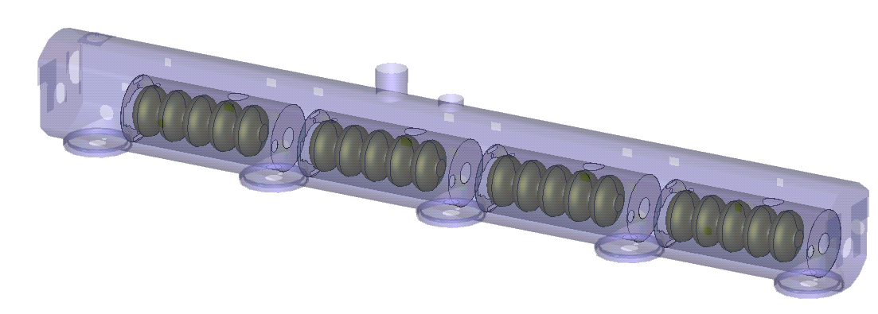
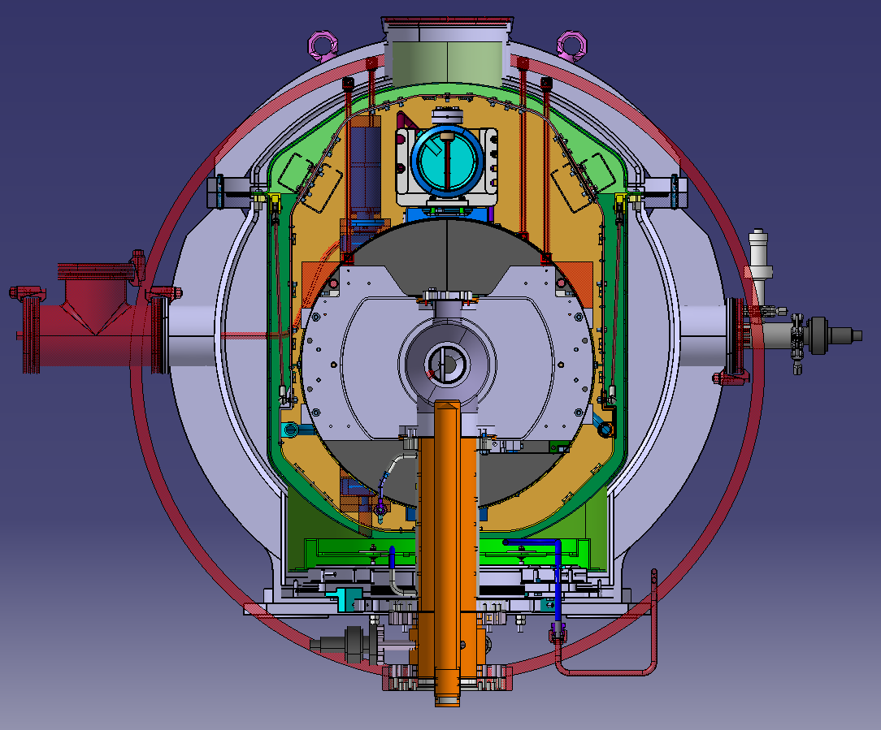
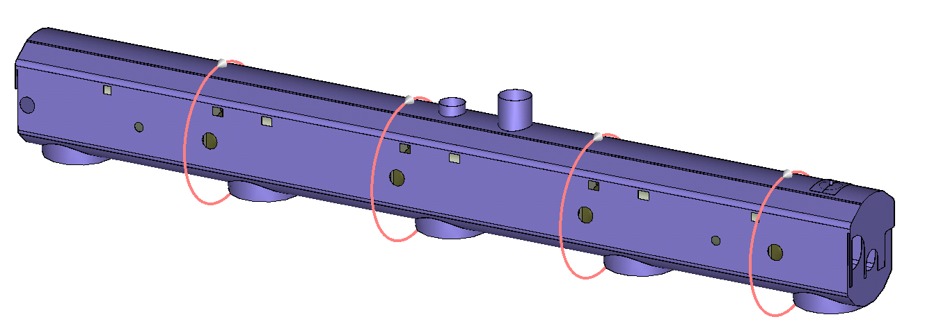
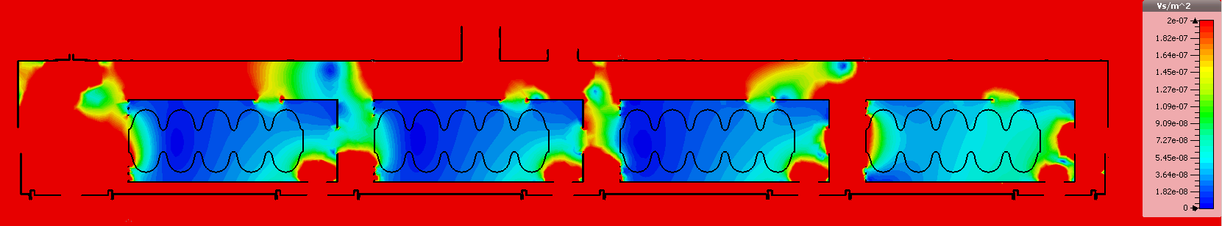
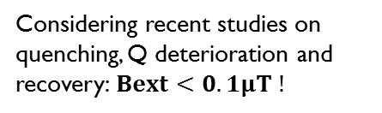
Magnetic shields
Lessons learned:
cold magnetic shield external to He vessel has lot of holes / intercavity region not shielded
Warm magnetic shield is effective / remove space but is not really complex
Magnetic permeability of the material inside the warm magnetic shield
Warm + cold magnetic shield + compensating coils
Considering recent studies on quenching, Q deterioration and recovery:$Bext<0.1μT !$
I
B=50μΤ
0.2 μT
|B|

Slide 5
Magnetic shields
Materials inside the magnetic shield: what about magnetic permeability? Which is the limit?
See commercial components: i.e. bellows and flexibles for cryogenic lines in proximity of cavities
Material for convolutions:
No 1.4429 (316LN) it in the market
No 1.4435 according to spec CERN in the market
Rarely standard 1.4435 in the market
1.4404 is the standard material in the market
Lesson learned:
it is required to clarify the real needs for material properties, above all for commercial components => see series production for Crab

Slide 6
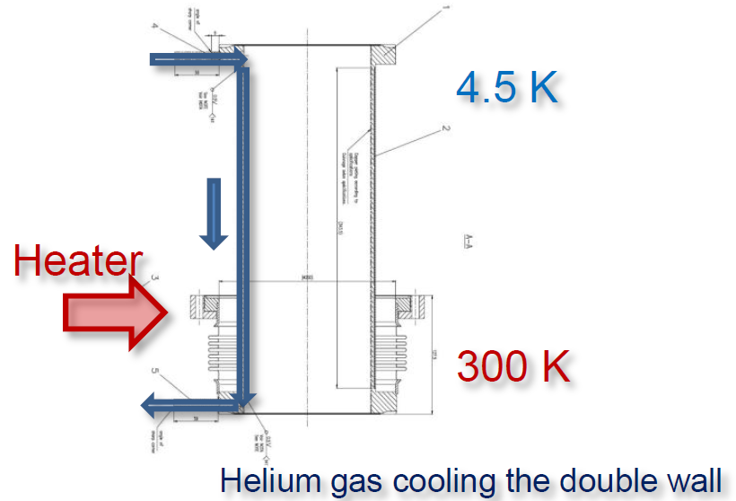
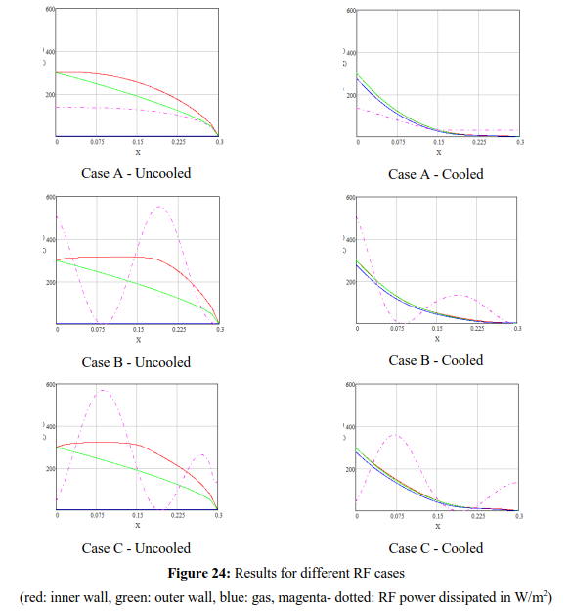
  Gas-cooled RF coupler double-wall tube (active cooling effect on cavity alignment)
RF power coupler
R. Bonomi, “Simulation Tool for Steady State Thermal Performance Applied to the SPL Double-Walled Tube RF Power Coupler”
Lessons learned:
Principle tested in the mock-up
Promising performances (see ESS cryomodule)
Complex manufacturing

Slide 7
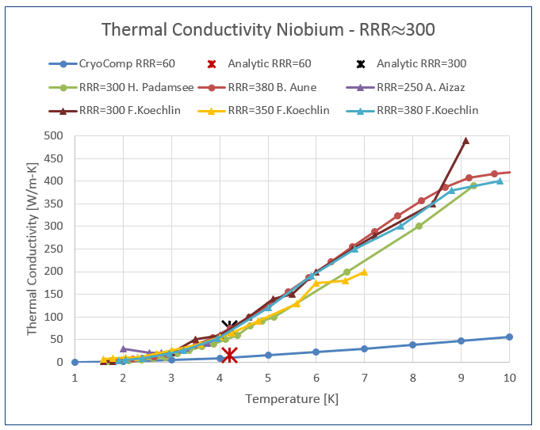
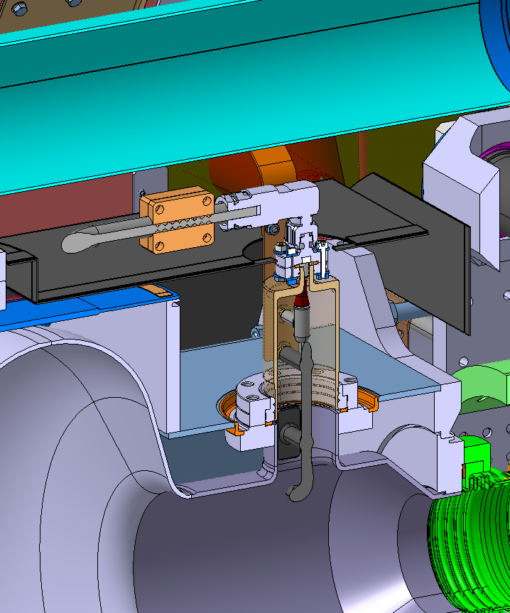
HOMs
  Study of HOMs cooled by conduction (no active cooling)
Lessons learned:
  Literature research on material properties
  Improvement of analytic tool (for cable thermal analyses)
  Coupling RF and thermal simulation
  Cables and connectors shall be considered soon in the design (see intercavity region)

Slide 8
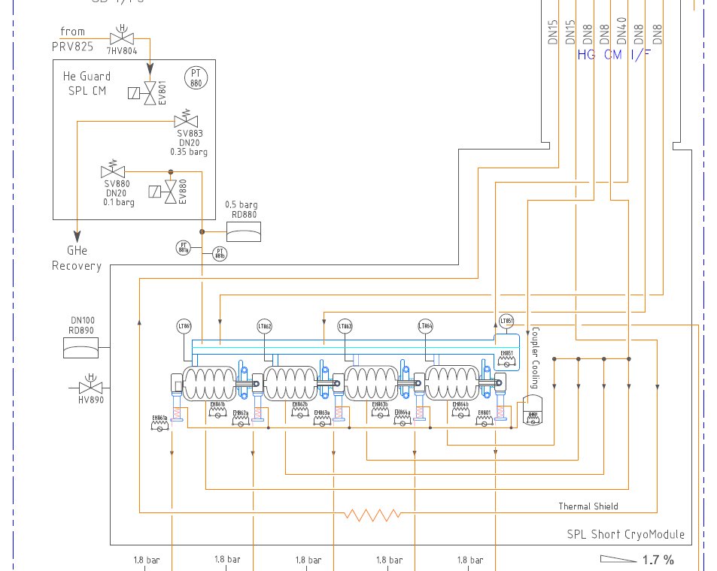
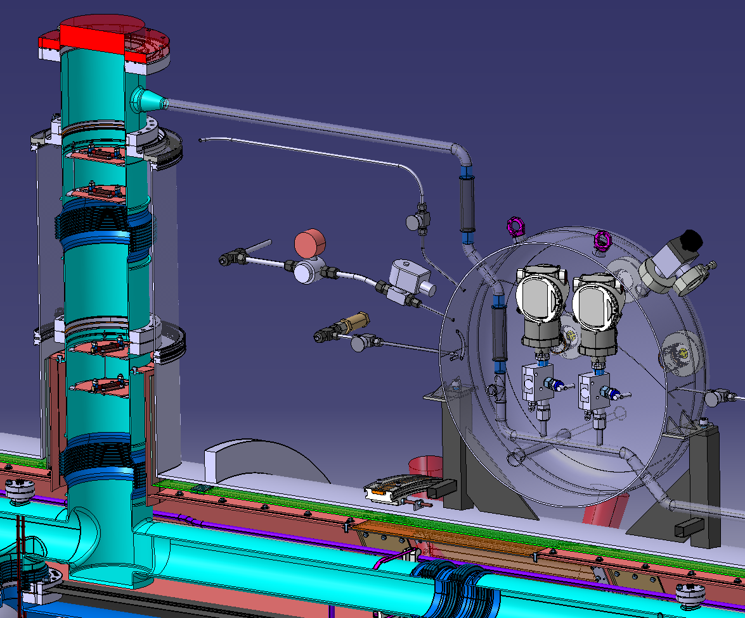
Main assumption for HG cryomodule: choice of Maximum Allowable Pressure to be out of the scope of the Directive 68/2014 (PED) => PS=0.5 barg
Cryogenic operation / Safety
Box with valves to reduce peaks during transient
NEVER TESTED!
Lessons learned:
  Too low operating pressure is fine from PED point of view but is creating operational difficulties => Never select the PS only to stay out of the PED scope
  Too low operating pressure implies difficulties in sizing of safety devices

Slide 9
For the 1st cryomodule, R&D included
Cost evaluation
 | CRYOMODULE
 | Total [kChF] | Achieved [kChF]
Couplers + pick-ups | 360 | 360
HOM (proto, material, 8 HOMs, design office) | 561 | 40
in kind contribution for cryomodule (SPL design, vacuum vessel, tuners) | 320 | 320
Design office (cryomodule revision + tools for clean room + tools for cryostating) | 190 | 100
Cryogenic system | 220 | 180
Cold magnetic shielding, Warm magnetic shield, Thermal shield | 325 | 0
Management support (fellow) + Quality Assurance | 274 | 274
Various | 640 | 250
Tooling for Clean Room assembly and cryostating + manpower | 560 | 60
total without cavities | 3450 | 1584
 | CAVITIES
 | Total [kChF] | Achieved [kChF]
R&D + tools for manufacturing and testing | 1194 | 1194
material (Nb) | 420 | 420
4 cavities produced by RI + 1 mono-cell | 375 | 375
1 CERN cavity | 175 | 175
cavities | 2164 | 2164
 | TOTAL
 | Total [kChF] | Achieved [kChF]
cavities | 2164 | 2164
total without cavities | 3450 | 1584
total with cavities | 5614 | 3748
Lessons learned:
  R&D costs for a cryomodule with 4 x 5 cells Nb cavities
  Cost per component
2nd one…
Total with cavities: 3203 kChF

Slide 10
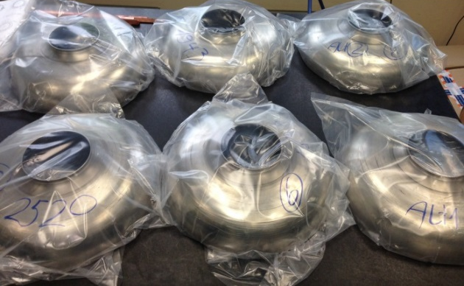
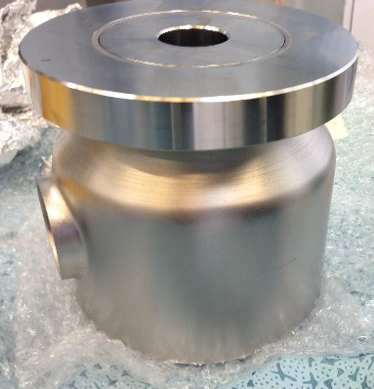
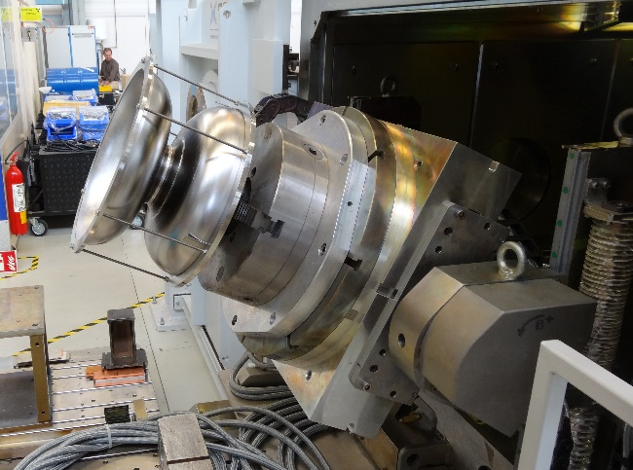
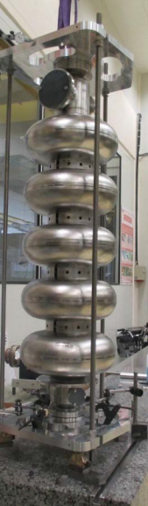
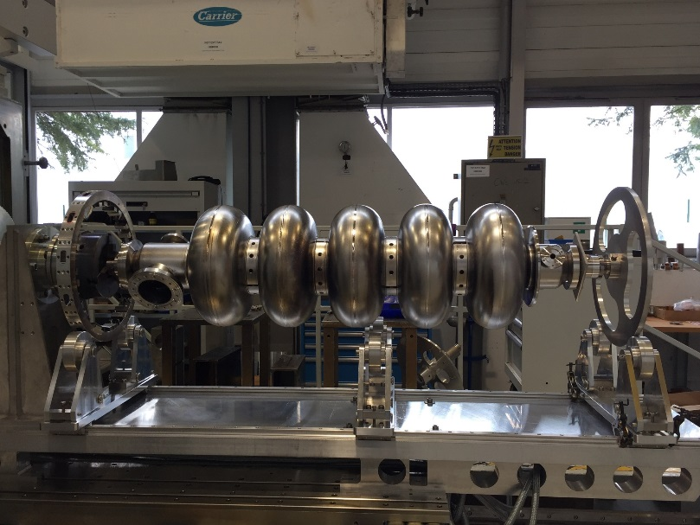
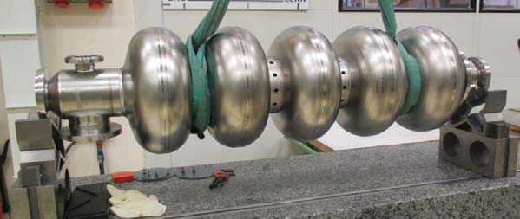
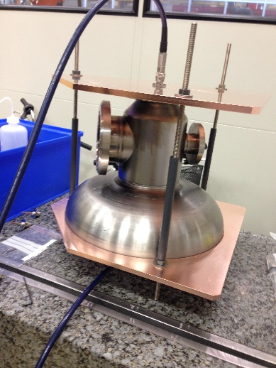
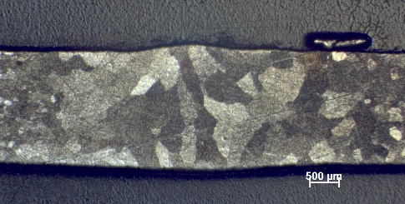
Cavity
EDMS 1511464 v.1 Fabrication SPL Nb 5-cell cavity at CERN
Lessons learned:
  Tooling
  Welding
  Brazing
  …
See Crab cavities

Slide 11
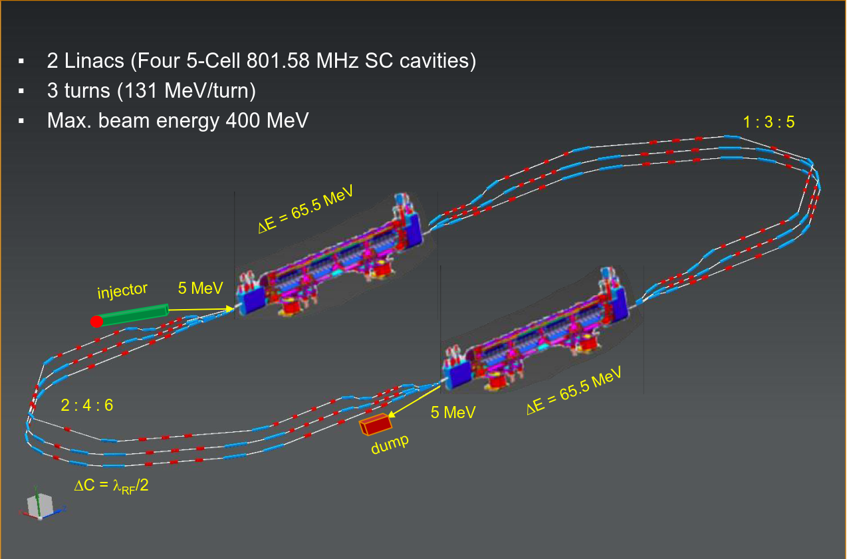
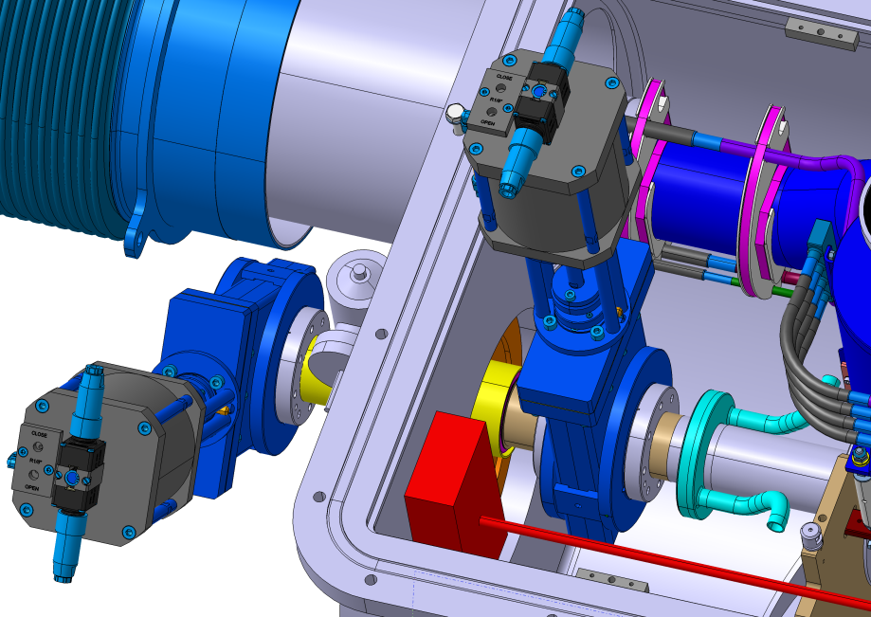
Towards PERLE
PERLE is a high current, multi-turn ERL facility (900 MeV), designed to study and validate main principles of the Large Hadron Electron Collider (LHeC: 60 GeV).
PERLE@Orsay is a smaller version (400 MeV) with the same design challenges and the same beam parameters.
https://indico.cern.ch/event/690826/
Can we adapt the HG cryomodule for utilization in PERLE?
New cavities, smaller than the actual ones
Higher heat loads (250 W for Perle / 200 W for HG)
2 HOMs per cavity (actively cooled)
Beam vacuum valve
Studies are ongoing:
PERLE management has shown high interest
the open question related to the valve is solved
Main point to solve: HOMs

Slide 12
Thank you.

