Slide 1
Review of LHC cavity cold tests
A. Miyazaki
CERN and University of Manchester
SRF workshop 2018 @ CERN

Slide 2
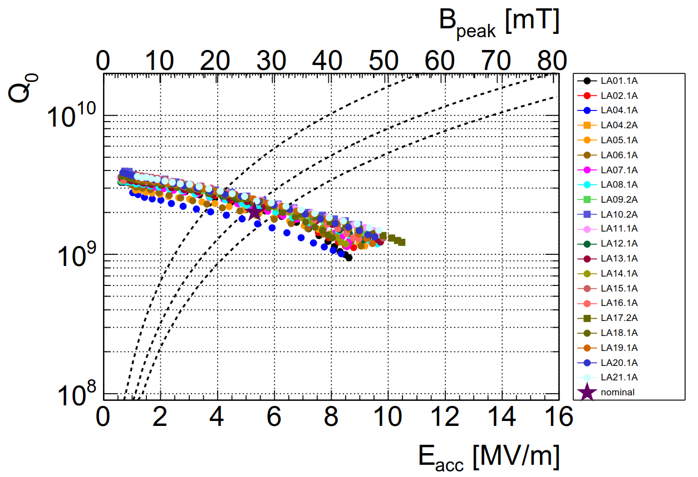
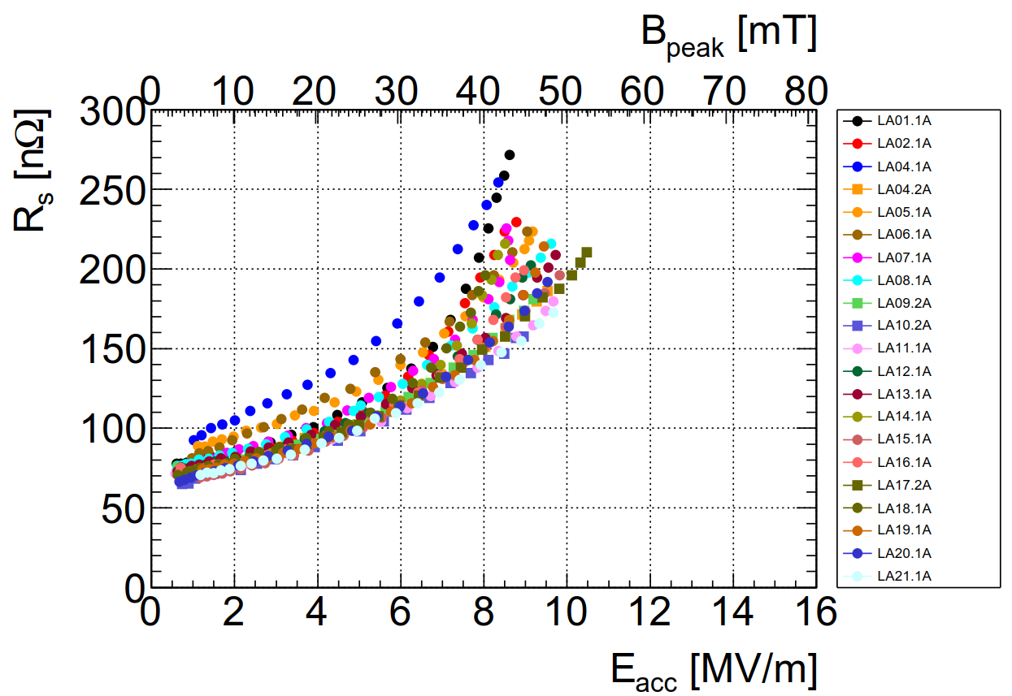



LHC cavities in 90s at 4.5K
10W
20W
30W
Famous Q-slope problem
Surface resistance
$$R_{s}\sim 257Ω/Q_{0}$$
Baseline: can we reproduce these results?
Even better result? Better substrate? Better coating?

Slide 3
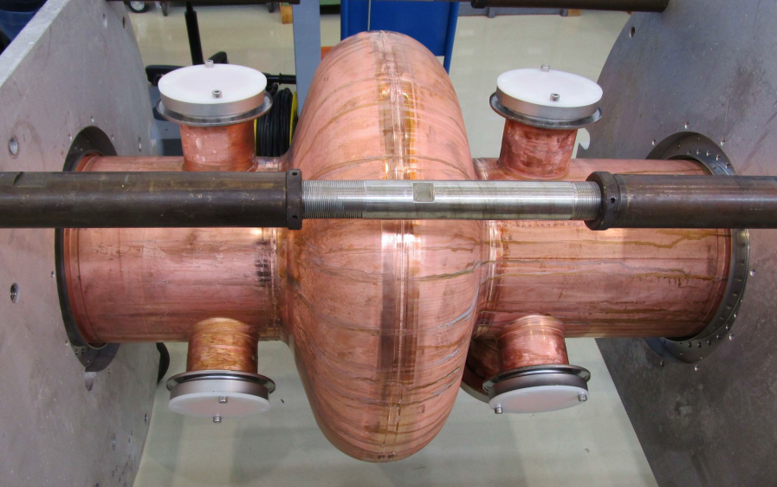
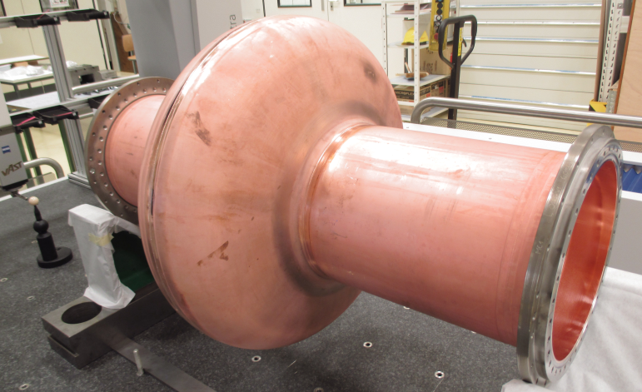
LHC spare project – history of cold test
Cavity | mechanical | coating | Cold test
PC01.1 | 1st substrate with full ports | Recipe not fixed (Kr) | Aug 2016
PC02.1 | Projections in the welding |  | Oct 2016
PC02.2 | Contamination before coating
PC02.3 |  | Recipe fixed (Kr) | Nov 2017
LHC19 | Spare cavity in 90s (dressed) |  | Dec 2017
PC05.1 | Simplified shape & polished welding | Same recipe as PC02.3 | Feb 2018
PC03.1 | Simplified shape | Same recipe as PC02.3 | Apr 2018
Full model
Simplified model

Slide 4
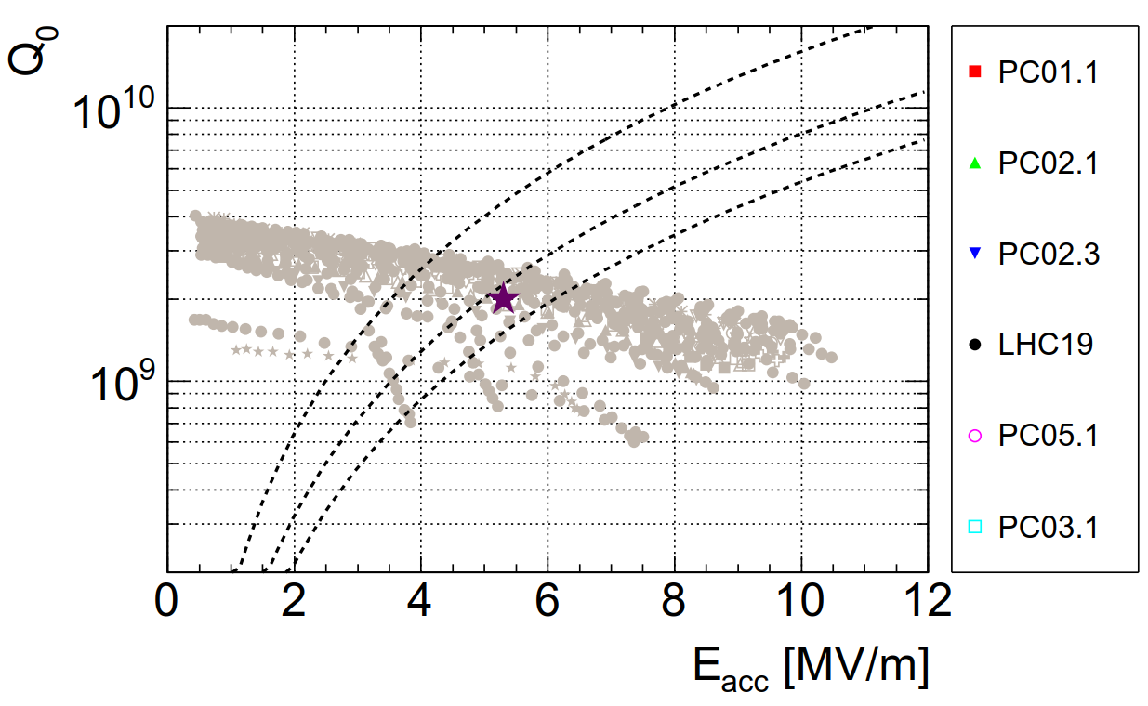
History of cavities: Q vs E at 4.5K
10W
20W
30W
All LHC cavities
Shadow of 90s…

Slide 5
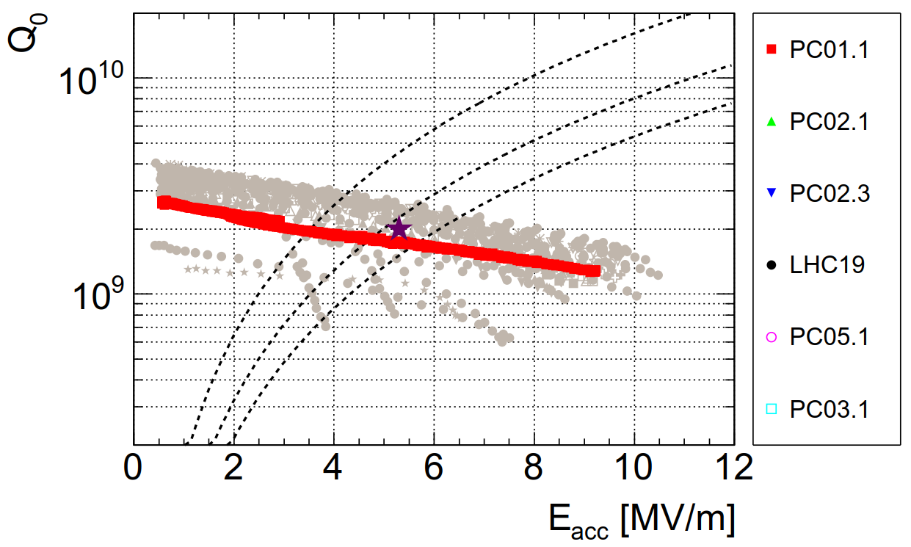
PC01.1 → the very first cavity → coating recipe not fixed
10W
20W
30W
All LHC cavities
Already comparable to the cavities of 90s

Slide 6
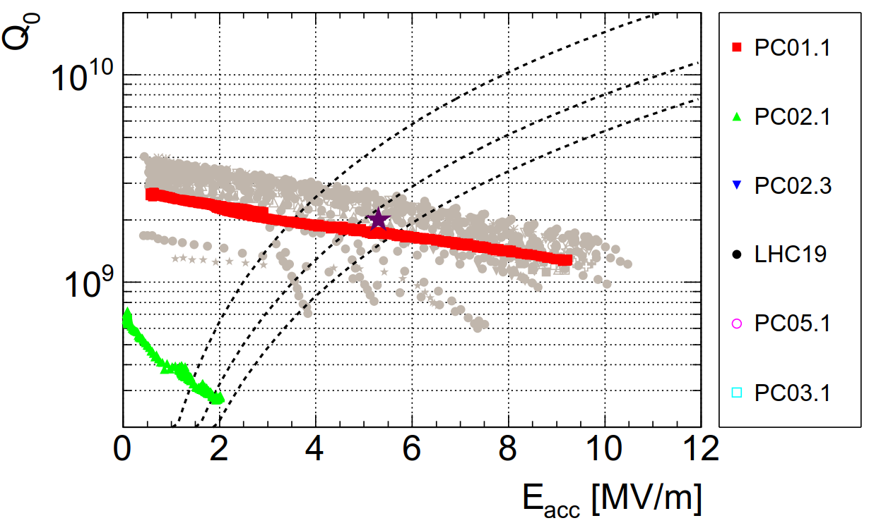
PC02.1 → projections in welding→ poor performance
10W
20W
30W
All LHC cavities

Slide 7
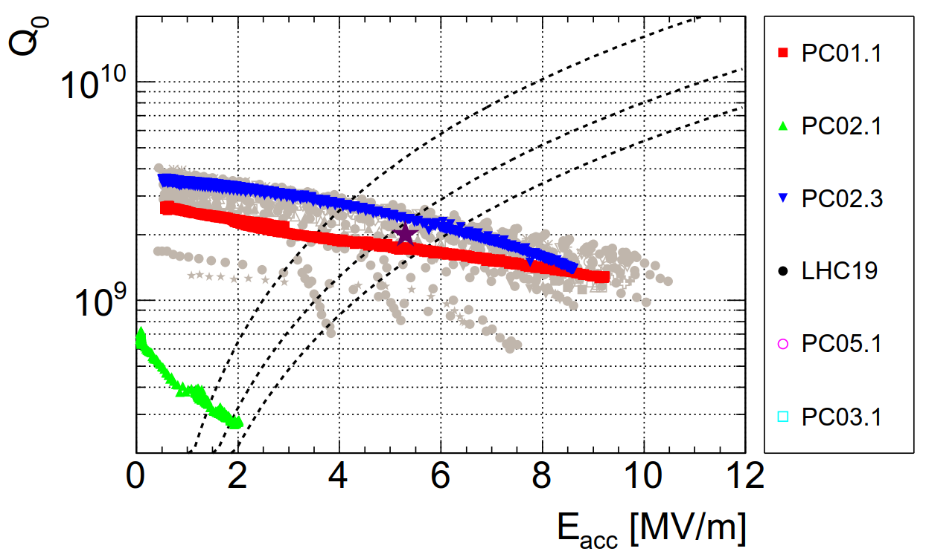
PC02.3 (PC02.2 skipped because of metallic contamination before coating process)
10W
20W
30W
All LHC cavities
comparable to the best cavities of 90s

Slide 8
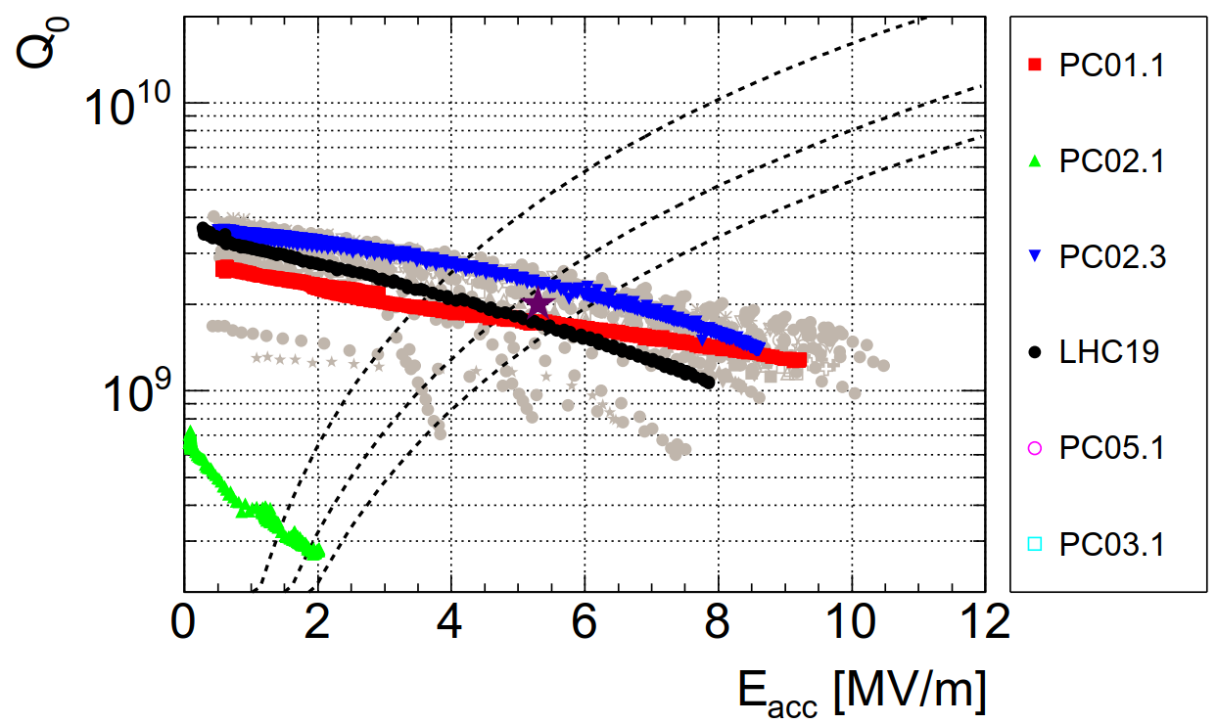
LHC19 → LHC spare (old substrate & coating)
10W
20W
30W
All LHC cavities
One of the worst of 90s (thus spare)
Benchmark the measurement system

Slide 9
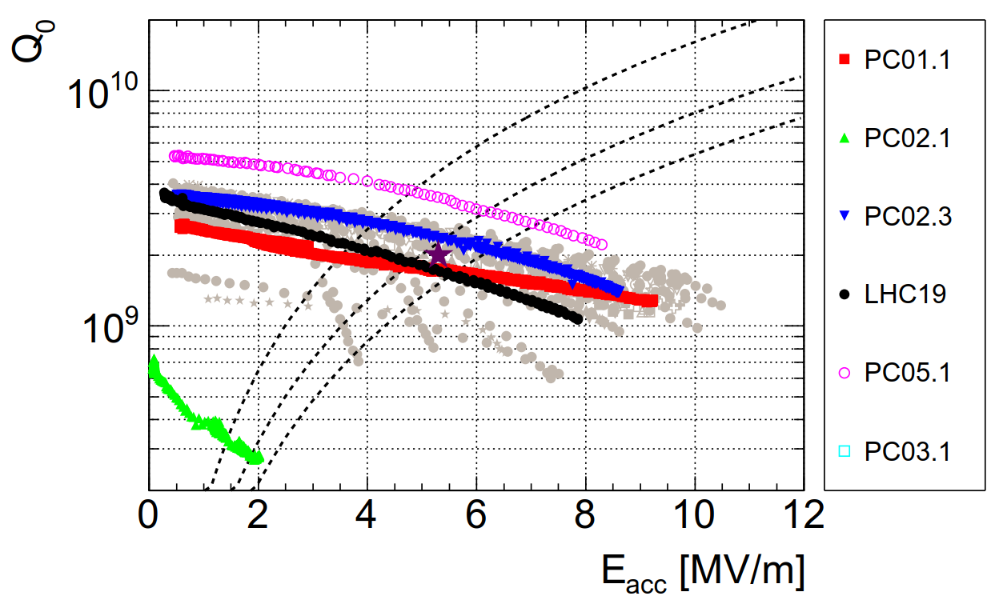
PC05.1 → simplified shape & welding was polished
10W
20W
30W
All LHC cavities

Slide 10
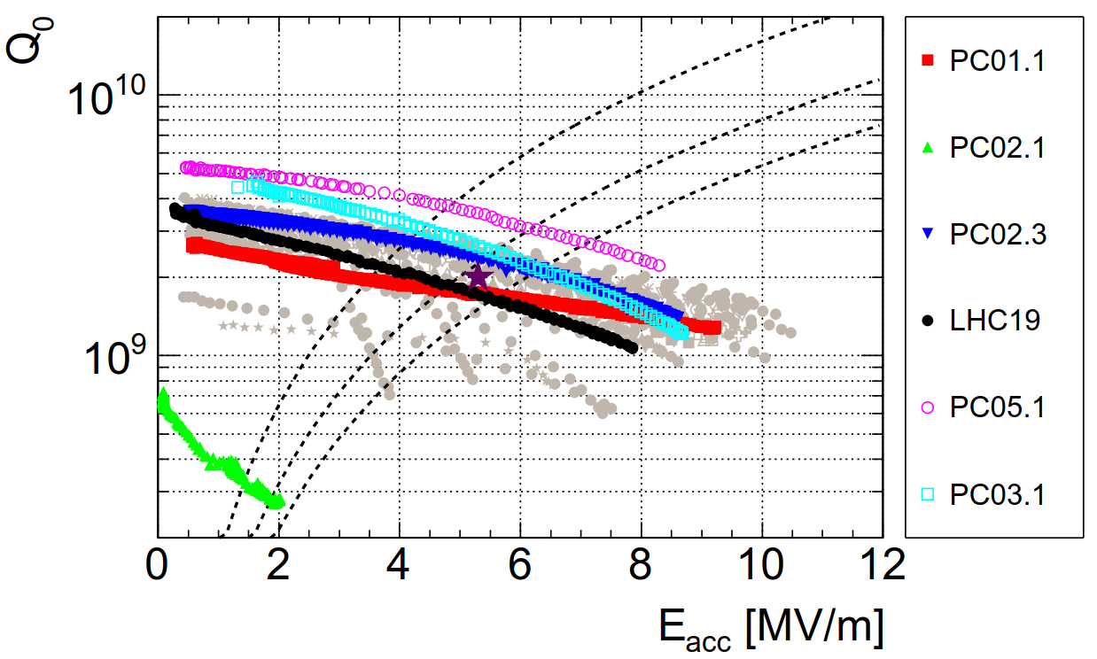
PC03.1 → simplified shape but welding was NOT polished
10W
20W
30W
All LHC cavities

Slide 11
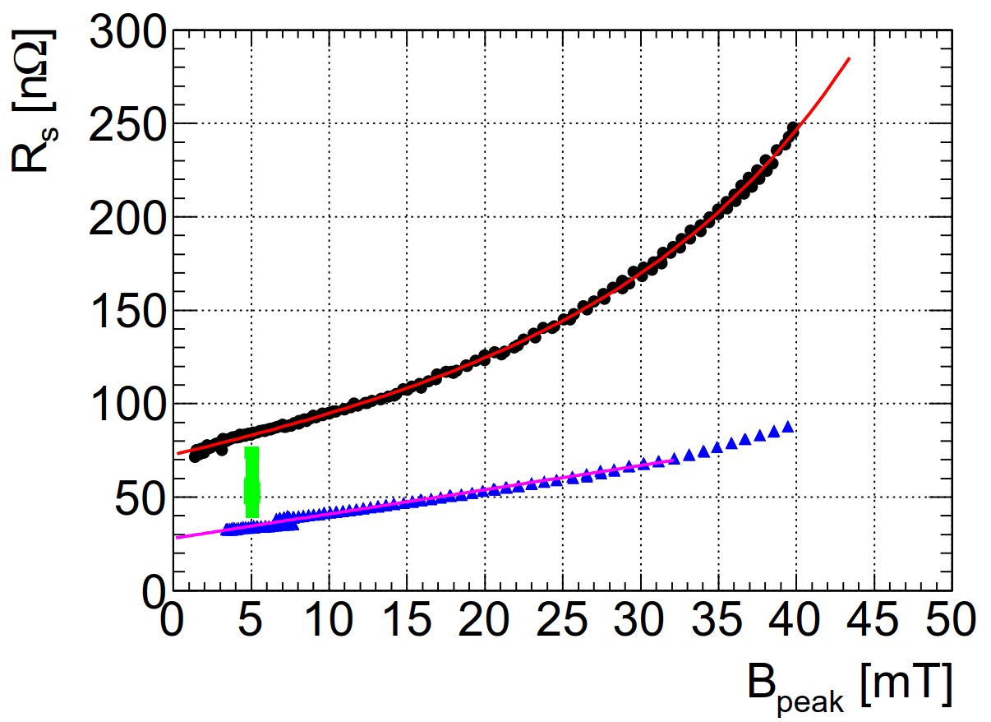
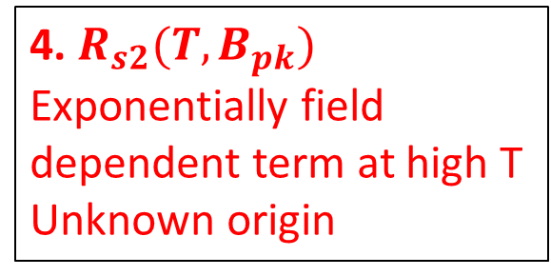
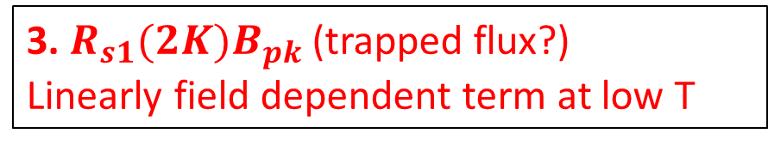
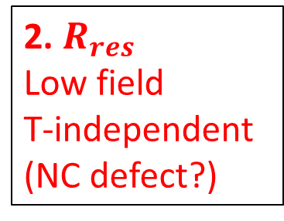
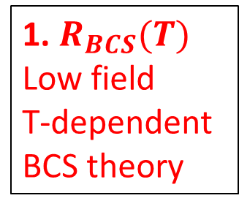
Systematic study: 4 components of surface resistance $R_{s}\sim 257Ω/Q_{0}$
Example: LHC19
4.5K
4. $R_{s2}(T, B_{pk})$
Exponentially field dependent term at high T
Unknown origin
1. $R_{BCS}(T)$
Low field
T-dependent
BCS theory
2.4K
3. $R_{s1}(2K)B_{pk}$ (trapped flux?)
Linearly field dependent term at low T
2. $R_{res}$
Low field
T-independent
(NC defect?)

Slide 12
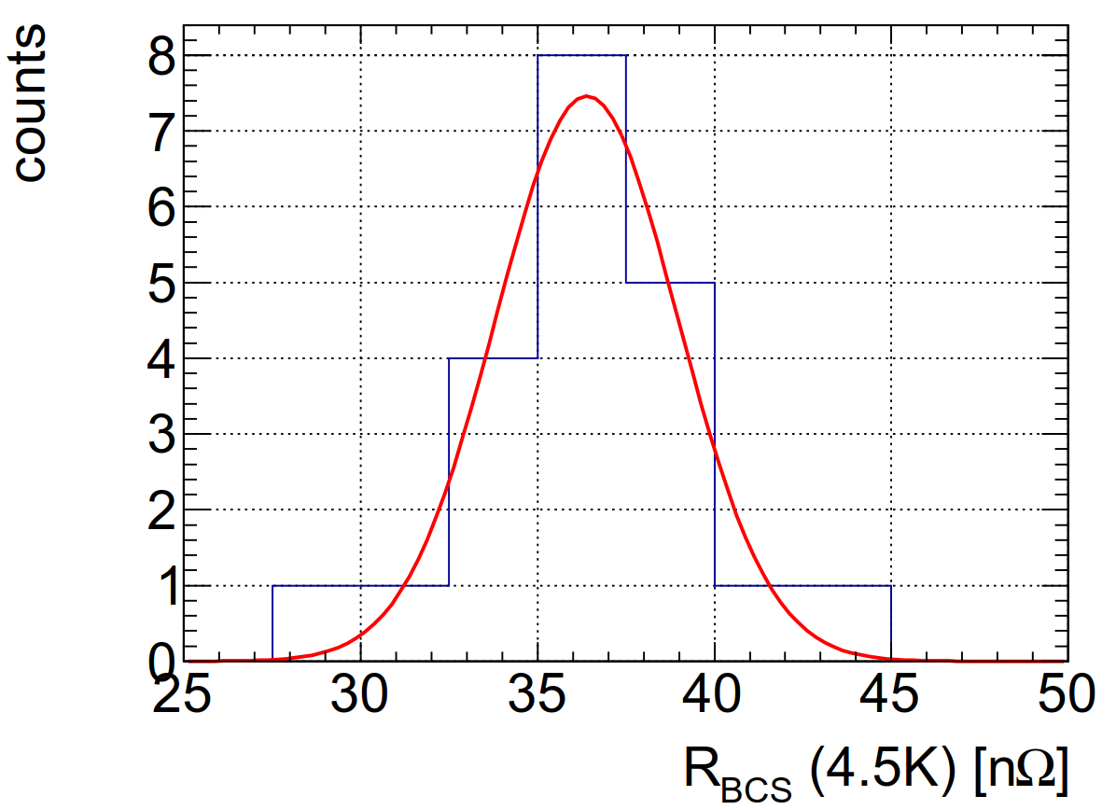
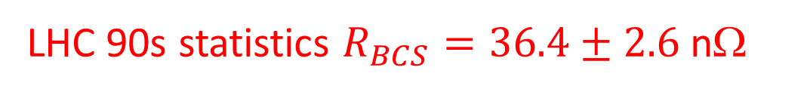
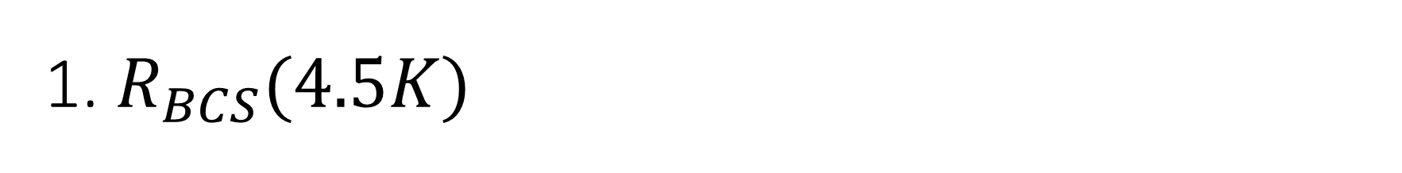
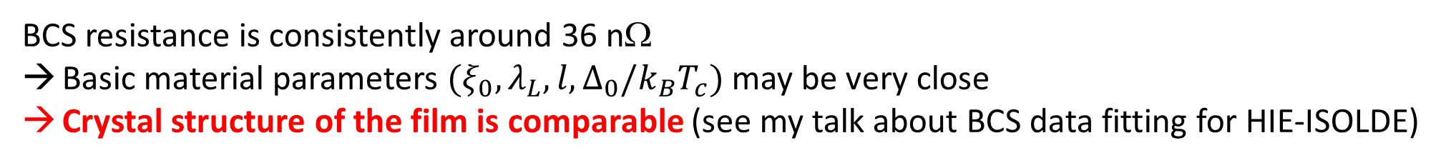
1. $R_{BCS}(4.5K)$
LHC 90s statistics $R_{BCS}=36.4±2.6$ nΩ
PC05: 34 nΩ
PC03: 31 nΩ
LHC19: 43 nΩ
BCS resistance is consistently around 36 nΩ
Basic material parameters $(ξ_{0}, λ_{L}, l, Δ_{0}/k_{B}T_{c})$ may be very close
Crystal structure of the film is comparable (see my talk about BCS data fitting for HIE-ISOLDE)

Slide 13
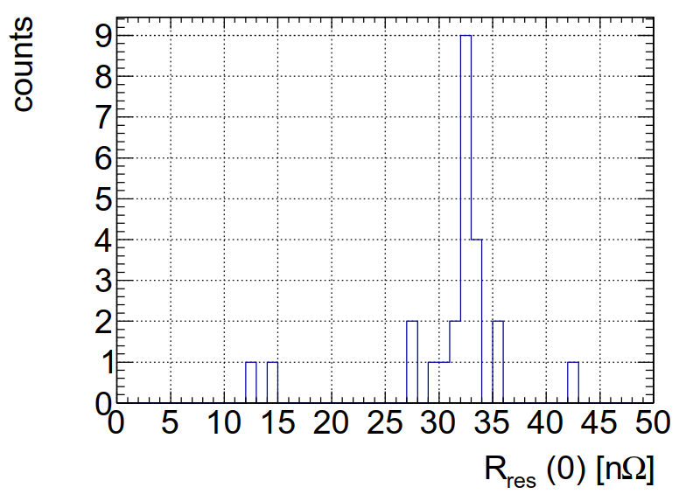
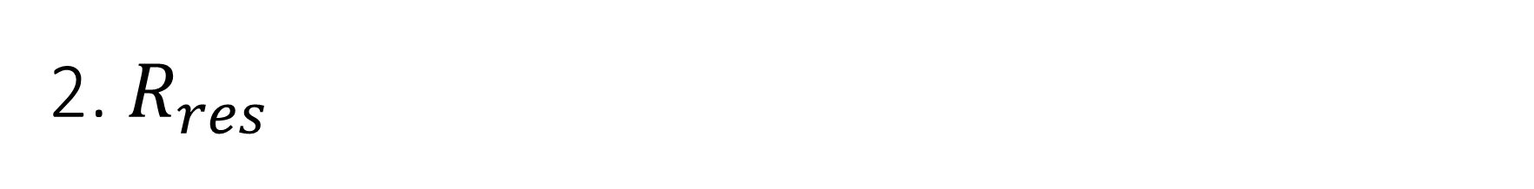
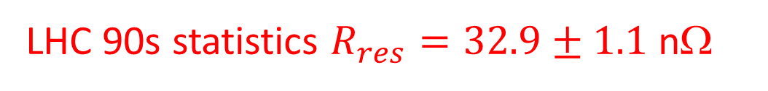
2. $R_{res}$
LHC 90s statistics $R_{res}=32.9±1.1$ nΩ
PC03
PC05
significance
17 s.t.d
Residual resistance was drastically improved in PC03 and PC05
Less normal conducting defect in the Nb film?
The simplified shape without ports may result in better coating

Slide 14
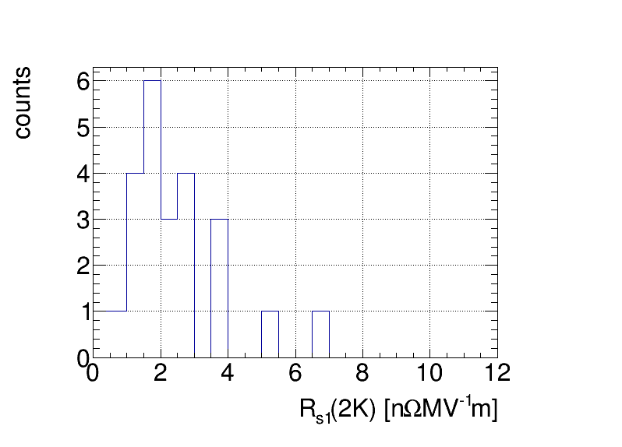

3. $R_{s1}B_{pk}$ linear Q-slope at low temperature
PC03
LHC19
Statistics:
non-Gaussian
Wide dispersion
Systematic effect?
PC05
This slope was very good in PC05
Trapped field sensitivity, flux expulsion (no magnetic shield, no detectors around…)

Slide 15
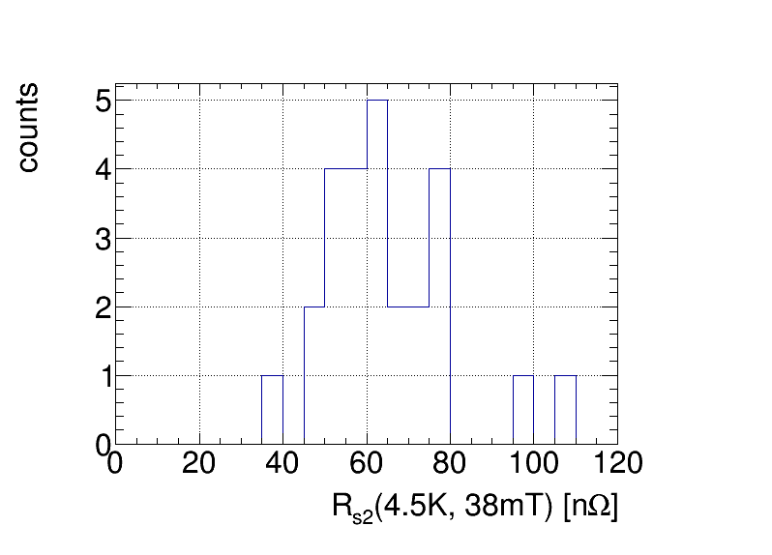
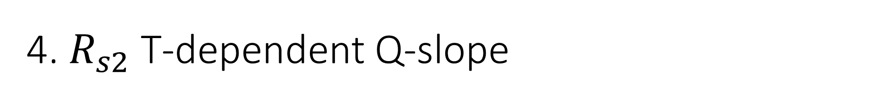
4. $R_{s2}$ T-dependent Q-slope
PC03
PC05
LHC19
PC05 has better T-dependent Q-slope than others
LHC19 has particularly high Q-slope

Slide 16
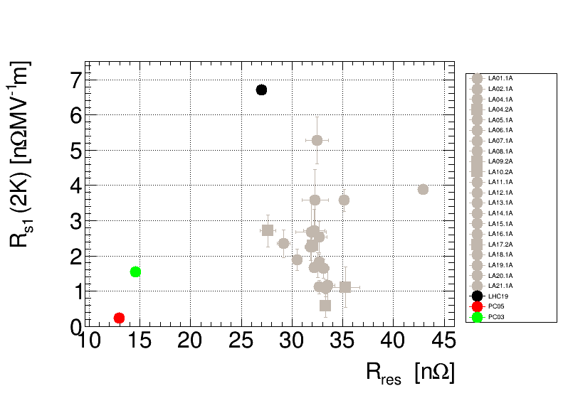
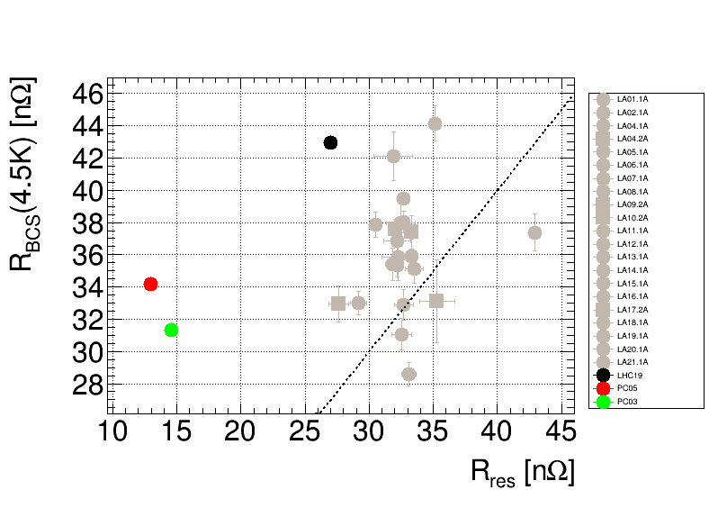
Correlation plots
Q-slope and residual resistance
→ No strong correlation
BCS and residual resistance
→ No strong correlation
BCS resistance, residual resistance, Q-slope does not share the same origin

Slide 17
Summary
LHC spare cavity project successfully reproduced the performance of LHC cavities in 90s
The coating recipe is not identical to 90s, but the resulting film (crystal structure) seems comparable according to the similar BCS resistance
The residual resistance seems sensitive to the different substrate shape
  The realistic substrate is consistent with LHC cavities
  The simplified substrate has better residual resistance
Comparison of two simplified cavities may give us the cause of Q-slope in the substrate production → discussion

Slide 18
Discussion: PC03 and PC05 (thanks to M. Karppinen, G. Rosaz)
 | PC03 | PC05
Half-cell forming | BMAX | Heggli & Gubler
Raw material Cu | 3mm OFE-Cu (scratches) | Annealed 4mm OFE-Cu
Shape | Simplified (no ports) | Simplified (no ports)
Fabrication | Electro Hydraulic Forming (EHF) | Spinning + internal machining
Heat treatment |  | During spinning process
Polishing before welding of iris & equator | Grinding entire RF surface (to remove scratches)
Welding (CERN) | Full penetration from outside | Full penetration from outside
Polishing after welding | Partially on the weld | Fully on the weld
coating | Standard recipe using Kr | Standard recipe using Kr
BCS resistance | 31 nΩ (consistent with LHC) | 34 nΩ (consistent with LHC)
Residual resistance | 14 nΩ (17σ smaller than LHC) | 13nΩ (17σ smaller than LHC)
Q-slope (2K) | 1.5 nΩ/(MV/m) | 0.1 nΩ/(MV/m)

Slide 19
Discussion: PC03 and PC05 (thanks to M. Karppinen, G. Rosaz)
 | PC03 | PC05
Half-cell forming | BMAX | Heggli & Gubler
Raw material Cu | 3mm OFE-Cu (scratches) | Annealed 4mm OFE-Cu
Shape | Simplified (no ports) | Simplified (no ports)
Fabrication | Electro Hydraulic Forming (EHF) | Spinning + internal machining
Heat treatment |  | During spinning process
Polishing before welding of iris & equator | Grinding entire RF surface (to remove scratches)
Welding (CERN) | Full penetration from outside | Full penetration from outside
Polishing after welding | Partially on the weld | Fully on the weld
coating | Standard recipe using Kr | Standard recipe using Kr
BCS resistance | 31 nΩ (consistent with LHC) | 34 nΩ (consistent with LHC)
Residual resistance | 14 nΩ (17σ smaller than LHC) | 13nΩ (17σ smaller than LHC)
Q-slope (2K) | 1.5 nΩ/(MV/m) | 0.1 nΩ/(MV/m)

Slide 20
Outlook
Nb/Cu technology
  Explore novel coating method
  Optimize coating recipe
This LHC study and HIE-ISOLDE study (see my talk about seamless cavity) clarified the importance of Cu substrates
  A part of Q-slope is associated with the welding
To exceed LHC? (FCC 400MHz option?)
  Fully polished welding cavity
  Seamless cavity → cost?
More statistics
  LEP-II data in 80s?

