Slide 1
Flat beams and radiation studies for the alternative triplet
Jose L. Abelleira, Leon Van Riesen Haupt (JAI-FCC team)
9 March 2018
Thanks to the CERN FLUKA team

Slide 2
CONTENTS
Luminosity evolution comparative
Energy deposition studies for the alternative triplet

Slide 3
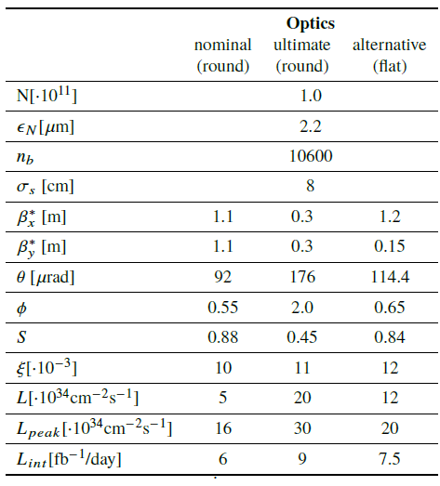
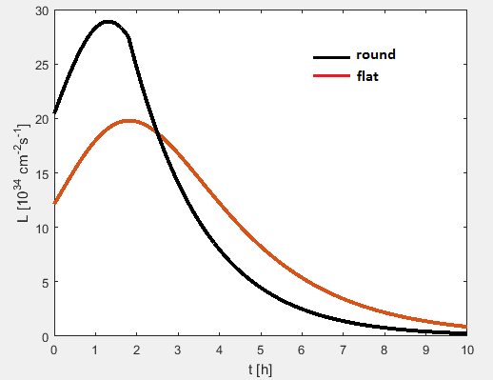
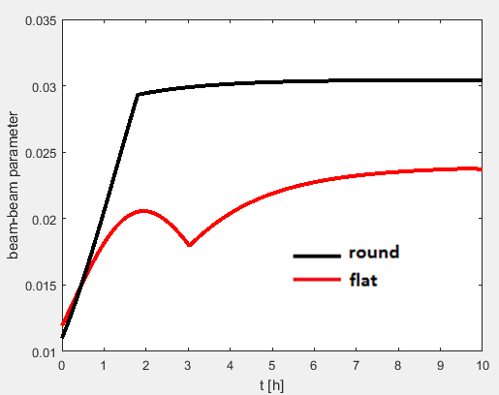
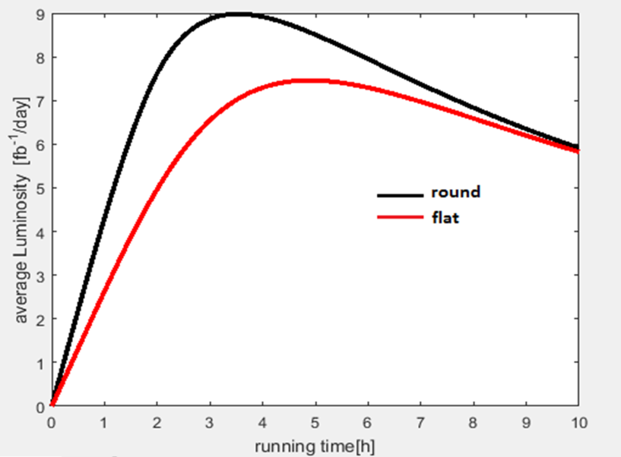
Luminosity evolution
CONTENTS

Slide 4
Dinamic Aperture
  Round, >16 sigma
  Flat, >8.4 (no phase optimization or linear correctors)
Emilia Cruz Alaniz, see talk this meeting

Slide 5
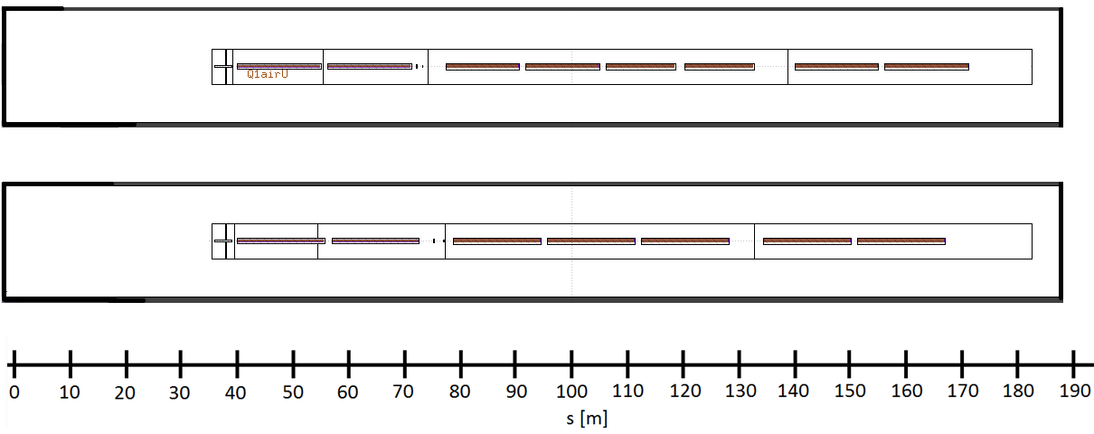
Triplet comparison
L*=40 m
Nominal triplet
14.3 m
12.5 m
14.3 m
Alternative triplet
15 m
15 m
15 m
4 m shorter

Slide 6
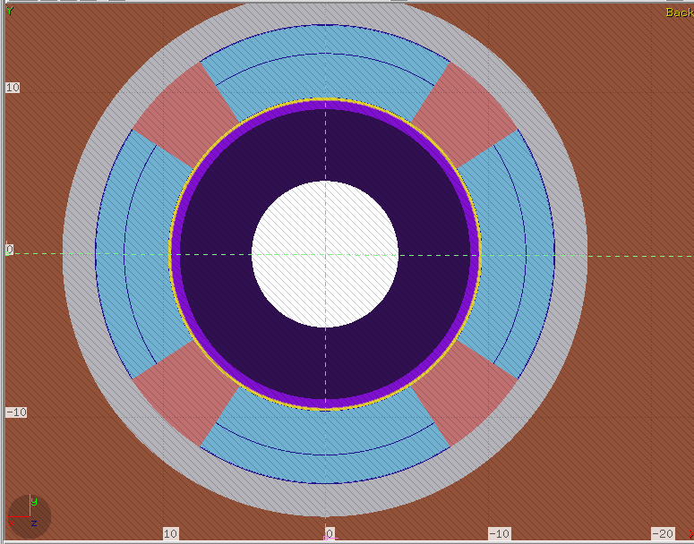
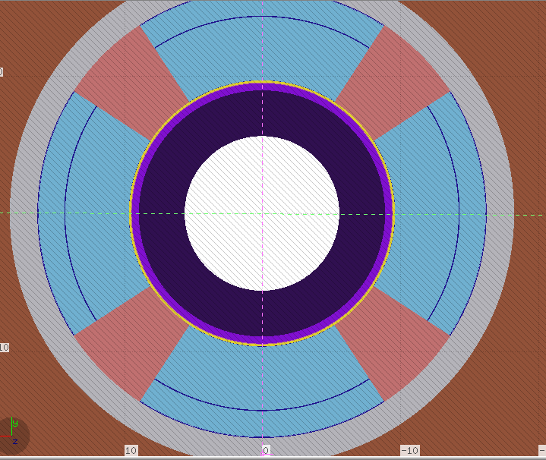
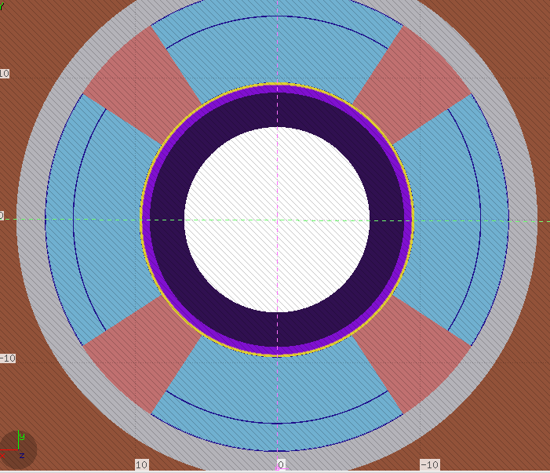
Triplet parameters
Q1
Q2
Q3
Comparison nominal triplet
 | g [T/m] | coil, r [cm] | free aper, r [cm] | Abs thickness [cm]
Q1 | 108 | 9.66 | 4.51 | 4.4
Q2 | 112 | 9.66 | 5.61 | 3.3
Q3 | 98.5 | 9.66 | 6.51 | 2.4
g [T/m]
127
102
100
Leon Van Riesen-Haupt (JAI-Oxford)

Slide 7
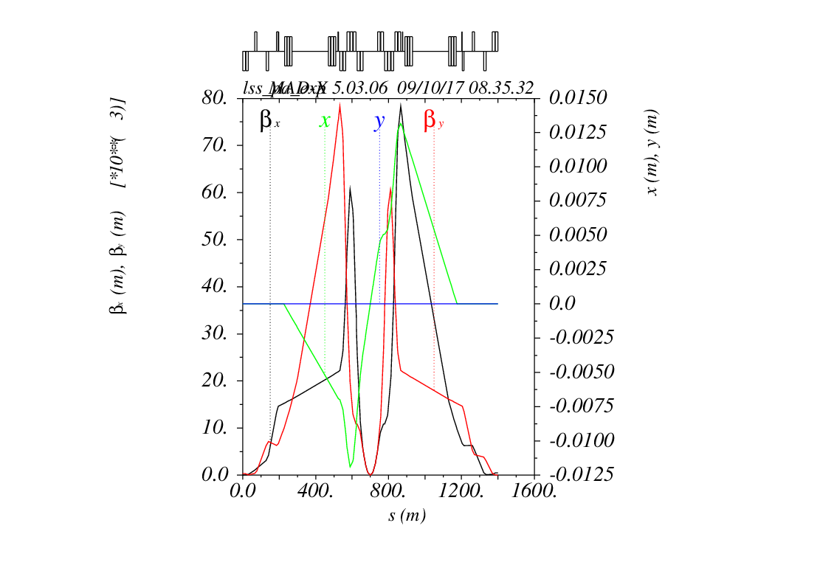
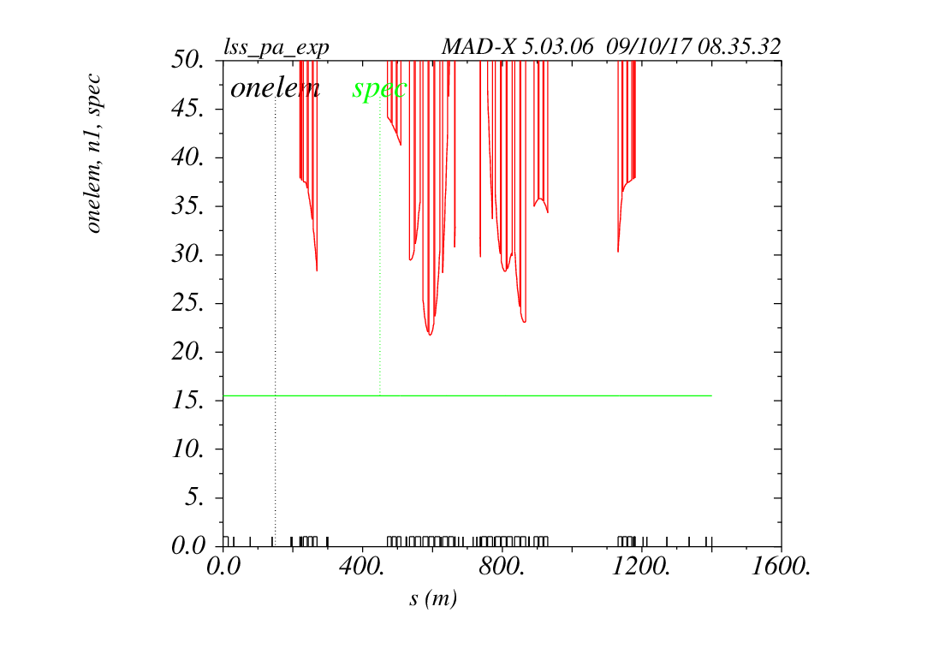




$β^{∗}=0.3 m$
$$β/km$$
$$orbit/m$$
$$21.6σ$$
Leon

Slide 8
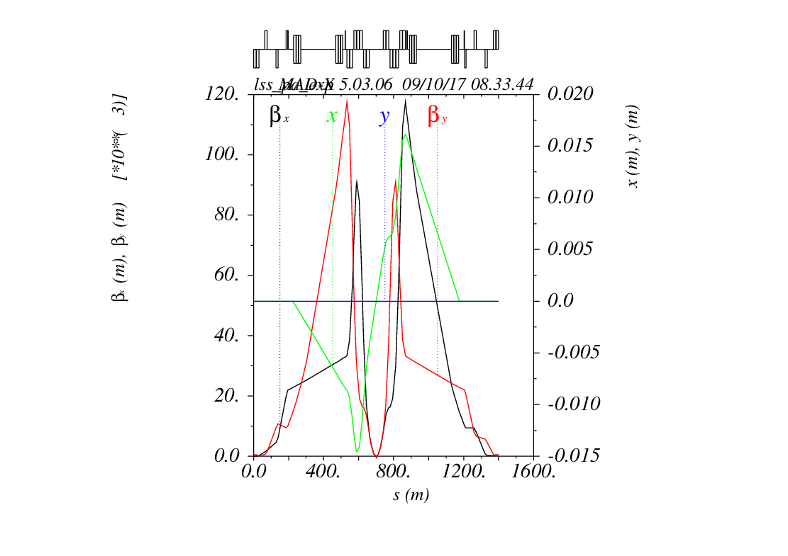
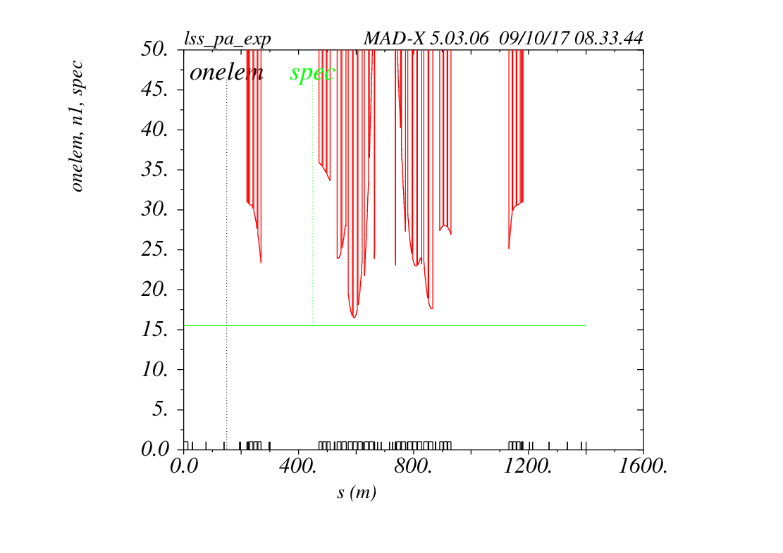




$β^{∗}=0.2 m$
$$β/km$$
$$orbit/m$$
$$16.4σ$$
Leon

Slide 9
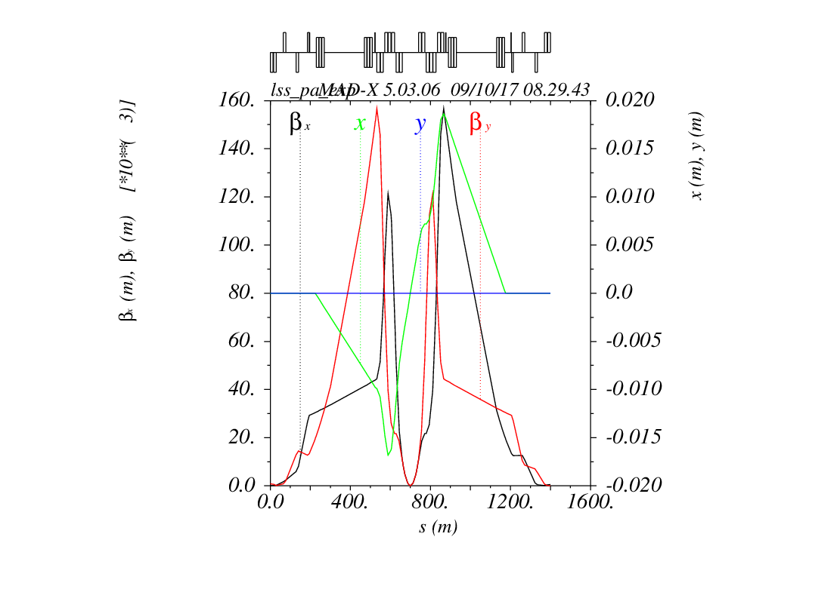
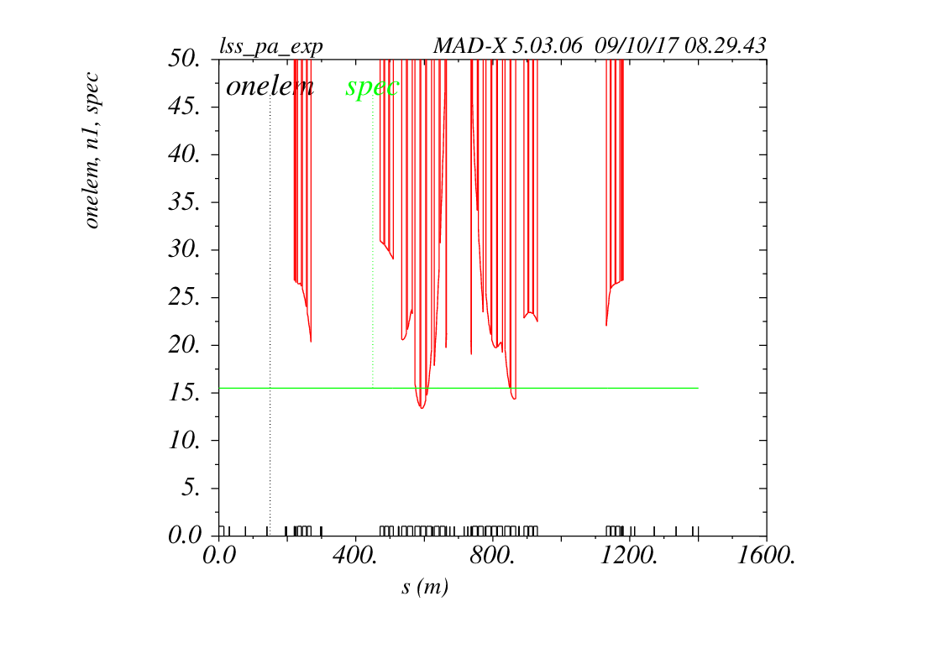




$β^{∗}=0.15 m$
$$β/km$$
$$orbit/m$$
$$13.3σ$$
Leon

Slide 10
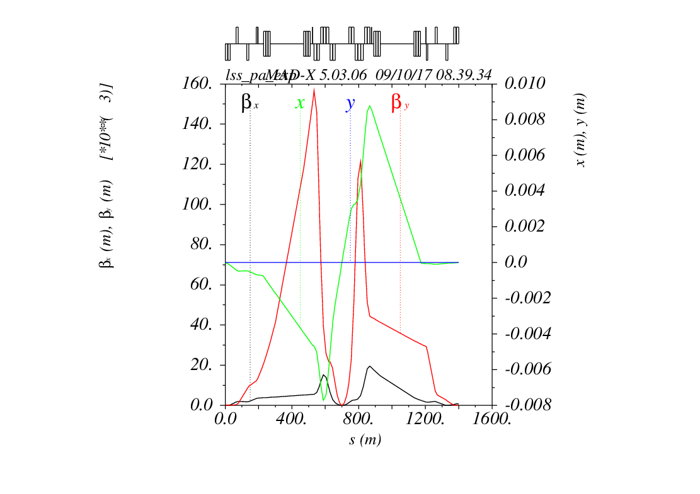
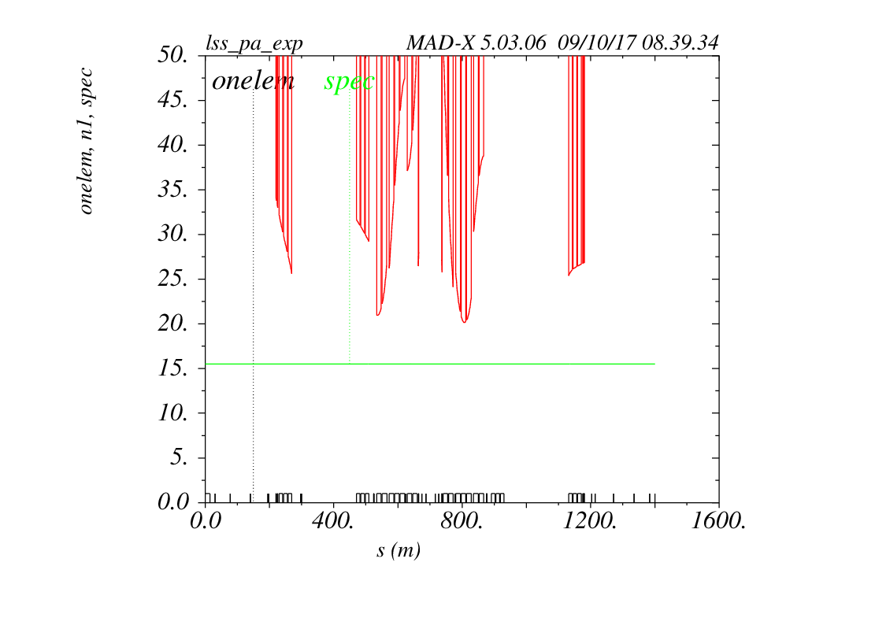



$β^{∗}=0.15×1.2 m$
$$β/km$$
$$orbit/m$$
$$20.2σ$$
Leon

Slide 11

Optics for beta*=0.3 m
$$21.6σ$$
Leon

Slide 12
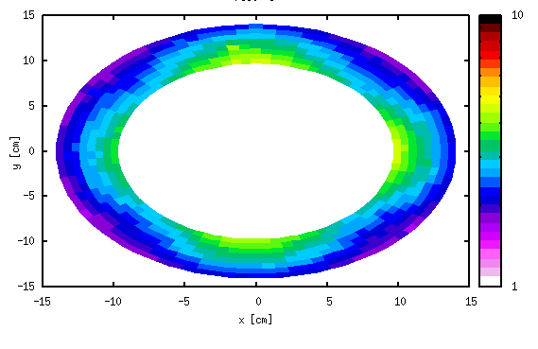
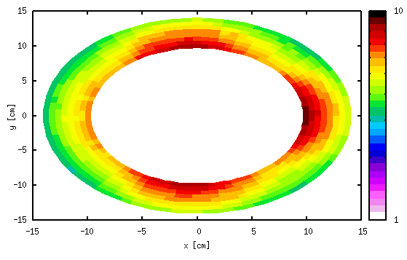
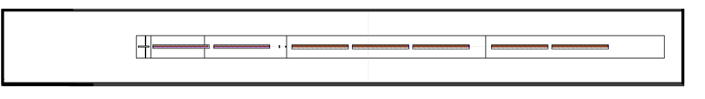
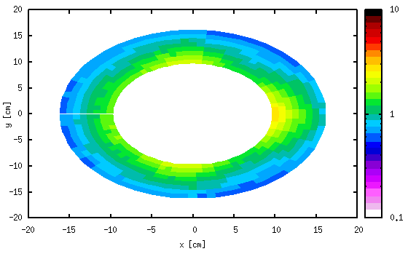
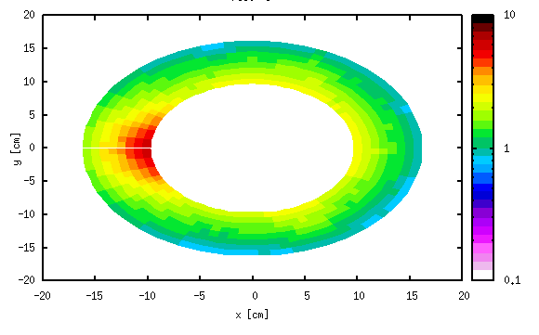
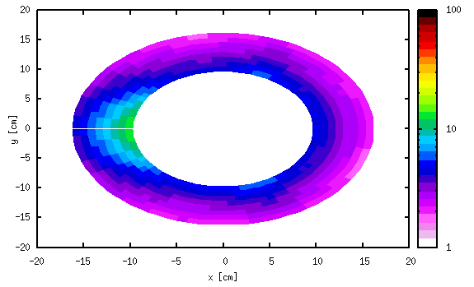
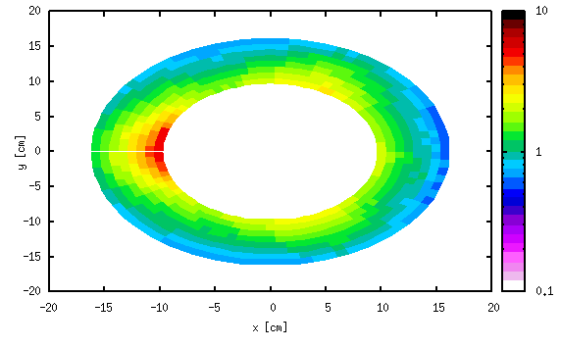
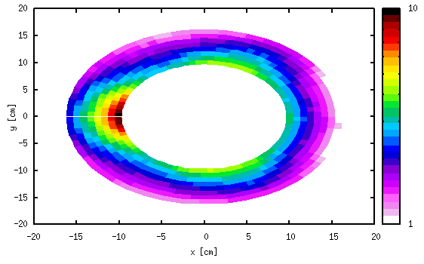
Energy deposition

Slide 13
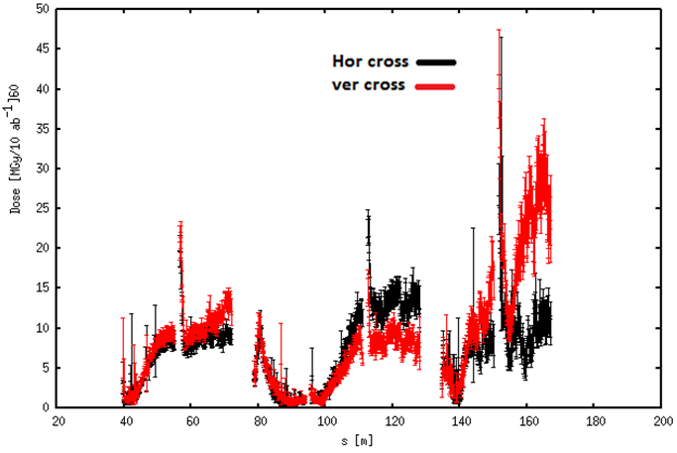
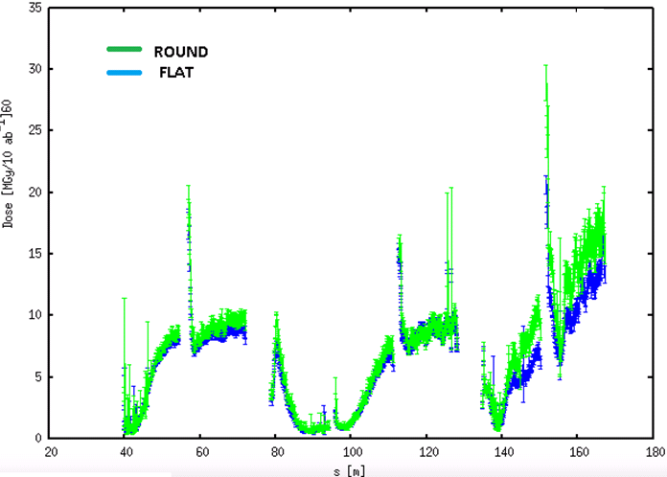
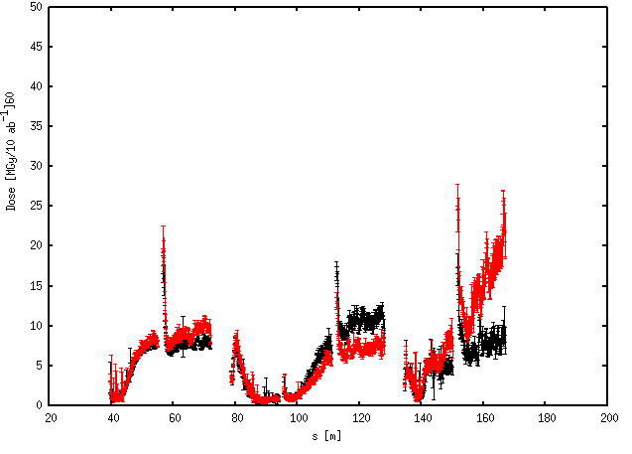
Energy deposition
ROUND
50% VERTICAL CROSSING
50 % HORIZONTAL CROSSING
FLAT
(values normalized to L_{int}=10 ab⁻¹ )

Slide 14
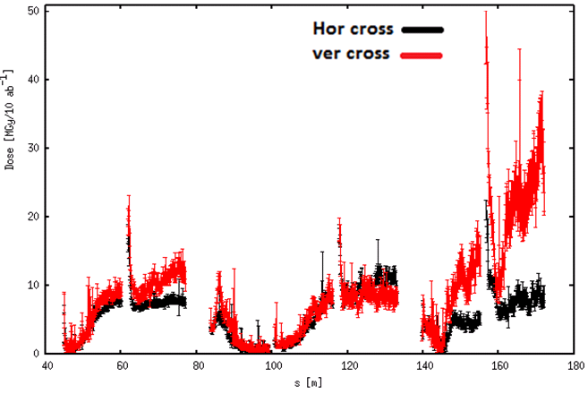
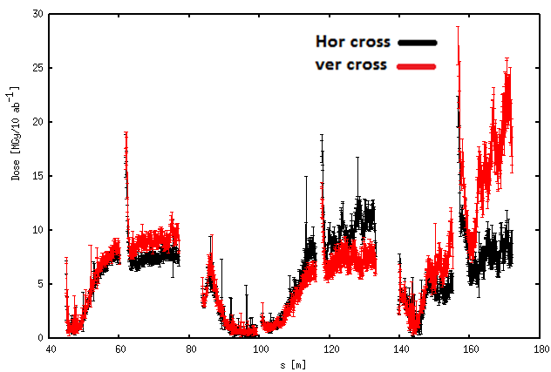
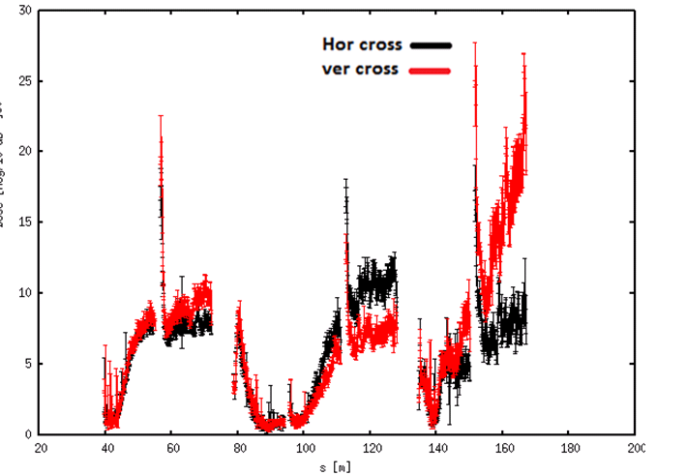
Energy deposition, L* 45m vs 40m
ROUND
FLAT
L*=45 m
ROUND
FLAT
L*=40 m

Slide 15
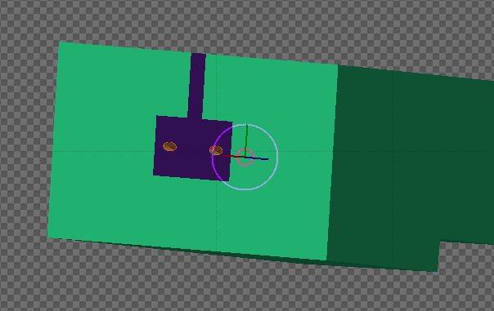
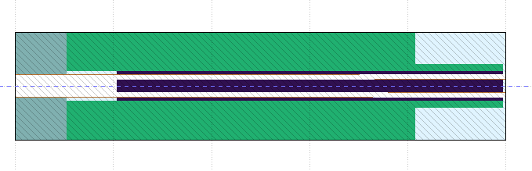
TAN
TAN included for energy deposition simulations in D1 & D1
Provided by CERN FLUKA team.
5 m

Slide 16
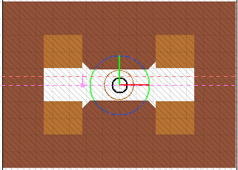
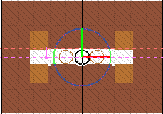
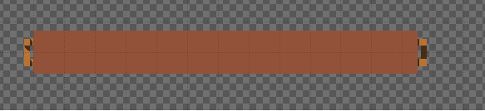
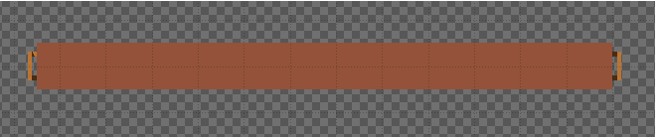
Separation magnets.
Model developed at JAI-Oxford
D1 (×3)
D2 (×3)
17 cm
8 cm
D1
D2
12.5 m

Slide 17
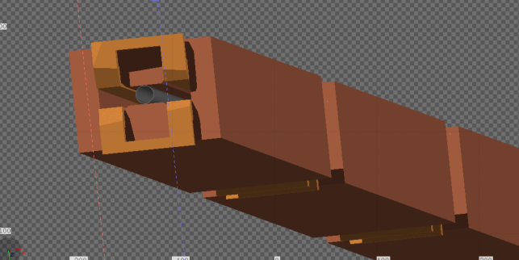
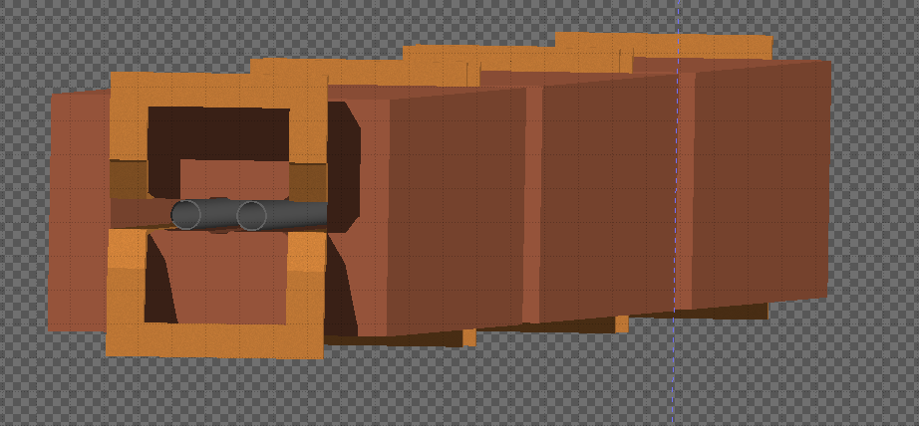
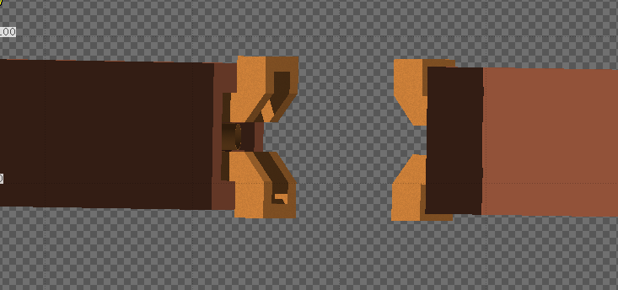
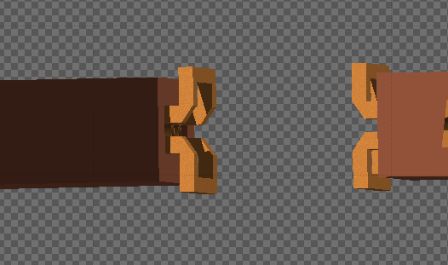
Separation magnets
Alternative triplet
D1 (x3)
D2 (x3)
TAN
D1
D2

Slide 18
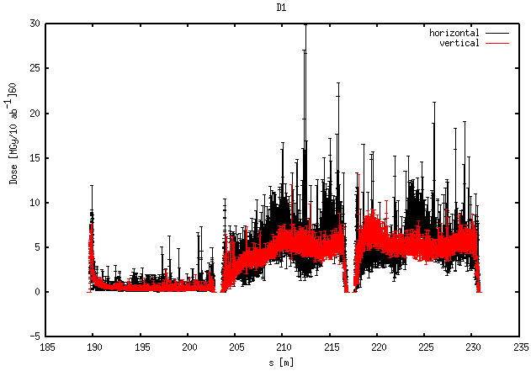
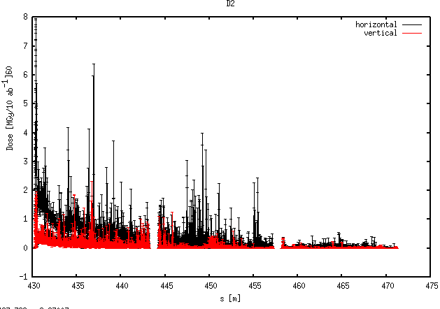
D1
D2

Slide 19
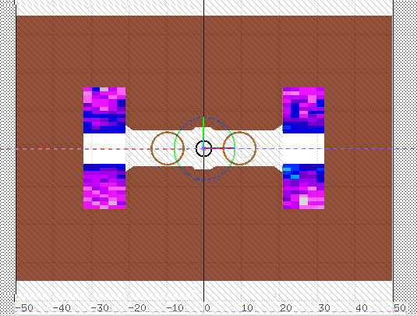
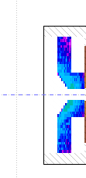
Maximum dose at coils

Slide 20
The alternative triplet design is finished, with L*=40 m.
This triplet is more compact that the nominal one.
The triplet is compatible with round and flat beams.
No energy deposition issues with L*40.
A model for D1 and D2 normal conducting model is presented
Energy deposition simulations in dipoles done with including TAN.
No issues in energy deposition.

