Slide 1
WP3 – Gun and Injector
Massimo.Ferrario@LNF.INFN.IT
WP3 Meeting 1 – March 1, 2018

Slide 2
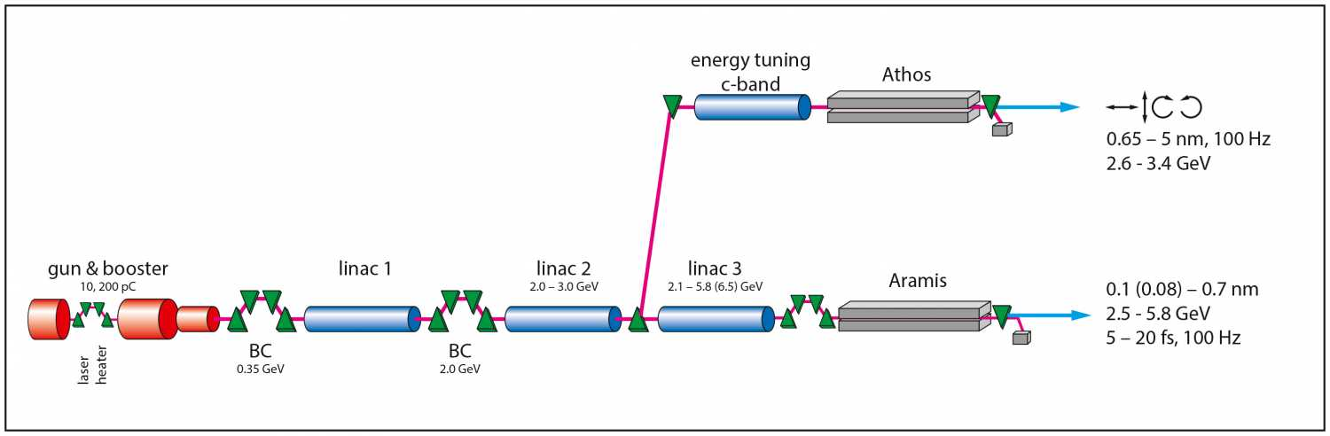
Relationship to other WPs: Jim View
WP6 – Beam Dynamics and Start to End Simulations
WP3 – Gun and Injector
WP5 – Undulators and Light Production
WP4 – RF Systems
Using SwissFEL as an example. https://www.psi.ch/swissfel/

Slide 3
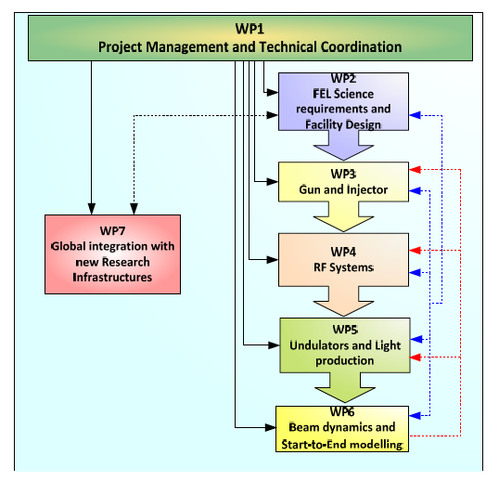

Slide 4
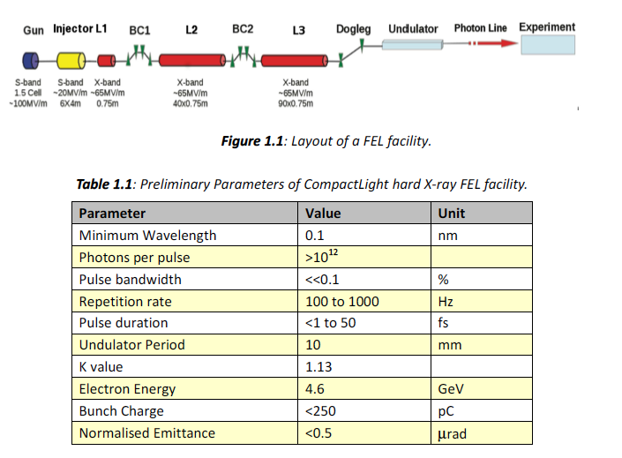
Tentative parameter list

Slide 6
Description of tasks
The work will be divided in four tasks:
Task 3.1 - Evaluation of an innovative full-X-band injector, inclusive of a higher-harmonic linearization in the K band. This ambitious goal aims to advance the recent achievements in the design of X-band guns and to explore the feasibility of RF components at unprecedented frequencies such as the K band. INFN will lead this task with the support of ST, CERN, UA-IAT, ULANC, TU/e, USTR.
Task 3.2 - Evaluation of a high-gradient C-band injector and S-band in jector inclusive of X-band linearizer and a magnetic chicane. INFN will lead this task with the support of all the partners working on this WP.
Task 3.3 - Design of CompactLight e-gun and injector inclusive of linearizer and a magnetic chicane. INFN will lead this task with the support of all the partners working on this WP.
Task 3.4 - Phase-space linearisers, and options for compact magnetic chicanes to achieve longitudinal bunch compression). Diagnostics tool based on X-band deflecting transverse cavity will also be considered. INFN will lead this task with the support of ST, CERN, UA-IAT, ULANC, URM, ALBA.

Slide 7
Deliverables
D3.1 - Preliminary assessments and evaluations of the optimum e-gun and injector solution for the CompactLight design, (=>M18).
D3.2 – A review report on the bunch compression techniques and phase space linearization, (=>M18).
D3.3 – Design of the injector diagnostics/beam manipulations based on a X-band cavities, (=>M36).
D3.4 - Design of the CompactLight e-gun and injector, with phase space linearizer (=>M36).

Slide 8
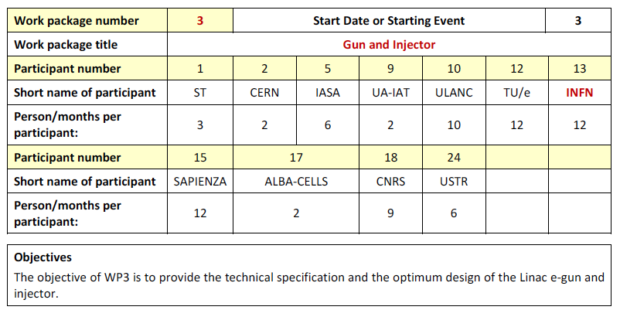

Slide 9
New Description of Tasks
(task leaders in bold)
Task 3.1 - Gun Design (RF, Solenoid, Cathode, Laser, Diagnostics) => D3.1 M18 => D3.3 M36
  S-Band Gun RF Design (CNRS + IASA+UAIAT-INFN+ALBA )
  C-Band Gun RF Design (INFN +IASA+Sapienza)
  X-Band Gun RF Design (CSIC-IFIC + UAIAT+ Sapienza)
  DC Gun Design (TU/e )
  Laser/Photocathode (IASA+CNRS+INFN )
Task 3.2 - Compressor Design (Velocity Bunching, Magnetic Chicane) ) => D3.2 M18 => D3.3 M36
  S-Band Velocity Bunching (TU/e + IASA+ALBA)
  C-Band Velocity Bunching (INFN +IASA+TU/e )
  X-Band Velocity Bunching ( Sapienza+CERN+IASA+INFN )
  Magnetic Compressor (ST + CERN+INFN+CNRS)
  Task 3.3 – X-Band Transverse RF Deflector (Sapienza+ IASA+ ) => D3.3 M36
Task 3.4 - : RF Linearizer Design => D3.2 M18 => D3.3 M36
  X-Band RF Linearizer Design (Sapienza )
  K-Band RF Linearizer Design (ULANC +Sapienza )
  Passive linearizer (CNRS )

Slide 10
Discussion Summary
A self-consistent FEL parameter list is needed from WP2 as soon as possible.
Beam dynamics simulation support is needed from WP6.
We all agreed on the new description of WP3 Tasks, Deliverables are unchanged.
Sub-Task leaders have been nominated. Sub-Task leaders are supposed to lead the assigned work in collaboration with the other participating institutes and to provide to the WP leader their specific contribution for the Deliverables.

Slide 11
Thanks for your attention

