Slide 1
Spokesperson report
OPERA Collaboration Meeting
Anacapri, May 31st – June 1st 2018
Giovanni De Lellis

Slide 2
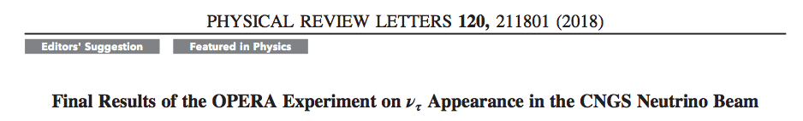
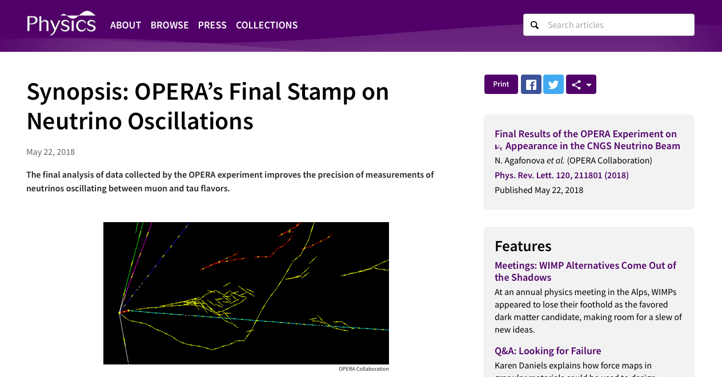
https://journals.aps.org/prl/abstract/10.1103/PhysRevLett.120.211801
https://physics.aps.org/synopsis-for/10.1103/PhysRevLett.120.211801

Slide 3
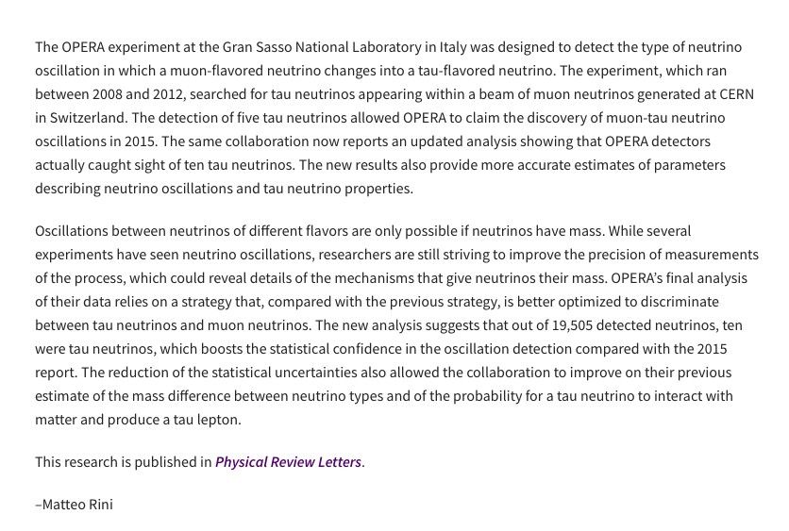
1/4 success rate of papers submitted to PRL
1/6 Editor suggestions

Slide 4
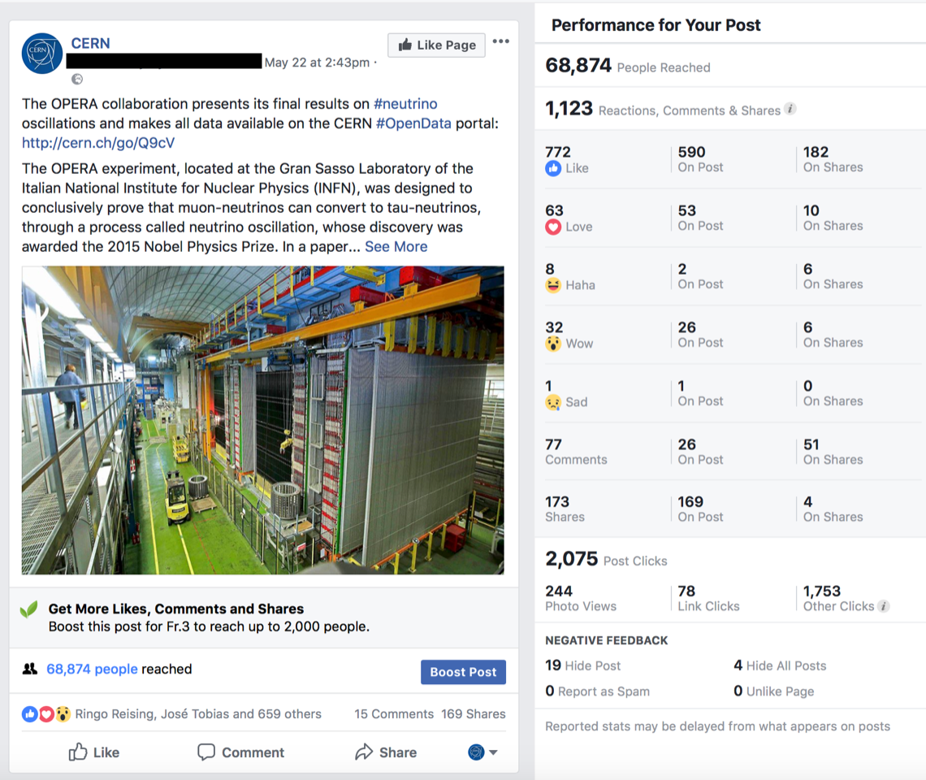
CERN press and social media as of May 30th
The article on the CERN home page (not the press website) has received 2263 unique pageviews so far, with readers spending an average of 04:54 on it.
The Facebook post has received 169 re-shares and 661 likes: https://www.facebook.com/cern/photos/a.173272186093468.45199.169005736520113/1708316059255732/
The Instagram post has received 6039 likes: https://www.instagram.com/p/BjFITsMlHAg/

Slide 5
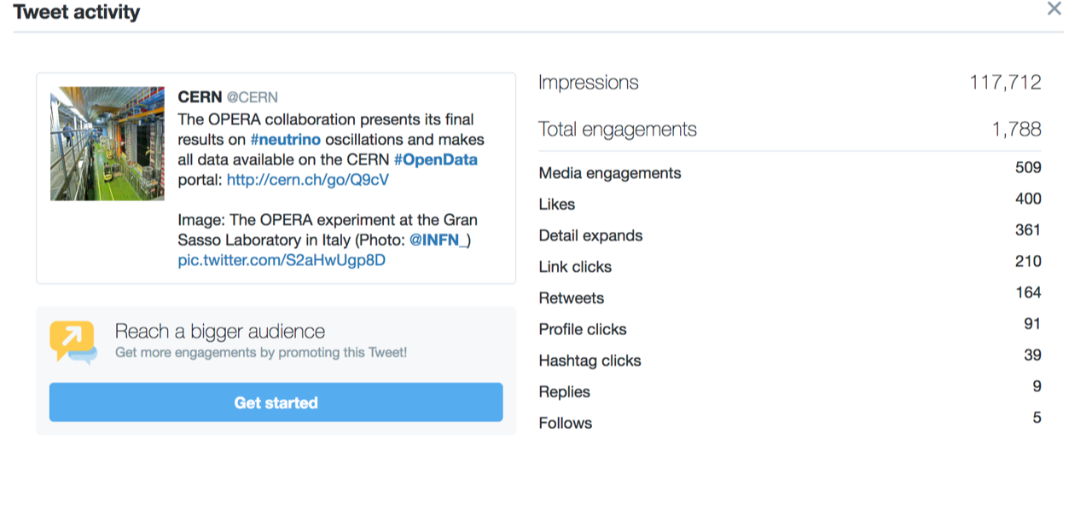
CERN press and social media as of May 30th
The Twitter post has received 164 re-tweets and 400 likes: https://twitter.com/CERN/status/998907266521862144
Around 2700 people view the article in just one week
2000 is considered the threshould above which the paper is considered a good and successful one by CERN Website standard

Slide 6
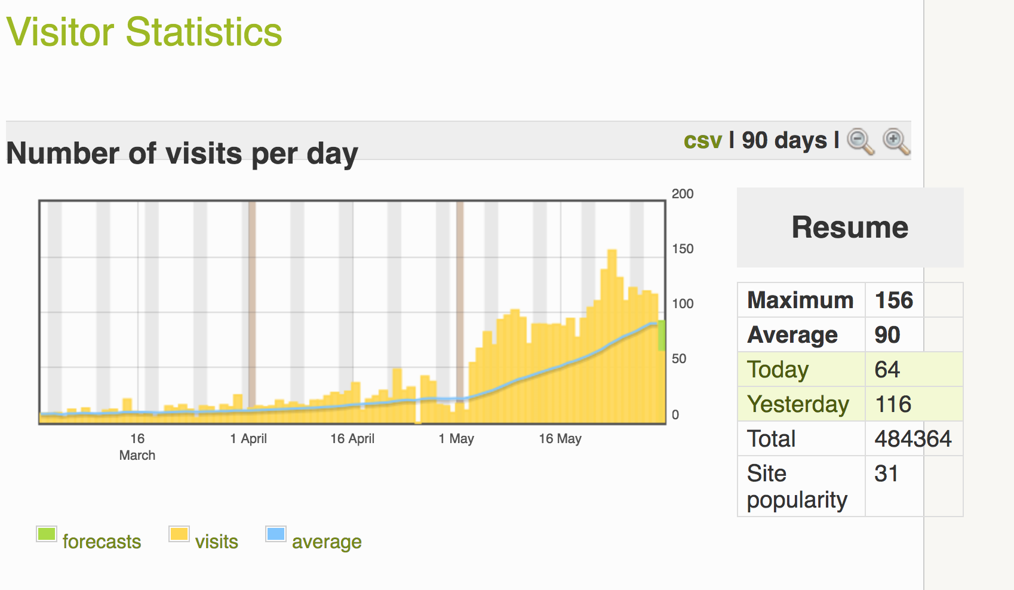
OPERA web site (Yuri)

Slide 7
Δm² measurement in the PDG
I have informed the editors of the chapter: they are willing to include it
Deadline for Summer 2018 already passed, but they will include it in the next round of update

Slide 8
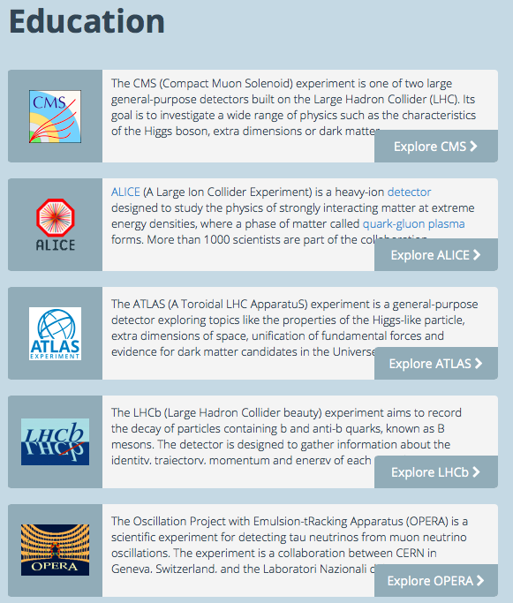
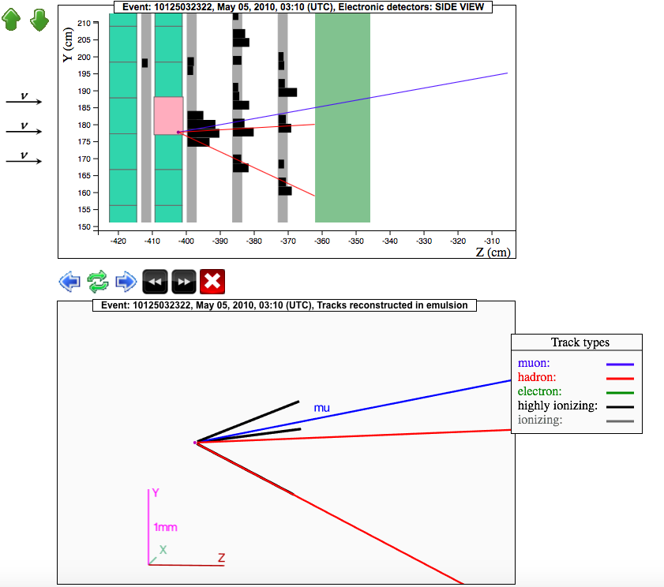
OPERA Open Data at CERN
OPERA is the first non-LHC experiment joining the educational and research program of the Open Data Portal service
Two samples of muon and tau neutrino interactions are now available at CERN: data & event display (effective for education)

Slide 9
Use of OPERA Open Data as of May 30th
- about 3100 accesses to the news item
http://opendata.cern.ch/docs/opera-news-first-release-2018
- about 1800 searches for OPERA related terms
- about 750 accesses to the "About OPERA" page
- about 500 accesses to the OPERA event display
- about 70 downloads of zipped multiplicity and tau datasets

Slide 10
Open Data is part of the OPERA legacy
Multiplicity sample and tau neutrino events are already published
First muon and tau neutrino interactions ever
Agreed already to publish Monte Carlo simulated data for electron showers and an empty volume (real data) to be used to train machine learning algorithms. Giuliana has provided the data. A tutorial will be provided by Andrey Ustyuzhanin
See whether we can publish also our 35 electron neutrino events (see Svetlana’s talk)
Cosmic-ray annual modulation data could also be published (Nicoletta/Alessandro)

Slide 11
OPERA data preservation
Each lab has copied/is copying data from the local database to IN2P3
Cristiano is copying the data to CERN (see Cristiano’s talk)

Slide 12
What OPERA can do in the near future
See Komatsu’s talk for more details
Complete ongoing papers
  Cosmic-ray annual modulation
  Event with three vertices
Sterile neutrino search in the muon to tau neutrino channel (10 events instead of 4!)
Combine electron and tau appearance (OPERA is unique in doing that) and report also muon disappearance
Study of non-standard interactions
Lorentz invariance violation study

Slide 13
Next appointments
Seminar at CERN on July 31st
Committees:
  SPSC final report on 16-17 October 2018

