Slide 1
European Scanning System
Andrey Alexandrov

Slide 2
Toward the automatic emulsion scanning
Before 1974 – the only way to find the
charged particle tracks and decays in
the nuclear emulsions was the eye
inspection using manual microscopes
1974 K. Niwa: Track recognition by
superimposing tomographic images from different focal planes
This was the first idea of the automatic
scanning but the digital technology was not ready yet in that time (the first Digital Camera prototype from Kodak -1975)
1980 – First semi-automatic scanning (Nagoya)
1985 – “Track Selector” (TS) the first automatic scanning system based on tomographic image processing. Started TS-NTS-UTS-SUTS development line (Nagoya)
1994 – CHORUS data analysis – Italian groups enters into scanning business: two microscopes equipped with NTS systems arrived to Naples
2004 – the first prototype of the European Scanning System dedicated for OPERA scanning operational in Naples, developed in collaboration with other Italian groups

Slide 3
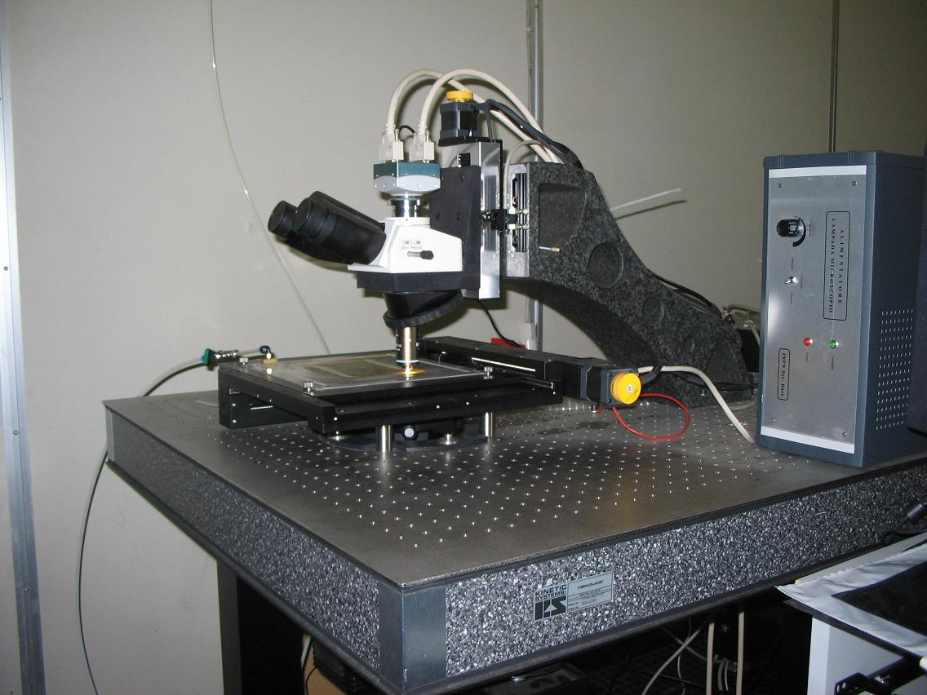
OPERA ESS
20 cm²/h (2004 year components)
Hardware performance of a scanning system for high speed analysis of nuclear emulsions NIMA568 (2006)
Z stage (Micos)
0.05 μm nominal
precision
CMOS camera
1280×1024 pixel
256 gray levels
376 frames/sec
(Mikrotron MC1310)
Emulsion Plate
XY stage (Micos)
0.1 μm nominal
precision
Illumination system, objective (Oil 50× NA 0.85)
and optical tube (Nikon)

Slide 4
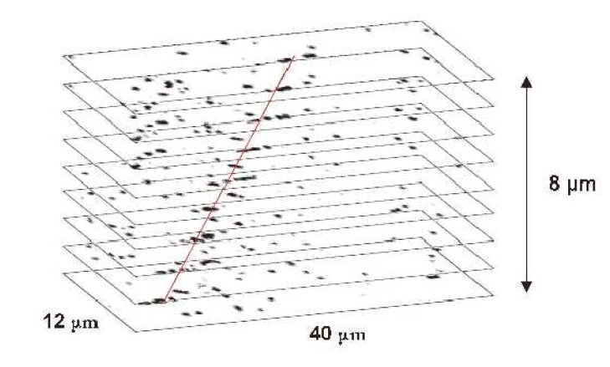
Principle of the automatic emulsion scanning
Professional Image Processing board
Motor control card
16 Tomographic Images taken through 44-micron Emulsion Layer
Movable stage

Slide 5
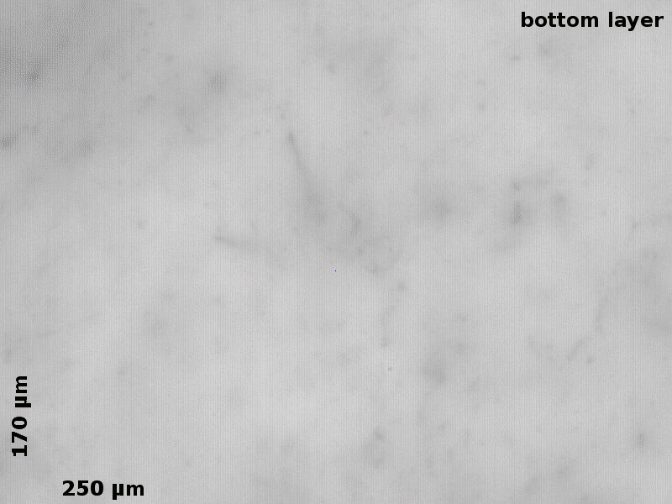
What the microscope CCD sees in one film..

Slide 6

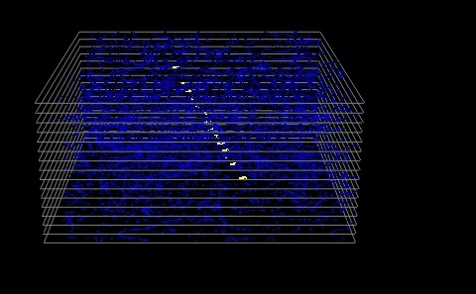
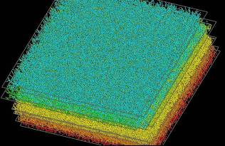
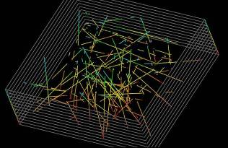
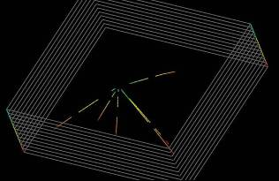
Tracks&vertices reconstruction in ECC
15 tomographic views
Field of view
44 µm
44 mm
390 μm × 310 μm
Track segment: aligned clusters
Track segment: aligned clusters
Images -> microtracks
Microtracks->basetracks
Plate-to-plate alignment
Long tracks reconstruction
Vertex location
Event analysis
Volume scan data (basetracks)
Passing-through and short tracks rejected
Vertex located in the brick

Slide 7
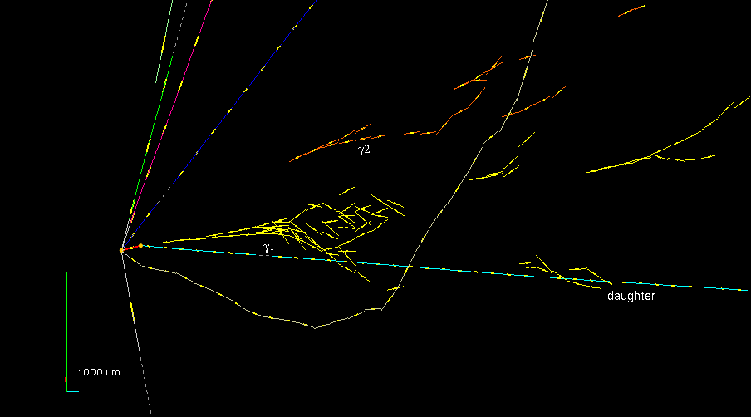
OPERA tau event
Notes:
Processing and reconstruction procedures has not changed since then. What has changed was the SW, the HW and scanning techniques.

Slide 8
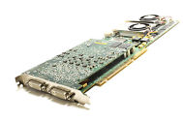
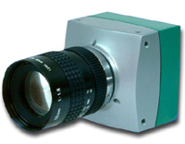
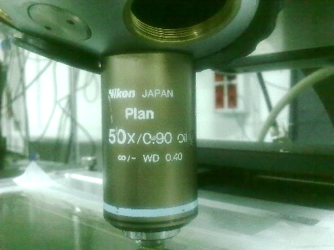
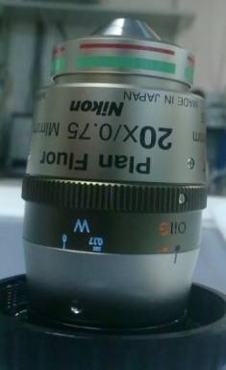
2014 HW upgrade: ESS -> NGSS
Matrox Odyssey Xpro SFCL
SiliconSoftware mE5
PCI-X interface
up to 680 MB/sec
PCIe 8x interface
up to 2200 MB/sec
Mikrotron MC-1310
Mikrotron MC-4082
SFCL interface
1280 x 1024 pixels
1.2 Mpixel @ 376 fps
DFCL interface
2336 x 1728 pixels
4 Mpixel @ 563 fps
Nikon Plan
Nikon Plan Fluor
50X Oil
0.9 NA
0.31 µm/pix
396x317 µm
20X Oil
0.75 NA
0.34 µm/pix
794x586 µm
3.7x larger FoV
Scanning speed:
20 cm²/h
84 cm²/h
“A new generation scanning system for the high-speed analysis of nuclear emulsions” in JINST 11 P06002 2016, doi:10.1088/1748-0221/11/06/P06002

Slide 9
Continuous Motion scanning technique
Proposed in 2011.
First published in NIM A 718 (2013) 184–185 .
“A novel approach for fast scanning of nuclear emulsions with continuous motion of the microscope stage ”

Slide 10
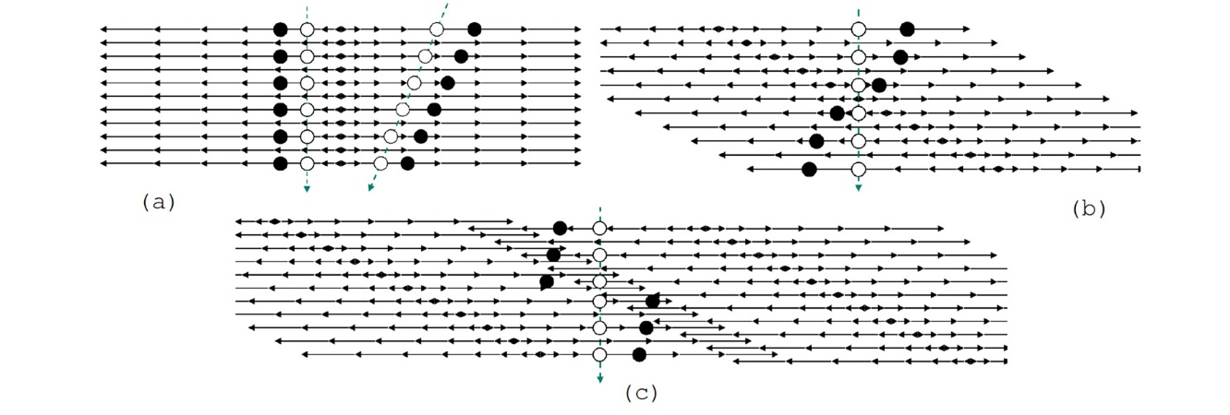
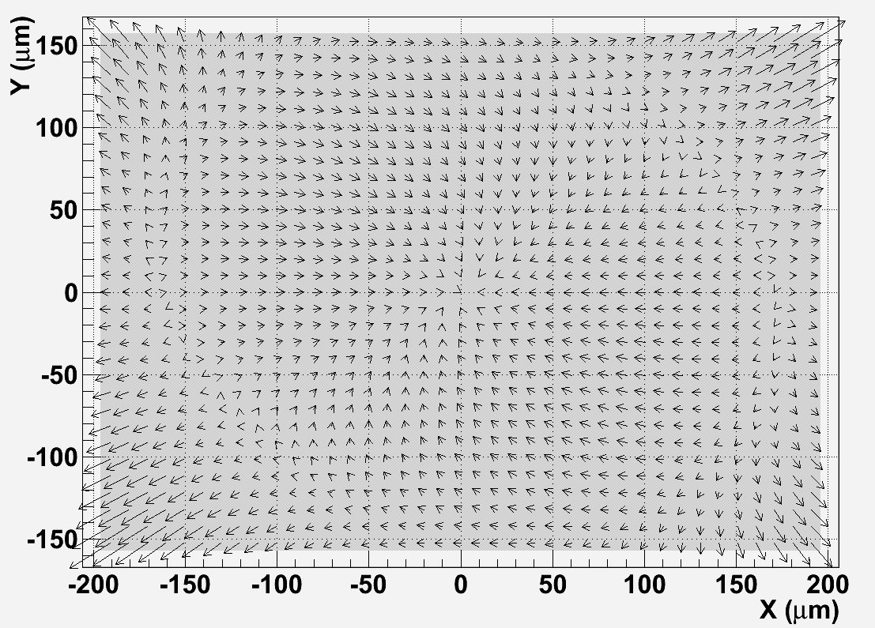
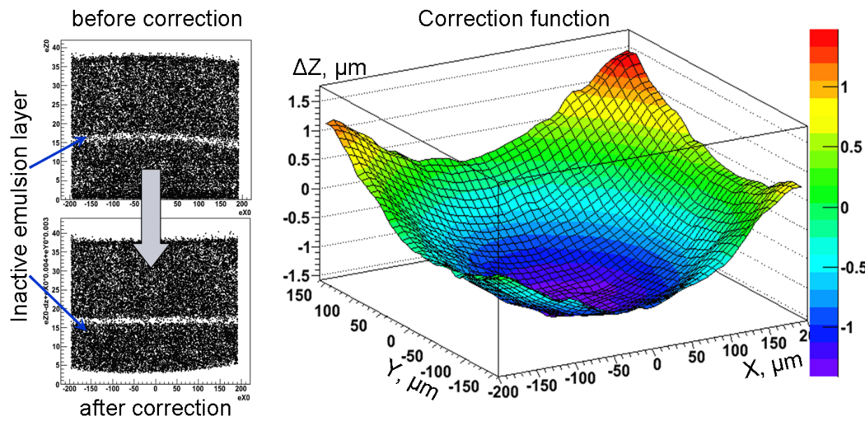
Distortion corrections for CM
CM
SG
CM
XY-corrections: up to 1.5 µm near the view corners
Z-corrections: ~3 µm near the view corners

Slide 11
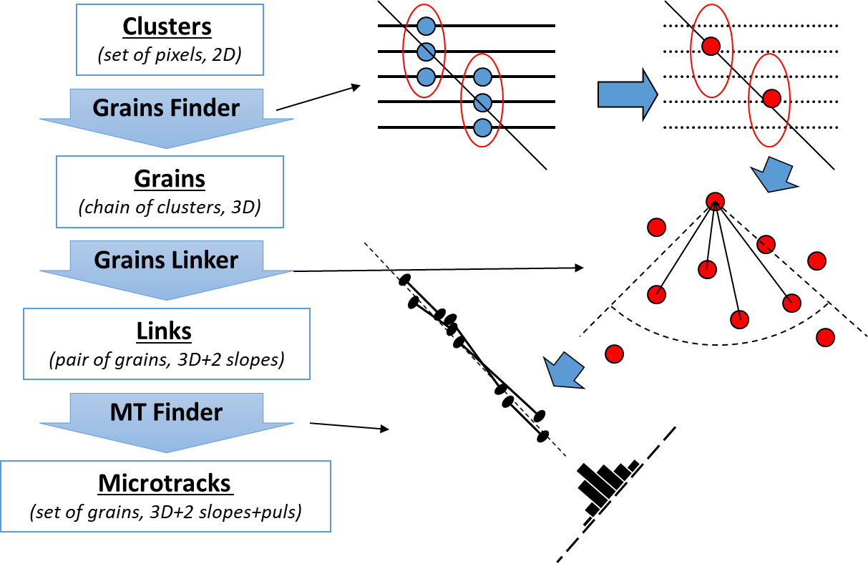
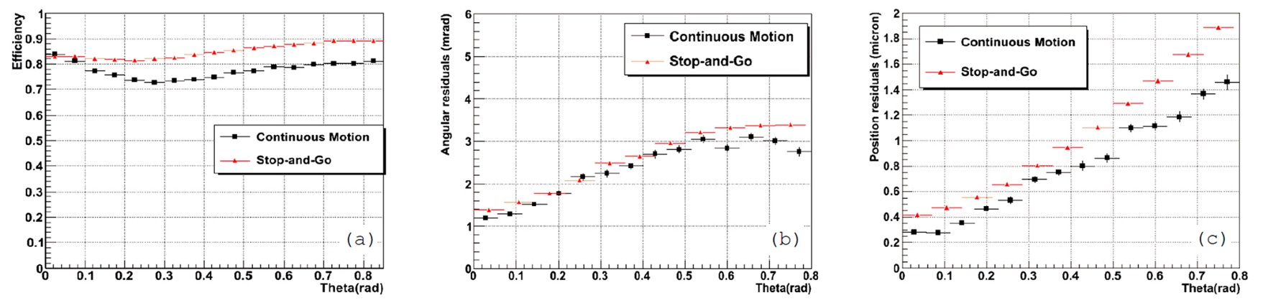
Microtracking performance in CM
Scanning speed:
84
190 cm²/h
“The Continuous Motion Technique for a New Generation of Scanning Systems” in Scientific Reports 7: 7310 2017, DOI:10.1038/s41598-017-07869-3

Slide 12
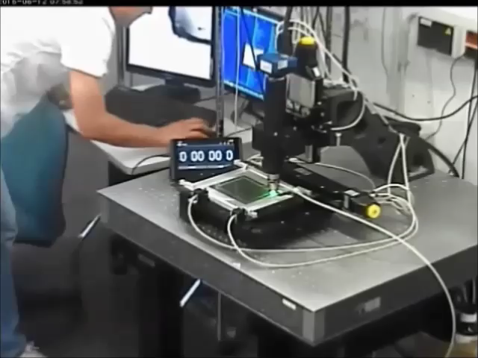

Slide 13
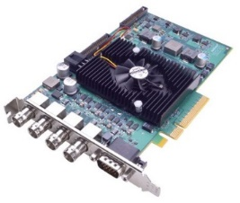




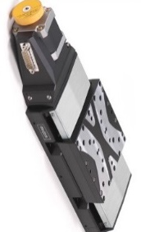
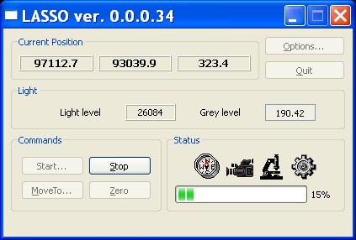
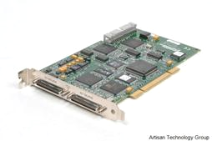



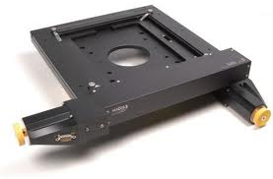

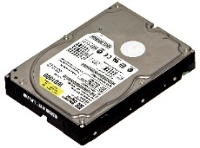
LASSO
Large Angle Scanning System for OPERA
Legend:
Main PC
Framegrabber
Board
Videocamera
(Win7 64bit)
- GUI Module
- Guide Module
LASSO
Z-stage
Stage Ctrl PC
- Stage Module
(WinXP 32bit)
- Camera Module
Motion Control
Board
- Image Proc. Mod.
- Microtracker Mod.
- Dispatcher Mod.
- Commands flow
- Data flow
- Feedback
HDD
LASSO
- External HW
Connections
XY-stage
GPU
Proc. PC
Proc. PC
Proc. PC
Proc. PC
LASSO
LASSO
LASSO
LASSO
GPU
GPU
GPU
GPU

Slide 14
How fast ESS can become?
NGSS @ CM+PiezoZ
ESS @ SG (OPERA)
ESS @ CM
NGSS @ CM
NGSS @ SG
New ideas to implement
2011-2018 R&D
New R&D

Slide 15
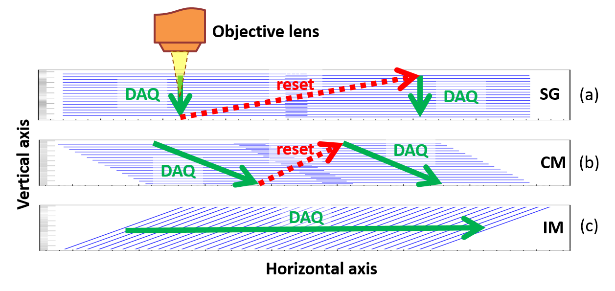
Inclined Focal Plane Motion (IM)

Slide 16

Possible IM implementations
Pros: Suitable for any objective type!
Cons:
The camera must be inclined at a relatively large angle
Pixel size may vary across the image
Pros: Easy to implement
Cons: An objective must have the WD > 0.5 mm -> dry objectives only

Slide 17
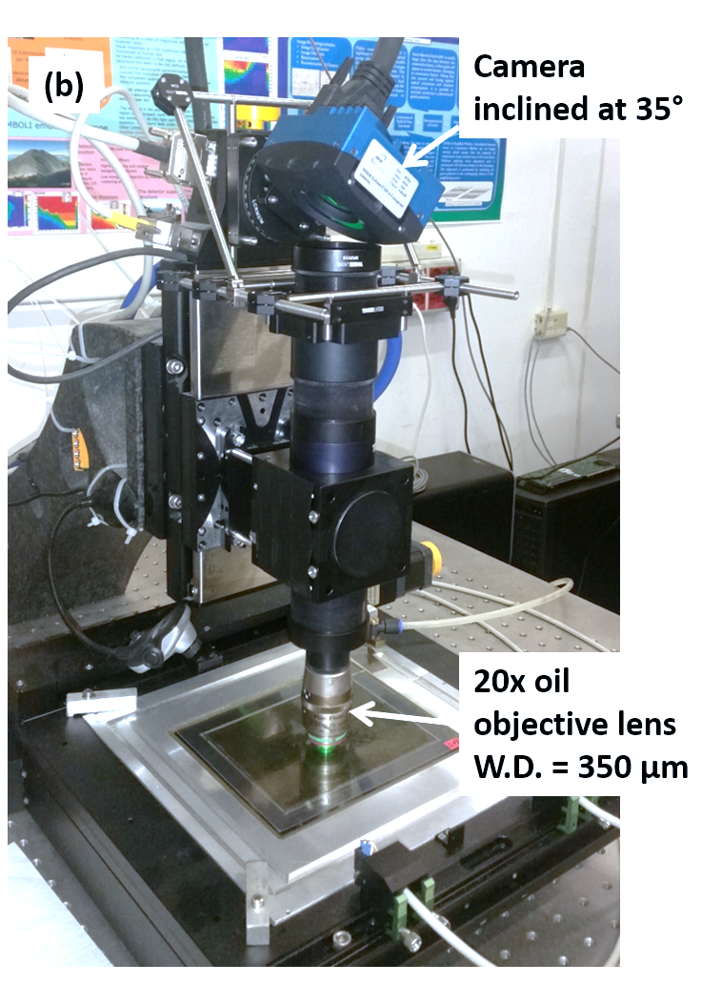
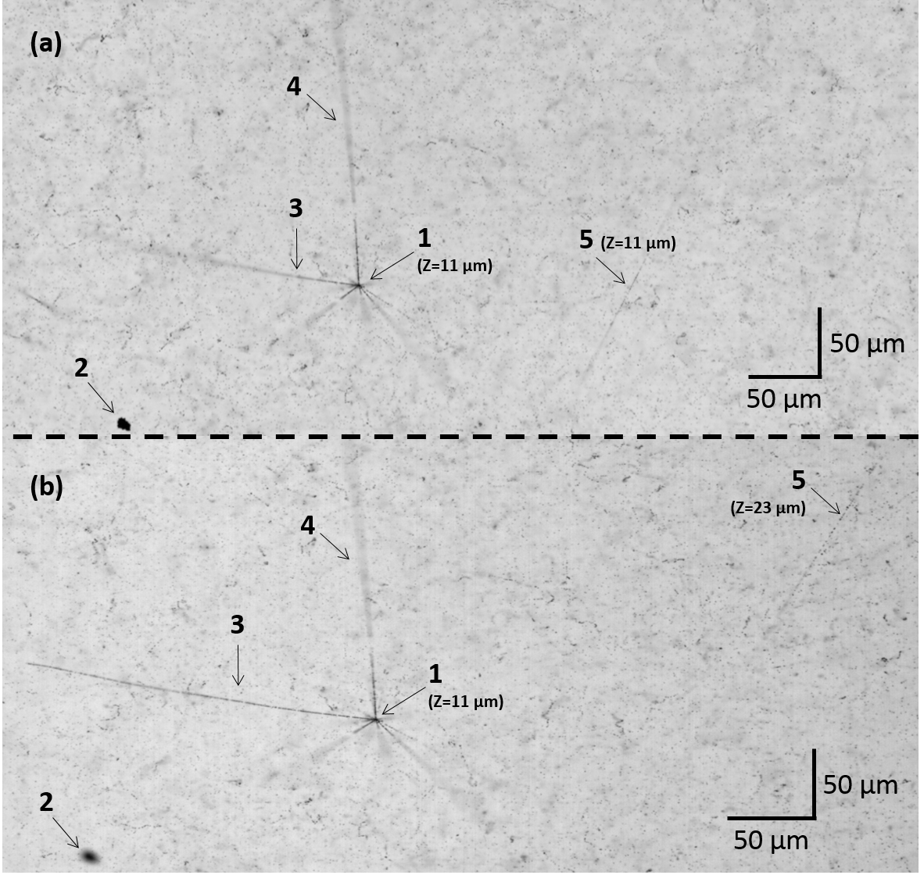
Test setup

Slide 18
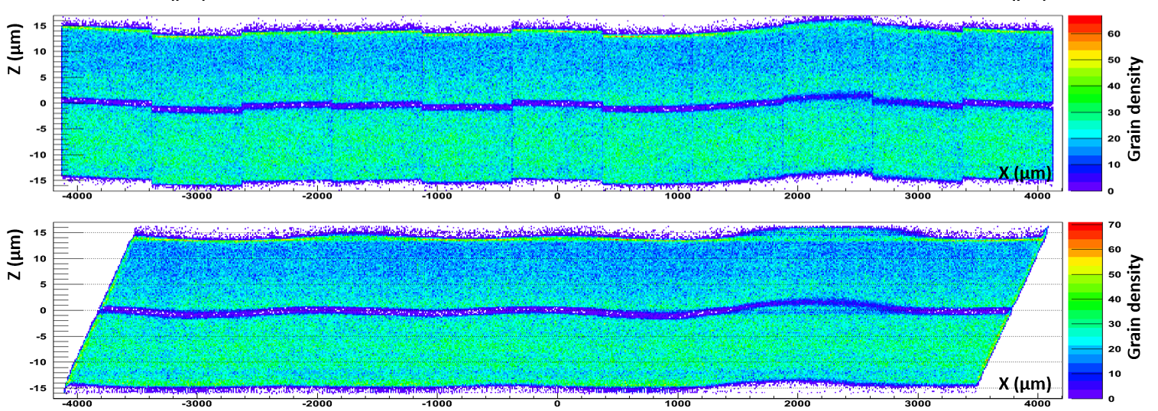
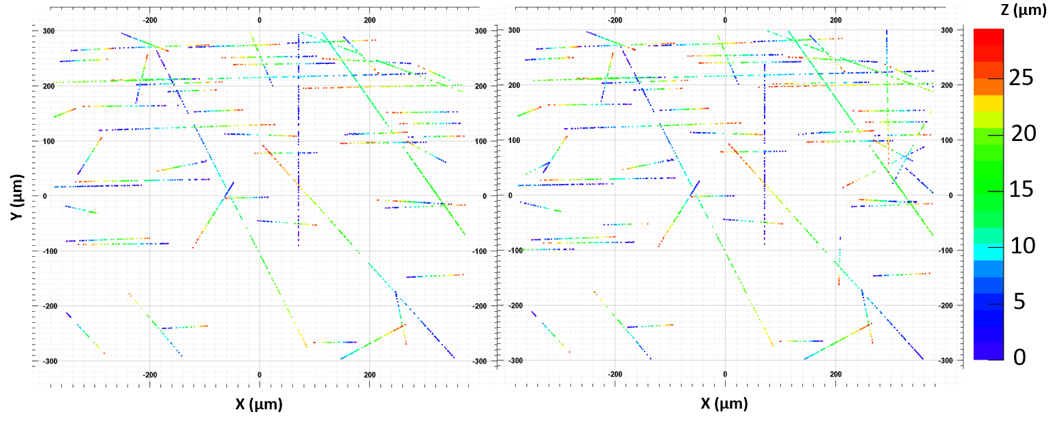
SG
IM
SG
IM

Slide 19
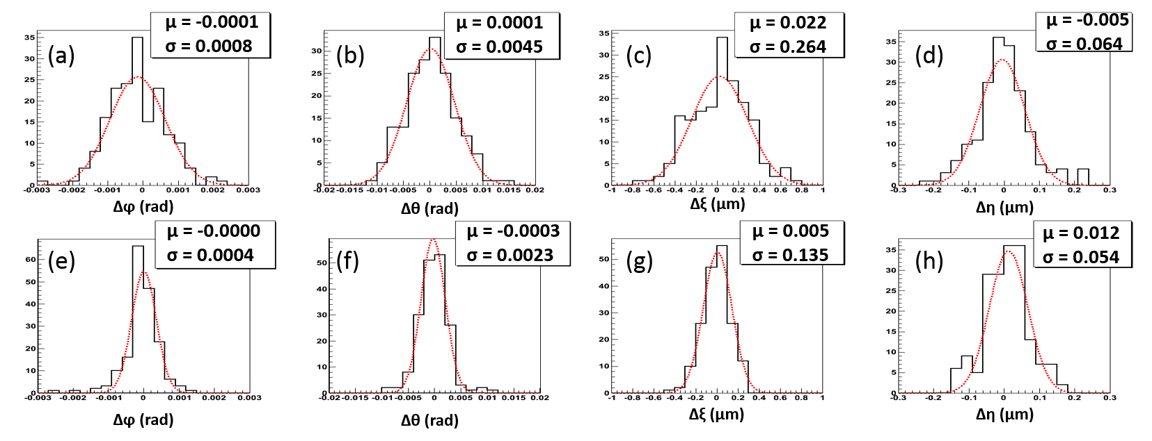
SG-IM microtracks matching
IM-SG
SG-SG
Dataset | Microtracks found
SG1+SG2+IM | 187
SG1+SG2 | 185
IM | 184
Microtracks selection:
Theta > 1.25 rad
Length > 90 µm

Slide 20
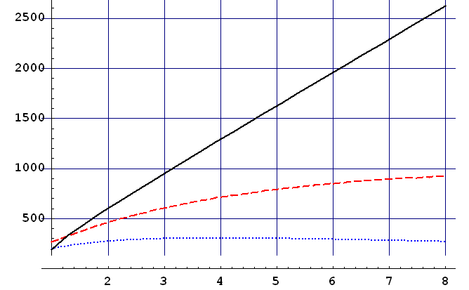
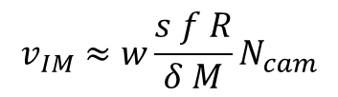
Scanning Speed vs Number of Cameras
Inclined Motion
Con. Mot. + Piezo Z
Continuous Motion
4M camera @ 563 fps
50 µm thick emulsion
30 µm overlap (X&Y)
Scanning Speed (cm²/h)
$$v_{IM}≈w\frac{s f R}{δ M}N_{cam}$$
Number of Cameras
HW limits:
Continuous illumination: 2 µs camera exposure -> 3500 cm²/h
Stroboscopic illumination: 30 cm/s stage speed -> 6000 cm²/h
XY-stage upgrade: 2 m/s stage speed -> 40000 cm²/h = 4 m²/h

Slide 21
Holographic Microscopy
Collaboration with Institute of Applied Sciences and Intelligent Systems (ISASI)
Advantages
  Laser beam -> very strong illumination
  Includes phase information
  No need to move along Z or incline camera
Disadvantages
  Speckles generated by coherent laser light

Slide 22
Summary
Successful 14 years history
20 cm²/h -> 190 cm²/h in last 7 years
Ongoing R&Ds
  High speed
  Super-resolution
Applications:
  OPERA
  FOOT & biomedical app (Cristina’s talk)
  SHiP (Antonia’s talk)
  Muography (Valeri’s talk)
  Directional DM search (Naka’s talk)

Slide 23
Thank You!

