Slide 1
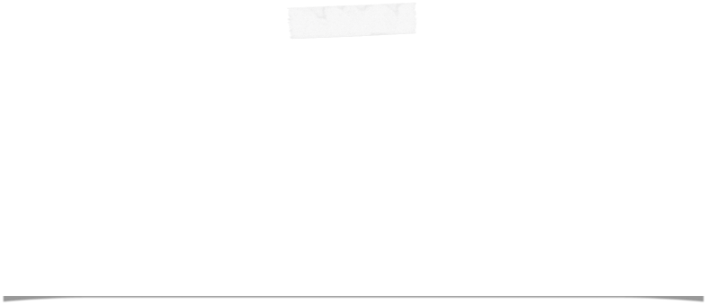

NEWSdm Collaboration Meeting
Anacapri, 29-30 May 2018
Giovanni De Lellis
Università “Federico II” and INFN Napoli

Slide 2
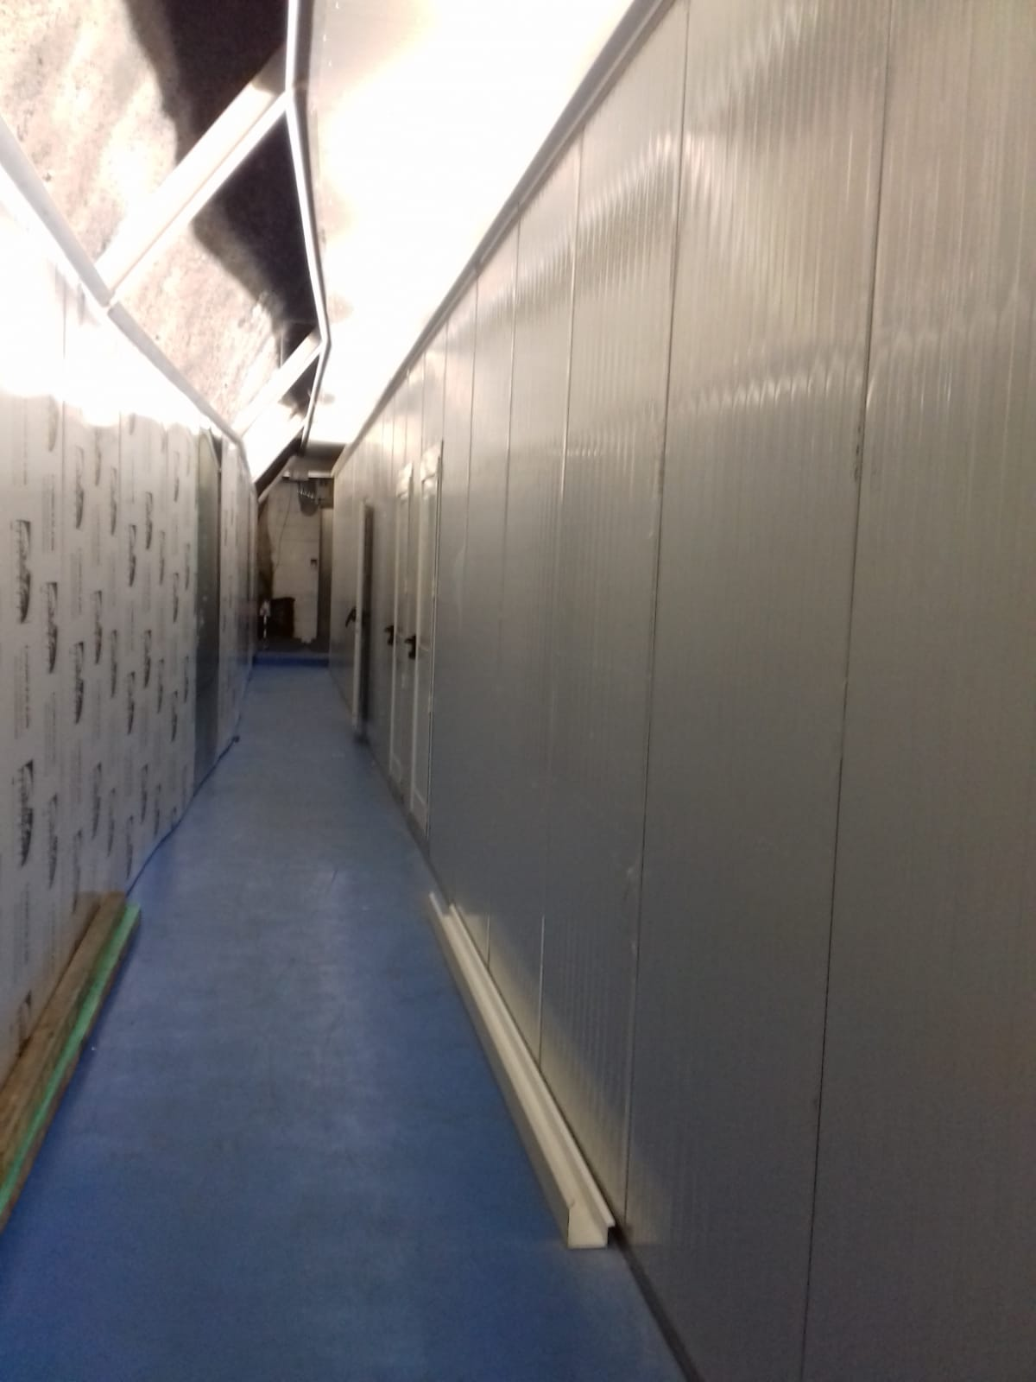
Underground facility
Emulsion facility in Hall F being finalized
Water supply and electric system being prepared
It should be ready by the first half of June

Slide 3
Underground facility
Ventilation system in Hall F to be improved. Tender still being finalized, ready not earlier than October
Facility to host also the emulsion production machine and the climatic chamber
Facility with ISO 8 class (100’000) rooms and the possibility to upgrade one room to ISO 6: equip this room with 2 filters providing similar local conditions
These filters should allow operation in the facility even before the completion of the ventilation system

Slide 4
Key points towards an experiment
Signal:
  capability to see nano-tracks demonstrated;
  Need to measure track parameters: length, sense..
  Important calibration with SEM
  Improve optical microscopy: colour camera, fast scanning
  Improve sensitivity → lower size grains, enough optical contrast
Background reduction:
  Fog
  electron recoils from ¹⁴C ~ 10⁸/kg/year → rejection power for 10g x 1month >10⁵÷10⁶ . In perspective (~kg year) requires ~10⁸÷10⁹ and more. Synthetic polymer?
  Low temperature conditions (-80° C), check electron sensitivity at low temperature
  Use machine learning technique for signal/background discrimination
Emulsion production underground in a clean room
Design appropriate shield with equatorial telescope

Slide 5
Experimental program in near future
Assemble the new facility with new equipment including the emulsion gel production by July
Prepare the cooling system for the emulsions inside the shield at -80° Celsius (Nicola by mid June)
Technical tests between July and September
Prepare the films and expose them inside the shield, physics test to measure background, September
Analyse the films, starting from October

Slide 6
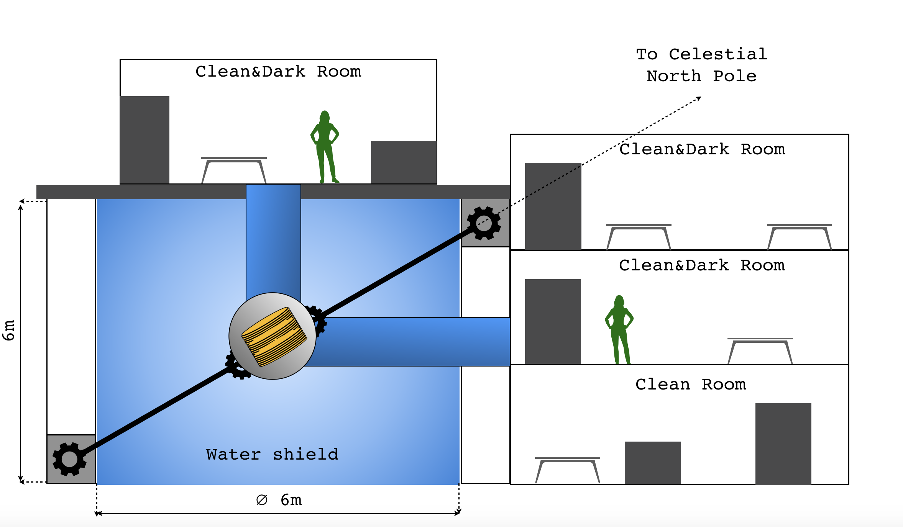
Detector and facility
Mechanical draftsmen at INFN Naples to help designing
Minimise the time without shield: from sensitization to exposure, from exposure to development

Slide 7
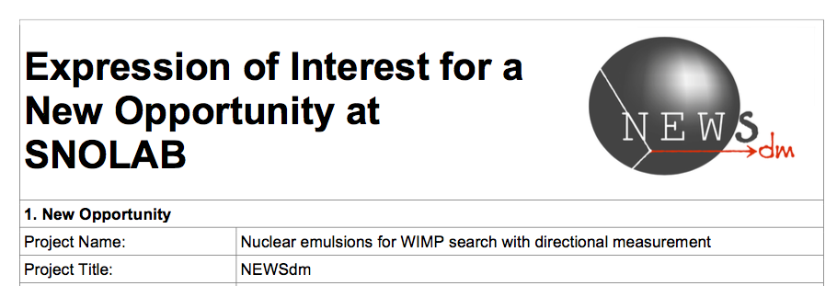
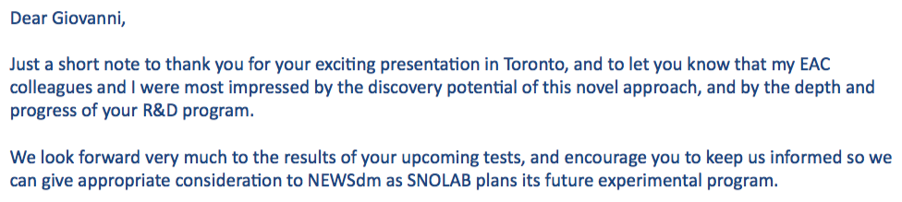
SNOLAB interest
Invited for a talk at the Scientific Committee on March 8th at the University of Toronto. EAC chair Stewart Smith on March 27th:

Slide 9
TDR preparation
Discussion with LNGS Committee at the meeting in March
Status report very well received, Committee impressed by the progress made in the signal detection
Agreed to set the deadline for the TDR preparation in Spring 2019
Agreement shared also with INFN referees

Slide 10
Next meetings and Committees
Next meeting in September. In the meanwhile, dedicated meetings on the different items
Next Gran Sasso Scientific Committee in Autumn

