Slide 1
Cryogeny at LNGS
NEWSdm
Status and Timeline
N. D’Ambrosio – Anacapri – 29 May 2018

Slide 2
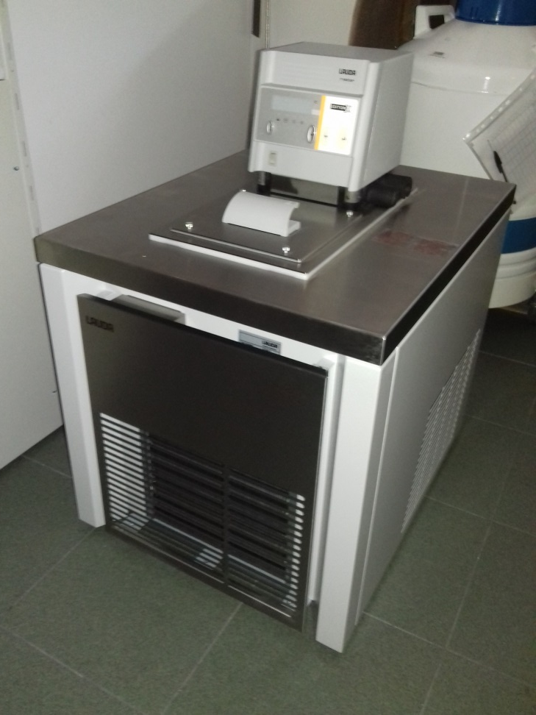
New Cryostat available at LNGS
LAUDA RP 890c
Temperature range -90 -> 200
Refrigerant capacity (at -50) 0,58 KW
Refrigerant capacity (at -70) 0,24 KW
Refrigerant capacity (at -90) 0,05 KW

Slide 3
Preliminary basic tests on cryostat DONE
new connection with our cooling system needed
to fit everything inside the shield
Better insulation needed (polystyrene box around cooling box)
We need to better handle the connections and satisfy all the safety rules (use of the cryo-liquid underground)
Due to some works in progress in hall B
I succeeded to open our shield and check everything last week

Slide 4
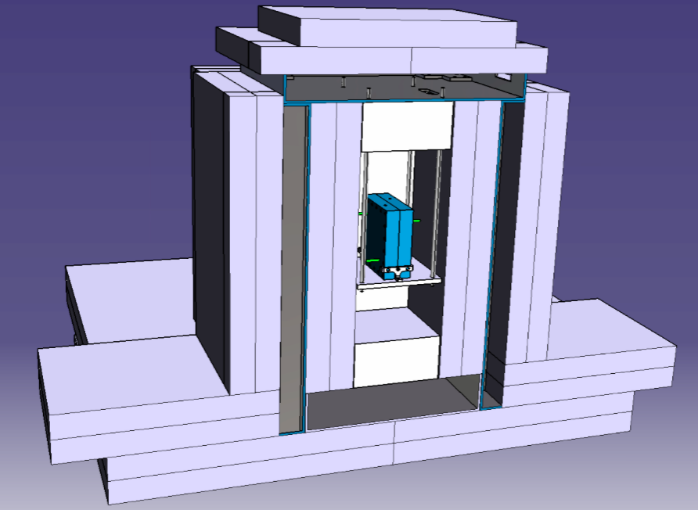
SHIELD 3D view – Section 1
Polyethylene
1880 mm
Cooling System
2870 mm

Slide 5
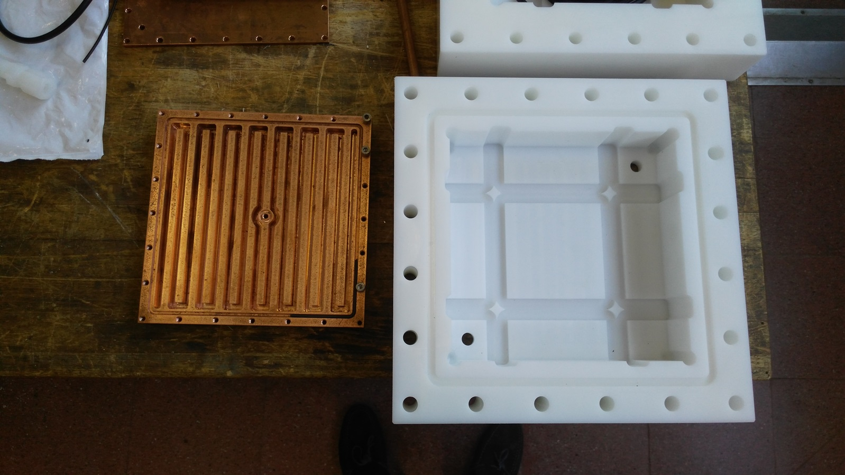
Cooling system
Made with low radiation copper (CUORE collaboration)
External box made with polypropylene
Nitrogen fluxed
Temperature sensor
Available space for emulsion 18x18x5 cm
Space between dissipators can range from 0 up to 5 cm
Polypropylene Box
20 cm

Slide 6
Timelime
additional connectors and tubes ordered :
- splitters
- short flexible tubes
- connectors
All the material should be available within June
In the mean time I am working on the insulation
and nitrogen system (try to use evaporated nitrogen -> more clean)
Preliminary test around beginning of July

