Slide 1
Plasmonic Spectrum analysis with Carbon and dust
05/30 2018
Notes:
The theme of my presentation is “Plasmonic spectrum analysis with Carbon track and dust”.
I will talk about demonstration of spectrum analysis and vision.

Slide 2
Motivation
Silver tracks and dusts which are remained with current ellipticity analysis may be identified by spectrum analysis
To verify this analysis, I evaluate target optical response to some wavelength by PTS2 scanning with optical band pass filter.
Verify that event identification can be performed by multivariable analysis using information acquired by spectrum analysis
Notes:
First, I will explain motivation.
My motivation is that silver track and dust which are remained with current ellipticity analysis may be identified by spectrum analysis. So, to verify this analysis, I evaluate target optical response to some wavelength by scanning with PTS2 installed optical band pass filter. And verify that event identification can be performed by multivariable analysis using information acquired by spectrum analysis.

Slide 3
Contents
Method of optical spectrum analysis
Demonstrate spectrum analysis with silver Nano crystal
(I have reported this work at previous meeting)
Practice this analysis with Carbon and Dust
Problem and vision
Notes:
So, This is contents of my presentation.

Slide 4
Contents
Method of optical spectrum analysis
Demonstrate spectrum analysis with silver Nano crystal
(I have reported this work at previous meeting)
Practice this analysis with Carbon and Dust
Problem and vision
Notes:
First content is Method of optical spectrum analysis.

Slide 5
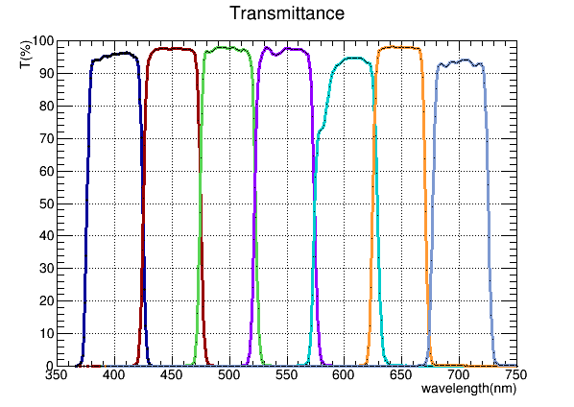
Flow of spectrum analysis
nd filter
scanning with each bandpass filter
band pass filter
scanning same area
with four bandpass filter;
450nm, 500nm, 550nm, 600nm
Xe
Lamp
aligning the event at all wavelengths
from each image
←Calibrated the wavelength dependence of optical system
analyzing with brightness of the matched event
Transmittance[%]
Wavelength[nm]
Notes:
First, scanning same area with each bandpass filter. Filters I used were bandpass filter. There is a width of 25nm with respect to the center value. There’s transmittance is described this bottom figure.
After scanning with each filter, aligning the event at all wavelengths from each image. Alignment with silver 40nm nano crystal on the surface. Then, Calibrating the wavelength dependence of the optical system and analyze it using brightness of matched event.

Slide 6
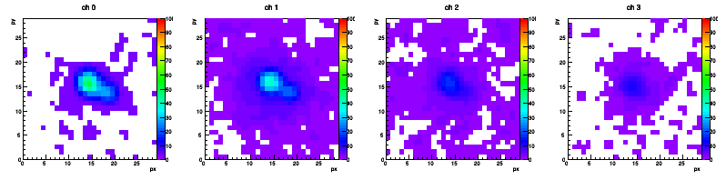
Information obtained by spectrum analysis
450nm
500nm
550nm
600nm
Event image
Max brightness
Mean brightness
Area of event
Minor, Major
Brightness barycenter
for each wavelength
Multivariable analysis
BDT, Deep Learning, etc
Notes:
Next slide, this analysis can be obtained some information, such as event image, max brightness, mean brightness, area of event, minor, major, and brightness barycenter of event for each wavelength. So, there are many parameters, I tried multivariable analysis. I will talk about multivariable analysis later slide.

Slide 7
Contents
Method of optical spectrum analysis
Demonstrate spectrum analysis with silver Nano crystal
(I have reported this work at previous meeting)
Practice this analysis with Carbon and Dust
Problem and vision
Notes:
Next, I will talk about Demonstration of spectrum analysis with silver nano crystal. The results shown here are briefly shown as they were reported at the previous meeting.

Slide 8



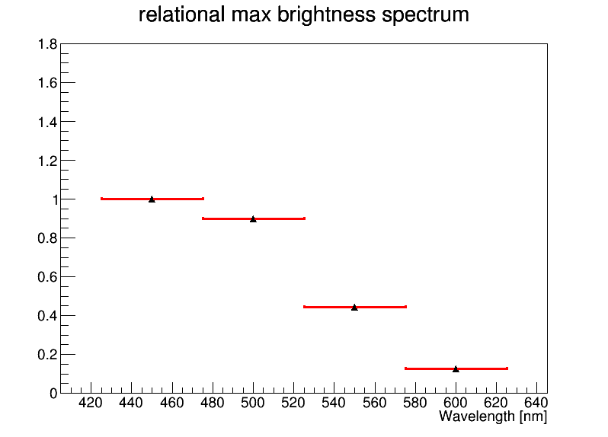
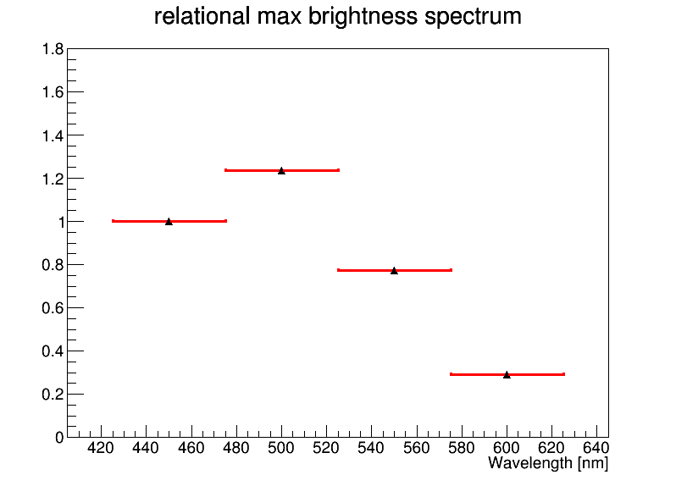
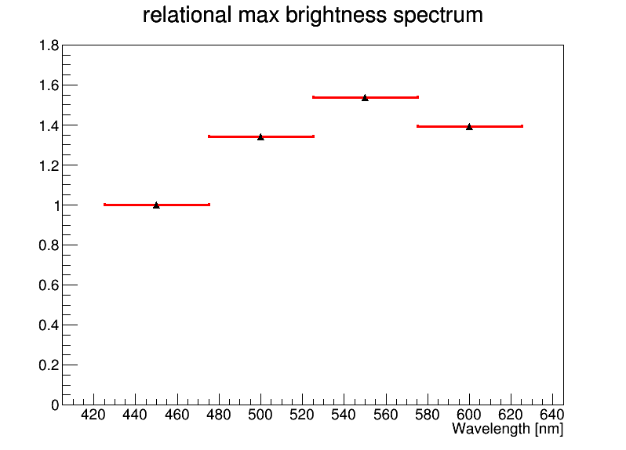
Spectrum of silver nano crystal
40nm
60nm
100nm
Plot the relative max brightness based on 450nm
Notes:
This slide is described spectrum of silver nano crystal. These are 40nm, 60nm and 100nm spectrum from the left. y-axis is represented relative max brightness based on 450nm value. You can see the difference from the shape of the spectrum.

Slide 9
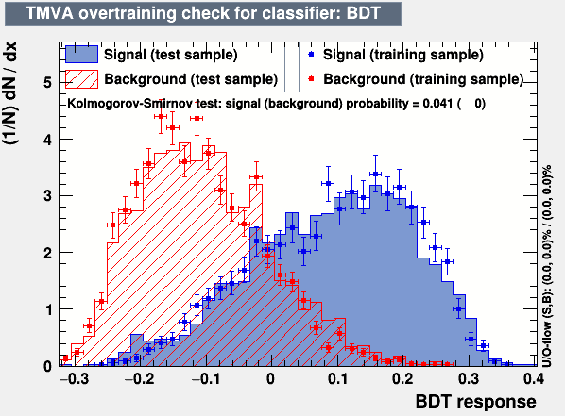
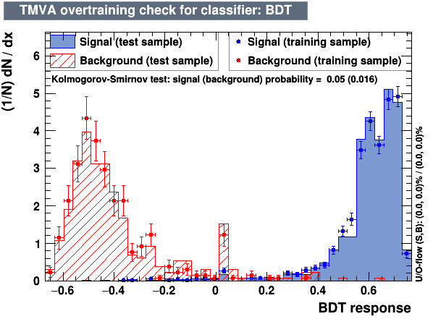
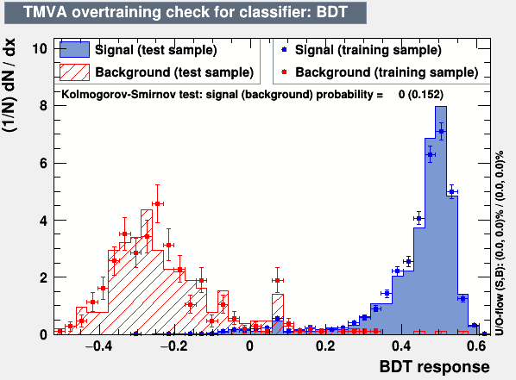


Multivariable analysis for silver nano crystal
Classified with Boosted Decision Tree
parameters used：relative max brightness at each wavelength based on 450nm, relative area of event
TMVA ver4.2
$←$BG like
signal like$→$
40nm vs 60nm
40nm vs 100nm
60nm vs 100nm
↑effect of size distribution？
signal: 40nm
BG : 60nm
signal: 40nm
BG : 100nm
signal: 60nm
BG : 100nm
Notes:
Next slide, it is result of discrimination with BDT. Parameters used in BDT are relative max brightness, relative area at each wavelength. The left figure is result of 40nm versus 60nm. Red is 60nm event and Blue is 40nm. Although discrimination ability is not so good, it is probably because the size distribution of silver nano crystal is close and the spectrum shape is also similar. The center figure represents the result of 40nm versus 100nm. Blue is 40nm and red is 100nm. Unlike the previous figure, discrimination ability is good. Finally the right figure is the result of 60nm versus 100nm. Blue is 60nm and red is 100nm.

Slide 10
Contents
Method of optical spectrum analysis
Demonstrate spectrum analysis with silver Nano crystal
(I have reported this work at previous meeting)
Practice this analysis with Carbon and Dust
Problem and vision
Notes:
The next content is practice the analysis with carbon and dust.

Slide 11


Flow of analysis
1st scan (volume scan)
overall scanning
minor
major
1st selection
Selection parameter: ellipticity, minor
ellipticity >2 && 4$≤$minor$≤$6
ellipticity=major/minor > 2
Notes:
First, I will explain about flow of this analysis. At first, I scanned overall of scan area with mercury-xenon lamp and chose the event with 1st selection. The selection parameter was higher than the ellipticity ratio 2 and the minor was set to 4 or more and less then 6.

Slide 12
Flow of analysis
1st scan (volume scan)
overall scanning
minor
major
1st selection
Selection parameter: ellipticity, minor
ellipticity >2 && 4$≤$minor$≤$6
ellipticity=major/minor > 2
2nd selection
number of pixel on binary image
Notes:
After the 1st selection, I eliminated obvious noise with 2nd selection.

Slide 13
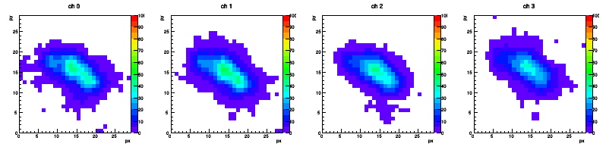
Flow of analysis
1st scan (volume scan)
overall scanning
minor
major
1st selection
Selection parameter: ellipticity, minor
ellipticity >2 && 4$≤$minor$≤$6
ellipticity=major/minor > 2
2nd selection
number of pixel on binary image
aligning the event at all wavelengths
from each image
Multivariable analysis of the matched event
450nm
500nm
550nm
600nm
Notes:
Then, I scanned the event area remaining in the selection with multiple wavelengths and analyzed after alignment with BDT.

Slide 14
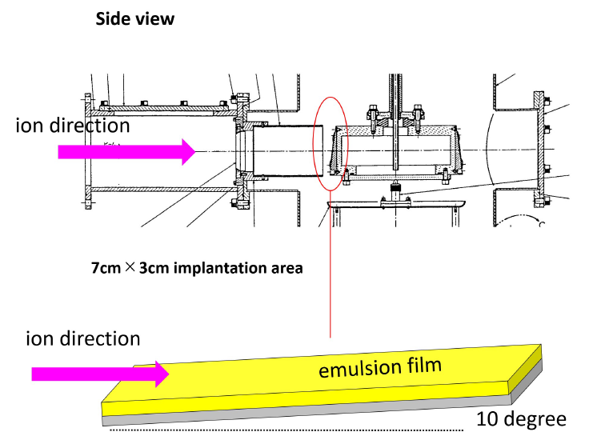


Signal and Background
signal
BG
200keV Carbon ion sample
Energy of incident C ion ~ 150 keV
$→$ expected track length ~400nm
uniform angle(>10mrad)
ellipticity > 2.0
Fix only sample (FAN085gf)
random angle
ellipticity > 2.0
selected
116 event
240 event
matched
79 event
Notes:
In this analysis, carbon ion track was used as signal, and dust event was used background event. These are the characteristics as shown in the figure. In signal, the sample is 200keV Carbon ion implanted sample. Energy of incident carbon ion is approximately 150keV. And expected track length is about 400nm. Carbon track’s angle is nearly uniform. And ellipticity is higher than 2. Number of event have finished is 240.
On the other hand, Background sample is Fix only sample. Emulsion batch ID is FAN085gf. And event angle is almost random. And ellipticity is also higher than 2. . Number of event have finished is 79.

Slide 15
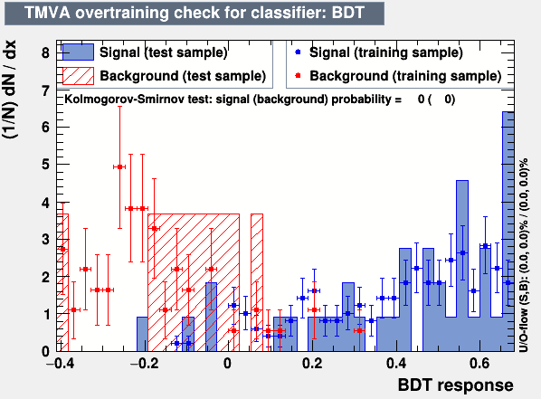
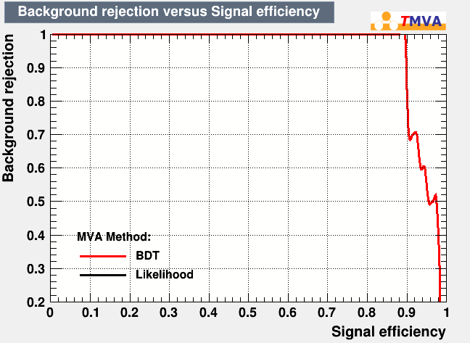
Classify carbon and dust with BDT
Parameters used： relative max brightness at each wavelength based on 450nm, relative area of event
preliminary
preliminary
Notes:
Slide number 15, I will talk about the result of BDT for carbon track and dust event. Parameters used in BDT are relative max brightness, relative area. Although the number of events is small, I cannot make a definite conclusion, but seems to be clearly distinguished.

Slide 16
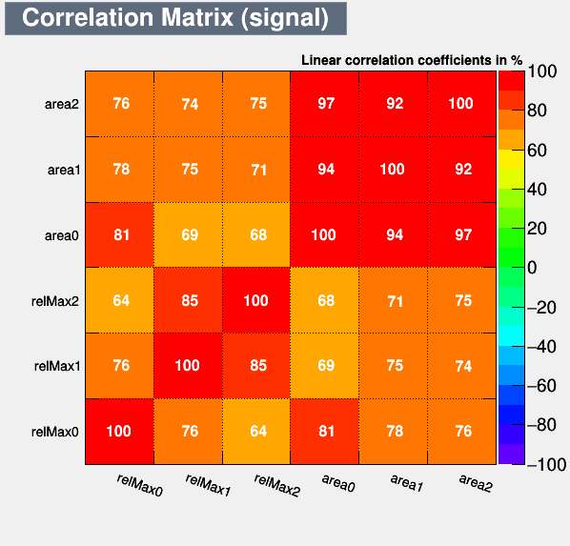
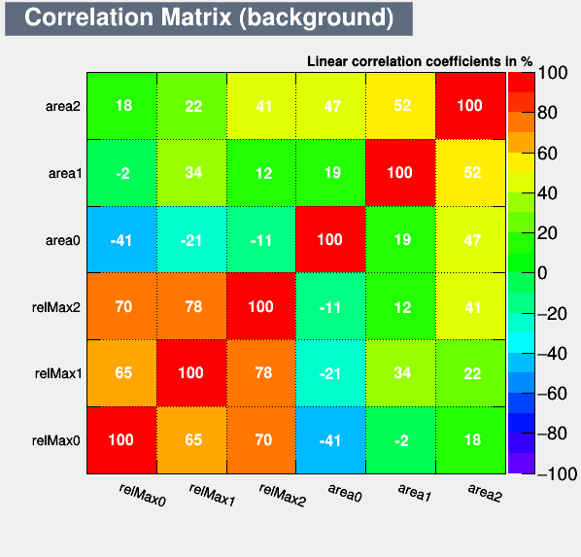
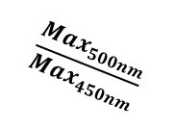


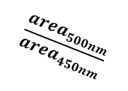
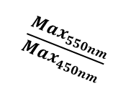




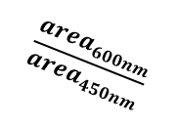
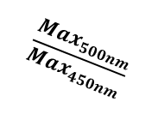




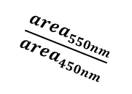

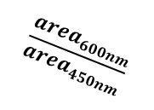
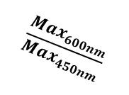

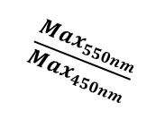
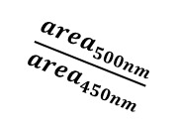
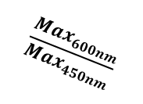
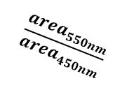
BDT correlation plot Carbon track vs Dust
$$\frac{{area}_{600nm}}{{area}_{450nm}}$$
$$\frac{{area}_{600nm}}{{area}_{450nm}}$$
$$\frac{{area}_{550nm}}{{area}_{450nm}}$$
$$\frac{{area}_{550nm}}{{area}_{450nm}}$$
$$\frac{{area}_{500nm}}{{area}_{450nm}}$$
$$\frac{{area}_{500nm}}{{area}_{450nm}}$$
$$\frac{Max_{600nm}}{Max_{450nm}}$$
$$\frac{Max_{600nm}}{Max_{450nm}}$$
$$\frac{Max_{550nm}}{Max_{450nm}}$$
$$\frac{Max_{550nm}}{Max_{450nm}}$$
$$\frac{Max_{500nm}}{Max_{450nm}}$$
$$\frac{Max_{500nm}}{Max_{450nm}}$$
$$\frac{Max_{500nm}}{Max_{450nm}}$$
$$\frac{Max_{550nm}}{Max_{450nm}}$$
$$\frac{Max_{600nm}}{Max_{450nm}}$$
$$\frac{{area}_{500nm}}{{area}_{450nm}}$$
$$\frac{{area}_{550nm}}{{area}_{450nm}}$$
$$\frac{{area}_{600nm}}{{area}_{450nm}}$$
$$\frac{Max_{500nm}}{Max_{450nm}}$$
$$\frac{Max_{550nm}}{Max_{450nm}}$$
$$\frac{Max_{600nm}}{Max_{450nm}}$$
$$\frac{{area}_{500nm}}{{area}_{450nm}}$$
$$\frac{{area}_{550nm}}{{area}_{450nm}}$$
$$\frac{{area}_{600nm}}{{area}_{450nm}}$$
Notes:
And, next slide shows correlation plot for Carbon and Dust. The more red it is, the stronger the correlation is, the more the blue the correlation disappears. It seems that the main difference is relative area.

Slide 17
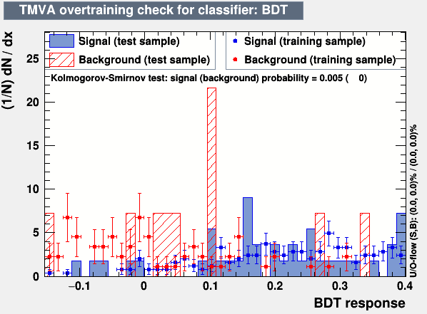
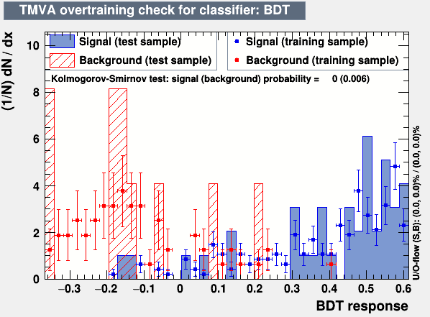
Classify carbon and dust with BDT
use parameter: relative area
use parameter: relative max brightness
Notes:
However, if the use parameter is set to only relative area, cutting is poor, and if only relative maximum brightness value is used, it seems that cutting is good. So, I think shape of spectrum is different.

Slide 18
Contents
Method of optical spectrum analysis
Demonstrate spectrum analysis with silver Nano crystal
(I have reported this work at previous meeting)
Practice this analysis with Carbon and Dust
Problem and vision
Notes:
Finally, problem and vision.

Slide 19
Problem and vision
Problem
I have scanned and analyzed only 142 signal event and 79 BG event. I need much more event, at least 1000 event for multivariable analysis.
Identify neutron samples using the learning model.
Evaluation with smaller ellipticity event
Add evaluation parameter
e.x. wavelength, shift of brightness barycenter, ...
necessity for much more scanning
Vision
Notes:
Problem is that the number of event is small for BDT analysis. Carbon events can be easily increased because event density is high, but dust event seems to take time. The 79 events are obtained by scanning for 3 days. I’m rescanning with high exposure and aim for 10 times statics.
Then, I would like to evaluate whether nuclear recoil event by neutron and dust can be identified with the learning model, and with smaller ellipticity event.
Also, add evaluation parameter, for example wavelength, shift of brightness barycenter.

Slide 20
Notes:
scanning takes time because of surface recognition failure

Slide 21
Back up

Slide 23
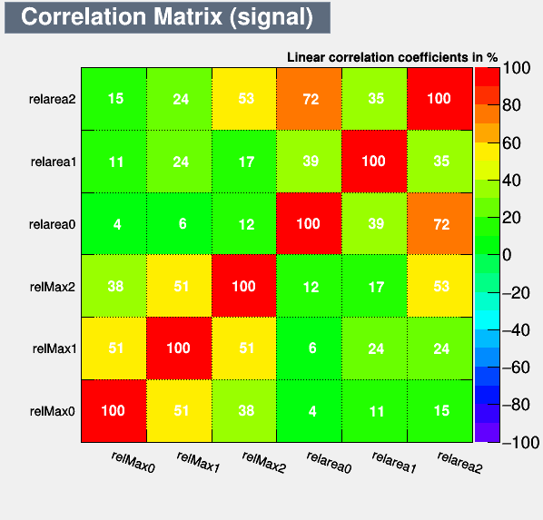
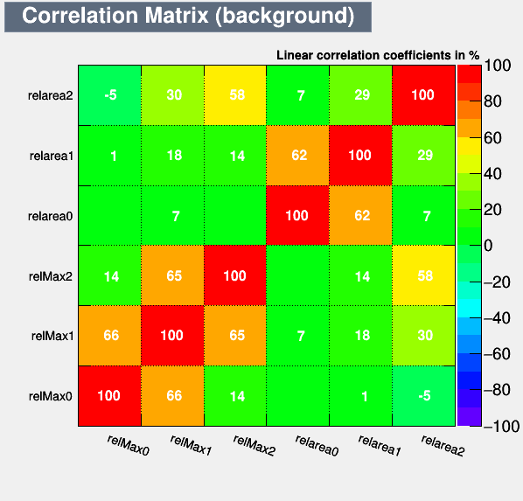
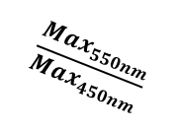

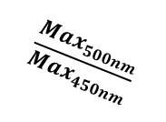

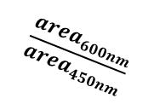
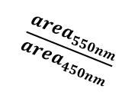
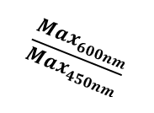
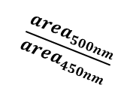
BDT correlation plot 40nm vs 60nm
$$\frac{{area}_{600nm}}{{area}_{450nm}}$$
$$\frac{{area}_{600nm}}{{area}_{450nm}}$$
$$\frac{{area}_{550nm}}{{area}_{450nm}}$$
$$\frac{{area}_{550nm}}{{area}_{450nm}}$$
$$\frac{{area}_{500nm}}{{area}_{450nm}}$$
$$\frac{{area}_{500nm}}{{area}_{450nm}}$$
$$\frac{Max_{600nm}}{Max_{450nm}}$$
$$\frac{Max_{600nm}}{Max_{450nm}}$$
$$\frac{Max_{550nm}}{Max_{450nm}}$$
$$\frac{Max_{550nm}}{Max_{450nm}}$$
$$\frac{Max_{500nm}}{Max_{450nm}}$$
$$\frac{Max_{500nm}}{Max_{450nm}}$$
$$\frac{Max_{500nm}}{Max_{450nm}}$$
$$\frac{Max_{550nm}}{Max_{450nm}}$$
$$\frac{Max_{600nm}}{Max_{450nm}}$$
$$\frac{{area}_{500nm}}{{area}_{450nm}}$$
$$\frac{{area}_{550nm}}{{area}_{450nm}}$$
$$\frac{{area}_{600nm}}{{area}_{450nm}}$$
$$\frac{Max_{500nm}}{Max_{450nm}}$$
$$\frac{Max_{550nm}}{Max_{450nm}}$$
$$\frac{Max_{600nm}}{Max_{450nm}}$$
$$\frac{{area}_{500nm}}{{area}_{450nm}}$$
$$\frac{{area}_{550nm}}{{area}_{450nm}}$$
$$\frac{{area}_{600nm}}{{area}_{450nm}}$$
23

Slide 24
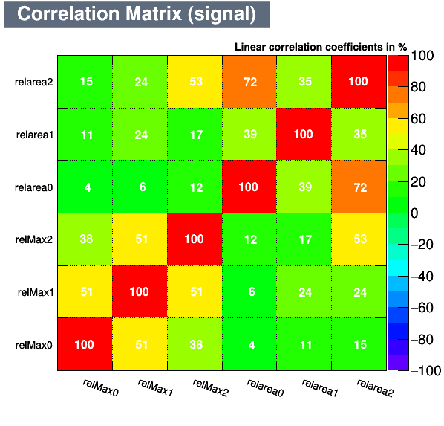
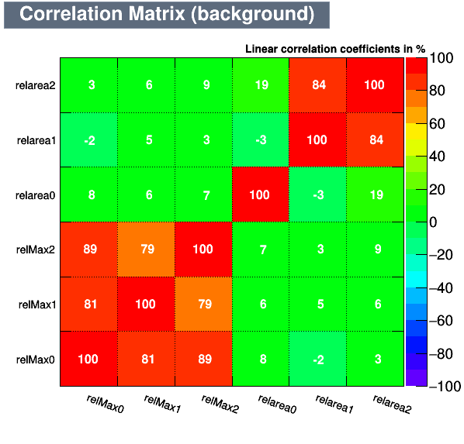


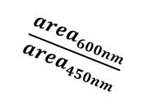




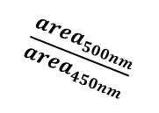
BDT correlation plot 40nm vs 100nm
$$\frac{{area}_{600nm}}{{area}_{450nm}}$$
$$\frac{{area}_{600nm}}{{area}_{450nm}}$$
$$\frac{{area}_{550nm}}{{area}_{450nm}}$$
$$\frac{{area}_{550nm}}{{area}_{450nm}}$$
$$\frac{{area}_{500nm}}{{area}_{450nm}}$$
$$\frac{{area}_{500nm}}{{area}_{450nm}}$$
$$\frac{Max_{600nm}}{Max_{450nm}}$$
$$\frac{Max_{600nm}}{Max_{450nm}}$$
$$\frac{Max_{550nm}}{Max_{450nm}}$$
$$\frac{Max_{550nm}}{Max_{450nm}}$$
$$\frac{Max_{500nm}}{Max_{450nm}}$$
$$\frac{Max_{500nm}}{Max_{450nm}}$$
$$\frac{Max_{500nm}}{Max_{450nm}}$$
$$\frac{Max_{550nm}}{Max_{450nm}}$$
$$\frac{{area}_{600nm}}{{area}_{450nm}}$$
$$\frac{Max_{500nm}}{Max_{450nm}}$$
$$\frac{Max_{550nm}}{Max_{450nm}}$$
$$\frac{Max_{600nm}}{Max_{450nm}}$$
$$\frac{{area}_{500nm}}{{area}_{450nm}}$$
$$\frac{{area}_{550nm}}{{area}_{450nm}}$$
$$\frac{{area}_{600nm}}{{area}_{450nm}}$$
$$\frac{Max_{600nm}}{Max_{450nm}}$$
$$\frac{{area}_{500nm}}{{area}_{450nm}}$$
$$\frac{{area}_{550nm}}{{area}_{450nm}}$$
24

Slide 25
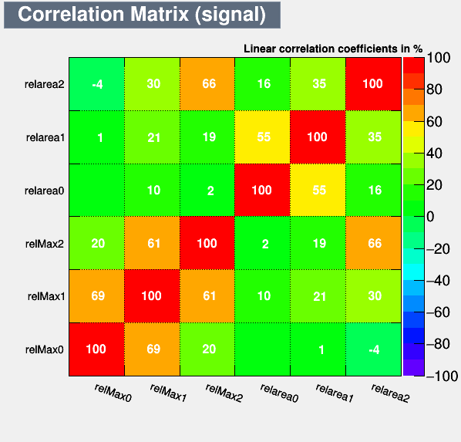
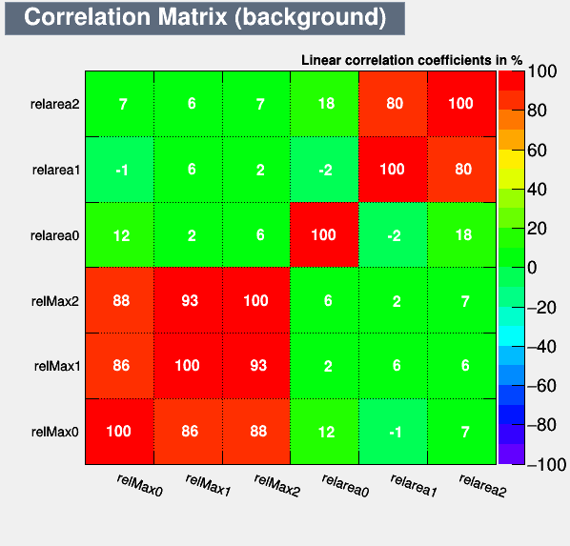
BDT correlation plot 60nm vs 100nm
$$\frac{{area}_{600nm}}{{area}_{450nm}}$$
$$\frac{{area}_{600nm}}{{area}_{450nm}}$$
$$\frac{{area}_{550nm}}{{area}_{450nm}}$$
$$\frac{{area}_{550nm}}{{area}_{450nm}}$$
$$\frac{{area}_{500nm}}{{area}_{450nm}}$$
$$\frac{{area}_{500nm}}{{area}_{450nm}}$$
$$\frac{Max_{600nm}}{Max_{450nm}}$$
$$\frac{Max_{600nm}}{Max_{450nm}}$$
$$\frac{Max_{550nm}}{Max_{450nm}}$$
$$\frac{Max_{550nm}}{Max_{450nm}}$$
$$\frac{Max_{500nm}}{Max_{450nm}}$$
$$\frac{Max_{500nm}}{Max_{450nm}}$$
$$\frac{Max_{500nm}}{Max_{450nm}}$$
$$\frac{Max_{550nm}}{Max_{450nm}}$$
$$\frac{Max_{600nm}}{Max_{450nm}}$$
$$\frac{{area}_{500nm}}{{area}_{450nm}}$$
$$\frac{{area}_{550nm}}{{area}_{450nm}}$$
$$\frac{{area}_{600nm}}{{area}_{450nm}}$$
$$\frac{Max_{500nm}}{Max_{450nm}}$$
$$\frac{Max_{550nm}}{Max_{450nm}}$$
$$\frac{Max_{600nm}}{Max_{450nm}}$$
$$\frac{{area}_{500nm}}{{area}_{450nm}}$$
$$\frac{{area}_{550nm}}{{area}_{450nm}}$$
$$\frac{{area}_{600nm}}{{area}_{450nm}}$$

Slide 26
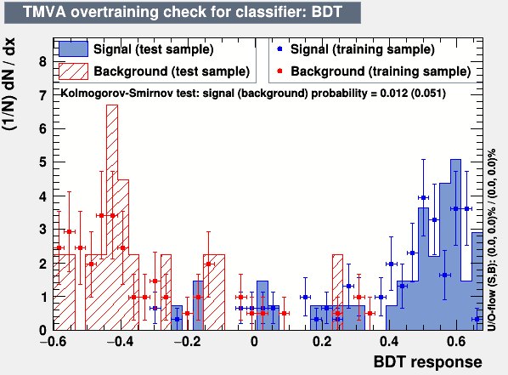
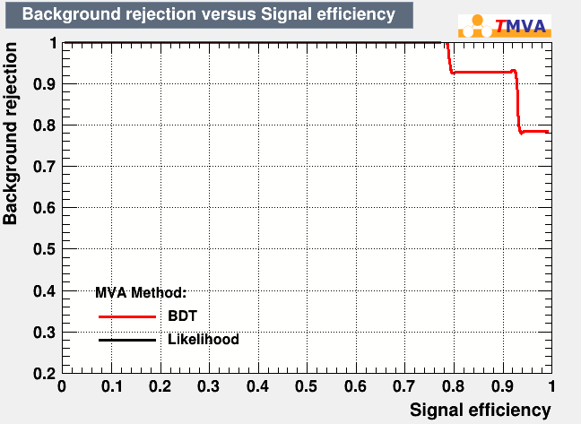
Classify carbon and dust with BDT
Parameters used： relative max brightness at each wavelength based on 450nm, relative area of event
preliminary
preliminary
Notes:
Slide number 15, I will talk about the result of BDT for carbon track and dust event. Parameters used in BDT are relative max brightness, relative area. Although the number of events is small, I cannot make a definite conclusion, but seems to be clearly distinguished.

Slide 27
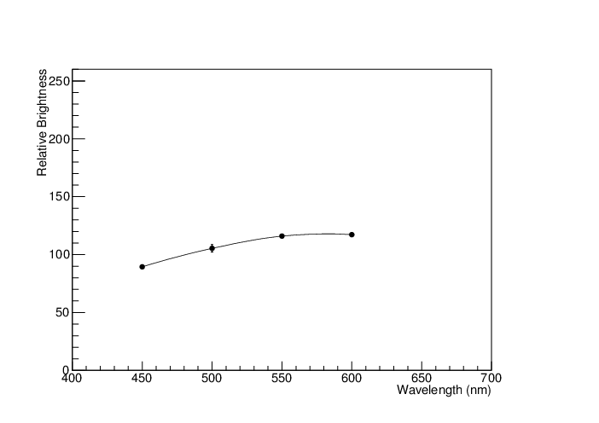
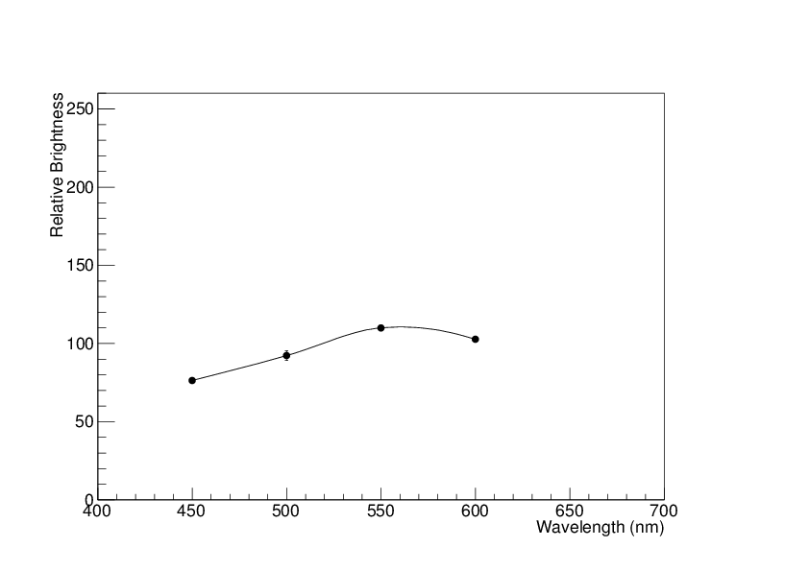





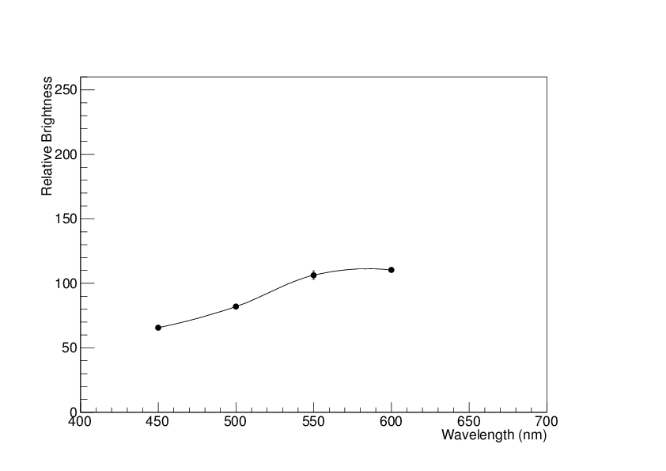




Dusts spectrum
Ev25 surface
Elli 1.49
Ev35 surface
Elli 1.42
450 nm 500 nm 550 nm 600 nm
Notes:
At first, I will talk about introduction of spectrum analysis. This slide is quote from Umemoto san. These were drawn spectrum of dust. This plot was created from taking one picture of surface silver coated Dust sample by multi changing wavelength. These spectra look broad.
So, I expected that spectrum analysis is effective to distinguish dusts and silver.

