Slide 1
Shield simulation for 10 kg detector: muon-induced background
Felice Dipace, Valerio Gentile
NEWSdm Collaboration Meeting, Anacapri, 30/05/2018

Slide 2
Summary
Simulation set up
Muon angular and energy spectra
Topological study
Results

Slide 3
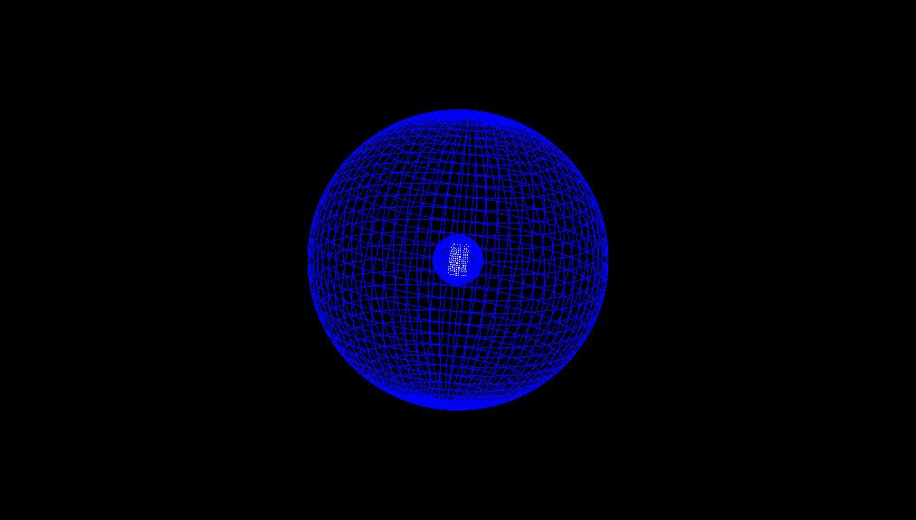
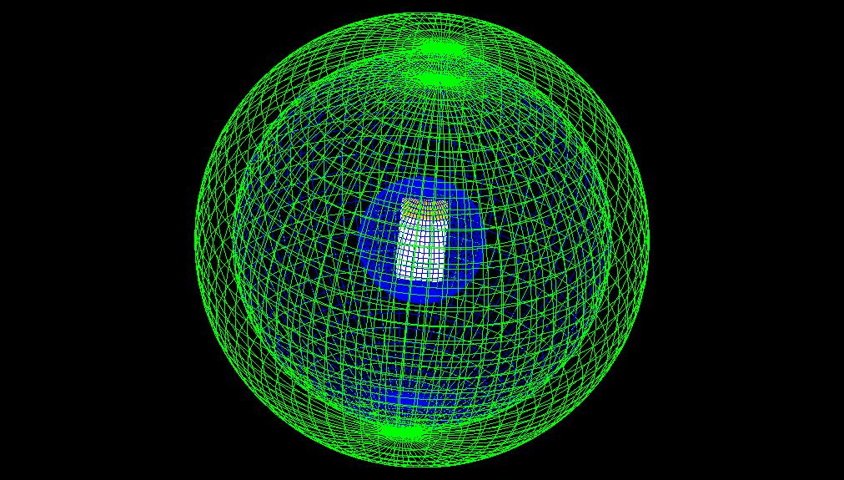
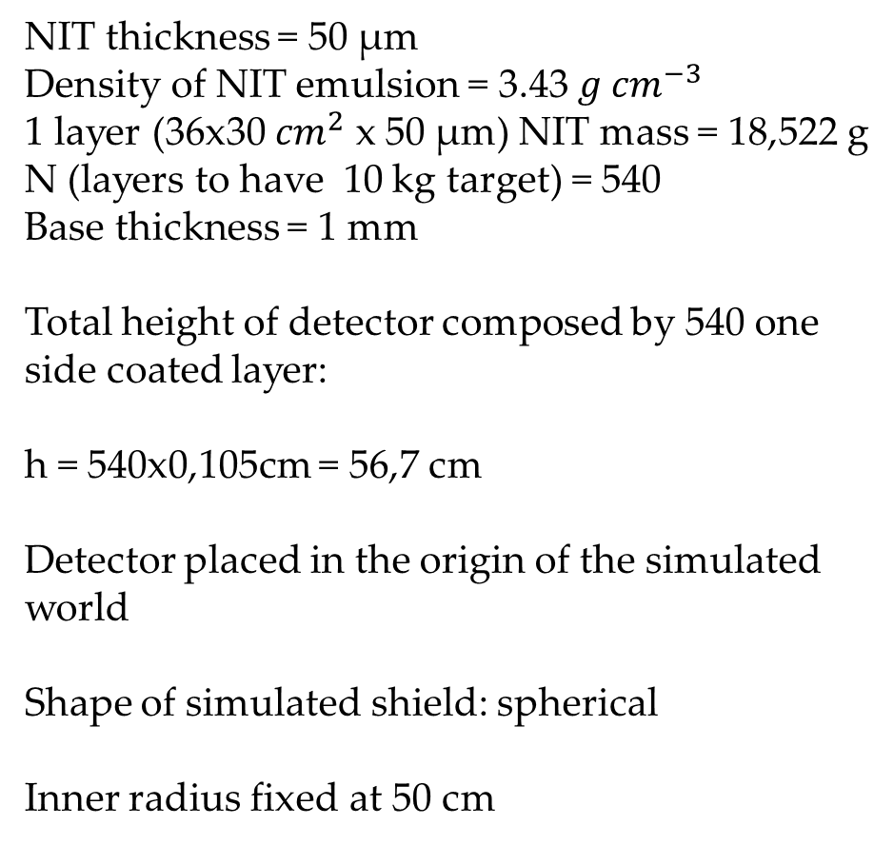
Simulation set up
Front view
NIT thickness = 50 μm
Density of NIT emulsion = 3.43 ${g cm}^{−3}$
1 layer (36x30 ${cm}^{2}$ x 50 μm) NIT mass = 18,522 g
N (layers to have 10 kg target) = 540
Base thickness = 1 mm
Total height of detector composed by 540 one side coated layer:
h = 540x0,105cm = 56,7 cm
Detector placed in the origin of the simulated world
Shape of simulated shield: spherical
Inner radius fixed at 50 cm
30 cm
36 cm
Side view

Slide 4
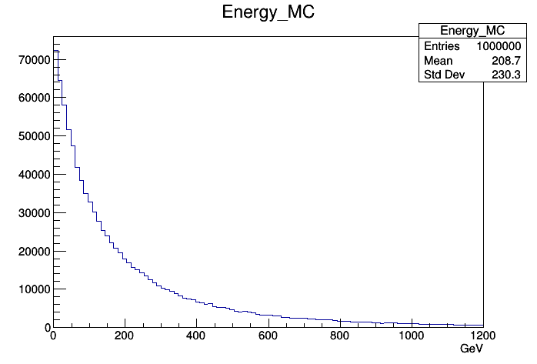
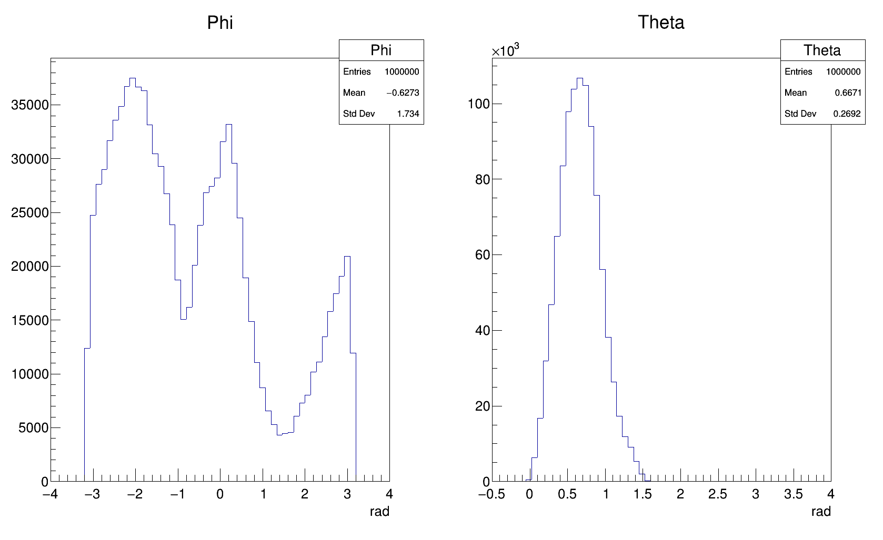
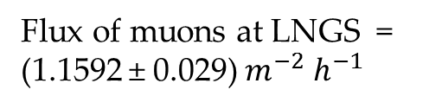
Simulation set up
Muon flux characterization
Flux of muons at LNGS = (1.1592 ± 0.029) $m^{−2}$ $h^{−1}$
Azimuth angle
Zenith angle
Generator of cosmic muons in Gran Sasso mountain: MUSUN from A. Kudraizev

Slide 5
Topological study
A study of event topology was performed in order to have a complete picture of interaction and distinguish different categories:
Elastic scattering
Neutron Inelastic scattering
Pion inelastic scattering
Muon Coulomb scattering
Neutron Capture

Slide 6
Topological study:
Elastic scattering
Parent track:neutron
Recoiling nucleus

Slide 7
Inelastic scattering of pion
creatorId==17 (pi minus Inelastic)
Parent track (pi minus): kinEn=171 MeV
photon: Length=49 µm, kinEn=446 keV
Pi minus track.: Length=7.6 mm, kinEn=118 MeV
Proton track.: Length=51 µm, kinEn=22.7 MeV
photon: Length=90 µm, kinEn=71 keV
Nucleus track.: Length=699 nm, kinEn=188 keV

Slide 8
Muon coulom scattering
creatorId==20 (Coulomb scattering)
Parent track (mu MC)
Nucleus track.: Length=252 nm, kinEn=131 keV

Slide 9
Neutron Inelastic scattering
creatorId==10 (neutronInelastic)
Parent track
phot: Length= 42µm, kinEn=552 keV
phot: Length=44 µm, kinEn=3.36 MeV
Nucleus track.: Length=200 nm, kinEn=88keV

Slide 10
Neutron Inelastic scattering
creatorId==10 (nInelastic)
Parent track
Nucleus track.: Length=295 nm, kinEn=42 keV
prot: Length=7.95 µm, kinEn=584 keV

Slide 11
Neutron Inelastic scattering
creatorId==10 (nInelastic)
Parent track
phot: Length=106.6 µm, kinEn=3.9 MeV
Nucleus track.: Length=216 nm, kinEn=100 keV
prot: Length=52.3 µm, kinEn=5.63 MeV
phot: Length=220.2 µm, kinEn=0.56 MeV

Slide 12
Neutron Inelastic scattering
creatorId==10 (nInelastic)
Parent track
phot: Length=92.63 µm, kinEn=2.67 MeV
phot: Length=58.24 µm, kinEn=1.09 MeV
phot: Length=5.86 µm, kinEn=2.79 MeV
Nucleus track.: Length=449 nm, kinEn=392 keV
phot: Length=129.93 µm, kinEn=0.125 MeV
prot: Length=100.16 µm, kinEn=7.3 MeV
phot: Length=69.65 µm, kinEn=0.38 MeV

Slide 13
Neutron Capture
creatorId==15 (nCapture)
Parent track
Nucleus track.: Length=151 nm
phot: Length=41.8 µm, kinEn=2.2 MeV

Slide 14
Background event selection
100 nm <= Track length <= 1000 nm
Nuclear recoils fully contained in emulsion
Selection 1: all nuclear recoils considered
Selection 2: protons not considered
Selection 3: protons not considered and elastic scattering only

Slide 15
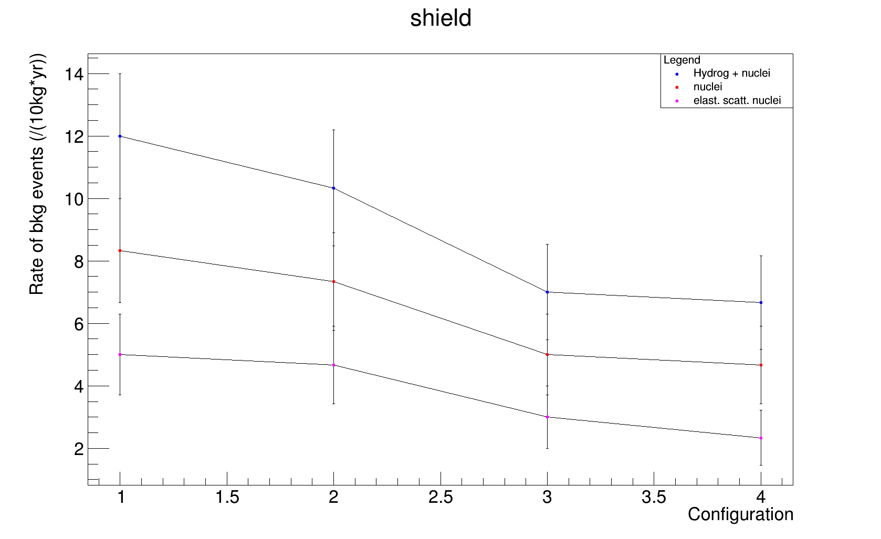
Results
All
All considered configurations give cosmogenic neutron background <= 0.2 n/(10kg*yr)
100cm polyethylene
50cm copper
200cm polyethylene 30cm copper
400cm Water
360cm polyethylene

Slide 16
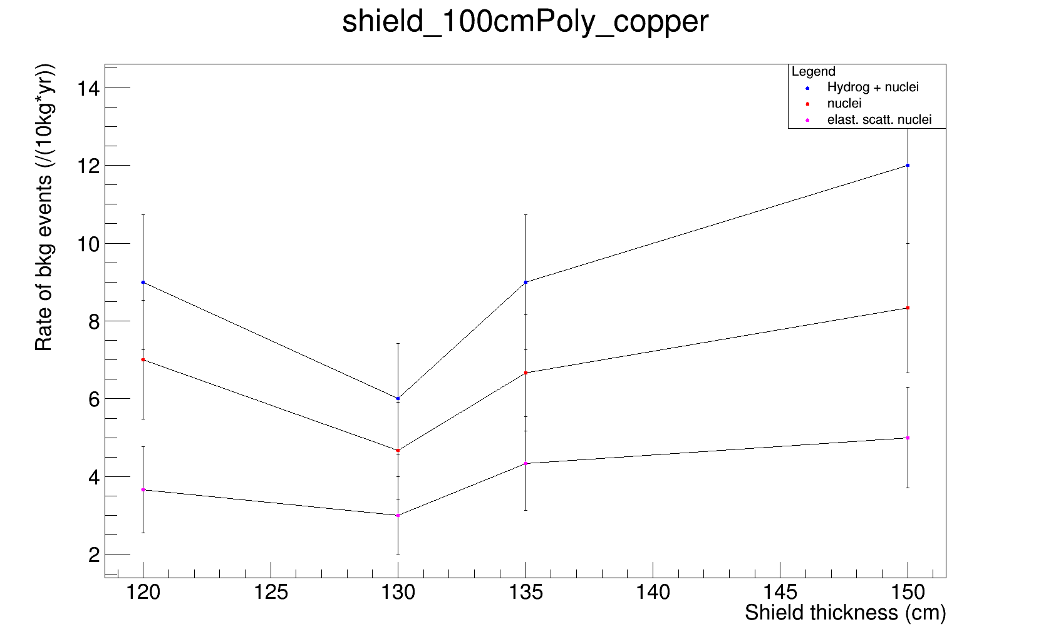
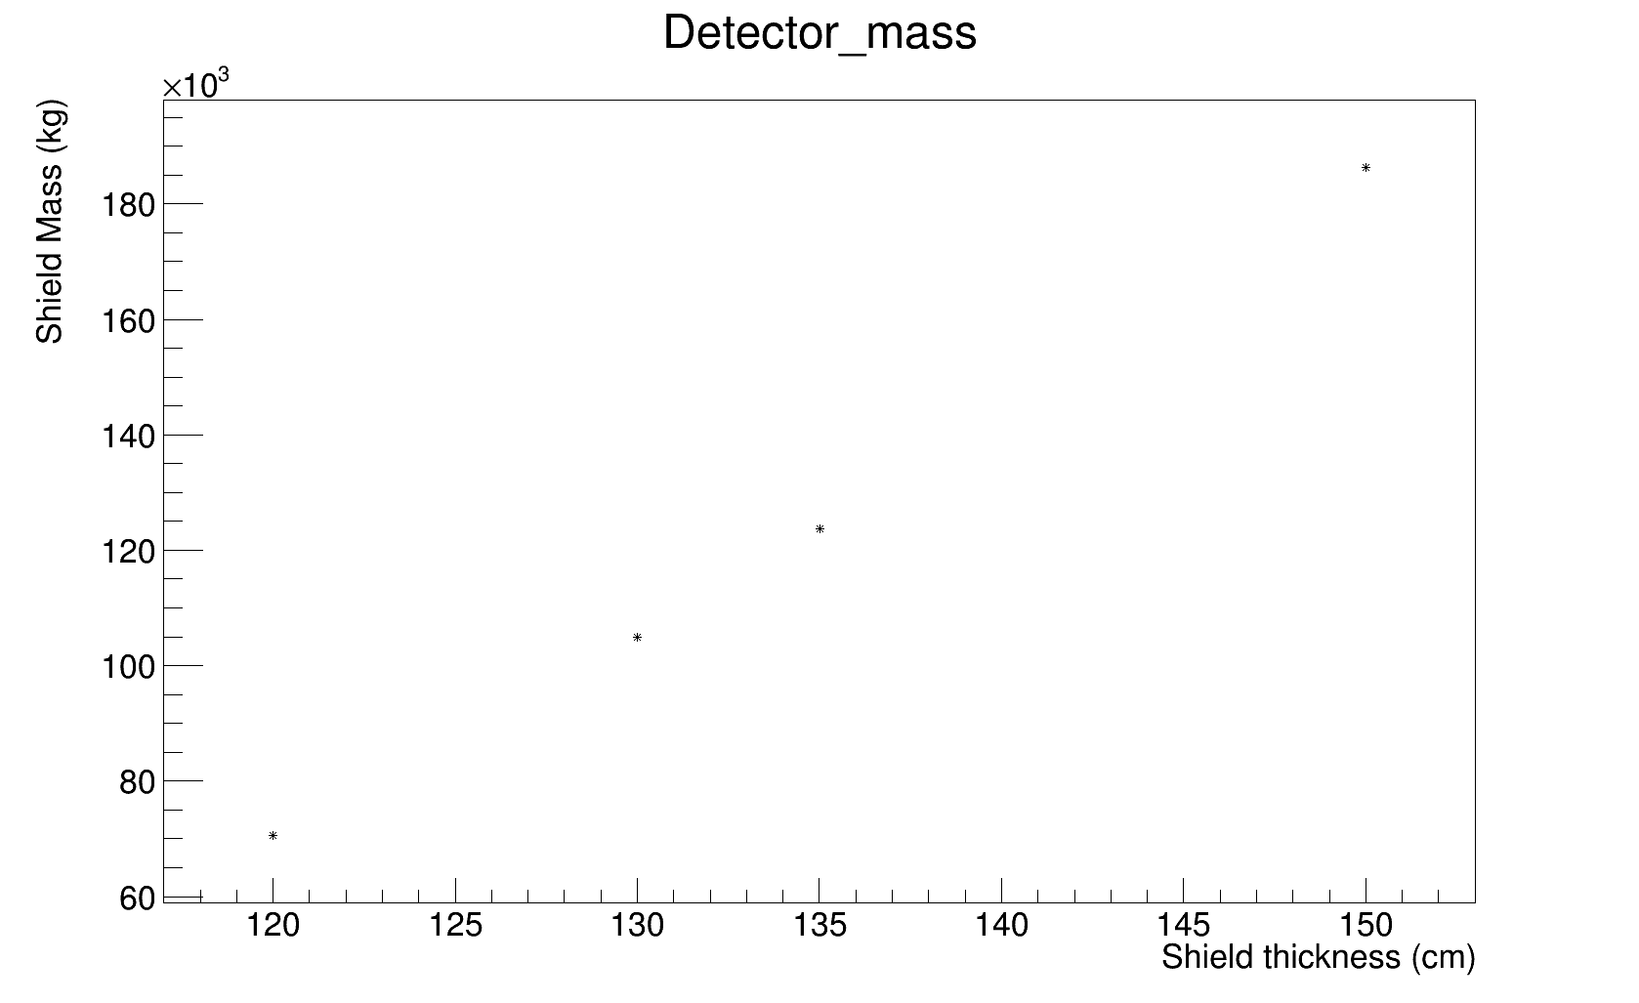
Results
Shielding structure: 100cm polyethylene + x cm copper

Slide 17
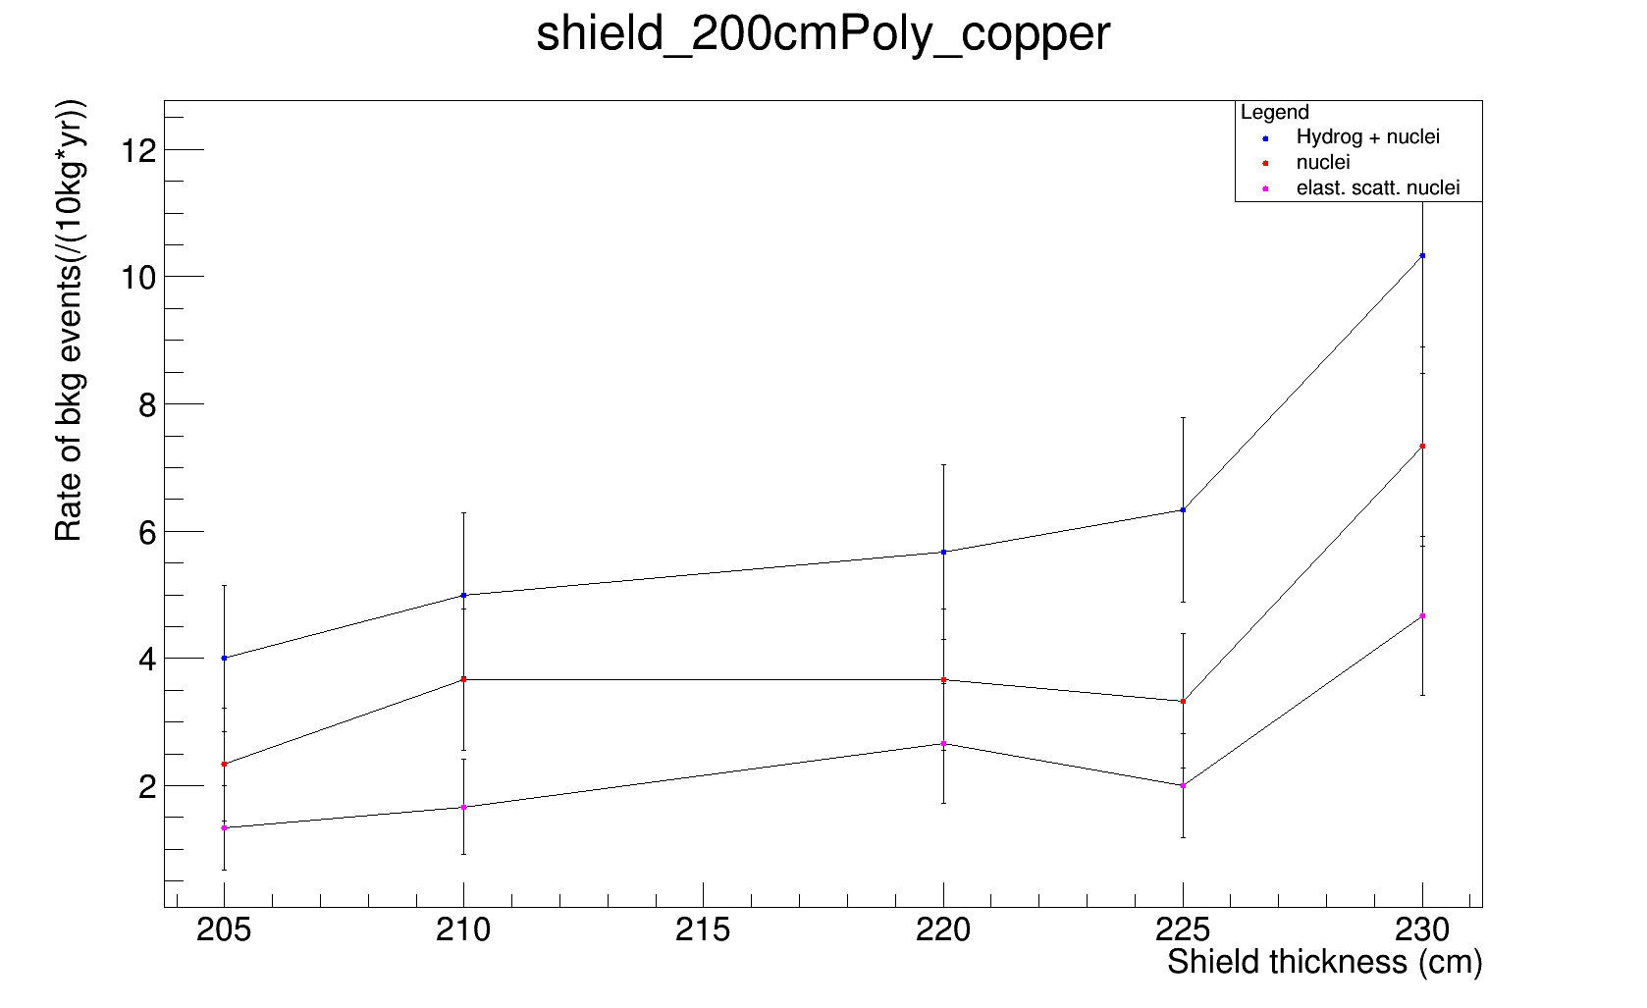
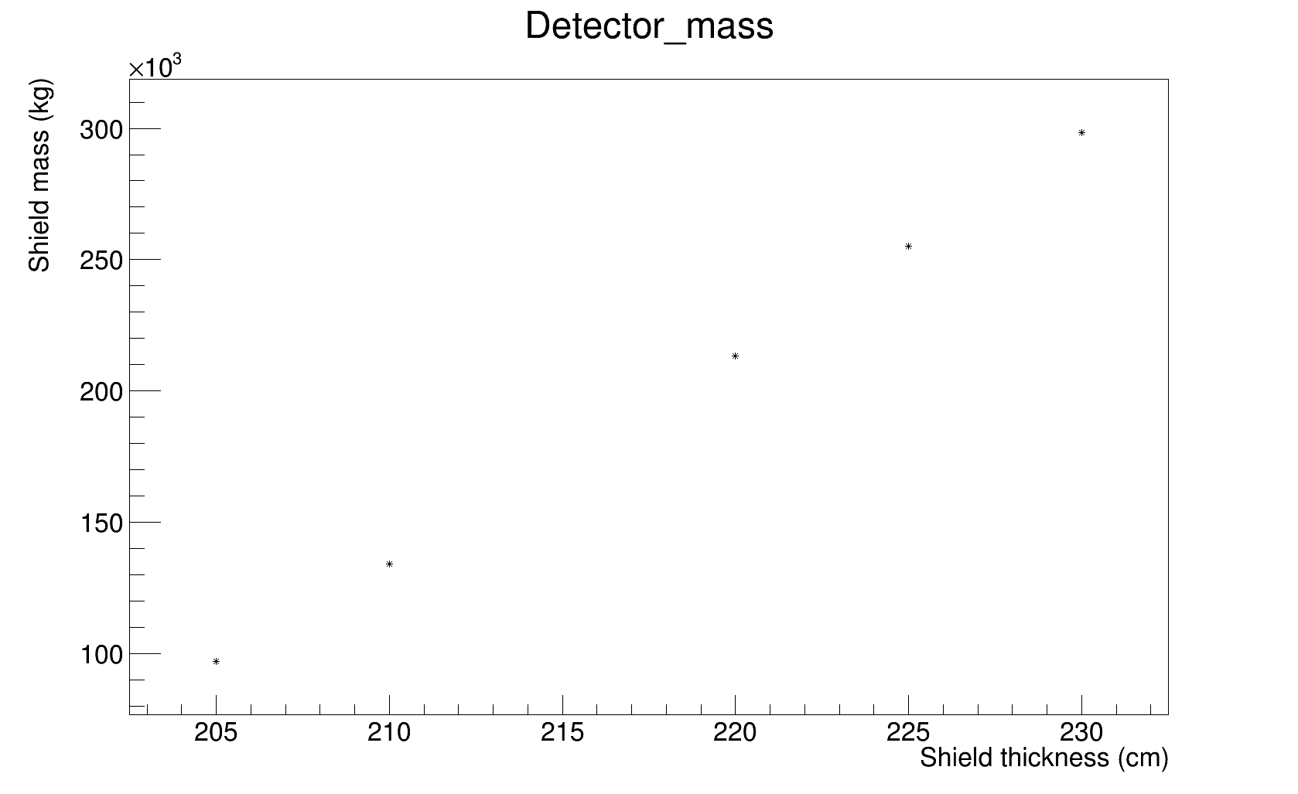
Results
Shielding structure: 200 cm polyethylene x cm copper

Slide 18
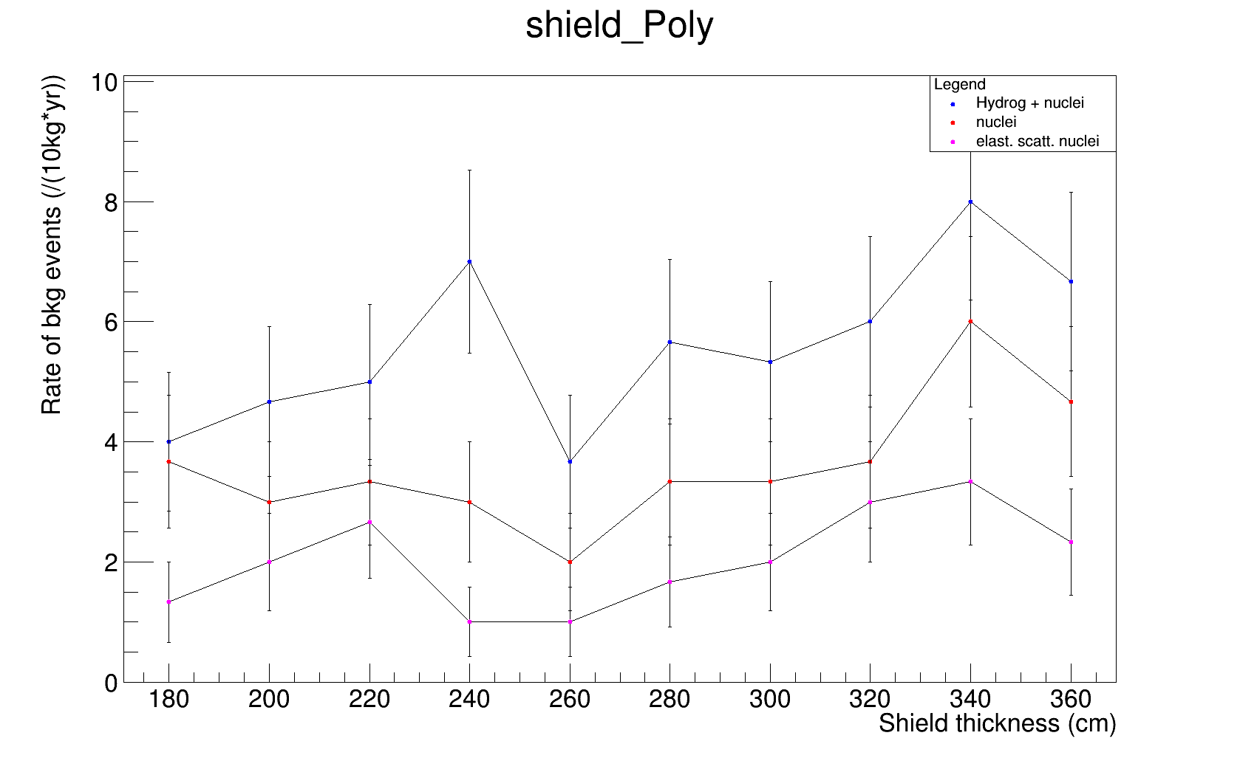
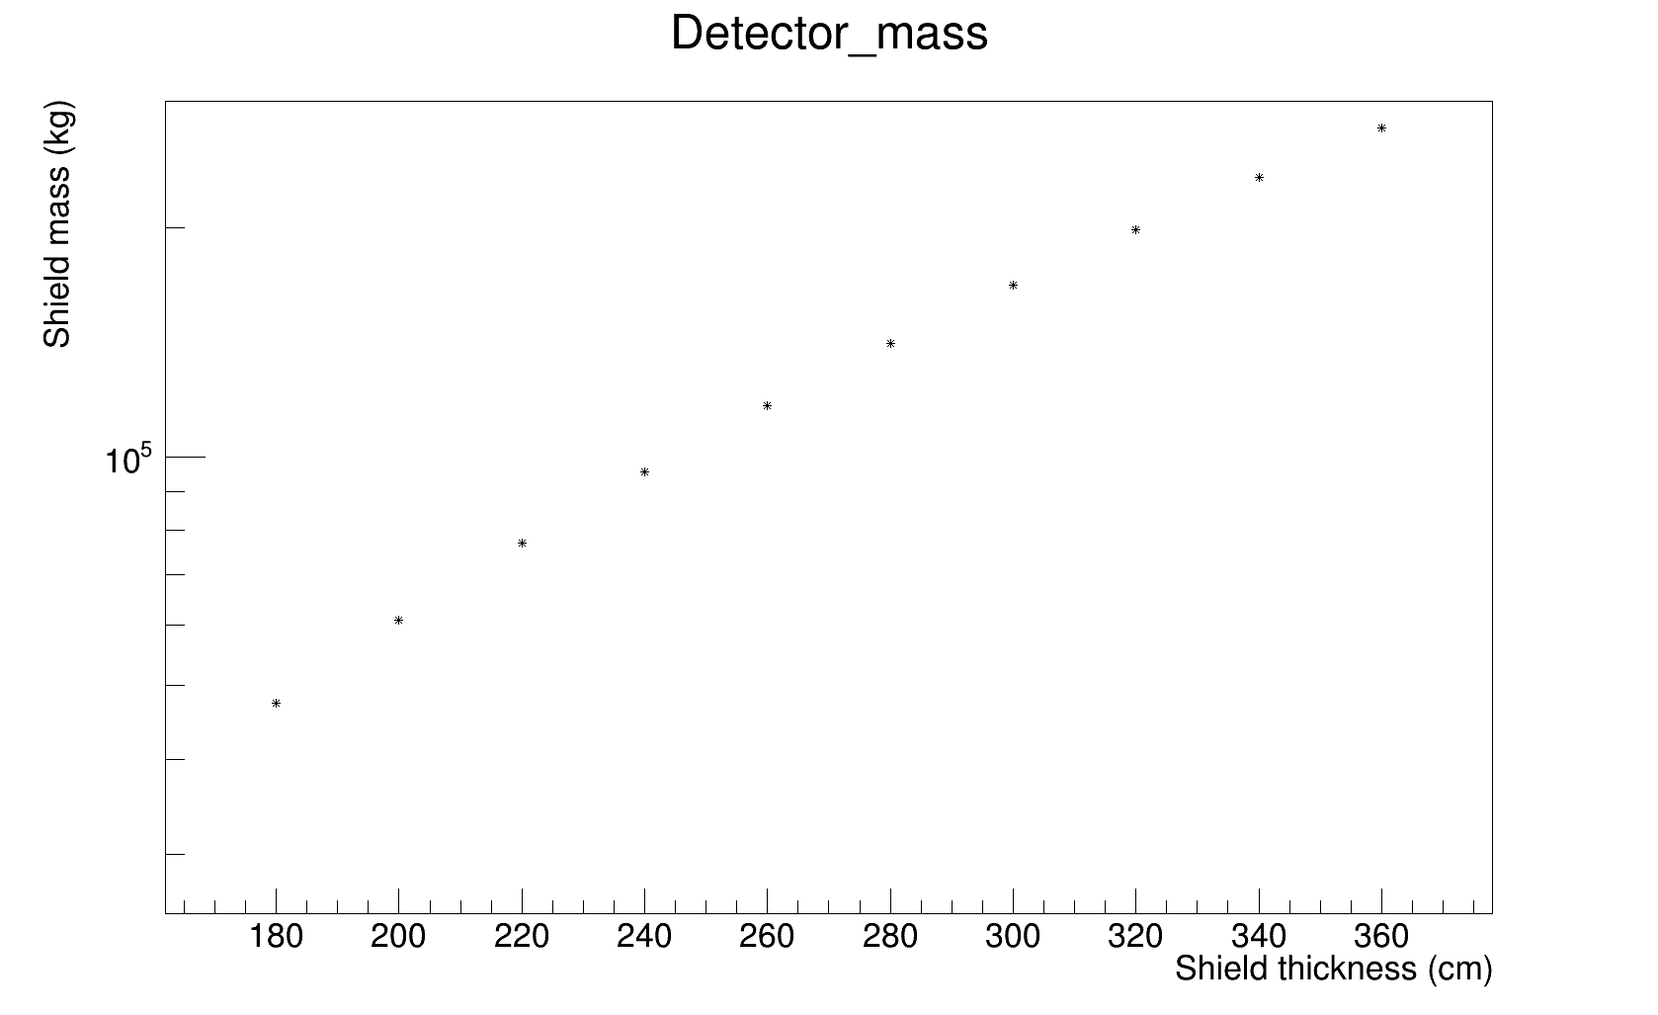
Results
Shielding structure: x cm polyethylene

Slide 19
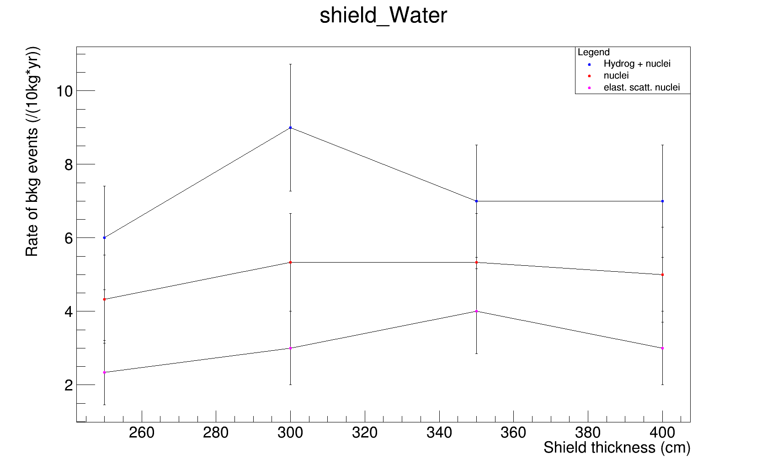
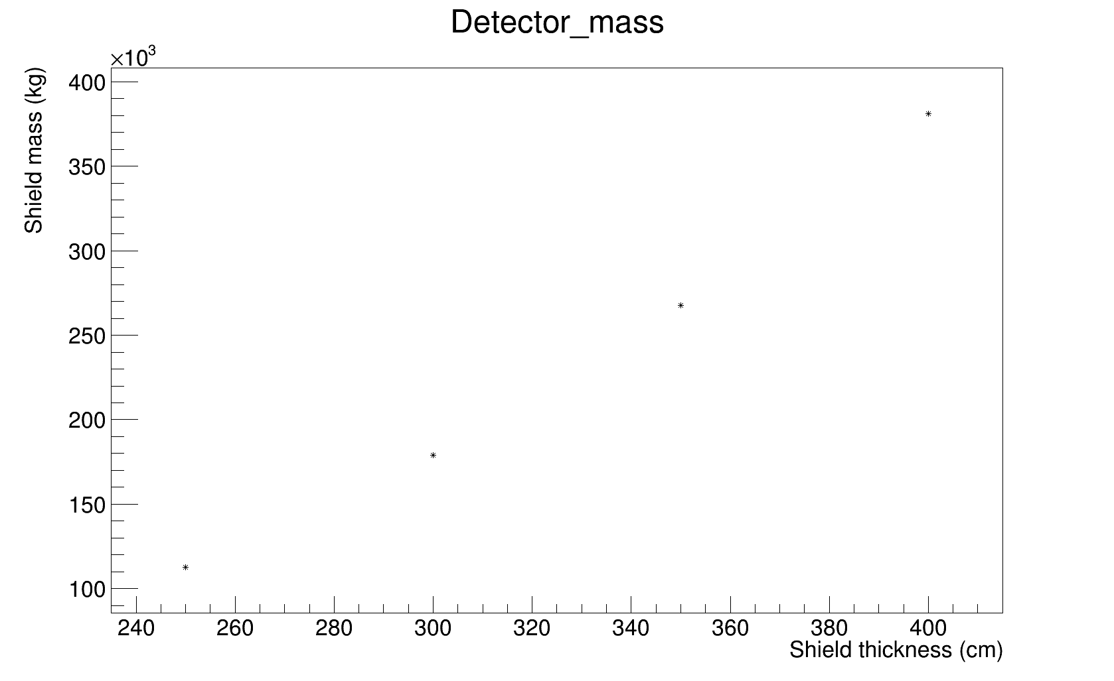
Results
Shielding structure: x cm Water

Slide 20
Conclusions
Muon-induced recoils constitute the most dangerous background source since emulsions don’t have timing information.
Two configurations have been identfied as the most effective for muon-induced background:
  260 cm plyethilene
  200 cm polyethylen + 5 cm copper
Muon induced background ≈ 1.5 event/(10kg*yr)

