Slide 1
Study for luminescence of fine-grained emulsion by charged particles
^{2018/05/30}
T. Shiraishi @ NEWSdm meeting (Anacapri)

Slide 2
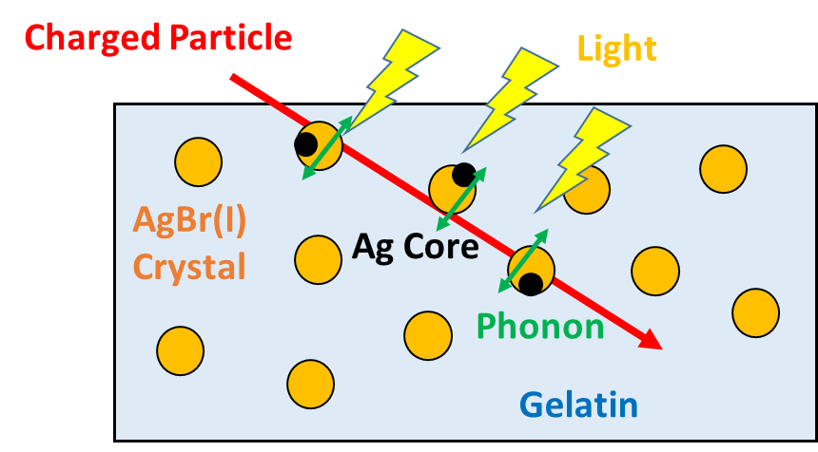
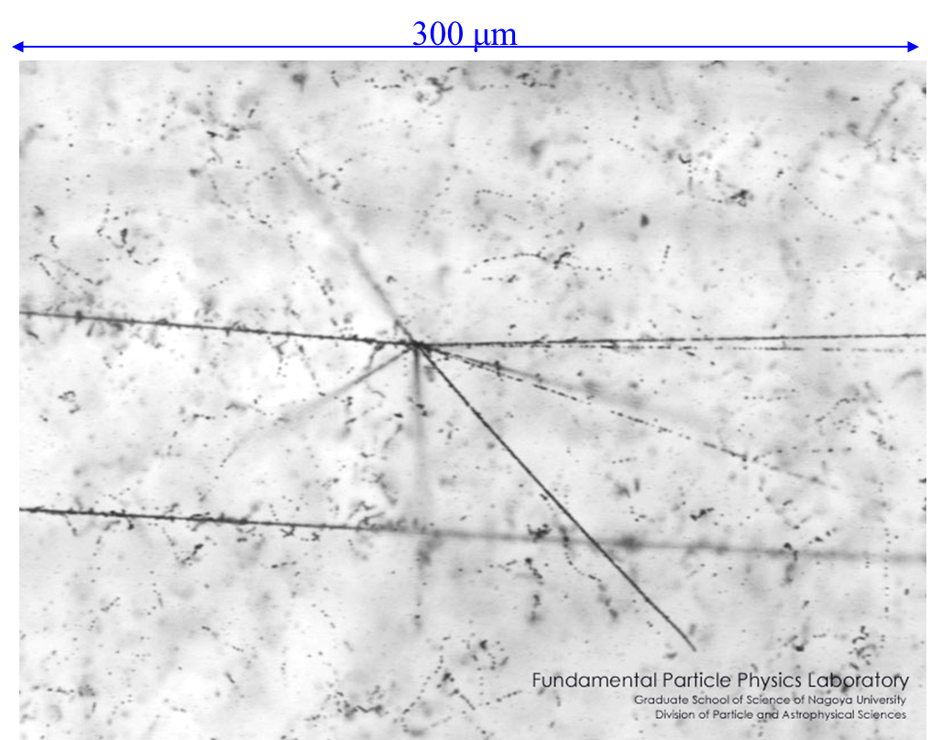
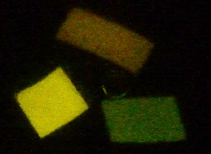
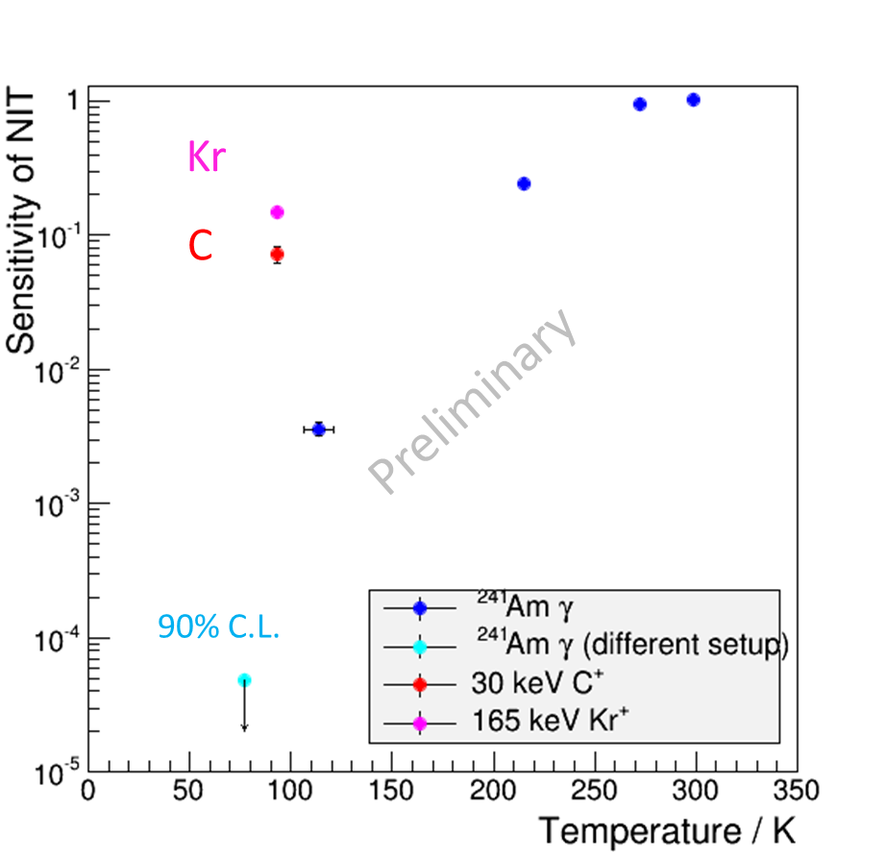
Energy deposition in nuclear emulsion
Energy Deposit
Ag core Development
Talk about this!
Light
Phonons
20 nm crystal
40 nm
200 nm
Sensitivity recovered by contribution of NSP?
Developed Ag can be seen as a track by microscope
Luminescence after exposure with the fluorescent lamp
M. Kimura et al., NIMA (VCI2016) 2016

Slide 3
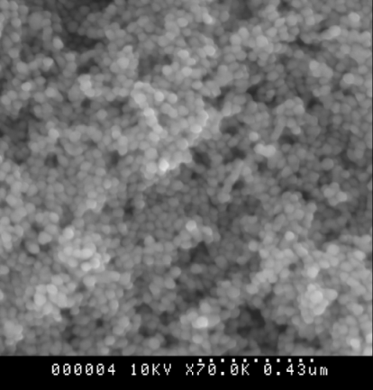
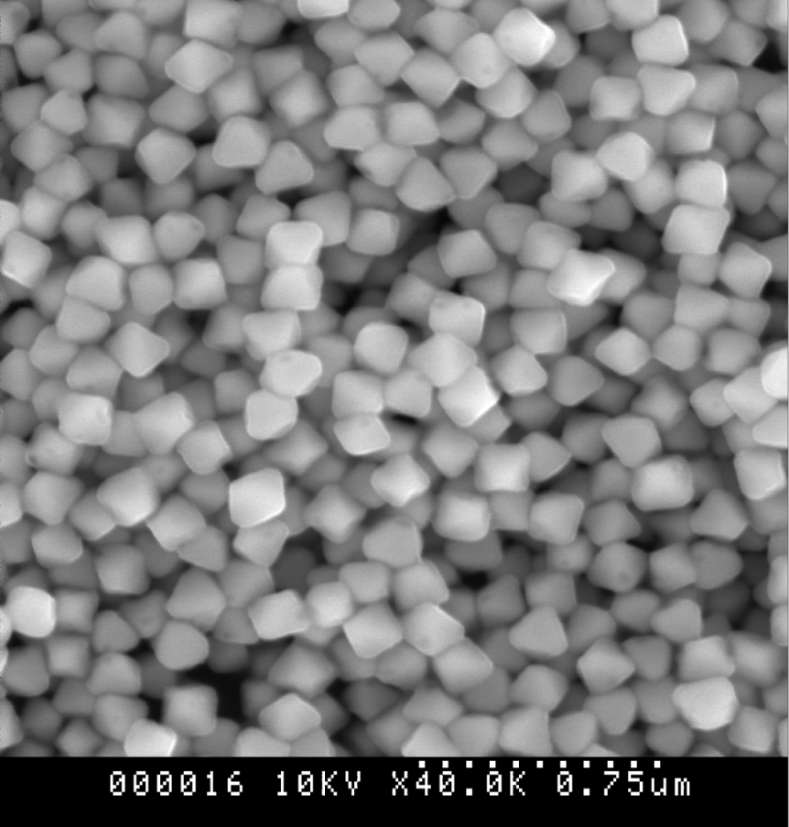
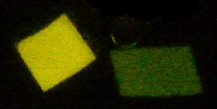
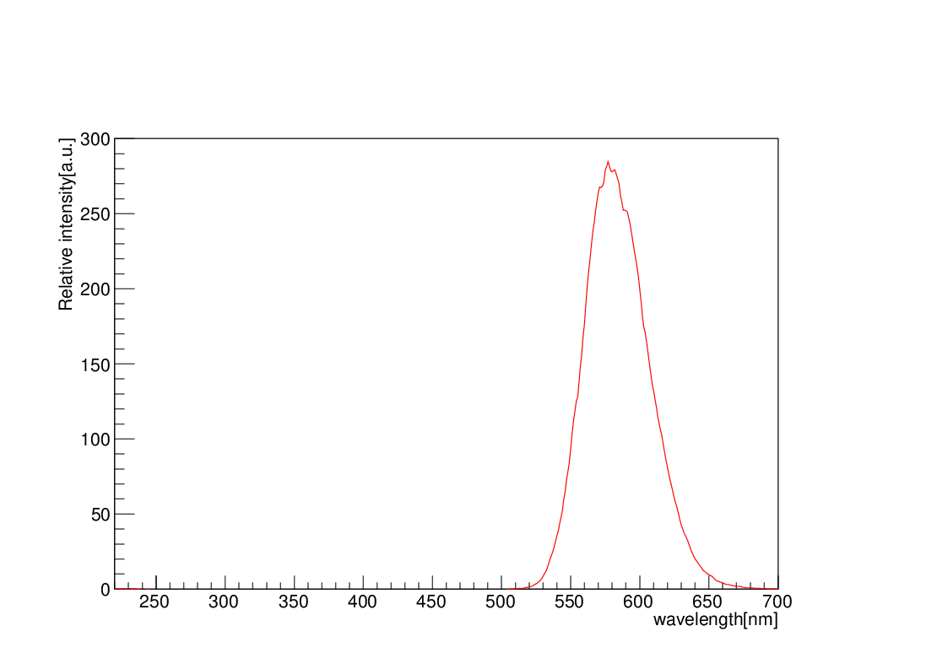
Luminescence of AgBr Crystal
E
electron
Conduction Band
* Reported only photoexcitation
NIT
40nm crystal
OPERA
200nm crystal
Frenkel defects
AgBr crystal
SEM image
Recombination
Hole trap (I⁻)₂
500nm
hole
Valence Band
Verification of emulsion luminescence excited by light
NIT (40nm crystal) luminescence spectrum
NIT (40nm)
OPERA (200nm)
Relative intensity (a.u.)
Peak at 577nm
Luminescence after exposure with the fluorescent lamp
* Observed at Lq. N₂ temperature to decrease heat inactivation
Wavelength (nm)

Slide 4
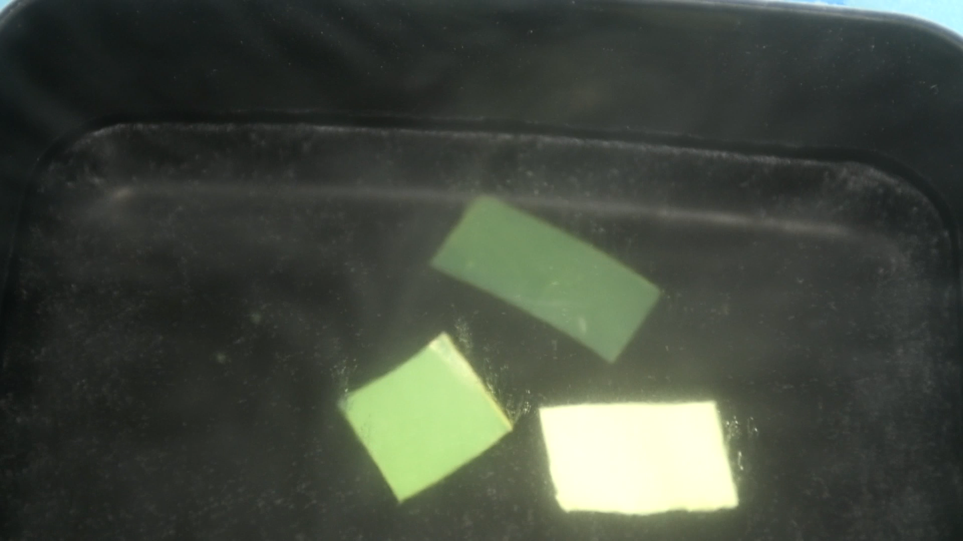
Luminescence of emulsions
UNIT (20nm)
Exposed white light
Light off
Luminescence
NIT (40nm)
OPERA (200nm)
Observable luminescence time with the naked eye
OPERA : ~1s
NIT : ~7s
* In liquid N₂
** Camera sensitivity is automatically adjusted

Slide 5
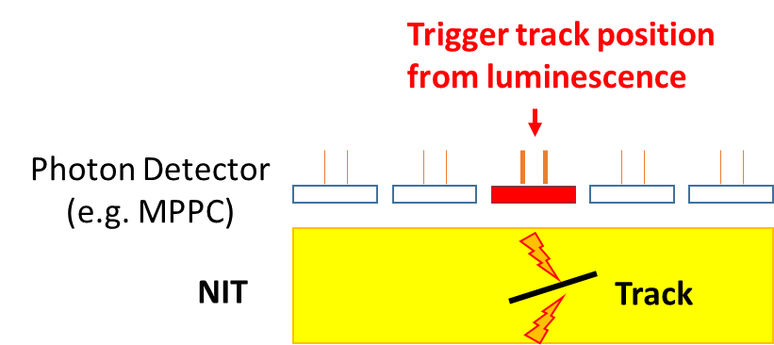
Motivation 1
Combined analysis with track detection
Locate the recorded track position in emulsion with mm accuracy
Dust and fog don’t luminescent
Identify particle property from luminescence information (intensity, life time, spectrum, …)

Slide 6
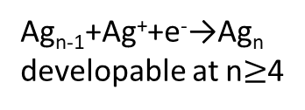
Motivation 2
Elucidation of detection mechanism for charged particles
 | dE/dx in AgBr crystal | Number of e-h pairs created in 40nm AgBr*
5.48 MeV α-ray | 300 (keV/μm) | 2000 (/fs)
60 keV γ-ray | 15 (keV/μm) | 100 (/fs)
1kW pulse laser |  | 0.001 (/fs)
Ag core creation mechanism
*1 e-h pair/ 5.8 eV (K. A. Yamakawa, Phys. Rev. 82, 4（1951）)
E
*Knowledge on photoexcitation
electron
Charged particle create a huge number of e-h pairs locally at the same time (High illuminance condition)
Conduction Band
Silver ion
Frenkel defects
energy
deposition
Latent image
Recombination is probably dominant
→ Ag core creation probability decrease
Ag_{n-1}+Ag⁺+e⁻→Ag_{n}
developable at n$≥$4
Can we get more information about Ag core creation mechanism from luminescence?
hole
Valence Band

Slide 7
Cryostat DAQ
Hamamatsu C12332-01 module
Cryostat
Coaxial cable
125Msps,
12bit, 8ch
ADC
Amplifier
x20
ZYNQ
(Xilinx FPGA)
BNC
feedthrough
Cosmo-Z
Power Supply
for MPPC
C11204-01
±5V
Power Supply
TCP/IP
USB → UART
Atlas-SoC
PC
TCP/IP
500ksps,
12bit, 8ch
ADC
Cyclone V
(Altera FPGA)
Pt resistor
He₂ Gas
MPPC
Fill He gas inside of chamber to keep no condensation
Adjust amount of Liquid N₂ for temperature control
Photon detector : MPPC
MPPC data taking : Cosmo-Z
Sample
Ga. He₂
Thermal sensor : Pt resistor
Pt resistor data taking : Atlas-SoC
Lq. N₂

Slide 8
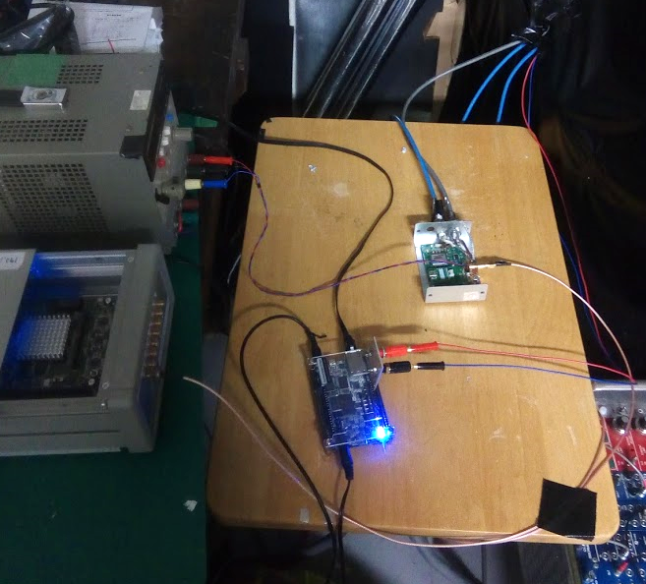
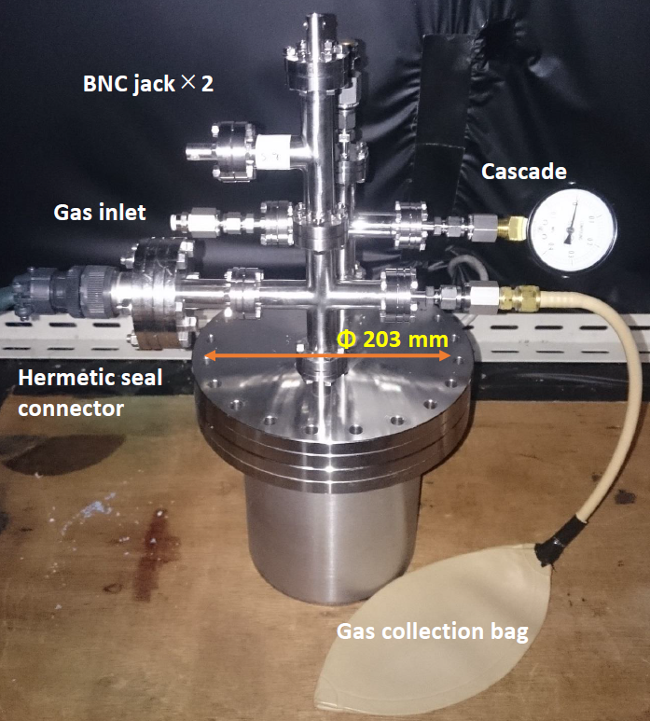
Cryostat DAQ (Photograph)
MPPC bias voltage cable
± 5V Power supply
Power supply & Amprifier for MPPC
MPPC signal cable
Cosmo-Z
(125Msps, 12bit, 8ch ADC and ZYNQ board)
Atlas-SoC
(500ksps, 12bit, 8ch ADC and Cyclone V soc board)
Pt resistor cables
Send data to PC via LAN cables

Slide 9
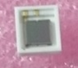
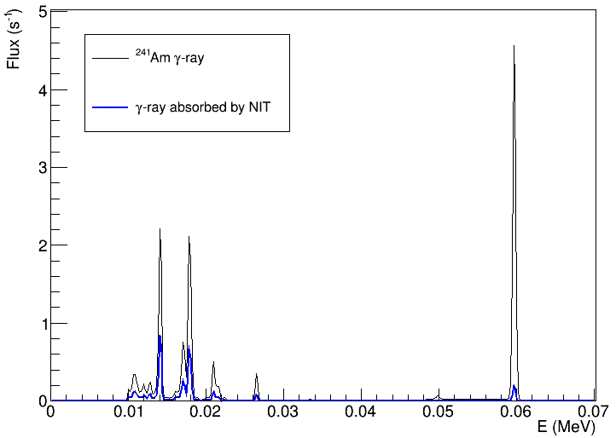
Setup of α-ray and γ-ray exposure
3.0mm
MPPC
Photon detector
VUV-MPPC (S13370-3050CN)
Light guide
(PMMA)
12.0mm
Fiducial Area : 9 mm² Number of pixel : 3600
Aperture : 60%
PDE(@577nm)：32%
Sample (NIT or Gelatin)
α-ray shield
(Al 110μm or no shield)
Stage
1.0mm
²⁴¹Am
59.5keV
Light
²⁴¹Am RI
α-ray : 5.48MeV
γ-ray : 10～60keV
Rate to forward : 33 Hz
13.9
17.8
Black：²⁴¹Am γ-ray spectrum
Blue：NIT absorbed spectrum
pixels
Notes:
Concerning g-ray, main component from am source is around 60keV, but almost of them are through NIT, because the absorption rate is very small. So main component of g-ray absorbed by NIT are 10-20 keV.

Slide 10
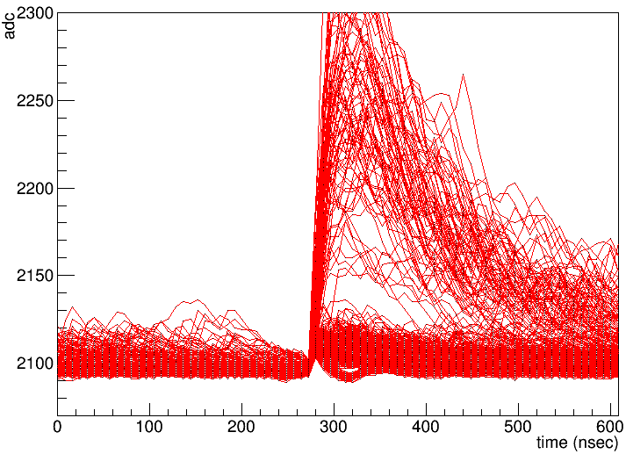
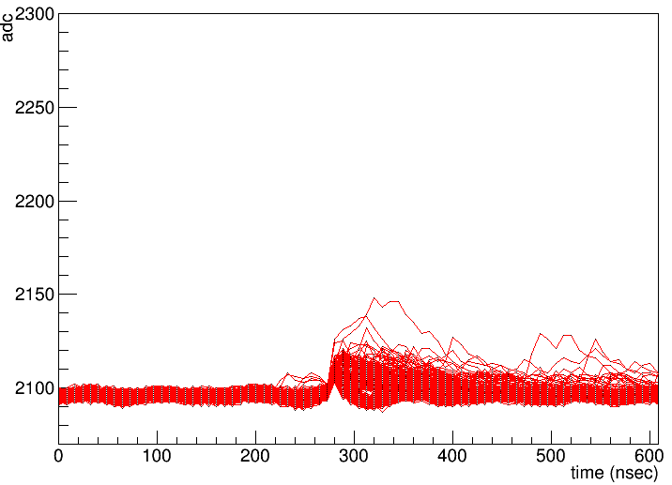
MPPC waveform
α-ray exposure
γ-ray exposure
trigger by 1p.e. level
10000 events overlay plot
@88K
10000 events overlay plot
@88K
pre-trigger 288ns
(for pedestal correction)
post-trigger 320ns
Integral ADC (Charge) → Index of number of photon

Slide 11
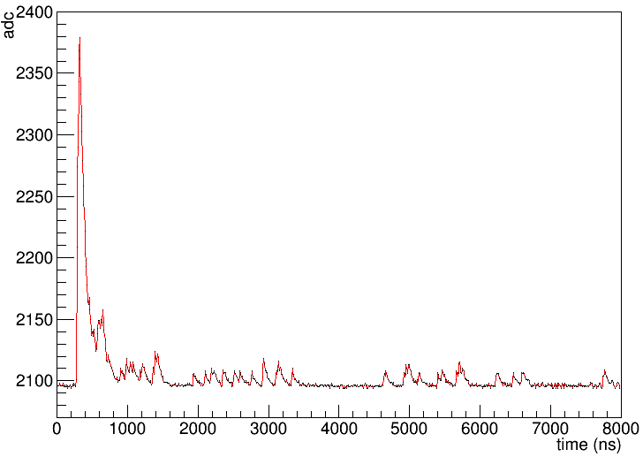
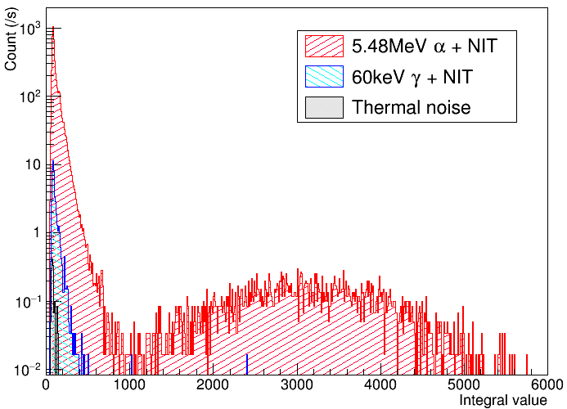
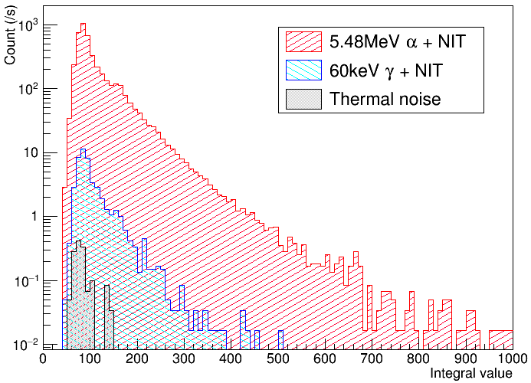
Integral ADC (Charge)
Long waveform data (time window 8μs)
Fluorescence (15~60p.e.)
1 p.e.
Phosphorescence
2 p.e.
Phosphorescence
15 ~ 60 p.e.
This rate is same as number of exposed α-ray
Fluorescence

Slide 12
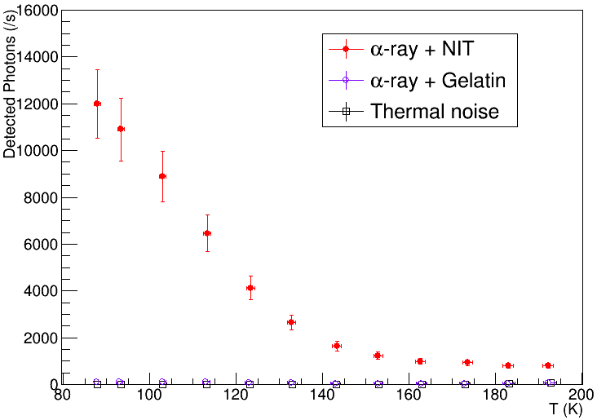
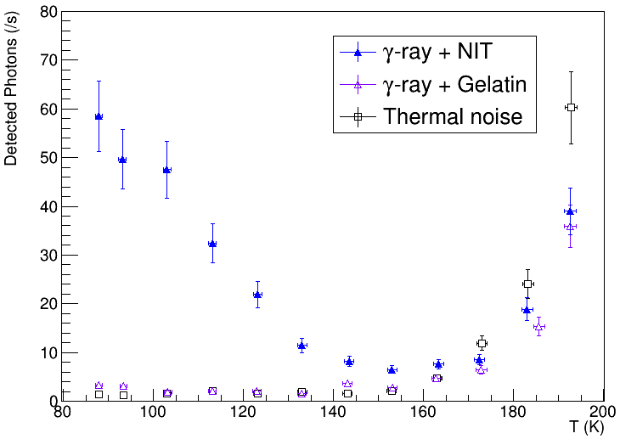
Detected number of photon
α-ray exposure
γ-ray exposure
Considered errors
1p.e. peak decision accuracy ~ 1%
Exposed α-ray and γ-ray number ~ 2.2%
MPPC noise (cross talk and after pulse rate) ~ 10%
Measurement repeatability ~ 6.8%

Slide 13
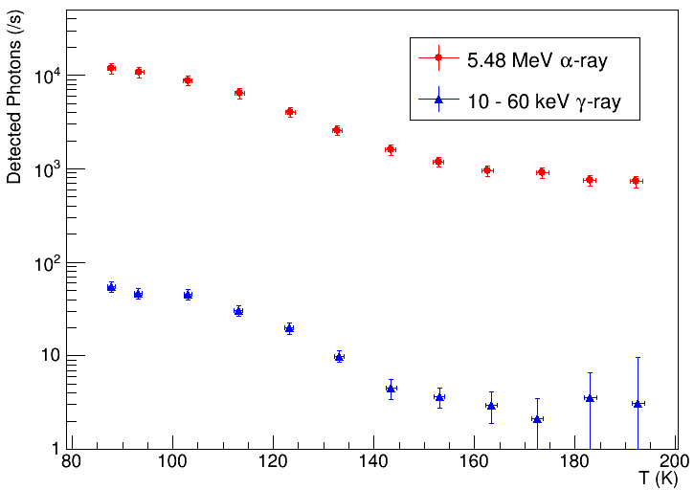
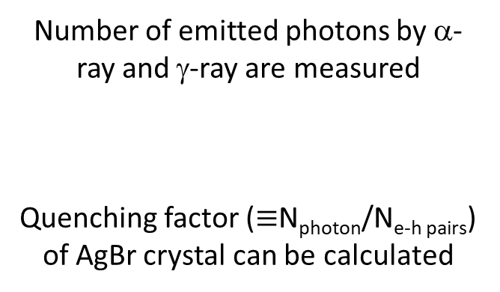
Detected number of photon
(Background subtracted)
Number of emitted photons by α-ray and γ-ray are measured
Quenching factor ($≡$N_{photon}/N_{e-h pairs}) of AgBr crystal can be calculated
Notes:
If we know energy deposition in AgBr crystal, we can estimate quenching factor

Slide 14
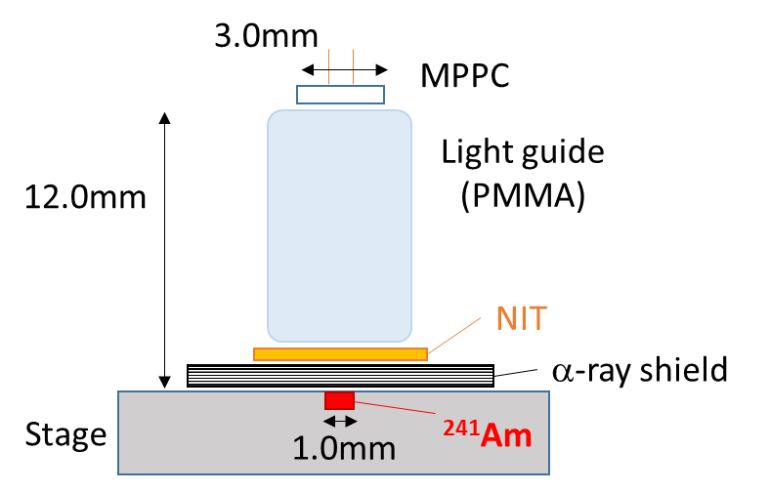
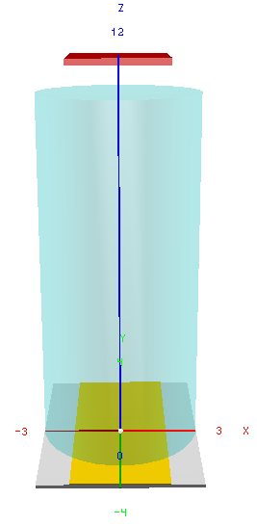
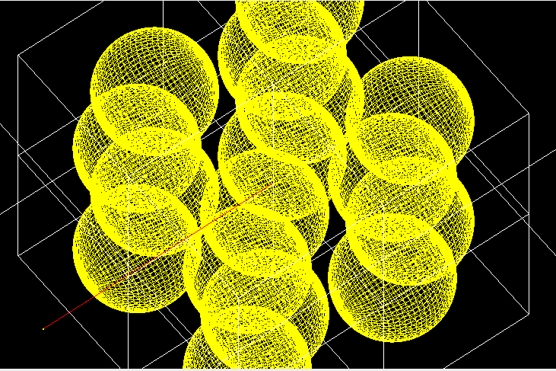
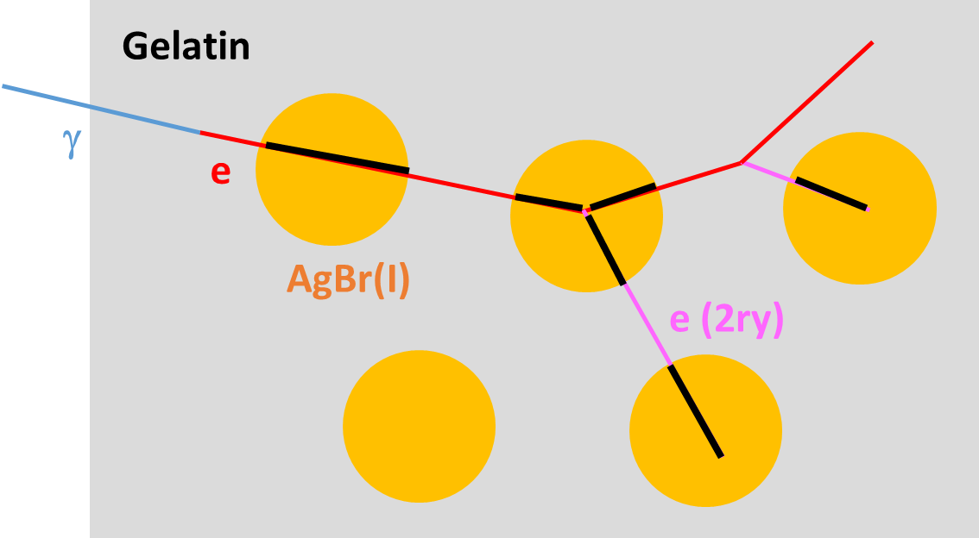
Estimation of energy deposition in AgBr crystal
Geant4 simulation Geometry
NIT internal structure
Face centered cubic lattice
Whole density : 3.44 g/cm³
Fill rate of AgBr(I) : 41.5%
Lattice constant : 75.5nm
e.g. γ-ray simulation
Integrate energy deposition in crystal by every charged particles
2ry generator condition is more than 5nm

Slide 15
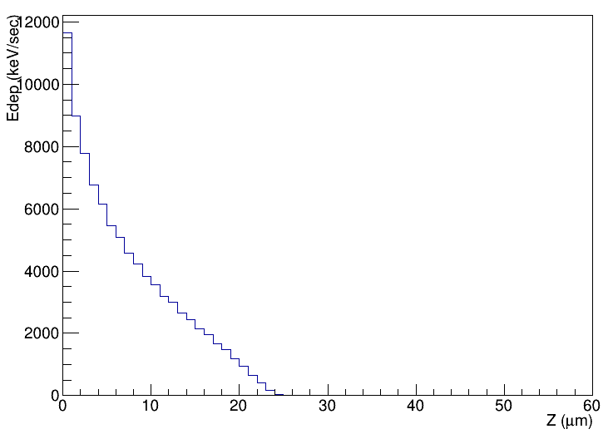
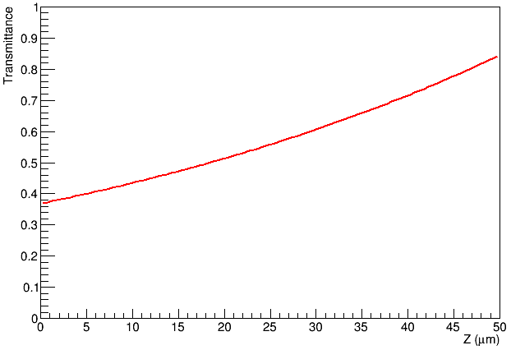
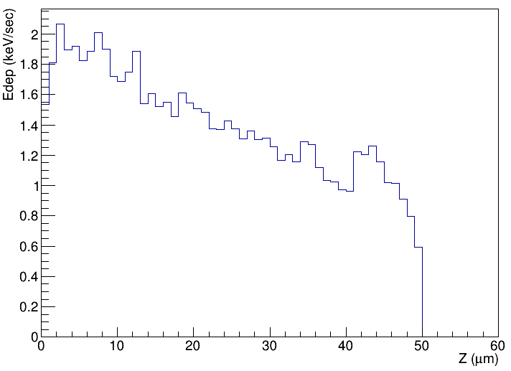
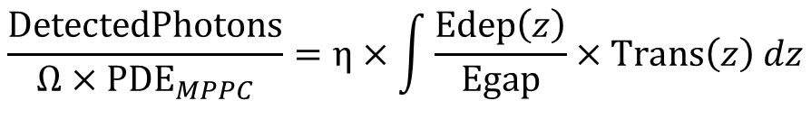
Quenching Factor Calculation
Number of detected photons
Energy deposition in NIT’s AgBr crystal
$$\frac{DetectedPhotons}{Ω×{PDE}_{MPPC}}=η×\int{\frac{Edep\left(z\right)}{Egap}×Trans\left(z\right) dz}$$
²⁴¹Am a-ray exposure
Edep_{total} = 90000 keV/s
Solid angle
～0.14
MPPC photon
detection efficiency
～0.32
AgBr energy gap
～5.8eV
NIT Transmittance of 577nm light
²⁴¹Am g-ray exposure
Edep_{total} = 70 keV/s
T=82.3*exp(-0.0165*x)
Z (μm)
Z (μm)

Slide 16
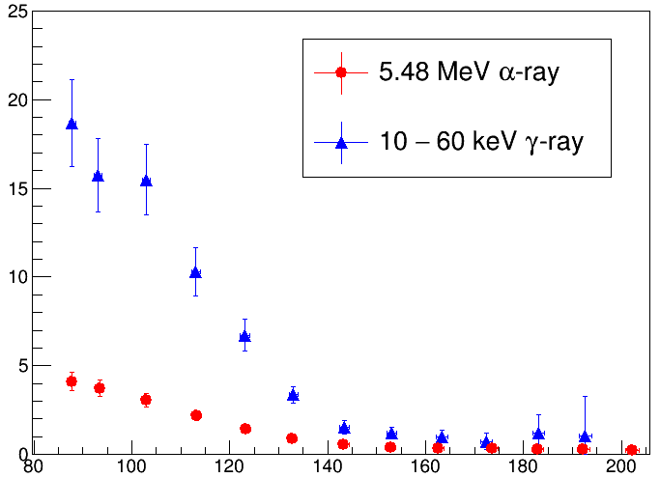
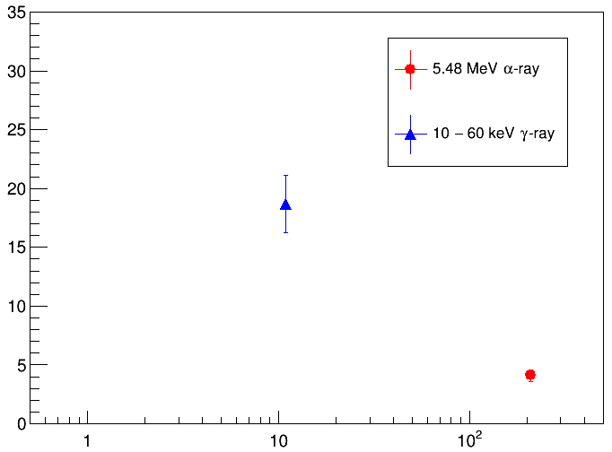
Quenching Factor
Temperature dependency
dE/dx dependency @ 88K
Quenching factor (%)
Quenching factor (%)
Preliminary
Temperature （K）
MIP
dE/dx (keV/μm)
Quenching factor is ~30% for MIP???

Slide 17
Comparison with typical scintillators
Preliminary
 | Ce : GAGG | Tl : NaI | Scintillating Fiber (BCF-60) | NIT @ 88K (*Gelatin contained)
Density (g/cm³) | 6.63 | 3.67 | 1.2 | 3.44
Life time (ns) | 88 | 230 | 7 | ~100 + ~10000
Deliquescent | no | yes | no | no
Number of photon (photon/MeV) | 60000 (MIP) | 40000 (MIP) | 7100 (MIP) | ~4000 (α 5.48MeV) ~18000 (γ 60keV) ~30000??? (MIP)
Energy resolution (% @ ¹³⁷Cs-662keV) | 6.3 | 5.6 | ??? | ???
Wavelength (nm) | 520 | 415 | 530 | 570?
Not yet optimized!
We can change amount of Iodine dope, size of AgBr crystal, …

Slide 18
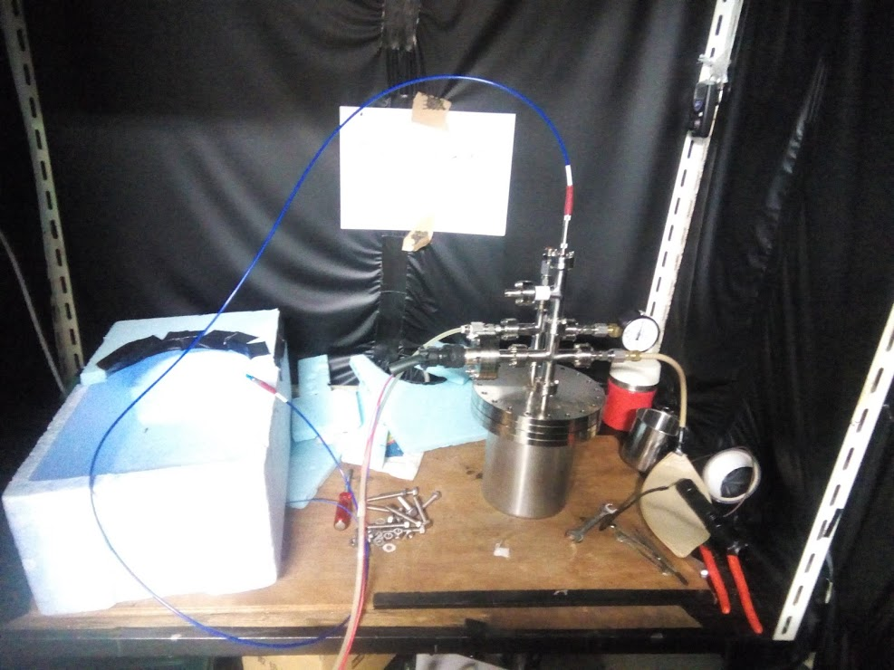
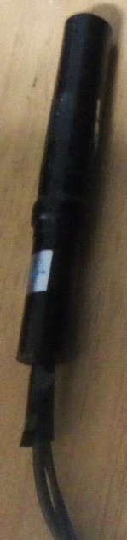
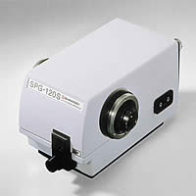
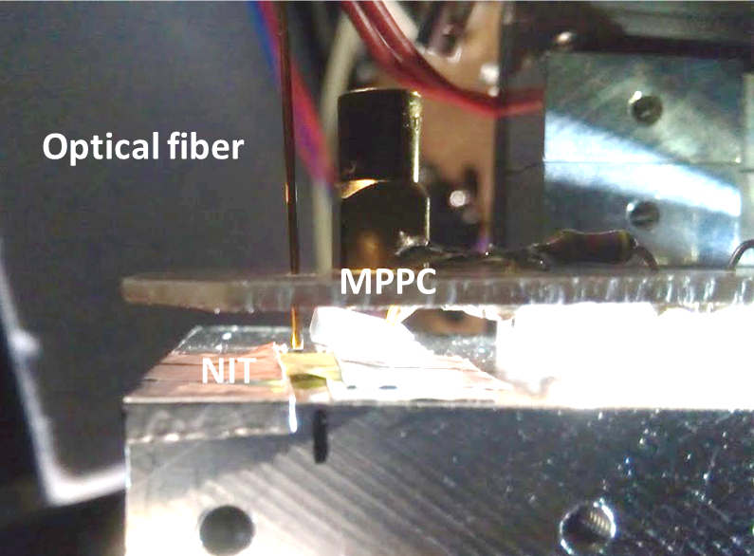
Luminescence spectrum analysis (On going)
Optical fiber
Monochromator (6/12~ available)
PMT
Optical fiber feedthrough
Inside of chamber
Trigger luminescence by MPPC inside of chamber
Optical fiber guide the luminescence to outside of chamber
Monochromator selects the wavelength (~10nm width)
PMT detects monochro-photon

Slide 19
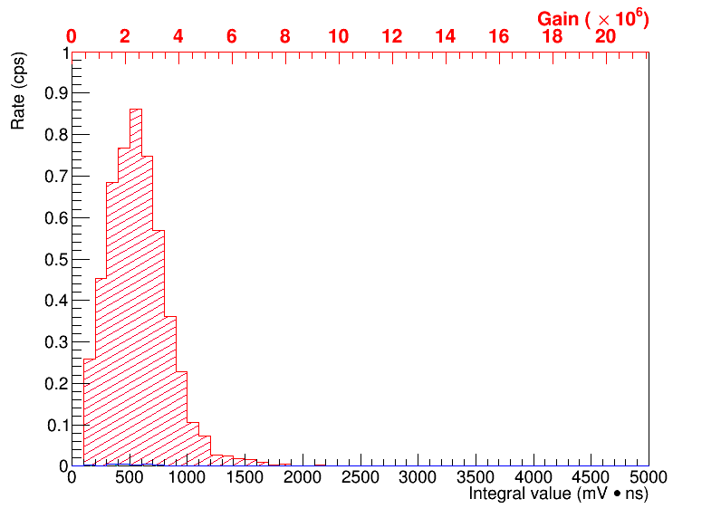
Luminescence spectrum analysis (On going)
PMT signal
(No monochromator measurement)
1 p.e. peak
It is succeed to guide NIT luminescence to outside of chamber with high S/N
NIT luminescence + Thermal noise
→ 5.0 cps
6/12~ monochromator will be available
NIT luminescence spectrum by charged particles will be able to be observed
Thermal noise → 0.02 cps

Slide 20
Summary
This is the first observation of luminescence of emulsion by charged particles
Measured the rate of contribution to luminescence of NIT excited by α-ray and γ-ray
  Luminescence efficiency is very high at low temperature (may be comparable to plastic scintillator)
Application for detector
  Measure for nuclear recoil event and M.I.P.
  Multi-channel readout
Elucidation of detection mechanism for charged particles
  Spectrum analysis
  Change crystal property
Plan

Slide 21
Backup

Slide 22
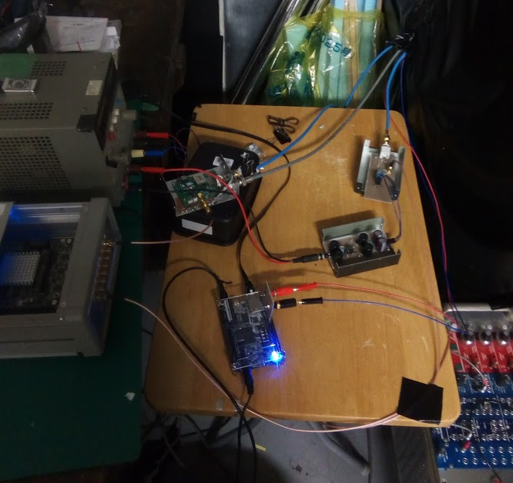
Cryostat DAQ (for spectrum analysis)
Monochromator
PMT
PMT signal cable
Optical fiber
MPPC signal cable
MPPC bias voltage cable
PMT amplifier
PMT HV cable
Pt resistor cables
High voltage power supply for PMT

Slide 23
To increase detection efficiency
Use GaAs PMT
  High quantum efficiency
Use wide optical fiber (600μm→1mm)
Increase RI rate
  Do anyone have high rate RI (> 100Bq) which can be used at low temperature (77K) ?
Light collection
  It seems difficult to collect light to optical fiber (600μm, NA=0.22)

Slide 24
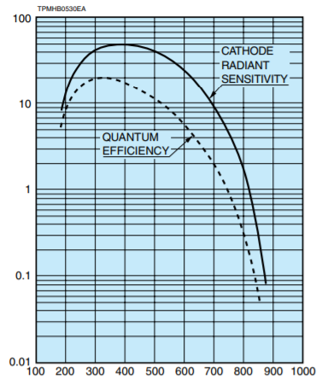
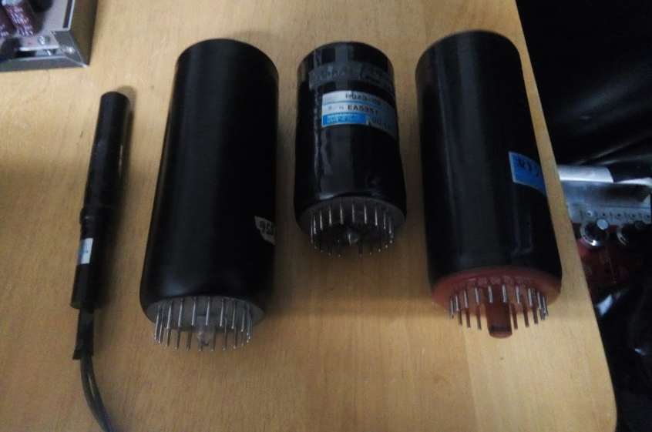
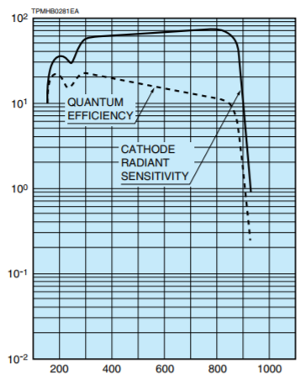
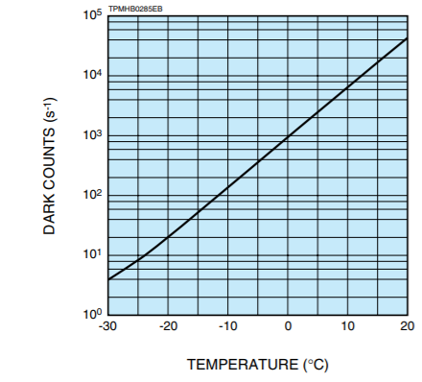
GaAs PMT
From Hamamatsu data sheet
Quantum efficiency
Thermal noise rate
R1463 (multi-alkali PMT)
100cps @20℃
7% @570nm
R943-02（GaAs PMT）
30000cps @20℃
20cps @-20℃
15% @570nm

Slide 25
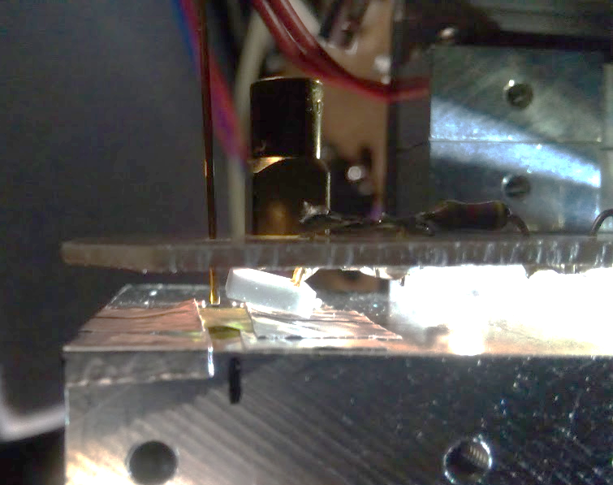
GaAs PMT を-20℃ぐらいに冷やしたい
モノクロメータ
密封容器
光ファイバー
入射
霜が付かないように窒素ガス置換
GaAs PMT
HV
出射
Signal
N₂ Gass
どうやって冷やす？
・氷水系は使いたくない
・保冷剤・ドライアイスだと溶ける、温度コントロールできない

Slide 26
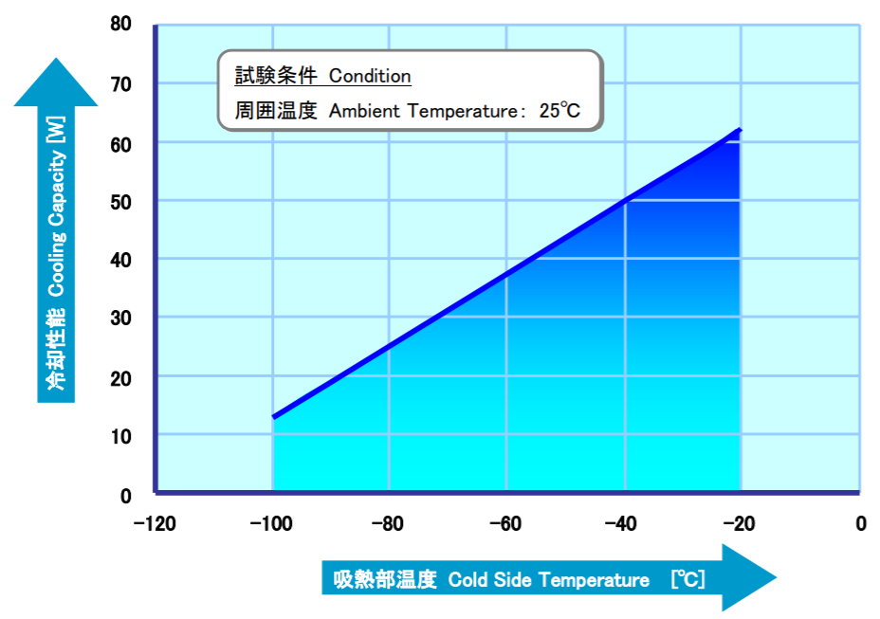
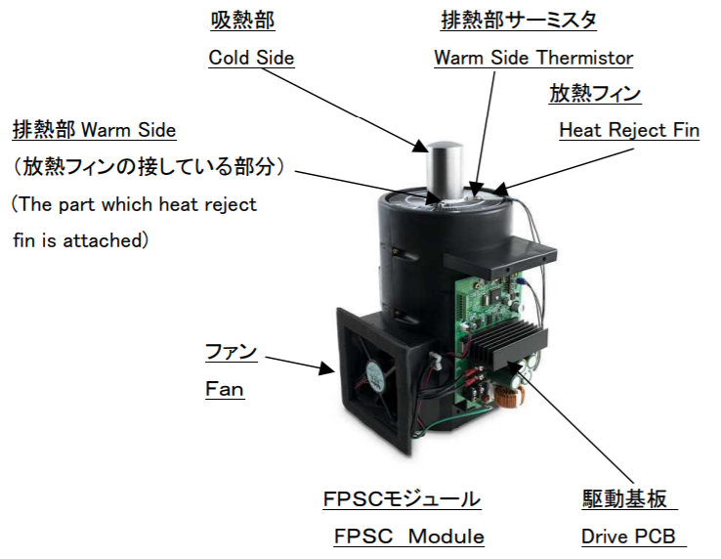
スターリング冷凍機 SC-UD08
冷却性能
・(10cm)³の体積のアルミニウム（2.7kg）の場合
-20℃から1℃下げるのに38s
-40℃から 48s
-60℃から 66s

Slide 27
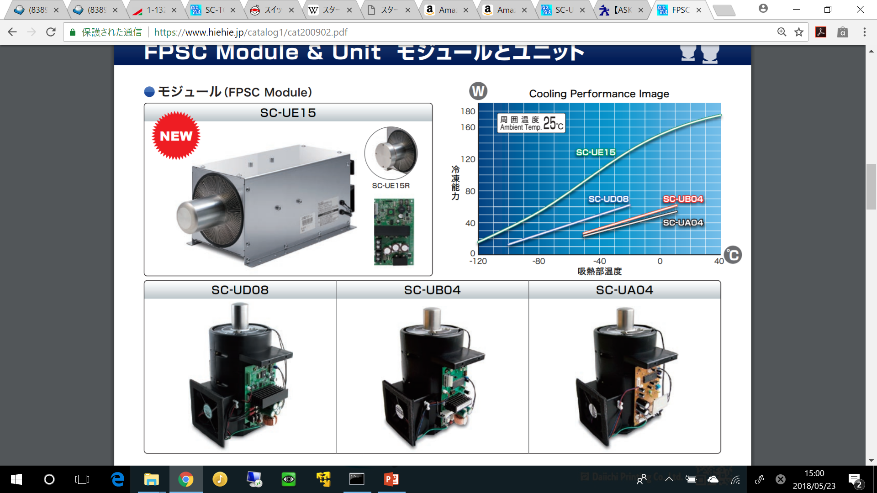
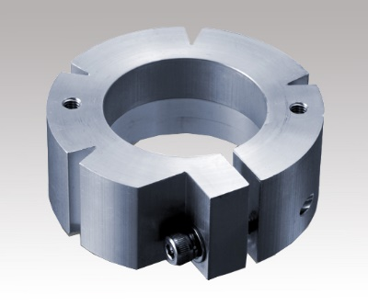
30万円→
アダプタ
12万円→
↑5500円
↑10万円
※100W級の24V電源が必要（Amazonで3000円ぐらい）

Slide 28

治具は各自で作れば良い
断熱材
？？？
冷却ステージ
アダプタ
冷凍機
アダプタ
Φ37.7mm
M4ねじ穴
Φ50mm
断熱材
PMT冷却用
アダプタ
冷凍機

Slide 29
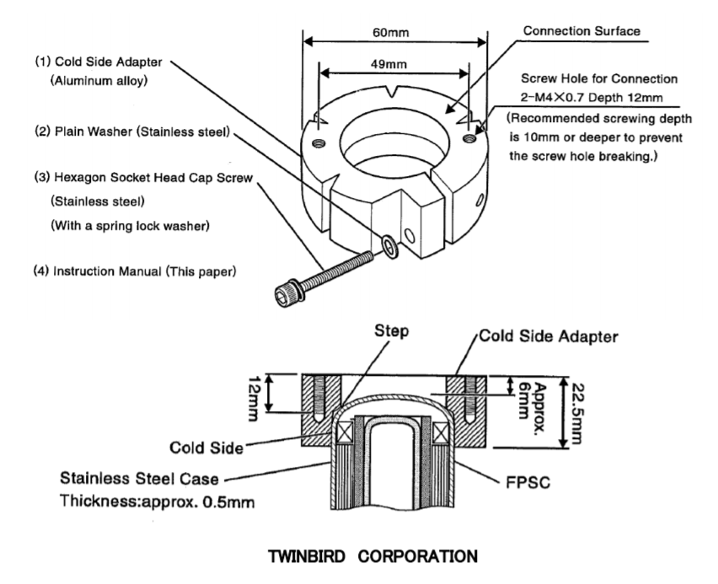
アダプタ

Slide 30


Data connection
Data file
Data file
Data file
Data file
PH$≥$96
・・・
・・・
・・・
50μs
α線による最初の発光（蛍光）
通常の測定
・トリガー閾値：2103
・タイムウィンドウ：600ns
（デッドタイム～800ns）
燐光

Slide 31

Averaged waveform
Pulse Height
log scale
Time (ns)
Time (ns)
赤：トリガー閾値2191、8μsの測定（8μs まではデッドタイムなし）
青：通常の測定（閾値2103、600ns）でデータをつなげたもの
Dead time

Slide 32


Long data (time window 8μs)
Average of α-ray long data @ 93K
Average of γ-ray long data @ 93K

Slide 33


Slide 34


Slide 35

α-ray simulation

Slide 36

α-ray simulation

Slide 37


γ-ray simulation

Slide 38

γ-ray simulation

Slide 39




Thermoluminescence of NIT by charged particles
Room temperature
Lq.N₂ -> Room Temperature
α
²⁴¹Am
Room temperature
Lq.N₂ -> Room Temperature
β
⁹⁰Sr
* ISO6400, shutter speed = 4 s (α), shutter speed = 8 s (β)

Slide 40


日本写真学会誌2016 年79 巻3 号：2–6 高田俊二、久下謙一

Slide 41

Triboluminescence
日本写真学会誌2016 年79 巻3 号：2–6 高田俊二、久下謙一

Slide 42

Temperature rise due to phonon effect
Presented at JPS meeting
Autumn 2015
Sensitivity recovery from Ag and Br tracks are promising.
 | Total phonon energy in 40 nm [eV] | δT for 40 nm AgBr [K] | δT for 20 nm AgBr [K]
Ag (150 keV) | 18600 | 58 | 234
Br (150 KeV) | 13800 | 43 | 173
C (50 keV) | 734 | 2.3 | 9.2
He (1000 keV) | 15.9 | 0.050 | 0.20
H (1000 keV) | 0.54 | 0.0017 | 0.067
Stopping powers in NIT (SRIM simulation)
Cv ~ 3.5 x 10²⁰ eV/mol/K @ 93 K (51.8 J/mol/K)
* K. Kamran et al., J. Phys. D : Appl. Phys. 40(2007)869-873
*ESP: Electron stopping power
NSP: Nuclear stopping power

Slide 43
Temperature rise due to phonon effect
Sensitivity recovery from Ag and Br tracks are promising.
 | Total phonon energy in 40 nm [eV] | δT for 40 nm AgBr [K]
Ag (150 keV) | 18600 | 58
Br (150 KeV) | 13800 | 43
C (50 keV) | 734 | 2.3
He (1000 keV) | 15.9 | 0.050
H (1000 keV) | 0.54 | 0.0017
Cv ~ 3.5 x 10²⁰ eV/mol/K @ 93 K (51.8 J/mol/K)
* K. Kamran et al., J. Phys. D : Appl. Phys. 40(2007)869-873
Average phonon energy in 40 nm AgBr layer
by various particles (simulated by SRIM)

Slide 44



Calibration of MPPC break down voltage
M = $\frac{A∗C(V_{bias}−V_{bd})}{e}$
-189℃
縦軸の誤差：
4点測定する間の温度上昇
1光子ピークの決定精度
横軸の誤差：
設定できる最小単位
y=a(x-b)
y=V₀+p₁*x+p2*x²
で補間
横軸の誤差：
温度計の測定誤差
Notes:
ゲインは1ピクセルの出力電荷を素電荷で割ったもの
(0.24*10^-3)/50*8*10^-9/20/(1.6*10^-19)＝8.6*10^5
0.056 pF
0.1 Vでゲイン2.8変わる
0.2 Vで波高値１変わるかどうかくらい

Slide 45


Slide 46

Transmittance in NIT

Slide 47

Transmittance in NIT
577nm light transmittance in NIT
T=71.3*exp(-0.0166*x)
NIT
2 times reflection → 71.3%
(1-R)²=0.713 ⇒ R=0.155
NIT transmittance is
T=84.5*exp(-0.0166*x)
2 times reflection in transmittance measurement
Thickness

Slide 48


Solid angle evaluation
3.0mm
3.0mm
MPPC
MPPC
Number of photon
x 39.9
Light guide
(PMMA)
15.0mm
15.0mm
θ
NIT
NIT
Stage
1.0mm
²⁴¹Am
Stage
1.0mm
²⁴¹Am
MPPC fiducial area ： 3mm*3mm
$$\frac{Ω}{4π}=0.00315×39.9=\text{0.12}\text{6}$$
$$\frac{Ω}{4π}=\frac{4\sin^{−1}\left(\sin^{2}{θ}\right)}{4π}=0.00315$$

Slide 49


Solid angle evaluation
3.0mm
MPPC
3.0mm
Number of photon
x 4.10
Light guide
(PMMA)
15.0mm
MPPC
4.0mm
θ
NIT
NIT
Stage
1.0mm
²⁴¹Am
Stage
1.0mm
²⁴¹Am
MPPC fiducial area ： 3mm*3mm
$$\frac{Ω}{4π}=0.0393×4.10=0.161$$
$$\frac{Ω}{4π}=\frac{4\sin^{−1}\left(\sin^{2}{θ}\right)}{4π}=0.0393$$

Slide 50
Combined analysis with track detection
Direct detection by Photon detector
Use WLSF (Wavelength Shifting Fiber) to reduce readout channels
Trigger track position from luminescence
Photon Detector
(e.g. MPPC)
NIT
Track
Wavelength Shifting Fiber
X axis
X axis
NIT
track
NIT
Y axis
Y axis

Slide 51

Cosmo-Z (ADC and ZYNQ board)
ADC : 125MHz, 12bit, 8ch
FPGA : ZYNQ (Xilinx FPGA)

Slide 52


memory
DDR3 1GB
SD card
Linux Web server
8ch analog input
LPF
125MHz
12bit
ADC
ZYNQ
Ethernet (1Gbps)
LPF
LPF
FPGA
CPU
SeriaATA (SSD or HDD)
LPF
PCI Express 2.0 (5Gbps)
not used
LVDS x32
USB3.0 (4Gbps)
LPF
125MHz
12bit
ADC
LPF
GTX (6Gbps x2ch = 12Gbps)
LPF
LPF
USB-UART (FPGA writing)
Extension board

Slide 53
Thermal conductivity
 | density (g/cm³) | Specific heat (J/kg・K) | Thermal conductivity (W/m・K)
Air @ 0℃ | 0.001251 | 1005 | 0.0241
Air @ -100℃ | 0.001984 | 1009 | 0.0157
He gas @ 0℃ | 0.000179 | 5192 | 0.1442
Stainless @ 0℃ | ~8 | ~0.5 | ~0.2
Aluminum @ 0℃ | 2.70 | 0.88 | 1.95

