Slide 1
Nuclear Emulsions in the FOOT experiment
FOOT: FragmentatiOn Of Target
An experiment for the measurement of nuclear fragmentation cross sections for Particle Therapy
M.C. Montesi (University of Napoli Federico II and INFN, Napoli)
for the FOOT Collaboration
Second International Workshop on Nuclear Emulsions
for Neutrino Studies and WIMP Search
Anacapri 1^{rt} June 2018

Slide 2
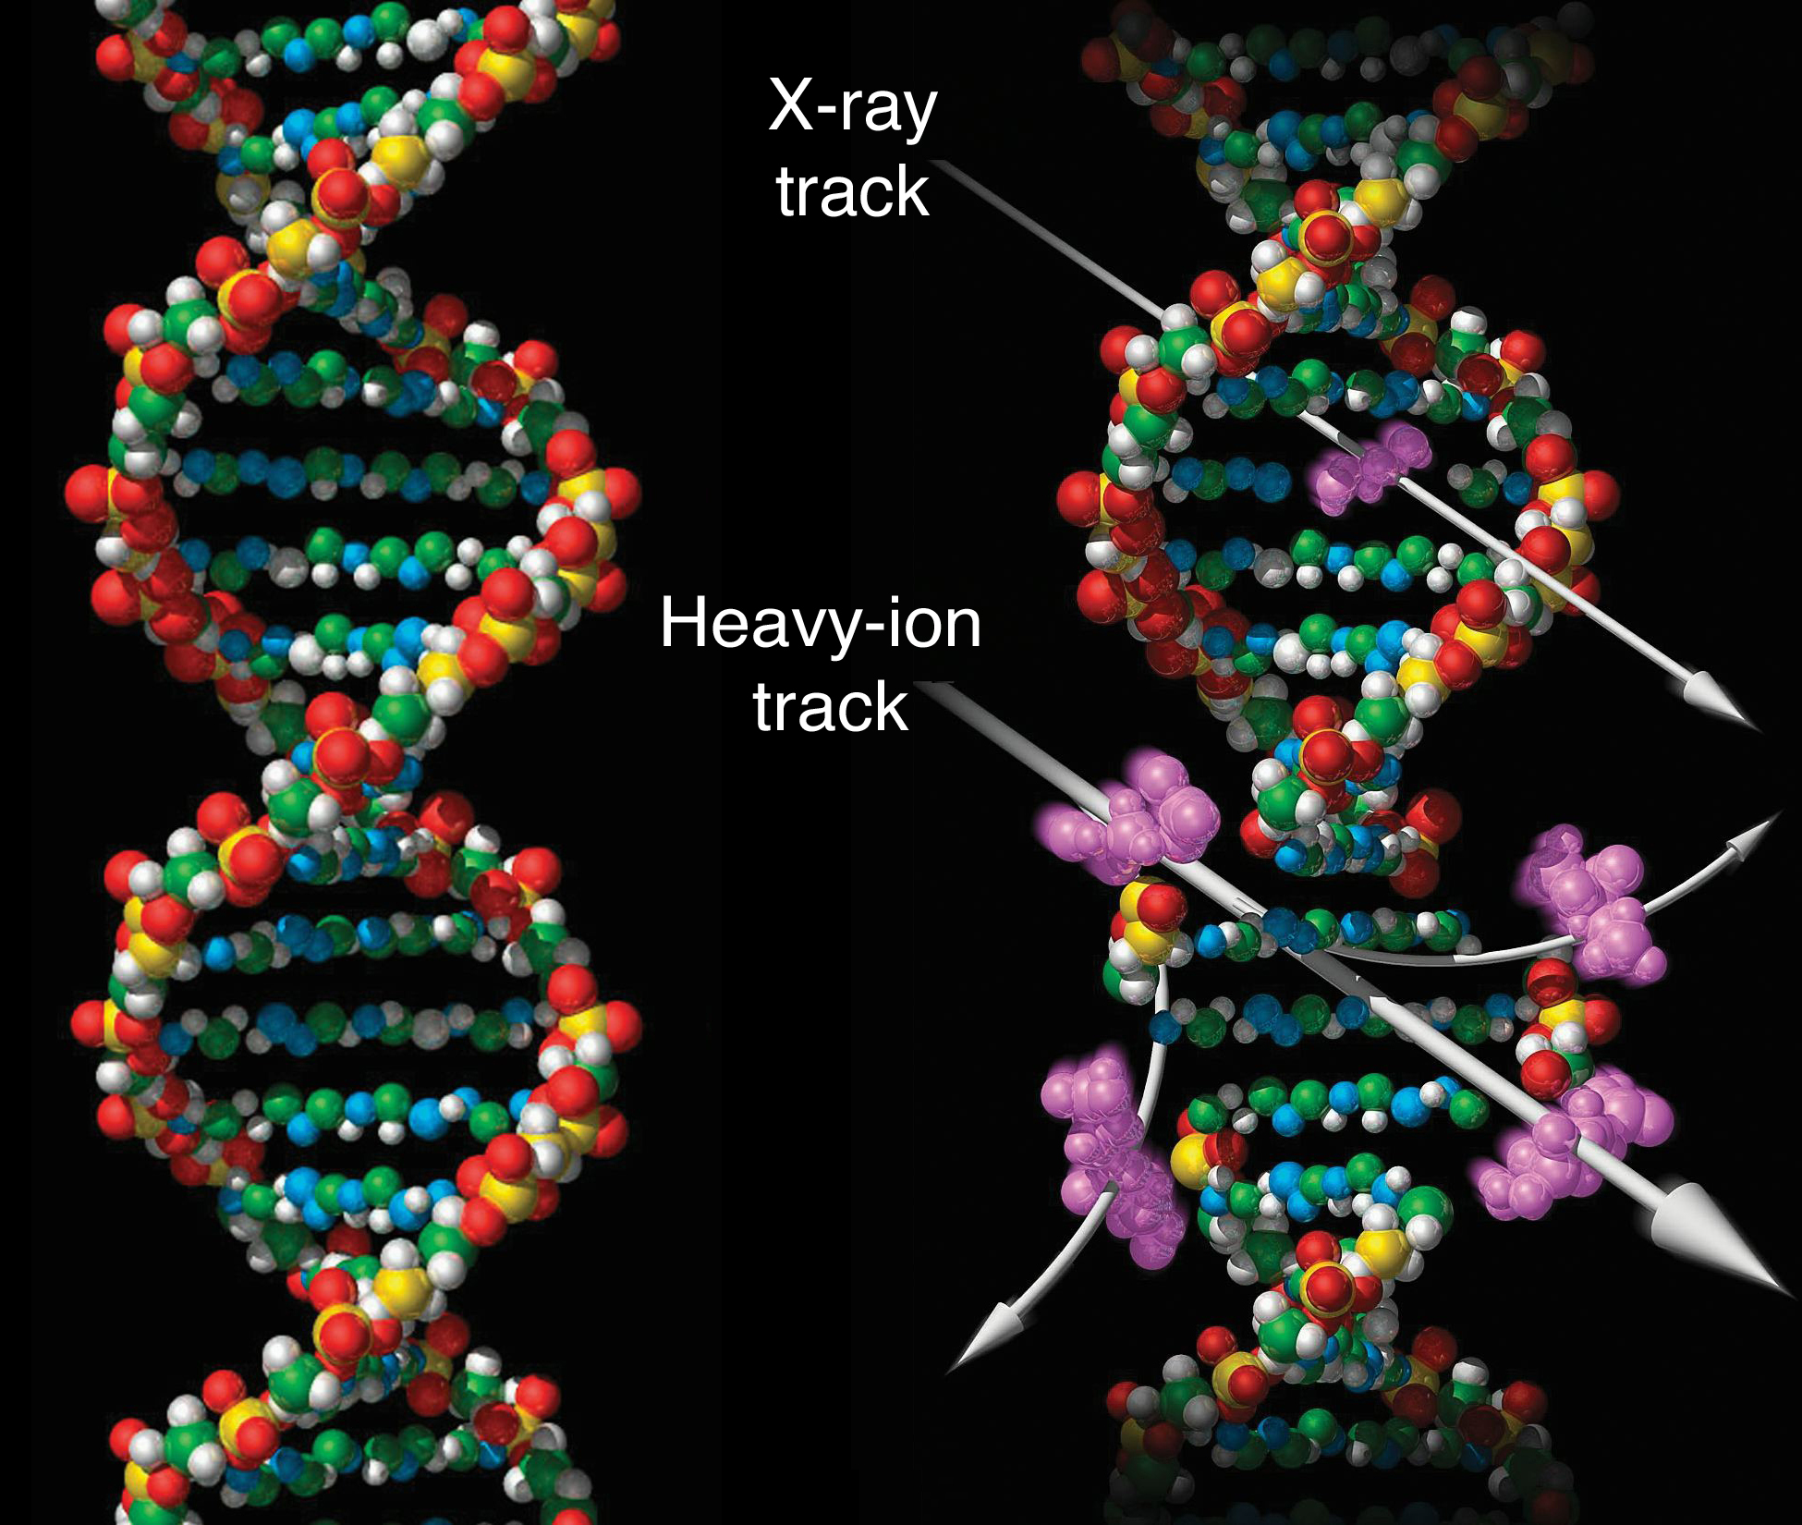
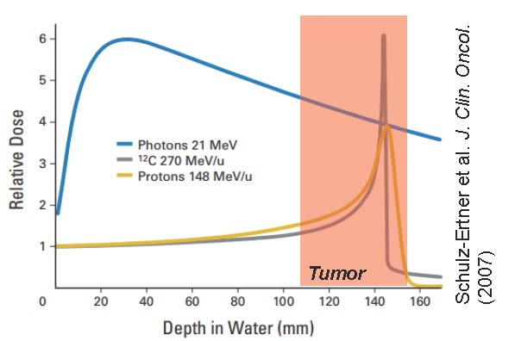
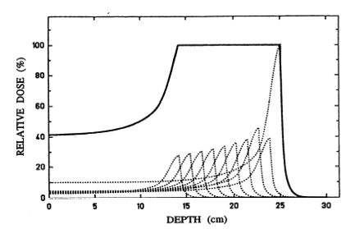
Charged Particle Therapy
Radiotherapy is based on the use of ionizing radiation to kill the cancer cells, by damaging the DNA chain.
Charged Particle vs photons
Peak of dose released at the end of the track, allows sparing the normal tissue
Beam penetration in tissue is function of the beam energy
Accurate conformal dose to tumor with Spread Out Bragg Peak
Greater biological effectiveness, increasing with the beam charge, well performing with radioresistant tumors

Slide 3
Nuclear fragmentation: target and beam
Proton Beam
Charged particle
Target fragmentation
Small range fragments (~tens of μm)
Missing experimental data for heavy fragments (He, C, Be, O, N) having the greatest contribution to the dose
Increase of biological damage (~10%) in the entrance channel (Grun 2013)
Beam and target fragmentation
Fragments have the same velocity of the beam, but the lower mass allows longer range producing tail beyond the Bragg peak
Scarce validation data for ¹²C clinical beam
New beams (⁴He and ¹⁶O) to be study
Measurements of nuclear fragmentation cross sections
useful to develop a new generation of biologically oriented Treatment Planning Systems for proton and ion therapy
200 MeV Proton

Slide 4
FOOT – FragmentatiOn Of Target experiment founded by INFN in 2017
Goals:
Fragments production cross sections (at level of 5%)
Fragments energy spectra dσ/dE (energy resolution ~1 MeV/u)
Charge ID (at the level of 2-3%)
Isotopic ID (at the level of 5%)
Data taking for beams at therapeutic energies and at high energy (space radioprotection):
  200 MeV for protons
  250 MeV/n (700 MeV/n) for He ions
  350 MeV/n (700 MeV/n) for C ions
  400 meV/n (700 MeV/n) for O ions
target simulating the human tissue (C, C₂H₄, 0)
Experimental strategy:
Inverse kinematic approach with double target
Experimental apparatus: electronic detector and emulsion spectrometer

Slide 5
FOOT: Inverse kinematic approach
(target fragmentation in proton therapy)
Protons @ E_{kin}= 200 MeV ( β~0.6) on a “patient” (98% C, O, and H nucleus)
can be replaced by ¹⁶O, ¹²C ion beams (E_{kin} ~ 200 MeV/n β~0.6) impinging on a target made of protons (C H )
by applying the Lorentz transformation (well known β) it is possible to switch from the lab. frame to the patient frame
Requirements: the fragment direction must be well measured in the lab. frame to obtain the correct energy in the patient frame

Slide 6
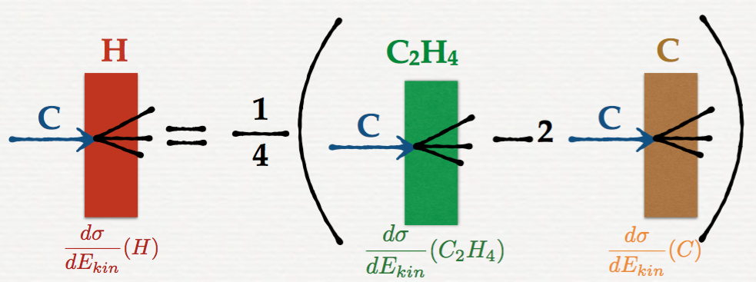

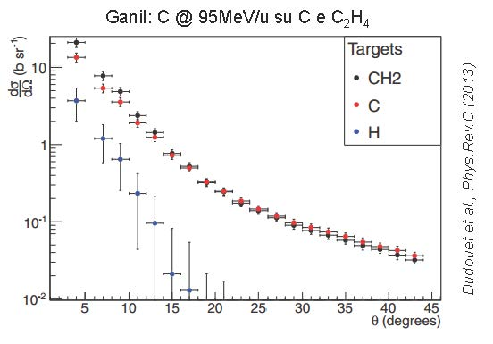
FOOT: Double target
H target? Use twin targets made of C and polyethylene (C₂H₄)_{n} and obtain the fragmentation results on H target from the difference
C H cross-section can be estimated by subtracting C C₂H₄ and C C cross-sections
GANIL experimental data

Slide 7
FOOT Detector
Design Solution to develop a “table top” detector (< 2 m long):
electronic detector optimized for fragments with Z ≥ 3 and angular acceptance ± 10°
emulsion spectrometer detecting light charged fragments at large angle (up to 70°)
Electronic detector

Slide 8
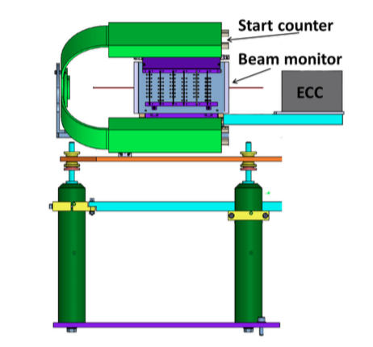
FOOT Detector: Emulsion spectrometer
It will measure fragments as protons, deuterons, He and Li emitted within a wider angular aperture (up to 70°) with respect to heavier nuclei
Detector based on the concept of Emulsion Cloud Chamber – ECC
The measurement setup will integrate the ECC with the start counter and the beam monitor of the electronic detector

Slide 9
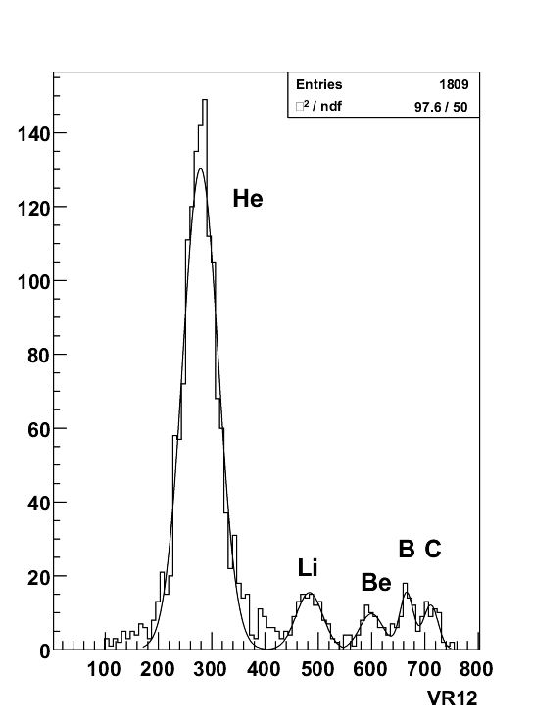
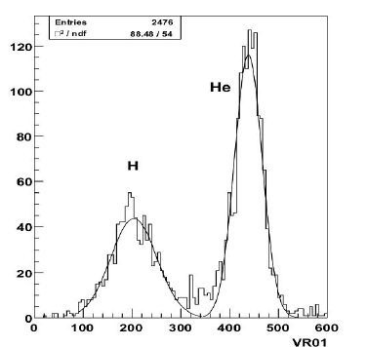
FOOT Detector: Emulsion Spectrometer
The emulsion technique has been already exploited to study the fragmentation of Carbon ions in polycarbonate: identification of the secondary nuclei produced by fragmentation of 400 MeV/n ¹²C can be achieved with high significance
G. De Lellis et al. JINST 2, 2007, P06004

Slide 10
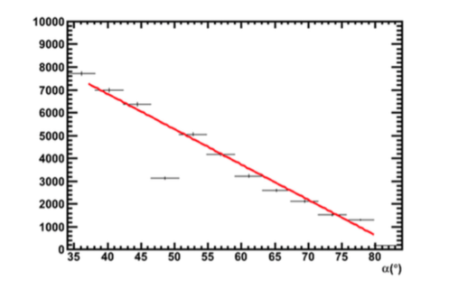
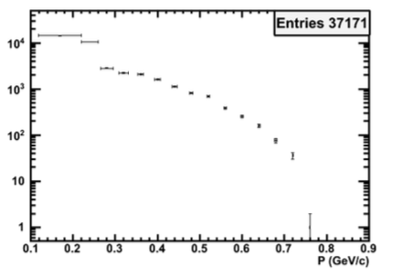
FOOT Detector: Emulsion Spectrometer
Other study: large angle fragmentation and momentum measurements of a 400 MeV/n ¹²C beam impinging on a composite target has been performed by using two ECC detectors to cover a range from 34° to 81° with respect to the beam axis
Angular Distribution
Momentum Distribution
A. Alexandrov et al., JINST 12 (2017) P08013

Slide 11
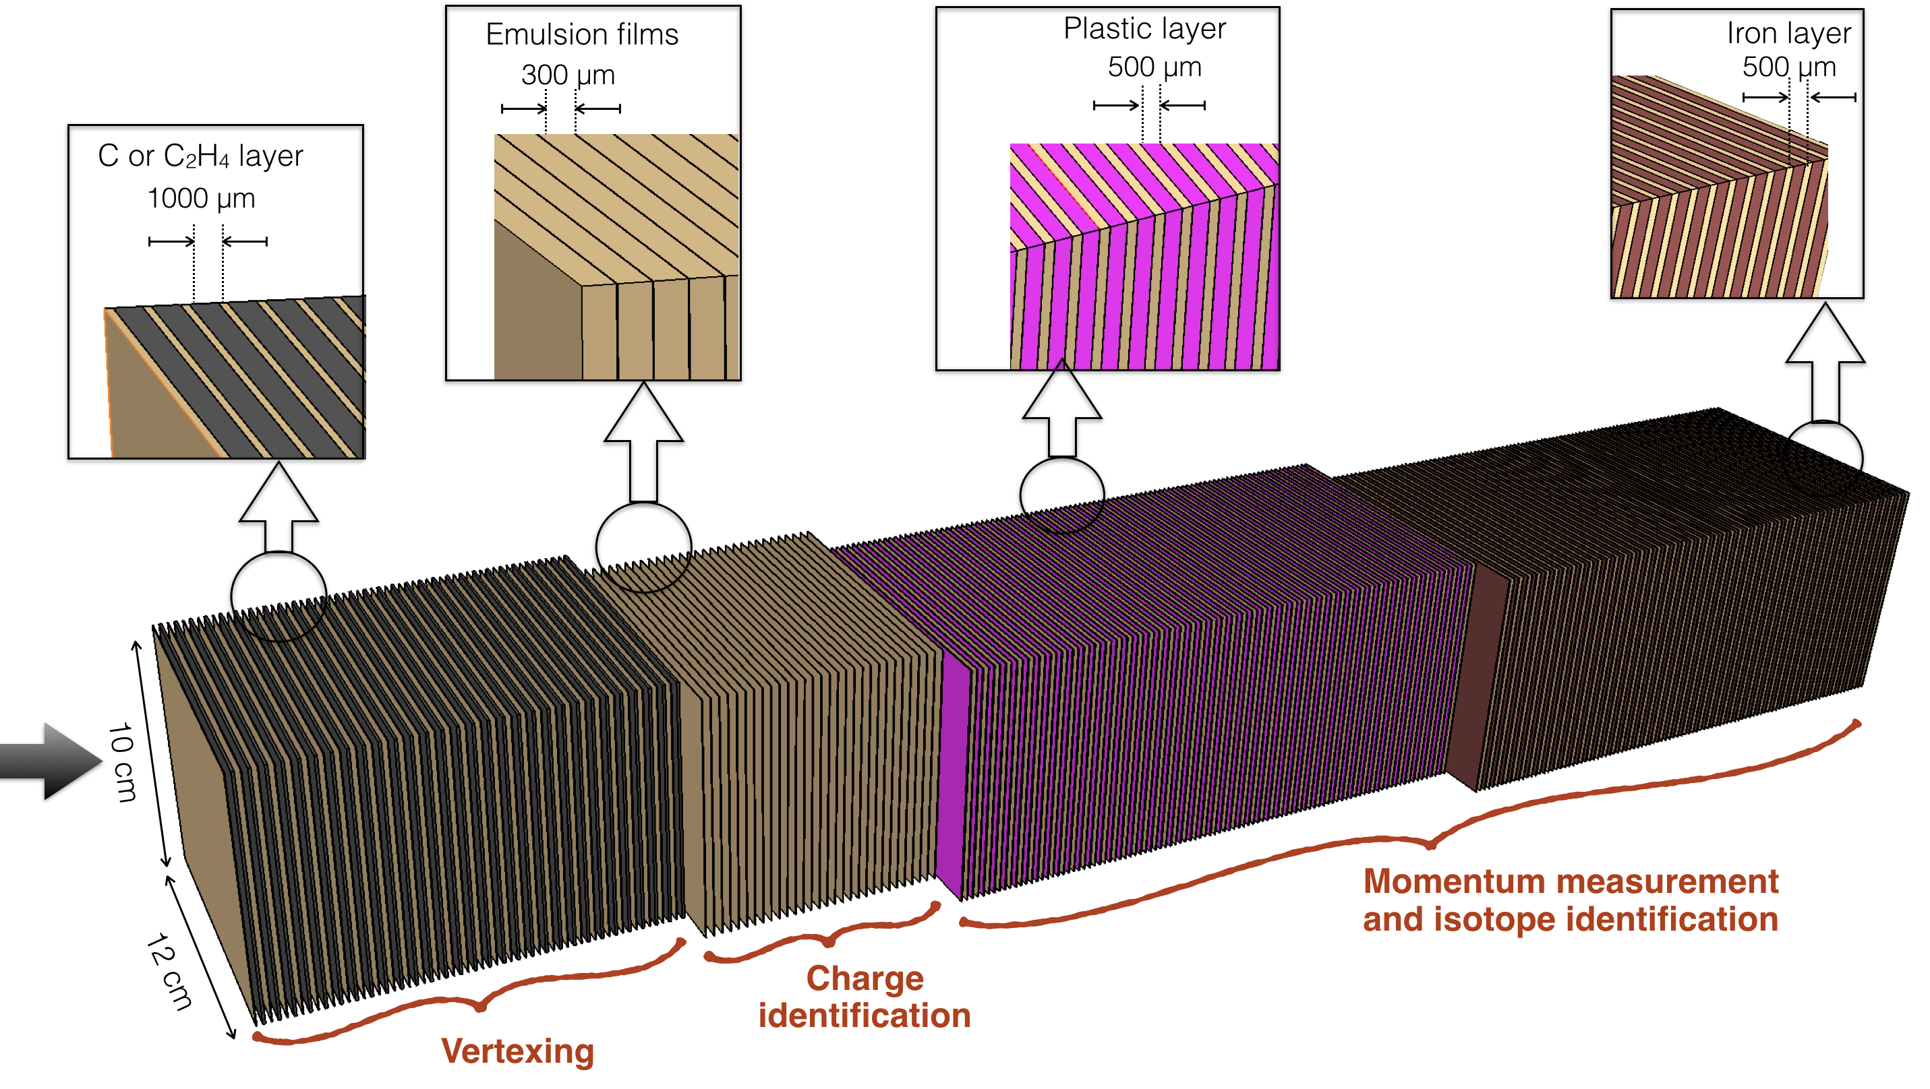
FOOT: Emulsion Spectrometer Layout
  Section 1: alternated layers of emulsions and target (C/C₂H₄)
    vertex detector
    Section 2: made of emulsion films only
    charge identification for low Z fragments (H, He, Li)
  Section 3: alternated layers of emulsions and passive materials (plastic and lead)
    Momentum measurement by range method and Multiple Coulomb Scattering (MCS)
    Isotopic identification

Slide 12
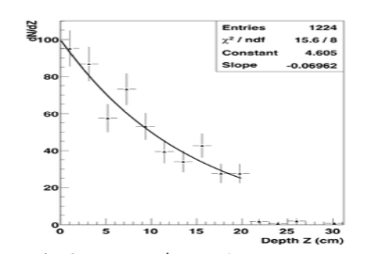
FOOT: Emulsion Spectrometer – section 1
Alternate target layers of C or C₂H₄ (1 mm) and emulsion films
Vertex detector and particle tracking
Chamber thickness defined by the interaction length → obtain a sufficiently high number of interactions
20% of Carbon ions interacting in 3 cm Lexan (G. De Lellis, Nucl. Phys. A Vol. 853, 2011)
Total length ∼ 30 cells = 39mm (30 films)

Slide 13

FOOT: Emulsion Spectrometer – section 2
Charge identification for low Z fragments (H, He, Li)
Emulsion will have a different thermal treatment according to its position in the elementary cell:
R0:
    Not refreshed
    Sensitive to m.i.p.
R1:
    Appropriate refreshing for protons
    Sensitive to protons
R2:
    Appropriate refreshing for He
    Sensitive to He
  To obtain a 3σ He-Li separation, 9 cells are necessary (27 films)
G. De Lellis et al. JINST 2, 2007, P06004

Slide 14
FOOT: Emulsion Spectrometer – section 3
Emulsion films interleaved with passive layers (plastic and lead) (30-50 passive layers)
Dedicated to the momentum measurements by using the range method and the Multiple Coulomb Scattering (MCS)
Range Method: the kinetic energy of the particle is estimated on the basis of the range measurements ( NIST data)
The MCS estimates the particles momuntum through the measurements of the position and the slope of the particles trajectory
Isotopic identification: by means two indipendent methods for the momuntum measurements

Slide 15
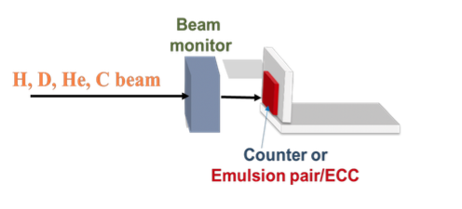


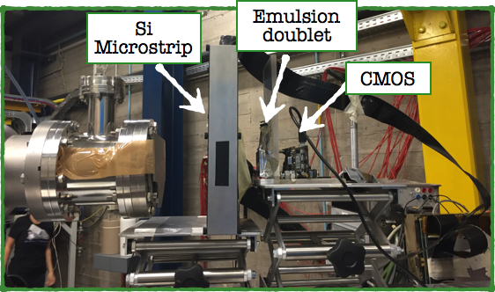


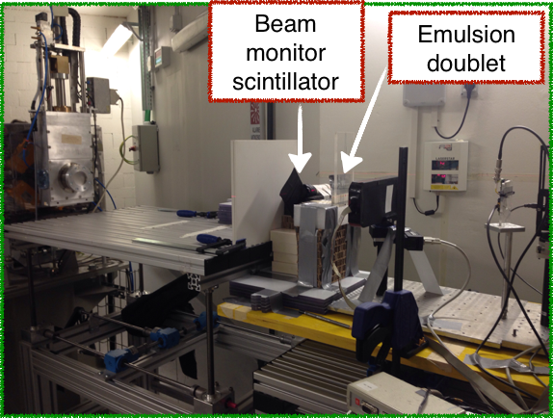
FOOT: Emulsion Spectrometer – test beam
New nuclear emulsions, produced by Nagoya group, have been tested to assess the refreshing procedures and to define the correct working point for the particle identification (Z<3)
LNS test beam with 80 MeV proton, deuterium, helium and carbon
  Exposure of nuclear emulsion to calibrate the response at different ionizing beam (charge identification)
  Exposure of two Emulsion Cloud Chambers for the isotopic identification
Proton Radiotherapy Center in Trento test beam with 50, 200 and 80 MeV

Slide 16
FOOT: Emulsion Spectrometer – test beam
Test with data an algorithm for isotopic identification
Exposure of two ECC to H and D @ 80 MeV/n
ECC: 21 nuclear emulsions spaced by 20 stainless steel layers (0.5 mm thick, X₀ = 1.76 cm)
Preliminary estimation of pβ from OPERA algorithm [1] assuming the fitted track not to lose energy during its path (10 layers)
Combination of p measurement by range and MCS ( dependent on the mass) provides isotope identification
[1] N. Agafonova et al. Momentum measurement by the Multiple Coulomb Scattering method in the OPERA lead emulsion target. New J. Phys., 14:013026, 2012

Slide 17
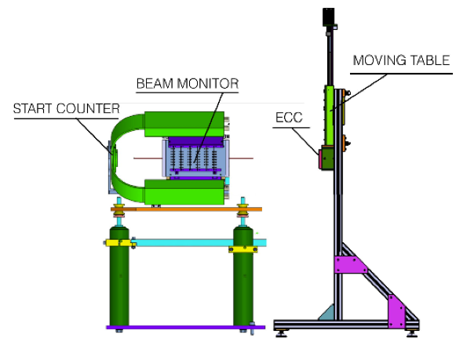

FOOT: Emulsion Spectrometer – first run
Planned for November 2018 at GSI
He @ 700 MeV/n on C target
ECC structure: almost 110 nuclear emulsions are needed
The emulsion setup will be XY stage remotely controlled to avoid pile-up (particle density < 10 particles/mm² )
The start counter and the beam monitor will provide a feedback (impact point and rate) to the stage movement
He Beam
Supporting structure for ECC: sliding up to touch the beam monitor

Slide 18
Conclusions
Target fragmentation and beam are ”hot” topics in Charged Particle Therapy
The FOOT detector will measure both target fragmentation in proton therapy and projectile fragmentation in charged particle therapy (He, C and O); energy of space radioprotection interest will be also investigated
The FOOT experiment has been approved and funded by INFN for 2018-2021
FOOT emulsion spectrometer data taking in November 2018 (GSI)
Whole detector data taking foreseen in early 2020 (CNAO/Heidelberg/GSI)

Slide 19
A. Sarti, R. Faccini, F. Ferroni, E. Iarocci, M. Marafini, R. Mirabelli, V. Patera, R. Paramatti, A. Schiavi, A. Sciubba, G. Traini
INFN & Univ. Roma La Sapienza
S. Branbilla, G. Battistoni, I. Mattei, S. Muraro, S. M. Valle
INFN - Milano
S. Biondi, G. Bruni, M. Franchini, M. Garbini,
M. Negrini, G. Sartorelli, M. Selvi, R. Spighi, M. Villa, A. Zoccoli
INFN & Univ. Bologna
M.Durante, F. Tommasino, M. Rovituso, P. Spinnato, E. Scifoni, C. La Tessa
INFN & Univ. Trento
O. Sato
Univ. Nagoya
C. Sanelli, E. Spiriti, M. Testa
INFN-LNF
FOOT collaboration
S. Argirò, P. Cerello, V. Ferrero, G. Giraudo, N. Pastrone, C. Peroni, L. Ramello, M. Sitta INFN & Univ. Torino
http://web.infn.it/f00t/index.php
M. Pullia
CNAO, Pavia
A. Alexandrov, A. Lauria, G. De Lellis, A. Di Crescenzo, M.C. Montesi, V. Tioukov INFN & Univ. Napoli Federico II
D. Barbosa, N. Belcari, G. Bisogni, N. Camarlinghi, E. Ciarocchi, M. Francesconi, L. Galli, M. Morrocchi, S. Muraro, V. Rosso, G. Sportelli
INFN & Univ. Pisa
Pastore
Univ. Bari
C. Schuy, U. Weber
GSI, Darmstadt, Germany
C. Finck, M. Vanstalle
IPHC, Strasbourg, France
G. Ambrosi, M. Ionica, K. Kanxheri
L. Servoli, M. Salvatore
INFN & Univ. Perugia
M.C. Morone, L. Narici , G. De Vitis
INFN & Univ. Roma Tor Vergata
M. Emde , R. Hetzel, A. Stahl
RWTH University, Aachen, Germany

Slide 20
Back-up slides

Slide 21
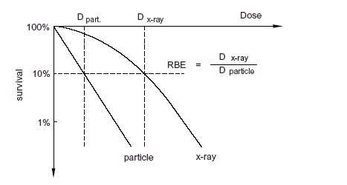
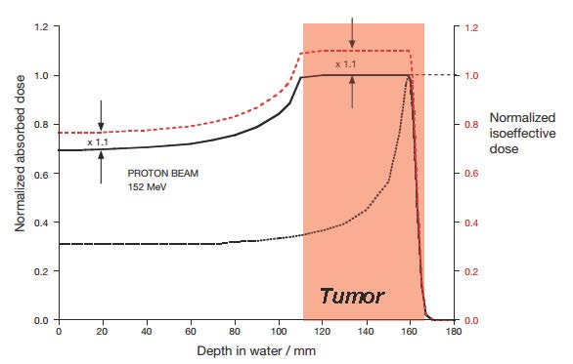

RBE: Relative Biological Effectiveness
D₀
SF_{XR}
$$D_{BIO}=R.B.E. {∗D}_{phys}$$
SF_{p}
Survival Fraction 10%
In clinical practice protons RBE is a constant equal to 1.1, but experimental data show that RBE varies with Linear Energy Transfer (LET)!
Notes:
ratio of photon to charged particle dose producing the same biological effect
Because of higher atomic numbers, the lateral and range scattering is much smaller for carbon or neon ions than for protons. One of the major advantages of heavy ion tumour therapy is the increase in relative biological effectiveness (RBE) of particle beams in particular at the end of their penetration depth, i.e. in the tumour volume (Fig. 3). This increased effectiveness has to be taken into account for treatment planning. The RBE cannot be represented by a single number, but depends in a complex way on different factors like e.g. ion type and energy, depth in tissue, dose level and the tissue type. For applications of ion beams in tumour therapy, the increased RBE requires a corresponding general reduction in dose. In particular, due to the variation of RBE with depth, the shape of the depth dose profile has to be adapted accordingly. In general ions are better for radio-resistant tumours while protons minimize the risk of appearance of secondary tumours.

Slide 22
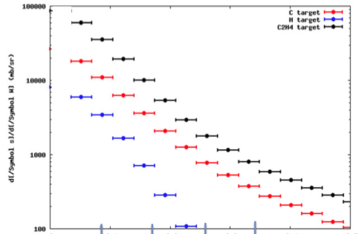
Double target strategy: preliminary results
C @ 95 MeV/n on C and C₂H₄
C @ 200 MeV/n on C and C₂H₄
5° 10° 15° 20°
GANIL experimental data
Fluka simulation in the FOOT experiment

Slide 23

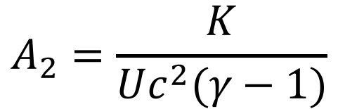
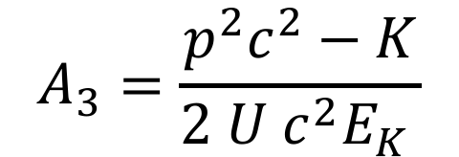

FOOT Detector: redundancy
Simultaneous determination of β and p respectively from the TOF and the magnetic spectrometer:
Simultaneous determination of β and E_{kin} respectively from the TOF and the calorimeter:
Simultaneous determination of p and E_{kin} respectively from the magnetic spectrometer and the calorimeter:
$$A_{1}=\frac{p}{Uβcγ}$$
$$γ=\frac{1}{\sqrt{1−β^{2}}}$$
where and U = 931.5 MeV (Unified Atomic Mass)
$$A_{2}=\frac{K}{Uc^{2}(γ−1)}$$
$$A_{3}=\frac{p^{2}c^{2}−K}{2 U{ c}^{2}E_{K} }$$

Slide 24
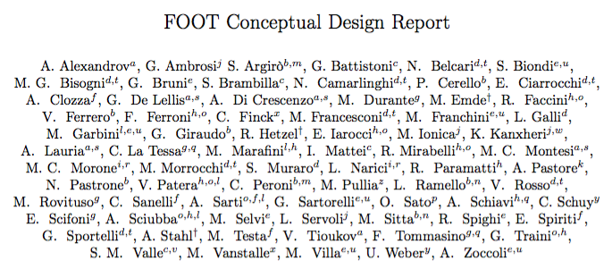


Slide 25
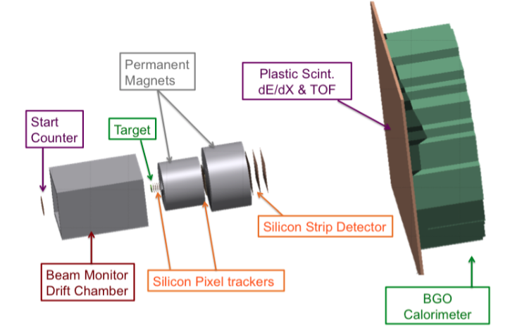
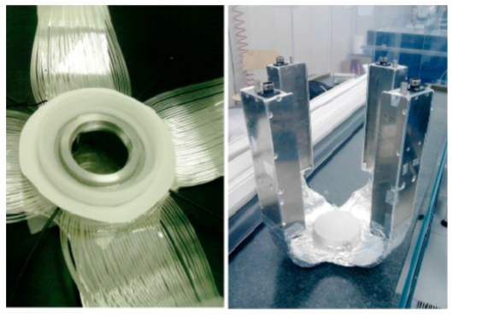
FOOT Detector: upstream/target region
Start counter: thin plastic scintillator (250 μm)
  start signal of the TOF (100 ps)
  counts primaries
scintillator foil and 160 optical fibers grouped in four different arms

Slide 26
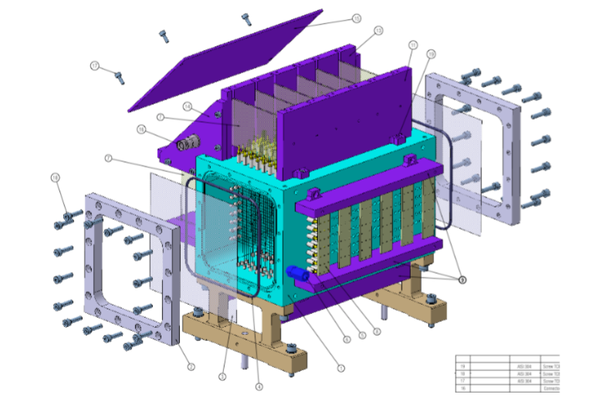
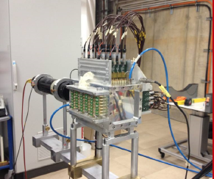

FOOT Detector: upstream/target region
Beam monitor: twelve layers of wires, with three drift cells per layer
measure the direction and the position (spatial resolution 140 μm) of the impinging beam on the target
looks for fragmented primaries
$$\sim$$

Slide 27
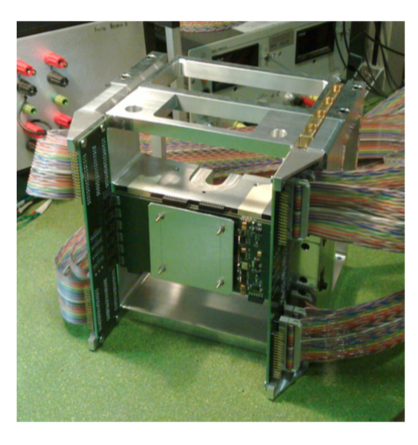
FOOT Detector: magnetic spectrometer
Target and vertex tracker
Vertex and Inner tracker

Slide 28
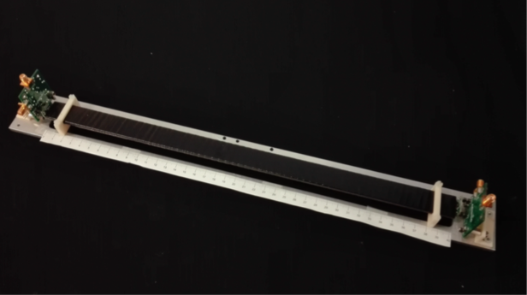
FOOT Detector: plastic scintillator & calorimeter
Two orthogonal layers of 20 plastic scintillator rods (2 cm large and 40 cm long for a total area of 40×40 cm², tickness 3 mm)
  the stop signal for the TOF measurement
  the measurement of the energy loss ∆E to identity the charge of the fragments
The calorimeter will be formed by about 360 BGO crystals (2x2 cm² transverse size) covering a circular surface of about 20 cm radius
  fragments kinetic energy
Plastic scintillator detector prototype

Slide 29
Required performances
Δp/p ~ 5 %
Δ TOF ~ 100 ps
Δ E_{kin} / E_{kin} ~ 2 %
Δ(dE)/dE ~ 2 %
Target /Emulsion Spectrometer
Sub-detector | Main features
Start counter | Plastic scintillator 250 μm | Stat TOF, counts primaries
Beam monitor | Drift chamber (12 layers of wires) | Beam position
Target | C / C₂H₄
Vertex | 4 layers silicon pixel (20x20 μm) | Vertex position
Permanent Magnet | Halbach geometry 0.8 T
Inner Tracker | 2 layers silicon pixel (20x20 μm) | Magnetic spectrometer: Δp/p
Outer Tracker | 3 layers of Silicon strip (125 μm pitch)
Scintillator | 2 layers of 20 barrels (2x40x0.3 cm) | Stop TOF, dE/dx
Calorimeter | 360 BGO crystals (2x2x14 cm) | Kinetic energy

Slide 30
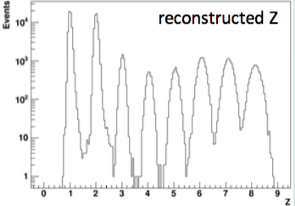

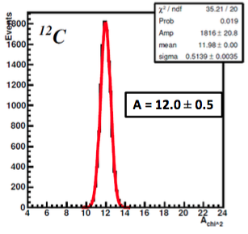
FOOT Detector: redundant measurements
The Z fragments can be reconstructed by the Bethe-Bloch equation and by measuring the energy deposited in the scintillator detector
The reconstructed Z resolution ranges from 2% (¹⁶O) to 5% (¹H)
The fragments mass A can be determined by:
measuring β and p respectively from the TOF and the magnetic spectrometer
measuring β and E_{kin} respectively from the TOF and the calorimeter
measuring p and E_{kin} respectively from the magnetic spectrometer and the calorimeter
Resolution for heavy fragments 4%

Slide 31
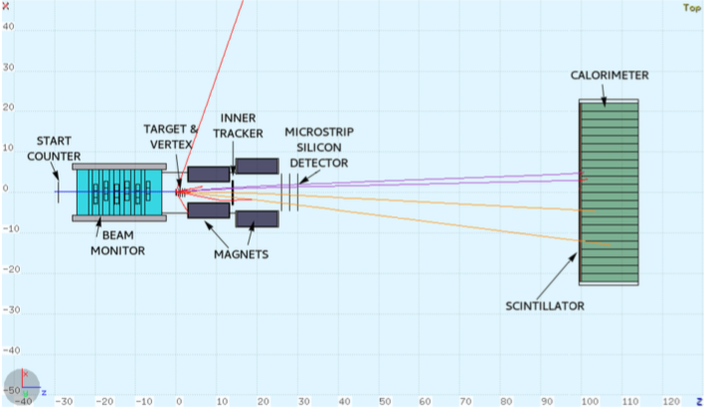
FOOT Detector: simulation with FLUKA
Schematic 2D event display of a primary ¹⁶O ion interacting in a polyethylene target

